Slide 1

Centrality/volume fluctuation in heavy-ion collisions
Jiangyong Jia
Stony Brook University and BNL
Based on work with Mingliang Zhou and Chunjian Zhang
July 18, 2019, Weihai, China

Slide 2
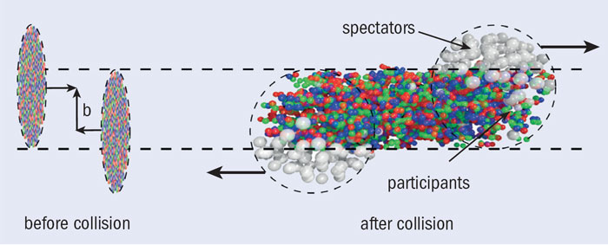
HI physics and centrality
Study of non-Abelian QCD matter
  Consists of nucleons, hadrons, quarks or gluons
  Occupy extended volume, has finite lifetime
Centrality/volume is a fundamental concept
How do we know the true centrality/volume?

Slide 3
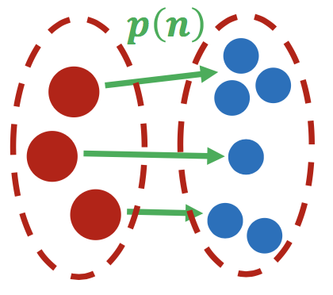
Centrality in A+A collisions
Many variables to quantify centrality/volume.
  At initial state: b, N_{part} , xN_{part}+(1-x) N_{coll}, N_{qp} , …
  At final state: N_{ch}, E_{T}, N_{neutron}, …
Initial state sources
Final state particles
True
centrality
Example:
|η|<1
3<|η|<5
η
Subevent B
Subevent A
Measurement
Observed centrality

Slide 4
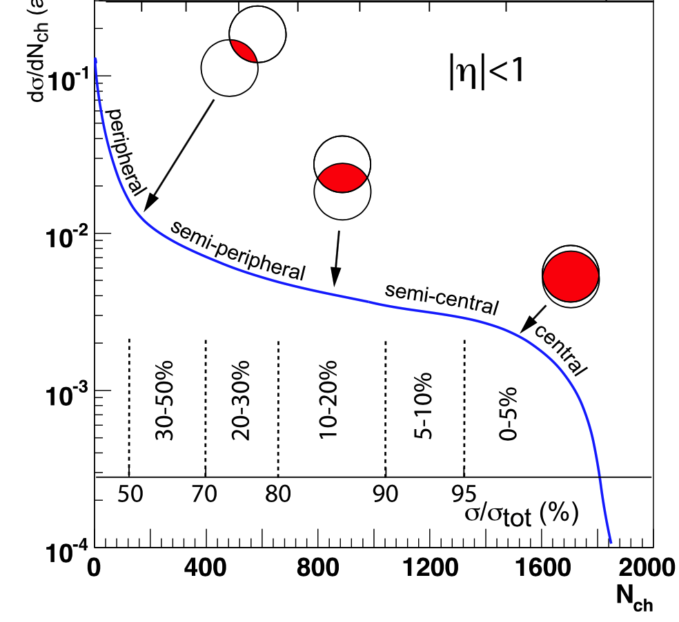
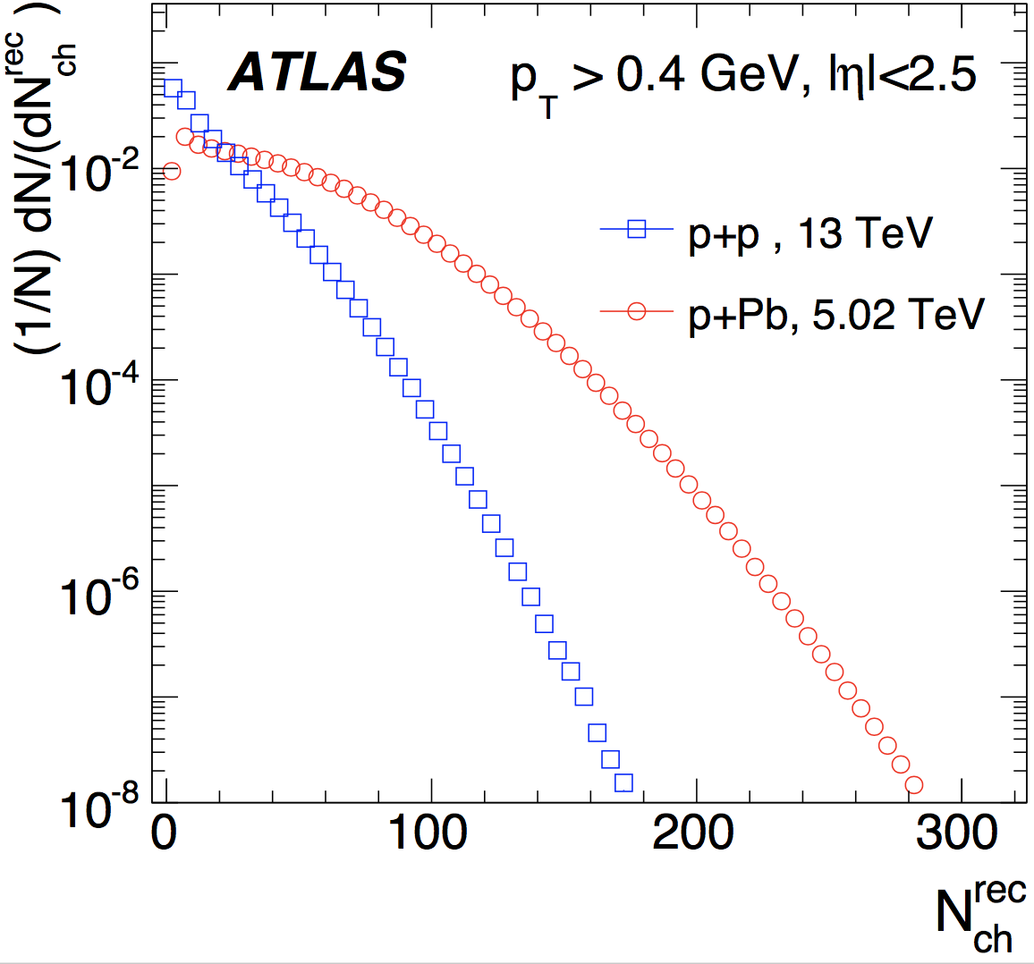
Centrality in A+A collisions
Many variables to quantify centrality/volume.
  At initial state: b, N_{part} , xN_{part}+(1-x) N_{coll}, N_{qp} , …
  At final state: N_{ch}, E_{T}, N_{neutron}, …
Main feature: Shoulder & Knee.
~Absent in pp, pPb
A+A

Slide 5
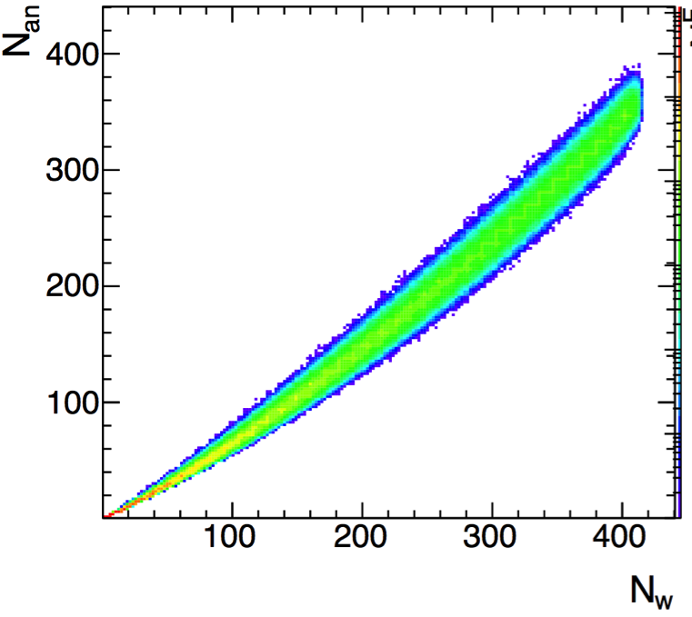
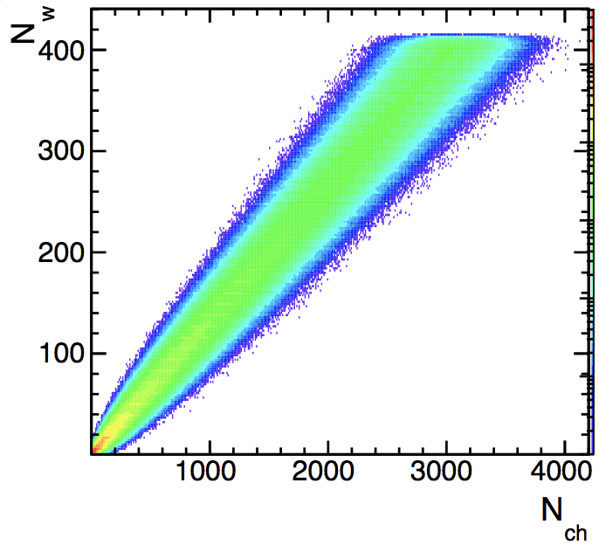
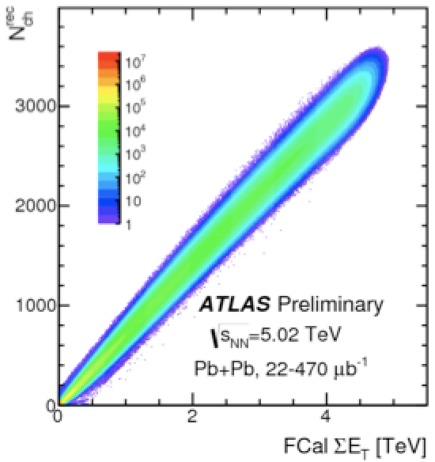
Centrality in A+A collisions
Many variables to quantify centrality/volume.
  At initial state: b, N_{part} , xN_{part}+(1-x) N_{coll}, N_{qp} , …
  At final state: N_{ch}, E_{T}, N_{neutron}, …
In absence of fluctuation→ all definitions are equivalent.
  One-to-one mapping between different measures
  In reality, fluc.. exist between different initial or final state variables.
Between initial states variables
Between initial & final states
Between final states variables
N_{part}
|η|<2.5
xN_{part}+(1-x) N_{coll}
N_{part}
|η|<2.5
3<|η|<5
Centrality/volume fluctuation: Main uncertainty for many measurements

Slide 6
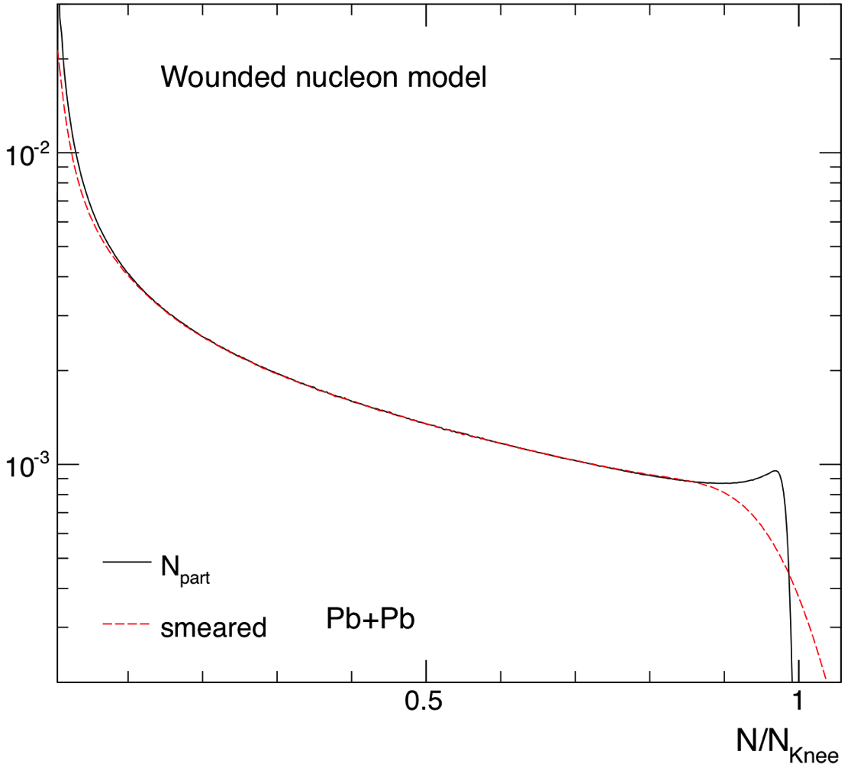
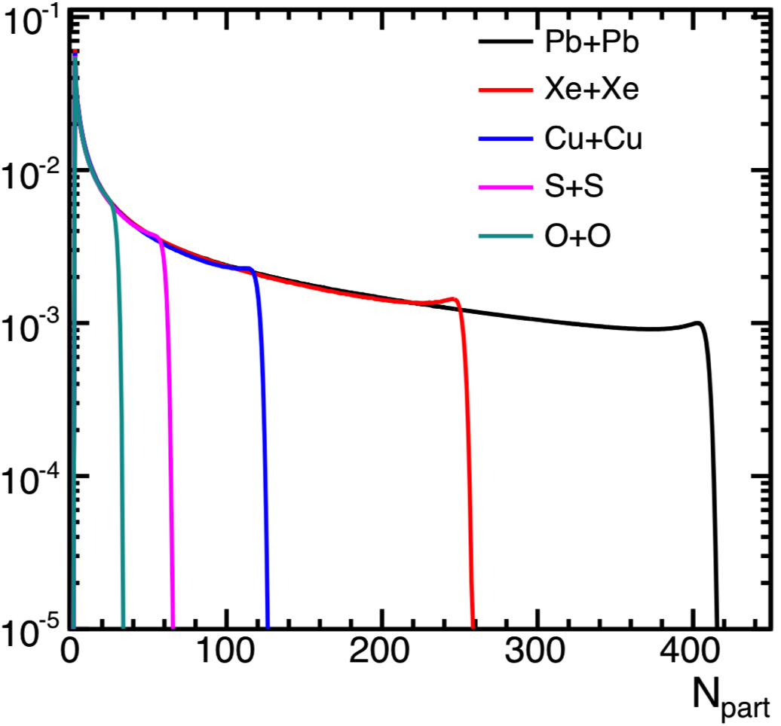
Expectation of centrality smearing
Strongest where p(cent) varies the fastest:
Peripheral and Ultra-central collisions
Stronger smearing expected for smaller system
each participant smeared by p(n)

Slide 7
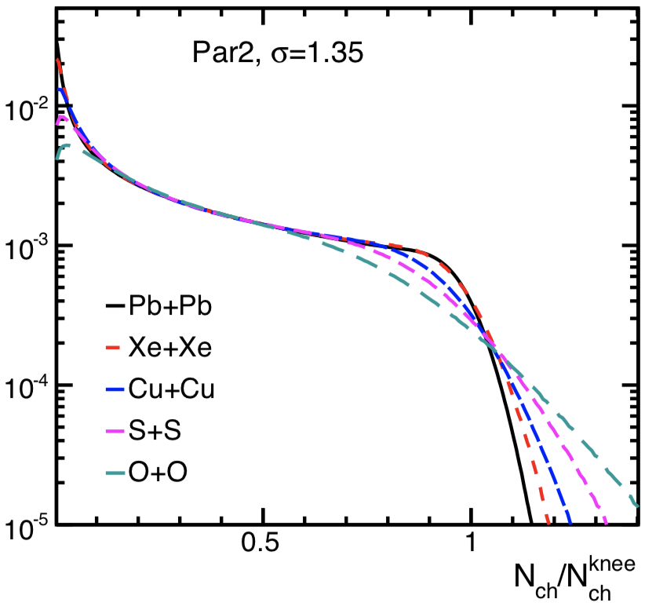
Expectation of centrality smearing
Strongest where p(cent) varies the fastest:
Peripheral and Ultra-central collisions
Stronger smearing expected for smaller system
p(N_{ch}) scaled by knee
Ultra-central collisions are sensitive to particle productions

Slide 8
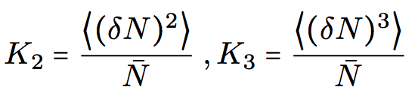


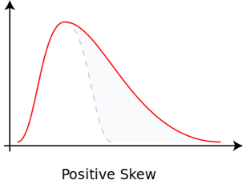
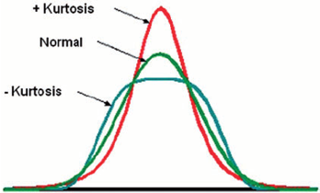
How to quantify centrality fluctuation
Multiplicity cumulants:
Quantifies the shape of p(N)
Mean, K₂ variance, K₃ Skewness, K₄ Kurtosis

Slide 9
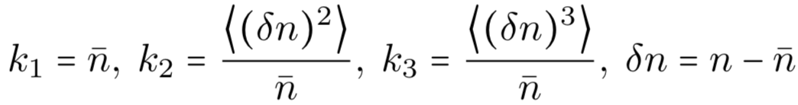
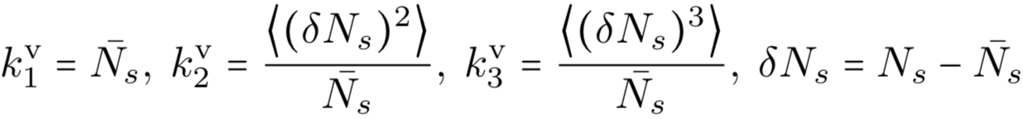
How to quantify centrality fluctuation
Multiplicity cumulants:
Quantifies the shape of p(N)
Mean, K₂ variance, K₃ Skewness, K₄ Kurtosis
Contains fluctuation in each source and fluctuation of number of sources
Cumulant in each source
Cumulant for number of sources

Slide 10


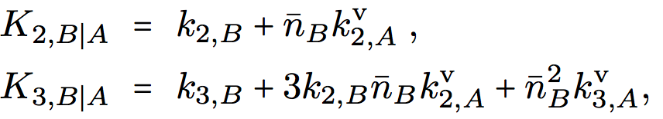
How to quantify centrality fluctuation
Multiplicity cumulants:
Quantifies the shape of p(N)
Mean, K₂ variance, K₃ Skewness, K₄ Kurtosis
Contains fluctuation in each source and fluctuation of number of sources
Cumulant in each source
Cumulant for number of sources
Practicality: centrality selection in subevent A, cumulant calc. in subevent B
or
K_{m} is cumulant for total multiplicity in subevent B.
k_{m} is cumulant for one source in subevent B
k_{m}^{v} is cumulant for centrality fluctuations in subevent A.
valid for independent source model
1205.4756, 1612.00702

Slide 11
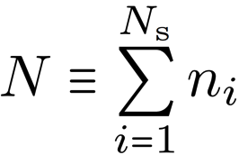
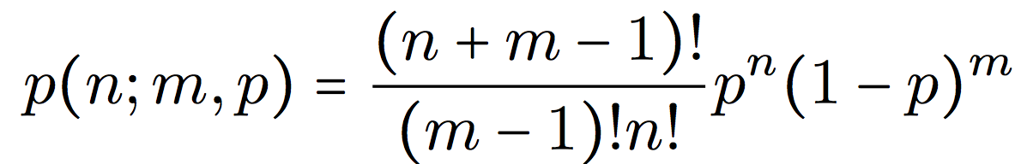
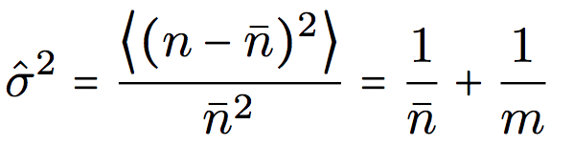
Toy model: Glauber+NBD
Independent source model: , n_{i} from NBD
controls the amount of smearing

Slide 12
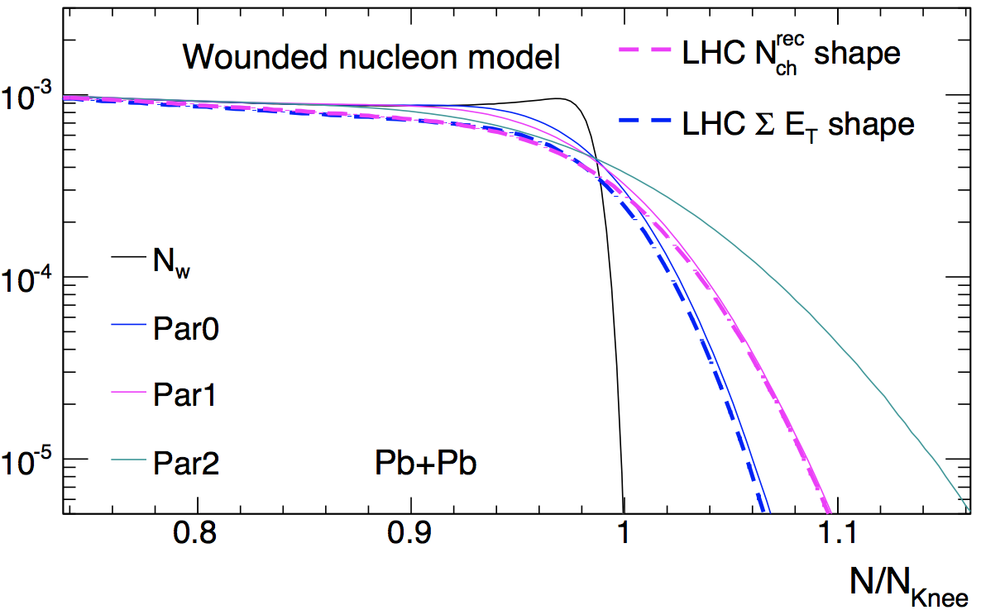
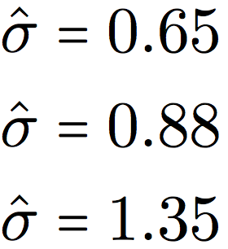

Toy model: Glauber+NBD
Independent source model: , n_{i} from NBD
controls the amount of smearing
p(N) distribution fit to the ATLAS data.
Knee defined as n_{knee}= <n>*2A
, |η|<2.5
N_{s}=N_{part}
, 3<|η|<5
Fixed
Calculate multiplicity cumulants

Slide 13
How to detect centrality fluctuation?
Cent₂
If no fluctuation:
Cent₁
<cent₁> in narrow slices of cent₂
<cent₂> in narrow slices of cent₁
<Cent₁>
<Cent₂>
Cent₂
Cent₁

Slide 14
How to detect centrality fluctuation?
Cent₂
Now smearing along cent₁ direction
with fluctuation:
<cent₂> increase more slowly with cent₁, due to poorer centrality resolution or more centrality fluctuation of cent₁.
Cent₁
<cent₁> in narrow slices of cent₂
<cent₂> in narrow slices of cent₁
<Cent₁>
<Cent₂>
Cent₂
Cent₁
This relation remains linear
Non-linearity expected in ultra-central region

Slide 15
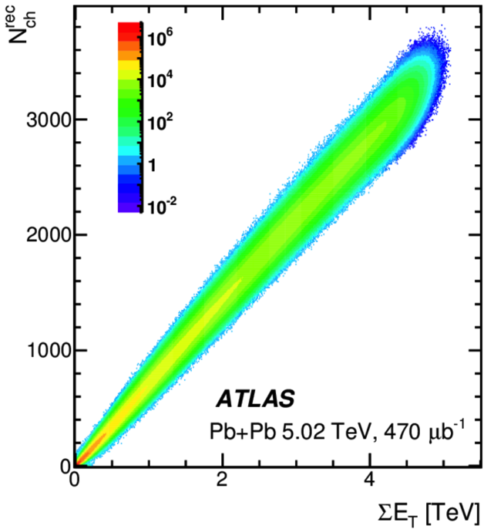
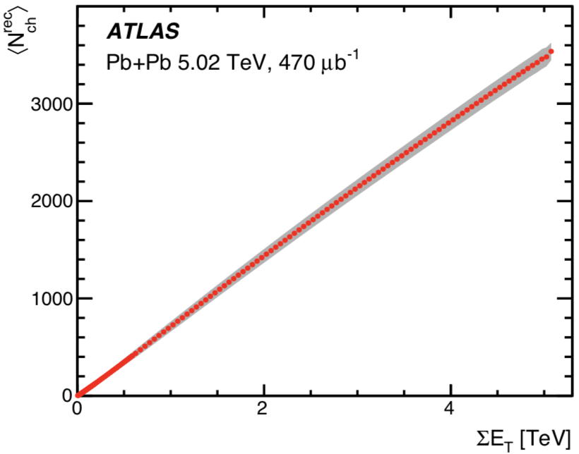
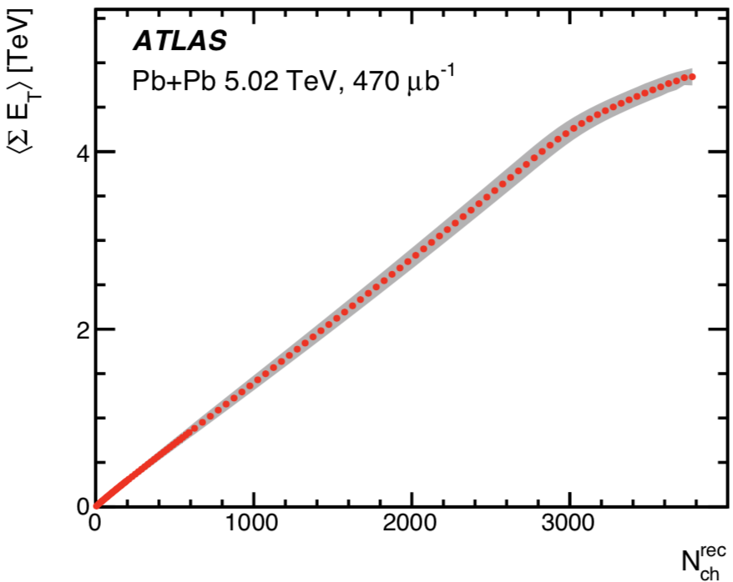
What is seen in the data?
5.02 TeV Pb+Pb
|η|<2.5
3<|η|<5
Cent in 3<|η|<5
Cent in |η|<2.5
|η|<2.5 has poorer resolution than 3<|η|<5

Slide 16
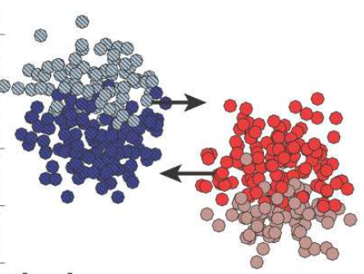
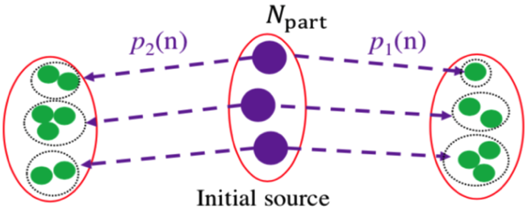


Two types of centrality fluctuations
All N_{part} contribute equally to the two subevents, i.e. A & B see same sources

Slide 17
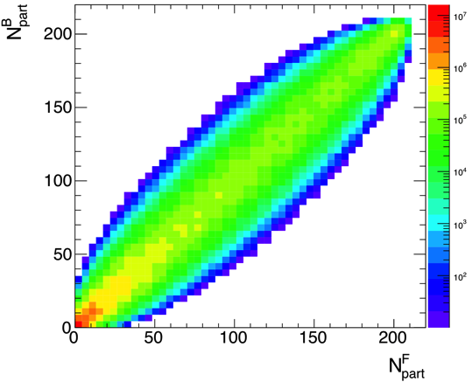
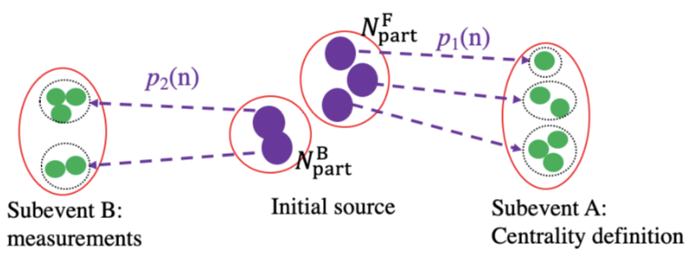
Two types of centrality fluctuations
All N_{part} contribute equally to the two subevents, i.e. A & B see same sources
Subevent A dominated by N_{part}^{F} while subevent B dominated by N_{part}^{B}

Slide 18
Two types of centrality fluctuations
All N_{part} contribute equally to the two subevents, i.e. A & B see same sources
Subevent A dominated by N_{part}^{F} while subevent B dominated by N_{part}^{B}
Centrality as a global concept
Centrality decorrelation
Centrality fluctuation purely due to particle production
Centrality fluctuation also arise from longitudinal fluctuation

Slide 19
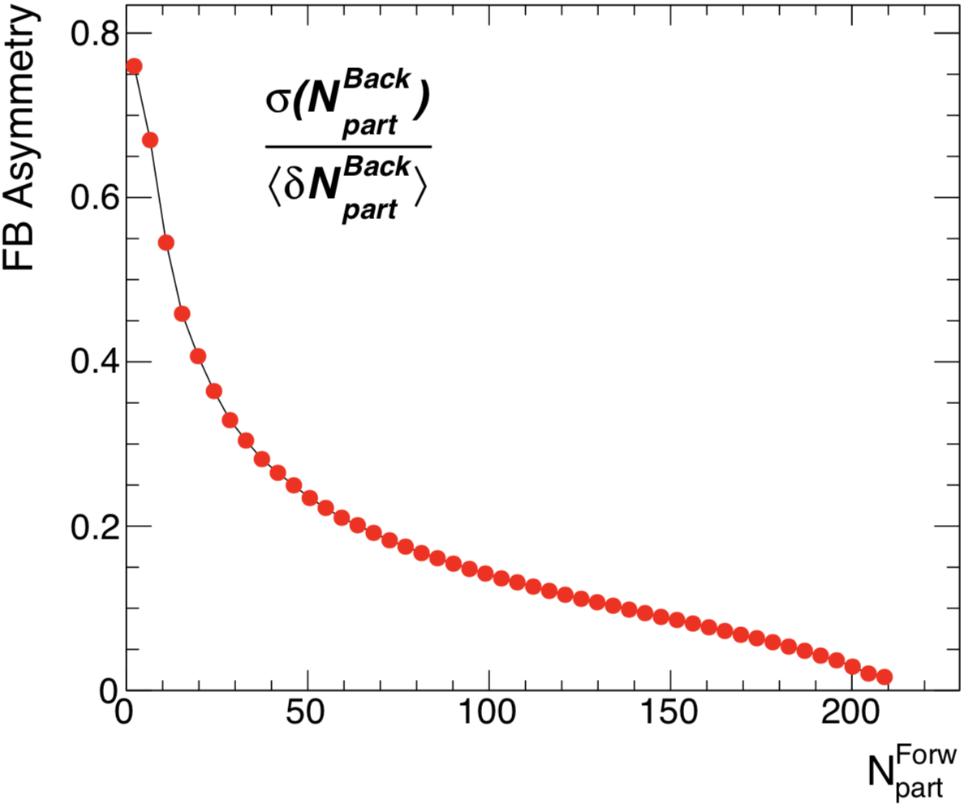
Centrality decorrelation expected to be large in peripheral collisions and small systems

Slide 20
Effects of multiplicity smearing

Slide 21
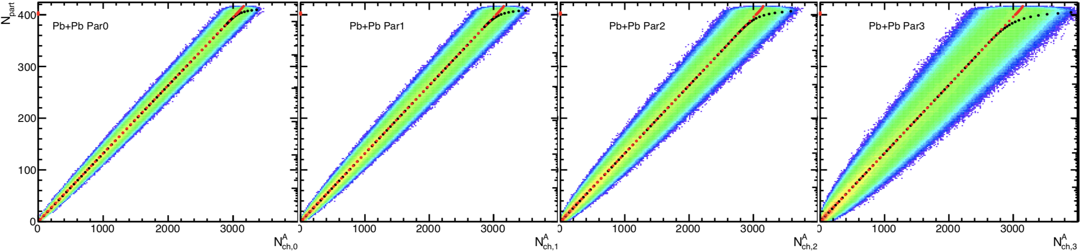
Centrality fluctuation for N_{ch}^{A}
smear
smear
smear
smear

Slide 22
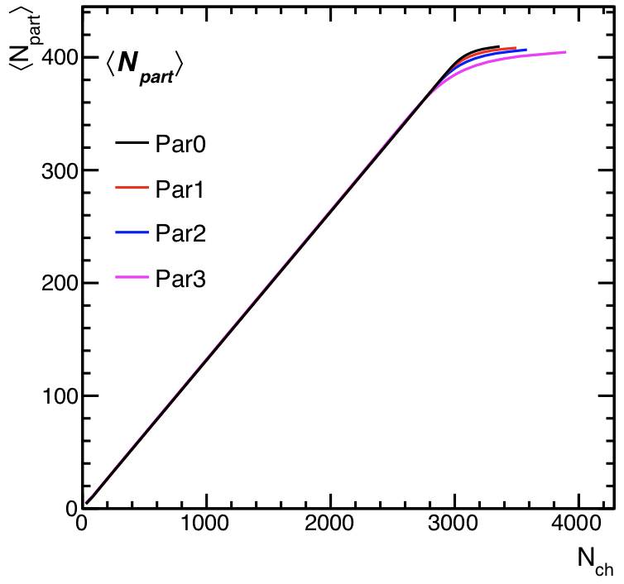
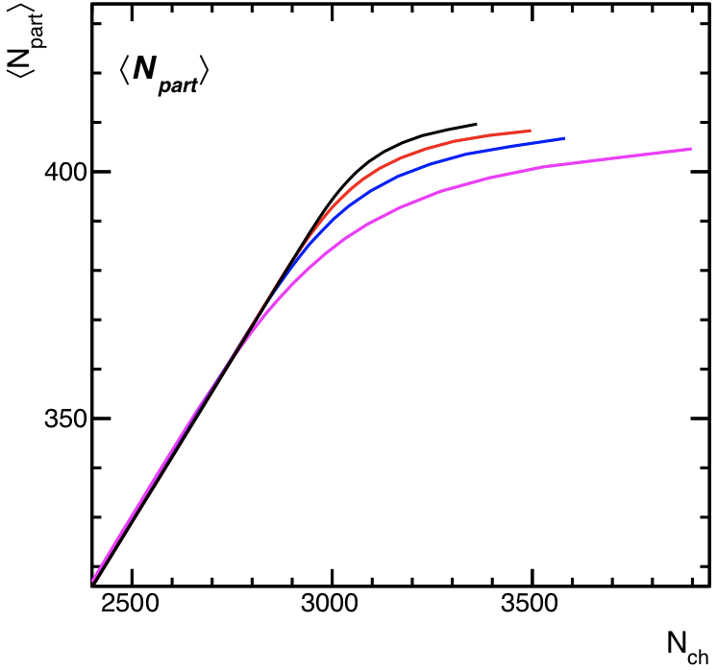
Centrality fluctuation for N_{ch}^{A}
smear
smear
smear
smear

Slide 23
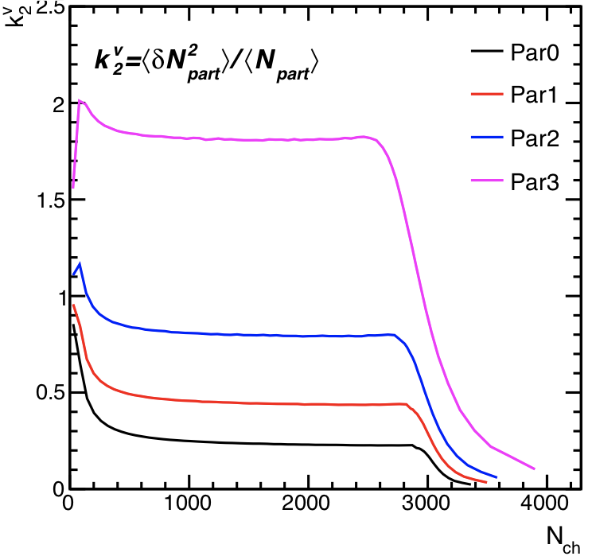
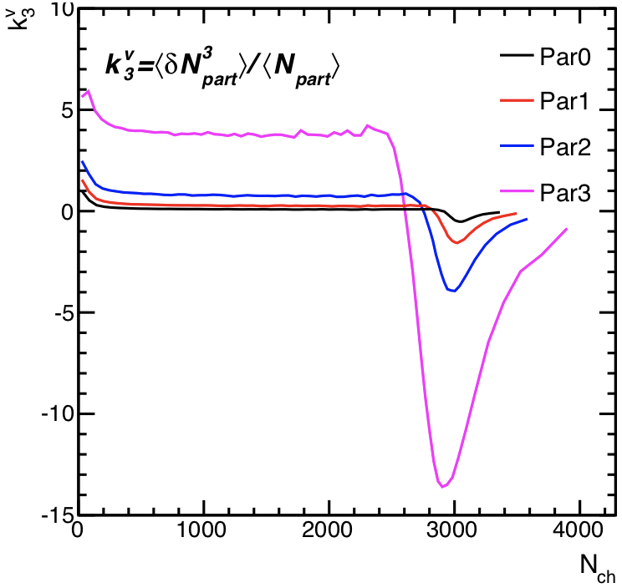

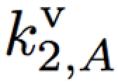
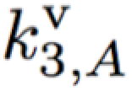
Centrality fluctuation for N_{ch}^{A}
smear
smear
smear
smear
N_{part} distribution strongly distorted in UCC
Leads to smaller variance and negative skewness

Slide 24
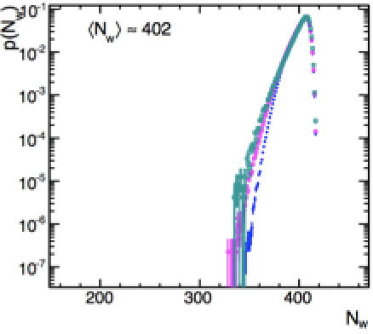
Centrality fluctuation for N_{ch}^{A}
smear
smear
smear
N_{part} distribution strongly distorted in UCC
Leads to smaller variance and negative skewness

Slide 25
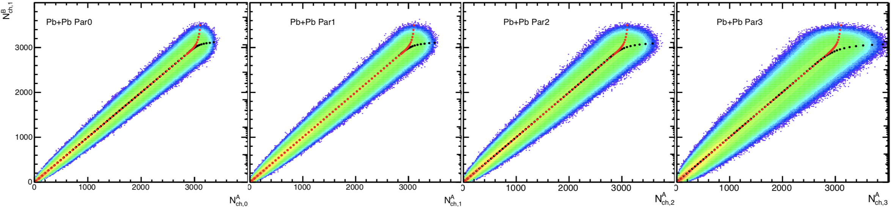
Multiplicity fluctuation in subevent B
smear
smear
smear
smear
smear
smear
smear
smear

Slide 26
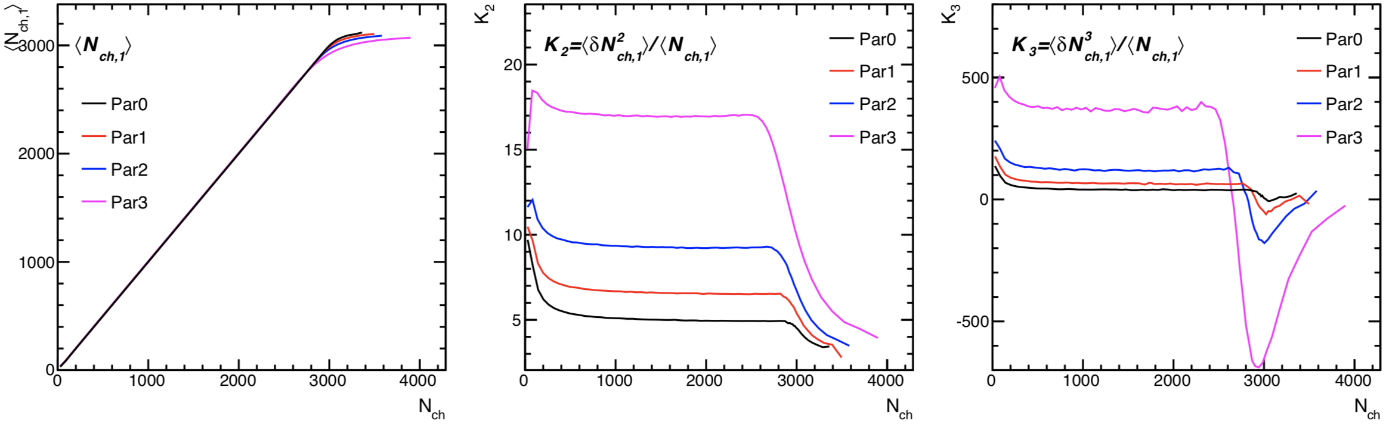




Multiplicity fluctuation in subevent B
smear
smear
smear
smear
smear
smear
smear
smear
Simple re-scaling
Re-scaling + offset
More complex relation

Slide 27
Effects of centrality decorrelation

Slide 28
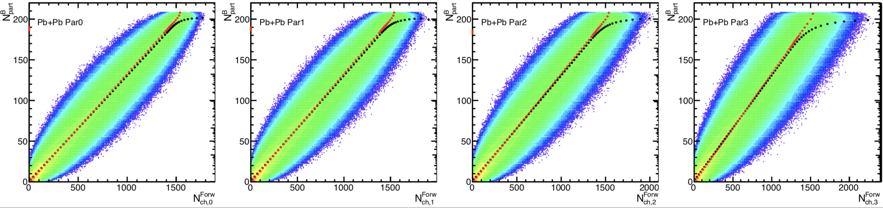

Centrality fluctuation for N_{ch}^{Forward}
smear
smear
smear
smear
Fatter correlation due to fluc of N_{part}^{B} relative to N_{part}^{F}

Slide 29
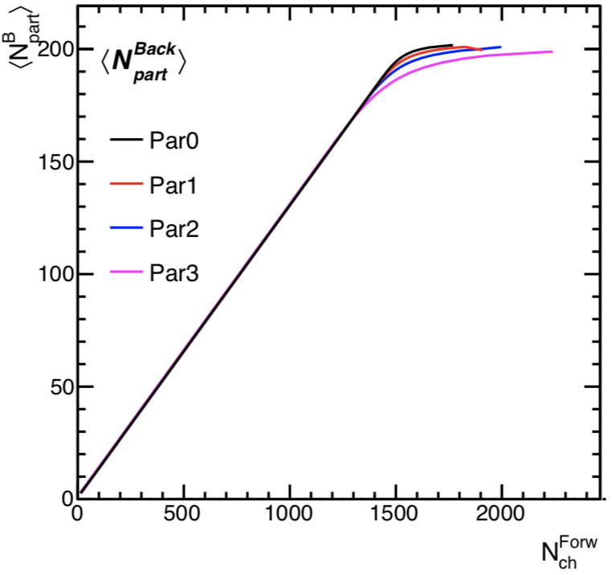
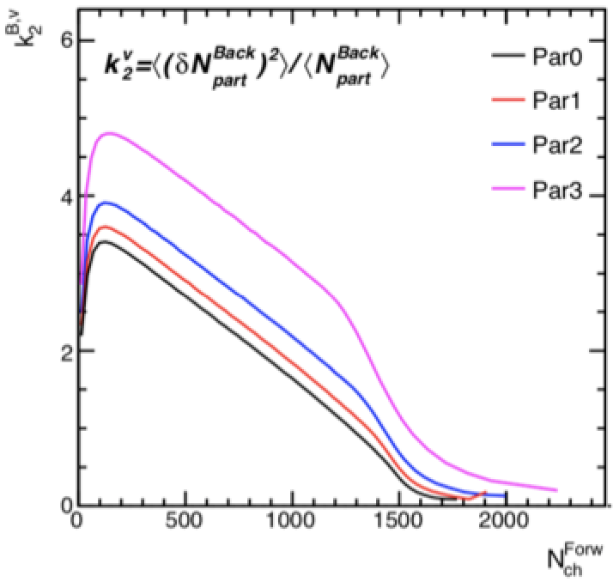
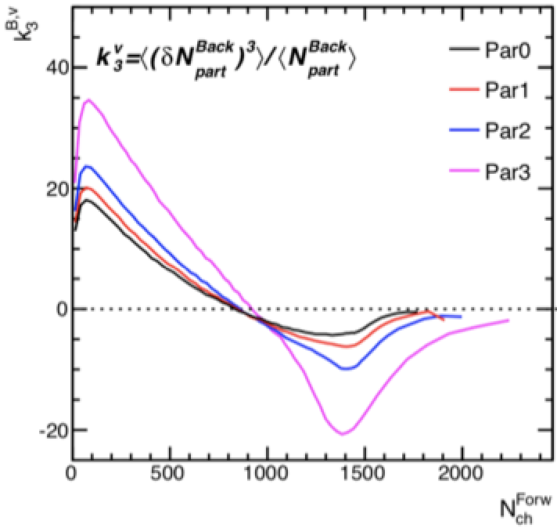
Centrality fluctuation for N_{ch}^{Forward}
smear
smear
smear
smear
Fatter correlation due to fluc of N_{part}^{B} relative to N_{part}^{F}
A decrease due to this, followed by a sharp decrease in UCC.
A decrease, followed by a sharp decrease in UCC
Similar to multiplicity smearing

Slide 30
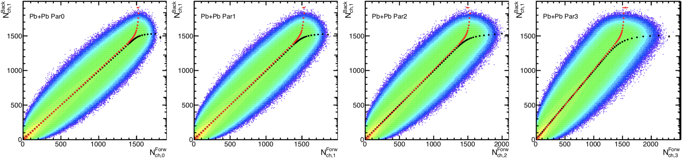
Multiplicity fluct. in Backward subevent
smear
smear
smear
smear
smear
smear
smear
smear

Slide 31
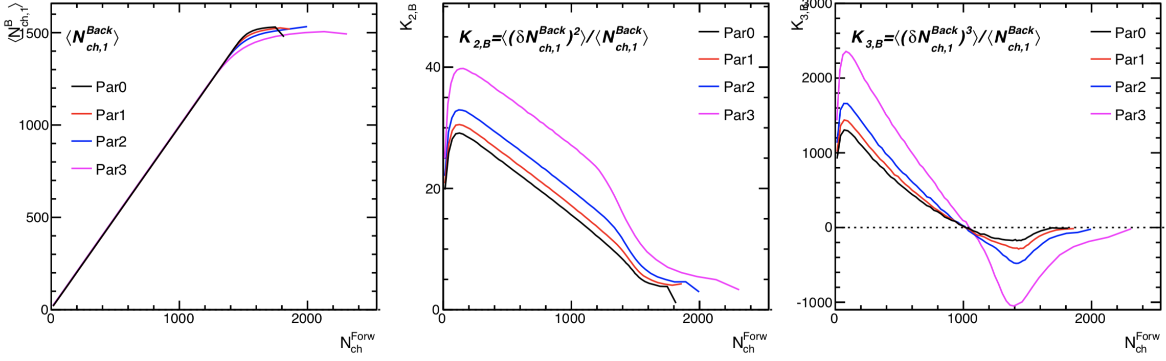
Multiplicity fluct. in Backward subevent
smear
smear
smear
smear
smear
smear
smear
smear
Simple re-scaling
Re-scaling + offset
More complex relation

Slide 32
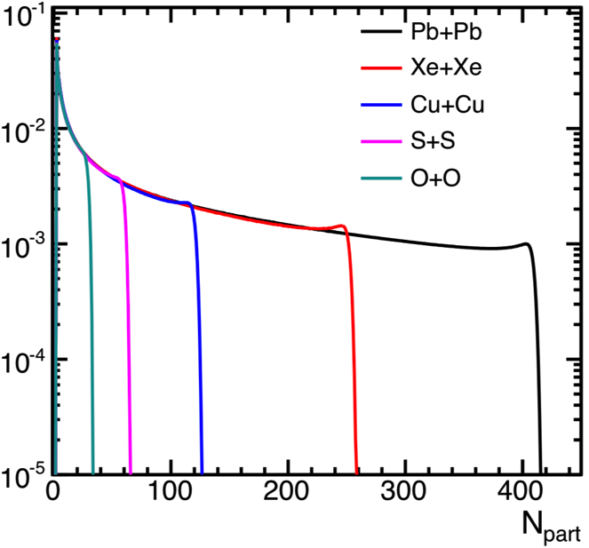
System size dependence
Repeat study for different systems (but in HIJING)
<N_{ch}^{B}> break-off in UCC in all systems at different N_{ch}
K_{2,B|A} decrease in UCC in all systems at different N_{ch}
<N_{ch,B}>
<K_{2,B}>
N_{ch,A}
N_{ch,A}

Slide 33
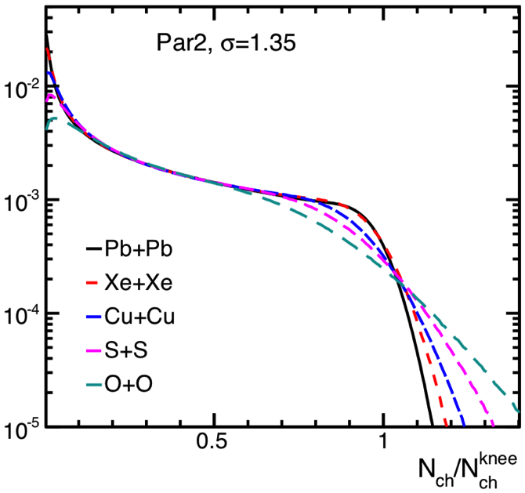
System size dependence
Repeat study for different systems (but in HIJING)
<N_{ch}^{B}> break-off in UCC in all systems at different N_{ch}
K_{2,B|A} decrease in UCC in all systems at different N_{ch}
Scaled distribution: smaller systems more affected
<N_{ch,B}>
<K_{2,B}>
N_{ch,A}/<N_{ch, A}>
N_{ch,A}/<N_{ch, A}>

Slide 34
Summary
Centrality fluctuation (CF) is one main uncertainty for interpreting the centrality dependence of experimental results.
Two sources of CF
  Due to multiplicity smearing from boost-invariant particle production
  Arise from longitudinal fluctuations in the particle product
Investigated using simple Glauber+NBD model
  CF is strongly distorted in UCC collisions, therefore can be used to learn about particle production mechanism
Extending these studies to small systems is a promising direction.

Slide 35
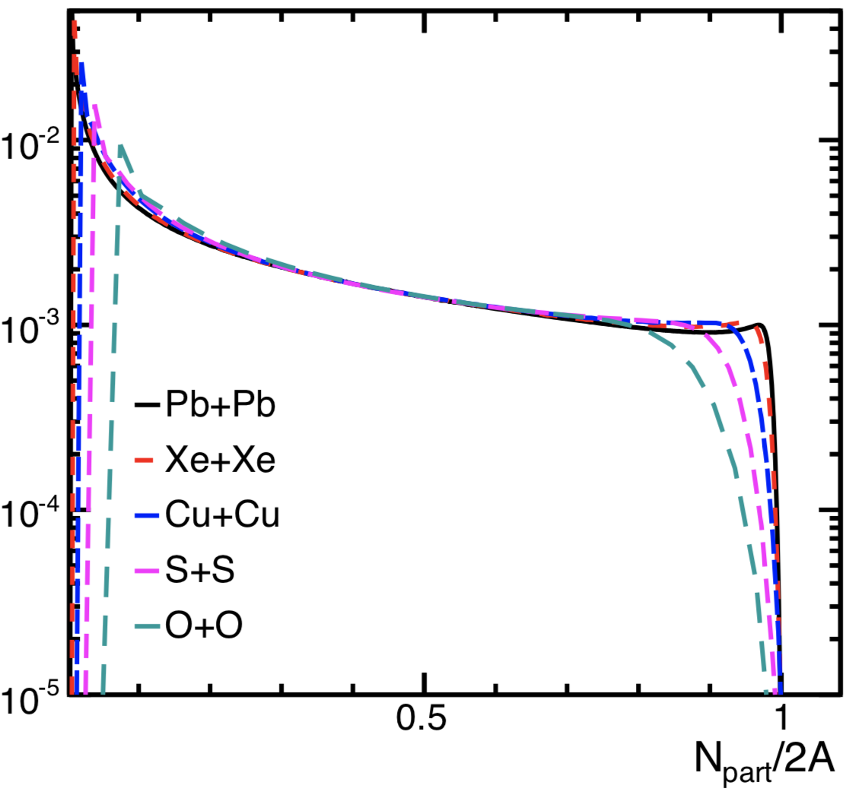
Expectation of centrality smearing
Strongest where p(cent) varies the fastest:
Peripheral and Ultra-central collisions
Stronger smearing expected for smaller system
p(N_{part}) rescale by atomic number
each participant smeared by p(n)

