Slide 1
Experimental status of the CME search
QCD 物 理 研 讨 暨 基 金 委 重 大 项 目 交 流 会
Fuqiang Wang
Purdue University, Huzhou University

Slide 2
Outline
What is CME? Why is CME important?
Background issue
New progresses
Summary

Slide 3
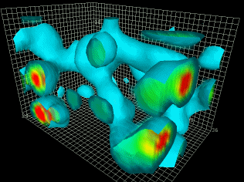
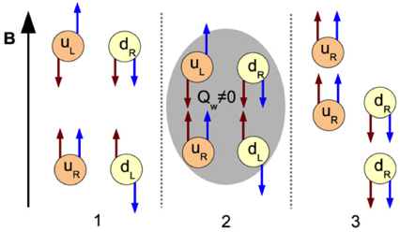
What is CME?
QCD vacuum fluctuations
  Non-zero topological charge gluon field
  Chirality imbalance, quantum anomaly
  Local P, CP violations
Chiral symmetry restoration
  Current quark degrees of freedom
Strong magnetic field
Derek Leinweber
Diakonov, PPNP 51
B
B
u_{R}
u_{R}
u_{R}
u_{R}
u_{L}
u_{R}
u_{L}
u_{R}
u_{R}
u_{R}
Kharzeev, et al. NPA 803 (2008) 227
Local C, CP violations
Q_{W}<0
Electric charge separation
d_{R}
d_{R}
d_{L}
d_{R}
d_{L}
d_{R}
d_{R}
d_{R}
d_{R}
d_{R}

Slide 4
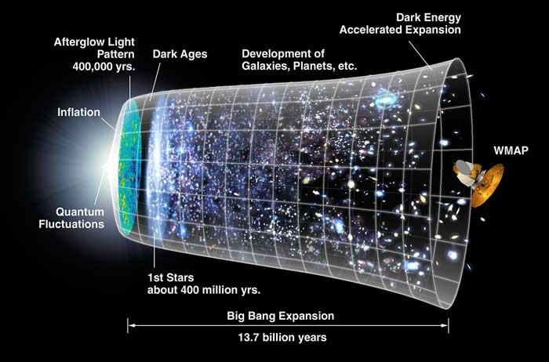
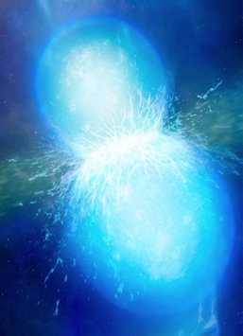
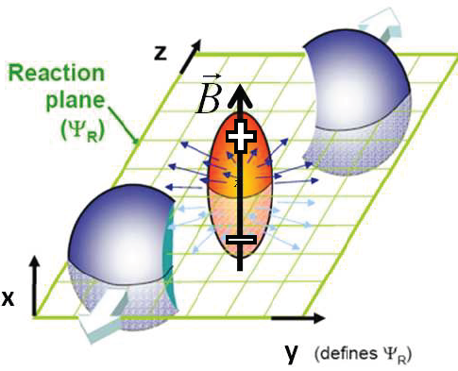
Why is CME important?
Kharzeev, Pisarski, Tytgat, PRL 81 (1998) 512; Kharzeev, et al. NPA 803 (2008) 227
CP
QGP
χ-sym.
Weak interaction too small
No is observed in strong interaction
The strong CP problem
CP
Vacuum fluctuations →
Topological gluon field
in local domains →
Local C and CP violations
CP
Strong magnetic field
Quark degree of freedom, χ-symmetry
QCD vacuum fluctuations,
Topological gluon field, Q_{w}≠0.
Local P, CP violations
Strong CP problem, matter-antimatter asymmetry
B ~ 10¹⁵ T

Slide 5
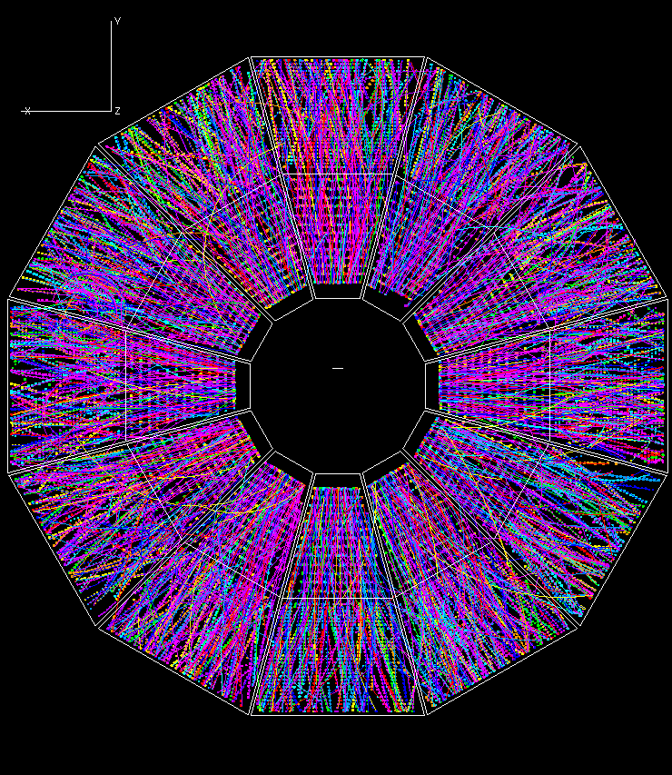
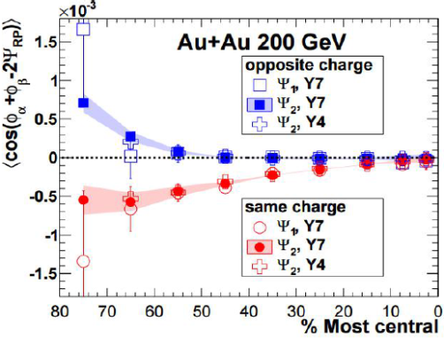
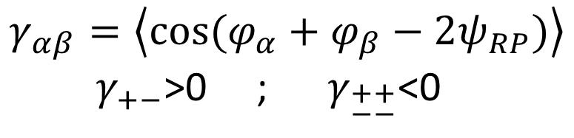
To measure CME: the γ observable
π⁺
π⁺
RP
π⁻
π⁻
Lead to BNL Press Release in 2010
Voloshin, PRC 70 (2004) 057901
$$γ_{αβ}=\left\langle cos⁡(φ_{α}+φ_{β}−2ψ_{RP})\right\rangle$$
$γ_{+−}$>0 ; $γ_{\begin{aligned}++ \\ −−\end{aligned}}$<0

Slide 6
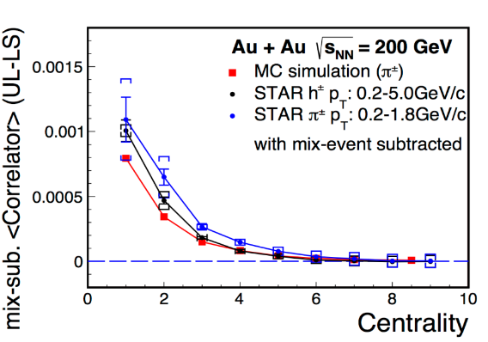


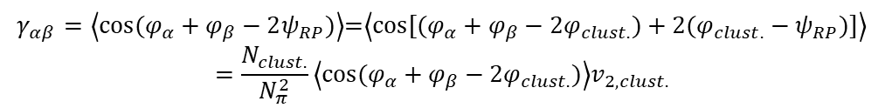

The Background Issue: It’s big!
CME
+ momentum conserv.
+ charge conserv.
CME
CME
+ momentum conserv.
π⁺
OS
OS
ρ
π⁺
$γ_{+−}$>0
OS
π⁻
$γ_{\begin{aligned}++ \\ −−\end{aligned}}$<0
SS
Signal is ambiguous
π⁻
SS
Use OS-SS
SS
$γ_{αβ}=\left\langle cos⁡(φ_{α}+φ_{β}−2ψ_{RP})\right\rangle$=$\left\langle \cos{[(φ_{α}+φ_{β}−2φ_{clust.})}+2(φ_{clust.}−ψ_{RP})]\right\rangle$
$$=\frac{N_{clust.}}{N_{π}^{2}}\left\langle cos⁡(φ_{α}+φ_{β}−2φ_{clust.})\right\rangle v_{2,clust.}$$
Next slide
Background: nonflow coupled with flow
FW, Jie Zhao, PRC 95 (2017) 051901
FW 2009, Bzdak, Koch, Liao 2010, Pratt, Schlichting 2010, …
$$\frac{N_{clust.}}{N_{π}^{2}}\left\langle cos⁡(φ_{α}+φ_{β}−2φ_{clust.})\right\rangle v_{2,clust.}$$
20/100²*0.65 ~ 10⁻³
0.1
Pratt, Schlichting

Slide 7
The resonance background in γ correlator
Voloshin 2004; FW 2009; Bzdak, Koch, Liao 2010; Pratt, Schlichting 2010; …
Y
π⁻
π⁺
π⁺
ρ
π⁺
ρ
π⁻
X
ψ_{RP}
ρ
π⁺
π⁻
π⁻
Background: nonflow coupled with flow

Slide 8
Handling background
When background is small
  Can be a bit sloppy in background estimation.
  Imprecision can be afforded by systematic uncertainty.
  Can be somewhat model-dependent (theo. syst. uncertainties).
When background is large
  Have to cleanly remove background.
  Extreme care should be taken.
  Small error in background can result in big mistake in signal.
  Should not rely on theory/model/trends (unless theory is very precise).
  Better be data-driven, often involving new observables and methods.

Slide 9
The infamous κ parameter
*κ
STAR, PRL 113 (2014) 052302
ΔH ≈ Δγ − κv₂δ
κ=1 is a misconception
Background size assumed!
No new info beyond the original
Δγ measurement. Over-sold.

Slide 10
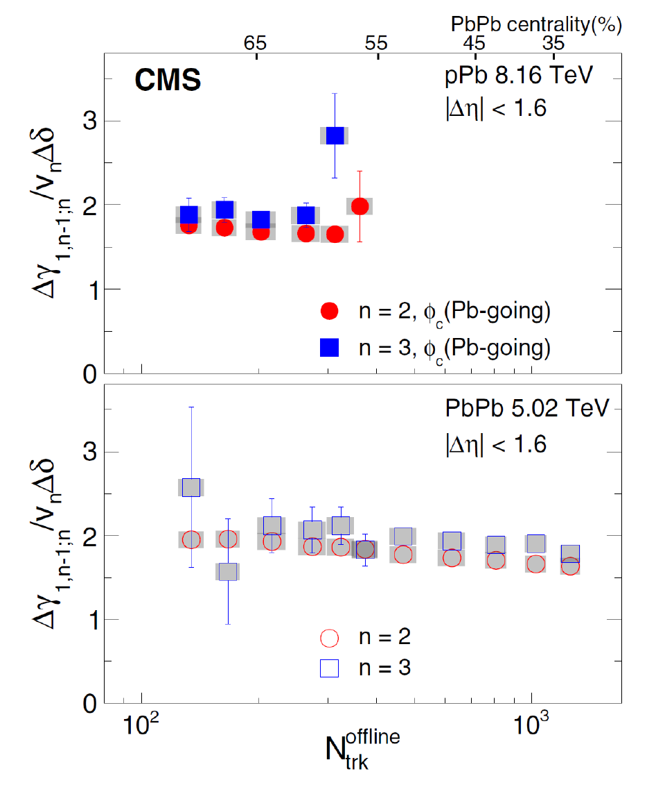
CMS clarification
*κ
$γ$=$\left\langle \cos{[(φ_{α}+φ_{β}−2φ_{clust.})}+2(φ_{clust.}−ψ_{RP})]\right\rangle =\frac{N_{clust.}}{N_{π}^{2}}\left\langle cos⁡(φ_{α}+φ_{β}−2φ_{clust.})\right\rangle v_{2,clust.}$
κ₂ = κ₃ accidental?

Slide 11

To eliminate background
Make v₂ zero…
STAR

Slide 12
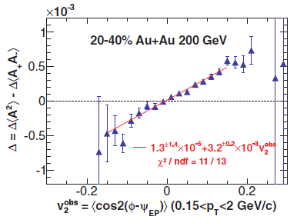
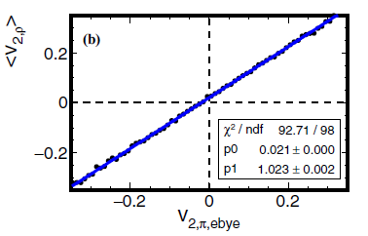
Make v₂ “zero” – EbyE technique
Event-by-event v₂ technique
Still has residual background,
because background ~ v_{2,ρ} not v_{2,π}
FW, Jie Zhao, PRC 95 (2017) 051901(R)
STAR PRC 89(2014)044908
Here Δ is similar to
cos(α+β−2ψ) correlator
STAR PRC 89 (2014) 044908

Slide 13
Make v₂ “zero” – EbyE technique
Event-by-event v₂ technique
Still has residual background,
because background ~ v_{2,ρ} not v_{2,π}
FW, Jie Zhao, PRC 95 (2017) 051901(R)
STAR PRC 89(2014)044908
Here Δ is similar to
cos(α+β−2ψ) correlator
v_{2,ρ}
STAR PRC 89 (2014) 044908
v_{2,π}
final state

Slide 14
Make v₂ “zero” – EbyE technique
Event-by-event v₂ technique
Still has residual background,
because background ~ v_{2,ρ} not v_{2,π}
FW, Jie Zhao, PRC 95 (2017) 051901(R)
STAR PRC 89(2014)044908
Here Δ is similar to
cos(α+β−2ψ) correlator
v_{2,ρ}
STAR PRC 89 (2014) 044908
v_{2,π}
final state

Slide 15
Make v₂ “zero” – EbyE technique
Event-by-event v₂ technique
Still has residual background,
because background ~ v_{2,ρ} not v_{2,π}
FW, Jie Zhao, PRC 95 (2017) 051901(R)
STAR PRC 89(2014)044908
Here Δ is similar to
cos(α+β−2ψ) correlator
v_{2,ρ}
STAR PRC 89 (2014) 044908
v_{2,π}
final state
Be self-critical!
Sciences often progress thru self-denials.

Slide 16
Event-by-event q² technique
Wen, Bryon, Wen, Wang, CPC 42 (2018) 014001
Similar to event-by-event v2 technique
v₂
v₃
Intercept = (7.51 ± 0.75)*10⁻³
Intercept = (8.32 ± 1.92)*10⁻³

Slide 17
To eliminate background
Three methods on the market that I think are hopeful to eliminate the backgrounds…
  Event-shape engineering
  Invariant mass
  RP vs. PP comparison

Slide 18
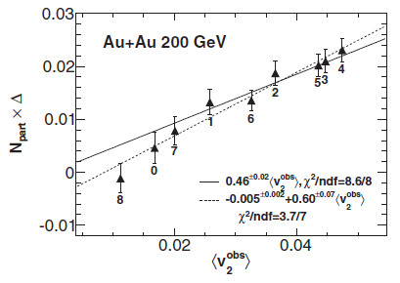
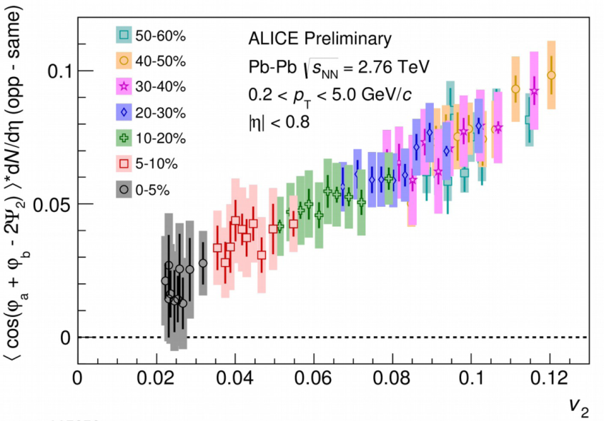
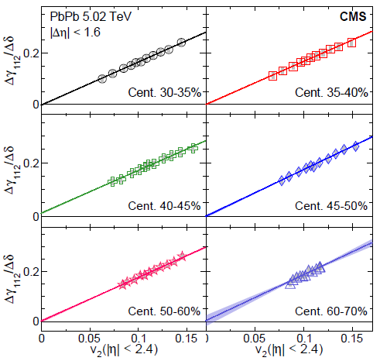
1) Event-shape-engineering technique
STAR PRC89(2014)044908
Here Δ is similar to
cos(α+β−2ψ) correlator
ALICE PLB777(2018)151
CMS PRC97(2018)044912
ESE displaced from α, β phase space

Slide 19
1) Event-shape-engineering technique
STAR PRC89(2014)044908
Here Δ is similar to
cos(α+β−2ψ) correlator
ALICE PLB777(2018)151
CMS PRC97(2018)044912
v_{2,ρ}
ESE displaced from α, β phase space
v_{2,π}
final state

Slide 20
2) The invariant mass method
Get rid of resonances, or utilize them…
Identify the backgrounds by invariant mass
arXiv:1705.05410

Slide 21
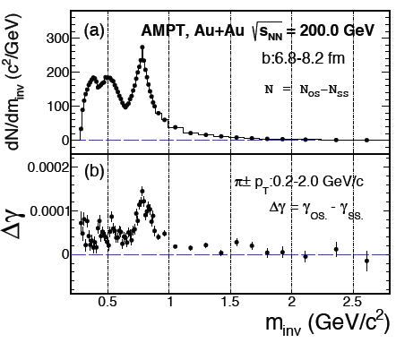
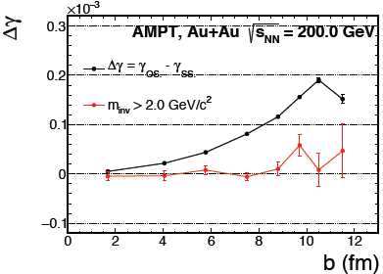
Check with AMPT
Jie Zhao, Hanlin Li, FW, arXiv:1705.05410
All are backgrounds
ρ
High mass Δγ consistent with 0 as it should be
Resonance structure in
Δγ as function of m_{inv}
Resonance background should be nearly zero at high mass
CME at large mass may also be zero…

Slide 22

Get away from resonances
Jie Zhao (STAR) Quark Matter 2018, arXiv:1807.09925
Resonance structure in
Δγ as function of m_{inv}
Major background
High mass Δγ:
(4$.5±2.5)$%

Slide 23
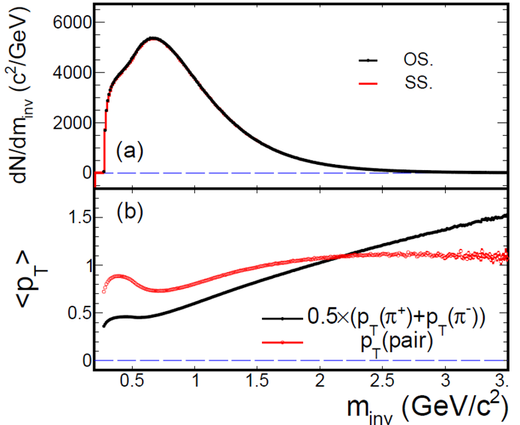
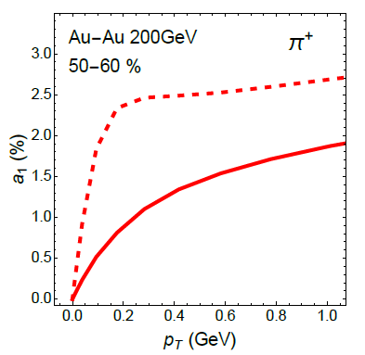
Can CME survive to high mass?
Kinematics
Directly produced
Final state
Shi et al., 1711.02496,
Ann.Phys.394(2018)50
m_{inv} > 2 GeV/c² contains appreciable low p_{T} pions
CME signal may not be limited only to low p_{T}
High mass should still contain CME

Slide 24

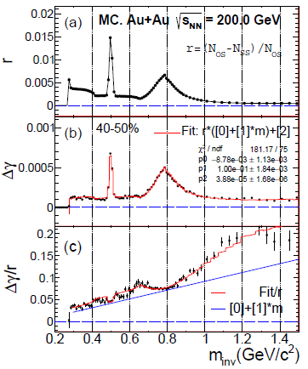
Can we access CME at low p_{T}?
Two component model: Resonances + CME: Jie Zhao, Hanlin Li, FW, arXiv:1705.05410
Low mass region
K_{S}
Δγ = (24.5 ± 0.1) × 10⁻⁵
Input CME: a₁ = 0.008
CME frac: 2a₁² (N_{prim}/N_{π})² = 4.6 × 10⁻⁵ (20%)
ρ
Input
Δγ (m_{inv}>2 GeV/c²) = (4.5 ± 0.8) × 10⁻⁵
Δγ traces r
Can really see signal
peaked
smooth
r(m_{inv}) * ( P₀ + P₁*m_{inv} ) + P₂
Fit result: P₂ = (3.9 ± 0.2) × 10⁻⁵

Slide 25
Can we access CME at low p_{T}?
Two component model: Resonances + CME: Jie Zhao, Hanlin Li, FW, arXiv:1705.05410
Low mass region
K_{S}
Δγ = (24.5 ± 0.1) × 10⁻⁵
Input CME: a₁ = 0.008
CME frac: 2a₁² (N_{prim}/N_{π})² = 4.6 × 10⁻⁵ (20%)
ρ
Input
Δγ (m_{inv}>2 GeV/c²) = (4.5 ± 0.8) × 10⁻⁵
Δγ traces r
Can really see signal
peaked
smooth
r(m_{inv}) * ( P₀ + P₁*m_{inv} ) + P₂
Fit result: P₂ = (3.9 ± 0.2) × 10⁻⁵

Slide 26
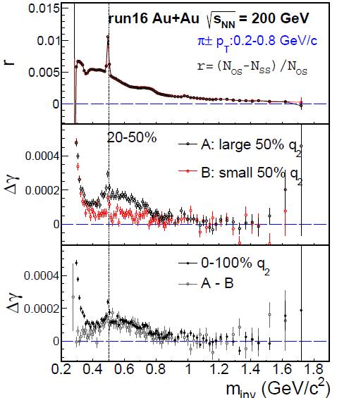
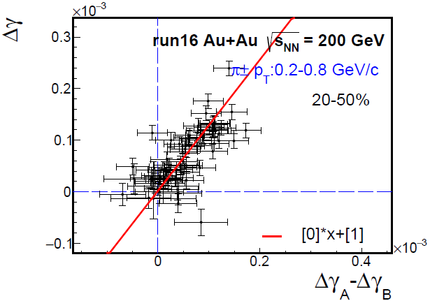

Indulge into the resonance region
ESE q₂ selects different v₂, but does not bias spectators or magnetic field
Δγ_{A}−Δγ_{B} represents background shape
Fit Δγ = k*(Bkg shape) + CME
Fit does not assume Δγ $∝$ v₂, but only dependent of v₂
Fit assumes constant CME. Fit χ²/ndf tells whether it’s a good assumption
Jie Zhao (STAR), QM18, 1807.09925
STAR Preliminary
STAR Preliminary

Slide 27

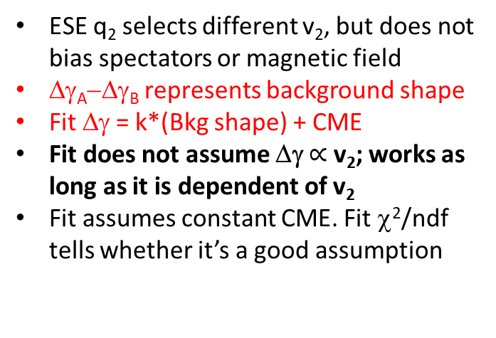
Indulge into the resonance region
ESE q₂ selects different v₂, but does not bias spectators or magnetic field
Δγ_{A}−Δγ_{B} represents background shape
Fit Δγ = k*(Bkg shape) + CME
Fit does not assume Δγ $∝$ v₂; works as long as it is dependent of v₂
Fit assumes constant CME. Fit χ²/ndf tells whether it’s a good assumption
Jie Zhao (STAR), QM18, 1807.09925
CME=$(2±4)$%
STAR Preliminary
STAR Preliminary

Slide 28
3) RP vs PP comparison measurement
H. Xu, J. Zhao, X. Wang, H. Li, Z.-W. Lin, C. Shen, F. Wang, CPC 42 (2018) 084103, arXiv:1710.07265
Intra-event “CME-v₂ Filter”
RP
BKG
BKG×a
CME
CME
CME and BKG are entangled in AA
PP
BKG
BKG
CME
CME×a
input
measured
SAME EVENT

Slide 29
“CME-v₂ Filter” results from STAR
RP
BKG
BKG×a
CME
CME
PP
BKG
BKG
CME
CME×a

Slide 30
Summary of Possible CME Signal
Jie Zhao (STAR) Quark Matter 2018
arXiv:1807.09925
Major physics backgrounds
Possible CME signal ~ a few %, 1-2σ from zero.

Slide 31
A day-1 prediction for isobar
⁹⁶₄₄Ru
⁹⁶₄₀Zr
Ru+Ru vs. Zr+Zr
Multiplicity sensitive to nuclear structure
Our prediction
Woods-Saxon
prediction
Haojie Xu et al. PRL 121 (2018) 022301
Haojie Xu et al. CPC 42 (2018) 084103
Hanlin Li et al. PRC 98 (2018) 054907

Slide 32
Summary
Very important physics
Background dominate in inclusive Δγ.
Rigorous treatment of background is critical.
Three viable methods so far:
  Event-shape engineering
  Invariant mass
  RP vs. PP comparison
Possible CME signal is small, a few % of the inclusive Δγ, current precision 1-2σ from zero.

