Slide 1
Longitudinal Beam Polarization@ CEPC-Z
Zhe Duan
On behalf of CEPC Beam Polarization Working Group
2019. 07. 05
This work is supported as a sub-task in CEPC MOST Grant 2018.

Slide 2
Requirements of longitudinal beam polarization
Figure of merit: Luminosity * f( P_{e+}, P_{e-} )
Typically, longitudinal beam polarization > 50% @IPs is required
Not interesting if luminosity loss is too high

Slide 3
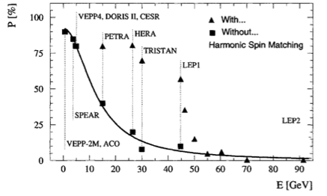
Self polarization @ CEPC
Beam polarization evolution in an electron storage ring between injections
$P\left(t\right)=P_{ens,DK}\left(1−e^{−t/τ_{DK}}\right)+P_{0}e^{−t/τ_{DK}}$, $\frac{1}{τ_{DK}}=\frac{1}{τ_{BKS}}+\frac{1}{τ_{dep}}$, $P_{ens,DK}≈\frac{92\%}{1+τ_{BKS}/τ_{dep}}$
Increasing energy spread leads to enhancement of synchrotron sideband resonances, and faster reduction of beam polarization with energy.
Rassmann, et al., AIP Conf. Proc, 570, 169-178, 2001
E. Gianfelice-Wendt, PRAB, 19, 101005 (2016)
Beam energy (GeV) | 45.5 | 80 | 120
Polarization build-up time $τ_{BKS}$ (hr) | 256 | 15.2 | 2
Beam lifetime for colliding bunches $τ_{b}$ (hr) | 3.2 | 1.2 | 0.22
Expected equilibrium beam polarization $P_{ens,DK}$ | >50% | < 50% | ~ 0

Slide 4
Beam polarization in CEPC Collider Rings
Top-up injection (continuous injection) is baseline to maintain a high average luminosity
Average beam polarization for continuous injection during physics runs
Injected beam polarization
Self-polarization: equilibrium beam polarization in the ring
$$P_{avg}=\frac{P_{ens,DK}}{{1+τ}_{DK}/τ_{b}}+\frac{P_{0}}{{1+τ}_{b}/τ_{DK}}$$
Competition between beam decay/injection
and polarization build-up in the ring
@CEPC-Z: $P_{ens,DK}$ > 50%, $τ_{DK}$ > 100 hour, $τ_{b}=2\sim 3 hour$, $τ_{DK}≫τ_{b}$
The first term is by default negligibly low.

Slide 5
How to achieve a high average beam polarization ?
Scenario 1: self-polarization + unpolarized injected beam
Mandatory to make $τ_{DK} \sim τ_{b}$
$τ_{DK}$ can be reduced down to ~ 10 hours, with asymmetric wiggler, limited by allowed energy spread increase
$τ_{b}$ is dominated by radiative Bhabha & beamstrahlung, increase in $τ_{b}$ -> loss in luminosity
Significant loss in luminosity makes this scenario uninteresting, according to FCC-ee CDR
A. Blondel, talk on FCC Week 2017

Slide 6
How to achieve a high average beam polarization ?
Scenario 2: polarized injected beam
$P_{avg}=\frac{P_{ens,DK}}{{1+τ}_{DK}/τ_{b}}+\frac{P_{0}}{{1+τ}_{b}/τ_{DK}}≈P_{0}$, given that $τ_{DK}≫τ_{b}$
A high average beam polarization is not in direct contradiction to a high luminosity!
Tasks:
Preparation of polarized beam in the injector (AGS, RHIC)
Design of spin rotators in the collider rings (LEP, HERA, SuperB, SuperT-C, RHIC)
Ensure $τ_{DK}≫τ_{b}$ via spin matching (LEP, HERA)
This scenario is not considered in FCC-ee CDR, and we can make a difference @ CEPC

Slide 7
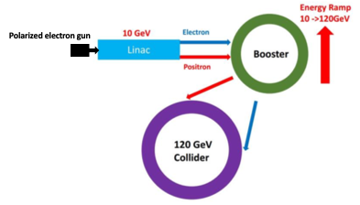
Longitudinal polarized e- beam preparation in CEPC
Longitudinal polarization in source & linac
Polarized electron source is a matured technology, polarization ~ 90% and nC-level bunch charge is achievable
Siberian snake
Siberian snake is necessary in the booster to maintain a decent polarization
Spin rotators are necessary in the collider ring to make the polarization along longitudinal direction @ IPs.
Spin rotators

Slide 8
Key R&D items
At the moment, we’ll focus on the accelerator physics study & design of polarized colliding beams, to give parameter specs. for harewares
Siberian snake in the booster
Spin rotators in the storage ring
Additional hardwares
Polarized electron gun
Longitudinal polarimeter

Slide 9
Questions
Physics motivation for longitudinal polarized beams @ CEPC-Z?
Single beam polarization or both beam polarization is needed?
At least what level of polarization is required?
What are the strongest physics cases?

Slide 10
Thanks!

Slide 11
Backup
What about higher CM energy?
More challenging to maintain beam polarization in the booster: stronger spin resonances, longer snakes
More challenging to ensure $τ_{DK}≫τ_{b}$ as depolarization is more severe at higher energy

