Slide 1
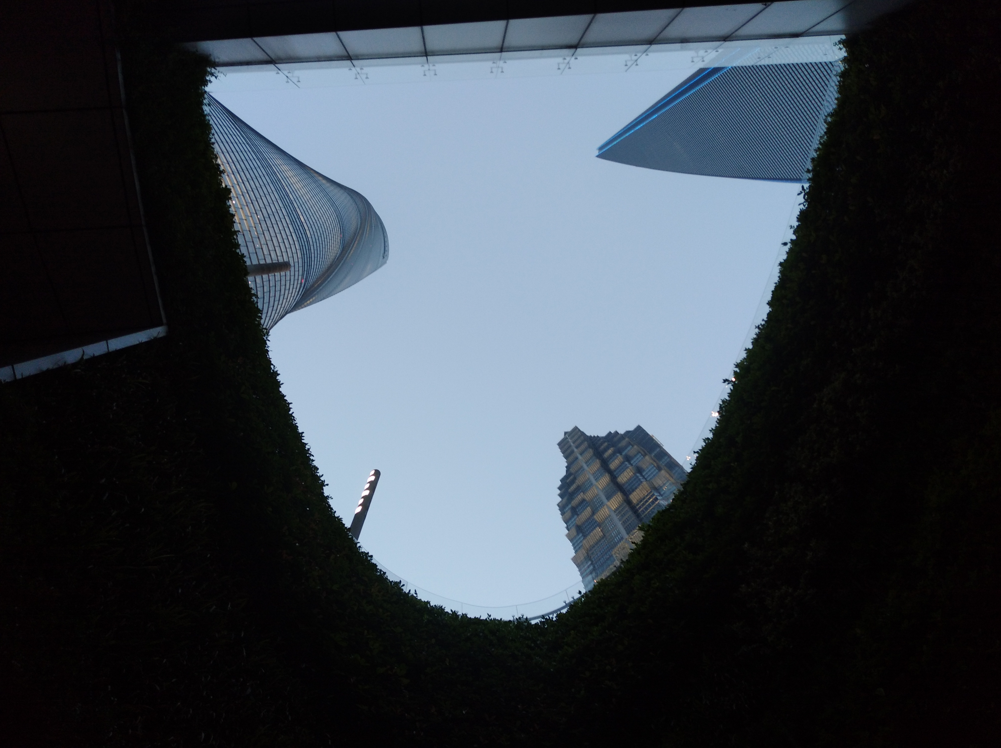

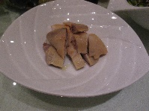
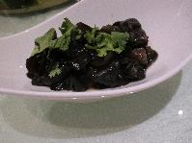
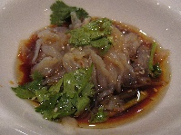
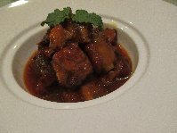
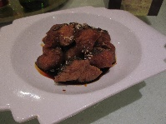

u
s
Hyperon Decays in LHCb
Diego Martínez Santos
GAIN
d

Slide 2

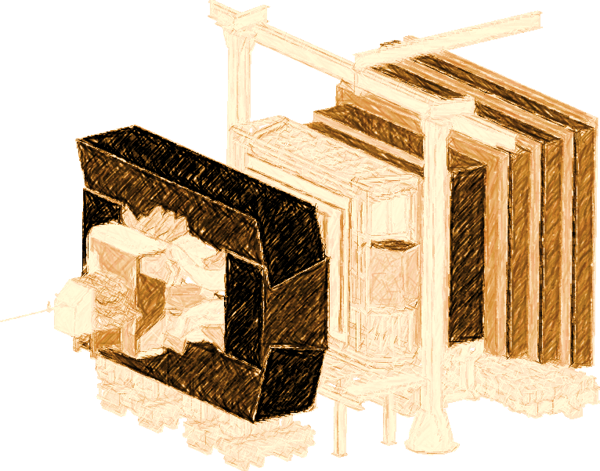

Introduction
LHCb experiment at LHC
  Designed mostly for b and c decays
    → low trigger efficiency otherwise
  But there is also an ~infinite strangeness production at LHC (kaon xs ~ 1.2 barn)
  Infinite production times zero efficiency requires L’Hopital
    In 2011 we managed to get world best result in K_{S} → μμ
  Major improvements in the trigger for s decays done for Run-II (2016-2018), and ongoing for Upgrade (>=2021)

Slide 3
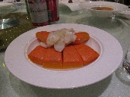
Strangeness decays
So far a kaons showed great success on indirect searches: c, b, t , CKM …
High theoretical interest, most notably to test departures from MFV paradigm (eg, flavor generic)
From G. Isidori KAON’16
For details see
G.Isidori , Y. Nir, G. Perez
arXiv:1002.0900v2
Useful to understand “Hints” for BSM in b sector
  Eg: deviations in b→sµµ: are they replicated in s → dµµ?
Potentially immense samples : high(est) ultimate experimental precision
Y ➔ interesting
N ➔ interesting

Slide 4
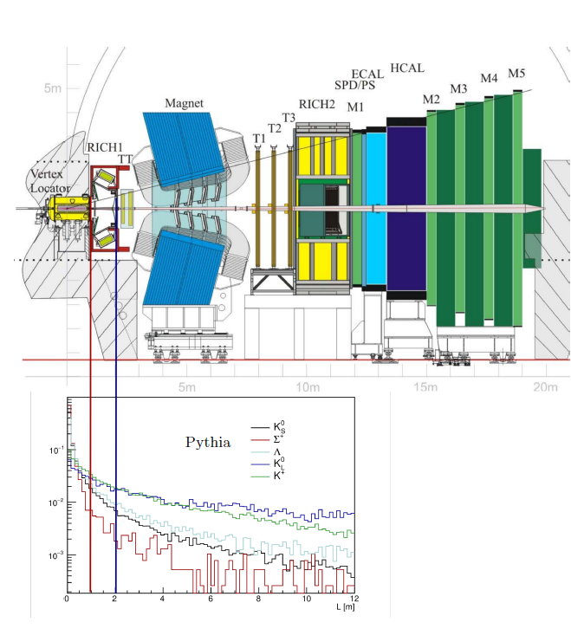
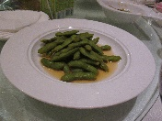
Strangeness production/detection at LHCb
The pp collisions @ LHC produce a ‘kaon flux’ of 10¹³ K_{S} per fb⁻¹ of luminosity in the LHCb acceptance
Charged decay products can be reconstructed using Long Tracks or Downstream Tracks
We use Long Tracks for RnS
Downstream will be investigated (extra yield, but worse reconstruction quality)
K_{L} , K_{S} produced in equal amounts. Acceptance ratio is ~2x10⁻³
(for Long Tracks)

Slide 5
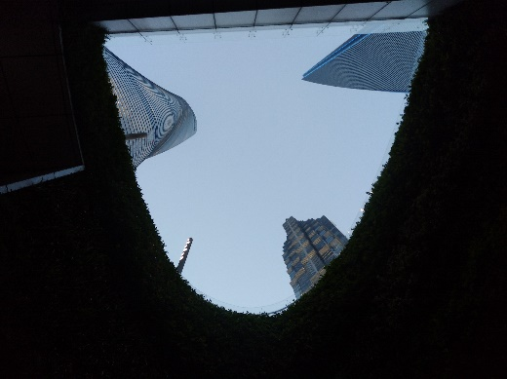
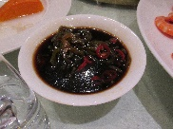

Strangeness cross sections
1808.03477
~0.15 barn
~0.04 barn
u
s
d
Λ
~ 3x10¹⁴ produced per year
u
s
u
Σ⁺
~ 8x10¹³ produced per year

Slide 6

Strangeness cross sections and acceptances
1808.03477
acc./acc(Ks→µµ)
σ/σ_{Ks}
Downstream tracks
Full tracks
acc./acc(Ks→ππee)
σ/σ_{Ks}
Full tracks
Downstream tracks

Slide 7

Data taking Runs

Slide 8
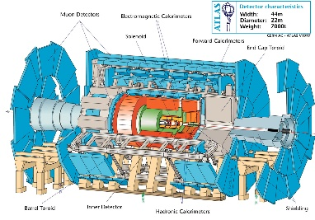


Trigger system: status and prospects
Typical PT
L0 (Hardware)
Main bottleneck for K. Can’t be changed
~30-40 GeV
~ 1-2 GeV
~0.08 GeV
HLT1 (Software)
Not designed for K, but flexible.
K triggers being implemented
B-physics
HLT2 (Software)
s-physics

Slide 9

Trigger system: status and prospects
Typical PT
L0 (Hardware)
Main bottleneck for K. Can’t be changed
~30-40 GeV
~ 1-2 GeV
~0.08 GeV
HLT1 (Software)
Not designed for K, but flexible.
K triggers being implemented
B-physics
HLT2 (Software)
s-physics
ε(2011-2012) ~ 1-2%
ε(Run-II) improved HLT ~ 18% (dimuons)
Maximum allowed by L0 ~30%

Slide 10


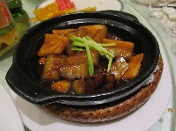
Trigger system: status and prospects
L0 (Hardware)
Main bottleneck for K. Can’t be changed
HLT (Software)
LHCb
Upgrade
HLT1 (Software)
Not designed for K, but flexible.
K triggers being implemented
HLT2 (Software)
(Note: This logo may not be official)
ε(2011-2012) ~ 1-2%
ε(Run-II) improved HLT ~ 18% (dimuons)
Maximum allowed by L0 ~30%

Slide 11

Trigger system: status and prospects
L0 (Hardware)
Main bottleneck for K. Can’t be changed
HLT (Software)
LHCb
Upgrade
HLT1 (Software)
Not designed for K, but flexible.
K triggers being implemented
HLT2 (Software)
(Note: This logo may not be official)
ε(2011-2012) ~ 1-2%
ε(Run-II) improved HLT ~ 18% (dimuons)
Maximum allowed by L0 ~30%
ε(Upgrade) ~ 80-100%?
Simulation studies show that rate would be under control
V. Chobanova et al,
CERN-LHCb-PUB-2016-017

Slide 12
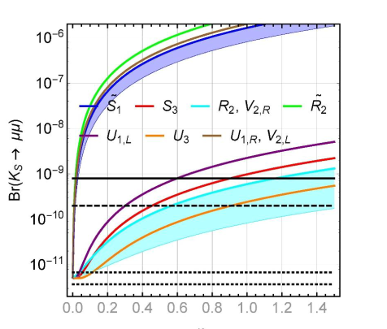
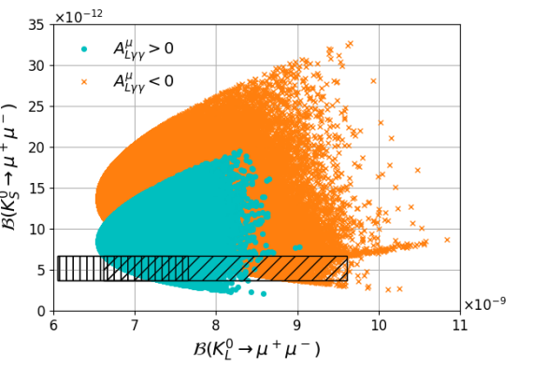
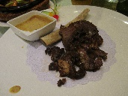
K_{S}→μμ: motivation
SM prediction: BR(K_{S} → µµ) = (5.18 ± 1.50_{LD} ± 0.02_{SD} )x10⁻¹²
JHEP05(2018) 024 , JHEP 0401 (2004) 009, NPB 366 (1991) 189
K_{S} → µµ sensitive to different physics than K_{L} → µµ, NP can be bigger than SM by ~1 order of magnitude or even saturate current EXP limit
Example of a SUSY scenario from
V.Chobanova et al., JHEP05(2018) 024
Leptoquark scenarios from Bobeth & Buras, JHEP02(2018)101

Slide 13
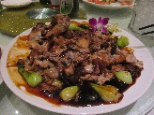
K_{S}→μμ prospects
Run- I: BR< 8 (10)x10⁻¹⁰ @90(95)%CL
Extrapolating from Run-I result
Full Run-II analysis ongoing: expected to improve by a factor 4 to 10 Run-I’s sensitivity
  Better trigger
  Better reco/selection
Future: start to investigate tagged decays, which would allow to access NP in the K_{S}-K_{L} interference
[D’Ambrosio&Kitahara PRL 119, 201802 (2017)]
LHCb-upgrade
Phase-II-upgrade?
Could well become the strongest limit on a BR by an LHC experiment

Slide 14
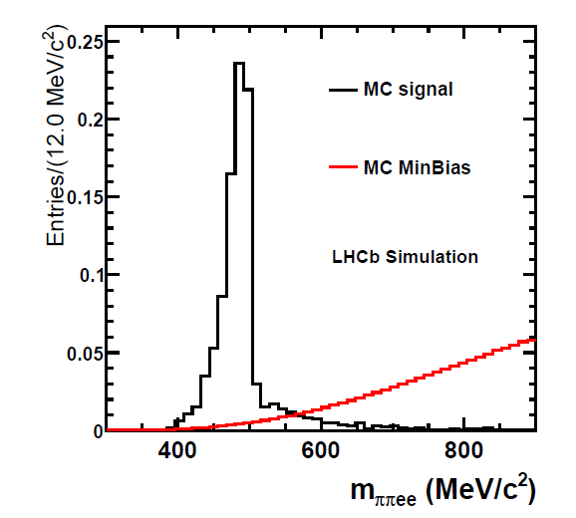


K_{S} →π⁺π⁻ee sensitivity study
C.Marin et al,
LHCb-PUB-2016-016
Based on simulation:
Expected a signal yield of
$${N=120}_{−100}^{+280}$$
For the full Run-I dataset
Expected background yield is not well known yet

Slide 15
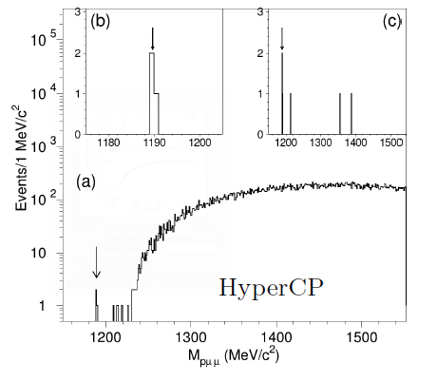

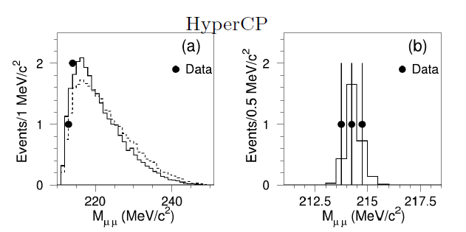
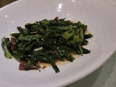
The HyperCP evidence
The HyperCP collaboration found evidence for Σ→pμμ decays, and provided a BR:
Consistent w/ SM: 1.6 < BR[x10⁻⁸] < 9
X G He et al, PRD 72 (2005) 074003
This evidence had wide relevance since all 3 observed events had the same dimuon invariant mass (214 MeV)
Suggested the existence of a new neutral particle at that mass

Slide 16
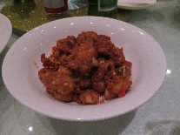
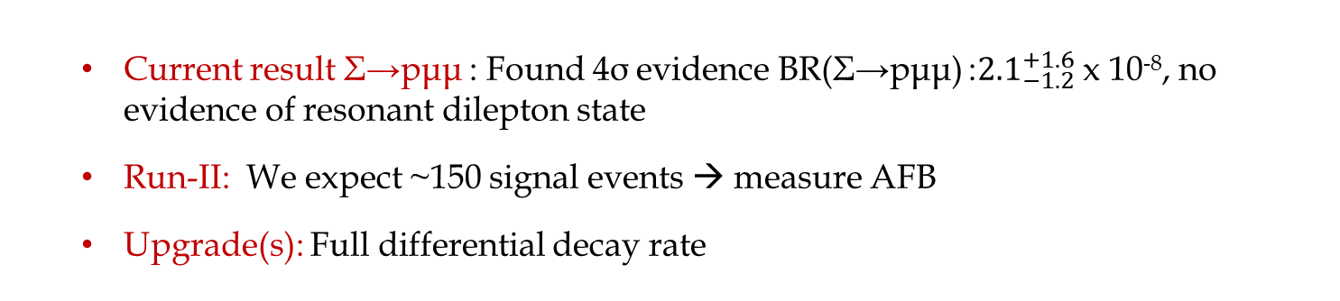
Σ→pμμ
LHCb-PAPER-2017-049
arXiv:1712.08606
PRL 120, 221803 (2018)
  Current result Σ→pμμ : Found 4σ evidence BR(Σ→pμμ) :${2.1}_{−1.2}^{+1.6}$ x 10⁻⁸, no evidence of resonant dilepton state
  Run-II: We expect ~150 signal events → measure AFB
  Upgrade(s): Full differential decay rate
10y ago we thought this channel was ~impossible and instead now we are even thinking on an amplitude analysis….

Slide 17
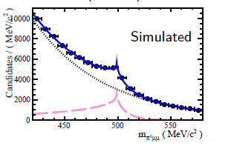
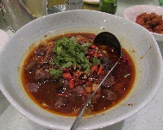
K_{S} →π⁰μμ sensitivity study
V. Chobanova et al,
LHCb-PUB-2016-017
arXiv:1808.03477 [hep-ex]
LHCb-upgrade
Phase-II-upgrade? →
|a_{S}|=1.2±0.2 from NA48 fixing b_{S} from VMD
PLB599 (2004) 197-211,
Much more bkg than K_{S}→μμ, but also 1000x more signal
(fixing b_{S})

Slide 18
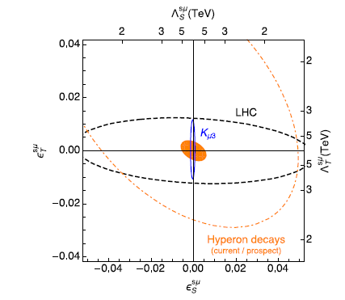
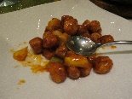
Semileptonic Hyperon Decays
arXiv:1808.03477 [hep-ex]
Semileptonic Hyperon Decays (SHD)
Very interesting in view of LUV hints in semileptonic B decays
Many muonic modes have still very poor precision (20%, 100%)
☺ High BR (10⁻⁴): Massive yields in LHCb acceptance
J. Camalich
(extrapolations from
1412.8484)
https://indico.cern.ch/event/590880/contributions/2485320/

Slide 19
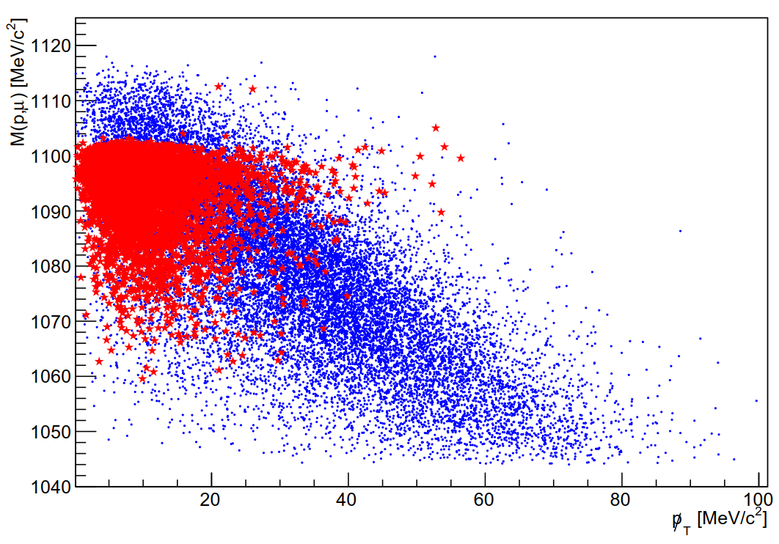
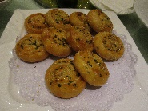
Semileptonic Hyperon Decays
arXiv:1808.03477 [hep-ex]
Semileptonic Hyperon Decays (SHD)
Very interesting in view of LUV hints in semileptonic B decays
Many muonic modes have still very poor precision (20%, 100%)
☺ High BR (10⁻⁴): Massive yields in LHCb acceptance
☹ Challenging peaking backgrounds:
For each
B1 → B2 μν there is always a
B1 → B2π (inc. →B2μv)
Fast Simulation
1808.03477
Λ→pπ
Λ→pμν
☺ Can be separated in search planes

Slide 20

Semileptonic Hyperon Decays
arXiv:1808.03477 [hep-ex]
Semileptonic Hyperon Decays (SHD)
Very interesting in view of LUV hints in semileptonic B decays
Many muonic modes have still very poor precision (20%, 100%)
☺ High BR (10⁻⁴): Massive yields in LHCb acceptance
☹ Challenging peaking backgrounds:
For each
B1 → B2 μν there is always a
B1 → B2π (inc. →B2μv)
Fast Simulation
1808.03477
Ξ⁻→Λπ
Ξ⁻→Λ μν
☺ Can be separated in search planes

Slide 21
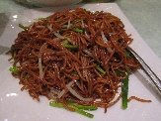
ΔS = 2 hyperon decays
arXiv:1808.03477 [hep-ex]
Very suppressed in SM (~10⁻¹⁷)
Current EXP limits are very loose
 | EXP limit @ 90% CL
Ξ⁰→pπ⁻ | < 8.2x10⁻⁶
Ξ⁻→pπ⁻π⁻ | < 2.9x10⁻⁶
Ω→Λπ⁻ | < 3.7x10⁻⁴

Slide 22
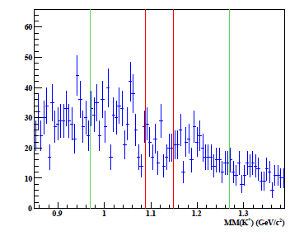
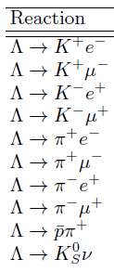
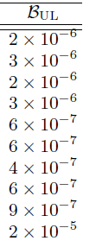
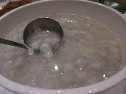
B and L violation (very low priority)
CLAS collaboration (Jefferson Lab):
Limits on B and L violation
We can easily do many of CLAS’ decays
…as well as others:
Σ→ 3μ
Λ→ π3μ
…and many other crazy (J conserving) combinations.
Currently very low priority, since we assume that BSM contributions can only be as much as BR ~10⁻⁵⁶
arXiv:1507.03859 [hep-ex]

Slide 23

Conclusions
s decays are awesome
  High interest for BSM
  Ultimate experimental precision ~ 10⁻¹¹ -10⁻¹²
There is an LHCs community in the LHCb village
  Trigger is constantly improving
  We aim for LHCb upgrade to reach efficiencies s as high as for b’s
Run-II (2016-2018) data analysis ongoing Σ→pμμ, K_{S} → µµ, K_{S} → (γ/π⁰)µµ...

Slide 24
谢
谢

Slide 25
Backup

Slide 27
K_{S} →γμμ?
arXiv:1808.03477 [hep-ex]
K_{S} →π⁰μμ analysis can also be extended to other neutrals, eg: K_{S} →γμμ
But harder to separate from K_{S} →ππ as the mass of the neutral gets lighter (unless a cut on the energy is used)
K_{S} →π⁰μμ
1808.03477
1808.03477
K_{S} →γμμ
K_{S} →ππ
K_{S} →ππ
Fast Simulation
Fast Simulation

Slide 28
Dielectrons

Slide 29
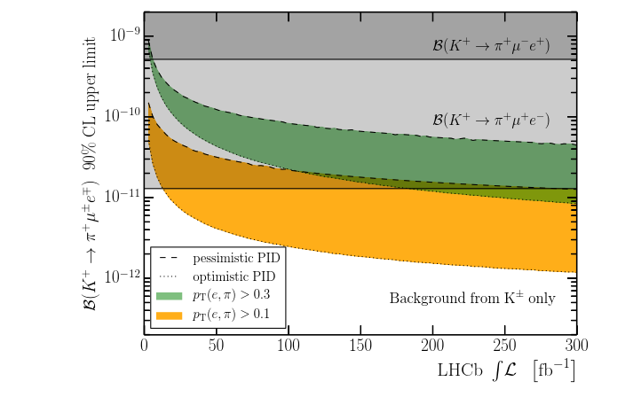
Lepton Flavour Violation
arXiv:1808.02006 [hep-ex]
Lepton Flavour Violation is a hot topic nowadays
1808.02006
LHCb can do:
K_{S} → eμ
K⁺ → π⁺μ⁻e⁺
Maybe K⁺ → π⁺μ⁺e⁻
Competition w/ NA62 to be clarified

Slide 30
Lepton Flavour Violation
arXiv:1808.02006 [hep-ex]
Lepton Flavour Violation is a hot topic nowadays
1808.02006
LHCb can do:
K_{S} → eμ
K⁺ → π⁺μ⁻e⁺

Slide 31
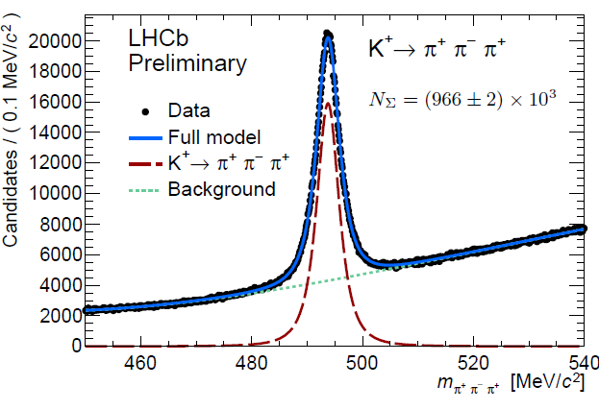
Charged kaons
arXiv:1808.03477 [hep-ex]
K⁺ mass in K → 3π
Under study sensitivity to K⁺ → π⁺μμ vs NA62
Benefits from the new dimuon triggers (the same way as K_{S} → µµ)
1808.03477
K⁺ →π⁺μμ
Fast Simulation
K⁺ →πππ

Slide 32
ALL LHC
https://arxiv.org/pdf/1904.08399.pdf

Slide 33
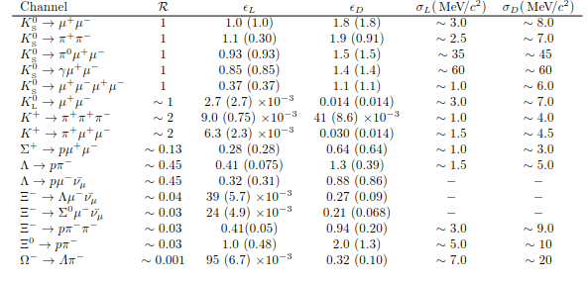
Efficiencies
* More details in: arXiv:1808.03477 [hep-ex]
eff/eff(K_{S})
w/ Downstream tracks
Mass resolution
Xs/Xs(K_{S})
eff/eff(K_{S})

Slide 35
K_{S} →π⁺π⁻ee sensitivity study
C.Marin et al,
LHCb-PUB-2016-016
Based on simulation:
Expected a signal yield of
$${N=120}_{−100}^{+280}$$
For the full Run-I dataset
Expected background yield is not well known yet

Slide 36
K0 tagging?
arXiv:1808.03477 [hep-ex]

Slide 37
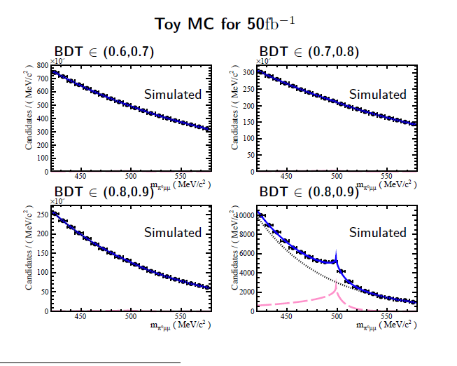

Slide 38


Lifetime acceptance and K_{L}→μμ background
K_{L} and K_{S} are distinguishable only by the decaytime…
… and that is in theory. In practice, LHCb decaytime acceptance is not great for kaons
$$ε\left(t\right)\sim e^{−βt}$$
With β $≳$ 5xΓs (>> Γ_{L}).
This makes the two lifetime distributions to look similar
But the overall efficiency ratio is of course different
And makes K_{L} →μμ to become a negligible background for the current level of precision
But can be relevant when we approach the 10⁻¹¹ level

Slide 39
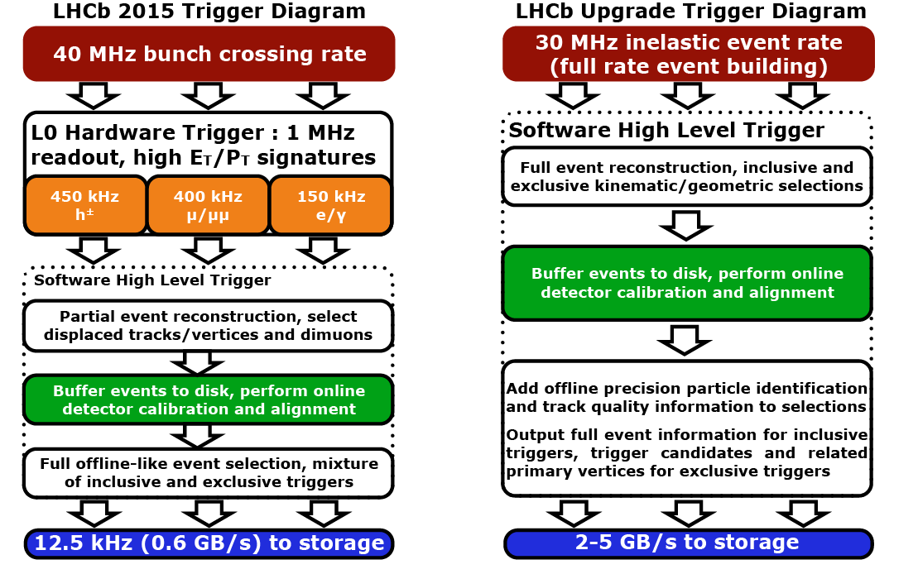

Slide 40


Normalization of event yield
Converting a signal yield into a branching ratio
$K_{s}^{0}$ production crossection
Absolute efficiency
$$Ν\left(K_{s}^{0}→πμμ\right)=σ\left(K_{s}^{0}\right)ΒR\left(K_{s}^{0}→πμμ\right)εL$$
Integrated luminosity

Slide 41
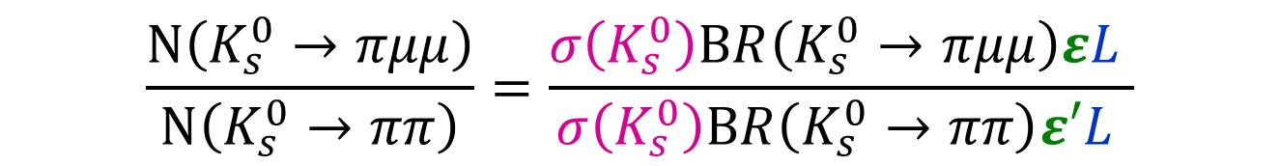
How? (normalization of event yield)
Converting a signal yield into a branching ratio
$K_{s}^{0}$ production crossection
Absolute efficiency
$$Ν\left(K_{s}^{0}→πμμ\right)=σ\left(K_{s}^{0}\right)ΒR\left(K_{s}^{0}→πμμ\right)εL$$
Integrated luminosity
$$\frac{Ν\left(K_{s}^{0}→πμμ\right)}{Ν\left(K_{s}^{0}→ππ\right)}=\frac{σ\left(K_{s}^{0}\right)ΒR\left(K_{s}^{0}→πμμ\right)εL }{σ\left(K_{s}^{0}\right)ΒR\left(K_{s}^{0}→ππ\right)ε′L }$$
Introduce in the ntuples a $K_{s}^{0}→ππ$ decays counter
Very well known
(69.20±0.05)%

Slide 42
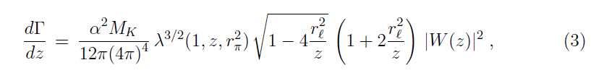

Dilepton mass distribution
Take formulae from hep-ph/9808289
z= m² ➔ dΓ/dm = 2m dΓ/dz

Slide 43
Remind of Bmm sensitivity

Slide 44
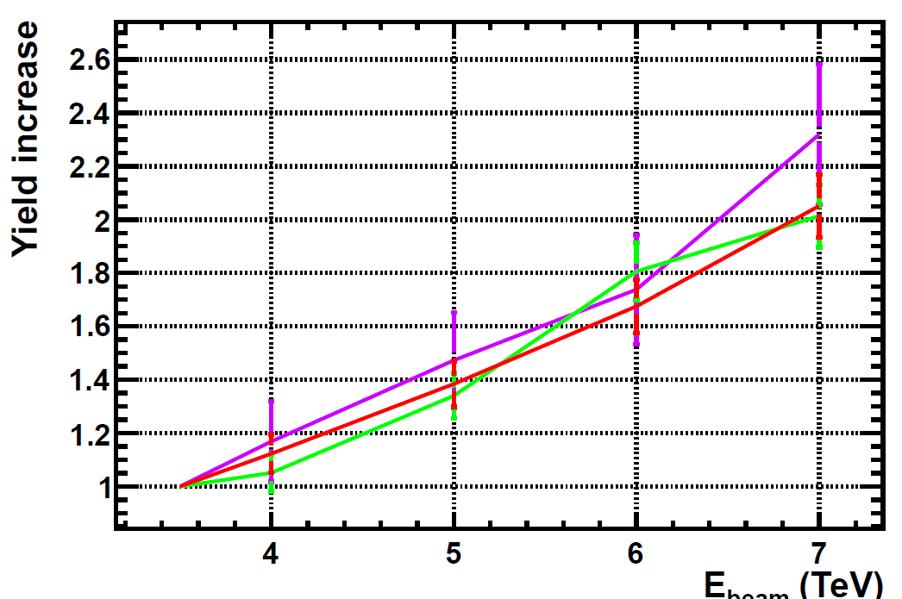
B mesons
We check that we get right the expected increase of B meson yields (i.e, a factor ~2)
B0s
B0d
B+/-

Slide 45
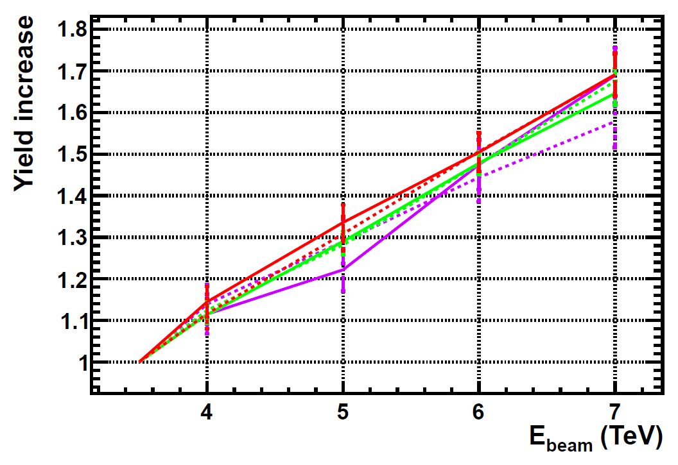
D mesons
For D mesons the increase is slightly smaller (~1.6- 1.7)
D+
D-
D0
Ds

Slide 46
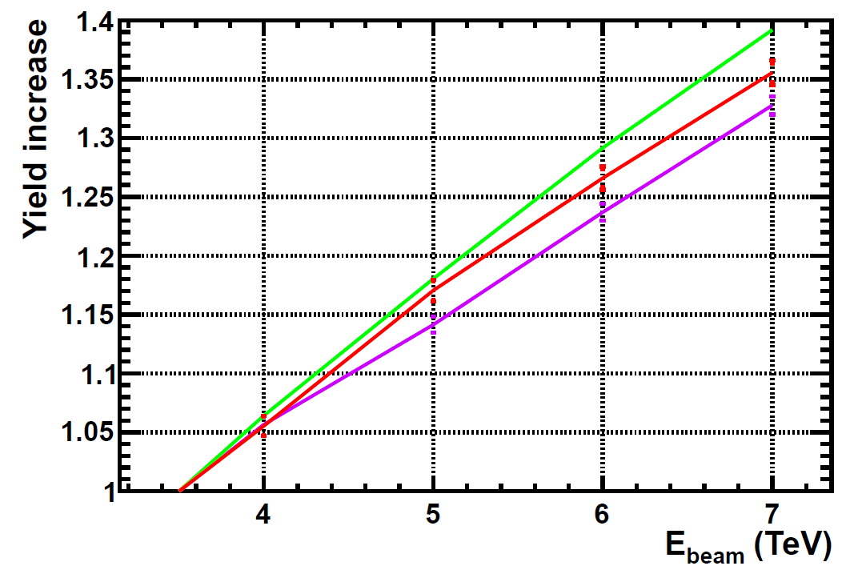
Strange particles
Increase for most of them is ~40%
A bit less for baryons (note: baryons, not anti-baryons)
However, the momentum is also different w.r.t 7 TeV.
K⁰s, K⁰_{L} ,K^{+/-/0}, φ(1020), K*
As well as anti baryons
Σ
Λ
In particular, for the K0s decaying in the VELO the increase is “only” ~30% → This is the number we really care for Ks → μμ studies

Slide 47
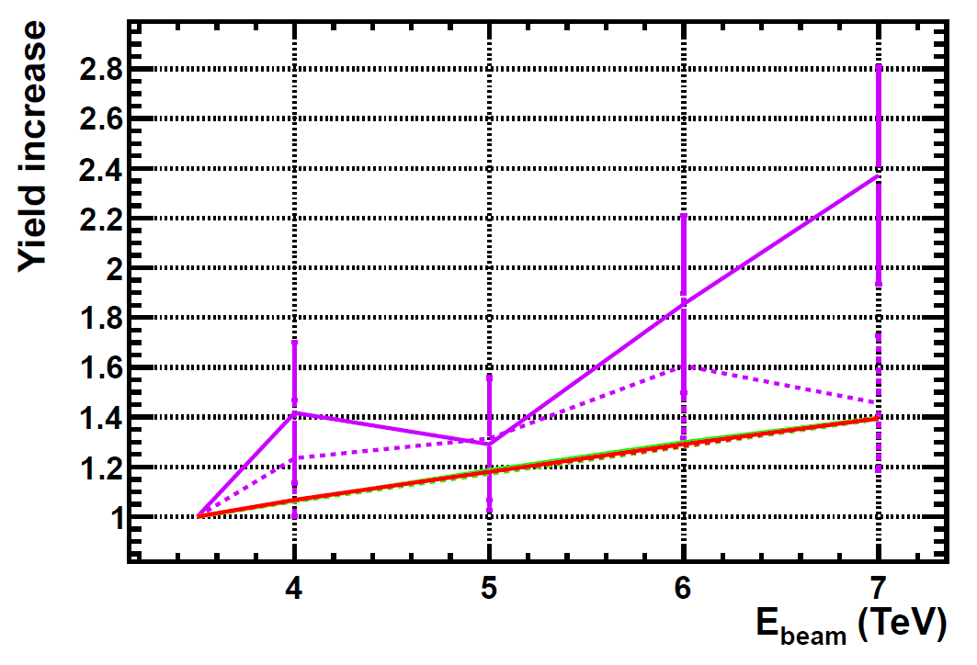
Leptons
Increase in tau yiled consistent with ~ 2 , expected by the fact that most of them come from b’s and c’s
Check with more stats if the asymmetry +/- is still there
τ+
τ-
Electrons, muons

Slide 48
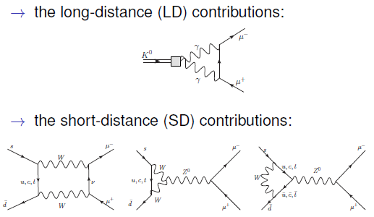

Slide 49
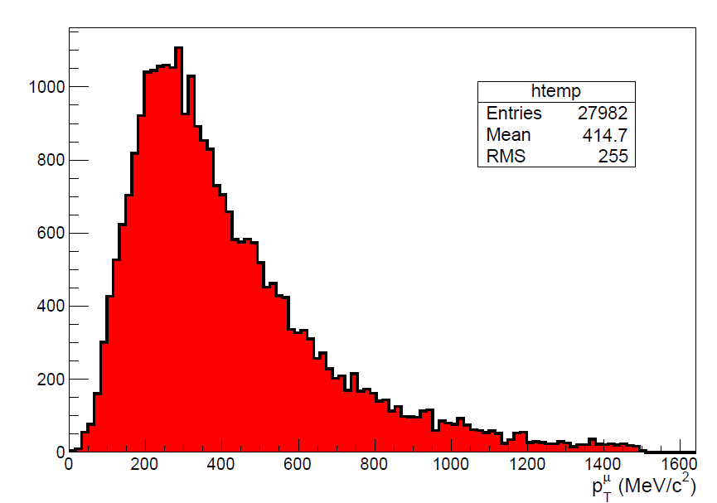

Slide 50
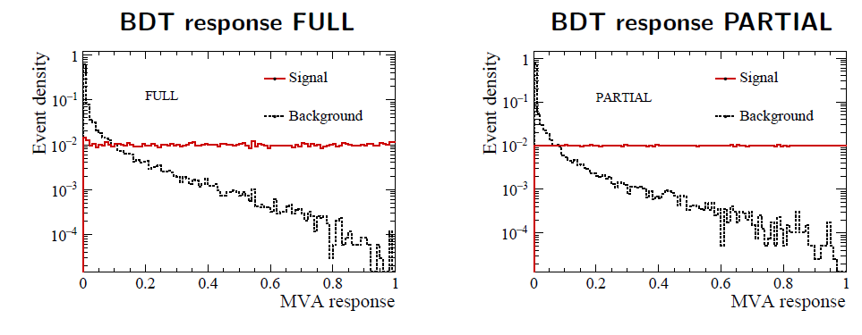
K_{S} →π⁰μμ sensitivity study
The background discrimination
V. Chobanova et al,
CERN-LHCb-PUB-2016-017
As usual: BDT trained against combinatorial background
Specific backgrounds: K_{S} →ππ, K_{L}→πππ, K_{S/L} →μμγγ (negligible)
Don’t affect the sensitivity estimate

Slide 51
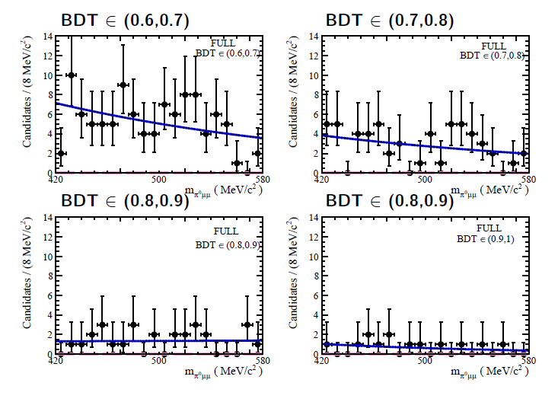
K_{S} →π⁰μμ sensitivity study
Fit, FULL
V. Chobanova et al,
CERN-LHCb-PUB-2016-017

Slide 52

K_{S} →π⁰μμ sensitivity study
Fit, PARTIAL
V. Chobanova et al,
CERN-LHCb-PUB-2016-017

Slide 53
Ongoing stuff
LHCb Fictitious
BR(K_{S} →X⁰μμ )
90% CL exclusion
X
γ
π⁰
m_{X}

Slide 54
K⁺ studies
Large samples of charged kaon decays are available
K⁺ mass is not very well known
K⁺→πμμ ?

Slide 55

K_{S} →X⁰μμ
The K_{S} →π⁰μμ PARTIAL analysis can be recasted for general/inclusive K_{S} →X⁰μμ. With X being whatever neutral system:
  K_{S} →γμμ. Can also be completed with photon reconstruction
  K_{S} →(l+l-)μμ. Some of them are also being searched for explicitly
  Some exotic, eg, 17 MeV neutral boson of Phys. Rev. Lett. 116, 042501 (2016)
Limits can be provided as a function of X⁰ mass
LHCb Fictitious
BR(K_{S} →X⁰μμ )
90% CL exclusion
X
γ
π⁰
m_{X}

Slide 56

K_{S}→μμ full Run-I analysis
arXiv:1706.00758 [hep-ex]
Analysed full Run-I (2011-2012) data
Events classified using a BDT trained against combinatorial background
Dedicated muon identification algorithm trained against K_{S}→ππ
Mass resolution 4 MeV
Background
K_{L}→μμ negligible: (down to 10⁻¹¹ precision)
K→πμν : negligible
Λ→ pπ removed by a cut in the Armenteros-Podolanski plot.
Combinatorial background
K_{S}→ππ double misid

Slide 57
K_{S} →π⁺π⁻ee sensitivity study
C.Marin et al,
CERN-LHCb-PUB-2016-016
Based on simulation:
Expected a signal yield of
$${N=120}_{−100}^{+280}$$
For the full Run-I dataset
Expected background yield is not well known yet

Slide 58


Why? (K_{S} → π⁰μμ and SM errors on K_{L} → π⁰μμ)
Dominant uncertainty, that makes difficult potential BSM interpretation of K_{L} → π⁰μμ
It comes from the experimental uncertainty on BR(K_{S} → π⁰μμ) measured by NA48
NA48
~50% relative error
Improved measurements of BR(K_{S} → π⁰μμ) will translate into improved BSM constraints from K_{L} → π⁰μμ

