Slide 1
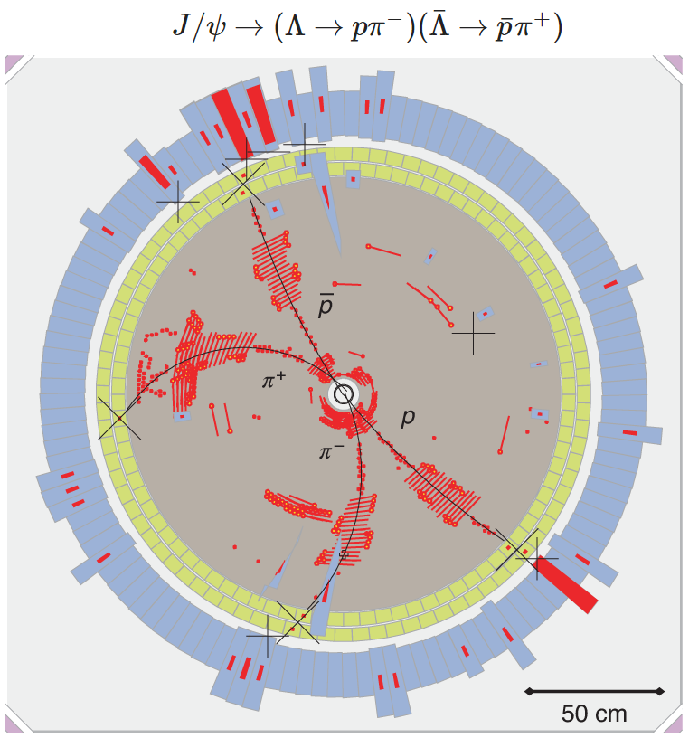
Introduction to hyperon physics
Stephen Lars Olsen, Institute for Basic Science (KOREA) & University of Chinese Academy of Science
Fudan Univ. Hyperon Physics Workshop, Sept. 7-8, 2019

Slide 2
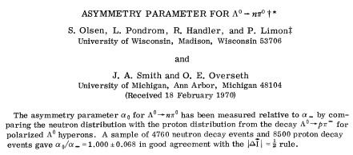


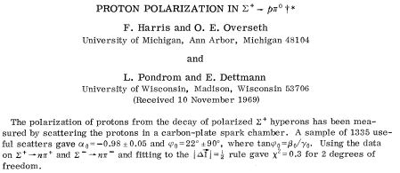

ancient history
Phys. Rev. Lett. 24, 843 (1970)
Phys. Rev. Lett. 24, 165 (1970)
Phys. Rev. 184, 1663 (1969)

Slide 3
Oliver Overseth
1928 – 2008
A graceful man with lots of style

Slide 4
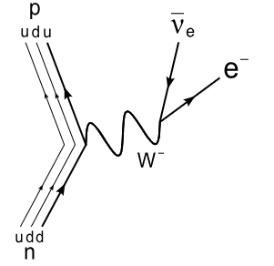
What have we learned from hyperons in the past?
ΔS=-ΔQ rule
Σ⁻ → ne⁻ν
Σ⁺ → ne⁺ν
n
ddu
n
ddu
⁺
ΔS=+1
ΔS=+1
ΔQ=+1
ΔQ=-1
W⁺
Bf ≃ 10⁻³
Bf < 5x10⁻⁶
dds
Σ⁻
uus
Σ⁺

Slide 5
What did we learn from hyperons in the past?
ΔS=±1 rule
Ξ⁻ → Λπ⁻
Ξ⁻ → nπ⁻
Λ
uds
n
ddu
_
π⁻
_
u
u
π⁻
d
⁺
d
ΔS=+1
ΔS=+2
Bf ≃ 100%
Bf < 2x10⁻⁵
dss
Ξ⁻
dss
Ξ⁻

Slide 6
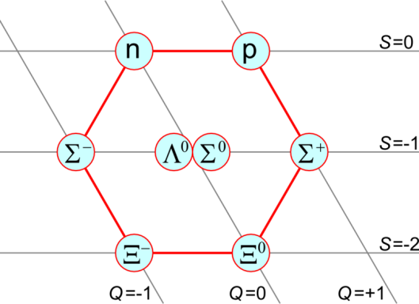
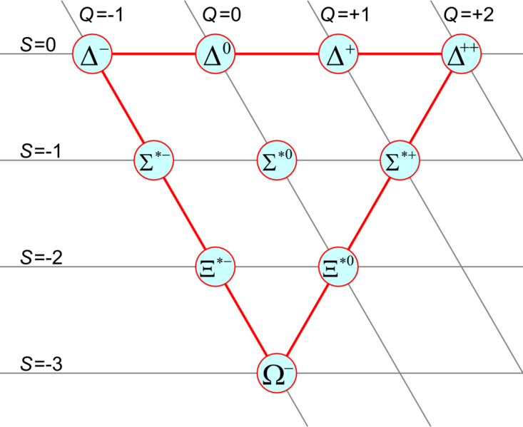
Baryon decuplets led to fractionally charged quarks
-- baryons in 1960 --
J=1/2
J=3/2
Q=I₃+ Y/2
Q=-1
Q=0
Q=+1
Y=+1
Y=0
Y = S + B
Y=-1
???
Y=-2
“missing:” S=-3, I₃=0, Q=-1, J=3/2 baryon?

Slide 7
Sakata model
wrong charge
wrong baryon number

Slide 8
Quark model
quarks have fractional charge & baryon number

Slide 9
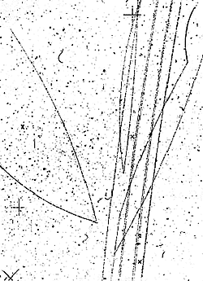
Ω⁻ event in the Berkeley 72” bubble chamber
π⁻
π⁺
K⁰
K⁻
Ω⁻
π⁻
Λ⁰
p
K⁻
K⁺
μ⁻
ν

Slide 10
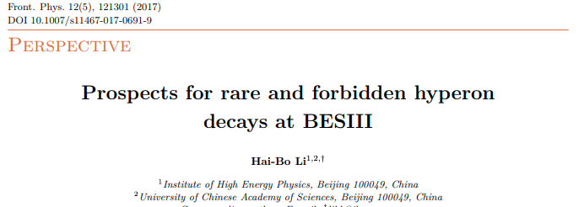
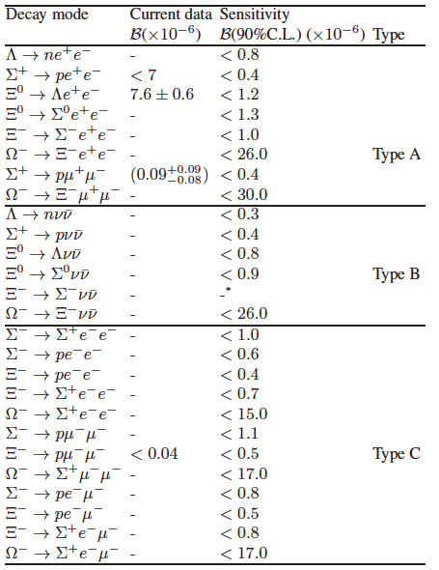
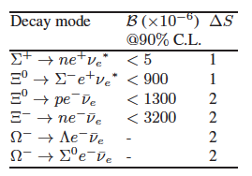
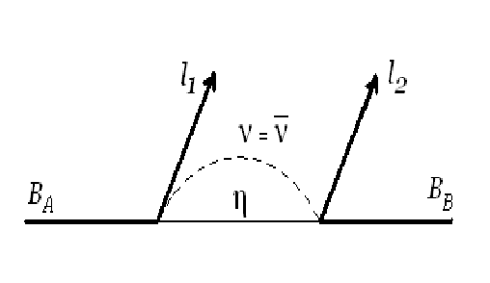
New Physics with hyperons?
virtual-γ
Penguin
0.02±0.01
FCNC
virtual-Z
Penguin
ΔS=+ΔQ
ΔS=+2
Ξ⁰ → pπ⁻ < 8 2
Ξ⁻ → nπ⁻ < 18 2
Ω⁻ → Λπ⁻ < 3 2
Ω⁻ → nπ⁻ -- 3
ΔL=2
ΔS=+3
mostly never measured

Slide 11
hyperon CP violation and new physics
Why CPV?
-- QCD conserves CP. QCD processes, in & of themselves, don’t produce CPV asymmetries
-- Baryon Asymmetry of the Universe means there must be non-SM CPV processes
Why hyperons?
-- SM CPV processes are expected to be small
b-sector: CPV effects are O(1)
c-sector: O(10⁻³)
s-sector: O(10⁻⁵)
-- Current limits are not severe: O(10⁻²)
3 orders of magnitude of reach
Why BESIII?
_
_
-- Bf(J/ψ →BB)≈10⁻³ → 10¹⁰ J/ψ: O(5x10⁶) ΛΛ & O(10⁶) ΞΞ pairs fully reconstructed
-- Polarized, quantum correlated, nearly zero background
-- Large acceptance; good control of systematics.
_

Slide 12

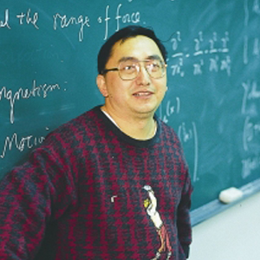
Classic paper
Phys. Rev. D34, 833 (1986)

Slide 13
primer on CP
P: multiply by γ₀ = C: multiply by iγ₂γ₀ & take charge conjugate
“coupling”
g
q′
g*
q’
CP
q
W
q
some basic process
W†
mirror
CP Violation: coupling has a complex phase

Slide 14
QM phase measurements require interference
A
B=|B|e^{iδs} ^{+ iφCP}
CP
A
B=|B|e^{iδs} ^{- iφCP}
|A+B|-|A+B|=4|A||B|sinδ_{s}sinφ_{CP}
_
A: non-CPV process to the same final state
δ_{s}; strong phase difference between A and B
measureable CPV asymmetry
requires:
1) non-zero φ_{CP}
2) interfering amplitude
3) non-zero δ_{s}
B
A+B
+φ_{CP}
δ_{s}+φ_{CP}
non-zero φ_{CP} is not enough!!
A
δ_{s}
-φ_{CP}
_
_
B
δ_{s}-φ_{CP}
A+B

Slide 15
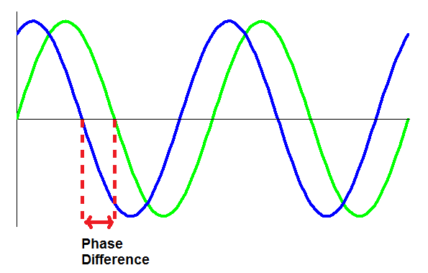
two kinds of phases in QFT
“strong”
phase
“CP”
phase
“same”
sign
“opposite”
sign
|B|e^{iδ −iφ}
|B|e^{iδ} ^{+ iφ}
s
_{CP}
s
_{CP}
g*
q’
g
q′
CP
q
q
W
W†
mirror
example of a strong phase:
π⁻p scattering phase shift
CP
π⁻
δ_{s}
π⁺
δ_{s}
p
p
_
particle-antiparticle phase shifts are the same

Slide 16
Example CPV in Λ→pπ⁻ (Λ◊pπ⁺)
-- assume CPV is in P-wave --
p
p
_
Λ
S-wave:
S e^{iδS}
Λ
S-wave:
S e^{iδS}
_
π⁻
π⁺
p
p
_
Λ
P e^{iδP+iφCP}
_
P-wave:
Λ
P e^{iδP−iφCP}
P-wave:
π⁻
π⁺
e^{-iδS} ( S + P e^{i(δP−δS)+iφCP})
e^{-iδS} ( S + P e^{iΔs + iφCP})
e^{-iδS} ( S + P e^{iΔs − iφCP})
or

Slide 17

α, β & γ parameters for hyperon decay
Phys. Rev. 108 1645 (1957)
y’
P_{p}
z’
γ
-α-P_{Λ}cosθ
p
β
P_{Λ}
θ
x’
Λ
π⁻

Slide 18
CPV observables in Λ decay:
see S. Pakvasa: hep-ph/991023v1
and hep-ph/0002210
decay rate
difference
ΔΓ=
T_{3/2(1/2)}: Ispin=3/2 (1/2) ampl & Δ_{s}= δ_{3/2}-δ_{1/2}
=0 for Ξ→Λπ decays
decay asymmetry
difference
Δα=
⬅ For Λ→pπ, need measurement of Δ_{s}= δ_{S}-δ_{P}
final-state polarization
difference
Δβ=
only practical
in BESIII for
Ξ→Λπ or Ω⁻→ΛK
⬅ Strong phase cancels out
⬅ measures the strong phase
y’
≈β/α
γ
β/γ (= tanφ) is commonly used
φ
x’
β

Slide 19
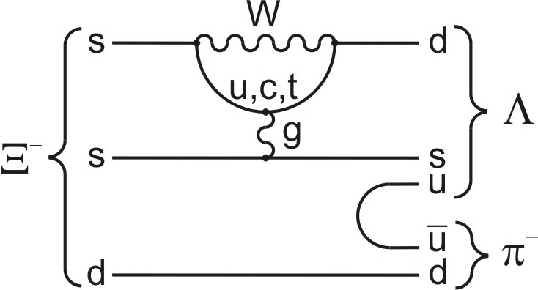
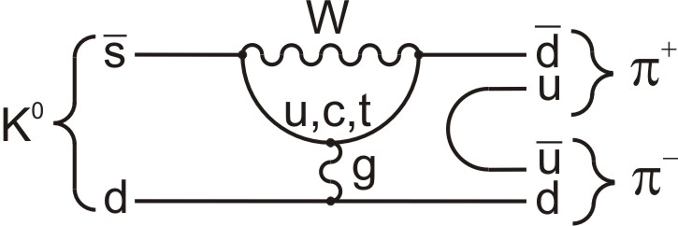
Constraints from Kaon decays
He & Valencia PRD 52, 5257
Λ→pπ⁻ A_{NP}
Re(ε’/ε)=(1.6+0.3)x10⁻³
p
S-wave <6x10⁻⁵
P-wave <3x10⁻⁴
parity violating
Λ
u
u
parity conserving
S- and P-waves
(parity violating
& conserving)
A_{SM} ∼10⁻⁵
S-wave only
(parity violating)
ε’/ε strongly constrains NP in S-waves, but not P-waves. Thus, hyperon NP searches are complementary to those with Kaons.

Slide 20
Measurements

Slide 21
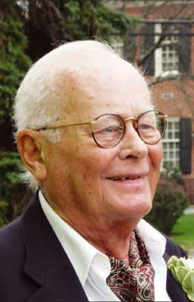
Measuring α, β & γ in the 20th century
Oliver Overseth
1928-2008
James Cronin
1931-2016
1.25 cm-thick
carbon plates
π⁻ p → K⁰ Λ⁰
Λ⁰→π⁻p
π⁻
π⁻
p
p C→p C
p
no H₂ target, no magnet;
use kinematics and proton’s range in carbon to infer E_{p}

Slide 22
Olsen et al., α₀ parameter in Λ⁰→nπ⁰ decays
Phys. Rev. Lett. 24, 843 (1970)
μ
exit-entry time
in the H₂O tank
π⁺ n→ K⁺ Λ⁰
K⁺
n
p
α₀/α₋=1.00±0.07

Slide 23
Use p C elastic scattering to measure p spin
π⁻
π⁻
p

Slide 24
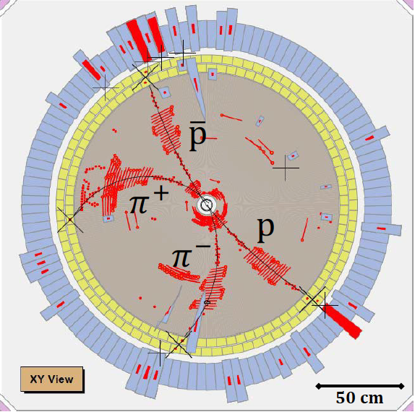
Measuring these in the 21st century

Slide 25
Production: 2 independent helicity amplitudes: A_{½ ½}, A_{½ -½}
m=±1
m=±1
A_{½ -½}
θ,φ
A_{½ ½}
θ,φ
J/ψ
J/ψ
A_{-½ ½}
m=±1
A_{-½ -½}
m=±1
θ,φ
θ,φ
J/ψ
J/ψ
parity: A_{½} _{-½} =A_{-½ ½}
parity: A_{½ ½} =A_{-½ -½}
Δ= complex phase between A_{½} _{½} and A_{½ -½}

Slide 26
if Δ ≠ 0, Λ and Λ are transversely polarized
_
Polarization is:
perpendicular to the production plane
θ_{Λ}-dependent
in opposite directions for Λ and Λ
_

Slide 27
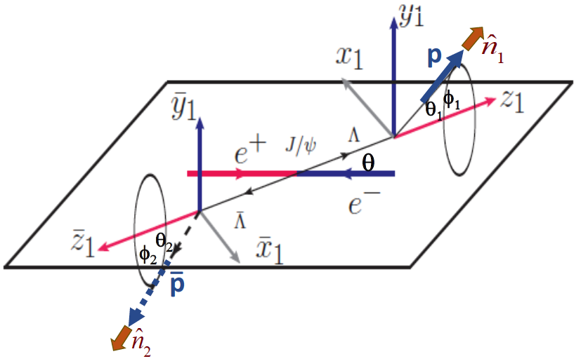
Correlated 5-dim. angular distribution
polarization-term
independent α₋ and α₊ dependence
Λ

Slide 28
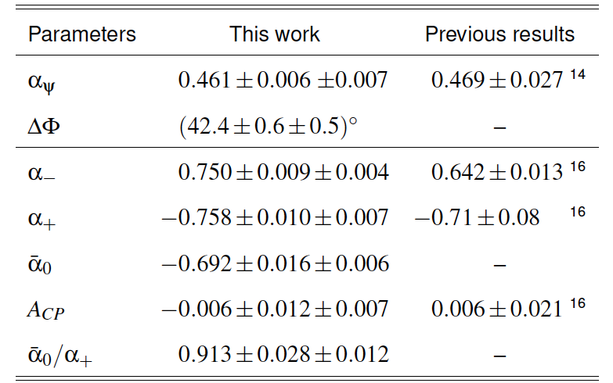
BESIII results
Nature Physics May 2019
arXiv:1808.08917
I have comments on these 3 items:
⬅ 1) 4x precision improvement
-same data sample-
2) ~7σ upward shift from all previous measurements
⬅ 3) ~3σ difference from 1. Is this reasonable?

Slide 29
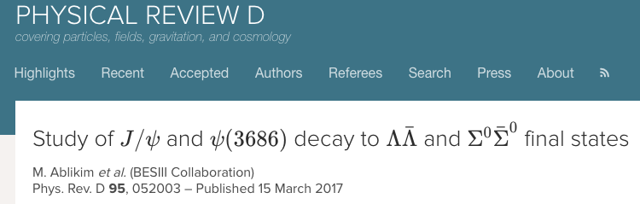
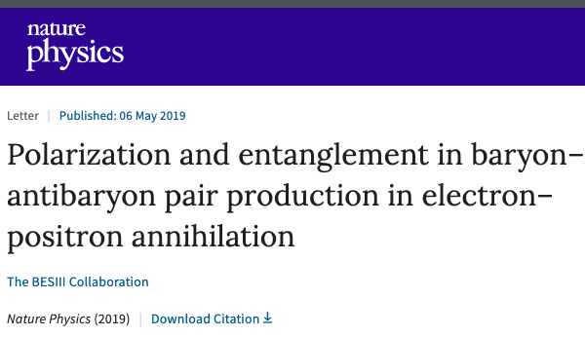
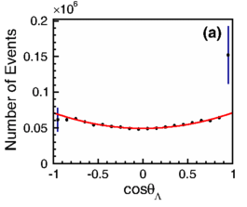
α_{ψ}: cut & count + 1-dim fit vs multi-dimensional fits
1)
BESIII PUB-150
BESIII PUB-212
J/ψ→Λ Λ
_
1-dimensional fit
5-dimensional fit
1+α_{ψ}cos²θ
α_{ψ}= 0.469 ± 0.026 ± 0.008
α_{ψ}= 0.469 ± 0.006 ± 0.007
same data, statistical precision
on α_{ψ} is 4.3x better!

Slide 30
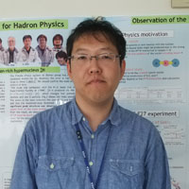
2)
Why the big change in α?
from: Kiyoshi Tanida
JAEA Japan

Slide 31
α₊/α₀ ≠ 1: ΔI=1/2 law violation
3)
_
lifetime=12 ns
ΔI=1/2 law: K⁺→π⁺π⁰ (ΔI=3/2 transition) : Γ(K⁺→π⁺π⁰)= |T_{3/2}|²≈ Bf (K⁺→π⁺π⁰)/τ_{K+}
K_{S}→π⁺π⁻ (ΔI=1/2 transition) : Γ(K_{S}→π⁺π⁻)= |T_{1/2}|²≈ Bf (K_{S}→π⁺π⁻)/τ_{KS}
lifetime=0.21 ns
good agreement

Slide 32
T_{3/2}≠ 0: decay rate asymmetry in BESIII?
use partial reconstruction of J/ψ→ΛΛ?
_
Can BESIII measure this with low systematic errors?
Λ→pπ-
or
Λ→pπ⁺
tag side
_
_
_
recoil nucleon
undetected
Detect a Λ→pπ⁻ or Λ→pπ⁺ accompanied by a π± or π⁰
Infer presence of the recoil nucleon by missing mass
_
_
π±
or
π⁰
recoil
side
the 10¹⁰ J/ψ data sample has >1M events in
each category ➔ statistical precision ≈10⁻³

Slide 33
π⁰ must be distinguished from n annihilation debris
-- not so easy --
_
use machine-learning algorithms?
under study by
Zhang Jian-Lu
n
_
π⁰

Slide 34
Decay rate asymmetry in BESIII
-- using partially reconstructed J/ψ→ ΛΛ events --
_
this Δ_{s}=δ_{3/2}-δ_{1/2}
sensitivity is nominally
reduced by a factor of ~5
here I used:
same data would be useful for an α₀+α₀/α₀-α₀ measurement
_
_
_

Slide 35

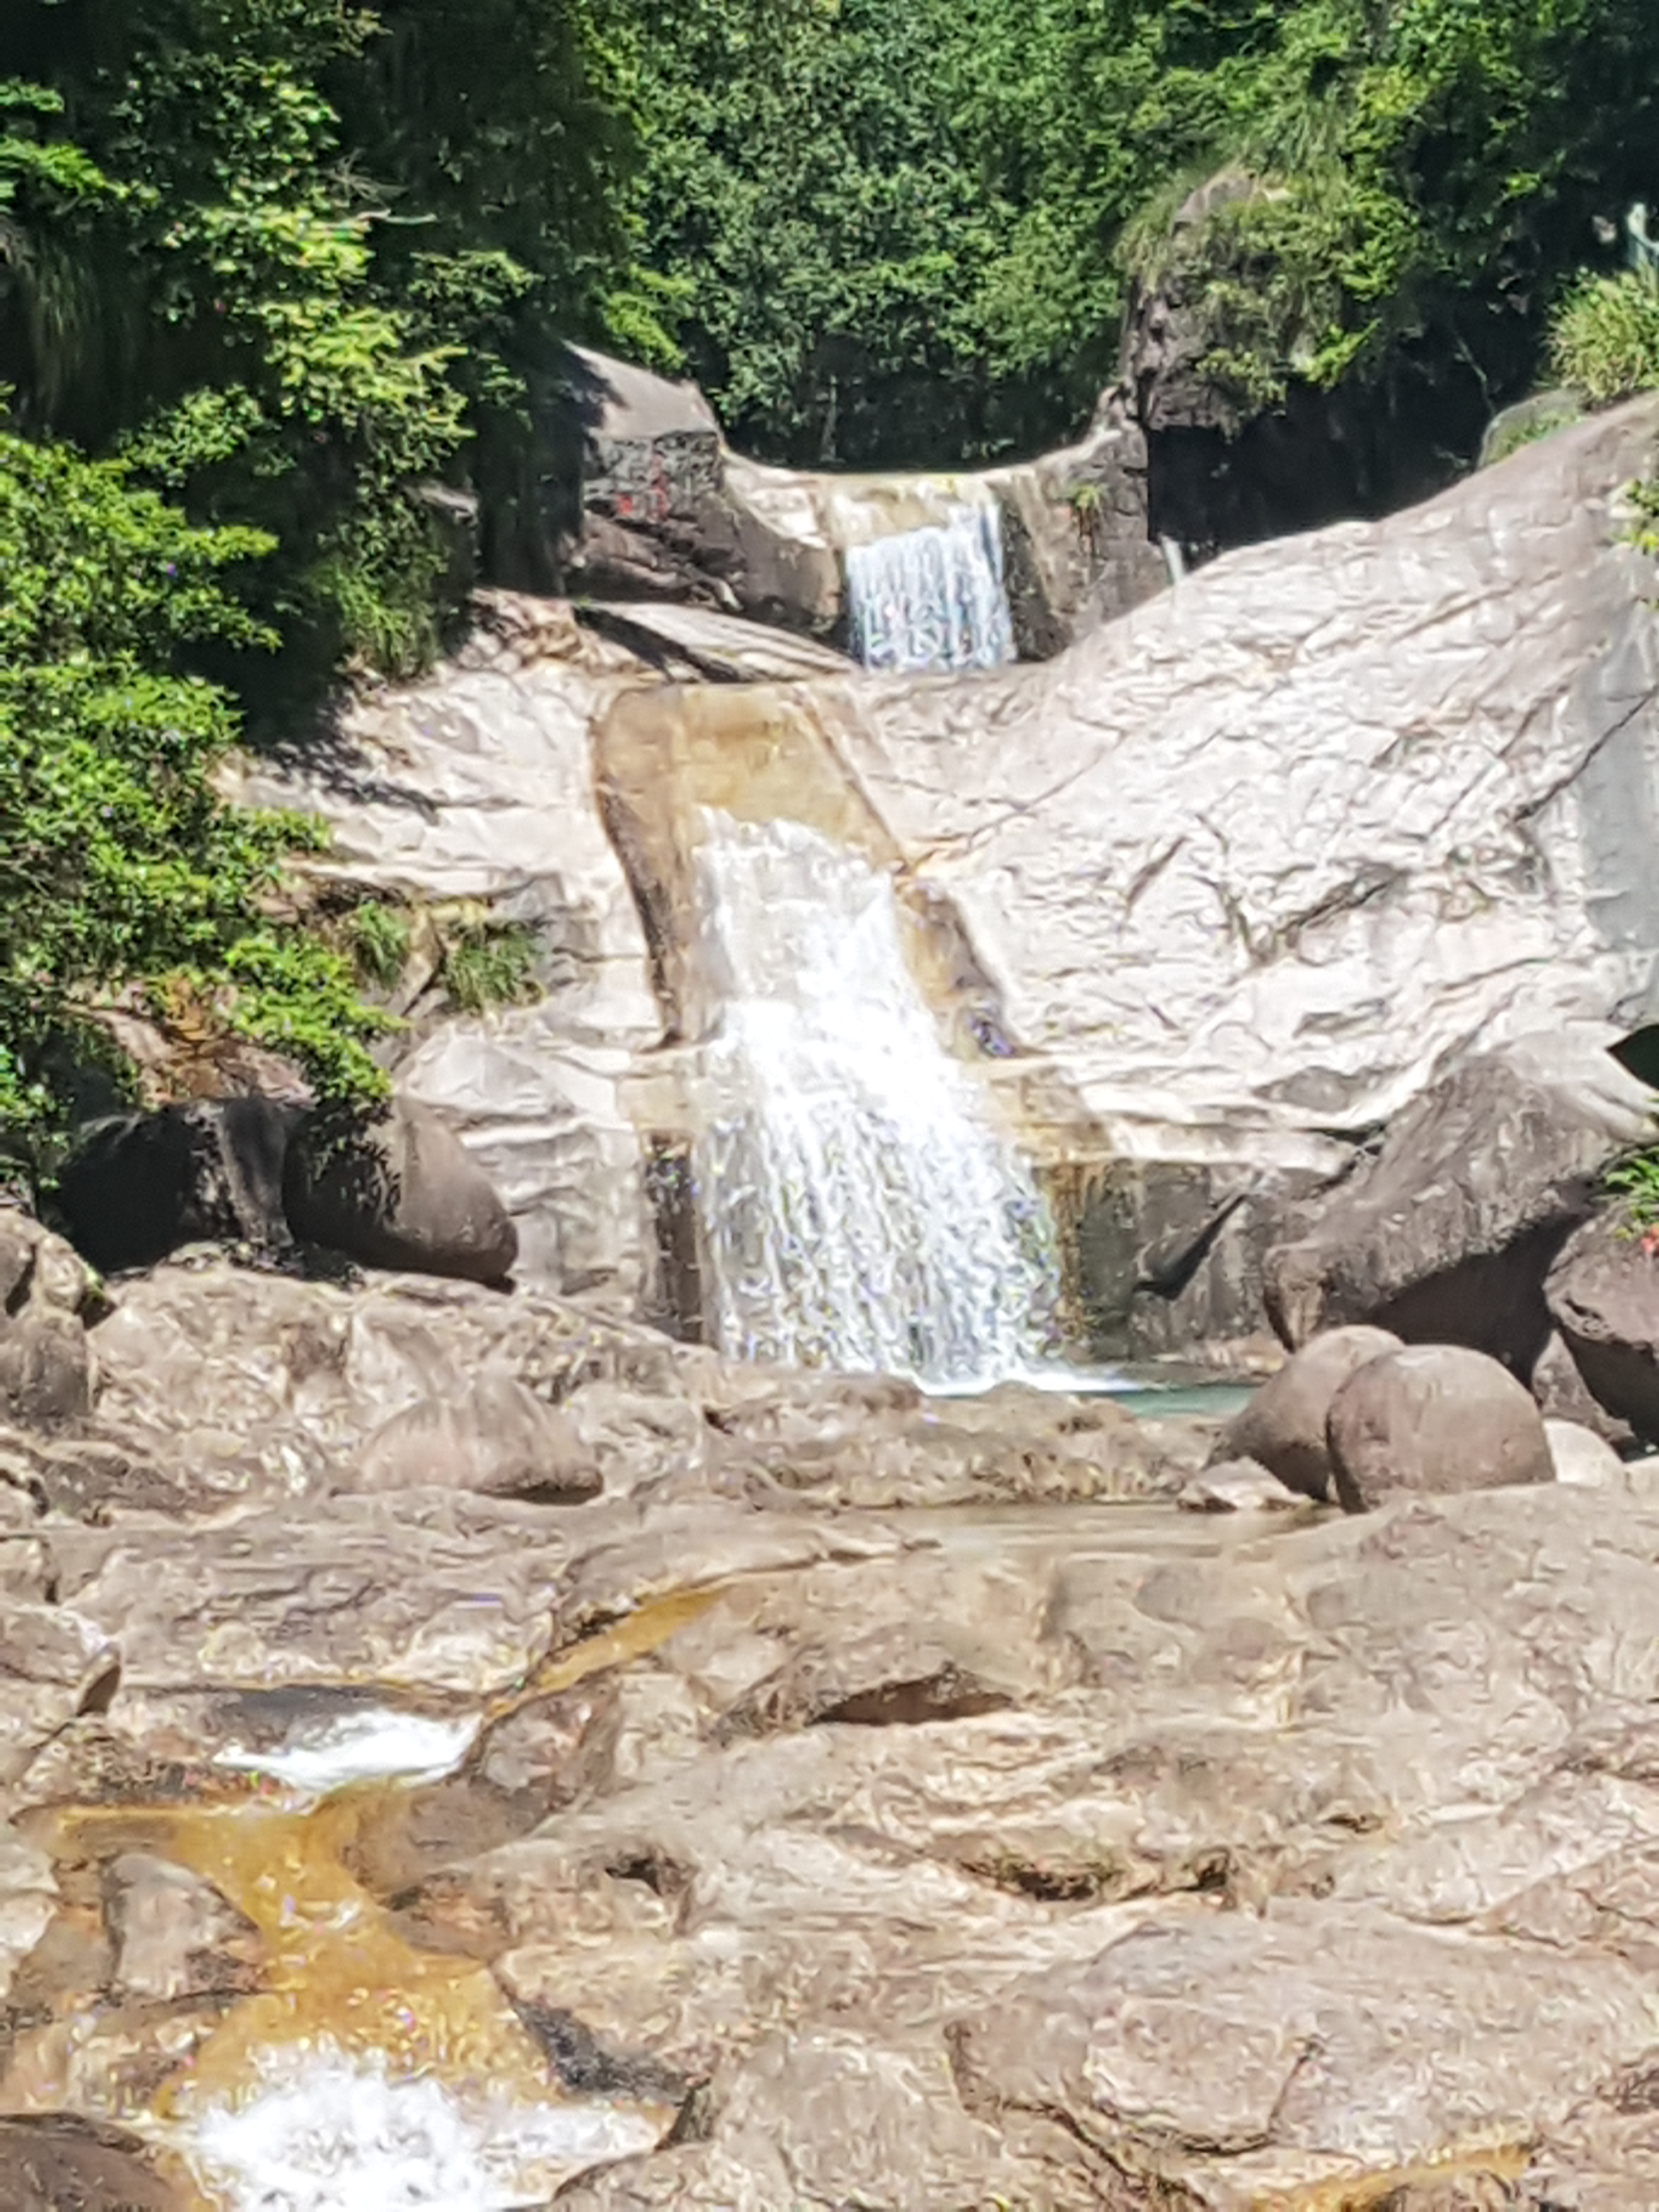
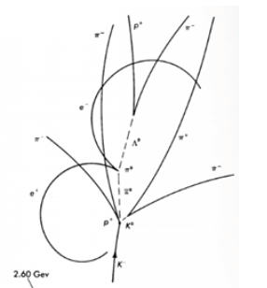
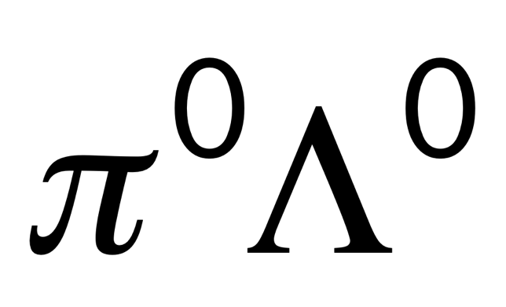
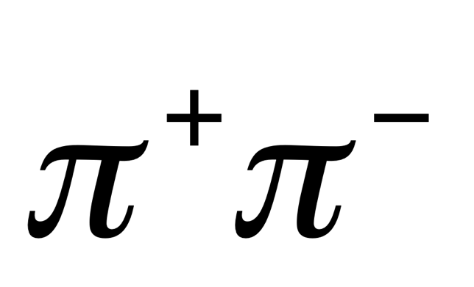
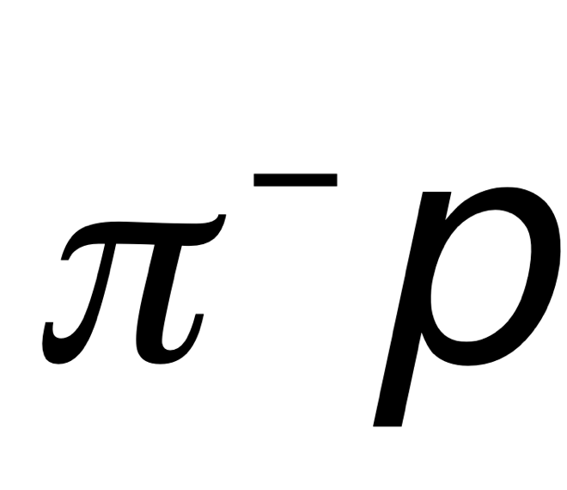

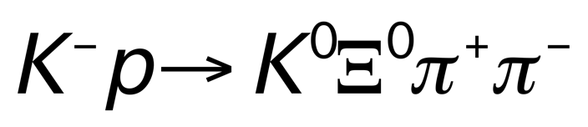
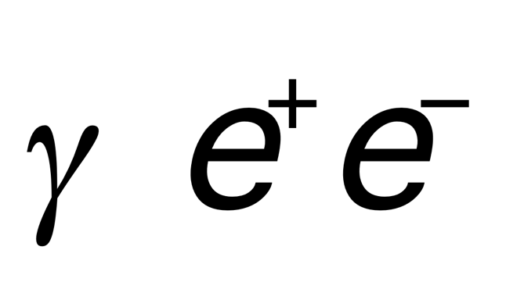
CPV with Ξ→Λπ decays
Ξ ⬅ Greek letter ”Xi” “cascade” ⬅English word for multi-tier waterfall
sounds like “psi” (ψ)
Cascade Waterfall
云绸瀑
書鵑瀑
Ξ⁰
Λ⁰

Slide 36
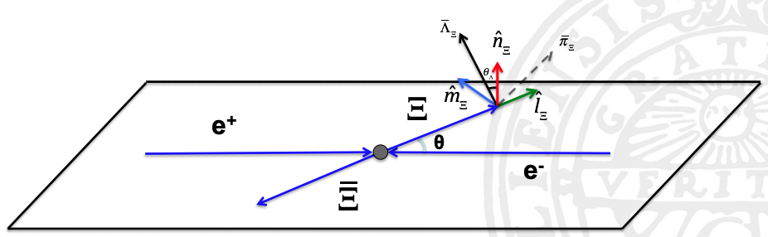
CPV with J/ψ→Ξ⁻(→Λπ⁻) Ξ⁺(→Λπ⁺): plusses and minuses
_
_
Minuses:
complicated topology: 9-dimensions
θ _{Ξ} ,θ _{Λ} ,ϕ _{Λ} ,θ _{Λ} ,ϕ _{Λ} ,θ _{p} ,ϕ_{p} ,θ _{p} ,ϕ_{p}
72 terms, 8 parameters to determine
Low rate compared to ΛΛ
1.3B J/ψ: 420K Λ(pπ⁻)Λ(pπ⁺) evts
61K Ξ(Λπ⁻) Ξ(Λπ⁻)
pπ⁻ pπ⁺ evts
Pluses:
Λ(Λ) polarizations are measureable via
their parity-violating pπ⁻ (pπ⁺) decays;
β₋ and β₀ parameters can be determined.
Preliminary results indicate that the
Ξs are even more polarized than the Λs.
_
_
_
_
_
BESIII internal only from Ma XinXin
_
_
_
_
_
_
_
_

Slide 37
CPV observables in Ξ⁻ decay
decay rate
difference
⎜ Λπ final states are purely Ispin=1, only ΔI=1/2 transitions
allowed, no ΔI=3/2 transition possible
decay asymmetry
difference
⬅ in this case, the strong phase (Δ_{s}= δ_{S}-δ_{P}) is measureable (see below)
final-state polarization
difference
⬅ Strong phase cancels out
big advantage
for Ξ over Λ
⬅ measures the strong phase

Slide 38
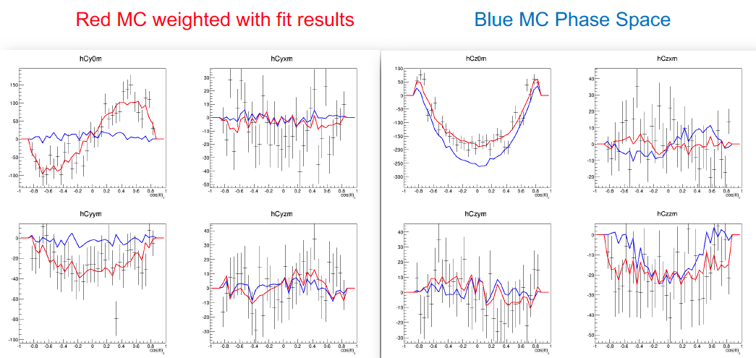
Preliminary BESII results (still internal)
Patrik Adlarson BESIII B=General Mtg @Wuhan (Nov 20018)

Slide 39
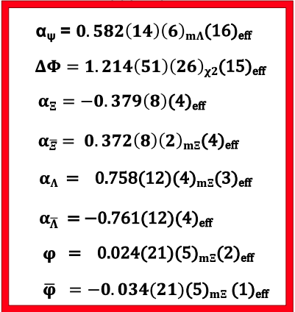
Preliminary Ξ results for 2008 & 2012 J/ψ data
Sorry
tanφ ≡ β/γ
HyperCP (PRL 93, 011802):

Slide 40
How about other weakly decaying hyperons?
Ω⁻→ΛK⁻
→Ξ⁰π⁻
→Ξ⁻π⁰
Σ⁺→pπ⁰
→nπ⁺
Σ⁻→nπ⁻
need ψ’→Ω⁻Ω⁺ data
rates are low
final state baryon polarization
measurements impractical with BESIII

Slide 41
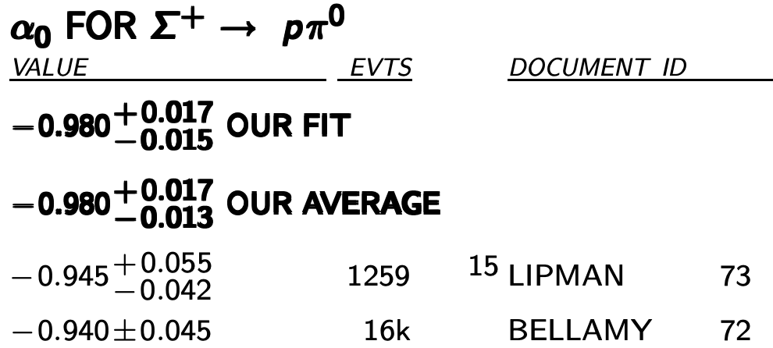
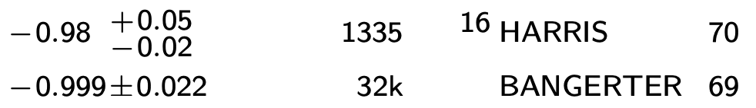
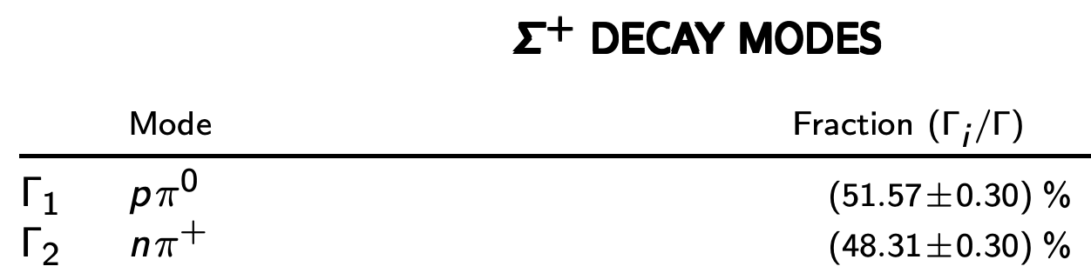
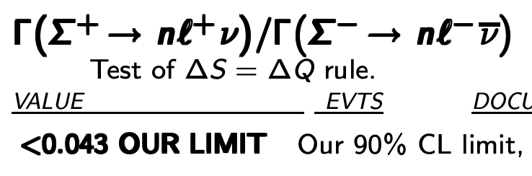
Σ⁺?
50 year-old measurements,
probably wrong for the same reason
the Λ measurements were wrong
α₀≈1 ➔ S-wave ≈ P-wave
interference is maximum
well suited for α₀+α₀/α₀-α₀
_
_
No measurements of α₀ or α₋
_
Γ(pπ⁰) ≈ Γ(nπ⁺) to ~10% ⬅T_{3/2} ≈ 5% T_{1/2}
ΔΓ will be suppressed
PDG 2018 ΔS=ΔQ limit is not severe,
BESIII can probably improve on this
by a large factor

Slide 42
Strong polarization in J/ψ→Σ⁺Σ⁻?
_
sorry
BESIII internal only from Ma XinXin
well suited for α₀+α₀/α₀-α₀ measurement
_
_

Slide 43
Harris et al., α₀ parameter in Σ⁺→pπ⁰ decays
Fred Harris
PhD Thesis
Phys. Rev. Lett. 24, 165 (1970)
π⁺ p→ K⁺ Σ⁺
α₀=-0.98±0.05
exit-entry time
in the H₂O tank
observed-expected
range of the proton
Fred used thin (1 cm-thick) carbon plates. Thus, according to Tajima-san’s hypothesis, his analyzing powers were more reliable

Slide 44
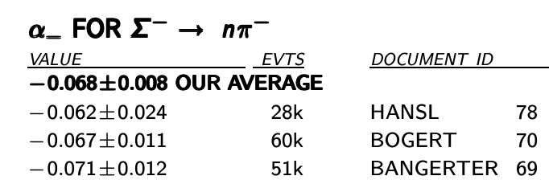
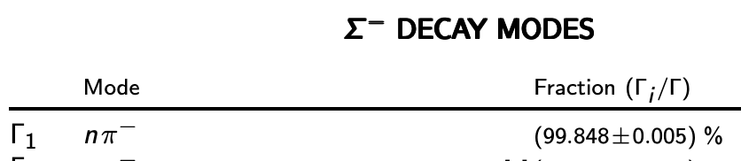
Σ⁻?
40∼50 year-old measurements,
probably wrong for the same reason
the Λ measurements were wrong
α₀≈0 ➔ 1 partial wave dominates
interference is small not
well suited for α₋+α₊/α₋− α₊
measurements
no measurements of α₊
single dominant decay mode
no suitable for ΔΓ measurements

Slide 45
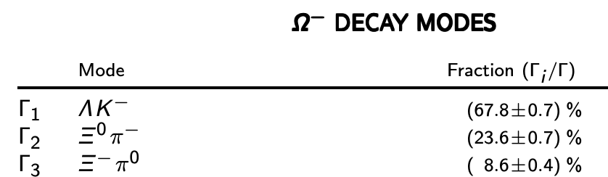
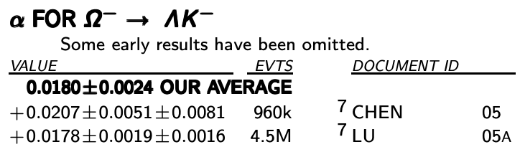
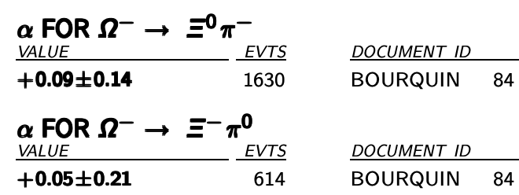
Ω⁻?
Ω⁻?
Γ(Ξ⁰π⁻) =(2.74 + 0.15) x Γ(Ξ⁻π⁰)
ΔI=1/2 rule expectation: ≈ 2 : ⬅T_{3/2} ≈ 0.15 T_{1/2}
ΔΓ will be enhanced (compared to Λs)
this Δ_{s}=δ_{3/2}-δ_{1/2}
α≈0 ➔ 1 partial wave dominates all modes
interference is small, not well suited
for α + α/α—α measurements
_
_
sensitivity is reduced but
only by a factor of ~0.7
BESIII should check all these measurements

Slide 46
Implications for a J/ψ factory for CPV measurements

Slide 47
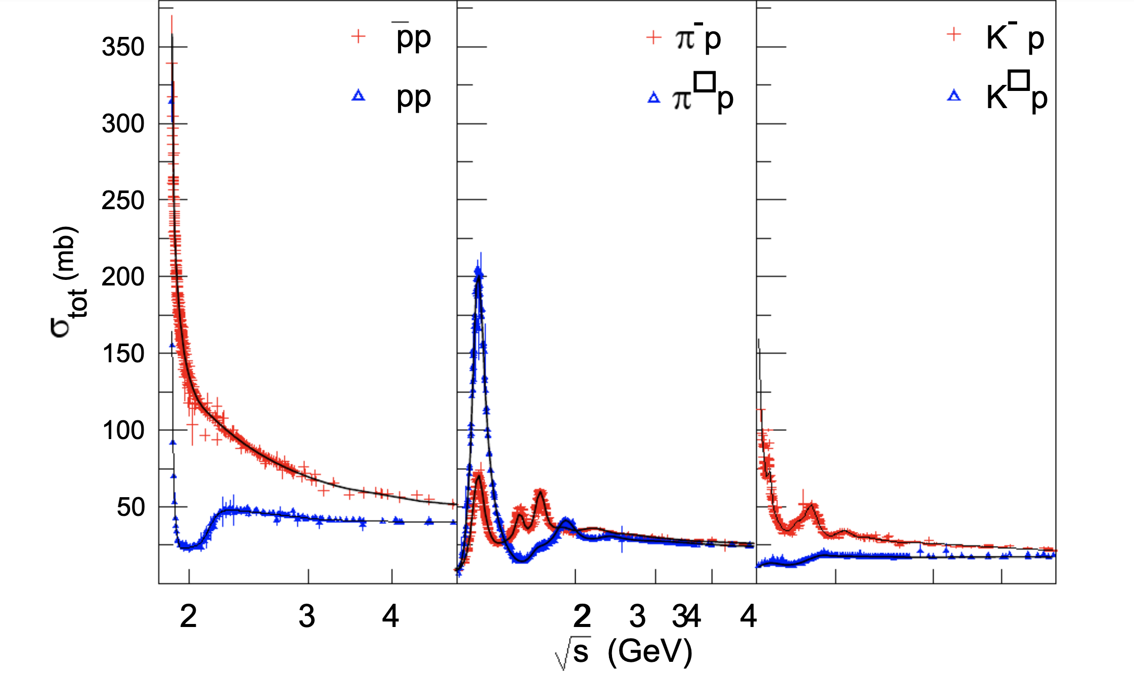
Minimize inner detector material
huge differences between
particle & antiparticle nuclear
interaction lengths.
gms/cm² is the relevant measure
not radiation length
no vertex detectors!
no GEMs!
+
+
π⁺p
K⁺p

Slide 48
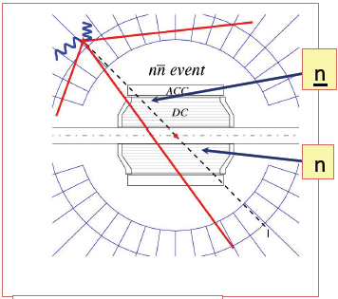

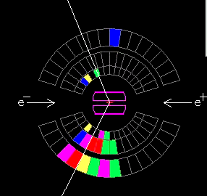
SND: e⁺e⁻ → nn at threshold
_
Λ→nπ⁰ & Λ→nπ⁰
backgrounds are
totally different
_
n
_
n
_

Slide 49
γ-ray microscope?
need very high-Z
“pre-radiator”
fine-grained calorimeter
--liquid Xenon?--
e⁺e⁻ tracker
tracking chamber
trick is to develop a highly
granular system that preserves
γ-ray energy resolution
tantalum preradiator
multi-layer?

Slide 50
summary and some random questions
Hyperon polarization in J/ψ (ψ’) decays ➔ new way to study CPV
→ complementary to CPV studies with Kaons
→ BESIII as already rewritten the PDG book for Λ decays
→ about to do the same for Ξ decays
→ good opportunities for Δα measurements with Σ⁺
◊ Σ⁻ and Ω⁻ CPV measurements are probably hopeless
Can partial reconstruction techniques be exploited with BESIII data
→ extracting π⁰ from n debris is essential for Δα₀ & ΔΓ measurements
→ Ω⁻ → Ξπ measurements are severely rate limited
Can detector/software be developed to cleanly reconstruct π⁰→γγ in the midst of debris
from n and p annihilations?
→ a future J/ψ-factory detector should include some kind of ”pre-radiator”
Question: Can BESII measure πp scattering phases at E_{cm}=m_{Λ} & m_{Σ} precisely?
_
_
_

Slide 51
thank you

