Slide 1
Forward Silicon Tracker Upgrade for STAR Detector
Jianing DONG, Qian YANG, Li YI
Shandong University
2019-10-10

Slide 2
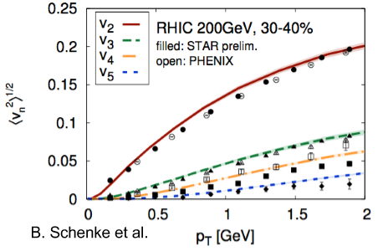
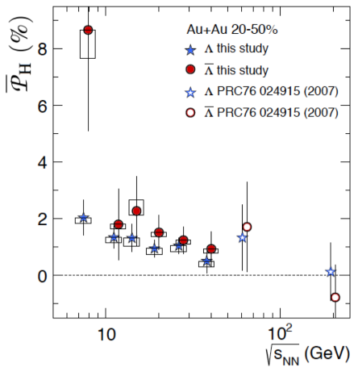
Why Forward Physics
Flow in transverse plane is well explored.
What about longitudinal fluctuations?
Lambda and anti-Lambda polarized.
What is the rapidity dependence?
Forward upgrade is essential to the longitudinal dynamics.
2019/10/10
Jianing Dong, CNPC 2019, Wuhan
2￼

Slide 3
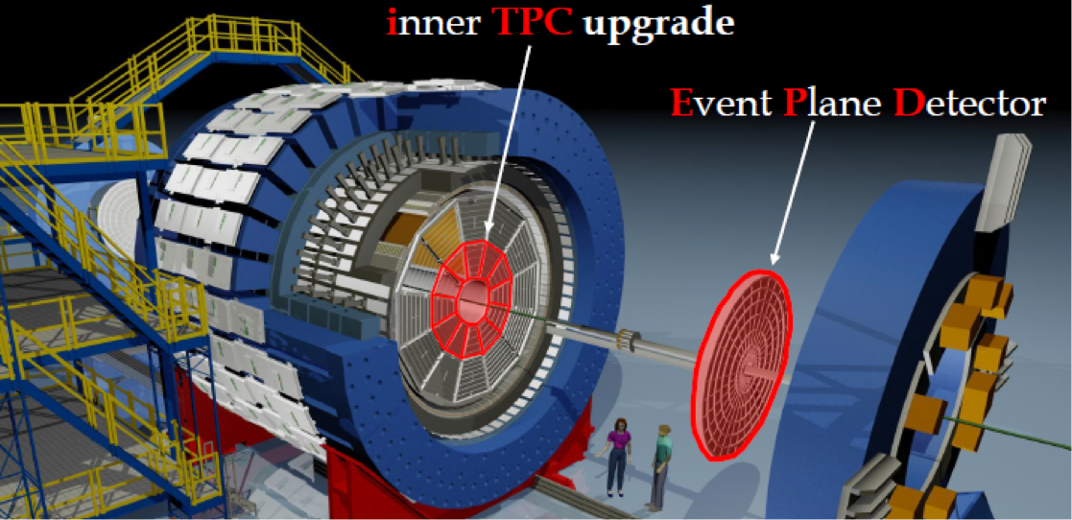
Current STAR Detector
Endcap TOF
iTPC upgrade | EPD upgrade | eTOF upgrade
Continuous pad rows Replace all inner TPC sectors | Replace Beam Beam Counter | Add CBM TOF modules and electronics (FAIR Phase 0)
|η| < 1.5 | 2.1 < |η| < 5.1 | -1.6 < η < -1.1
p_{T} > 60 MeV/c | Better trigger & b/g reduction | Extend forward PID capability
Better dE/dx resolution Better momentum resolution | Greatly improved Event Plane info | Allows higher energy range of Fixed Target Program
2019/10/10
Jianing Dong, CNPC 2019, Wuhan
3￼

Slide 4
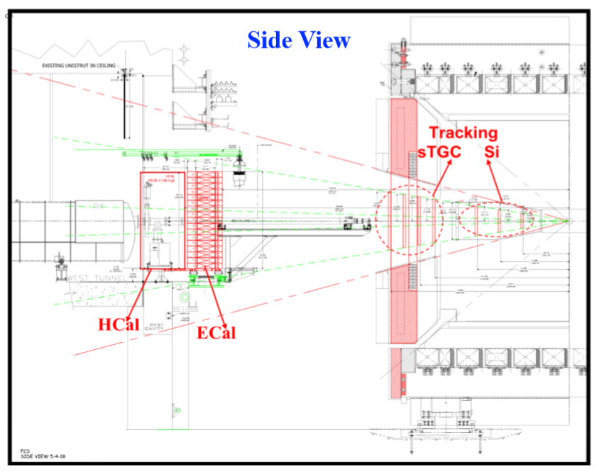
Forward Upgrade
Calorimetry:
Electromagnetic and Hadronic
Forward Tracking System:
4 layers of small Thin Gap Chambers
3 layers of Silicon microstrip detectors
Fine φ segmentation and coarse in r
Low material budget
Cost effective (reuse Intermediate Silicon Tracker DAQ system)
High tracking efficiency
Charge separation
Momentum measurement (20-30%)
2.5 < η < 4
2019/10/10
Jianing Dong, CNPC 2019, Wuhan
4￼
Notes:
Tracking efficiency > 90%
Charge separaion > 99%
Strip pitch 100um

Slide 5
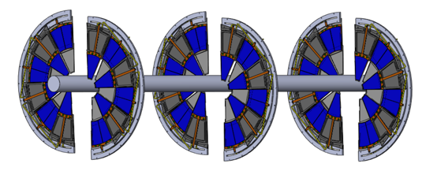
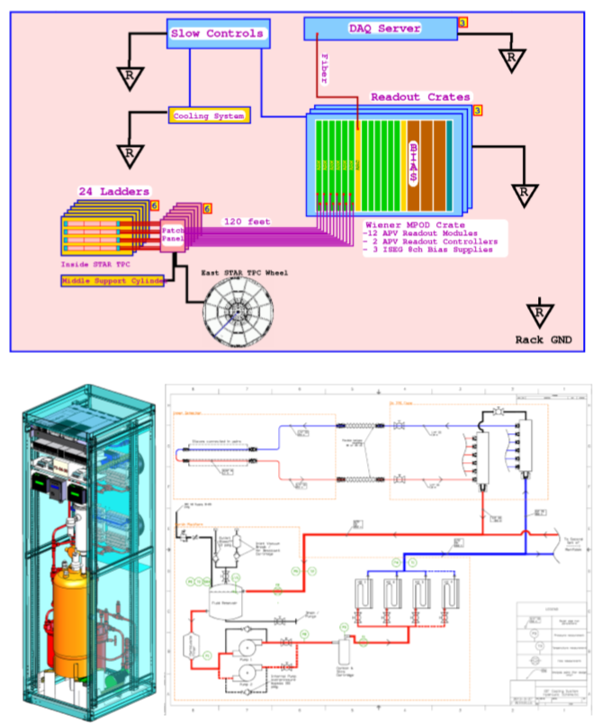
Forward Silicon Tracker
Three layers of identical Silicon disks
Silicon microstrip sensors
APV25 frontend readout chips
Flexible hybrid:
mechanical structure
DAQ system
Inner signal cables
Outer signal cables, readout modules,
and so on
Cooling system
Cooling manifold, cooling lines
Rack (cooler, pumps)
Integration
Supporting structure
Blue: existing Red: new
2019/10/10
Jianing Dong, CNPC 2019, Wuhan
5￼

Slide 6
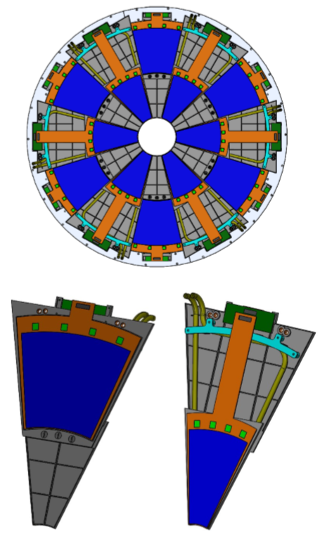
Silicon Disk Design
Each disk: 12 modules
Each module split into two regions：
Inner region
1 Silicon microstrip inner sensor:
each 128×4 strips
4 APV25 chips
1 Kapton flexible inner hybrid
Outer region
2 Silicon microstrip outer sensor:
each 64×4 strips
4 APV25 chips
1 Kapton flexible outer hybrid
Mechanical structure for each module
Each module connect to a T-board for signal transmission
2019/10/10
Jianing Dong, CNPC 2019, Wuhan
6￼

Slide 7
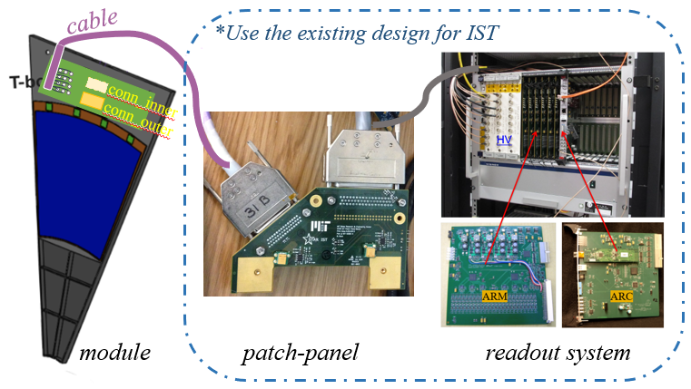
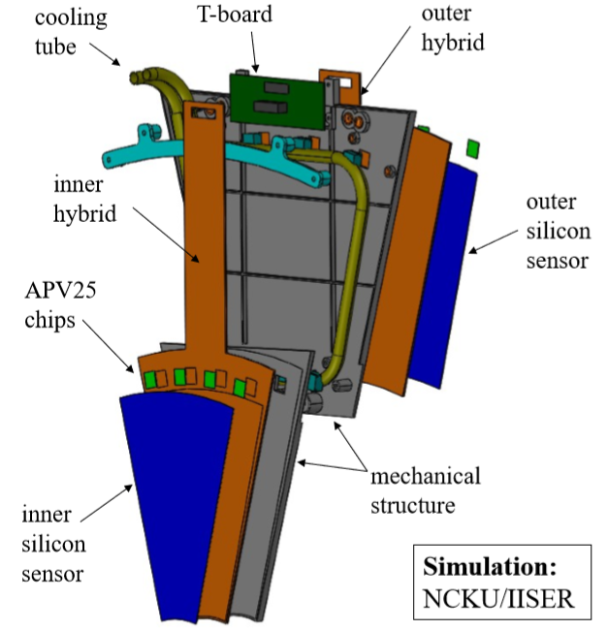
FST Module Design
inner cable
2019/10/10
Jianing Dong, CNPC 2019, Wuhan
7￼

Slide 8
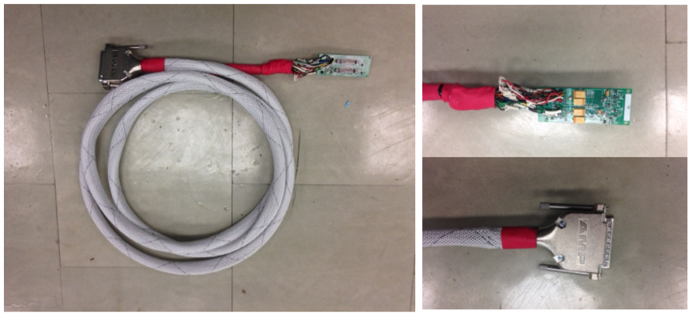
FST Module Design
inner cable
inner cable
2019/10/10
Jianing Dong, CNPC 2019, Wuhan
8￼

Slide 9
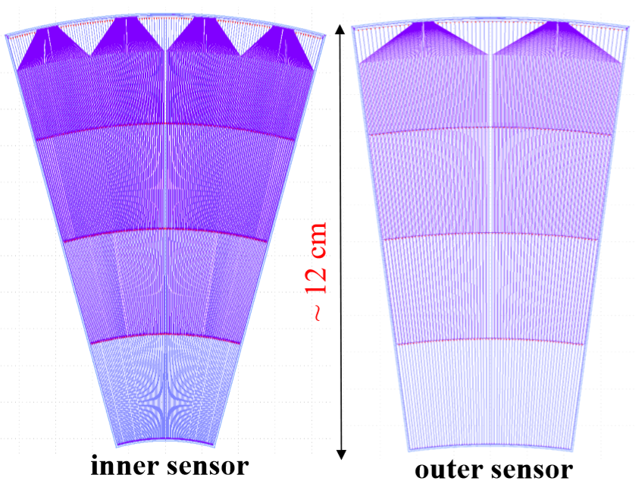
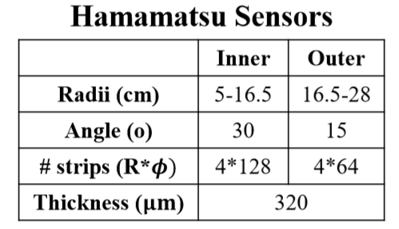
Silicon Sensor
Design completed at UIC in 2019/1
4 + 6 prototype sensors ordered from Hamamatsu
2019/10/10
Jianing Dong, CNPC 2019, Wuhan
9￼

Slide 10
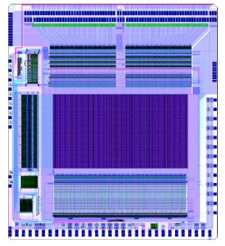
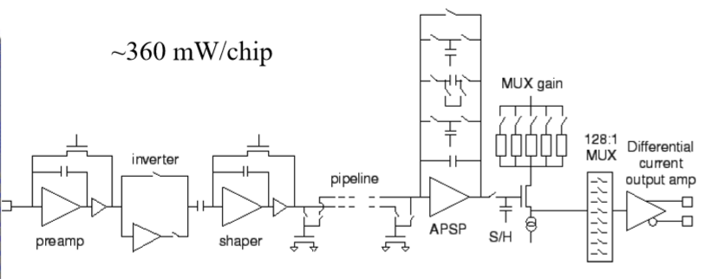
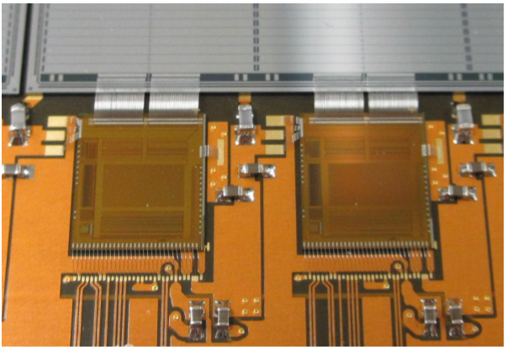
APV25 Chip
128 front-end input pads
Preamplifier + shaper + 192 analog pipelines + capacitor filter + multiplexer
Control and output pads
Designed for CMS Silicon strip detector
Fabricated in 0.25 μm CMOS process
2019/10/10
Jianing Dong, CNPC 2019, Wuhan
10￼

Slide 11
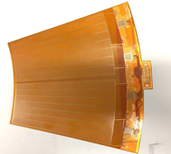
Hybrids & T-board
1st version design completed at SDU in 2019/2.
1st version hybrids & T-board received from the vendor.
Then they are assembled and tested at UIC.
inner hybrid
Phi angle: 31°
Inner radius: 47.5 mm
Outer radius: 185 mm
Tail length: 135 mm
outer hybrid
Phi angle: 31°
Inner radius: 163 mm
Outer radius: 300 mm
Tail length: 10 mm
T-board
Length: 60 mm
Width: 24 mm
2019/10/10
Jianing Dong, CNPC 2019, Wuhan
11￼

Slide 12
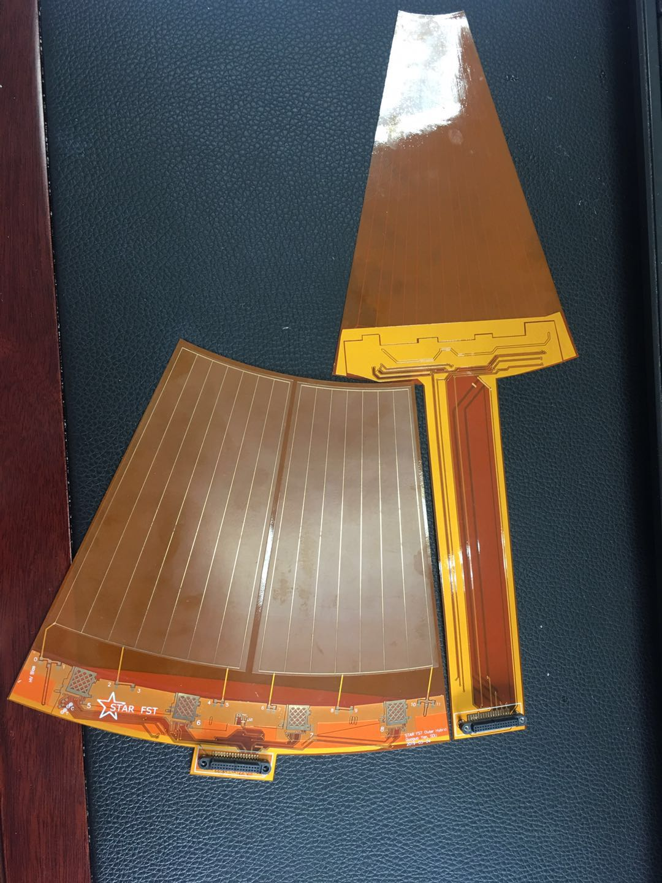
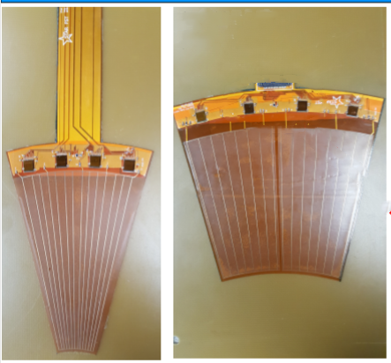
Hybrids & T-board
8 APV25 chips wire-bonded on the 1st version of hybrids and read out by 1st T-board and test cables at UIC.
Testing on-going
2019/10/10
Jianing Dong, CNPC 2019, Wuhan
12￼

Slide 13
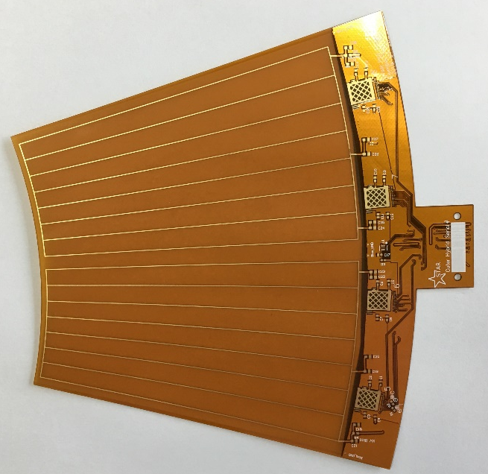
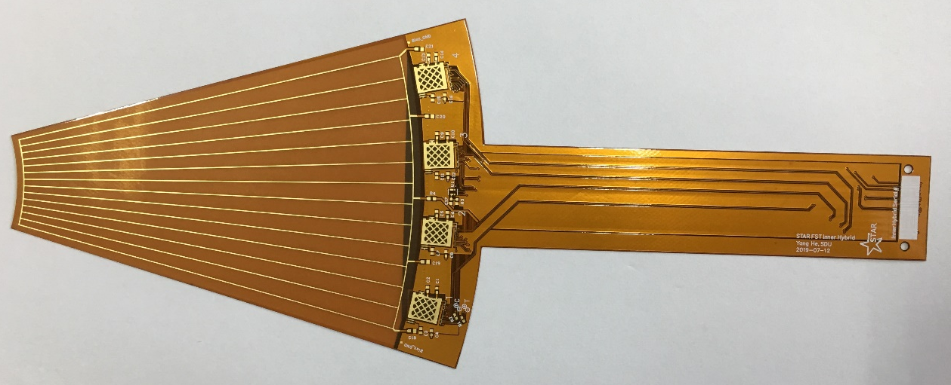
Hybrids & T-board
2nd version design completed at SDU in 2019/7: adjust dimensions to better fit the mechanical structure.
2nd version hybrids & T-board received from the vendor.
inner hybrid
Phi angle: 31° → 32°
Inner radius: 47.5 mm → 49 mm
Outer radius: 185 mm
Tail length: 135 mm → 126 mm
outer hybrid
Phi angle: 31° → 32°
Inner radius: 163 mm → 164 mm
Outer radius: 300 mm
Tail length: 10 mm → 20 mm
T-board
Length: 60 mm → 70 mm
Width: 24 mm
2019/10/10
Jianing Dong, CNPC 2019, Wuhan
13￼

Slide 14
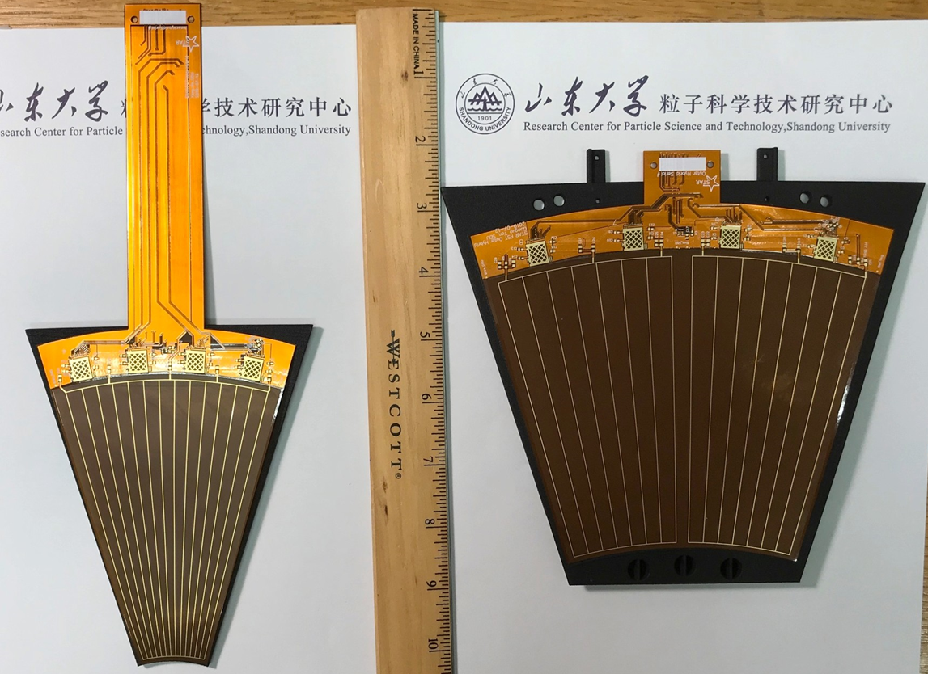
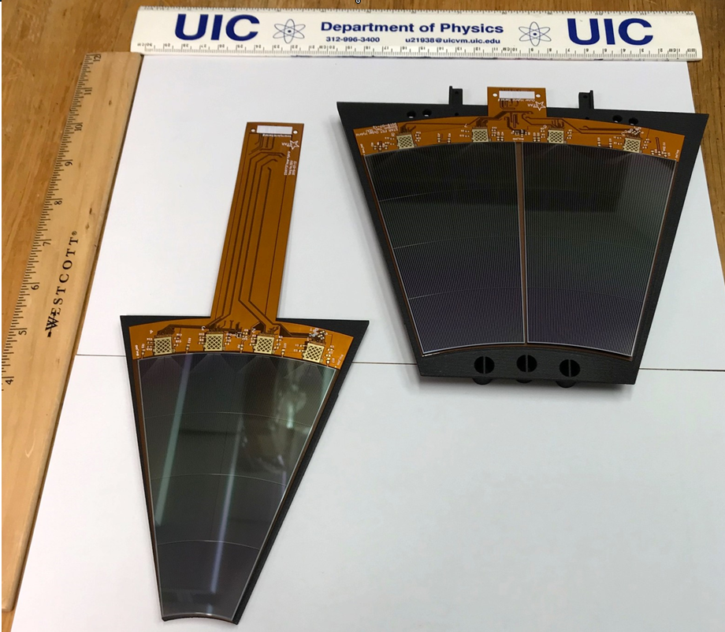
Current Status
sensors on hybrids
hybrids on mechanical structure
2nd version hybrids & T-board delivered to UIC, BNL & Taiwan.
Module assembly on-going
2019/10/10
Jianing Dong, CNPC 2019, Wuhan
14￼

Slide 15
Summary
A 3-layer forward tracking detector based on the Silicon microstrip detector technology is designed for STAR Forward upgrade.
The FST utilized the successful experience and infrastructure of the previous STAR Intermediate Silicon Tracker, in order to reduce cost and risk.
The project is currently in the R&D phase to build prototype detector modules, in which hybrids and T-boards are designed at Shandong University.
2nd version hybrids & T-boards have been received from the vendor, and delivered to the cooperators to be assembled and tested. And the module assembly is on the way.
2019/10/10
Jianing Dong, CNPC 2019, Wuhan
15￼

Slide 16
Summary
A 3-layer forward tracking detector based on the Silicon microstrip detector technology is designed for STAR Forward upgrade.
The FST utilized the successful experience and infrastructure of the previous STAR Intermediate Silicon Tracker, in order to reduce cost and risk.
The project is currently in the R&D phase to build prototype detector modules, in which hybrids and T-boards are designed at Shandong University.
2nd version hybrids & T-boards have been received from the vendor, and delivered to the cooperators to be assembled and tested. And the module assembly is on the way.
Thank you!
2019/10/10
Jianing Dong, CNPC 2019, Wuhan
16￼

Slide 17
Backup
2019/10/10
Jianing Dong, CNPC 2019, Wuhan
17￼

Slide 18
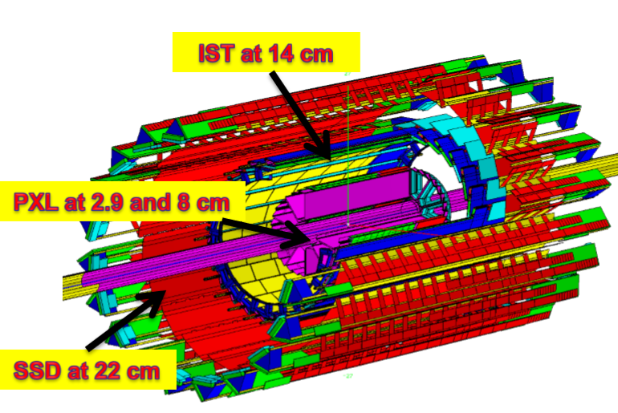
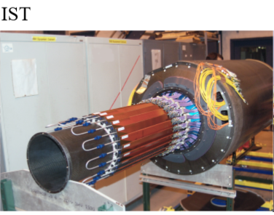
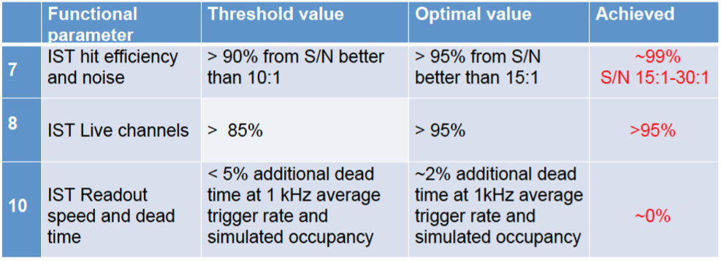
STAR IST Detector
STAR Heavy Flavor Tracker in 2014 – 2016
2 layers of thin Silicon MAPS (PXL)
360M pixels, each 12*12μm
2 layers of Si strip sensors (IST/SSD)
2019/10/10
Jianing Dong, CNPC 2019, Wuhan
18￼
Notes:
A very successful run for IST in 2014
Operational with beam for more than 110 days since March 15th
Participated in physics data taking for low/medium/high luminosity Au + Au @ 200 GeV and most of the He3 + Au collisions
Performance exceeds all of the optimal specifications
All project deliverables are provided.

Slide 19
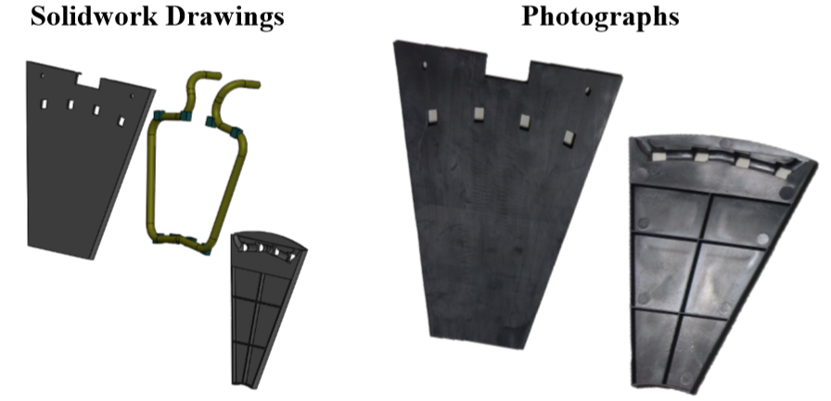
Mechanical Structure
1st version design completed at NCKU in 2019/2.
1st version structures received with uneven surface in 2019/3
2nd version design completed at NCKU in 2019/7: optimize material composite and thickness; adjust dimension and shape; thermal-stress simulation
2nd version structures expected in 2019/8
2019/10/10
Jianing Dong, CNPC 2019, Wuhan
19￼

Slide 20
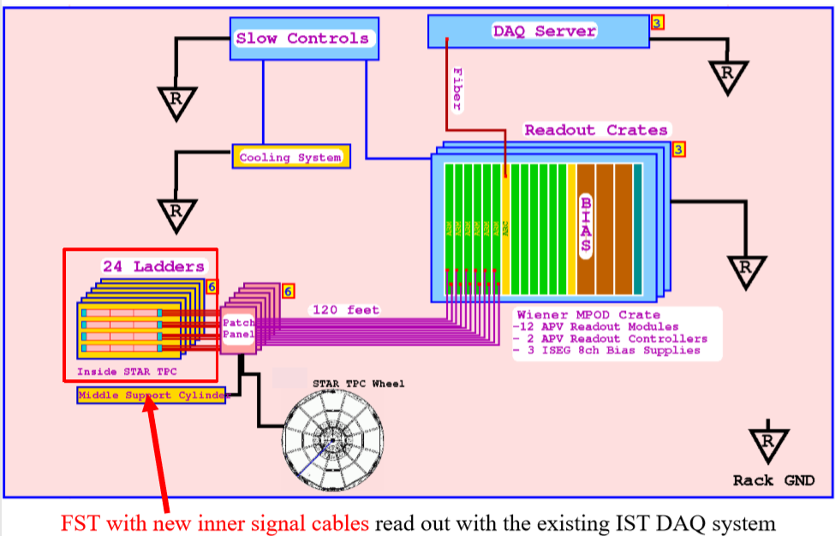
DAQ System
2019/10/10
Jianing Dong, CNPC 2019, Wuhan
20￼

Slide 21
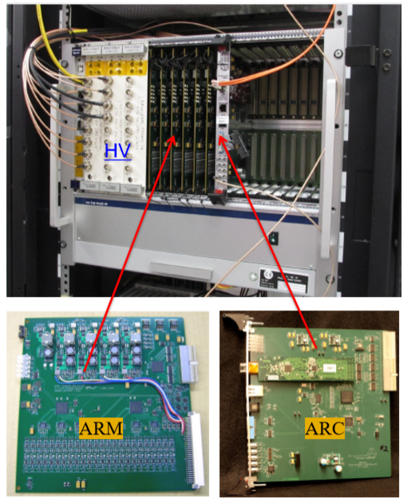
DAQ System
Custom-designed DAQ system in a WIENER MPOD HV-cPCI frame
3 crates, 6 ARCII, 36 ARM, 36 Patch-panel boards, 72 outer signal cables from IST can be used fro FST.
FST inner signal cable designs completed by BNL/IU
1st version assembled in 2019/8
2nd version expected in 2019/9
2019/10/10
Jianing Dong, CNPC 2019, Wuhan
21￼

Slide 22
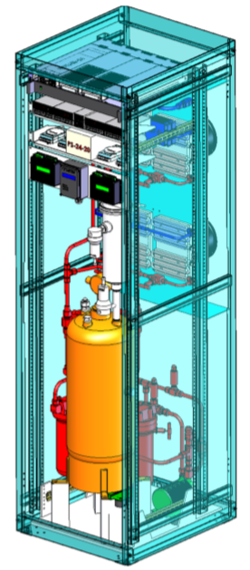
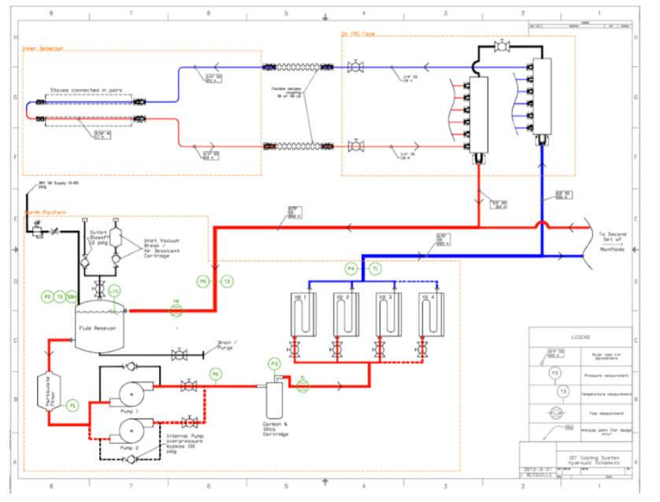
Cooling System
Heat load ~ 100 W (300 W for IST)
Coolant: 3MTM NovecTM 7200 (C4F9OC2H5)
Sitting on STAR platform, maintenance needed
2019/10/10
Jianing Dong, CNPC 2019, Wuhan
22￼

