Slide 1
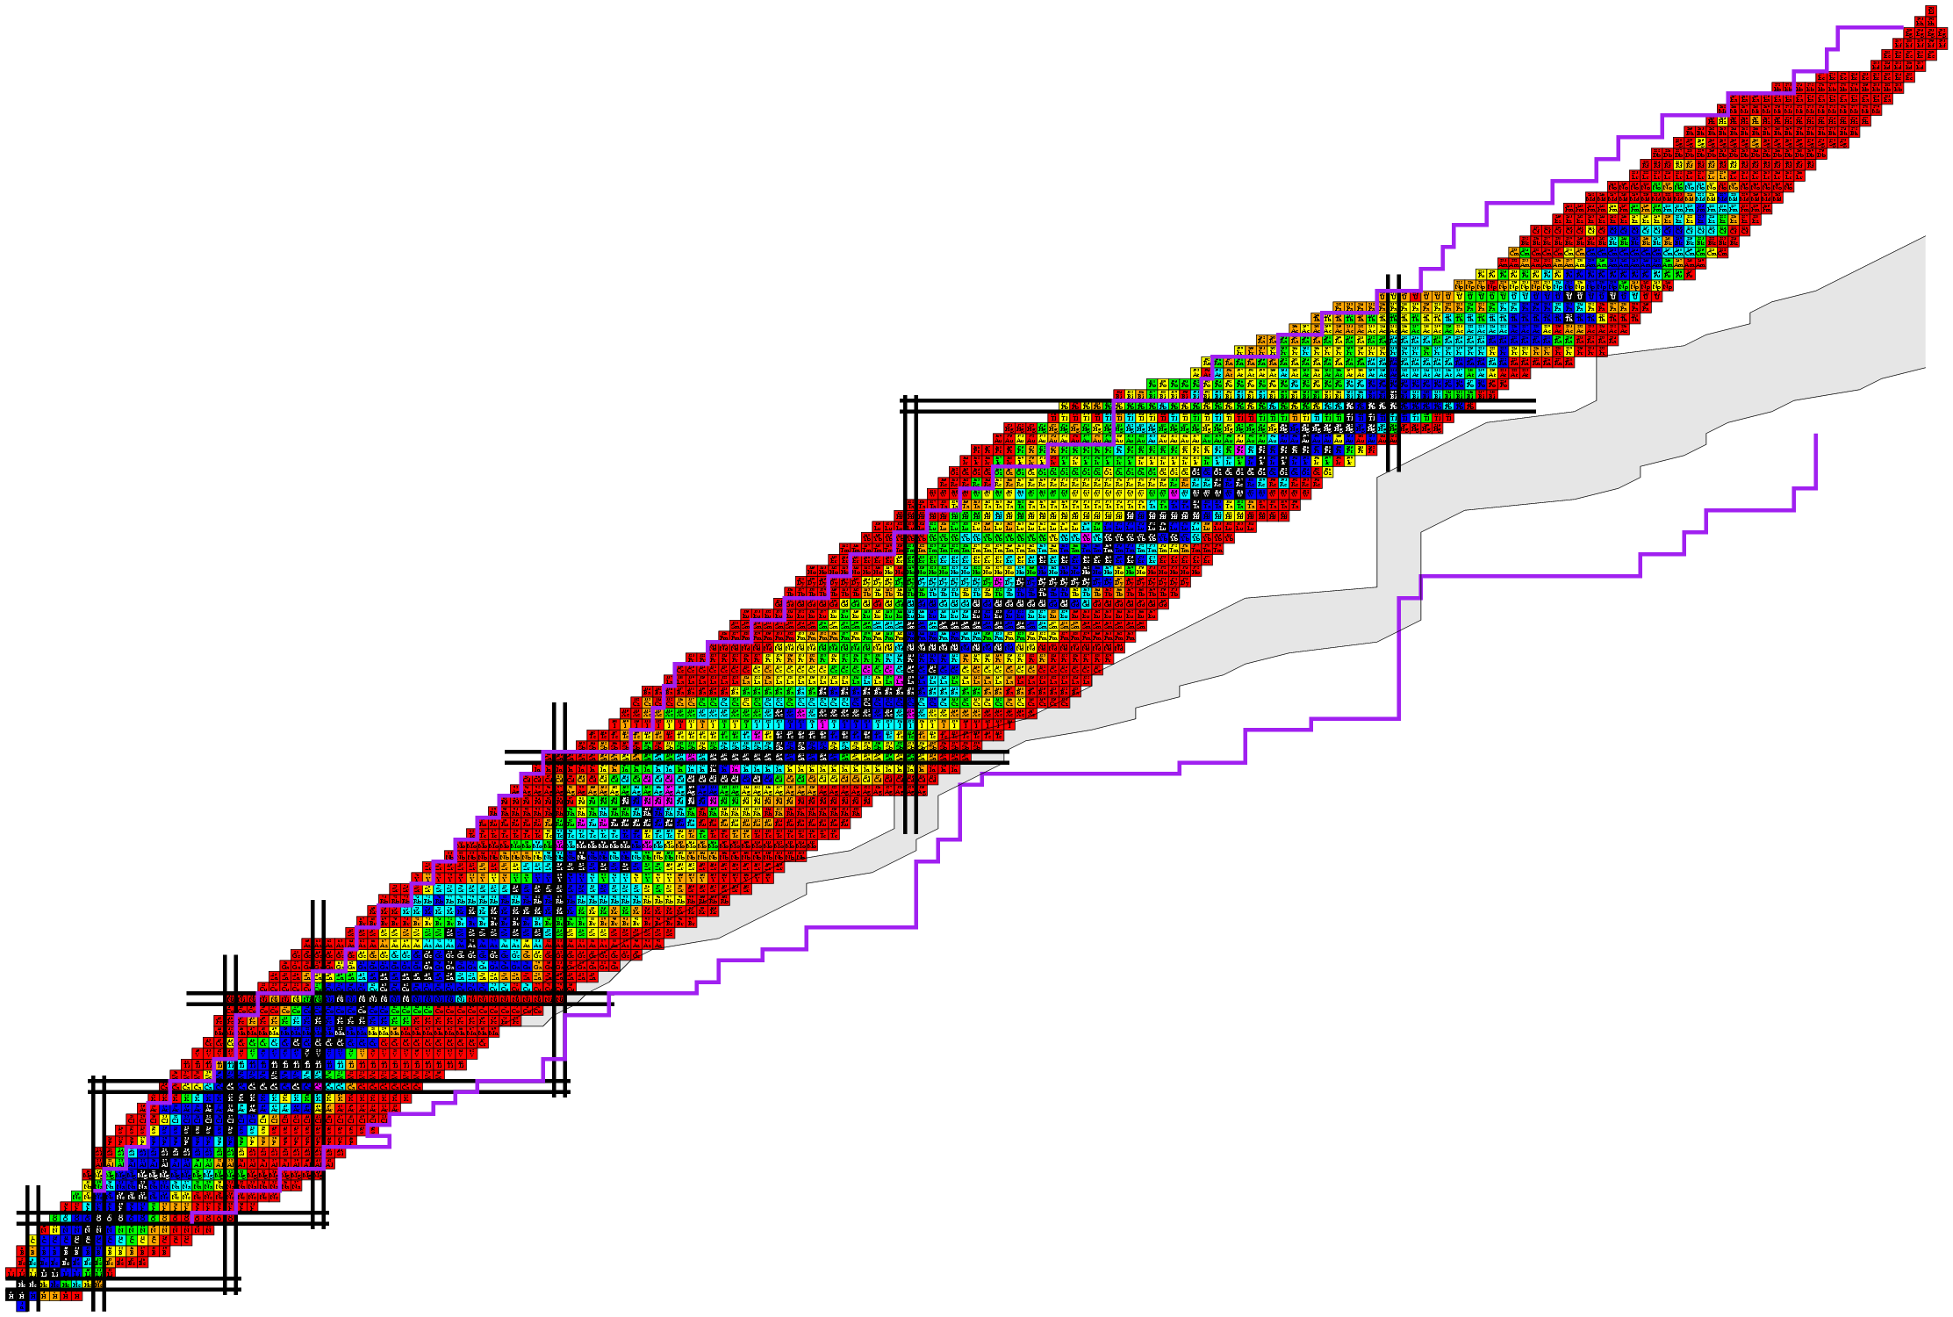
Beyond mean-field description of Gamow-Teller resonances and β-decay half-lives
第十七届全国核物理大会，武汉
牛一斐
兰州大学
核科学与技术学院

Slide 2

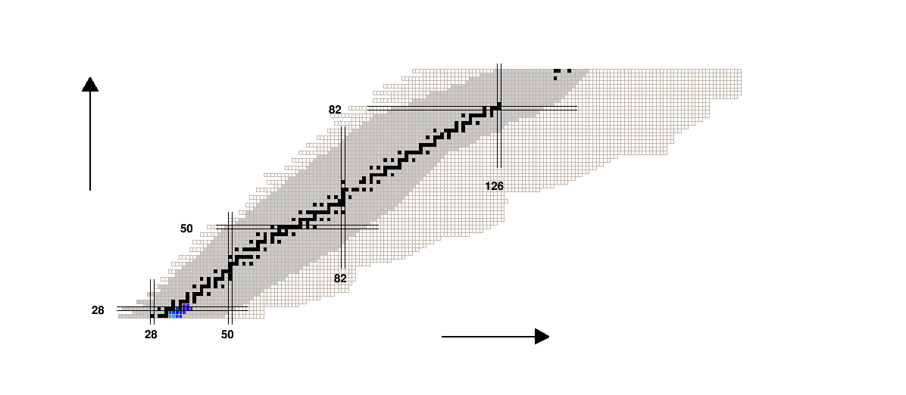
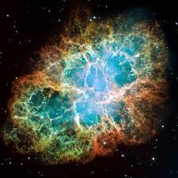
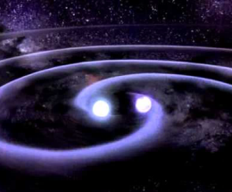
How Were the Heavy Elements Made?
How were the heavy elements from iron to uranium made?
The 11 greatest unanswered questions of physics
r-process
Where does r-process happen?
Supernova
Neutron star merger
GW170817 neutron star merger：
One of the r-process sites
r-process
Accurate nuclear physics inputs
β decay
β decay half-lives,
Neutron-capture cross section,
…
Nature 551,64; 67; 80 (2017)
Science 358, 1559 (2017)
ApJL 848, L17; L19 (2017)
Neutron capture
Courtesy of Xiaodong Tang

Slide 3
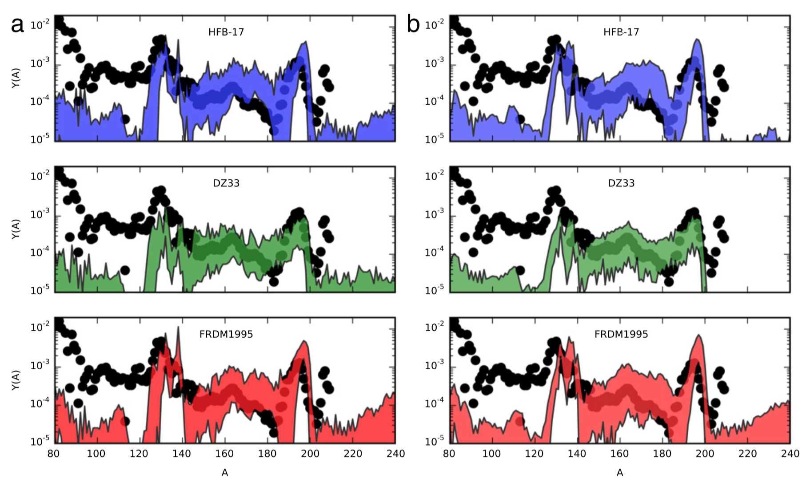
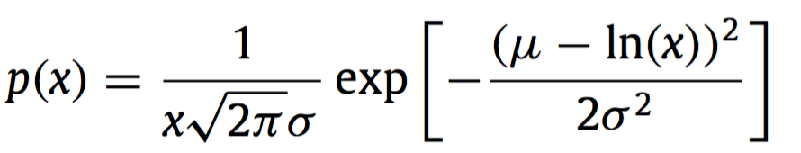
Consequences of uncertainties in nuclear physics inputs
β-decay half-lives (10⁻¹ - 10)
Neutron-capture rates (10⁻³ - 10³ )
R-process abundance
Multiplicative factor
Mumpower et al., PPNP 86, 86 (2016)

Slide 4
Experimental Investigations
Development of radioactive ion-beam facilities => important advances
  ⁷⁸Ni and around Hosmer, et al., PRL 94, 112501 (2005); Xu, et al., PRL 113, 032505 (2014)
  very neutron rich Kr to Tc isotopes Nishimura, et al., PRL 106, 052502 (2011)
  Zn Ga isotopes Madurga et al., PRL 109, 112501 (2012)
  110 neutron-rich nuclei across N=82 shell gap Lorusso, et al., PRL 114, 192501 (2015)
  94 neutron-rich nuclei from Z=55-67 Wu, et al., PRL 118, 072701 (2017)
  N=126 r-process nuclei? Not reached yet.
provide a good test ground for theoretical models

Slide 5
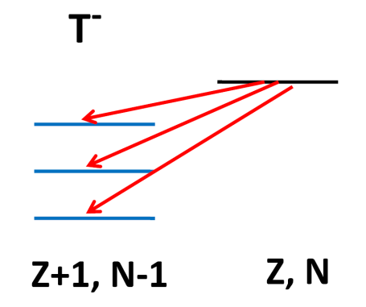



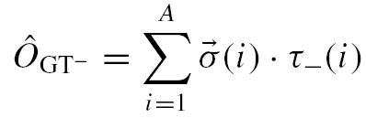
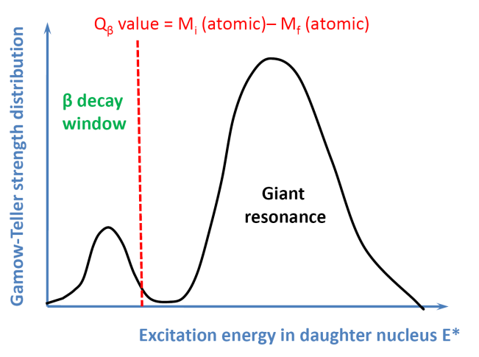
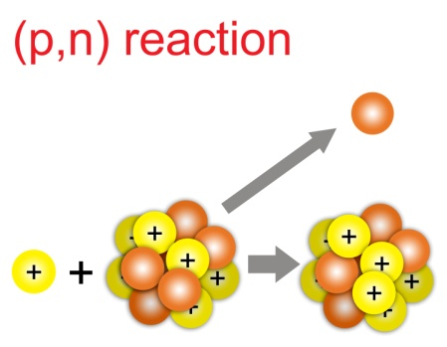
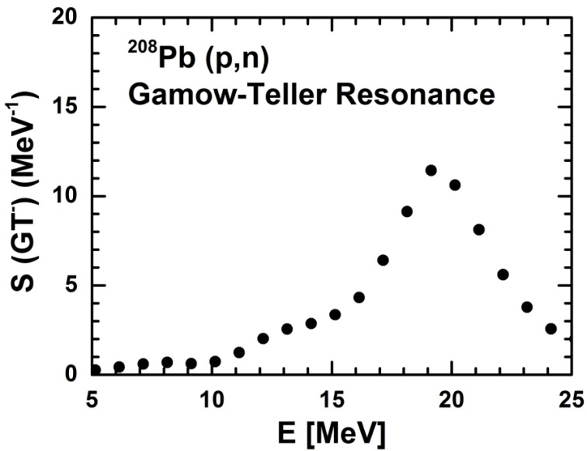
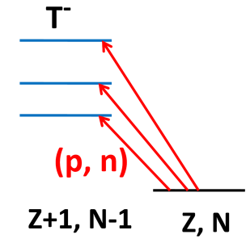
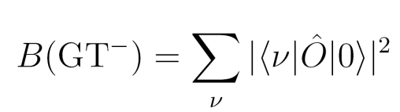
β decay and Gamow-Teller Transitions
β-decay
dominant nuclear transition
Gamow-Teller transition
ΔS=1 ΔL=0 ΔT=1
electron antineutrino
Gamow-Teller Transition
Transition strength S= smoothed B
Strong
Resonance
Transition probability B
Wakasa, et al., PRC 85, 064606 (2012)

Slide 6
Theoretical Investigations
ab initio approach: for very light nuclei Barrett, et al., PPNP 69, 131 (2013)
shell model: up to A=60 or around magic regions
Langanke et al., ADNDT 79, 1 (2001); Suzuki, et al., PRC 85, 015802 (2012); Li and Ren, JPG 41,
105102 (2014); Zhi, et al., PRC 87, 025803 (2013)
Quasiparticle Random Phase Approximation (QRPA)
  Spherical
    Non-self-consistent
      FRDM + Quasiparticle RPA (QRPA)
      Moller, et al., ADNDT 66, 131 (1997)
    Self-consistent
      Skyrme QRPA
      Engel, et al., PRC 60, 014302 (1999)
      Relativistic QRPA
      Marketin, et al., PRC 93, 025805 (2016);
      Niu, et al., PLB 723, 172 (2013).
  Quadrupole deformation
    deformed QRPA with realistic force Ni and Ren, PRC 89, 064320 (2014)
    Skyrme deformed QRPA Sarriguren, et al., PRC 81, 064314 (2013); Yoshida, JPS CP, 6, 020017 (2015); Mustonen and Engel, PRC 93, 014304 (2016)

Slide 7
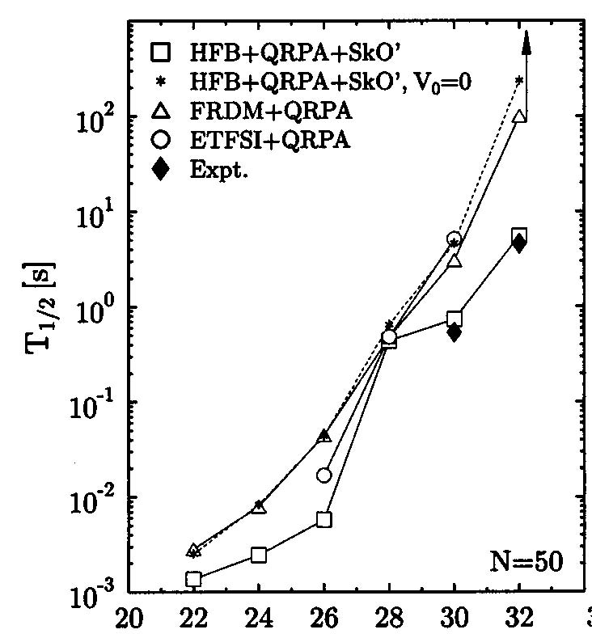
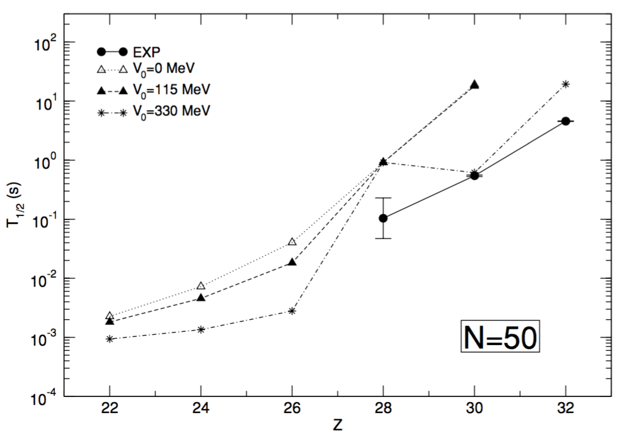
Half-life Is a Hard Problem
RHB+QRPA
Skyrme HFB+QRPA
⁷⁸Ni
⁷⁸Ni
Niksic, et al., PRC 71, 014308 (2005)
Engel, et al., PRC 60, 014302 (1999)
Half-lives are overestimated
Due to the nuclear structure part – Gamow-Teller transition

Slide 8
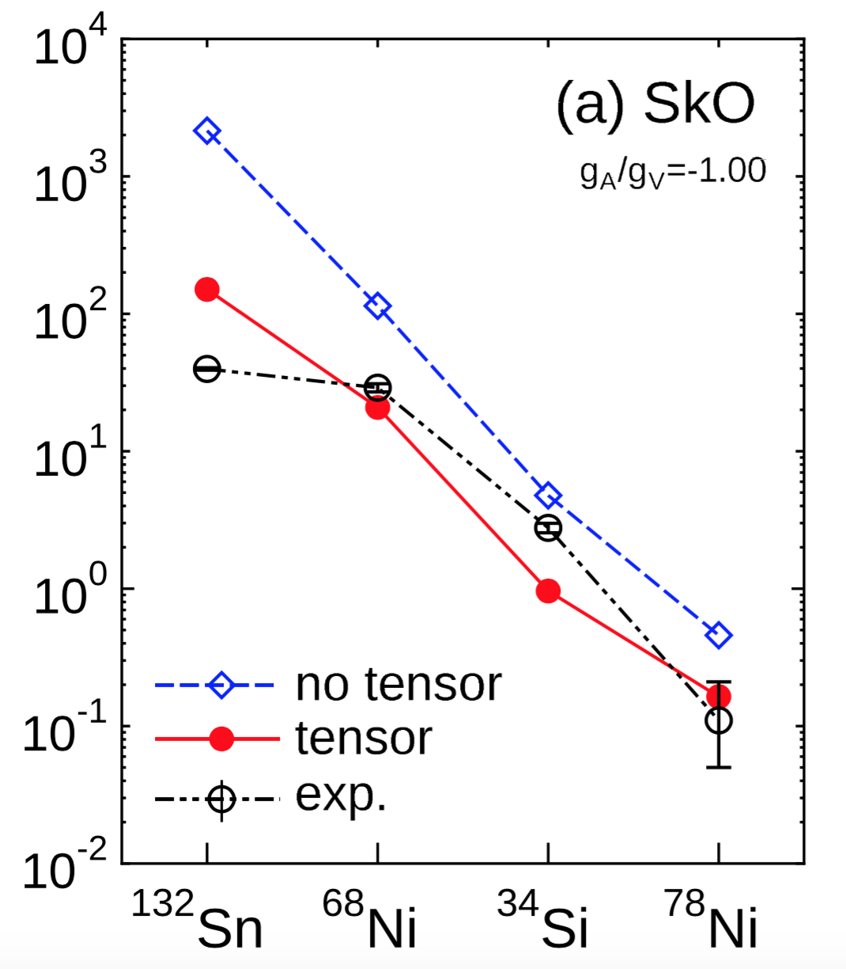
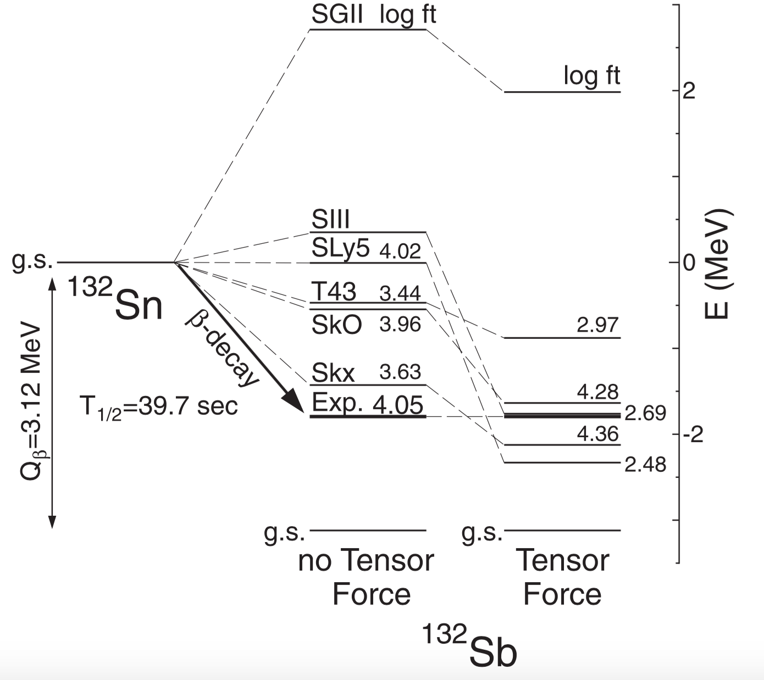
What are missing in the calculation?
Nuclear Force: tensor force skyrme HF + RPA + tensor
Minato and Bai, PRL 116, 089902 (2016)
Nuclear Model: more correlations beyond RPA model

Slide 9
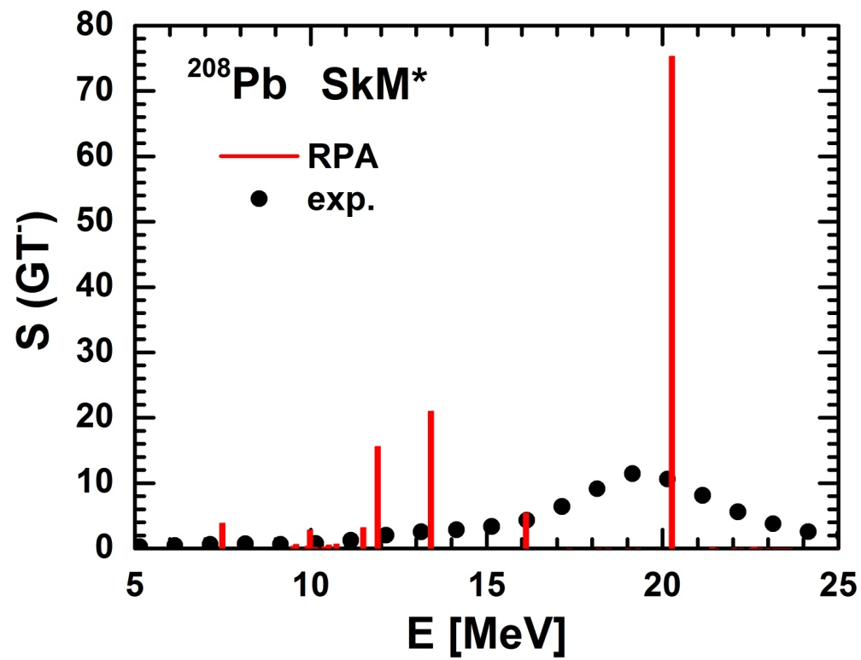
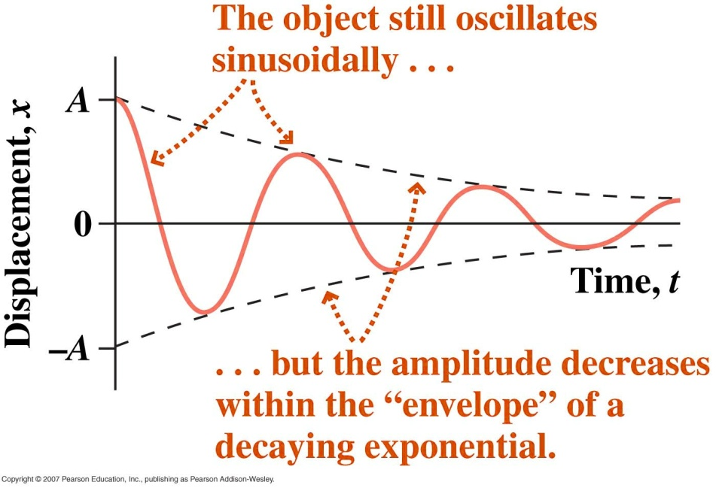
Limits of (Q)RPA Description
(Q)RPA cannot describe the spreading width
Correlations beyond RPA
RPA
Spreading Width (Damping Width)
energy and angular momentum of coherent vibrations
→ more complicated states of 2p-2h, 3p-3h, … character
http://www.physics.louisville.edu/

Slide 10
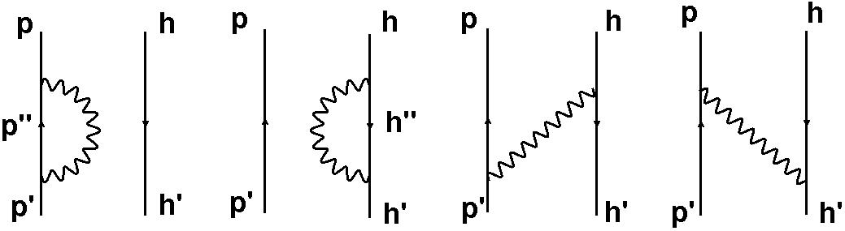
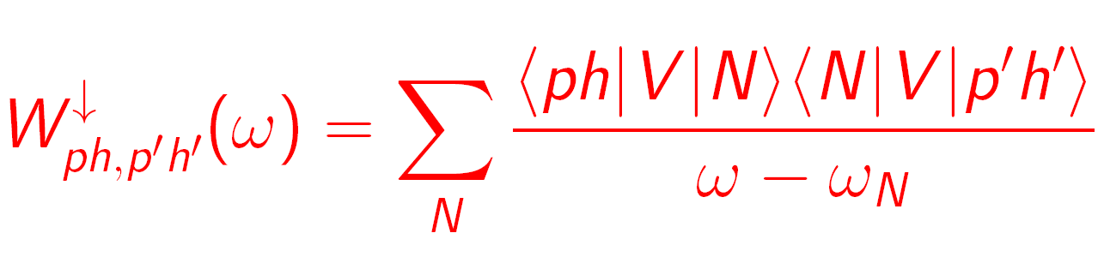
Solution: RPA + PVC
RPA
Second RPA drozdz et al., PR 197, 1 (1990)
Gambacurta et al., PRC 81, 054312 (2010)
RPA + PVC (particle vibration coupling)
Low-lying vibration phonons |N>
RPA+PVC model based on Skyrme DFT
Colo et al., PRC 50, 1496 (1994); Niu et al., PRC 85, 034314 (2012)
RPA+PVC model based on relativistic DFT Litvinova et al., PRC 75,064308 (2007)

Slide 11
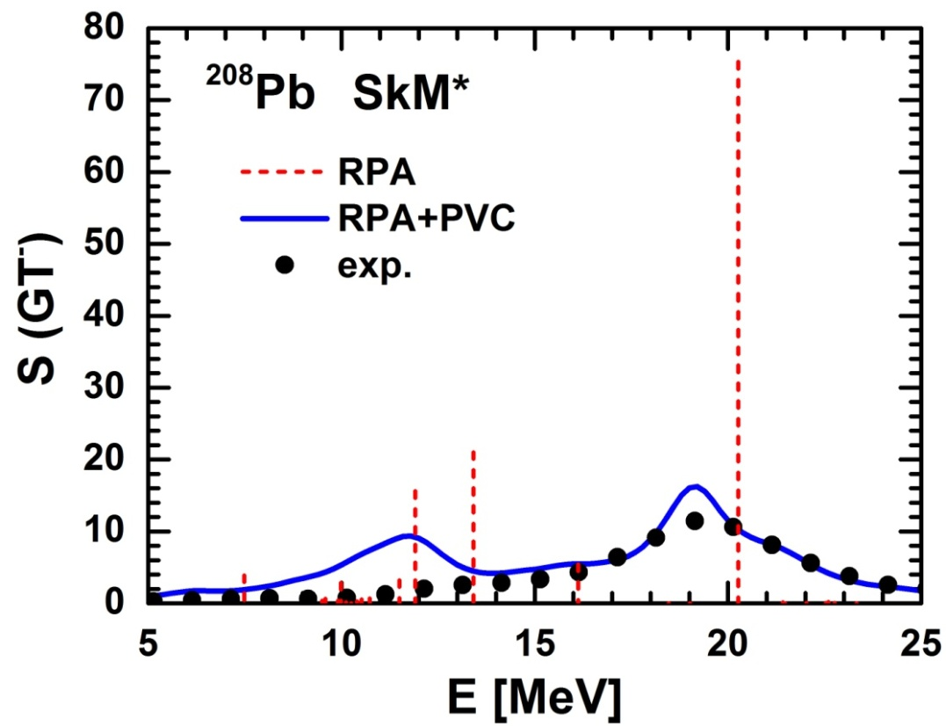
RPA+PVC: Gamow-Teller Resonance
Improved description of GT resonance in ²⁰⁸Pb
Develop a spreading width
Reproduce resonance lineshape
Y. F. Niu, G. Colo, and E. Vigezzi, PRC 90, 054328 (2014)

Slide 12
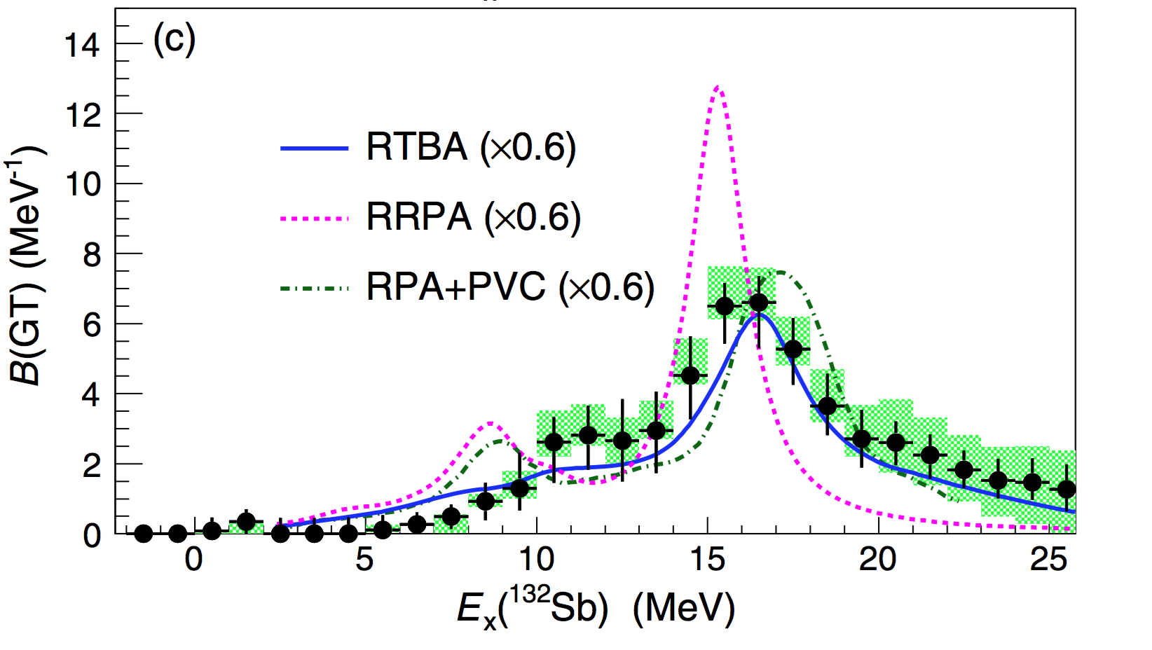
RPA+PVC: Gamow-Teller Resonance
Improved description of GT resonance in unstable nucleus ¹³²Sn
Yasuda, Sasano, et al., PRL 121, 132501 (2018)
Exp: (p,n) reaction @ RIBF, RIKEN
Yasuda, Sasano, et al., PRL 121, 132501 (2018)
RPA+PVC: Y. F. Niu, G. Colo and E. Vigezzi, PRC 90, 054328 (2014)
RTBA: E. Litvinova et al., PLB 730, 307 (2014)
RRPA: H. Z. Liang, and Z. M. Niu private communication

Slide 13
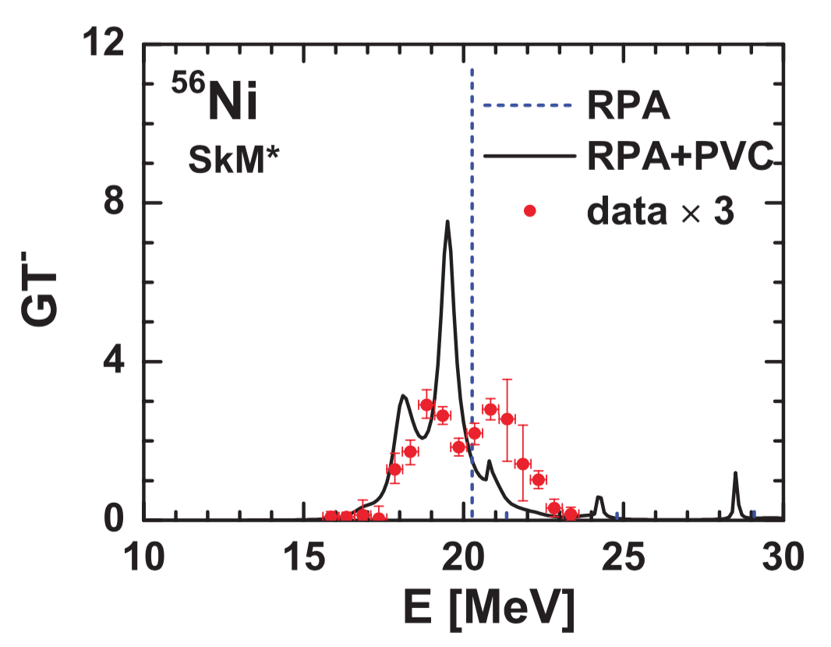
RPA+PVC: Gamow-Teller Resonance
Reproduction of double-peak structure of GT resonance in ⁵⁶Ni
Y. F. Niu, G. Colo, M. Brenna, P.F. Bortignon, and J. Meng, PRC 85, 034314 (2012)
Exp: (p,n) reaction with Tp=296 MeV @ NSCL, MSU
Sasano et al., PRL 107, 202501 (2011)

Slide 14
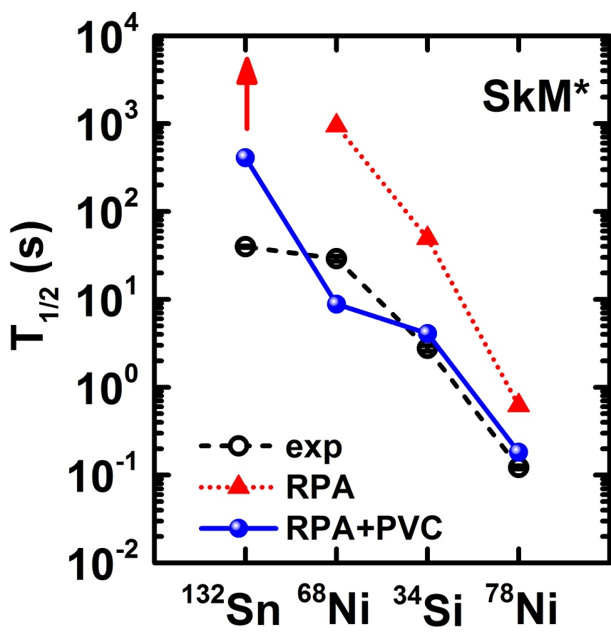
RPA+PVC: β-Decay Half-Lives
Improved description of β-decay half-lives
Reduce half-lives systematically
Reproduce β-decay half-lives
Y.F. Niu, Z. M. Niu, G. Colo, and E. Vigezzi, PRL 114, 142501 (2015)
Exp: G. Audi, F. G. Kondev, M. Wang, W. J. Huang, and S. Naimi, CPC 41, 030001 (2017)

Slide 15
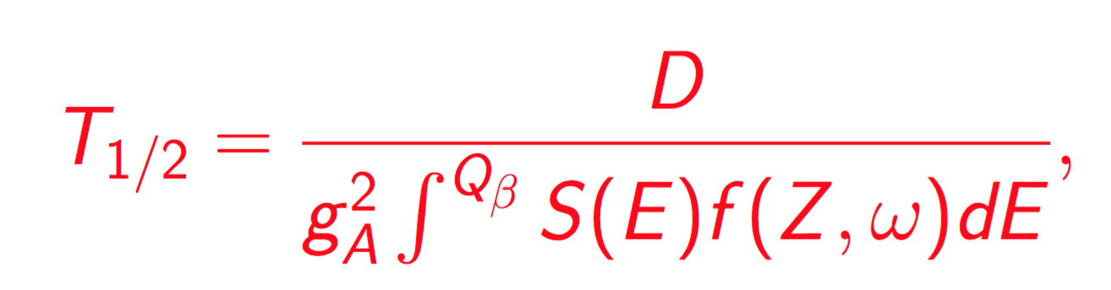
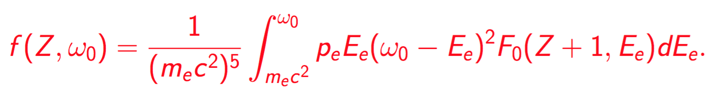
How PVC reduces half-lives?
Exp.: Xu, et al., PRL 113, 032505, 2014
Half-life
Phase Volume

Slide 16

RPA+PVC: only for magic nuclei…
Taken from Nature News & Views 465 2010
To include pairing correlations for superfluid nuclei
Quasiparticle RPA + quasiparticle vibration coupling
(QRPA) + (QPVC)
for the study of Gamow-Teller resonance in superfluid nuclei
for the study of β-decay half-lives of the whole isotopic chain
Y. F. Niu, G. Colo, E. Vigezzi, C. L. Bai, and H. Sagawa, PRC 94, 064328 (2016)
Y. F. Niu, Z. M. Niu, G. Colo, and E. Vigezzi, PLB 780, 325 (2018)

Slide 17
GT Strength Distribution
(p,n) data: normalized by unit cross section
Sasano, et al., PRC 79, 024602 (2009)
QRPA + QPVC
  Develop a width of 5.3 MeV (6.4 MeV from exp.), reproduce exp. profile in GTR
  Overestimate the low-lying strength
Y. F. Niu, G. Colo, E. Vigezzi, C. L. Bai, and H. Sagawa, PRC 94, 064328 (2016)

Slide 18
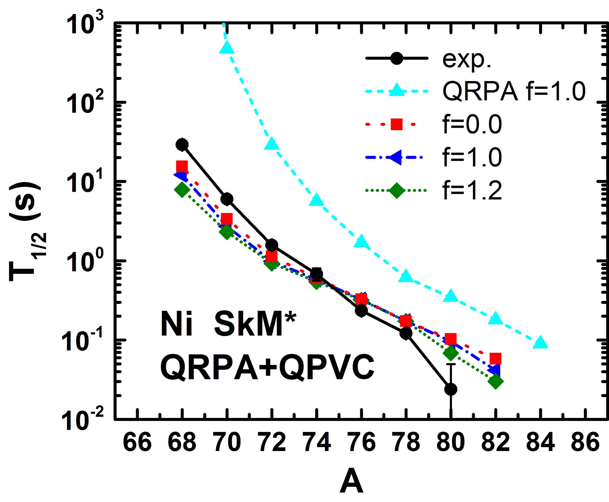
β-Decay Half-Lives in Ni isotopes
Isoscalar Pairing:
not so effective for Ni isotopes
(nuclei before N=50 closed shell)
QPVC:
reduce the half-lives
Y. F. Niu, Z. M. Niu, G. Colo, and E. Vigezzi, PLB 780, 325 (2018)

Slide 19
β-Decay Half-Lives in Sn isotopes
Isoscalar Pairing:
effective for Sn isotopes
(nuclei above N=82 closed shell)
Y. F. Niu, Z. M. Niu, G. Colo, and E. Vigezzi, PLB 780, 325 (2018)

Slide 20
β-Decay Half-Lives in Sn isotopes
Isoscalar Pairing:
effective for Sn isotopes
(nuclei above N=82 closed shell)
Isoscalar Pairing + QPVC:
reduce the half-lives
Y. F. Niu, Z. M. Niu, G. Colo, and E. Vigezzi, PLB 780, 325 (2018)

Slide 21
The role of IS pairing
N < 82
N > 82
V^{pp}(2d_{3/2} 2d_{5/2,} 2d_{3/2} 2d_{5/2} )
-0.50 (¹³⁰Sn)
u²(2d_{3/2})u²(2d_{5/2})+ v²(2d_{3/2})v²(2d_{5/2})
0.069 (¹³⁰Sn)
V^{pp}(1h_{9/2} 1h_{11/2,} 1h_{9/2} 1h_{11/2} )
-1.68 (¹⁴⁴Sn)
u²(1h_{9/2})u²(1h_{11/2})+ v²(1h_{9/2})v²(1h_{11/2})
0.89 (¹⁴⁴Sn)

Slide 22
Summary
β-decay is mainly determined by the low-energy Gamow-Teller (GT) transitions
Go beyond RPA/QRPA: we developed self-consistent RPA+PVC / QRPA+QPVC model
Successfully describe the GT resonance and β-decay half-lives in doubly magic nuclei and superfluid nuclei at the same time

Slide 23
Perspective
Complete Nuclear Physics Inputs for r-process
  Nuclear mass
  Nuclear beta-decay half-lives
  Neutron capture rates
  Nuclear fission
Physics Goal at HIAF

Slide 24
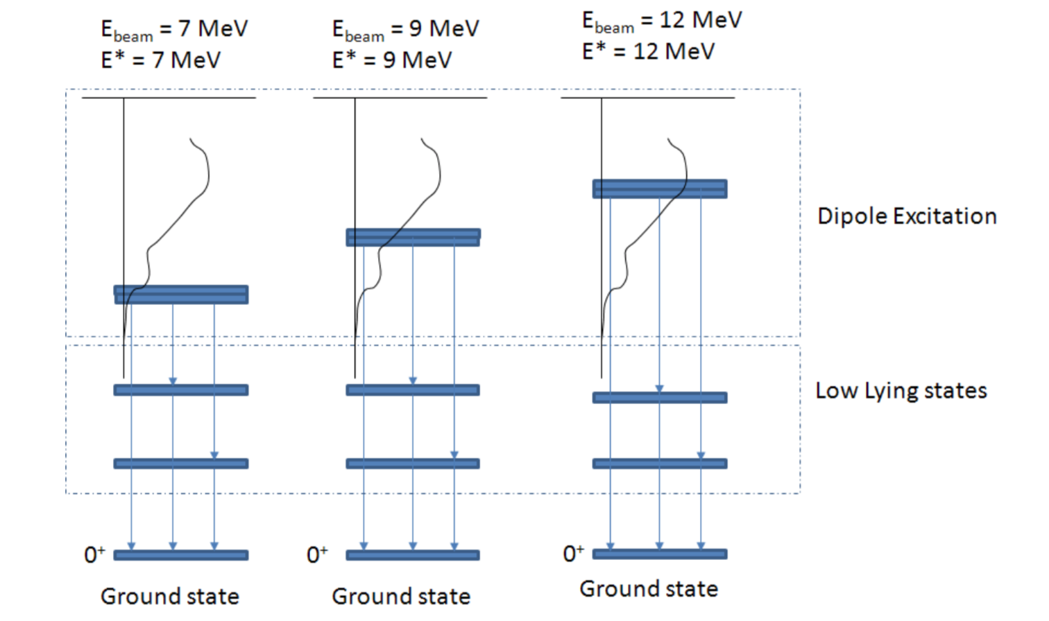
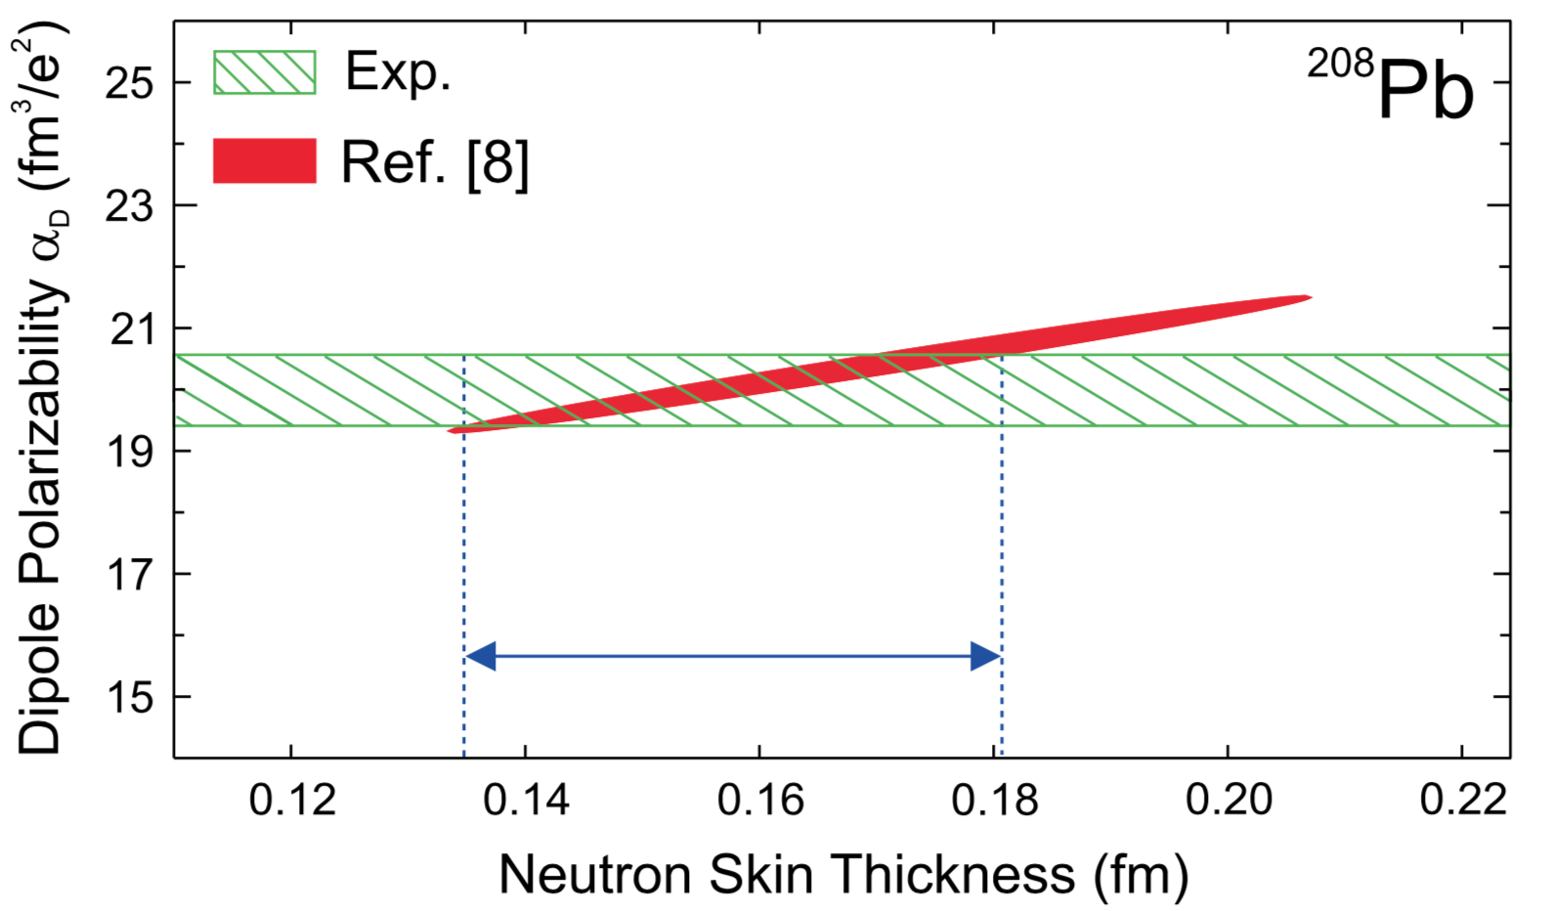
Perspective
Photonuclear reaction
  Giant Dipole Resonances (GDR)
  Pygmy Dipole Resonances (PDR)
  Gamma decay of GDR to low-lying states
Experiments at SLEGS
Symmetry Energy Slope
A. Tamii, et al., PRL 107, 062502 (2011)
Romanian Reports in Physics, 68, Supplement, S539 (2016) ELI-NP TDR

Slide 25
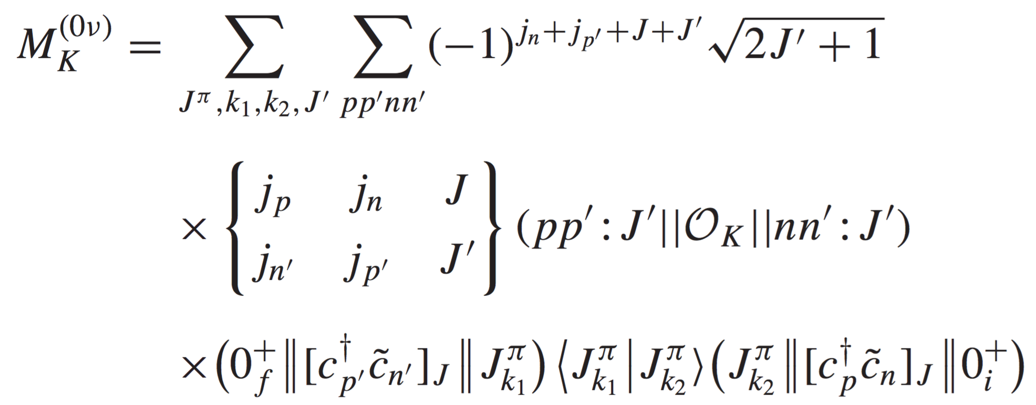
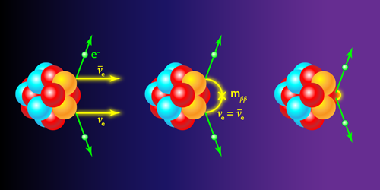
Perspective
Neutrino Physics
  Neutrinoless double beta decay
  Neutrino-nucleus scattering
Experiments at CJPL
Nuclear Matrix Element (NME) of 0νββ

Slide 26
Acknowledgement
Collaborators:
Sichuan University: Bai Chunlin
Lanzhou University: Long Wenhui, Sun Baoyuan
Peking University: Meng Jie
Anhui University: Niu Zhongming
IMP: Dong Jianmin, Fang Dongliang, Gan Zaiguo, Liu Zhong, Shang Xinle, Tang Xiaodong, Xu Nu, Zuo Wei
University of Milan: P. F. Bortignon(deceased), G. Colo, E. Vigezzi
University of Zagreb: N. Paar, D. Vretenar
RIKEN: T. Hatsuda, H. Z. Liang, H. Sagawa
ELI-NP: M. Krzysiek, D. Balabanski
Technical University of Munich: P. Ring
……

Slide 27
Thank you!

Slide 28
Cumulative Sum
Cumulative sum
Cumulative sum with normalized data
f=0 -> f=1
  low-lying strength is increased for both QRPA and QRPA + QPVC
QRPA -> QRPA+QPVC:
  better reproduces the exp. profile
  cumulative strength is quenched by 10% at E=25 MeV
  QRPA+QPVC strength ✕ 0.75 = exp. strength ((p,n) data) at E=25 MeV
Niu, Colo, Vigezzi, Bai, Sagawa, PRC 94, 064328 (2016)

Slide 29
QRPA+QPVC model
Step 1: HFB+QRPA calculation (non-charge-exchange) => vibrational phonons 1-, 2+, 3-, 4+, 5-
HFB+QRPA calculation (charge-exchange) => Gamow-Teller response in QRPA level
Particle-particle interaction
The QRPA equation will give the energy , and wavefunction
Step 2: QPVC calculation => Gamow-Teller response in QRPA+QPVC level
The QRPA+QPVC equation reads
Y. Niu, G. Colo, E. Vigezzi, C. Bai, and H. Sagawa, PRC 94, 064328 (2016)
where , and the matrices contain the spreading contributions, e.g.,
The GT strength function

Slide 30
Isoscalar Pairing
f = 0 : without isoscalar pairing
f = 1 : with isoscalar pairing
Effect of isoscalar pairing
QRPA level
  Increase the low-lying strength
  Decrease the splitting between two
  high-lying states
QRPA+QPVC level
  Increase the low-lying strength
  Similar profile
Y. F. Niu, G. Colo, E. Vigezzi, C. L. Bai, and H. Sagawa, PRC 94, 064328 (2016)

Slide 31
Spreading Terms
The matrix elements of the spreading term in the quasiparticle basis
where represents a doorway state, and a, b are quasi-particle states.
The vertex reduced matrix element:
Y. F. Niu, G. Colo, E. Vigezzi, C. L. Bai, and H. Sagawa, PRC 94, 064328 (2016)

Slide 32
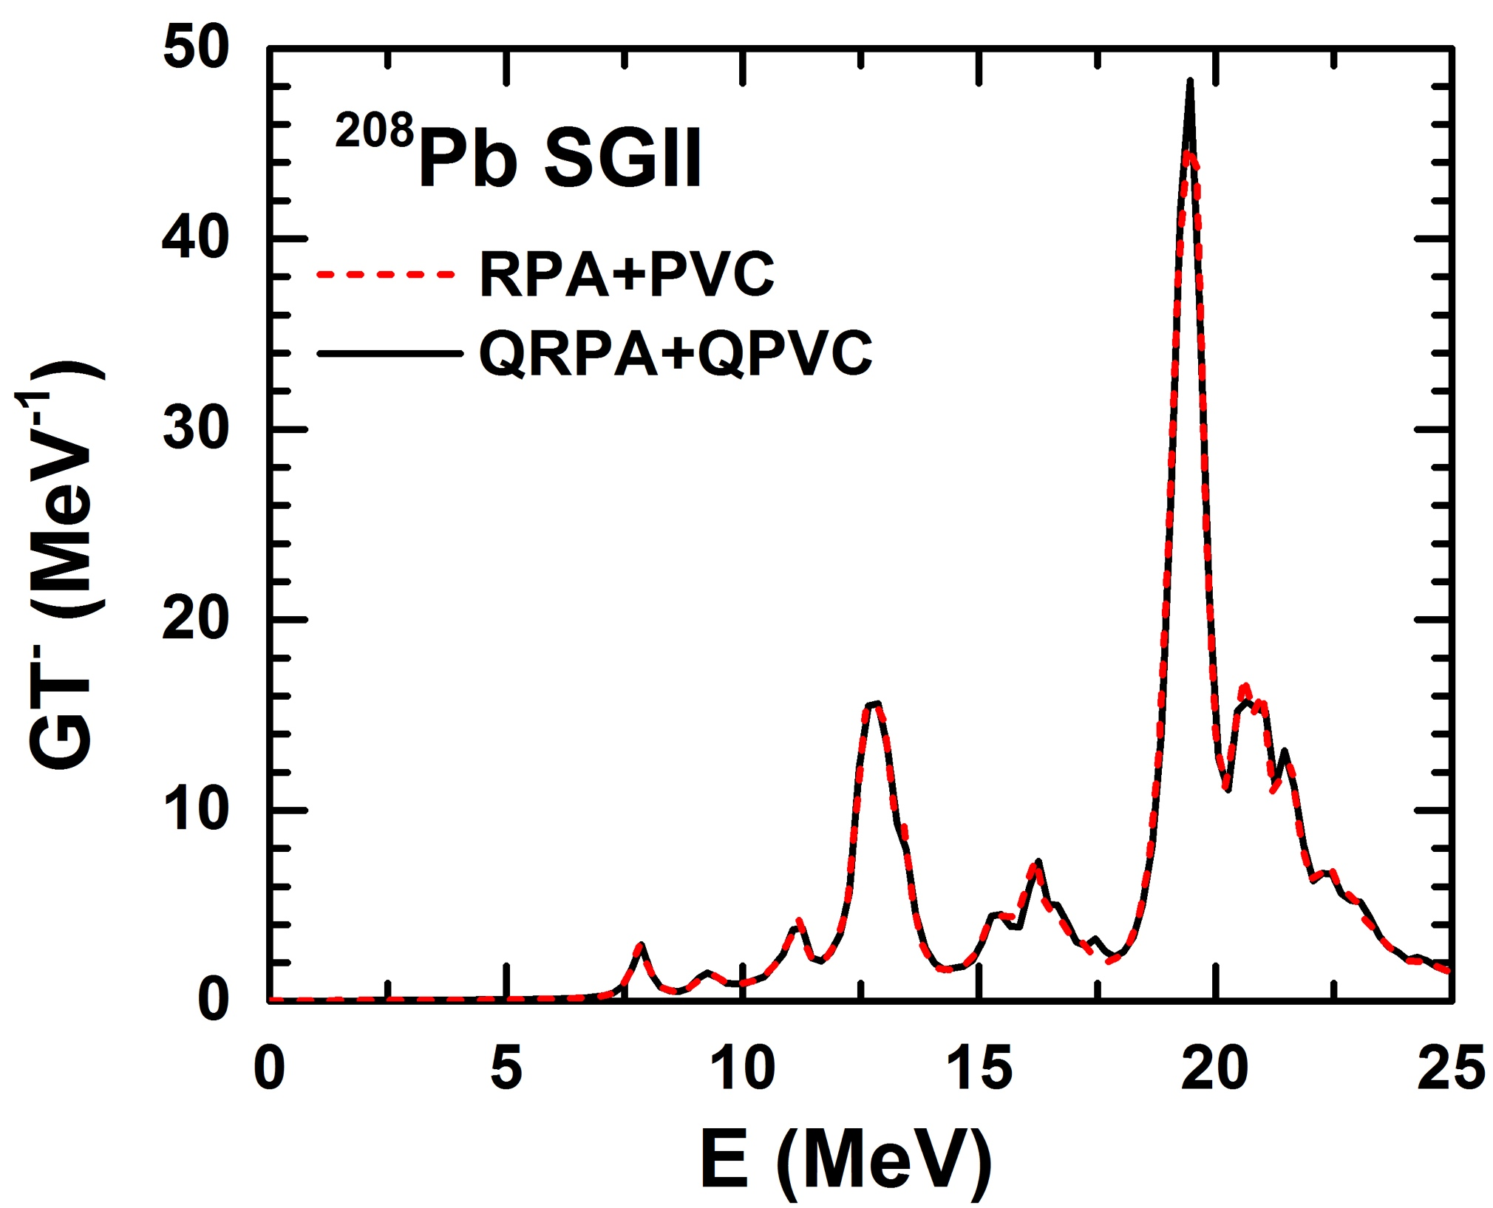
Numerical Check
Numerical Details
HFB Bennaceur, et al., CPC, 168 96 (2005)
  solved in coordinate space R = 20 fm rstep = 0.1 fm
  Surface pairing, which reproduces the exp. pairing gap 1.34 MeV
QRPA
  Ecut = 100 MeV, uv > 0.001 for quasiparticle configuration space

Slide 33
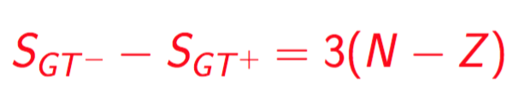
Sum Rule
Fulfillment of Ikeda Sum Rule for Gamow-Teller response at QRPA+QPVC level
Ikeda Sum Rule

Slide 34
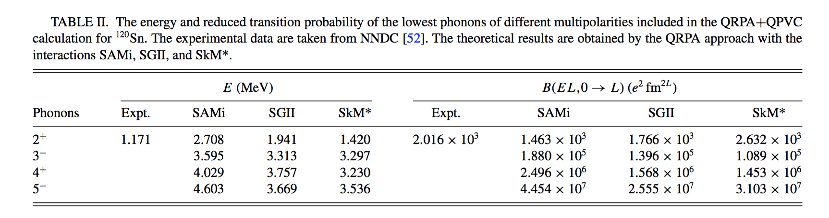
Phonon Properties

Slide 35
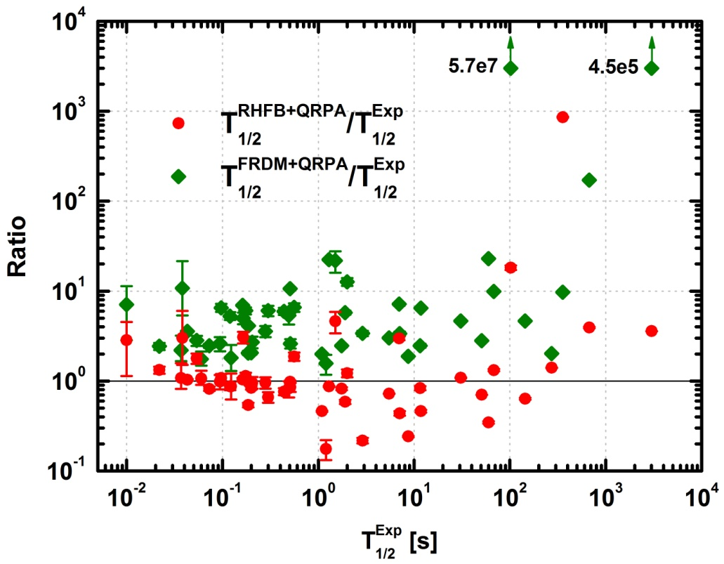
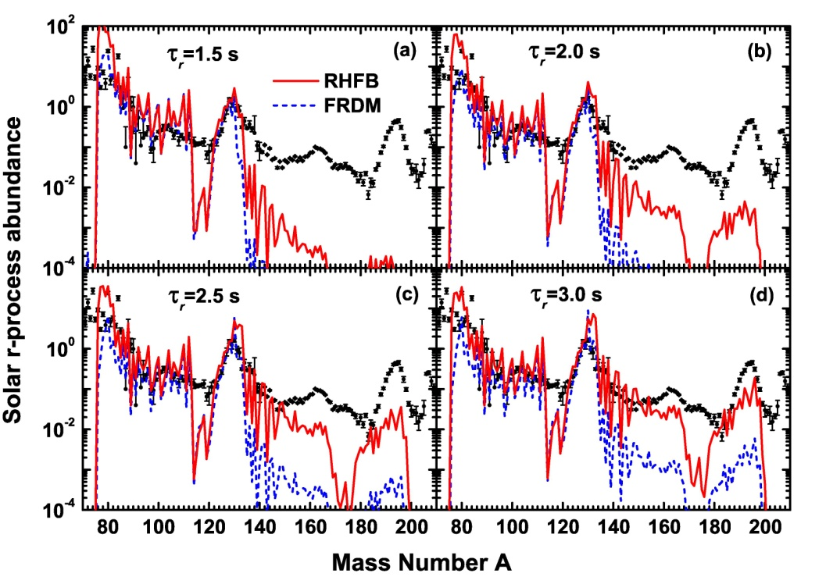
β- decay and r-process
β-decay half-lives
r-matter flow
Key nuclei: ¹³⁰Cd ¹³⁴Sn
FRDM: widely used nuclear inputs
RHFB: our self-consistent results
Faster matter flow
Z. M. Niu, Y. F. Niu, H.Z. Liang, W.H. Long, T. Nikšic, D. Vretenar, J. Meng, Phys. Lett. B 723,172 (2013)

