Slide 1
A Quick Guide to the new CEPC Software Framework
Zou Jiaheng
2019-04-01

Slide 2
Content
General introduction
Key concepts
Examples
Plan for CEPC

Slide 3
Offline Software System for HEP
Application layer
Basis layer
Common services
Software framework
External libraries and tools
ROOT
Generator
Simulation
Calibration
Reconstruction
Analysis
Geant4
EDM
Data I/O
Database
Geometry
Other
Tools & Svcs
etc.
Software Framework
The appearance of a system is mainly determined by the framework
Software architecture, organization, strategy
Software development standards, user interfaces
Framework: programming problems
Physicists: concentrate on calculation algorithms

Slide 4
Considerations on CEPC
Marlin: the framework at present
The developing is not very active now
Is not very modernized: hard to support parallel computing…
Gaudi
Very powerful, but very complex and heavy
A new framework developed by ourselves?
Integration with new technologies, such as parallel computing
Long Term and Rapid Supporting
Feasibility: we have the experience of SNiPER

Slide 5
The SNiPER Framework
Originally Developed for JUNO
Fulfill the requirements for neutrino experiments
Comprehensive and generality is considered at the beginning
A general purpose framework, not only for neutrino experiments
Functions as a Framework
Modularized, extensible, customizable, and friendly to use
High performance
Current Status
Has been used in JUNO, LHAASO, CSNS, nEXO
Is still being in developing for more application scenarios
https://github.com/SNiPER-Framework/sniper

Slide 6
Technical Overview of SNiPER
Hybrid of C++ and Python
C++ is used in key functions for better performance
Python is flexible: configuration, simple algorithms and services…
Binding with Boost.Python
Lightweight and Simple
Less dependencies: the kernel only depends on the boost library
Be simple to build, learn and use
The key ideology are similar to Gaudi (a lightweight Gaudi)
Similar concepts, such as algorithms, services
Minimize the cost of migration from Gaudi

Slide 7
Software Based on SNiPER
A compact kernel
The common functions for all experiments
SNiPER Kernel
A group of optional components
Functions for collider physics experiments
Functions for neutrino experiments
…
Optional Components
Special functions for each experiment
Data model
Algorithms
…
Special for Experiments

Slide 8
Prospect of a SNiPER Ecosystem
Functions for collider experiments
CEPC software
SNiPER Framework
JUNO software
SNiPER Kernel
Functions for neutrino experiments
LHAASO software
nEXO software
Etc…
Etc…
Be attractive to community developers
To find more application scenarios

Slide 9
Content
General introduction
Key concepts
Examples
Plan for CEPC

Slide 10
Key Concepts
DLElement: Dynamically Loadable Element
Task
Algorithm
Service
Tool
Data Memory Service
Incident
Property
Log (message output)
Each DLElement object has a unique string name(path)

Slide 11
Task
Similar to the Gaudi application manager
Management of algorithms, services and sub-tasks
Controlling the execution of algorithms
Has its own data memory management service
Has its own I/O management service
There can be more than one Tasks in a single job (e.g. event mixing)
All DLEs are organized in a tree structure
TopTask
Service
Algorithm
Task
Service
Algorithm
Task
Service
Algorithm
Task
Service
Algorithm
Service
Algorithm
Service
Algorithm

Slide 12
Algorithm in C++
A concept inherited from Gaudi
An unit of codes for Data Processing, (similar to marlin::Processor)
the event calculation during event loop
Most frequently used by users
AlgBase, the abstract base class in SNiPER
User’s algorithm must be inherited from AlgBase
Its constructor takes one std::string parameter as the object name
3 abstract interfaces must be implemented, they are called by SNiPER automatically
bool initialize() : called once per Task (at the beginning of a Task)
bool execute() : called once per Event
bool finalize() : called once per Task (at the end of Task)

Slide 13
Service in C++
A concept inherited from Gaudi
A piece of code for common uses
Such as RootIOSvc, GeometrySvc …
Be invoked by users, not limited to the event loop
Be initialized before algorithms in each Task
SvcBase, the abstract base class in SNiPER
A new service must be inherited from SvcBase
Its constructor takes one std::string parameter as the object name
2 abstract interfaces must be implemented
bool initialize() : called once per Task (at the beginning of a Task)
bool finalize() : called once per Task (at the end of Task)

Slide 14
Tool
A concept inherited from Gaudi
Tool is also a Dynamically Loadable Element
It belongs to an algorithm and helps the algorithm to organize code more clearly
One algorithm can have one or more tools
A tool can be accessed via its name

Slide 15
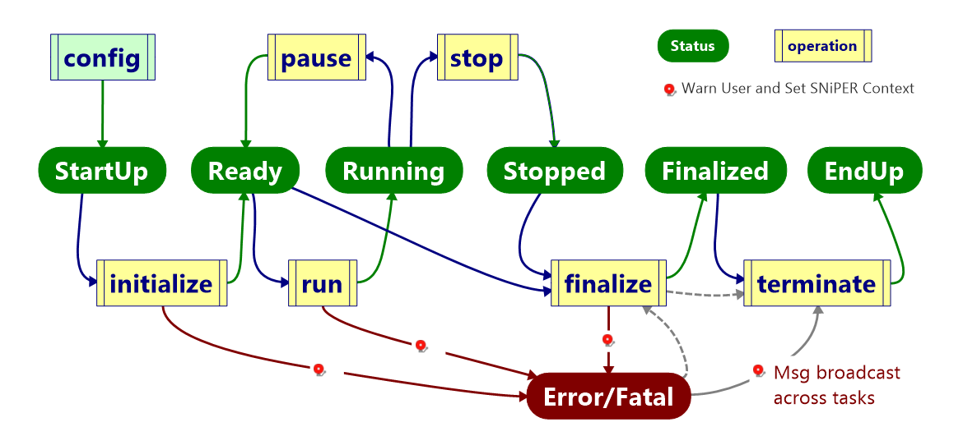
Task Execution
A state machine of the execution:

Slide 16
Data Processing with Task
Task means the event processing procedure (a event loop)
Task and SubTask provide a more flexible execution procedure
SubTask(s) are executed synchronously on demand
Can be used for different event loops
Multi-Thread Computing (run each task in an individual thread)
Task is a FSM (finite-state machine)
Startup
Ready
Running
Finalized
Endup
Event Loop
Algorithm 1
Executed on Demand
Algorithm 4
Executed on Demand
Algorithm 2
Algorithm 5
Algorithm 6
Algorithm 3
TopTask
SubTask
SubTask

Slide 17
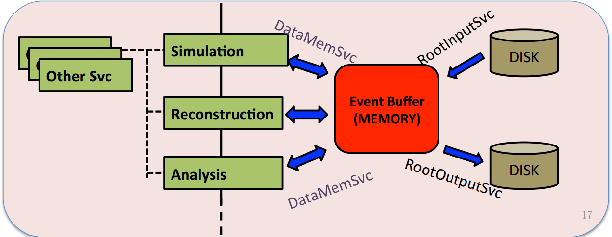
Data Memory Service
Data memory service is in charge of the dynamically allocated memory, by which to hold events data that being processed
Applications (in terms of algorithms) get events data via the data memory service and update them after processing
Task
Event Data

Slide 18
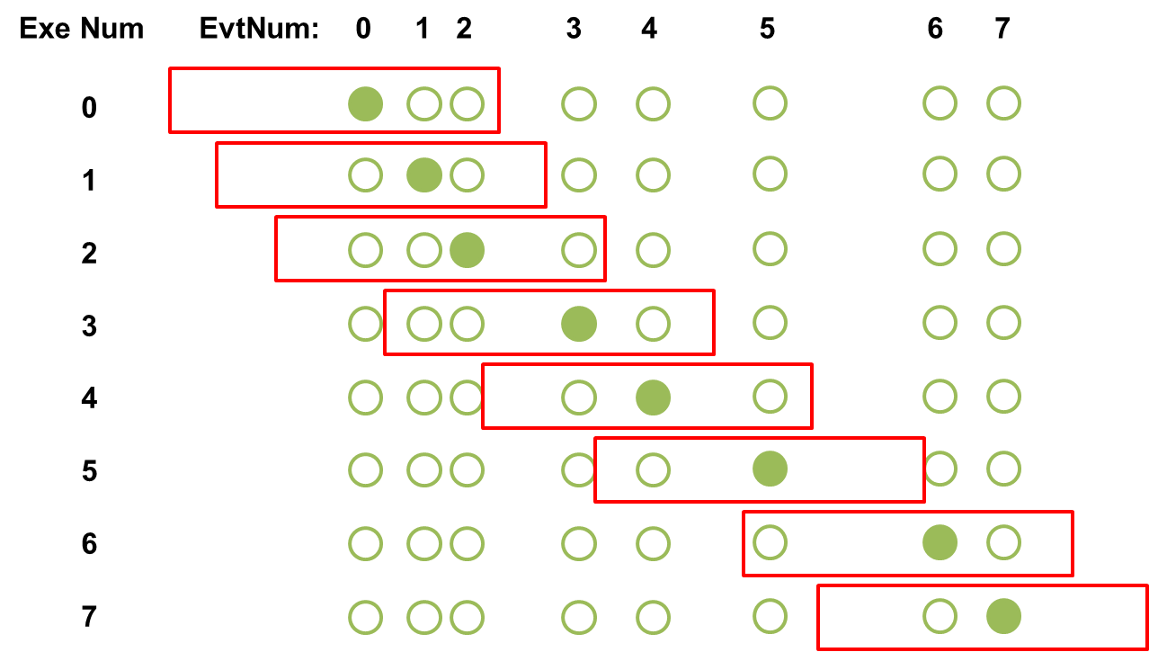
Optional Data Memory Services
Different type of experiments have different requirements
Several implementations to select
DataBuffer for neutrino experiments
A sequence of events in a time window
Be able to handle events correlations
PyDataStore: transfer data between C++ and Python
Writing algorithms in Python
Mixing execution of C++ algorithms and Python algorithms
Examples/HelloWorld
EventStore (to be implemented): similar to the TDS in Gaudi
Reset event by event automatically

Slide 19
Incident
Provides an additional degree of execution freedom:
Incident: trigger the execution of corresponding handlers
IncidentHandler: the wrapper of any specific procedure
Regular Procedure
Extra Procedure
IIncidentHandler
Incident
1, fire()
IIncidentHandler
handle(Incident&)
regist(string)
string name()
fire()
handle(Incident&)
regist(string)
2, handle()
Regular execution procedure jumps to another extra procedure
Back to the original procedure after all corresponding Handlers are executed
We can fire an incident anywhere according to the requirements
It’s easy to define and use a customized incident

Slide 20
Incident Management
IncidentMgr correlates incidents with their handlers
Incidents are distinguished by its name, such as “BeginEvent”, “EndEvent”
One IncidentHandler can be registered to several Incidents
One Incident can be handled by several IncidentHandlers
Currently Event I/O and SubTask execution are based on incident mechanism
Incident
IIncidentHandler
string name()
fire()
handle(Incident&)
regist(string)
IncidentMgr
handle(Incident&)
Incident::name()
Handler
name1
Handler
Handler
name2
Handler

Slide 21
Property
Configurable variable at run time
Declare a property in DLElement (C++ code)
Configure a property in Python script
Types can be declared as properties:
scalar: C++ build in types and std::string
std::vector with scalar element type
std::map with scalar key type and scalar value type
This mechanism is also used to create and load algorithms and services:

Slide 22
Logs
SniperLog: simple and thread-safe, supports different output levels
0: LogTest
2: LogDebug
3: LogInfo
4: LogWarn 5: LogError
6: LogFatal
Each DLElement has its own LogLevel and can be set at run time
very helpful for debugging
The output message includes more information
where it happens
the message level
The message contents

Slide 23
Parallel Computing
Current Status of MT-SNiPER
Run each SNiPER Task in a separated thread
Based on Intel TBB, implemented the prototype SniperMuster
Non-invasive, no change to the SNiPER kernel module
Almost be transparent to users, easy to migrate from serial apps
The testing of JUNO simulation shows a reasonable result
Next
More general
Parallel algorithms
MPI

Slide 24
Content
General introduction
Key concepts
Examples
Plan for CEPC

Slide 25
Create an Algorithm and a Service
Package management
C++ and Python coding
CMT configuration
Compile and run
Advanced topic: a job with multiple-tasks
svn co http://juno.ihep.ac.cn/svn/juno/people/zoujh/example/FirstToy

Slide 26
Coding and Running
FirstToy C++
FirstAlg, our first algorithm
Show different level of logs
FirstSvc, our first service
A string message as property (can be modified in python)
An interface to print the string message (answer())
SecondAlg
Call the service in an algorithm
FirstToy Python
Compile with CMT (or CMake), and run in Python
vs.

Slide 27
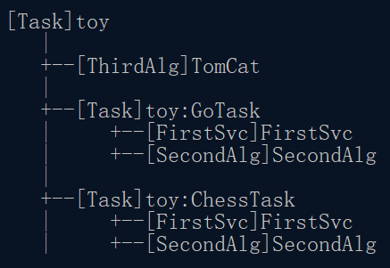
Advanced Topic: multiple-tasks job
The DLElement Map of
ThirdAlg + SecondAlg + FirstSvc + Task
SubTask(s) are executed on demand
Odd execution of toy::TomCat
Event Loop
[SecondAlg]
Tomcat
[ThirdAlg]
TomCat
[Task] GoTask
Even execution of toy::TomCat
[SecondAlg]
Tomcat
[Task] toy
Details can be found in ThirdAlg of FirstToy
[Task] ChessTask

Slide 28
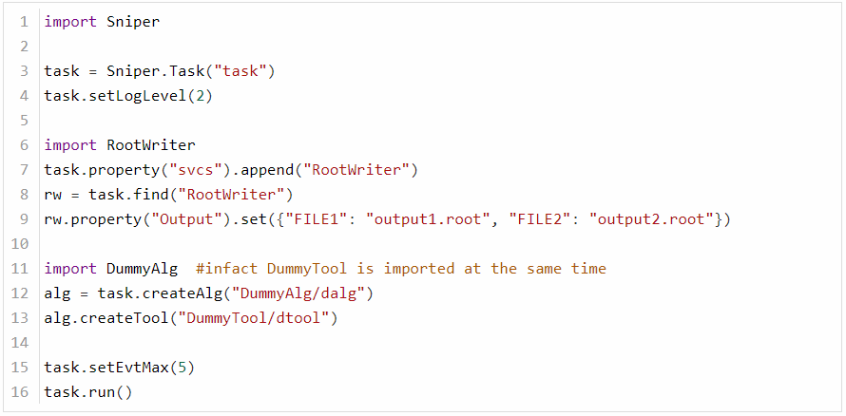
Configuration with Python
Execute a dummy algorithm in SNiPER, create 2 root output files:
Examples/DummyAlg/share/run.py
Each job must has at least 1 Task instance
Create and set the RootWriter service
Create a DummyAlg instance with a DummyTool
Set event number and begin the execution

Slide 29
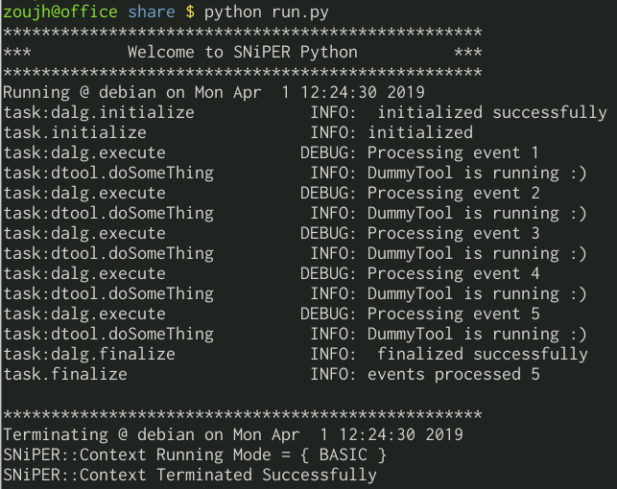
Execution with Python
Startup
Initialization
Event loop
Messages for each event
Finalization
Endup

Slide 30
Plans for CEPC
Common Functions
EventStore for Collider Physics Experiments
Data Model: be similar to the LCIOEvent, but ROOT based
Data (ROOT format) I/O Services
Before the end of April 2019 ?
Convert the existed LCIO data to ROOT data for analysis
Other services and algorithms
Geometry service based on DD4hep
marlin::Processor -> Sniper Algorithm migration should be easy
Keep similar interfaces, such as data model and geometry

Slide 31
Thanks for your attention
Any questions?

