Slide 1
MOST2 PLL Weekly Report
Xiaoting Li
IHEP
April 1, 2019

Slide 2
Two issues
PIN definition
Central frequency of PLL (or VCO)

Slide 3
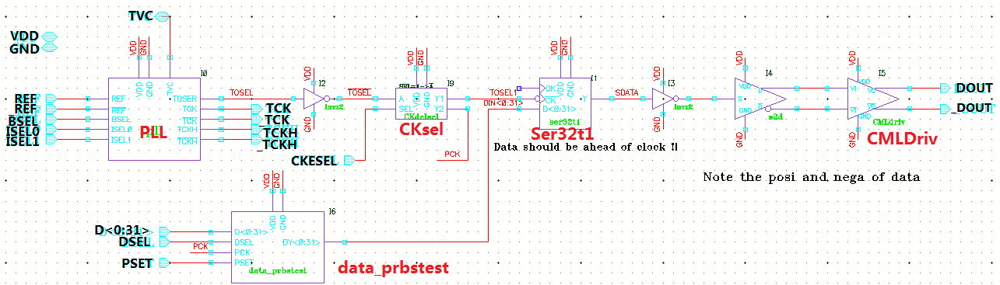
IO definition
160Mbps
40MHz
80MHz
80MHz
80MHz
5Mbps
5Mbps
IO Name | Description | IO Name | Description
BSEL | Loop bandwidth Configuration | VDD/GND | Power
ISEL0 | Charging Current Configuration | REF/_REF | Differential input clock (LVDS)
ISEL1 |  | DOUT/_DOUT | Serial-data outputs (CML)
CKESEL | Clock delay selection | TCK/_TCK | Low-speed test clock of PLL (LVDS)
DSEL | Input data selection | TCKH/_TCKH | High-speed test clock of PLL (CML)
PSET | PRBS initial setting |  | (↑ Remove one pair of TCK/_TCK and TCKH/_TCKH, if IOs are not enough)
TVC | Control voltage test port
Total | 7 | 10+
Top schematic
Enough IOs for PLL_Ser?

Slide 4
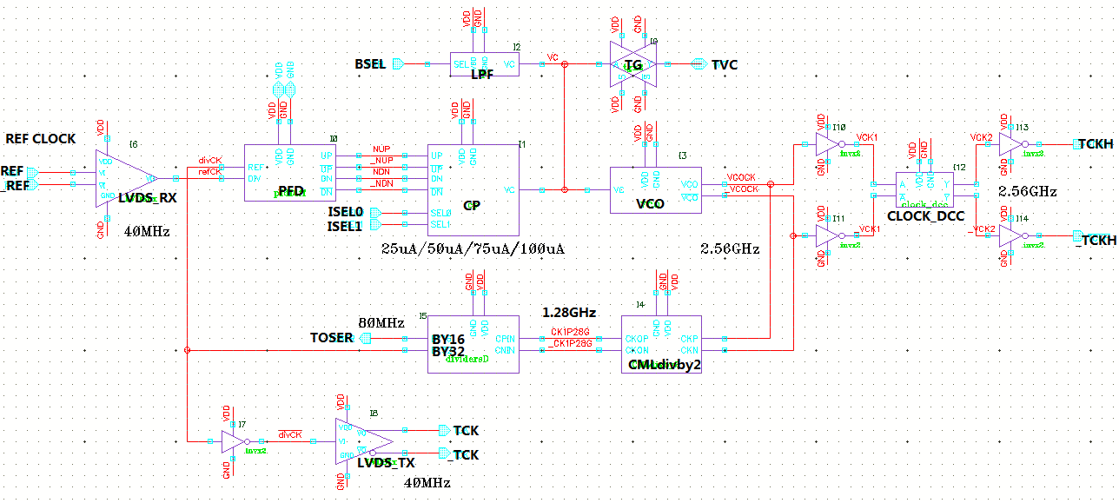
PLL top sch
÷64
Unfinished blocks
  LVDS RX、TX
  VCO: 2.56 or 1.28 GHz
  LPF
If working at 1.28GHz
  Just remove CMLdivby2
DFF-based dividers
2.52 GHz max @SS 85

Slide 5
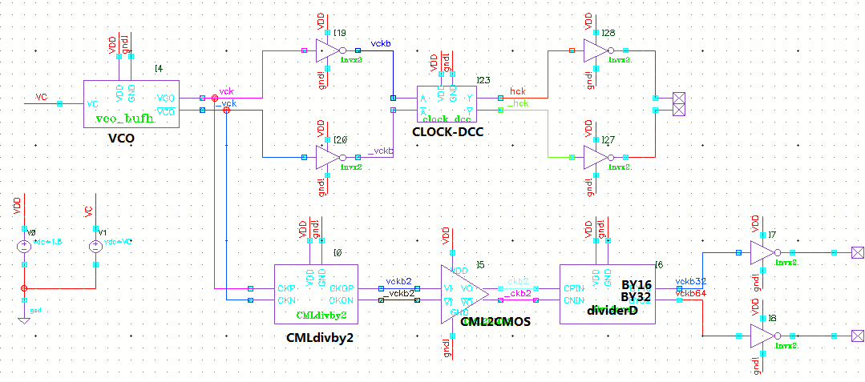
VCO test bench
For the convergence issue in simulation
  Remove dividerD
  Remove CMLdivby2, using capacitance loads instead
 |  | TT -40 | TT 27 | TT 85 | FF -40 | FF 27 | FF 85 | SS -40 | SS 27 | SS 85
Pre-sim | Freq (GHz) @VC=0 | 4.258 | 3.835 | 3.534 | 4.800 | 4.342 | 4.011 | 3.962 | 3.548 | 3.257
 | Ivco (mA) | 18.166 | 16.574 | 15.506 | 22.047 | 20.272 | 19.033 | 15.730 | 14.225 | 13.235
 | DC@ckb2 | 44.45% | 42.97% | 42.12% | 42.40% | 42.50% | 42.78% | 42.62% | 44.76% | 44.92%
 | DC@A3 in clock_dcc | 52.74% | 52.64% | 52.52% | 52.50% | 52.37% | 52.20% | 52.70% | 52.53% | 52.37%
Post-sim (VCO DFF INV) | Freq (GHz) @VC=0 |  | 2.849 |  |  |  |  |  |  | 2.432
 | Ivco (mA) |  | 16.252 |  |  |  |  |  |  | 13.067
 | DC@A3 in clock_dcc |  | 51.32%

Slide 6
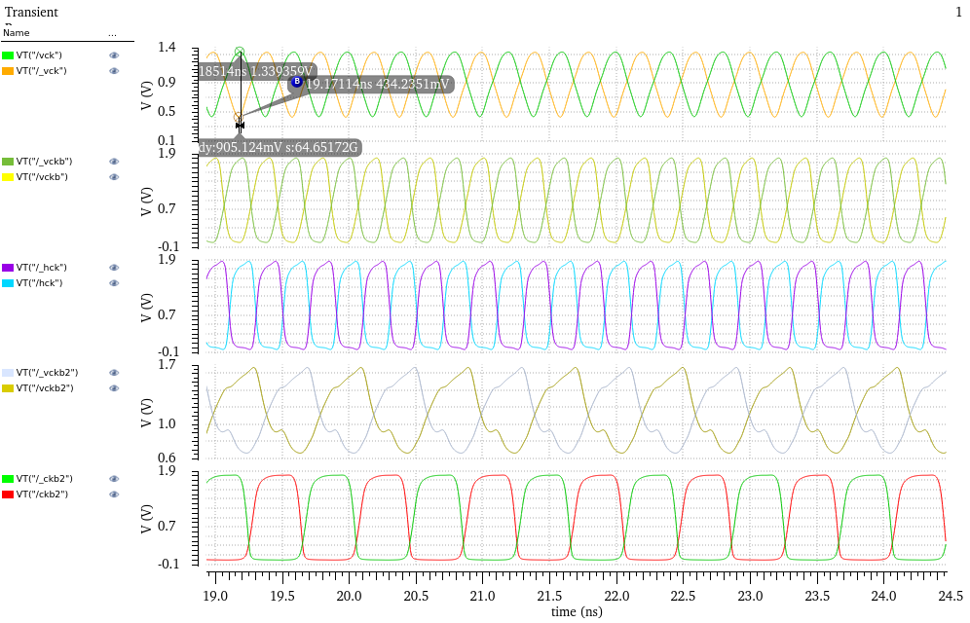
VCO with a half size buffer as the last stage
Maximum frequency is 2.49GHz @ SS 85
Phase noise is about -62.3 dBc/Hz, that’s too big; but in the preliminary simulation, it’s smaller than -90dBc/Hz
The single-end output swing of VCO is about 905 mV, that’s not a full-range swing
The following dividers work fine
Duty cycle distortion
Big DC variation between different process corner and temperature, hard to compromise by adjusting threshold of INV-buffers
Affect the high-frequency performance
  Big-small-eye issue in eye diagram
DCC circuit
VCO out
Before DCC
After DCC
After CMLby2
After CML2CMOS

Slide 7
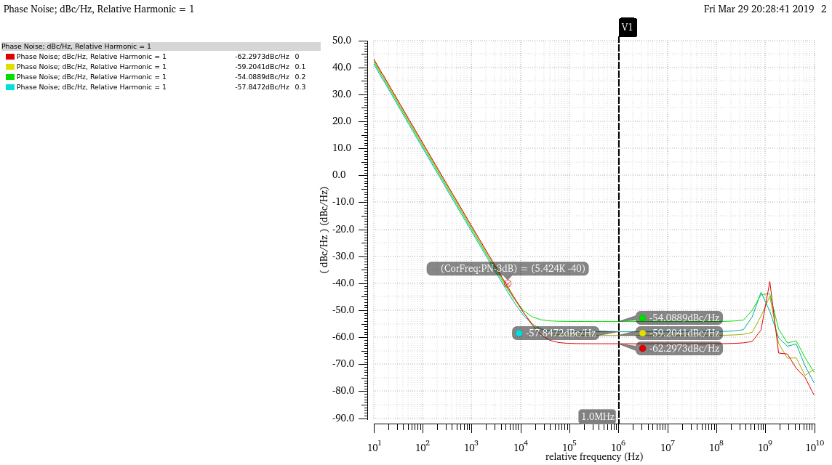
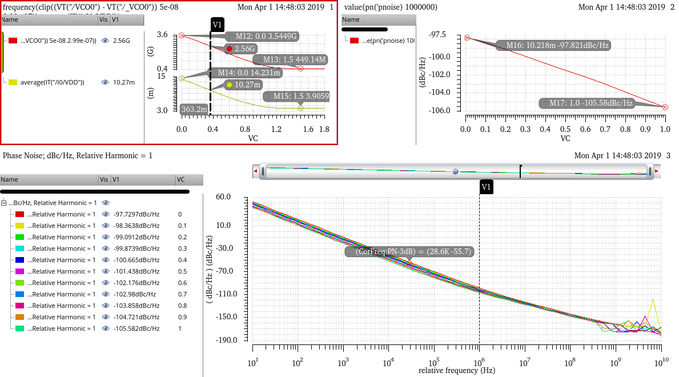
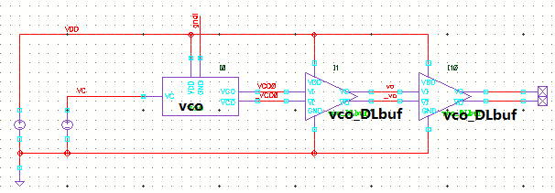
Phase Noise issue
Phase noise curve
VF-Curve
PN@1MHz
offset
Iavr
ss 85 post-sim
Phase noise curve
ss 27 pre-sim
Test bench 2

