Slide 1
CgemGeomSvc检查
孙童 赵康

Slide 2
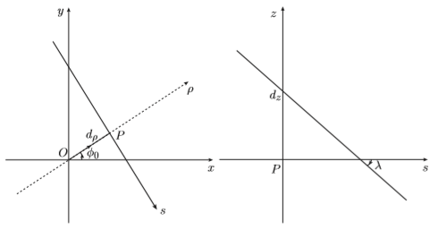
Parameters
$$d_{ρ} φ_{0} Z_{0} tgλ$$
posDown[3] posUp[3]
Phi V
y
$$z$$
$$\frac{L}{2}$$
x
V
$$ϕ$$
$$α$$
$$−\frac{L}{2}$$

Slide 3
task
$$d_{ρ} ϕ_{0} Z_{0} tgλ$$
$d_{ρ} ϕ_{0} Z_{0} tgλ$ $∆x ∆y ∆z Rz$
m_geomSvc->getMidDriftPtr()->getPointIdealGeom()
m_geomSvc->getMidDriftPtr()-> getPointAligned()
posUp posDown phiVUp phiVDown
posUp posDown phiVUp phiVDown
Track parameters after transform
1. alignment参数都为0时，理想几何 和 alignment后的探测器与径迹交点值是否一致
2. alignment参数非零时，检查alignment后的径迹与CGEM交点的值以及径迹参数是否正确

Slide 4
流程图
$$d_{ρ} ϕ_{0} Z_{0} tgλ$$
StraightLine.xAtR(double R, direction)
posDown,posUp
调用：m_geomSvc->getMidDriftPtr（）->getPointIdealGeom()
xyzToPhiVIdealGeom(int layer, HepPoint3D pos, double phiV[])
posUp posDown phiVUp phiVDown
phi, V

Slide 5
流程图
CgemGeoAlighn.StrightLineConversion(int layer,StrightLine Pline)
$d_{ρ} ϕ_{0} Z_{0} tgλ$ $∆x ∆y ∆z Rz$
New straignt line paramenters
StraightLine.xAtR(double R, direction)
m_geomSvc->getMidDriftPtr-> getPointAligned()
posDownLocal,posUpLocal
xyzToPhiVIdealGeom(int layer, HepPoint3D pos, double phiV[])
posUp posDown phiVUp phiVDown
Track parameters after transform
point_invTransform(int layer, HepPoint3D pos)
phi, V
posUp,posDown

Slide 6
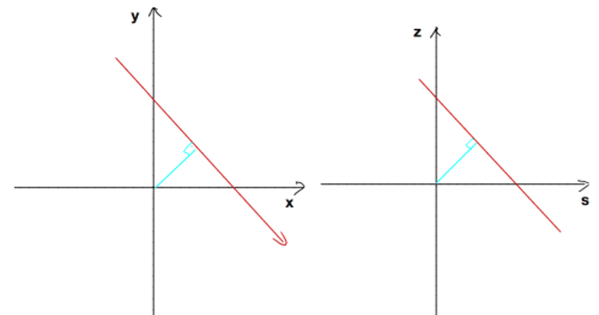
dr=0.707107 phi0=0.785398 dz=1 tanl=-1
global , local: straignt line function , circle function,dz,lamda
getXYZ()
Straight line function and circle function
Local:(x,y,z)
posUp,posDown:(x,y) 圆心与直线的垂足的坐标
$$ϕ$$
atan2(y,x),
ss
phi
s-z plane: posUp[2],posDown[2]
$ϕ$–z plane: V
global: (x,y,z)

Slide 7
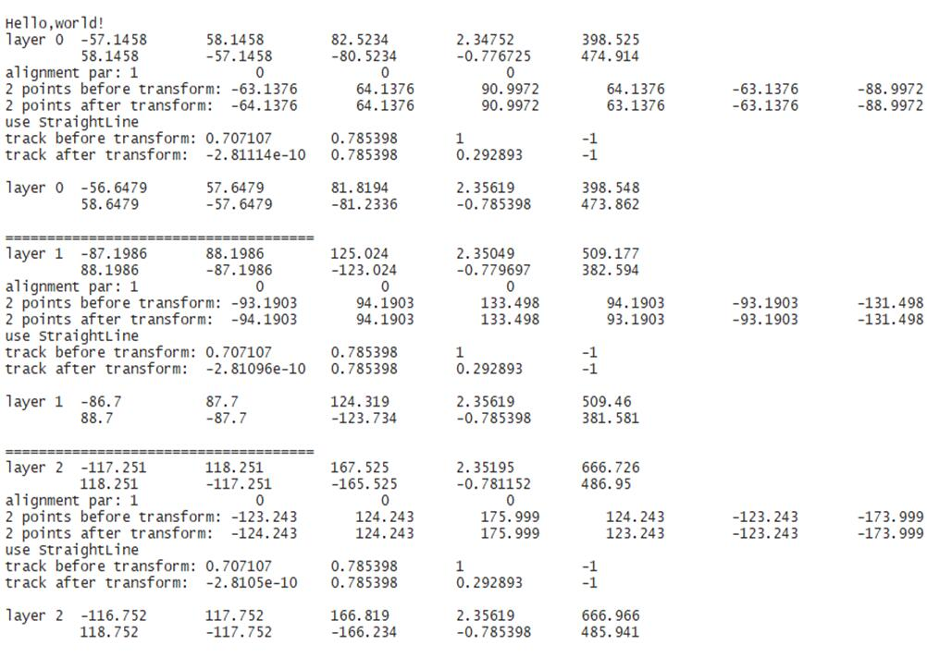
Alignment parameter deltX=1

Slide 8
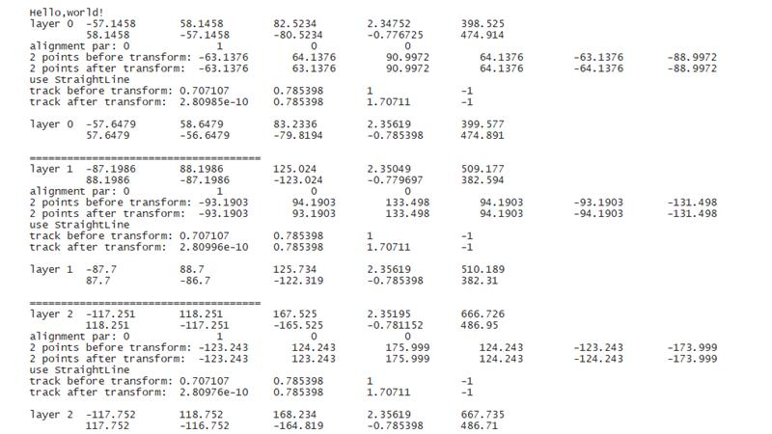
deltY=1

Slide 9
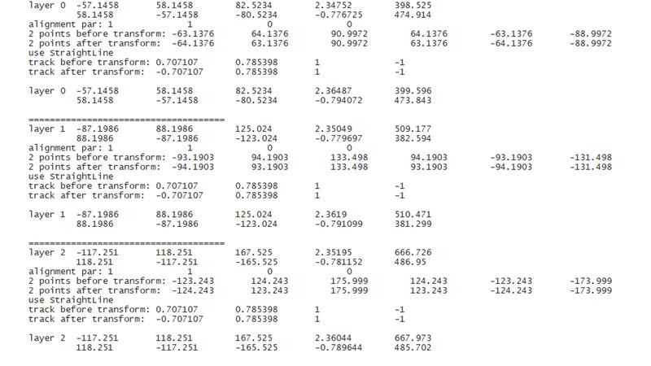
deltX=1, deltY=1

Slide 10
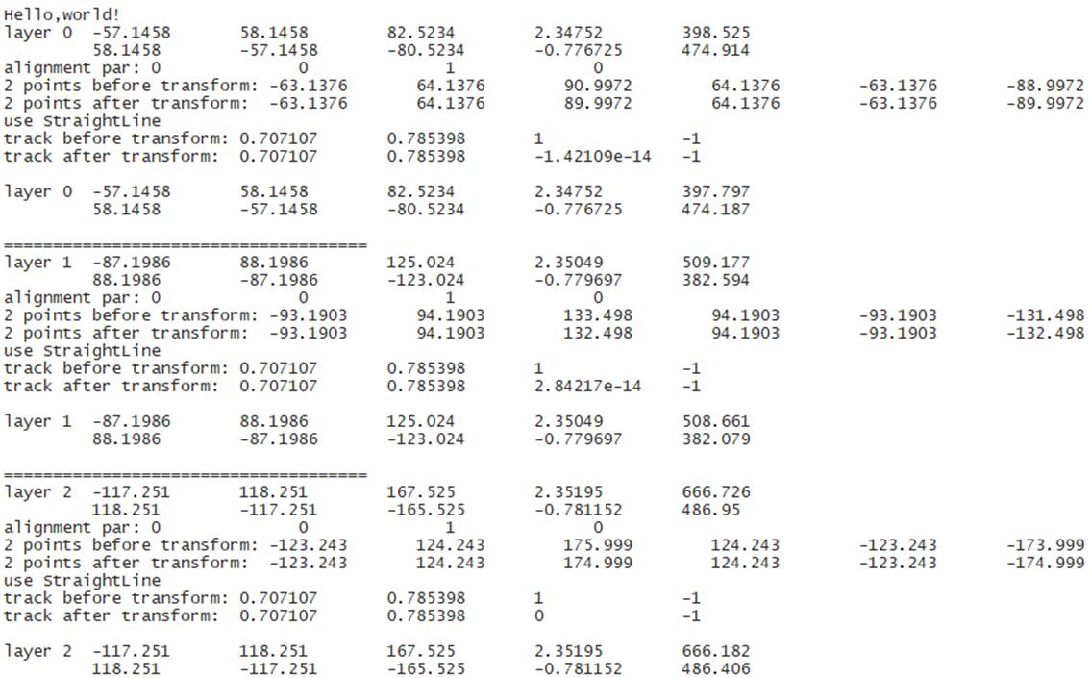
deltZ=1

