Slide 1
2019 International Summer
School of TeV Experimental Physics
Exam Group 3
Reporter:Licheng Zhang
Peking University
Yulei Zhang Cunyang Que Caigan Xi Yifeng Zou Keqing Zhang Jiachao Liu Yuzhu Huang He Zhou Fei Li Qifan Dong Hao Guo Qingtao Man
20/07/2019

Slide 2
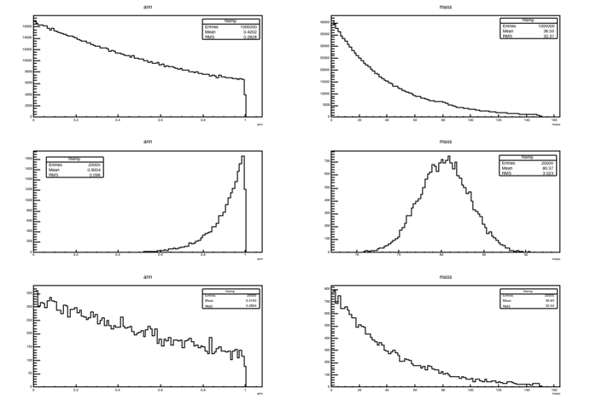
Data
Signal
Background

Slide 3
Task1: Event Selection
Find the cuts using“MC tree”
Find cuts using“tree_mc_sig”
Keep 90% of the signal
Evaluate the background rejection rate
Definite power
Optimize cuts using power(90% std)
Find better cuts
Task2: Fit to the Data
Find mass peak
Apply cuts into “tree_data”
Separate signal and background
Define a composed function(Gaus&Expo) to fit the signal
Fit and Find Peak

Slide 4
Signal
Find cuts
Background
Evaluate and Optimized
using power
Data
Apply cuts
Fit

Slide 5
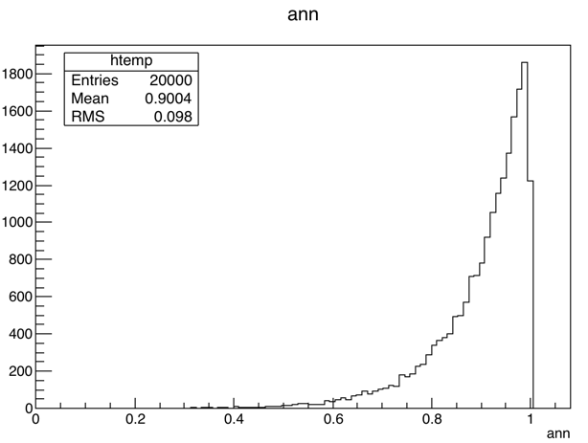
cut_min
cut_max
90%
Tree_mc_sig_ann

Slide 6
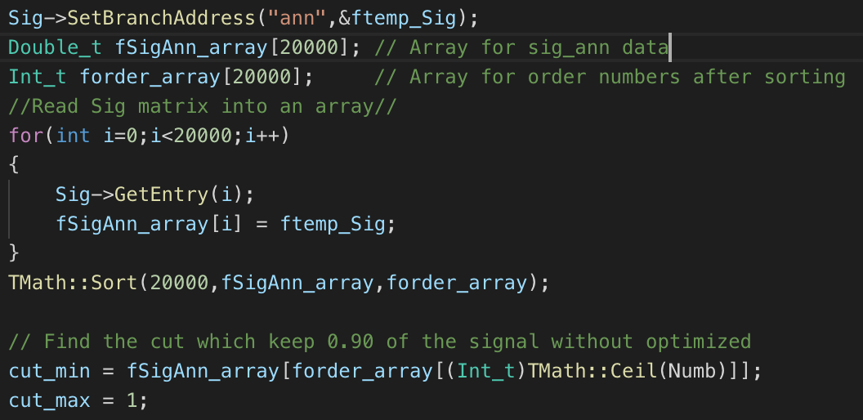
SigAnn_array
Sort
Cut
0.66
1.00
1.00
0.12
0.99
0.99
0.33
0.98
0.98
18k
20k
0.66
0.04
0.04
0.12
0.01
0.01
2k
0.33
0.00
0.00
cut_min = 0.772879
cut_max = 1.000000

Slide 7
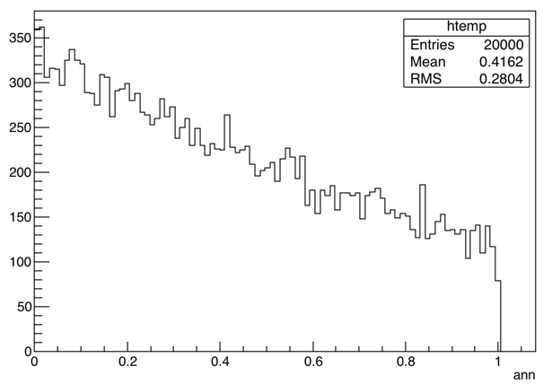
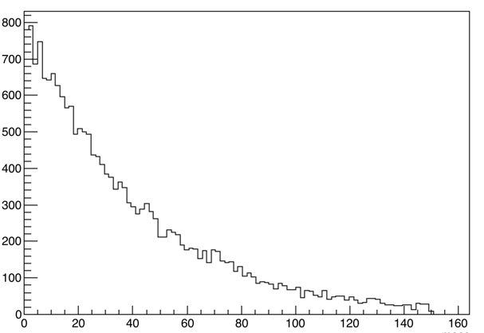
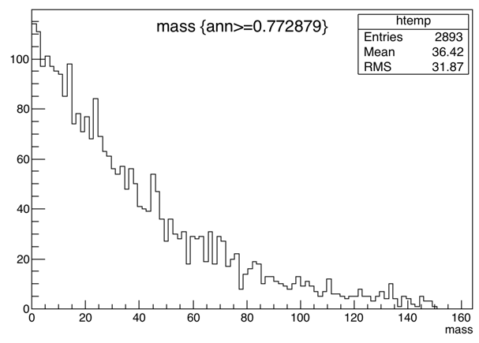
Tree_mc_bkg_ann
2893 remaining
85.535%

Slide 8
cut_min
cut_max
90%
Tree_mc_sig_ann

Slide 9
cut_min
cut_max
90%？
Tree_mc_sig_ann

Slide 10
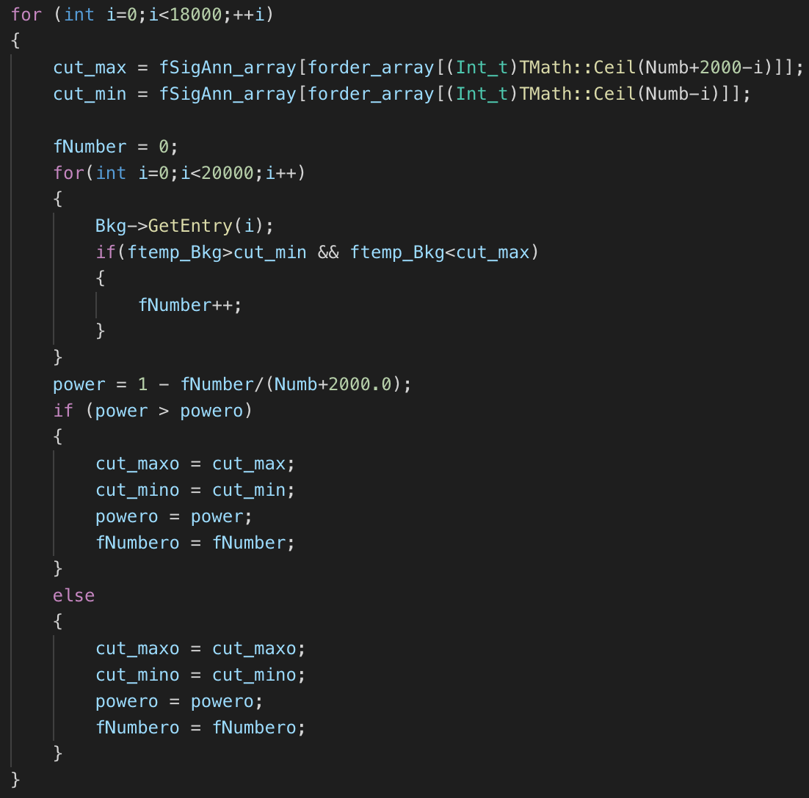
Cut1
Cuti
Cut18000
1.00
1.00
i
1.00
0.99
0.99
0.99
2k
0.98
0.98
0.98
18k
18k
18k
0.04
0.04
0.04
0.01
2k
0.01
2k-i
0.01
0.00
0.00
0.00

Slide 11
Tree_mc_bkg_ann
cut_min = 0.761967
2748 remaining
86.26%
cut_max = 0.987218
power = 86.26%

Slide 12
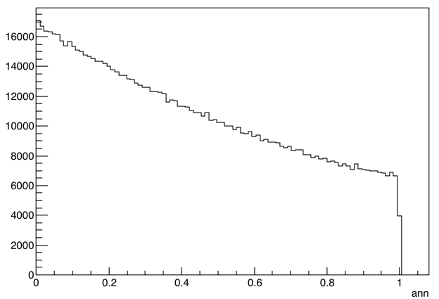
cut_min
cut_max
Tree_Data_ann
cut_min = 0.761967
cut_max = 0.987218
power = 86.26%

Slide 13
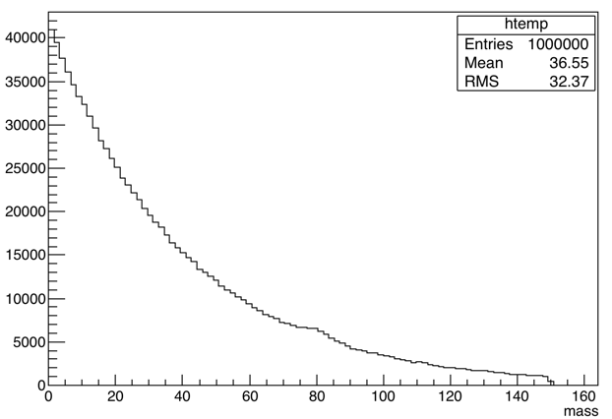
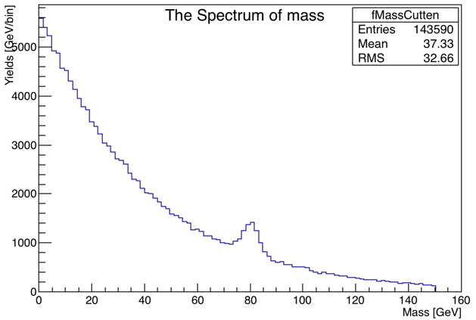
Fit

Slide 14
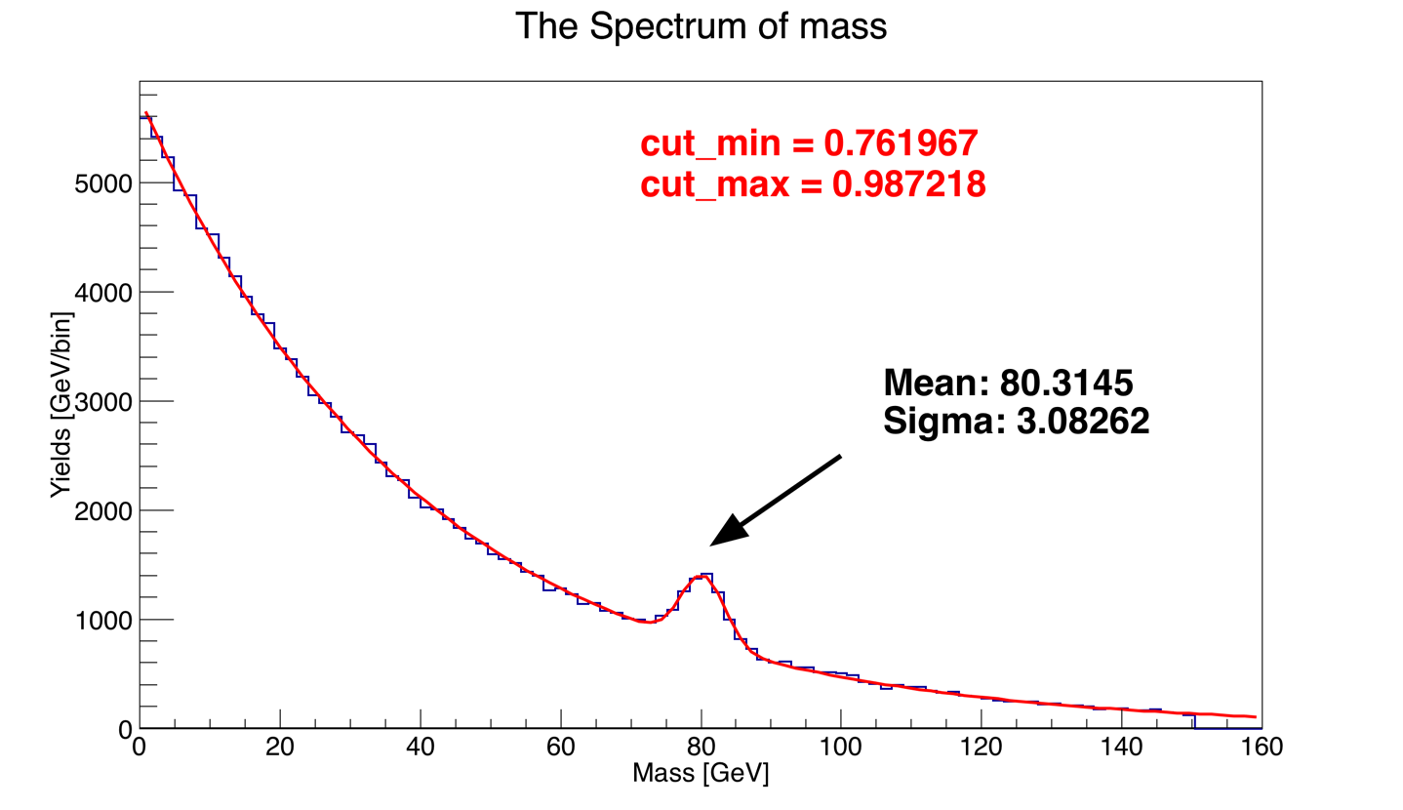

Slide 15
[0]*exp([1]+[2]*x)+[3]*TMath::Gaus(x,[4],[5])

Slide 16
Optimize without the limit of 90%
Analyze and Optimize using Significance

Slide 17
2019 International Summer
School of TeV Experimental Physics
Exam Group 3
Thank You
Yulei Zhang Cunyang Que Caigan Xi Yifeng Zou Keqing Zhang Jiachao Liu Yuzhu Huang He Zhou Fei Li Qifan Dong Hao Guo Qingtao Man
Reporter:Licheng Zhang
Peking University
20/07/2019
17

