Slide 1


Slide 2
Study of J/ψ Decays into $π^{0}X$
Farzana Younas, Haris Rashid, Abrar Ahmad Zafar, Talab Hussain
Centre for High Energy Physics, University of the Punjab, Lahore, Pakistan

Slide 3



Introduction
Three light flavored two body decays of J/ψ have been discussed
1.
2.
3.

Slide 4

motivation
To explore about
1. Leads towards $ρπ puzzle$
2. Strangeness violating decay of
3. Iso-spin violation of

Slide 5


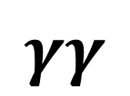
Study of
π+ π-
$$γγ$$

Slide 6
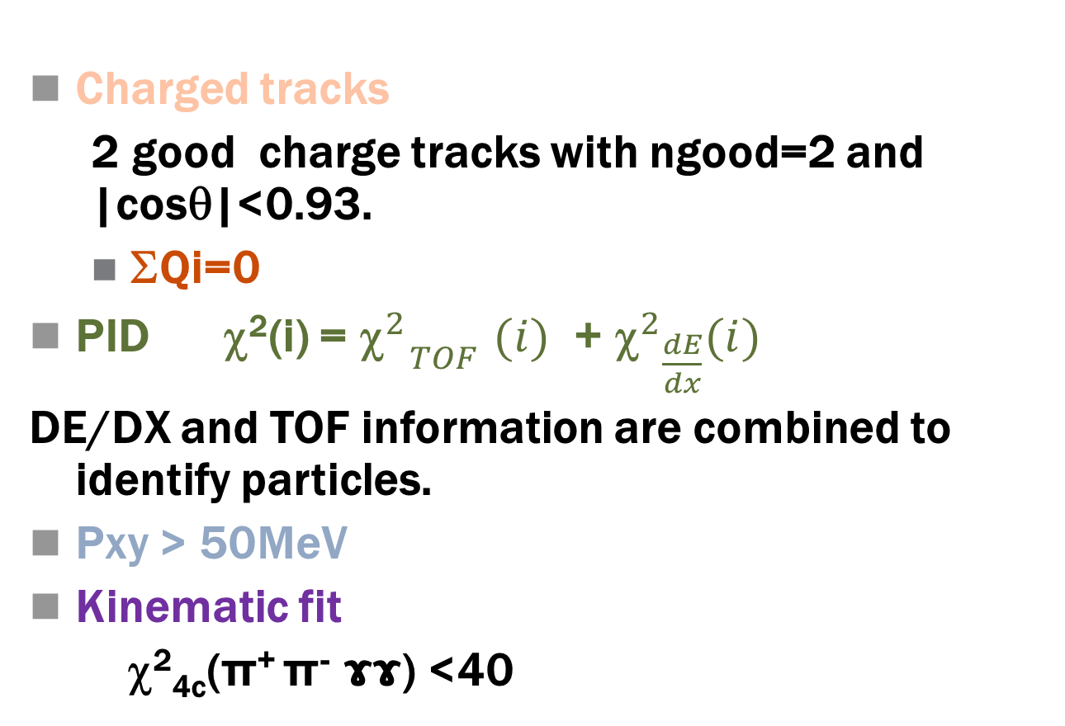
Events Selection
Charged tracks
  2 good charge tracks with ngood=2 and |cosθ|<0.93.
  ΣQi=0
PID χ²(i) = ${{\text{}}^{2}}_{TOF}^{}$ $(i)$ + ${{\text{}}^{2}}_{\frac{dE}{dx}}^{}(i)$
DE/DX and TOF information are combined to identify particles.
Pxy > 50MeV
Kinematic fit
χ²_{4c}(π⁺ π⁻ ɤɤ) <40

Slide 7
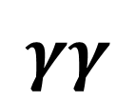
Analysis of
π+ π-
$$γγ$$

Slide 8

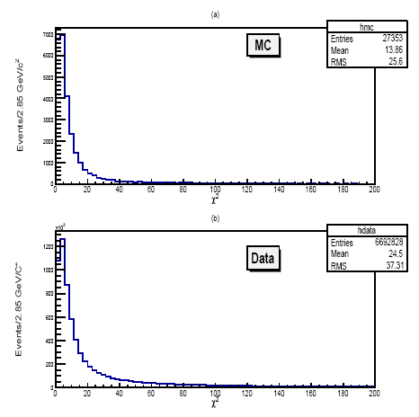
^{distribution}

Slide 9


Selection of $ρ^{0}$ and $π^{0}$
To find $π^{0}$ and $ρ^{0}$ at the same time for all possible $π^{0}ρ^{0}$combinations that can pass fitting.

Slide 10
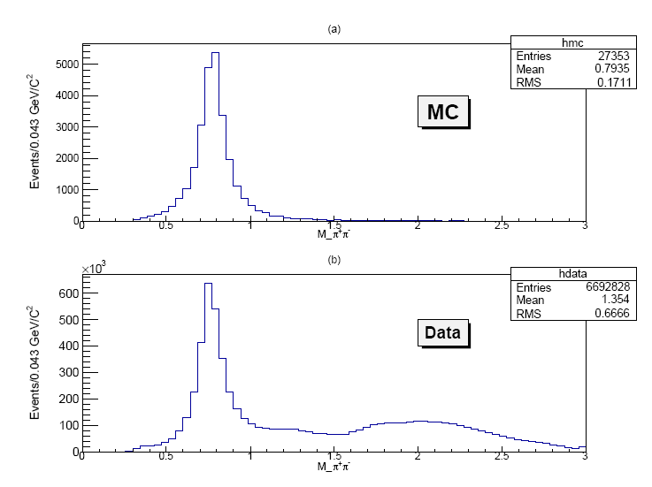
Invariant mass ${ M(π}^{+}$ $π^{−})$

Slide 11
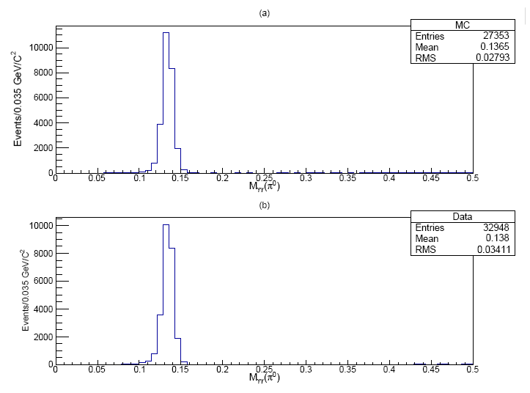

Invariant mass of $γγ(π^{0})$

Slide 12
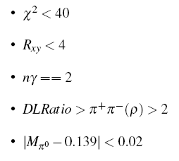
Final event selection criteria

Slide 13
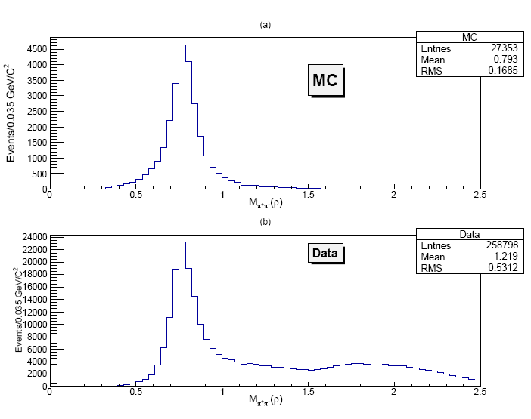

Invariant masses of${ π}^{+}$ $π^{−}$(MC & Data) after final selection criteria

Slide 14
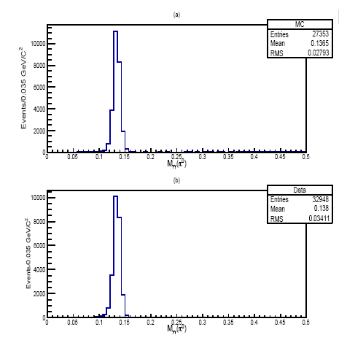

Results for invariant mass M$γγ$ ($π^{0}$)after final Event selection

Slide 15
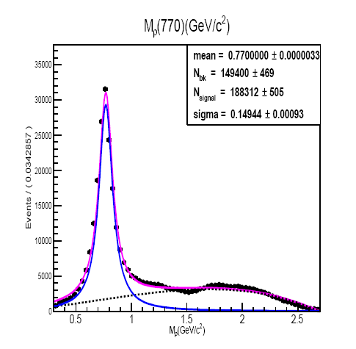

Fit Results of invariant mass $M_{π^{+}π^{−}} →ρ$

Slide 16
Detection Efficiency
We generated 3 Χ 10⁵ MC events, after final selection and background suppression the detection efficiency is,

Slide 17

Branching Fraction of

Slide 18
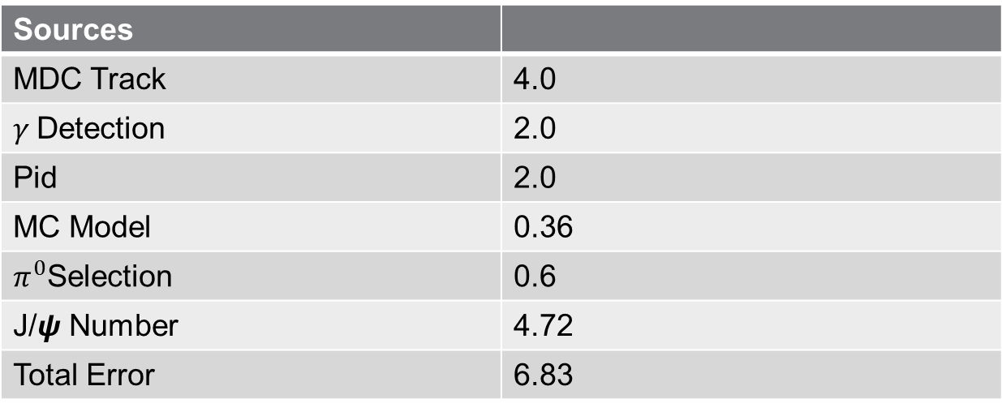
Systematic Errors
Sources
MDC Track | 4.0
$γ$Detection | 2.0
Pid | 2.0
MC Model | 0.36
$π^{0}$Selection | 0.6
J/$ψ$ Number | 4.72
Total Error | 6.83

Slide 19
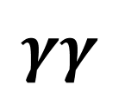
Study of
π+ π-
$$γγ$$

Slide 20
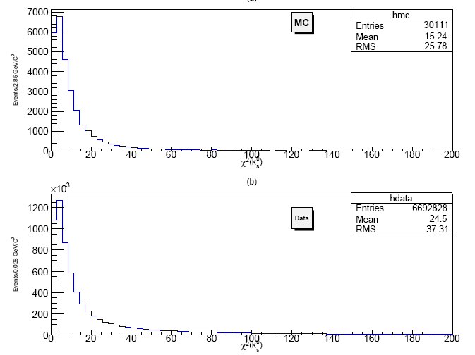
^{distribution}

Slide 21
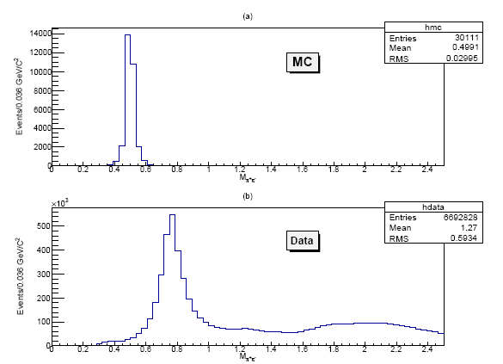

Invariant mass of $M_{π^{+}π^{−}} \text{K}\text{s}\text{0}\text{ (}\text{MC}\text{ \& }\text{Data}\text{)} \text{after} \text{initial} \text{selection} \text{criteria}$

Slide 22
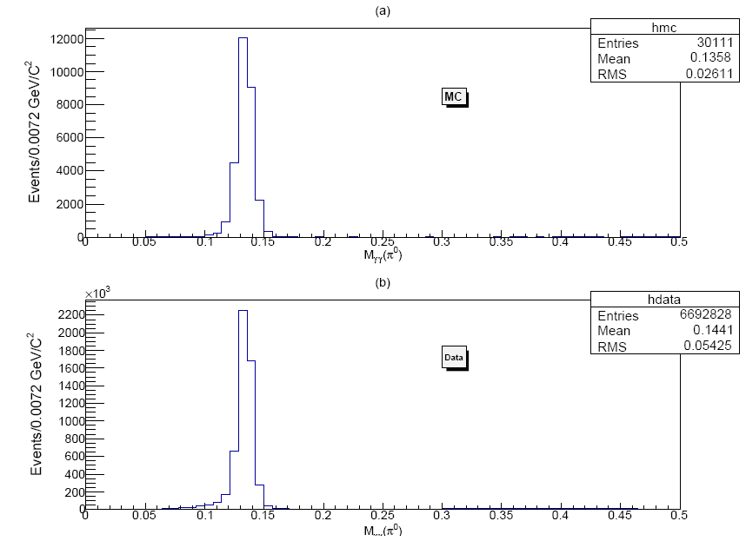

Invariant mass of $γγ(π^{0}) \text{MC}\text{ \& }\text{Data} \text{after} \text{initial} \text{selection} \text{criteria}$

Slide 23
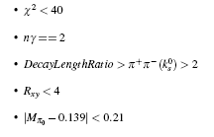
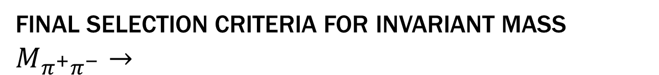
Final selection criteria for invariant mass $M_{π^{+}π^{−}}→$

Slide 24
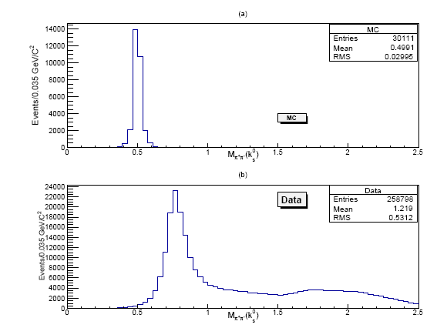

Results for invariant mass after final Event selection $M_{π^{+}π^{−}}→$

Slide 25

Sideband Analysis for J/ψ$→{\text{K}\text{s}\text{0}π}^{0}$
In order to calculate upper limit
Assuming 3 events

Slide 26
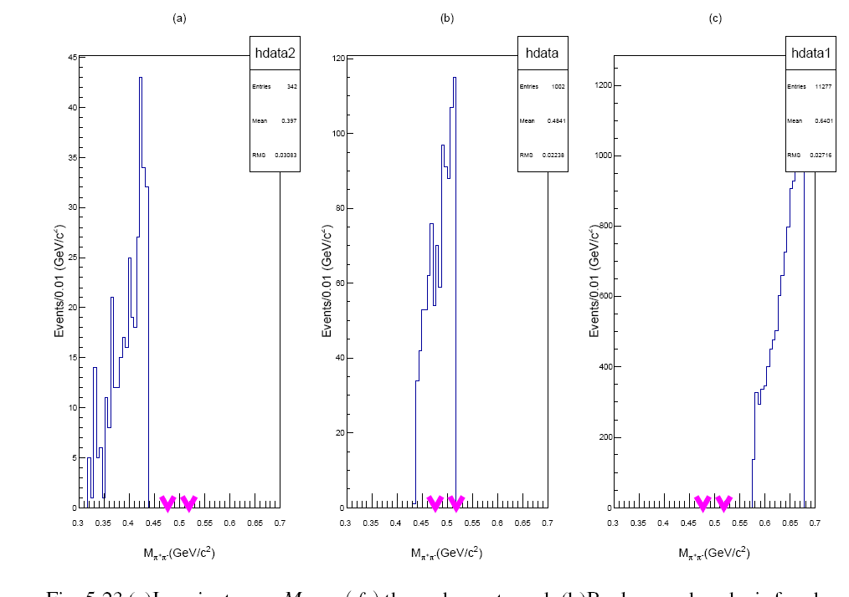
Invariant mass of $M_{π^{+}π^{−}} \text{(}\text{K}\text{s}\text{0}$ )

Slide 27
Detection Efficiency
We generated 3 Χ 10⁵ MC events, after final selection and background suppression the detection efficiency is,

Slide 28
Upper Limit of Branching Fraction

Slide 29
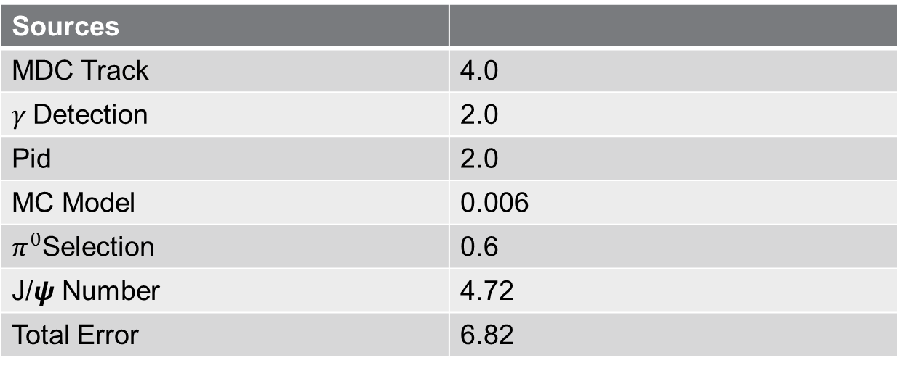
Systematic Errors
Sources
MDC Track | 4.0
$γ$Detection | 2.0
Pid | 2.0
MC Model | 0.006
$π^{0}$Selection | 0.6
J/$ψ$ Number | 4.72
Total Error | 6.82

Slide 30

Study of
π+ π-
$$γγ$$

Slide 31
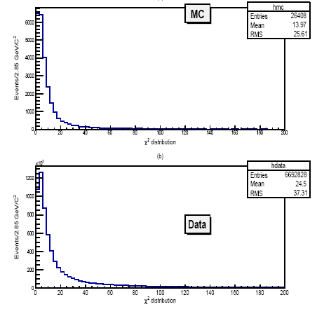
^{distribution}

Slide 32
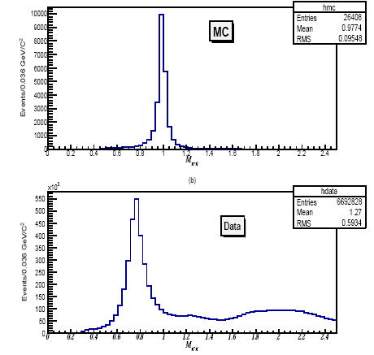

Invariant mass of $M_{π^{+}π^{−}}\text{ (}f^{0}\text{) } \text{MC}\text{ \& }\text{Data} \text{after} \text{initial} \text{selection} \text{criteria}$

Slide 33
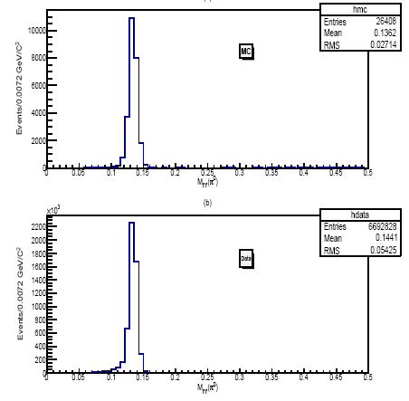
Invariant mass of $γγ(π^{0}) \text{MC}\text{ \& }\text{Data} \text{after} \text{initial} \text{selection} \text{criteria}$

Slide 34
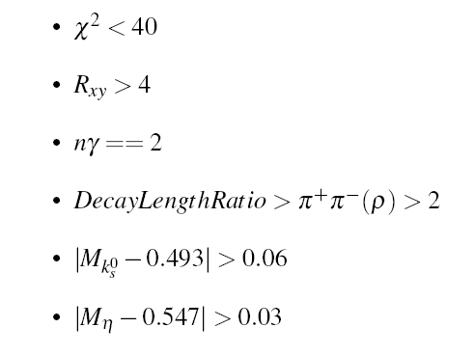



Final selection criteria for invariant mass $M_{π^{+}π^{−}}→f^{0}$
$$f^{0}$$

Slide 35

selection criteria for invariant mass $M_{π^{+}π^{−}}→$

Slide 36

Sideband Analysis for J/ψ$→f^{0}π^{0}$
In order to calculate upper limit
Assuming 3 events

Slide 37
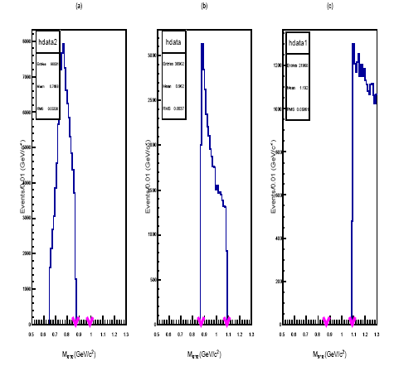
Invariant mass $M_{π^{+}π^{−}}$ ($f^{0}$)

Slide 38
Detection Efficiency
We generated 3 Χ 10⁵ MC events, after final selection and background suppression the detection efficiency is,

Slide 39
Upper Limit of Branching Fraction

Slide 40

Systematic Errors
Sources
MDC Track | 4.0
$γ$Detection | 2.0
Pid | 2.0
MC Model | 0.24
$π^{0}$Selection | 0.6
J/$ψ$ Number | 4.72
Total Error | 6.83

Slide 41
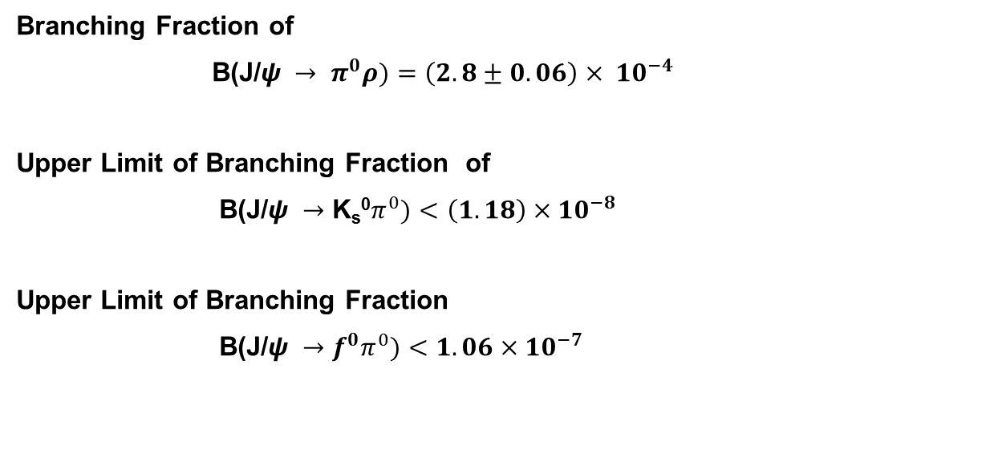
Conclusion
Branching Fraction of
B(J/$ψ → π^{0}ρ)=\left(2.8±0.06\right)× {10}^{−4}$
Upper Limit of Branching Fraction of
B(J/$ψ →{\text{K}\text{s}\text{0}π}^{0})<\left(1.18\right)×{10}^{−8}$
Upper Limit of Branching Fraction
B(J/$ψ →{f^{0}π}^{0})<1.06×{10}^{−7}$

Slide 42
Thanks

Slide 43
Questions & Suggessions
SUGGESSION

