Slide 1
$$J/ψ { ∆}^{++}{\overline{∆}}^{−−}$$ $ψ(2S)$ $∆^{++}{\overline{∆}}^{−−}$
$${pπ}^{+}$$
$${\overline{p}π}^{−}$$
TASAWER SHAHZAD AHMAD, HARIS RASHID, TALAB HUSSAIN
Charmonium Group Meeting

Slide 2
Data Samples
1310.6 Million and 447 Million data samples were used to study the $J/ψ ∆^{++}{\overline{∆}}^{−−}$and $ψ(2S) ∆^{++}{\overline{∆}}^{−−}$respectively.
The sample of 100000 events was generated by using phase space model in case of signal Monte Carlo.
1225 Million and 500 Million inclusive MC data samples were used for the background studies of $J/ψ ∆^{++}{\overline{∆}}^{−−}$and $ψ(2S) ∆^{++}{\overline{∆}}^{−−}$respectively.
Monte Carlo (MC) samples and real data were reconstructed with the help of BOSS version 664p01

Slide 3
Event Selection
To select 4 good charged tracks the Initial event selection criteria is:
Range of polar angle in MDC i.e. $|cosθ|< 0.93$ with mfit=2.
The requirements for the vertex is < 10 cm and $V_{z} < 15$ cm.
The threshold value of transverse momentum of each track should be 0.07 GeV i.e.,$Pxy ≥ 0.07$GeV.
Tracks can be identified by the calculation of energy loss and TOF.
The energy loss $dE/dx$ in MDC and TOF information were used to identify a particle.

Slide 4
Particle Identification
Particle identification was performed to get events each having one Proton, one anti-Proton, one π+ and one π−, by using the combined information of $dE/dx$ and TOF. For this purpose the following $χ2$ values were used.
The $χ2$ is assigned to each charged track and is used to decide the type of the particle after applying the following conditions.

Slide 5
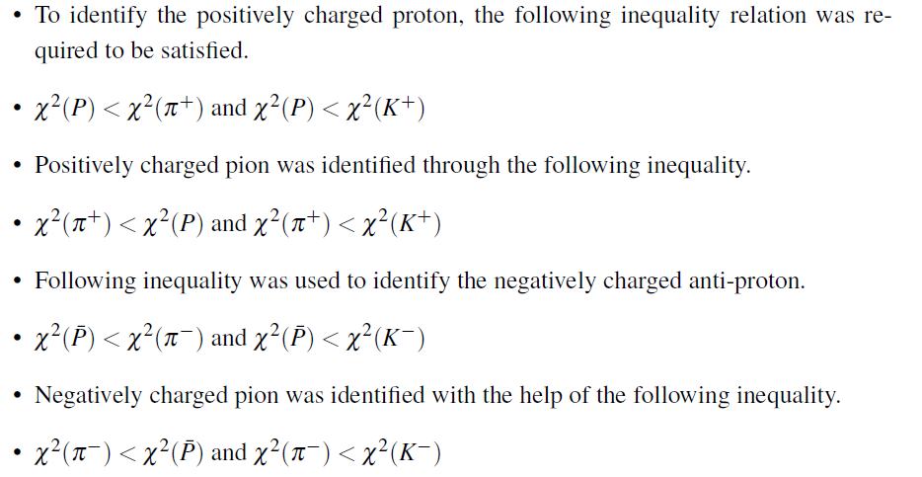
The successful event after particle identification contains one proton, one anti-proton, a positive pion and a negative pion.

Slide 6
Kinematic Fit
To conserve total momentum and energy, we applied 4C kinematic fit. Important information related to final state particles and their parent resonant particles such as invariant mass of $Pπ^{+}$ and $\overline{P}π^{−}$ to reconstruct $Δ^{++}$ and ${\overline{Δ}}^{−−}$was saved after 4C fit.
Such criteria were used on all selected signal MC events, inclusive MC events, exclusive background MC events and real data events to get events.

Slide 7
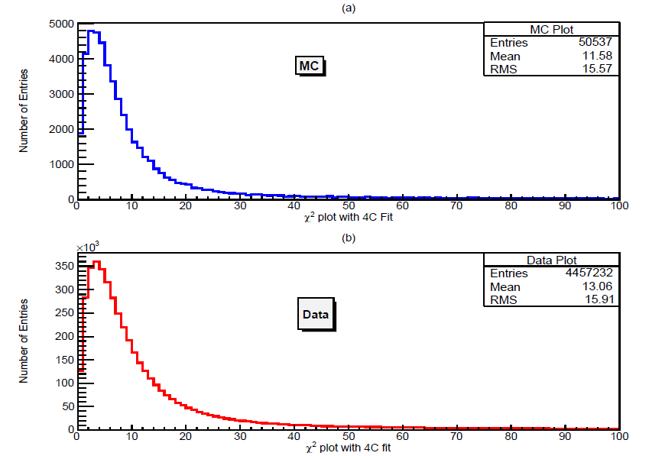

Slide 8
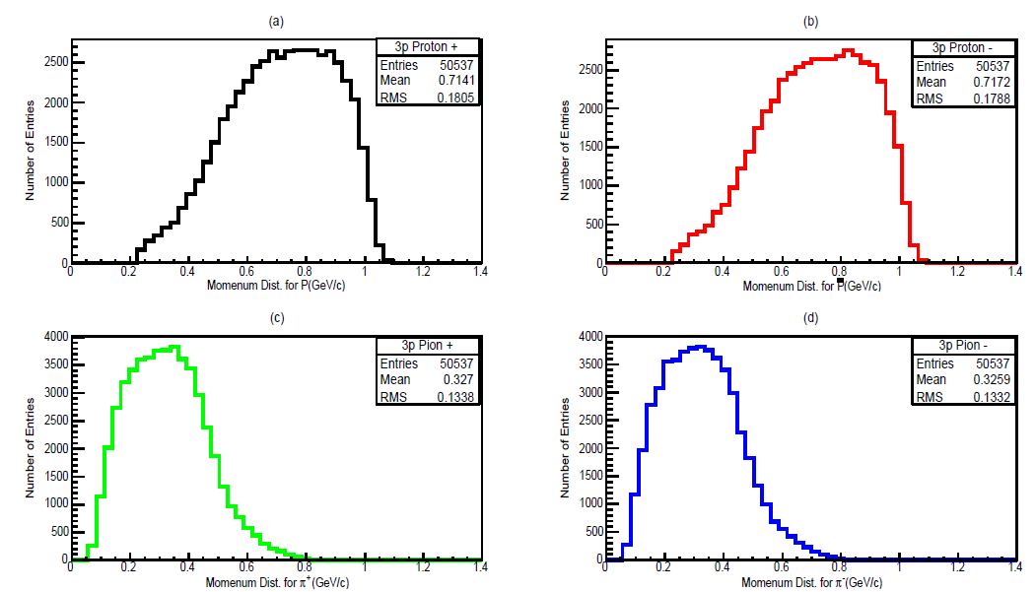

Slide 9
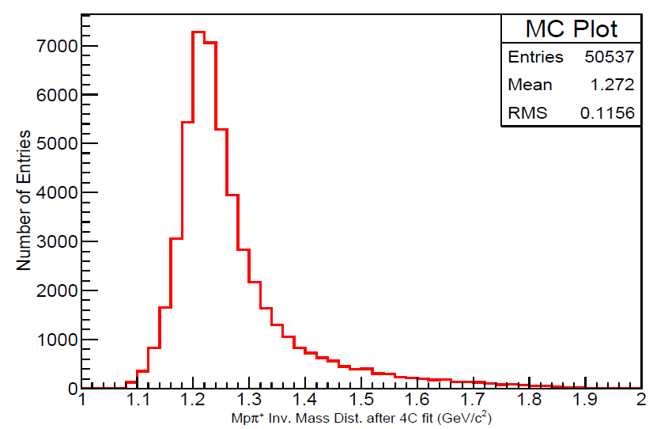

Slide 10
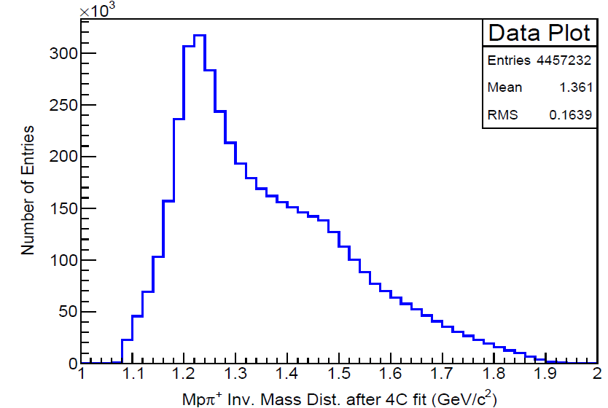

Slide 11
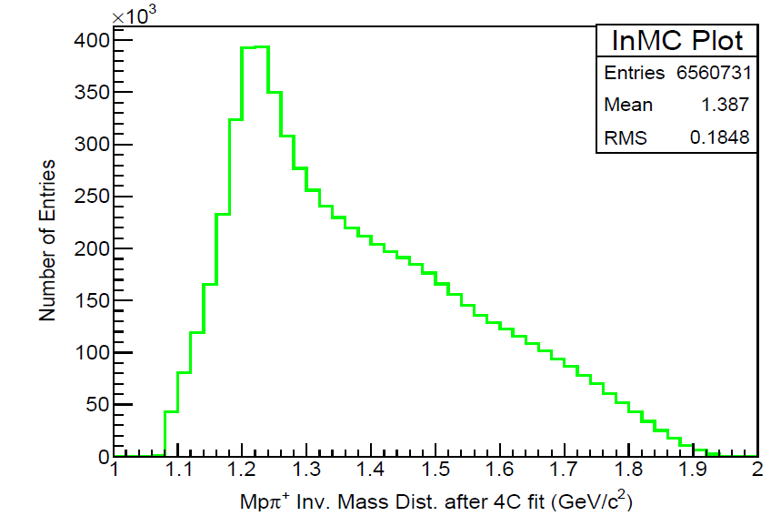

Slide 12
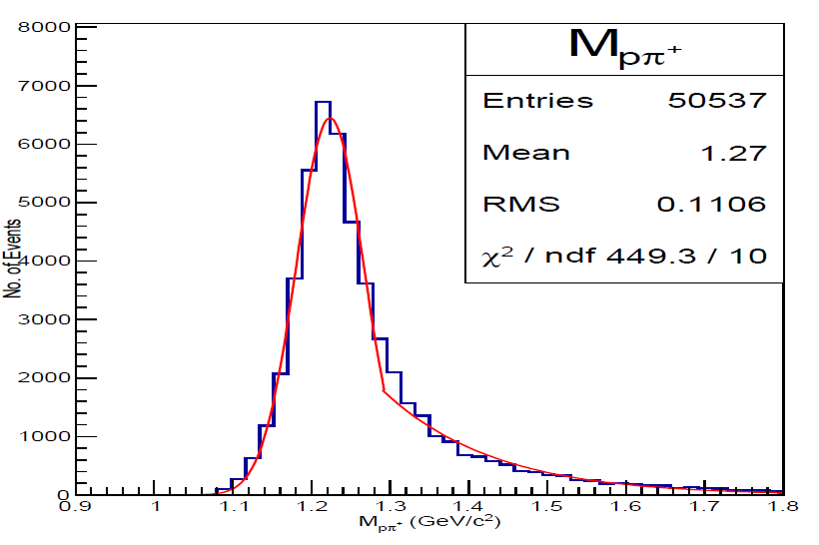

Slide 13
FINAL EVENT SELECTION
The following constraints were used
3σ mass constraints, decay length ratio cuts for $Δ^{++}$ and ${\overline{Δ}}^{−−}$and $χ_{}^{2}_4C$cut which was optimized through maximizing the ratio of MC signal and signal plus background from real data.
To obtain good signals of $Δ^{++}$ and ${\overline{Δ}}^{−−}$from real data through invariant mass distributions of $Pπ^{+}$and $\overline{P}π^{−}$in the presence of small background was the main objective of these constraints.

Slide 14
Final Cuts
In addition to $χ2$_4C constraint, the following constrains were also applied to obtain final plot of $Pπ^{+}$invariant mass distribution.
$\left|M_{\overline{p}π^{−}}−M_{{\overline{∆}}^{−−}}\right|<0.2140$
$\left|M_{pπ^{−}}−M_{Λ}\right|>0.015$
$\left|M_{\overline{p}π^{+}}−M_{\overline{Λ}}\right|>0.015$
$\left|M_{pπ^{−}}−M_{∆^{0}}\right|>0.27$
$\left|M_{\overline{p}π^{+}}−M_{\overline{{\overline{∆}}^{0}}}\right|>0.27$
$\left|M_{π^{+}π^{−}}−M_{ω^{0}}\right|>0.031$
$\left|M_{π^{+}π^{−}}−M_{ρ^{0}}\right|>0.03$
$\left|M_{π^{+}π^{−}}−M_{f_{2}}\right|>0.21$
Decay Length Ratio= $\left|\frac{Decay Length of ∆^{++}}{Decay Length Error of ∆^{++}}\right|>3$

Slide 15
In addition to $χ2$_4C constraint, the following constrains were applied to obtain final plot of $\overline{P}π^{−}$invariant mass distribution.
$\left|M_{pπ^{+}}−M_{∆^{++}}\right|<0.2140$
$\left|M_{pπ^{−}}−M_{Λ}\right|>0.015$
$\left|M_{\overline{p}π^{+}}−M_{\overline{Λ}}\right|>0.015$
$\left|M_{pπ^{−}}−M_{∆^{0}}\right|>0.27$
$\left|M_{\overline{p}π^{+}}−M_{\overline{{\overline{∆}}^{0}}}\right|>0.27$
$\left|M_{π^{+}π^{−}}−M_{ω^{0}}\right|>0.031$
$\left|M_{π^{+}π^{−}}−M_{ρ^{0}}\right|>0.03$
$\left|M_{π^{+}π^{−}}−M_{f_{2}}\right|>0.21$
Decay Length Ratio= $\left|\frac{Decay Length of{\overline{∆}}^{−−}}{Decay Length Error of {\overline{∆}}^{−−}}\right|>3$

Slide 16
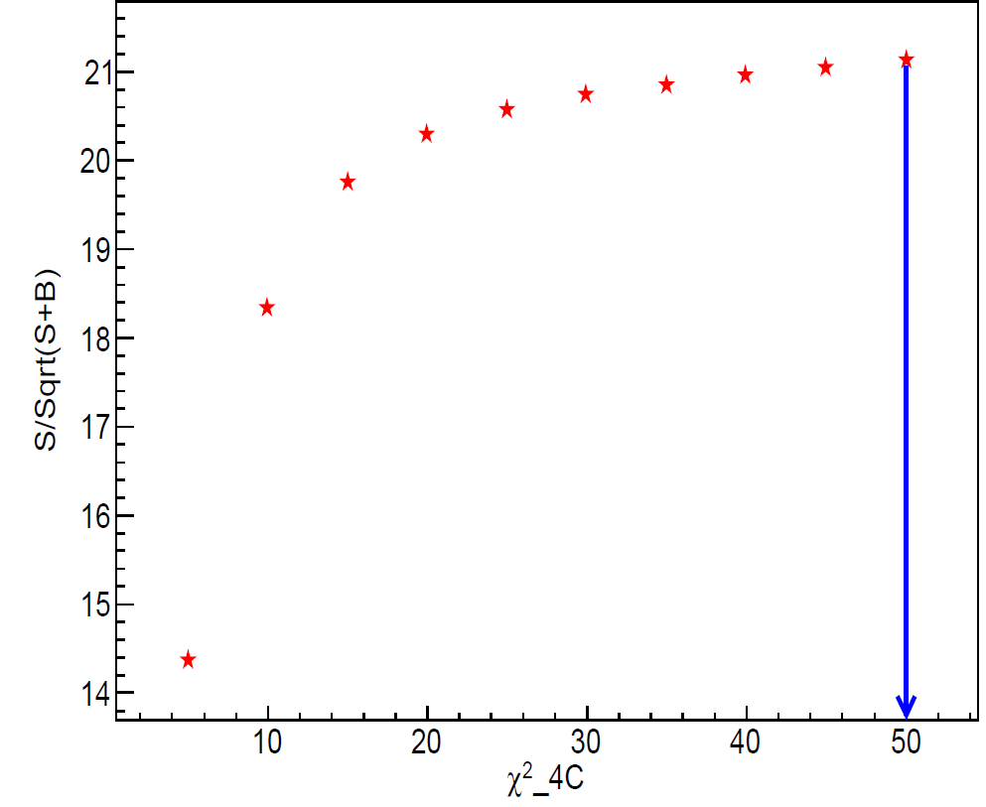
$χ^{2}$Optimization after 4C Fit

Slide 17
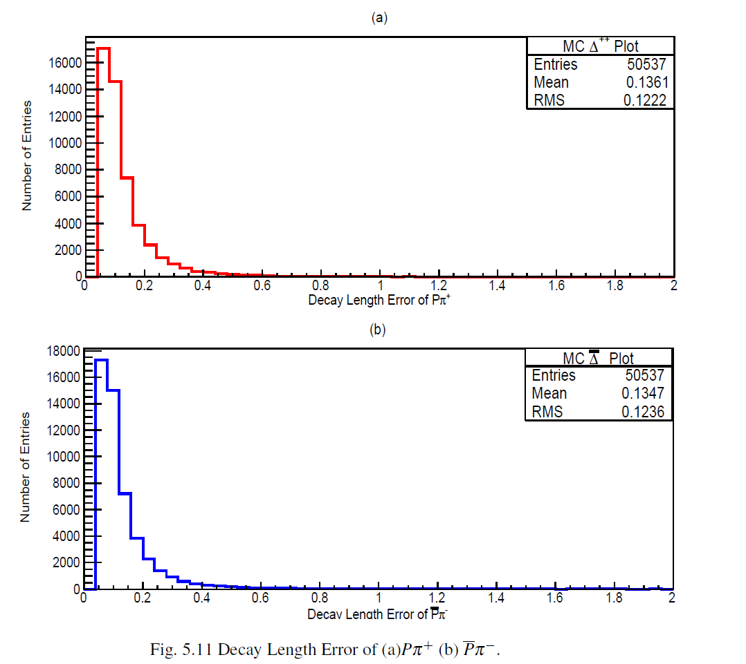
Decay Length Error

Slide 18
MC Proper Time Distribution

Slide 19
Data Proper Time Distribution

Slide 24
Statistical Significance
To measure statistical significance, we made two maximum likelihood fits to each of the $∆^{++}$ and ${\overline{∆}}^{−−}$invariant mass distributions.
First fit was made by using respective fixed Monte Carlo histogram as signal and the second fit was made by setting signal to zero (mean no signal function)
In order to obtain the significance level, the values of log likelihood, obtained from the two fits were used in the following formula
where 2lnLmax(s+b) represents the value of log likelihood obtained from first fit and 2lnLmax(b) represents the log likelihood value from second fit. The statistical significance of $∆^{++}$ and ${\overline{∆}}^{−−}$signals was determined to be 15.5$σ$ and 17$σ$ respectively.
$$S=\sqrt{\left|2lnL_{max}\left(s+b\right)−2lnL_{max}\left(b\right)\right|}$$

Slide 25
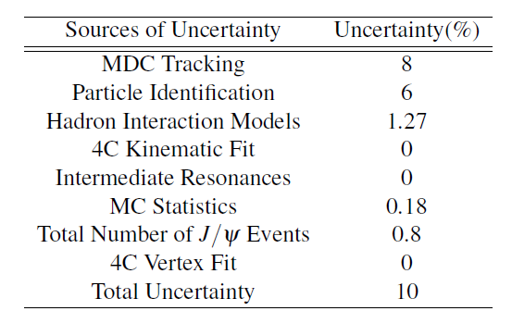
Systematic Error Analysis
Summary of the Systematic Error Analysis

Slide 26
Branching Fraction
The Branching Fraction of $J/ψ→∆^{++}{\overline{∆}}^{−−}$can be determined by using the following relation
Where detection efficiency ε = 50%. NObserved is the average of total number of observed signals equal to 559. Total number of J/ψ events NJ/ψ = 1310.6 Million. The Branching fractions of B(Δ++ →Pπ+) and B(Δ−− →Pπ−) are equal to 0.994.
B$(J/ψ→∆^{++}{\overline{∆}}^{−−}$)=(0.86±0.08)× ${10}^{−6}$

Slide 27
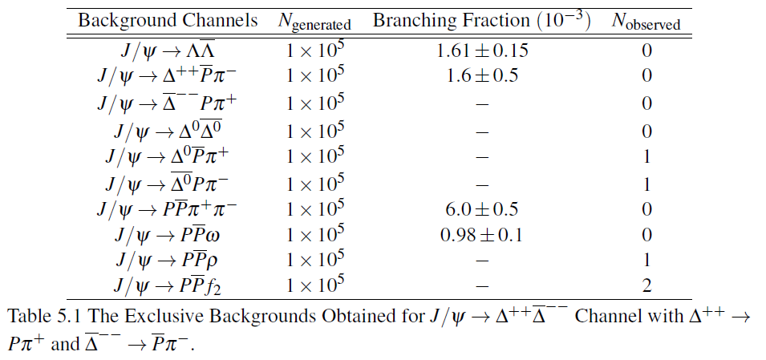
The background channels were observed after the topological background study

Slide 28
In addition to $χ2$_4C constraint, the following constrains were applied to obtain final plot of $Pπ^{+}$invariant mass distribution.
$\left|M_{\overline{p}π^{−}}−M_{{\overline{∆}}^{−−}}\right|<0.2140$
$\left|M_{pπ^{−}}−M_{Λ}\right|>0.015$
$\left|M_{\overline{p}π^{+}}−M_{\overline{Λ}}\right|>0.015$
$\left|M_{pπ^{−}}−M_{∆^{0}}\right|>0.27$
$\left|M_{\overline{p}π^{+}}−M_{\overline{{\overline{∆}}^{0}}}\right|>0.27$
$\left|M_{π^{+}π^{−}}−M_{ω^{0}}\right|>0.031$
$\left|M_{π^{+}π^{−}}−M_{ρ^{0}}\right|>0.03$
$\left|M_{π^{+}π^{−}}−M_{f_{2}}\right|>0.21$
Decay Length Ratio= $\left|\frac{Decay Length of ∆^{++}}{Decay Length Error of ∆^{++}}\right|>3$

Slide 29
In addition to $χ2$_4C constraint, the following constrains were applied to obtain final plot of $\overline{P}π^{−}$invariant mass distribution.
$\left|M_{pπ^{+}}−M_{∆^{++}}\right|<0.2140$
$\left|M_{pπ^{−}}−M_{Λ}\right|>0.015$
$\left|M_{\overline{p}π^{+}}−M_{\overline{Λ}}\right|>0.015$
$\left|M_{pπ^{−}}−M_{∆^{0}}\right|>0.27$
$\left|M_{\overline{p}π^{+}}−M_{\overline{{\overline{∆}}^{0}}}\right|>0.27$
$\left|M_{π^{+}π^{−}}−M_{ω^{0}}\right|>0.031$
$\left|M_{π^{+}π^{−}}−M_{ρ^{0}}\right|>0.03$
$\left|M_{π^{+}π^{−}}−M_{f_{2}}\right|>0.21$
Decay Length Ratio= $\left|\frac{Decay Length of{\overline{∆}}^{−−}}{Decay Length Error of {\overline{∆}}^{−−}}\right|>3$

Slide 32
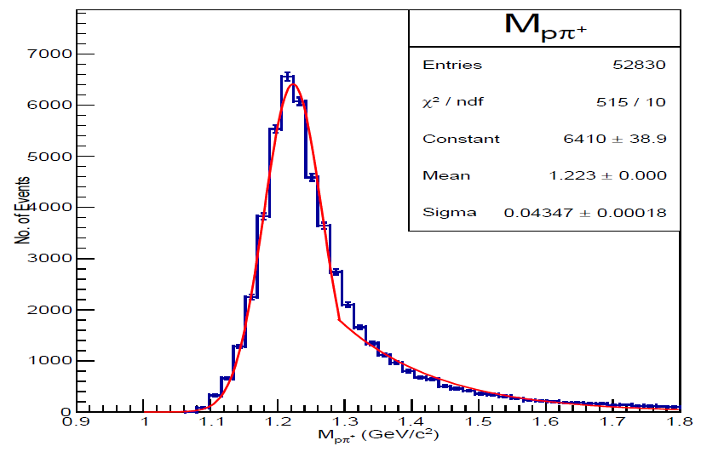
MC Mass Distribution of $Pπ^{+}$

Slide 33
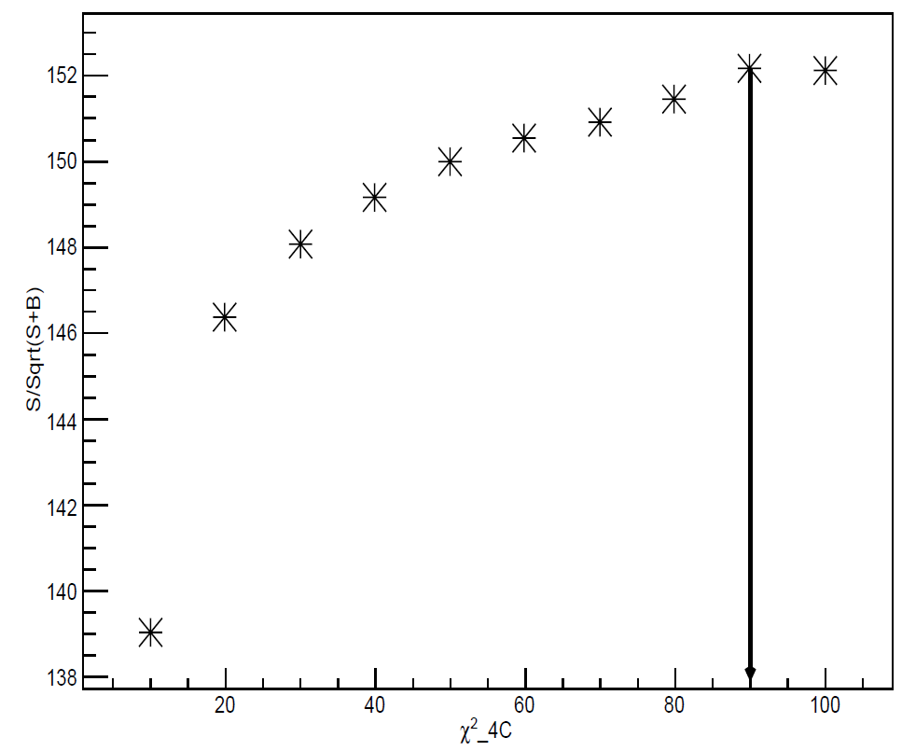
$χ^{2}$Optimization after 4C Fit

Slide 34
Decay Length Error

Slide 35
MC Proper Time Distribution

Slide 36
Data Proper Time Distribution

Slide 41
Statistical Significance
To measure statistical significance, we made two maximum likelihood fits to each of the $∆^{++}$ and ${\overline{∆}}^{−−}$invariant mass distributions.
First fit was made by using respective fixed Monte Carlo histogram as signal and the second fit was made by setting signal to zero (mean no signal function)
In order to obtain the significance level, the values of log likelihood, obtained from the two fits were used in the following formula
where 2lnLmax(s+b) represents the value of log likelihood obtained from first fit and 2lnLmax(b) represents the log likelihood value from second fit. The statistical significance of $∆^{++}$ and ${\overline{∆}}^{−−}$signals was determined to be 5.6$σ$ and $4.49σ$respectively.
$$S=\sqrt{\left|2lnL_{max}\left(s+b\right)−2lnL_{max}\left(b\right)\right|}$$

Slide 42
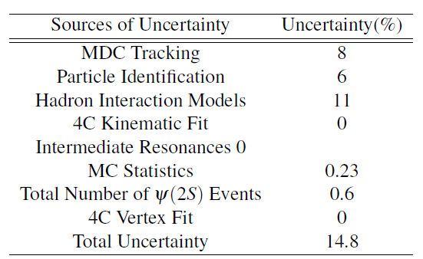
Systematic Errors
Summary of the Systematic Error Analysis

Slide 43
Branching Fraction
The Branching Fraction of $ψ(2S)→∆^{++}{\overline{∆}}^{−−}$can be determined by using the following relation
Where Detection efficiency ε = 52.8%. NObserved is total number of observed signals equal to 28. Total number of ψ events Nψ = 448 Million. The Branching fractions of B(Δ++ →Pπ+)
and B(Δ−− →Pπ−) are equal to 0.994.
$B(ψ(2S)→∆^{++}{\overline{∆}}^{−−}$)=(1.07±0.16)× ${10}^{−7}$

Slide 44
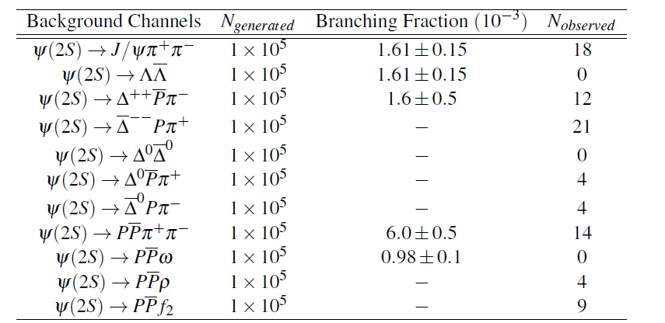
Background Estimation
The background channels were observed after the topological background study

Slide 45
Conclusion
Through these analyses, it is found that the 12% rule is nearly obeyed by these channels i.e. The ratio of ψ(2S)→ $Δ^{++}$ ${\overline{Δ}}^{−−}$and that of J/ψ → $Δ^{++}$ ${\overline{Δ}}^{−−}$is about 12%
$Q_{h}=\frac{\text{1.07±0.16× }{10}^{−7} }{\text{0.86±0.08× }{10}^{−6}}=12.4\%$
It is also found that our measured branching fractions are better than the PDG values of branching fractions of these decay channels by about of order three.
With increased statistics of data at BESIII, these measurements can be further improved through their precision and accuracy.

