Slide 2
Study of (J/Ψ,Ψ(2S)) → ΛX
Khadija Saeed, Haris Rashid, Abrar Ahmad Zafar, Talab Hussain Centre for High Energy Physics, University of the Punjab, Lahore, Pakistan
Charmonium Group Meeting
April 17, 2019

Slide 3
Outline
Overview
Motivations
Experiment Overview
Data Analysis
Results
Conclusion

Slide 4
Motivations
The isospin conserving modes containing baryon pair with meson has been reported in PDG, also some searches have been performed to explore isospin violation process.
In this study we searched the violation process in two ways isospin and strangeness which is highly suppress but kinematic ally it is possible.
To find any hint beyond the Standard Model of Particle Physics.
This work is devoted to the analysis of
and try to measure its branching fraction using the large statistics at BESIII

Slide 5
What is “X”
Here X can be any anti baryon e.g . Here we will discuss these channels

Slide 6
Observation of
This study is based upon two steps
Monte Carlo (MC) simulations.
Real data results
Where real data contain events and
events

Slide 7
MC simulation
A MC sample of 100000 events is generated using different generators for each channel.

Slide 8
Event Selection for
There are 4 charge tracks in
as
and
Only those events are selected having
nGood == 4
number of ɣ == 1
nCharge == 0
PID is applied to select events having 1 proton 1 anti proton 1 pion and 1 anti pion

Slide 9
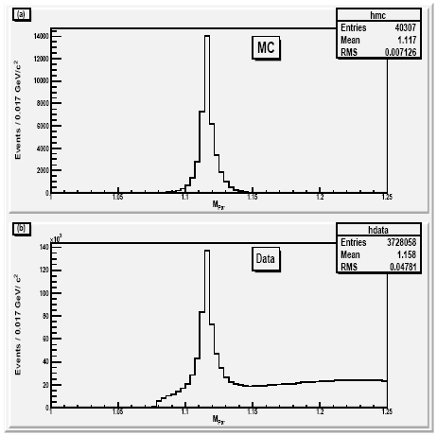
MC and Data invariant mass of using kinematic fit for

Slide 10
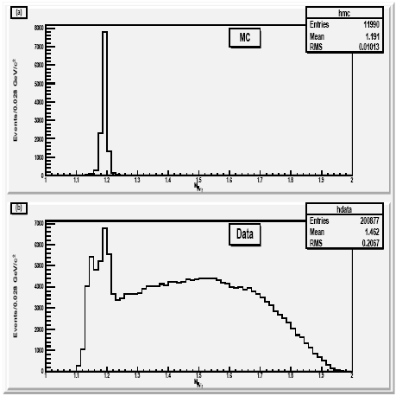
MC and Data invariant mass of using kinematic fit for

Slide 11
Background Analysis for

Slide 12
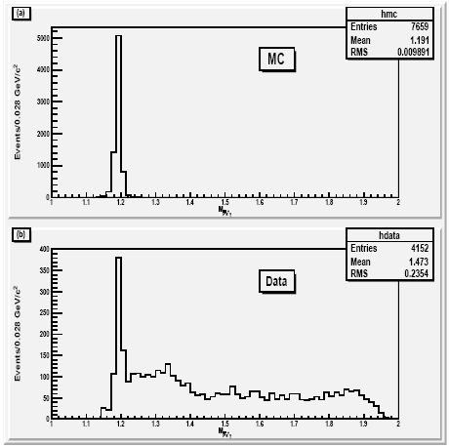
MC and Data invariant mass of after applying cuts

Slide 14
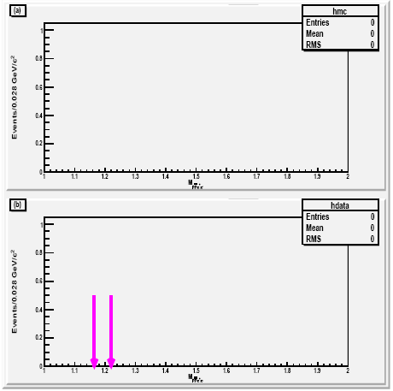

Slide 15
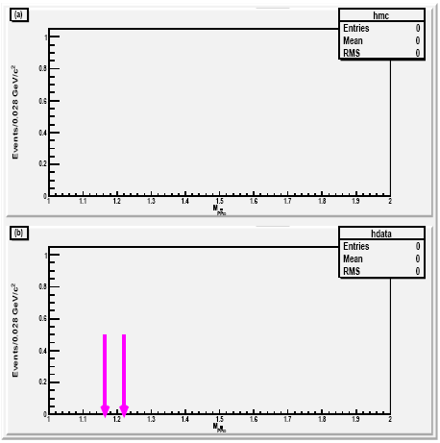

Slide 16
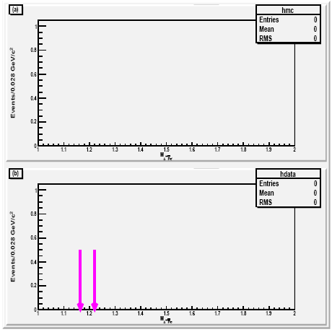

Slide 17
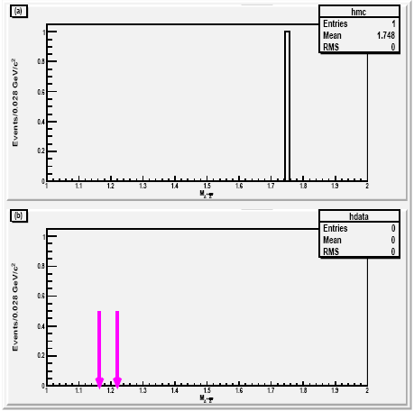

Slide 21
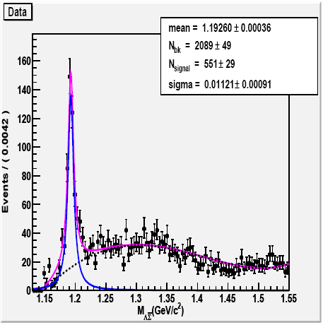
Fit result of

Slide 22
Calculated Branching Fraction for
Formula for the calculation of Branching fraction is given bellow
Here represents number of observed signal events, detection efficiency and intermediate branching fraction . The calculated branching fraction is

Slide 23
Initial Event Selection for
There are 4 charge tracks in
as
and
Only those events are selected having
nGood == 4
nCharge == 0
PID is applied to select events having 1 proton 1 anti proton 1 pion and 1 anti pion

Slide 24
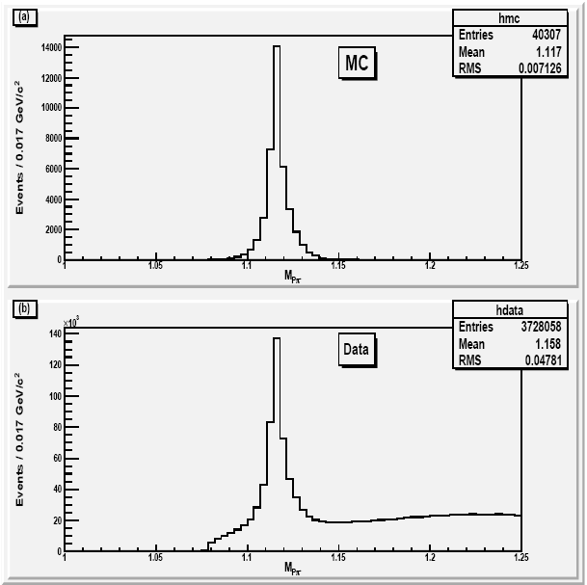
MC and Data invariant mass of using kinematic fit

Slide 25
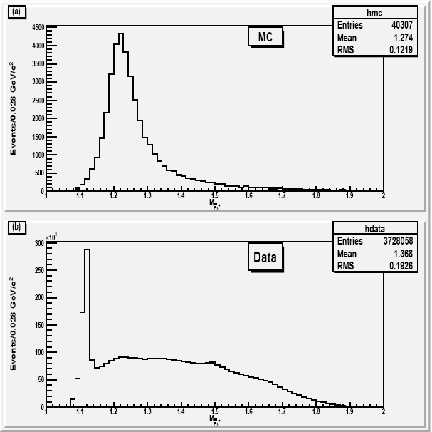
MC and Data invariant mass of using Kinematic fit

Slide 26
Final Event Selection for

Slide 27
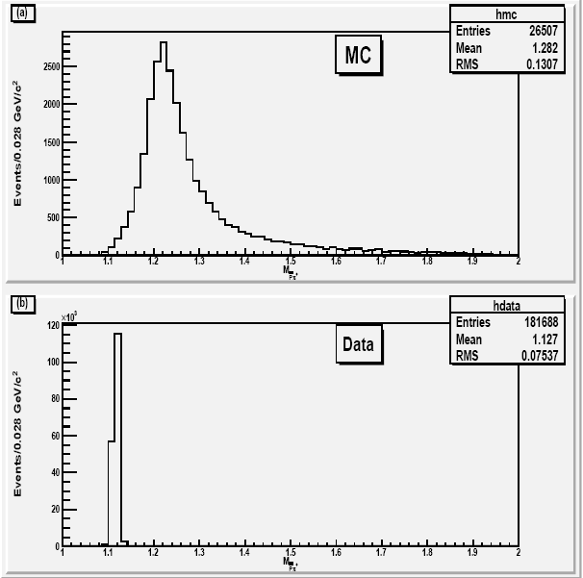
MC and Data invariant mass of after applying cuts

Slide 28
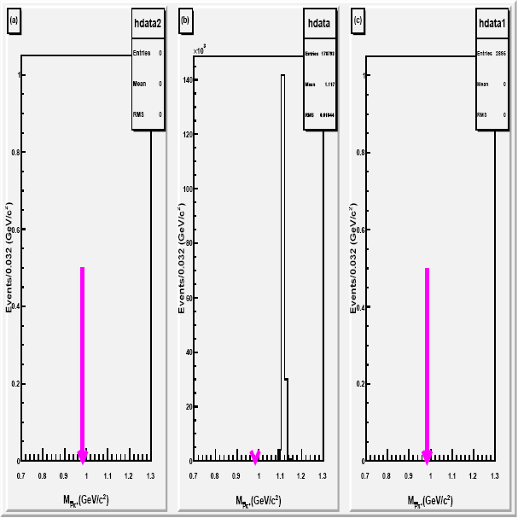
Sideband Analysis for

Slide 29
Upper Limit using Poisson Distribution

Slide 30
Calculated Upper Limit at 95% Confidence Level for
Formula for the calculation of upper limit is given bellow
Here represents number of observed signal events, detection efficiency and intermediate branching fraction . The calculated branching fraction is

Slide 31
Initial Event Selection for
There are 4 charge tracks in
as
and
Only those events are selected having
nGood == 4
number of ɣ == 2
nCharge == 0
PID is applied to select events having 1 proton 1 anti proton 1 pion and 1 anti pion

Slide 32
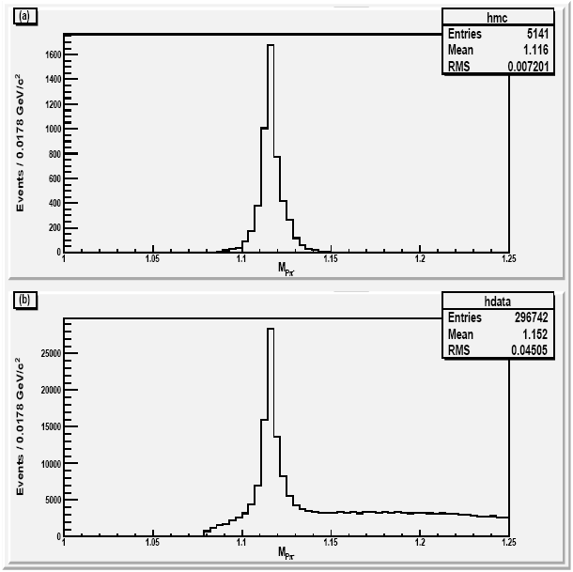
MC and Data invariant mass of using kinematic fit for

Slide 33
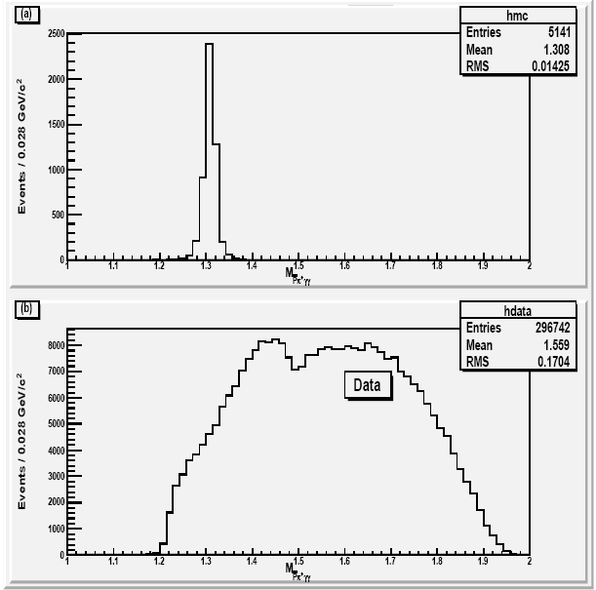
MC and Data invariant mass of using kinematic fit for

Slide 34
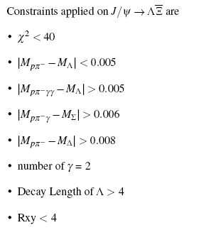
Background Analysis for

Slide 35
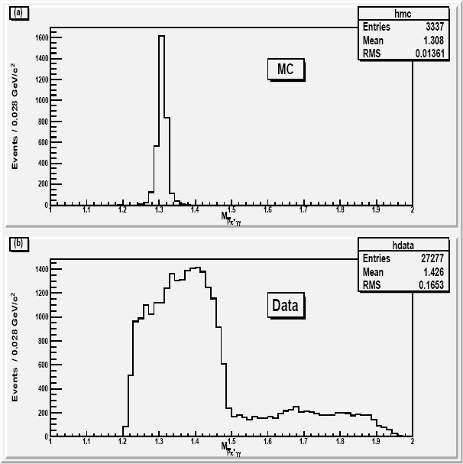
MC and Data invariant mass of after applying cuts

Slide 36
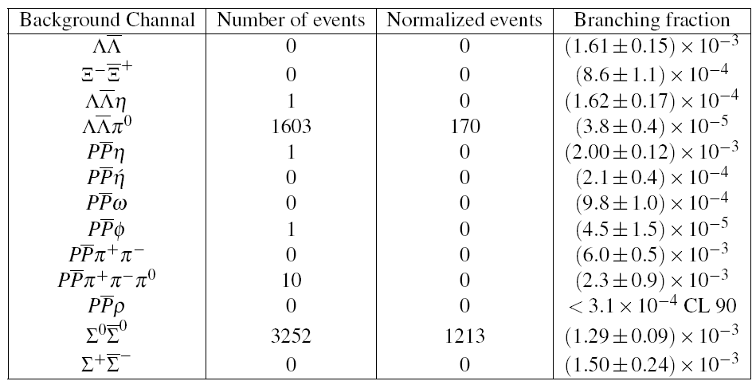

Slide 37
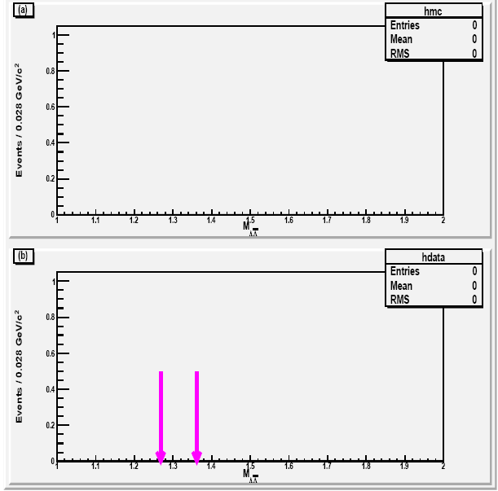

Slide 38
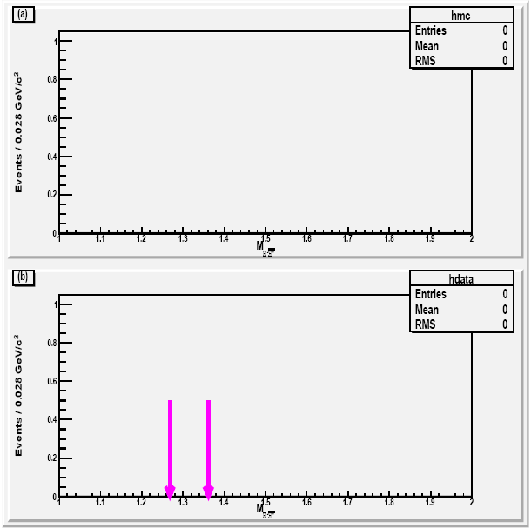

Slide 39
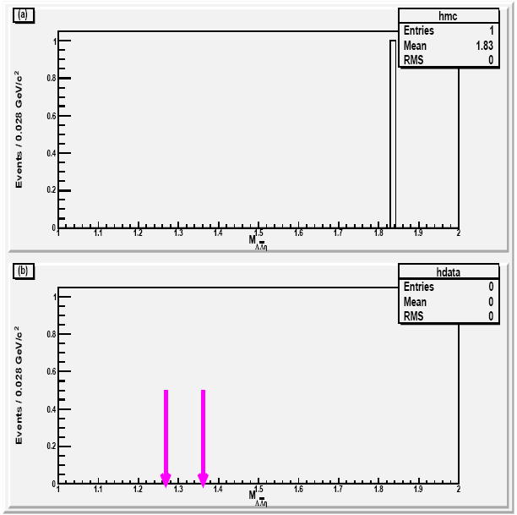

Slide 40
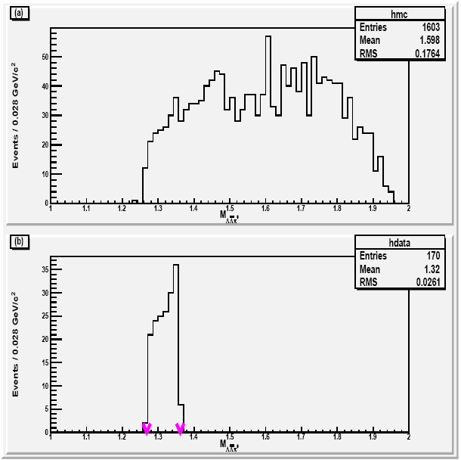

Slide 41
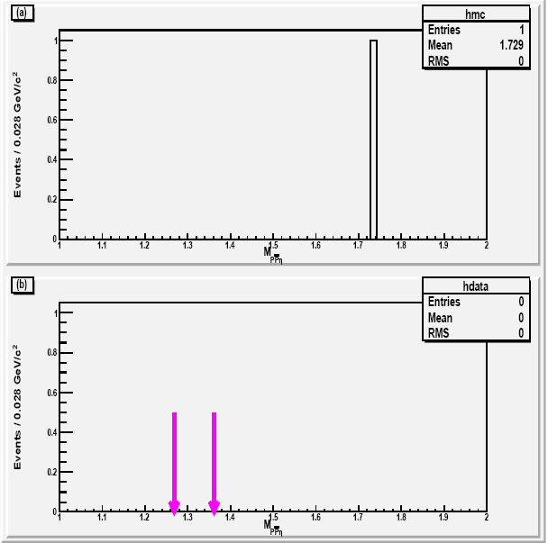

Slide 42
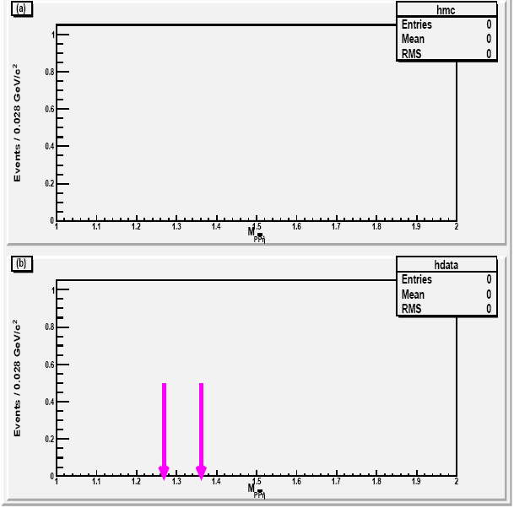

Slide 43
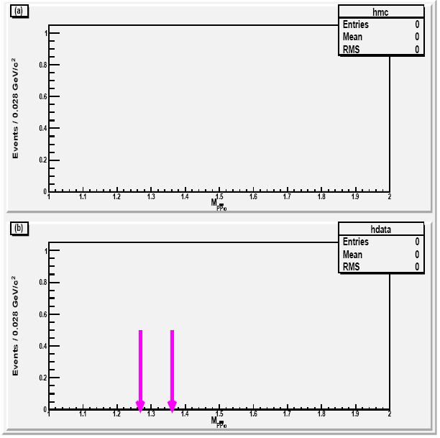

Slide 44
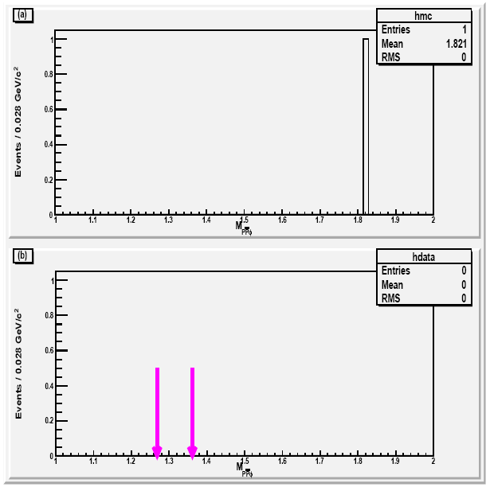

Slide 45
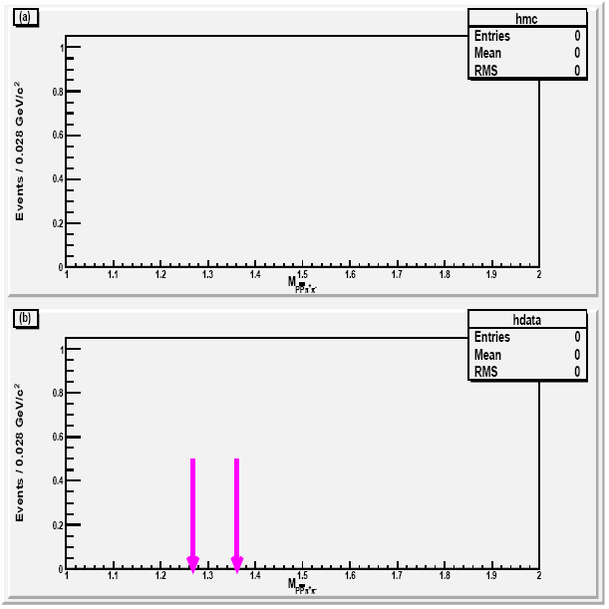

Slide 46
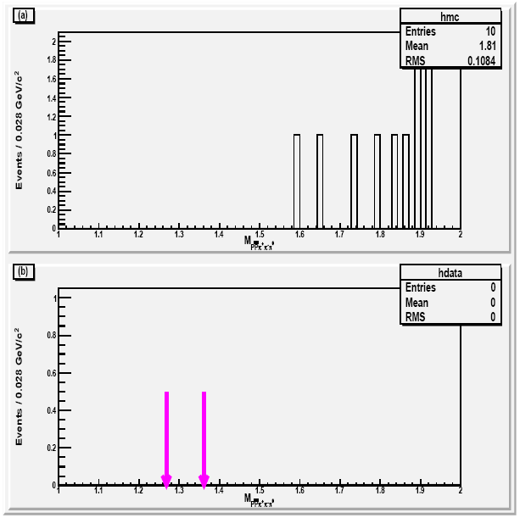

Slide 48
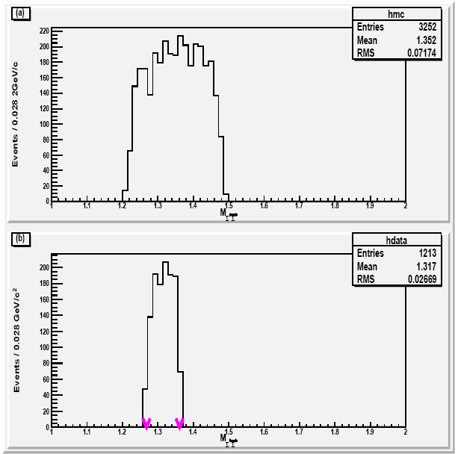

Slide 50
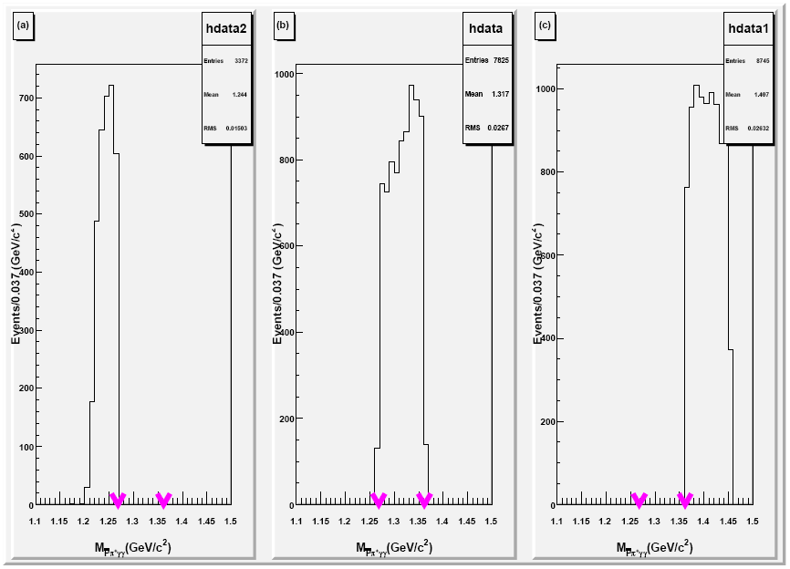
Sideband Analysis for

Slide 51
Calculated Upper Limit at 95% Confidence Level for
Formula for the calculation of upper limit is given bellow
Here represents number of observed signal events, detection efficiency and intermediate branching fraction . The calculated branching fraction is

Slide 52
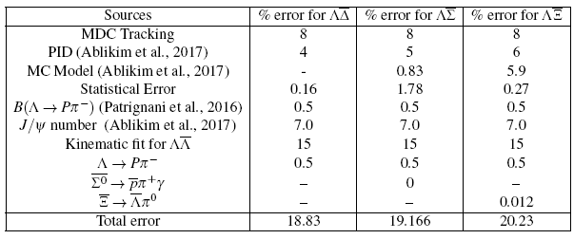

Slide 53
Initial Event Selection for
There are 4 charge tracks in
as
and
Only those events are selected having
nGood == 4
nCharge == 0
PID is applied to select events having 1 proton 1 anti proton 1 pion and 1 anti pion

Slide 54
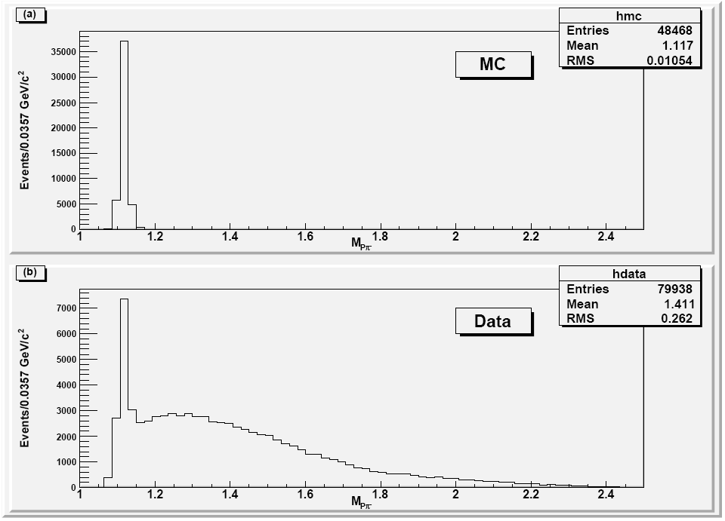
MC and Data invariant mass of using kinematic fit for

Slide 55
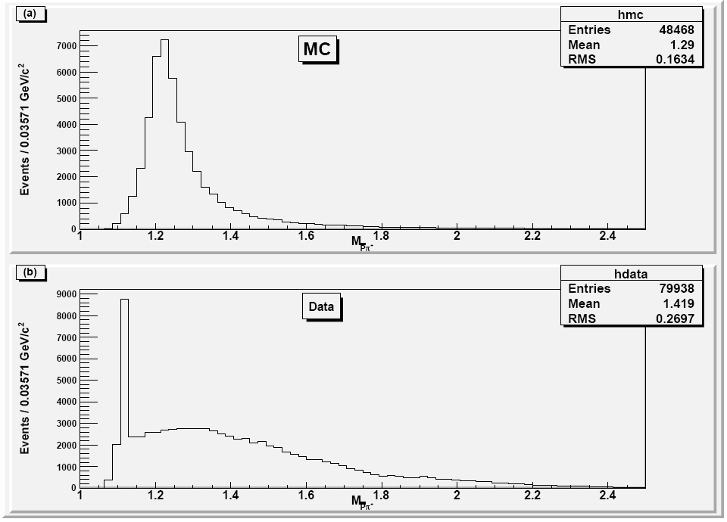
MC and Data invariant mass of using kinematic fit

Slide 56
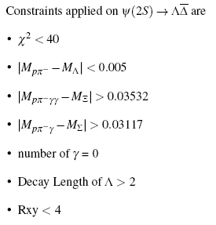
Background Analysis for

Slide 57
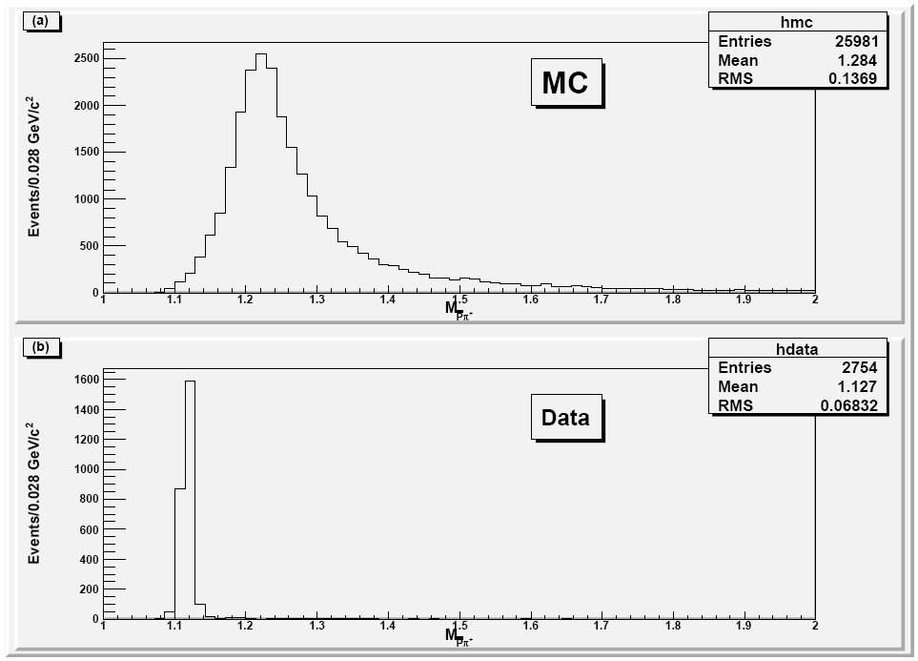
MC and Data invariant mass of after applying cuts

Slide 58
Sideband Analysis for

Slide 59
Calculated Upper Limit at 95% Confidence Level for
Formula for the calculation of upper limit is given bellow
Here represents number of observed signal events, detection efficiency and intermediate branching fraction . The calculated branching fraction is

Slide 60
Event Selection for
There are 4 charge tracks in
as
and
Only those events are selected having
nGood == 4
number of ɣ == 1
nCharge == 0
PID is applied to select events having 1 proton 1 anti proton 1 pion and 1 anti pion

Slide 61
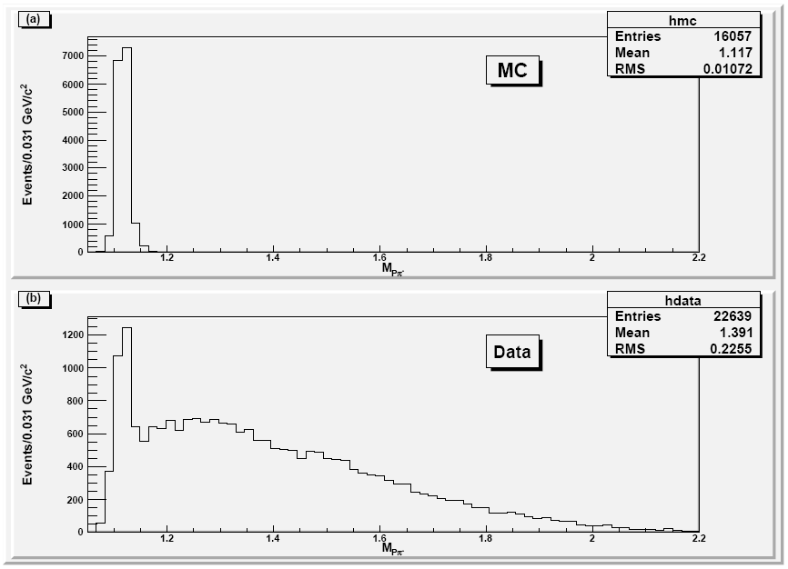
MC and Data invariant mass of using kinematic fit for

Slide 62
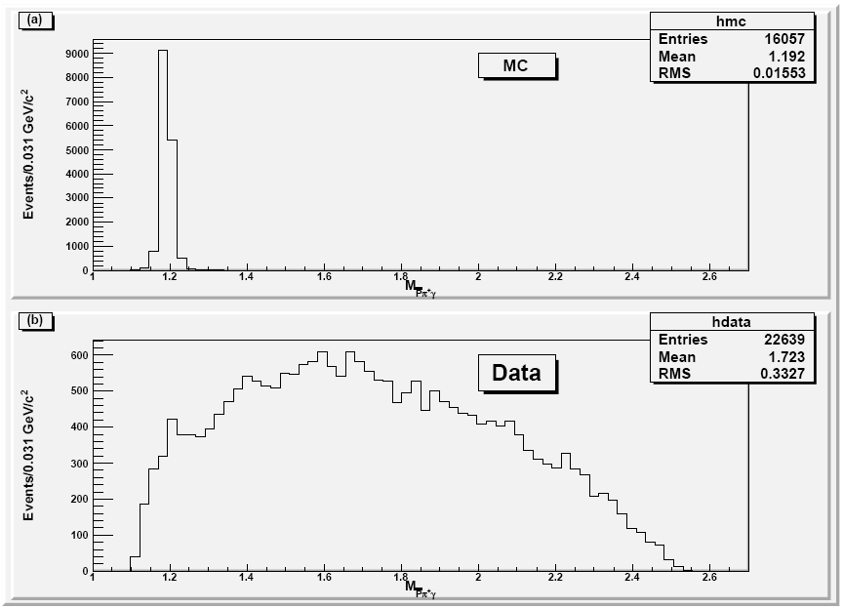
MC and Data invariant mass of using kinematic fit for

Slide 63
Background Analysis for

Slide 64
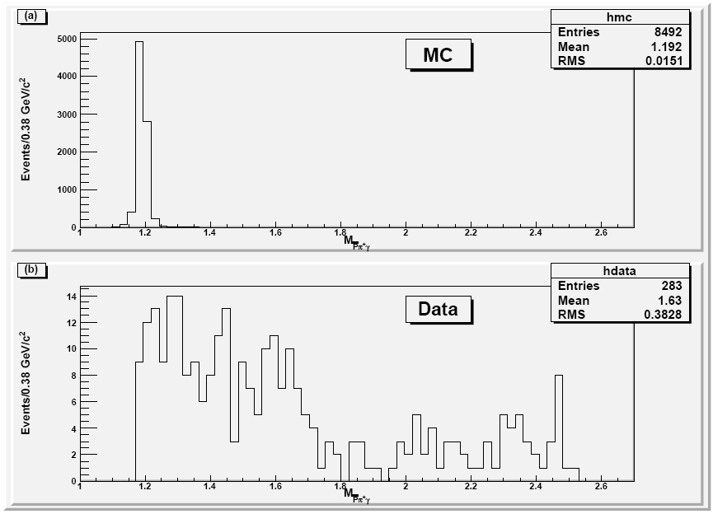
MC and Data invariant mass of after applying cuts for

Slide 65
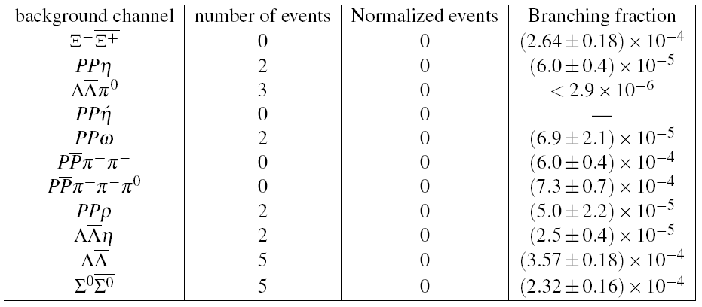

Slide 67
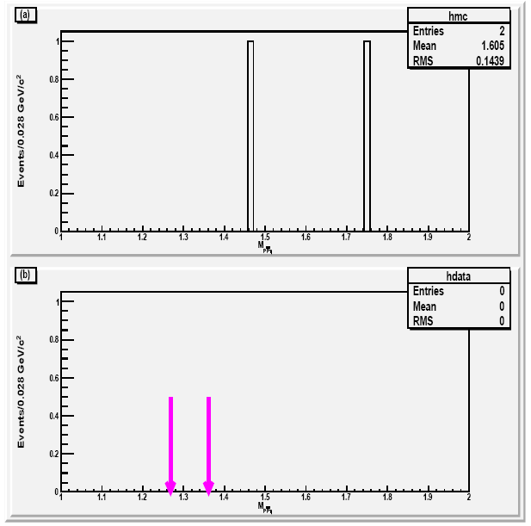

Slide 68
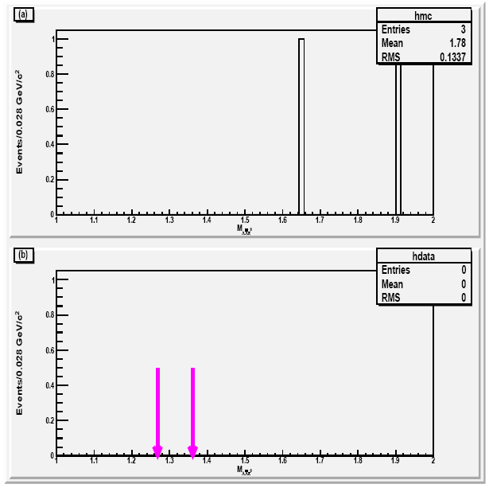

Slide 77
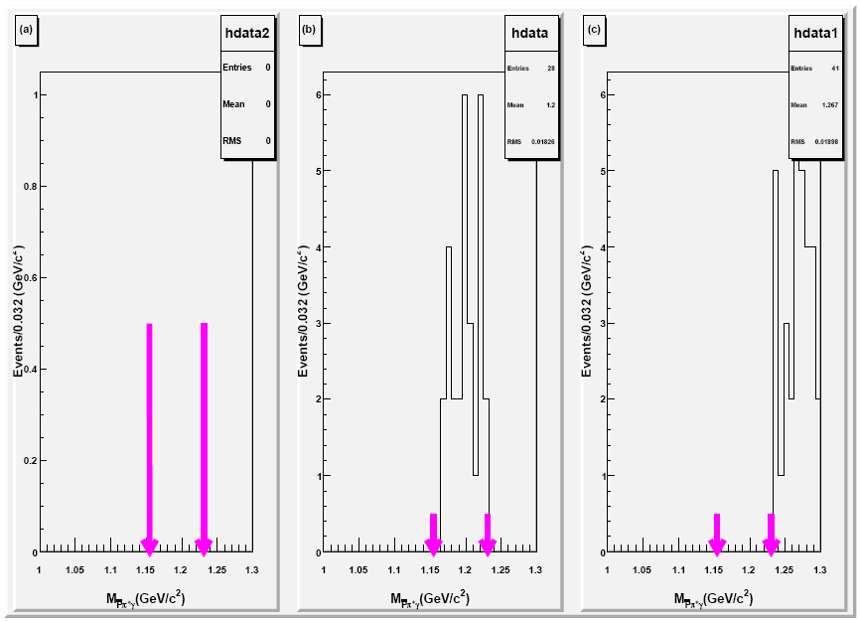
Sideband Analysis for

Slide 78
Calculated Upper Limit at 95% Confidence Level for
Formula for the calculation of upper limit is given bellow
Here represents number of observed signal events, detection efficiency and intermediate branching fraction . The calculated branching fraction is

Slide 79
Event Selection for
There are 4 charge tracks in
as
and
Only those events are selected having
nGood == 4
number of ɣ == 2
nCharge == 0
PID is applied to select events having 1 proton 1 anti proton 1 pion and 1 anti pion

Slide 80
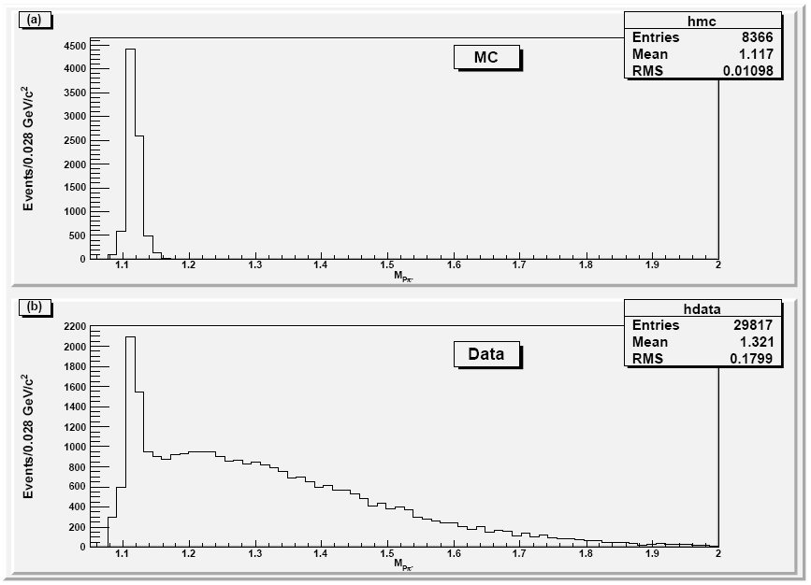
MC and Data invariant mass of using kinematic fit for

Slide 81
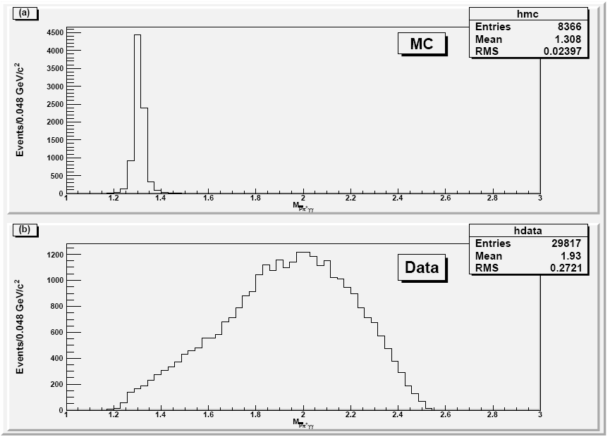
MC and Data invariant mass of using kinematic fit for

Slide 82
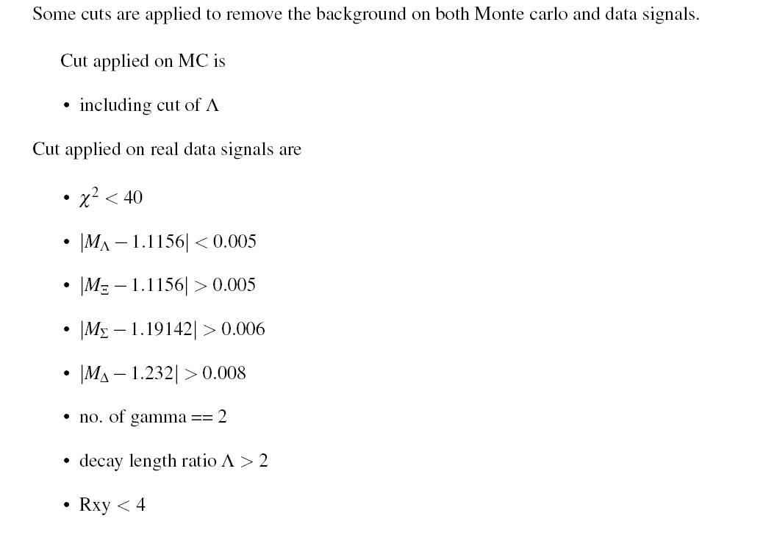
Background Analysis for

Slide 83
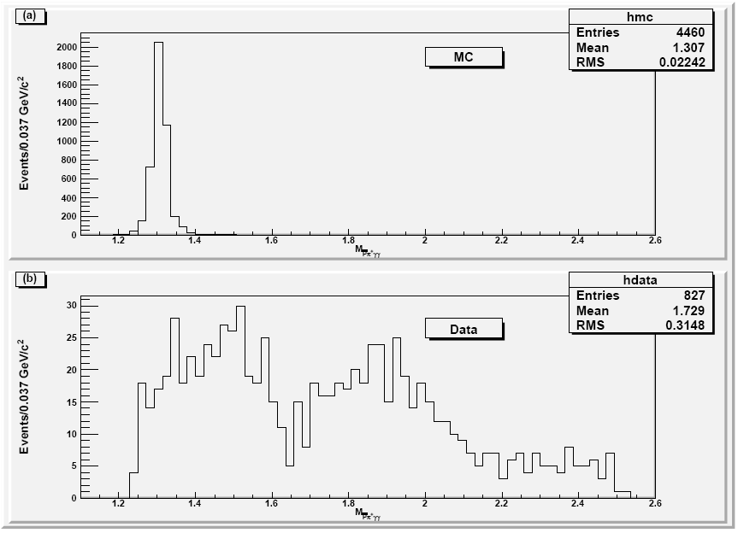
MC and Data invariant mass of after applying cuts for

Slide 84
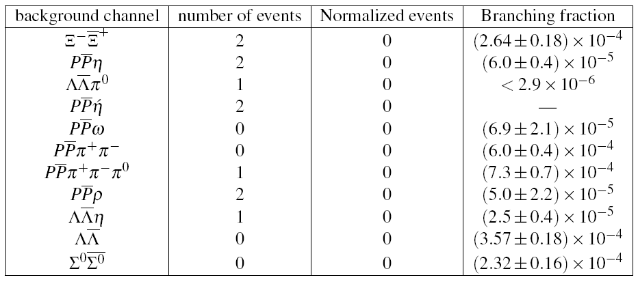

Slide 86
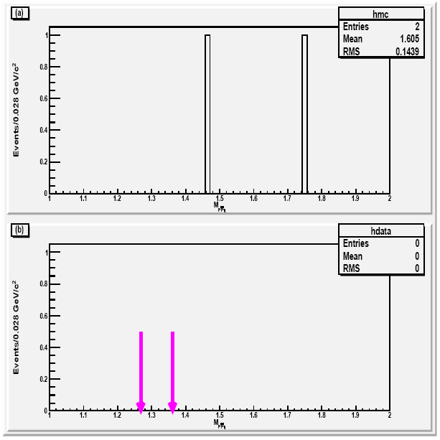

Slide 96
Sideband Analysis for

Slide 97
Calculated Upper Limit at 95% Confidence Level for
Formula for the calculation of upper limit is given bellow
Here represents number of observed signal events, detection efficiency and intermediate branching fraction . The calculated branching fraction is

Slide 99
Results
Calculated Branching fraction and upper limits are

Slide 100
Thanks

