Slide 1
Higgs->gamma gamma
Yaquan Fang (IHEP), Fangyi Guo (IHEP)
April 8, 2019

Slide 2
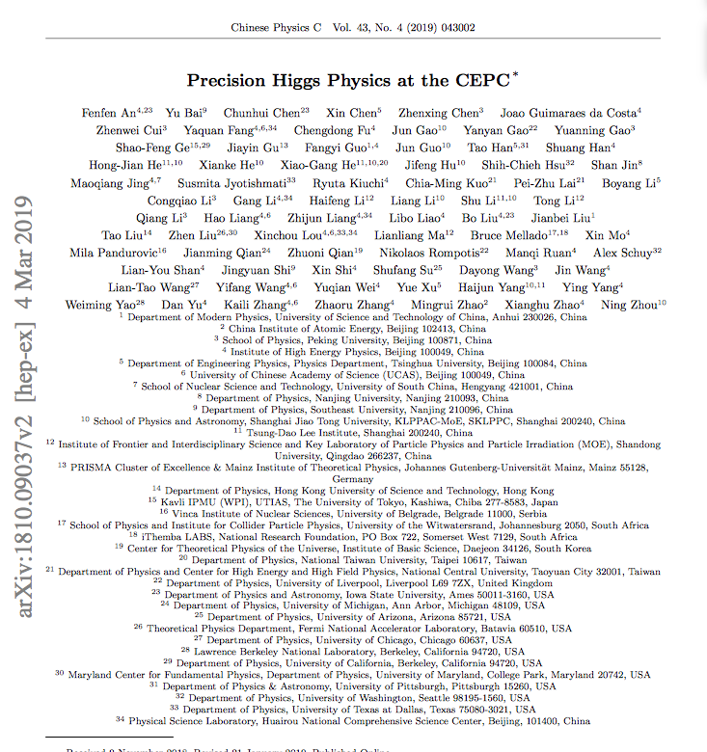
Status of the white paper @ CDR
V2 is at arxiv.
CPC : Vol 43, No.4 (2019) 043002

Slide 3
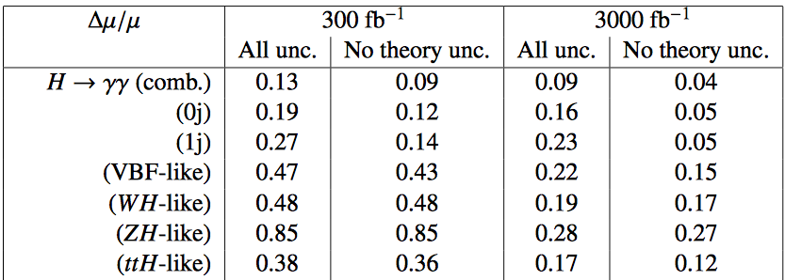
HL-LHC H->γγ: 2014
ATLAS 2014 results
CMS 2014 results
BDT
Use current theoretical uncertainty
Theoretical uncertainty is reduced by a factor of 2 w.r.t current one.
Other uncertainties are rescaled with square root of the Lum.
Theoretical uncertainty plays an important role.
Small production mode can help constrain the measurement.

Slide 4
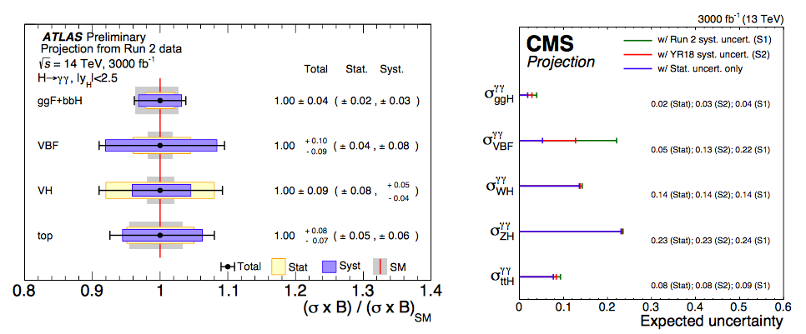
HL-LHC H->γγ: 2019
S2 scenario
Scenario S1: Total uncertainty is half of the one used for the result of 80 fb⁻¹.
Scenario S2: Total uncertainty is 1/3 of the one for 80 fb⁻¹.

Slide 5
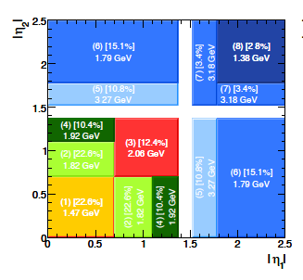
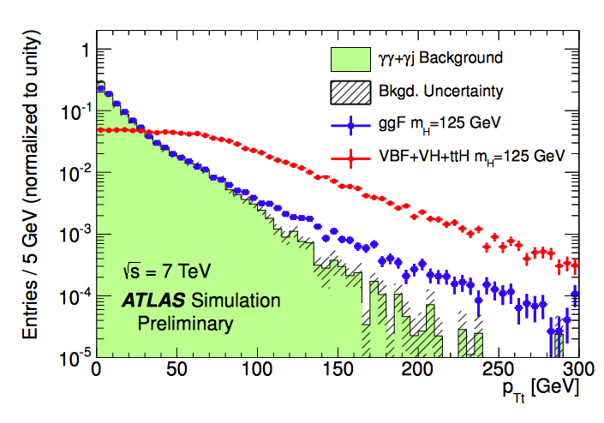
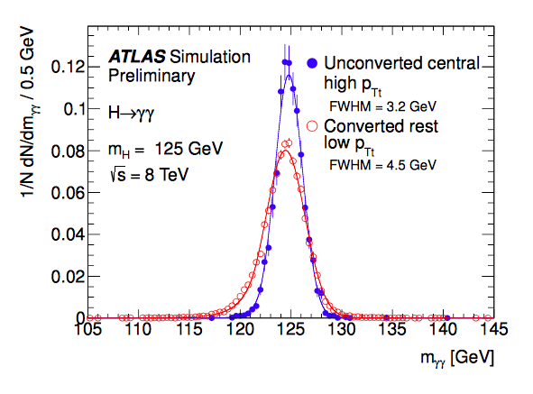
Optimizations of the H->γγ analysis in ATLAS:
The inclusive analysis is very simple :
Photon ID, Isolation, Kinematic cuts on leading/subleading photon.
Explore other possible improvements ?
Divide events into different categories.
P_{T} of Higgs (P_{Tt} is perpendicular to the thrust direction of two photon)
Divide different eta regions for two photons
Conversion of the photons

Slide 6
One example
ATLAS-CONF-2016-017
The improvement of significance w.r.t. inclusive one is from 4.0 to 4.6, corresponding 13% improvement on the
precision.

Slide 7
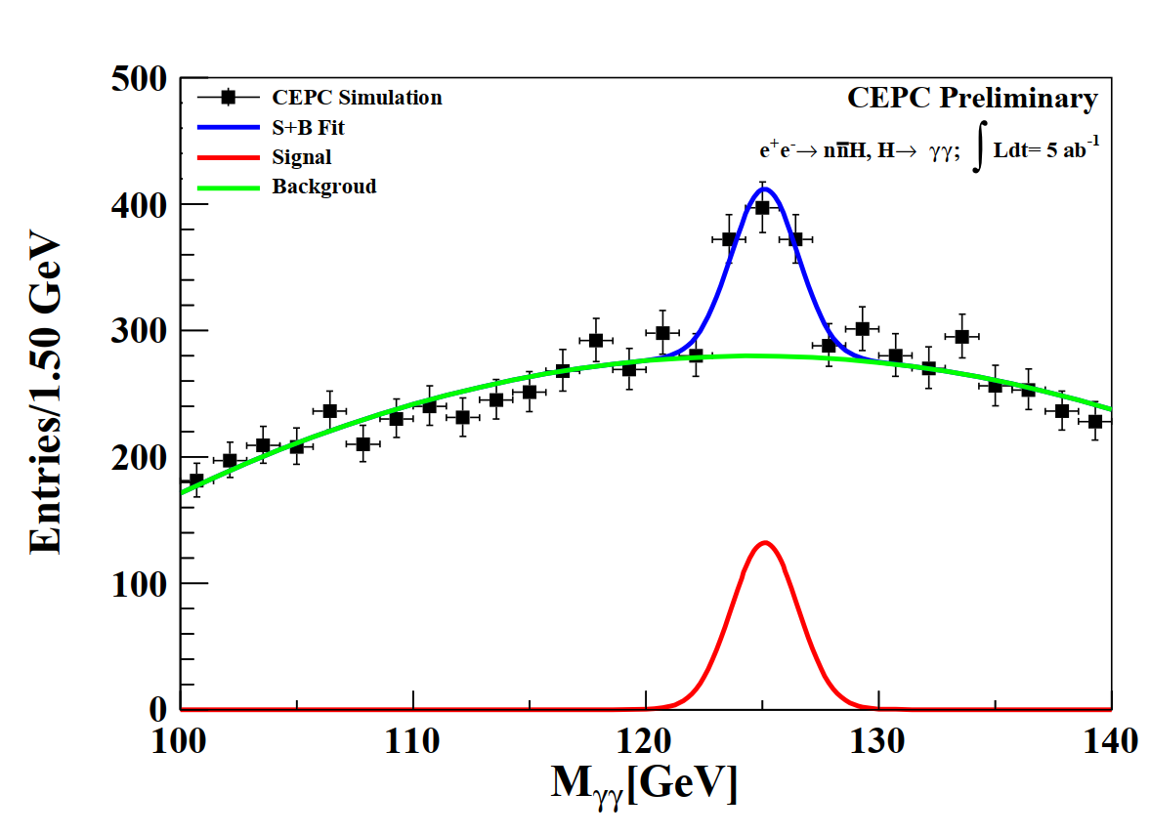
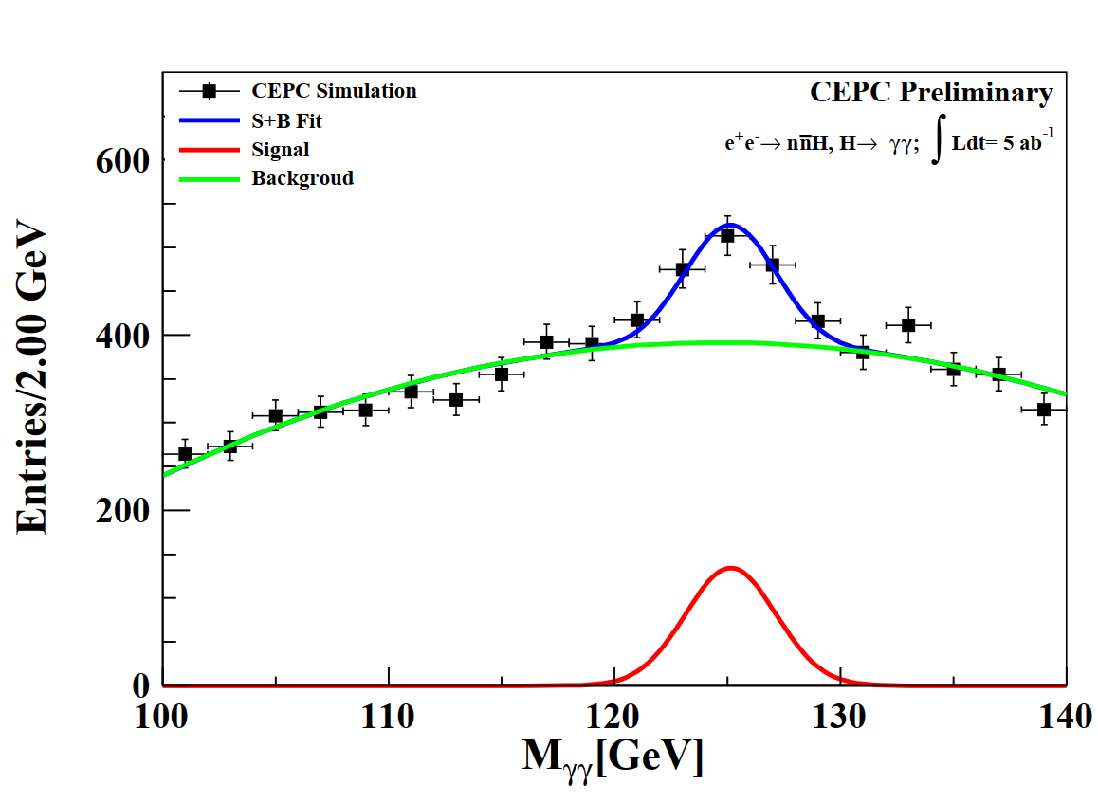
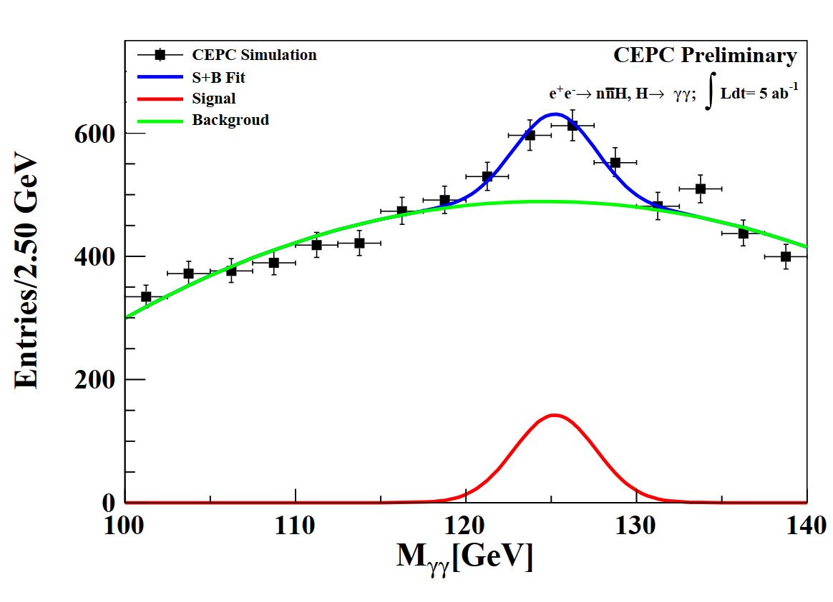
CEPC ECal resolution in $ZH→llγγ$
Smear the objects with resolution of $\frac{10\%}{\sqrt{E}}⊕1\%$, $\frac{16\%}{\sqrt{E}}⊕1\%$, $\frac{20\%}{\sqrt{E}}⊕1\%$ in fast simulation.
By Feng Wang
Figure: Higgs invariance mass spectrum measured in $Higgs→γγ$ in $ν\overline{ν}γγ$final state under the different Ecal performance assumptions which are $\frac{10\%}{\sqrt{E}}⊕1\%$(left), $\frac{16\%}{\sqrt{E}}⊕1\%$(medium), $\frac{20\%}{\sqrt{E}}⊕1\%$(right)
$δE$/$E$ | 10%/$\sqrt{E}$ | 16%/$\sqrt{E}$ | 20%/$\sqrt{E}$
$${δ\left(BR×σ\right)}/{BR×σ}$$ | 7.7% | 9.0% | 10.0%
Have been improved by re-optimizing the analysis (6.2% in 16%/$\sqrt{E}$)
Arxiv:1810.09037
Combined precision in 3 sub channel ($Z→qq, νν, μμ$)
It is possible that we can improve the result ~20-30% if we are aggressive......
-> categorize events, resolution improvement,….

