Slide 1
Weekly Report
Long Peixun
2019.4.11

Slide 2
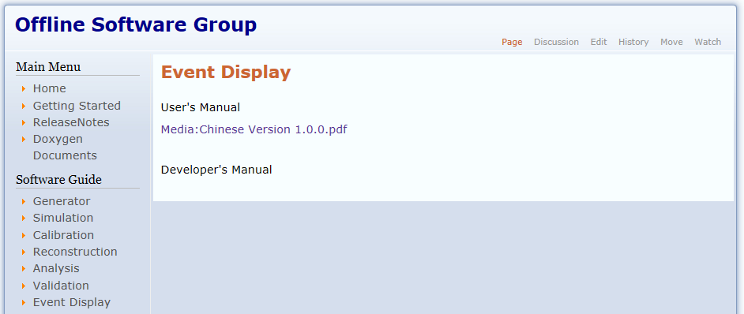
BesVis User’s Manual
I have uploaded User's Manual (Chinese Version) of BesVis to Offline Software Group Website.

Slide 3
Mdc Status Options in 3D View

Slide 4
Discussion of Circular Tracks
If $P_{z}=0$, the function of constructing MDC tracks in BesVis will fall into endless loop. In this case, the shape of track is circle.
How to solve this problem?
Restrict the length of track.
Use another constructing algorithm if $P_{z}<δ$.

