Slide 1
My Perspectives on High Energy Physics
Outline
Key questions to high energy physics
Current facilities and status
On the future
Summary
Zhengguo Zhao
University of Science and Technology of China
11/9/2019

Slide 2
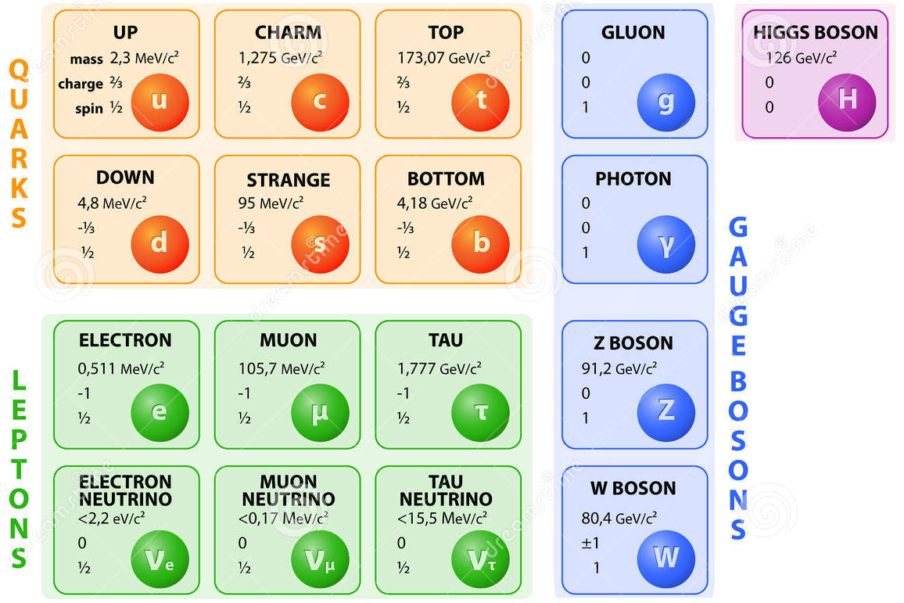




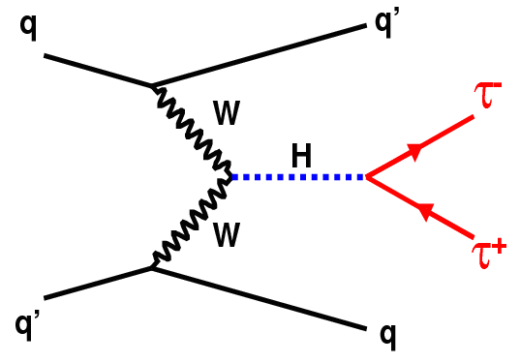
Standard Model of Elementary Particles
QCD
?
SM has being tested for decades by many experiments with precision down to ppm at low energy and ~1% at TeV scale.
A new interaction
to be understood!
Notes:
Questions to the SM:
Are these elementary particles fundamental?
Why there are three families?
Are there more interactions and what are their relations?
Why gravity cannot be built into the SM?
Are there more Higgs bosons? Does Higgs has structure?
What is the origin of the electroweak symmetry spontaneous breaking?
What is the property of neutrinos?
Why the mass of photon is zero, why the mass of them differ over 11 orders.
Why electric charge is quantitated?

Slide 3
Big Questions to the Standard Model
Are these elementary particles fundamental?
Why there are three families?
Are there more interactions and what are their relations?
Why gravity cannot be built into the SM?
Are there more Higgs bosons? Does Higgs has structure?
What is the origin of the electroweak symmetry spontaneous
breaking?
What is the property of neutrinos?
Why the mass of photon is zero, why the masses of them differ
over 11 orders.
Why electric charge is quantitated?

Slide 4
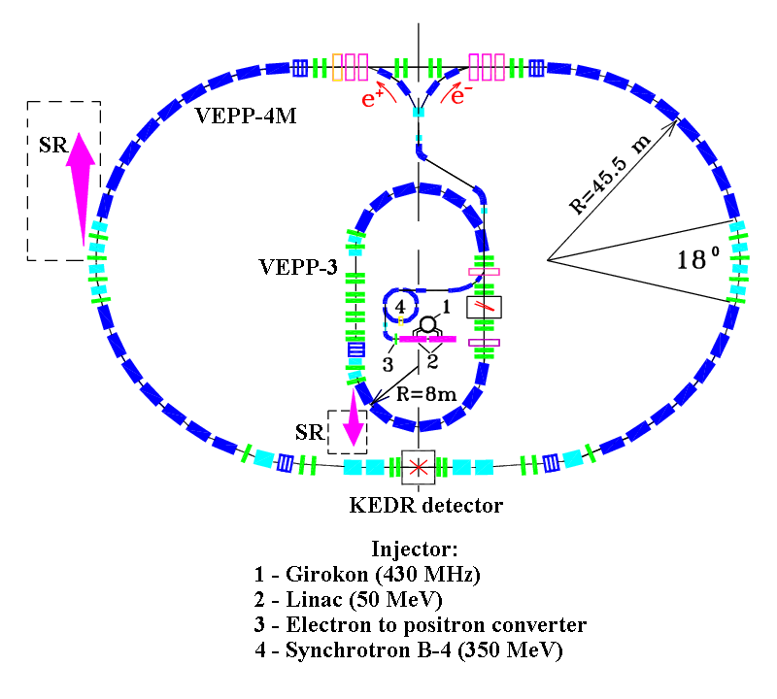
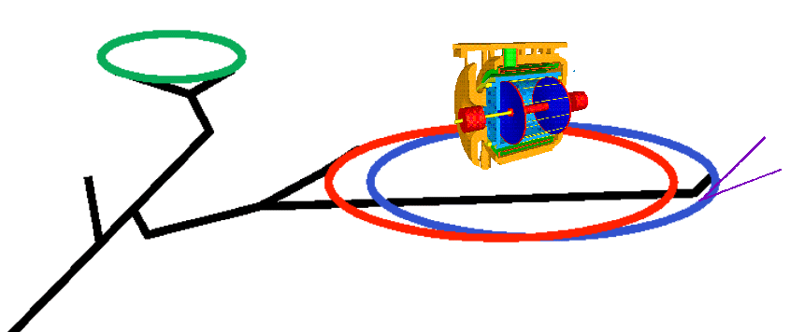
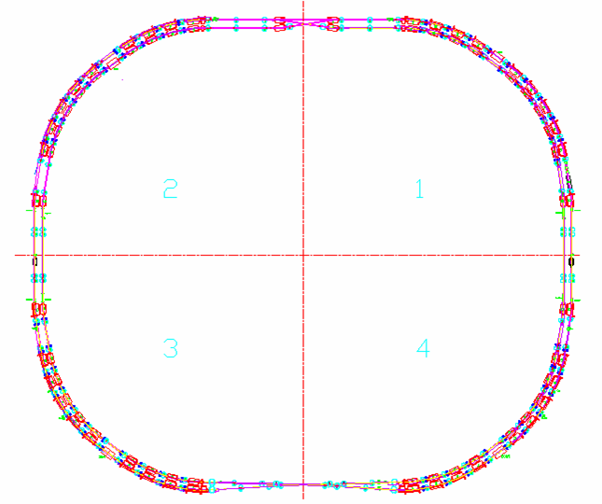
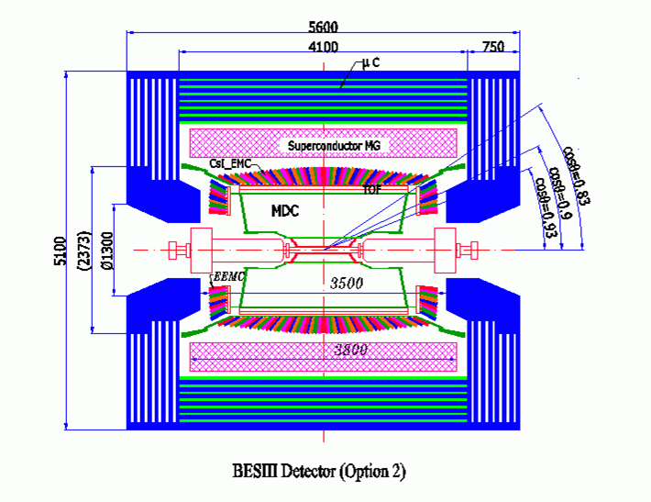
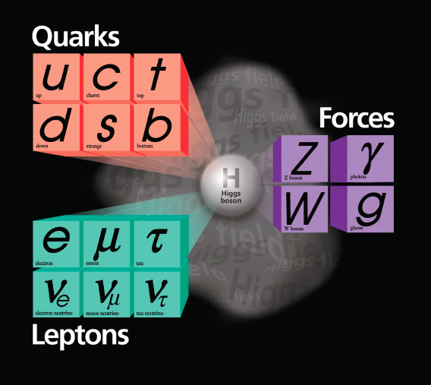

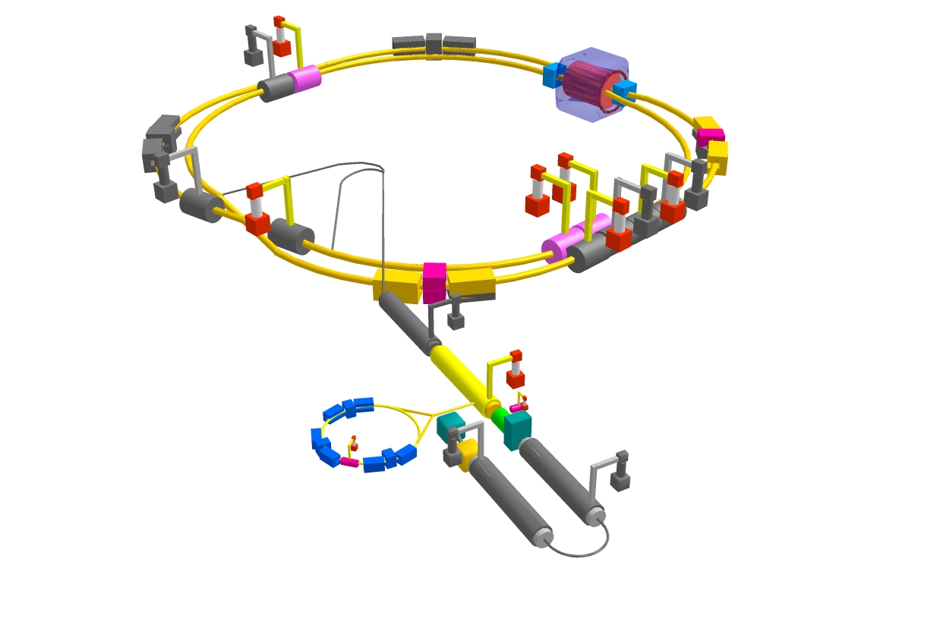
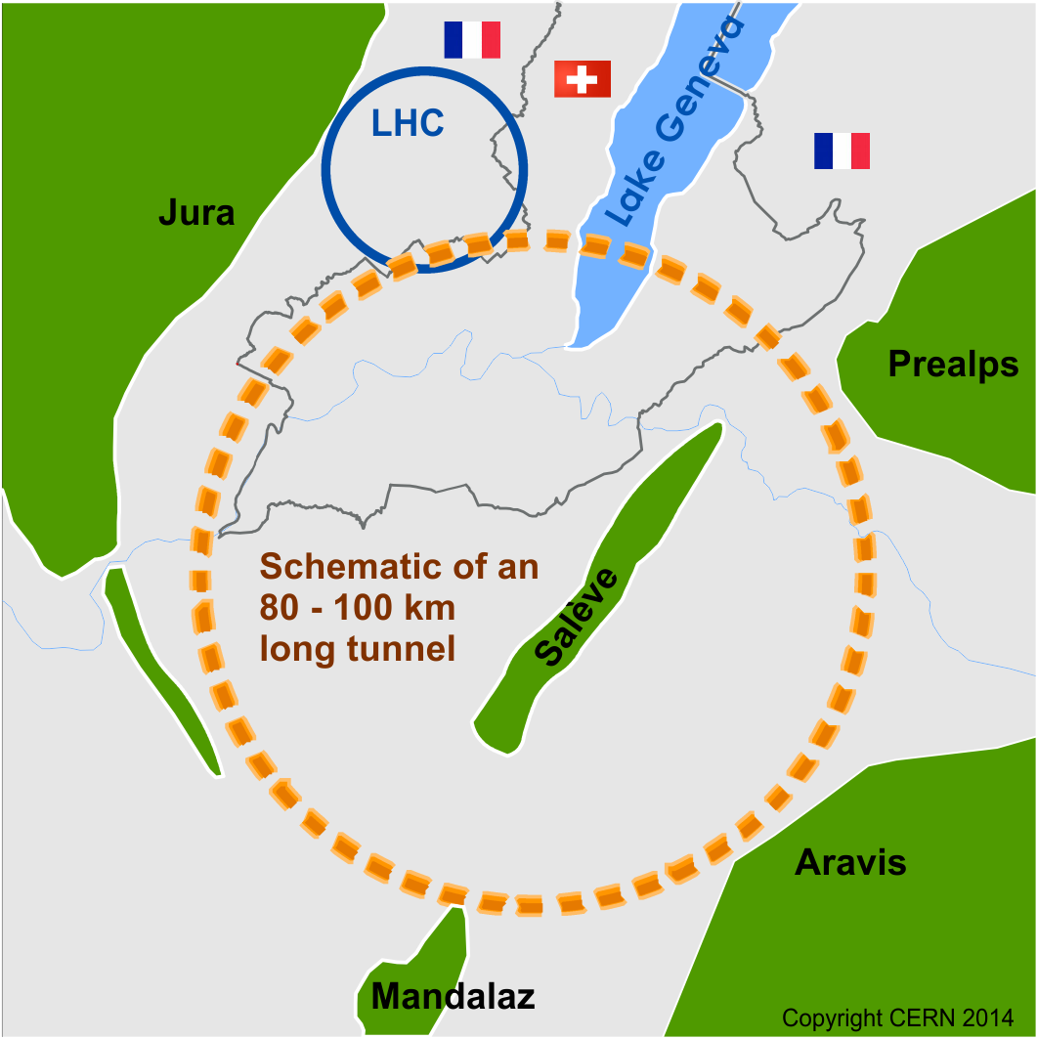
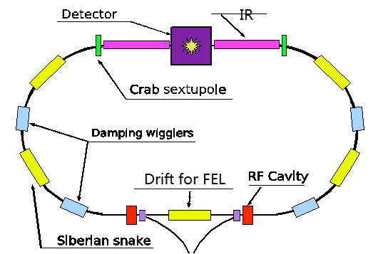
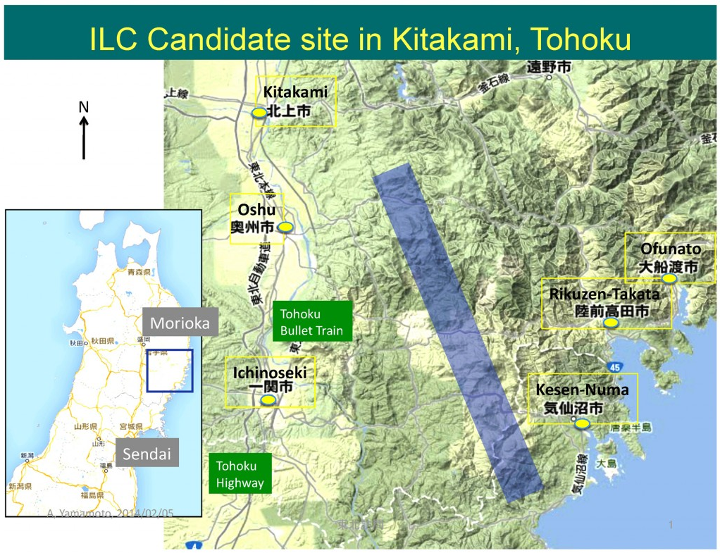
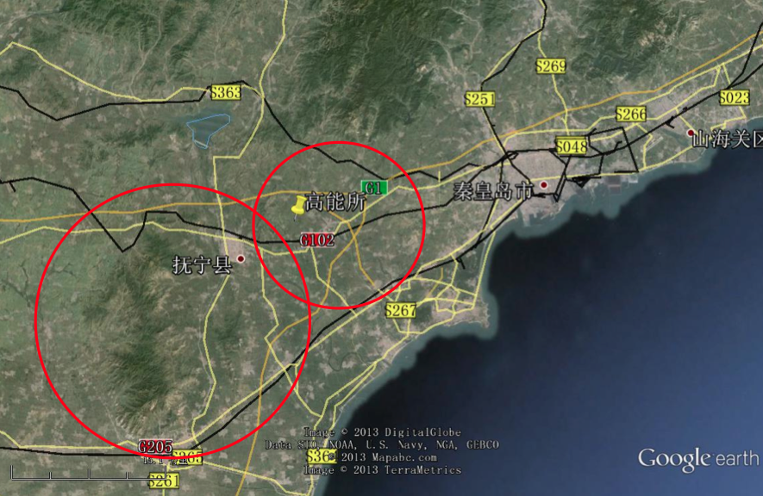
The Standard Model and Accelerators for Particle Physics
DAFNE
BEPC
SKEKB
Notes:
Add SBF, CEPC, HIEPA, DAMPE

Slide 5

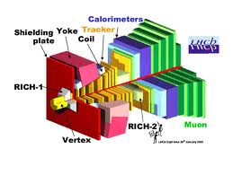


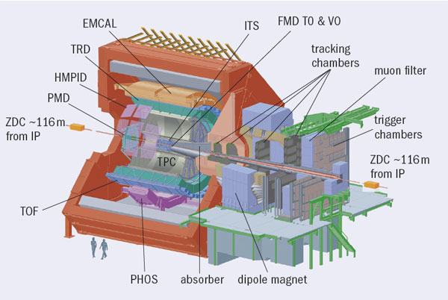
Experiments at Large Hadron Collider
Frontier of high energy physics in the next two decades
ATLAS
2800 Physicists
182 Institutions
40 countries
550 MCHF
CMS
2800 Physicists
184 Institutions
40 countries
550 MCHF
LHCb
1160 Physicists
69 Institutions
16 countries
75 MCHF
ALICE
1550 Physicists
151 Institutions
37 countries
150 MCHF
CMS
Tunnel circumference: 27 km
{p(TeV) = 0.3 B(T) R(km)]
Diameter: 3.8 m
Depth: 70 – 140 m
5
ATLAS

Slide 6
Physics at LHC
Search for Higgs bosons and alternative schemes for the spontaneous symmetry-breaking mechanism
Search for SUSY particles, new gauge bosons, leptonquarks and quark and lepton compositeness, dark matter particles and new phenomenon beyond SM
High-precision measurement of the 3rd quark family(m_{t}, t decay properties, rare decays and spectroscopy of B-hadrons; B⁰_{s}-mixing)
Study of CP violation via high precision measurement of CP-violating B-decays
QCD studies (proton structure, hard diffractive scattering, physics of jet, photon and heavy flavor…)
Physics with Heavy Ion Collision, QGP and its properties….

Slide 7
Major Tasks of Energy Frontier in Post Higgs Era
Higgs physics: know the property of the Higgs boson
Mass, width, spin parity, modes of production and decay;
Coupling to other particles (bosons and fermions);
Structure?
Higgs as a tool for the discovery → indirect search
New physics and phenomenon beyond SM
Search for other Higgs particles, SUSY particles, dark matter, exotic hadrons, new form of mater at extreme condition;
Direct search: higher energy→(7, 8, 13, 14 TeV), higher
statistics (→25, 100, 300, 3000 fb⁻¹) look for unusual
signatures and rare final states;
Indirect search: high statistics and high precision →
precision measurements of the known processes.

Slide 8
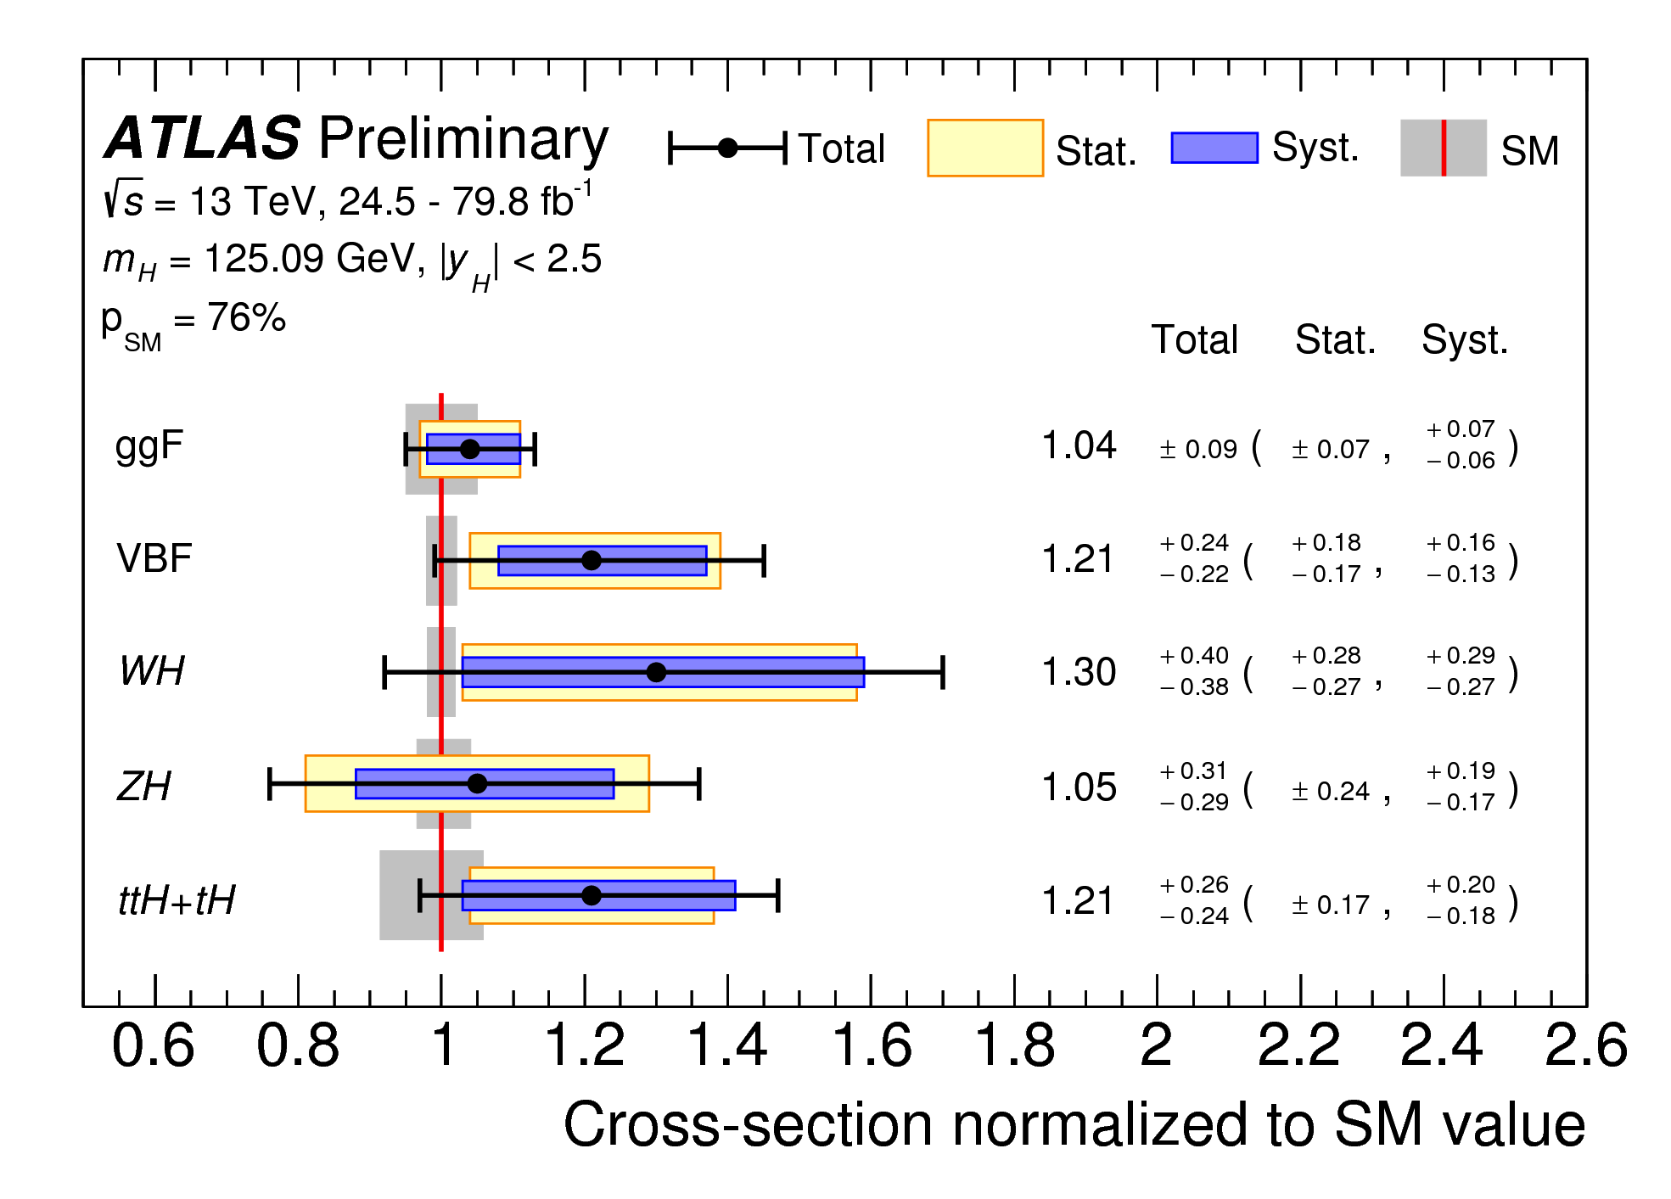
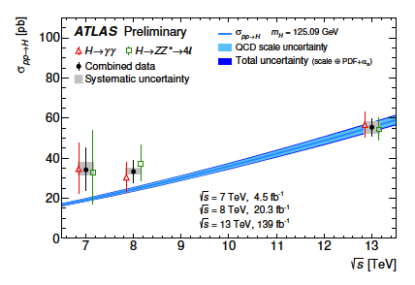
Mass, Width and Production Cross Section
Mass
125.26±0.21 GeV (CMS)
124.97±0.24 GeV (ATLAS)
Width
0.08<𝚪_{H}<9.16 MeV (CMS)
𝚪_{H}<14.4 MeV(ATLAS)

Slide 9
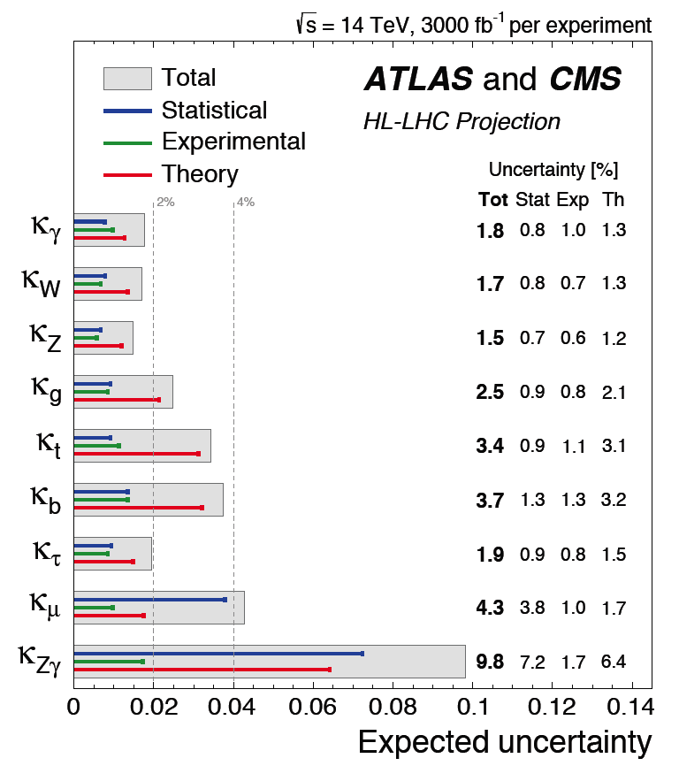
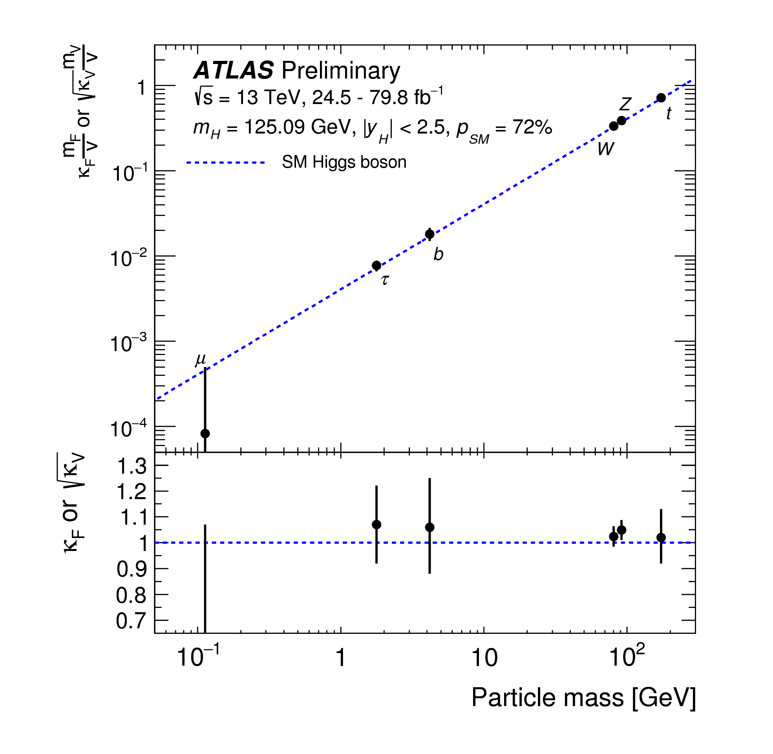
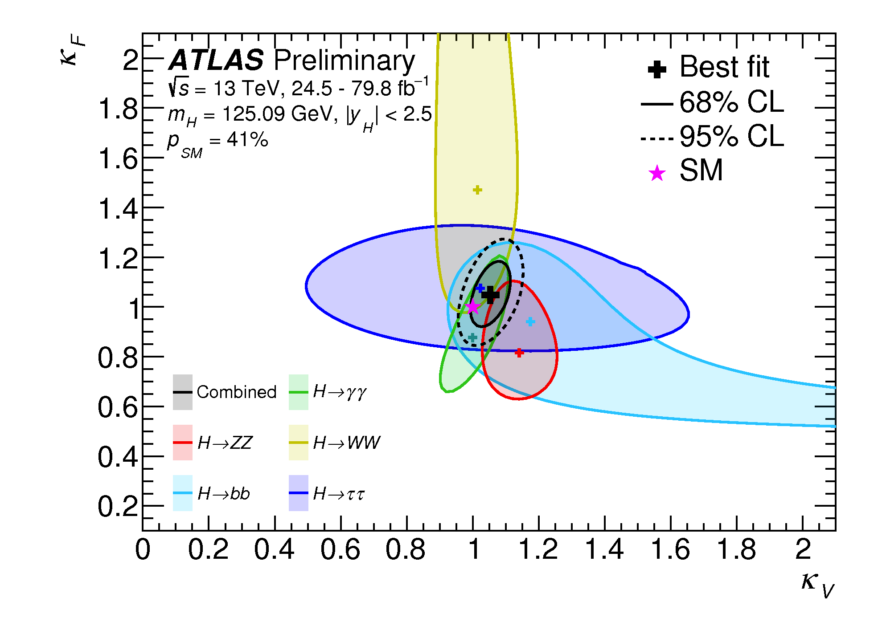
Higgs Couplings
Higgs boson couples to the other SM particles:
- to bosons with strength ~M_{V}²/v, where v is the vacuum
expectation value v≈246 GeV.
- to fermions with strength ~M_{f} /v.
Reveal new physics at 0.1% level

Slide 10
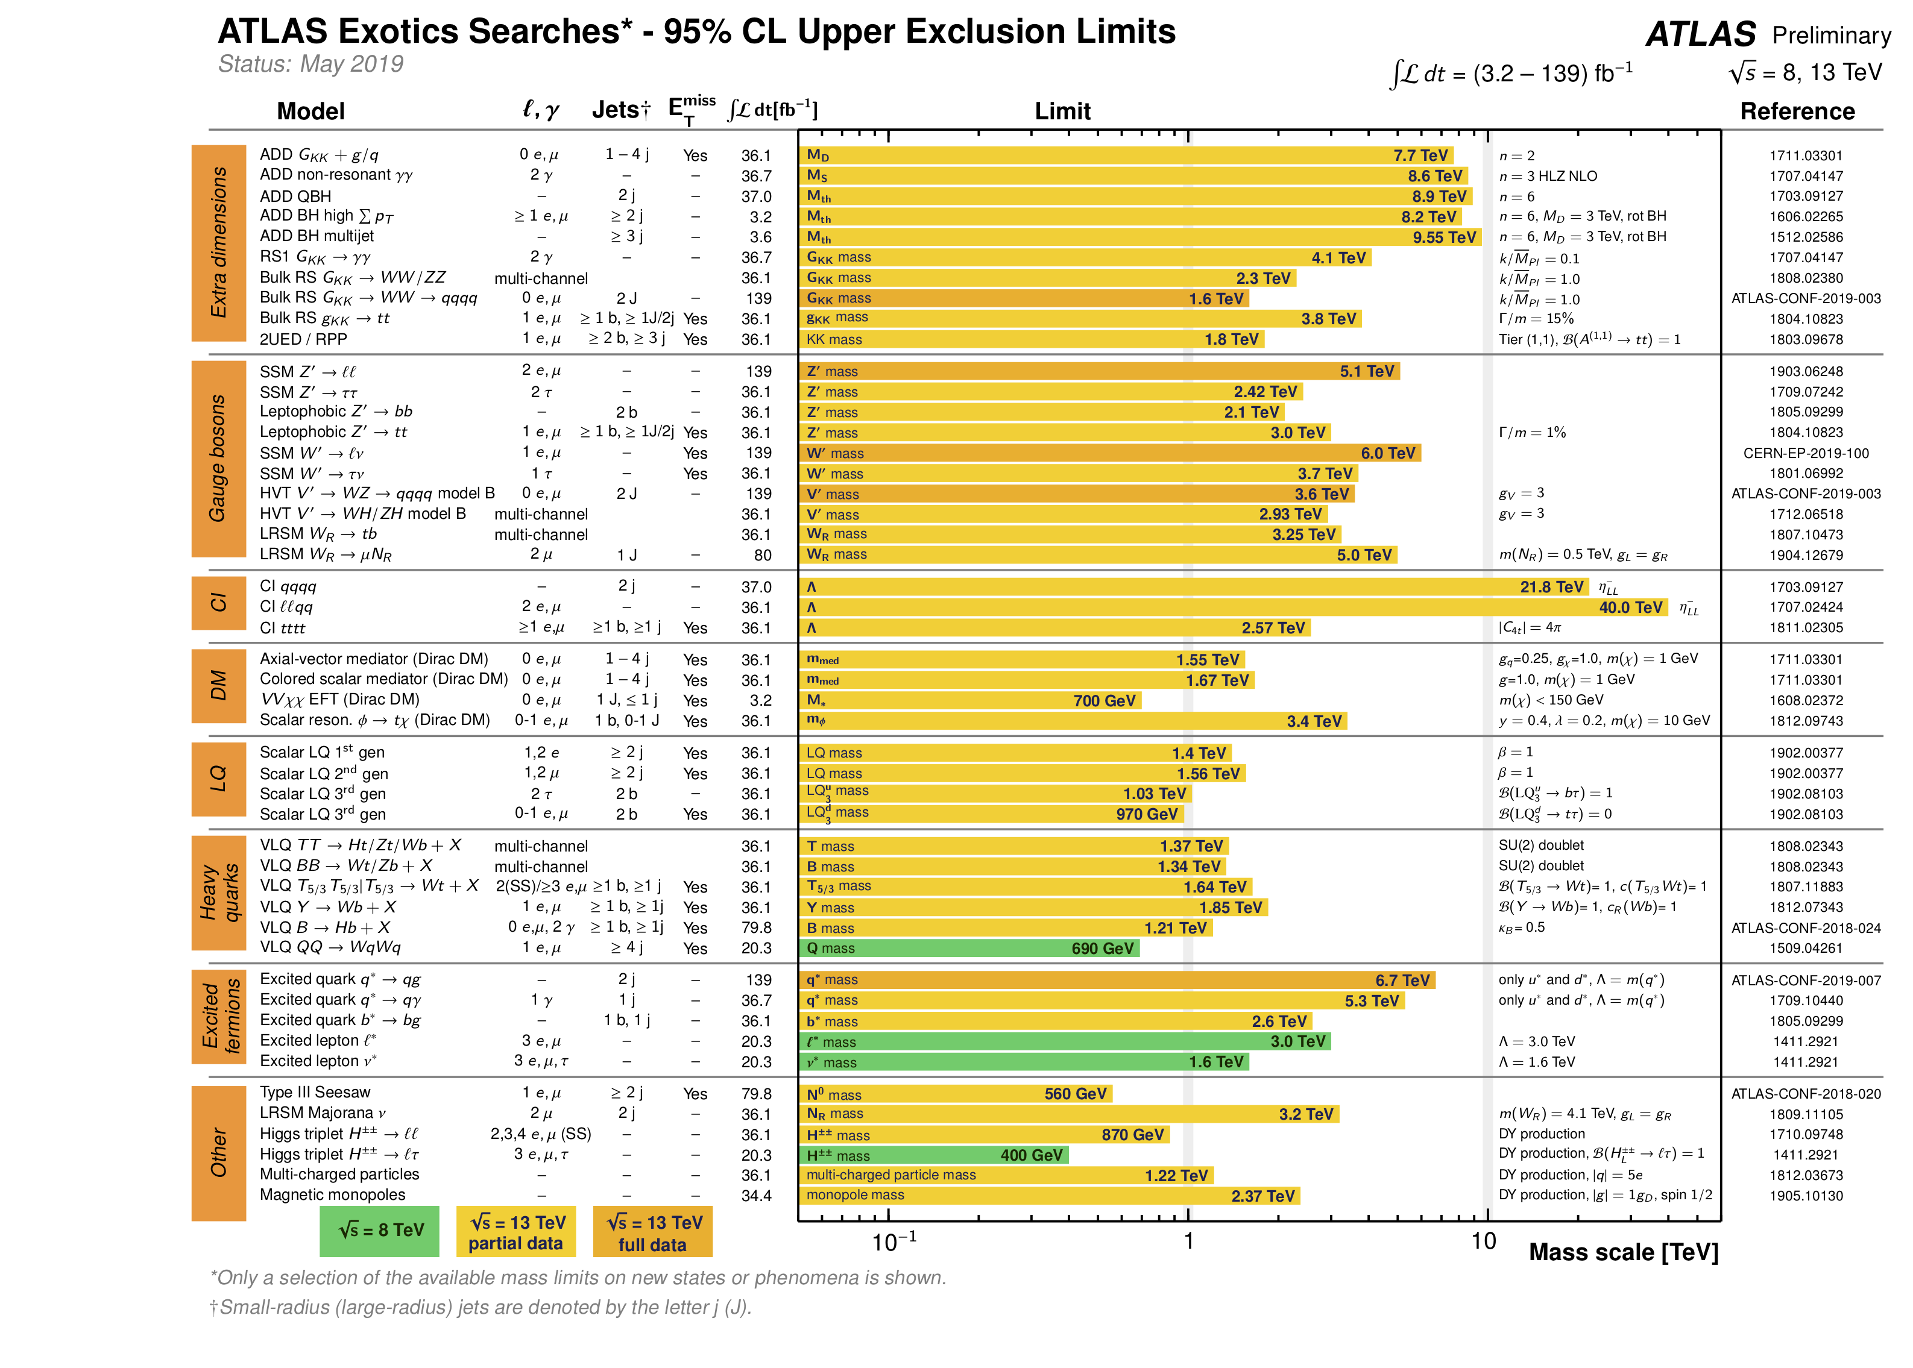
https://twiki.cern.ch/twiki/bin/view/AtlasPublic/
1 TeV
10 TeV

Slide 11
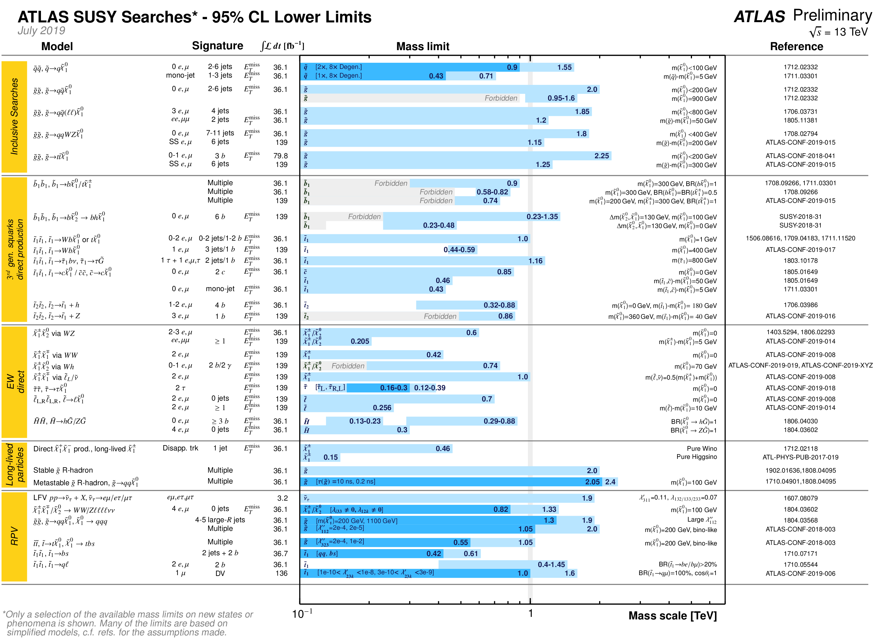
1 TeV

Slide 12
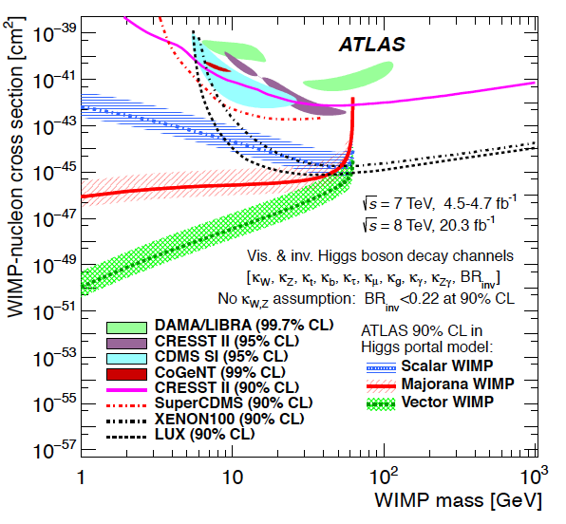
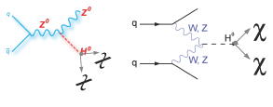
Search for Dark Matter (WIMP)
DM could be directly produced at the LHC through decays (LSP in SUSY cascades, or Higgs portal).
Complementary to direct and indirect searches.
Best for low DM masses and spin-dependent couplings
Invisible Higgs decays
g_{q}
g_{χ}
Contact interaction-
effective field theory
Simplified models
arXiv 1603.04156 (2016)
Notes:
90%CL upper limits on the WIMP-nucleon scattering cross section as a function of the Dark Matter particle mass. Spin-independent results excluded
and favored regions from direct detection experiments are also shown. (iv) the λτZ = κτ /κZ ratio constrained by the τ+τ− channel; (v) the λbZ =

Slide 13
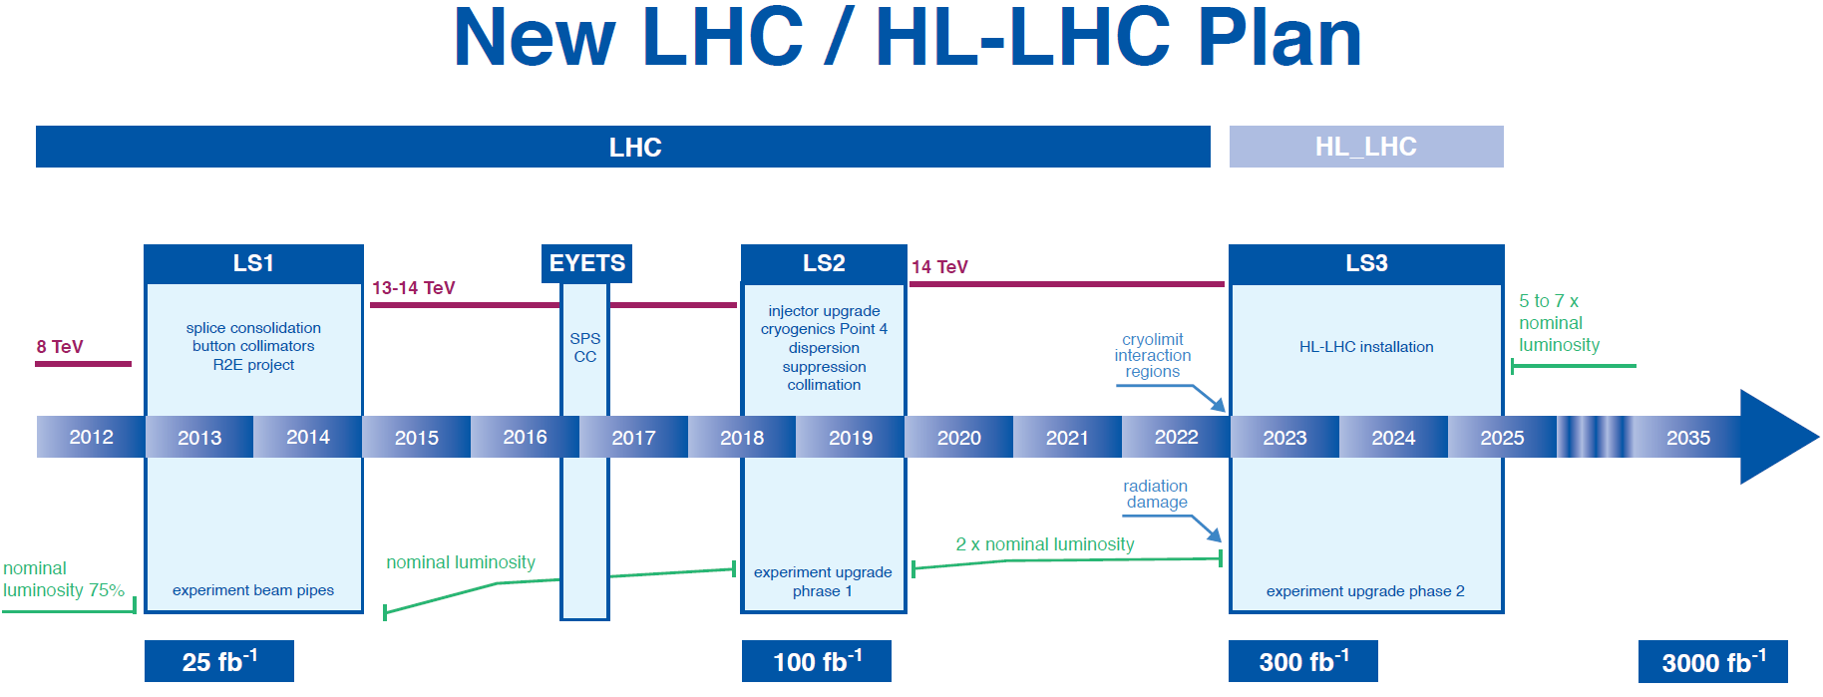
High statistics data to study Higgs boson property and
search for new phenomenon beyond SM.
Unique frontier for tackling key science questions,
training world first class scientists and develop cutting
edge technologies.

Slide 14
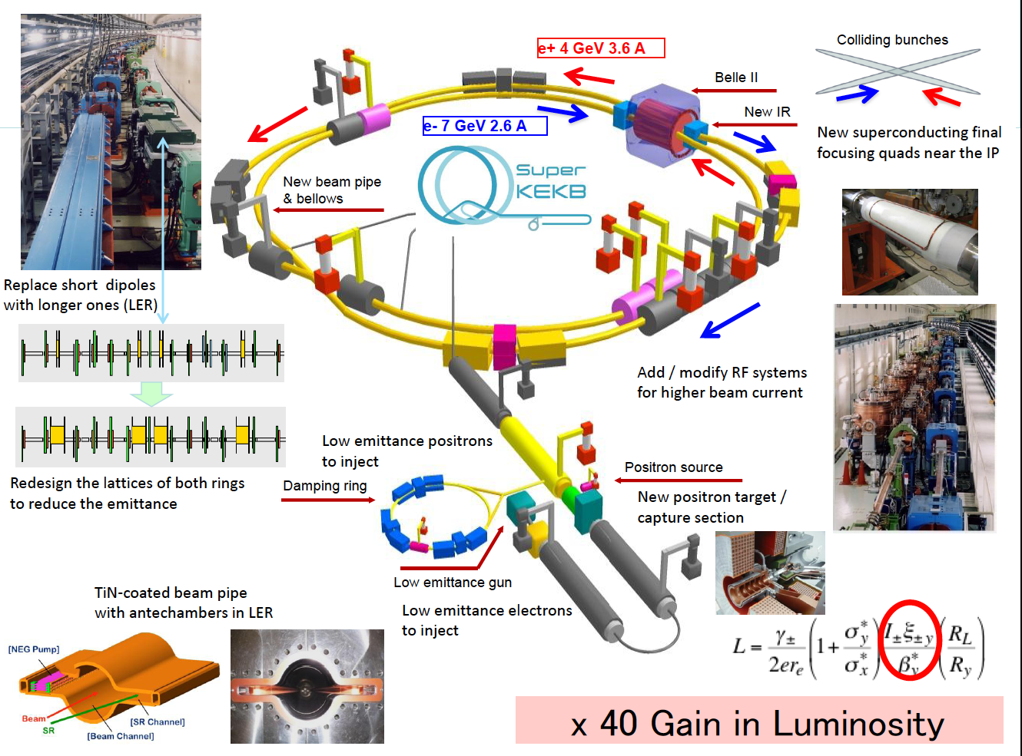

Slide 15
Belle II Detector
BEAST (Background commissioning detector)
KL and muon detector:
Resistive Plate Counter (barrel outer layers)
Scintillator + WLSF + MPPC (end-caps , inner 2 barrel layers)
EM Calorimeter:
CsI(Tl), waveform sampling (barrel)
Pure CsI + waveform sampling (end-caps)
Particle Identification
Time-of-Propagation counter (barrel)
Prox. focusing Aerogel RICH (fwd)
electrons (7GeV)
Beryllium beam pipe
2cm diameter
Vertex Detector
2 layers DEPFET + 4 layers DSSD
positrons (4GeV)
Central Drift Chamber
He(50%):C2H6(50%), small cells, long lever arm, fast electronics
Reuses the structure, solenoid and CsI(Tl) crystals and
part of the barrel RPCs. Most other components are new.
Notes:
Reuses the structure, solenoid and CsI(Tl) crystals and part of the barrel RPCs. Most other components are new.
We must prepare for backgrounds a factor of 10-20 higher. Hence the use of DEPFET pixels for inner vertexing and a new silicon vertex detector with the APV2.5 readout chip from CMS. The PID is based on Cherenkov counters. For the barrel, the Cerenkov light is totally internally reflected to an array of pixelated PMTs. High precision timing and position information is used to distinguish kaons from pions.

Slide 16
Physics at SuperB Factory—Precision Frontier
Search and understand new form of hadron.
Search for new phenomena:
– CPV from the new physics (non KM), and in charm sector.
– Lepton flavor violations (LFV) in τ decays.
– B/tau decays
Probe the charged Higgs in large tanβ region through pure leptonic decay, B→τν,D_{τν}.

Slide 17
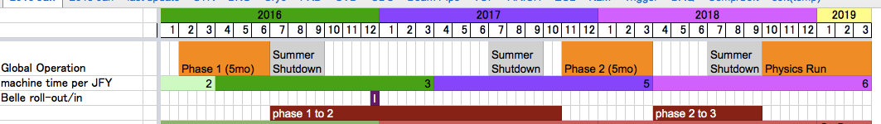
Belle II Schedule
BEAST PHASE I:
Started Feb 2016 (Belle II roll-in at the end of the year)
BEAST PHASE II:
Starts Nov 2017 [first collisions, limited physics without vertex detectors]
Belle II Physics Running:
Fall 2018 [vertex detectors in]

Slide 18
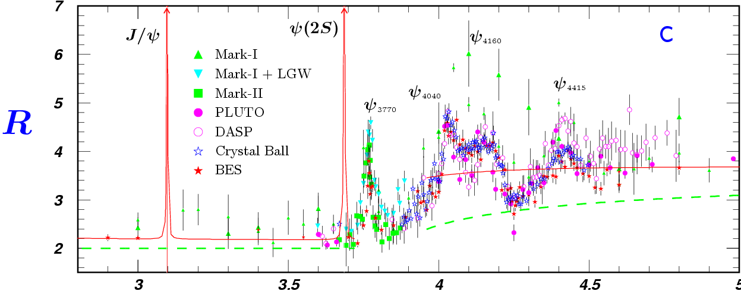
Features of the τ-c Energy Region
Rich of resonances, charmonium and charmed mesons.
Threshold characteristics (pairs of τ, D, D_{s}, charmed baryons…).
Transition between smooth and resonances, perturbative and non-perturbative QCD.
Mass location of the exotic hadrons, gluonic matter and hybrid.
18
τ⁺τ⁻
D_{s}D_{s}
Λ_{c}Λ_{c}

Slide 19
Physics at STCF
Test and understand QCD at low energy
Search and understand of new forms of hadrons.
Structure of hadrons (form factors)
Light hadron, Charmonium(-like) spectroscopy
Precision test of the Standard Model
R values, tau decays, CKM matrix, lepton universality test
Decay constants
CP violation in tau, charm, baryon, charmed baryon
New physics searches
Rare and forbidden decays relating to c and τ
→ LFV, LNV, BNV, FCNC, LFV, LNV, invisible decays
Light dark matter candidates, light Higgs boson(a₀)…

Slide 20
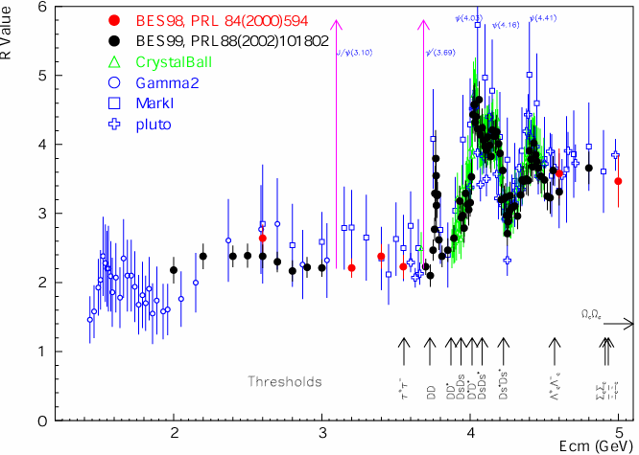
Physics at τ-c Energy Region
R=σ(e⁺e⁻→hadron)/
σ(e⁺e⁻→μ⁺μ⁻)
Hadron form factors
Y(2175) resonance
Mutltiquark states with s quark, Zs
MLLA/LPHD and QCD sum rule predictions
Light hadron spectroscopy
Gluonic and exotic states
Process of LFV and CPV
Rare and forbidden decays
Physics with τ lepton
XYZ particles
Physics with D mesons
f_{D} and f_{Ds}
D₀-D₀ mixing
Charmed baryons
_
R scan
Precision Δα_{QED}, a_{μ}, charm quark mass extraction.
Hadron form factor(nucleon, Λ, π).

Slide 21
Publication of BESIII
≈200 publications, 1/5 PRL, Excellent in terms of in number and quality. http://bes3.ihep.ac.cn/pub/physics.htm
A couple of more years to run.
Further upgrade power is very much limited.

Slide 22
Where to Go?

Slide 23
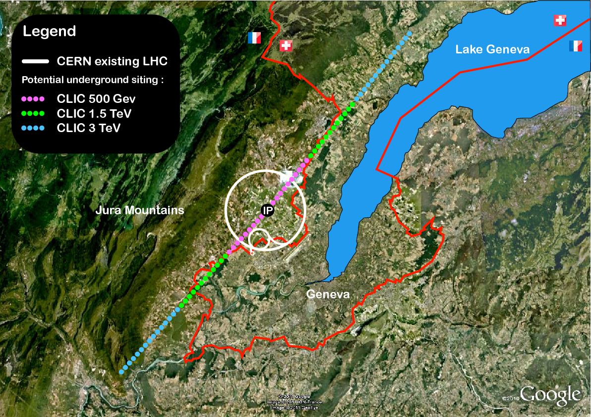
Future High Energy Frontiers
ILC
CLIC
F_{CC}:
e⁺e⁻
pp
e⁻ ion
CEPC+SppC
16 T ⇒ 100 TeV pp in 100 km

Slide 24
Possible Options for HEP in China
e+
IP1
e-
High Energy Booster(7.2Km)
Medium Energy Booster(4.5Km)
e+ e- Linac
(240m)
CPC
Proton Linac
(100m)
STCF
Low Energy Booster(0.4Km)
Booster(50Km)
CEPC Collider Ring(50Km)
IP2
SppC Collider Ring(50Km)
E_{cm}: 2-7 GeV
L: 5×10³⁴ cm⁻²s⁻¹
Cost: ~4.5 B RMB
CEPC(with ZF)+SppC
Z, H factory (ee)
~100 TeV (PP)
Order of 10 B USD
Notes:
Add SBF, CEPC, HIEPA, DAMPE

Slide 25
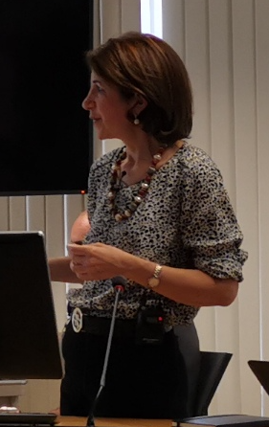
European Strategy for Particle Physics 2019
Strong support for:
e⁺e⁻ Higgs factory: potential of ILC@250, CLIC@380, CepC and
FCC-ee for Higgs measurements considered to be similar to first order
accelerator R&D, including muon colliders and plasma wakefield
scientific diversity programe
energy-frontier proton-proton collider
No clear consensus on the next collider at CERN: CLIC vs FCC.
But broad consensus there should be one
Support for stronger CERN’s engagement in astroparticle physics
(in particular, but not only, from the astroparticle community)
From Fabiola Gianotti, including next 6 slides

Slide 26
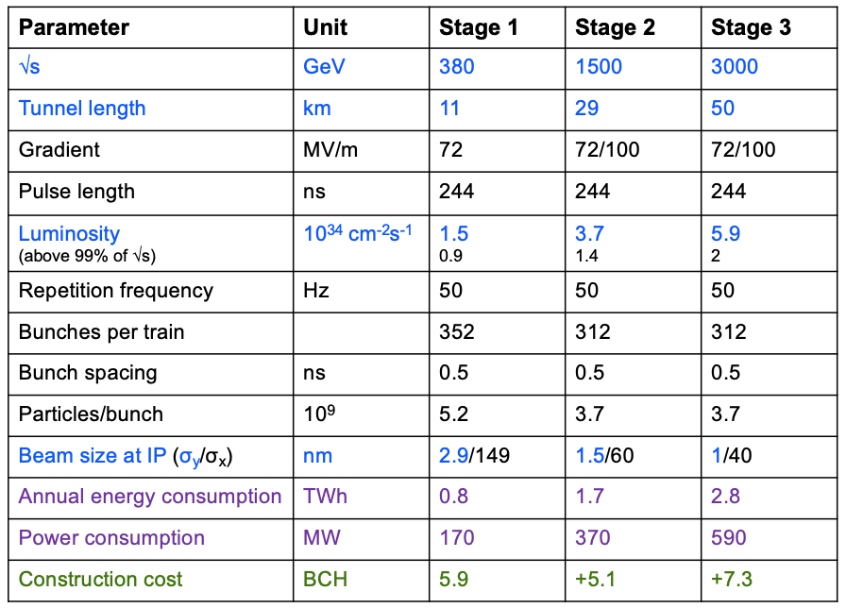
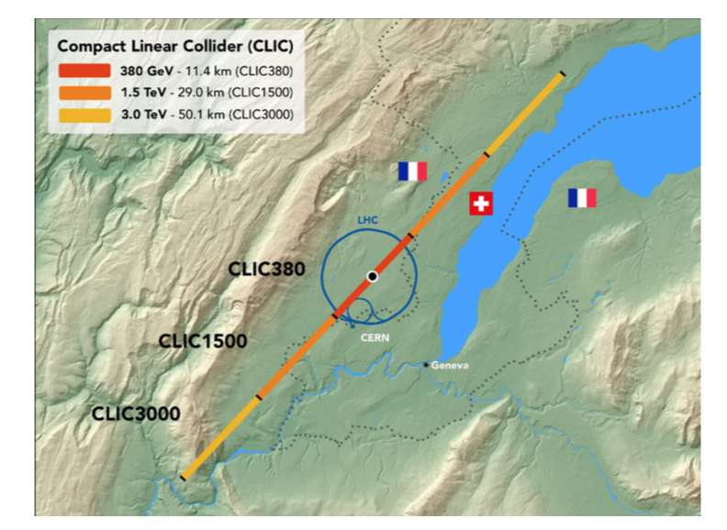
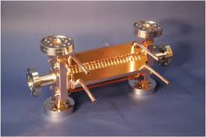
CLIC: multi-TeV e⁺e⁻ linear collider
CERN today: 1.2 TWh
100 MV/m accelerating gradient needed for compact (~50 km) machine
at 3 TeV→based on normal-conducting 12 GHz accelerating structures and a
two-beam acceleration scheme providing short (244 ns) high-power RF pulses

Slide 27
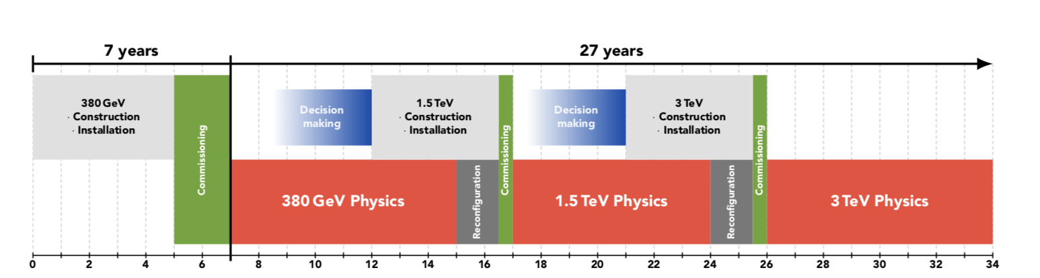
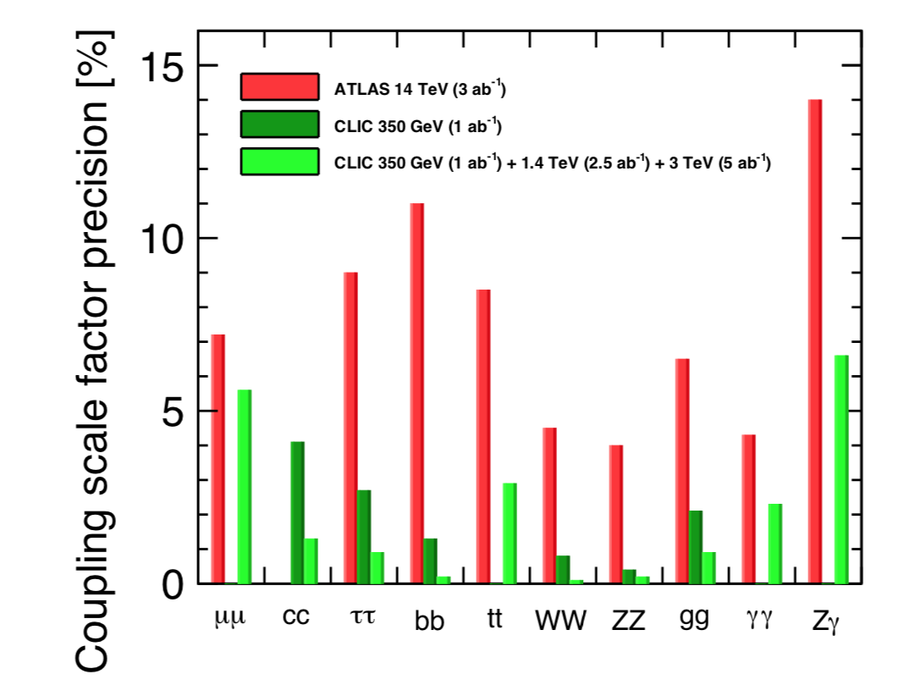
CLIC: multi-TeV e⁺e⁻ linear collider
Technically, construction could start in ~2026 (TDR in 2025) → first collisions
at √s=380 GeV in ~2035 → 25-30 years of physics exploitation
1 ab⁻¹
2.5 ab⁻¹
5 ab⁻¹
Measured couplings/SM prediction
assuming no Beyond SM decays
Physics reach:
Measurements of Higgs couplings, including
ttH (to ~3%) and HH (~ 10%) from direct production
Direct discovery potential and precise measurements
of new particles up to the kinematic limit
Indirect sensitivity to E scales up to Λ ~ 100 TeV;
different √s probe E-dependent operators of new physics;
±80% electron polarization also helps characterize
the new physics
Coupling scale factor precision [%]

Slide 28
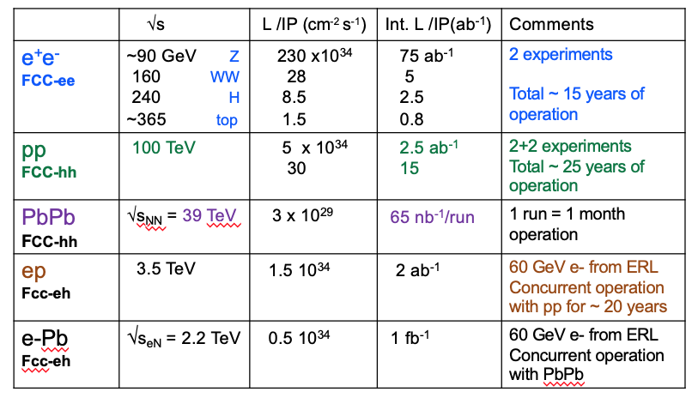
F_{CC}: Future Circular Collider
HE-LHC
FCC CDR emphasizes advantages of integrated programme, i.e. sequential implementation of
FCC-ee followed by FCC-hh:
variety of collisions (ee, pp, PbPb, eh) → largest breadth of programme, 6++ experiments
exploit synergies by combining complementary physics reach and information of different
colliders → maximise indirect and direct discovery potential for new physics
E.g. Measurement of HZZ and ttZ couplings at FCC-ee removes model-dependence of several couplings
that are best measured at hadron colliders (e.g. ttH, H→µµ, H → Z𝞬)
start with technologically ready and cheaper e⁺e⁻ machine; develop in parallel best technology
(e.g. HTS magnets) for highest possible pp energy (100++ TeV!) and spread cost of expensive
pp machine over more decades

Slide 29
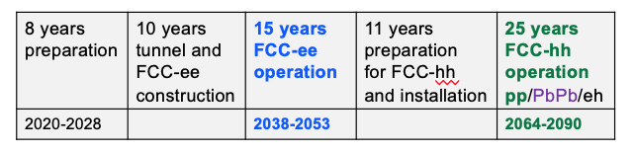
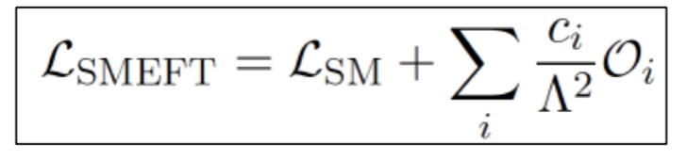
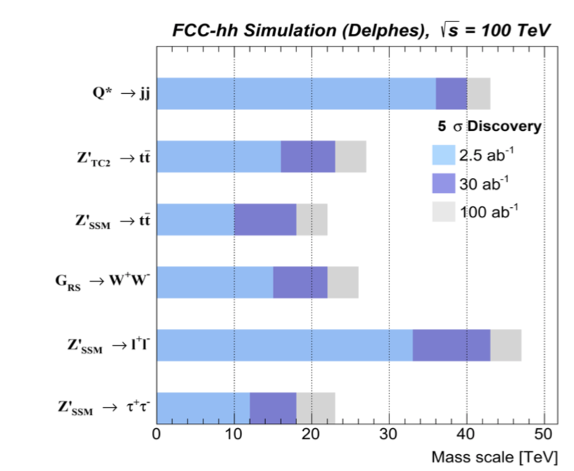
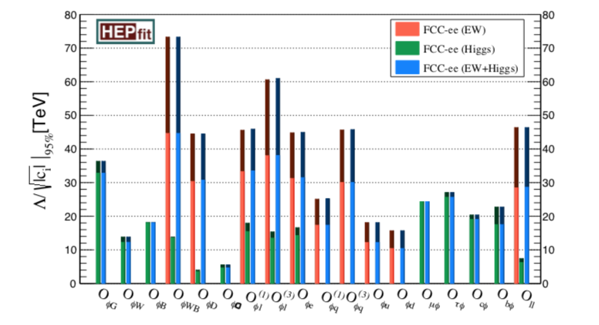
Future Circular Collider
Preliminary, purely technical schedule
for integrated programe, assuming
green light to preparation work in 2020.
If no FCC-ee: FCC-hh could technically start in ~ 2043
Estimated cost:
FCC-ee ~ 11.6 BCHF: 5.4 B (tunnel) + 5.1 B (up to √s=240 GeV) + 1.1 B (additional RF for √s ~365 GeV)
FCC-hh ~ 17 BCHF if built after FCC-ee, 24 BCHF if standalone.

Slide 30
Physics Beyond Colliders (PBC)
Physics Beyond Colliders study group set up in 2016 to explore the opportunities offered by the
CERN accelerator complex and other scientific infrastructure to get new insight into some of
today’s outstanding questions in particle physics through projects complementary to high-energy
colliders (i.e. projects requiring different types of beams and experiments) and other initiatives in the world.
Projects should exploit the uniqueness of CERN accelerator complex and infrastructure.
QCD measurements
COMPASS++, DIRAC++
NA61++, NA60++
Fixed target (gas, bending crystals) in ALICE and LHCb
Hidden sector with “beam dump”
NA64++ (e,μ)
NA62++
Beam Dump Facility at North Area (SHiP)
LDMX@eSPS
AWAKE++
Rare decays and precise measurements
KLEVER (K⁰_{L} → π⁰𝜈𝜈)
TauFV@BDF: 𝜏 → 3μ
REDTOP (𝜂 decays)
MUonE (hadronic vacuum polarization for (g-2_{μ}))
Proton EDM
Long-lived particles from LHC collisions
FASER, MATHUSLA, CODEX-b, milliQAN
Other facilities:
𝛾-factory from Partially Stripped Ions; nuSTORM
Non-accelerator projects
Exploit CERN’s technology (RF, vacuum, magnets, optics, cryogenics) for
experiments possibly located in other labs.
E.g. axion searches: IAXO (helioscope), JURA (Light Shining through Wall)
Comprehensive report
submitted to ESPP
30

Slide 31
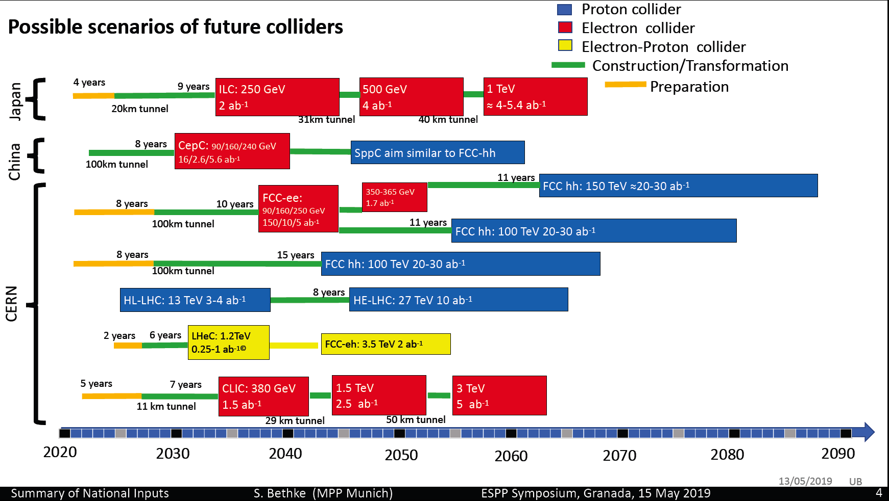
Future Colliders Are Discussing

Slide 32
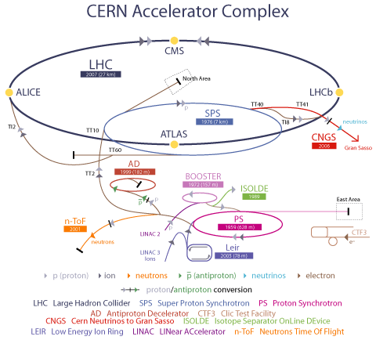
LEP: 1988-2000
E_{cm}(e⁺e⁻) = 200-209 GeV
LHC: Construction 1998-2007
Commission 2007
E(pp) = 14 TeV
2007
Discover W, Z
450 GeV
ν_{τ}–ν_{μ}
Produce >1000 different
isotopes
Over 60 years!
1969
25 GeV
1959, 678 m
Why is CERN so successful?

Slide 33
Year of First Physics
1960 1970 1980 1990 2000 2010 2020 2030 2040
CERN | PS (1960) | ISR (1970) | SppS (1984) |  | LHC (2008)
 |  |  |  | LEP (1989-1995) | LEP2 (1996-2001)
USA |  |  |  | Tevatron (1988-2004) | Plan A LC No plan B
 |  | SPEAR (1972-1980) | PEP (1980-1990) | CESR (1988-2003) | PEPII (1998-2008)
Japan |  |  |  | ILC
 |  |  |  | KEKB (1998-2012) |  | SKEKB (2018-???)
China |  |  |  | BEPC (1989-2005) | BEPC2 (2009-?)
No accelerator based
high energy physics.
Go off shore!
Learn the lesson
From USA!

Slide 34
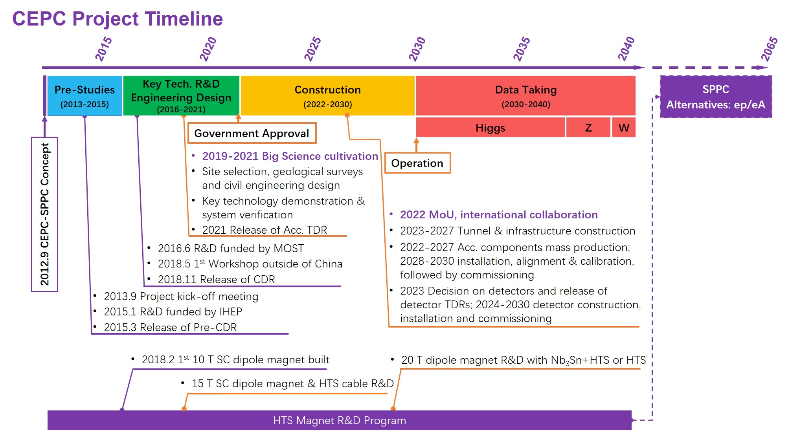
CEPC Roadmap and Schedule (ideal, 2013)
From Yifang Wang, including next 3 slides

Slide 35
New Parameters for Higgs after CDR
 | tt | Higgs | W | Z（3T） | Z（2T）
Number of IPs | 2
Beam energy (GeV) | 175 | 120 | 80 | 45.5
Circumference (km) | 100
Synchrotron radiation loss/turn (GeV) | 7.61 | 1.68 | 0.33 | 0.035
Crossing angle at IP (mrad) | 16.5×2
Piwinski angle | 0.91 | 3.78 | 8.5 | 27.7
Number of particles/bunch N_{e} (10¹⁰) | 24.15 | 17.0 | 12.0 | 8.0
Bunch number (bunch spacing) | 34 (4.9μs) | 218 (0.76μs) | 1568 (0.20μs) | 12000 (25ns+10%gap)
Beam current (mA) | 3.95 | 17.8 | 90.4 | 461.0
Synchrotron radiation power /beam (MW) | 30 | 30 | 30 | 16.5
Bending radius (km) | 10.7
Momentum compact (10⁻⁵) | 0.91
β function at IP β_{x}* / β_{y}* (m) | 1.2/0.0037 | 0.33/0.001 | 0.33/0.001 | 0.2/0.001
Emittance ε_{x}/ε_{y} (nm) | 2.24/0.0068 | 0.89/0.0018 | 0.395/0.0012 | 0.13/0.003 | 0.13/0.00115
Beam size at IP σ_{x} /σ_{y} (μm) | 51.8/0.16 | 17.1/0.042 | 11.4/0.035 | 5.1/0.054 | 5.1/0.034
Beam-beam parameters ξ_{x}/ξ_{y} | 0.077/0.105 | 0.024/0.113 | 0.012/0.1 | 0.004/0.053 | 0.004/0.085
RF voltage V_{RF} (GV) | 8.93 | 2.4 | 0.43 | 0.082
RF frequency f _{RF} (MHz) (harmonic) | 650 (216816)
Natural bunch length σ_{z} (mm) | 2.54 | 2.2 | 2.98 | 2.42
Bunch length σ_{z} (mm) | 2.87 | 3.93 | 5.9 | 8.5
HOM power/cavity (kw) | 0.53 (5cell) | 0.58 (2 cell) | 0.77 (2 cell) | 1.94 (2 cell)
Energy spread (%) | 0.14 | 0.19 | 0.098 | 0.080
Energy acceptance requirement (%) | 1.57 | 1.7 | 0.90 | 0.49
Energy acceptance by RF (%) | 2.67 | 3.0 | 1.27 | 1.55
Photon number due to beamstrahlung | 0.19 | 0.104 | 0.050 | 0.023
Beamstruhlung lifetime /quantum lifetime* (min) | ~ 60 | 30/50 | >400
Lifetime (hour) | 0.7 | 0.22 | 1.2 | 3.2 | 2.0
F (hour glass) | 0.89 | 0.85 | 0.92 | 0.98
Luminosity/IP L (10³⁴cm⁻²s⁻¹) | 0.38 | 5.2 | 14.5 | 23.6 | 37.7
*include beam-beam simulation and real lattice

Slide 36
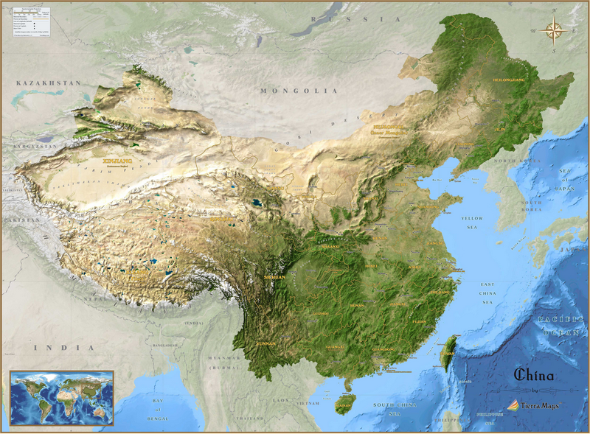
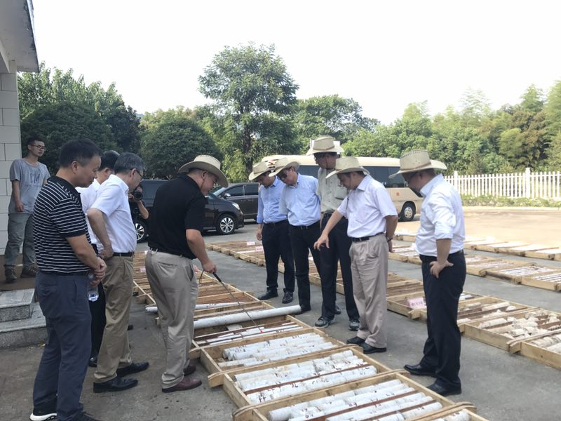
CEPC site investigation and facility study
Site selection based on geology, electricity supply, transportation, environment for foreigners, local support & economy,…
North are better for running cost
CDR study is based on Qing-Huang-Dao, which is 300 km from Beijing
More invitations from local governments: Changsha, Changchun, …
Recent visit to Shangsha: best for geology & transportation(20 km from large city & international airport)

Slide 37
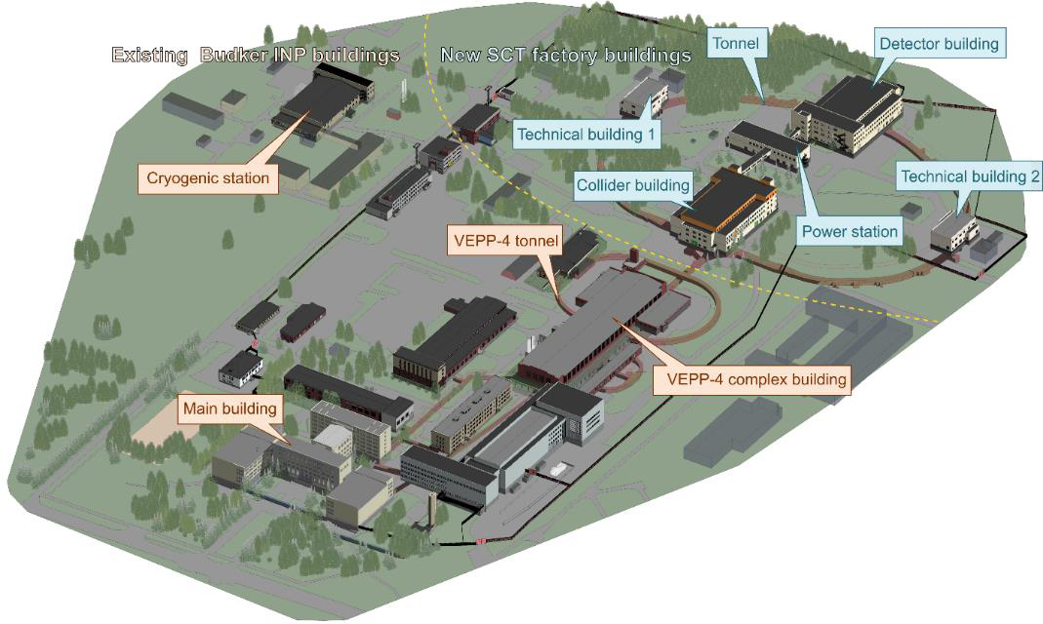
Super Charm Tau Facility in Russia
Existing underground tunnels and new buildings for the SCT accelerator complex

Slide 38
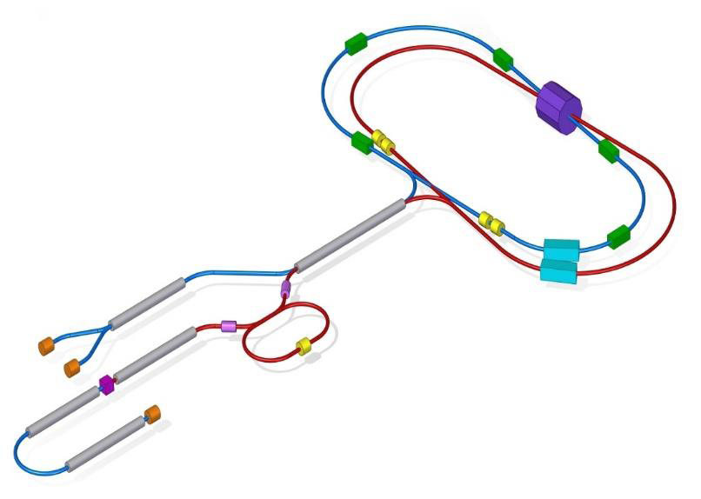
General Configuration of the SCT Factory
WG: damping wiggler
SS: Siberian snake
RF: accelerating cavity
DR: damping ring (1-1.5 GeV) 𝑒⁻pol: polarized electron source 𝑒⁻:electron source
𝑒⁻/𝑒⁺:conversion system

Slide 39
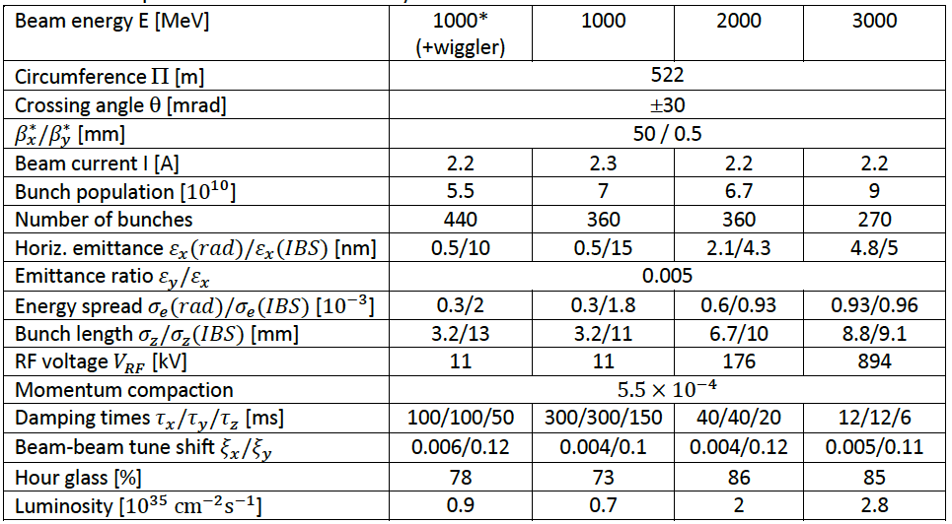
Main parameters of the SCT factory

Slide 40
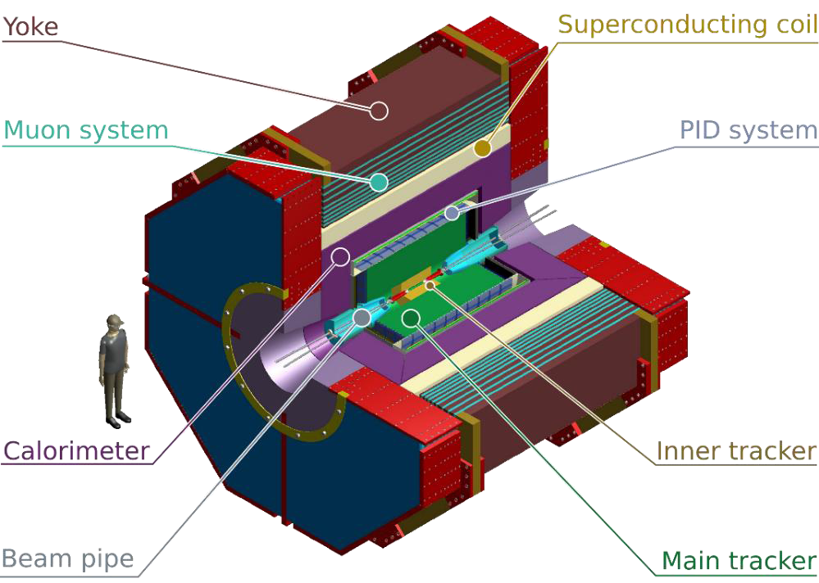
Detector for the SCT factory

Slide 41
Super Tau-Charm Facility (STCF) in China
Peak luminosity 0.5-1×10³⁵ cm⁻²s⁻¹ at 4 GeV
Energy range E_{cm} = 2−7GeV
Upgrade to Polarization beam
Basic Features of the collider:
- Symmetric double ring with circumference of 600-1000 m
- Large Piwinski angle collision + crabbed waist for the IR
- Siberia snake for polarization
Notes:
BEPCII/BESIII will end her mission around 2020,
Led by the high energy Physics association of China, we are exploring possible
Future collider proejct post BEPCII and BESIII
High intensity Electron Positron accelerator (HIEPA) is one of the options.
HIEPA facility can be serviced as a collider machine,
Which provide peak lumin…..
The energy range from 2-7Gev, polarization available on one beam
And the symmertic machine with low currents and crabbed saist solution for the interation….
It also can

Slide 42
STCF
E_{cm}= 2-7 GeV, L: 0.5×10³⁵ cm⁻² s⁻¹
Circumference : 600-1000 米
Cost: ~4.5 B RMB
Detector
LINAC: ~300 m
RF cavity

Slide 43

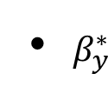

Parameters of Machine
Luminosity:
Increase beam current
Minimize β function
Optimize and H
Strategy:
Phase 0 pilot: 0.5×10³⁵
Phase I nominal: 1.0×10³⁵
Parameters | 1 | 2
Circumference/m | ~600 | ~600
Beam energy/GeV | 2 | 2
Current/A | 1.5 | 2
E/nm•rad | 5/0.05 | 5/0.05
β function @ IP /mm | 100/0.9 | 67/0.6
Collision angle (full θ)/mrad | 60 | 60
Tune shift | 0.06 | 0.08
Hour-glass factor | 0.8 | 0.8
Luminosity/×10³⁵cm⁻²s⁻¹ | ~0.5 | ~1.0

Slide 44

Detector Concept for STCF
PID system
Barrel: MPGD-RICH
Endcap: DIRC-like TOF
ECAL
Barrel: Pure CsI Endcaps: LYSO
Outer tracker
Drift chamber
Superconducting Magnetic (~1T)
Inner tracker
Silicon detector: DMAPS
A novel MPGD: uRWELL
MUC
MRPC timing layers
RPC layers

Slide 45

Candidate Site：Hefei

Slide 46

Accelerator Complex: HIAF-HIEPA-EicC
Storage rings: 2km
Polarized beam:
- E(e⁻) = 10 GeV
- E(p) = 60 – 100 GeV
e-ring
EicC-2
HIEPA
e⁻ & p rings
EicC-1
p-ring
BRing
e⁻ injector
SRF Linac-ring 3.5-10 GeV
HIAF
Proton ring

Slide 47

Operating accelerators for particle physics
China
CEPC (ZF)?
HIEPA ?
Europe
LHC
CLIC ?
F_{CC} ?
Russia
SCTF ?
USA
EIC ?
Japan
SKEK-B
ILC ?

Slide 48

Big Facilities for Particle Physics in China
Beijing
BEPCII
HEPS
Lanzhou
HIRFL
Hefei
HLS2, HALS
HIEPA
Shanghai
SLS
Tibet
Cosmic observatory
Sichuan
CJPL
LHASSO
Guangdong
Daya Bay Reactor ν JUNO
CNSS
HIAF→HIEPA-EiC
Notes:
Yanba Jing in Tibet: Cosmic Ray Observatory
IMP of CAS in Lanzhou: Heavy Ion Accelerator
IHEP of CAS in Beijing: BEPC
Shanghai Light Source
Neutron Spallation Source in Dongguan, Guang Zhou
Daya Bay Nuclear Reactor Neutrino Experiment
Deep Underground Laboratory: Jing Ping Shan in Shi Chuan

Slide 49
Forthcoming Discoveries in Particle Physics
Topic | Crucial measurement | Significance
Higgs boson | M =125 GeV | Confirm spontaneous symmetry breaking in gauge theory
Gravitational waves (Graviton) | Existence | Support general relativity
Glueball, exotic hadron | Existence | QCD, hadron structure
Dark matter | Existence | Missing mass in the universe
Antimatter | Existence | Baryon number asymmetry
Neutrino oscillation and mass | M < 1 eV | Structure of GUTs. Eventual fate of the universe
Proton decay | Existence (t>1.67x10³⁴ years) | Evidence for validity of GUTs
Magnetic monopole | Existence, mass, electric charge | Electric and magnetic charge symmetry. Structure of gauge field configuration
Fractionally charged particle | Existence | Would confuse all current prejudice
Super-symmetric particles | Existence, M > 1 TeV | Hope of understanding gravity
Extra dimension | Existence, Heavy W/Z like particle, graviton, microscopic black hole | Hierarchy problem

Slide 50
Summary
The major physics focusing at energy frontier is physics with Higgs boson and search for new phenomenon beyond SM→LHC will continue to be the unique energy frontier in the next two decades to come.
The future of energy frontier could be Higgs factory, accelerator complex for both lepton and hadron collision with higher energy and higher luminosity.
SKEKB will be the precision frontier for flavor physics and search for new physics for ~10 years.
BEPCII’s life time is approaching, a STCF could be an attractive facility for the QCD study.
China has contributed greatly to the test and understand QCD theoretically and experimentally (e.g. PKU and BES)

Slide 51
Extra Slides

Slide 52


ATLAS and CMS
A Toroidal LHC ApparatuS
(ATLAS)
Compact Muon Solenoid
(CMS)
Total weight: 7900 T
Overall diameter: 25 m
Overall length: 46 m
Magnet filed: 2, 3-8 Tesla
Total weight: 14500 T
Overall diameter: 14.5 m
Overall length: 21.5 m
Magnet filed: 4 Tesla

Slide 53

Open Mass Window for Low Mass Higgs Boson
Joint efforts for decades from many experiments with accelerators (factories of φ, τ-c, B, Z…) and non accelerators

Slide 54
General Consideration of Detector
Much larger radiation tolerance, especially at IP and forward regions
The detector and electronics should withstand the expected does
Efficient event triggering and state reconstruction and tagging
  High efficiency and resolutions for charged and neutral particles
  Low noise and high rate capability
The Systematic uncertainty control
  Detector acceptance : geometrical acceptance and detector response
  Mis-measurement : mis-tracking, fake photon, particle mis-id, noise
  Luminosity measurement
Reasonable cost

Slide 55
General Consideration
Vertex performance and low-momenta tracking eff.
Tracking : multiple scattering effect is important
- P _{T} resolution : 0.5∼0.7%@ 1 GeV/c, and dE/dx resolution: 6%
- low material budge.
PID : π/K and K/p separation up to 2GeV/c
- modest material budget (<0.5X₀)
- Cherenkov detector is necessary
EMC : fast response to match the high luminosity
- stochastic term<2%/√E and constant term < 0.75%,
- angular resolution?
MUC : large-area fast sensors (RPC/MPRC etc)
- μ/π suppression power>10/30, down to p=0.5GeV/c
Large solid angle detector ∼nearly 4π

Slide 56

Detector
245 cm
PXD
Material budget ~0.15%X₀ / layer
σ_{xy}=50 μm
York/Muon
185 cm
MDC
σ_{xy}=130 μm
dE/dx<7%, σ_{p}/p =0.5% at 1 GeV
Superconducting magnet
(0.7-1 T)
York/Muon
135 cm
EMC
PID
π/K (and K/p) 3-4σ separation up to 2GeV/c
105 cm
PID-barrel
85 cm
20°
PID-endcap
EMC
Energy range: 0.02-2GeV
At 1 GeV σ_{E} (%)
Barrel(Cs(I): 2
Endcap (Cs): 4
MDC
15 cm
PXD/SSD
10 cm
MUD
μ/π suppression power >10
3~6 cm
IP
120 cm
140 cm
190 cm
240 cm
300 cm
Notes:
Better inner tracker to adapt high luminosity
Better PID
Better Muon detector
Better ECAL

Slide 57
Institutions Shown Interest
中国科学技术大学
清华大学
北京大学
上海交通大学
复旦大学
山东大学
浙江大学
南京大学
南京师大
南开大学
中山大学
高能物理研究所
兰州近代物理所
合肥物质研究院
合肥同步辐射国家实验室
西安光极所
南华大学
北京航天航空大学
湖南大学
湖南师大
四川大学
河南师大
河南科技大学
辽宁大学
广西大学
广西师大
兰州大学
香港大学
香港中文大学
黄山学院
武汉大学
华中师大
Stanford University, USA
Wayne State University, USA
Carnegie Mellon University, USA
GSI Darmstadt and Goethe University Frankfurt,
Germany
Goethe University Frankfurt, Germany
GSI Darmstadt, Germany
Johannes Gutenberg University Mainz, Germany
Helmholtz Institute Mainz, Germany
LAL (IN2P3/CNRS and Paris-Sud University),
Orsay, France
Sezione di Ferrara, Italy
L'Istituto di Fisica Nucleare di Torino, Italy
L'Istituto di Fisica Nucleare di Firenze, Italy
Scuola Normale Superiore, Pisa, Italy
Laboratori Nazionali di Frascati, Italy
INFN, Padova, Italy
University of Pavia, Pavia, Italy
University of Parma, Italy
Institute for Basic Science, Daejeon, Korea
T. Shevchenko National University of Kyiv, Ukraine
University Ljubljana and Jozef Stefan Institute Ljubljana, Slovenia
Jozef Stefan Institute Ljubljana, Slovenia
University of Silesia, Katowice, Poland
Dubna, Russia
Budker Institute and Novosibirsk University, Russia

Slide 58
Tentative Plan
 | 2018 | 2019 | 2020 | 2021 | 2022 | 2023 | 2024 | 2025 | 2026 | 2027 | 2028 | 2029 | 2030- 2040 | 2041- 2042
Form International Collaboration
Conception Design Report (CDR)
Technical Design Report (TDR)
Construction
Commissioning
Upgrade
A unique precision frontier in the world for 30 years!

Slide 59

STCF in Perspective
SKEKB
STCF
BEPC-II
BEPC
2028
A luminosity 1×10³⁵ cm⁻²s⁻¹ at 4 GeV at 2028 is reasonable !!

Slide 60




Z_{c}(3900) Observed at BESIIII and Belle
Belle with ISR: PRL110, 252002
967 fb⁻¹ in 10 years running time
BESIII at 4.260 GeV: PRL110, 252001
0.525 fb⁻¹ in one month running time
M = 3894.5±6.6±4.5 MeV
Γ = 63±24±26 MeV
159 ± 49 events
>5.2σ
M = 3899.0±3.6±4.9 MeV
Γ = 46±10±20 MeV
307 ± 48 events
>8σ
Notes:
The fit to the piJ/psi invariant mass distribution show clearly the contribution of a state at 3900 MeV, the Zc(3900), in both BESIII and the Belle data. The width is around 50 MeV, and the statistical significance is large than 5 sigma in both experiments, so it is an observation.
This is a good example indicating the advantage of tau-charm factory (threshold characteristics)

Slide 61



Competition from Belle II?
Integrated luminosity
0.4ab⁻¹ from Belle II 2024
1.0ab⁻¹ from HIEPA/year
Belle with ISR: PRL110, 252002
967 fb⁻¹ in 10 years running time
>5.2σ
@ 4.26 GeV for π⁺π⁻J/ψ
ε_{BESIII} = 46%, ε_{Belle} = 10%
BESIII at 4.260 GeV: PRL110, 252001
0.525 fb⁻¹ in one month running time
>8σ
Have incomparable superiority to explore Charmonium(like) states

Slide 62


τ→μγ
The process e⁺e⁻→τ⁺τ⁻γ, dominant background source at Υ(4S), does not contribute below 2E ≈ 4m_{τ}/√3 ≈ 4.1 GeV.
The favorable kinematical condition and the use of polarization can allow an UL(STCF in 1-2 years) ≤ UL(SuperBelle@Y in 12-15 yrs).
γ
μ⁻
μ
e⁻
ν
τ⁻
τ
γ
γ
ν
ν
e⁺
τ⁺
ν
4.0 GeV
10.6 GeV
τ→μγ
τ→μγ
E_{γ}
E_{γ}

Slide 63






Nucleon Electromagnetic Form Factors(NEFFs)
, Λ Λ
Time-like:
FF complex
Space-like:
FF real
time-like
Only 2 measurements, but
results are contradict
JLab
10-24% precision from
B factory
Cristina Morales
Notes:
Complete picture of the nucleon structure requires space-like and time-like measurements!

Slide 64




CP Violation in τ Decay
CP violation is observed in B, D and K systems to date
No CPV has been observed in the lepton sector
The discovery of CPV in the tau sector would be a clean signature of NP
One of the most promising CPV channels is τ⁻→K_{S}π⁻ν
SM CP asymmetry from K_{S}-K_{L} mixing is expected to be :
[Bigi & Sanda, PLB 625, 2005, Grossman &Nir JHEP 1204 (2012) 002]
BaBar measurement [PRD 85, 031102]
Belle measurement [PRL 107, 131801]
Charge Higgs, new Scalar,
W_{L}-W_{R} Mixings, LeptonQuarks
A_{cp} = (1.8±2.1± 1.4) ×10^{-3 @} W ∼ [0.89-1.11] GeV
Notes:
Now, we move to the CPV in tau decay.
To day, CP violation is observed in B,D and Ksystem
But no ovserved in the lepton sector,
The discovery of CPV in tau decay is a clean signture of NP.
The most promising CPV channels is tau-Ks pi v,
The SM predicted the CVP at 10-3 level duo to the Ks-Kl mixing,
But Belle and Babar did not observed any evindence for it CPV

Slide 65



τ CPV in Angle Distribution
Need new measurement on the angular CPV asymmetry
Use T-odd rotationally invariant products : e.g.
in τ⁺ and τ⁻ decays to >=2 hadrons such as :
τ⁻→π⁻π⁰ν_{τ} /k⁻π⁰ν_{τ} , τ⁻→π⁻π⁺π⁻ν_{τ} /K⁻π⁺π⁻ν_{τ} ,
Need
polarized beam
tau-charm
“Figure Of Merits” -- Y. S. TSAI
BESIII @ 4.25 (10³³cm⁻²s⁻¹) FOM=1
HIEPA @ 4.25 (10³⁵cm⁻²s⁻¹) FOM=100
Super B @ (10³⁶cm⁻²s⁻¹ ) FOM=65
B factory
Y. S. Tsai, PRD 51.3172
Notes:
So we need a new measurement on the angular CPV asymmerty.
Like use T-od ratationally invariant products.
The kind of analysis can be performed in the tau decay into final state with more than 2 hadron.
But the polarized beam is necessary.
As we know, the polarization of electron beam can be transver to the produce
Tau,
In tau-charm region, all the produce tau is expected to the 100% poralaztion
While in the super factor, the proporazation is expected to be about 50% with
Tau cos\thet is 0.
A important variable “Figure Of Merits” proposed by the Y.S TSAI which take
into accouting luminorcist, polarization and total cross section,
to quantitative evaluate the feature of different experiment on CPV study
And HIEPA is found to be with the best quilaty.
Evaluate the characters of

Slide 66





Lepton Flavour Violating (LFV)
CLFV processes sensitive to New Physics (NP)
through lepton-lepton coupling
PSI
Mu2e
Anomalous
magnetic
moment
μ, τ anomalous decays
μ → e
conversion

Slide 67

Charged Lepton Flavor Violation (cLFV)
In SM, cLFV is negligibly even taking into account neutrino mass
μ/τ anomalous decays
μ → e
conversion
Anomalous
magnetic moment
In tau-charm factory, τ→μγ decay is a golden mode to search for NP
W. Altmannshofer et al. arXiv : 0909.1333
Notes:
Now we move the new physics,
As we know, the discovery of Higgs complete the list of the partilce in SM.
But there some still a lots questions can not be explain the the SM framework.
To date, there are not any evidence of new physics at high energy frontiers,
So it is important and complementart to directly search for new physics in the presision frontier.
This table is DNA for the new physics search in flavor physics,
and charge letpon Falvor violavation decay is found to be a promising process to find the new physics
And discribmate the different models and contraint theirs parameters.

Slide 68


cLFV Decay τ→μγ @ B Factory
From A. Bondar, Charm2010
Current limit : ~ 4×10⁻⁸ (5×10⁸ τ-pairs)
BABAR : 516fb⁻¹ [PRL, 104, 021802]
BELLE : 545fb⁻¹
At (4S) :
ISR background e+e-→τ⁺τ⁻γ
Upper Limit ∝ 1/√L
Expected limit : 3x10⁻⁹@75ab⁻¹ (7×10¹⁰ τ-pairs)
Background e⁺e⁻→τ⁺τ⁻γ
Super-B 75 ab⁻¹
7×10¹⁰ τ-pairs
Does not contribute below √s ≈ 4m_{τ}/√3 ≈ 4.1 GeV.
Notes:
Tua->gamma mu have been detail studying for many years in B facotry.
This plot show the update limint as function of luminosity for the different experiment.
The current update limit is about 4x10-8 from both BABAR and BELLE,
It is clear see that the upper limit is proportional to 1/sqrt(L)
The strudy from Supper B show the expected UL is 3x10-9 with 75ab-1 data.
At HIEPA, we expected to collected 3x109 tau pair per year
It is interesting to know what the expected UL can be acieved in hiepa.

Slide 69
Expected τ→μγ Br upper limit
Dominant background
E(GeV) | σ(nb) | L(ab⁻¹) | N_{ττ}(10¹⁰)
3.686 | 5.0 | 1.5 | 0.75
3.77 | 2.9 | 3.5 | 1.03
4.17 | 3.6 | 2.0 | 0.71
Total |  | 7.0 | 2.49
τ decays, direct (τ⁺→π⁺π⁰ν_{τ}) and combinatorial
QED processes: e⁺e⁻ → μ⁺μ⁻γγ, e⁺e⁻ → e⁺e⁻ μ⁺μ⁻γ
Continuum hadron production e⁺e⁻ → qq
ψ(2S) and D-meson decays
 | σ_{E}/E=1.5% | σ_{E}/E=2.5%
Signal (Br=10⁻⁹) | 17 | 15
Muon background | 7 | 11
Pion background | 83 | 271
Expected 90% CL upper limit for Br | 1.1×10⁻⁹ | 3.0×10⁻⁹
Expected 90% CL upper limit for Br with pion suppression by a factor of 30 | 3.3×10⁻¹⁰ | 5.1×10⁻¹⁰
Supper-B Expected limit : 3x10⁻⁹@75ab⁻¹ (7×10¹⁰ τ-pairs)
Notes:
The study from Vlaimir show with 7ab-1 data, super tau-charm can get
The comparable or better upple limit than that of Supper-B expections.
We are prosssing the correspond fast simulation for NP sensitivity and to
Optimization the detector perfromance.

Slide 70

Data samples
Data samples with 1 ab⁻¹ integral luminosity
STCF have more yields /per luminosity
STCF is expected to have higher detection efficiency
Belle II can have larger integral luminosity
Detail simulations are ongoing to study the potential for the physics research

Slide 71




High Energy Physics in Post Higgs Era
Origin of the electroweak spontaneous symmetry breaking
- Higgs property (m_{H}, Γ, J^{PC}, couplings, σ, Br of all possible modes)
- Higgs as a tool for discovery (structure, additional Higgs bosons..)
New physics beyond the SM
- New energy territory → F_{cc}, CEPC+SppC
- Precision measurements of SM rare processes: SKEKB, LHCb
Mu2e
g−2
μ→eγ
0.14 ppm
4.2×10⁻¹³ 90% C.L.

Slide 72
Data Samples / Year
Luminosity
Seconds/days
Running time/year
Efficiency
10³⁵cm⁻²s⁻¹ × 86400s × 180days × 90% = 1.4ab⁻¹
 | CLEO-C |  | BES-III/ year 10³³cm⁻²s⁻¹(10fb⁻¹) | HIEPA/year 10³⁵cm⁻²s⁻¹ (1ab⁻¹)
J/ψ | − | − | 10×10⁹ | 10×10¹¹
ψ(2S) | 54 pb⁻¹ | 27×10⁶ | 3×10⁹ | 3×10¹¹
ψ(3770) | 818 pb⁻¹ | 5×10⁶ D-pair | 4×10⁷ | 4×10⁹
4.17 GeV | 586 pb⁻¹ | 7×10⁵ D_{s}-pair | 1×10⁶ | 1×10⁸
τ⁺τ⁻ (4.25) |  | 4×10⁶ | 3×10⁷ | 3×10⁹
Notes:
With assumed 10^35 luminrocity, it is estimated to get the 1.4ab-1 data per year
Taking into account the data taking efficiency.
It is expected to collected 10^9 D meson pair and Tau lepton pairs.
These data is about 1/3 of BELLE-II data/per year which is expected to run with luminosity at 10^36

Slide 73
Key Technologies for Future Accelerator
High power superconducting RF cavity.
Superconducting magnet with strong filed (>16 T).
Polarized particle beam.
New technologies for particle acceleration, high luminosity particle collision
……

Slide 74
Key Technologies for Particle Detection
Challenge to detector: high resolution and efficiency, radiation hardness, pileup rejection, super weak signal and super low background
High spatial resolution, large area, radiation hardness, e.g. Si pixel/strip.
High rate, high spatial resolution, large area tracking and trigger detector.
New type of calorimeter with high energy resolution, high granularity calorimeter.
New type of TOF detector with high time resolution.
Detector for super low background and weak signal.
Advanced micro, low temperature electronics.
New technology for trigger, DAQ, data transfer and treatment.
Notes:
Detector design for radiation hardness and pile-up rejection

Slide 75


SM and Higgs Boson

Slide 76

Puzzles on Higgs Boson: Mass and Force
The Higgs potential: V = -μ²|φ|² + λ|φ|⁴
mass
force
Mass puzzle, beyond naturalness
m_{H}² = 36,127,890,984,789,307,394,520,932,878,928,933,023
- 36,127,890,984,789,307,394,520,932,878,928,917,398
= (125 GeV)² → mass puzzle, beyond naturalness
New force? In SM, free parameter λ is measured to be
λ = m_{H}²/2v² ~ 0.13 → Is it fundamental?

Slide 77

Interactions: Boson Exchange
Strong
Electromagnetic
Weak
Gravitation
γ, Z, W, τ, μ, e
H
?
γ, Z, W, τ, μ, e
A weakly couple unknown new interaction!

Slide 78

Precision Frontier: Flavor Physics
EW Hierarchy... driven by the top in SM
- strong CP problem
- origin of weak CP and
matter-antimatter
asymmetry
- flavor puzzle (quarks,
charged leptons, neutrinos)
Flavor is the frontier for the searches of new physics BSM.

