Slide 1


Chirality, Criticality and Heavy Quarks
In Heavy Ion Collisions
HUAN ZHONG HUANG (黄焕中）
Fudan University
&
University of California, Los Angeles
Frontiers of QCD: Opportunities and Challenges
November 9-10, Peking University

Slide 2
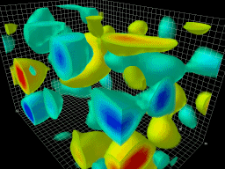
Quark-Gluon Plasma
Non-Abelian Gauge Theory
Dynamical by nature !
gluon excitations
topological domains
nature of phase
transition
properties of QGP
The volume of the box is 2.4 by 2.4 by 3.6 fm.
The topological charge density
Animation by Derek Leinweber

Slide 3
Outline
Chiral Magnetic Effect and
Charge Separation Across the RP
2) QCD Phase Diagram and Critical Point
3) Probing QGP at RHIC with sPHENIX

Slide 4
Chiral Magnetic Effect → Charge Separation
Chiral Magnetic Effect (CME): finite chiral charge density induces an electric current along external magnetic field.
D. E. Kharzeev, L. D. McLerran, and H. J. Warringa, Nuclear Physics A 803, 227 (2008)

Slide 5
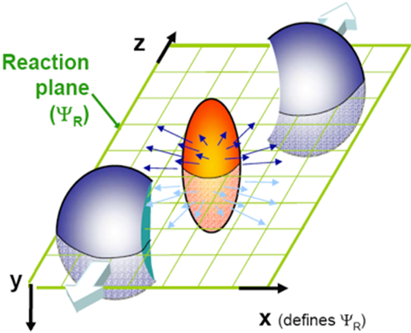
γ correlator
A quantitative measure for extra charge fluctuation.
γ₁₁₂
S. Voloshin,
PRC 70 (2004) 057901
background effects
P-even quantity:
sensitive to charge separation fluctuation
Directed flow
γ₁₂₃ = <cos(φ_{α}+2φ_{β} -3ψ₃)>

Slide 6
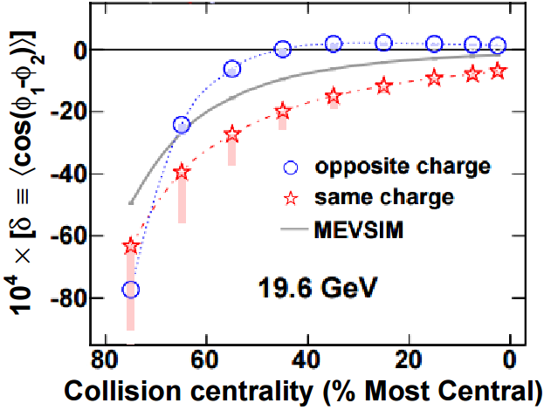
H Measure
Phys. Rev. Lett 113 (2014) 052302
Against CME expectation, δ_{OS} > δ_{SS}
Indicate overwhelming background, larger than any possible CME effect.
Try combining information from γ and δ to retrieve the CME contribution, H
A. Bzdak, V. Koch and J. Liao, Lect. Notes Phys. 871, 503 (2013).

Slide 7
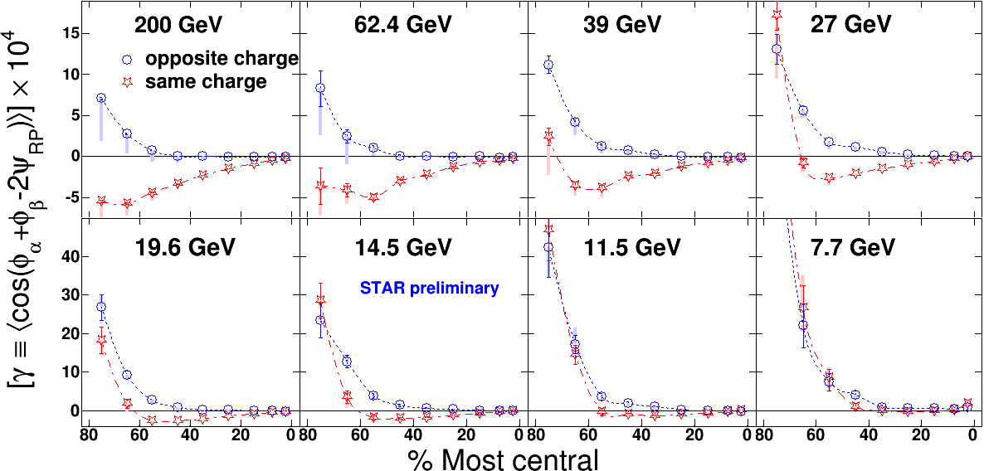
Beam Energy Scan
Phys. Rev. Lett 113 (2014) 052302
At lower beam energies, charge separation starts to diminish.
If Δγ is largely background, the background cannot be
proportional to v₂ alone as suggested !

Slide 8
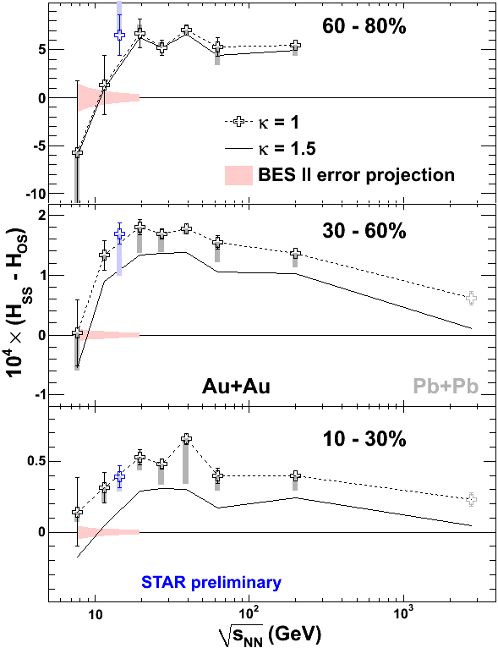
Difficult to Remove Charge Separation
Phys. Rev. Lett 113 (2014) 052302
A. Bzdak, V. Koch and J. Liao, Lect. Notes Phys. 871, 503 (2013).
Optimal Beam Energy:
15-50 GeV
Low beam energy A+A
reduces short-range
non-flow background!

Slide 9
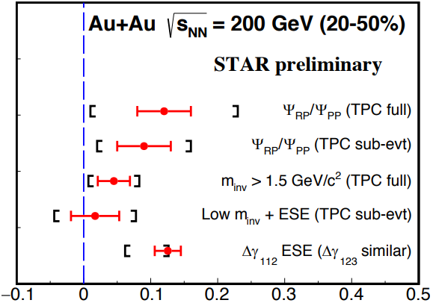
Need Time to Reconcile Various
Event Shape Selection Analyses
@QM2018
CME Fraction
Improve sensitivity !

Slide 10
CME or not CME in HIC
The current analyses are inclusive
There must be significant background
in the gamma correlations
Features of measurements cannot be
explained by background model alone,
and signal and background may be
energy dependent
Background in pA and AA collisions may
arise from different sources !

Slide 11
What Constituents a Discovery of CME in Heavy Ion Collisions
Need to establish a B field effect (5 sigma)
Relating to charge separation effect
Establish a beam energy dependence
OR
Ruled out with quantitative analyses !

Slide 12
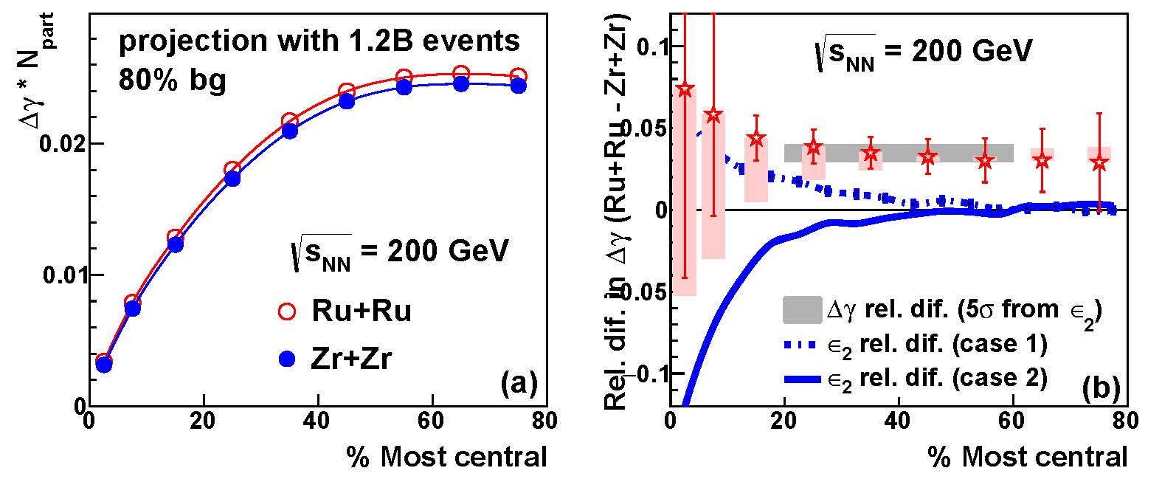
Isobars: charge separation
Projection from 1.2B events shows difference in ΔH
The ratio is 5σ above 1 (3σ with 400M events)
If it's v₂-driven, the ratio will follow eccentricity (be 1 or below 1)
Very Successful RHIC Run in 2018 !

Slide 13
Experimental Window of Opportunity
Isobaric running to see B field effect
Successful Run 2018 @200 GeV
2) Au+Au data from low RHIC energies
to observe B magnitude and life-time
difference 2019-2022
3) If promising, another run for isobaric
system would be needed
There must be some background –
yet no satisfactory background model can
explain all features in data –
any room for CME/CMW? Definitive Answer?

Slide 14
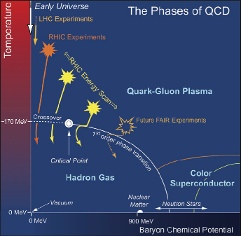
QCD Phases and Phase Transition
Crossover -- Critical Point – first order PT ?

Slide 15
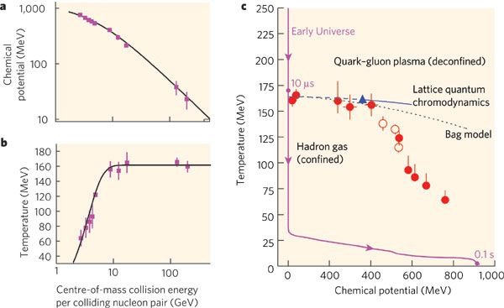
Chemical Freezeout Conditions
Nature 448, 302-309 (2007)
Beam Energy Scan Program at RHIC:
Approaching Critical Region via BES

Slide 16
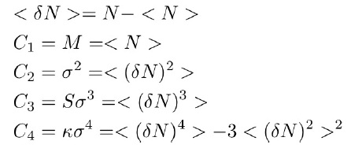
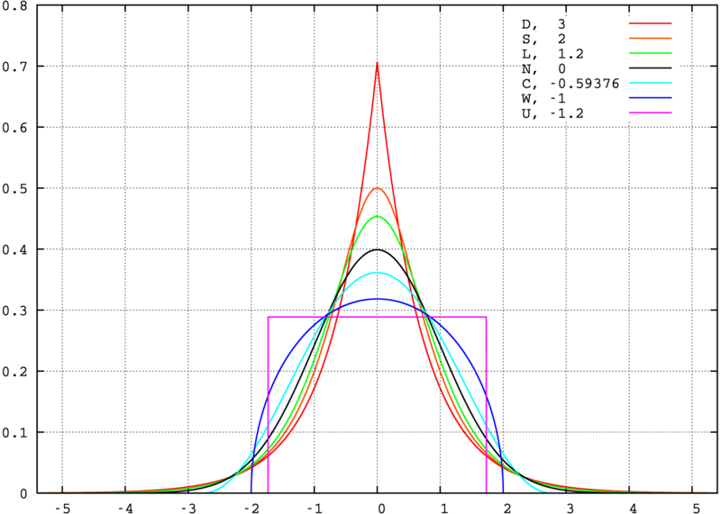
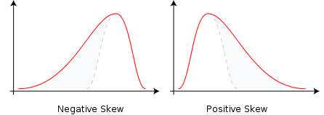
Experimental Searches for CP
Higher order cumulants/moments: shape of distributions and quantify fluctuations -- correlation length (ξ)
Kurtosis ( ) → Sharpness
Skewness (S) → asymmetry
S<0
S>0
M. A. Stephanov, Phys. Rev. Lett. 102, 032301 (2009); 107, 052301 (2011).
M.Asakawa, S. Ejiri and M. Kitazawa, Phys. Rev. Lett. 103, 262301 (2009).
2. Connect to the susceptibility of the system
Cheng et al, PRD (2009) 074505. F. Karsch and K. Redlich , PLB 695, 136 (2011).
S. Gupta, et al., Science, 332, 1525(2012). A. Bazavov et al., PRL109, 192302(12) // S. Borsanyi et al., PRL111, 062005(13)

Slide 17
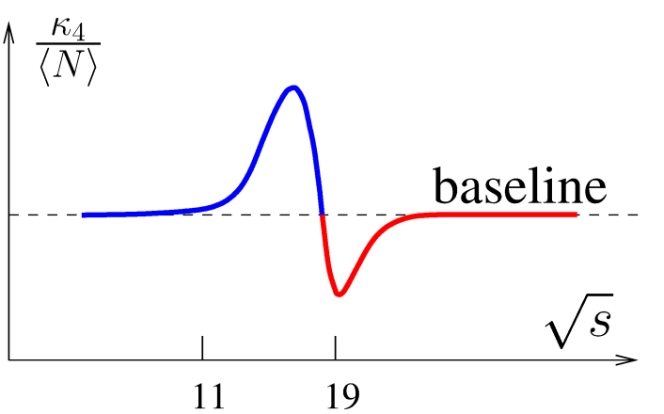
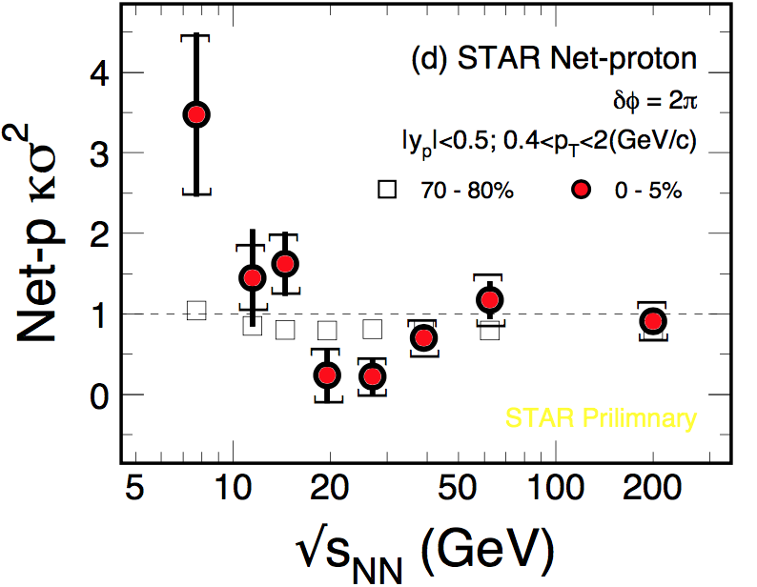

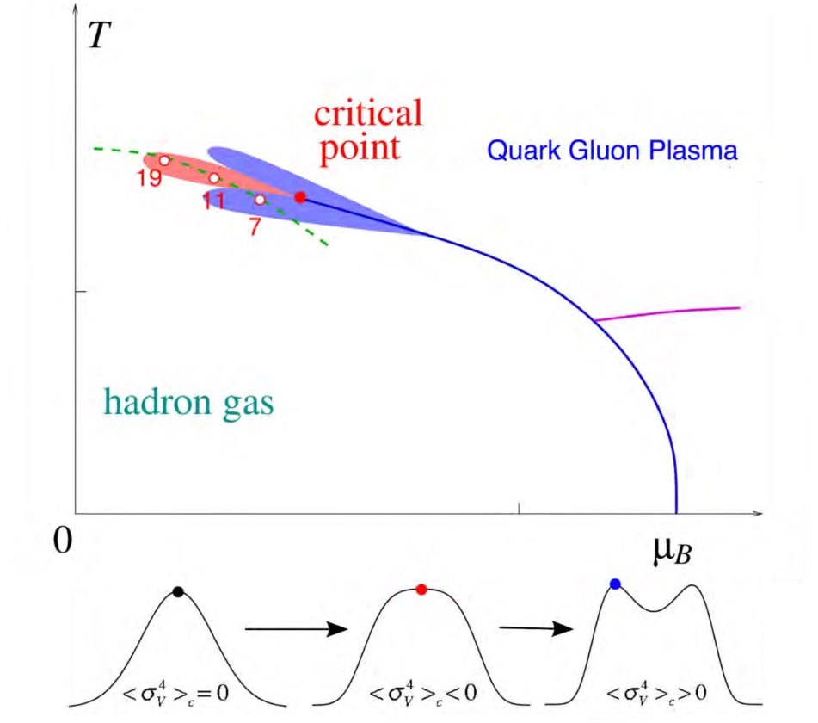


净质子数分布的高阶矩测量
κσ² = C₄/C₂
A theoretical Expectation
Experimental Measure
𝜅𝝈²
1
0
Net-Proton κσ²
STAR Preliminary
√s_{NN} (GeV)
Non-monotonic κσ² in net-proton – critical fluctuations?
Not observed in other conserved quantities – strangeness/charge !
More statistics and more theoretical guidance !

Slide 18
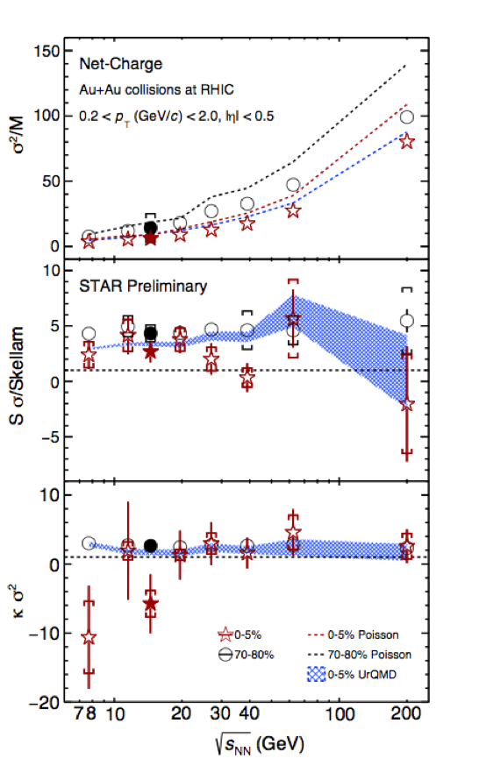
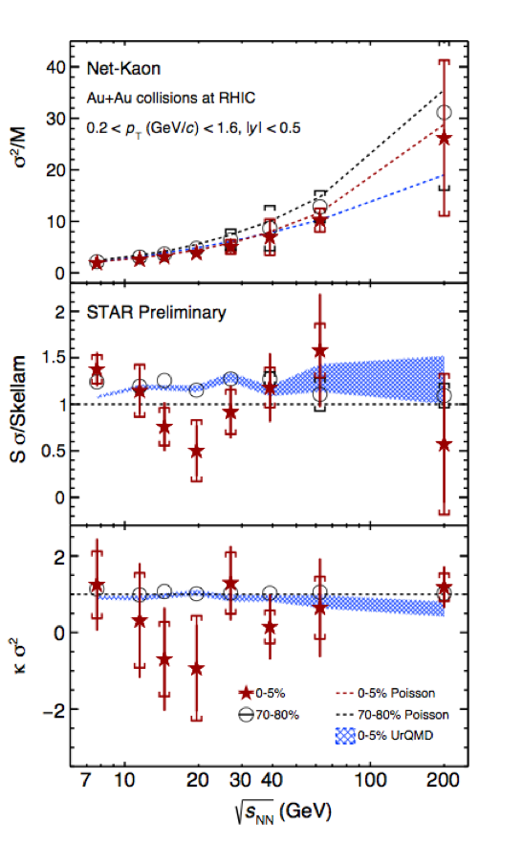
Net Charge
Net Strangeness
No significant non-monotonic fluctuations!

Slide 19
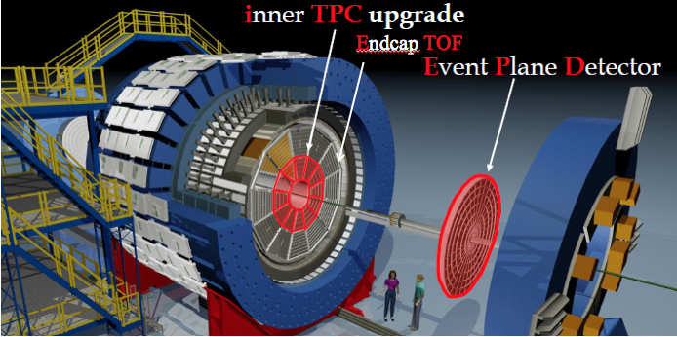
Beam Energy Scan Phase II Program
(2019-2021)
√s_{NN} (GeV) | Events (10⁶) | BES II / BES I
19.6 | 400 | 2019 / 2011
14.5 | 300 | 2019 / 2014
11.5 | 230 | 2020 / 2010
9.2 | 160 | 2020 / 2008
7.7 | 100 | 2021 / 2010
17.1 | 250 | 2021
Upgraded Detector
More Statistics
Enough? What constitutes a discovery of CP?

Slide 20
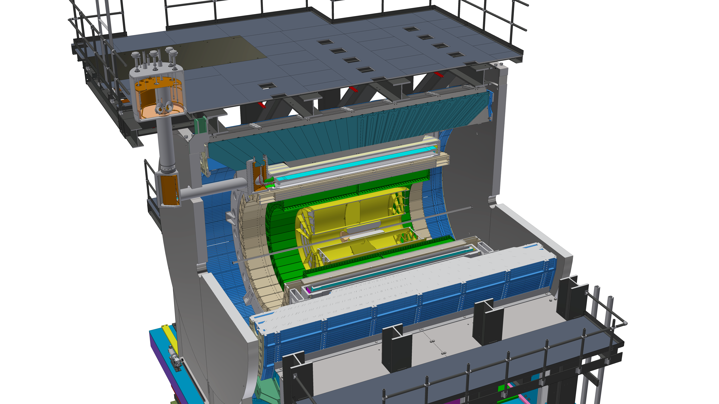
RHIC Future > 2023 --- sPHENIX
Outer HCAL
SC Magnet
Inner HCAL
EMCAL
TPC
INTermediate Tracker
Cryo
chimney
MAPS VerTeX Detector
Collider Detector with full Cal, Trackers & Super DAQ

Slide 21
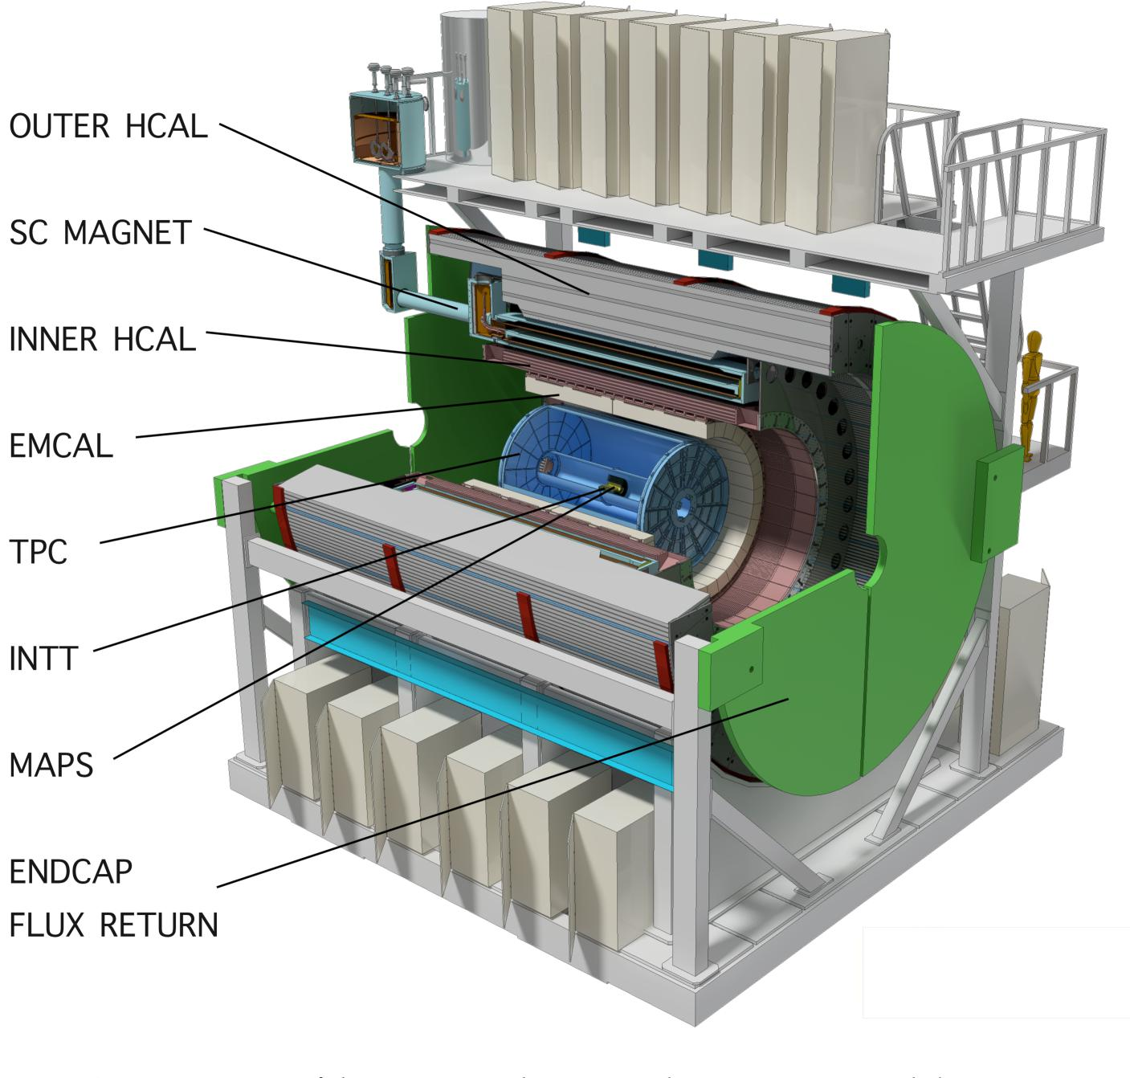
中国合作组参加了sPHENIX实验
Fudan/CCNU/IMP/PKU/CIAE/SINAP/Tsinghua/SYSU/USTC
sPHENIX实验是美国2015年核科学长远规划推荐的高能核物理项目，得到美国能源部和BNL支持
sPHENIX是在BNL-RHIC的新一代大型探测器，预期在2023年完成建造并开始运行
sPHENIX实验将主导2023年后RHIC的主要科学目标和运行规划
美国生产80% EMCal模块快度区间 0<|η|<0.8；
中国生产20% EMCal模块快度区间 0.8 <|η|<1.1。
20% 高快度区间的探测器可以增加对喷注和底夸克偶素衰变产物的
接受度 > 50%, 非线性增长！

Slide 22
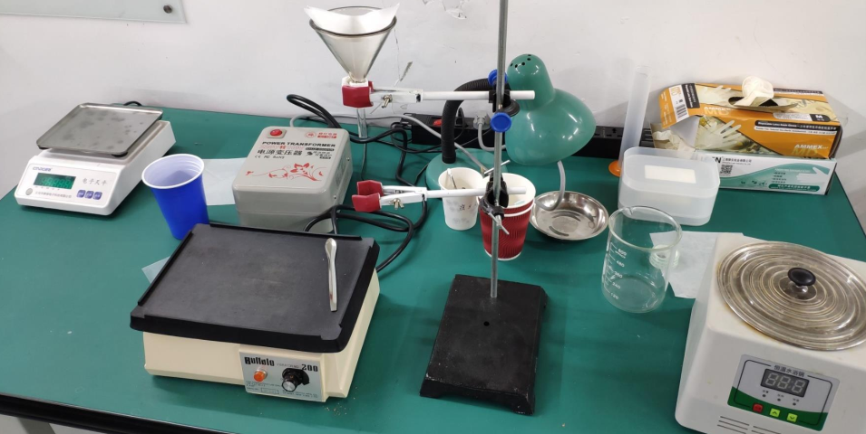
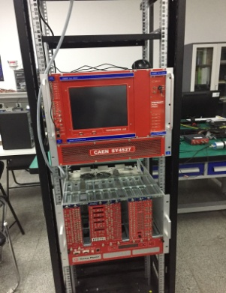
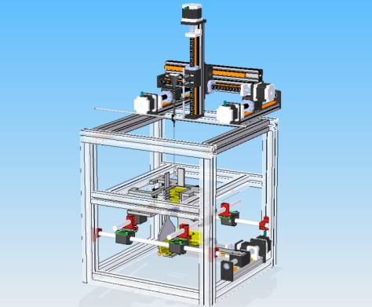
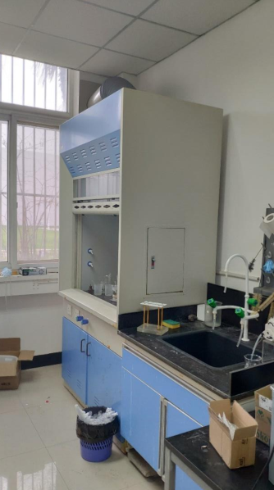

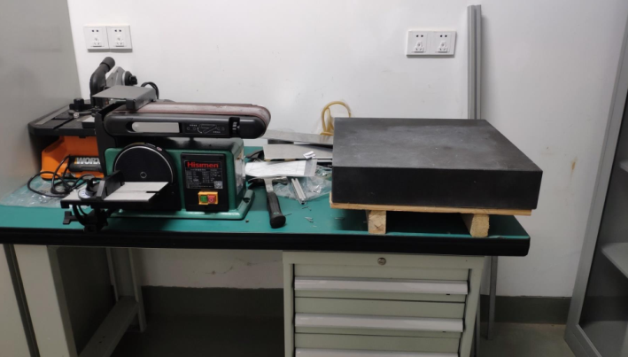
复旦大学实验室
AFFM
DAQ
振动台
通风柜
机床
测量台
基本完成探测器研制任务，
批量生产 2020+

Slide 23
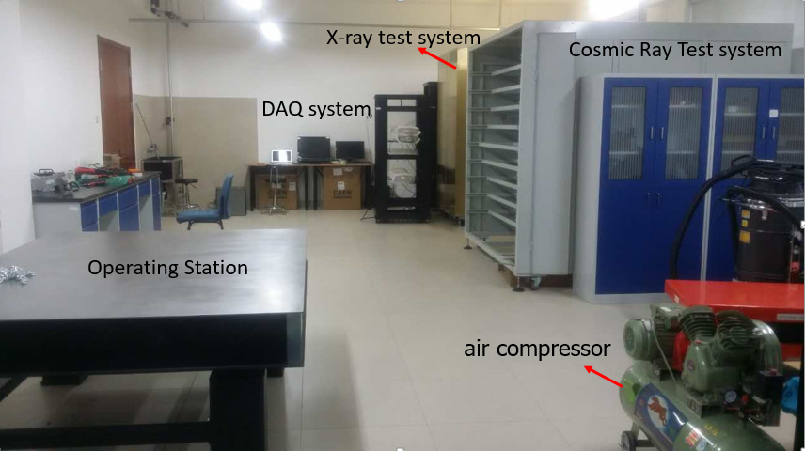
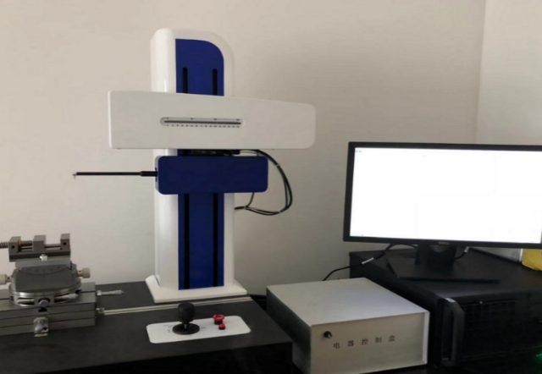
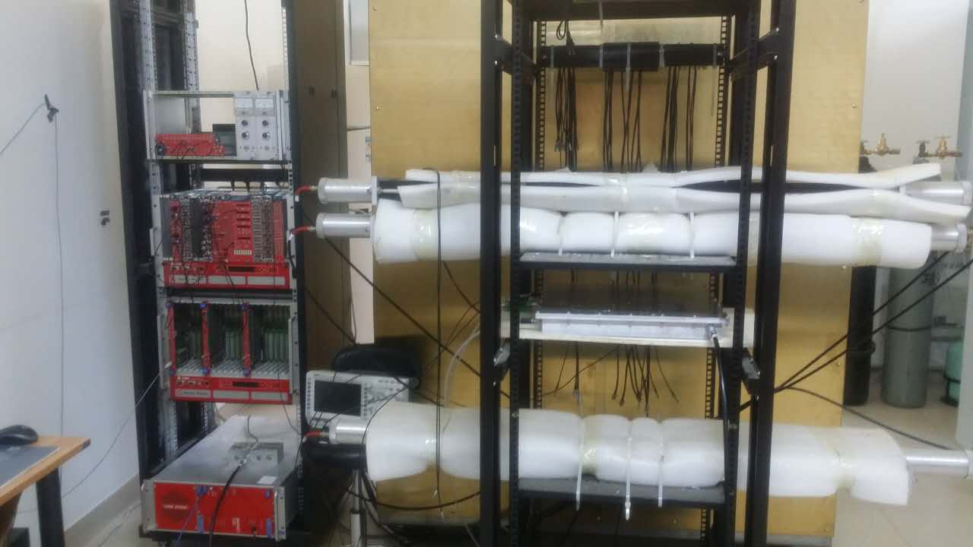
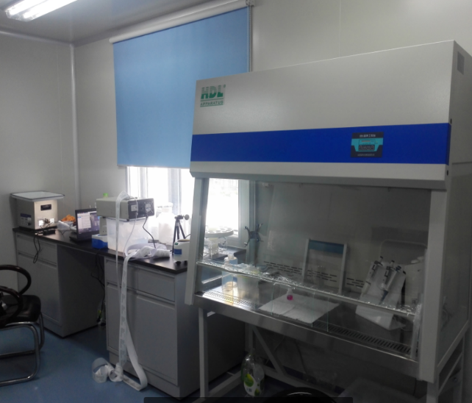
北京大学实验室
Overview
电子几何测量仪
超净台
DAQ

Slide 24
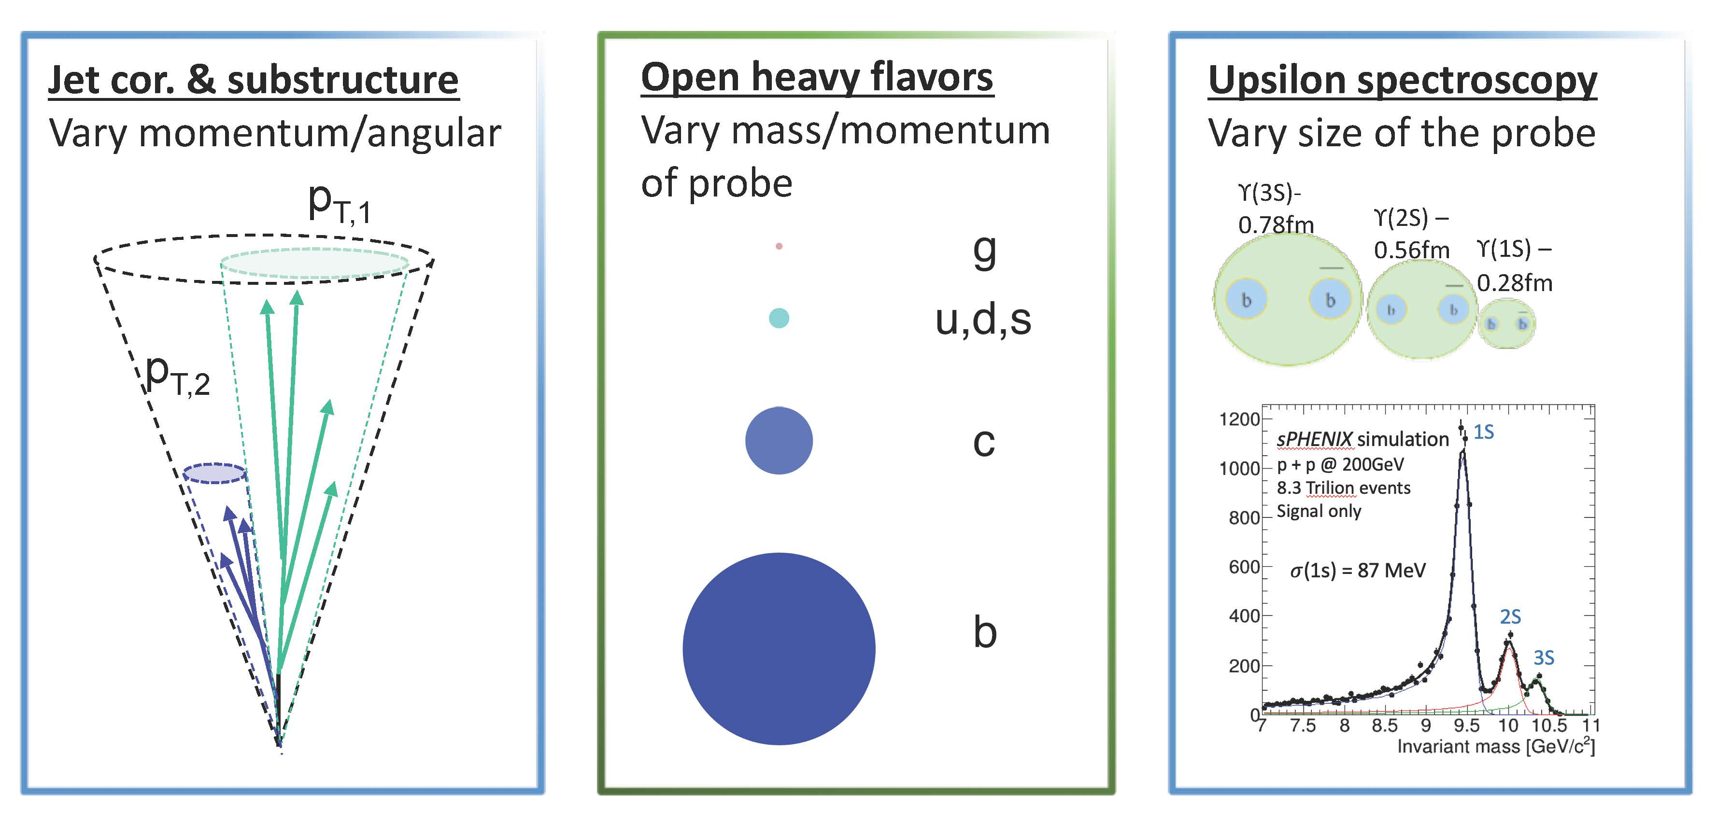
sPHENIX CORE Science Program
Jets
Quark Tagged
Upsilon
Strong Chinese theory groups in Jets and Heavy Quarks
Great future for Chinese sPHENIX collaboration !

Slide 25
RHIC continues to be an outstanding
dedicated facility for QCD physics;
Quark chiral magnetic effect remains an
intriguing hypothesis for HI collisions;
Promising opportunity to discovery Critical
Point in QCD phase diagram at RHIC;
The RHIC future beyond 2023 is sPHENIX
and Chinese groups are well positioned to
play leading roles in sPHENIX;
We need your support !!

Slide 26
祝贺赵老师八十华诞！
感谢赵老师对实验高能核物理的支持！

Slide 27
THE END

Slide 28
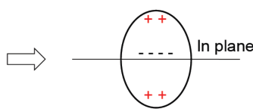
Chiral Magnetic Wave
Y. Burnier, D. E. Kharzeev, J. Liao and H-U Yee, PRL 107, 052303 (2011)
quadrupole moment
Formation of electric quadrupole: ,
where charge asymmetry is defined as .
Then π⁻ v₂ should have a positive slope as a function of A_{ch},
and π⁺ v₂ should have a negative slope with the same magnitude.
net charge density

Slide 29
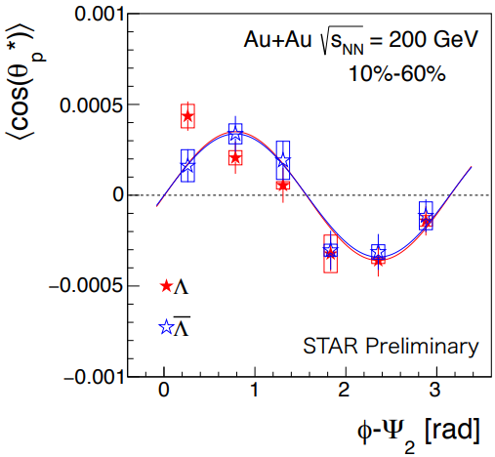
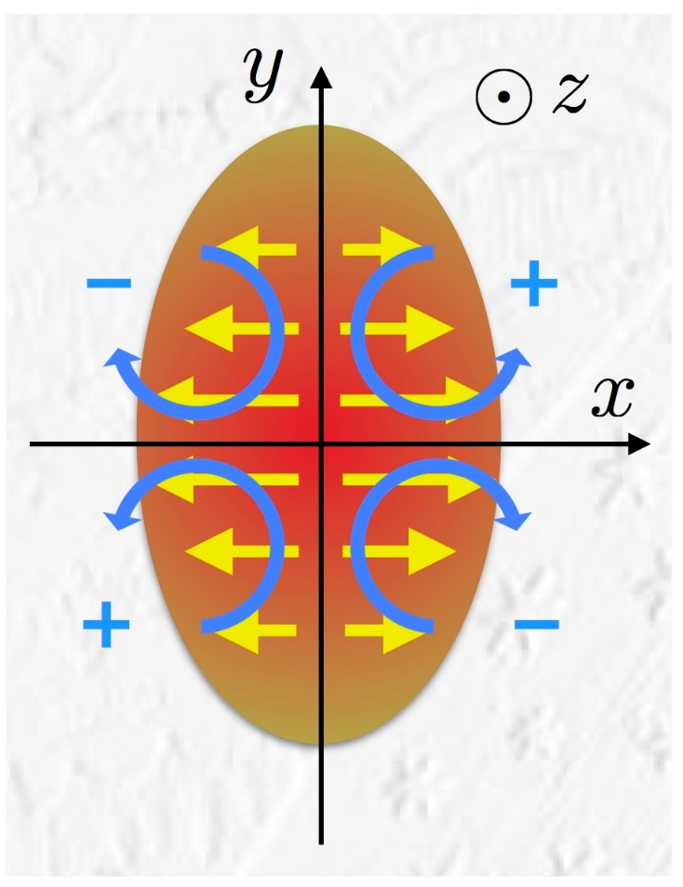
Longitudinal Polarization of Lambda
Polarization – Manifestation of Quantum Fluid
not yet established theoretically!
S. Voloshin, EPJ Web Conf. 17 (2018) 10700
F. Becattini and I. Karpenko, PRL120, 012302 (2018)

