Slide 1
Machine Learning for Accelerators/High Energy Photon Source (HEPS)
Paul Chu (储中明）
Institute of High Energy Physics (中国科学院高能物理研究所）

Slide 2
Outline
Introduction
Overall Software Architecture for HEPS
Preparation for Machine Learning
ML Application Ideas
Summary

Slide 3
Machine Learning Conferences/Workshops for Accelerators
12th International Workshop on Personal Computers and Particle Accelerator Controls (PCaPAC), Hsinchu, Taiwan, October 16 th to 19 th, 2018
ICAP'18 - 13th International Computational Accelerator Physics Conference, Key West, Florida, USA, October 20 to 24, 2018
2nd ICFA Workshop on Machine Learning for Charged Particle Accelerators, Villigen PSI, Feb. 26 to Mar. 1, 2019
IPAC, ICALEPCS…
HEPS, CEPC lattice design

Slide 4
Where ML in Accelerators so far
Everybody wants it and everybody jumps in without much thinking
Mostly theoretical studies so far
Equipment control such as temperature controlled RF cavities, i.e. still at“lower”level for individual device or simple tuning
Still very little activities in Asia/China
However, AI is a super hot topic in China – why not apply Ml to our facilities

Slide 5
How ML performed so far
Well, definitely not an instantaneous magic
Computing power and algorithms more matured
Some limited success, but case by case
Some success can be done with traditional optimization methods anyway
What to do next to improve the success rate
Have complete data to train the model
Logging everything, e.g. implementing Central Message Logging System
High quality data
As much data as possible
Understand your systems well – a good model to start with

Slide 6
Where Can ML Be for Accelerators
Basically, everywhere…
Best fit: non-linears issues with sufficient and good quality data
Entire accelerator life cycle needs ML
Accelerator design
Accelerator/beamline controls
Beam Tuning – online and offline optimization
Operation optimization – productivity,
Machine reliability – maintenance,
Human resources: who performs the best at work

Slide 7
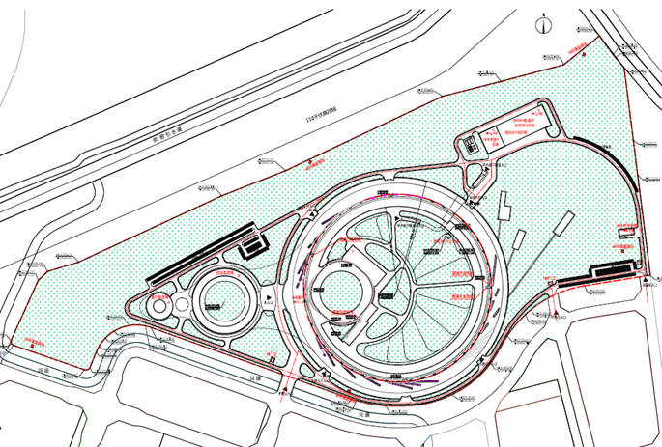
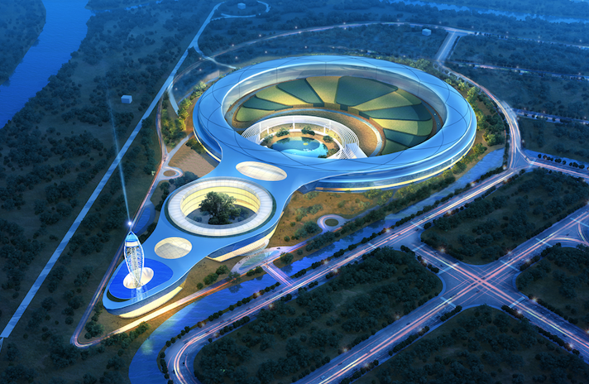
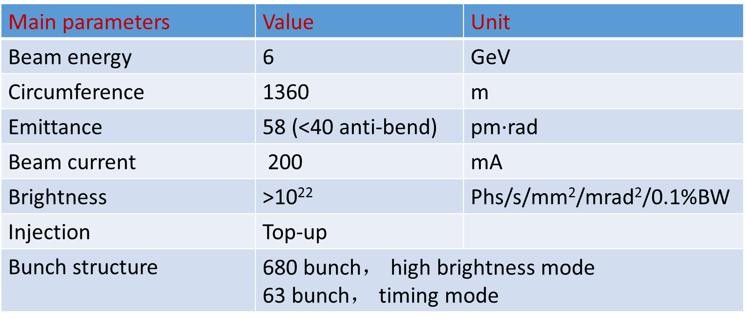
Introduction
HEPS– 4th generation synchrotron light source, 7BA-lattice
Construction period – Jun. 2019 – Dec. 2025, ~US$700M

Slide 8
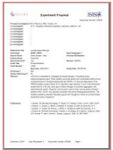
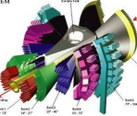
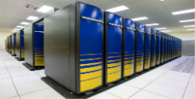
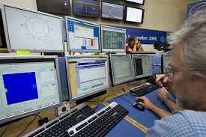
User Facility Software Architecture (courtesy F.Z. Qi)
DAQ Temp
Storage
File Transfer
Local Analysis
User Office&
Scientific Committee
Raw Data
Repository
Proposal
Computing Service
Online Data
Processing
Online Data
Analysis
Detector
DAQ
Scheduling
Potential
Users
Users
Sample
Environment
Radiational
Source
Local Users&
Instrument Scientists
Metadata
Catalogue
Sample
Instrument
Ctrl
Scientific
Metadata
Data Service
Publication
Database
User
Database
Proposal
Database
Sample
Database
Data Management
Remote Analysis
Administrative Metadata
Pre-Experiments
Experiments Duration
Post-Experiments

Slide 9
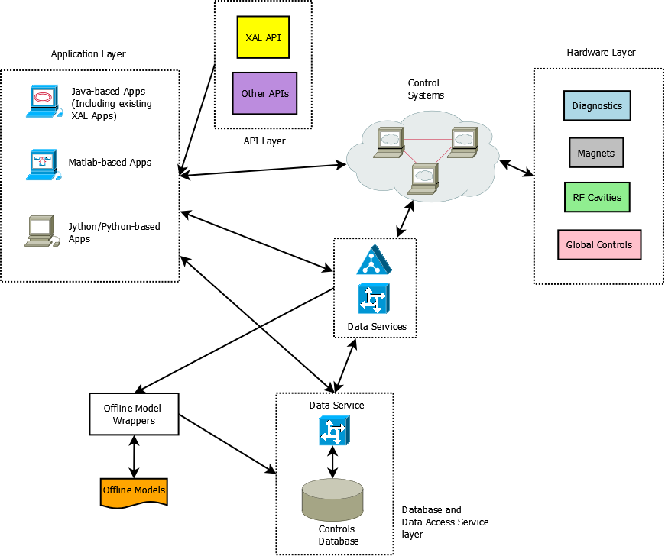
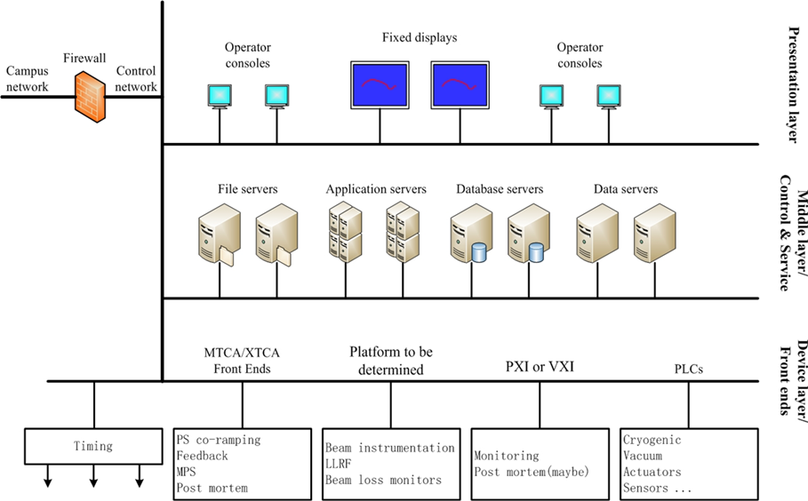
Controls and Online/Offline Software
Databases: online/offline
Control systems
Physics Modeling
Services
API
commonly used modules
Online Applications
Offline applications
Lattice Design w/ ML

Slide 10
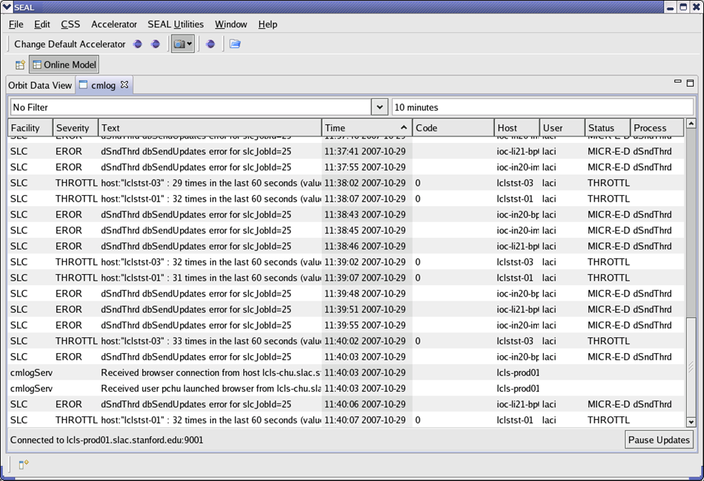
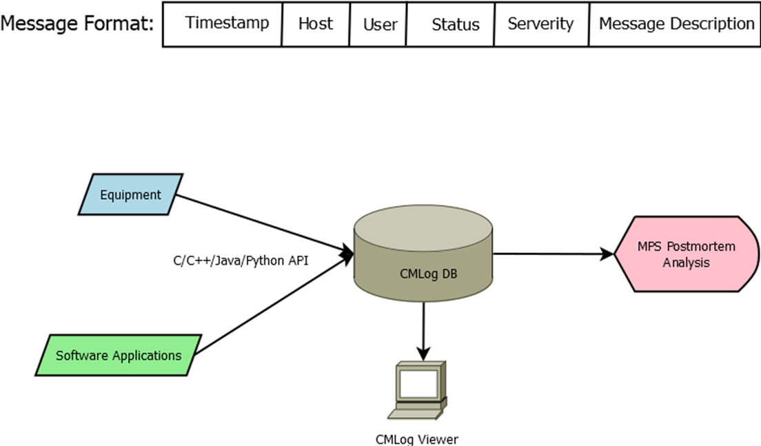
Central Message Logging System
Recording every action occurred in the system
CMLog data format
CMLog database（noSQL）
C/C++/Java/Python API
CMLog client viewer
Can serve for MPS postmortem analysis

Slide 11
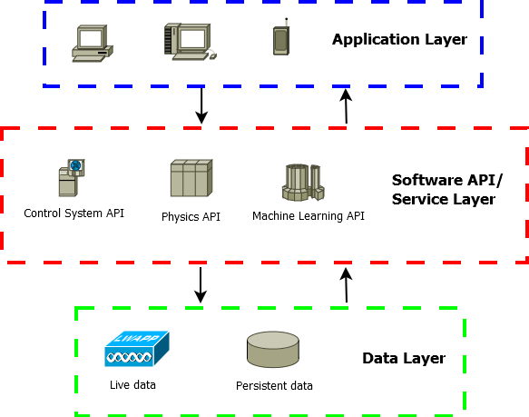
High-level Application Architecture
Collecting as much data as possible
Central messaging logging
Operation logging
…
Data Pre-processing
Clean up
Line up
Programming applications with 3 categories of APIs
Software re-usability, cut development time
General-purpose, physics, and Machine Learning (ML)
Standard data formats & popular algorithms

Slide 12
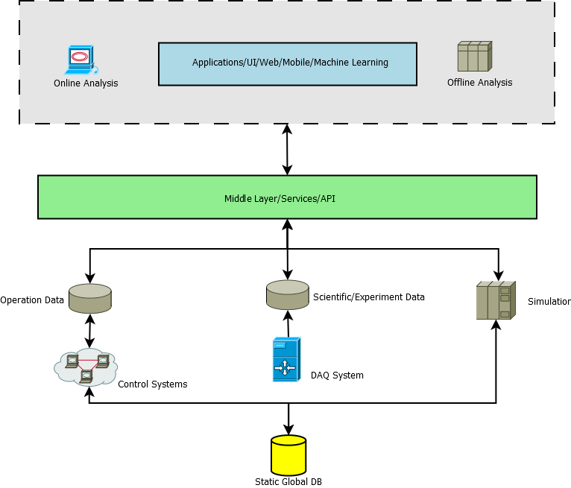
High-level Application Platforms
Data Layer
Simulated data
Experiment data
Control system data
Middle Layer
Services
API
Applications
Desktop
mobile

Slide 13
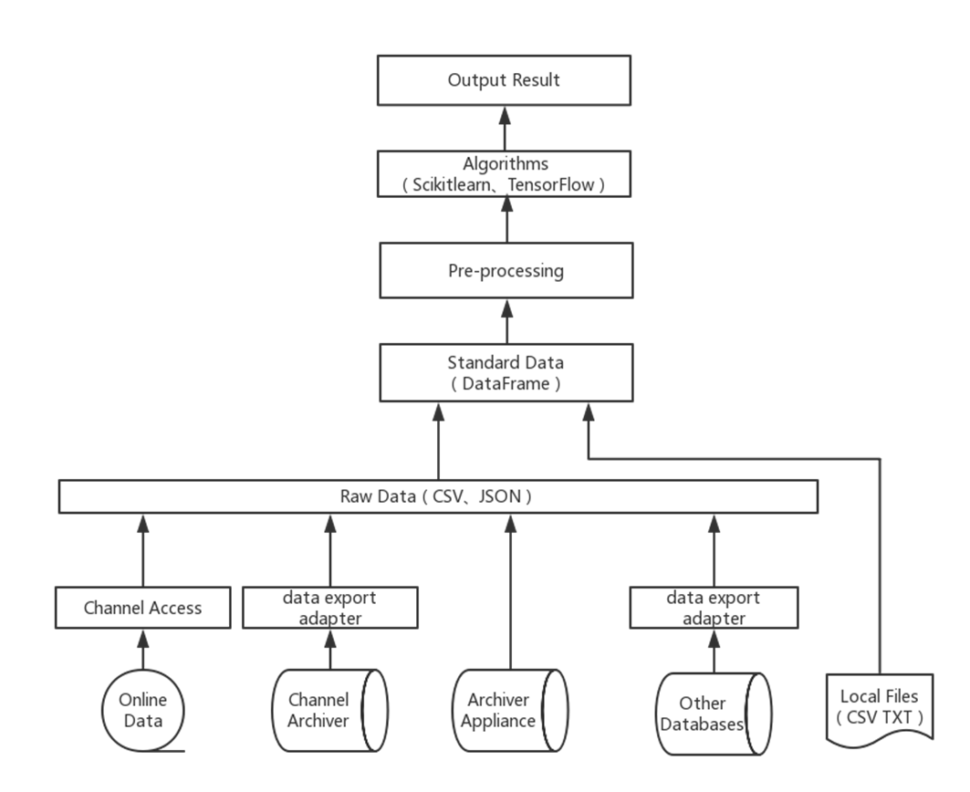
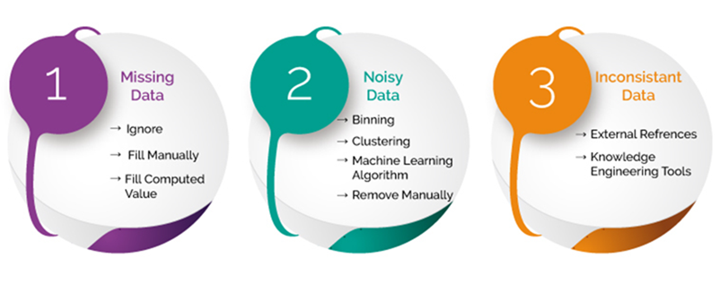
Machine Learning Platform
Getting data
Pre-processing data
Applying algorithms
Displaying results
Applying results/predictions

Slide 14
ML Platform General Ideas
Machine Learning in Python
Scikit-learn/TensorFlow
Simple and efficient tool for data mining & data analysis
Built on NumPy, SciPy, and matplotlib
Open source, commercially usable - BSD license
Machine Learning in MATLAB
MATLAB Machine Learning Toolbox

Slide 15
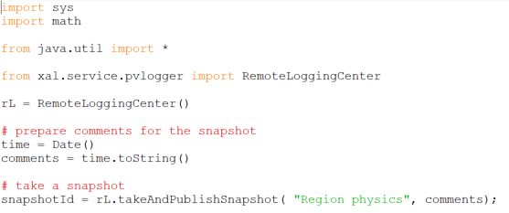
Preparation for Machine Learning
Data Collection
Archived accelerator data
Experiment data from Data Acquisition (DAQ) systems
PVLogger (EPICS based) or time synchronized meta data
Define own EPICS PV list, logging period easily
Aligned timestamp PVs
MySQL DB
Periodic logging
On-demand logging

Slide 16
Data Handling
Data Sources
EPICS live data
TXT/Excel Files
EPICS Channel Archiver
EPISC Archiver Appliance
Other data sources (e.g. PVLogger)
Output Data Format
Pandas DataFrame
TXT/Excel Files
Other format: HDFS
Code Snippet
pvnames=['BIBPM:R1OBPM02:XPOS','BIBPM:R1OBPM03:XPOS','BIBPM:R1OBPM04:XPOS]
#also can load pvnames from files
engine=LoadData.getKey(server_addr,pvnames)
data=LoadData.getFormatChanArch(server_addr,engine,pvnames,start_time='11/30/2018 14:15:00’,end_time='11/30/2018 14:16:00’,merge_type='outer’,interpolation_type='linear’, fillna_type=None,how=0)

Slide 17
Data Export & Unification [1]
Raw data characteristics
Large amount of PVs as model features
Different PV has different acquisition period
Handling null or abnormal data
Pandas
DataFrame
Timestamp Alignment
Data Unification
Data Merging

Slide 18
Data Export & Unification [2]
For temporal data from archiver
PV Timestamp alignment
3 data line-up types:
Outer -> smallest time period -> data addition
Inner -> biggest time period -> data deletion
Defined time period -> data addition & deletion
Standardization
Normalization
Discretization (quantization or binning)
Encoding categorical features

Slide 19
Data Pre-processing [1]
Data quality check
Handling empty, abnormal, inconsistent data
Padding
Not changing over time
Bad machine status
Interpolation
Linear, nearest, polynomial, cubic, spline……
Neural network
Predict uncertain data through NN algorithm based on known data

Slide 20
Data Pre-processing [2]
Data feature analysis
distribution analysis
comparative analysis
periodic analysis
contribution analysis
correlation analysis
Diagnostic functions
common statistical indicators
histograms
scatter matrix diagrams
correlation tables & associated heat maps
box plots

Slide 21
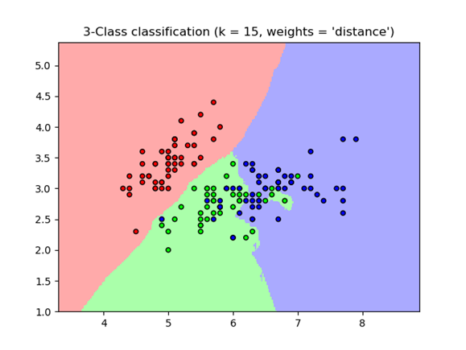
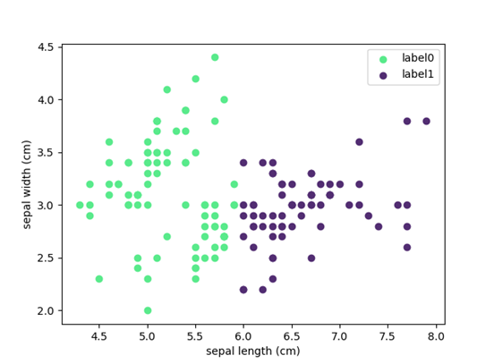
Algorithms
Regression
Linear Regression
Bayesian Linear Regression
Polynomial Regression
Decision Tree
K-Nearest Neighbors
Clustering
K-Means
DBSCAN
Multi-layer Perceptron (MLP)
…

Slide 22
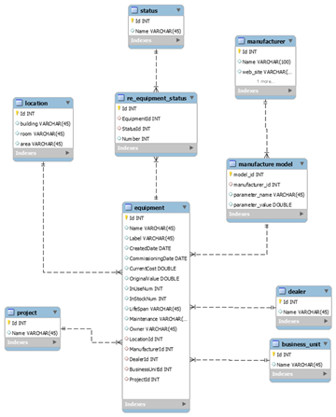
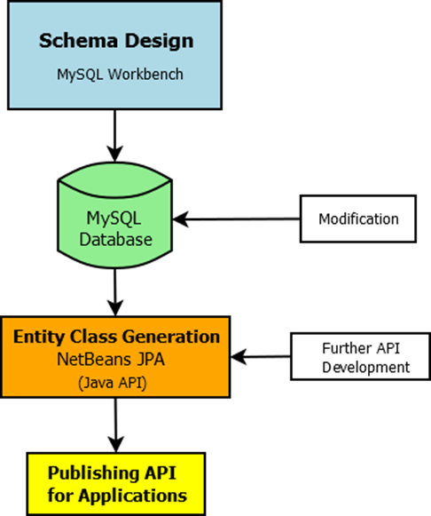
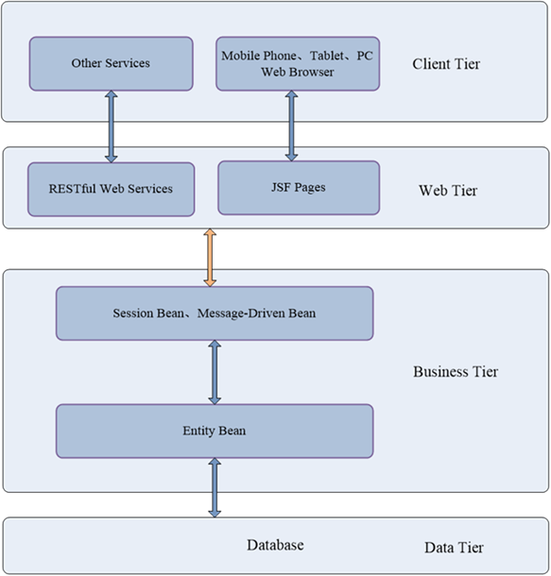
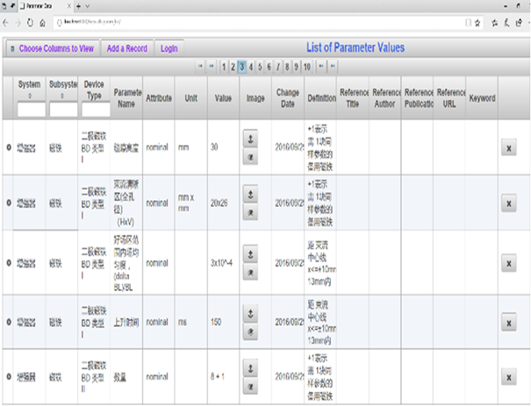
Databases
17 database domains in plan
MySQL or Microsoft SharePoint/SQL
Parameter List | Logbook and Issue Tracking | Cable
Naming Convention | Maintenance/Operation | Security
Magnet | Inventory | Alarm
Accelerator Model/Lattice | Survey and Alignment | Machine Protection/Interlock
Equipment and Configuration | Work Flow Control/Traveler | MPS Postmortem
Physics Data and Machine State | Document DB

Slide 23
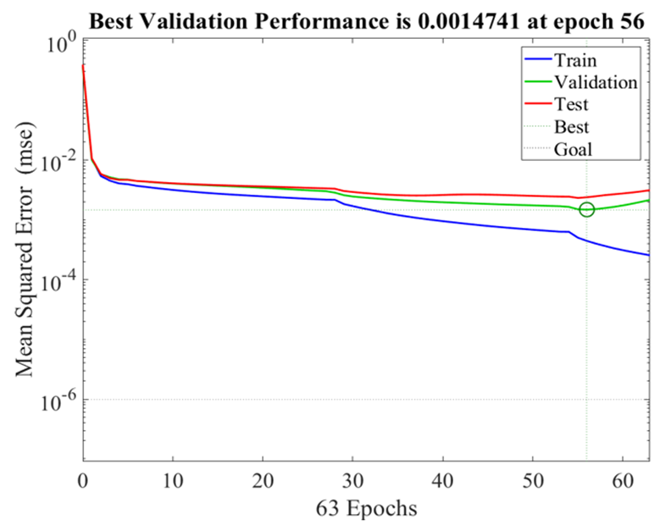
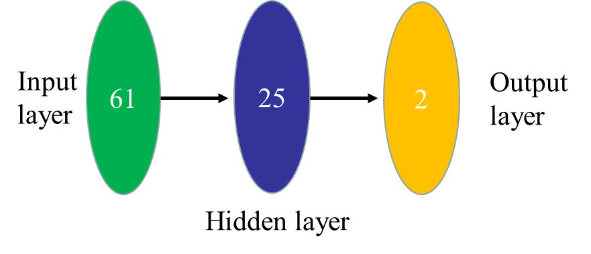
ML for HEPS Lattice Design [1]
Using DNN for HEPS lattice design
Highly nonlinear model
Applying HEPS optimized lattice data
Optimize brightness (BN) and dynamic aperture (DA)

Slide 24
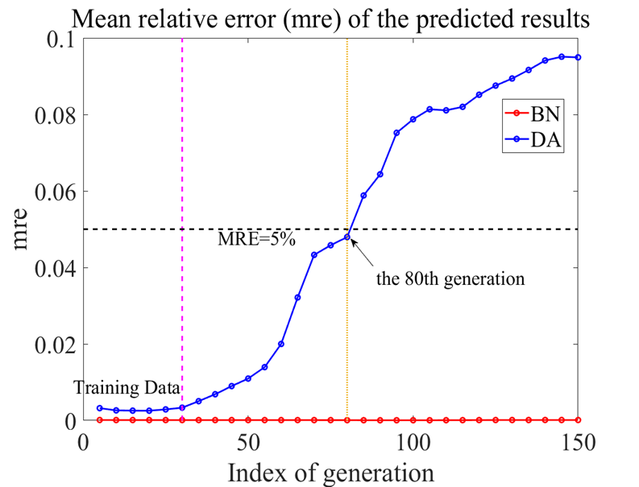
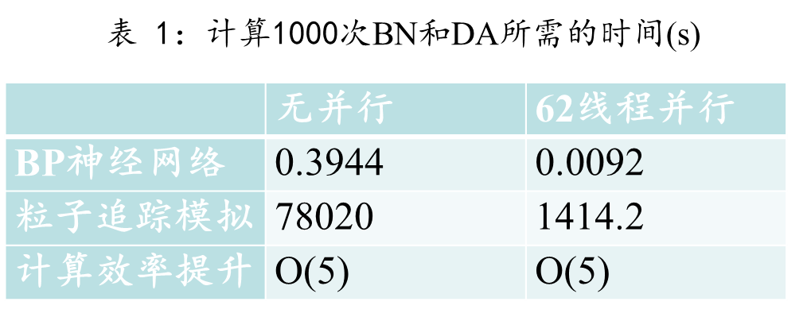
ML for HEPS Lattice Design [2]
The DNN method can predict the BN close to 100% and DA over 95% at 80th generation
DNN is 5 Orders better efficiency than Particle Tracking!

Slide 25
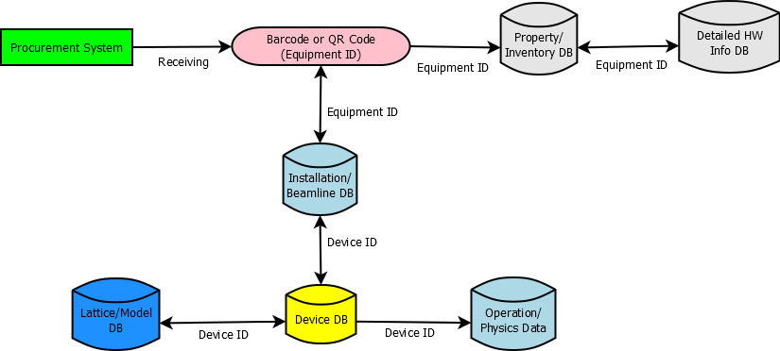
Project Control
Procurement, Equipment
Issue Tracking System, Maintenance, Operation Logbook…
Work Breakdown Structure (WBS) for project management
Cost and schedule control/monitoring
SharePoint based document system
Project Web site
Work flow control
Document and data sharing

Slide 26
ML Application Ideas [1]
Facility Operation Optimization
Use regression algorithms to improve the performance of key accelerator systems, such as high frequency cavity, superconducting system, water cooling system, etc.
Beam Physics or experiment optimization
Apply the machine learning platform to beam physics optimization progress, to realize the automatic optimization of DA, emittance, current intensity, etc.
Data driven data acquisition
Equipment maintenance
To avoid unexpected failures by analyzing equipment running data

Slide 27
ML Application Ideas [2]
Big Data applications
Installing various sensors to collect as many data as possible
Data mining, data correlation, interdisciplinary data analysis
Light source data center for data sharing
Accelerator data archive center
Domestic and international data archive for various accelerator related data
…

Slide 28
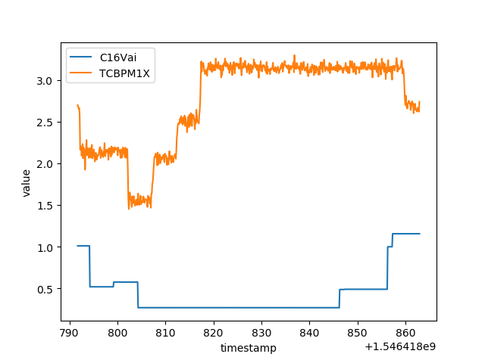
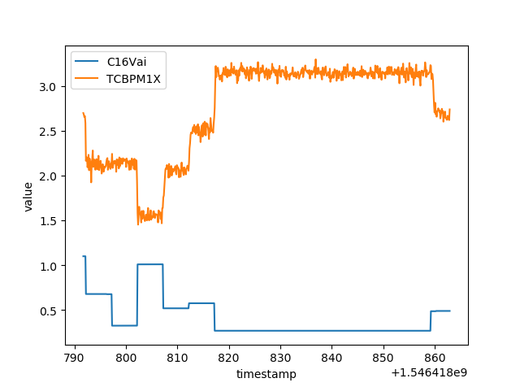
A Test: 时间戳矫正
f1(t)&f2(t) : The relation between 'value' and 'timestamp' of two systems(such as correctors with BPM).
h(): Projection of one group of value to another.
ζ(): Integral coefficient. (Remove interference and noise. Keep normalization)
相关函数:
优化目标:
这种基于机器学习的方法是精确的，而且可以在少量的操作下广泛的应用在其他加速器系统中
Input data
return
结果展示了一个有效的矫正
矫正时间 dT = 13s
应用在传输线和直线的其他矫正子和BPM上，结果显示是一致的

Slide 29
Summary
HEPS Control Systems designed for ML
Overall consideration, modularized implementation
Integration with project business sector
Data centric approach
Machine Learning for Accelerator Platform prototyped
Many application ideas are emerging
Collaborations are welcome

Slide 30
Machine Learning Platform Source Code Repository
https://github.com/NicoleQiao/MLPlatform

