Slide 1
Development of CEPC booster dipole magnet
Wen Kang
CEPC international workshop
Beijing, Nov. 18, 2019

Slide 2
Contents
Specifications and challenges
Designs of the dipole magnet
Fabrication of the subscale prototype magnets
Test of the subscale prototype dipole magnet
Problems
Summary

Slide 3
Specifications and Challenges
 | BST-63B
Quantity | 16320
Minimum field (Gs) | 28
Maximum field (Gs) | 338
Gap (mm) | 63
Magnetic Length (mm) | 4700
Good field region (mm) | 55
Field uniformity | 0.1%
Field reproducibility | 0.05%
Challenges
Total length of the dipoles ~75km how to reduce cost
Field error <29Gs*0.1%=0.029Gs how to design
Field reproducibility<29Gs*0.05%=0.015Gs how to measure
Magnet length ~4700mm how to fabricate

Slide 4
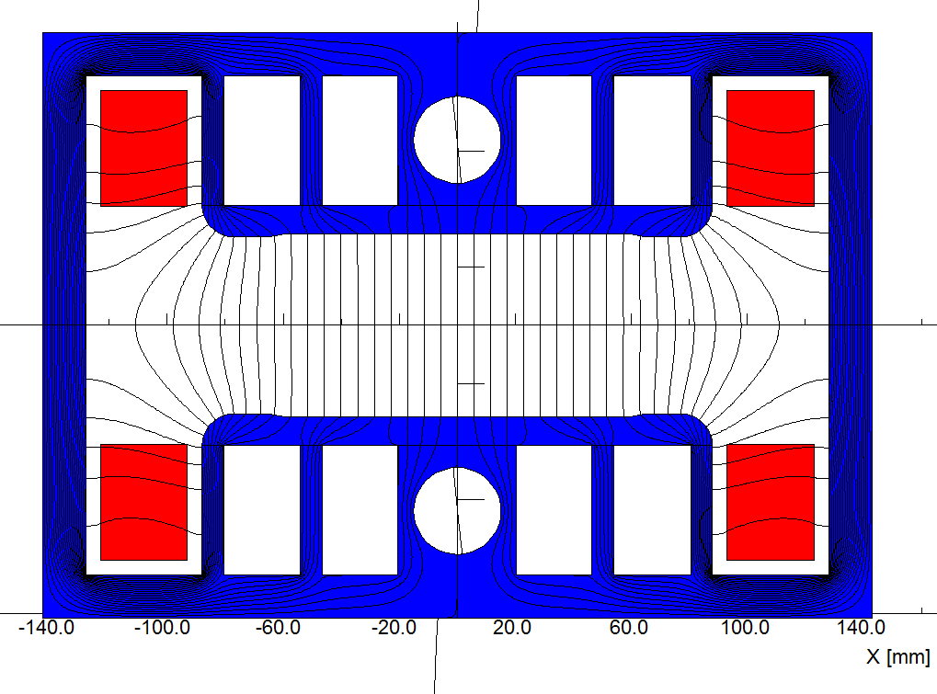
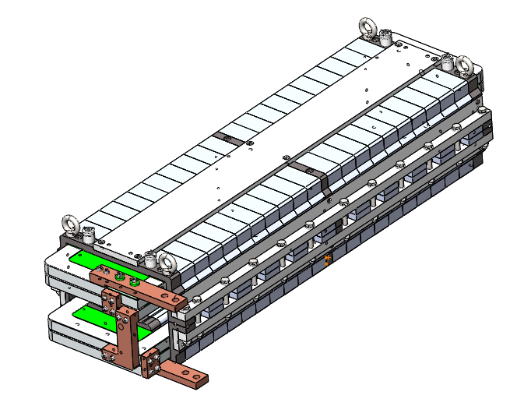
Designs of the dipole magnets
Since a high quality dipole magnet with the min. working field of only 28 Gs has never been developed in the world, three kinds of fully new magnet designs have been proposed and investigated.
1) The dipole magnet with diluted iron core
In order to get a better shielding of earth field, a closed H-type core is selected.
To increase field in the cores and decrease weight of the cores, the technology of core dilution is adopted.
  The cores of the magnet are stacked by silicon steel laminations and aluminum laminations with the thickness ratio of 1:1.
  The return yokes are designed as thin as possible and some holes are stamped in the pole areas of the laminations.

Slide 5
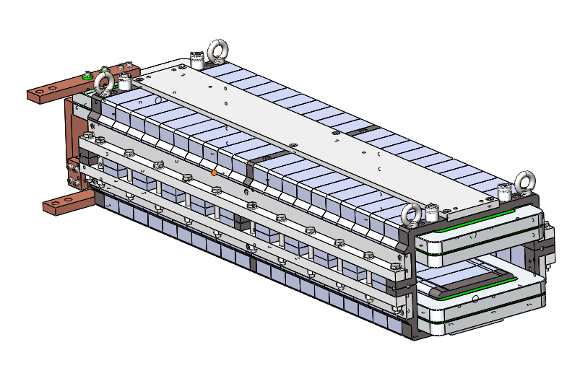
Designs of the dipole magnets
To reduce the influence of the remnant field on the low field precision, the grain-oriented silicon steel laminations instead of the conventional low carbon steel laminations are used to stack the magnet cores due to their low coercive and remnant field.
To reduce the cost and weight, the coil per pole of the magnet has only two turns, which are formed by long aluminum bars without water cooling.
 | Hc// | Hc┴
Conventional low carbon steel | 56A/m | 56A/m
Grain oriented steel | 4A/m | 12A/m

Slide 6
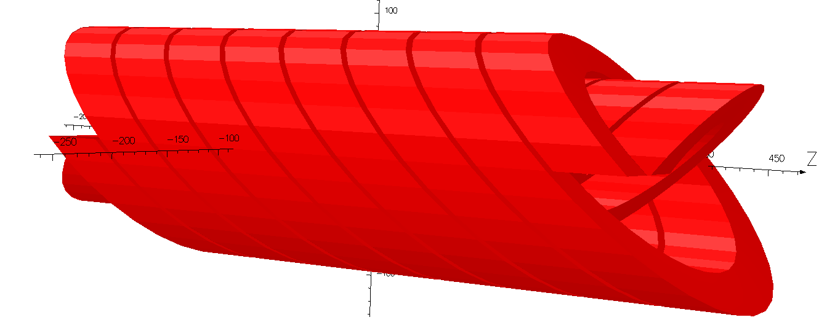
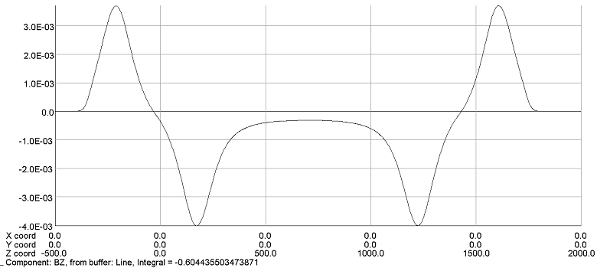
Designs of the dipole magnets
2) CCT dipole magnet without iron core
The dipole magnet with CCT coils is composed of two or four canted solenoids, of which the excited currents have different direction.
The main advantage of CCT design is that it is easy to get a high precision field in its 80% aperture and the field errors are not sensitive to the mechanical errors of the coils.
To improve the excitation efficiency, the canted angle of the CCT is 25 degree instead of 30 degree as in superconducting magnet case.

Slide 7
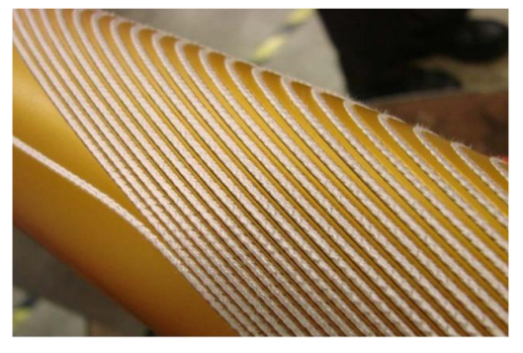
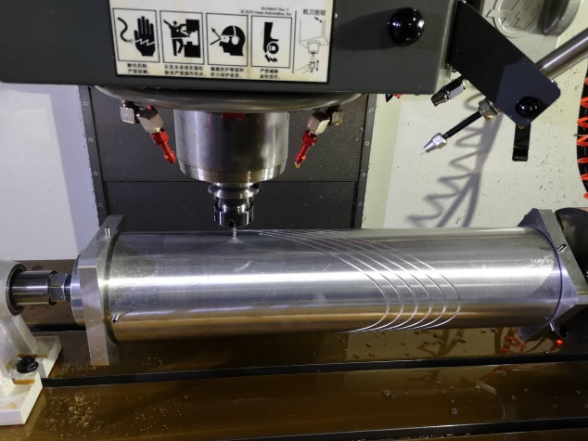
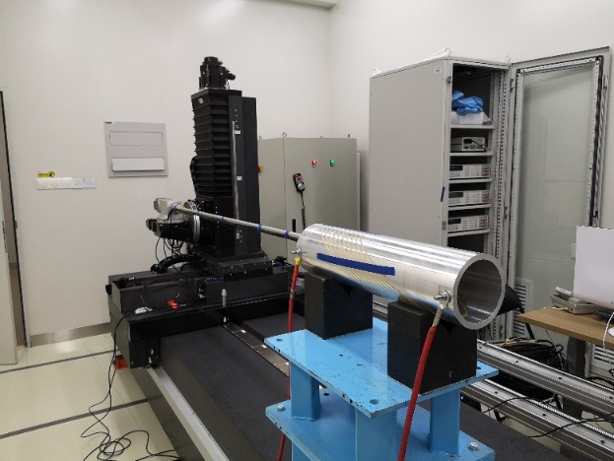
Designs of the dipole magnets
In the case of superconducting magnets, the CCT coils are made by inserting the conductors into the grooves that are fabricated on the surfaces of the supporting cylinders.
In our case, we tried to make one part of CCT coil directly by fabricating it from an aluminum tubes.
The test results showed that the field distribution had a good agreement with the simulated one and the field reproducibility was better than 2E-4 at low field level of 30Gs, but this design was given up because it was not an economic one.

Slide 8
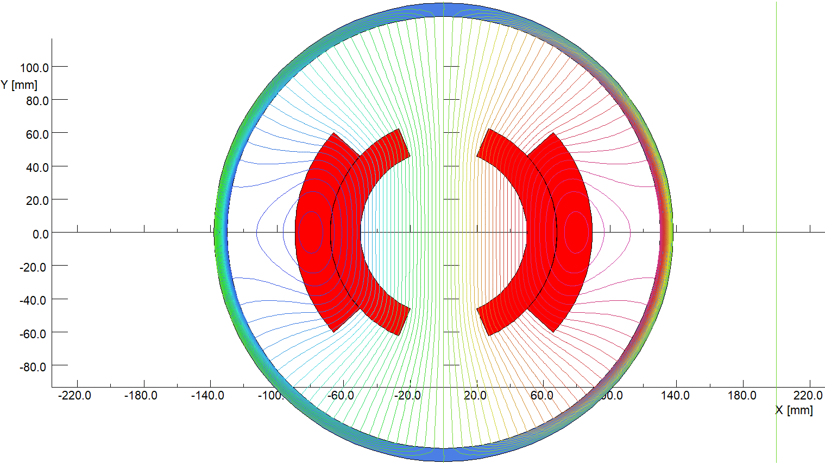
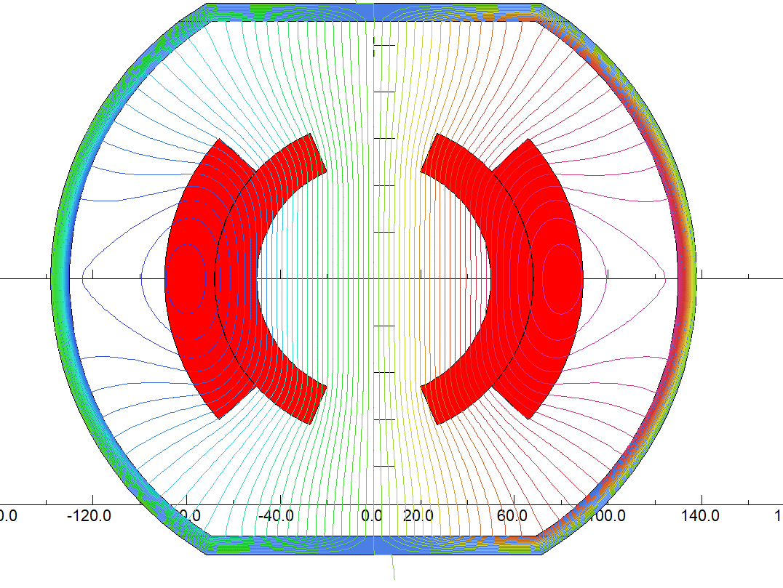
Designs of the dipole magnets
3) CT dipole magnet without iron core
The design of dipole magnet with Cosθ (CT) coil is a conventional measure for high field superconducting magnets, it is the first time for design of the high precision low field magnet.
To increase excitation efficiency at high field level of the magnet, the top and bottom of the shielding cylinder can be flatted.
To reduce the production cost, the structure of the CT coils is designed as simple as possible. The magnet have two coils, each coil has two layers, which are formed by aluminum bars with the same cross section areas.

Slide 9
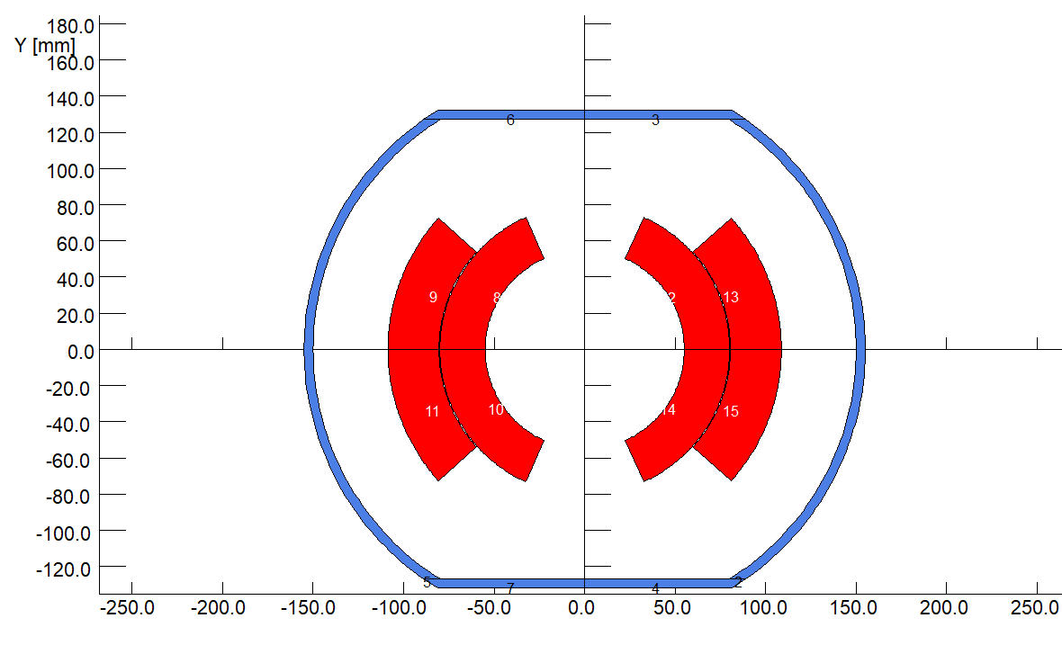
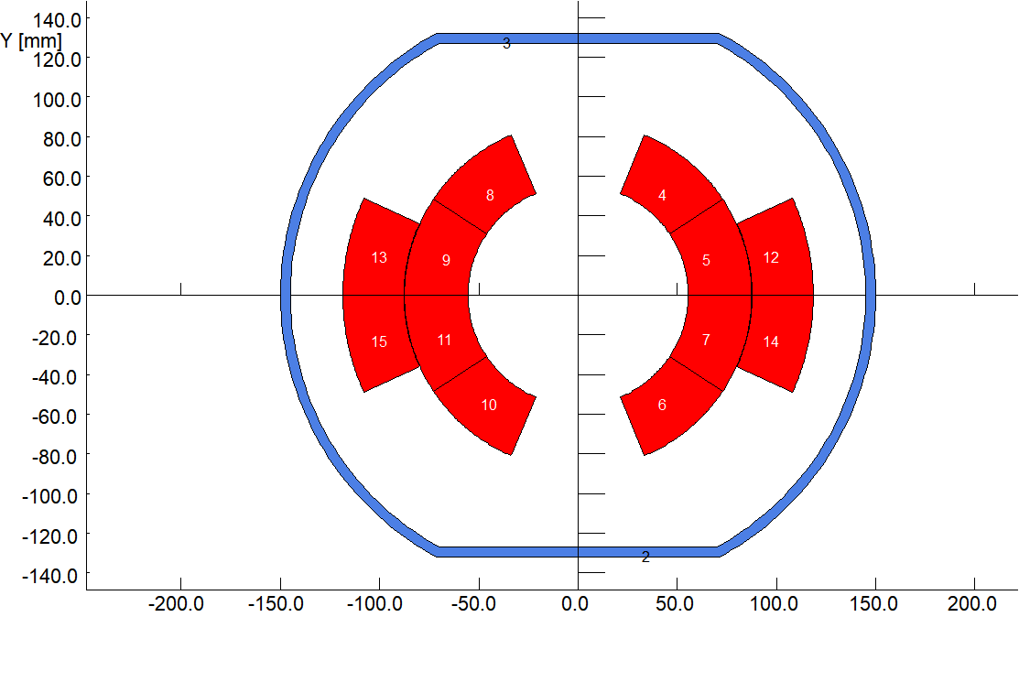
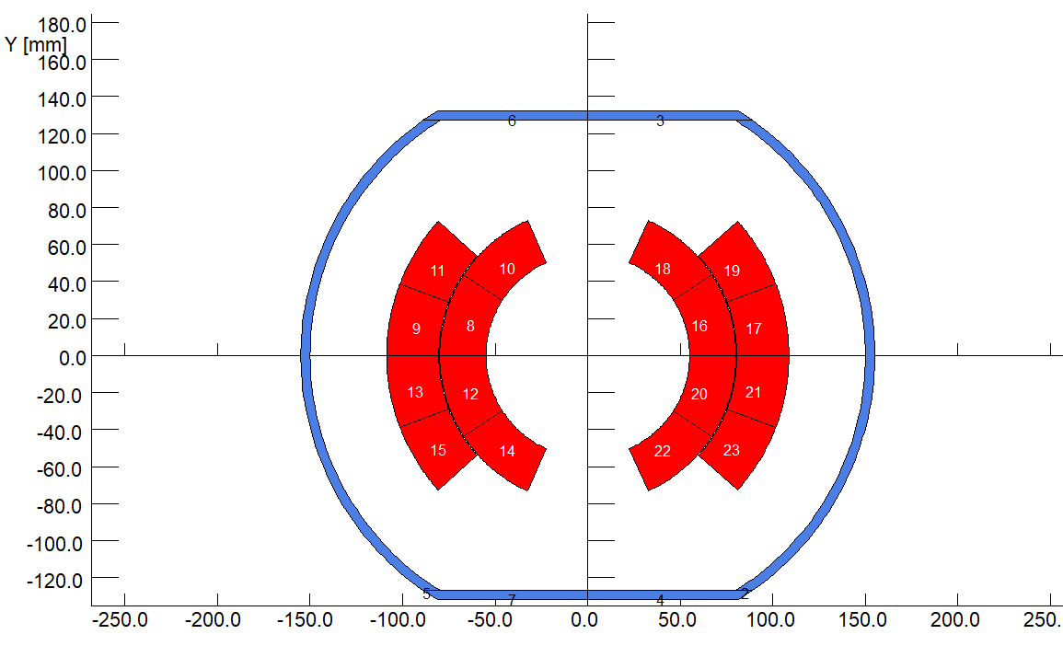
Designs of the dipole magnets
Since the field of the dipole magnets for CEPCB will ramp with the beam energy, eddy current will be induced in the coil conductors.
To study the influence of the eddy current on the field quality of the magnet, the AC field of the CT coil with 2 turns, 3 turns and 4 turns was simulated.
2 turn per coil
3 turn per coil
4 turn per coil

Slide 10
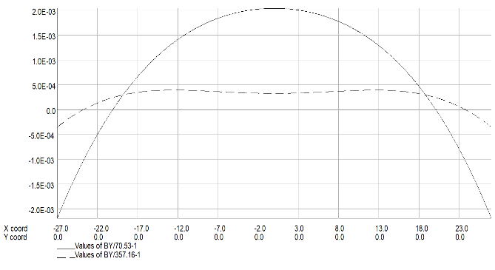
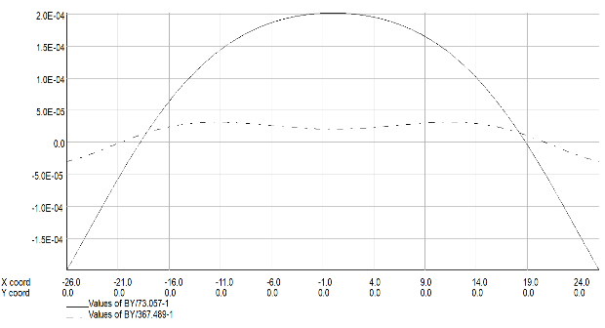
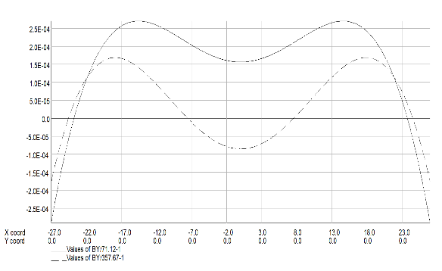
Designs of the dipole magnets
The field simulation shows that the field quality at low field level is destroyed more seriously by eddy current than that at high level.
The more turns the coil has, the less eddy current induced in the conductors, the better field quality at low level is.
Although the magnet with 4 turn per coil has the best field quality at low level, the magnet with 3 turn per coil is preferred because it is easier to be produced.
field distribution
(2 turn case)
field distribution
(3 turn case)
field distribution
(4 turn case)

Slide 11
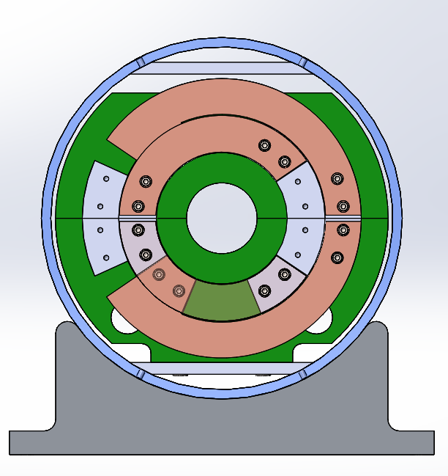
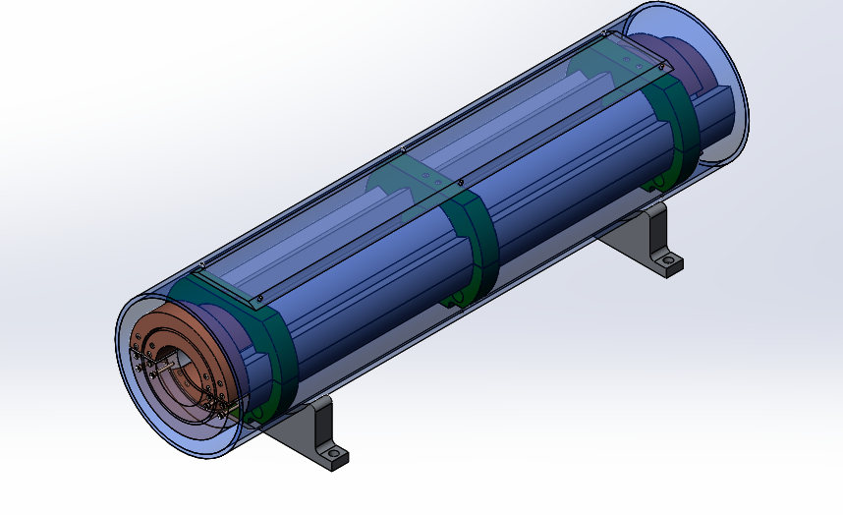
Designs of the dipole magnets
In the structure, the upper and lower coils of the magnet are formed by six aluminum arc bars with the same cross section areas, so each coil has three turns, two turns in the inner and one turn in the outer.
Because the field and the magnetic force are not high, the supporters at three positions per meter in the longitudinal direction are strong enough to fix the bars of coils together.

Slide 12
Designs of the dipole magnets
Main parameters of three dipole magnet
 | Iron Yoke | CT | CCT
Max. field [Gs] | 338 | 338 | 338
Min. field [Gs] | 28 | 28 | 28
Good field region (mm) | 55 | 55 | 55
Field uniformity | 0.1% | 0.1% | 0.1%
Coil turns per magnet | 4 | 6 | 234
Max.current (A) | 428 | 1000 | 481
Min.current (A) | 37 | 80 | 41
Conductor area (mm²) | 1000 | 1348 | 900
Max.current density(A/mm²) | 0.43 | 0.73 | 0.53
Max. power loss (W) | 245 | 1350 | 1665
Avg. power loss (W) | 98 | 540 | 666
Inductance (mH) | 0.32 | 0.36 | 1.5
Magnet size（mm） | 330 | 310 | 360
Magnet length (mm) | 4650 | 4632 | 4865
Magnet weight (ton) | 1.4 | 1.1 | 0.65

Slide 13
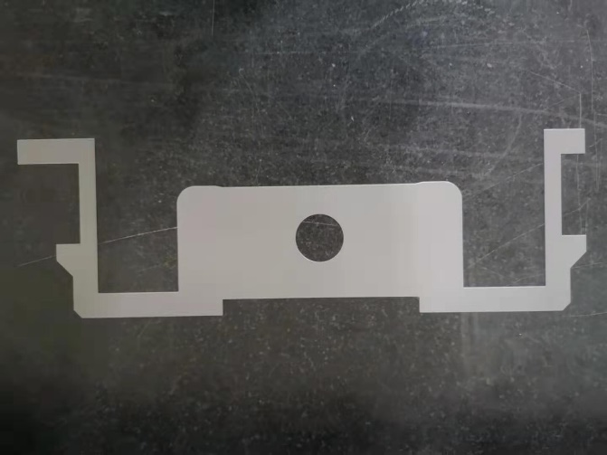
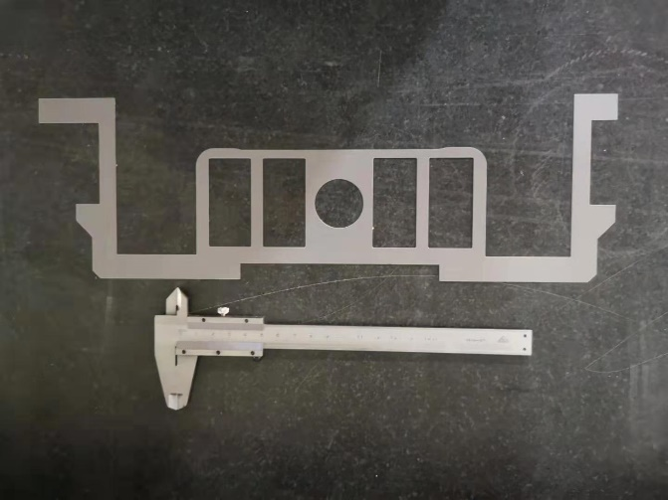
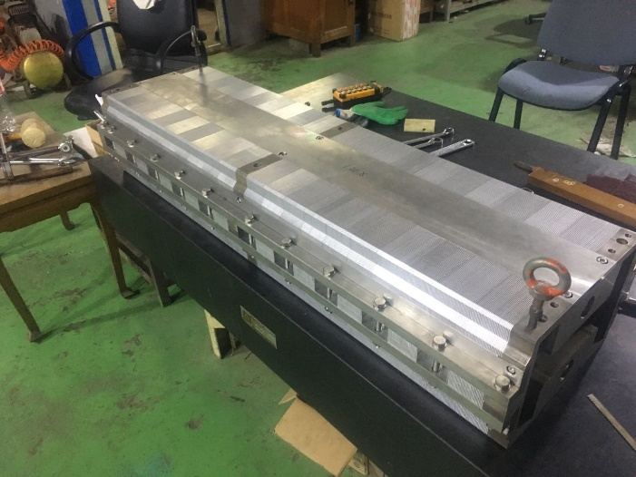
Fabrication of the subscale magnets
To verify the designs of the dipole magnets, two kinds of subscale magnets are fabricated, one is the magnet with diluted iron core, another is the CT coil magnet without iron core.
1) The subscale dipole magnet with diluted iron core
The magnet has the upper and lower cores, which are stacked by the grain-oriented silicon steel and aluminum laminations with the thichness ratio of 1:1.
To investigate the influence of the holes in the pole areas, two kinds of laminations with and without holes are produced. So half of the cores is stacked by the laminations with the holes and half without holes.

Slide 14
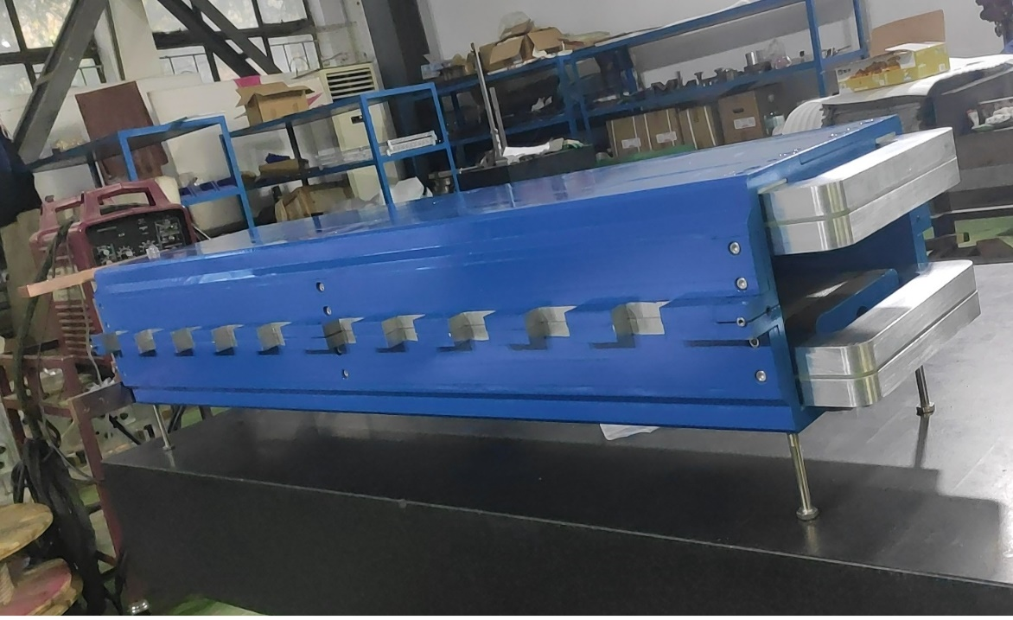
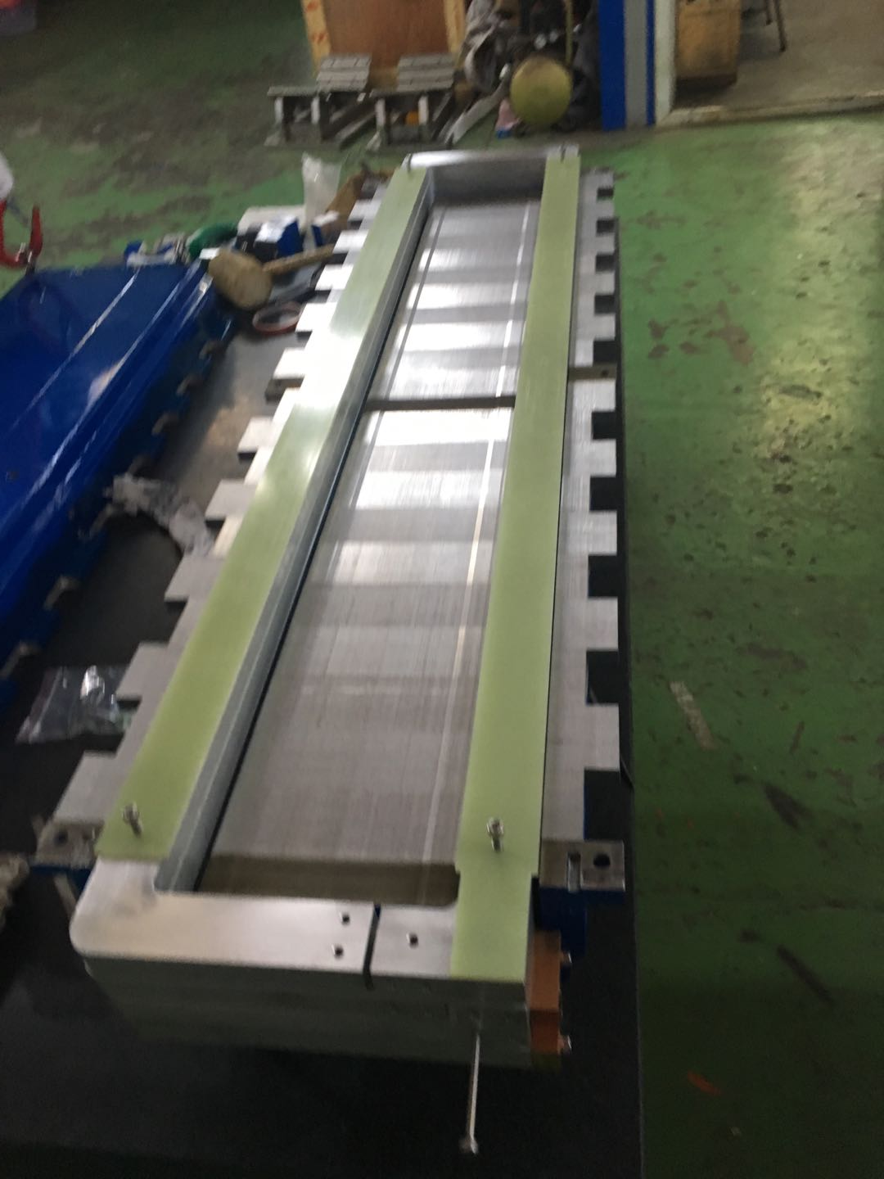
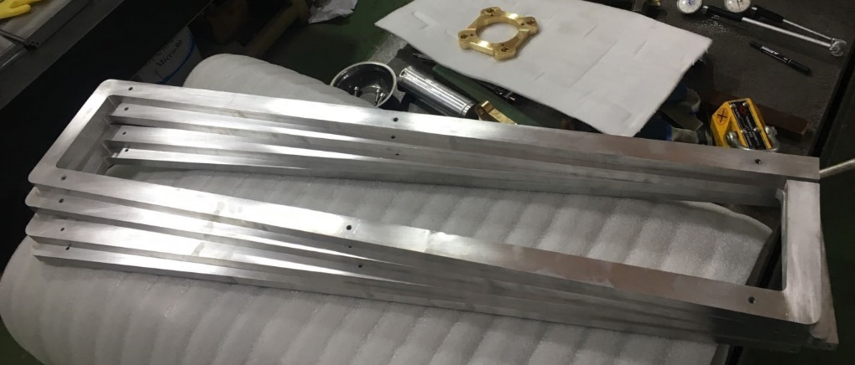
Fabrication of the subscale magnets
The magnet has two coils and each coil has two turns. The conductors of each turn are directly fabricated from the aluminum plates
Because the working voltage is not high, the G10 plates with thickness of 4mm are used for the insulation either from turn to turn or between the coils and cores. The test results show that it can stand 500V.

Slide 15
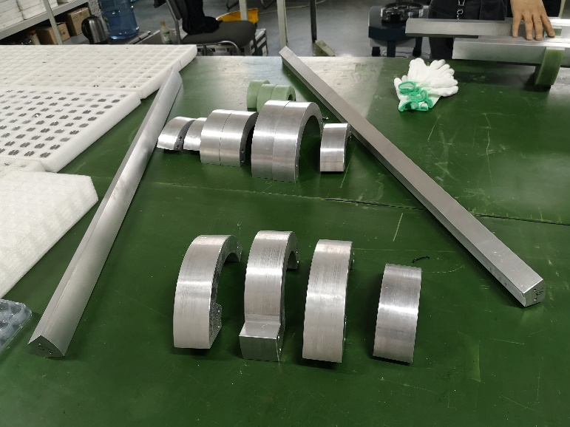
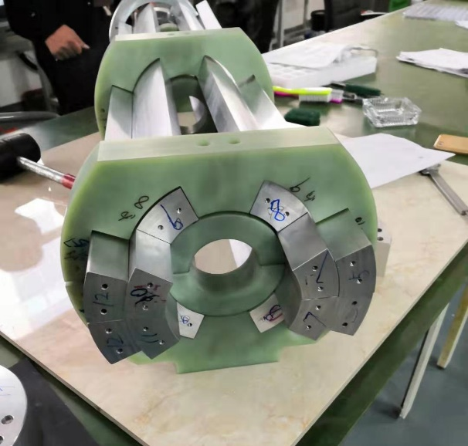
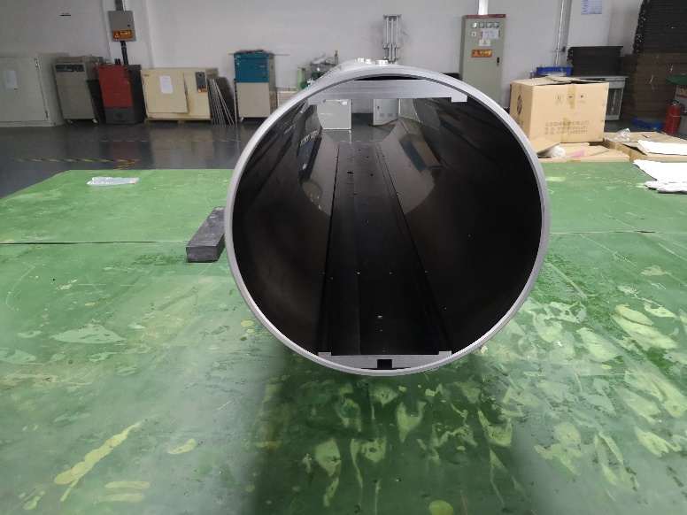
Fabrication of the subscale magnets
2) The subscale CT dipole magnet without iron core
The inner and outer conductors of the CT coils are directly fabricated from two aluminum tubes with the right diameters.
The mechanical deformation of the fabricated conductors was too large to be accepted, so the conductors were carefully reformed before assembling into the coils.
The shielding cylinder was made from a long iron tube with inner diameter of 300mm, two long plates for the field adjustment at the top and bottom of cylinder were also made by iron.

Slide 16
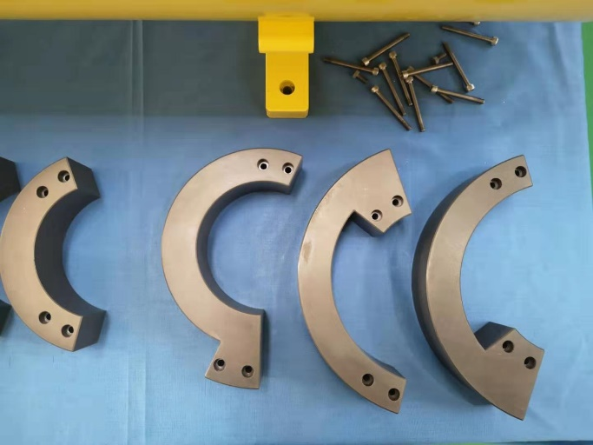
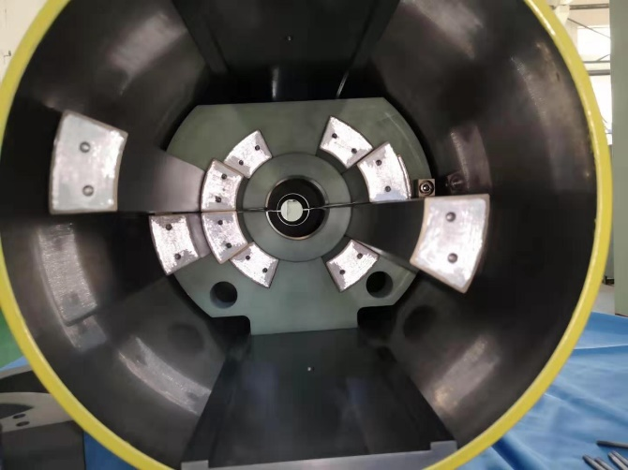
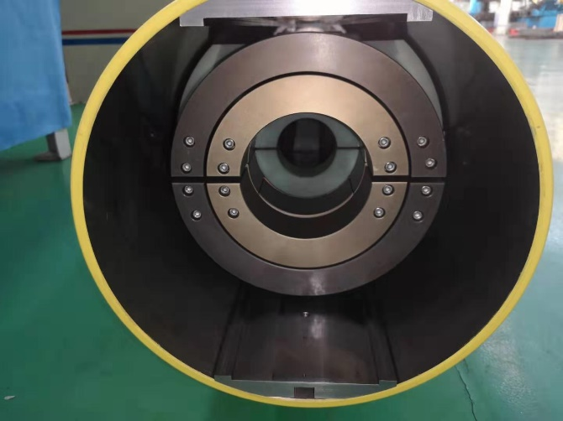
Fabrication of the subscale magnets
All the surfaces of the aluminum conductors were anodized for the insulation from turn to turn, the thickness of the anodized film is about 50 microns.
The inner and outer conductors of the coils were connected by the by-pass circular conductors, the anodized film of the connected touch surfaces was gotten rid of before the conductors were connected.
The final assembling errors of the CT coil dipole magnet were checked to be less than 50 microns.

Slide 17
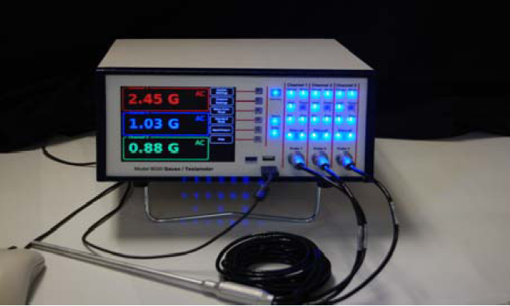
Test of the subscale dipole magnets
1) High precision field measurement system
By exploring several international companies that can produce high precision Hall probe field measurement systems, the precision of one system from F.W. Bell company was found to reach the requirement of the low field measurement.

Slide 18
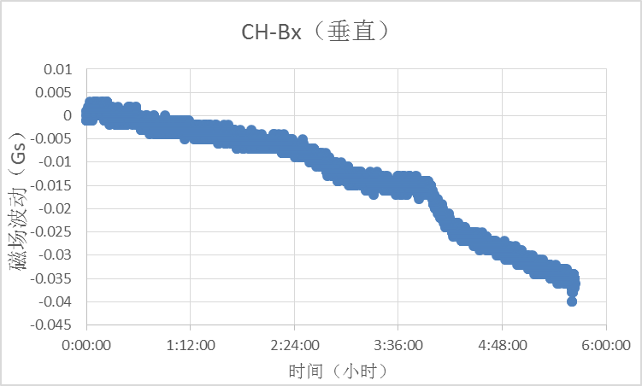
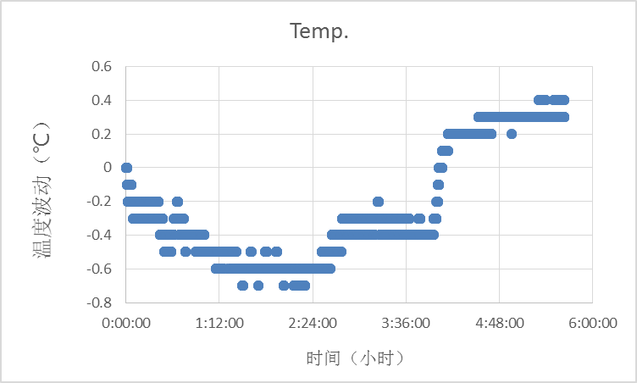
Test of the subscale dipole magnets
The performance of the measurement system was tested with a permanent magnet in the field measurement lab.
The precision of the system is 0.006Gs in the first hour and 0.01Gs in the second hour.
The precision is very sensitive to the temperature change of the lab. From the third hour, the temperature of the lab changed 1ºC, the precision became 0.035Gs.
To realize the precision of 0.01Gs, the temperature change in the lab should be controlled within 0.5ºC

Slide 19
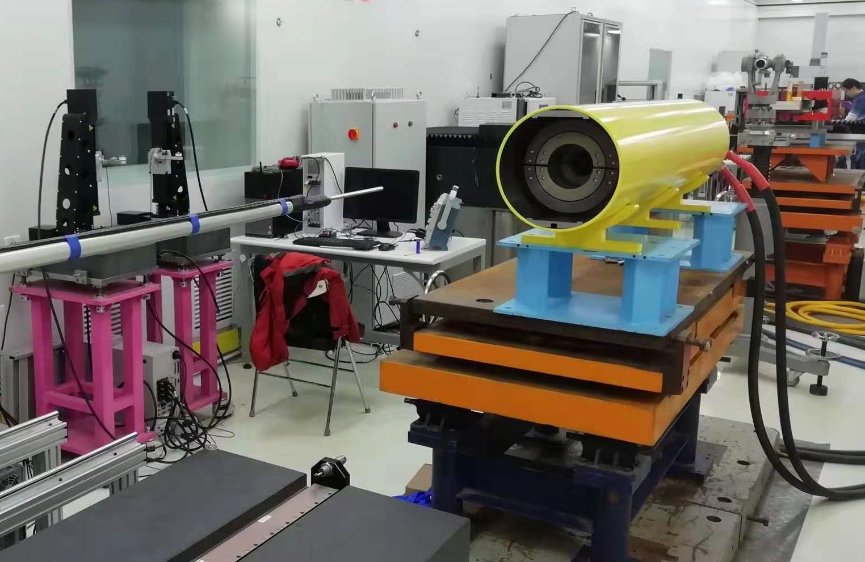
Test of the subscale dipole magnets
2) Test of the CT coil dipole magnet without iron core
The CT coil dipole magnet was tested in the lab. last week.

Slide 20
Test of the subscale dipole magnets
The measurement results show,
The field precision at all level, especially at low field level of 28Gs, is better than the required value of 0.1%.
The magnet is excited for 3 times from 28Gs to 338Gs then back to 28Gs, the field reproducibility at all level is better than the required value of 5E-4.
The field precision and field reproducibility become worse when the field decreases.

Slide 21
Test of the subscale dipole magnets
The reason that the magnet performance at low field level is worse than that at high field level is probably the influence of remnant field in the shielding cylinder and field adjustment plates.
The test results show that the remnant field in the aperture of the magnet is not only about 2.1Gs, but also not uniform along in the transverse direction after the excited current decreases to zero.

Slide 22
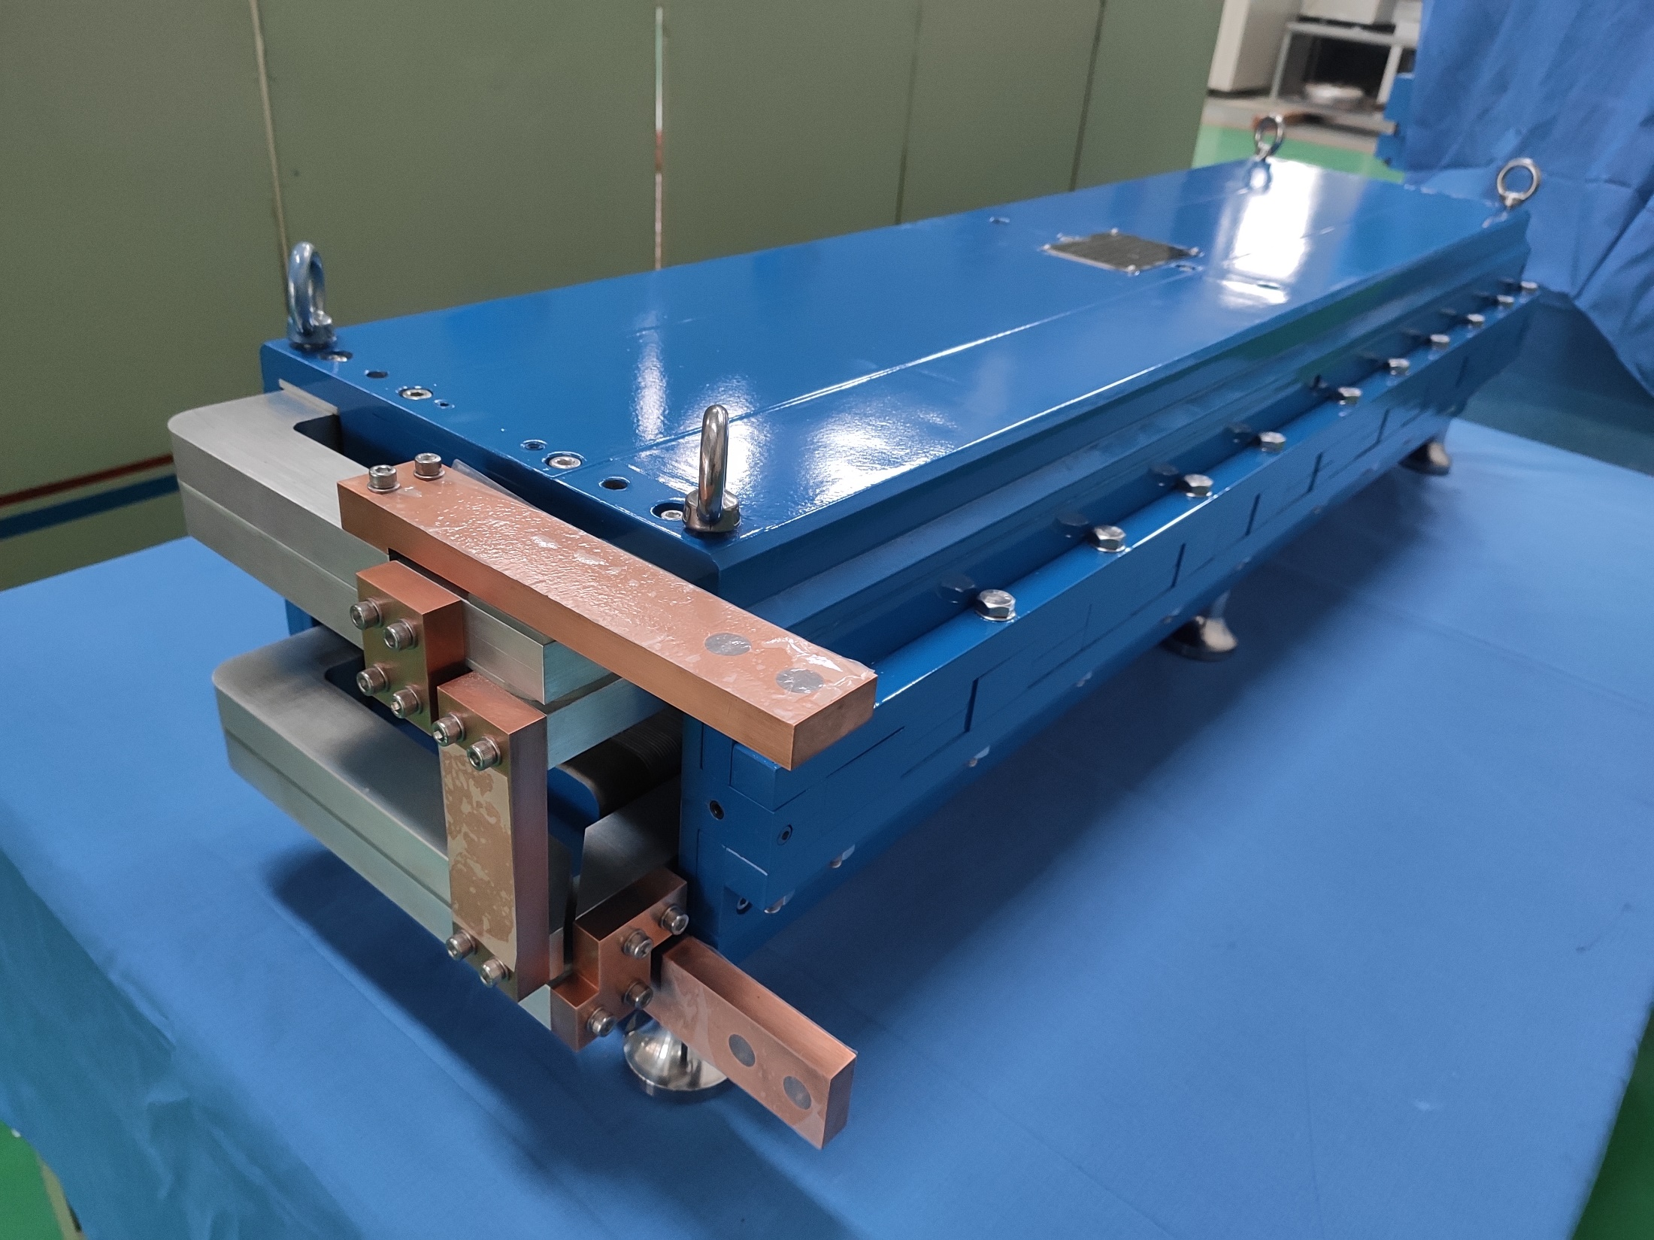
Test of the subscale dipole magnets
3) Test of the dipole magnet with diluted iron core
Because the production of the dipole magnet with diluted iron core was just finished in the end of last week, the magnet has not been tested up to now.

Slide 23
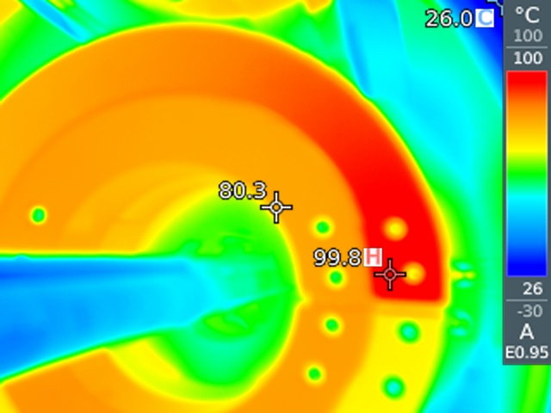
Problems of the CT coil dipole magnet
A serious problem is that the temperature of the coils increases to 80ºC-100ºC when the field increases to high level.
The reason is that the aluminum alloy not the pure aluminum was selected as the material of the conductors because of its good mechanical properties when the magnet was produced.
The resistivity of the aluminum alloy is 1.6 times larger than the pure aluminum, so the power loss of the coils increases by 1.6 times.
In addition, the touch resistance of the contacted surfaces of the conductors is larger than the expected one.

Slide 24
Problems of the CT coil dipole magnet
To decrease the temperature of the coils at high field level in future,
The pure aluminum not aluminum alloy will be selected as the material of the conductors.
Increasing the cross section areas of the conductors or considering to insert water cooling tube into the coils.
Coating the silver film on the touch surfaces of the connected conductors.

Slide 25
Problems of the CT coil dipole magnet
Another problem is that the performance of the CT coil dipole magnet is not as good as the expected due to the influence of the remnant field from the shielding cylinder and field adjustment plates, it can be improved
By increasing the diameter of the shielding cylinder.
By canceling the field adjustment plates at the top and bottom of the shielding cylinder.

Slide 26
Summary
To reach the high precision both at low and high field level, three kinds of new designs for the CEPC booster dipole magnet were proposed and studied.
The magnet with iron core has high excitation efficiency at high field level but poor performance at low field level whereas the magnet without iron core has good performance at low field level but low excitation efficiency at high field level.
To verify the designs of the magnet, two kinds of subscale prototype dipole magnets with and without iron cores were fabricated.
The test results show that the CT coil dipole magnet without iron core has high precision and good reproducibility field both at low and high field level, which is satisfied with the requirements.
Two problems were found in the test of the CT coil dipole magnet and will be solved in full-scale prototype dipole magnet in future.

Slide 27
Thank you for your attention！

