Slide 1

CEPC Collider Ring Magnets
Mei Yang, Fusan Chen, Xianjing Sun
IHEP, CAS
2019 International Workshop on the
high energy Circular Electron-Positron Collider (CEPC)
Nov.18-20,2019, IHEP, Beijing, China

Slide 2
Outline
Introduction
Dual aperture dipole(DAD)
  Physical and mechanical design
  Earth field effect simulation
  Primary measurement results of prototype
Dual aperture quadrupole(DAQ)
  Physical and mechanical design
  Prototype progress
Sextupole design
Summary

Slide 3
Overview of collider magnets
Over 80% of collider ring is covered by conventional magnets. All these magnets work at DC mode.
The most important issues are Cost & Power Consumption.
  Make the magnets compact and simple.
  Aluminum wire is used for the excitation coils.
  Dual aperture magnets save nearly 50% power consumption.
  Consider the combined function magnets.
  Increase the coil cross section and decrease the operating current.
 | Dipole | Quad. | Sext. | Corrector | Total
Dual aperture | 2384 | 2392 | - | - | 13742
Single aperture | 80*2+2 | 480*2+172 | 932*2 | 2904*2
Total length [km] | 71.5 | 5.9 | 1.0 | 2.5 | 80.8
Power [MW] | 7.0 | 20.2 | 4.6 | 2.2 | 34

Slide 4
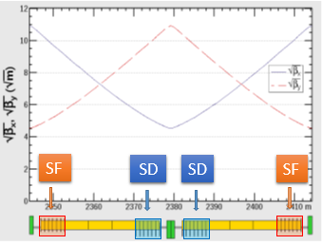
Parameters of the DAD
Parameters of main dipole magnets.
Short prototype of DAD (1m in length)
  Central field：140Gs@45GeV~373Gs @120GeV
  Difference between the two aperture center fields <0.5%
  High order harmonics<5×10⁻⁴ @R=13.5mm(except b3)
  Separate coils in two apertures：±1.5%
  Size of vacuum chamber：(W*H) 99mm ×62mm
  Thickness of radiation lead：25mm
Field strength(Gs) | 140Gs~373Gs
Aperture(mm) | 70
Effective length(m) | 28.7m, 5 parts
GFR(mm) | 13.5
Adjustment capability | ±1.5%
Field quality | 5×10⁻⁴

Slide 5
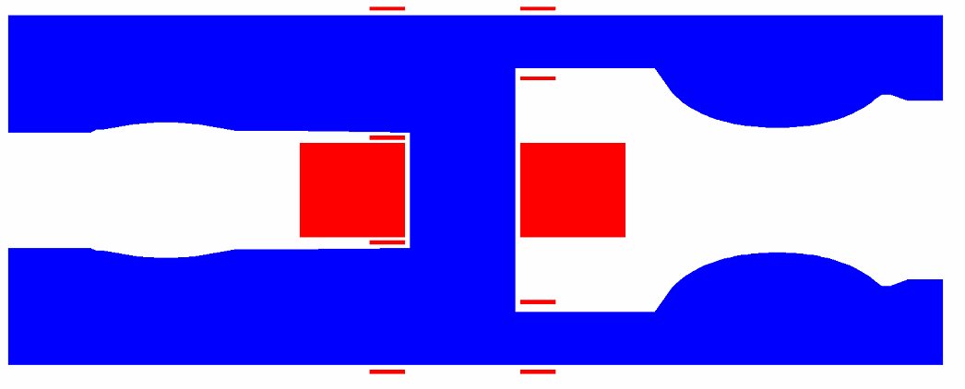
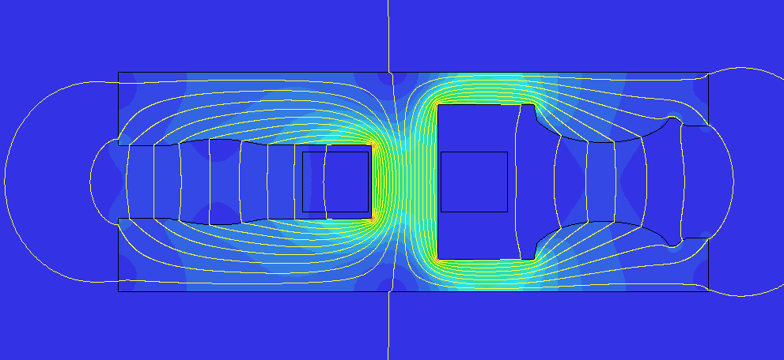
Physical design of DAD prototype
2D&3D OPERA simulations are done and the results meet the requirements.
Ap1-a
Ap2-t
66.6mm
78mm
71.8mm
350mm
Ap1:Field adjustment@120GeV
Field strength at different energy
 | B | B+1.5% | B-1.5%
B(T) | 0.037324 | 0.037892 | 0.036756
S(T/m²) | 4.888 | 4.9612 | 4.8145
 | Harmonics(Bn/B1,1e-4)
1 | 10000 | 10000 | 10000
2 | -0.68 | -0.606 | -0.751
3 | 119.34 | 119.309 | 119.362
4 | 0.79 | 0.795 | 0.778
5 | -3.42 | -3.423 | -3.418
E(GeV) | J(A/mm2) | Ap1- B1(T) | Ap2- B1(T) | Ap1- S(T/m2) | AP2-S(T/m2)
45 | 0.263 | 0.01409 | 0.01405 | 1.846 | -2.640
80 | 0.463 | 0.02486 | 0.02484 | 3.257 | -4.668
120 | 0.694 | 0.03732 | 0.03734 | 4.888 | -7.017

Slide 6
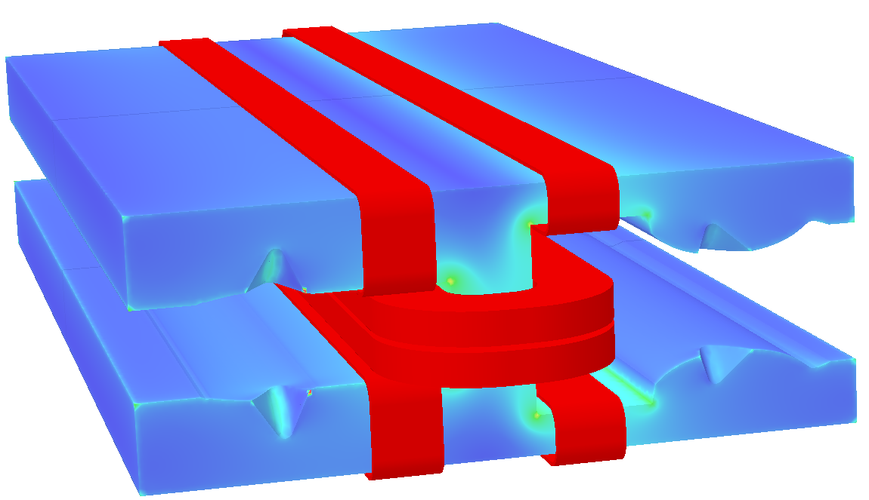
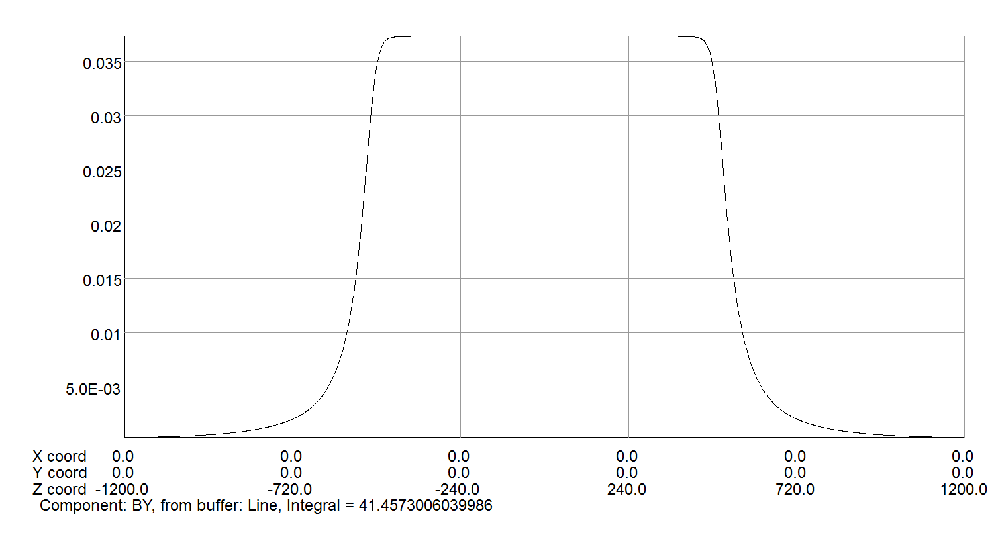
Physical design of DAD prototype
Integral field and higher harmonics at 120GeV
Ap1: Field adjustment @ 120GeV
Integral field @120GeV
High harmonics@120GeV
Ap1 | B | B+1.5% | B-1.5%
BL(T.mm) | 41.605 | 42.229 | 40.981
 | Harmonics(Bn/B1, 1e-4)
1 | 10000 | 10000 | 10000
2 | -2.72 | -2.51 | -1.83
3 | 113.60 | 113.80 | 113.85
4 | 2.28 | 2.35 | 2.38
5 | -3.11 | -3.09 | -3.08
 | Ap1 | Ap2
BL(T.mm) | 41.605 | 41.457
B0(T) | 0.03732 | 0.03733
SL(T/m) | 5.168 | -7.036
Leff(mm) | 1114.7 | 1110.7
 | Ap1 | Ap2
1 | 10000 | 10000
2 | 2.72 | 1.06
3 | 113.60 | -155.236
4 | 2.83 | -1.92
5 | -3.11 | 2.0
Conclusion
The magnetic field coupling between the two apertures can be ignored in the case of existing correction coils.
The magnetic field has a linear relationship with the current, without considering the hysteresis effect.

Slide 7
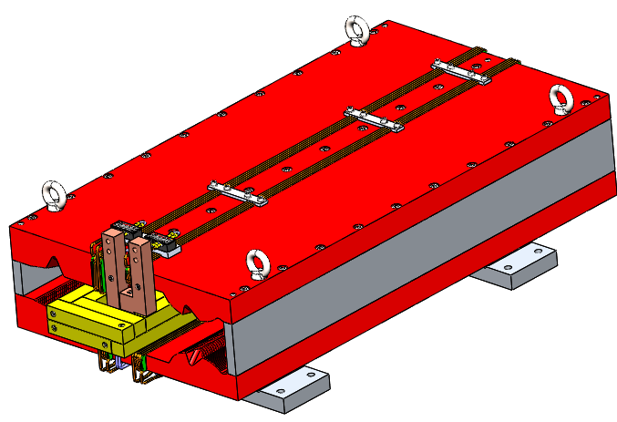
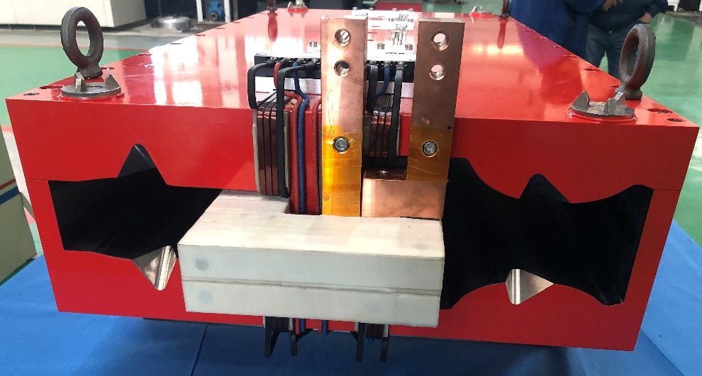
Mechanical design of DAD prototype
Liron=1m, solid yoke , three parts;
Main coils: aluminum bus bars, 4 turns, air cooled, interconnect by screw;
Trim coils: copper wire, 4 turns per pole, air cooled;
Two stainless steel supporters to increase rigidity of the overall structure.
Magnetic strength [T] |  | 0.0373
Aperture [mm] |  | 70
Main coil | Turns | 4
 | Material | Aluminum
 | Current [A] | 563
 | Current density [A/mm2] | 0.7
 | Power consumption [kW] | 0.12
Trim coil | Turns | 1×4
 | Material | Copper
 | Current [A] | 16.7
 | Current density [A/mm2] | 0.093
 | Power consumption [kW] | 0.0005
Tot cross section(mm) |  | 535*200
Iron length (mm) |  | 1000
Iron weight(kg) |  | 510
Al weight(kg) |  | 22
Cu weight(kg) |  | 0.3
CAD model of dual aperture dipole
Dual aperture dipole prototype

Slide 8
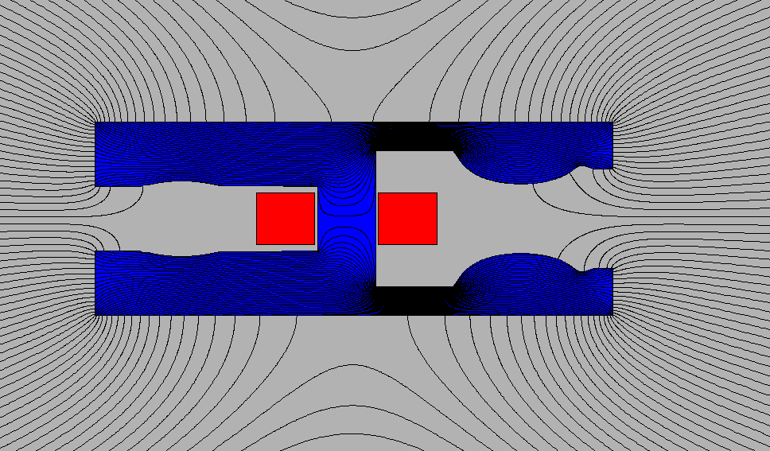
Earth field effect simulation on DAD
The earth field is ~0.5Gs, which is 0.36% of the lowest field 140Gs at 45GeV.
A pair of current plates are used to approximate the earth field effect on the field distribution of the DAD.
  Case 1:only the earth field E0.5Gs------~0.5Gs
  Case 2: E0.5Gs+B0Gs with Iron-------0.012 and 0.032Gs in two apertures.
    The magnetic flux is bent and concentrated through the iron core for its magnetic resistance is much smaller than that in the air.
    The field uniformity at the GFR is less than 5%.
  Case 3:E0Gs+B140Gs and Case 4: E0.5Gs+B140Gs
    The central field difference is less than 2.5e-4 of 140Gs.

Slide 9
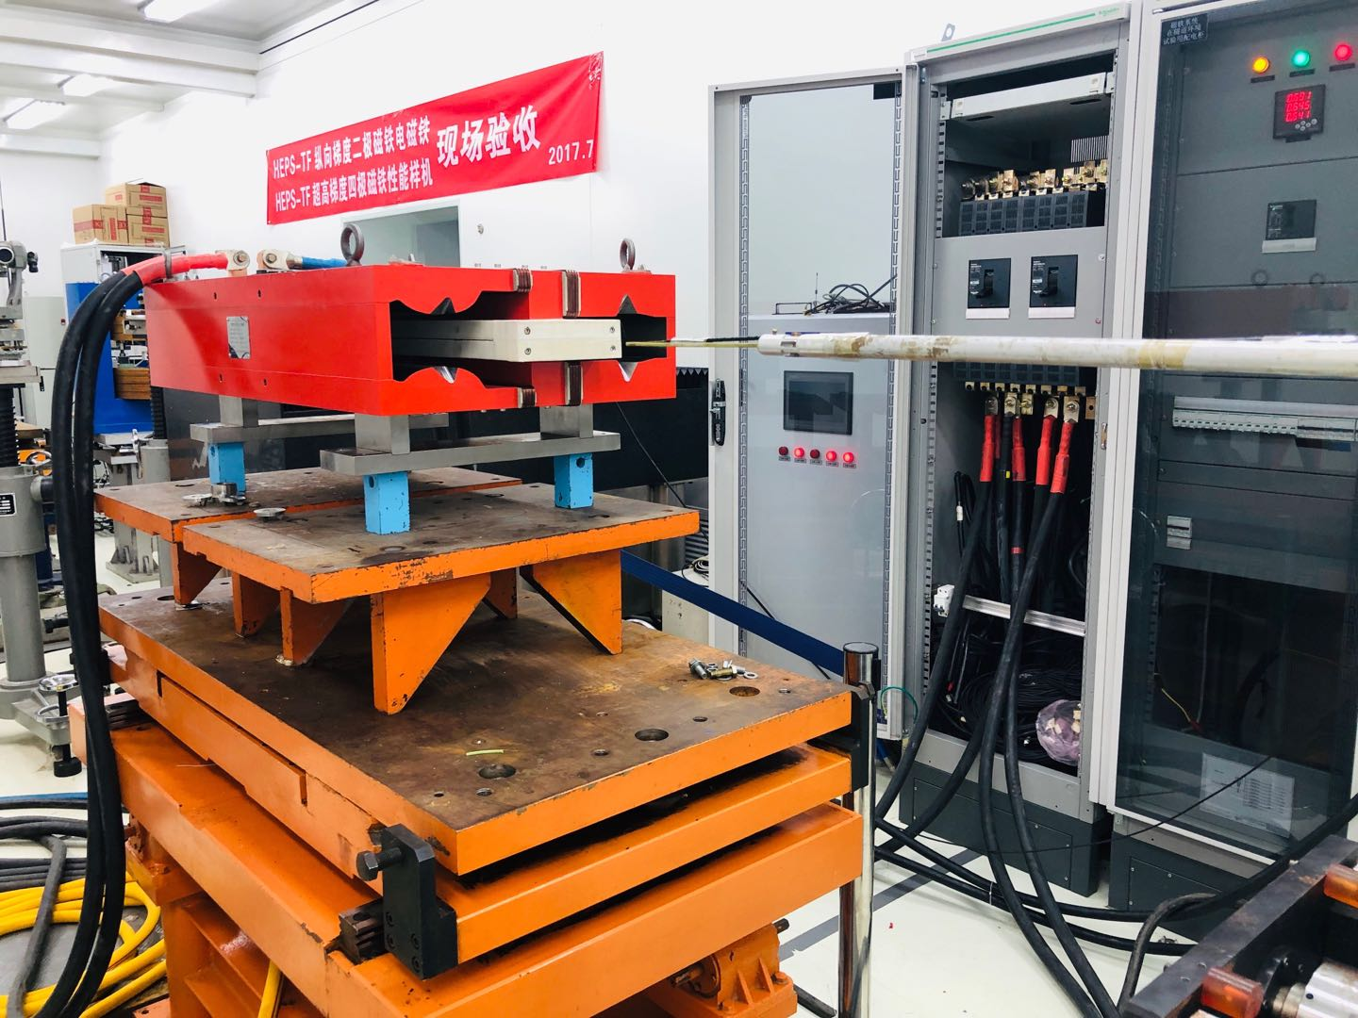
Magnetic measurements: dipole transfer function
The transfer function at two apertures:
  Center field difference <0.3% in two apertures(residual field effect and different gaps at the two apertures).
Ap2
Ap1
Dipole measured by a hall probe system
B/I Transfer function
By along z at different energy

Slide 10
Magnetic measurements: field difference and harmonics
Integral field differences
  Difference is less than 0.15%@45GeV.
Harmonics@Rref=13.5mm
E(GeV) | Ap1 ByL(T.mm) | Ap2 ByL(T.mm) | Differ
45 | 15.3972 | 15.3765 | -0.13%
80 | 27.3358 | 27.3199 | -0.06%
120 | 41.2001 | 41.1810 | -0.05%
Harmonics at two apertures
n | Ap1@45GeV | Ap2@45GeV
2 | 5.38 | -1.40
3 | 113.24 | -157.23
4 | 4.49 | -2.00
5 | 0.015 | 2.14
6 | -5.29 | 2.60
Measured integral field in the vertical midplane (y=0)

Slide 11
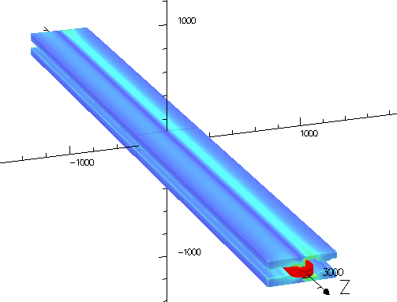
Long DAD design
As the magnetic length is up to 28.7m, the 5.7m model will be built to check the field quality, mechanical strength and deformation.
Using the same cross section of 1m long model, without end chamfering, the 5.7 m model can meet the field uniformity requirement. All the other harmonics are less than 5 units.
 | Ap1 | Ap2
BL(T.mm) | 217.1834 | 217.0064
 | Harmonics(Bn/B1×10000)
1 | 10000 | 10000
2 | 2.87 | -1.34
3 | 116.55 | -169.29
4 | -0.97 | 0.79
5 | --3.31 | 2.76

Slide 12
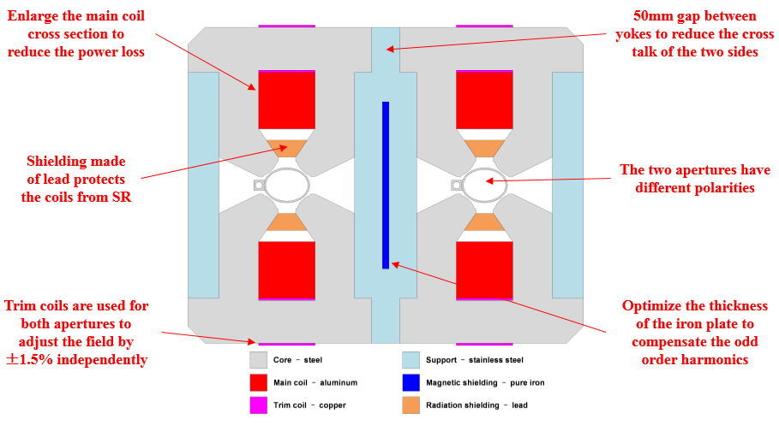
Dual aperture quadrupole(DAQ)
(by F. S. Chen)
Requirements of DAQ(number: 2392）
Prototype study
  Complex structure to verify assembly tolerances and mechanical structure
  Cross talk effect and compensation method study
  Verify the hollow aluminum wires
  Effect of trim coils on the main field
Gradient(T/m) | 8.42
Aperture(mm) | 76
Effective length(m) | 1 or 2
GFR(mm) | 12.2
Adjustment capability | ±1.5%
Field quality | 5×10⁻⁴

Slide 13
Physical design of DAQ prototype
2D simulation results
3D simulation results
  The iron plate can not compensate b1 & b3 at once.
B_{n}/B₂ | Without shielding | Shielding sheet (t=11.52mm)
1 | -2132.7 | -0.2
3 | -169.9 | 0.0
4 | 0.4 | 0.5
5 | -2.3 | 0.0
6 | -0.1 | 0.0
7 | 0.2 | 0.0
Mechanical decoupling
Shielding thickness | 11.2mm | 13mm | 16mm | 19mm
B₁/B₂ | -667 | -413 | 38 | 371
B₃/B₂ | -82 | -63 | -30 | -4
Magnetic compensation

Slide 14
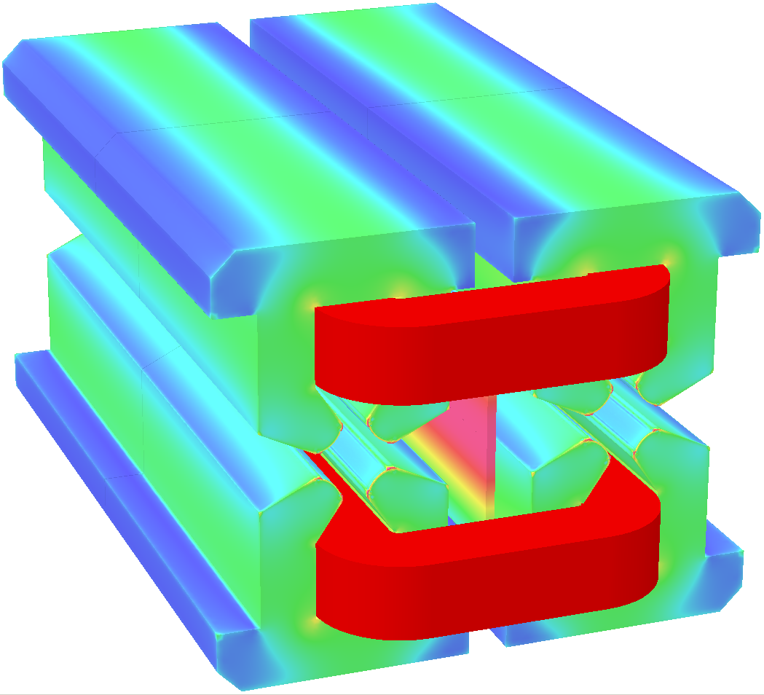
Physical design of DAQ prototype
Design parameters of DAQ prototype
Gradient [T/m] |  | 8.42
Aperture [mm] |  | 76
Main coil | Turns | 64×2
 | Material | Aluminum
 | Current [A] | 154
 | Current density [A/mm²] | 1.89
 | Power consumption [kW] | 3.3
Trim coil | Turns | 20×4
 | Material | Copper
 | Current [A] | 7.2
 | Current density [A/mm²] | 0.9
 | Power consumption [kW] | 0.04
Cooling water | Velocity [m/s] | 1.3
 | Flux [l/s] | 0.201
 | Temperature rise [°C] | 6.3

Slide 15
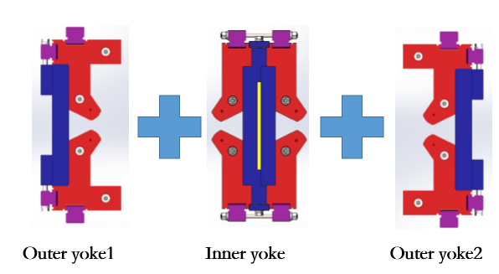
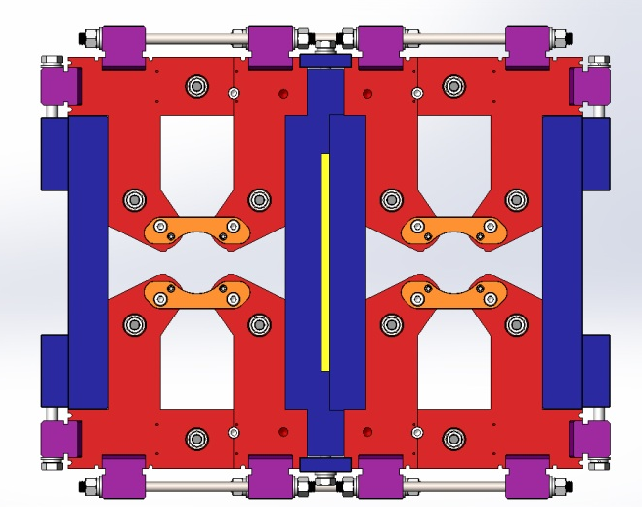
Mechanical design of DAQ prototype
Short model (1m in length),laminated yoke
Trim coils :±1.5% adjustability, enameled copper wire
Main coils: hollow aluminum coils, water cooled, 64 turns/pole
Large size of wire and low current density
Stainless steel as a supporter and separate two yokes.

Slide 16
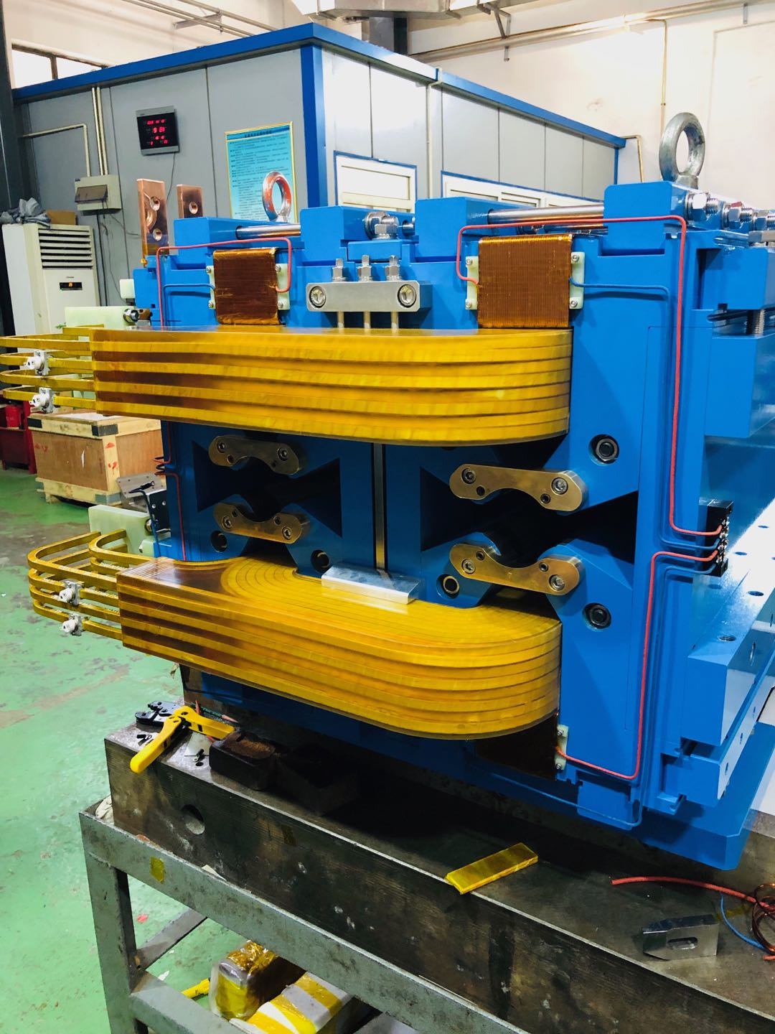
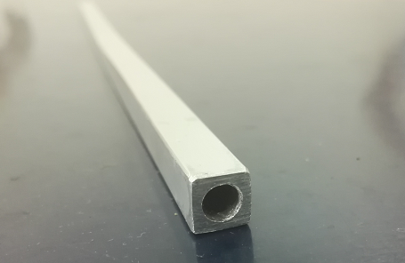
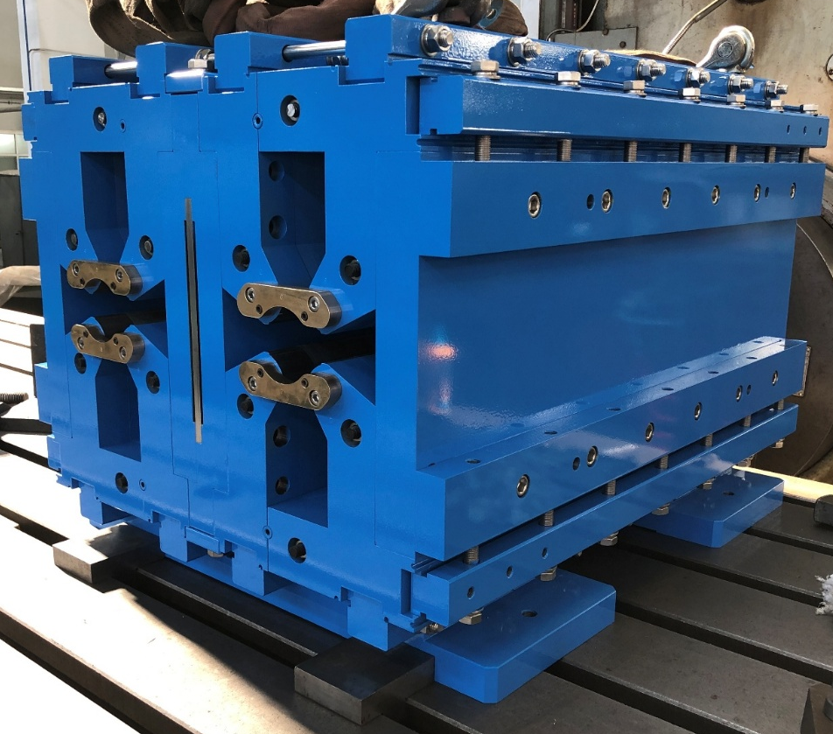
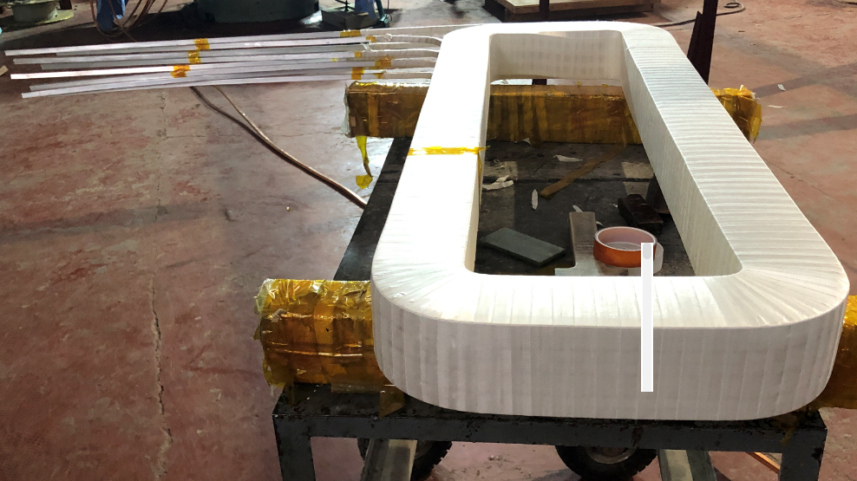
Dual aperture quadrupole prototype
The DAQ prototype has been finished and will be measured later.
Hollow aluminum wire
Iron of dual aperture quadrupole
Dual aperture quadrupole prototype
Main coil

Slide 17
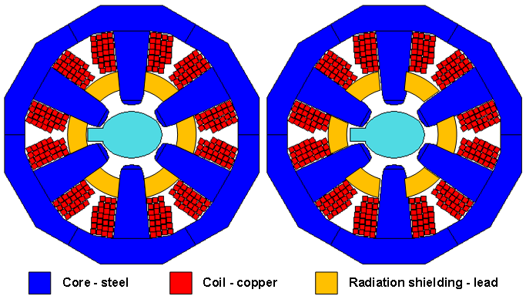
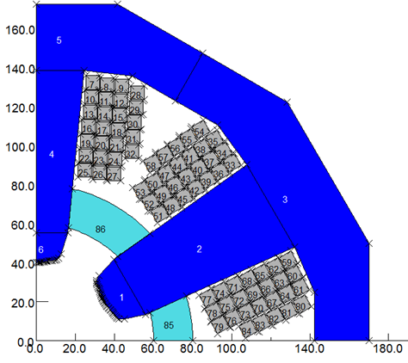
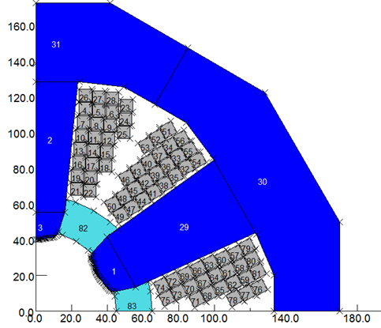
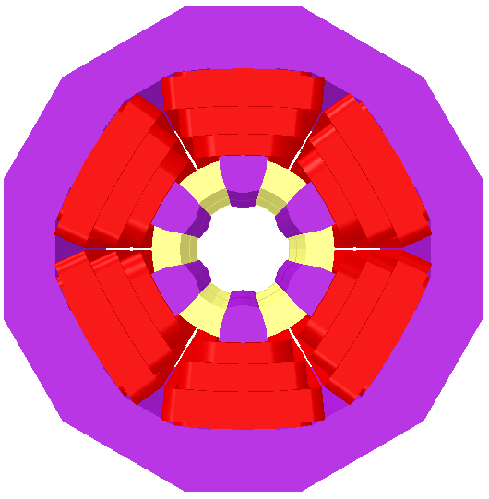
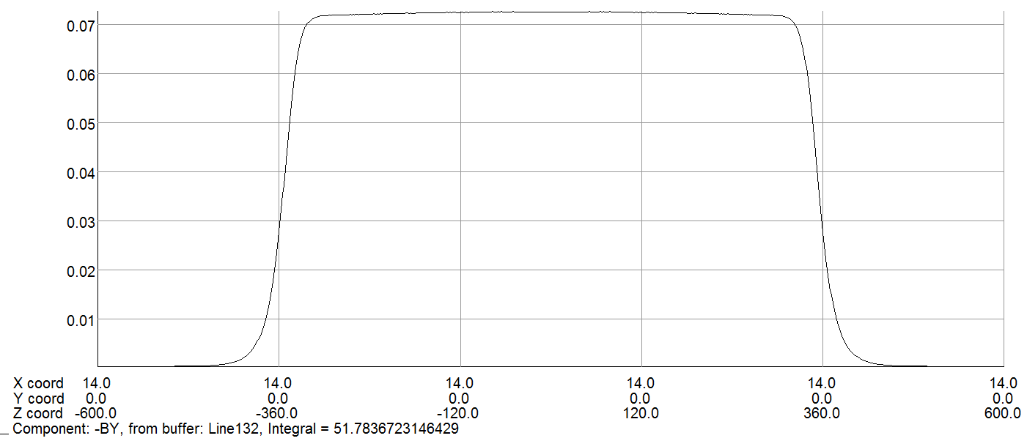
Sextupole magnet design
Two single aperture sextupoles are installed side by side.
  Core size is limited by the 350mm beam center separation.
  Use copper for coils & enlarge the cross section as much as possible.
  10mm gap between two magnets but the cross talk effect can be ignored.
  Field Strength: 191T/m² @45GeV to 506T/m² @120GeV
Optimization
  Rearrangement of the wire layout and enlarge the yoke from 28mm to 37mm.
(by X.J. Sun)

Slide 18
Summary
The design of combined dipole and sextupole magnet with aluminum bus bars is accessible. The center dipole field and sextupole strength is basically consistent with the design value.
Further field measurement will be taken by the stretched wire or rotating coil measurement system.
The water cooled aluminum conductor will be considered for long dipole model magnet.
The DAQ prototype will be also measured by the stretched wire or rotating coil measurement system. The cross talk effect of the DAQ will be further studied and discussed with physics.
A sextupole magnet prototype is in plan.

Slide 19
Thanks for your attention!

