Slide 1
The development of 650MHz/800kW klystron for CEPC in GLVAC
Wang Shaozhe Li Yongming

Slide 2
Outline
Gantt chart of the work in GLVAC
Facilities establishment in GLVAC
Components manufacture in GLVAC
Final assembly & baking
Future plan
Development of 650MHz/800kW klystron

Slide 3
Outline
Gantt chart of the work in GLVAC
Facilities establishment in GLVAC
Components manufacture in GLVAC
Final assembly & baking
Future plan
Development of 650MHz/800kW klystron

Slide 4
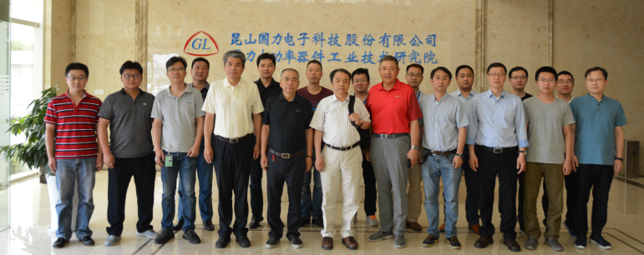
Gantt chart of the work in GLVAC
To develop the 650MHz/800kW CW klystron for CEPC and push its efficiency up to 80%, IHEP, IECAS and GLVAC established the collaboration group for the klystron development in 12th 2017, and its group meeting was held every 3 months.
Collaboration group meeting held in GLVAC (6th 2018)
Development of 650MHz/800kW klystron

Slide 5
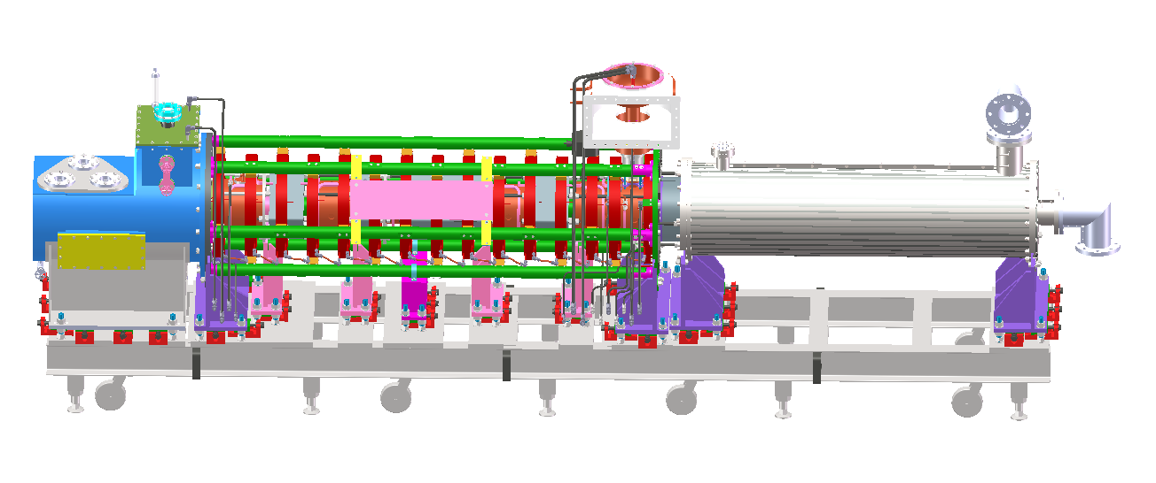
Gantt chart of the work in GLVAC
Cooperation of IHEP, IECAS and GLVAC
Design
Collector
Coils
Oil cylinder
Operation support
E-gun
Cavities
Development of 650MHz/800kW klystron

Slide 6
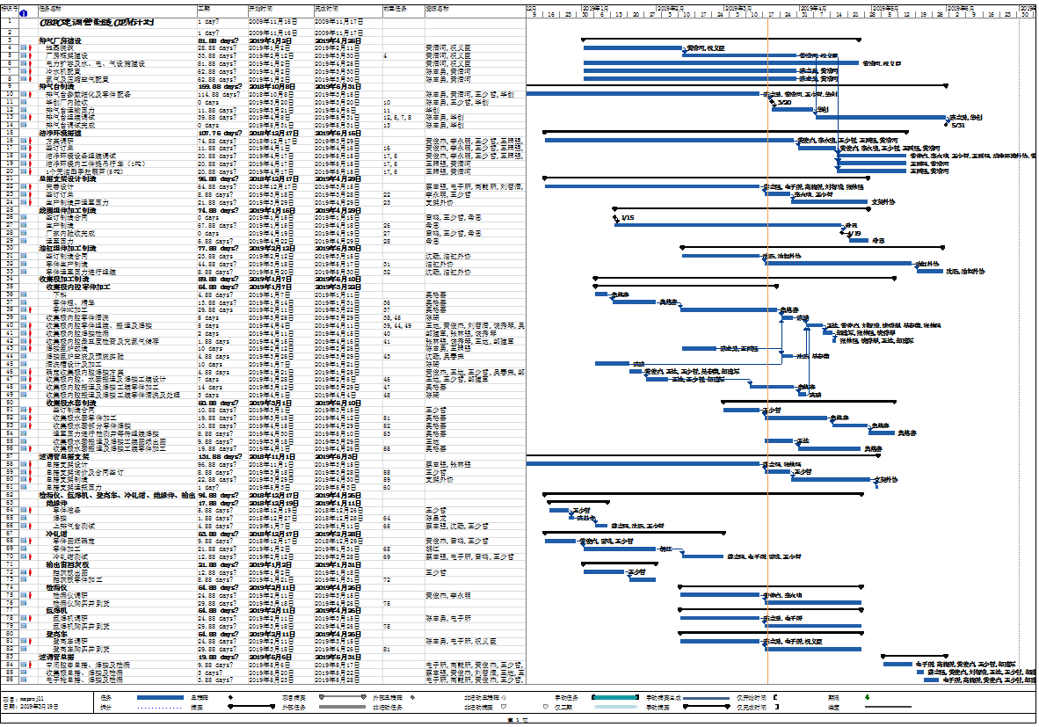
Gantt chart of the work in GLVAC
Gantt chart of the work in GLVAC
The work in GLVAC includes baking-workshop building construction, baking oven customization, clean room construction, final assembly support, collector, coils, oil cylinder, operation support and so on.
Development of 650MHz/800kW klystron

Slide 7
Gantt chart of the work in GLVAC
Gantt chart of the work in GLVAC
The work in GLVAC also includes mold design, final assembly, baking, post processing, packaging and so on. Its time schedule starts from 12th 2017 to 12th 2019.
The Invest capital of all in GLVAC is about RMB 20,000,000
Development of 650MHz/800kW klystron

Slide 8
Outline
Gantt chart of the work in GLVAC
Facilities establishment in GLVAC
Components manufacture in GLVAC
Final assembly & baking
Future plan
Development of 650MHz/800kW klystron

Slide 9
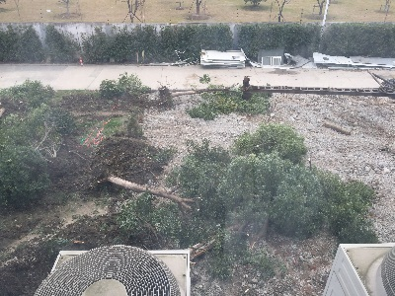
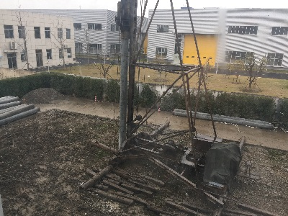
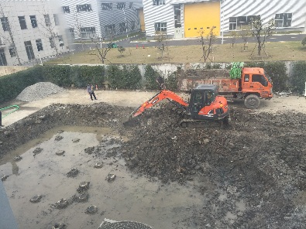
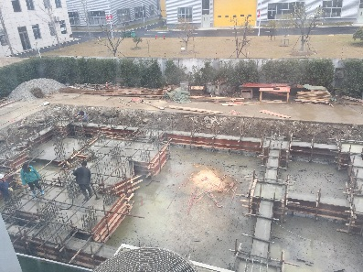
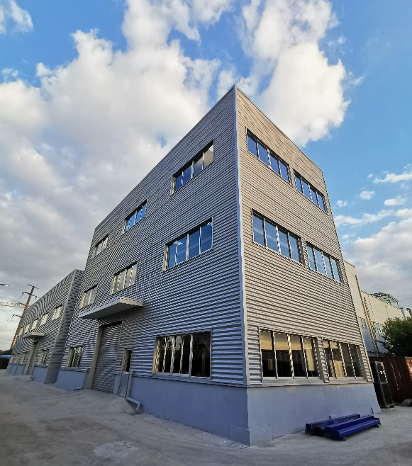
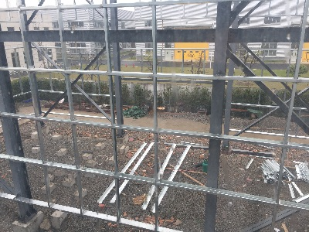
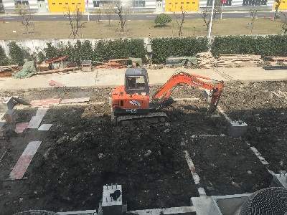
Facilities establishment in GLVAC
1. Baking-workshop building construction
1st 2019
2nd 2019
3th 2019
4th 2019
Development of 650MHz/800kW klystron

Slide 10
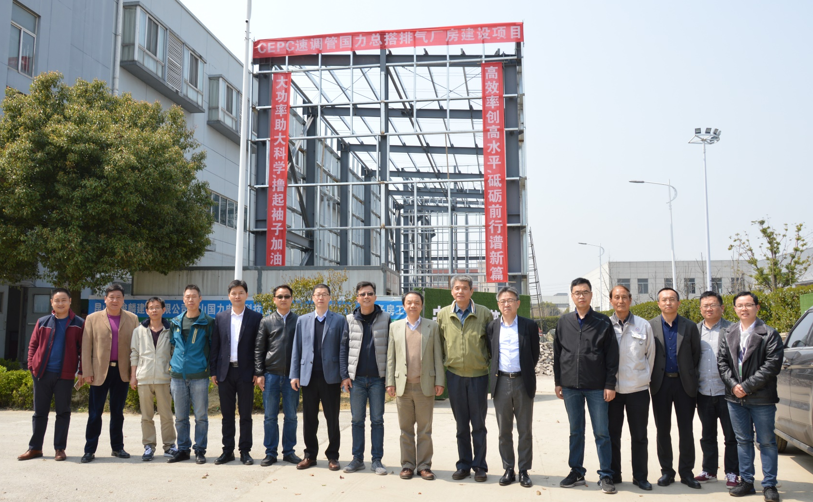
Facilities establishment in GLVAC
1. Baking-workshop building construction
Collaboration group meeting held in GLVAC (3th 2019)
Development of 650MHz/800kW klystron

Slide 11
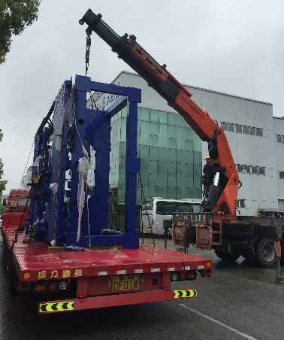
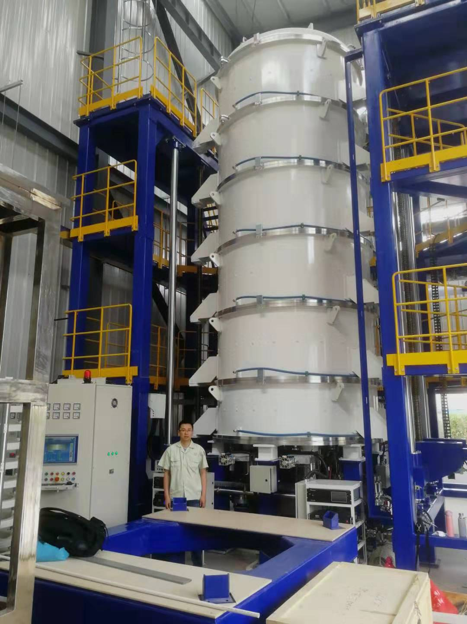
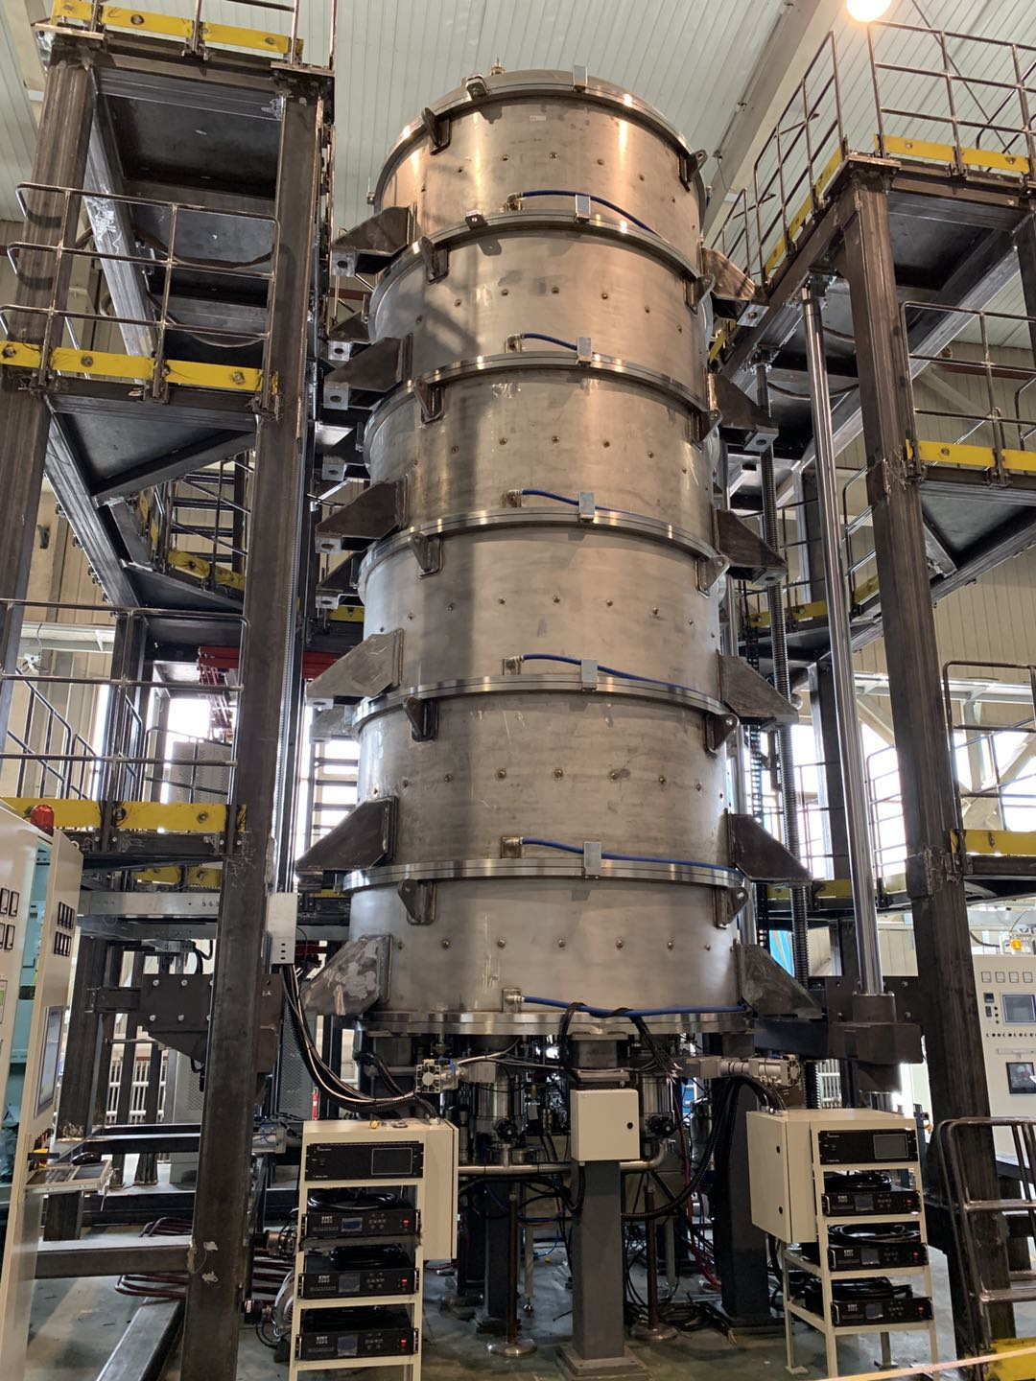
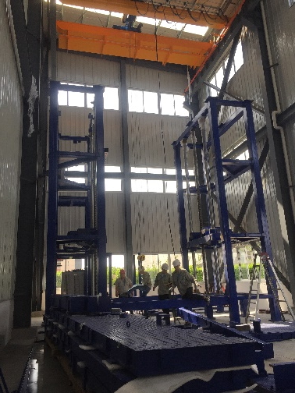
Facilities establishment in GLVAC
2. Baking oven customization
Unloading
End of debugging
8th 2019
Acceptance check
3th 2019
Assembling
4th 2019
Development of 650MHz/800kW klystron

Slide 12
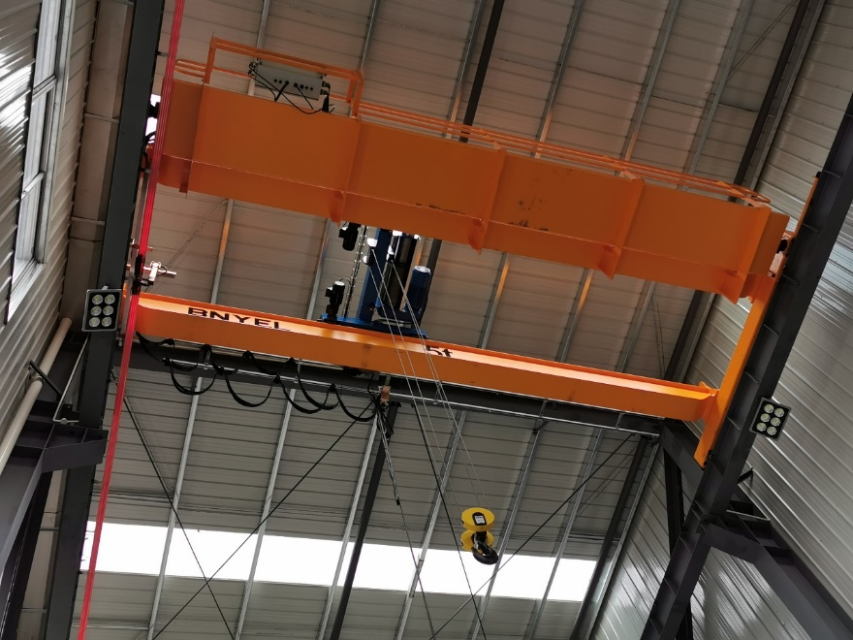
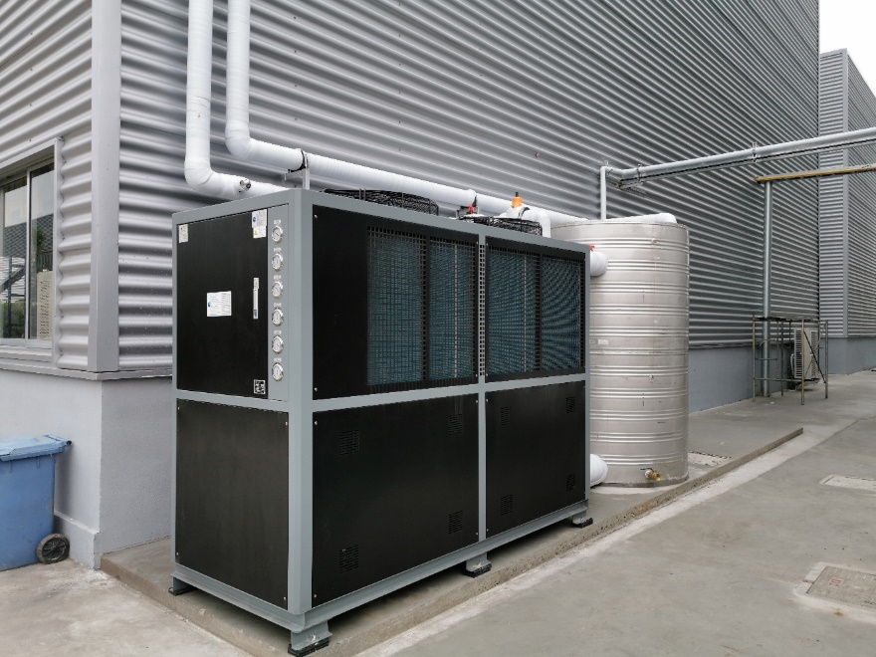
Facilities establishment in GLVAC
3. Overhead travelling crane (5T) & cooling-water machine
4th 2019
4th 2019
Development of 650MHz/800kW klystron

Slide 13
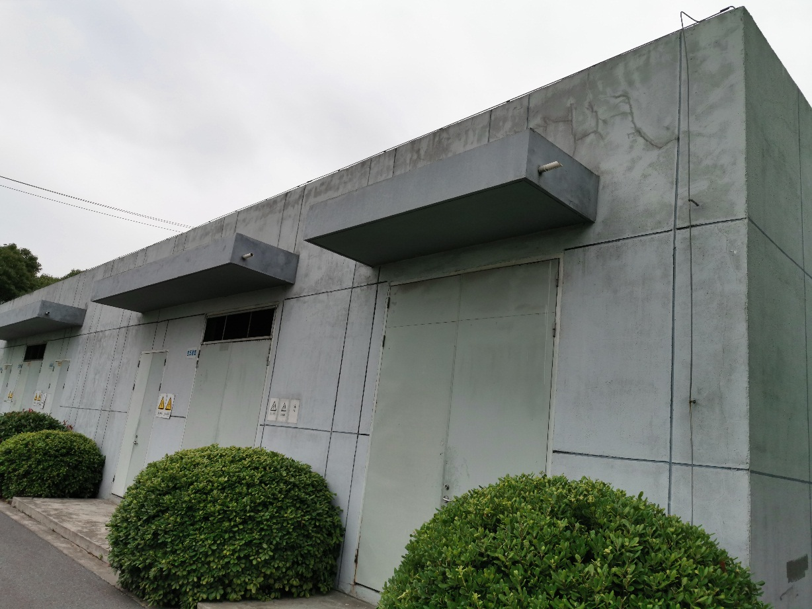
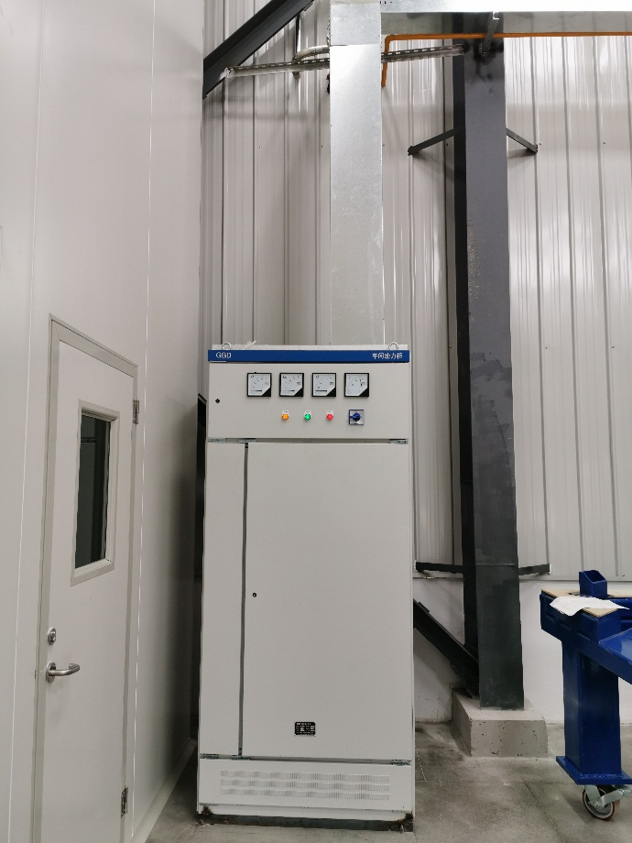
Facilities establishment in GLVAC
4. 400kW Electricity expansion only for baking oven
Electricity expansion in GLVAC, 17-19 5th 2019
Development of 650MHz/800kW klystron

Slide 14
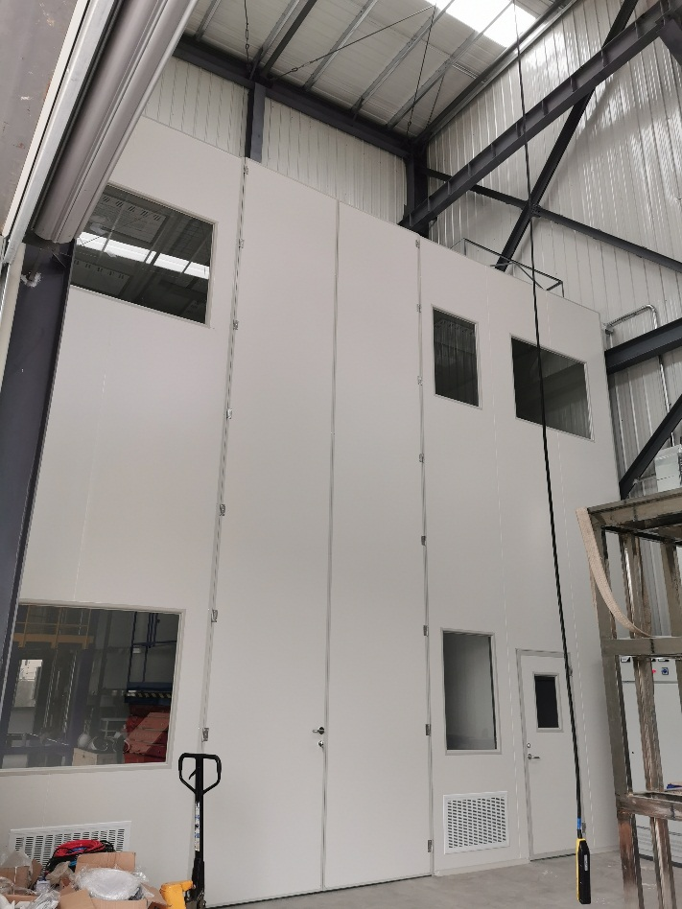
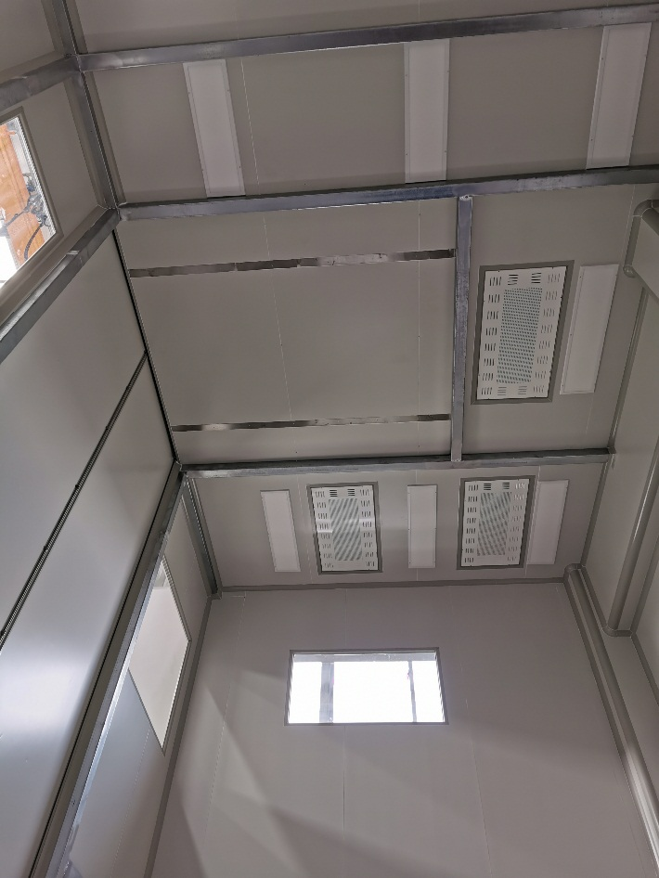
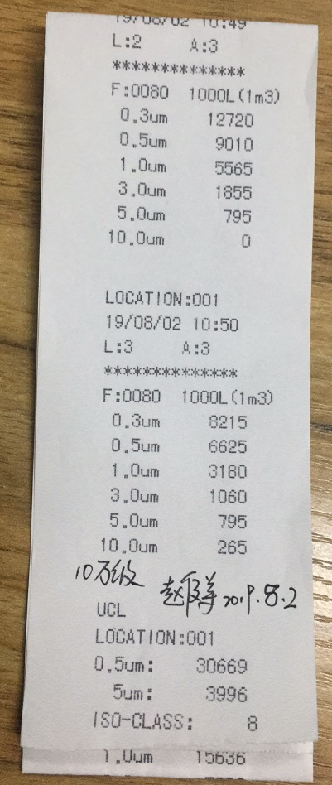
Facilities establishment in GLVAC
5. Clean room
7 meters high and air cleanliness CL-100K clean room, 6th 2019
Development of 650MHz/800kW klystron

Slide 15
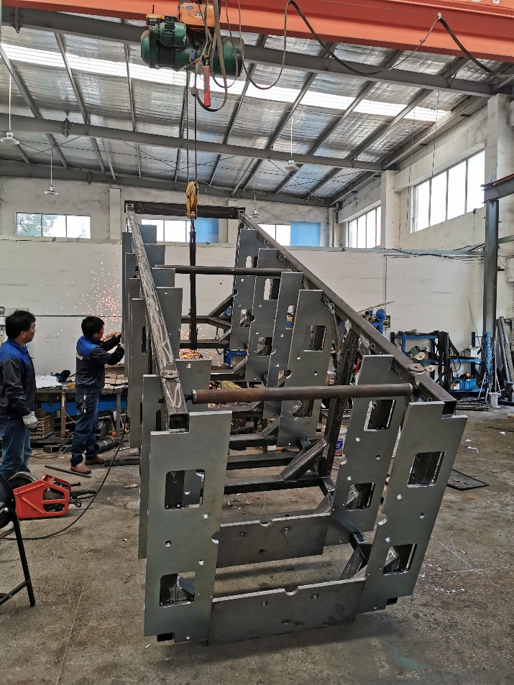
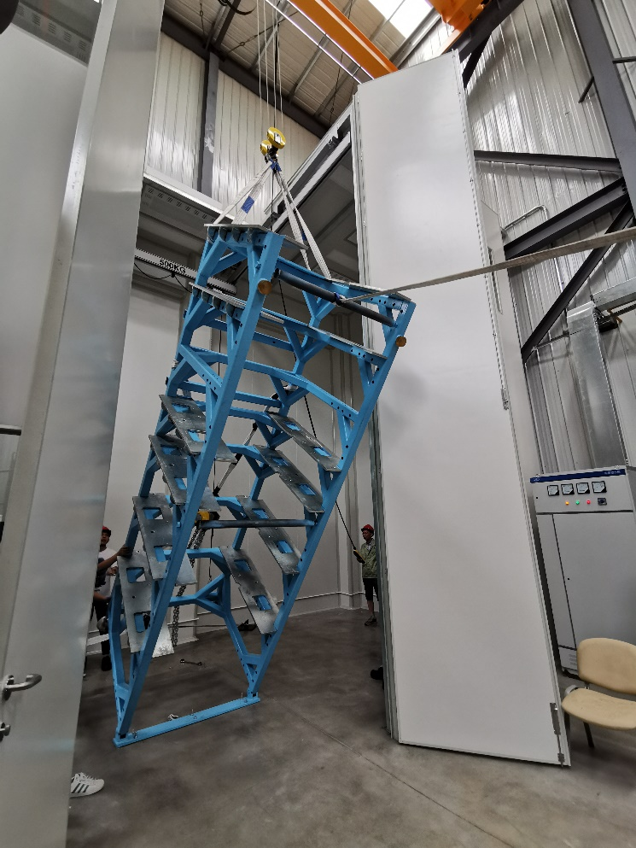
Facilities establishment in GLVAC
6. Final assembly support
Final assembly support, 6th 2019
Development of 650MHz/800kW klystron

Slide 16
Outline
Gantt chart of the work in GLVAC
Facilities establishment in GLVAC
Components manufacture in GLVAC
Final assembly & baking
Future plan
Development of 650MHz/800kW klystron

Slide 17
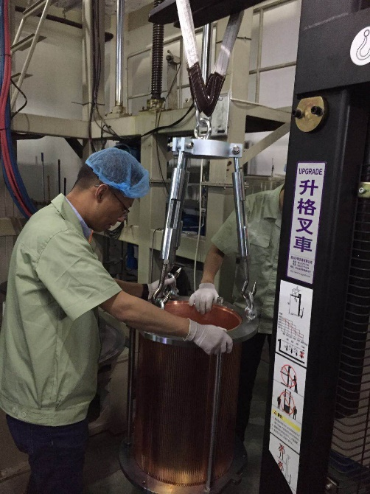
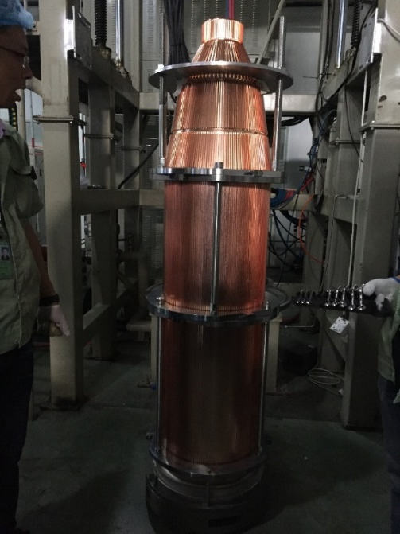
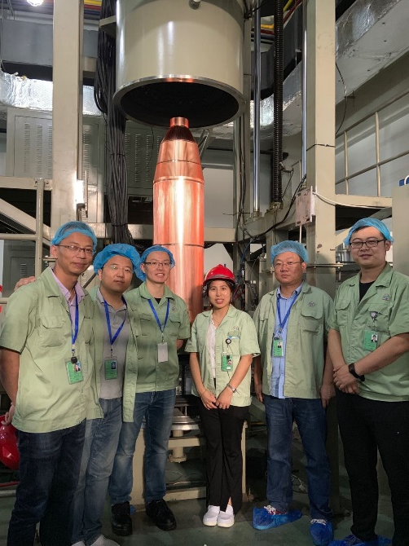
Components manufacture in GLVAC
1. Copper parts of the collector
1.8 meters high and 300 kg weight, it is the largest copper collector brazed in the world, and its whole perpendicularity is less than 0.2mm
Development of 650MHz/800kW klystron

Slide 18
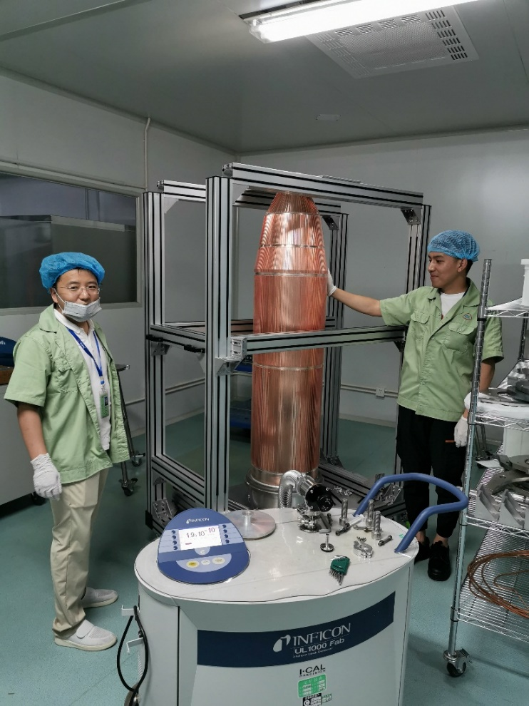
Components manufacture in GLVAC
1. Copper parts of the collector
Leak hunting for the copper part of the collector in the leak rate less than -10 Pa· m³ /s after brazed
Development of 650MHz/800kW klystron

Slide 19
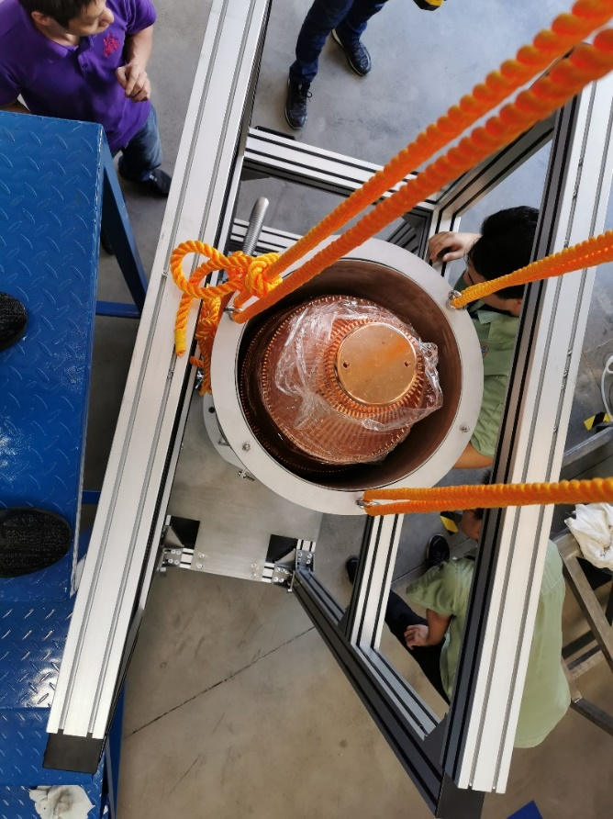
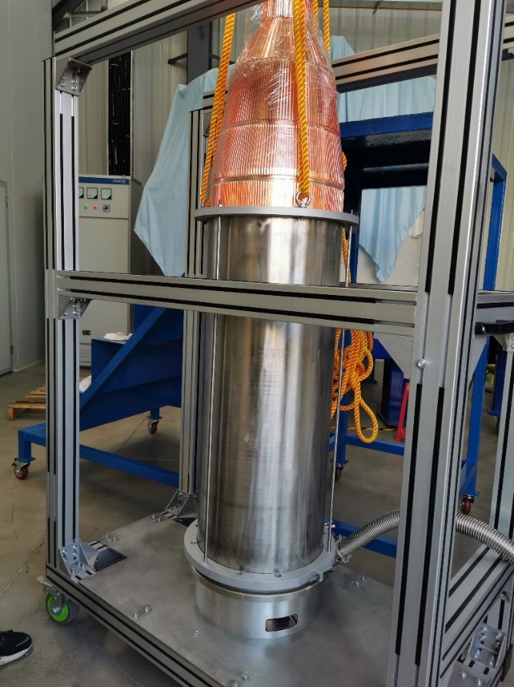
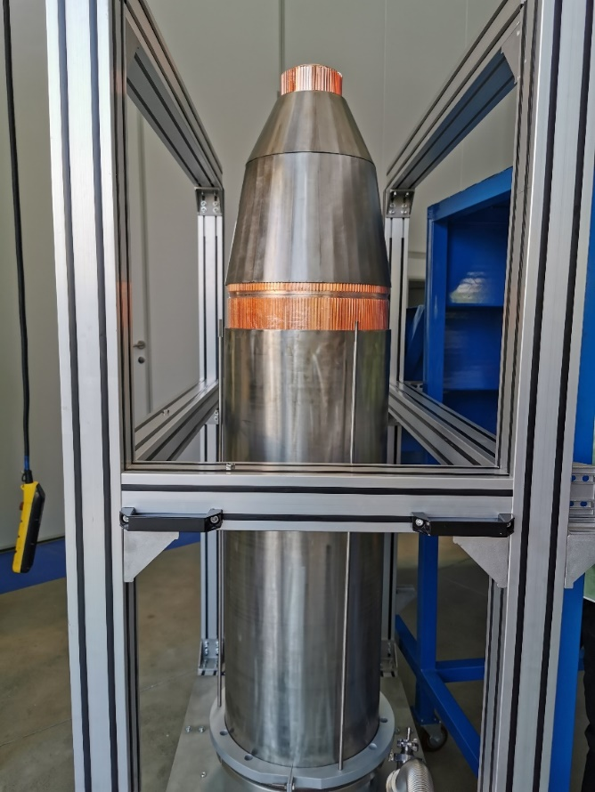
Components manufacture in GLVAC
2. Water jacket of the collector
Trial assembly of the inter part of the water jacket (Only 0.2mm gap was left on one side)
Development of 650MHz/800kW klystron

Slide 20
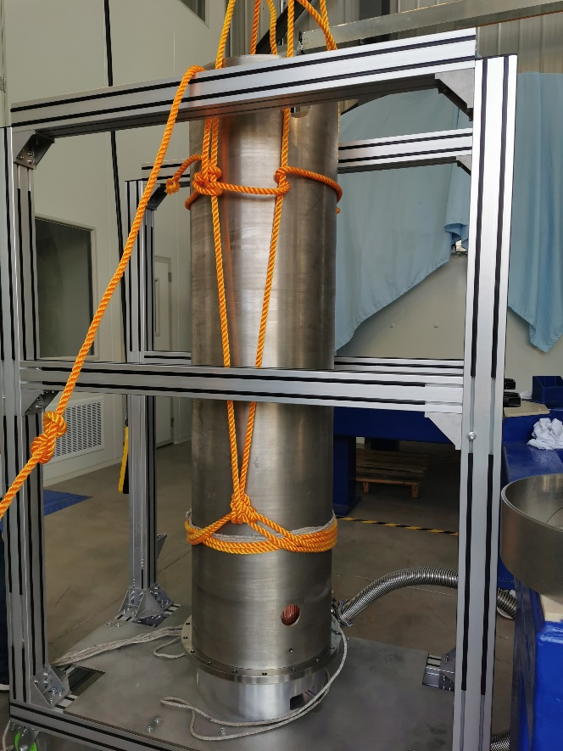
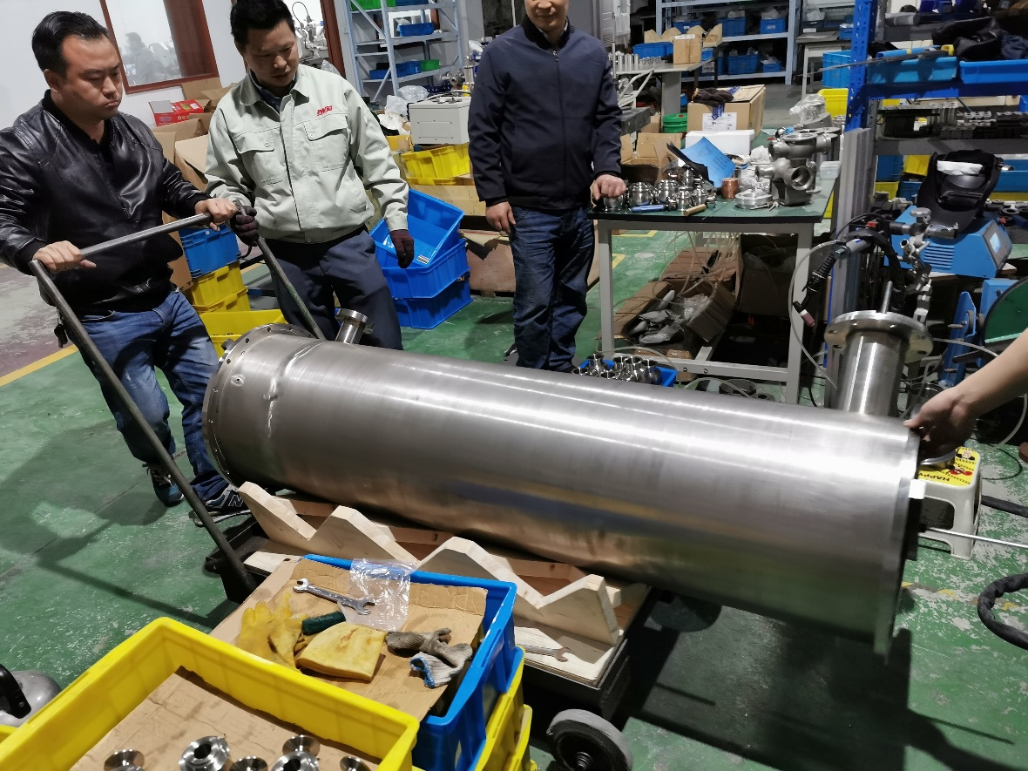
Components manufacture in GLVAC
2. Water jacket of the collector
Trial assembly and argon arc welding of the outer part of the water jacket
Development of 650MHz/800kW klystron

Slide 21
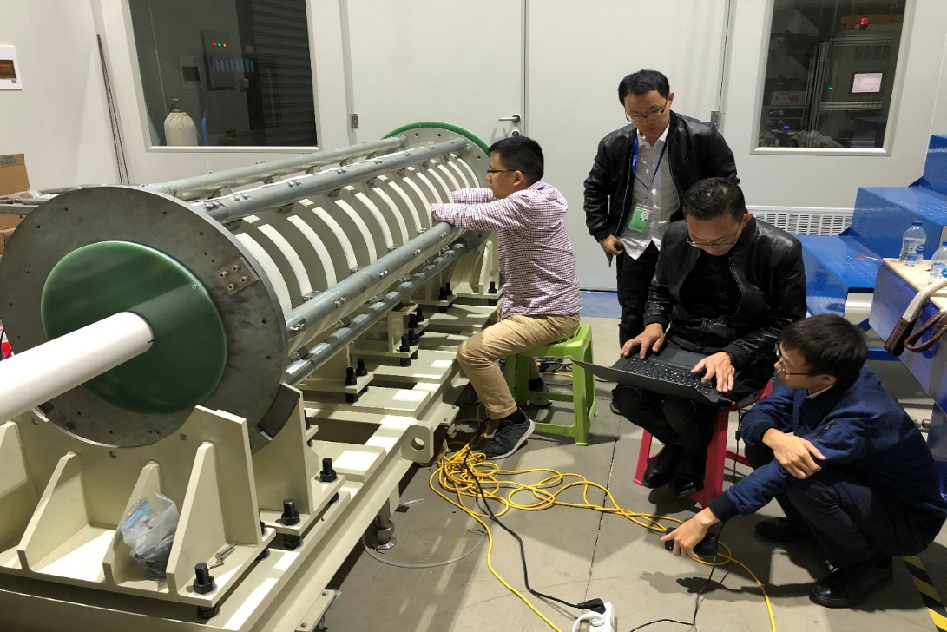
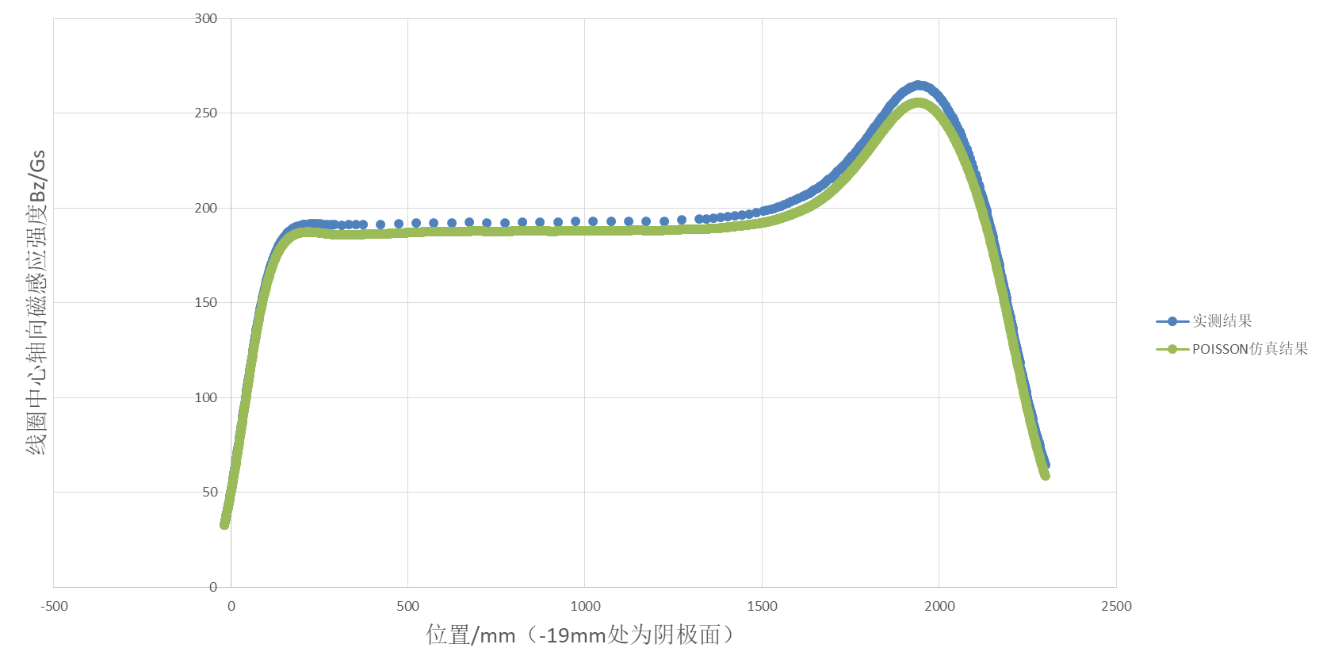
Components manufacture in GLVAC
3. Coils
Trial assembly measurement of coils
Development of 650MHz/800kW klystron

Slide 22
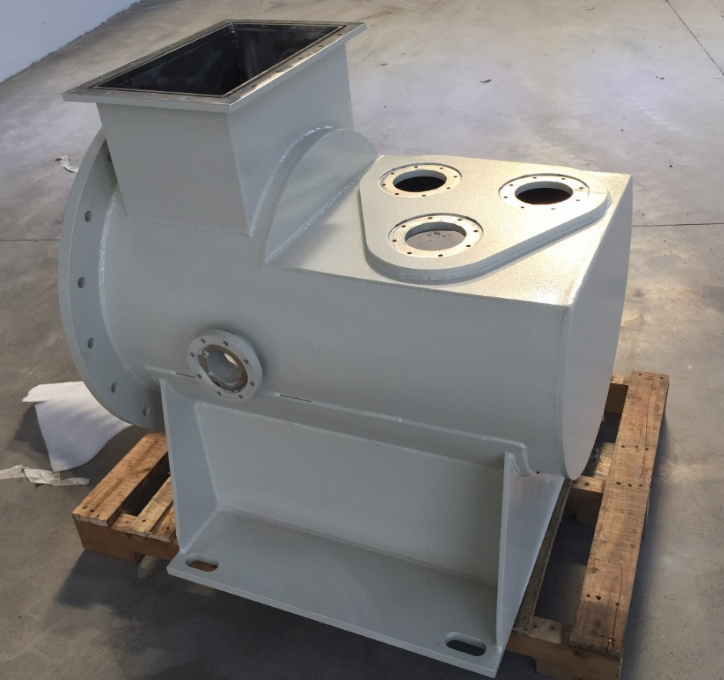
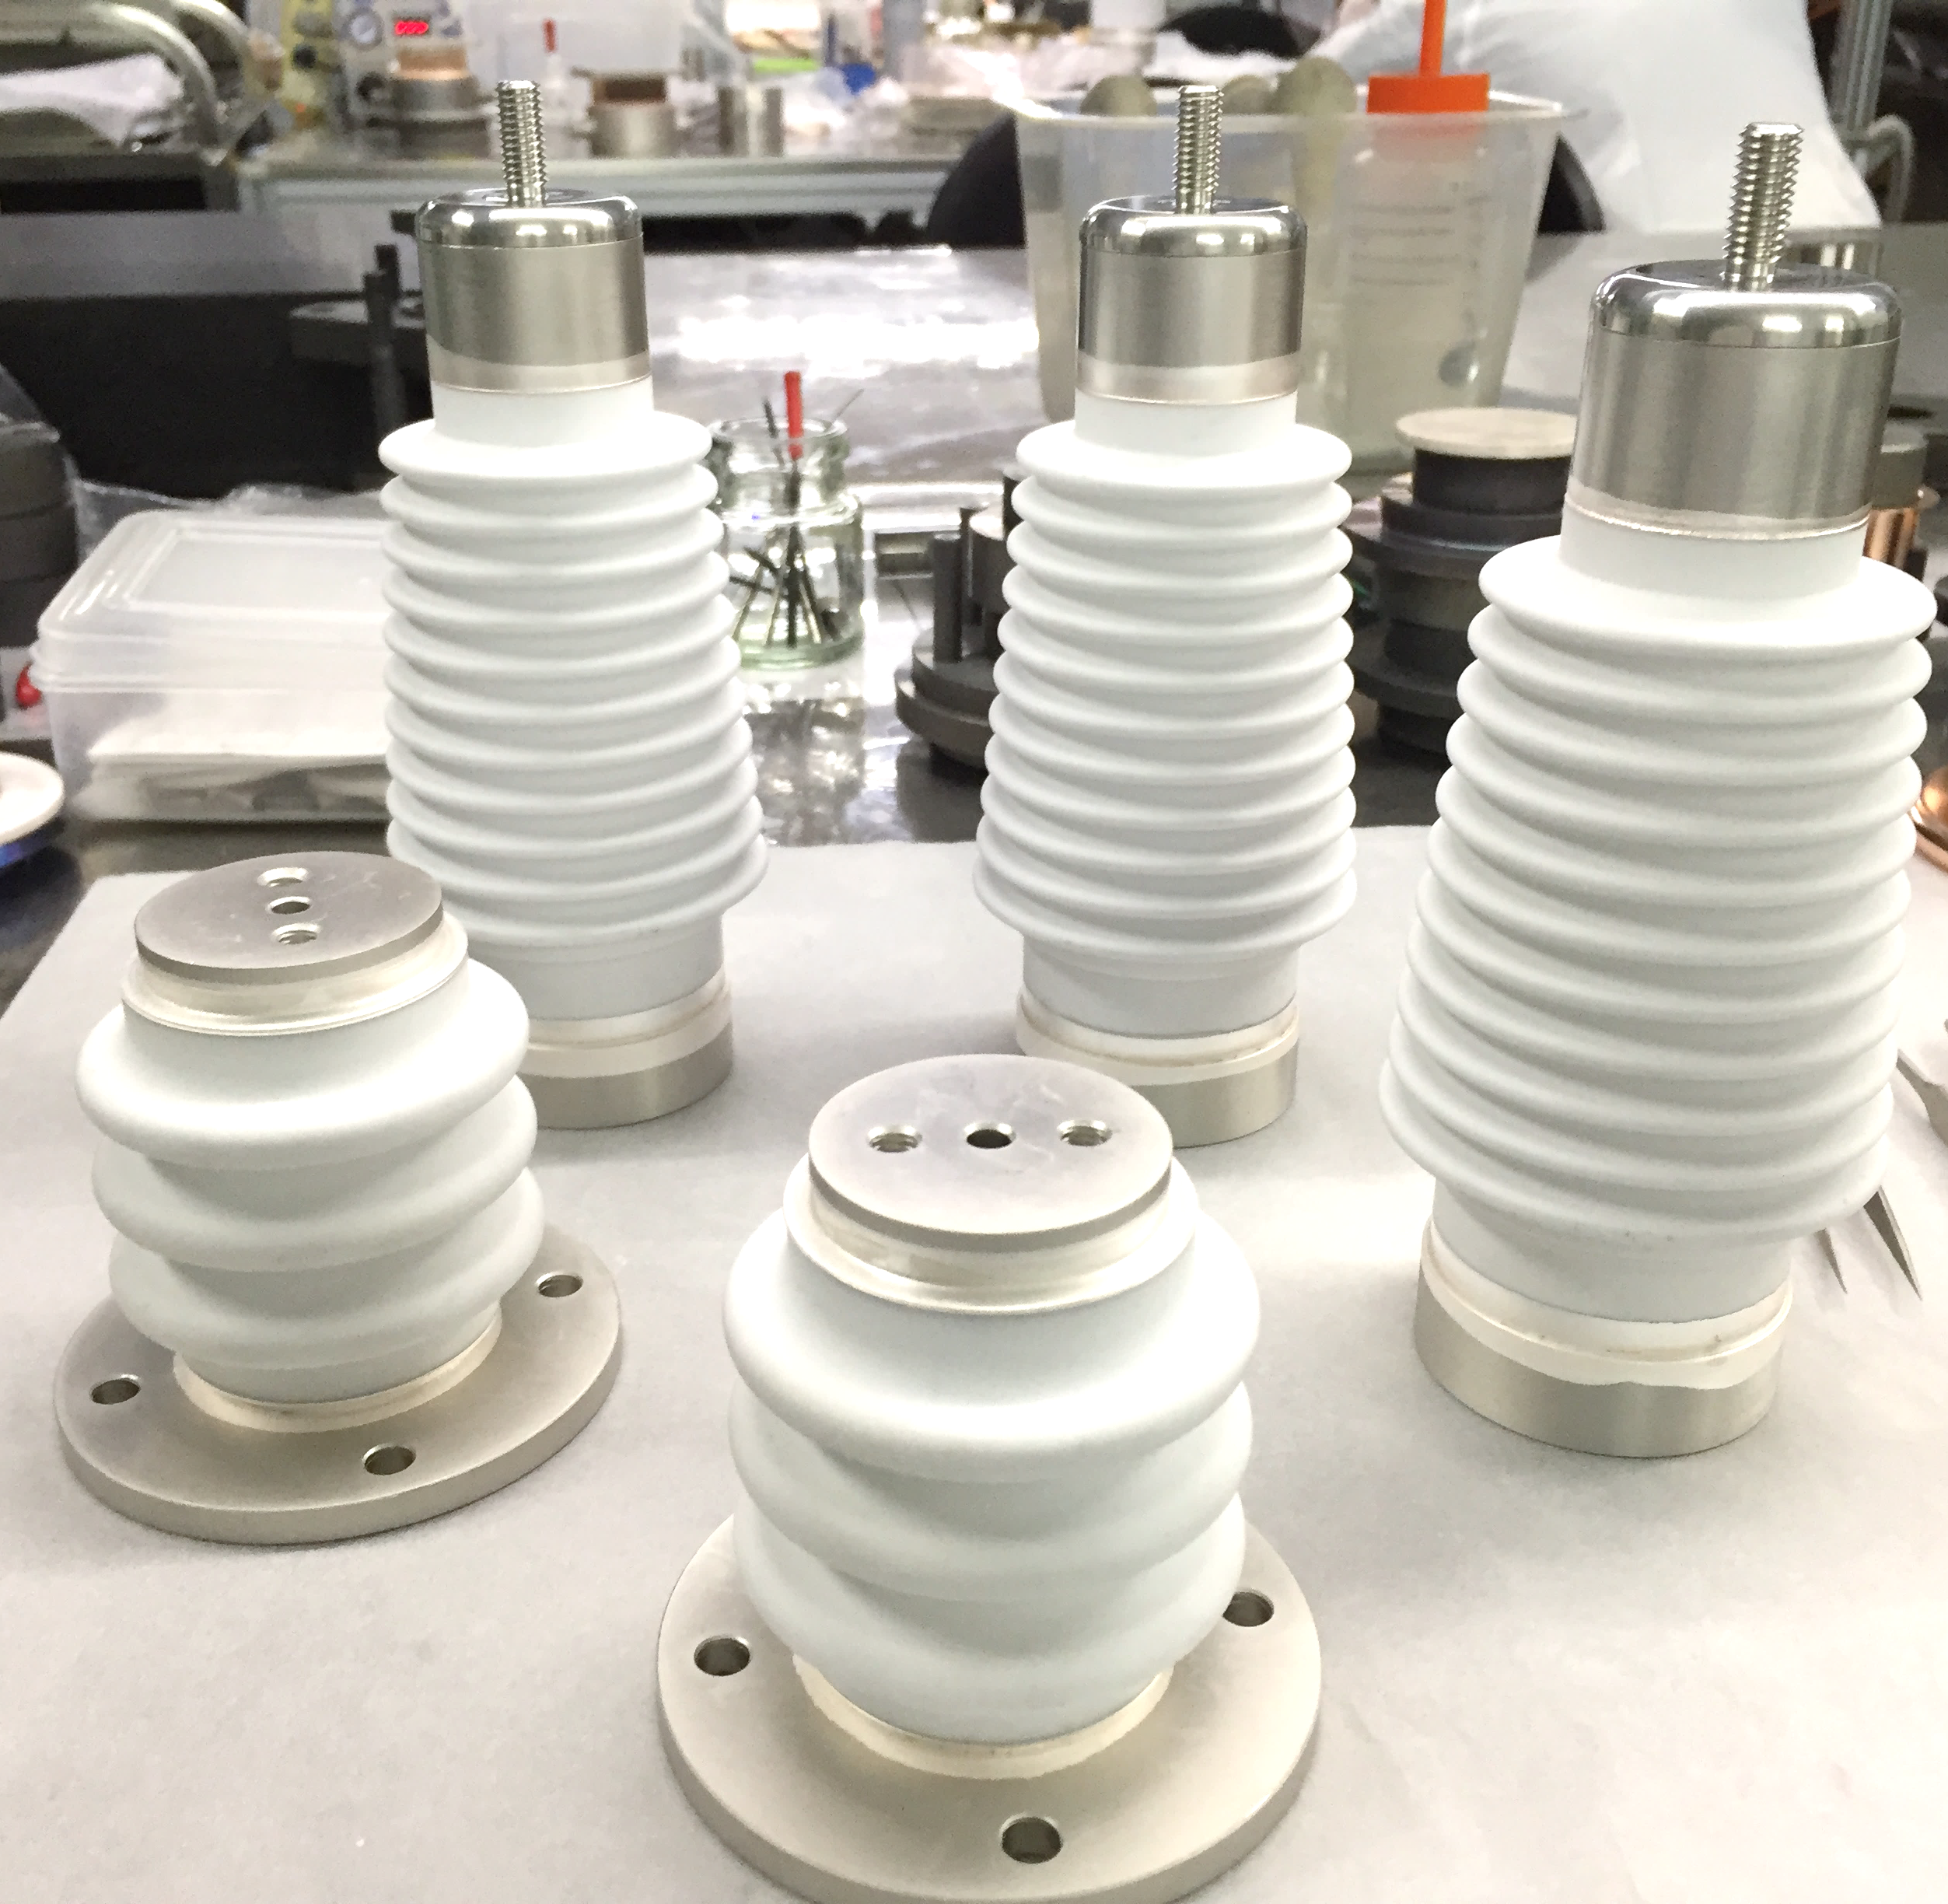
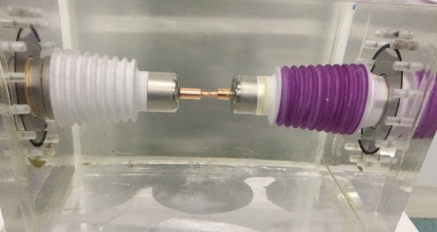
Components manufacture in GLVAC
4. Oil cylinder
Shell of oil cylinder and the high-pressure components (passed 200kV test)
Development of 650MHz/800kW klystron

Slide 23
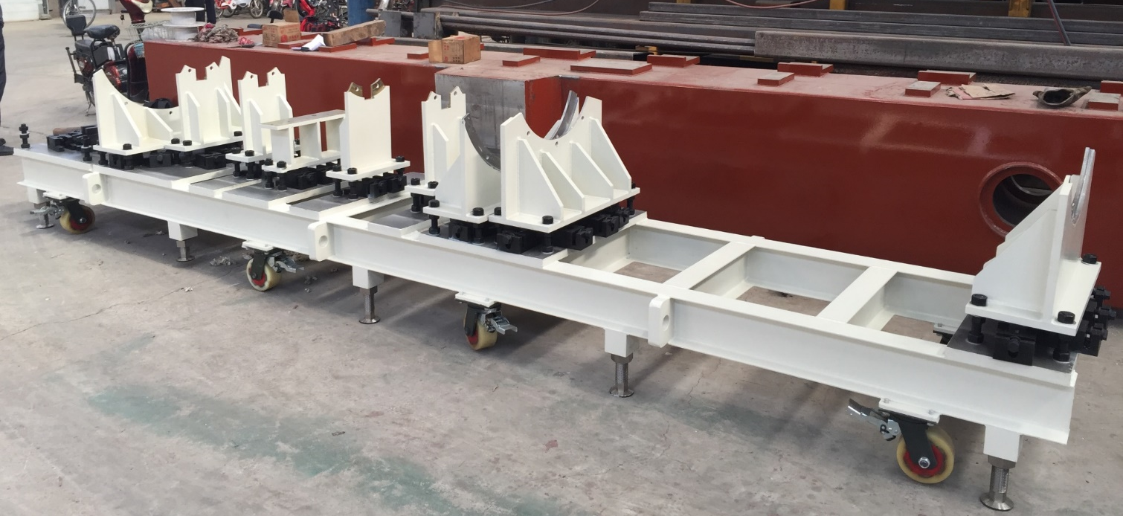
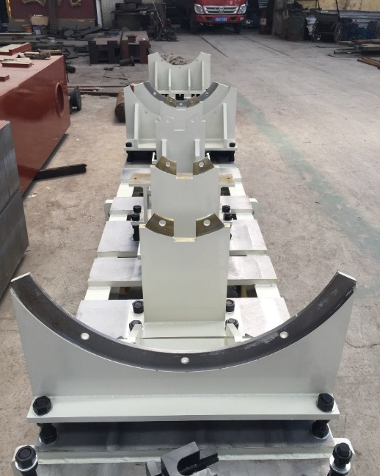
Components manufacture in GLVAC
5. Operation support
5th 2019
Development of 650MHz/800kW klystron

Slide 24
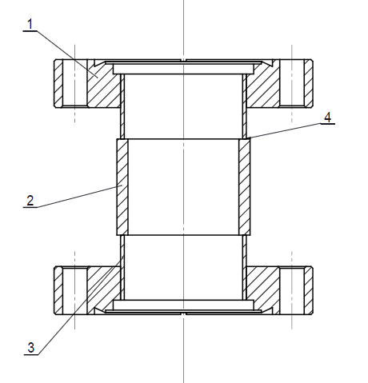
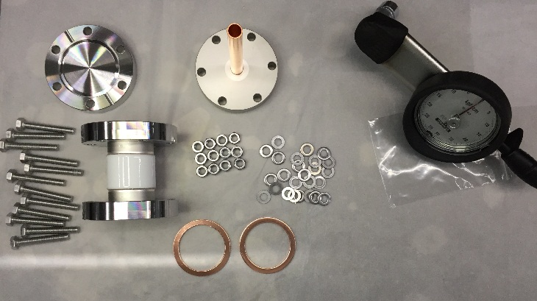
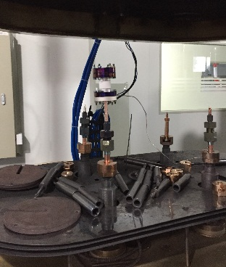
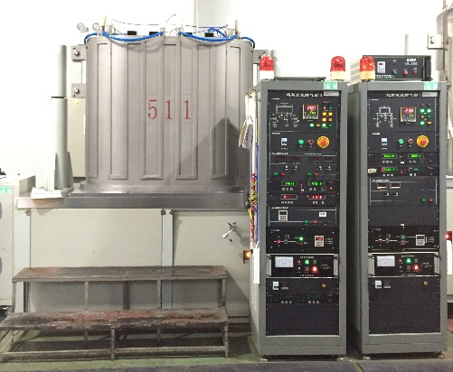
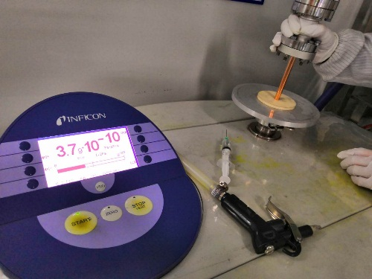
Components manufacture in GLVAC
6. Insulating part for klystron baking
Drawing
Assembly
leak hunting
Pinch off
Baking test
Development of 650MHz/800kW klystron

Slide 25
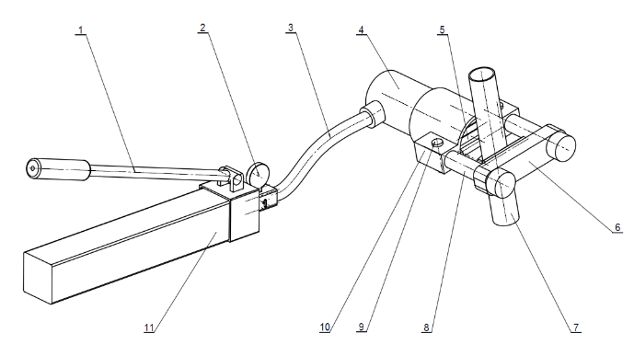
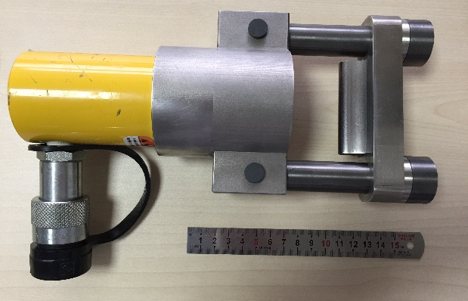
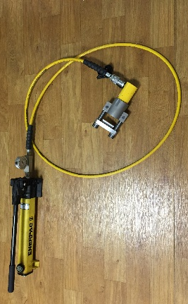
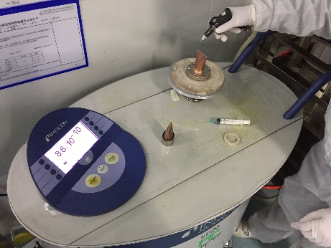
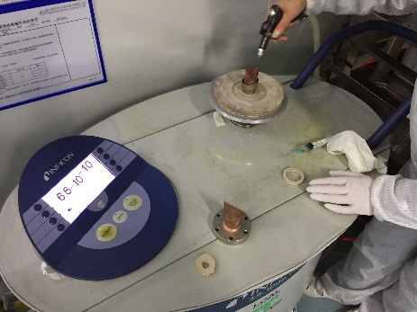
Components manufacture in GLVAC
7. Pinch off tool
Drawing
Assembly
Pinch off test
leak hunting 2
leak hunting 1
Development of 650MHz/800kW klystron

Slide 26
Outline
Gantt chart of the work in GLVAC
Facilities establishment in GLVAC
Components manufacture in GLVAC
Final assembly & baking
Future plan
Development of 650MHz/800kW klystron

Slide 27
Final assembly & baking
Assembly and leak hunting of the 2nd , 3th and 4th cavity
Development of 650MHz/800kW klystron

Slide 28
Final assembly & baking
Assembly and leak hunting of the 2nd , 3th and 4th cavity
Collimation using laser tracker
Development of 650MHz/800kW klystron

Slide 29
Final assembly & baking
Assembly and leak hunting of the 2nd , 3th and 4th cavities
After adjusting, the concentricity of the cavities is ±0.11mm
Development of 650MHz/800kW klystron

Slide 30
Final assembly & baking
2. Assembly and leak hunting of the 4-5th and e-gun cavities
After adjusting, the concentricity of the cavities is ±0.18mm
Development of 650MHz/800kW klystron

Slide 31
Final assembly & baking
3. Assembly and leak hunting of collector
Development of 650MHz/800kW klystron

Slide 32
Final assembly & baking
4. End of final assembly
Development of 650MHz/800kW klystron

Slide 33
Final assembly & baking
5. Move the klystron to the baking oven
Development of 650MHz/800kW klystron

Slide 34
Final assembly & baking
6. Cover the oven
Development of 650MHz/800kW klystron

Slide 35
Final assembly & baking
7. Start baking
Development of 650MHz/800kW klystron

Slide 36
Outline
Gantt chart of the work in GLVAC
Facilities establishment in GLVAC
Components manufacture in GLVAC
Final assembly & baking
Future plan
Development of 650MHz/800kW klystron

Slide 37
Future plan
Finish baking (10.25-11.28)
Klystron post processing (11.28-12.31)
Another one …
Development of 650MHz/800kW klystron

Slide 38
Acknowledgement
Thanks !
Development of 650MHz/800kW klystron

