Slide 1
CEPC installation and alignment
Wang xiaolong
On behalf of Installation and Alignment team
CEPC International Workshop
Nov. 18-20, 2019, IHEP Beijing China

Slide 2
Contents
  Overall installation scheme
  Component installation and alignment scheme
  Component fiducialization schedule
  Smooth alignment
  Summary

Slide 3
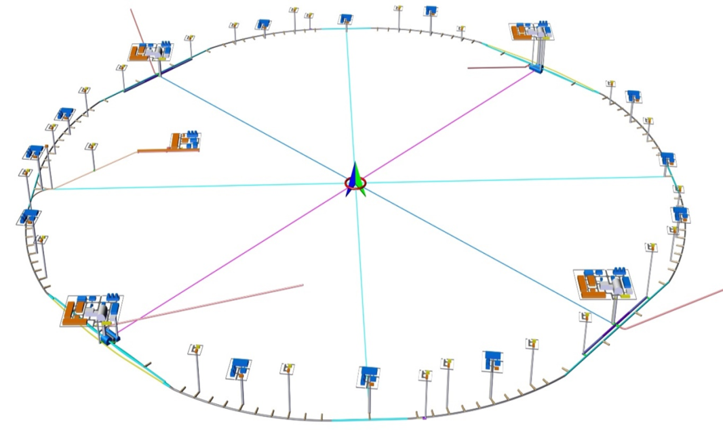
  Overall installation scheme
  CEPC construction time :2023 —2030
  HDEC CPM, Civil construction will be divided into two phases
    2023,4,1—2027,3,31 TBM
    2023,4,1—2028,3,31 Drilling &blasting
Ⅰ
finish the first phase civil
construction
start component installation as
soon as possible
Ⅱ

Slide 4
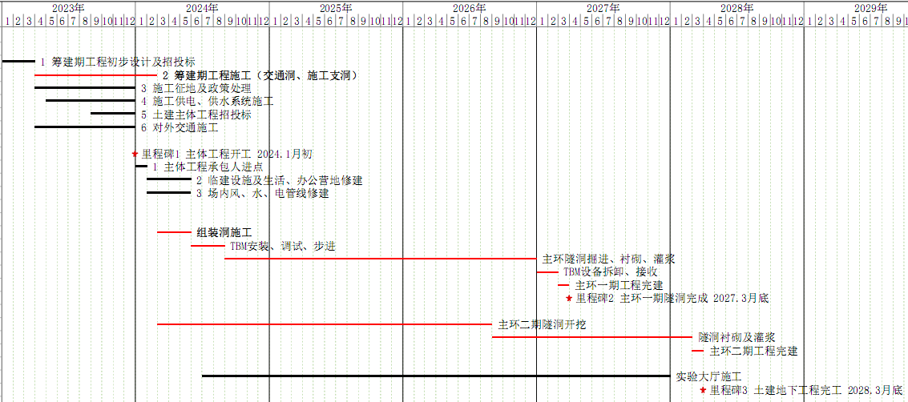
  Overall installation scheme
  HDEC Civil construction CPM
  Installation and alignment scheme is made based on the civil construction schedule
  project period is :2027,1-2030,9

Slide 5
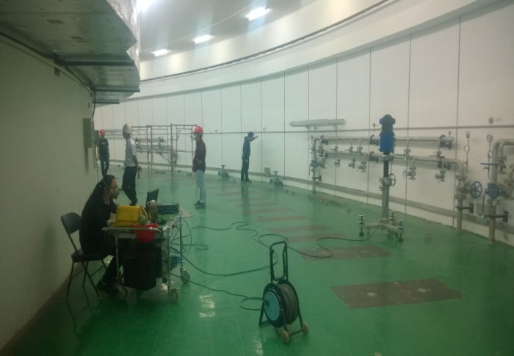
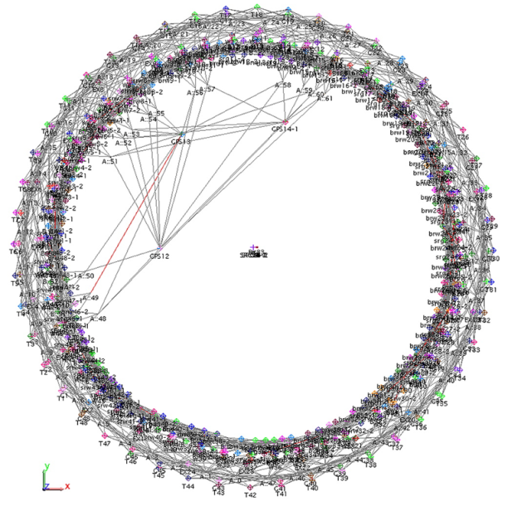
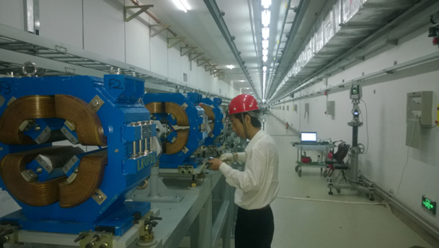
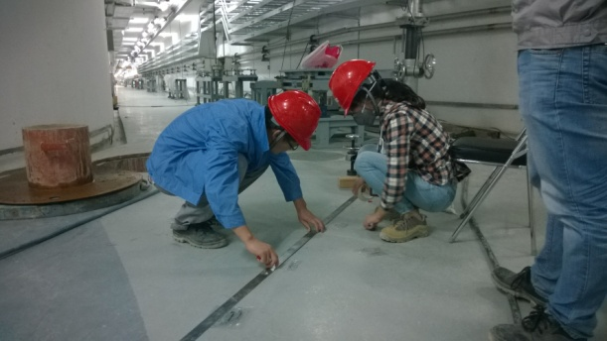
Tasks of alignment and installation
  Control network construction.
  Control network measurement
  Support setting out and installation
  Component fiducialization
  Ring installation and alignment.
  Linac and BT installation and alignment
  Smooth alignment

Slide 6
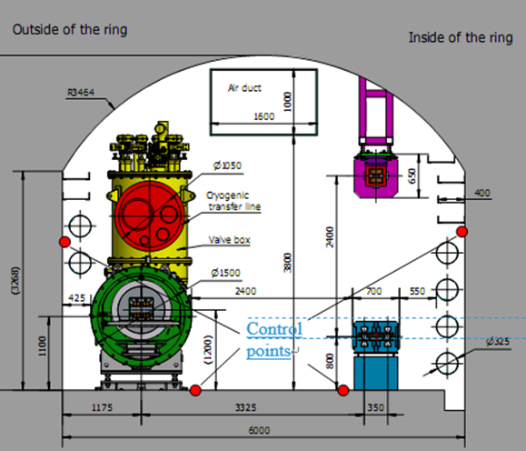
Control network construction
  Follow the civil construction schedule, installation works will include two phases.
  Control network construction
  Tunnel length 109.55km：100.034km main ring + 6.64kmIR booster tunnel + 1.21km Linac + 0.06km DR+ 1.07km BT + 2X0.268km BT
  Control network: along the tunnel, every 6m one section,
    18259 sections,
    4 points/section, 73036 points.
  Start 2 months later than lining.
  Workload :
    3~4 persons/1 group,
    1 section 2.5h/1 group
    18259 sections will devote 16 groups, 9 months.

Slide 7
Control network construction
  Control network construction will be divided into two phases, parallel with the civil construction
  First phase:
    2027,1,1—2027,9,30
    8 groups, 9 months 230m/day
  Second phase:
    2028,1,1—2028,9,30
    8 groups, 9 months

Slide 8
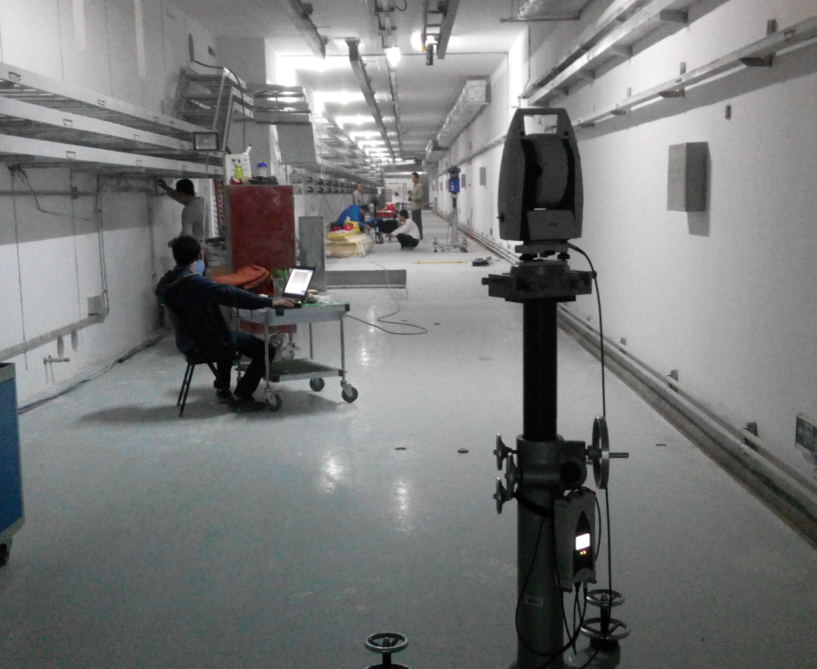
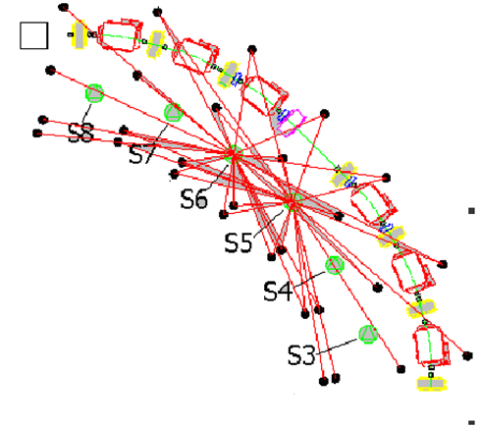
Control network measurement
  Control network measurement
    Tunnel control network measurement
    Backbone control network measurement
    Level control network measurement
  Tunnel control network measurement
    Use laser tracker
    stations will be set between every adjacent sections
    Each station measure twice. 18259 X2=36518 stations.
    1 group 10 stations / day.
    12 groups, 1 year

Slide 9
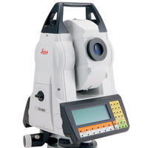
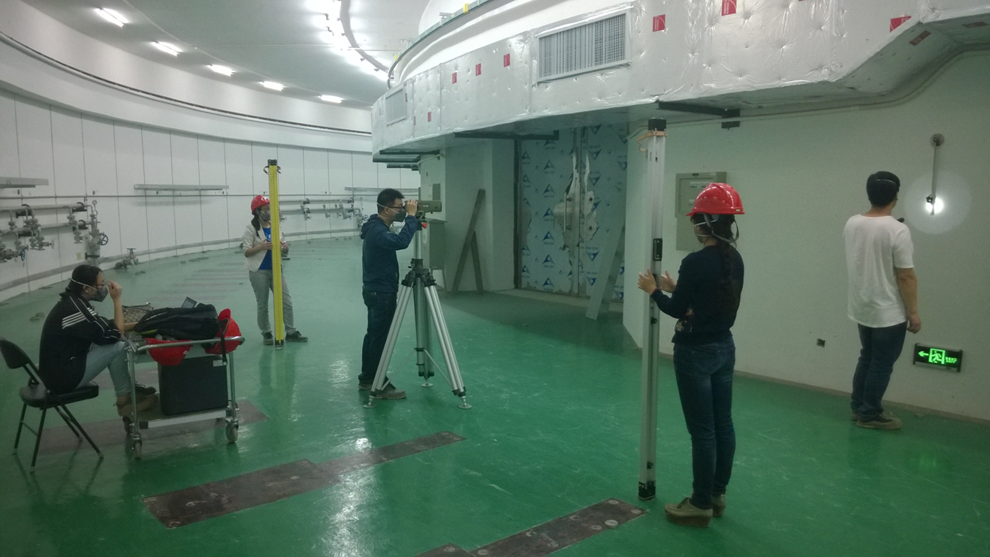
Control network measurement
  Backbone control network measurement.
    To satisfy the intervisible requirement, the distance between adjacent section is about 220m. About 996 points in backbone control network.
    Use total station forced center on each point, total 996 stations.
    1 group 8 stations / day.
    4 groups, 32 working days.
  Level control network measurement
    Level , back and forth measurement method for every kilometer
    The back and forth sight distances are 18m respectively.
    The level route length is 109550 X2=219km.
    1 group 4km / day.
    4 groups,14 days.

Slide 10
Control network measurement
  Start 2 month later than control network construction
  Parallel with the control network construction.
  first phase:
    2027,3,1—2027,12,31,
    16 groups, 8 months for measurement, ended 1 month later than control network construction.
      12 groups for tunnel control network measurement
      4 groups for backbone and level control network measurement.
    2 months for data processing
  second phase:
    2028,3,1—2028,12,31,
    16 groups, 8 months for measurement
    2 months for data processing

Slide 11
Support position setting out and installation
  Support position setting out and installation
  Collider ring and booster will be carried out simultaneously
  Support number: collider ring 50378 + booster 38966 = 89344
  Setting out will begin after the end of tunnel network measurement
  first phase:
    2028,1,1—2028,8,31,
    8 groups, 8 months for collider ring, 16 supports/group/day
    8 groups, 8 months for booster, 12 supports/group/day
  second phase:
    2029,1,1—2029,8,31,
    8 groups, 8 months for collider ring, 16 supports/group/day
    8 groups, 8 months for booster, 12 supports/group/day

Slide 12
Support position setting out and installation
  Support installation
  Support installation will begin one month later than support setting out
  parallel with setting out
  first phase:
    2028,2,1—2028,9,30,
    8 groups, 8 months for collider ring, 16 supports/group/day
    8 groups, 8 months for booster, 12 supports/group/day
  second phase:
    2029,2,1—2029,9,30,
    8 groups, 8 months for collider ring, 16 supports/group/day
    8 groups, 8 months for booster, 12 supports/group/day

Slide 13
Ring installation and alignment
  Ring component installation and alignment
    Collider ring & Booster
    Component installation will begin one month later than support installation and parallel with it.
    32 teams, 1 team: 1 installation group and 1 alignment group
    Collider ring component installation and alignment
Component | Collider Ring
Dipole | 2546 (13006 core)
Quadrupole | 3712
Sextupole | 1864
Corrector | 5808
Superconducting Cavity | 240
Cryomodule | 40（11m）
Superconducting quadrupole | 8
Superconducting sextupole | 32
Solenoid | 4
BPM | 2910
Total | 16976

Slide 14
Ring installation and alignment
  Installation plan
Collider ring
Component | Piece (1 team / day) | Team | Month
Dipole | 2 | 16 | 16.3
Quadrupole | 4 | 8 | 4.7
Sextupole | 4 | 6 | 3.2
Corrector | 6 | 8 | 4.9
Cryomodule | 1 | 1 | 2
Superconducting quadrupole |  | 3
Superconducting sextupole
Solenoid | 4
BPM | 6 | 6 | 3.2
Total |  | 16 | 24
  first phase:
    Suppose component amount is half of the total.
    2028,3,1—2029,2,28, 12 months, 16 teams

Slide 15
Ring installation and alignment
  second phase:
    2029,3,1—2030,2,28, 12 months
    16 teams
  Booster component installation and alignment
Booster
Component | Number | Piece (1 team / day) | Team | Month
Dipole | 16320 | 2 | 16 | 20.4
Quadrupole | 2036 | 4 | 8 | 2.6
Sextupole | 640 | 4 | 4 | 1.6
Corrector | 1600 | 6 | 8 | 1.4
Cryomodule | 12（12米） | 1 | 4 | 2
Septum Magnet | 144 | 4
Kicker | 22 | 4
BPM | 1900 | 6 | 8 | 1.6
Total | 22674 |  | 16 | 24

Slide 16
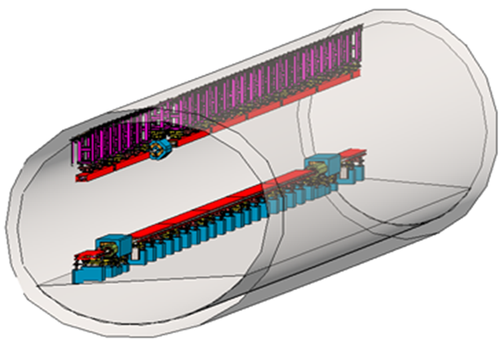
Ring installation and alignment
  first phase:
    2028,3,1—2029,2,28, 12 months
    16 teams
  second phase:
    2029,3,1—2030,2,28, 12 months
    16 teams

Slide 17
  Schedule of ring installation and alignment
work | First phase | Month | Group | Second phase | Month | Group
Network construction | 2027,1,1—2027,9,30 | 9 | 8 | 2028,1,1—2028,9,30 | 9 | 8
Network measurement | 2027,3,1—2027,12,31 | 10 | 16 | 2028,3,1—2028,12,31 | 10 | 16
Support setting out | 2028,1,1—2028,8,31 | 8 | 16 | 2029,1,1—2029,8,31 | 8 | 16
Support installation | 2028,2,1—2028,9,30 | 8 | 16 | 2029,2,1—2029,9,30 | 8 | 16
Ring installation | 2028,3,1—2029,2,28 | 12 | 32+32 | 2029,3,1—2030,2,28 | 12 | 32+32
  The peak time 2028,3 —2028,9, it needs 64 alignment groups and 56 installation groups. 2029,3 —2029,9, it needs 48 alignment groups and 48 installation groups.
  To decrease the manpower fluctuation, we try to make the most labor-intensive work , ring installation, in the two phases end to end.

Slide 18
Linac and BT installation and alignment
  Support position setting out
    Support number: 1511
    2028,10,1—2028,12,31, 3 months, 1 group
  Support installation
    2028,11,1—2029,2,28, 4 months, 1 group, parallel with setting out
  Component installation and alignment
Component | Linac and BT
Dipole | 140
Quadrupole | 464
Sextupole | 24
Corrector | 139
RF Cavity | 2
Septum Magnet | 2
Kicker | 2
Solenoid | 41
Accelerating structure | 285
Cavity | 3
BPM | 300
Total | 1402

Slide 19
Linac and BT installation and alignment
  Installation progress
Component | Piece (1 team / day) | Month | Team
Dipole | 2 | 3 | 1
Quadrupole | 4 | 4 | 1
Corrector | 6 | 1 | 1
Sextupole | 4 | 1 | 1
RF Cavity | 2 |  | 1
Septum Magnet | 4 |  | 1
kicker | 4 |  | 1
Solenoid | 4 |  | 1
Cavity | 2 |  | 1
BPM | 6 | 2 | 1
Accelerating structure | 4 | 3 | 1
  2028,12,1—2030,1,31 14 months 1 team

Slide 20

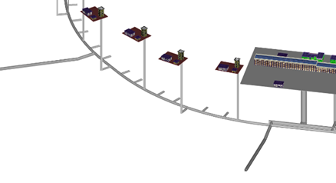
  Component installation and alignment scheme
  Ring construction: phaseⅠ, phaseⅡ， each phase：half a ring
  Each phase: construction is divided into four sections to be carried out in parallel.
  Take one construction section as an example
  Length is 12.5km
2
3
1
4
Phase Ⅰ
Phase Ⅱ
Transport corridor

Slide 21
  Component installation and alignment scheme
  The middle transport corridor divides the section into two installation sections.
  Each installation section: 2 teams for collider ring and booster installation separately
  Each team includes 1 installation group and 1 alignment group
  Working process
    The first working day : the installation group should finish the components transportation and installation which will be used in the second working day.
    The second working day: the alignment group should finish the components alignment which is installed in the first working day. The installation group should finish the components transportation and installation which will be used in the third working day.
  Challenge: many works will be carried out in parallel (setting out, transportation, installation, alignment), the width of tunnel is only 6m, how to avoid the interruption between work teams?

Slide 22
  Component installation and alignment scheme
an installation section
middle transport corridor
Left transport corridor
booster
Collider ring
  Installation scheme
    Installation will begin from the middle and the directions of collider ring and booster installation will be opposite
    Collider ring components will be transported from the left corridor, booster components will be transported from the middle corridor. After finish their half section, they will switch to each other.
  Advantages
    In tunnel, the longest transportation distance is a little more than 3km
    Alignment is always behind installation, transportation do not interrupt alignment
    Collider ring and booster installation carry out in different places

Slide 23
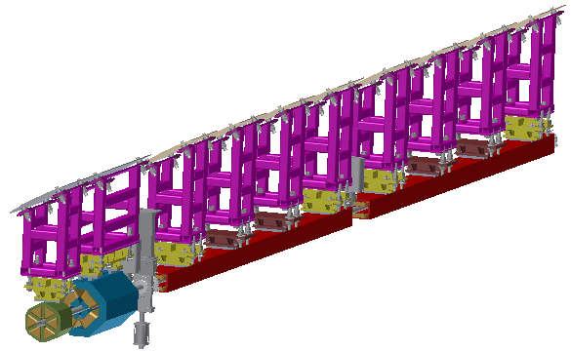
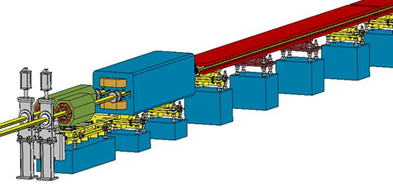
  Component fiducialization schedule
  FODO cells make up most of the ring components.
  Take the FODO cells in one construction section as an example to analyze component fiducialization schedule.
  One construction section
    Collider ring: 28 FODO cells
    Booster:20 FODO cells
Collider ring | Number
Dipole | 1400
Quadrupole | 280
Sextupole （long） | 56
Sextupole （short） | 56
total | 1792
booster | Number
Dipole | 2000
Quadrupole | 200
Sextupole | 80
Corrector | 200
BPM | 200
total | 2680

Slide 24
  Component fiducialization schedule
  According to the overall schedule, first phase ring installation period is 2028,3,1—2029,2,28
  Suppose the FODO cells will be installed first and the sequence is as the follow
  Collider ring:
  Dipole：(2028,3,1一2028,8,31)
  Quadrupole：(2028,9,1一2028,9,18)
  Sextupole: (2028,9,19一2028,9,26)
  Booster
  Dipole： (2028,2,1一2028,11,30)
  Quadrupole：(2028,12,1一2028,12,15)
  Sextupole: (2028,12,16一2028,12,22)

Slide 25
  Component fiducialization schedule
  Corrector: (2028,12,23一2029,1,2)
  BPM: (2029,1,3一2029,1,12)
  Component fiducialization schedule
  Component fiducialization schedule will be decided by its installation schedule. All of the components must be finished fiducialization before it is transported to tunnel.
  In the same conditions, component fiducialization will takes twice as much time as its alignment.
  Fiducialization do not limited by the tunnel civil construction, it can be carried out in early stage.
  Suppose the component fiducialization is one month earlier than its installation. The fiducialization schedule of one construction section FODO cells are as the follow
  Collider ring : 4 groups

Slide 26
  Standard periods installation and alignment
  Dipole： (2027,5,1一2028,6,30)
  Quadrupole：(2028,7,1一2028,8,10)
  Sextupole: (2028,8,11一2028,8,26)
  Booster: 4 groups
  Dipole： (2027,1,16一2028,9,15)
  Quadrupole：(2028,9,16一2028,10,15)
  Sextupole: (2028,10,16一2028,10,31)
  Corrector: (2028,11,1一2028,11,15)
  BPM: (2028,11,16一2028,11,30)

Slide 27
Smooth alignment
  CEPC installation and alignment will last more than 2 years
  Control network deformation, ground settlement and component stress release will destroy the alignment result.
  After the initial alignment, it needs an overall smooth alignment.
  Smooth alignment
    overall survey of control network and component
    component offset smooth adjustment.
  2030,3,1—2030,9,30 7 months 32 teams

Slide 28
Summary
  Overall installation scheme is made
    Control network construction
    Control network measurement
    Support installation
    ring installation and alignment
    Linac and BT installation and alignment
    Smooth alignment
  Restrictions include: civil construction schedule, workload, manpower, working efficiency and CEPC construction deadline.
  A refined plan of ring installation is made to solve the interruption problem that so many groups work together in such a narrow tunnel.
  Component fiducialization should follow the installation schedule, an example of FODO cells is analyzed.
  Next:
    Further refine the installation scheme as well as component fiducialization scheme.
    Promote CEPC warehouse scheme design.

Slide 29
Thank You !

