Slide 1
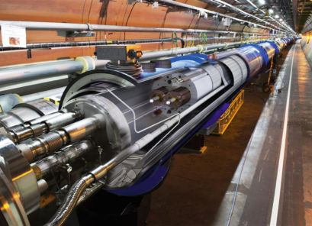
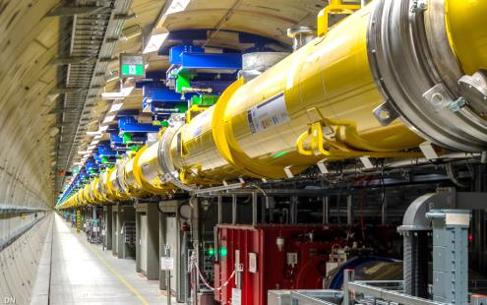
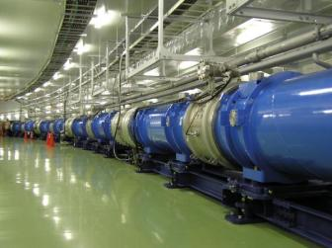
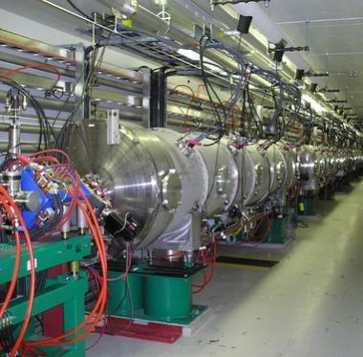
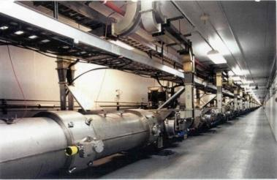
Cryogenic Equipment for Superconducting Accelerator at VACREE
Xuehua Zhang
VACREE TECHNOLOGIES CO., LTD

Slide 2
Outline
1
About VACREE
2
Cryogenic Equipment for Superconducting Accelerator
3
Cryogenic Project Phase
4
Future Prospects

Slide 3
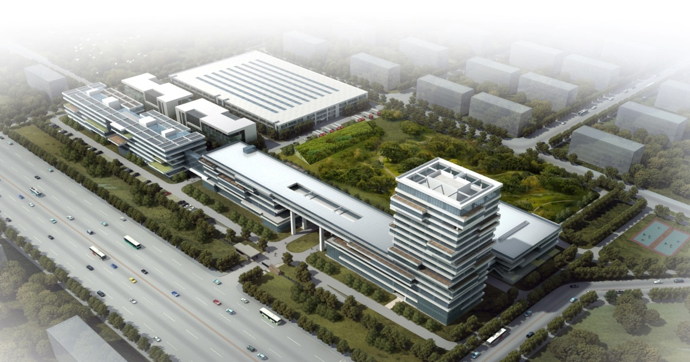
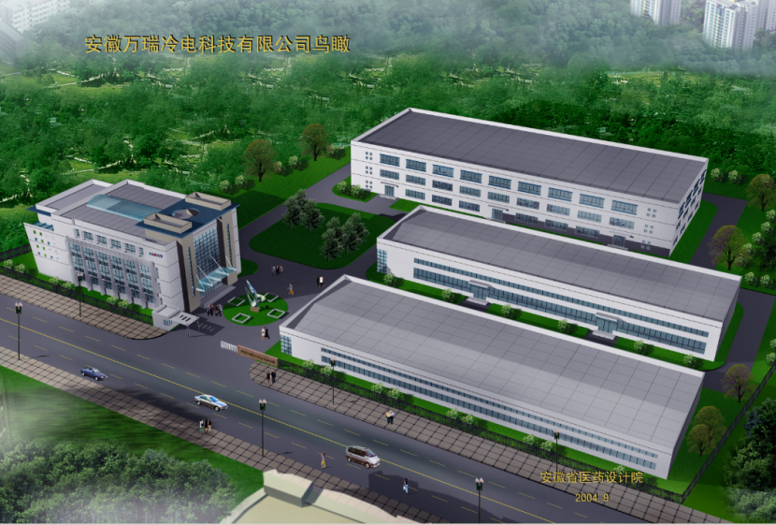
About VACREE
VACREE was founded in April 2003 in Hefei, has specialized in the engineering, designing, machining and fabrication of parts and equipment used in a variety of cryogenic, industrial, scientific R&D and process applications for more than 16 years.
VACREE has developed innovative and economical engineering and design practices based on its extensive practical experience in the design and manufacture of cryogenic equipment, vacuum chambers and pressure vessels.
Our products are mainly used in national defense and military industry, scientific research and education, aerospace, advanced manufacturing and other fields.
An ever increasing number of customers have discovered VACREE to be
their best partner for cutting edge cryogenic technologies

Slide 4
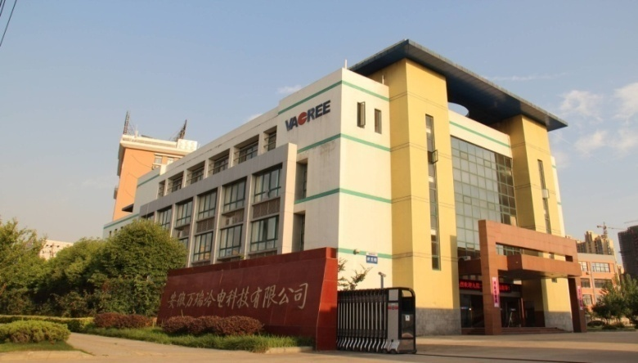
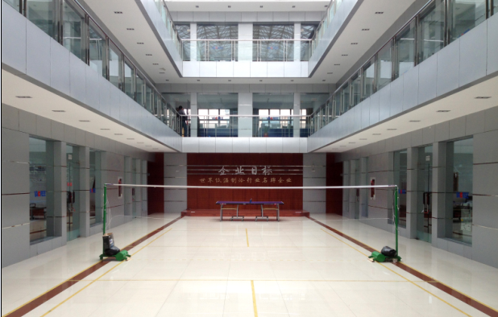
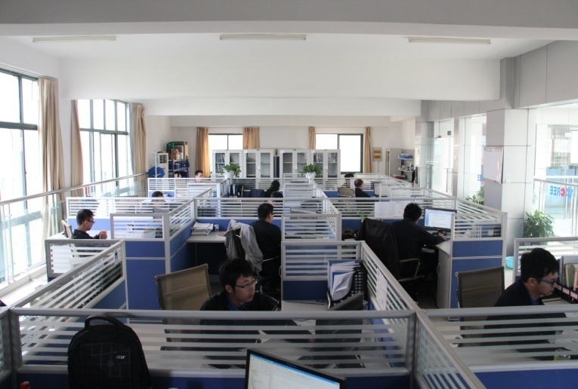
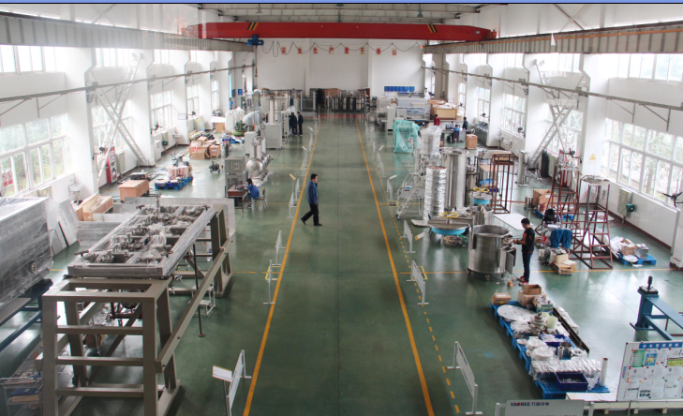
About VACREE-Site
Office Building
Office Building
Office Room
Assembly Room

Slide 5
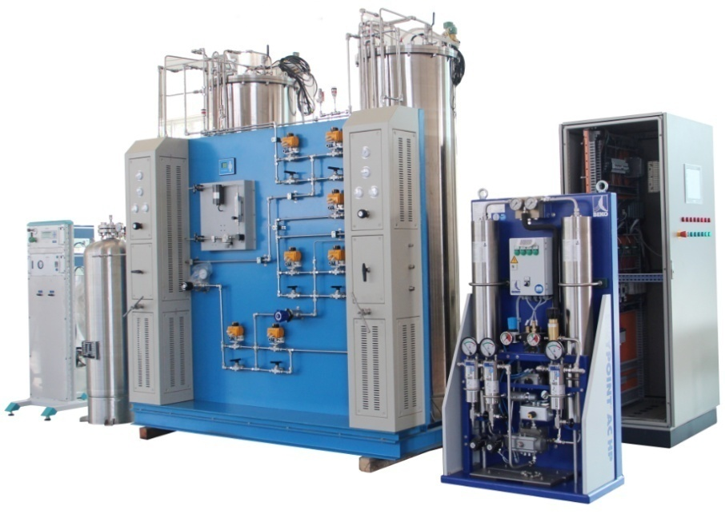
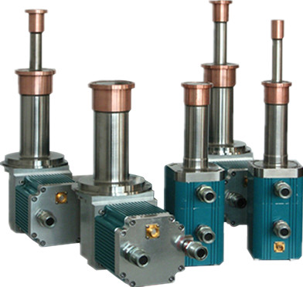
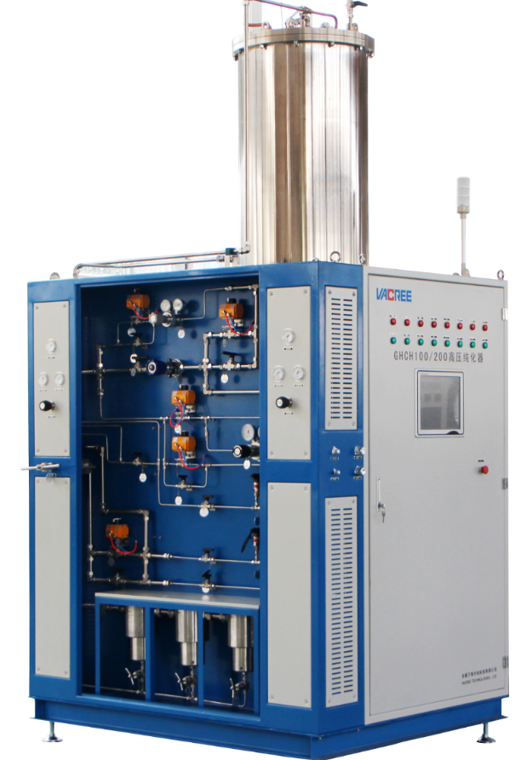
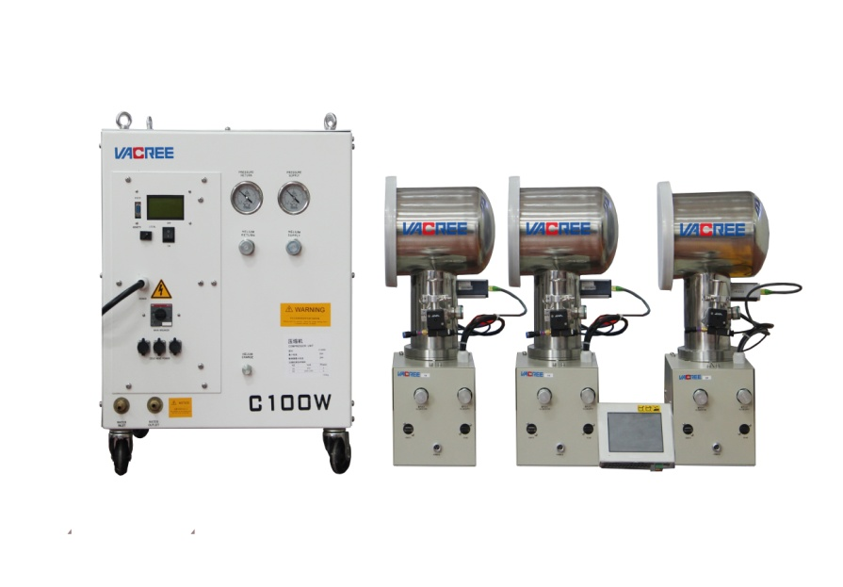
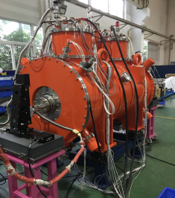
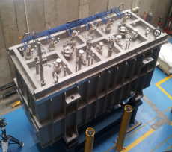
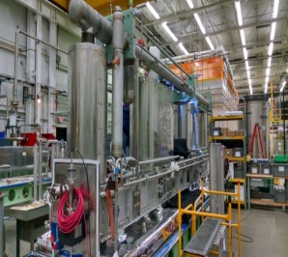
About VACREE-Profession&Product
Product
Cryogenics
Rare Gas
Recovery &Purification
Cryocooler & Cryopump
Vacuum
Automation
Customized Cryogenic Systems
Rare Gas
Recovery &Purification
Customized Cryogenic Systems
Cryopump &
Cryocooler
Cryocooler & Cryopump
Integration

Slide 6
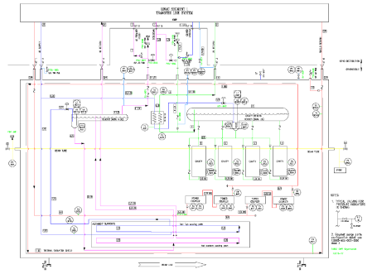
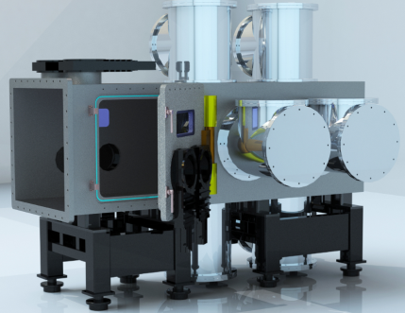
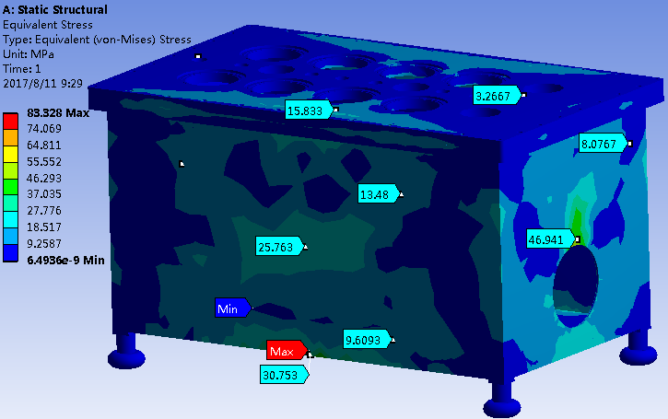
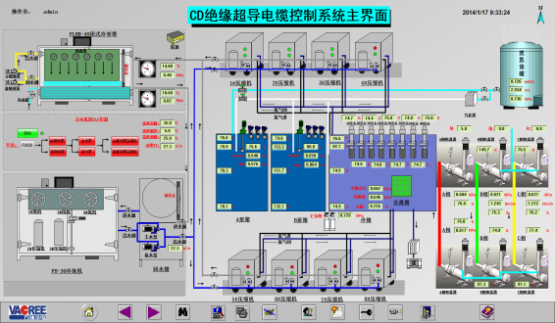
About VACREE-Fields of Activities
Service That We Can Offer
Process Design & Optimization
Instrumentation & Controls
Mechanical Engineering & Design
Project Management
Cryocooler & Cryopump
Electrical Engineering & Design
Custom Service

Slide 7
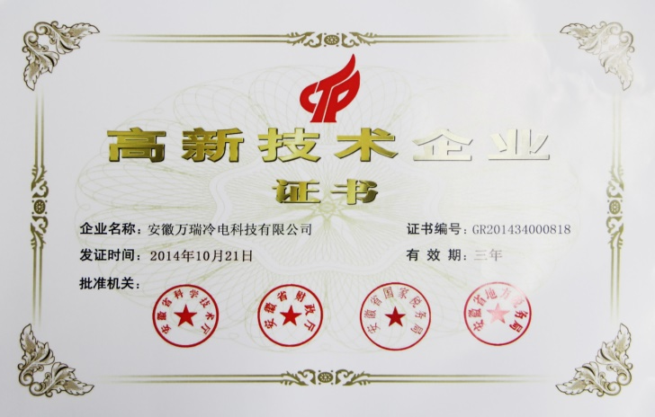
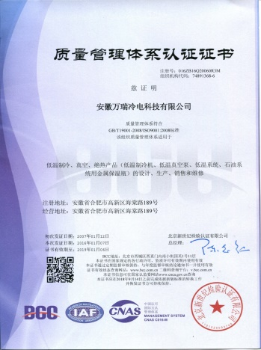
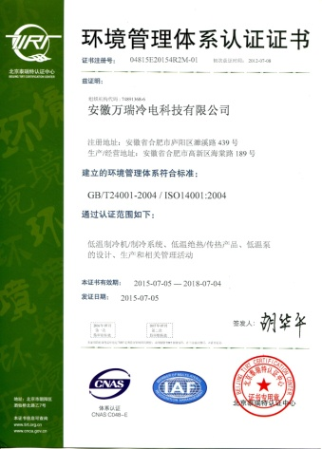
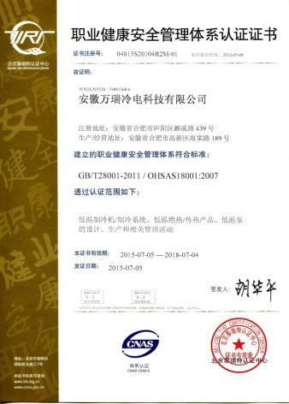
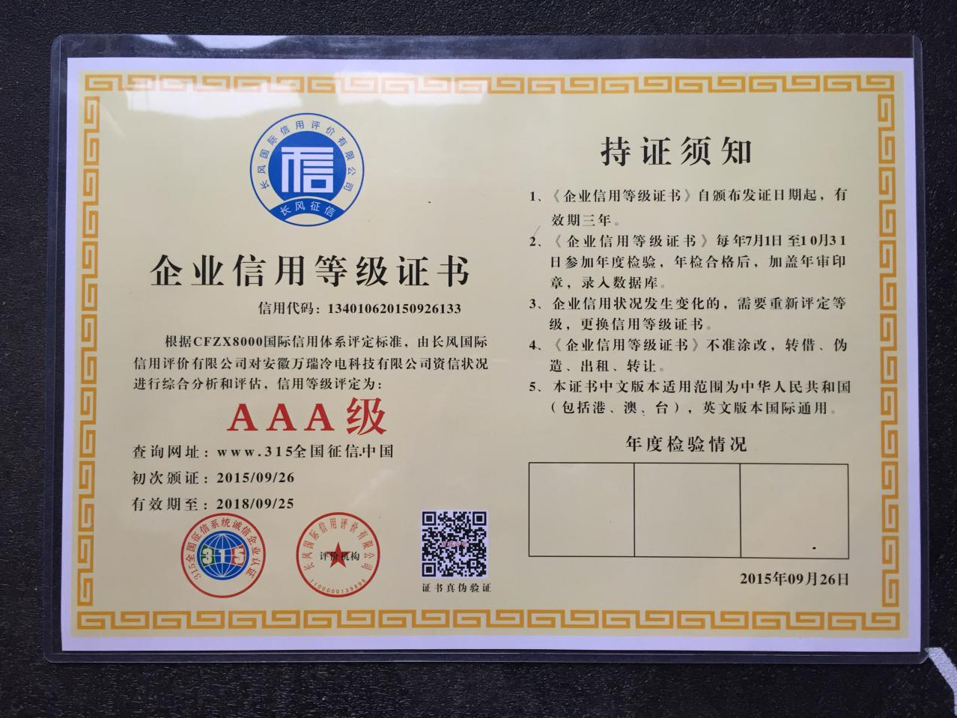
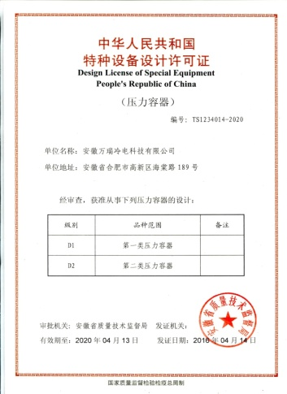
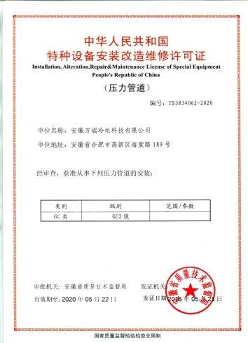
About VACREE-Cerfitication
China Hi-tech enterprise
Quality Management System
Enviroment Management System
Occupational Health and Safety
Management System
Enterprise credit rating certificate
Design License of Special Equipment
Installation,Alterlation,Repair
&Maintenance License of Special Equipment
Qualified Supplier of CNNC

Slide 8
Outline
1
About VACREE
2
Cryogenic Equipment for Superconducting Accelerator
3
Cryogenic Project Phase
4
Future Prospects

Slide 9
CEPC Cryogenic System
引自：Shaopeng Li ，Large cryogenic system at IHEP，Accelerators (ASSCA2018), IHEP, Beijing, China, 9-17 December 2018.

Slide 10
Cryogenic Infrastructure for Superconducting Accelerator
Integrated helium cryogenic system usually include:
External Purifier
Dryer
Impure Helium Storage (Gas Bag)
Gas Helium Tank(s)
Compressor(s)
Liquid Nitrogen Tank
Liquid Nitrogen Tank
Buffer
Oil Removal Unit
Vacuum pumps
VACREE CAN PROVIDE
Liquid Helium Tank(s)
Cold box (+ Internal Purifier)
Heater(s)
Mobile Dewars
Distribution Box(es)
Cryogenic Transfer Lines
Cryomodules
Distant Users

Slide 11
CEPC Cryogenic System
引自：Shaopeng Li ，Large cryogenic system at IHEP，Accelerators (ASSCA2018), IHEP, Beijing, China, 9-17 December 2018.

Slide 12
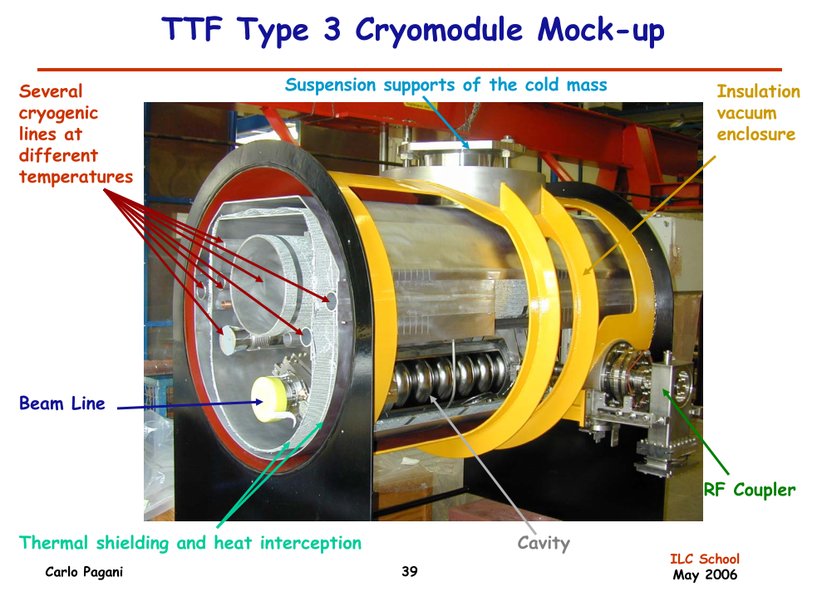
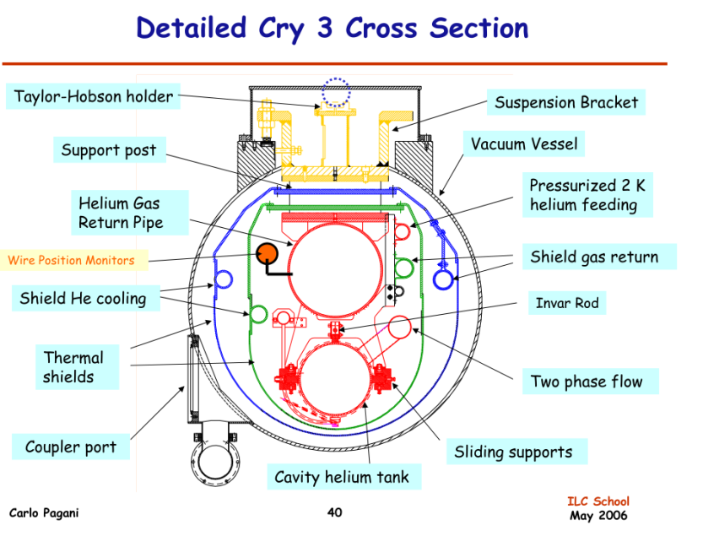
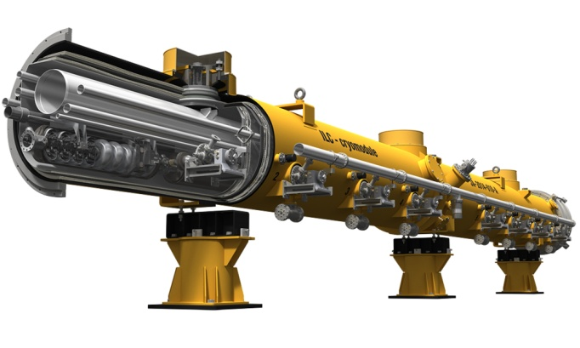
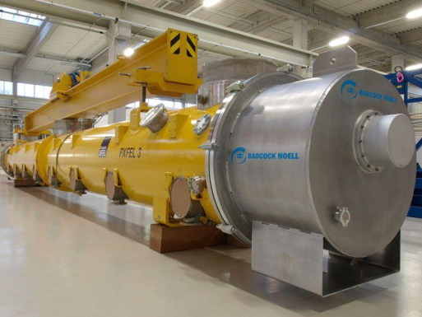
Cryogenic Infrastructure for Superconducting Accelerator
Cryomodule （for example）
TESLA Test Facility
TESLA(Tera-Electronvolt Superconducting Linear Accelerator) style cryomodule（late 1980s early 1990s）
ILC
EXFEL

Slide 13
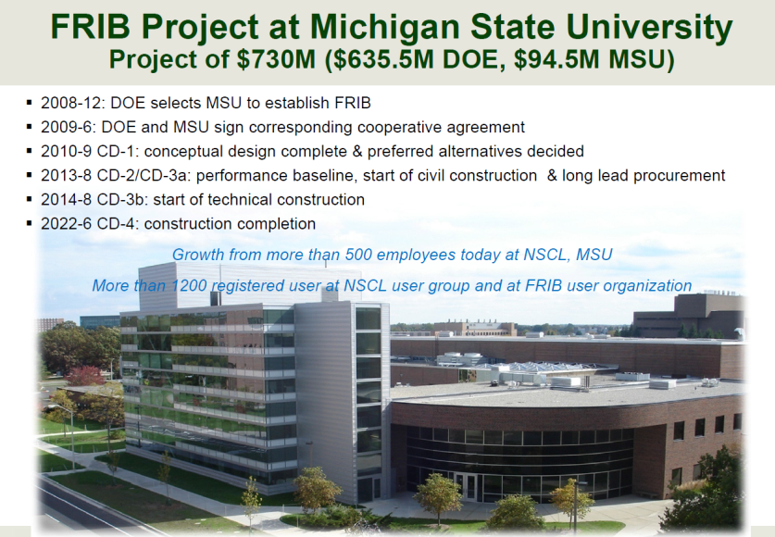
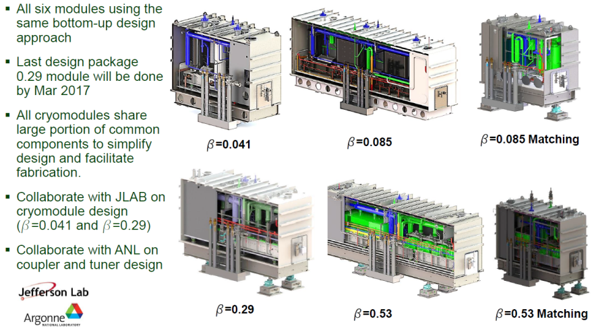
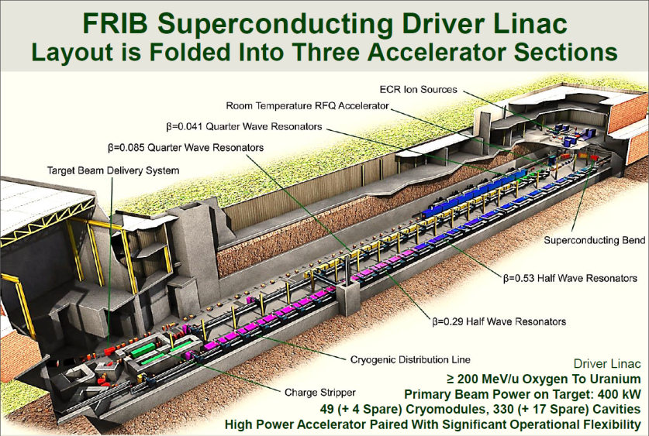
Cryogenic Infrastructure for Superconducting Accelerator
Cryomodule （for example）
FRIB Cryomodule

Slide 14
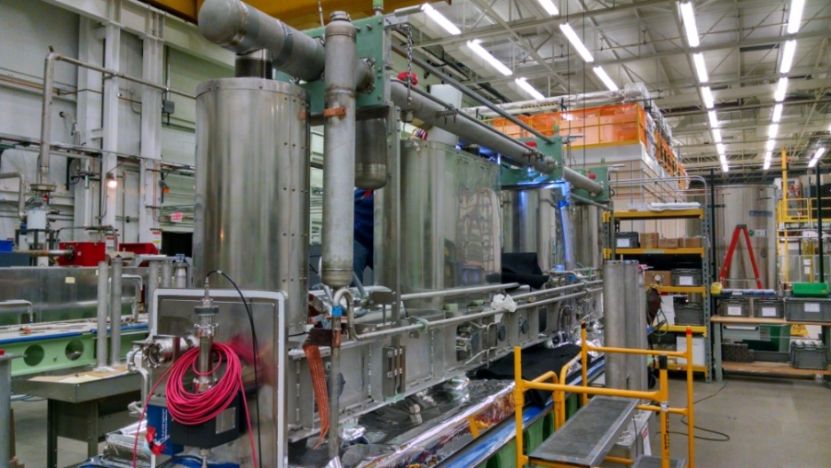
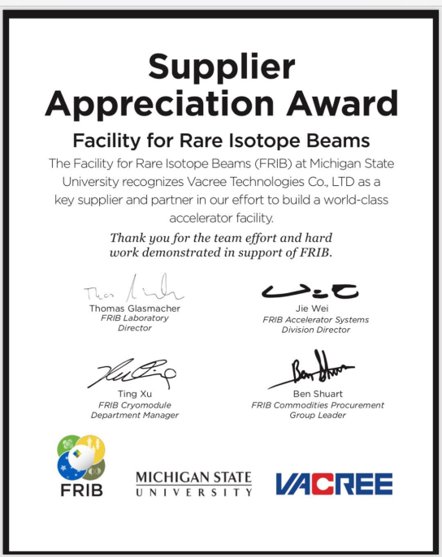
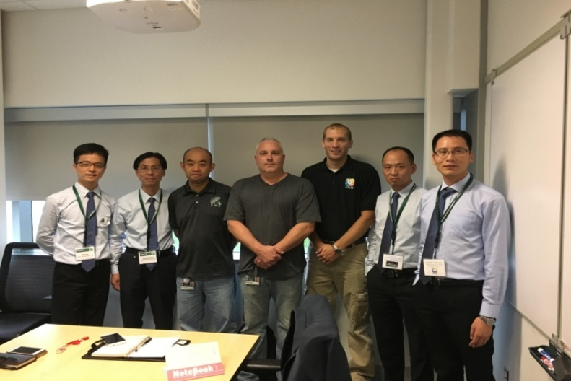
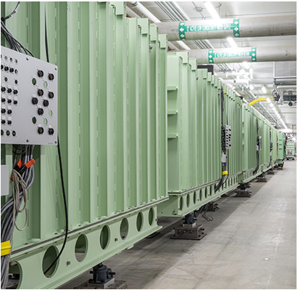
Cryogenic Infrastructure for Superconducting Accelerator
Since 2015, VACREE have offerde the components to FRIB cryomodule
Deliverables:
Beta=0.041 Cryogenic Support Structure 4 EA.
Beta=0.085 Cryogenic Support Structure 14 EA
Beta=0.29 Cryogenic Support Structure 12 EA
Beta=0.53 Cryogenic Support Structure 17 EA
2K Side of Warm Manifold 39 EA
4K Side of Warm Manifold 39 EA

Slide 15
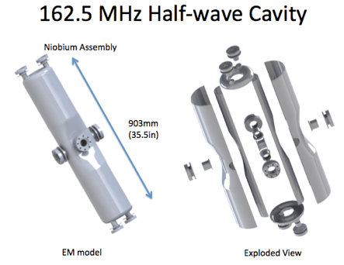
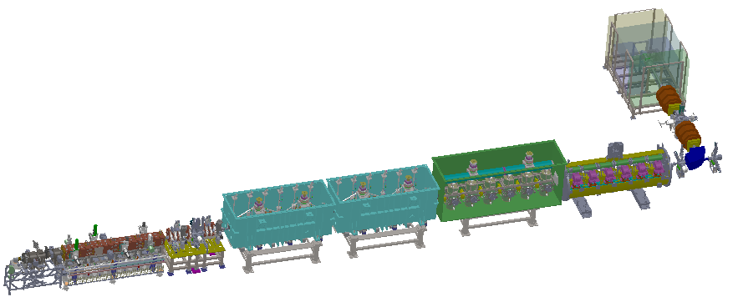
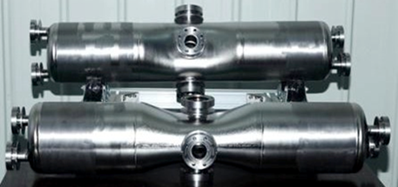
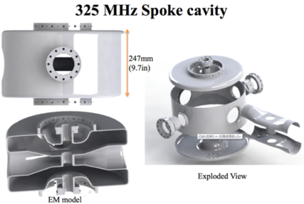
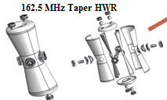
Cryogenic Infrastructure for Superconducting Accelerator
Component of Accelerator driven sub critical system(ADS) injectorⅡ
ECRIS + LEBT + RFQ + MEBT + CM1(HWR)+ CM2(HWR)+ CM3(TAPER)+ CM4(SPOKE)
IMP
IHEP

Slide 16
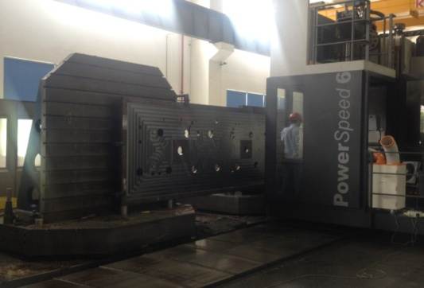
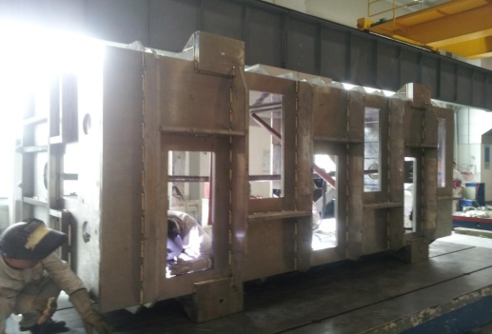
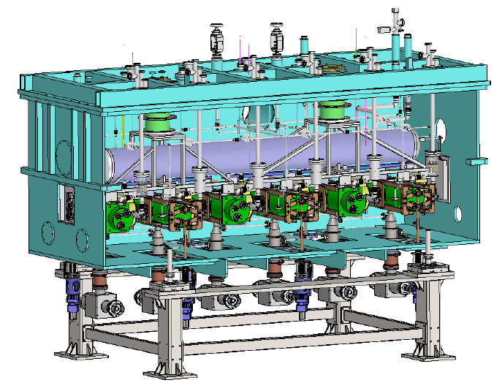
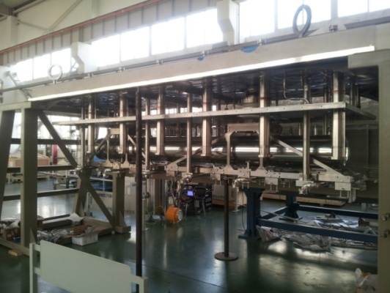
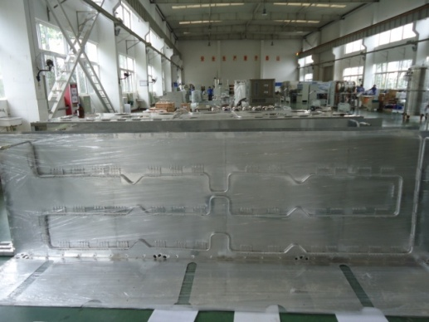
Cryogenic Infrastructure for Superconducting Accelerator
Since 2014, VACREE have offered 6 Cryomodules to IMP
CM6 Cryomodule for Institute of Modern Physics (IMP)
Manufacturing,Installation&Commissioning

Slide 17
Cryogenic Infrastructure for Superconducting Accelerator
研制时间 | 产品名称 | 尺寸与材料 | 用户单位
2013.1—2013.5 | CM1低温恒温器 | 外形尺寸：1750X1460X1840 主体材料：316L+无氧铜+TC4 | 中科院兰州近物所
2014.5—2014.10 | CM6低温恒温器 | 内腔尺寸：4090X1470X1750 主体材料：316L+铝材 | 中科院兰州近物所
2015.4—2015.10 | HCM6低温恒温器 | 内腔尺寸：4090X1470X1520 主体材料：316L+铝材 | 中科院兰州近物所
2015.10—2015.12 | TAPER单腔低温恒温器 | 内腔尺寸：Φ1270X2216 主体材料：Q235+铝材 | 中科院兰州近物所
2016.3—2016.8 | CM3低温恒温器 | 内腔尺寸：4400X1450X2300 主体材料：Q235+铝材 | 中科院兰州近物所
2016.10—2017.4 | CM4t低温恒温器 | 内腔尺寸：5025X1450X2300 主体材料：Q235+铝材 | 中科院兰州近物所
公司自成立以来，研制各类低温恒温器共计50余套

Slide 18
Cryogenic Infrastructure for Superconducting Accelerator
Cryogenic Distribution System
Cryogenic Distribution System usually include Cryogenic Vavle Box and Cryogenic Transfer Line.
for example:ESS Linac Cryogenic System Layout
ACCP
Cryogenic
Transfer
Line (65 m)
Cryogenic Distribution Line (310 m)
comprising 43 valve boxes
Auxiliary process lines
Splitting
box
Endbox
21 High Beta Cryomodules (174 m)
9 Medium Beta
Cryomodules
(75 m)
13 Spoke
Cryomodules
(54 m)
Superconducting section of the Optimus linac (303 m)
Cryogenic Distribution System for Superconducting Accelerator is intended for delivering the cooling power from the Accelerator Cryogenic Plant (ACCP) to the cryomodules by means of the constant flows of supercritical and cold gaseous helium, at 4.5 K and 40 K, respectively.

Slide 19
Cryogenic Infrastructure for Superconducting Accelerator
Cryogenic Distribution System-Cryogenic Valve Box
2014,VACREE offered 2K Valve Box to IHEP CAS

Slide 20
Cryogenic Infrastructure for Superconducting Accelerator
Cryogenic Distribution System-Cryogenic Valve Box
2014,VACREE offered 4K Valve Box to IHEP CAS

Slide 21
Cryogenic Infrastructure for Superconducting Accelerator
Cryogenic Distribution System-Cryogenic Valve Box
2019,VACREE offered 2K Valve Box to SHINE

Slide 22
Cryogenic Infrastructure for Superconducting Accelerator
低温分配阀箱设备应用情况
时间 | 产品名称 | 用户单位
2014 | 2K运行低温阀箱 | 中科院高能所
2014 | 4K主分配阀箱 | 中科院高能所
2014 | 垂测低温阀箱 | 中科院高能所
2015 | 4K低温阀箱 | 中科院近代物理研究所
2016 | 低温永磁波荡器过冷液氮系统 | 中科院上海应用物理研究所
2018 | 2K水平测试阀箱 | 中科院上海应用物理研究所
2019 | NBI/TCP/主分配阀箱 | 585所
2019 | PAPS阀箱3套 | 中科院高能所

Slide 23
Cryogenic Infrastructure for Superconducting Accelerator
Cryogenic Distribution System-Cryogenic Transfer Line
2018,VACREE offered Cryogenic Transfer Line to SHINE （Machine Phase）

Slide 24
Cryogenic Infrastructure for Superconducting Accelerator
多通道管线生产线建设，现已承接上海硬线六通道和五通道管线约200米

Slide 25
Cryogenic Infrastructure for Superconducting Accelerator
Vertical Test Cryostat-Cavities test at 2K or 4.5K
Before installation in the cryomodule, the cavities need to be subjected to a quality
control with Radio Frequency (RF) performance test. For this purpose test stands usually are foreseen to be needed.
The main element of each test stand is the Test Cryostat (XATC), where 4 cavities can be simultaneously tested.
The cavities will be installed on a transport frame suspended on the upper part insert. Due to high radiation levelduring the RF tests, the cryostat will be placed in a hole drilled in the AMTF floor and covered with a concrete shield.
Helium will be supplied via 4-channel transfer line, while helium vapours will be pumped via warm-up line.Additionally, each cryostat will be protected against overpressure with pressure relief line.

Slide 26
Cryogenic Infrastructure for Superconducting Accelerator
Vertical Test Cryostat-Cavities test at 2K or 4.5K

Slide 27
Cryogenic Infrastructure for Superconducting Accelerator
Vertical Test Cryostat-Cavities test at 2K or 4.5K
Since 2014,VACREE have offered 5 VTCs to IHEP,IMP,Peking University etc.

Slide 28
Cryogenic Infrastructure for Superconducting Accelerator
Horozontal Test Cryostat
Cryogenic piping
Vacuum vessel
Vacuum vessel
Thermal Insulation
Interface
String of cavities
Supporting components
Supporting and positioning
Thermal shields
Thermal Insulation
Cryogenic piping
Cryogenic environment
Magnetic shield
Magnetic protection
1,80m
Magnetic shield
Thermal shield
Supporting components
Cold mass (cavities, magnets)

Slide 29
Cryogenic Infrastructure for Superconducting Accelerator
公司自成立以来，研制各类低温恒温器共计50余套
研制时间 | 产品名称 | 尺寸与材料 | 用户单位
2013 | CF250低温恒温器1套 | 外形尺寸：φ1136×7500 主体材料：316L+铝材+304 | 中科院兰州近物所
2014 | 2K超导腔垂直测试恒温器1套 | 外形尺寸：φ1150×5200 主体材料：316L+铜材+304 | 中科院高能所
2016 | 2K超导腔垂直测试恒温器1套 | 外形尺寸：φ1250×5600 主体材料：316L+铜材+304 | 北京大学
2017 | 2K超导腔垂直测试恒温器1套 | 外形尺寸：φ2020×6000 主体材料：316L+铝材+304 | 中科院兰州近物所
2013 | CF250垂直测试低温恒温器1套 | 外形尺寸：φ1136×7500 主体材料：316L+铝材+304 | 中科院兰州近物所
2014 | 2K超导腔垂直测试恒温器1套 | 外形尺寸：φ1150×5200 主体材料：316L+铜材+304 | 中科院高能所
2018 | 2K超导腔垂直测试恒温器1套 | 外形尺寸：φ1000×2200 主体材料：316L+铝材+304 | 中科院上海应用物理研究所
2019 | 2K超导腔垂直测试恒温器3套 | 外形尺寸：φ2020×5200 φ1150×5200 主体材料：316L+铜材+304 | 中科院高能所
2019 | 2K超导腔垂直测试恒温器2套 | 外形尺寸：φ1750×5200 主体材料：316L+铜材+304 | 中科院上海应用物理研究所
2019 | 2K超导垂直测试恒温器改造2套 | 外形尺寸：φ1136×7500 主体材料：316L+铝材+304 | 中科院近代物理研究所
2019 | 2K超导腔水平测试恒温器1套 | 外形尺寸：φ850×1500 主体材料：316L+铜材+304 | 中科院上海应用物理研究所

Slide 30
Cryogenic Infrastructure for Superconducting Accelerator
Helium Recovery System
Cryogenic Users

Slide 31
Cryogenic Infrastructure for Superconducting Accelerator
Purification System
型号 | GCH30/70 | GCH80/20 | GCH100/200 | GCH200/50 | GCH300/200
工作压力（MPa） | 7 | 2 | 20 | 5 | 20
流量（m³/h） | 30 | 80 | 100 | 200 | 300
进气纯度（%） | 进气纯度≥50%
出气纯度指标 | 99.999%
最大压降（bar） | 2 | 2 | 3 | 3 | 3
连续工作时间（h） | ≥8h，具备连续24h运行,全自动切换，无人值守，远程操作、监控功能。
首次加注液氮（L） | ≈200 | ≈250 | ≈250 | ≈300 | ≈350
运行时液氮消耗（L/Nm³） | 0.2-0.4
进出口温差（℃） | ≤10
双塔结构
单塔结构

Slide 32
Cryogenic Infrastructure for Superconducting Accelerator
Helium Purifiers Reference List

Slide 33
Cryogenic Infrastructure for Superconducting Accelerator
Helium Purifiers Reference List
序号 | 用户单位 | 设备/服务信息及主要技术指标 | 项目时间
1 | 富通（深圳）光纤光缆有限公司 SEFC | purification capacity:25Nm³/h；output purity:99.9995% （24h连续运行，无人值守，远程控制） | 2016年
2 | 富通住电光纤（杭州）有限公司 FUTONG GROUP | purification capacity:25Nm³/h；output purity:99.9995% （24h连续运行，无人值守，远程控制） | 2016年
3 | 北京大学 Peking University | purification capacity:80Nm³/h；output purity:99.9995% | 2016年
4 | 法国液化空气公司 Air Liquid | purification capacity:100Nm³/h；output purity:99.9995% | 2016年、2018年
5 | 中科院北京物理与化学研究所 IPC,CAS | purification capacity:100Nm³/h；output purity:99.9995% | 2016年
6 | 中科院合肥等离子体研究所 IPP,CAS | purification capacity:80Nm³/h；output purity:99.9995% | 2015年
7 | 首都航天机械公司 BJCAMC | purification capacity:60Nm³/h；output purity:99.9995% | 2014年
8 | 中国工程物理研究院 CAEP | purification capacity:20Nm³/h；output purity:99.9995% | 2013年
9 | 中科院北京高能物理研究所 IHEP,CAS | purification capacity:105Nm³ /h；output purity:99.9995% | 2013年、2018年
10 | 中科院上海应用物理研究所 SINAP,CAS | purification capacity:30Nm³/h；output purity: 99.995% | 2013年
11 | 中科院兰州近代物理研究所 IMP,CAS | purification capacity:100Nm³/h；output purity:99.9995% | 2013年
12 | 中科院武汉物理与数学研究所 Wuhan IPM,CAS | purification capacity:20Nm³/h；output purity: 99.995% | 2012年
13 | 中科院兰州近代物理研究所 IMP,CAS | purification capacity:100Nm³/h；output purity:99.9995% | 2012年
14 | 中科院北京高能物理研究所 IHEP,CAS | purification capacity:100Nm³/h；output purity:99.9995% | 2012年
15 | 中科院上海应用物理研究所 SINAP,CAS | purification capacity:10Nm³/h；output purity: 99.995% | 2009年、2018年
16 | 中国科学技术大学 USTC | purification capacity:5Nm³/h；output purity:99.9995% | 2008年

Slide 34
Outline
1
About VACREE
2
Cryogenic Equipment for Superconducting Accelerator
3
Cryogenic Project Phase
4
Future Prospects

Slide 35
Cryogenic Project Phase
Engineering
OUTPUT
INPUT
Technical Specification
P&IDs
Drawings
PDR
FDR
MRR
FDR
FDR
PM Plan
Q&A Plan
Preliminary:
Models
Structural analysis
- Seismic analysis
- Heat leak analysis
- Cryogenic valves
- Instruments
Final:
Models
Structural analysis
- Seismic analysis
- Heat leak analysis
- Cryogenic valves
- Instruments
WPS, WPQ, PQR documents etc.
Procedures:
- Leak check
- Pressure test
- Inspection and examination

Slide 36
Cryogenic Project Phase
Manufacturing
OUTPUT
INPUT
MANF.
FAT
DELI
Dimensional check
NDE
Vacuum retention test
Pressure test
Helium leak test
Cold shock test
Valve/actuator test
Instrumentation test
Material test reports
Instruments calibration data
Final report:
- Pressure test
- Leak test
- Calibration
Compliance certificates

Slide 37
Cryogenic Project Phase
Installation
OUTPUT
INPUT
IRR
INSTL
SAT
Quality Plan
ITP documents
Installation procedures
Installation drawings
Assembly procedure
Test procedures
Manufacturer instructions
Progress reports
Individual qualifications
Manufacturing Dossier including:
- Acceptance certificates
- Quality plan and ITPs
- Welding documentation - NDT documentation
Test reports
As built drawings
Installation, operation and maintenance documentation

Slide 38
Outline
1
About VACREE
2
Cryogenic Equipment for Superconducting Accelerator
3
Cryogenic Project Phase
4
Future Prospects

Slide 39
Future Prospects
There is a window of opportunity for China to become a world leader in HEP by constructing a big ring collider as a Higgs factory and upgradable to a pp collider.
The realization of CEPC-SppC plan will make China's basic physics research in the forefront in the world in the next 30 years, and greatly enhance the soft power of national scientific and technological innovation ability and international competitiveness, and greatly improve China's international status.
VACREE has unique expertise in the field of low temperatures and recognised know-how in the design, production, and installation of cryogenic infrastructure for superconducting accelerator.
We will strive to specialize in extreme cryogenics and gas engineering ,offer novel and competitive solutions for CEPC.

Slide 40
Thanks for your attention！
Contact information
Company: Vacree Technologies Co., Ltd.
Add： No. 189 Haitang Road Hi-Tech Zone ,Hefei, China.
Website：www.vacree.com
Cellphone：13956079943
E-mail：zhangxh@vacree.com

