Slide 1
Effect of energy loss on accuracy of precision energy measurements in CEPC
Daria Leshenok and Sergei Nikitin
Budker Institute of Nuclear Physics, Novosibirsk, Russia
Beijing, 2019

Slide 2
Content:
Motivation
Azimuthal dependence of energy
Features of the magnetic structure of CEPC
Calculation of shift of average energy relative to the local energy at the interaction point for CEPC in one super period due to SR
Shift of average energy relative to local energy with Beamstrahlung (BS)
Effect of field errors in the magnetic structure of CEPC
Energy shift of center of mass system, taking into account non-zero angle of intersection of the beams, SR and Beamstrahlung
Remark on influence of Resistive Wall losses
Conclusion

Slide 3
Motivation:
It is planned to carry out at CEPC the precision mass measurement experiments at 45.5 and 80 GeV with an accuracy of 10⁻⁶. With this aim, the resonant depolarization technique (RD) will be applied to measure the particle energy averaged over turns with the same accuracy. Various factors will contribute to the error of such experiments. Among them, we can distinguish those that determine the energy losses by particles during motion in the accelerator ring and in collisions with counter beam.
The items under study:
Due to the distributed energy losses, the local particle energy at IPs may differ from that measured by RD.
Mass measurement error related to the center-of-mass energy shift and spread, depending on the energy loss through the equilibrium parameters of the beams

Slide 4
Azimuthal dependence of energy
$E\left(θ\right)=E_{0}\left[1+f\left(θ\right)+μ\right]$ is the azimuthal dependence of energy ( E₀ is the energy without losses)
–U/2 ≤ f(θ) ≤ U/2 is normalized function describing the azimuthal distribution of losses
(U is the total loss per turn)
shift due to Saw-Tooth orbit
(K - curvature; η_{x} - dispersion)
Difference between local E(θ) and average energy:
Spin precession frequency (Ω_{sp}) measured with RD technique (Ω₀ - angular revolution frequency)
Difference between energy in IP and energy measured by RD method:

Slide 5
Factors of energy loss under consideration
Synchrotron radiation (SR)
Beamstrahlung (BS)
Impedance

Slide 6
Features of the magnetic structure of CEPC
The energy losses per revolution at CEPC are very large:
45.5 GeV: 4·10⁻⁴ rel. un.
80 GeV: 2·10⁻³ rel. un.
120 GeV: 7·10⁻³ rel. un.
The magnetic structure of CEPC is built on the principle of tapering. Tapering implies a variation of magnetic field of dipoles in proportion to particle energy at each azimuth (ideal tapering)
Absence of noticeable distortions of the orbit (Saw-Tooth orbit), compared with the case without radiation is the result of tapering
But it is actually assumed the separation into families of dipole magnets, each of which will have its own degree of tapering
In our calculation we used approximation of ideal tapering.
Scheme of CEPC

Slide 7
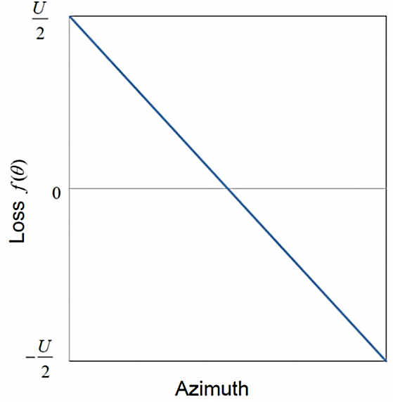
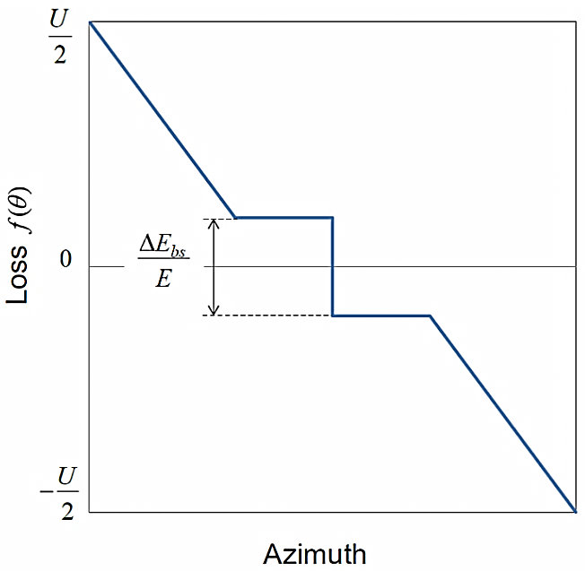
Calculation of shift of average energy relative to the local energy
at the interaction point for CEPC in one super period due to SR
The difference between the local energy and the average energy measured
by the method of resonant depolarization is
$\frac{E\left(θ\right)−〈E〉}{E_{0}}=f\left(θ\right)−〈f〉$, where –U/2 ≤ f(θ) ≤ U/2 is a normalized function describing the azimuthal
distribution of losses (U is the total loss per turn)
2π
$$\frac{∆E_{BS}}{E}$$
2π
An example of the function f(θ) in the azimuthally homogeneous case
Schematic view of the function f(θ) in a storage ring with one RF cavity taking into account BS at the interaction point (mirror-symmetric case).

Slide 8
Table presents the calculations of the systematic error (energy shift) caused by
the absence of mirror symmetry of the magnetic structure
CEPC
 | Z(3T) | Z(2T) | W
E [GeV] | 45.5 | 45.5 | 80
ΔE_{SR} [GeV] / CEPC CDR | 0.018 | 0.018 | 0.17
ΔE_{SR} [GeV] / our calc. | 0.01787 | 0.01787 | 0.1708
<f > | 1.75561·10⁻⁷ | 1.75561·10⁻⁷ | 4.93311·10⁻⁷
f_{IP} | 1.3213·10⁻⁶ | 1.3213·10⁻⁶ | 5.3218·10⁻⁶
f_{IP} - <f > | 1.1457·10⁻⁶ | 1.1457·10⁻⁶ | 4.8285·10⁻⁶
Shift of average energy relative to the local energy at the IP significantly exceeds the declared accuracy of the experiment (10⁻⁶) at energy 80 GeV.
Therefore, it requires special consideration when processing the results of energy measurements.

Slide 9
Shift of average energy relative to local energy with Beamstrahlung (BS)
RF
RF
BS is radiation of an individual particle in the collective electromagnetic field of the counter beam.
BS has two features: it depends on the spatial distribution of particles in the beam and on the square of the current of the counter bunch.
According to estimates of Dmitry Shatilov and our calculations, the additional energy losses on BS (at energies of 45.5 and 80 GeV) can be neglected due to their smallness
IP
The symmetrized function f(θ) constructed for CEPC at an energy of 45.5 GeV on one
super-period

Slide 10
Effect of field errors in the magnetic structure of CEPC
$σ_{H}=\frac{∆H}{H}={10}^{−3}$ is probable error of magnetic field manufacture in the worst case
Saw-Tooth orbit due to the spread of magnetic fields is not taken into account because of smallness of its deviations.
The energy loss in the i-th magnet is described as $δE_{i}≈δE_{i}^{(0)}∙\left(1+2\frac{∆H}{H}\right),$
the quadratic terms are discarded because of smallness, $δE_{i}^{(0)}$ is energy losses.
Then additional energy losses per revolution due to the spread of magnetic fields :
$∆(δ{E)}^{2}≈N{\left(δE_{i}^{(0)}∙2σ_{H}\right)}^{2},$
N is the number of magnets in the ring (2518 in CEPC). Relative energy losses per revolution are defined as
$\frac{\sqrt{∆(δ{E)}^{2}}}{E_{0}}≈\sqrt{N∙4{σ_{H}}^{2}{\left(\frac{∆E_{turn}}{NE_{0}}\right)}^{2}}=\frac{∆E_{turn}}{\sqrt{N}E_{0}}∙2σ_{H}.$
Contribution of additional radiation losses (without BS):
45.5 GeV: 5.83·10⁻⁹ ± 4.28·10⁻⁸
80 GeV: -1.79·10⁻⁸ ± 2.377·10⁻⁷
The contribution of BS in this case is negligible.

Slide 11
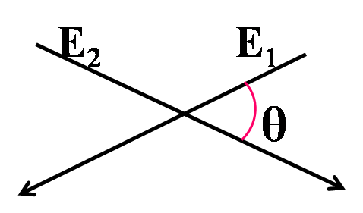
Energy shift of center of mass system, taking into account non-zero angle of intersection of the beams, SR and BS
The average center-of-mass energy
$\overline{M}=\sqrt{2E_{1}E_{2}\left(1+\cos{θ}\right)}\left\{1−\frac{1}{4\left(1+\cos{θ}\right)}∙\left[\frac{E_{1}}{E_{2}}\left(δ_{h1}^{2}+δ_{v1}^{2}\right)+\frac{E_{2}}{E_{1}}\left(δ_{h2}^{2}+δ_{v2}^{2}\right)\right]−\frac{1}{8}\left(σ_{E1}^{2}+σ_{E2}^{2}\right)−\frac{1}{8}\frac{\sin^{2}θ}{{\left(1+\cos{θ}\right)}^{2}}\left(δ_{h1}^{2}+δ_{h2}^{2}\right)\right\}$
Here E is the beam energy, σ_{E} is the energy spread,
δ_{v} and δ_{h} are vertical and horizontal angular spread,
θ is the angle of intersection of the beams.
Systematic error due to the center-of-mass energy shift
$∆M=\overline{M}−\sqrt{2E_{1}E_{2}\left(1+\cos{θ}\right)}$
The center-of-mass energy spread
$σ_{M}^{2}=\frac{1}{2}E_{1}E_{2}(1+\cos{θ})∙\left[σ_{E1}^{2}+σ_{E2}^{2}+\frac{\sin^{2}θ}{{(1+\cos{θ})}^{2}}\left(δ_{h1}^{2}+δ_{h2}^{2}\right)\right]$
Beams meet in the IP at a
non-zero angle

Slide 12
Calculation of shift of average
center-of-mass energy system
E [GeV] | 45.5 / Z(3T) | 45.5 / Z(2T) | 80 / W
Without BS
ΔM / rel. un. | -3.7038·10⁻⁸ | -3.6708·10⁻⁸ | -1.094·10⁻⁷
σ_{M} / rel. un. | 0.000269 | 0.000269 | 0.000467
With BS
ΔM / rel. un. | -1.609·10⁻⁷ | -1.6057·10⁻⁷ | -2.4066·10⁻⁷
σ_{M} / rel. un. | 0.000566 | 0.000566 | 0.000693
BS significantly affects the center-of-mass energy spread and
thereby increases the volume of required statistics of experiments on measuring mass

Slide 13
How do corrections to center-of-mass energy effect on mass measurement experiments?

Slide 14
How do beam lengthening effect on luminosity?
Single collision luminosity at an arbitrary crossing angle:
The larger beam length → the larger Piwinski’s angle Ψ
→ the smaller luminosity

Slide 15
Remark on influence of Resistive Wall losses
 | Relative energy losses per revolution due to RW | Relative energy losses per revolution due to SR | Bunch length with impedance [mm]
Z [45.5 GeV] | 10⁻⁴ | 4·10⁻⁴ | 5.1
W [80 GeV] | 8.7·10⁻⁵ | 2·10⁻³ | 4.2
At energy of 45.5 GeV, the relative RW losses are comparable to the SR losses per revolution.
However, the calculations show that the difference between the average energy measured
by the resonance depolarization method and the local energy at the IP is practically unchanged due to additional impedance losses.
f_{IP} - <f> with BS at energy 45.5 GeV | f_{IP} - <f> with BS and Resistive wall at energy 45.5 GeV
1.14482·10⁻⁶ | 1.1535·10⁻⁶

Slide 16
BS calculation without beam-beam simulation
In order to simplify estimates of the influence of BS, we have developed an analytic-based approach that allows us to determine the corresponding energy loss and also the BS contribution to the diffusion rate without using beam-beam simulation codes
Our approach is approximate. At the same time, it makes it relatively easy to consider various models that study the combined effect of SR, BS, and Impedance on formation of the beam length and energy spread

Slide 17
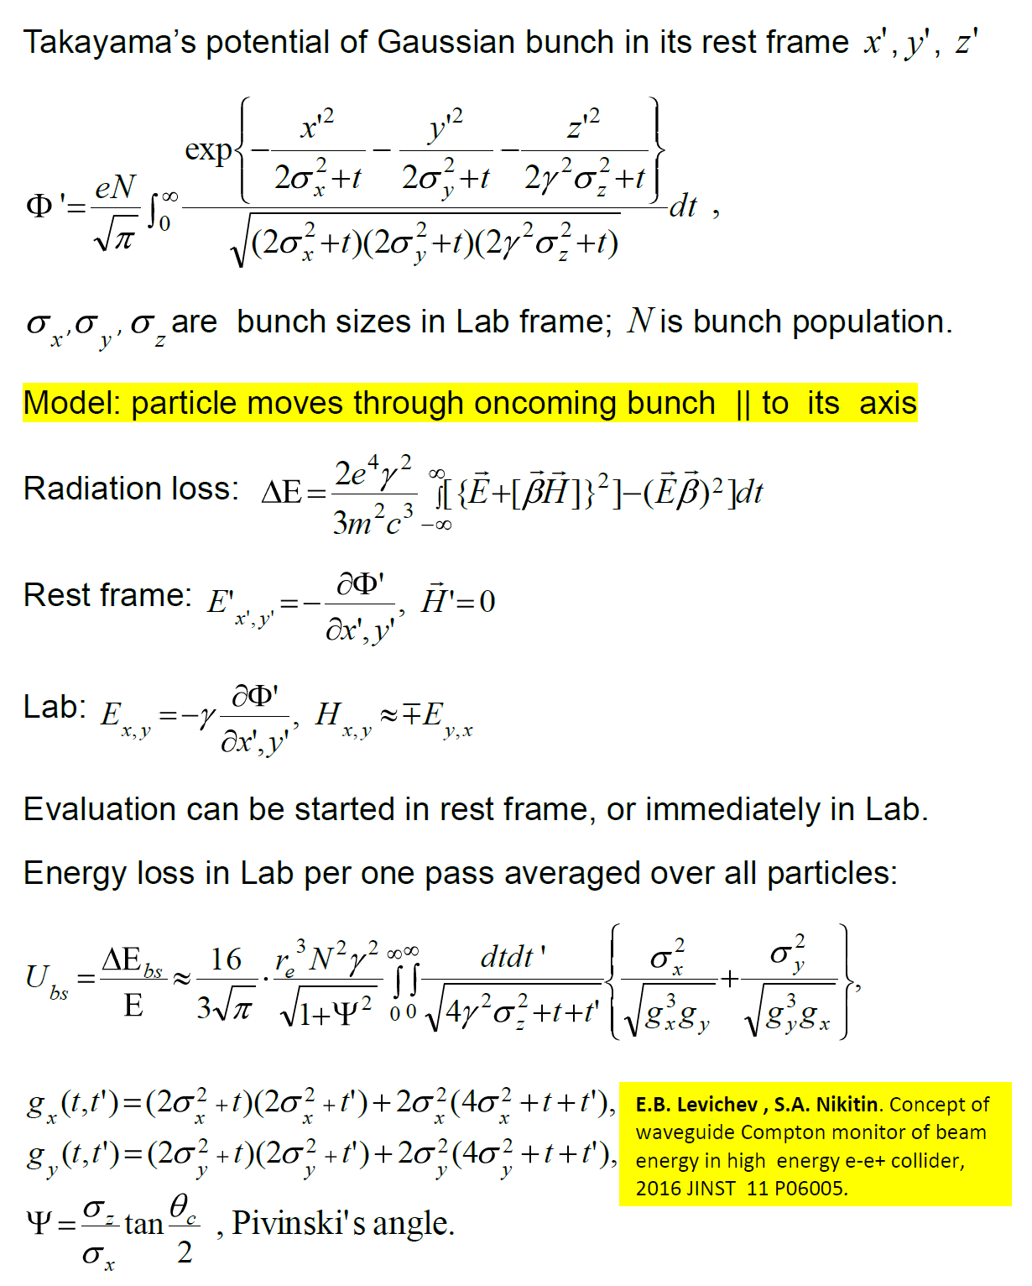
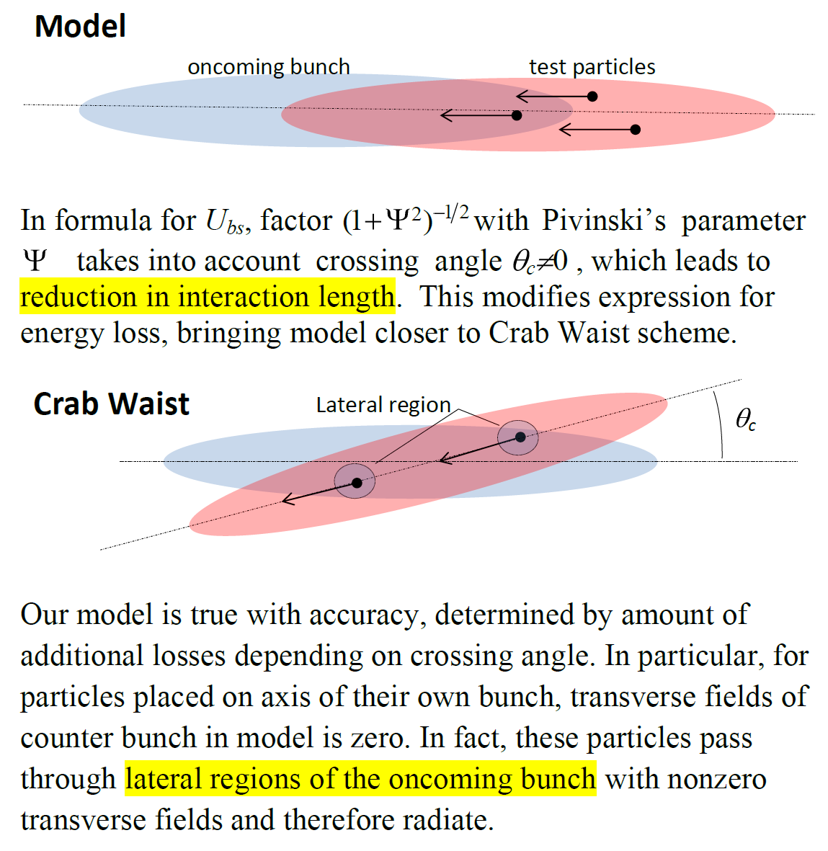
Model to estimate energy loss due to Beamstrahlung (BS)
counter
counter

Slide 18
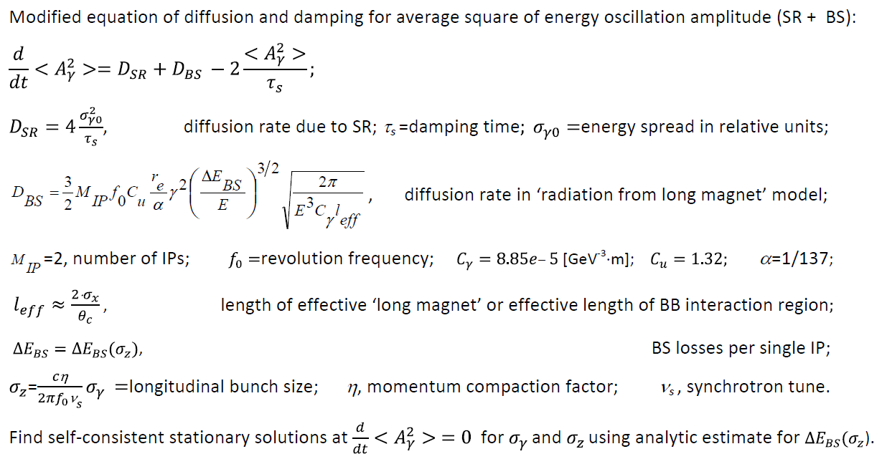
Accounting BS in energy diffusion rate

Slide 19
Calculation of the longitudinal beam size with BS at CEPC
The lengths of the beams σ_{z} are indicated with complete energy losses at SR and BS
(BS exists at two IPs).
CEPC
 | Z(2T) / 45.5 GeV | Z(3T) / 45.5 GeV | W / 80 GeV
σ_{z} [mm]/ CEPC CDR | 8.5 | 8.5 | 5.9
σ_{z} [mm]/ results of our model | 6.33 | 6.303 | 4.7
The table shows that our estimates of the longitudinal size of the beam (and, consequently, the energy spread) are close to the values ​​obtained by numerically simulating the encounter effect.
The differences are due to the fact that our simple model does not take into account additional losses in the lateral regions of the counter bunch.

Slide 20
To study SR + BS + Potential Well distortion effect
For the case of a bunch intensity below the microwave instability threshold, Mikhail Zobov (INFN) has suggested to consider bunch lengthening due to the potential well distortion (PWD) in combination with our analytic-based approach to BS problem. It may help estimating beam parameters after starting collision in presence of the beam coupling impedance.
Motivation: according to the CEPC CDR data for Z(2T) option, bunches in CEPC lengthen from 2.42 mm to 5.1 mm. Since the lengthening is dominated by the potential well distortion for simplicity we will consider only PWD in order to evaluate an impact of the coupling impedance on the bunch length and energy spread in collision.

Slide 21
Iterative model of combined effect of SR+PW+BS for CEPC at Z(2T)
1. Initial state
nominal parameters
like in CEPC Z(2T)
without impedance
and collision
2. ‘Impedance on’
beam lengthening (CDR) is
from 2.42 up to 5.1 mm;
5.1/2.42 times reduction
in synchrotron tune;
no beam collision;
‘no impedance variation’
when length changes
3. State at each iteration
‘collision on’;
‘impedance on’;
BS depends on current
length and contributes with
SR to energy diffusion rate
and thus to ‘instant’ stationary
energy spread and length

Slide 22
Discussion on model
The model demonstrates, although slow, but convergence. The asymptotic value of the beam length, found as the average over the 'saw-tooth-like' sequence, is self-consistent and is 9 mm. It is easily verified by its substitution into the system of used equations
PWD, which lengthens the bunch, does not give rise to the energy spread growth. Instead, in collision it leads to a decrease of 30% in the resulting energy spread due to a decrease in the total diffusion rate (BS + SR). At the same time, the bunch length increases by a factor 1.5
So far, this model only indicates that the interaction between various factors, such as the beam of the beam and impedance,
in this case can lead to a change in the parameters of the beam.
By and large, a self-consistent iterative (on beam current) approach is needed, since
a) the length of the bunch depends on the current, impedance and BS, but in turn
b) and effective impedance and BS depend on the length of the bunch.
 | SR | SR+PW | SR+BS | SR+BS+PW | (SR+BS+PW)/(SR+BS)
Energy spread | 0.00038 | 0.00038 | 0.001 | 0.00069 | 0.69
Beam length | 2.42mm | 5.1mm | 6.33mm | 9mm | 1.5
Bunch lengthening due to the beam coupling impedance results in
energy spread reduction in colliding beams!

Slide 23
Conclusions:
Shift of average energy (measured by RD) relative to the energy at IP due to the lack of mirror symmetry of magnetic structure is negligible at energy 45.5 GeV. But at energy 80 GeV this value 4.8285·10⁻⁶ of systematic error far exceeds the accuracy of the experiment 10⁻⁶.
The contribution of additional radiation losses due to the error of magnetic field manufacture is negligible at both energies (45.5 and 80 GeV). The contribution of BS is negligible in this case.
The energy shift of the center of mass due to non-zero angle of the beams intersection is negligible without and with BS at both energies.
BS significantly affects the energy spread of the center of mass. But at energy of Z-boson, this effect can be neglected due to the large width of the resonance (Г ≈ 2 GeV).
Our analytic-based approach allows us to determine the corresponding energy loss and also the BS contribution to the diffusion rate without using beam-beam simulation codes

Slide 24
Acknowledgments
Authors thank
Dmitry Shatilov and Mikhail Zobov
for discussions and useful advice
and the team of Chinese colleagues for the assistance provided
Thanks for your attention.

