Slide 1
Dynamic Aperture optimization
Kseniia Kariukina,
Accelerator laboratory,
Budker Institute of Nuclear Physics

Slide 2
Accelerator toolbox code
Accelerator Toolbox (AT) is a tracking code implemented in Matlab to model accelerator rings and beam dynamics.
With AT it is possible to:
create and manipulate accelerator lattice elements
track particles through the lattice
compute accelerator parameters and beam properties
AT is a collaboration of scientist around the world from 15 institute (about 27 members) who is writing the code.
The latest version you could find at: https://github.com/atcollab/at

Slide 3
Nuclotron-based Ion Collider fAсility
NICA is a new accelerator complex designed at the Joint Institute for Nuclear Research (Dubna, Russia) to study properties of dense baryonic matter.
Start of the construction: 2013. Commissioning: 2020
NICA will provide variety of beam species ranged from protons and polarized deuterons to very massive gold ions.
Heavy ions will be accelerated up to kinetic energy of 4.5 GeV per nucleon,
the protons – up to 12.6 GeV.

Slide 4
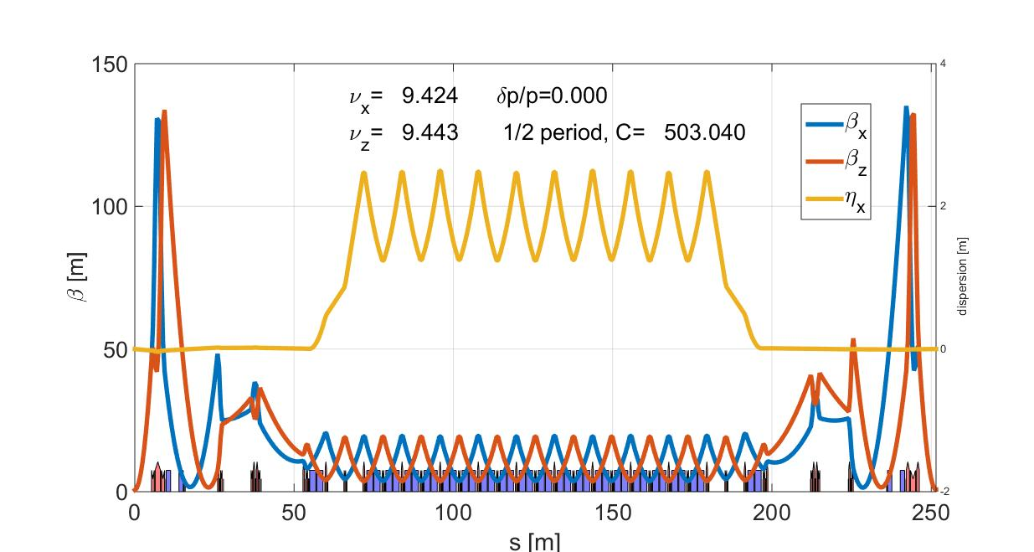
The NICA LATTICE

Slide 5
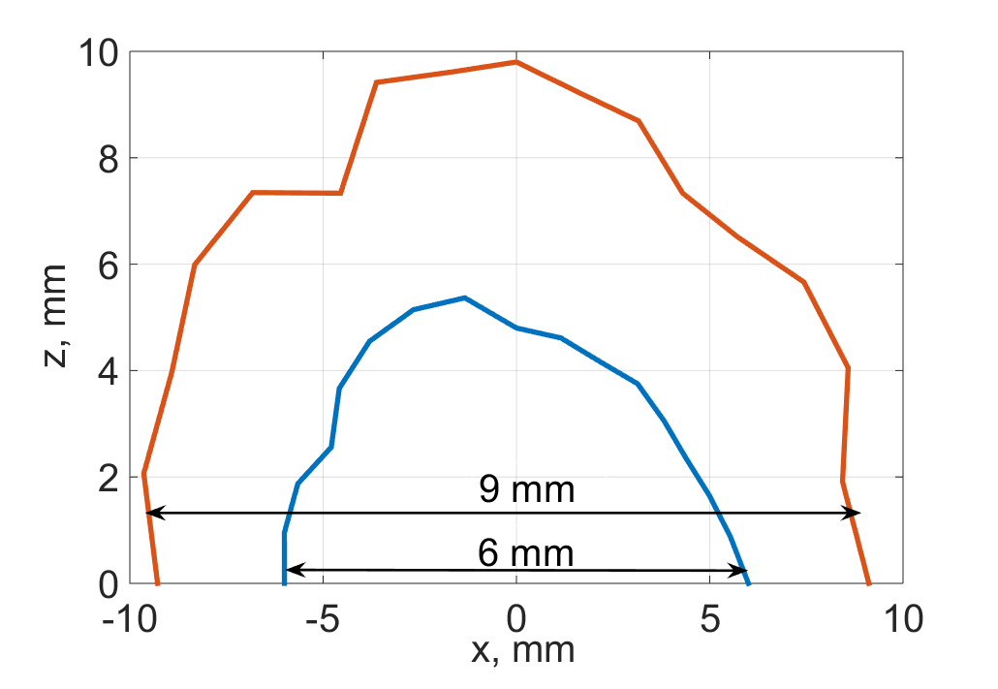
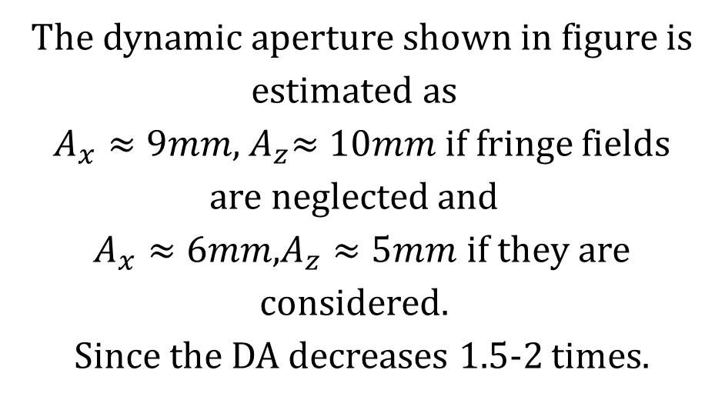
Fringe field effects of final focusing quadrupoles
Red line – without fringes.
Blue line – with fringes.
The dynamic aperture shown in figure is estimated as
$A_{x}≈9mm$,${ A}_{z}≈10mm$ if fringe fields are neglected and
$A_{x}≈6mm$,$A_{z}≈5mm$ if they are considered.
Since the DA decreases 1.5-2 times.

Slide 6
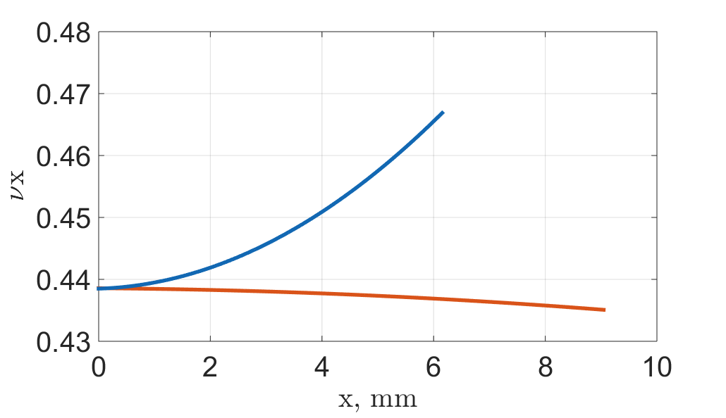
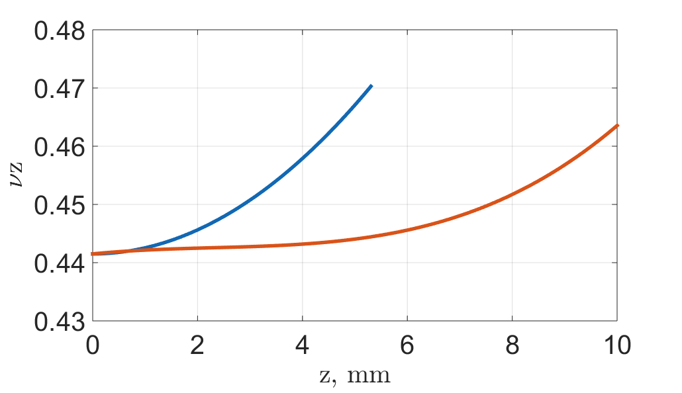
Horizontal and vertical betatron tunes as functions of the amplitudes
Red line – without fringes.
Blue line – with fringes.
The contribution of quadrupoles fringe to the tunes significantly exceeds that of chromatic sextupoles . Since the unperturbed tunes is selected close to the half integer resonance, increasing the oscillation amplitude shifts the horizontal and vertical tunes, which may result in a particle loss at the half-integer resonance.

Slide 7
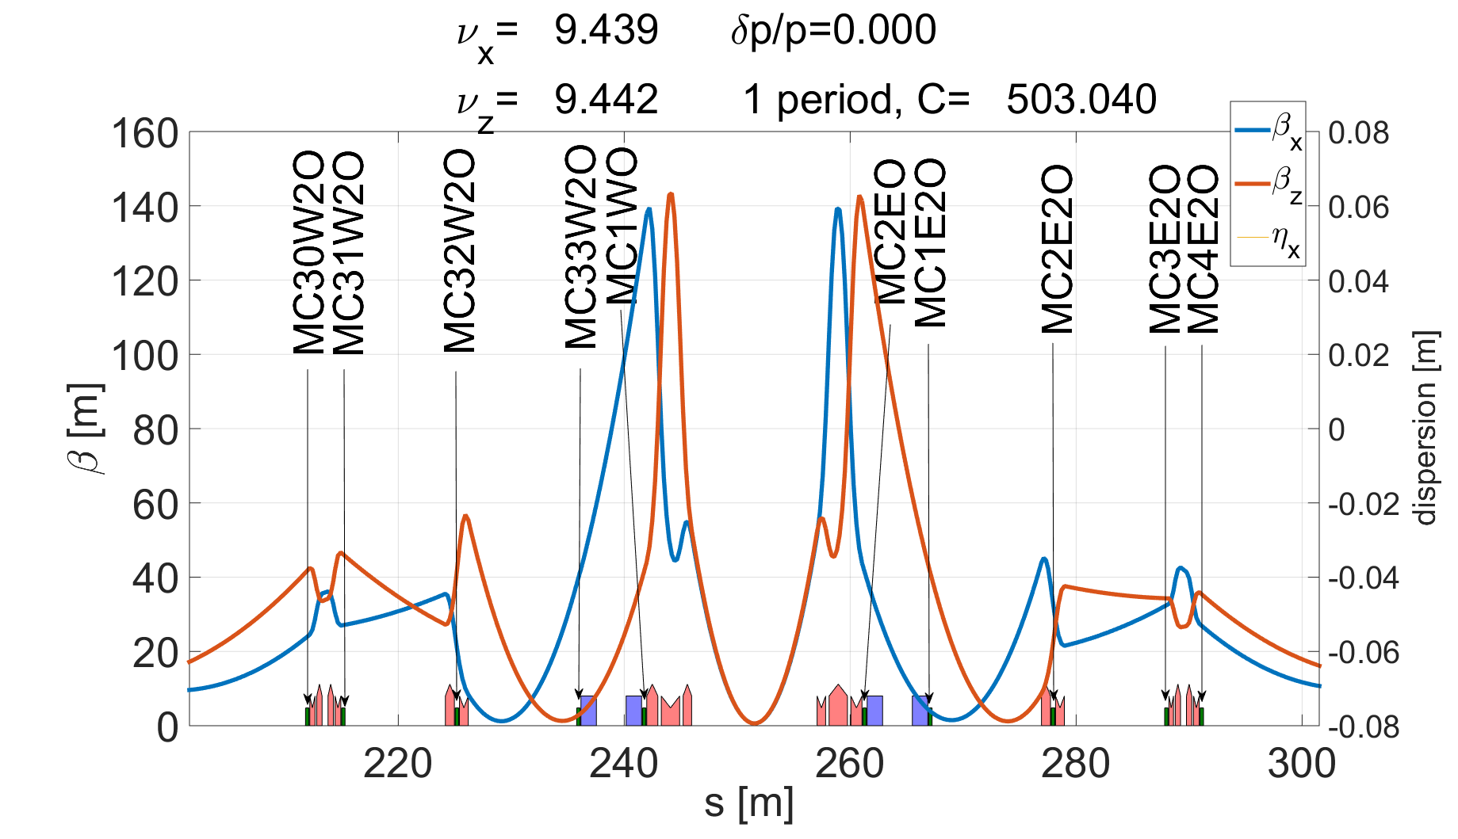
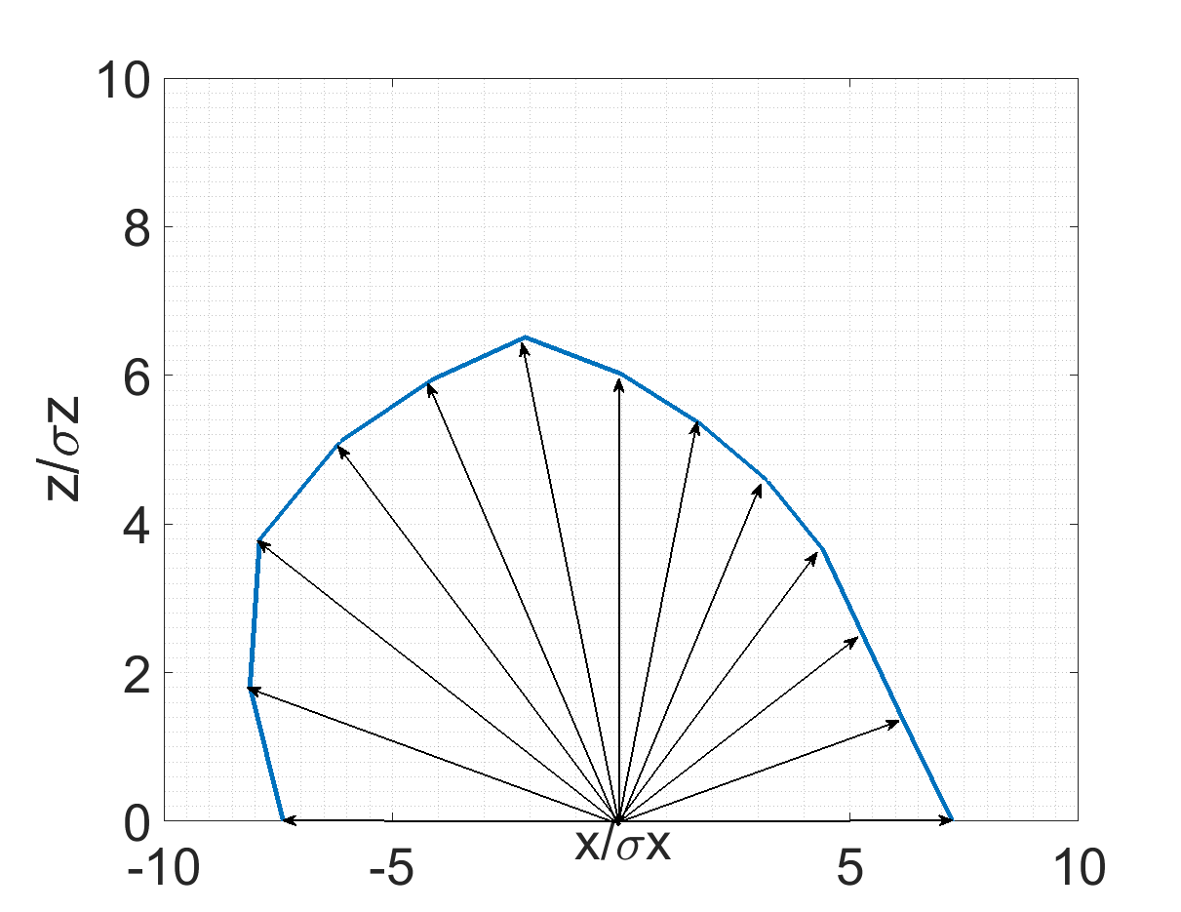
The Object and parameters of the optimization

Slide 8
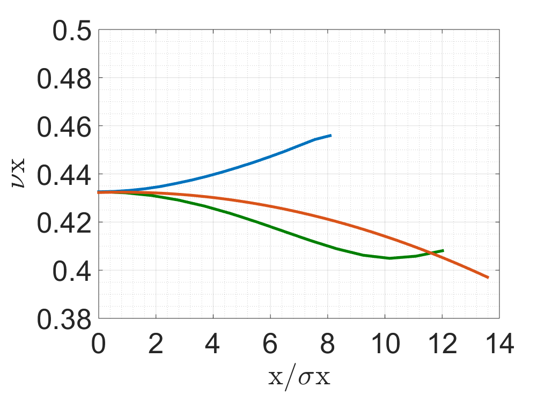
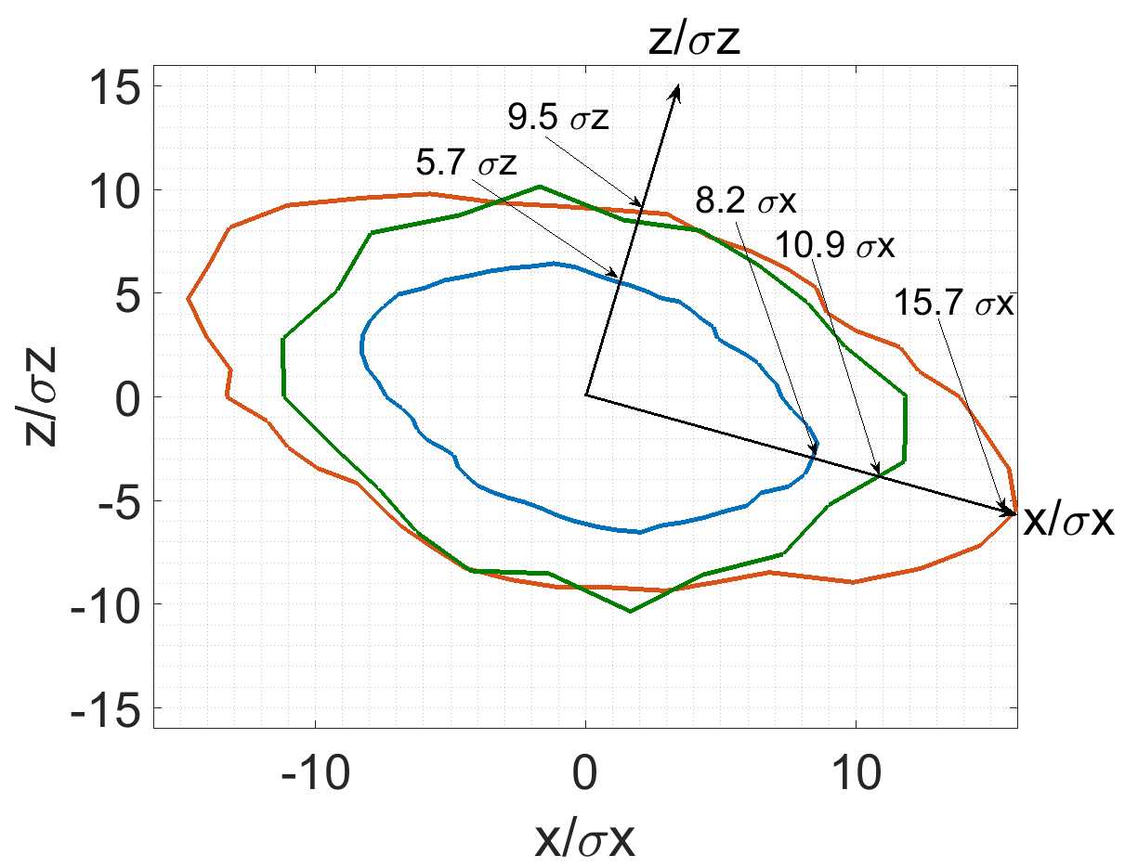
Results of the work of genetic algorithm optimization
The blue line is the initial dynamic aperture and detuning.
The green one is the result of the optimization by only two families of octupoles.
The red one is the result of the optimization by 4 families of octupoles.

Slide 9
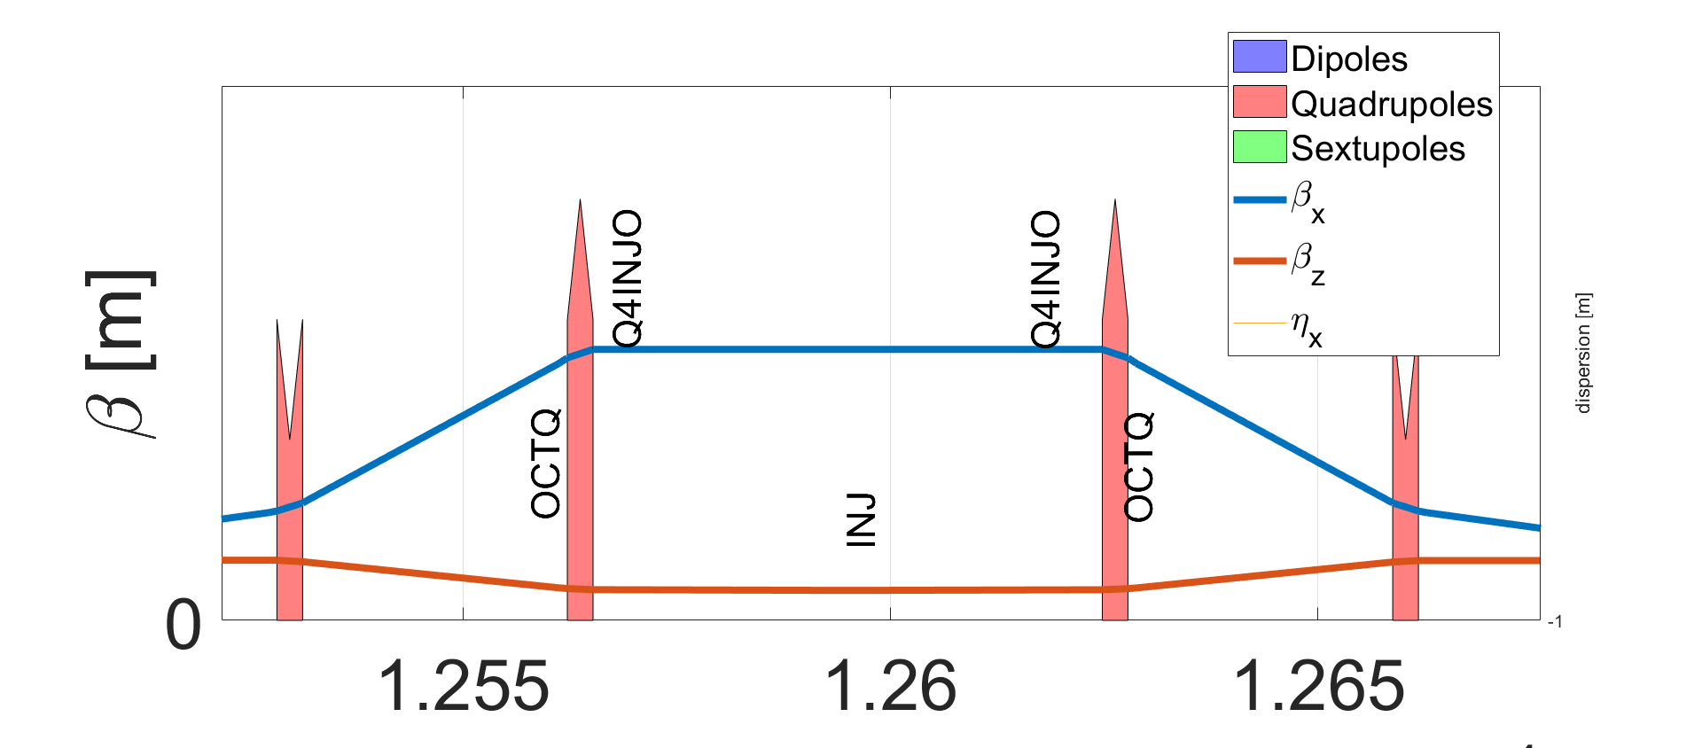
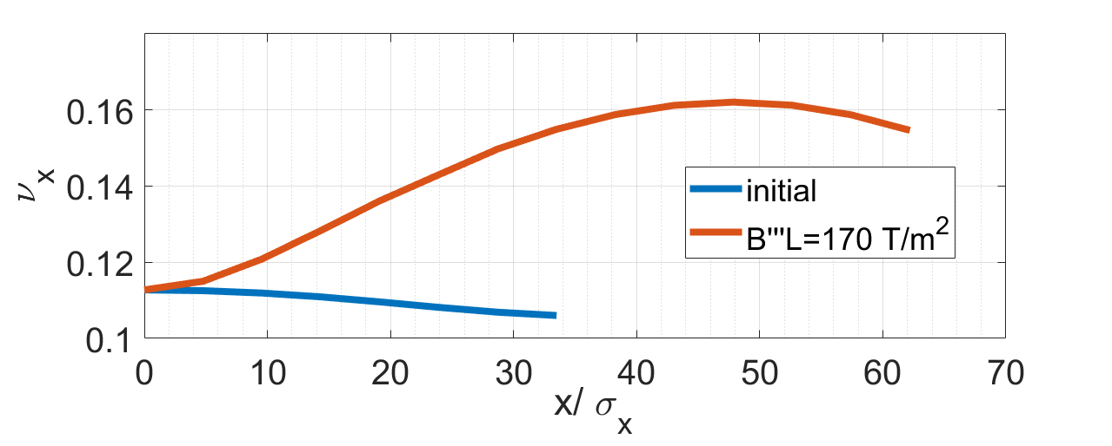
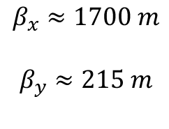
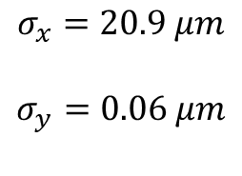
About CEPC
$$σ_{x}=20.9 μm$$
$$σ_{y}=0.06 μm$$
$$β_{x}≈1700 m$$
$$β_{y}≈215 m$$

Slide 10
THANK YOU!
THANK YOU!

