Slide 1
Imperfection and correction for CEPC
Yuanyuan Wei, Bin Wang, Yiwei Wang, Chenghui Yu, Yuan Zhang
The Institute of High Energy Physics, Beijing
CEPC workshop 18 Nov 2019, IHEP

Slide 2
Outline
The sensitivity of CEPC lattice
The correction scheme
The correction results
50μm FF quadupole misalignment
30μm FF quadupole misalignment

Slide 3
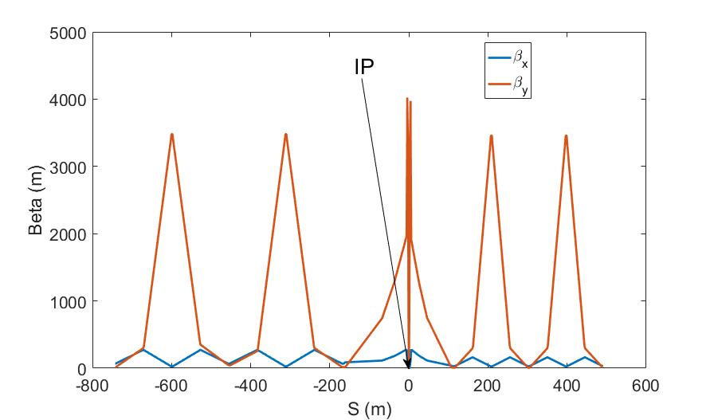
Lattice
E=120GeV
$ν_{x}$=363.11
$ν_{y}$=365.22
$β_{x }^{∗}$= 0.36m
${ β}_{y }^{∗}$= 0.0015m
$β_{x,max}$=599m
$β_{y,max}$=4023m
$ε_{x}$ = 1.21nm

Slide 4
Orbit amplification factor
<Δy_{rms}> = 4.69mm
Orbit amplification factor = 4.69/50e-3 = 94
Turn off sextupoles and FF is left perfectly aligned.

Slide 5
Quadrupole jitter sensitivity
The RMS vertical orbit distortion caused by 0.15μm quadrupole jitter is equal to beam size at 2.4pm vertical emittance.
Turn off sextupoles and FF is left perfectly aligned.

Slide 6
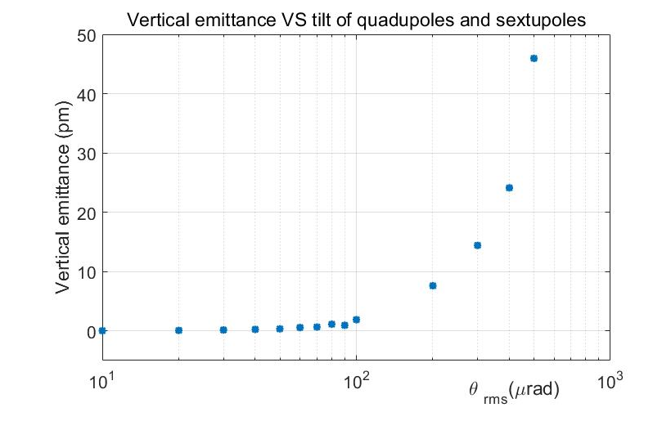
Quadrupoles and sextupoles tilt sensitivity
FF is left perfectly aligned.

Slide 7
Misalignment sensitivity
 | Super B LER | Super B HER | ILC DRs | KEK ATF | CEPC
Vertical emittance (pm) | 4 | 4 | 2 | 4.5 | 2.4 (0.2%couplig)
Orbit amplification factor | 46 | 44 | 32 | 21 | 94
Quadrupole jitter sensitivity (nm) | 209 | 217 | 221 | 227 | 150
Sextupole alignment sensitivity (μm) | 95 | 87 | 70 | 50 | 16
Quadrupole tilt sensitivity (μrad) | 166 | 183 | 79 | 800 | 100 (sextupoles included)
The alignments are included in the calculation now.

Slide 8
Correction scheme
COD correction with sextupoles off
Turn on the sextupoles and perform COD correction again.
Dispersion correction (DFS)
Beta beating correction (LOCO)
Coupling and vertical dispersion correction (Local coupling parameter correction）.

Slide 9
COD correction
BPMs placed at quadrupoles (~1500, 4 per betatron wave)
Horizontal correctors placed beside focusing quadrupoles（~1500）
Vertical correctors placed beside defocusing quadrupoles（~1500）
Orbit correction is applied using orbit response matrix and SVD method.

Slide 10
Dispersion correction
Dispersion free steering principle (DFS): orbit manipulation by knob correctors.
$$\vec{d}=\left(\begin{aligned}\left(1−α\right)\vec{u} \\ α\vec{D}u\end{aligned}\right)$$
M$=\left(\begin{aligned}\left(1−α\right)A \\ αB\end{aligned}\right)$
$$\vec{d}+M\vec{θ}=0$$
$\vec{u}: O$rbit vector
$\vec{D}u :Dispersion$ vector
$$\vec{θ}: Corrector strengths vector$$
$α$: Weight factor
A: Orbit response matrix
B: Dispersion response matrix

Slide 11
Beta-beating correction
Correct the beta functions with sextupoles on.
Based on AT LOCO: model based correction
Establish lattice model M_{mod}, multi-parameter fit to the orbit response matrix M_{meas} to obtain calibrated model:
Parameters fitted: K, KS …
Use calibrated model to perform correction and apply to machine.
Application to correct beta-beating, dispersion and coupled response matrix.

Slide 12
Coupling correction
Neglecting beam-beam effects
Local coupling parameter matching was developed for BEPCII.
Both coupling and vertical dispersion are controlled.
Using the trim coils of the sextupoles (~1000), which providing skew-quadrupole field, to perform emittance tuning for CEPC.
The vertical orbit distortion due to a horizontal deflection at a BPM is:
$\frac{∆y_{cod}}{∆x_{cod}}={\overline{c}}_{b,22}k_{1}+{\overline{c}}_{b,12}k_{2}$+${\overline{c}}_{c,11}k_{3}$+${\overline{c}}_{c,12}k_{4}$
$k_{1}$, $k_{2}{,k}_{3},k_{4}$ ：only related to the decoupled linear optics
${\overline{c}}_{b,22}{,\overline{c}}_{b,12},{\overline{c}}_{c,11},{\overline{c}}_{c,12}$: local coupling parameters
${\overline{c}}_{b,12}=M_{c}\vec{ks}$
$M_{c}$: ${\overline{c}}_{b,12}$ response matrix
$\vec{ks}$ : skew-quadrupole vector

Slide 13
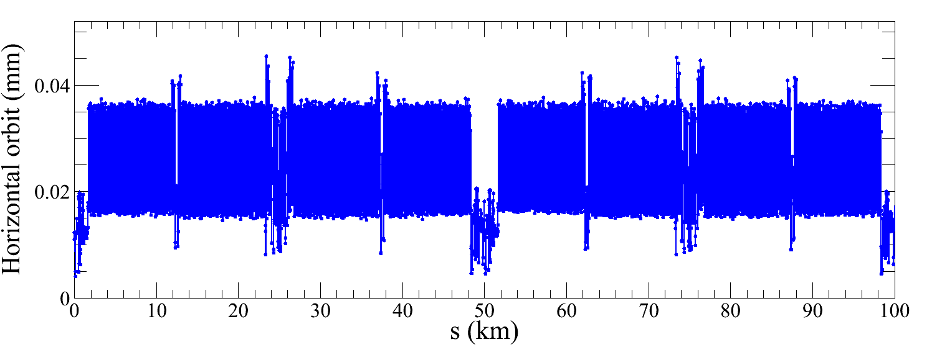
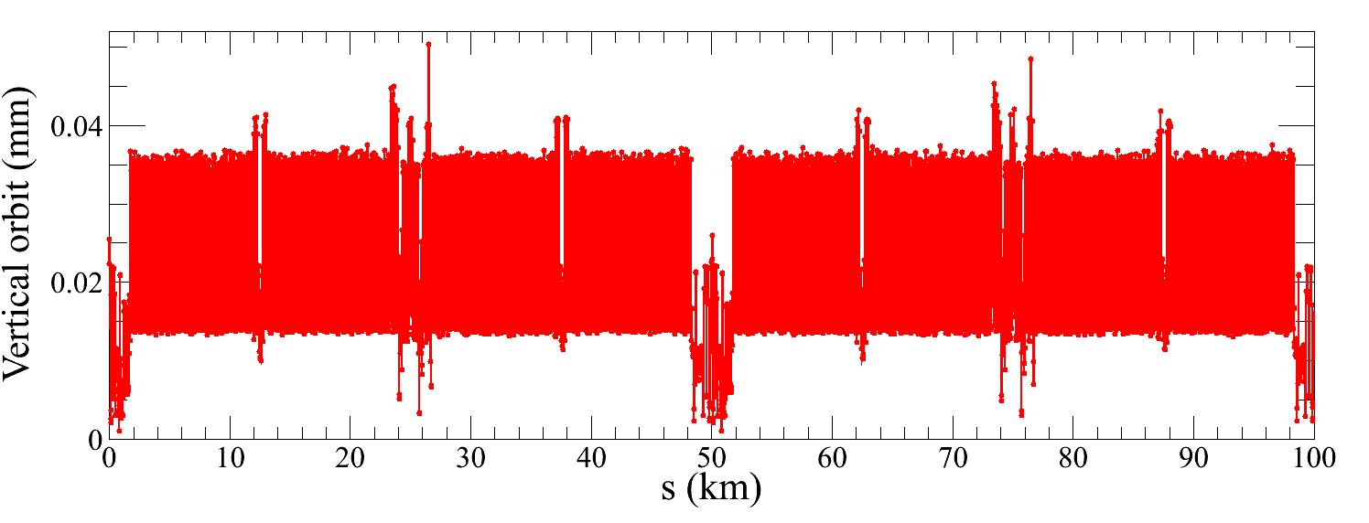
Correction results (FF=30μm)
Component | Δx (μm) | Δy (μm) | Δθ_{z} (μrad)
Arc quadrupole | 100 | 100 | 100
IR Quadrupole | 50 | 50 | 50
FF Quadrupole | 30 | 30 | 30
Sextupole | 100 | 100 | 100
Component | Field error
Dipole | 0.01%
Arc Quadrupole | 0.02%
COD correction
${RMS}_{COD}<0.05 mm$

Slide 14
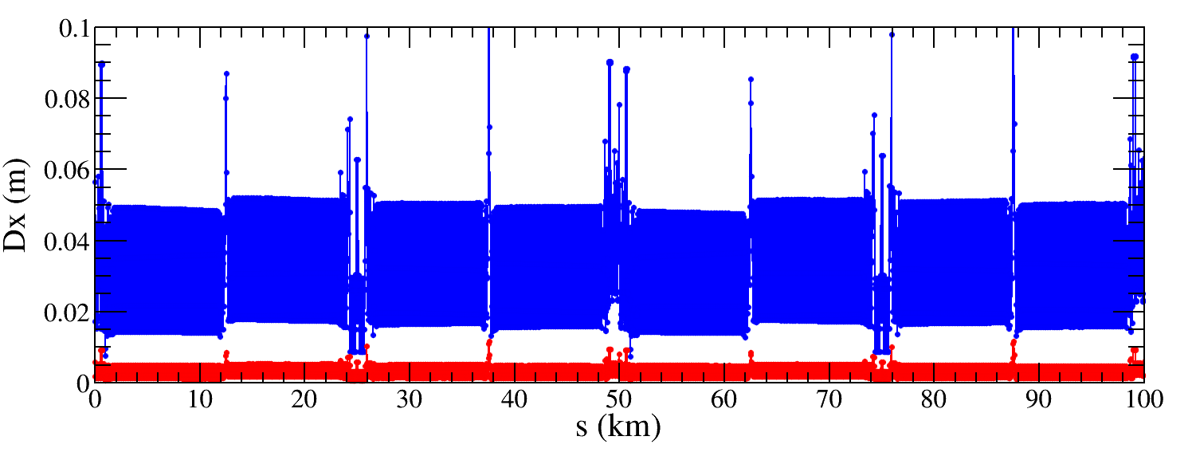
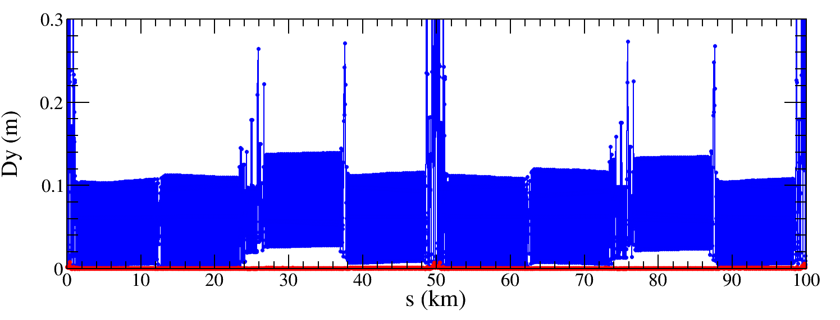
Dispersion correction (FF=30μm)
${∆D}_{x,rms}$ decreased from
30mm to 2.9mm
Factor 10 improvement
$D_{y,rms}$ decreased from
77mm to 0.5mm
Factor 154 improvement

Slide 15
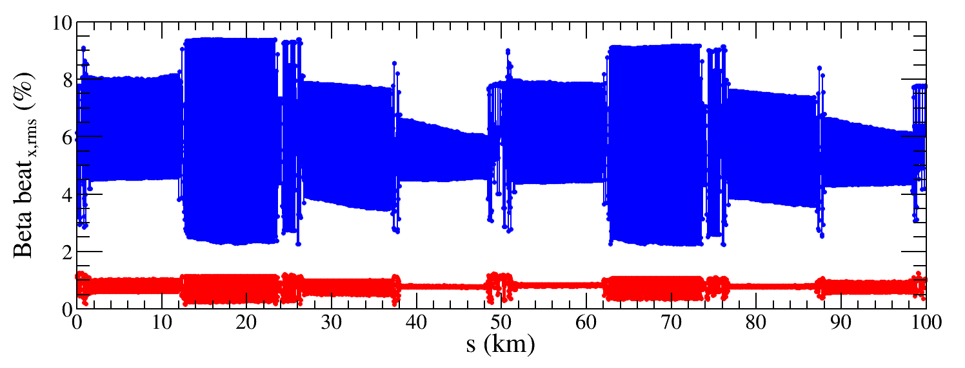
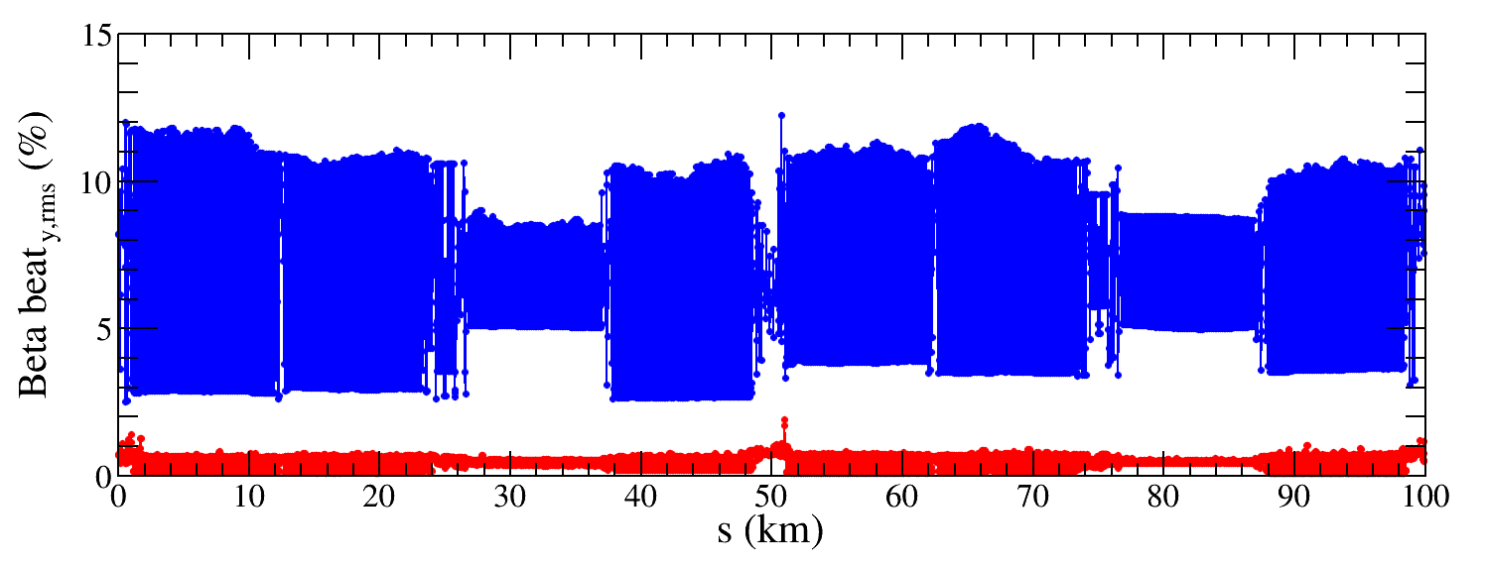
Beta-beating correction (FF=30μm)
1/5 quadrupole (~600 out of 3000 quadrupoles) strengths are changed to restore beta functions along the ring.
${∆β/β}_{x,rms}$ decreased from
5.7% to 0.8%
${∆β/β}_{y,rms}$ decreased
from 6.8% to 0.5%

Slide 16
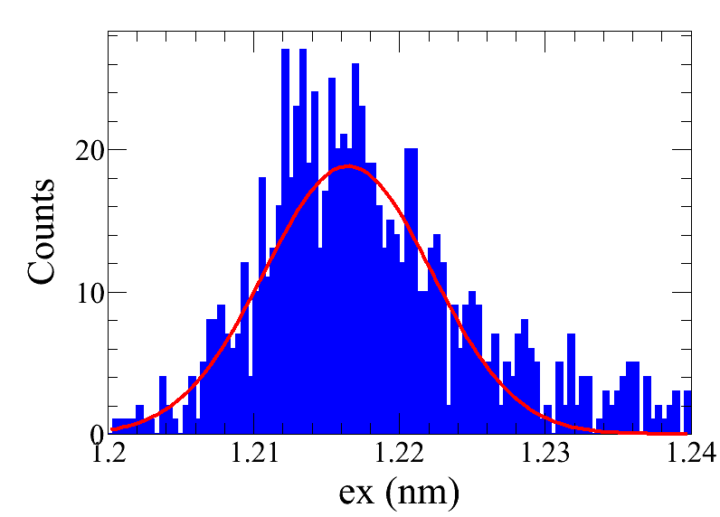
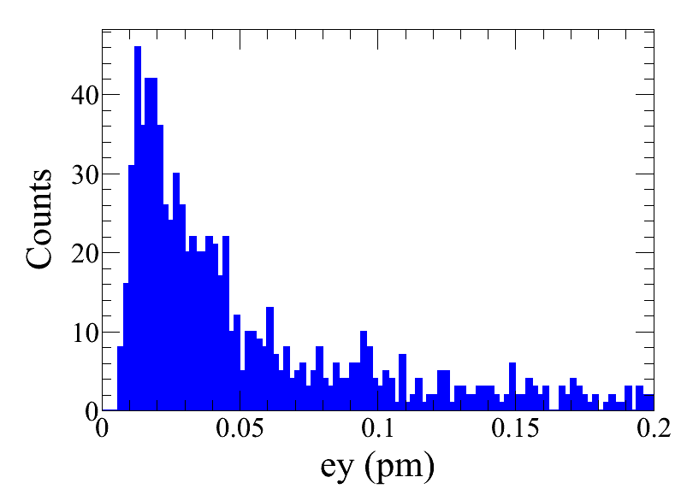
Emittance tuning (FF=30μm)
Component | Δx ((μm) | Δy ((μm) | Δθ_{z} ((μrad)
Arc quadrupole | 100 | 100 | 100
IR Quadrupole | 50 | 50 | 50
FF Quadrupole | 30 | 30 | 30
Sextupole | 100 | 100 | 100
Component | Field error
Dipole | 0.01%
Arc Quadrupole | 0.02%
Out of 1000 seeds, 831 converged
ex = 1.217$±$0.005 nm ey = 0.043 $±$0.002 pm
ey/ex = (0.0035 $±$0.0002)%

Slide 17
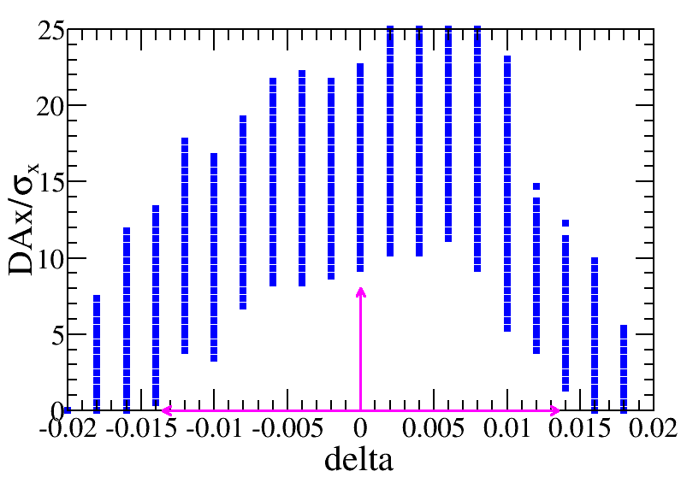
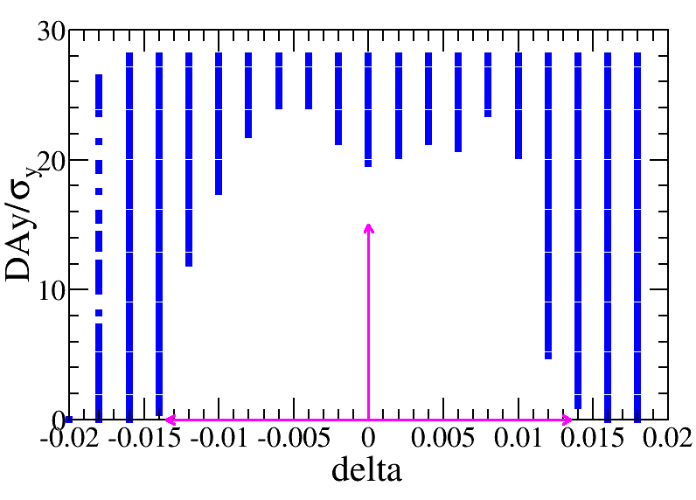
DA and MA (FF=30μm)
>500 seeds
Tracking by Bin Wang
satisfy 10$σ_{x}×$17$σ_{y}×$0.014

Slide 18
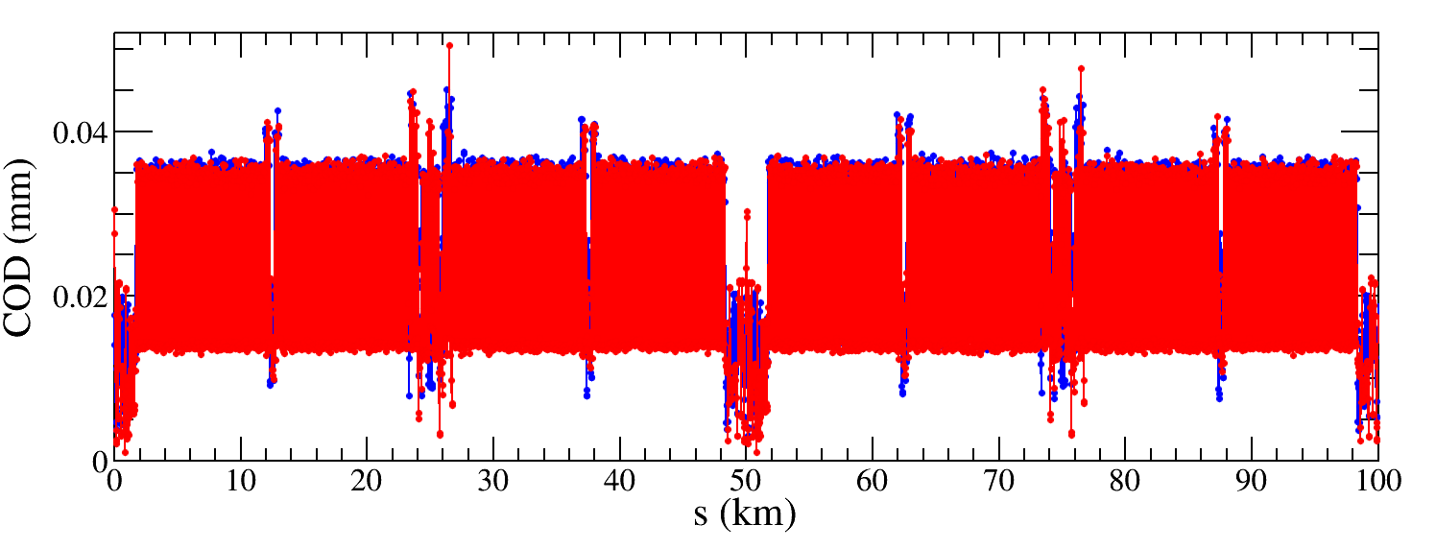
Correction results (FF=50μm)
Component | Δx (μm) | Δy (μm) | Δθ_{z} (μrad)
Arc quadrupole | 100 | 100 | 100
IR Quadrupole | 50 | 50 | 50
FF Quadrupole | 50 | 50 | 50
Sextupole | 100 | 100 | 100
Component | Field error
Dipole | 0.01%
Arc Quadrupole | 0.02%
COD correction
${RMS}_{COD}<0.05 mm$

Slide 19
Correction results (FF=50μm)
Component | Δx (μm) | Δy (μm) | Δθ_{z} (μrad)
Arc quadrupole | 100 | 100 | 100
IR Quadrupole | 50 | 50 | 50
FF Quadrupole | 30 | 30 | 30
Sextupole | 100 | 100 | 100
Component | Δx (μm) | Δy (μm) | Δθ_{z} (μrad)
Arc quadrupole | 100 | 100 | 100
IR Quadrupole | 50 | 50 | 50
FF Quadrupole | 50 | 50 | 50
Sextupole | 100 | 100 | 100
Observable | Before correction | After correction
Hori. disp. | 30.0 mm | 2.9 mm
Vert. disp. | 77.0 mm | 0.5 mm
Hori. Beta-beating | 5.7% | 0.8%
Vert. Beta-beating | 6.8% | 0.5%
Observable | Before correction | After correction
Hori. disp. | 32.3 mm | 4.9 mm
Vert. disp. | 133.7 mm | 1.0 mm
Hori. Beta-beating | 5.5% | 1.2%
Vert. Beta-beating | 10.7% | 0.9%

Slide 20
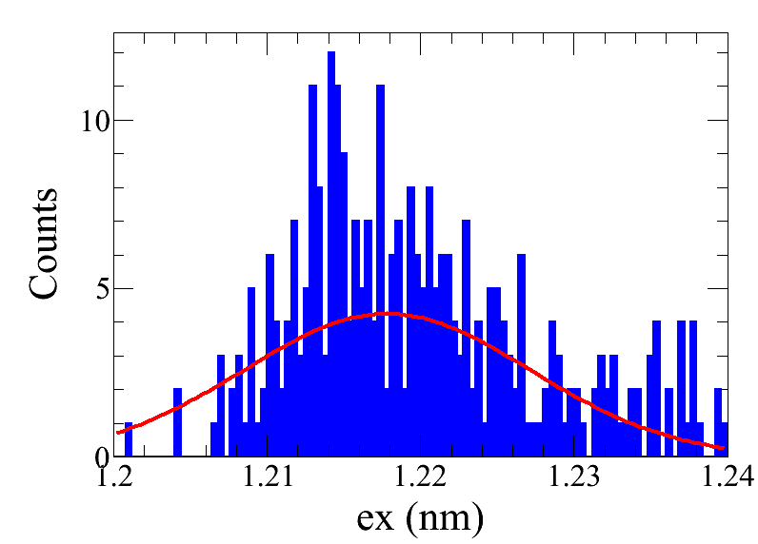
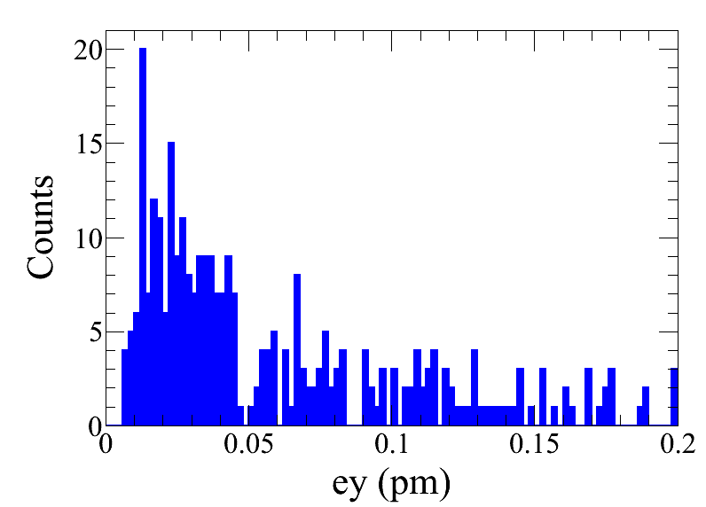
Emittance tuning (FF=50μm)
Component | Δx ((μm) | Δy ((μm) | Δθ_{z} ((μrad)
Arc quadrupole | 100 | 100 | 100
IR Quadrupole | 50 | 50 | 50
FF Quadrupole | 50 | 50 | 50
Sextupole | 100 | 100 | 100
Component | Field error
Dipole | 0.01%
Arc Quadrupole | 0.02%
Out of 500 seeds, 300 converged
ex = 1.218$±$0.009 nm ey = 0.059 $±$0.002 pm
ey/ex = = (0.0048 $±$0.0002) %

Slide 21
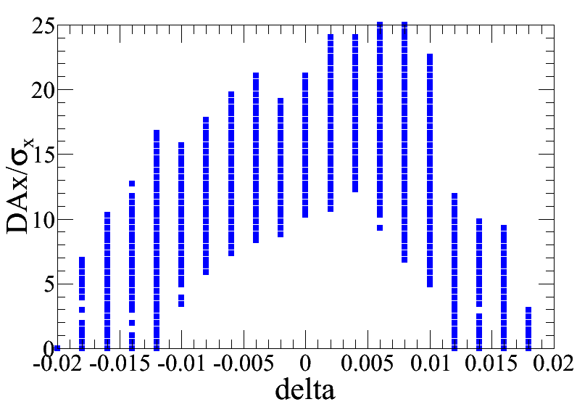
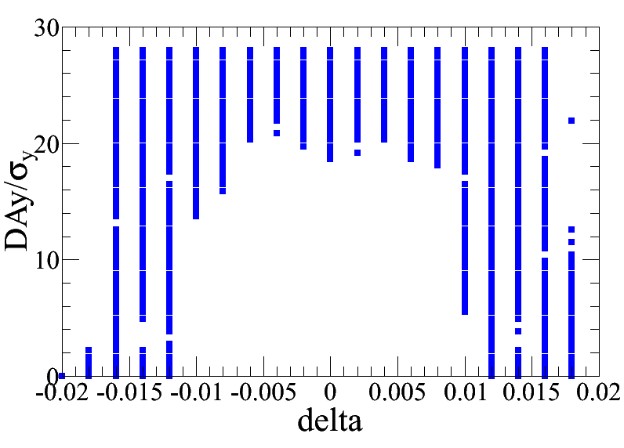
DA and MA (FF=50μm)
25 seeds
Tracking by Bin Wang
9$σ_{x}×$18$σ_{y}×$0.012
More seeds need to be studied

Slide 22
Summary
CEPC lattice is sensitive to the imperfections. Therefore, the optics correction is very challenging.
CEPC optics correction procedure was demonstrated to be effective.
With the abovementioned imperfections, both DA and MA after correction are acceptable for the on-axis injection.

Slide 23
To do list
Study whether the tolerance of the imperfections can be relaxed.
Optimize the correction strategy to achieve finer tuning of optics.
Include more types of imperfections.
Study off-momentum correction.

Slide 24
Thanks for your attention

Slide 25
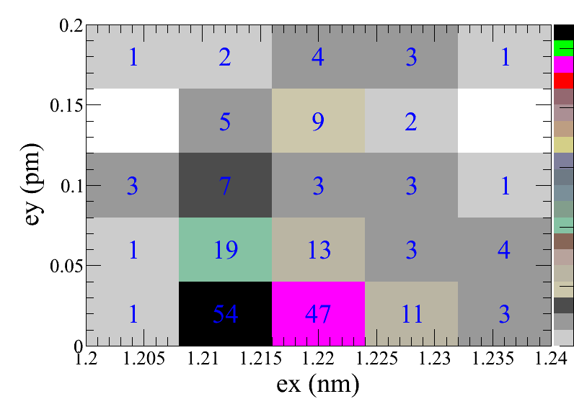
Case3: preliminary result (25 seeds)

