Slide 1

Cost Estimation for HCAL
Haijun Yang (SJTU)
for CEPC Calo Working Group
International Workshop on CEPC
IHEP, November 18-20, 2019

Slide 2
CEPC HCAL: Geometry and Layout

Slide 3
Cost Estimation: SDHCAL
- Barrel, R_{in} = 203.6cm, R_{out} = 310.4cm, length = 2.34*2=4.68m, N_{layer}=40
Area of HCAL barrel = 2*PI*[(R_{in}+R_{out})/2]*L*N_{layer} = 3021 m²
- Endcap (2), R_{in} = 35cm, R_{out} = 285.78cm, N_{layer}=40
Area of HCAL endcap = 2*PI*(R_{out}*R_{out} – R_{in}*R_{in})*N_{layer} = 2020 m²
∼ 100 Euro

Slide 4
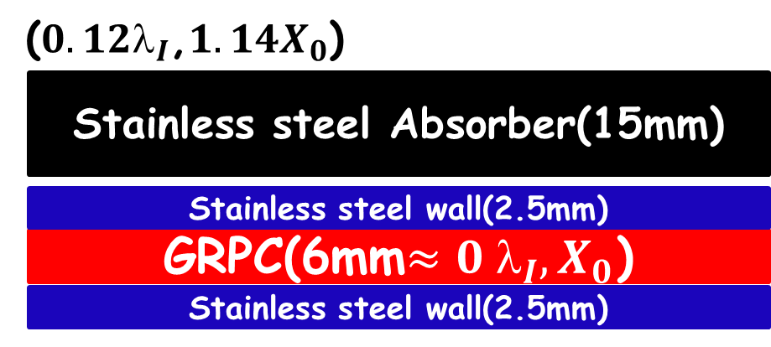
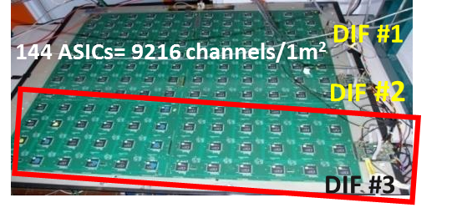
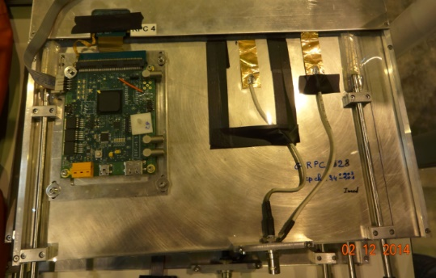
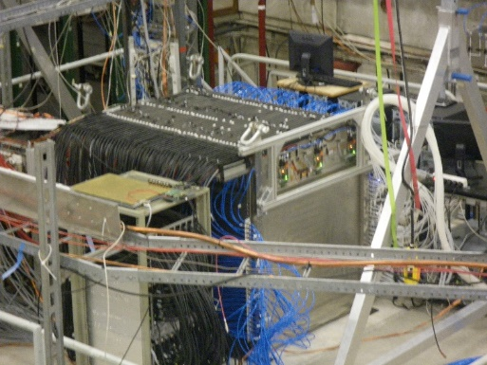
Cost Estimation: SDHCAL

Slide 5
Cost Estimation: SDHCAL
Item | Cost (M€) for CDR baseline
Absorber | 3.0
RPCs | 0.5
Cassettes | 3.3
Readout Electronics | 22.7
Gas system | 0.3
HV/LV Supplies, Cabling | 1.0
Assembly, Installation | 2.0
Cooling system | 3.5
DAQ | 0.5
Sum SDHCAL | 36.8 (*7.7 ∼ 283M RMB)

Slide 6
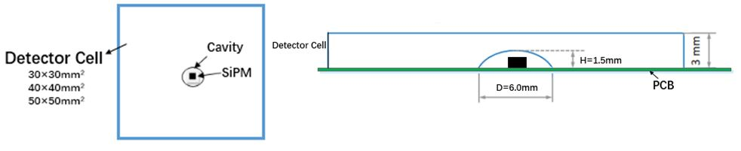
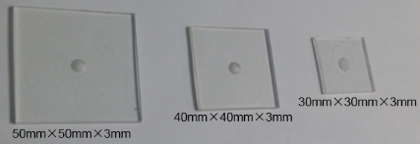
Cost Estimation: AHCAL (From Y. Liu)
Scintillator-Steel Hadronic Calorimetry is conventionally referred to AHCAL
Based on the Table III-7.3 (page 306) in Ref. [1]
Material | Cost (EUR in 2018) [*] | Comments (in 2013)
Stainless Steel | 5 /kg | processing costs to be added (1-4 EUR/ kg)
Photosensor (e.g. SiPM) | 1 /piece | based on manufacturer extrapolation, current price 7-10 EUR/piece
Front-End Electronics (ASIC) | 0.22 – 0.25 /ch | Current price 0.5 EUR/ch
PCB | 1800 /m² | for AHCAL extrapolated from the CALICE AHCAL prototype price of 10800/m²

Slide 7
Cost Estimation: AHCAL
Item | Cost (M€) for CDR baseline [*] | Cost with current price of SiPM
Absorber | 4.1 | 4.1
Module production | 2.7 | 2.7
Cassettes | 1.7 | 1.7
Scintillators | 1.2 | 1.2
Reflective Foil | 0.9 | 0.9
Photosensor (SiPM) | 6.1 | 42.7
Cooling system | 3.5 | 3.5
Sum AHCAL | 38.8 | 38.8 + 36.6
Item | Cost (M€) for CDR baseline [*]
ASIC | 1.4
Readout Board | 10.4
Readout | 1.8
Cabling, connections | 0.8
HV/ LV supplies | 0.8
Tooling, testing | 0.5
Assembly, installation | 2.8
DAQ | 0.2

Slide 8
Notes and references
Notes
  The cost estimate of scintillator-steel HCAL for CEPC is based on the ILC TDR for the ILD detector, as these two designs are very similar.
  PFA-calorimetry prototyping within the CALICE collaboration provides solid inputs for the cost estimate of ILD calorimetry (also for the detector for CLIC, aka “CLICdet”)
References
  The International Linear Collider Technical Design Report - Volume 4: Detectors, 2013
    https://arxiv.org/abs/1306.6329
  The International Large Detector (ILD) IDR (ILD Design Report), 2019
    Only draft version available till now, to be reviewed within the ILD collaboration
    https://confluence.desy.de/display/ILD/The+ILD+Design+Report%2C+IDR
  Cost estimate for CLICdet, 2018
    https://edms.cern.ch/document/2027873
  CEPC Conceptual Design Report, 2018
    http://cepc.ihep.ac.cn/CEPC_CDR_Vol2_Physics-Detector.pdf

Slide 9
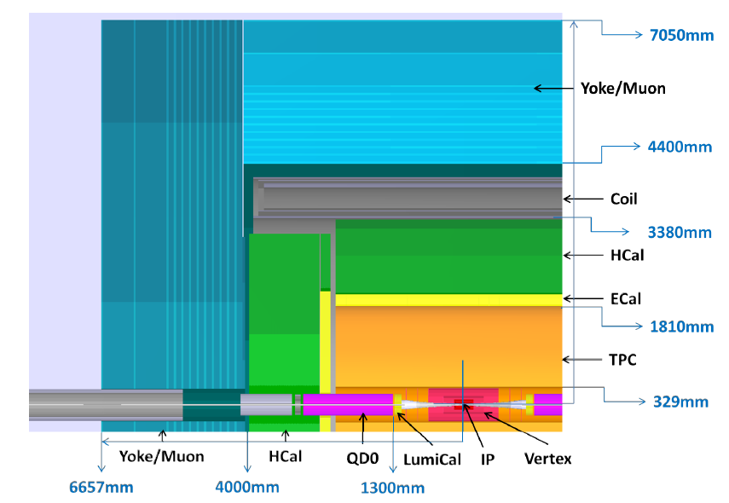
Schematic of CEPC Detector

Slide 10
Outline of CEPC Calorimeters
PFA Concept
  ECAL: 30 layers, W, 24 X₀ , 1 λ_{I}
    10mm*10mm Si pads; 5mm*45mm scintillator strips
  HCAL: 40 layers, Fe, 5 λ_{I}
    SDHCAL: 1cm*1cm; gRPC, THGEM
    AHCAL: 3cm*3cm; scintillator tiles + SiPM
Dual readout concept
  Cu/Fe, 10 λ_{I}
  Scintillation fibers + quartz fibers

Slide 11
Estimation of HCAL Power Consumption
- Barrel, R_{in} = 203.6cm, R_{out} = 310.4cm, length = 2.34*2=4.68m, N_{layer}=40
Area of HCAL barrel = 2*PI*[(R_{in}+R_{out})/2]*L*N_{layer} = 3021 m²
- Endcap (2), R_{in} = 35cm, R_{out} = 285.78cm, N_{layer}=40
Area of HCAL endcap = 2*PI*(R_{out}*R_{out} – R_{in}*R_{in})*N_{layer} = 2020 m²
Cell Size \ channels | HCAL Barrel | HCAL Endcap | Channels (N_{ch}) | Power AHCAL | Power SDHCAL
1cm x 1cm | 30.21M | 20.2M | 50.4M |  | 77.6 kW
3cm x 3cm | 3.36M | 2.24M | 5.6M | 84.2 kW
Power Consumption (rough estimation):
AHCAL: 7mW/ch * N_{ch3} + 9W/DIF/m² * 5041 (45kW)
SDHCAL: 1mW/ch * N_{ch1} + 5.4W/DIF/m² * 5041 (27.2kW)

Slide 13
AHCAL: geometry and #channels
AHCAL detector unit: 30×30×3mm³
Configurations | AHCAL in ILD |  | AHCAL for CEPC
Model | IDR-S | IDR-L (DBD in TDR) | CDR Baseline | Depth for 380GeV
Barrel R_in | 171.5 cm | 205.8 cm | 205.8 cm [*]
Barrel Depth | 128.7 cm, 48 layers |  | 40 layers | 48 layers
Barrel Segments | 2 in Z, 16 in phi; z_max=235 cm |  | idem
Barrel #channels | 3.73 M | 4.27 M | 3.59 M | 4.27 M
Endcap R_max | 287.6 cm | 322.6 cm | 301.2 cm | 322.6 cm
Endcap R_min | 35 cm |  | 40 cm
Endcap Depth | 128.7 cm, 48 layers |  | 40 layers | 48 layers
Endcap Segments | 16 in phi; 2 endcaps |  | idem
Endcap #channels | 2.74 M | 3.44 M | 2.49 M | 3.43 M
Total #channels | 6.47 M | 7.71 M | 6.08 M | 7.70 M
[*] CEPC CDR: SiW-ECAL inner radius R=184.3 cm, with a total depth of 24X0 (30 sampling layers, the first 20 layers with 2.1mm W, 10 with 4.2mm W); 0.5mm thick silicon layer; 2.1mm 14-layer PCB (CALICE SiW prototype); no cooling plates yet. This value 205.8 cm is taken from Ref [1], the same as ILD.

Slide 14
AHCAL cost reduction: further R&D
Photosensor
  A new option for SiPMs from a local Chinese vendor (Novel Device Lab, aka NDL)
  Can be a significant cost saver
Front-end electronics
  Currently no existing ASIC that is designed and verified for the PFA calorimeters at CEPC (continuous working mode, fast readout, minimal dead time).
  Thus no solid information on the power consumption, but only knowledge from ASICs designed for ILD at ILC. Further info could be learned from the “HGCROC” for CMS HGCAL.
  Requires further R&D, especially in China
  Can be a significant cost saver
Active cooling system
  The current cost estimate of cooling is from ILD, which requires no active cooling. So it can be underestimated.
  Need thorough R&D studies in a scalable way towards the final system level, and identify the items that can not be scaled.
[*] Disclaimers: these are my personal remarks and understandings. All the errors are mine.

