Slide 1
Dual readout calorimeter for CepC
Franco Bedeschi.
CepC International Workshop,
Beijing, November 2019
OUTLINE
Basic geometry
  Options
Cost evaluation
  Unit costs
  Global cost
R&D for cost consolidation

Slide 2
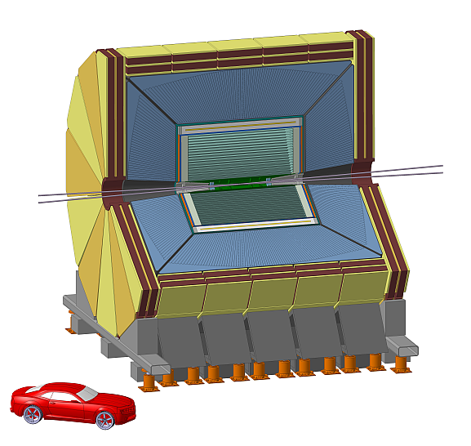
IDEA DR geometry
Fiber size & spacing
  1.0 mm fibers
  0.5 mm absorber
    1.5 mm pitch

Slide 3
IDEA DR geometry
2x75 θ slices
  Each split in 36 φ towers
Δθ = 1.125º
Δφ = 10º
Total number of fibers
130,729,608 ~ 131 M

Slide 4
IDEA DR Geometry
Fibers have different lengths
  ~35% are 2m long
  ~38% are < 1m long
Total length 166,987 km ~167,000 km
Tower 75

Slide 5
IDEA DR fiber grouping
Optimal grouping is 8 + 8 = 16 fibers → 2 readout channels
  Granularity is 6 mm x 6 mm
Total readout channels: 131 M/8 = 16 M

Slide 6
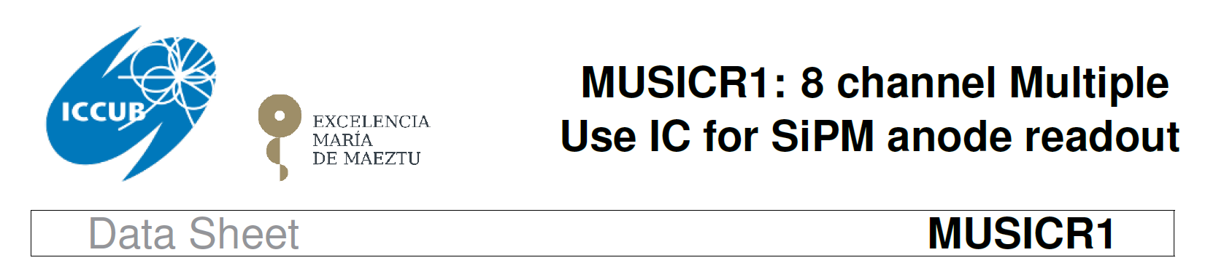
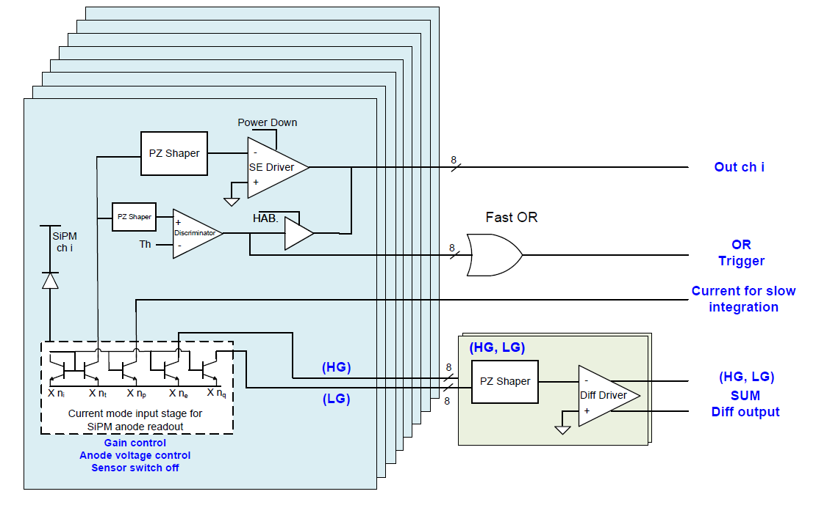
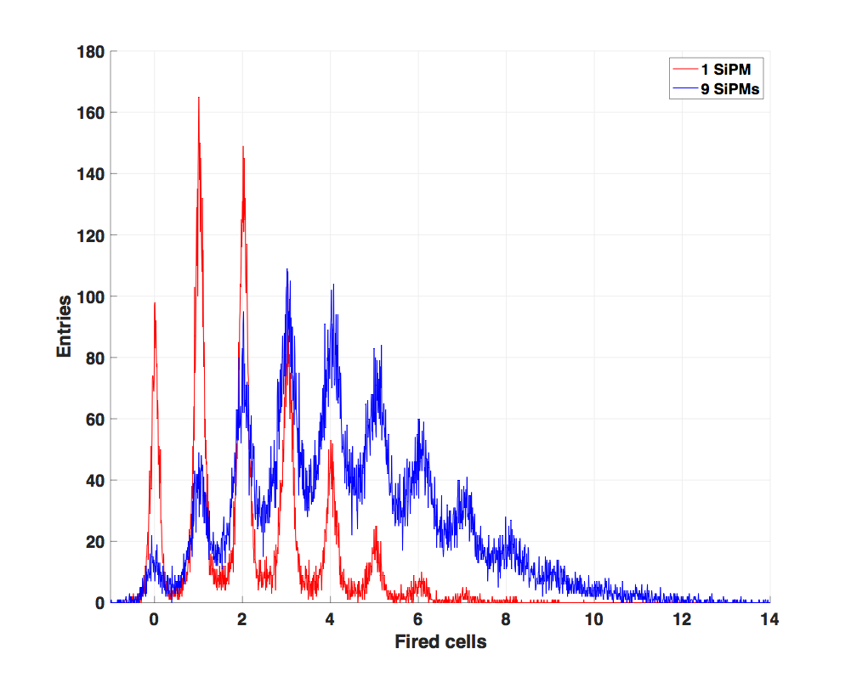
IDEA DR fiber grouping. Opt 1
8 SiPM are summed electronically
  Demonstrated with custom board
  Investigating use of dedicated chip: MUSIC (made for CTA)
Multi-Photon spectrum preserved also with 9
grouped SiPM

Slide 7
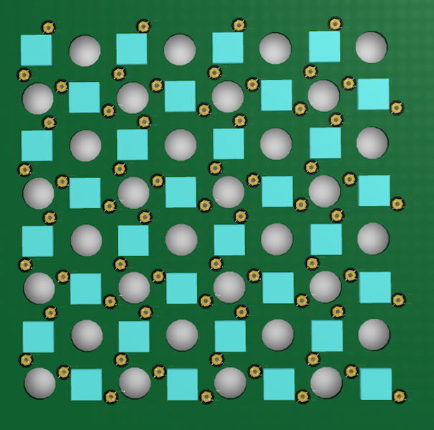
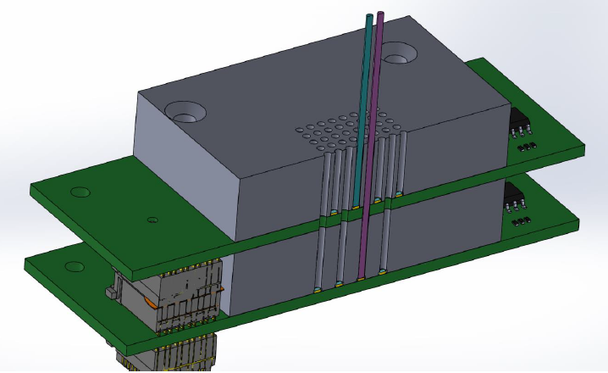
IDEA DR fiber grouping. Opt 2
Try using fewer SiPM’s → Save ~57 M SiPM
  Treat Cherenkov fibers electronically (low light levels)
  Merge Scintillator fibers optically with concentrator cookie
Cherenkov fiber SiPM board with holes for Scintillating fibers
Current two layer readout to minimize optical x-talk

Slide 8
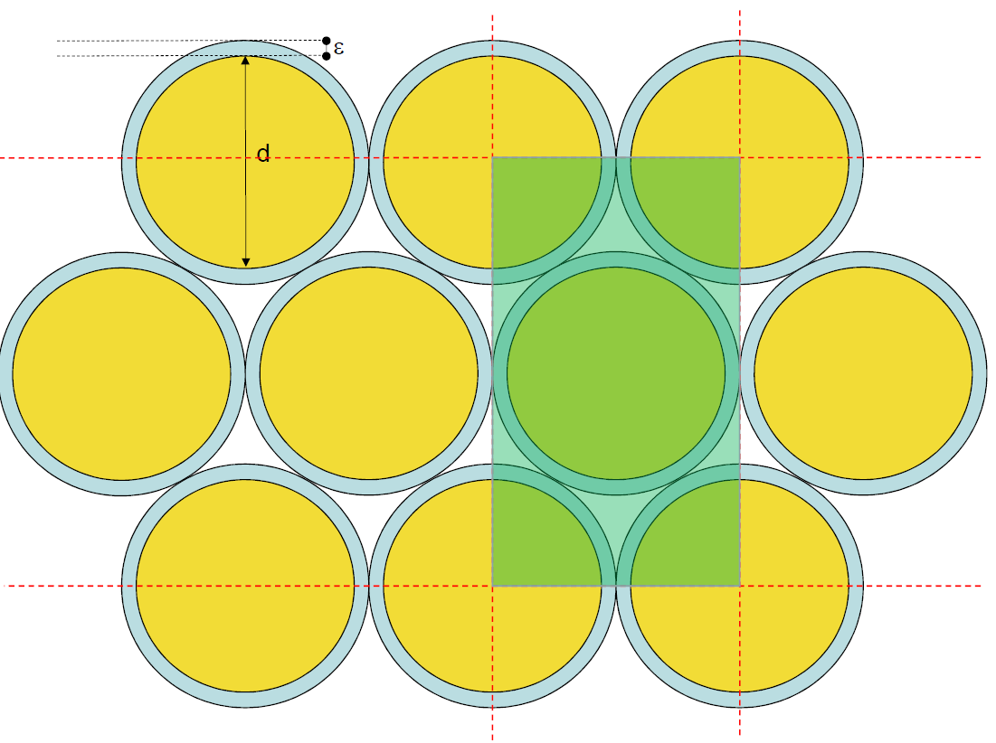
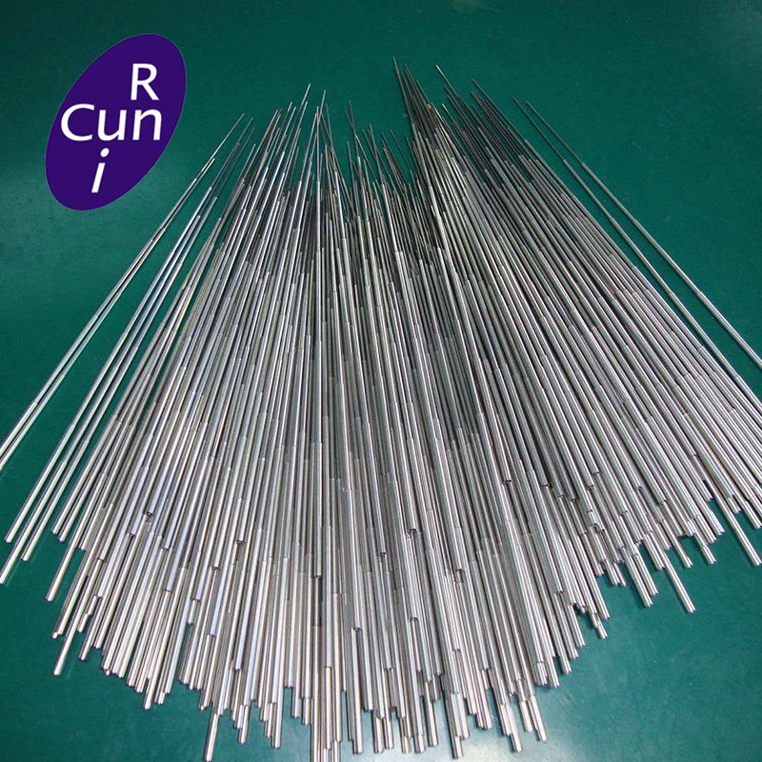

IDEA DR metal
Current options use capillary tube assembly
  Total weight – Iron: 1.1 kton
  Total weight – Copper: 1.2 kton
1/$\sqrt{E}$

Slide 9
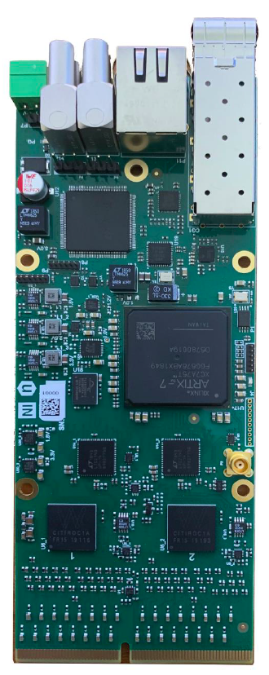
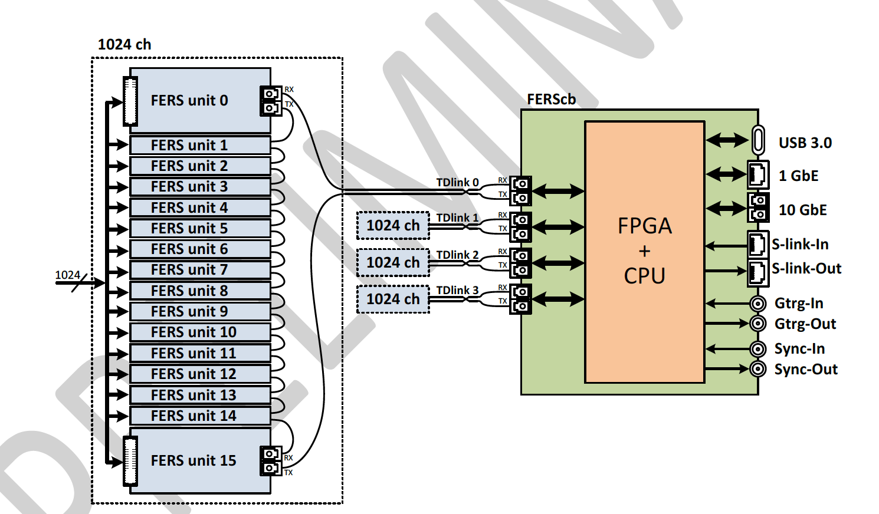
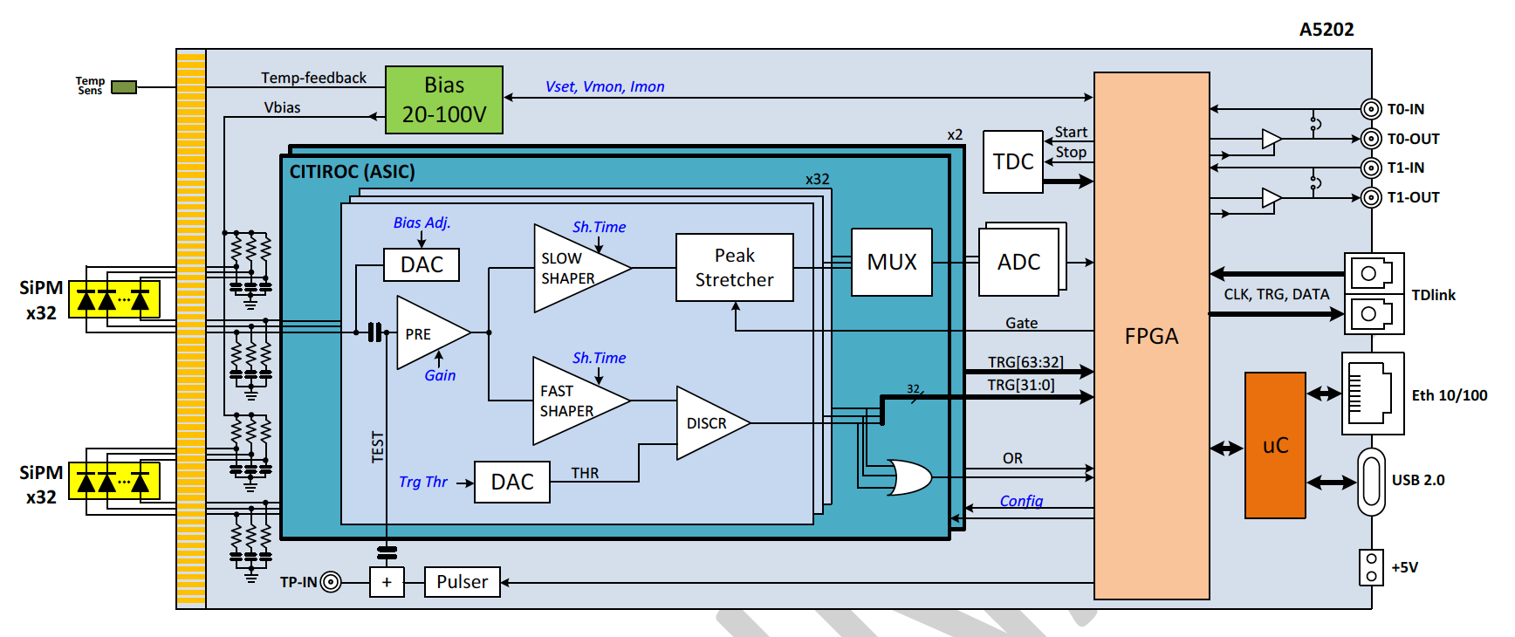
Readout - Citiroc
Some options already on the market
  CAEN FERS system based on Citiroc → 64 ch/board
  16 boards/opt link
  4 opt link/concentrator
  4096 ch/concentrator

Slide 10
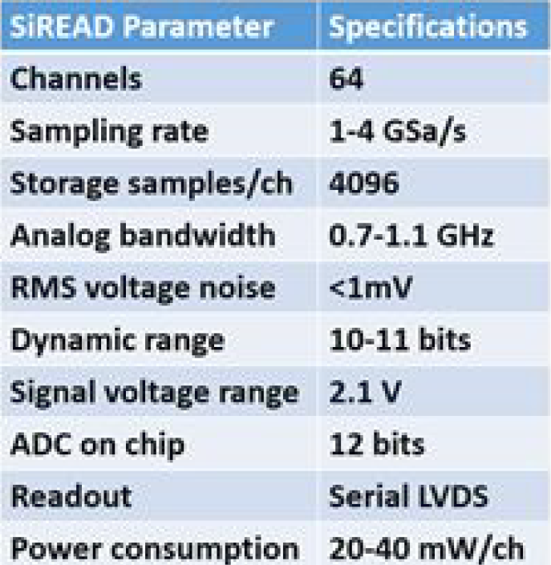
Readout - SiREAD
Nalu Scientific – SiREAD chip
  Next version 32 → 64 ch

Slide 11
Cost assumptions
Metal tubes (Source ALIBABA):
  Iron: 2,000 €/ton [1.1 kton] → 2.1 M€
  Copper: 6,000 €/ton [1.2 kton] → 7.3 M€
Fibers:
  Scintillating: 250 €/km [83,500 km] → 20.9 M€
  Clear: 100 €/km [83,500 km] → 8.3 M€
SiPM (1 mm): 0.30 € each (goal) → 0.1 € each (maybe)
  Opt 1: full readout [131 M] → 39.2 M€
  Opt 2: optical concentrator [ 73 M] → 22.1 M€
Readout: 1.5 €/channel (goal) [ 16 M] → 25.5 M€
  Could bring down to 13-15 M€

Slide 12
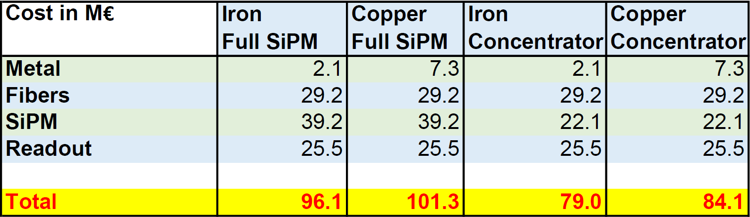
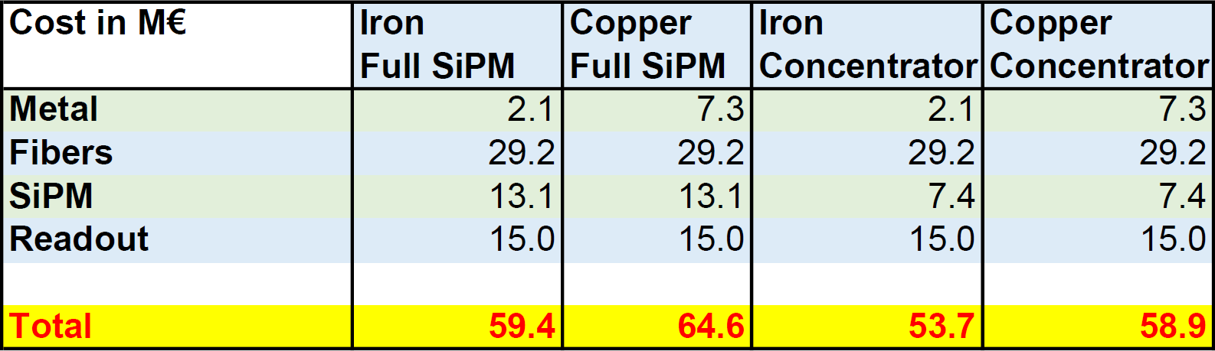
Cost summary baseline
4 options related to absorber and # SiPM
SiPM → 0.1 € each, Readout total 15 M €

Slide 13
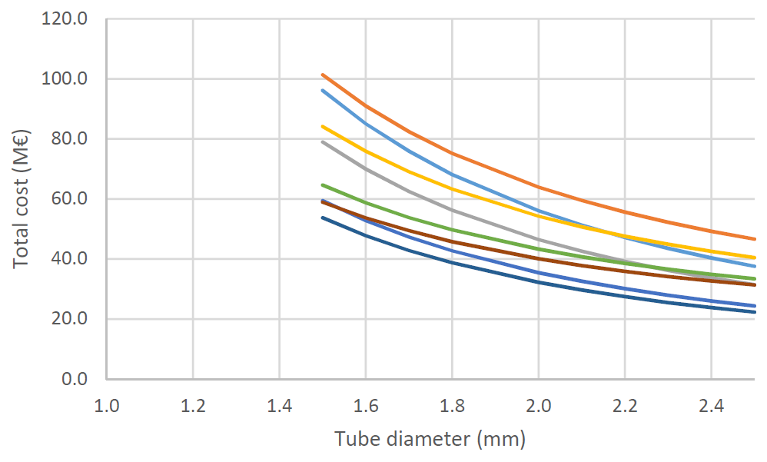
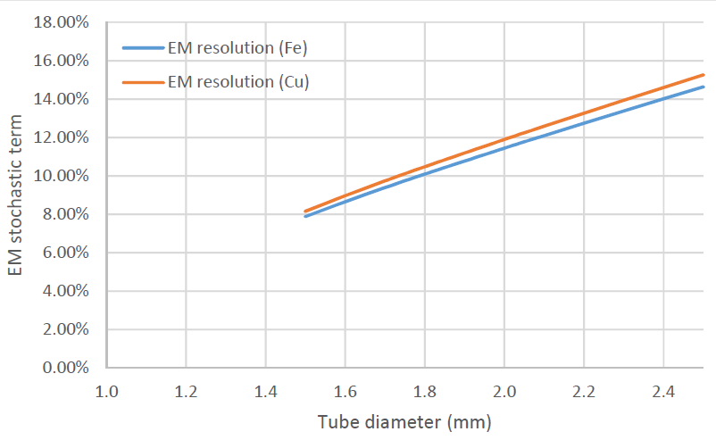
Scaling granularity
Scale by tube diameter (1.5 → 2.5 mm)
  All costs but material scale as 1/d^2
Baseline
Optimistic

Slide 14
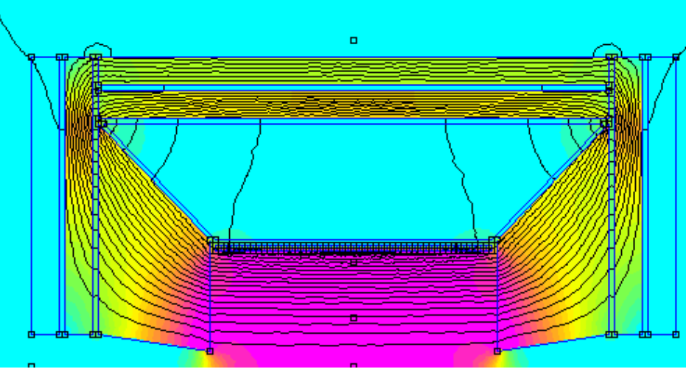
Final comments
Total cost < 100 M€
  Includes both Em and Had calorimeters
Forward/backward made of iron reduce needs for yoke
Critical items:
  SiPM
  Readout electronics
    Needs much larger integration ~ 4096 ch/board
    Preliminary estimates indicate that total costs of 13-15 M€ could be possible i.e. < 1 €/ch
Additional savings possible on fibers due to large quantity
Sampling fraction/EM resolution drives cost

Slide 15
Backup
BACKUP

