Slide 1






Future Circular Collider (FCC)
Frank Zimmermann, CEPC 2019, 18 Nov. 2019, Beijing
gratefully acknowledging input from FCC coordination group,
global FCC design study team and all other contributors
LHC
HE-LHC
PS
SPS
FCC
http://cern.ch/fcc
Work supported by the European Commission under the HORIZON 2020 projects EuroCirCol, grant agreement 654305; EASITrain, grant agreement no. 764879; ARIES, grant agreement 730871; and E-JADE, contract no. 645479
photo: J. Wenninger
photo: J. Wenninger

Slide 2
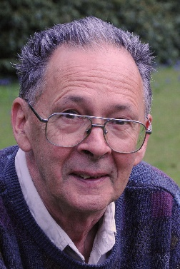
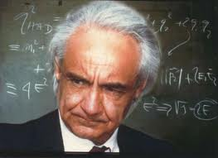
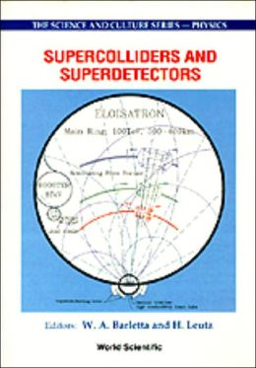

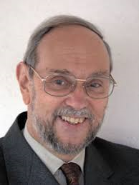
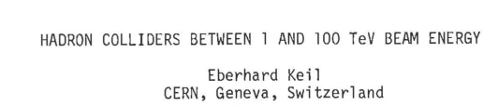
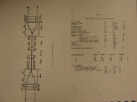
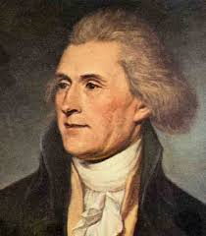
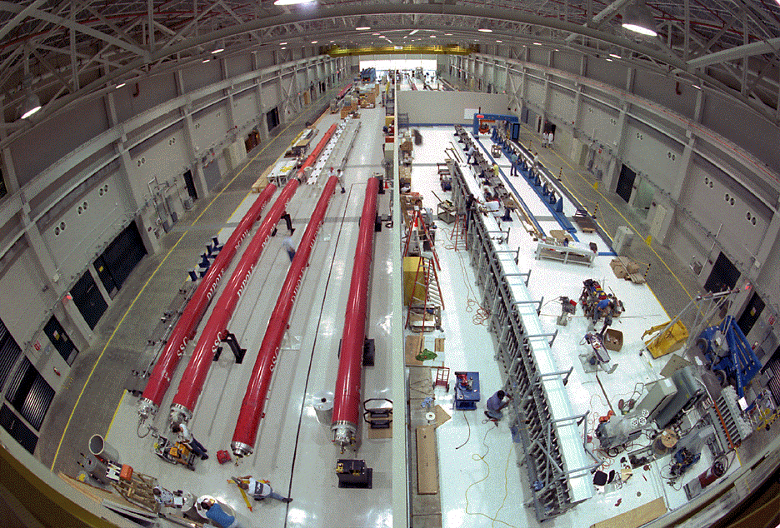
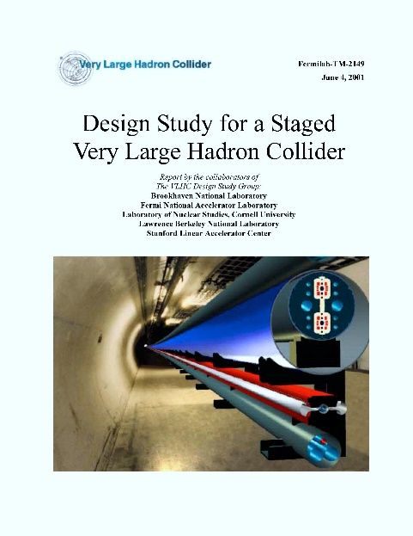
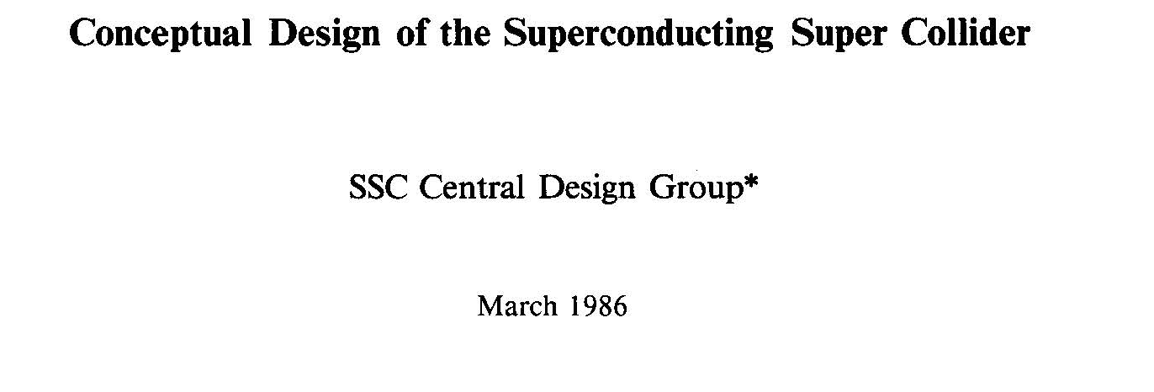
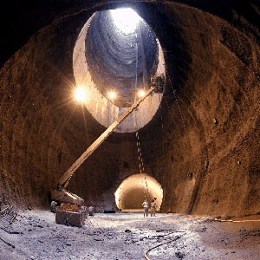
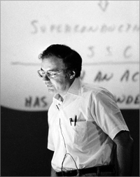
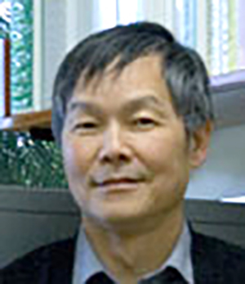
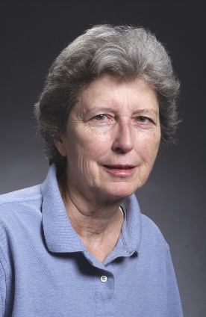
on the historical path towards 100 TeV pp collider …
W. Barletta
E. Keil
ISABELLE/
CBA
1972-83
Eloisatron Study since 1979
200 TeV, 300 km, 13.5 T, still ongoing
R. Palmer
A. Zichichi
20 TeV Hadron Collider Workshop 1983
Proceedings in Cornell Library Section of „historically valuable manuscripts“ together with an original manuscript of Thomas Jefferson !
SSC construction till 1993
H. Edwards
SSC
CDR
1986
VLHC
design
2001
87 km circumference,
20 TeV beam energy
M. Tigner
A. Chao

Slide 3

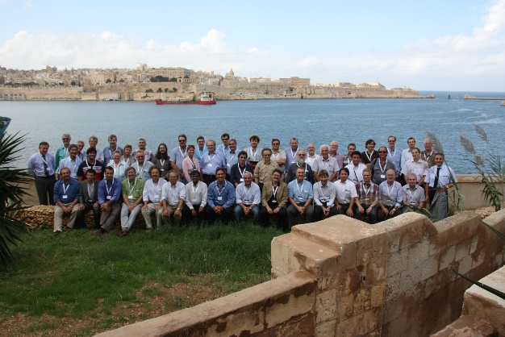

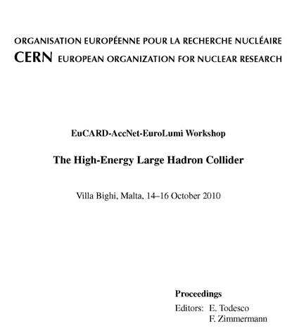
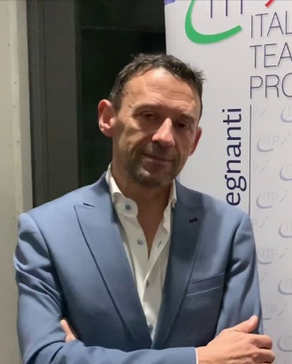
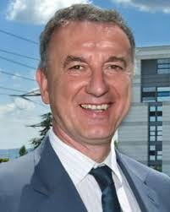
EuroLumi: HE-LHC & VHE-LHC
EuCARD-AccNet workshop HE-LHC’10, Malta, 14-16 October 2010 → new large tunnel
Proceedings (ed. E. Todesco, F. Zimmermann)
“EuCARD-AccNet-EuroLumi Workshop:
The High-Energy Large Hadron Collider”
arXiv:1111.7188 ; CERN-2011-003
1st workshop on HE-LHC
J.-P. Koutchouk, EuCARD
coordinator
E. Todesco
Joint Snowmass-EuCARD/AccNet-HiLumi LHC meeting 'Frontier Capabilities for Hadron Colliders 2013’ a.k.a. VHE-LHC Days, 21-22 February 2013
1st workshop on VHE-LHC
L. Rossi
W. Barletta

Slide 4
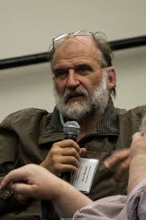
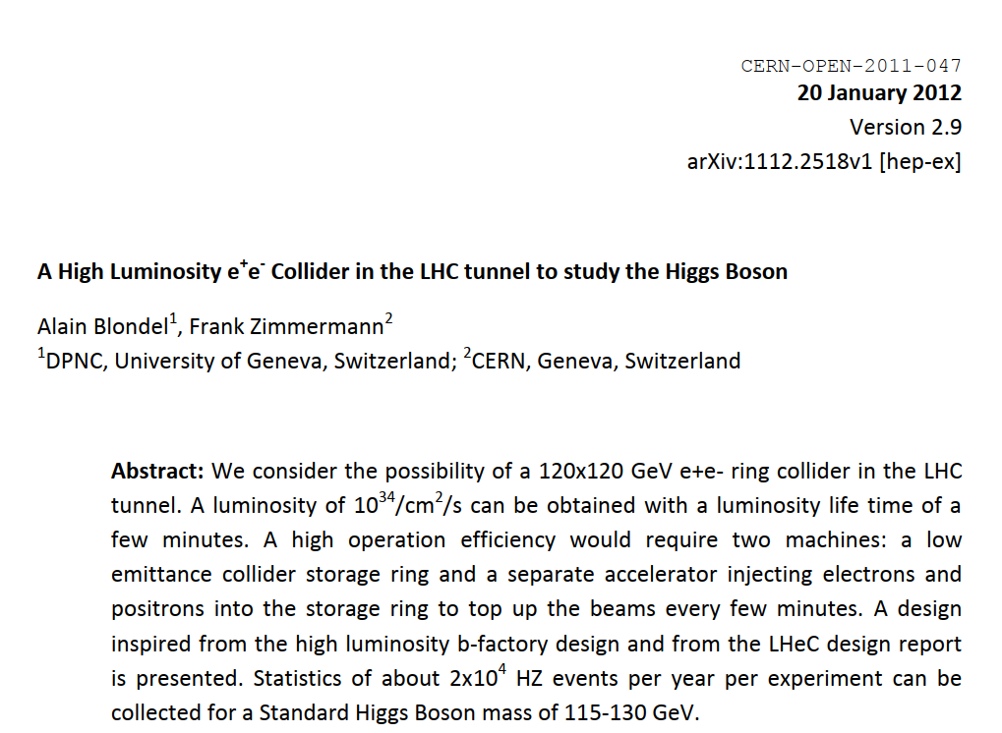
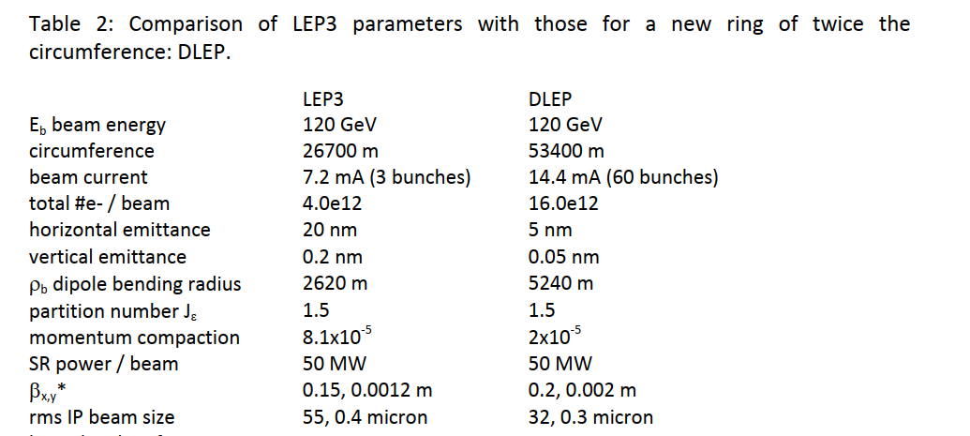
historical path towards e⁺e⁻ Higgs & electroweak factory …
LEP2 was looking for the Higgs at beam energies up to 104.5 GeV, but unsuccessfully so; LEP was shut down in late 2000
11 years later, in early December 2011, I got a phone call from Alain Blondel who asked me what luminosity we could achieve at 120x120 GeV with a new e⁺e⁻ collider in the LEP tunnel; he requested much more than at LEP
I considered this question at the flight gate in London Heathrow, on 7 Dec.’11 and swiftly put together a parameter set meeting Alain’s request – factor 100 more luminosity than LEP easily achieved !
lower β*, top-up
(Alain!), 50 MW
SR/ beam,…
→ “LEP3”
On 12 December
2011 we published
on arxiv
Double ring, lower emittance,
A. Blondel
here we also considered a new tunnel 2xLHC (53 km) – “DLEP”

Slide 5
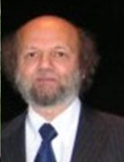
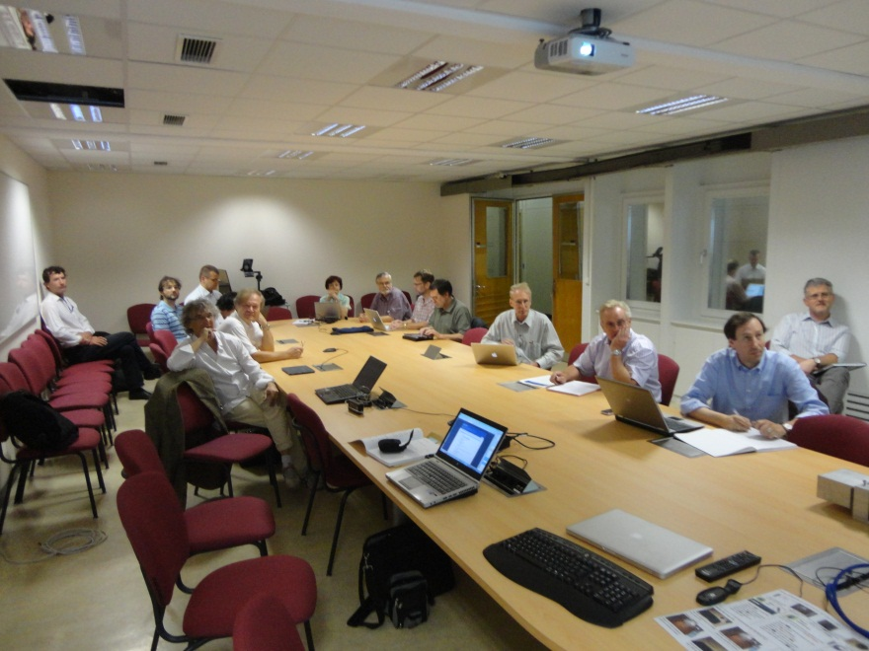
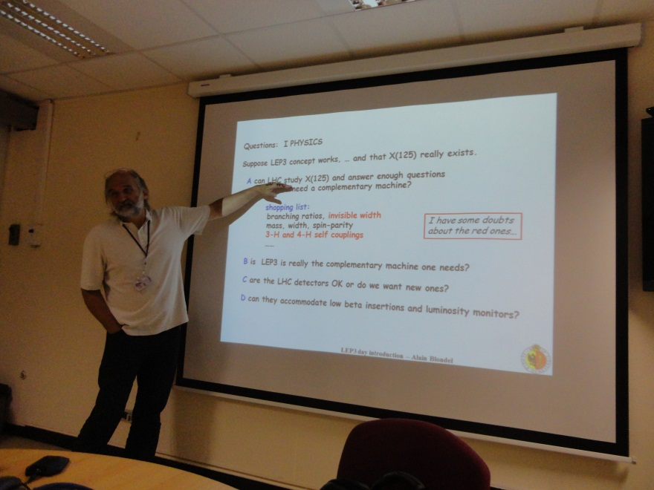
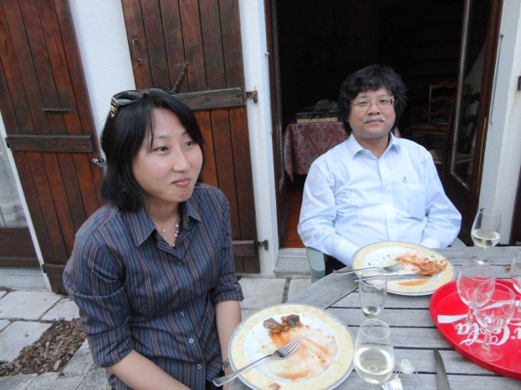
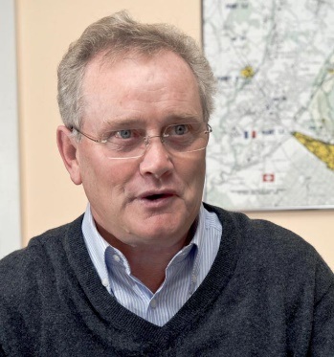
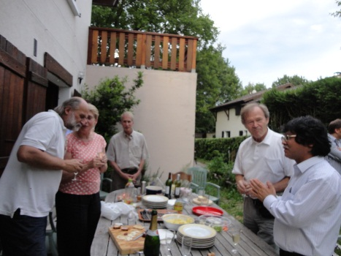
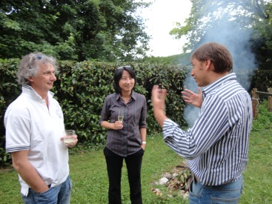
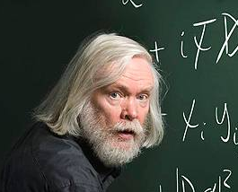
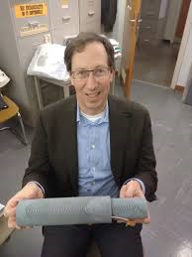
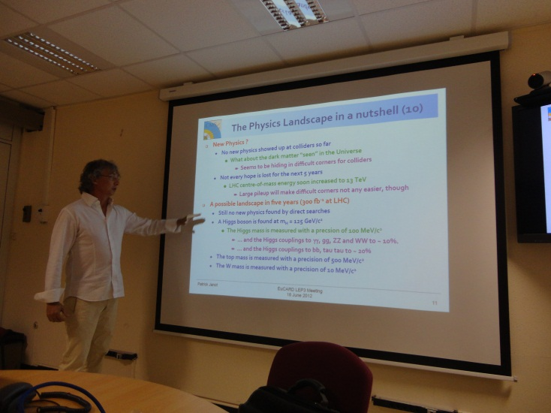
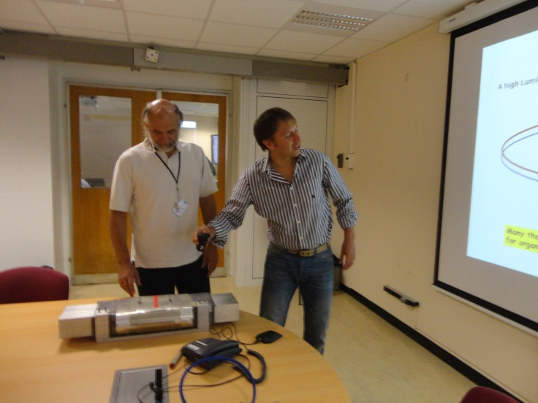
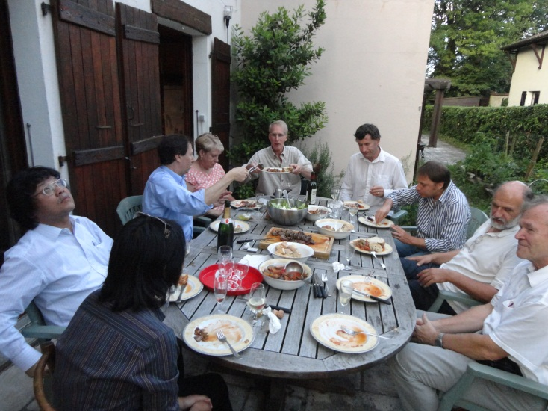
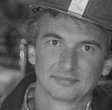

1st EuCARD LEP3 Day, CERN, 18 June 2012
physics case, beam parameters, beam dynamics (beamstrahlung), hardware (RF, vacuum, magnets), tunnel (80 km! → “TLEP”),…
$\sim$40 participants
followed by series of AccNet LEP3 & TLEP mini-workshops:
1st EuCARD LEP3 Day, 18 June 2012, CERN
other proposals in 2012: SuperTRISTAN, “FNAL site filler”, CEPC, SLAC/LBNL
2nd EuCARD LEP3 workshop, 23 October 2012, CERN
HF2012 at FNAL, 14-16 November 2012
3rd EuCARD TLEP3 workshop, 10 January 2013, CERN
4th EuCARD TLEP mini-workshop, 4-5 April 2013, CERN
5th EuCARD TLEP mini-workshop , 25-26 July 2013, FNAL
6th EuCARD TLEP workshop, 16-18 October 2013, CERN
S. Myers
R. Aleksan
J. Ellis
M. Koratzinos
P. Janot

Slide 6



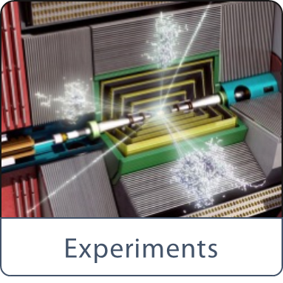
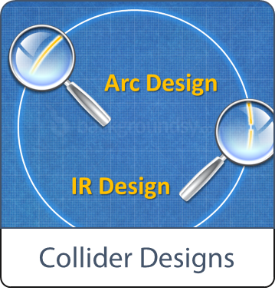
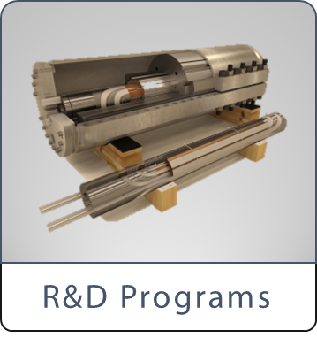

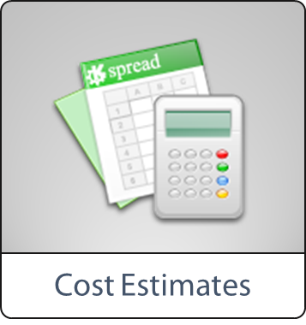
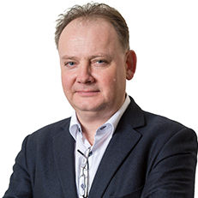
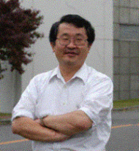
Future Circular Collider (FCC) Study
launched in 2014 following EPPSU 2013
international study (CERN as host lab):
~100 km tunnel infrastructure in Geneva area, linked to CERN
e⁺e⁻ collider (FCC-ee, former TLEP), as potential first step
pp-collider (FCC-hh, former VHE-LHC) → long-term goal, defining infrastructure requirements
HE-LHC with FCC-hh technology
lepton-hadron collisions as options for hadron colliders
HE-LHC
~16 T ⇒ 100 TeV pp in 100 km
M. Benedikt
K. Oide

Slide 7
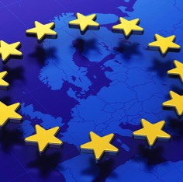
Global FCC Collaboration today
136
Institutes
25
Companies
34
Countries
EC
H2020

Slide 8
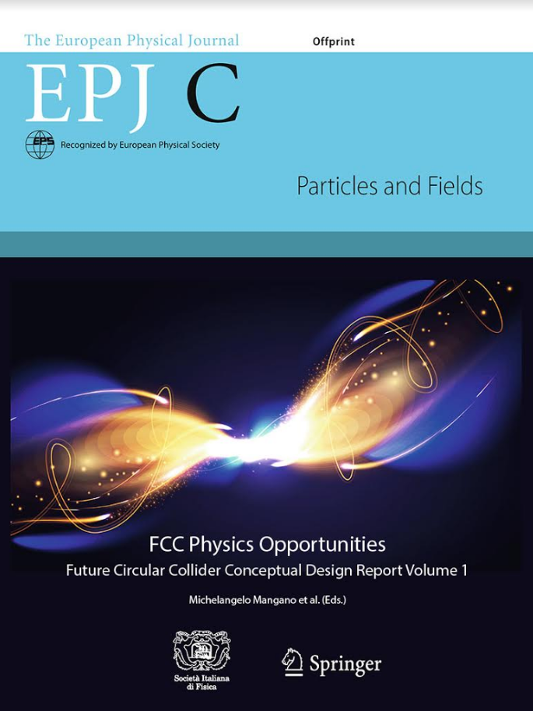
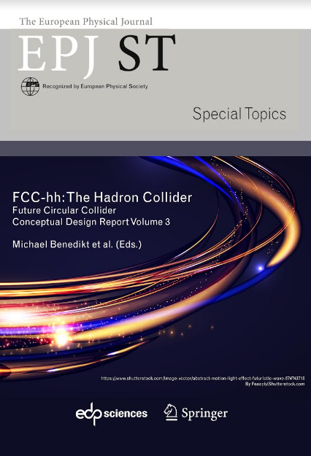
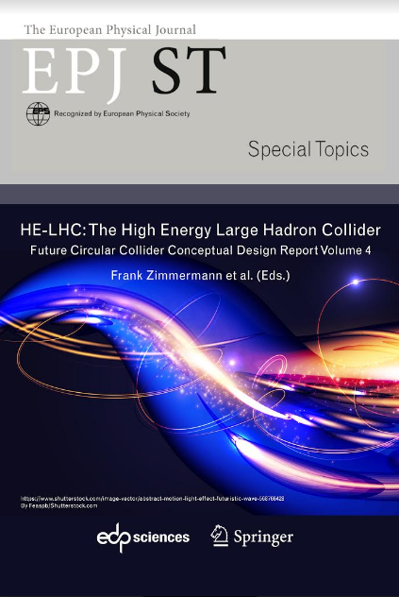
FCC CDR and Study Documentation
4 CDR volumes
published in
EPJ C and EPJ ST:
  FCC Physics Opportunities
    EPJ C 79, 6 (2019) 474, doi: 10.1140/epjc/s10052-019-6904-3
  FCC-ee
    EPJ ST 228, 2 (2019) 261-623, doi: 10.1140/epjst/e2019-900045-4
  FCC-hh
    EPJ ST 228, 4 (2019) 755-1107, doi: 10.1140/epjst/e2019-900087-0
  HE-LHC
    EPJ ST 228, 5 (2019) 1109-1382, doi: 10.1140/epjst/e2019-900088-6
more than 1350 contributors from 350 institutes, a truly global collaboration and effort as suggested by the EPPSU 2013
more than 1350 contributors from 350 institutes, a truly global collaboration and effort as suggested by the EPPSU 2013

Slide 9
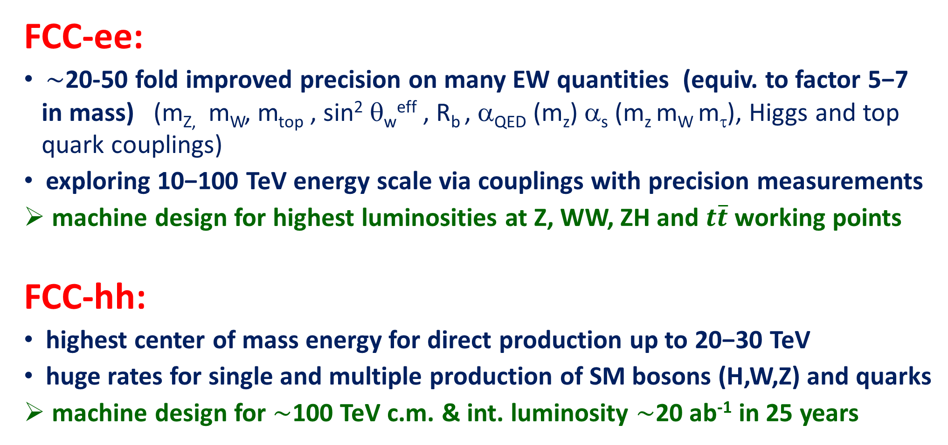
FCC : physics and performance targets
FCC-ee:
$\sim$20-50 fold improved precision on many EW quantities (equiv. to factor 5−7 in mass) (m_{Z,} m_{W}, m_{top} , sin² θ_{w}^{eff} , R_{b} , α_{QED} (m_{z}) α_{s} (m_{z} m_{W} m_{τ}), Higgs and top quark couplings)
exploring 10−100 TeV energy scale via couplings with precision measurements
machine design for highest luminosities at Z, WW, ZH and $t\overline{t}$ working points
FCC-hh:
highest center of mass energy for direct production up to 20−30 TeV
huge rates for single and multiple production of SM bosons (H,W,Z) and quarks
machine design for $\sim$100 TeV c.m. & int. luminosity $\sim$20 ab⁻¹ in 25 years

Slide 10
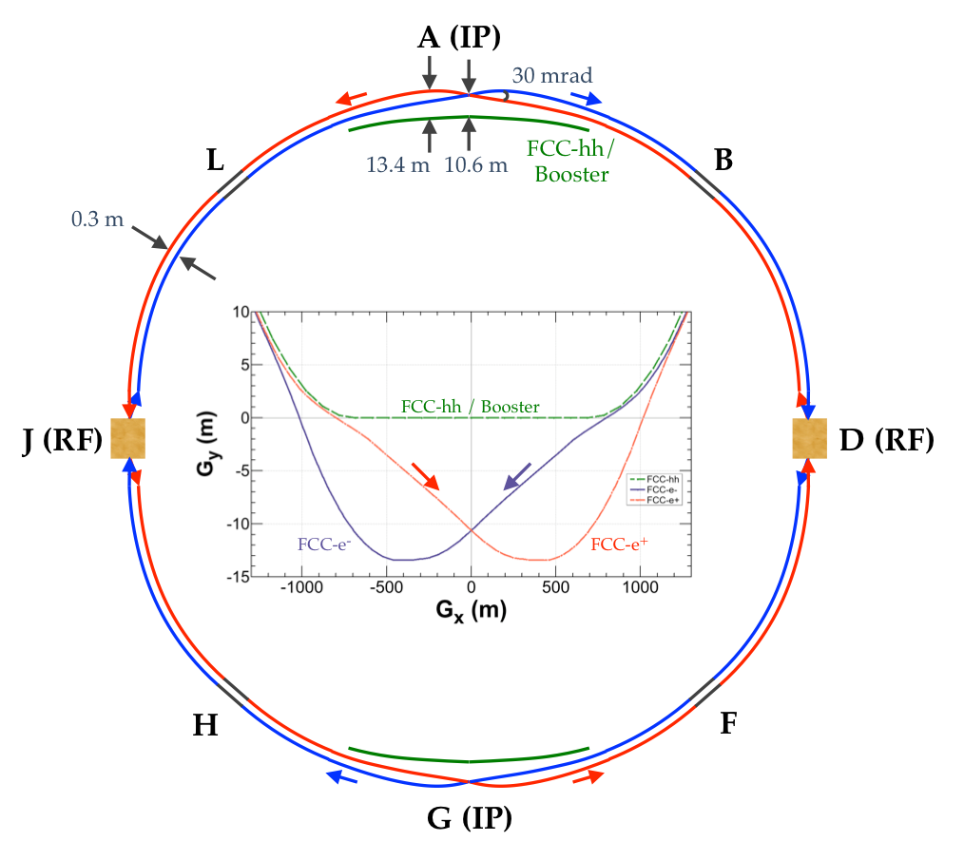
common layouts for hh & ee
in the baseline two main IPs in A, G for both machines
A. Chance, D. Schulte
K. Oide
FCC-hh
FCC-ee

Slide 11
FCC-ee collider parameters
parameter | Z | WW | H (ZH) | ttbar
beam energy [GeV] | 45 | 80 | 120 | 182.5
beam current [mA] | 1390 | 147 | 29 | 5.4
no. bunches/beam | 16640 | 2000 | 393 | 48
bunch intensity [10¹¹] | 1.7 | 1.5 | 1.5 | 2.3
SR energy loss / turn [GeV] | 0.036 | 0.34 | 1.72 | 9.21
total RF voltage [GV] | 0.1 | 0.44 | 2.0 | 10.9
long. damping time [turns] | 1281 | 235 | 70 | 20
horizontal beta* [m] | 0.15 | 0.2 | 0.3 | 1
vertical beta* [mm] | 0.8 | 1 | 1 | 1.6
horiz. geometric emittance [nm] | 0.27 | 0.28 | 0.63 | 1.46
vert. geom. emittance [pm] | 1.0 | 1.7 | 1.3 | 2.9
bunch length with SR / BS [mm] | 3.5 / 12.1 | 3.0 / 6.0 | 3.3 / 5.3 | 2.0 / 2.5
luminosity per IP [10³⁴ cm⁻²s⁻¹] | 230 | 28 | 8.5 | 1.55
beam lifetime rad Bhabha / BS [min] | 68 / >200 | 49 / >1000 | 38 / 18 | 40 / 18

Slide 12
FCC-ee luminosity versus energy
H s-channel
with mono-
chromatization

Slide 13
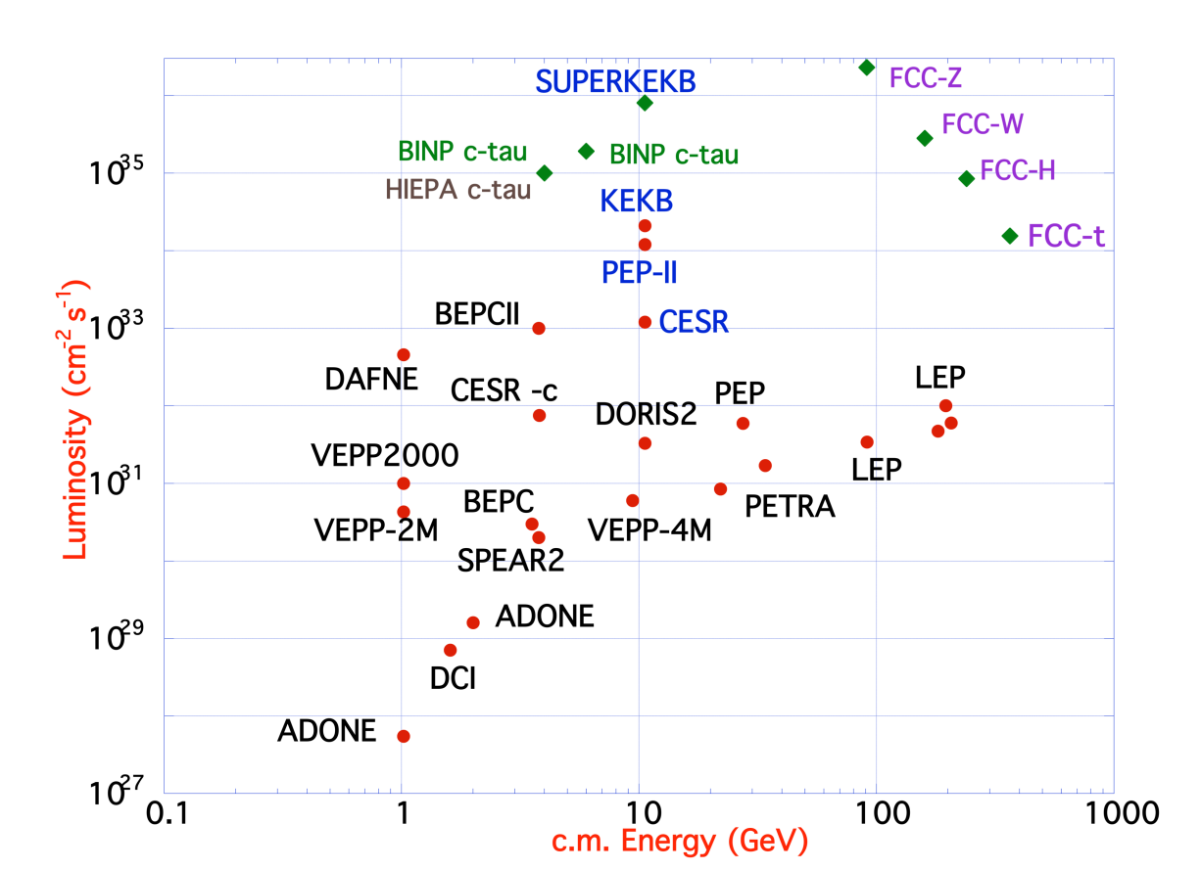
FCC-ee design
based on lessons and techniques from past colliders
B-factories: KEKB & PEP-II:
double-ring lepton colliders,
high beam currents,
top-up injection
DAFNE: crab waist, double ring
SuperB-factories, S-KEKB: low β_{y}*
LEP: high energy, SR effects
VEPP-4M, LEP: precision energy calibration w. res. depolarisation
KEKB: e⁺ source
HERA, LEP, RHIC: spin gymnastics
L/IP
Marica Biagini
combining successful ingredients of several recent colliders → highest luminosities & energies

Slide 14

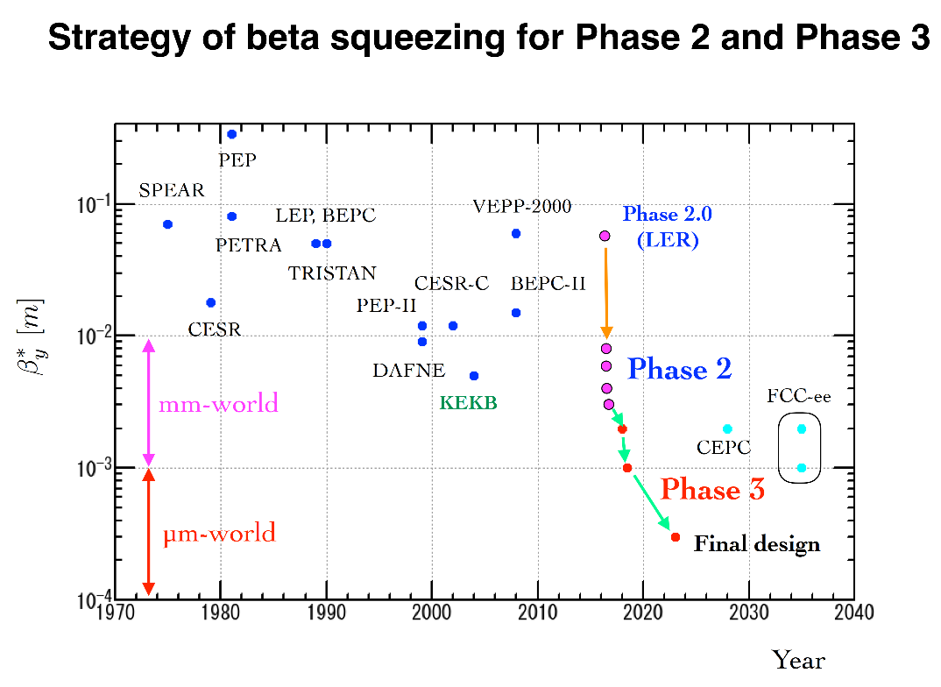
SuperKEKB – pushing luminosity and β*
double ring e⁺e⁻ collider as B-factory at 7(e⁻) & 4(e⁺) GeV; design luminosity $\sim$8 x 10³⁵ cm⁻²s⁻¹; β_{y}* $\sim$0.3 mm; nano-beam – large crossing angle collision scheme (crab waist w/o sextupoles); beam lifetime$\sim$5 minutes; top-up injection; e⁺ rate up to $\sim$ 2.5 10¹² /s ; under commissioning
SuperKEKB is exploring FCC-ee key concepts
β_{y}* =1.2 mm achieved!
Y. Funakoshi, Y. Ohnishi, K. Oide

Slide 15
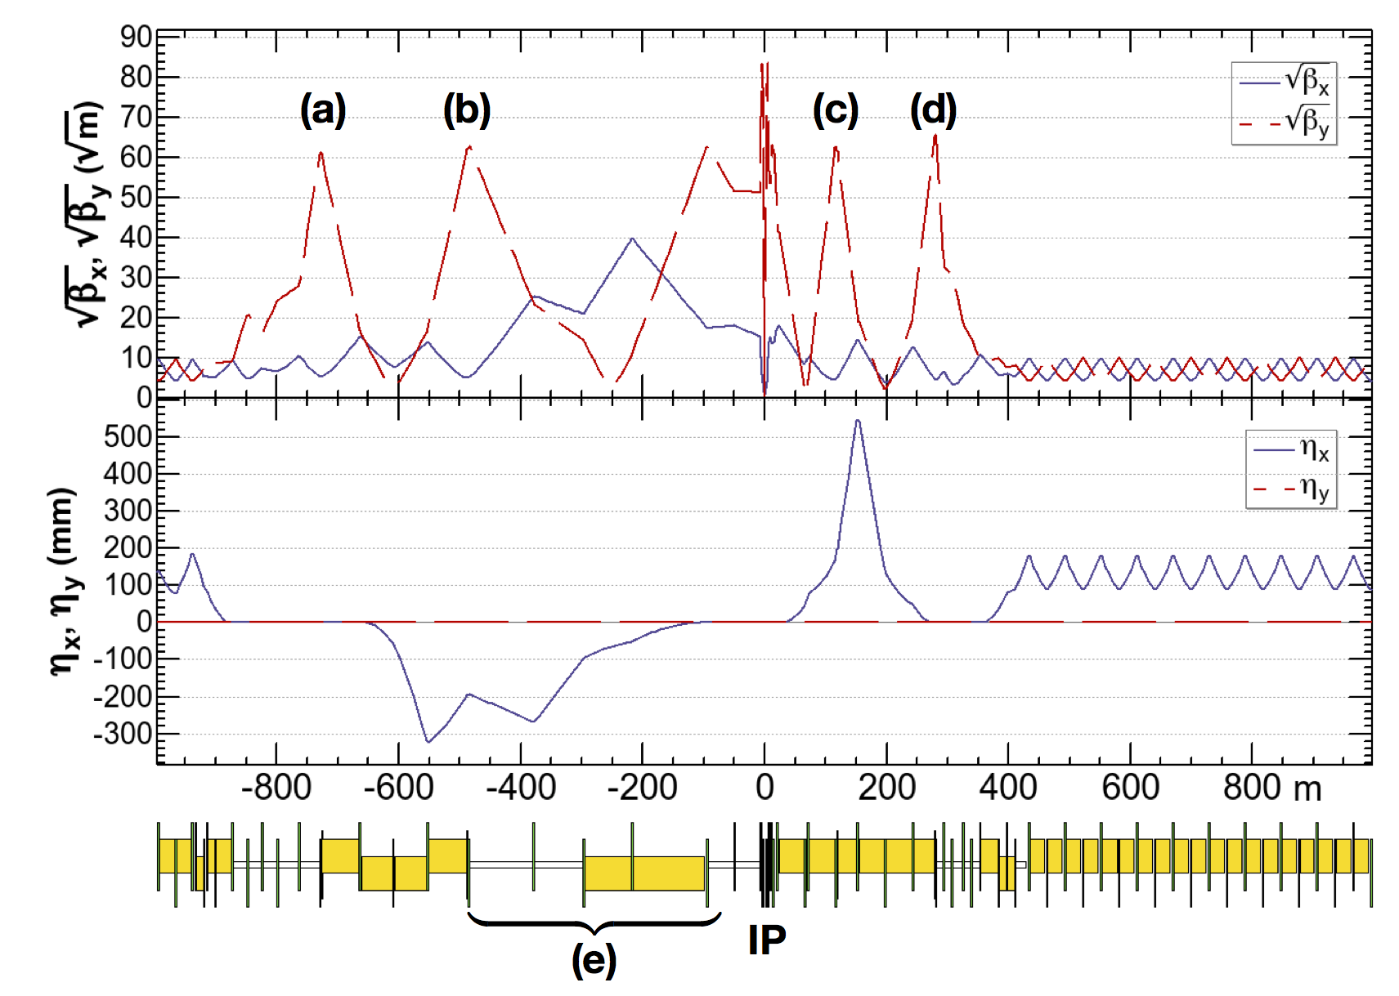
FCC-ee asymmetric crab-waist IR optics
Novel asymmetric IR optics to suppress synchrotron radiation toward the IP, E_{critical} <100 keV from 450 m from IP (e) – lesson from LEP
4 sextupoles (a – d) for local vertical chromaticity correction combined with crab waist, optimized for each working point – novel “virtual crab waist”, standard crab waist demonstrated at DAFNE
low incident SR,
minimum nonlinearities
ttbar 182.5 GeV
K. Oide et al., Design of beam optics for the future circular collider e⁺e⁻ collider rings, Phys. Rev. Accel. Beams 19, 111005 (2016).
yellow boxes:
dipole magnets
H. Burkhardt, K. Oide, et al.

Slide 16
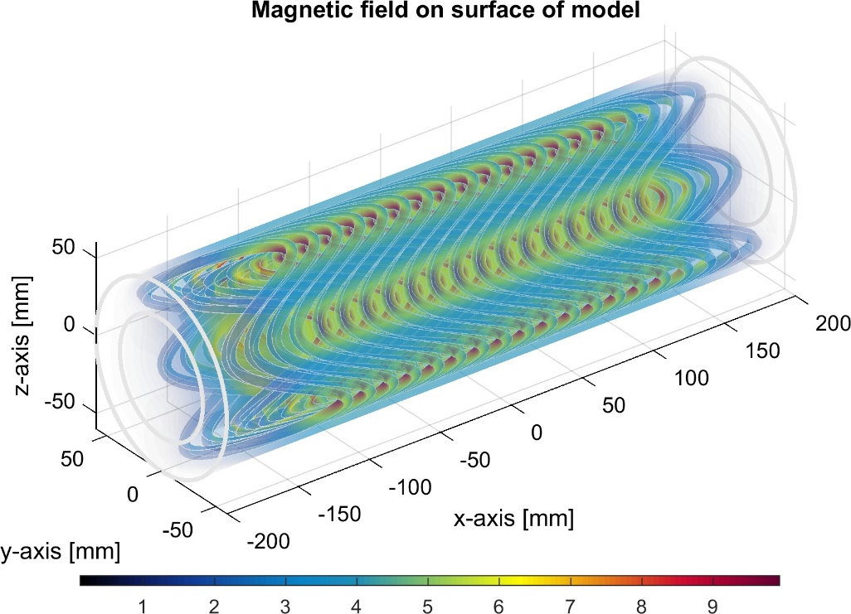

advanced SC final-focus magnets
final-focus sextupole:
7350 T/m²; 30 cm long; canted-cosine-theta concept; 10-11 T on surface ; HTS wires
M. Koratzinos
the strongest magnet in FCC-ee
final quadrupole pair near IP; canted-cosine-theta concept;
with orbit corrector & skew quadrupole ;
to be built with
Nb-Ti or HTS wires
prototype under construction
M. Koratzinos

Slide 17



FCC-ee interaction region (IR)
A. Novokhatski, M. Sullivan, E. Belli, M. Gil Costa, and R. Kersevan, Unavoidable trapped mode in the interaction region of colliding beams, Phys. Rev. Accel. Beams 20, 111005 (2017)
M. Boscolo, H. Burkhardt, and M. Sullivan, Machine detector interface studies: Layout and synchrotron radiation estimate in the future circular collider interaction region, Phys. Rev. Accel. Beams 20, 011008 (2017)
IR heat loads: rad Bhabha (kW), beamstrahlung (MW), res. wall (kW), HOMs, quadr. synchrotron rad.
3D sketch of key IR systems over ﬁrst 3 m from IP
Q1 with shielding
solenoid
luminometer
M. Boscolo, N. Bacchetta, A. Bogomyagkov, H. Burkhardt, M. Dam, D. El Khechen, M. Koratzinos, E. Levichev, M. Luckhof, A. Novokhatski, L. Pellegrino, S. Sinyatkin, M. Sullivan, et al.
IP
compensation
solenoid
stiff-skeleton cryostats?

Slide 18


off-energy dynamic aperture
Dynamic apertures in z-x plane after sextupole optimisation with particle tracking for each energy.
sufficient dynamic aperture
The initial vertical amplitude for the tracking is always set to J_{y}/J_{x} = ε_{y}/ε_{x}. Number of turns $\sim$2 longitudinal damping times.
K. Oide
important for top-up injection and for beam lifetime with beamstrahlung

Slide 19




vertical emittance with errors
T. Charles, S. Aumon, T. Tydecks,….
realistic misalignments and roll angles
after iterative optics corrections:
well below target emittance with realistic errors
*BPM error relative to quadrupole position
$ε_{x,rms}=1.65 nm$
$ε_{y,rms}=0.123 pm$
$$\frac{ε_{y,rms}}{ε_{x,rms}}=0.0071\%$$
target in collision:
2.9 pm
target in collision:
0.2%
simulated vertical emittance much smaller than needed

Slide 20


FCC-ee RF staging scenario
three sets of RF cavities:
high intensity (Z, FCC-hh): 400 MHz mono-cell cavities (4/cryom.), Nb/Cu, 4.5 K
higher energy (W, H, t): 400 MHz four-cell cavities (4/cryomodule), Nb/Cu, 4.5 K
$t\overline{t}$ machine complement: 800 MHz five-cell cavities (4/cryom.), bulk Nb, 2 K
installation sequence comparable to LEP ( ≈ 30 CM/shutdown)
“Ampere-class” machine
WP | V_{rf} [GV] | #bunches | I_{beam} [mA]
Z | 0.1 | 16640 | 1390
W | 0.44 | 2000 | 147
H | 2.0 | 393 | 29
ttbar | 10.9 | 48 | 5.4
RF system tailored for optimum performance at each energy
“high-gradient” machine
O. Brunner

Slide 21





FCC-ee RF cavities – optimized for each running mode
Z running: single-cell cavities, 400 MHz, Nb/Cu at 4.5 K, like LHC cavities
$t\overline{t}$running: five-cell cavities, 800 MHz bulk Nb at 2 K, prototyped at JLAB, added to 400 MHz Nb/Cu four-cell cavities at 4.5 K, similar to LEP-2 cavities
400 MHz single-cell
RF cavity, Nb/Cu
800 MHz five-cell RF cavity, bulk Nb
CERN
$\sim$1999
F. Marhauser et al
JLAB,
Oct. 2017
$t\overline{t}$ : 396 four-cell 400 MHz + 852 five-cell 800 MHz cavities
(collider + booster)
Z-pole: 116 single-cell cavities (collider + booster)

Slide 22






FCC-ee cost-effective, energy-efficient arc magnets
twin-dipole magnet design with $2×$ power saving 16 MW (at 175 GeV), with Al busbars
twin F/D arc quadrupole design with 2× power saving; 25 MW (at 175 GeV), with Cu conductor
2900 units, 0.057 T, $\sim$22 m
2900 units,
10 T/m,
3.1 m
A. Milanese, Efficient twin aperture magnets for the future circular e⁺/e⁻ collider,
Phys. Rev. Accel. Beams 19, 112401 (2016)
prototype
prototype

Slide 23



avoiding μ-wave & e-cloud instability → ultrathin NEG coating
with 100 nm coating far
below μ-wave instability threshold at the Z pole
innovative approach validated in lab tests: low-impedance & high performance
resistive-wall impedance
dominant
longitudinal wake potentials for a Gaussian bunch with nominal bunch length σ_{z} = 3.5 mm due to the main FCC-ee components compared with the RW contribution
RMS energy spread vs bunch population, at the Z, considering the RW impedance for NEG films with different thicknesses
NEG coatings with thicknesses from 30 nm to 1.1 μm
E. Belli et al., Phys. Rev. Accel. Beams 21, 111002 (2018)
morphology of NEG thin films analyzed by scanning electron microscope

Slide 24



FCC-ee with 4 IPs?
almost 2x higher total luminosity, or equal luminosity at half the power
K. Oide, D. Shatilov, M. Benedikt
periodic alternative
with 4 IPs
less symmetric alternative with 4 IPs
baseline w 2 IPs
impact on layout!
so far OK for lattice
and beam-beam
not yet studied,
but considered challenging
works fine

Slide 25

ERL option -“Future High Energy Circular e⁺e⁻ Collider using Energy-Recovery Linacs,” Vladimir N Litvinenko, Thomas Roser, Maria Chamizo Llatas, BNL, http://arxiv.org/abs/1909.04437 presented at FCC Week 2019 and submitted to ESU process, similar to former ERL eRHIC design
FCC-ee ERL upgrade – recent proposal from BNL
green FCC ee w. 10% of ring-ring power consumption
and/or much higher performance and energy reach
V. Litvinenko, T. Roser, M. Chamizo

Slide 26
FCC-hh (pp) collider parameters
parameter | FCC-hh |  | HE-LHC | HL-LHC | LHC
collision energy cms [TeV] | 100 |  | 27 | 14 | 14
dipole field [T] | 16 |  | 16 | 8.33 | 8.33
circumference [km] | 97.75 |  | 26.7 | 26.7 | 26.7
beam current [A] | 0.5 |  | 1.27 | 1.1 | 0.58
bunch intensity [10¹¹] | 1 | 1 | 2.5 | 2.2 | 1.15
bunch spacing [ns] | 25 | 25 | 25 | 25 | 25
synchr. rad. power / ring [kW] | 2400 |  | 101 | 7.3 | 3.6
SR power / length [W/m/ap.] | 28.4 |  | 4.1 | 0.33 | 0.17
long. emit. damping time [h] | 0.54 |  | 1.8 | 12.9 | 12.9
beta* [m] | 1.1 | 0.3 | 0.45 | 0.15 (min.) | 0.55
normalized emittance [μm] | 2.2 |  | 2.5 | 2.5 | 3.75
peak luminosity [10³⁴ cm⁻²s⁻¹] | 5 | 30 | 16 | 5 (lev.) | 1
events/bunch crossing | 170 | 1000 | 460 | 132 | 27
stored energy/beam [GJ] | 8.4 |  | 1.4 | 0.7 | 0.36

Slide 27



FCC-hh: performance
order of magnitude performance increase in both energy & luminosity
100 TeV cm collision energy (vs 14 TeV for LHC)
20 ab⁻¹ per experiment collected over 25 years of operation (vs 3 ab⁻¹ for LHC)
similar performance increase as from Tevatron to LHC
key technology: high-field magnets
via
HL-LHC technology
11 T Nb₃Sn
from
LHC technology
8.3 T NbTi
16 T Nb₃Sn

Slide 28








16 T dipole design activities and options
H2020
Swiss contribution
Cos-theta
Common coils
Canted
Cos-theta
Blocks
INFN
CIEMAT
LBNL
CEA
PSI
FNAL
Short model magnets (1.5 m lengths) will be built from 2019 – 2025
Russian 16 T magnet program is being coordinated by BINP.

Slide 29


superconductor for 16 T
recent US wires with Artificial Pinning Centres “APCs” have reached FCC target J_{c} (50% above HL-LHC wire, →size & cost) …
… and after less than one year, new suppliers from Japan, Korea and Russia already achieve HL-LHC specification
high B_{c2} (28.8 T at 4.2 K)
X. Xu et al.
FNAL, Hyper Tech Research Inc., and Ohio State, X. Xu et. al., https://arxiv.org/abs/1903.08121 ;
NHMFL, FAMU/FSU: S. Balachandran et al. https://arxiv.org/ftp/arxiv/papers/1811/1811.08867.pdf

Slide 30

14 T accelerator dipole at FNAL !
A. Zlobin et al., NAPAC2019, MOPL020
15 T dipole demonstrator
staged approach: in first step pre-stressed for 14 T
second test in fall 2019 with additional pre-stress for 15 T
60-mm aperture
4-layer graded coil

Slide 31



FCC implementation - footprint baseline
Present baseline position was established considering:
lowest risk for construction, fastest and cheapest construction
feasible positions for large span caverns (most challenging structures)
next step: review of surface site locations and machine layout

Slide 32

Civil Engineering studies
4.5yrs
6.5yrs
Total construction duration 7 years
First sectors ready after 4.5 years

Slide 33


FCC-tunnel integration in arcs
  FCC-ee FCC-hh
  5.5 m inner diameter

Slide 34
FCC integral project technical schedule
1
2
3
4
5
6
7
8
9
10
11
12
13
14
15
16
17
18
15 years operation
34
35
36
37
38
39
40
41
42
43
~ 25 years operation
70
Project preparation &
administrative processes
Permis-sions
Update
Permissions
Funding strategy
Funding and
in-kind contribution agreements
Funding and
in-kind contribution agreements
Geological investigations, infrastructure detailed design and tendering preparation
Tunnel, site and technical infrastructure construction
FCC-ee dismantling, CE & infrastructure adaptations FCC-hh
FCC-ee accelerator R&D and technical design
FCC-ee accelerator construction, installation, commissioning
FCC-hh accelerator R&D and technical design
FCC-hh accelerator construction, installation, commissioning
Set up of international experiment collaborations, detector R&D and concept development
FCC-ee detector technical design
FCC-ee detector
construction, installation, commissioning
FCC-hh detector R&D,
technical design
FCC-hh detector
construction, installation, commissioning
Superconducting wire and magnet R&D
SC wire and 16 T magnet R&D, model magnets, prototypes, preseries
16 T dipole magnet
series production

Slide 35
FCC - Next steps
2019 – 2020:
Layout optimisation and work on implementation with host states.
Near-term focus on FCC-ee as potential first step (awaiting strategy recommendation).
Preparation of EU H2020 DS project (INFRADEV call November 2019), focused on infrastructure implementation. Proposal submitted to Brussels last week.
2020/21 – 2025/26: project preparation phase (if supported by EPPSU and CERN Council)

Slide 36
众人拾柴火焰高

