Slide 1

CEPC Linac dynamics with S &C band accelerating structures
环形正负电子对撞机
Circular Electron Positron Collider
CEPC Workshop 2019
18 November, 2019
C. Meng, J. Zhang, X. Li, G. Pei, G. Shu, D. Li, J. Gao, Y. Chi
Institute of High Energy Physics, CAS

Slide 2
Outline
Introduction
  Redundancy design consideration
CEPC Linac alternative design
  20 GeV scheme with S&C bands accelerating structure
  PWFA driven Linac preliminary design
Summary

Slide 3
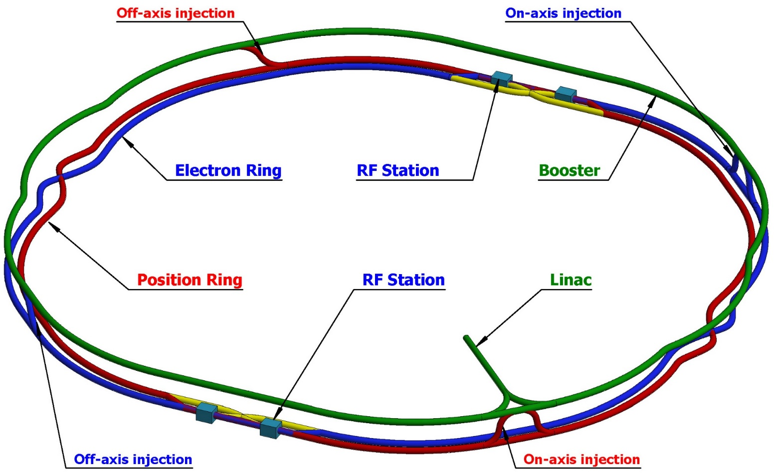
Introduction
CEPC Layout
CEPC layout
  10 GeV Linac
  10-120GeV Booster
  120 GeV Collider
  Transport lines
Particle Physics factory
  High integrated luminosity
Parameter | Unit | Value
Particle |  | H/Z/W⁺W⁻
Beam energy | GeV | 120/45/80
Operation plan | Year | 7/2/1
 | Days/year | 250
Physics data taking efficiency | % | >60
@ CEPC CDR

Slide 4
Introduction
Why high availability
CEPC is a very huge and complex system
To reach high integrated luminosity, high luminosity, long operation time and high availability is needed
  Beam effectiveness
    Beam physics
    Injection
    Powerful injector
  Beam collision effectiveness
    Top-up operation (~1)
    Low performance operation
High availability Linac is necessary
  Redundancy design is important
  Necessary ? How much?

Slide 5
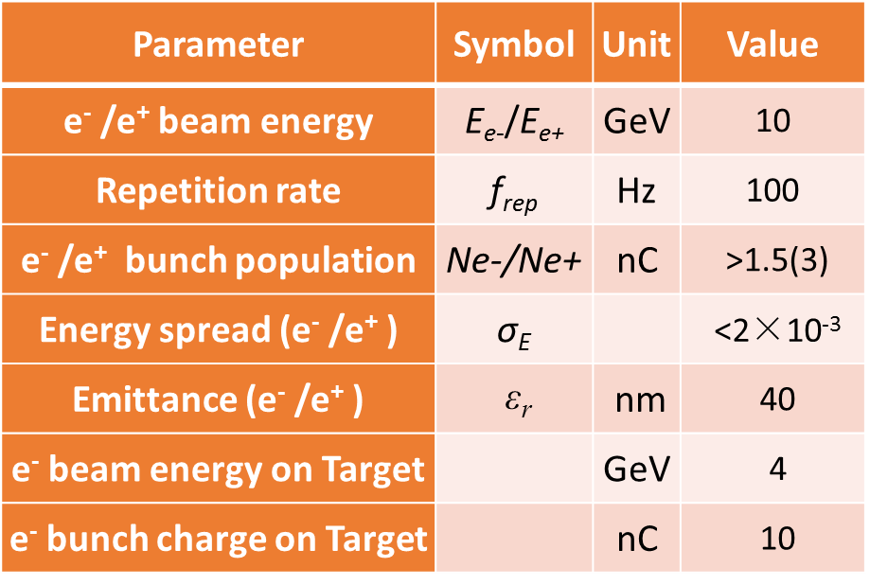
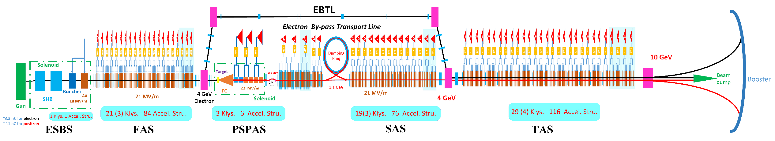
Introduction
Linac baseline design
Baseline design principles and consideration
  Meet the requirements of the Booster injection
  High availability and simplicity
    About 15% backups for Klystrons and accelerating structures (Redundancy)
  More potential
    Have potential to provide electron/positron beam with bunch charge larger than 3nC
    Lower emittance with more cycles in Damping Ring

Slide 6
Introduction
How to predict availability
How to predict the availability of the CEPC Linac?
Based on AvailSim 1.0 (for ILC) and AvailSim 2.0 (for IFMIF), the reliability and availability analysis program (RAAS) is under developing
  Monte Carlo simulation program
  Can include every system/device, with the information MTBF, MTTR, and so on
    Location, tunnel or independent maintenance site
  Can define different effect to the whole system
    down or wait for next maintenance down or low performance operation
  Can define any maintenance plan, for example.
    Each year 250 days to operation
    Each week with 12h short scheduled down, about 16 days
    Each year 100 days long scheduled down

Slide 7
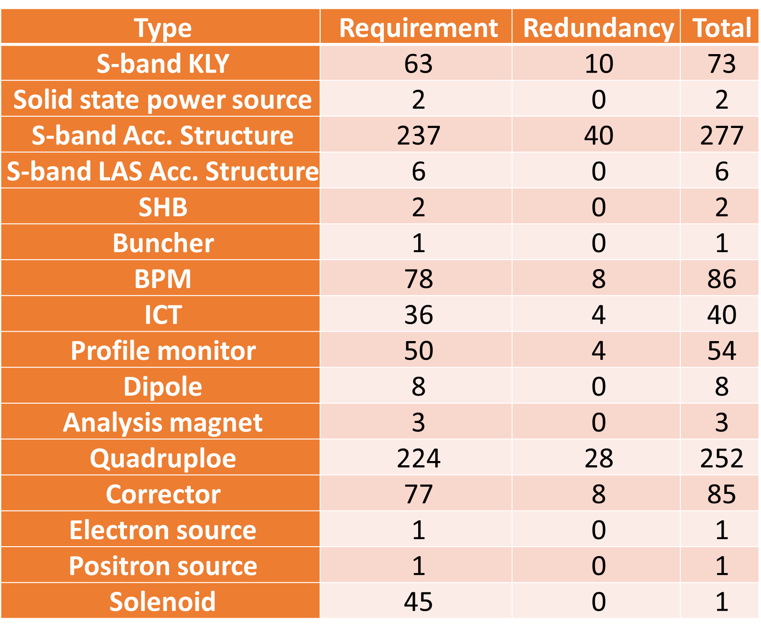
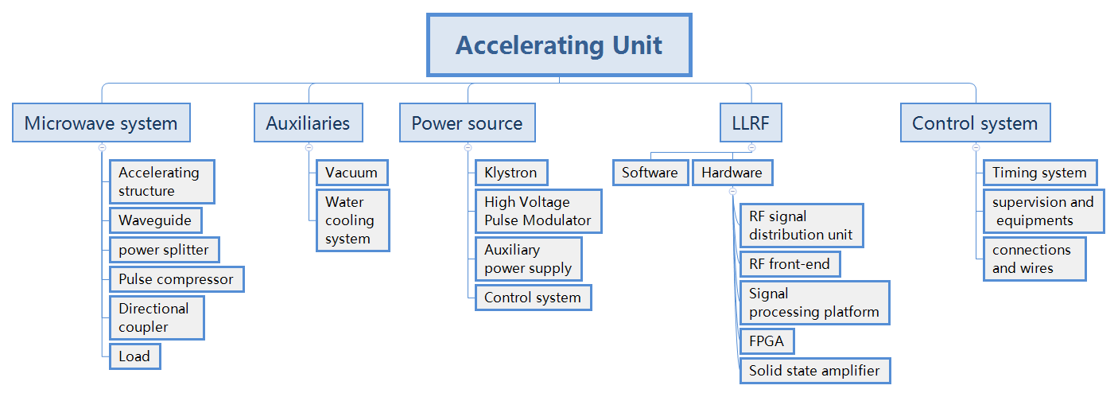
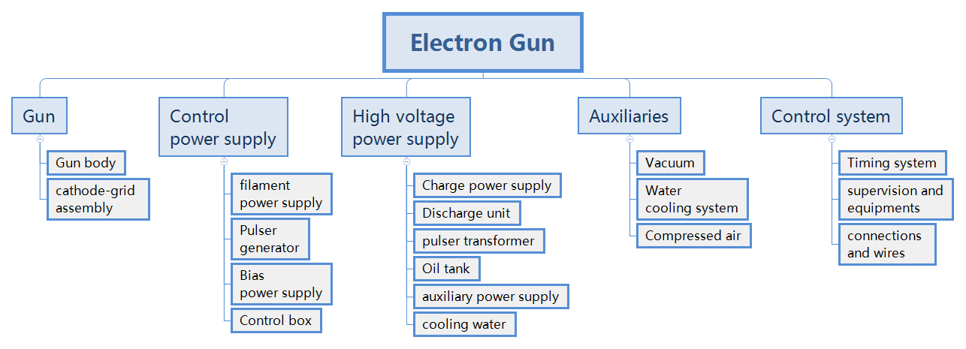
Introduction
Model the Linac for RAAS
In the baseline design, there are 15% accelerating units redundancy
  Electron source
  Positron source
  Bunching system
  Accelerating unit
  Magnet system (inc. PS)

Slide 8
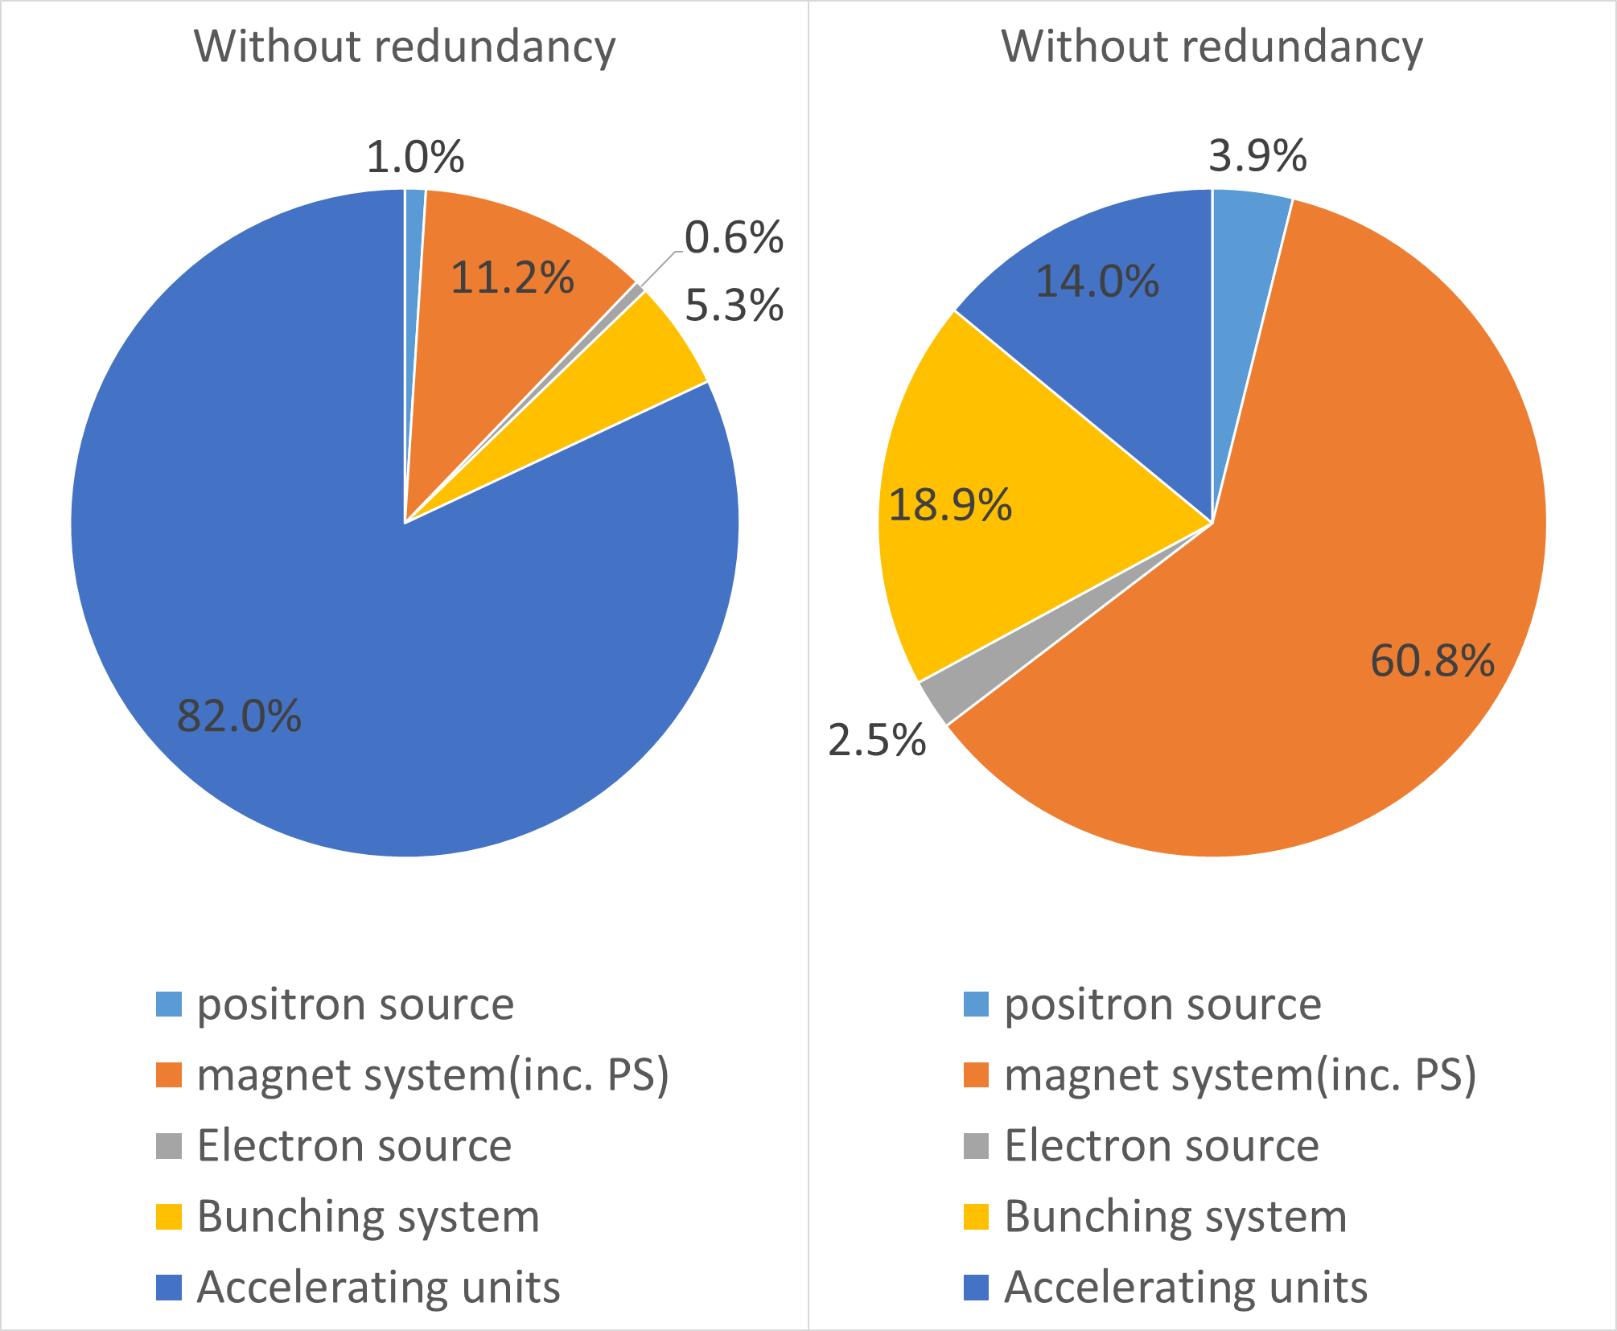
Introduction
Redundancy is necessary
With the redundancy design of accelerating units, the availability of the CEPC Linac is increased from 85% to 96%
Redundancy design is important for high availability and 15% is reasonable by now
  The MTBF and MTTR data of the systems are vary preliminary or experience value in the simulation, more detailed statistics are need to update the availability results in the future

Slide 9
Introduction
Motivation
Low magnetic field in the Booster at low energy injection is a very difficult and critical problem
  The magnetic field of dipole is only 30 Gs
  The control of stray magnetic field in the tunnel should be considered
  The design of magnet and power supply is challenging
Increase the Linac energy is one solution, so high energy alternative design was proposed
  20-GeV Linac with s-band and c-band accelerating structures
  45-GeV Plasma Wakefield acceleration based Linac
Higher magnetic field for LTB (Linac to Booster) magnets

Slide 10
20-GeV scheme
Parameters
Energy raise
  Energy at Linac exit → 20GeV
  High gradient accelerating structure to control Linac length
  Keep the bunch potential → Wakefield, accelerating structure aperture
C-band
Parameter | Symbol | Unit | Baseline | Alternative
e⁻ /e⁺ beam energy | E_{e-}/E_{e+} | GeV | 10 | 20
Repetition rate | f_{rep} | Hz | 100 | 100
Bunches/pulse |  |  | 1 | 1
e⁻ /e⁺ bunch population | Ne-/Ne+ | nC | >1.5 (3) | >1.5 (3)
Energy spread (e⁻ /e⁺ ) | σ_{E} |  | <2×10⁻³ | <2×10⁻³
Emittance (e⁻ /e⁺ ) | ε_{r} | nm | 40 | 20
Parameter | Unit | S-band | C-band
Frequency | MHz | 2860 | 5720
Length | m | 3.1 | 1.8
Cavity mode |  | 2π/3 | 3π/4
Aperture diameter | mm | 20~24 | 11.8~16
Gradient | MV/m | 21 | 45

Slide 11
20-GeV scheme
Layout
Alternative Linac design
  Linac exit energy: 10GeV → 20GeV
  C-band: start energy~ 4GeV
  Transverse focusing: Triplet
S-band Accelerating structure
S-band Accelerating structure
S-band: 4GeV → 10GeV

Slide 12
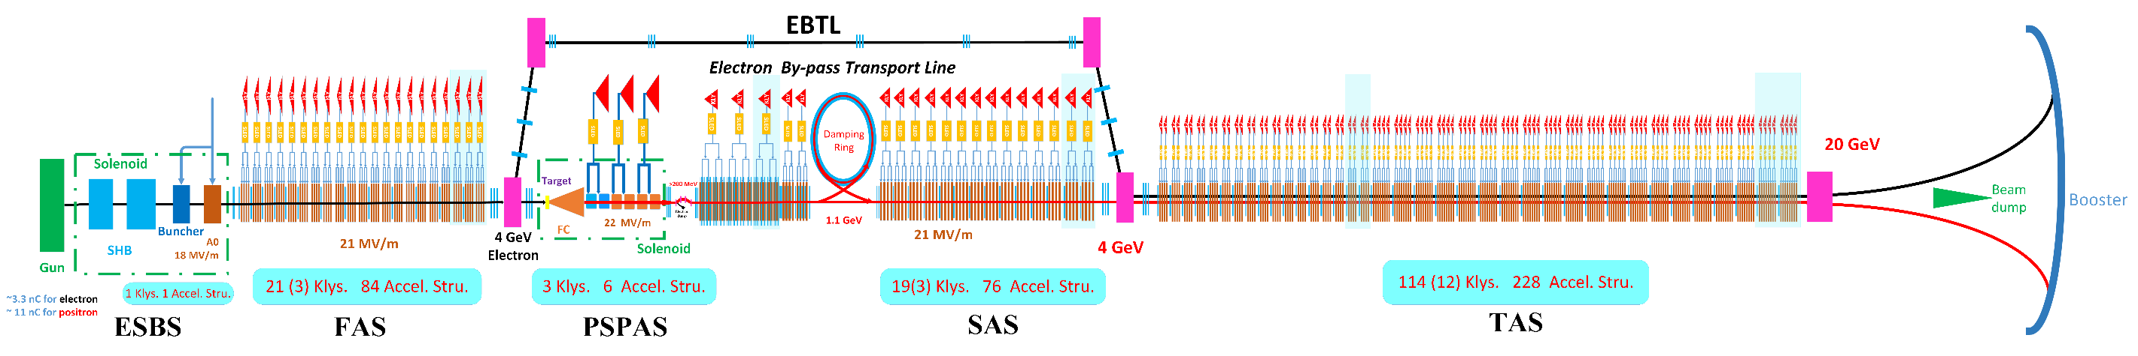
20-GeV scheme
Layout
Alternative Linac design
  Linac exit energy: 10GeV → 20GeV
  C-band: start energy~ 4GeV
  Transverse focusing: Triplet
  One klystron drive 2 accelerating structure
Alternative design
S-band Accelerating structure
C-band Accelerating structure
C-band: 4GeV → 20GeV
12% redundancy of accelerating unit

Slide 13
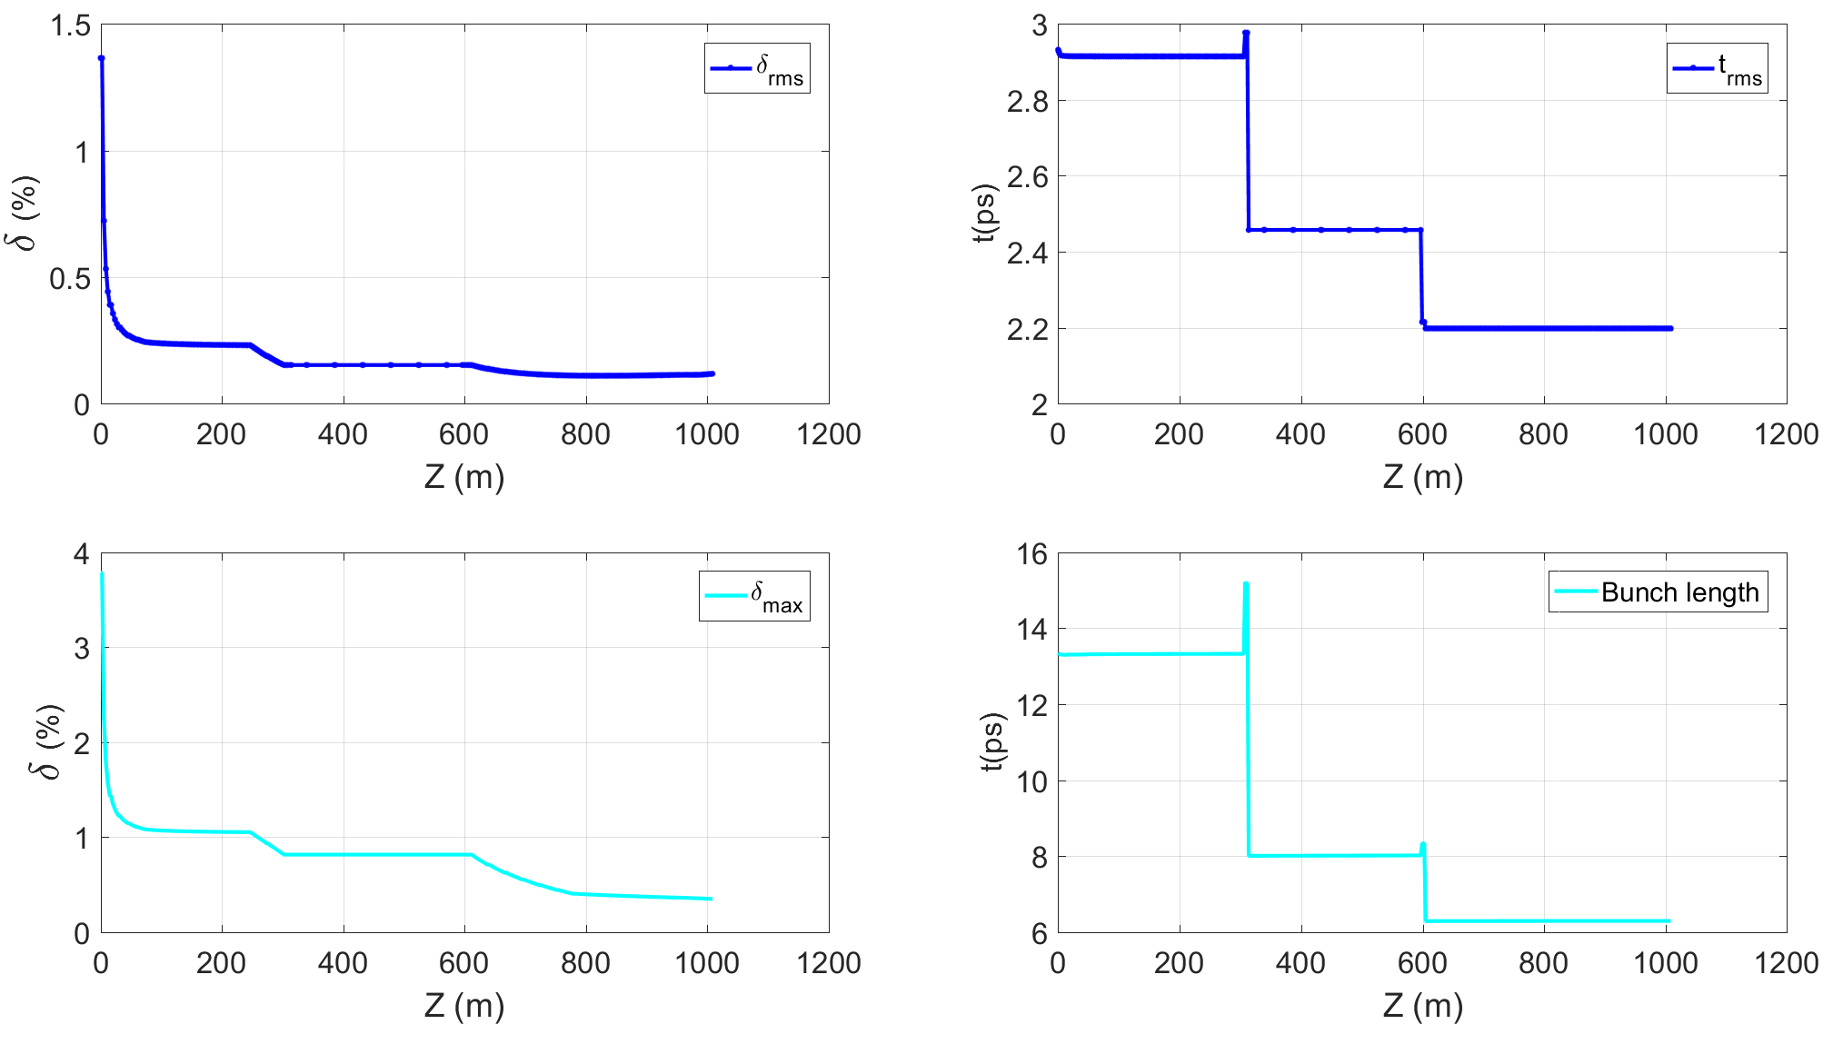
20-GeV scheme
Beam dynamics
The third accelerating section accelerating structure is replaced by S-band with C-band
  Larger Wakefield
  Need shorter bunch length ~ 0.5mm (rms)
    Positron beam: Bunch length compressor section
    Electron beam: EBTL

Slide 14
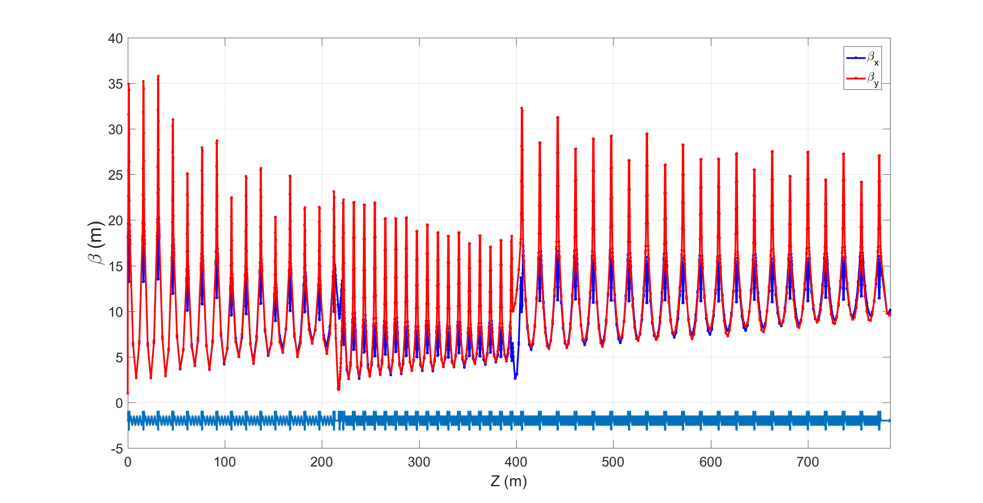
20-GeV scheme
Optics function
Lattice design (optics)
  1.1GeV (damping ring) →20GeV

Slide 15
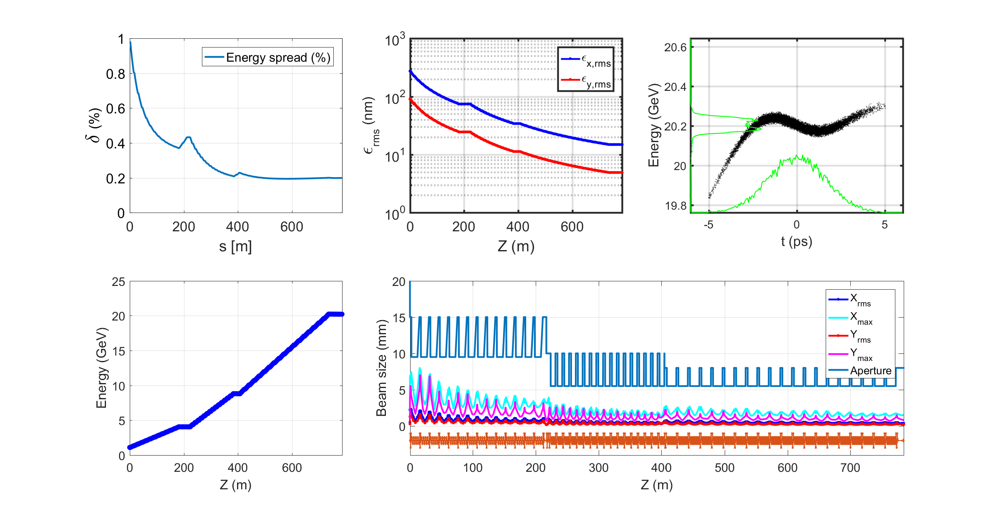
20-GeV scheme
Beam dynamics
Energy spread
  0.2%
  Rms Bunch length~ 0.5mm
    Difficulty design of BCS after Damping Ring
    Difficulty design for booster injection
  Maybe need an energy compressor
Emittance
  15nm
  More damping time in DR

Slide 16
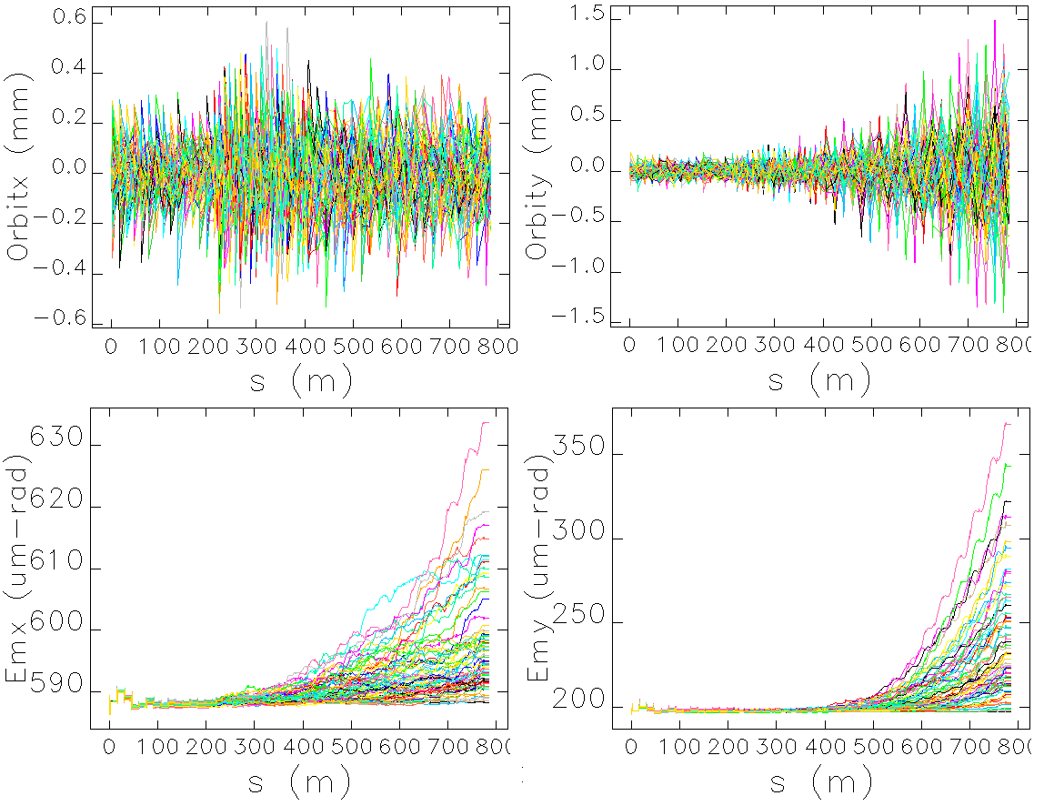
20-GeV scheme
Error study
Orbit distortion
  Without correction, beam lost at most case
  With correction
    Cx<0.6mm, emittance growth~2%
    Cy is growth greatly, emittance growth~20%, which is because the correction method, actual beam correction will get better results
    Emittance smaller than the required value
Element | Error | Value (mm)
Quadrupole | Misalignment(x/y/z) | 0.1/0.1/0.2
 | Field error | 0.1%
Accelerating structure | Misalignment(x/y) | 0.1/0.1
BPM | Uncertainty | 0.1

Slide 17
20-GeV scheme
Dynamic errors
Accelerating structure
  Phase errors and amplitude errors
    1 klystron → 4 S-band accelerating structure
    1 klystron → 2 C-band accelerating structure
  0.5 degree && 0.5%

Slide 18
45-GeV scheme
PWFA
Plasma Wakefield acceleration ~ transformer
  Energy-transfer from driver to witness
  High transformer ratio, asymmetrical bunch shapes
@Gregor Loisch IPAC19

Slide 19
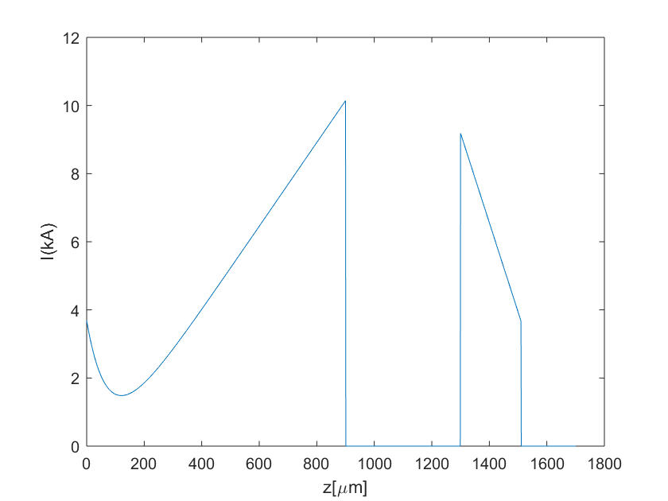
45-GeV scheme
PWFA
The Linac
  High bunch charge
  Low emittance
  Asymmetrical bunch shapes
S-band accelerating structure (short bunch length)
  Bunch compressor
L-band RF Gun
Parameters | Driver | Witness
Energy (GeV) | 10 | 10
Bunch charge (nC) | 5.8 | 1
Bunch length (ps) | 2 | 0.267
Energy spread | - | 0.2%
Norm. emittance (mm.mrad) | 50 | 100
Beam size (µm) | 20 | 20
Parameters | Driver | Witness e⁻ | Witness e⁺
Energy (GeV) | 10 | 10 | -
Bunch charge (nC) | 15 | 4.5 | 1.2
Bunch length (ps) | 3 | 0.7 | 0.07 (rms)
Energy spread | - | - | 0.2%
Norm. emittance (mm.mrad) | 50 | 100 | 50
Beam size (µm) | 30 | 20 | 20

Slide 20
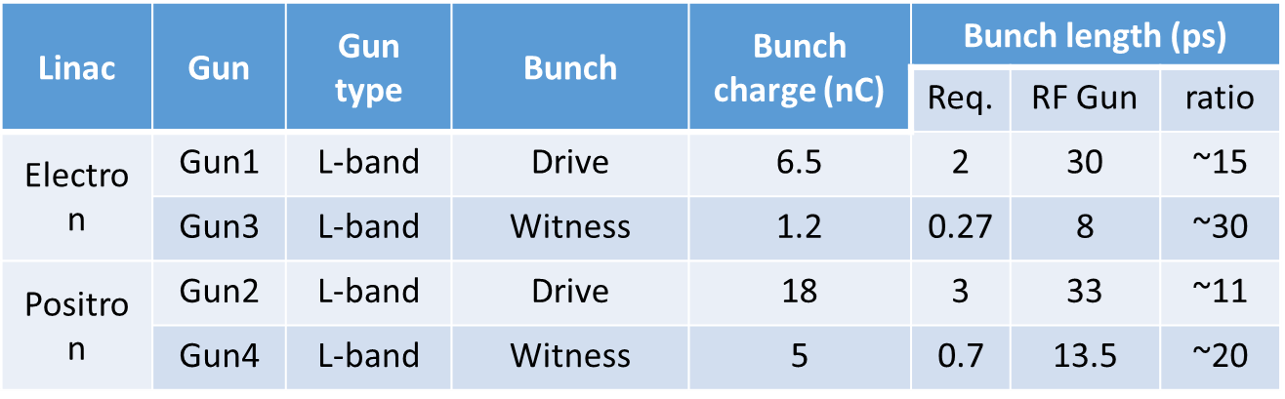
45-GeV scheme
layout
RF gun: Bunch shaping
Bunch compressor section
  Bunch compress and bunch shaping
Main linac
  Bunch charge~ 20nC

Slide 21
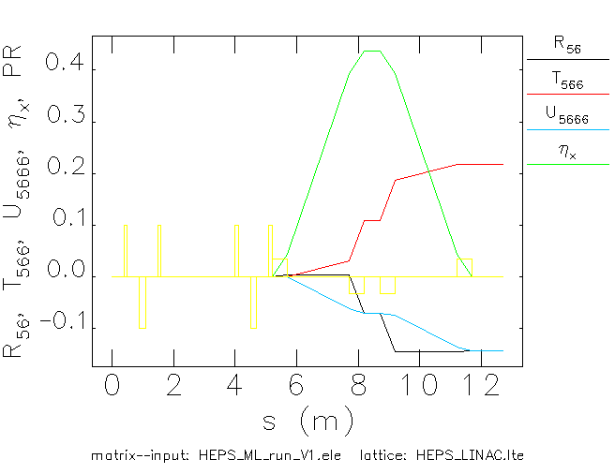
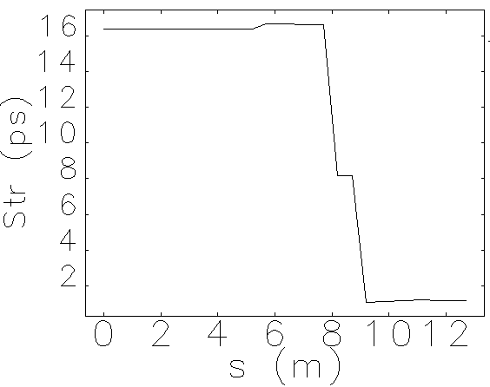
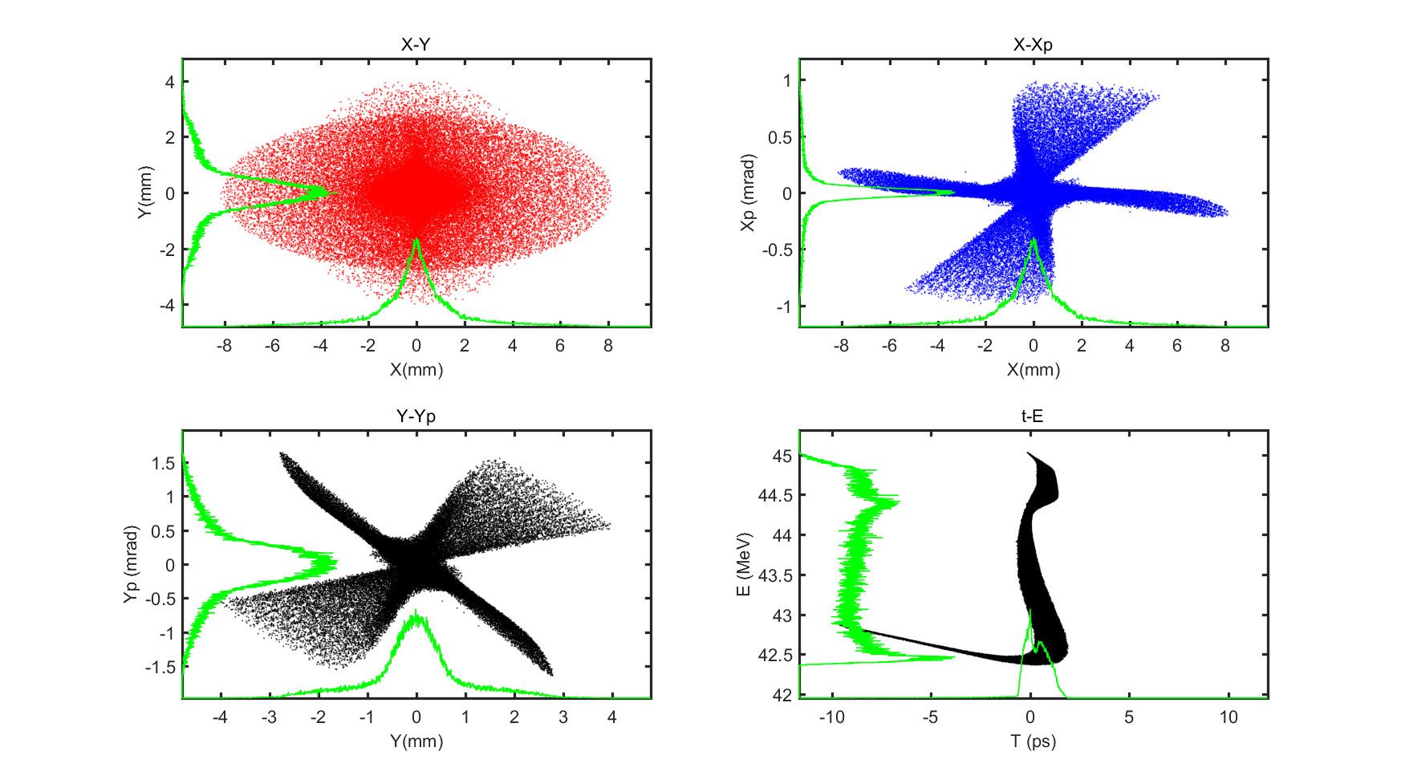
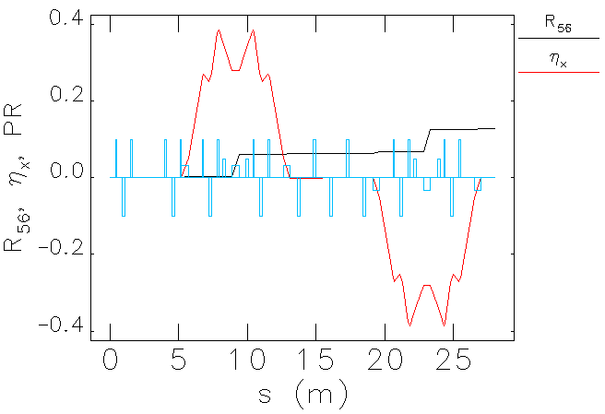
45-GeV scheme
Bunch compressor
Chicane or TBA
  Energy VS CSR
  Under design and optimization

Slide 22
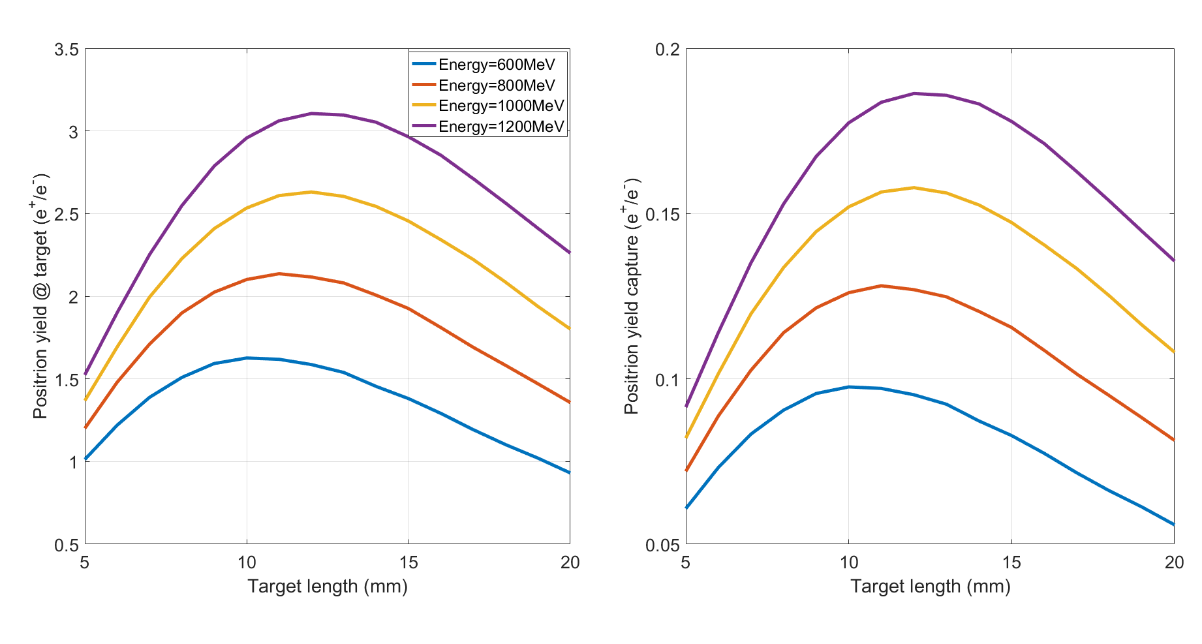

45-GeV scheme
Positron source
Positron beam (C₀)
  1.5nC
Electron bunch charge (n₀) VS. Electron linac energy (E₀)
Electron bunch charge: 10nC
Electron linac energy: 1GeV
Target
  tungsten@12 mm
  Beam size: 0.5 mm
G4beamline
$$C_{0} ≈k \text{×} n_{0}×E_{0}$$
@target
@capture, 6%

Slide 23
Summary
Preliminary analysis of CEPC Linac availability is proposed and about 15% redundancy of accelerating unit is important and effective based on the simulation by RAAS;
To reduce the risk of low magnetic field of booster injection, two alternative scheme of the Linac was proposed;
The alternative design with C-band accelerating structure and energy up to 20 GeV have been finished (12% redundancy for C-band accelerating units), including the scheme design, lattice design and error study, which can meet the requirements.
The scheme design with Plasma Wakefields acceleration is proposed, detailed lattice design and dynamic simulation is under going on.
Thank you for your attention!

Slide 24
backups

Slide 25
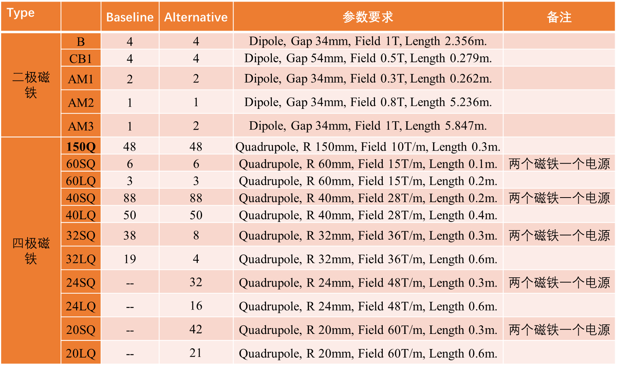
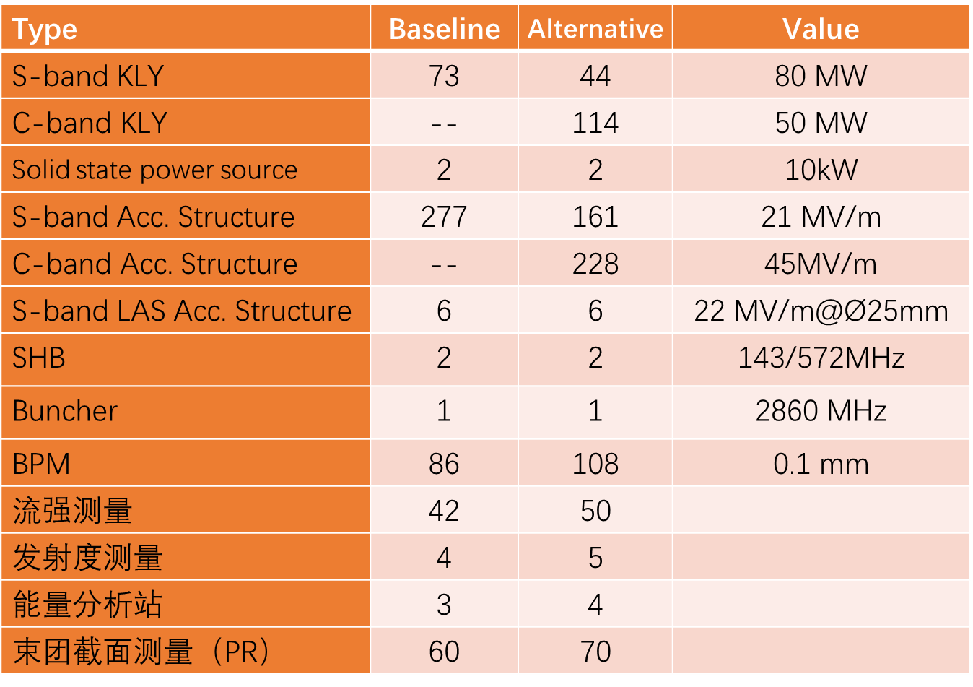
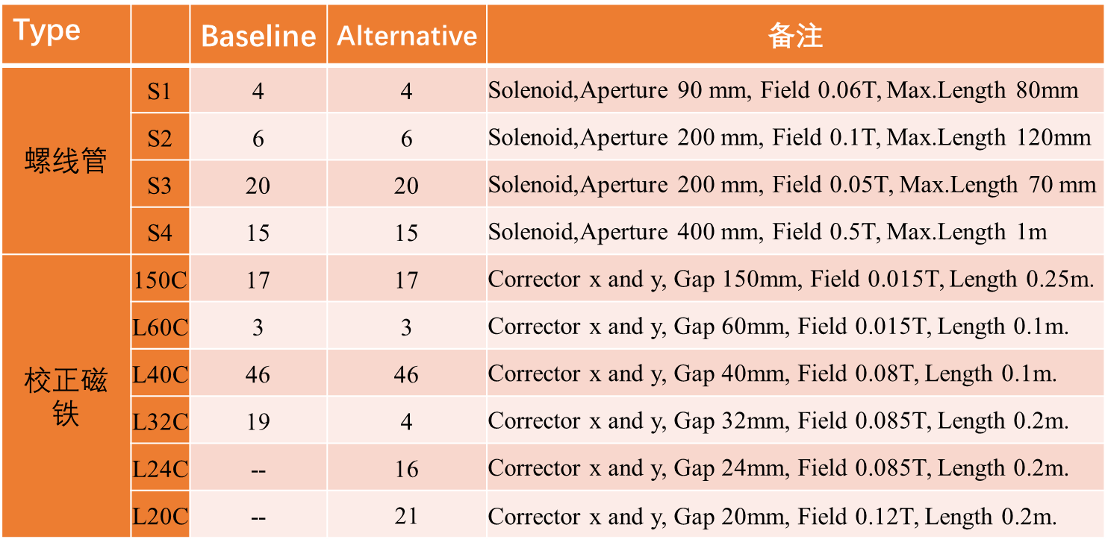
Alternative design
elements
Devices
  Magnet system
  Power source system
  Microwave system
  Beam diagnostic system
  Power supply system

Slide 26
Alternative design
COST!
The cost not included
  Source & Damping ring & transport lines @ LINAC
  All LTB hardware device
The cost increase 0.34 Billion CNY (38%), the energy grows up from 10 GeV to 20GeV
@J. R. Zhang
No. | System | Price （Ten thousand）
 |  | S-band (10 GeV) | S&C-band (20 GeV) | Gap
1 | RF system (Ch 6.5.1) | 33338 | 45622 | 12284
2 | RF power source (Ch 6.5.2) | 32190 | 46740 | 14550
3 | Magnets (Ch 6.5.3) | 2183 | 3323 | 1140
4 | Magnet power supplies (Ch 6.5.4) | 2050 | 2328 | 278
5 | Vacuum system (Ch.6.5.5) | 6060 | 10221 | 1847
6 | Instrumentation (Ch 6.5.6) | 6400 | 7335 | 935
7 | Control system (Ch 6.5.7) | 5793 | 6112 | 319
8 | Mechanical systems (Ch 6.5.8) | 1070 | 1327 | 257
 | Total | 89084 | 123008 | 33924

