Slide 1
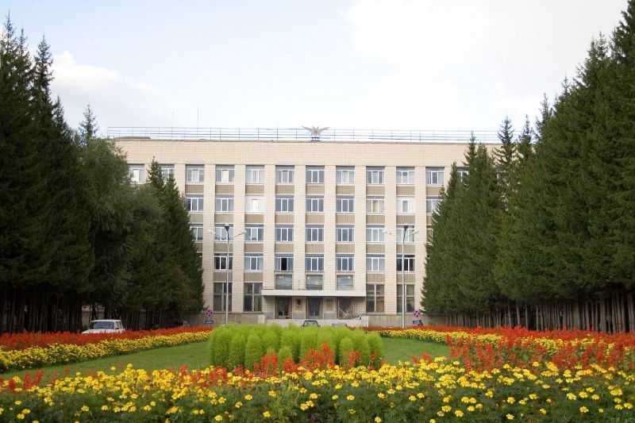
Development and optimization of FF superconducting magnets
(Super ct-factory)
KseniIa RIabchenko
Budker Institute of Nuclear Physics Siberian Branch of Russian Academy of Science
2019

Slide 2
OUTLINE
Super CT factory
Quad configuration
Field quality
Pole geometry
Shielding collar
Coils tolerance
Pole tolerance
Conclusion

Slide 3
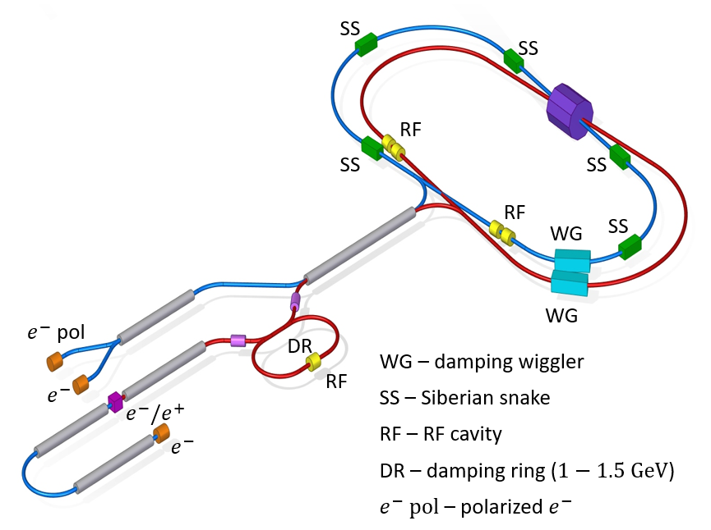
SUPER CT FACTORY IN NOVOSIBIRSK
Super Charm-Tau (CT) Factory is a double ring e+e- collider to be operated in the centre-of-mass energy range from 2 to 6 GeV, with a peak luminosity of about 10³⁵ cm⁻²s⁻¹ (Crab Waist collision) and with longitudinally polarized electrons at the IP.
This high luminosity will allow access to data samples, which are 3 orders of magnitude greater than those previously collected in any other experiments. This will provide the opportunity of a systematic study of all states of quarks of the first two generations.

Slide 4
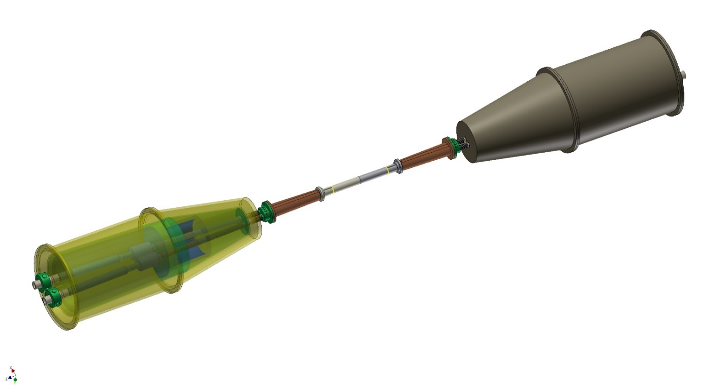
FF CONFIGURATION
One of the most essential element of the Super CT FF is a dual aperture superconducting quadrupole to squeeze the beams at the IP with the following parameters:
Aperture radius, mm | 23
Gradient, T/m | 100
Gradient integral, T | 22
Current, kA turn | 21,5
Crossing angle, mrad | 30
Effective length, m | 0,22
IP
QD0
QF1
IP
3.3 m
IP
Cryostat with FF magnets
Beam trajectories in FF
Cryostat with FF magnets
Artist view of the FF arrangement

Slide 5
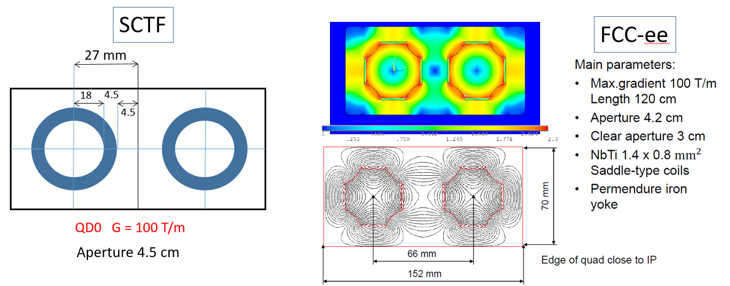
TASKS OF THE STUDY
We decided to produce a full scale prototype of the quad and the main tasks of the study include:
3D simulation of the quad field
Production tolerance study
Optimization of the field components
Transverse dimensions and parameters of QD0s for SCTF and FCC-ee are rather similar…

Slide 6
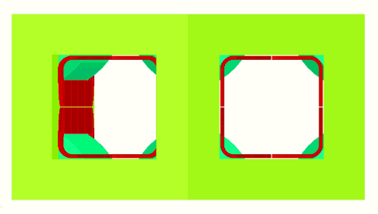
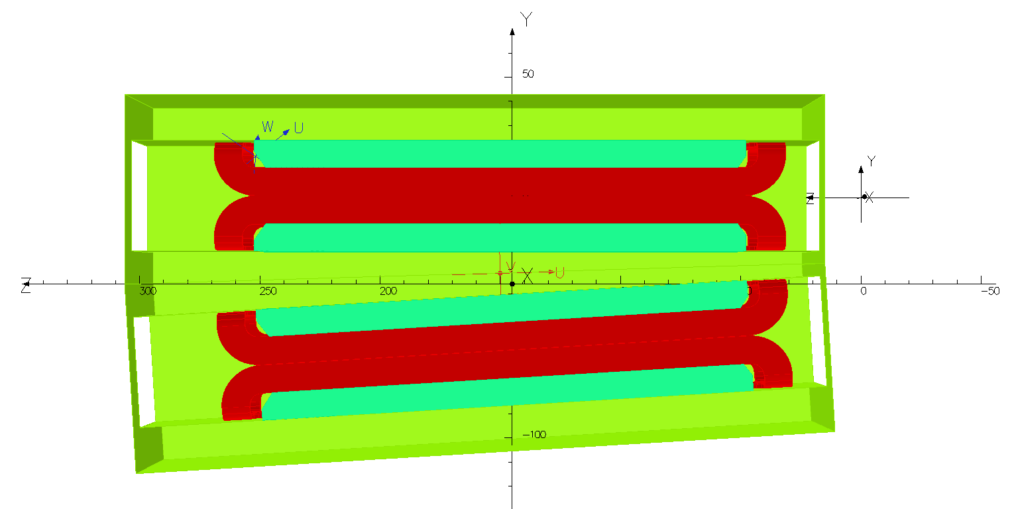
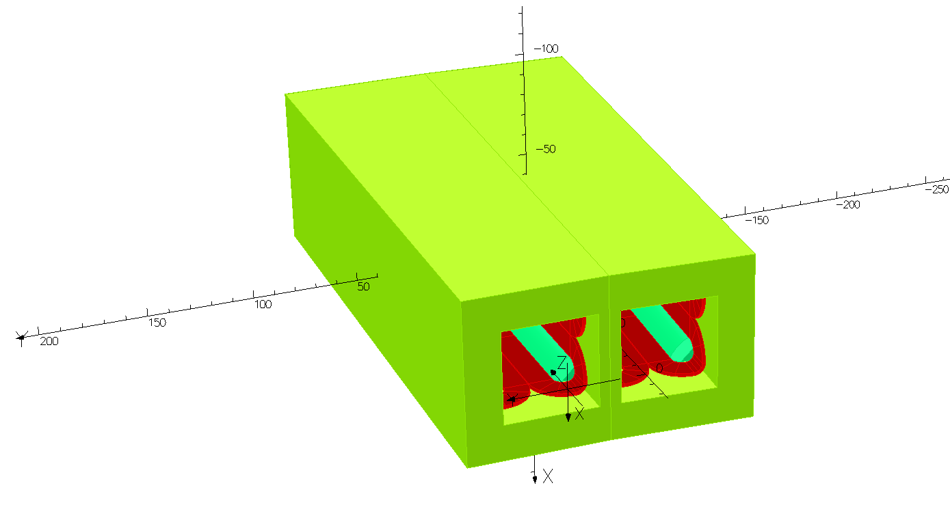
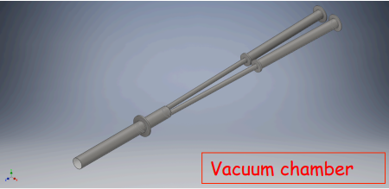
Quadrupole configuration
Yoke
54 mm
Poles
Coils
151,8
17,4
300,1mm
79,8 mm
133,8
The slide shows a draft version of the vacuum chamber

Slide 7
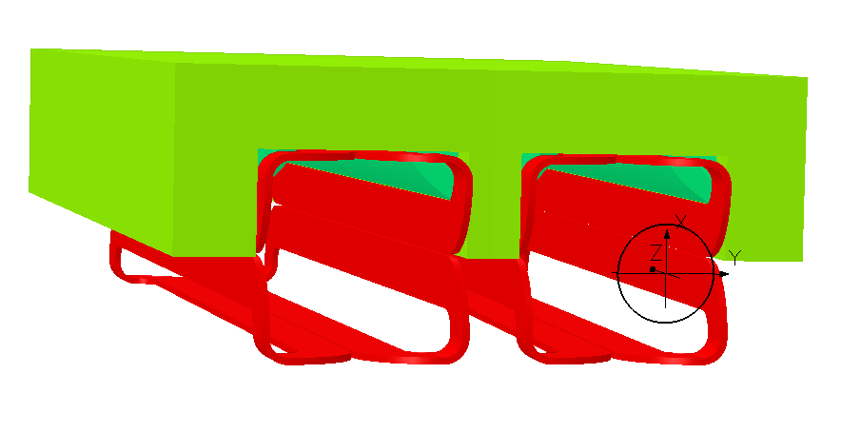
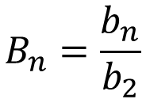
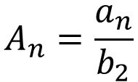
Field quality
All calculations were performed by the Opera program. Formula to determine the quality of the magnet. The field integrals are taken at the radius $r_{0}=10 mm$:
X
r
Relative multipole coefficient:
ϕ
Y
$$B_{n}=\frac{b_{n}}{b_{2}}$$
$$A_{n}=\frac{a_{n}}{b_{2}}$$

Slide 8
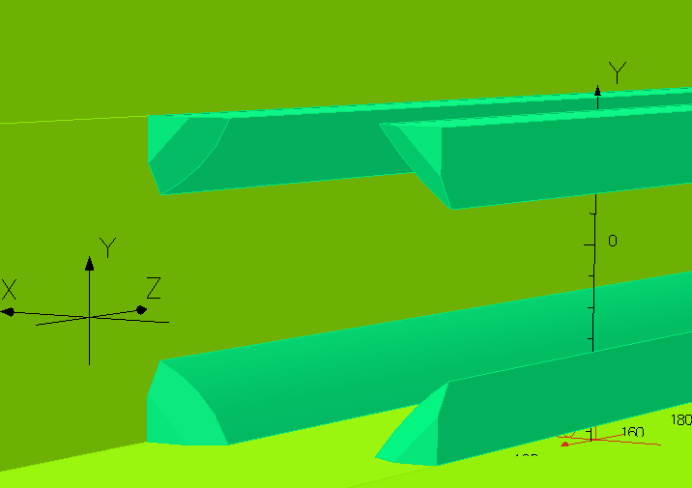
End pole chamfer
In order to reduce B6 harmonics, it is necessary to make end pole chamfer. After carrying out calculations with different chamfer sizes, the following dependency was obtained:
I = 21500 A
Pole/ nose piece
chamfer
L
45°
B10 harmonic varies slightly with increasing chamfer sizes, B6 harmonic can be reduced by a maximum chamfer size to 1.5 units
L
X
Z
As you can see from the graphs, chamfers are not enough, so we continued the optimization process

Slide 9
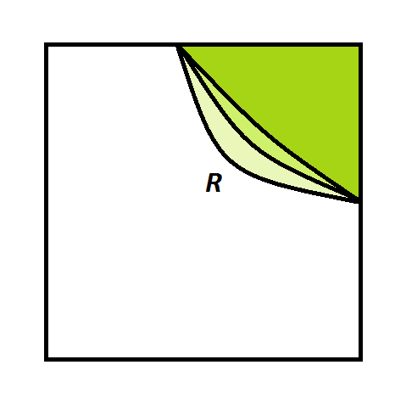
Pole profile
If it is necessary to further reduce the harmonics, we need to modify the pole profile. For example, to reduce B6 harmonic, you can change the radius of the hyperbola of the pole.
I = 21500 A
For our case, it can be seen, that when the radius is increased by 3 mm, the magnitude of B6 harmonics decreases by 3 units

Slide 10
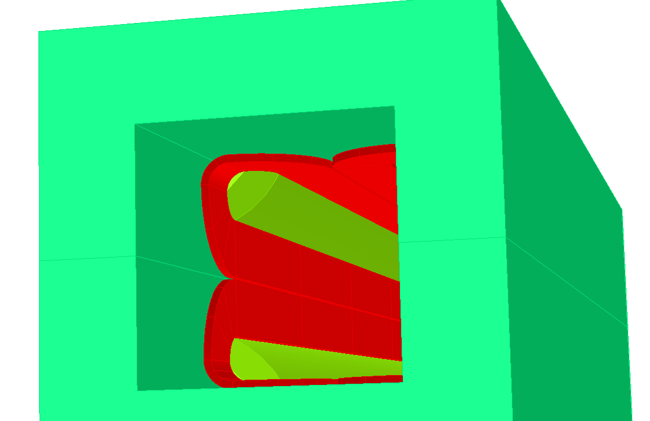
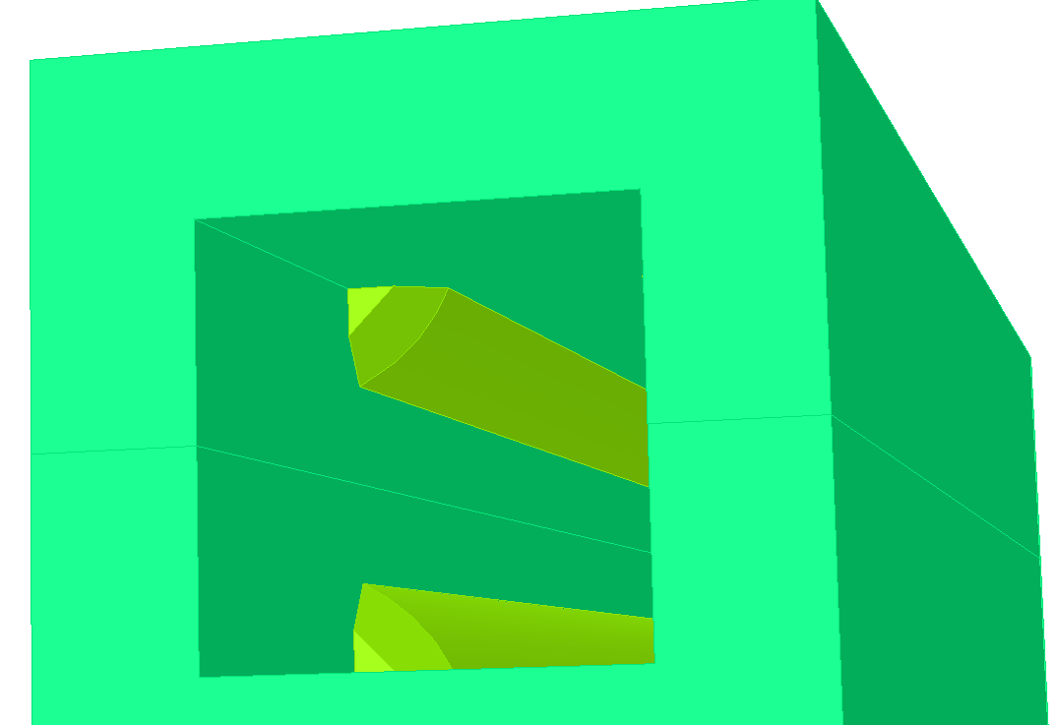

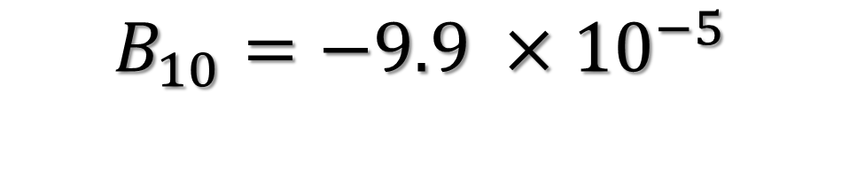
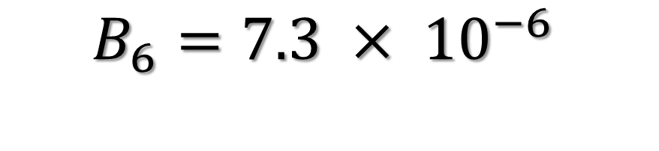
Pole geometry
Based on the previously presented results, the following combination of pole geometry was chosen: the hyperbola radius was 26.6 mm and the chamfer was 5 mm.
$$I=21500 A$$
$$B_{6}=7.3 × {10}^{−6}$$
$$B_{10}=−9.9 ×{10}^{−5}$$

Slide 11
Steel for yoke
All initial calculations were performed for a quadrupole consisting entirely of permendur. Choosing the best pole geometry, we carried out for several types of steel.
First - the calculations for the permendur quadrupole, second, the case when we replaced the permendur on the ordinary electro technical steel, and the case when the yoke is made of ordinary steel, and the poles are made of permendur.
In general, the permendur poles are enough to improve the quality of the field. So, we decided to choose this types of steel for the model.

Slide 12
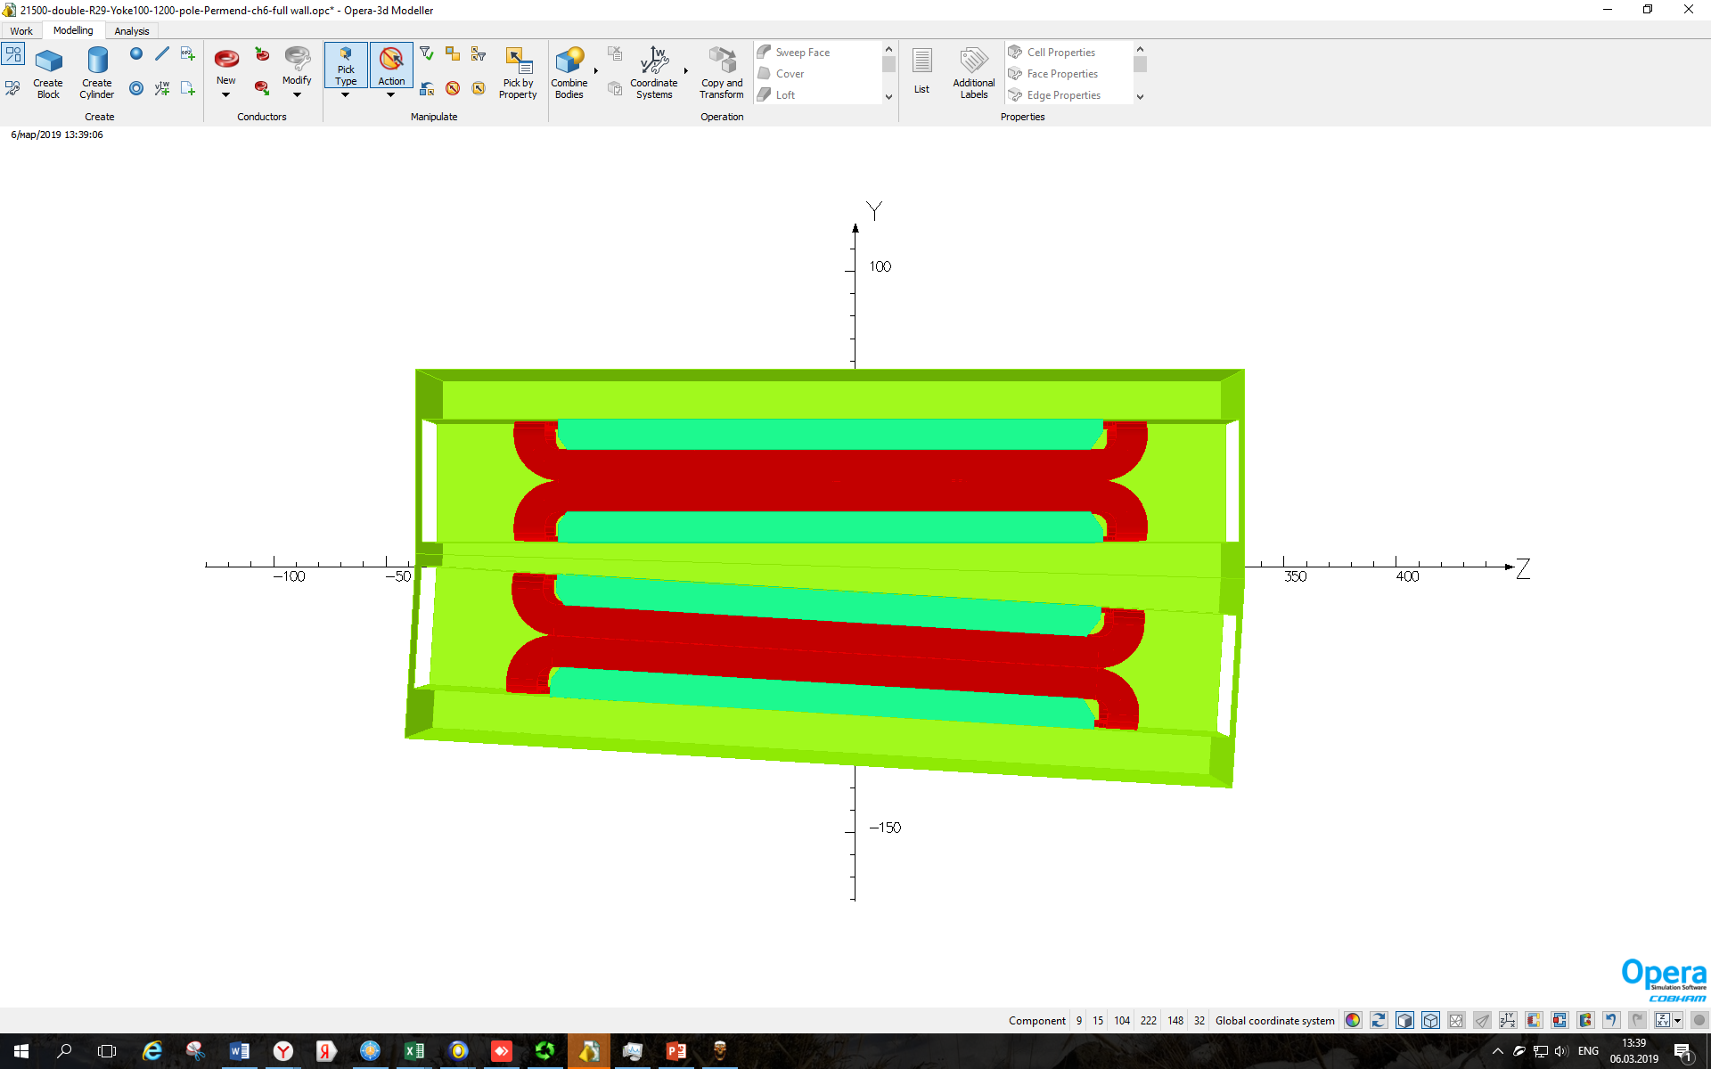
Shielding collar
There was an idea, that for shielding the action of one coil to another, it is necessary to make an iron collar. It was expected that the longer the collar, the coils would interact less.
I = 21500 A
L1
L1 – iron screen length
A3 | L1 = 2.5 mm | L1 = 4 mm | L1 = 20 mm
I = 21500 A | 0.29 | -4.42 | -0.08
I = 10750 A | 0.56 | -5.14 | 0.05
According to calculations, we see that there is a small shield at which the A3 harmonic vanishes. Therefore, it would be better to make a small collar, but with a smaller current value, the magnitude of this harmonic changes by 5 units. In this case, there will be a need for additional harmonic correction.

Slide 13
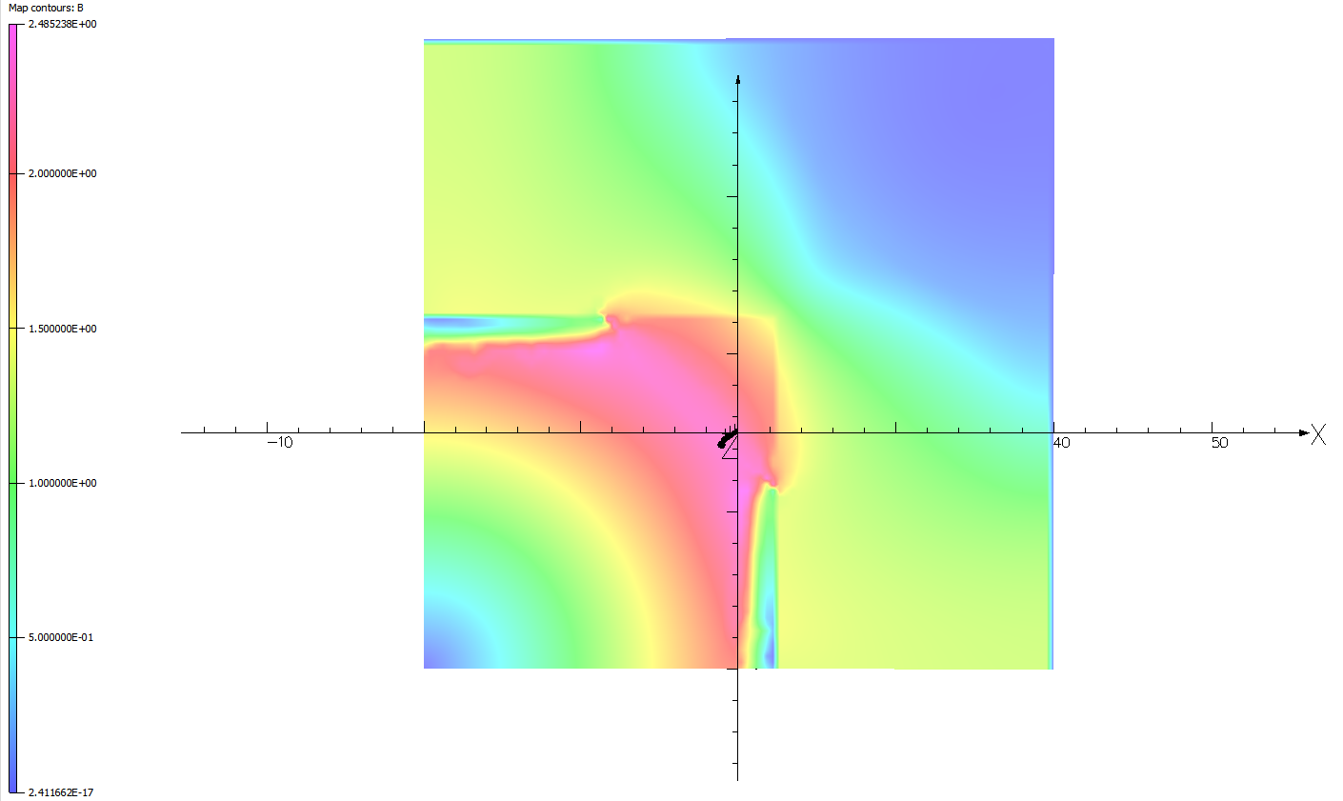
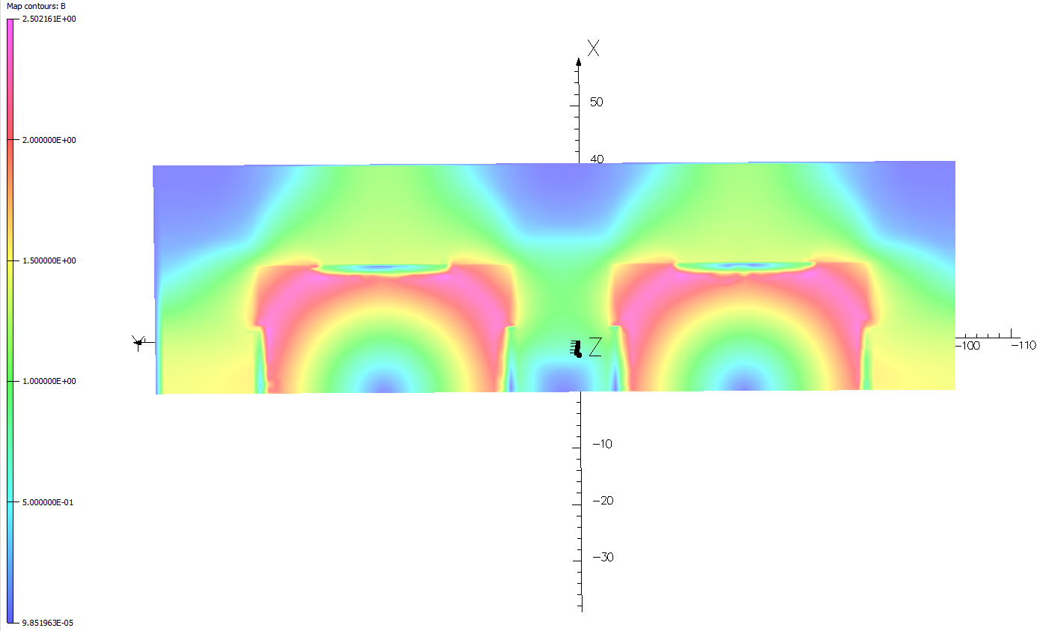

Single aperture vs twin-aperture
Calculations for a single and twin aperture quadrupole with a full shielding collar of 50 mm and without it were made. On this slide, you can see cross section of magnetic field in the middle of a quadrupole.
B max = 2,5 T
B min = 5 x ${10}^{−1}$ T

Slide 14
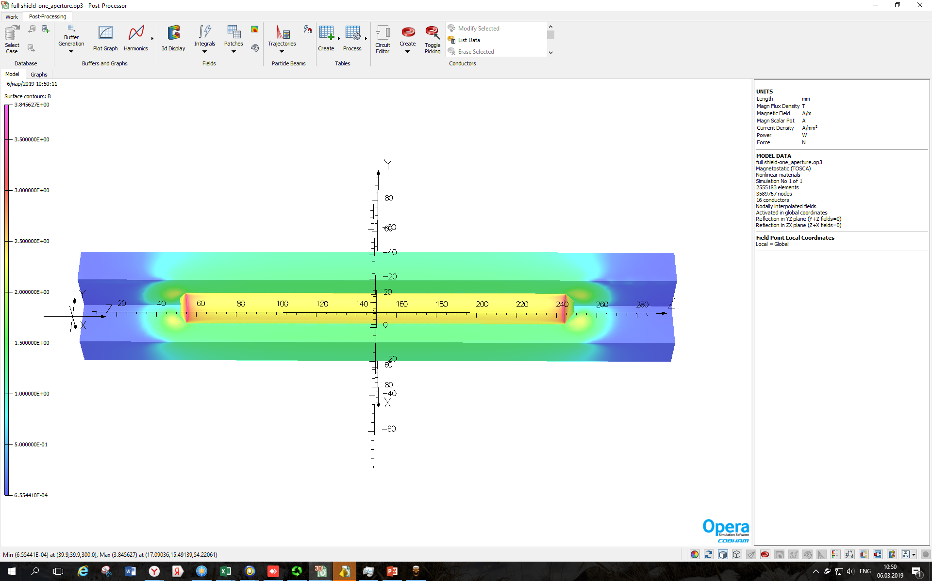
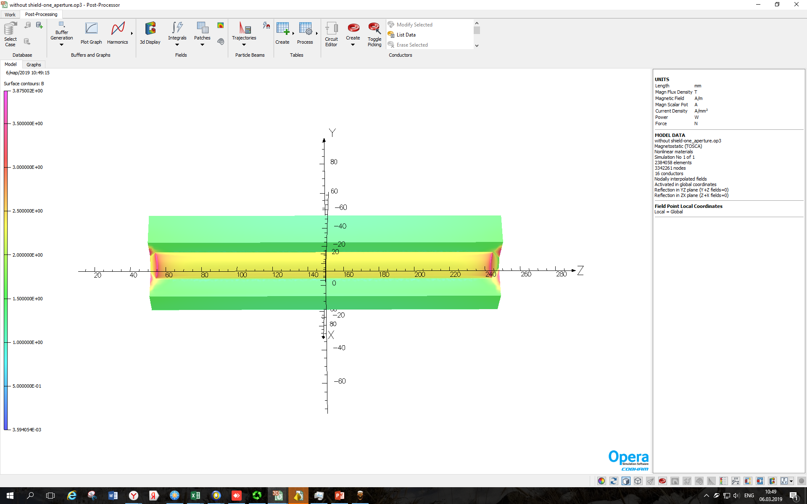
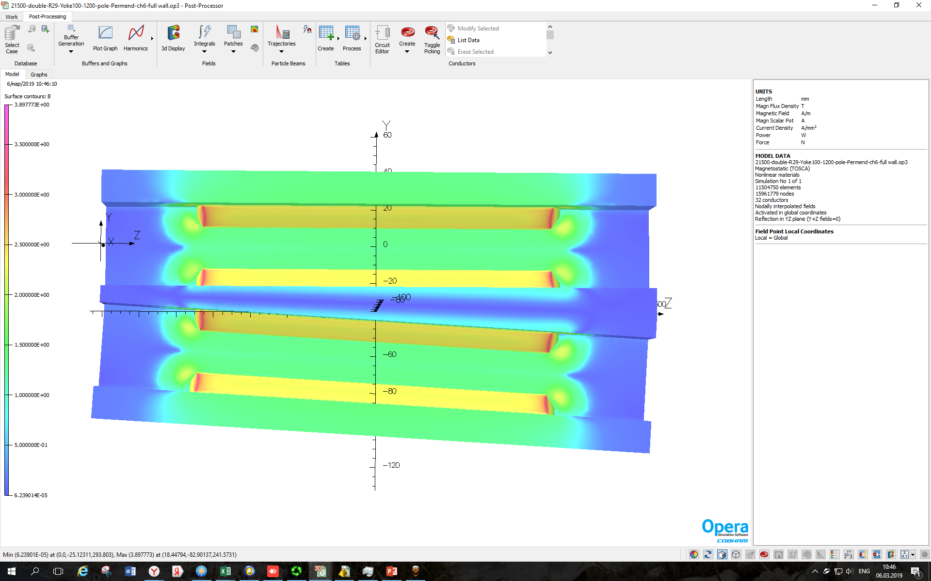
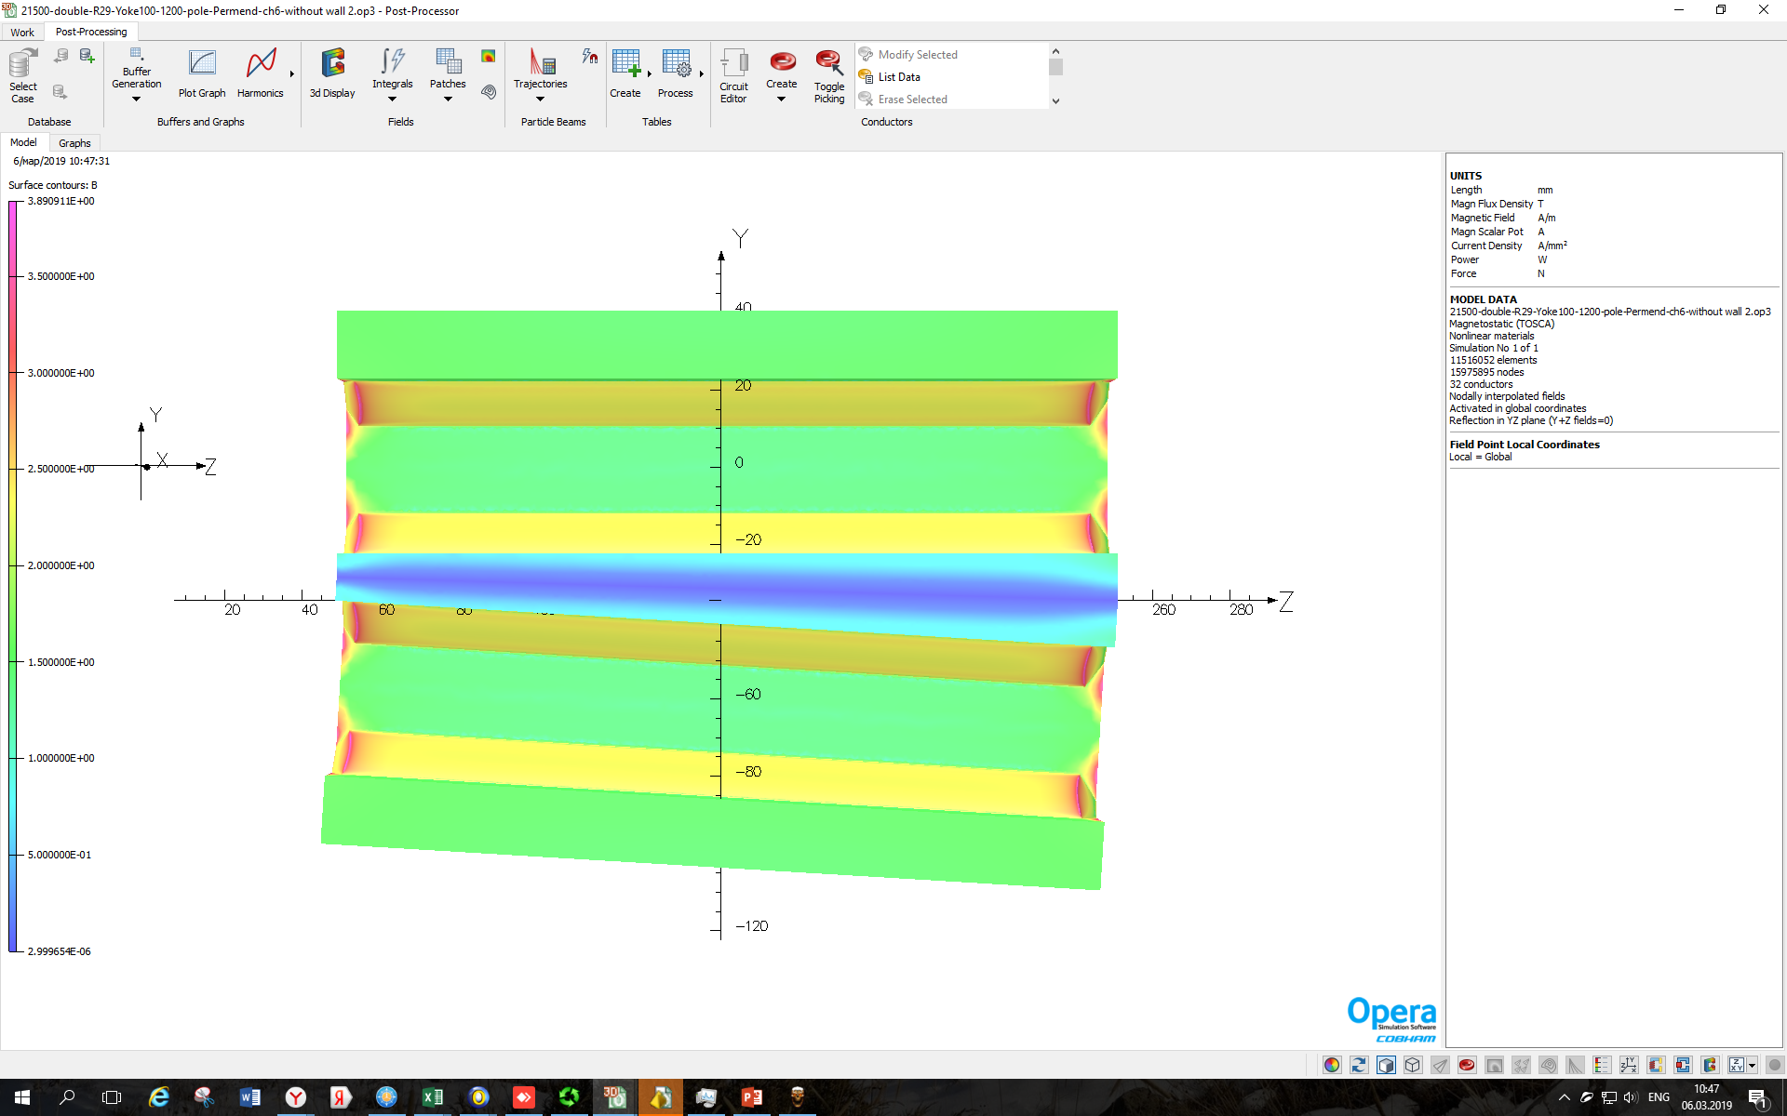


w/wo shielding collar
B max = 3,9 T
B max = 3,9 T
B min = 6,6 x ${10}^{−4}$ T
B min = 2,9 x ${10}^{−6}$ T

Slide 15
Field quality comparison
I = 21500 A
I = 21500 A
There are practically no differences in harmonics between single and twin aperture lenses with a collar.

Slide 16
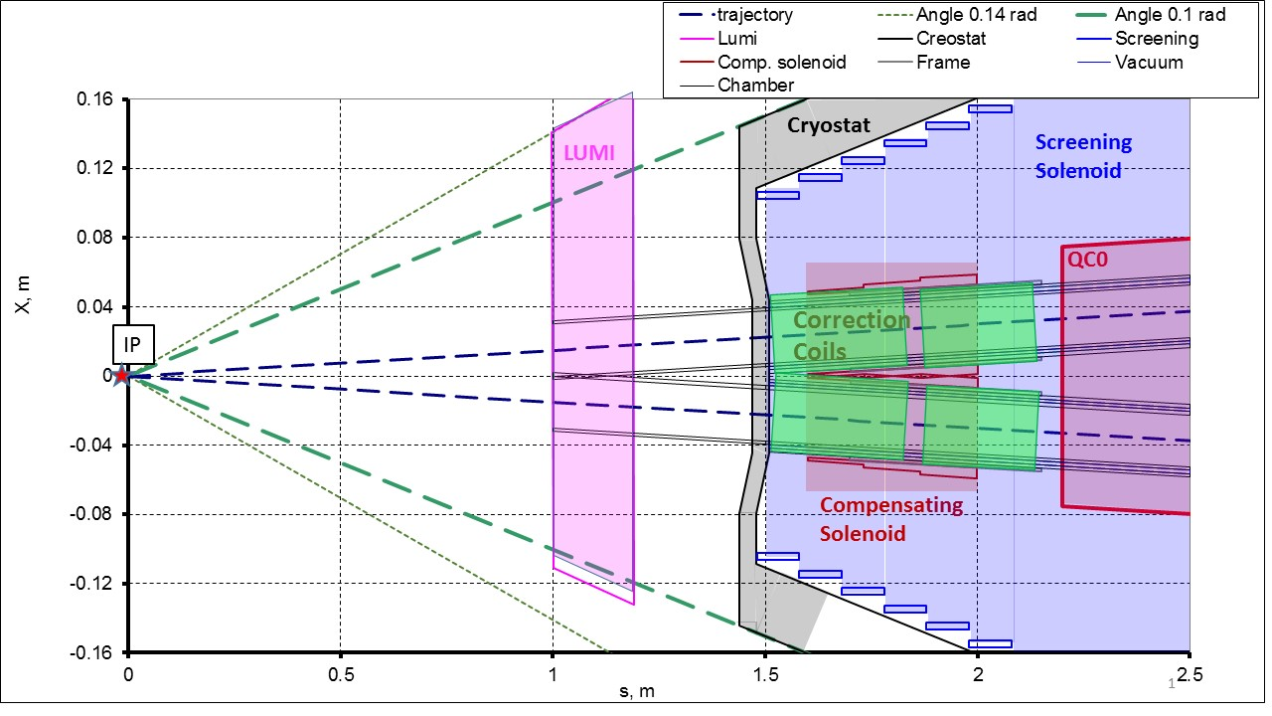
external field with collar i
At the point of interaction is a system of solenoids. For example, an external solenoid creates a field 2 tesla. The screening solenoid (L=2,4 m) zeros the fields in the quadrupole region. There is also another solenoid – compensating (B=3 T, L=0,3 m ). Because the compensating solenoid is at close range to the quadrupole, this solenoid creates a field acting on the lens.
Solenoids edge fields in the quadrupole area:
B_{s}<0.01 T, B_{x}<0.002 T
It is necessary to introduce additional corrections in the screening area.

Slide 17
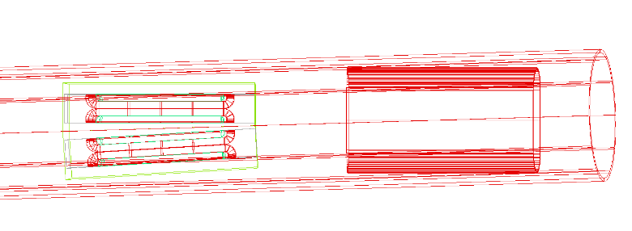
external field with collar ii
For this reason, we made a model task: how does the external field of all solenoids affect the integral harmonics.
Screening solenoid
Quadrupole lense
Compensating solenoid
The results for the system of solenoids show that a sextupole component arises. However, this is not scary, since we can suppress these harmonics.

Slide 18
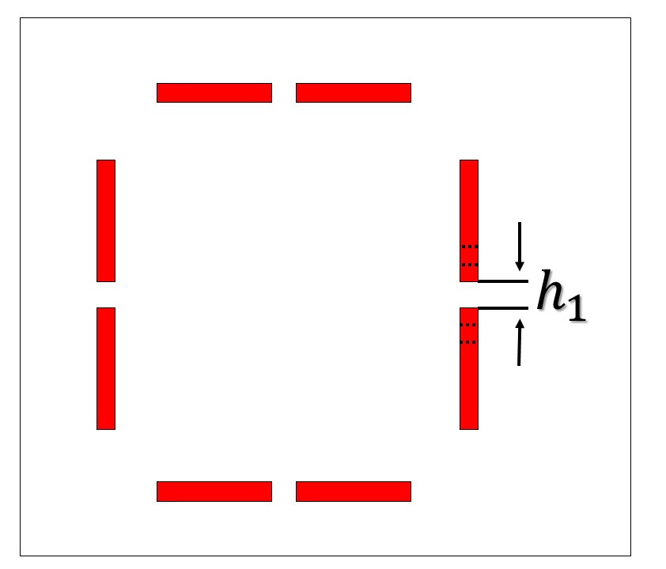

Coils tolerance i
Now consider the effect of coils shift on the integral harmonics. Firstly, we change the width of the conductors on one side, which, respectively, leads to a change in the distance between them. The current was not changing, but the current density was.
$h_{1}$ - distance between the conductors
The harmonic A3 changes with an increase in the distance between the conductors to about 65 units. The harmonics B4 and A5 increase with increasing distance between the conductors. B6 harmonic changes to the level of -10 units.

Slide 19
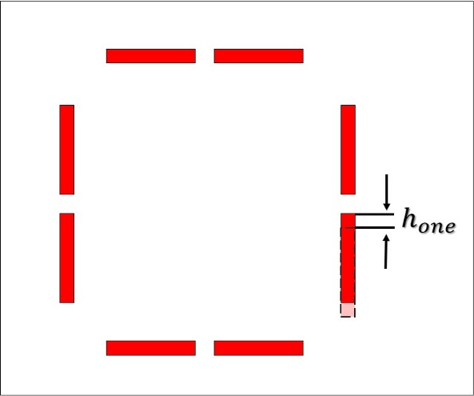
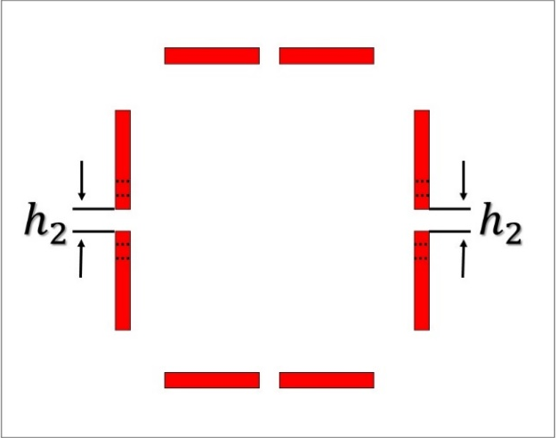
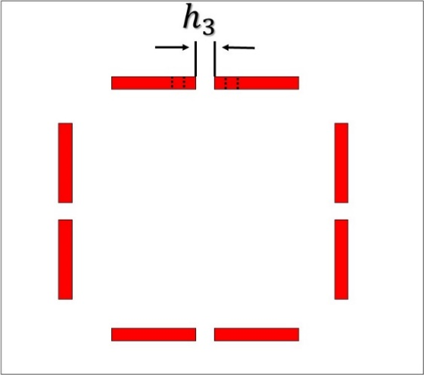
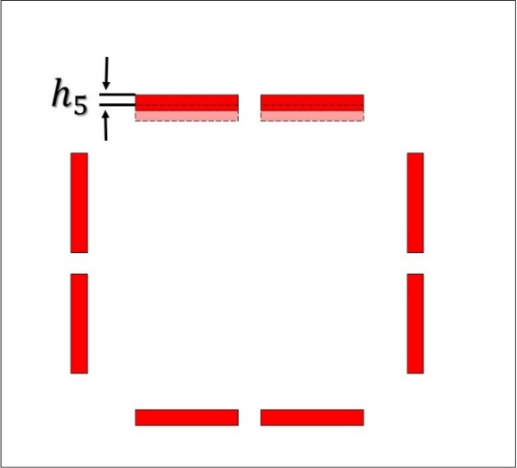
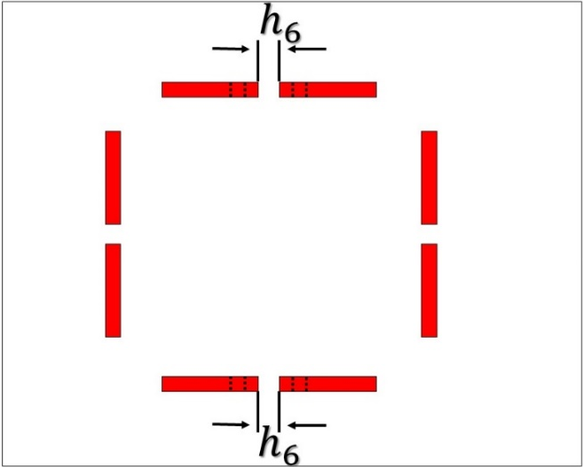
Coils tolerance Ii
Many variant of coil displacements have been studied. From the results, it can be seen that after manufacturing a quadrupole lens, it is possible to easily get rid of unwanted harmonics by this method

Slide 20
Pole tolerance i
The effect of nonlinearities at the poles on the harmonics was investigated. We simulated the presence of micro cracks in one of the poles, in other words, made it laminated with a packing factor equal to 0.9.
I = 21500 A
g – packing factor
The graph shows that in this case, the harmonic A3 from the zero level increases to 16 units. A5 from the zero level to 4. The harmonics B6 and B4 varies slightly, but B10 does not change at all

Slide 21
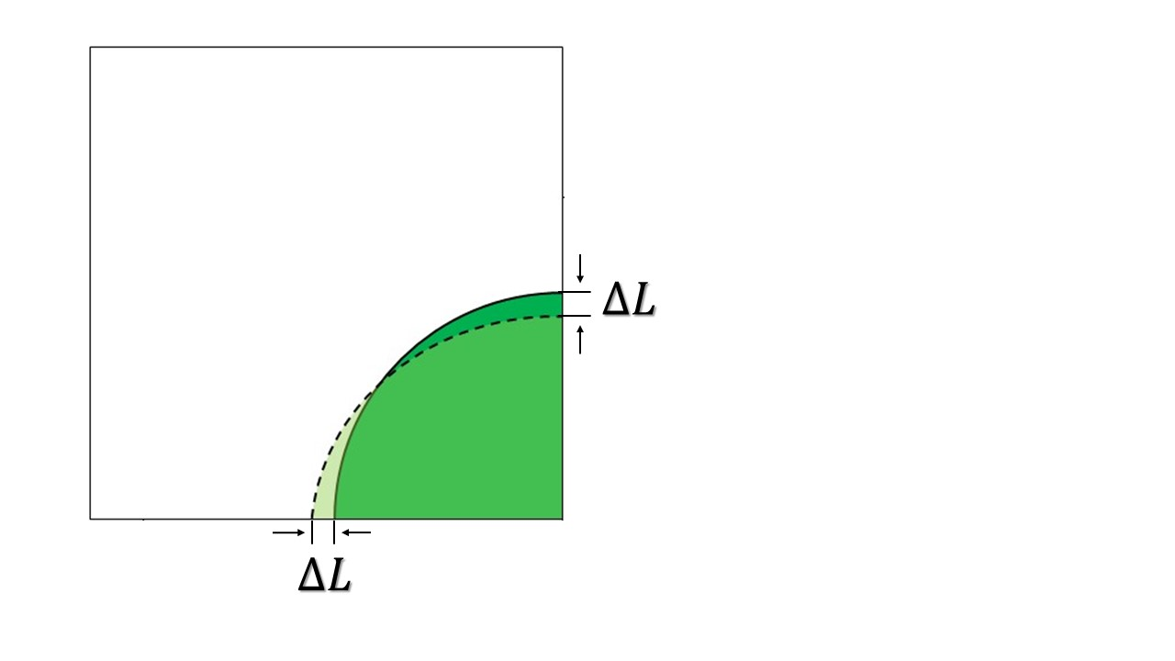
Pole tolerance ii
The case when the pole is rotated by a certain amount has also been considered.
I = 21500 A
∆L - the amount by which the pole shifts
By calculations it can be seen that such a shift leads to an increase in the A3 harmonic by 3 units, a change in A5 in the negative direction by 1 unit.

Slide 22
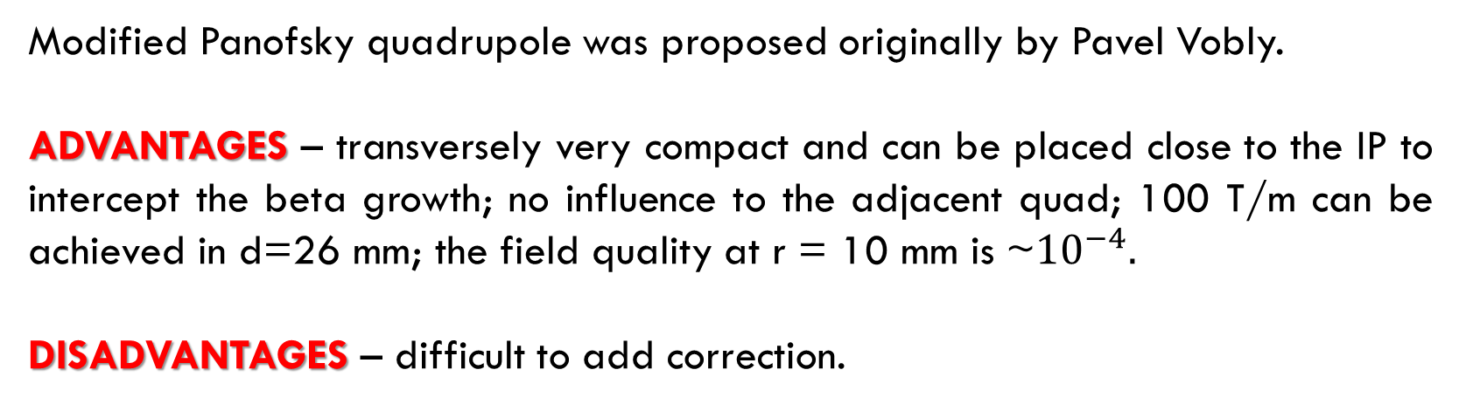
dual aperture superconducting quadrupole
Modified Panofsky quadrupole was proposed originally by Pavel Vobly.
ADVANTAGES – transversely very compact and can be placed close to the IP to intercept the beta growth; no influence to the adjacent quad; 100 T/m can be achieved in d=26 mm; the field quality at r = 10 mm is ~${10}^{−4}.$
DISADVANTAGES – difficult to add correction.

Slide 23
conclusion
3D field simulation has been done.
Geometrical parameters were chosen.
Sources of possible errors and methods to correct unwanted harmonics were found.

Slide 24
Thanks for your attention!!!
For any questions please contact us by mails:
kseny121195@mail.ru
e.b.levichev@inp.nsk.su
a.a.starostenko@inp.nsk.su

Slide 25
Development and optimization of FF superconducting magnets
(Super ct-factory)
KseniIa RIabchenko
Budker Institute of Nuclear Physics Siberian Branch of Russian Academy of Science
2019

Slide 26

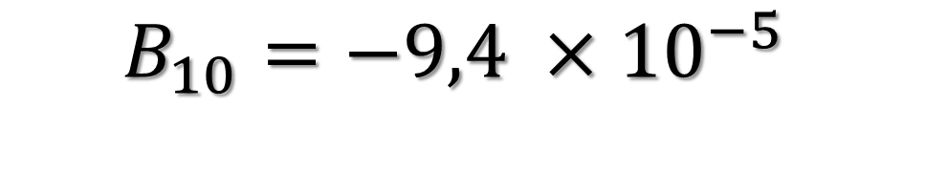
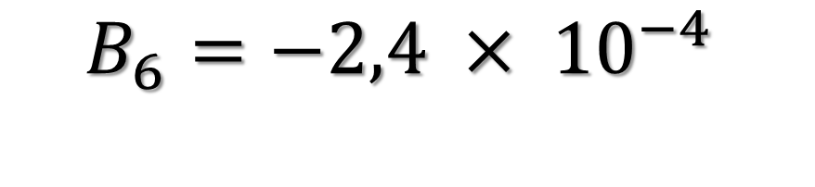
Pole geometry
Based on the previously presented results, the following combination of pole geometry was chosen: the hyperbola radius was 26.6 mm and the chamfer was 5 mm.
$$I=10750 A$$
$$B_{6}=−2,4 × {10}^{−4}$$
$$B_{10}=−9,4 ×{10}^{−5}$$

Slide 27
Steel for yoke (I=10750 A)

Slide 28
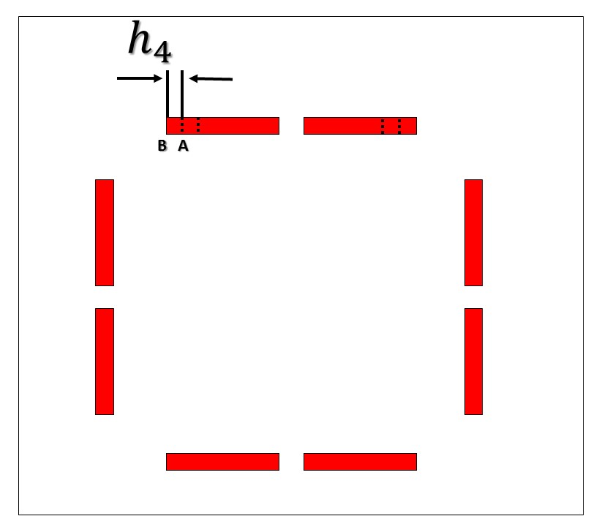

Coils tolerance I
The effect of changing the thickness of the upper conductors and the distance between points A to B on the integral harmonics.
$h_{4}$ - distance between points A to B

Slide 29
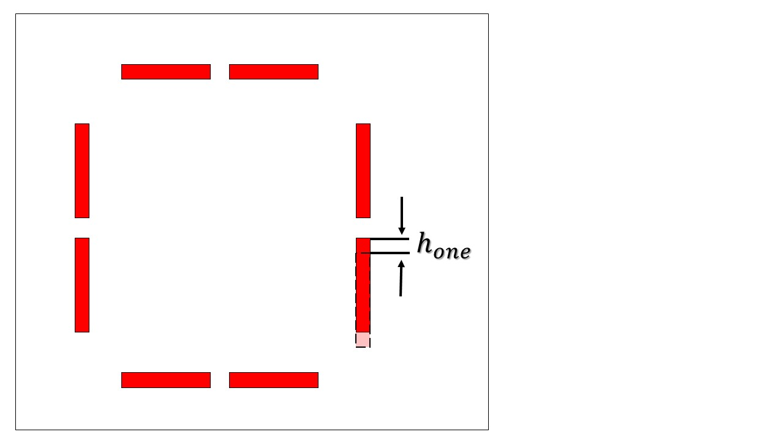
Coils tolerance ii
The effect offset down the one lateral conductor on the integral harmonics.
$h_{one}$ - thickness of the one lateral conductor

Slide 30
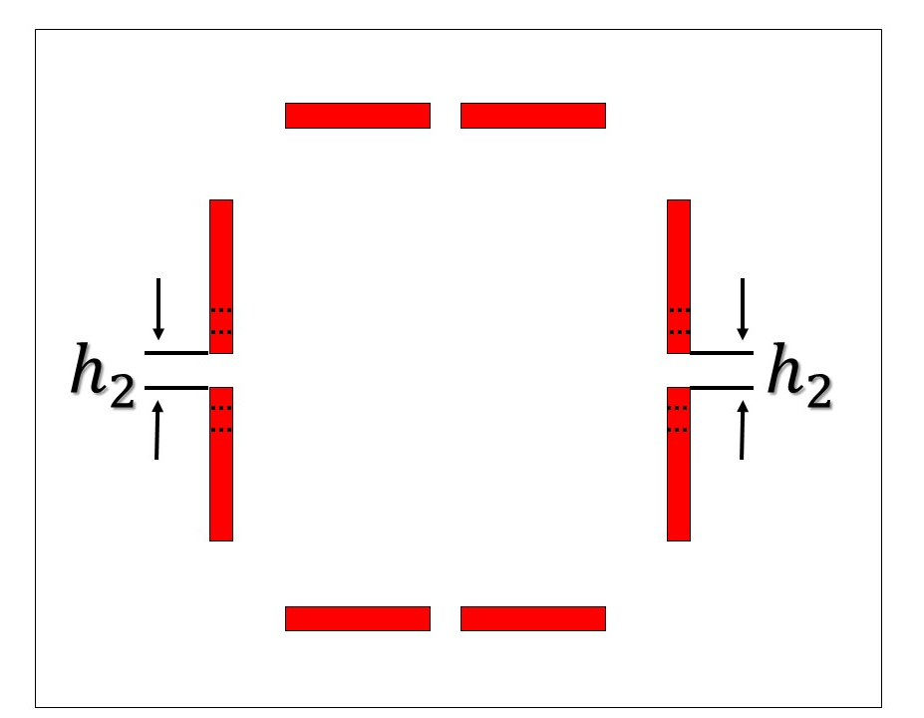

Coils tolerance Iv
The effect of changing the thickness of symmetrical side conductors and the distance between them on the integral harmonics.
$h_{2}$- distance between the conductors

Slide 31


Coils tolerance v
The effect of changing the thickness of the upper conductors and the distance between them on the integral harmonics.
$h_{3}$ - distance between the conductors

Slide 32

Coils tolerance Vi
The effect of changing the height of the position of the upper conductors on the integral harmonics.
$h_{5}$ - height at which the upper conductors fall

Slide 33
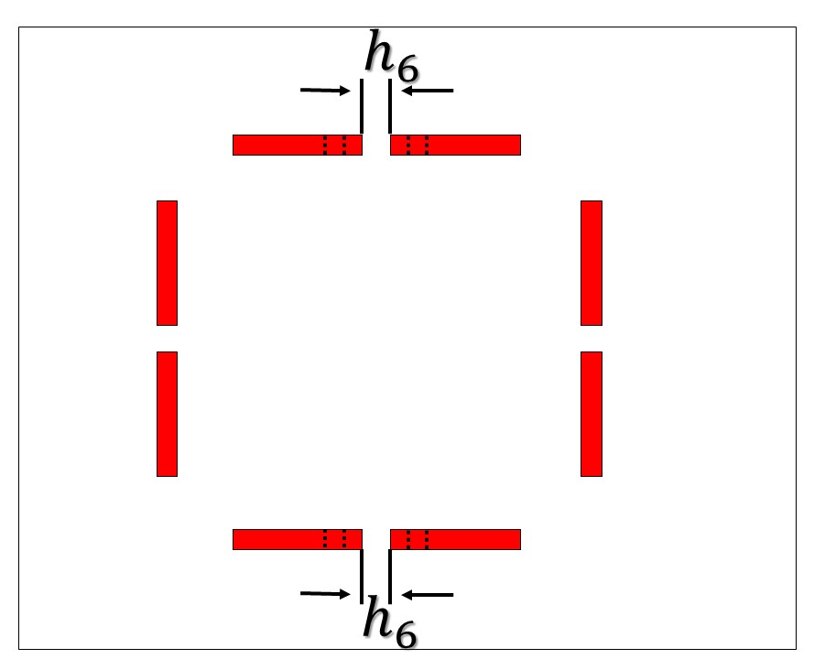
Coils tolerance Vii
The effect of changing the thickness of symmetrical upper conductors and the distance between them on the integral harmonics.
$h_{6}$ - distance between the conductors

Slide 34
Pole tolerance
The effect of steel quality change by 10% on the integral harmonics.
I = 21500 A

Slide 35
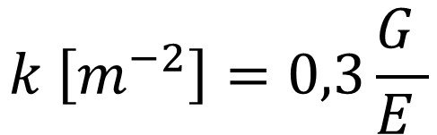


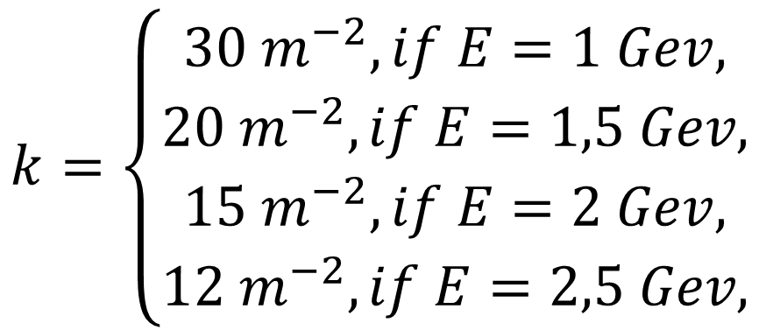

Calculation of some parameters
The quadrupole lens parameters such as magnetic field energy and normalized quadrupole strength were evaluated:
$$W [J]=\frac{B^{2}}{2μ_{0}}V$$
B, T | 2
V (coil), m^3 | 7593,6
G, T/m | 100
E, Gev | 1÷2,5
$$k \left[m^{−2}\right]=0,3\frac{G }{E }$$
y
$$W_{∑} =96,7 J$$
$$k=\left\{\begin{aligned}30 m^{−2}, if E=1 Gev, \\ 20 m^{−2}, if E=1,5 Gev, \\ 15 m^{−2}, if E=2 Gev, \\ 12 m^{−2}, if E=2,5 Gev,\end{aligned}\right.$$
B
N
S
x
S
N
$$F_{x}=−kx$$

