Slide 1
Detector concepts for CepC
Franco Bedeschi.
CepC International Workshop,
Beijing, November 2019
OUTLINE
The detectors
Detector requirements
Ongoing R&D
Concluding comments

Slide 2
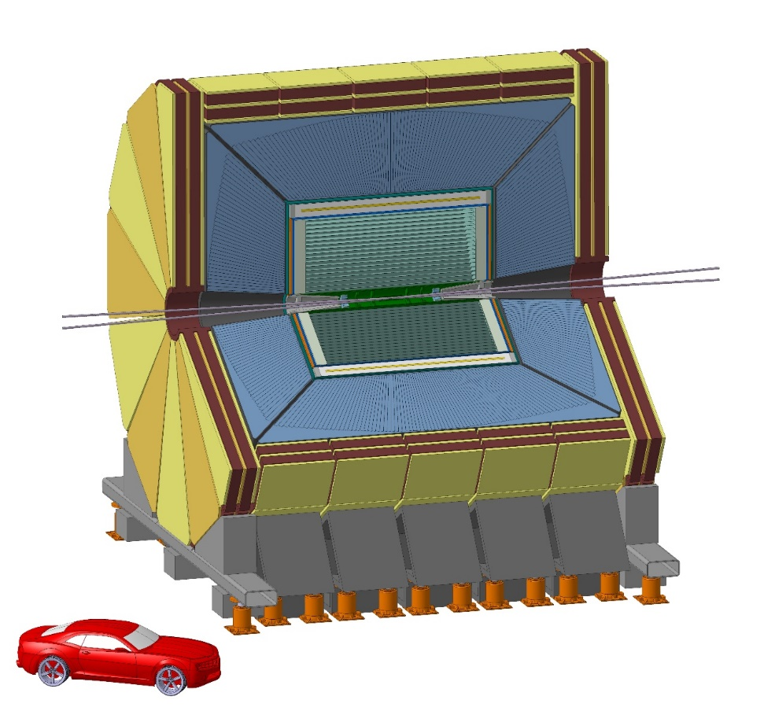
Detector concepts for CepC
ILD-like (baseline) w/ PF calorimetry & TPC
Alternate detector, IDEA w/ DR calorimetry & Drift Ch.
/SiD-like /Si
IDEA concept
FST concept
Baseline concept

Slide 3
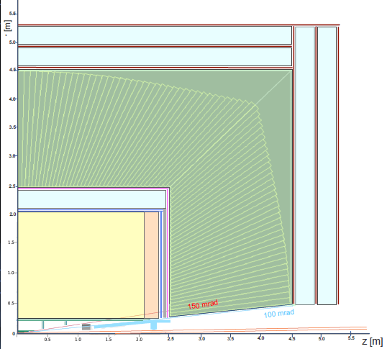
Detector concepts FCCee
CLD (CLIC like): PF calorimetry/Si
IDEA: DR calorimetry/Drift chamber
Yoke/μ chambers
Calorimeter
Yoke/μ chambers
Solenoid
DCH

Slide 4
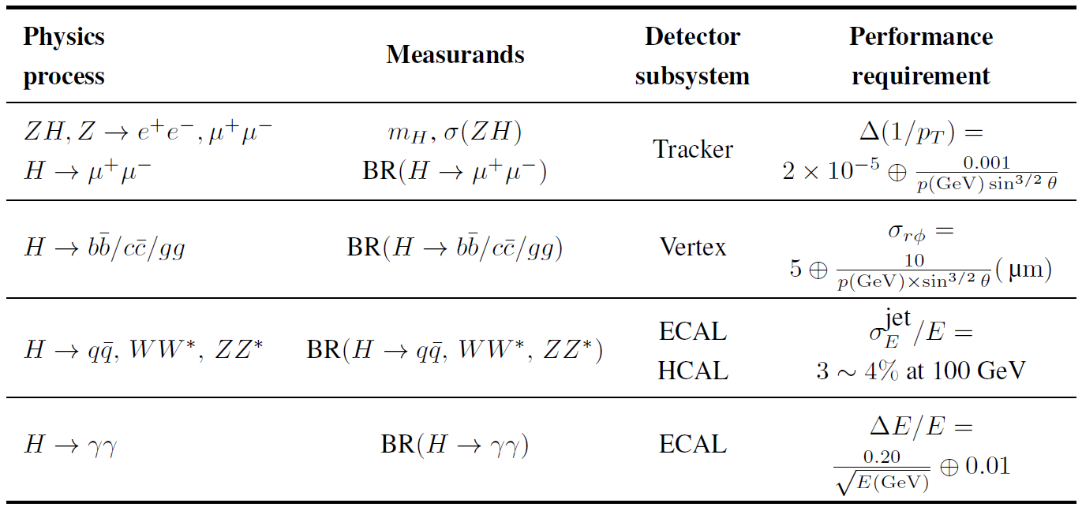
Detector requirements
Requirements:
  Constraints from physics (similar to LC …. more or less)
  Additional constraints
    Excellent acceptance and luminosity control
    PID & π⁰ ID for HF/τ physics
    Low B field to avoid emittance blow up
    Power pulsing not allowed
From CDR
Too tight?
Not enough?
Too tight?
Not enough?
Not present at LC

Slide 5
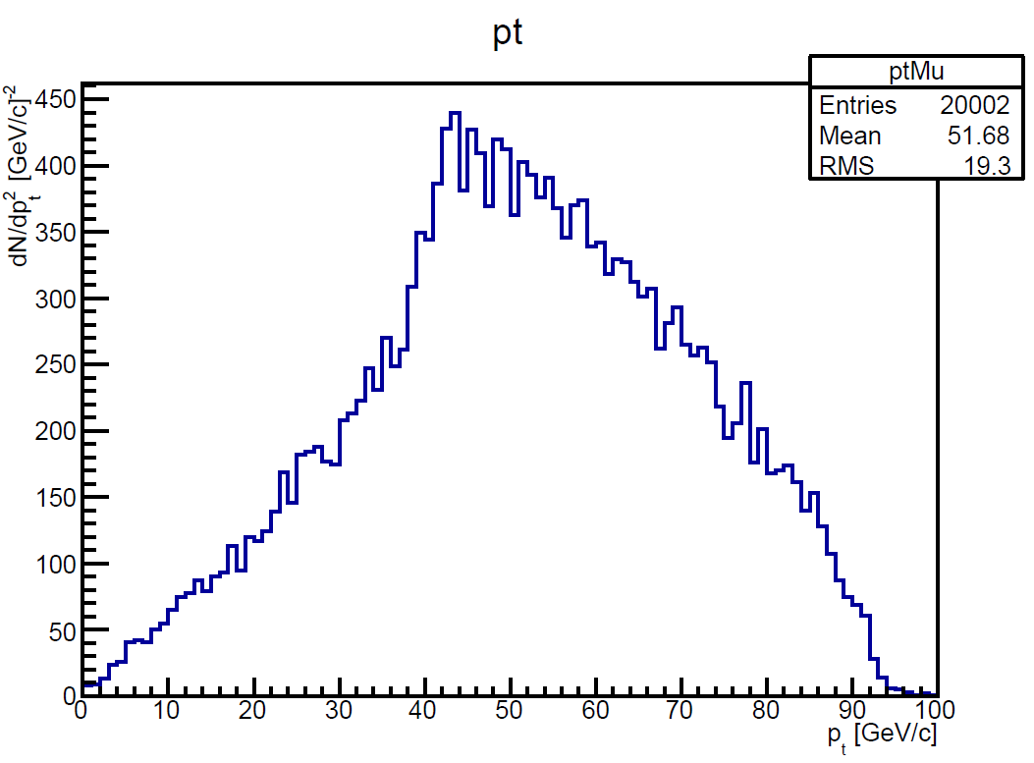
Momentum resolution
Z or H decay muons in ZH events have rather small p_{t}
  Transparency more relevant than asymptotic resolution
ZH (H→μμ)
Muon pt
ZH (Z→μμ)
Muon pt
90 degree

Slide 6
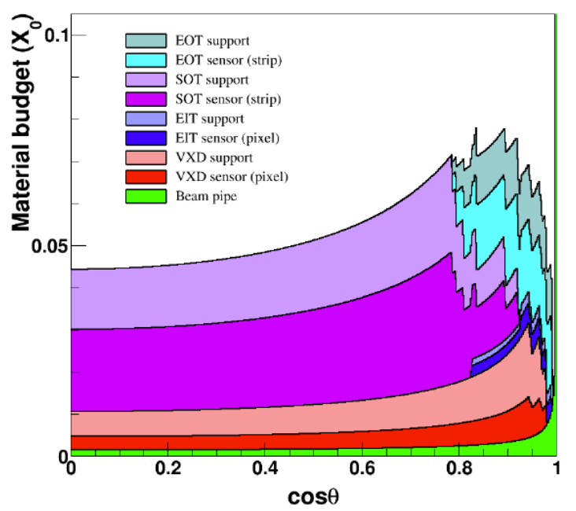
Transparency
Comparison
  FST, IDEA, CLD
    CLD old design – pessimistic
    FST very new – optimistic
  R&D important
    Design/materials
    No cooling
FST

Slide 7
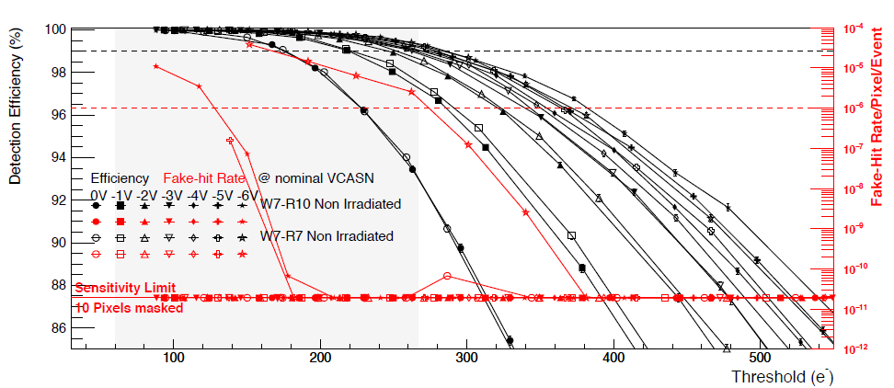
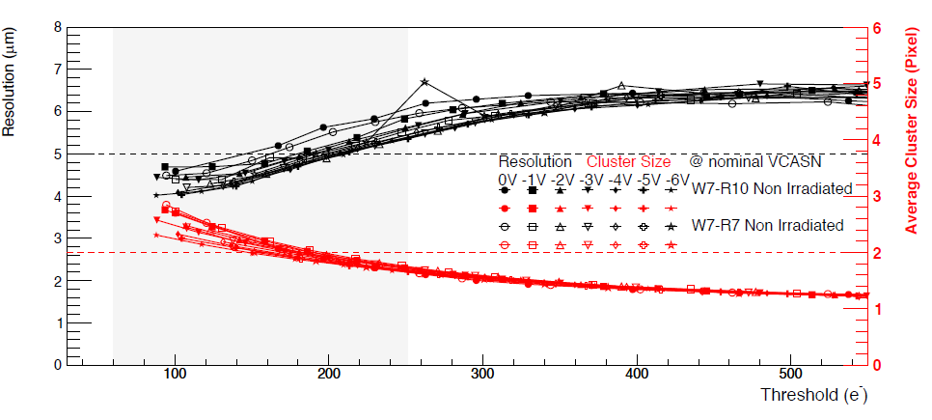
VTX resolution
5 μm resolution demonstrated with 30 μm pads
  ALICE ITK: ALPIDE
σ_{D} ~ 65% σ_{Rφ}
  ~ 2 μm with 20 μm pad
Limited by:
  Alignment
  Mechanical stability
  Transparency
    @low momentum

Slide 8
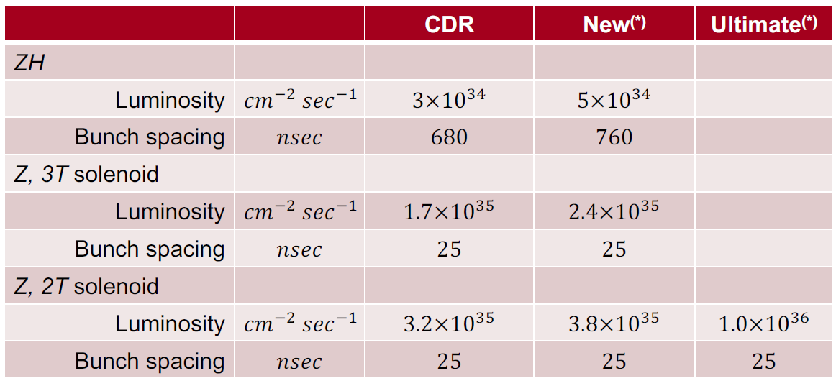
Luminosity
Event rates scale with luminosity – Highest at Z pole
  Physics ~ 50 kHz @1e36, crossings 40 MHz
    Faster detectors integrate less background
    Readout < few μs to avoid dead time/event overlap
  Large solenoid field → reduce luminosity at Z pole
from Jie Gao, Korea 2019

Slide 9
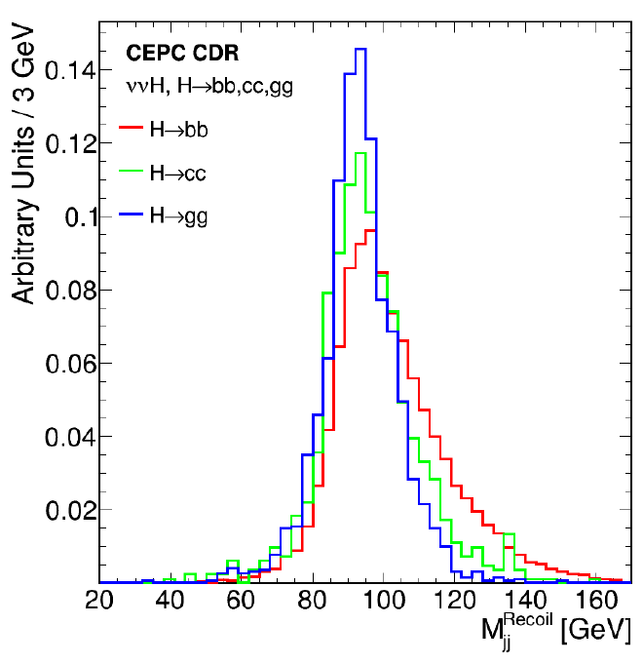
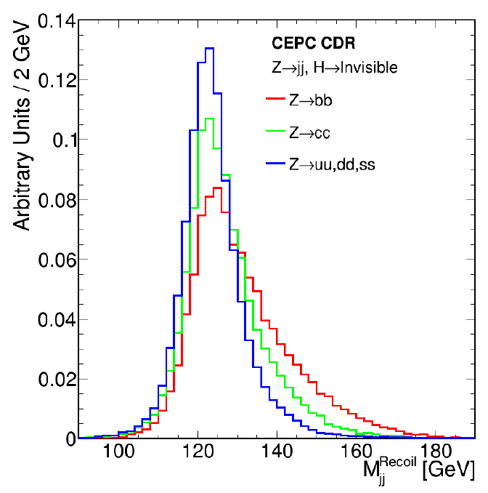
Calorimeter resolution (jets)
Separation of H→ZZ* from H→ WW*
  3-4% @ 100 GeV adequate – Can it be worse?
Recoil mass in HZ (Z→qq)
H→qq

Slide 10
Calorimeter resolution (γ)
Is 20%/sqrt(E) acceptable? Can we trigger on single γ?
What about radiative return analysis?
  Eg. Nν, and Z→ ν_{e} ν_{e}
Need 5-10%/sqrt(E)
for a good measurement
σ(g_{νe}): 18% →1.4-2.4%
- Worse resolution make separation difficult
Only ν_{e} interfere

Slide 11
Calorimeter separation (γ)
Transverse granularity below 1 cm seems adequate
Extreme granularity achievable with DR
  At a cost ….
50 GeV electrons
100 GeV π⁰
Z→τ⁺τ⁻
τ⁺◊ρ⁺ν◊π⁺π⁰ν
Δγ cm @ 2 m

Slide 12
(Some)
Detector R&D

Slide 13
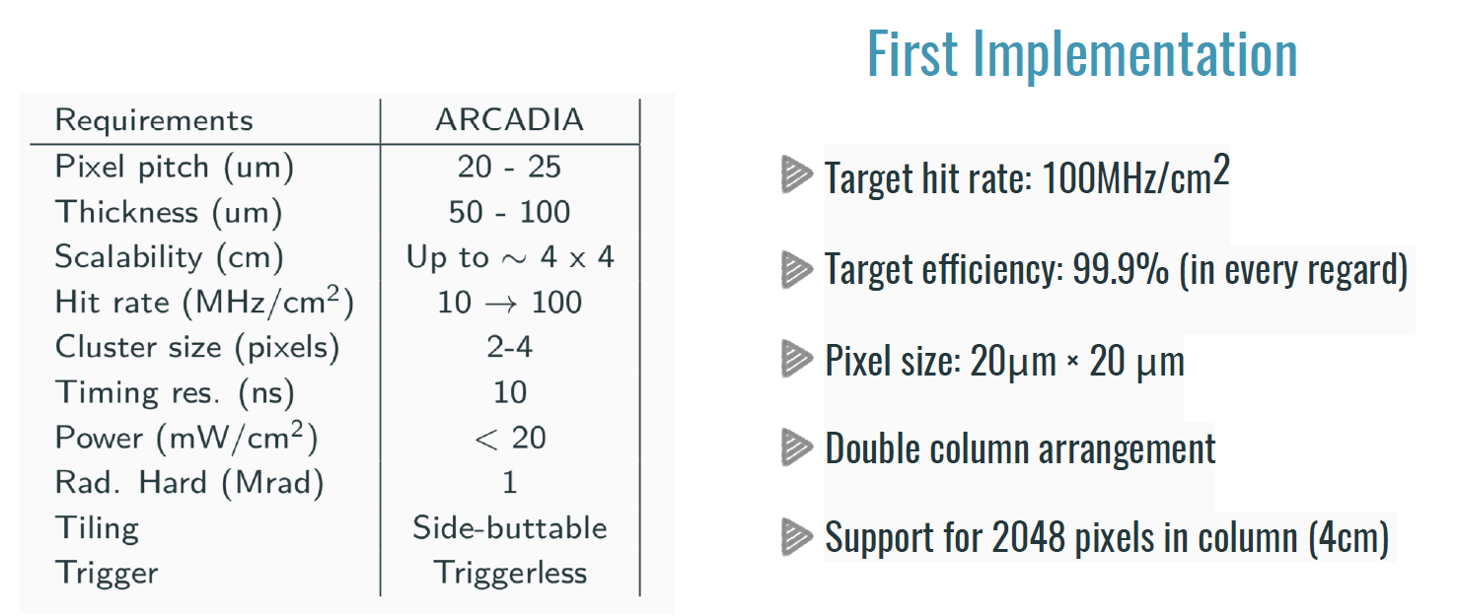
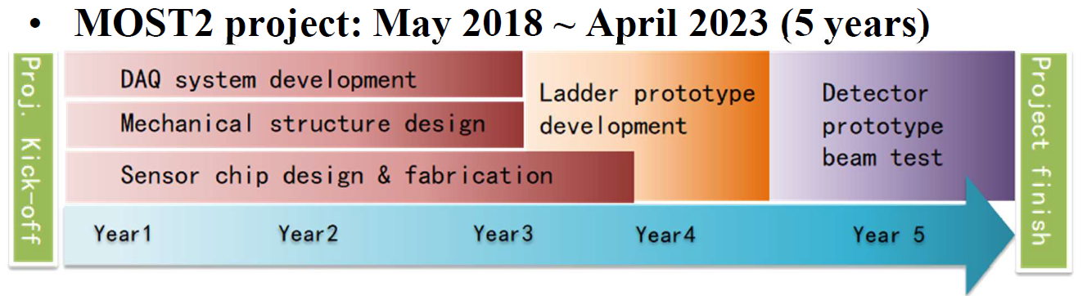
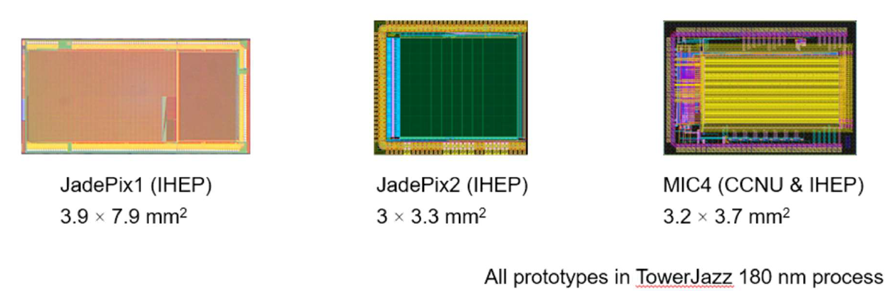
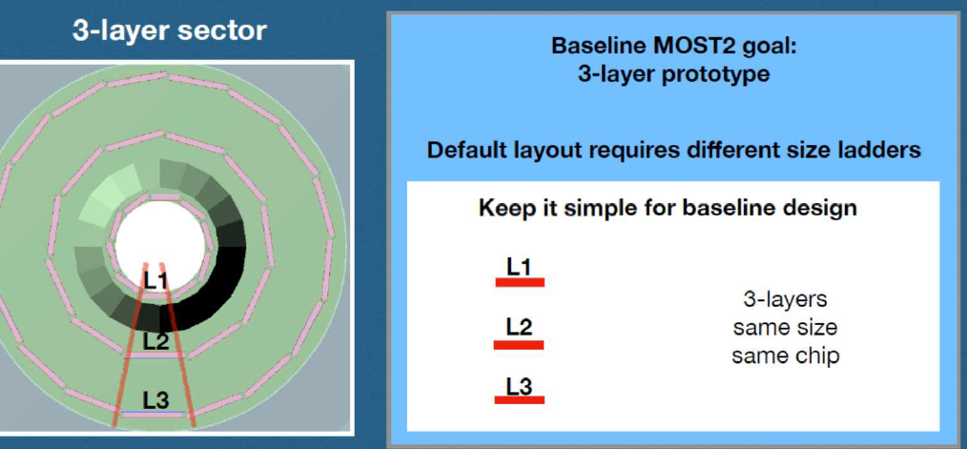
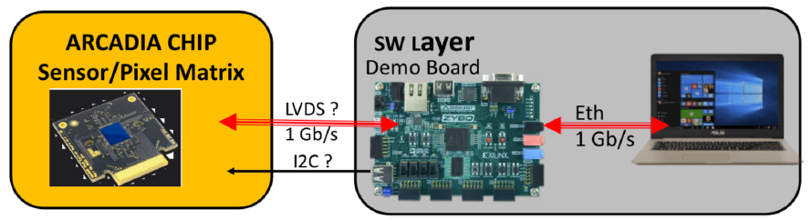
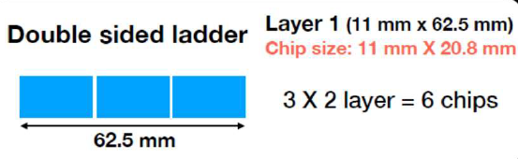
VTX R&D
Final chips available by 2021
Goals:
  Resolution/efficiency
  Power vs readout speed
    Low power for speed needed → air cooling (< 20 mW/cm²)
  High transparency/stable construction
Main efforts:
  MOST2 - China
    Continuation of extensive past R&D
  ARCADIA
    INFN - Italy
Matisse: small scale demonstrator
DAQ based on previous CERN experience

Slide 14
Large area Si R&D
So far relies mostly on work done for LHC upgrades
  Detectors obtained with standard CMOS process
    HV-CMOS
    Passive CMOS
  Some of these techniques may apply also for vertex detectors
Some dedicated pixelated R&D is just starting (SUPIX-2)

Slide 15
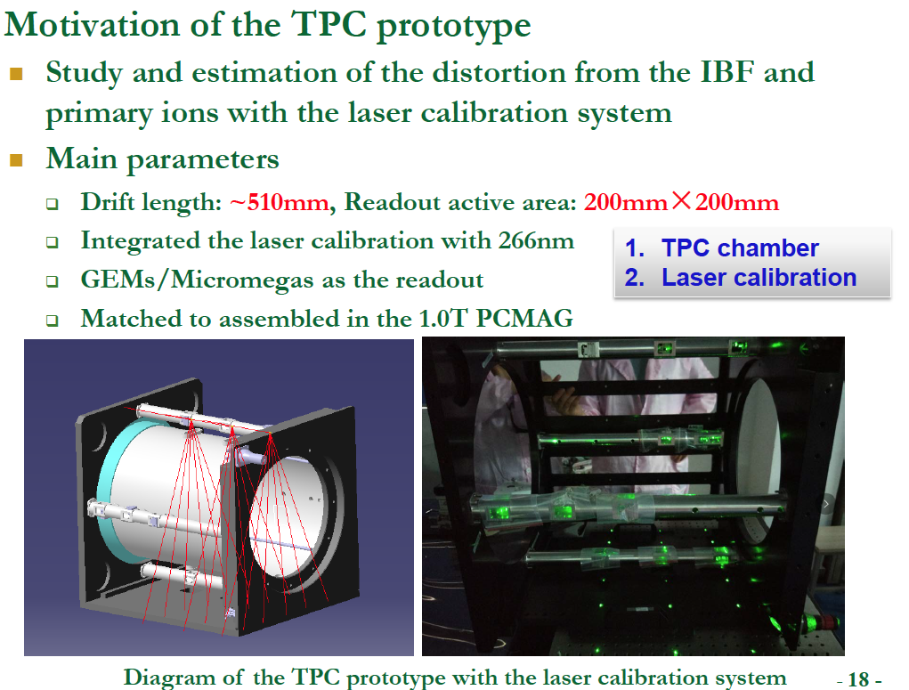
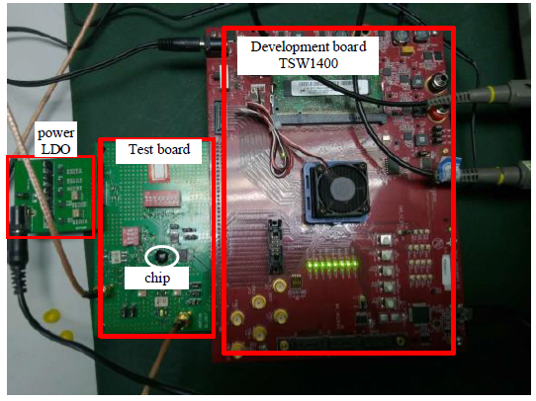
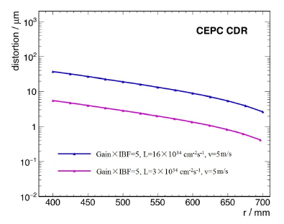
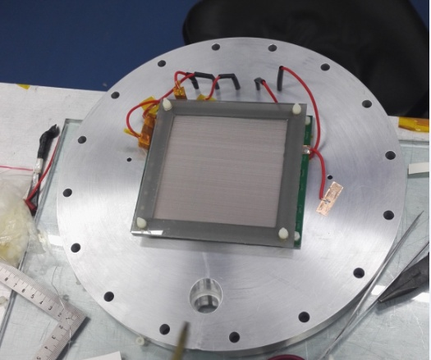
TPC R&D
Issues:
  IBF & Distortion
    Study with 10 cm GEM-MM module
  Calibration
    Correct distortions
    Scaled prototype
  FE chip
    Low power ASIC
      65 nm

Slide 16
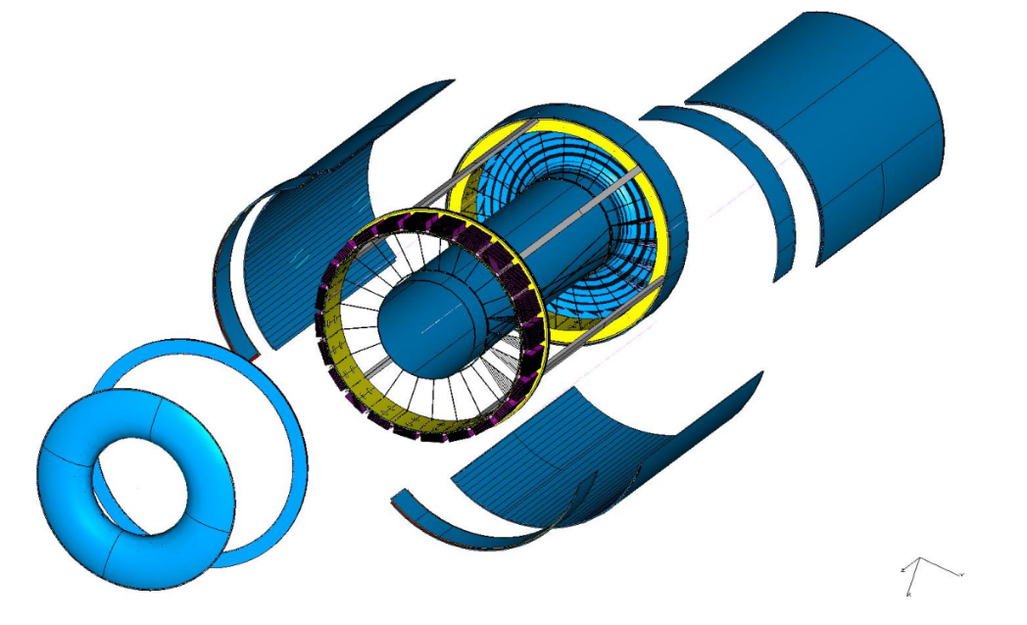
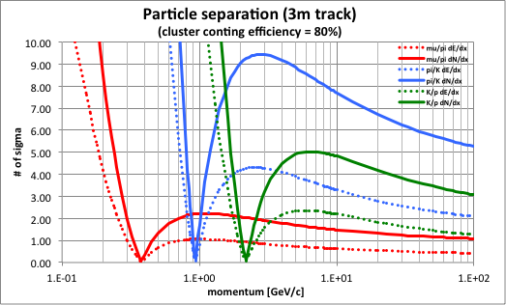
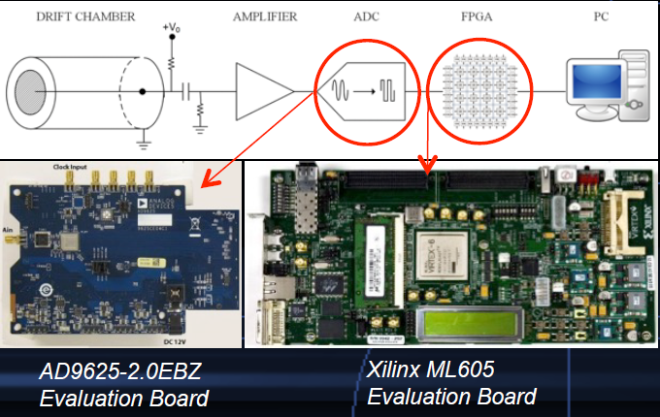
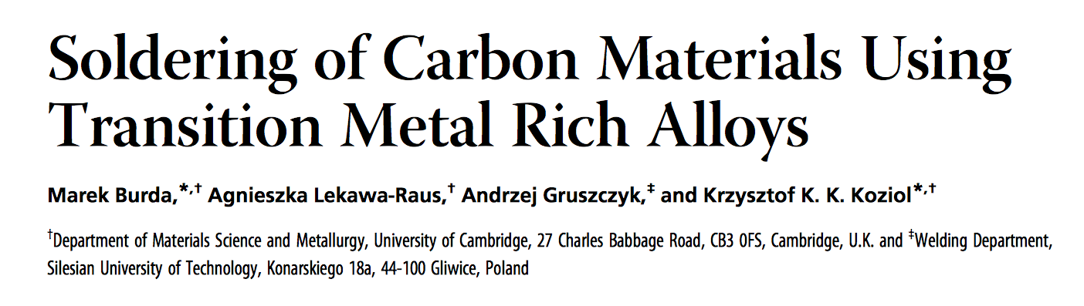
Drift Chamber R&D
Main issues:
  Mechanical structure
  Wire strength
  Cluster counting electronics for PID
    Of interest to TPC
Wire Cage
Gas envelope

Slide 17
PF Calorimeter R&D
EM calorimeter
HAD calorimeter
Baseline det.

Slide 18
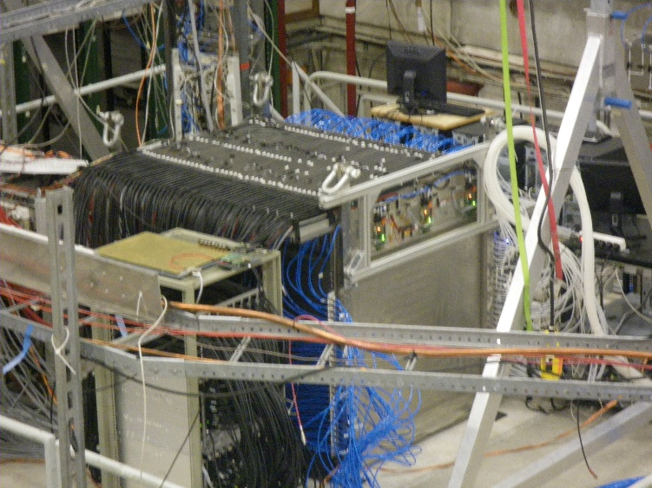
PF calorimeter R&D
Very large R&D activity and many options
  Baseline options studied for ILC with CALICE
  Large prototypes tested
Big effort toward solutions based on Scintillator with SiPM readout
HAD: SDHCAL
With RPC
EM: Si-W

Slide 19
PF: EM Scintillator
Replace Silicon with scintillator tiles readout by SiPM
  Much cheaper → prototype in progress
  30 layers W(3 mm)/(2+2 mm) Sc.+board → total 24 X₀
  Cell size 5x45 mm² – 11 M machine wrapped tiles
  Readout chip ready SPIROC-2e
  Expected performance better than Si
    Concern about uniformity/stability

Slide 20
PF: HAD Analog
Scintillator with SiPM readout
  Cell size 3x3 cm2 (other sizes tested)
  Synergy with Scintillator ECAL
    Readout electronics
    Wrapping/gluing machines
Prototype preparation
  0.5 m x 0,5 m x 35 layers

Slide 21
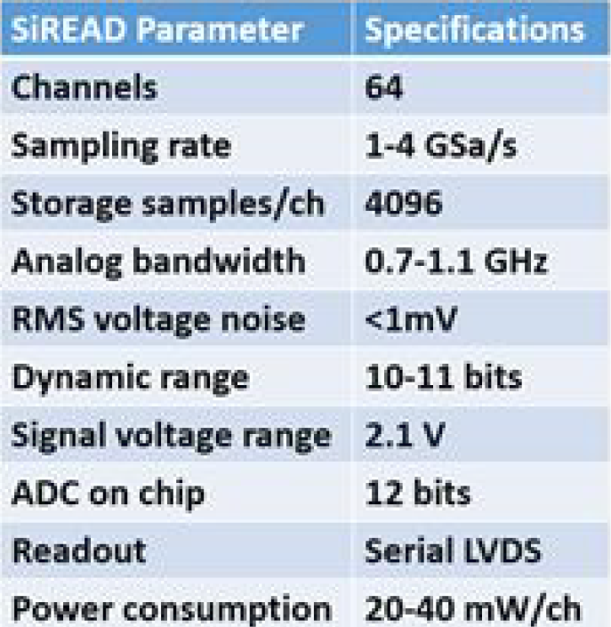
DR calorimeter R&D
Testing new mechanical options
  Spaghetti → bucatini – Prototype in progress 10x10x100 cm³
Compact readout with CAEN FERS based on Citiroc
  64 ch/board with TDC → 4096 ch/controller
Interest for SiREAD (timing = longitudinal segmentation)
  New version: 64 ch with 4 GHz ADC and feature extraction

Slide 22
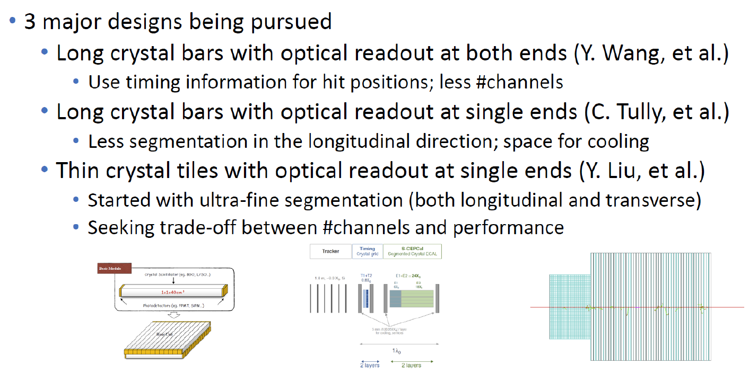
Crystal calorimeter R&D
Gaining interest
  Several options explored with simulation
from Yong Liu

Slide 23
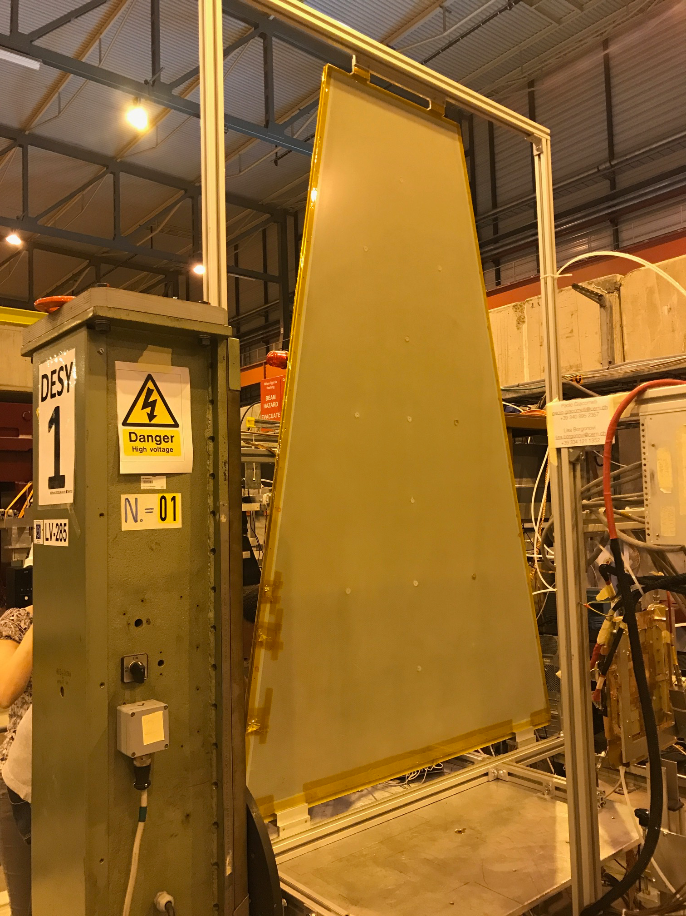
Muon chambers R&D
RPC – Same as SDHCAL
μRwell:
  Concept proved
  R&D for
    Industrialization
    Cost reduction
    DLC+Cu sputtering
CMS GE2/1 with 2 μRwell 2 m x 1.2 m

Slide 24
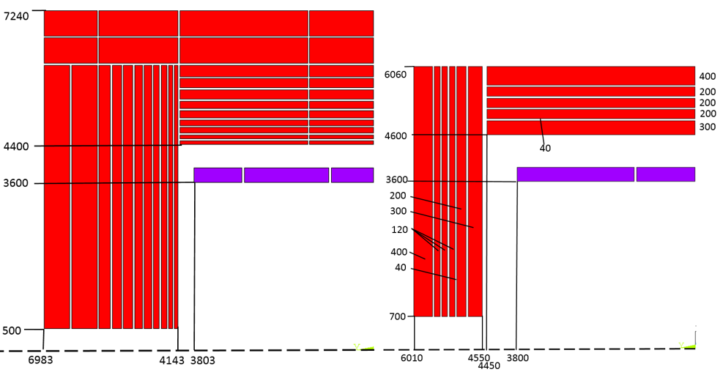
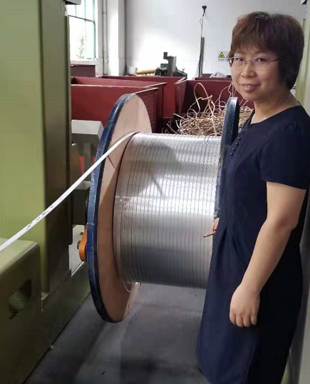
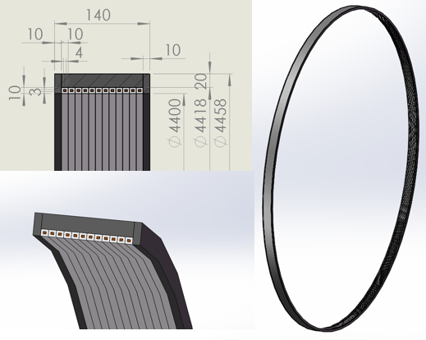
Solenoid R&D
Significant reduction of baseline detector yoke
Progress in aluminum stabilized coil and cryogenics
HTS cable development for IDEA started

Slide 25
Final comments
Detector concepts explore different technologies
  Final detectors will probably be a mixture
  Good to explore many options
Detector requirements still need better definition
  Potential large impact on detector design
Several R&D’s in progress
  Main issues are targeted – Need to converge
  ...but need better coordination and planning
    Limited resources everywhere due to LHC upgrades
    How much time do we still have for R&D?
Scenarios and associated plans are difficult in times of uncertainty, but we must have at least an evolving plan

Slide 26
Backup
BACKUP

