Slide 1
Recent development of ultra-fast timing detector in Cina and its potential application in CEPC
Zhijun Liang
Institute of High Energy Physics ,
Chinese Academy of Science
CECP workshop 2019

Slide 2
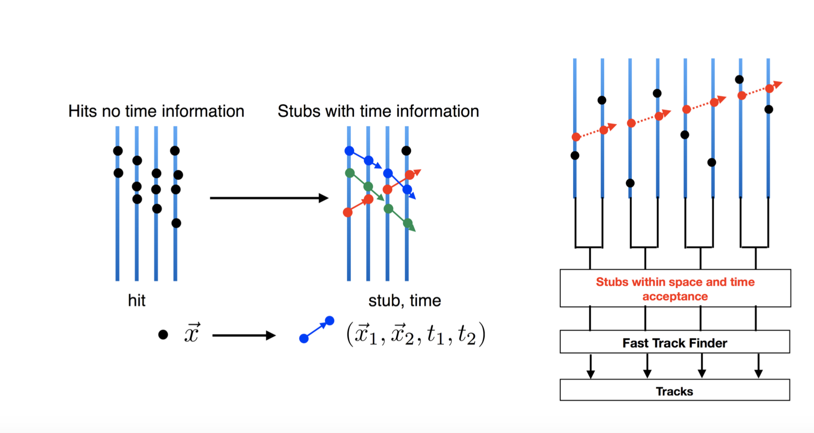
Timing detector for CEPC
4D tracking for CEPC particle flow reconstruction.
Need a silicon technology with both time and spatial resolution
https://iopscience.iop.org/article/10.1088/1748-0221/11/11/C11040/pdf

Slide 3
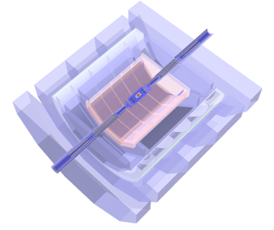
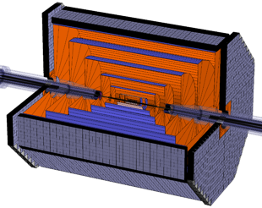
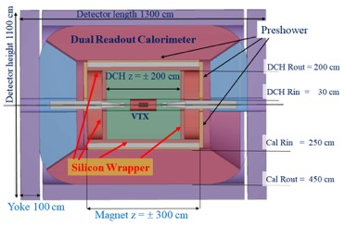
Timing detector for CEPC
For full silicon concept, there is no particle identification
Need a silicon technology with both time and spatial resolution
ILD-Like, Baseline design
Full silicon
IDEA

Slide 4
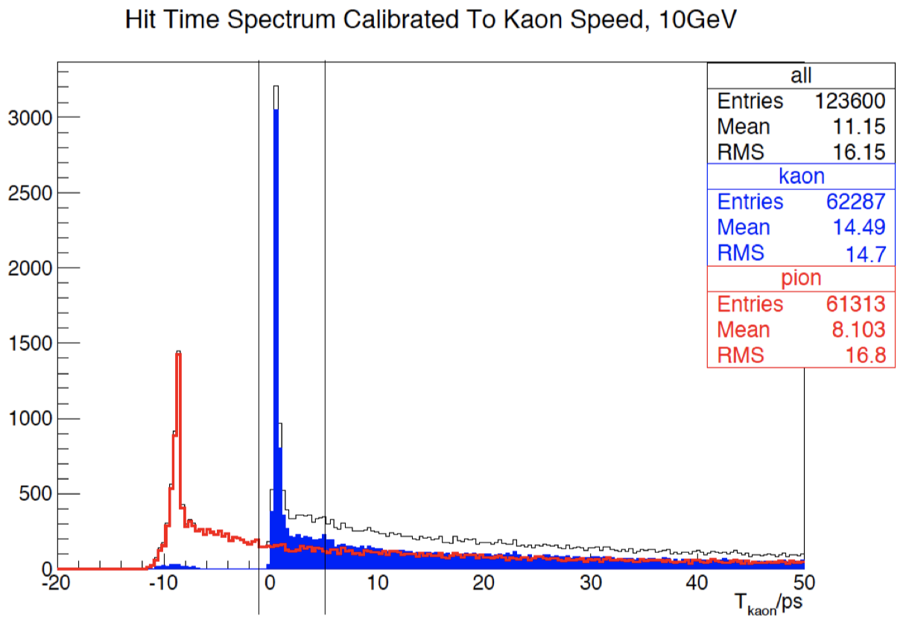
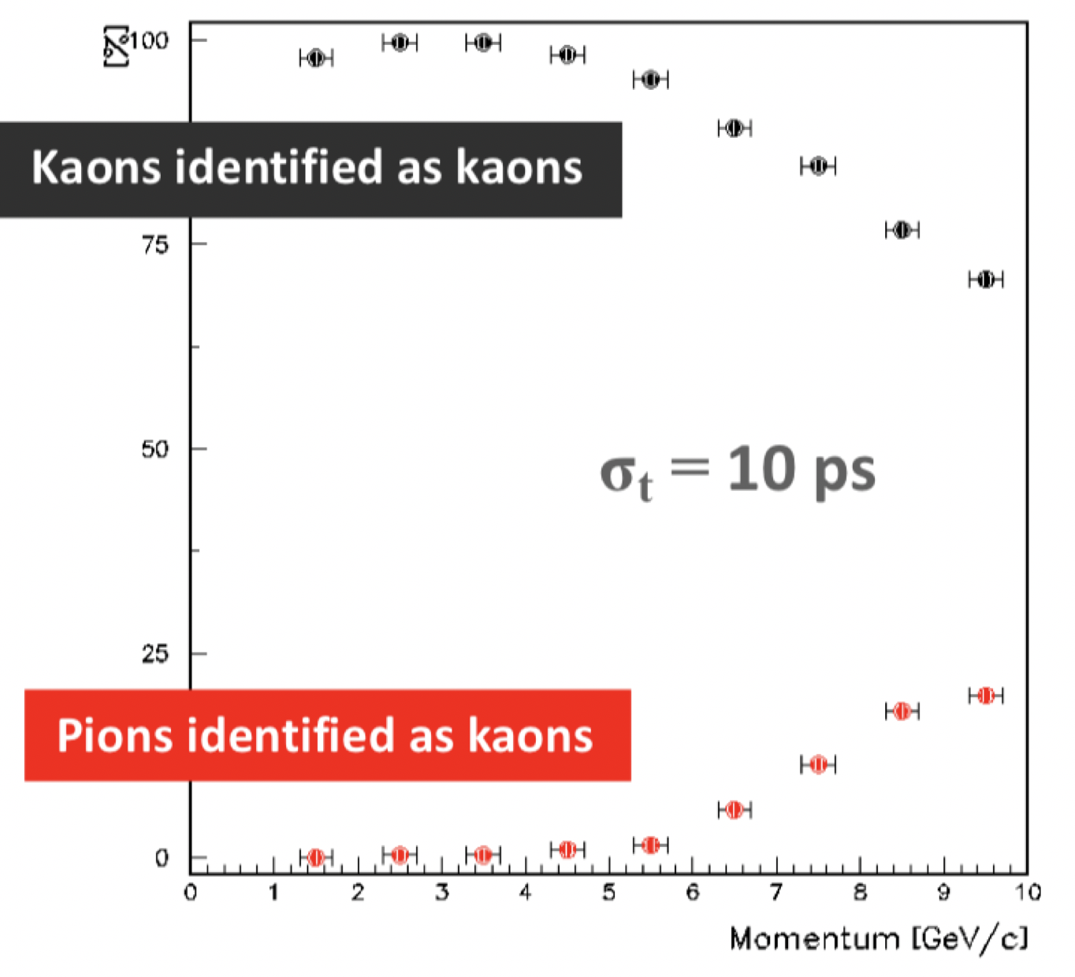
Particle identification for CEPC
K/pi separation for CEPC flavor physics for full silicon concept
10ps time solution can provide 2~3 sigma K/pi separation at 5~7GeV
Study from CEPC (by Manqi)
Study from Topside

Slide 5
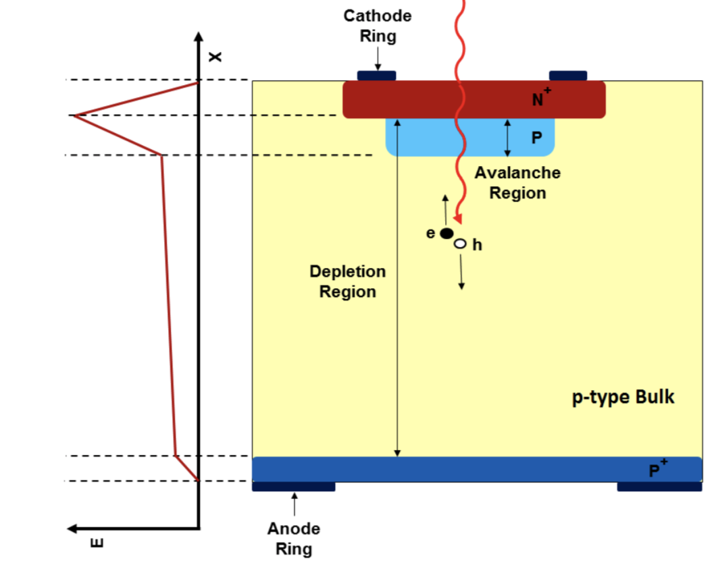
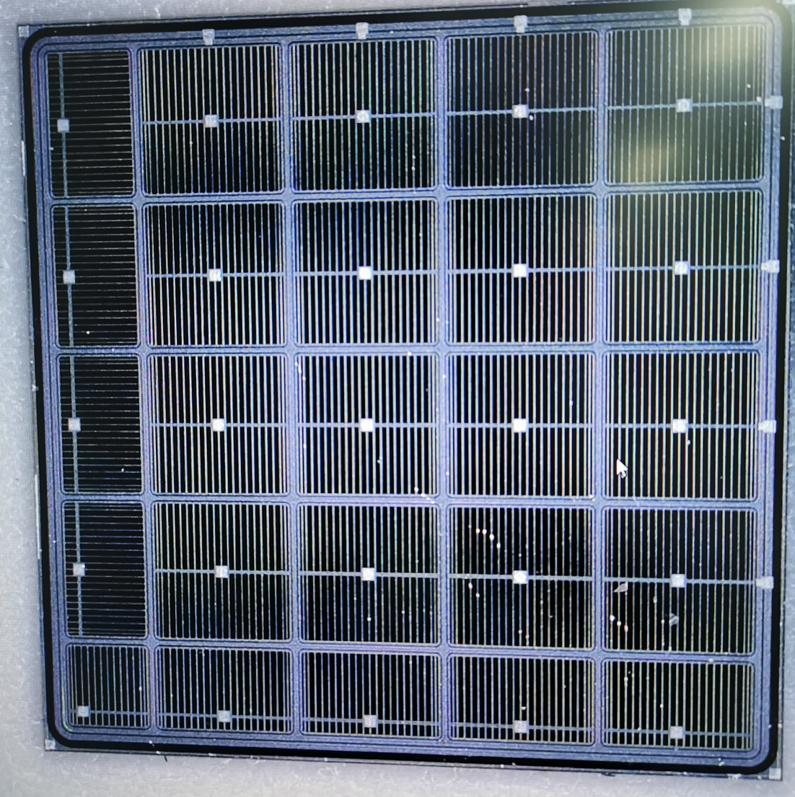
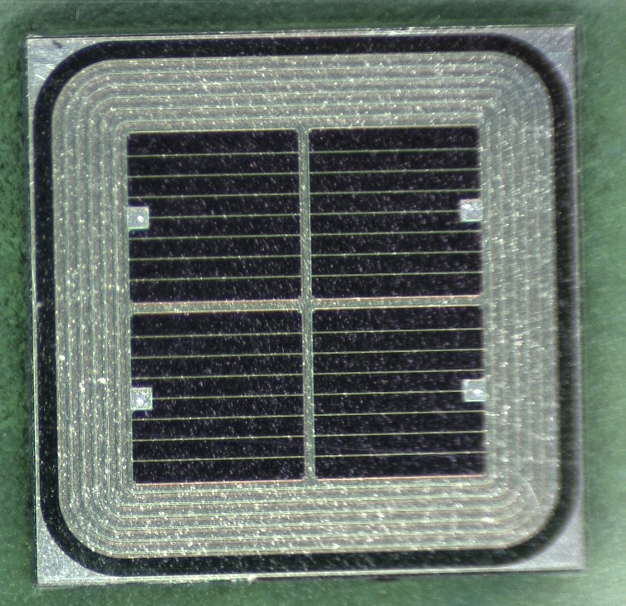
Low gain Avalance detector (LGAD）
Low-Gain-Avalanche-detector (LGAD)
Compared to APD and SiPM, LGAD has lower gain (~10)
high drift velocity, thin active layer ( fast timing)
High S/B, no self-triggering
LGAD Foundry:
HPK (Japan)
CNM(Spain)
FBK (Italy)…
IHEP-NDL (China)
Prototype of IHEP-NDL LGAD sensors

Slide 6
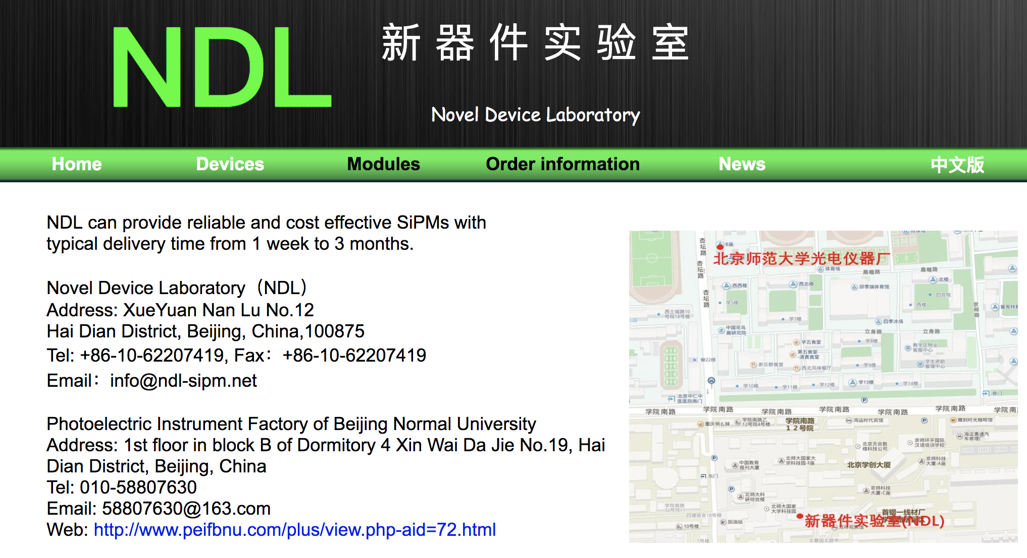
LGAD sensor R & D in China： NDL LGAD sensor
LGAD sensor with Epitaxial layer
NDL is foundry for SipM. They started at LGAD R & D with IHEP in 2019.
Three batches LGAD sensor fabricated in 2019.
Thickness of epitaxial layer: 33um
epitaxial layer Resistivity: 100 Ohm.cm or 300 Ohm.cm
http://www.ndl-sipm.net/contacteng.html

Slide 7
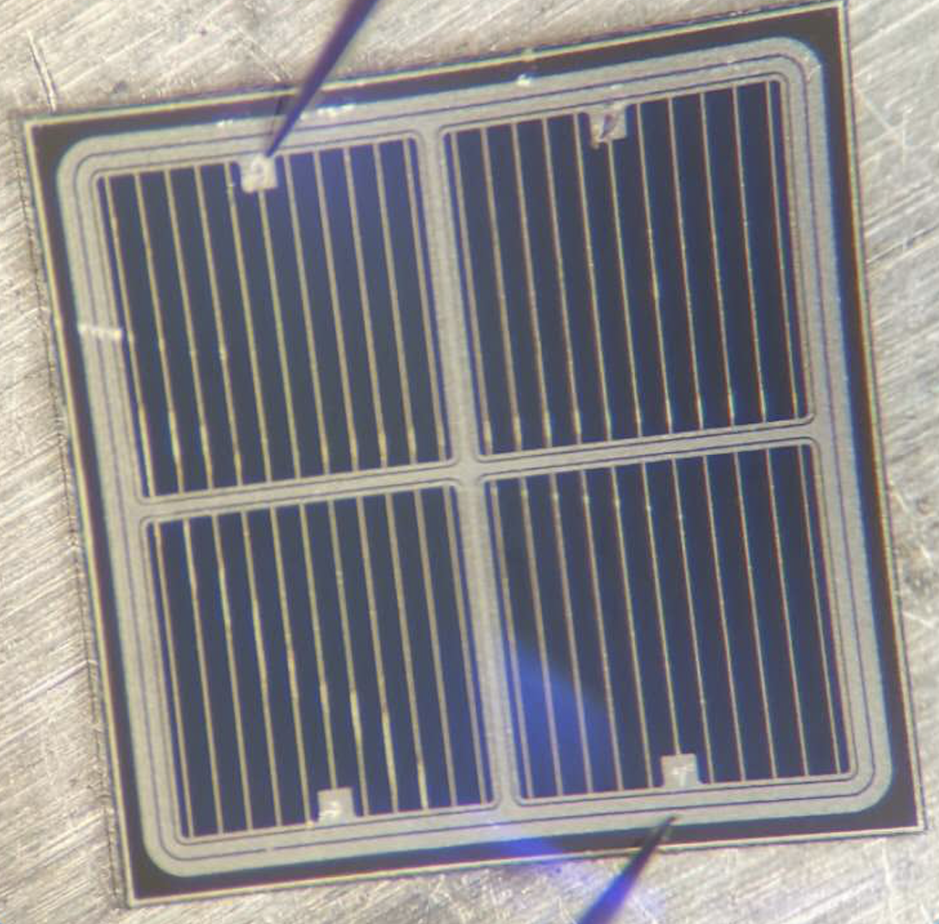
IHEP-NDL sensor design
6 guard ring (floating, no metal contact ) : BV170, BV60
(new!!) 2 guard ring (with metal contact, can be grounded) : Type 9#, 10#
Higher breakdown voltage (VBD) with new guard ring design
 | VBD | V_Depleted | Layout | Wafer | Gain
Type 13# (BV170) | ~165V | ~100V | 6GR | 100Ω.cm | 40
Type 12#(BV60) | ~95V | ~40V | 6GR | 300Ω.cm | 40
Type 10# (new!) | ~300V | ~40V | 2GR | 300Ω.cm | 80
Type 9# (new!) | ~250V | ~40V | 2GR | 300Ω.cm | 80
6 guard ring design
No Metal contact
Guard ring floating
2 guard ring design
(new!!)
With metal contact
Can be grounded
pad2
pad3
pad1
pad4

Slide 8
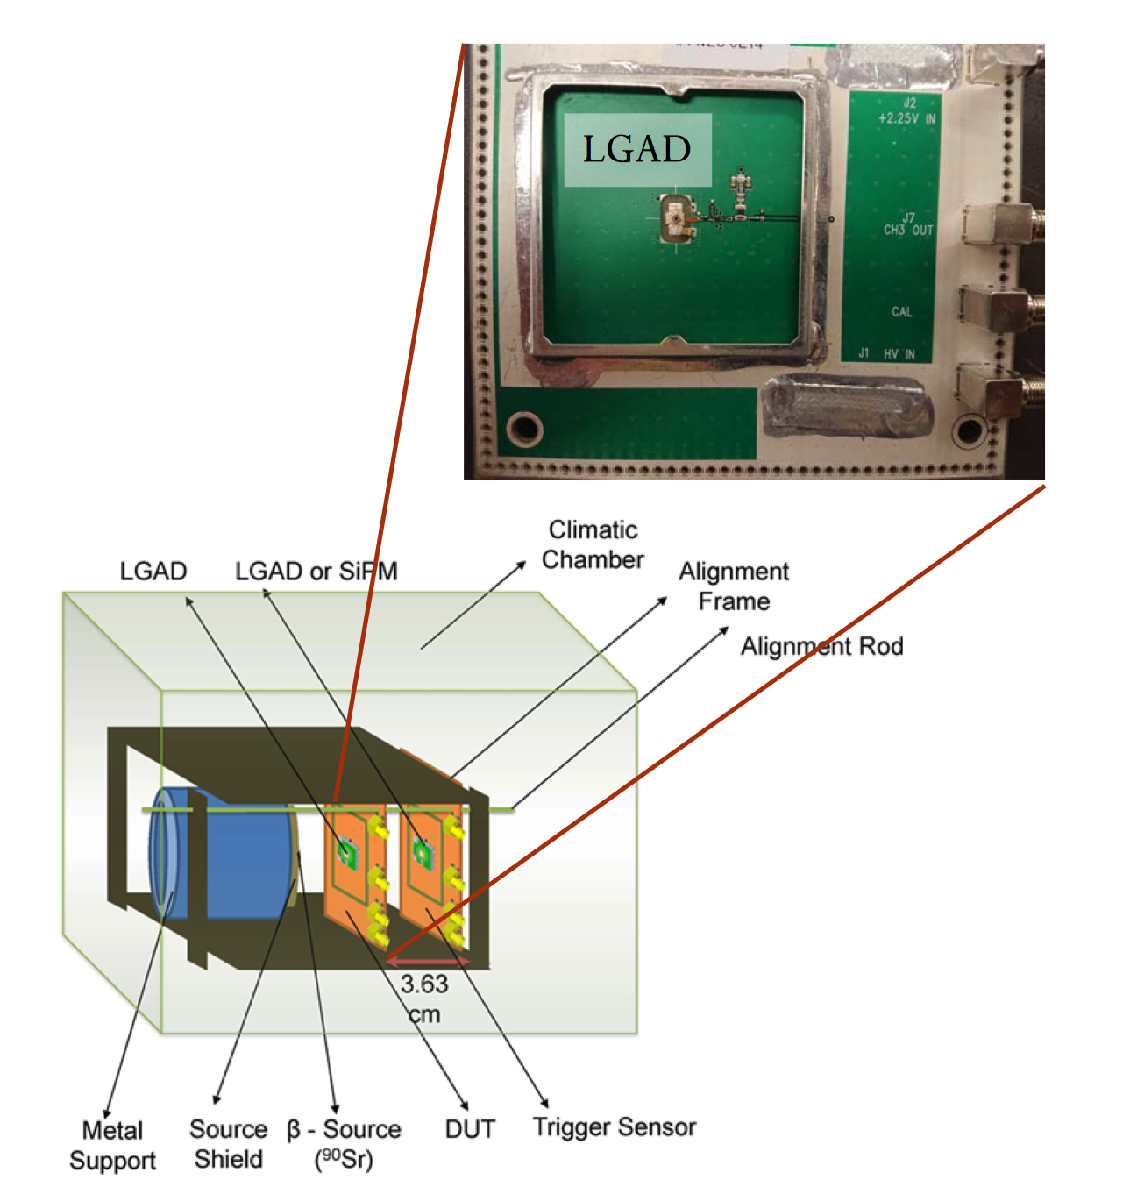
Beta test
Beta test (collected charge, gain, time resolution)
Electrons by Sr90 Beta source
Single channel board developed by UCSC
Fast amplifier with bandwidth >1GHz
Climate chamber to run at -30C

Slide 9
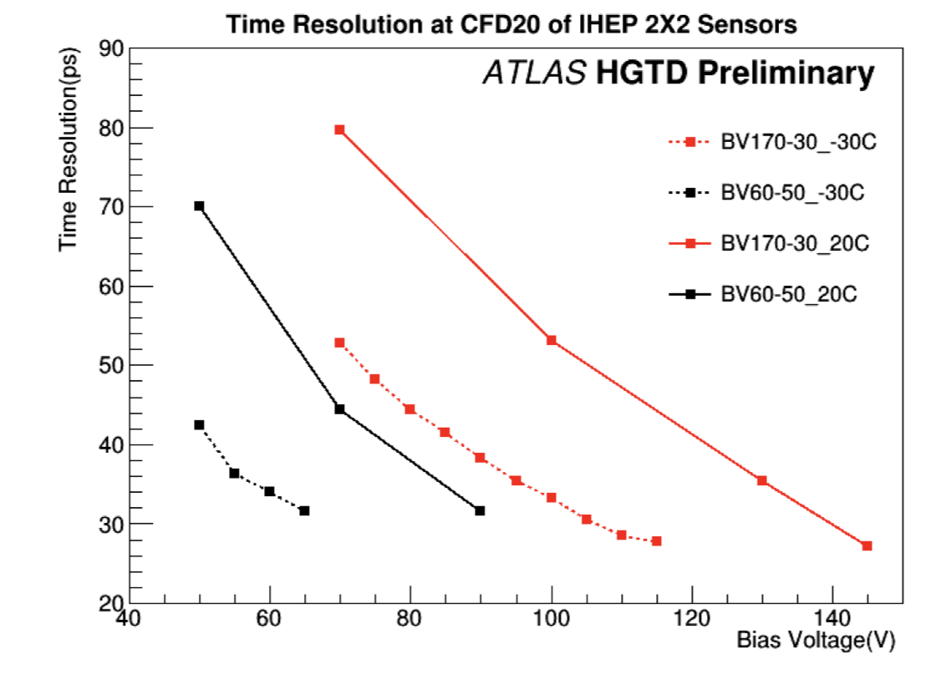
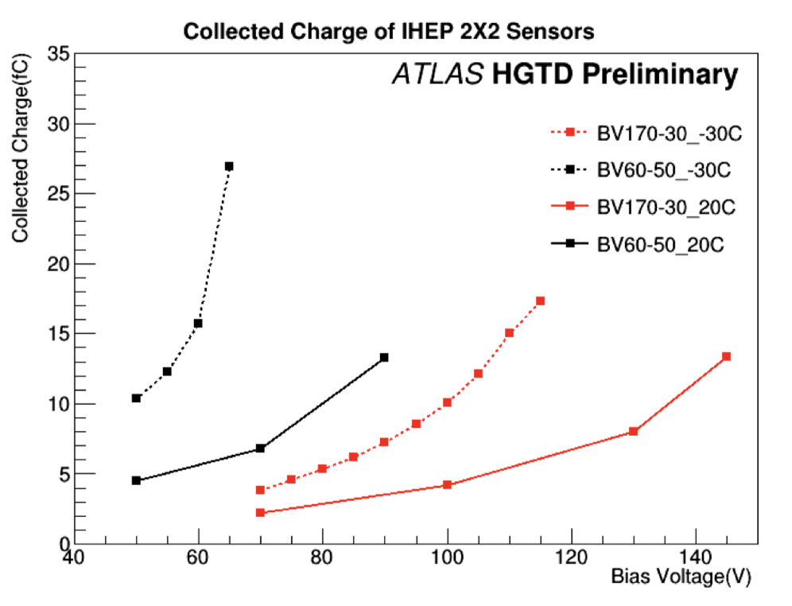
IHEP-NDL LGAD sensor performance
New LGAD foundry in China: The Novel Device Laboratory
just start prototyping LGAD sensor early 2019
Two prototype of 2x2 LGAD, 5x5 LGAD
Time resolution is about 30ps
Charge collection: 10~30 fC
30ps
4fC

Slide 10
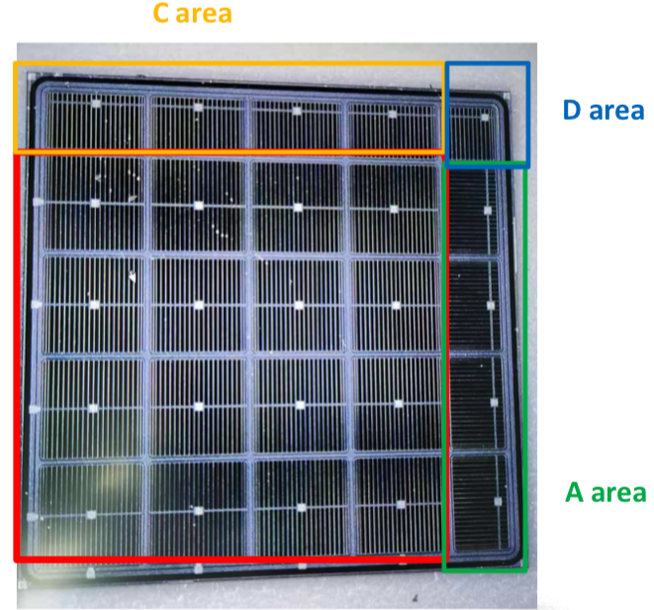
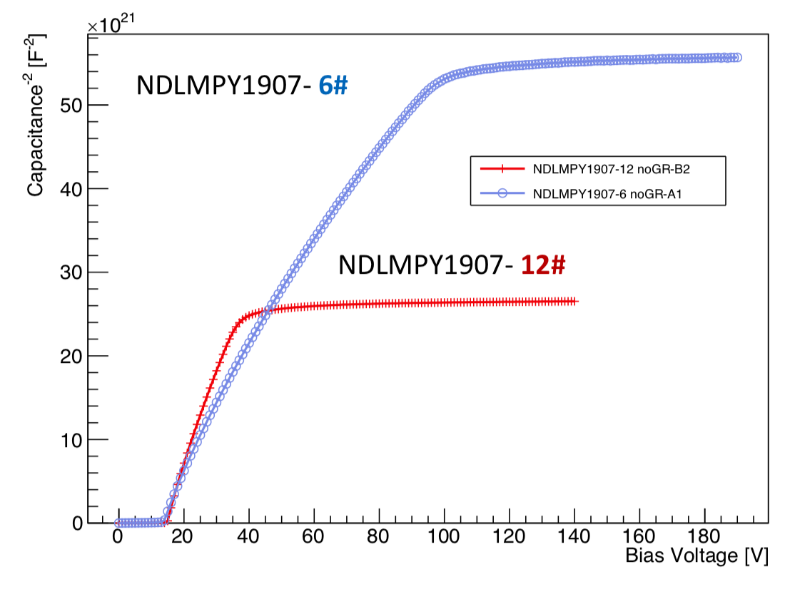
5x5 NDL sensors
Two type of NDL 5x5 sensors are fabricated in Sep 2019
 | VBD | V_Depleted | Layout | Epi layer(33um) resistance | Gain
NDL 5x5 6# | ~250V | ~120V | 2 guard ring | 100Ω.cm | 10~20
NDL 5x5 12# | ~235V | 35V | 2 guard ring | 300Ω.cm | 10~20

Slide 11
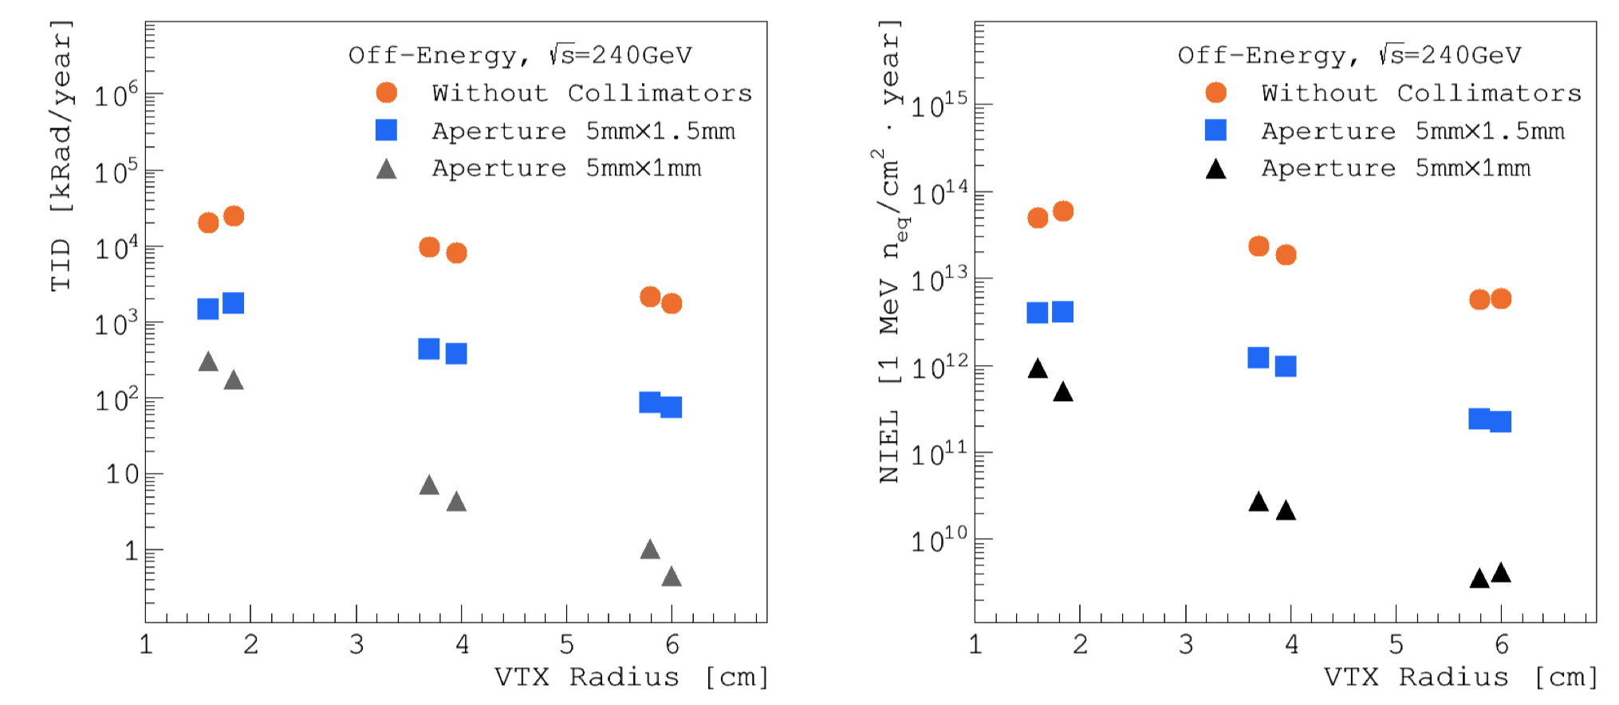
Irradiation hardness requirement
The requirements will change with different MDI design
Total ionization dose(from CDR): ~ 10MRad (100kGy）
Fluence (from CDR): ~10¹³N_{eq}/cm²

Slide 12
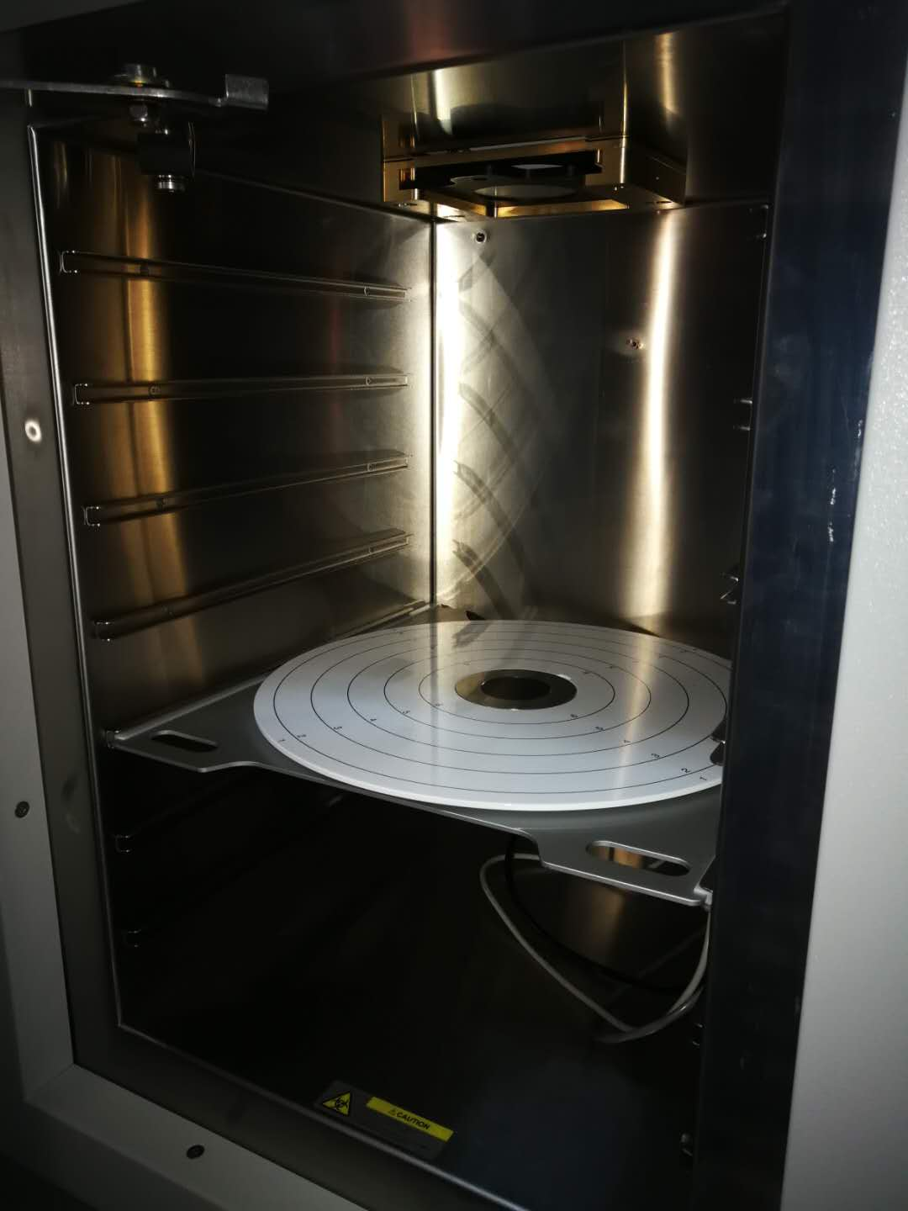
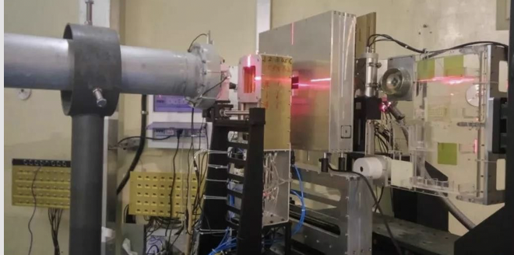
Irradiation campaign
Irradiation hardness is important for HGTD project
IHEP is responsible for irradiation tests
Leading total ionization dose (TID) study for sensor and module
X ray irradiator in IHEP, TID up to 200MRad
Carried out one irradiation campaign for non-ionization damage
Collaboration with China atom energy institute (CIAE) for 100MeV proton irradiation
Fluence up to 4x10¹⁵ n_{eq}/cm²
X ray irradiation in IHEP
100MeV Proton irradiation campaign in CIAE

Slide 13
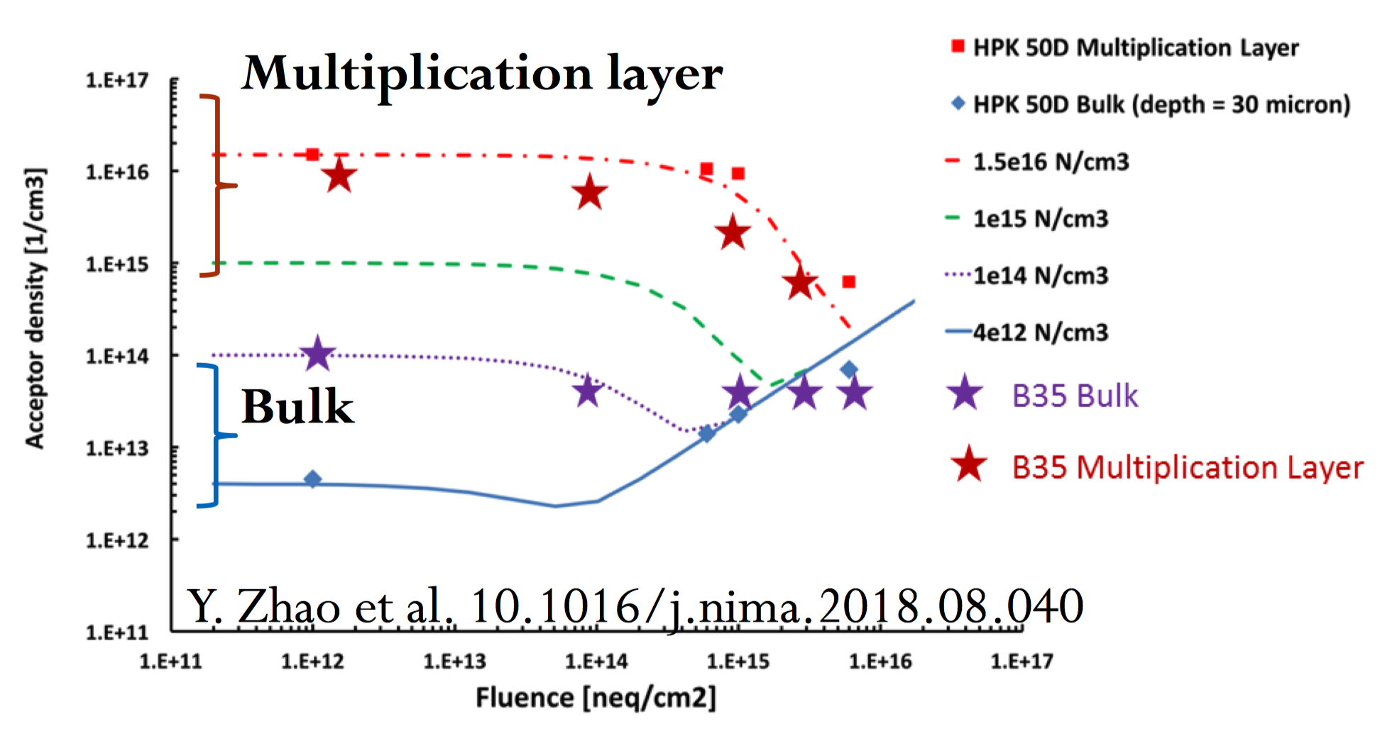
Radiation damage effect for LGAD：Acceptor removal
Radiation damage effect for LGAD
Acceptor removal
Interstitials inactivate the doping elements (Boron) via kick-out reactions that produce ion-acceptor complexes
Reduction of gain, collected charge

Slide 14
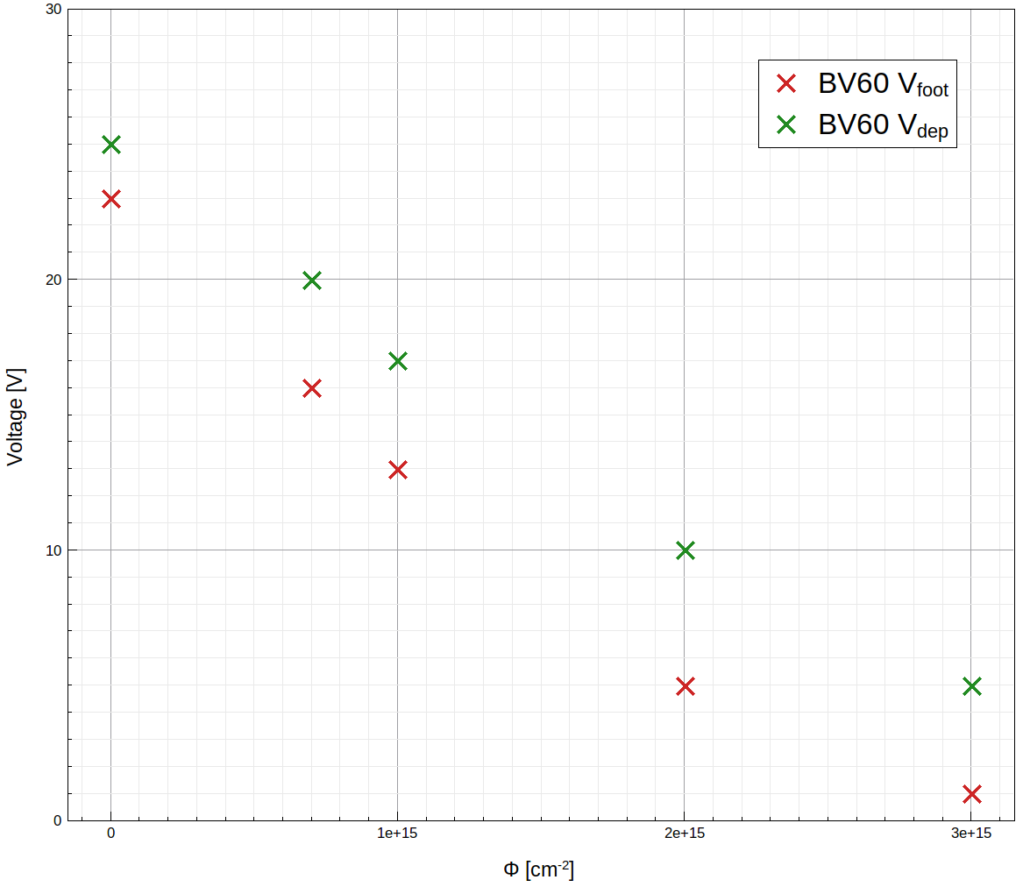
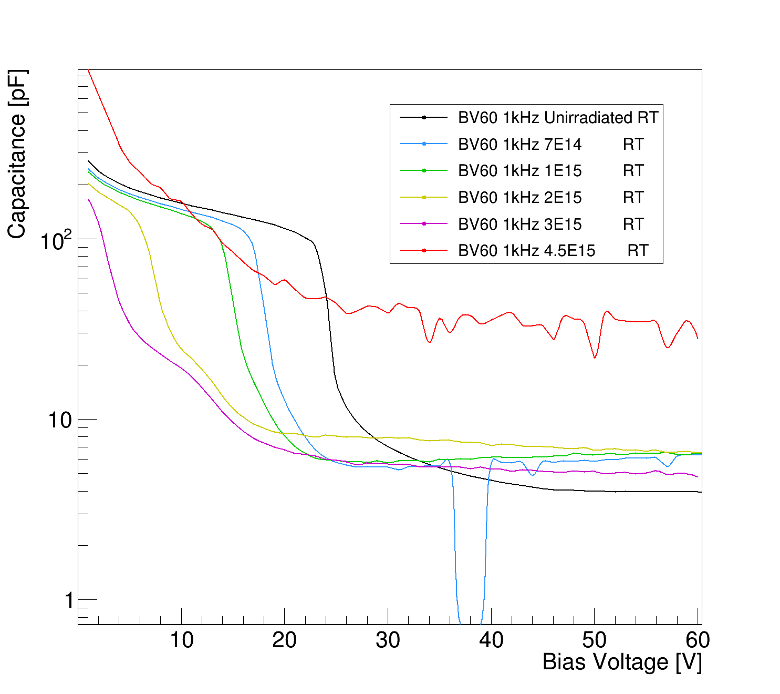
First Results of CIAE irradiation: NDL sensors
Depleted voltage and foot voltage Vs fluence
Much easier to depleted the LGAD sensor after 1e15 N_{eq}/cm²
It should be good for CEPC application (10¹³N_{eq}/cm² )
Need more study for LHC application

Slide 15
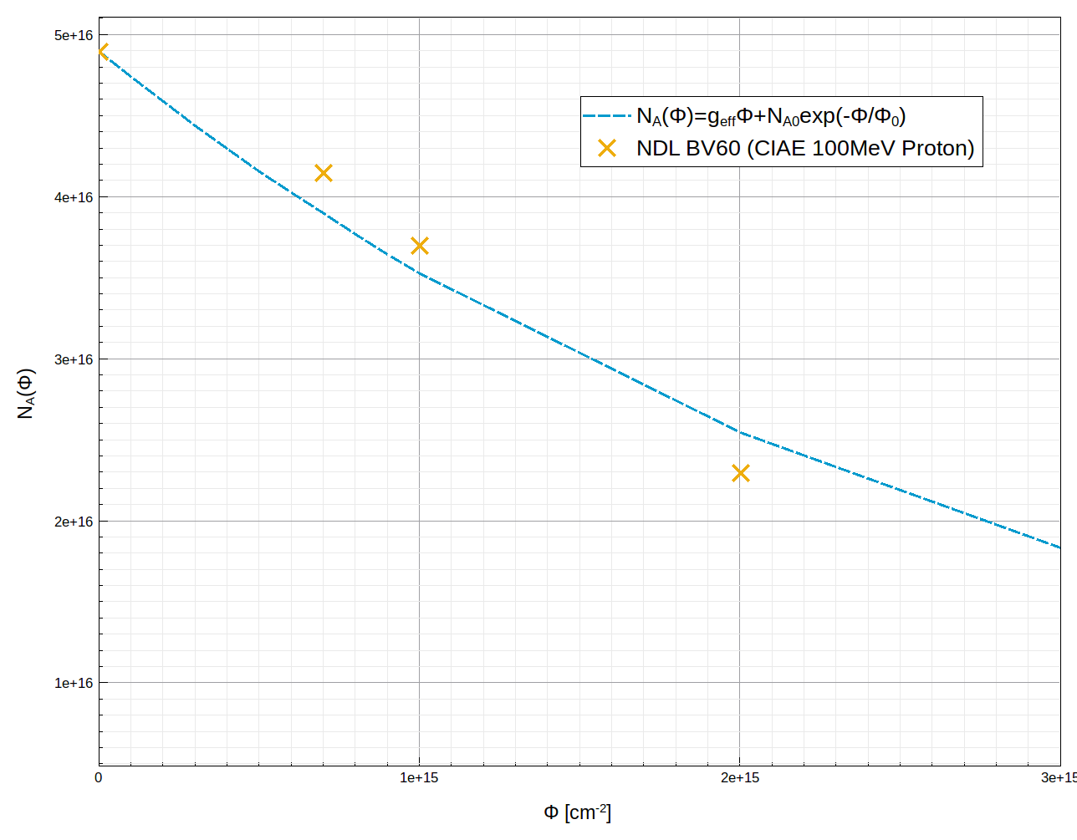
Acceptor removal effect
P+ doping density decrease after irradiation
Need more study for LHC application
It should be good for CEPC application (10¹³ N_{eq}/cm² )
CEPC irradiation hardness requirement
By Tao Yang

Slide 16
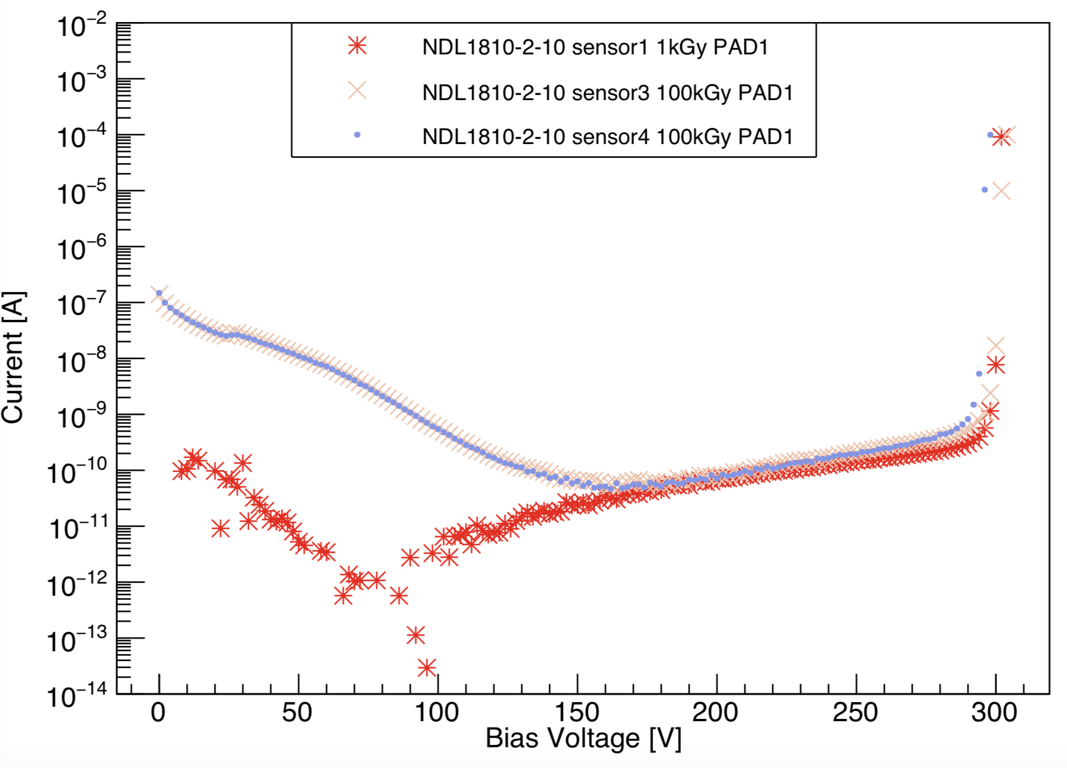
I-V after X ray irradiation :NDL sensor (1)
 | VBD | V_Depleted | Layout | Wafer | Gain
Type 13# (BV170) | ~165V | ~100V | 6GR | 100Ω.cm | 40
Type 12#(BV60) | ~95V | ~40V | 6GR | 300Ω.cm | 40
Type 10# | ~300V | ~40V | 2GR | 300Ω.cm | 40
Type 9# | ~250V | ~40V | 2GR | 300Ω.cm | 80
I_leak is lower after irradiation
~ 0.1 nA
I_leak is large at low V_bias
can improve by adjusting GR
From
Yunyun
Due to Metal pad in Guard ring?

Slide 17
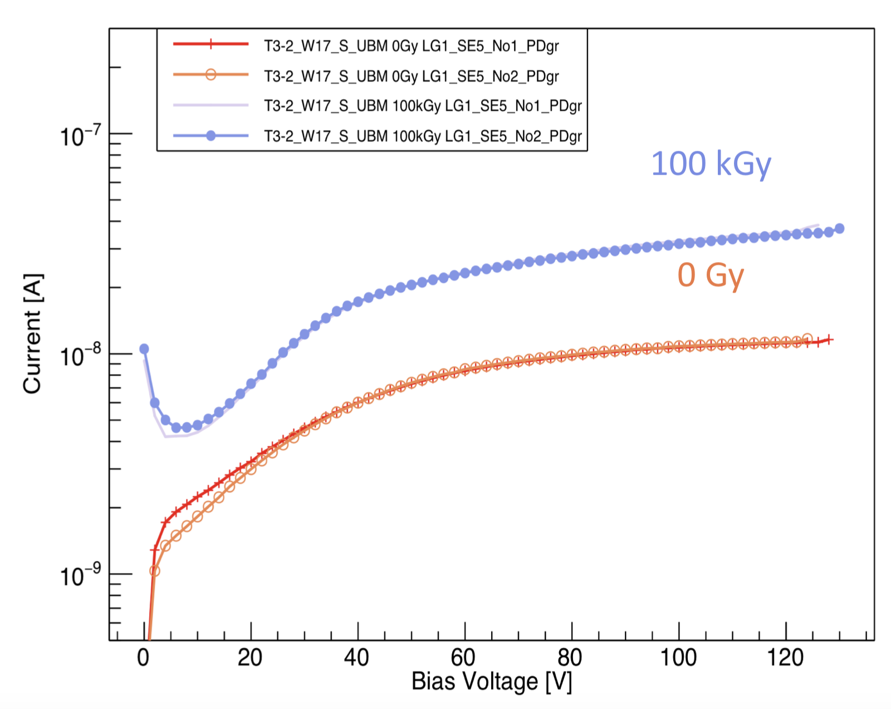
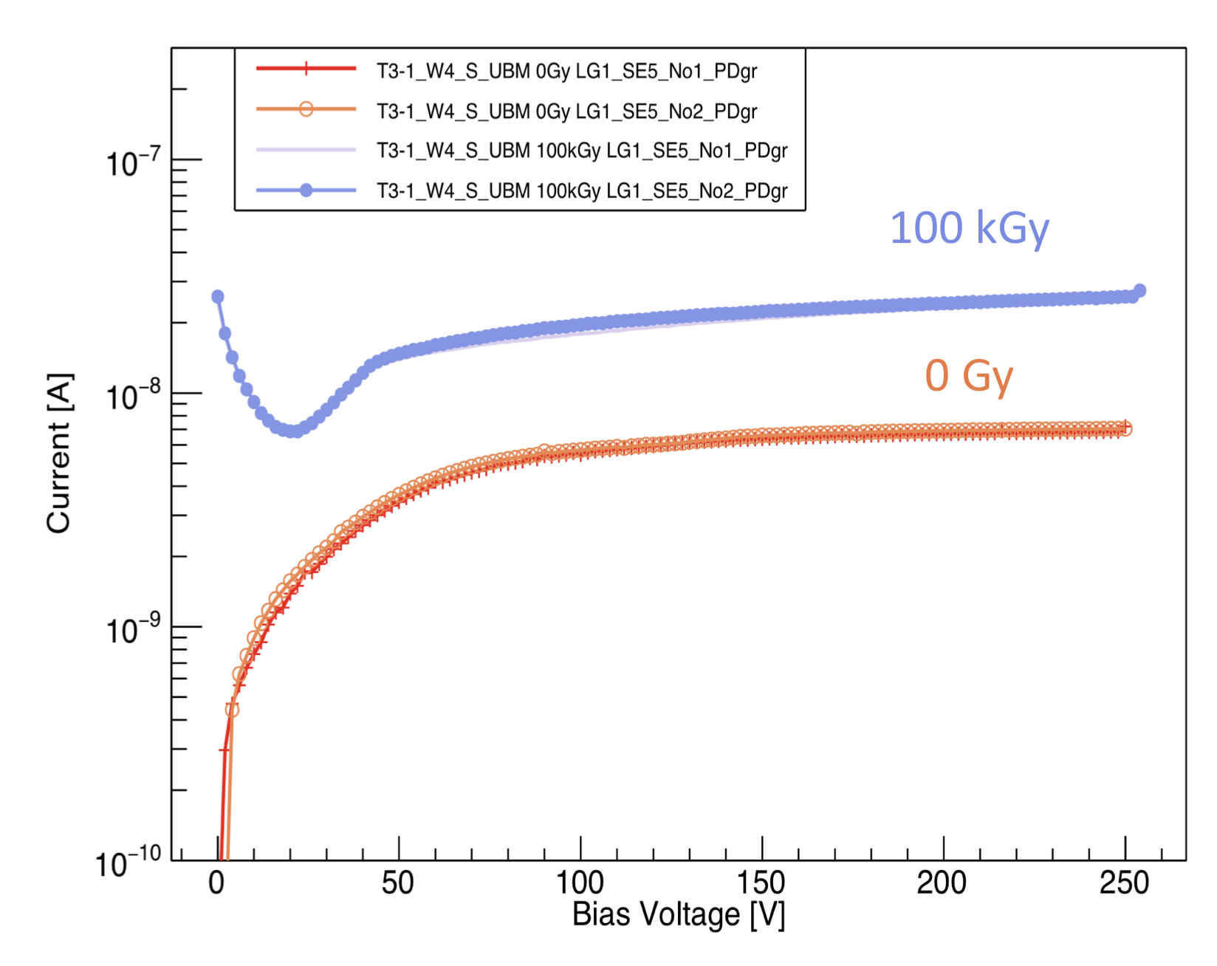
I-V after X ray irradiation : HPK sensor
Guard Ring current at 100kGy increases
>= 4 times compared the current at 0Gy.
HPK type 3.2 with UBM
HPK type 3.1 with UBM
From Yunyun

Slide 18
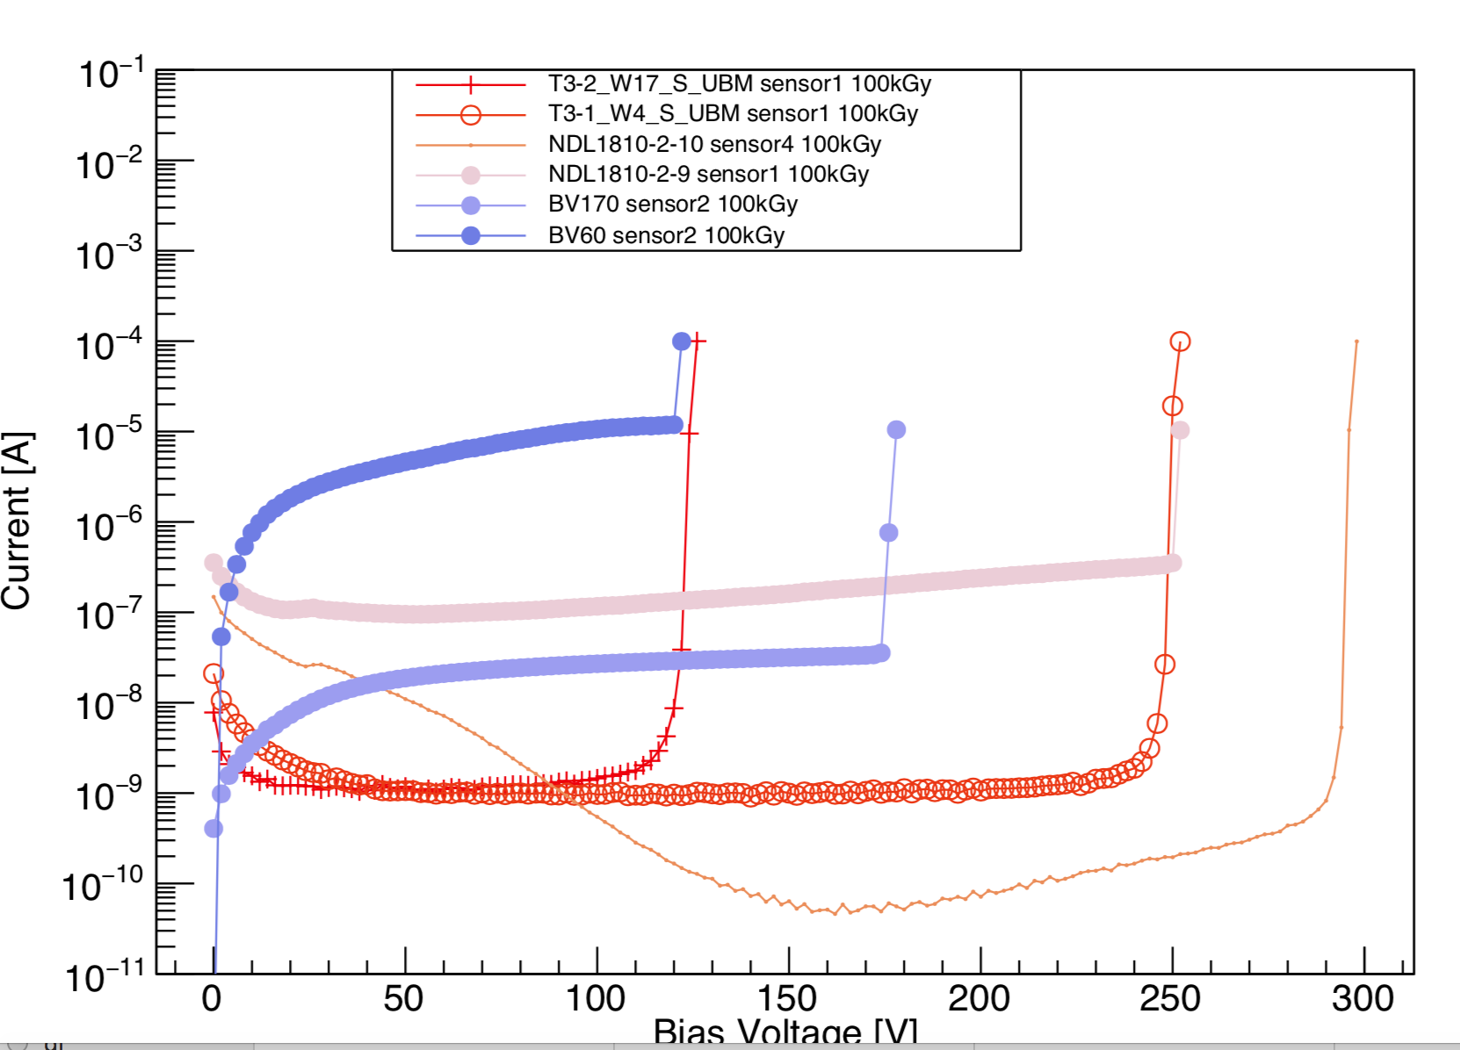
I-V after X ray irradiation : comparisons
Short summary of leakage current on working point before VBD
NDL 9# and 10# have the same laytout (2GR design)
9# has higher p+ dose for gain layer, longer annealing time than type 10#

Slide 19
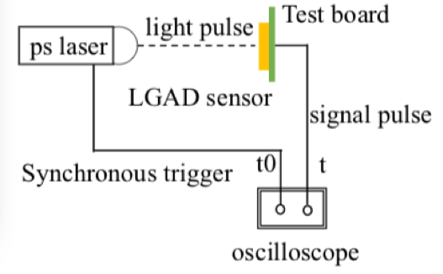
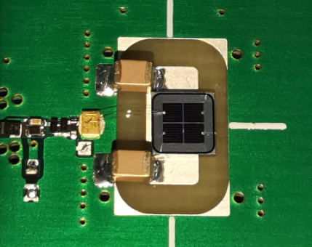
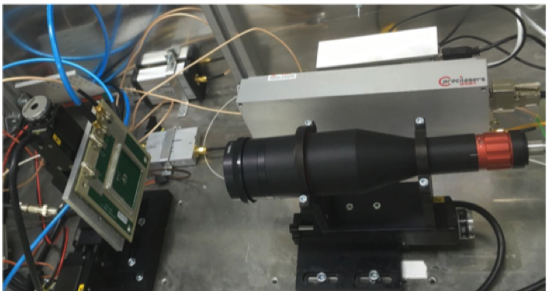
Laser test ： timing resolution study
Testing timing response for NDL LGAD sensor with TCT laser system
Replace the TCT laser with pico-second pulse laser
pico-second Laser Pulse width : 7ps; wavelength: 1064nm, , Frequency: 20MHz
Evaluate the jitter contribution
Less than 10ps
Laser power is larger than MIP
Try Beta test in next step for more realistic measurement
Wirebond one pixel
to UCSC single channel board
By Yuzhen, Yunyun, Suyu,Liaoshan

Slide 20
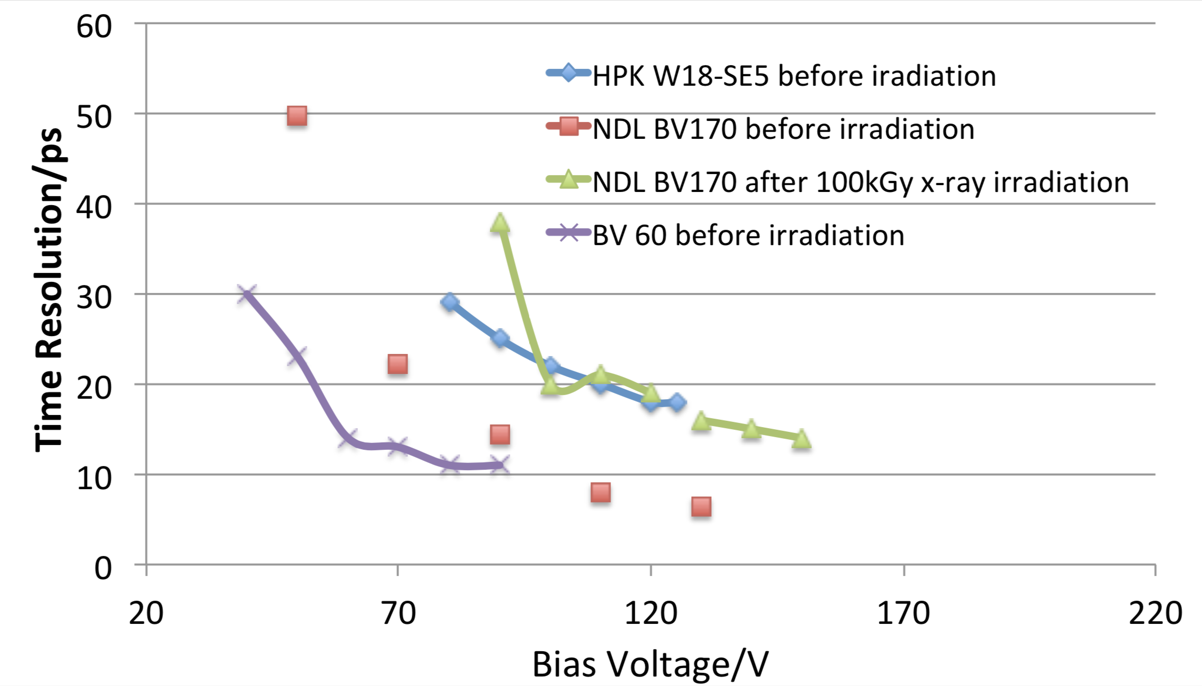
Laser test ： timing resolution study
Preliminary irradiation results
Time resolution of NDL LGAD is slightly worse after 100kGy

Slide 21
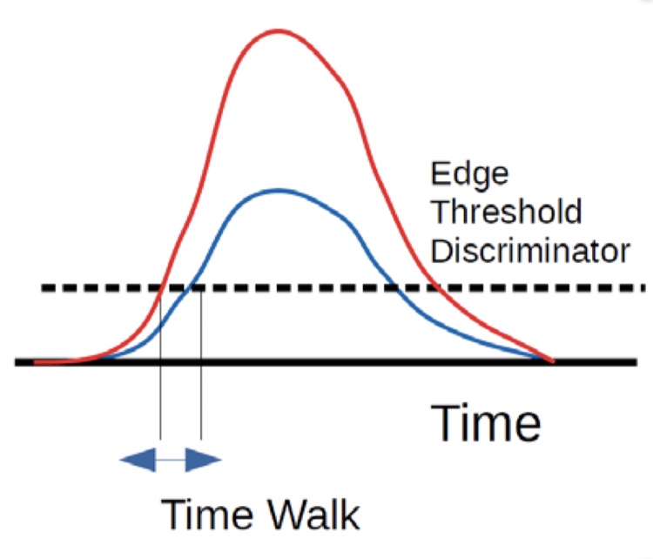
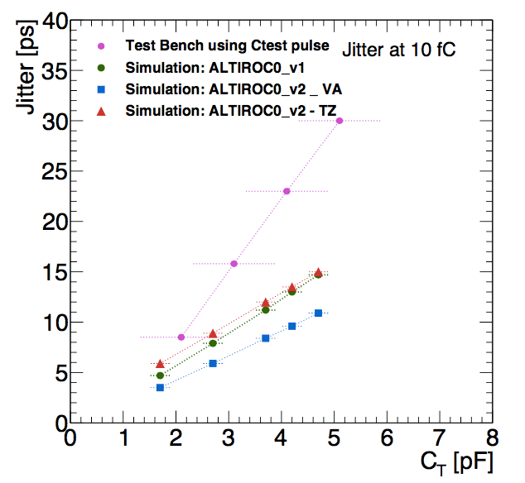
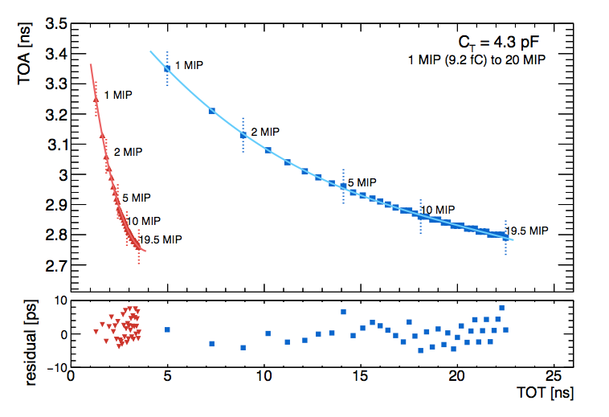
ASIC for fast timing detector
To design ASIC for fast timing detector
Need to handle jitter, Time walk (TW) and TDC uncertainty
record Time of arrival (TOA)and Time over Threshold (TOT)
Correction for Time walk, precision within 10ps
Reduce capacitance to reduce jitter
Time walk correction with TOA and TOT
From ATLAS

Slide 22
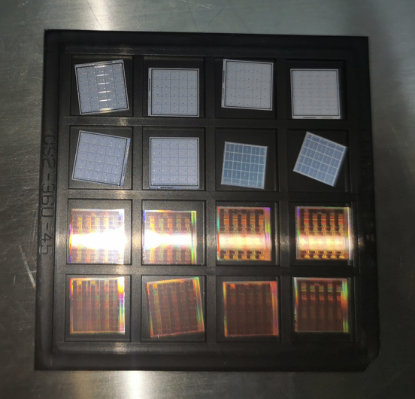
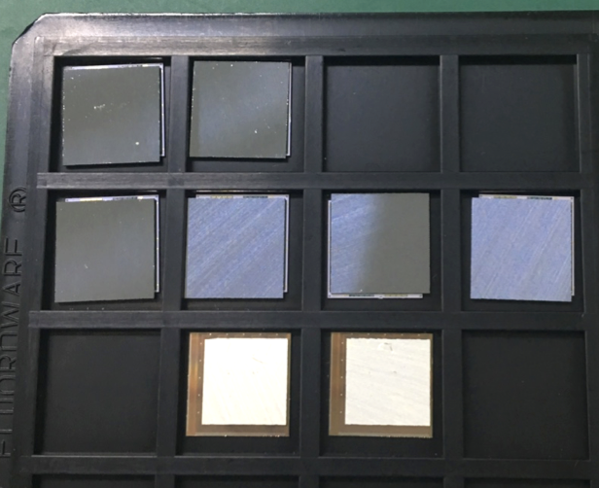
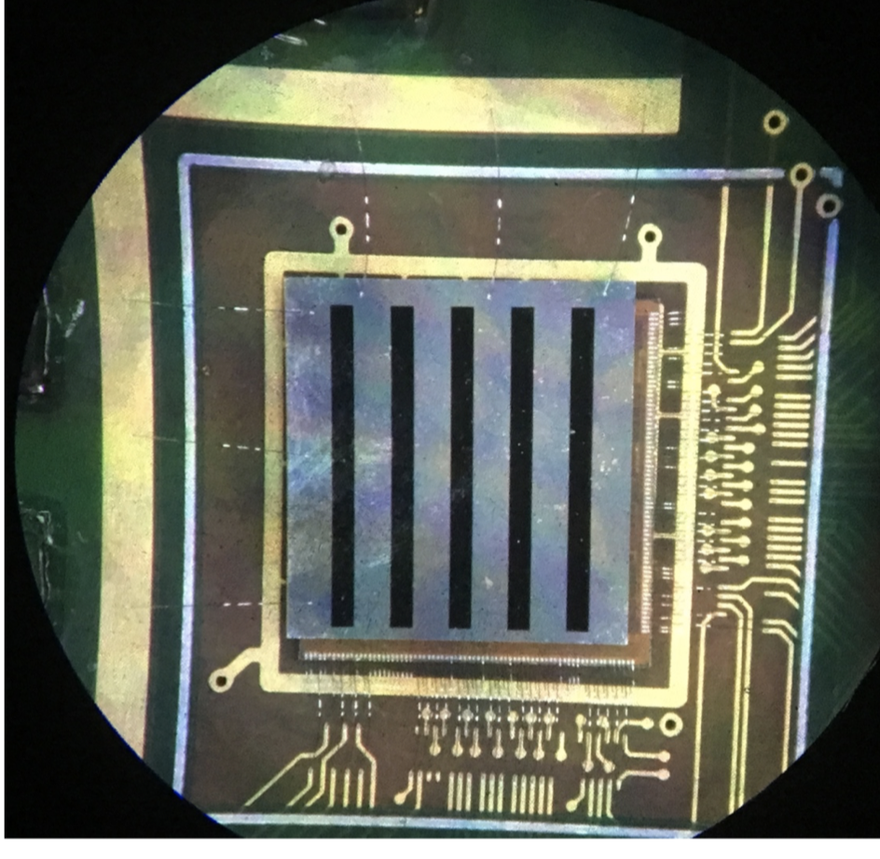
ATLAS HGTD Module
Full size Module :1 LGAD + 2 ASIC
15x30 channels
2cm x 4cm
Existing module
5x5 channels
Built by IHEP
LGAD
ASIC
bump-bonding
Wire-bonding
HGTD module
Assembled in IHEP

Slide 23
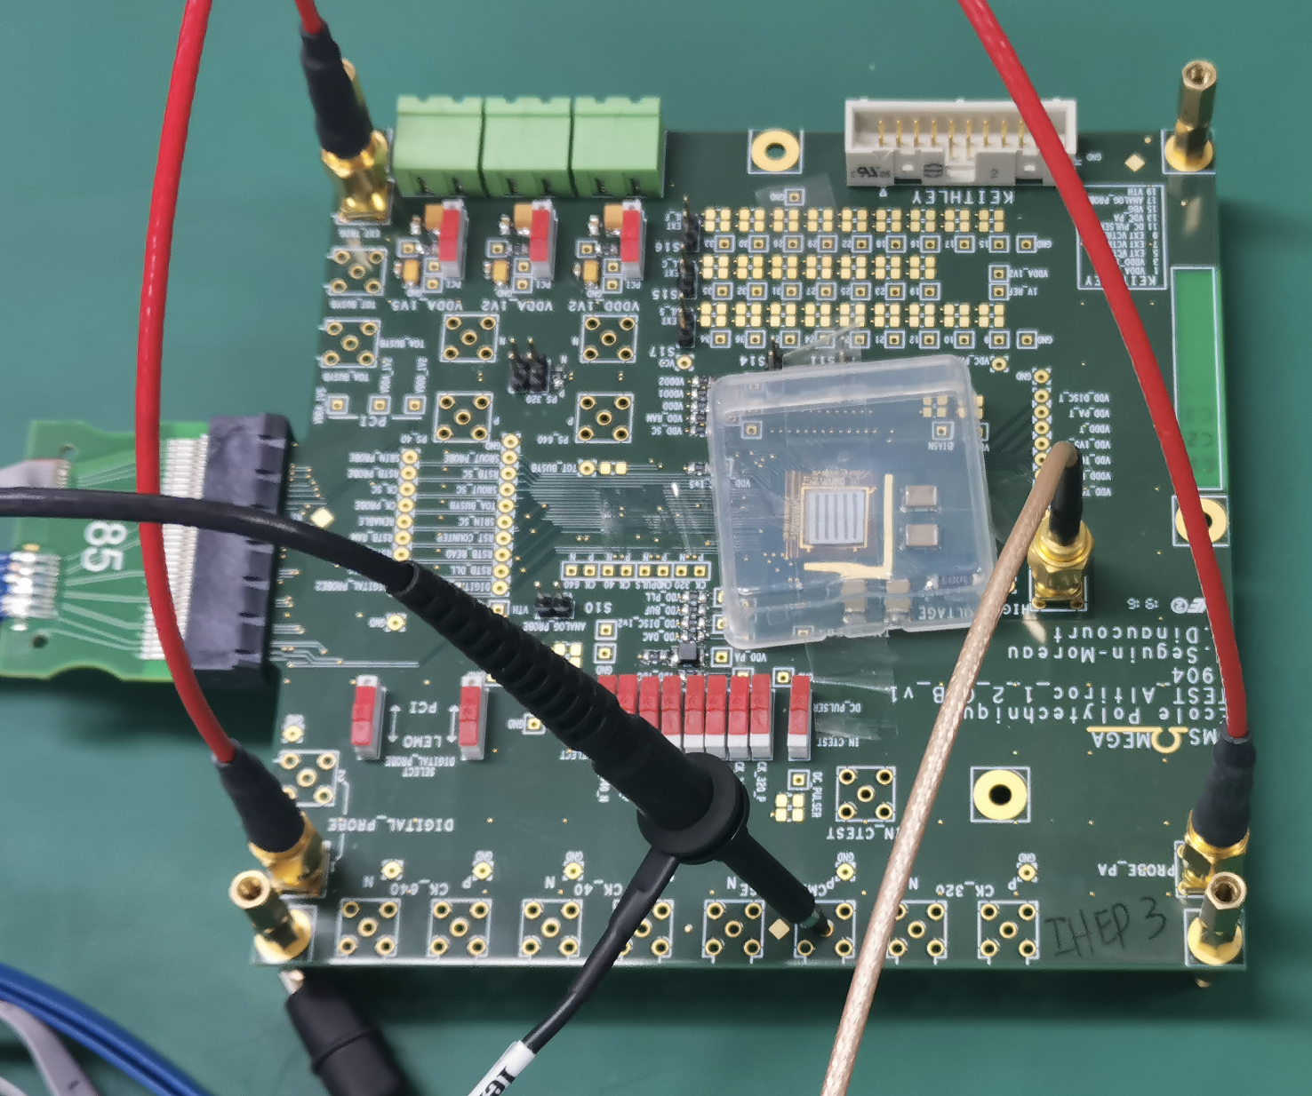
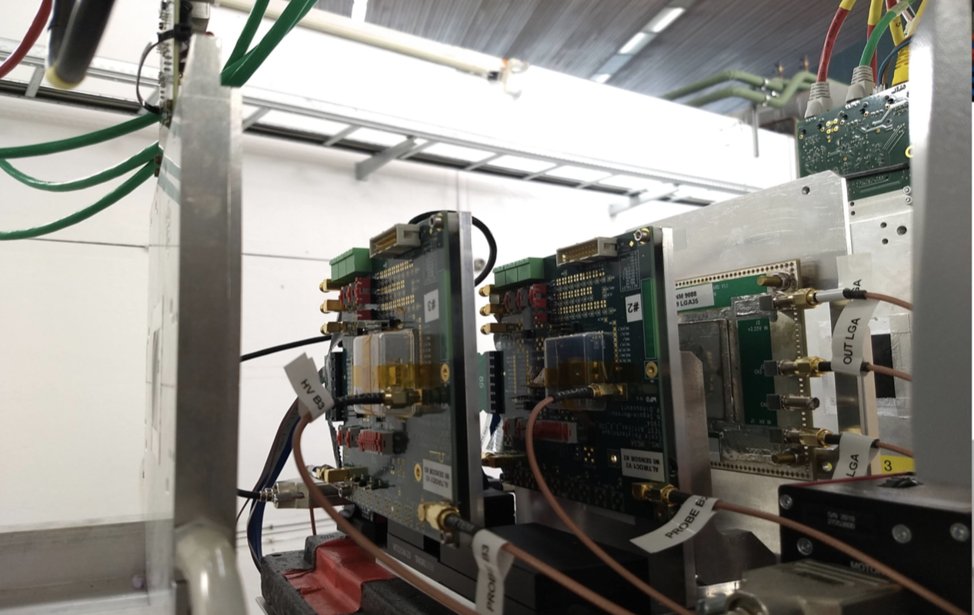
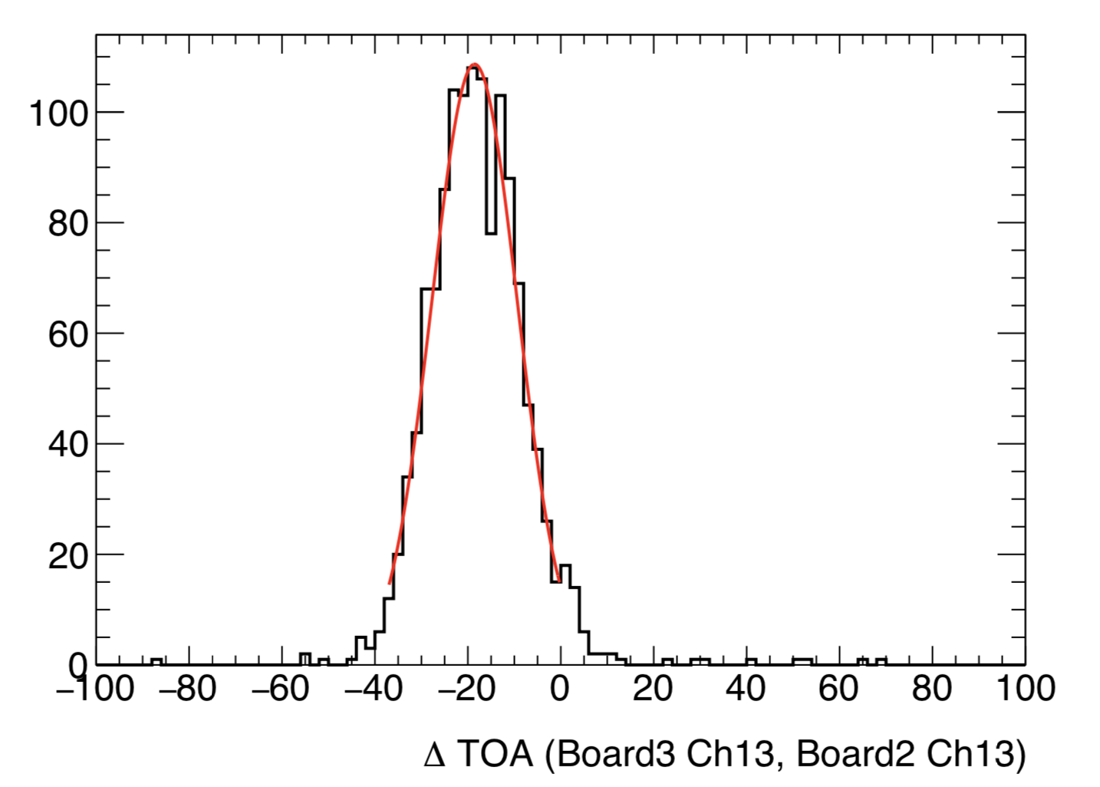
HGTD detector Module R & D
IHEP assembled first batch of HGTD modules with ALTIROC1_v2
IHEP modules showed good performance in DESY beam test
35ps time resolution in module level
HGTD module prototypes assembled in IHEP
performance
2019 DESY beam test for HGTD modules
IHEP module time resolution
In DESY 2019 test beam

Slide 24
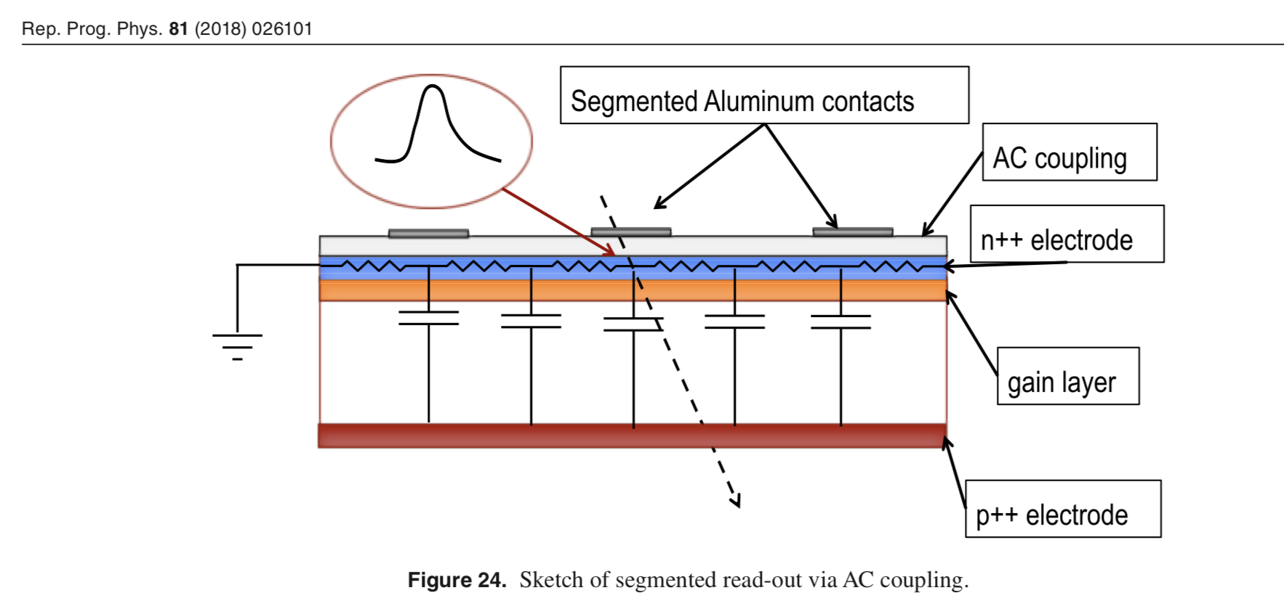
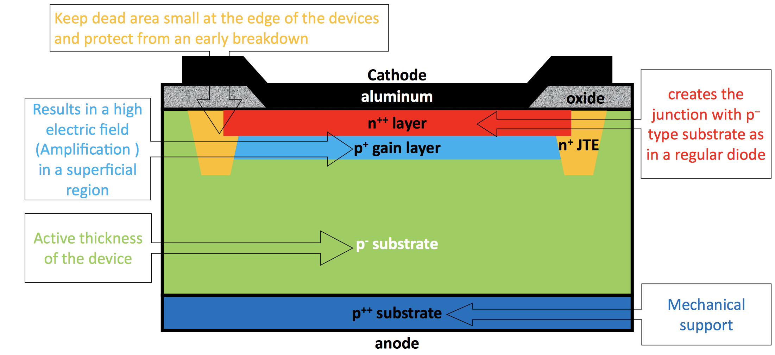
Future 4D LGAD
LGAD we have now
One gain layer per pixel
Relative large dead area
Spatial resolution is not good
LGAD in the future:
Uniform gain layer
Small dead area
Both time and spatial resolution

Slide 25
Summary
New foundry of ultra-fast LGAD sensor in China
Novel device lab (NDL) in Beijing Normal university
30ps time resolution in beam test and beta tests
~10ps in jitter term , Landau term dominated
Irradiation hardness of NDL has been tested
It meets CEPC requirements
Next step:
Beam test to verify its K/pi separation power

Slide 26
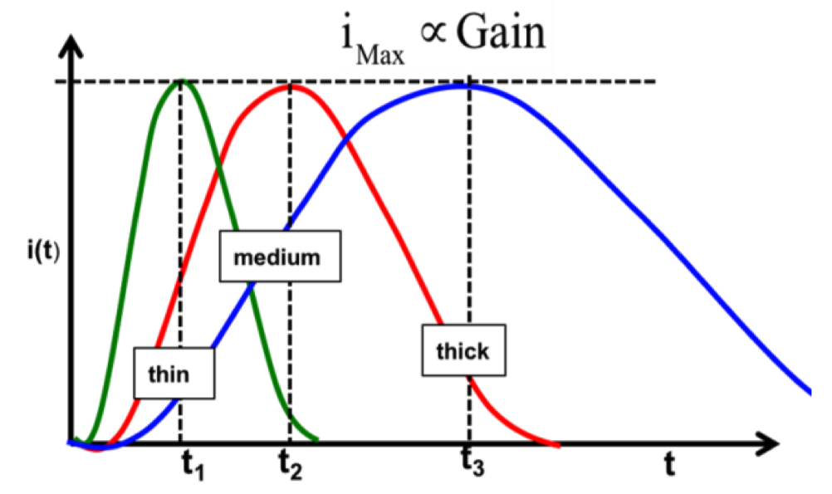
Low-Gain-Avalanche-detector
Landau Noise term:
Signal fluctuation due to non-uniform charge deposition
Minimized by reducing thickness of the sensor (50um)
Time walk
corrected using the amplitude
estimate with the time over threshold (TOT).
Jitter
Need gain to increase S/N
Need thin detector to decrease t_{rise}

Slide 27
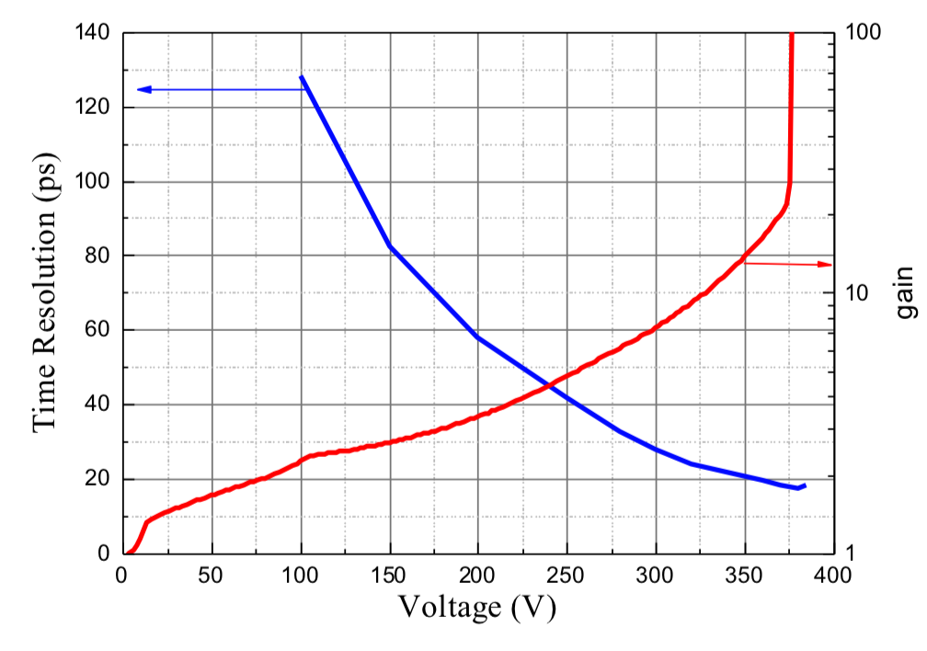
Time resolution vs gain in 5x5 NDL LGAD
Pico-second laser measurement
The power of the laser is reduced to simulate MIP
Jitter term can reach 20ps in this laser tests
PS: Landau term can not be evaluated in laser test

Slide 28
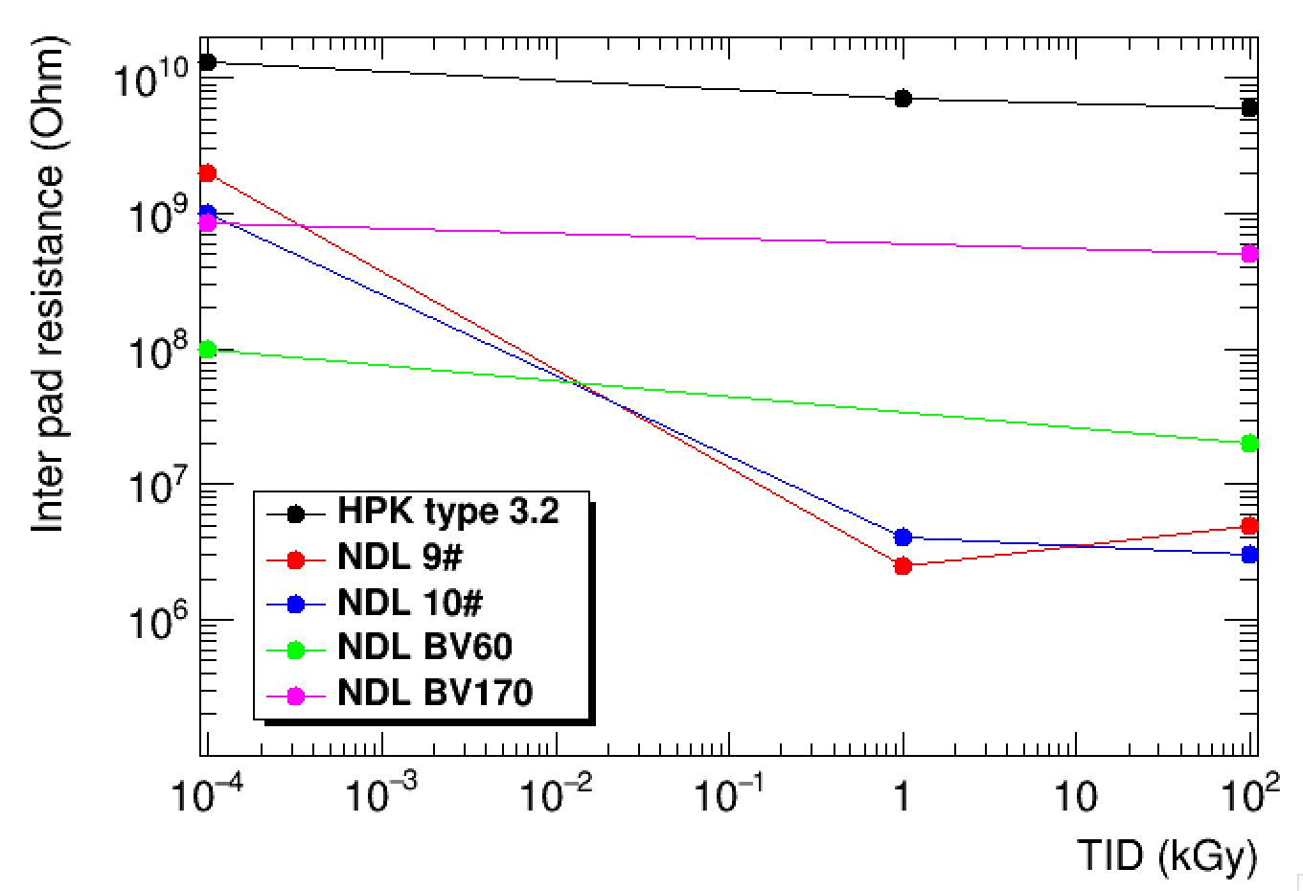
Inter-pad resistance
Measure the resistance between neighbor pad in 2x2 and 5x5 LGAD
HPK type 3.2 (5x5) sensors showed good inter-pad isolation after irradiation
NDL 2x2 sensors :
6GR design has better Inter-pad resistance than 2GR design after irradiation.
pad2
pad3
pad1
pad4
From Yunyun

Slide 29
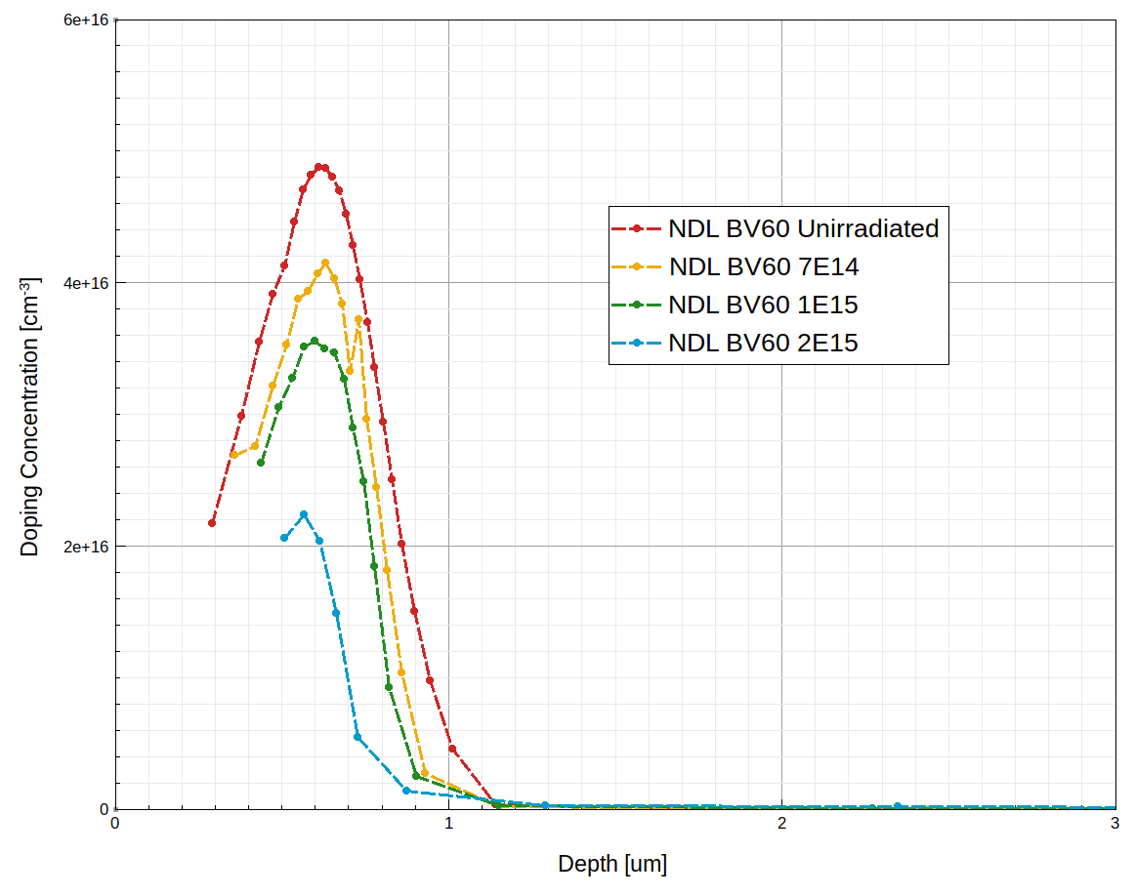
Doping profile Vs Flence
By Tao Yang

Slide 30
fast readout ASIC R & D
Fast readout ASIC (ALTIROC) R & D is one of the key for HGTD Project
TDC Time resolution is better than 10ps
Radiation hard electronics: >200MRad
IHEP is one of key institute in ALTIROC design team
leading part of ALTIROC2 digital blocks design, will contribute to radiation hard design
Leading chip emulator development

