Slide 2
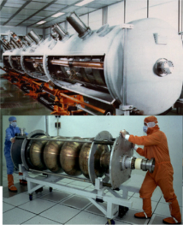
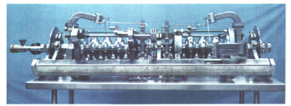
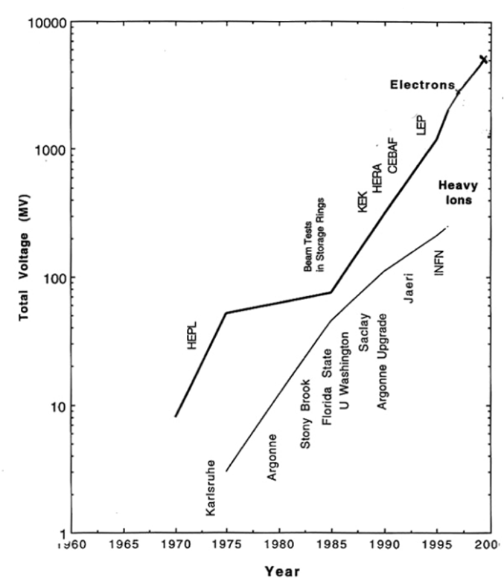
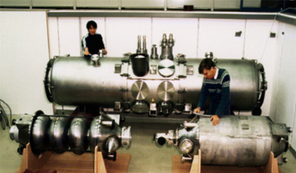
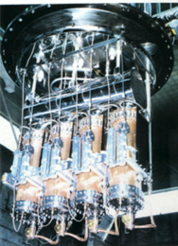
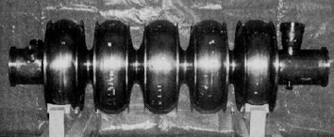
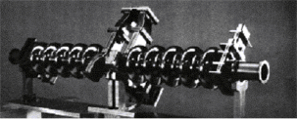
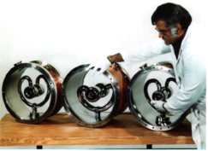
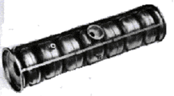
SCRF From HEPL to year 2000
“Livingston Plot” from Hasan Padamsee

Slide 3
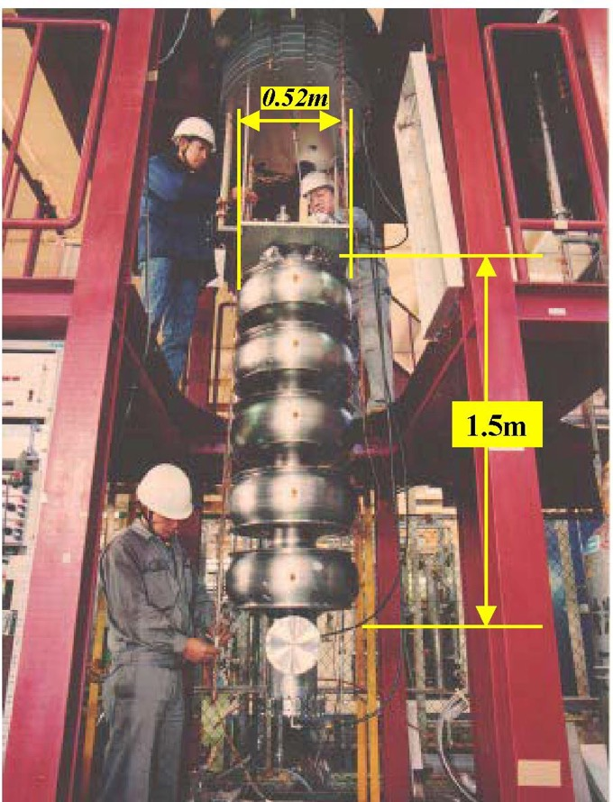
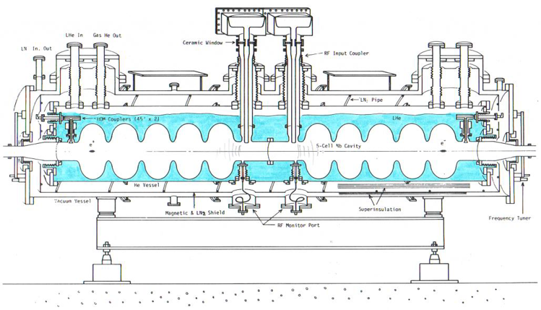
First Industrial Production in Japan (1988 – 1995)
The first mass-production of SRF Cavities in the world
SRF Cavity for TRISTAN at KEK
Bulk-Nb - 508MHz - 5-Cell Cavity
32 SRF cavities were fabricated by Mitsubishi and operated in TRISTAN

Slide 4
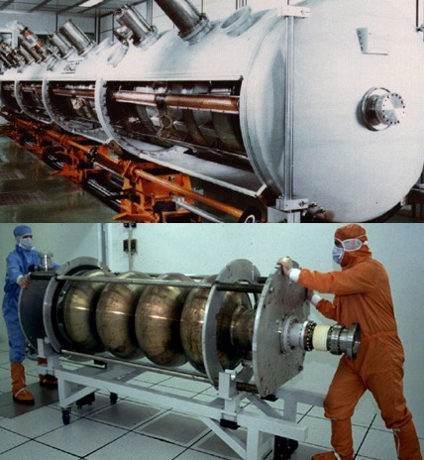
Large Scale Production: CEBAF & LEP II
CEBAF @ TJNAF
338 bulk niobium cavities
  Produced by industry
  Processed at TJNAF in a dedicated infrastructure
5-cell cavities
1.5 GHz, L_{act}=0.5 m
4-cell cavities
LEP II @ CERN
32 bulk niobium cavities
  Limited to 5 MV/m
  Poor material and inclusions
256 sputtered cavities
  Magnetron-sputtering of Nb on Cu
  Completely done by industry
  Field improved with time
  <E_{acc}> = 7.8 MV/m (Cryo-limited)
352 MHz, L_{act}=1.7 m

Slide 5
A great success for LEP II
Accelerating Field Evolution with time
Final energy reach
limited by cryogenic
from G. Geschonke’s Poster for the ITRP visit to DESY
100 GeV: 3500MV
Mean Nb/Cu
6.9 MV/m
96 GeV:
Mean Nb/Cu
6.1 MV/m
104 GeV: 3666MV
Mean Nb/Cu
7.5 MV/m
design

Slide 6
A great success for CEBAF
Lost Time Totals June'97-May'01
1.5 % in FY 01
0.0 % in FY 01

Slide 7
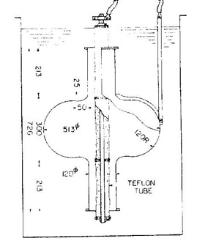
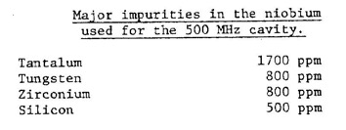
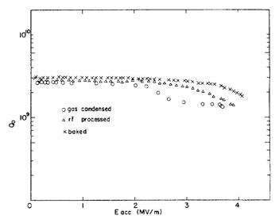


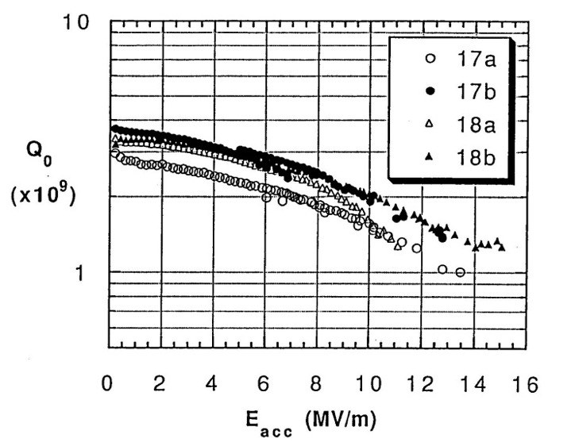
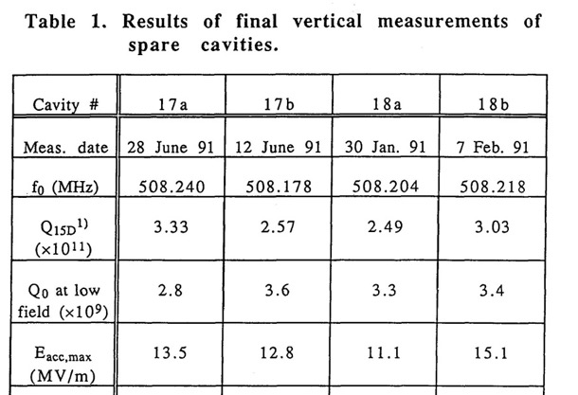
TRISTAN SRF from KEK to MHI
KEK 1981
1995

Slide 8
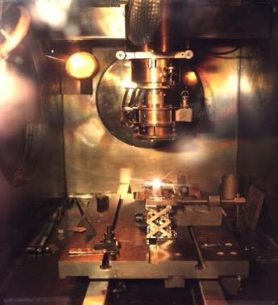
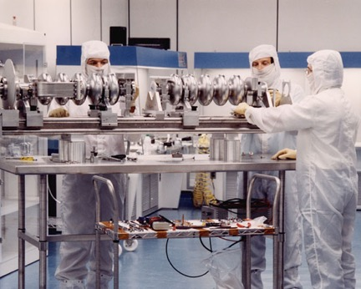
Lessons from CEBAF, LEP2 and TRISTAN
Use of the best niobium (and copper) allowable in the market at the time
Industrial fabrication of cavity components with high level quality control
Assembly of cavity components by Industry via Electron Beam Welding in clean vacuum
Use of ultra pure water for all intermediate cleaning
Use of close loop chemistry with all parameters specified and controlled
Cavity completion in Class 100 Clean Room
  Final cleaning and drying (UV for bacteria and on line resistivity control)
  Integration of cavity ancillaries in ISO4 clean room
That is
New level on Quality Control

Slide 9
1.3 GHz multicell cavities

Slide 10
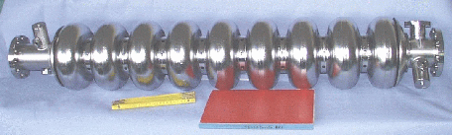
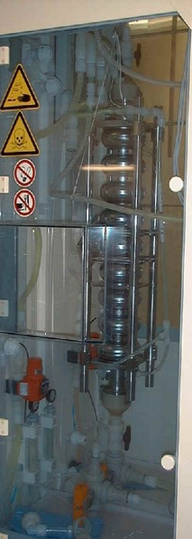
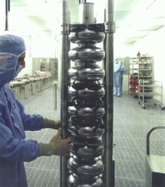
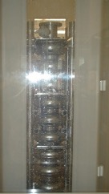
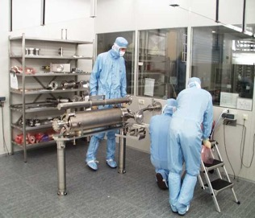
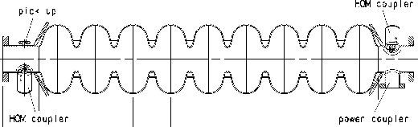
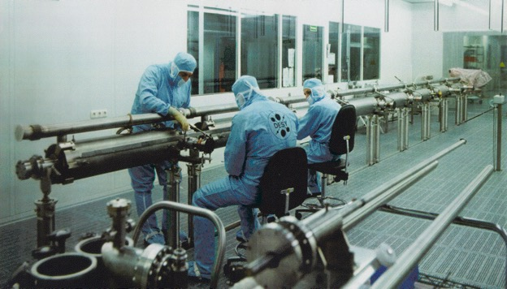
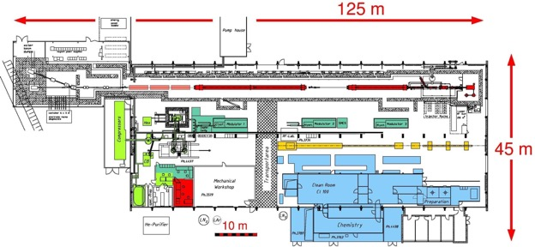
The TESLA Challenge: SCRF Linear Collider
E_{acc} = 25 MV/m Cost/MV = LEP/20
1992
TESLA Collaboration set up at DESY
9-cell, 1.3 GHz

Slide 11
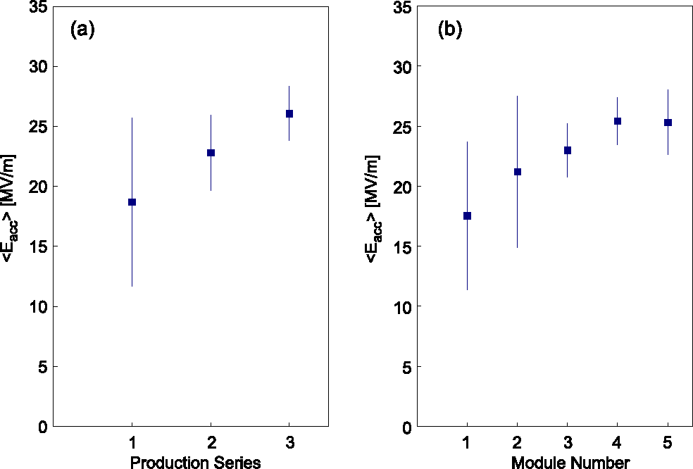
Learning Curve with BCP
BCP = Buffered Chemical Polishing
3 cavity productions from 4 European industries: Accel, Cerca, Dornier, Zanon
4th production of 30 cavities to define Quality Control for Industrialization
<E_{acc}> @ Q₀ ≥ 10¹⁰
<E_{acc}> @ Q₀ ≥ 10¹⁰
<2001>
<1999>
<1997>
Improved welding
Niobium quality control
Module performance in the TTF LINAC

Slide 12
3rd cavity production with BCP – TESLA TDR ref.
Year 2000
TESLA 500 specs:
24.3 MV/m @ Q₀ = 5 × 10⁹

Slide 13
Two major contributions to rise the limits
In-Situ Baking (120-140 °C) from CEA-Saclay (Bernard Visentin)
  Cures Q-drop at High Field
    Formation of a uniform Nb₂O₅, dielectric, layer on the surface
      Reduction of the normal conducting dissipation from NbO and NbO₂
    Diffusion of the high oxygen concentration in the superconducting layer
      Better BCS performances, i.e. lower surface resistance
Electro-polishing (EP) from KEK (Kenji Saito)
  Improves field emission and maximum field
    Much smoother surface, less local field enhancement
      Better cleaning with high pressure water rinsing
      Q-drop cure by in-situ baking more efffective
      High temperature (1400 °C) heat treatment avoidable

Slide 14
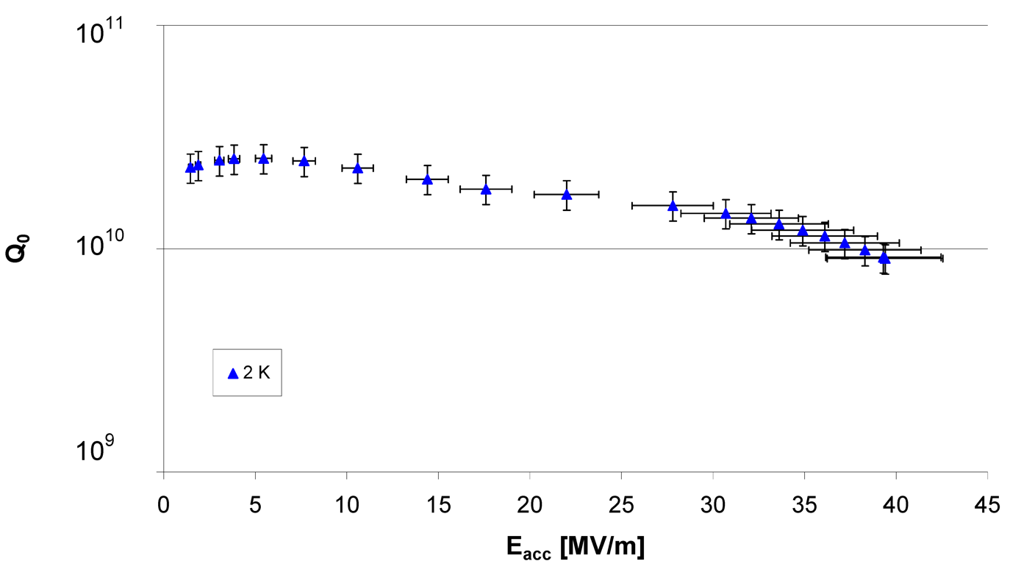
Results on AC70 – 1 (2004)
EP at the new DESY plan 800°C annealing 120°C Backing
TESLA 800 specs:
35 MV/m @ Q₀ = 5 × 10⁹

Slide 15
European XFEL Cavity Production - 1
At the end of the long prequalification process (TTF, FLASH, ILC,…)
Ettore Zanon, EZ & Research Instruments, RI
were contracted at the end 2010 to produce each
8 Cavities for infrastructure rump/up and qualification
  4 Dummy CVs (DCV), 4 Reference CVs (RCV)
280 XFEL type series cavities (first 8 are PCV)
12 ILC HiGrade cavities
Additional 120 cavities allocated end 2012 to each companiy
Nb & NbTi supplied by DESY
Production precisely following detailed specifications which also include the exact definition of infrastructure to be used (build to print)
Final treatment after main EP: final EP for RI / flash BCP for EZ

Slide 16
European XFEL Cavity Production - 2
No performance guaranty by the vendors, i.e. the risk of unexpected low gradient or field emission is taken over by XFEL/DESY (responsibility for re-treatment).
Goal: average usable XFEL gradient 23.6 MV/m at Q₀=1x10¹⁰,
X-Rays <1x10⁻²mGy/min
First series cavities (PCV) to be delivered end 2012 – begin 2013
All cavities to be delivered till end 2014 – begin 2015
Delivery rate: about 8 CVs/week (4/each vendor)
Supervision of the CV production: DESY & INFN/LASA

Slide 17
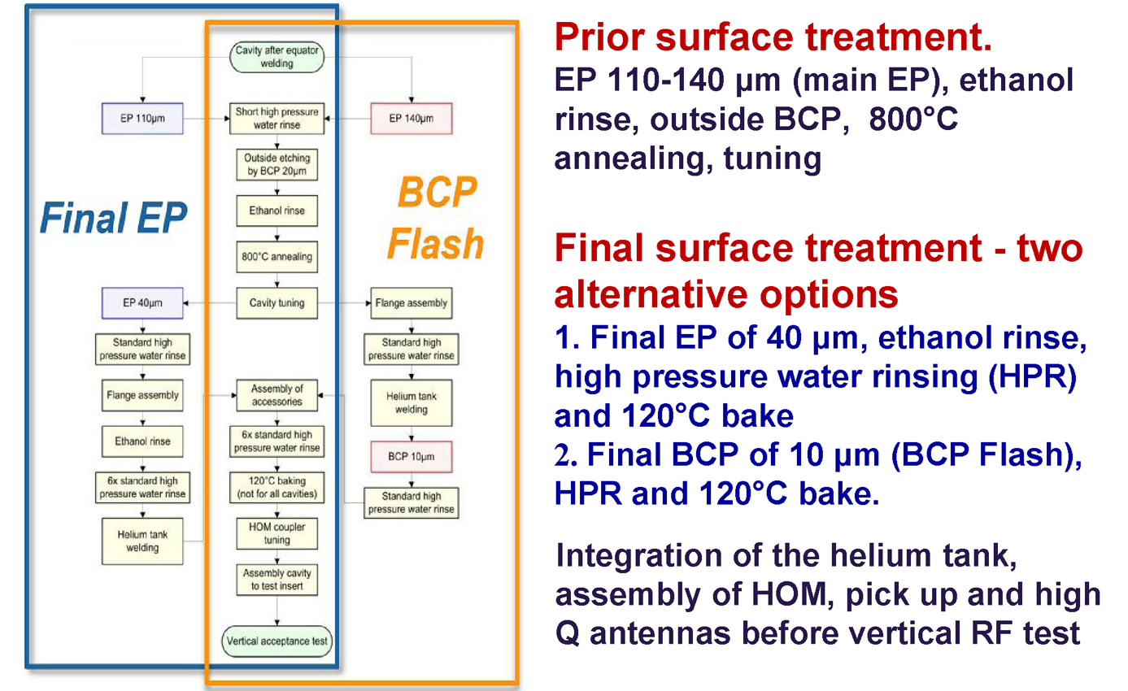
Surface Treatments from Prototypes

Slide 18
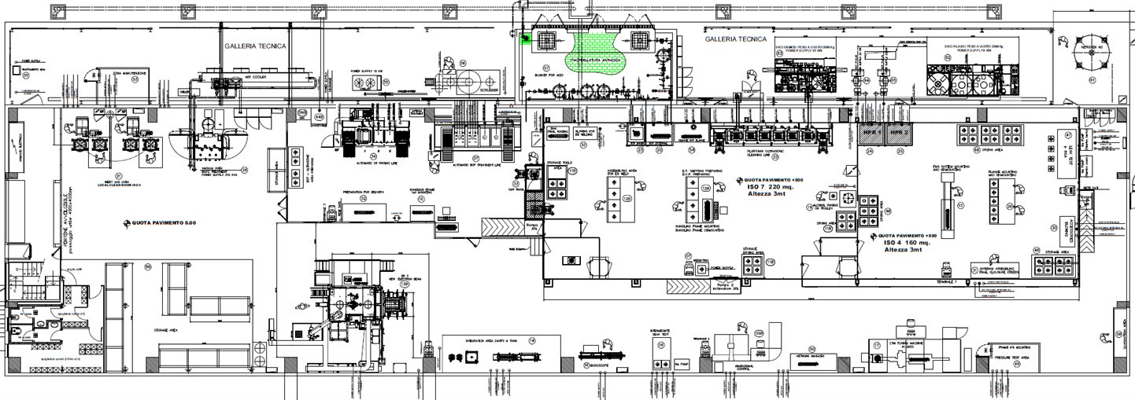
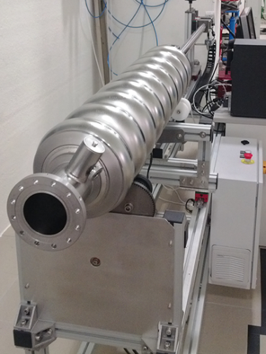
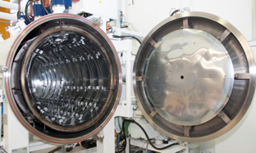
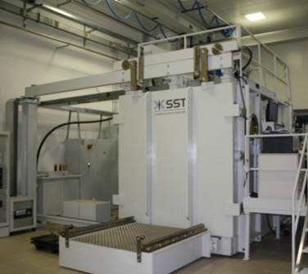
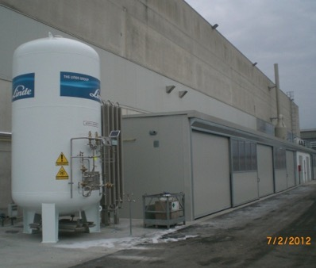
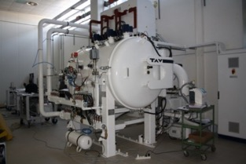
Part of the Cavity Infrastructure at EZ

Slide 19
E-XFEL experience on cavity production rate
2013
2014
2015
EZ cavity production udated on May 6th, 2015

Slide 20
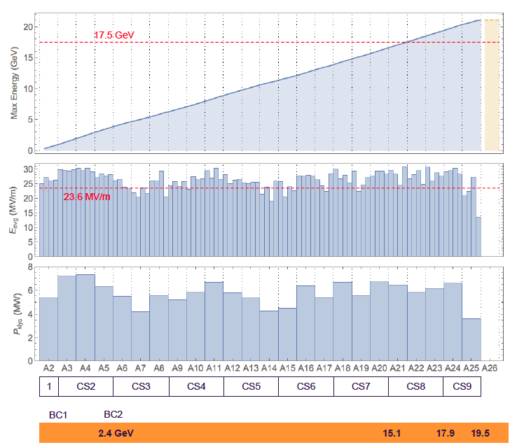
E-XFEL: Usable Installed Voltage

Slide 21
1.3 GHz E-XFEL cavities «as received»
EP
BCP
RI
EZ
RI
EZ

Slide 22
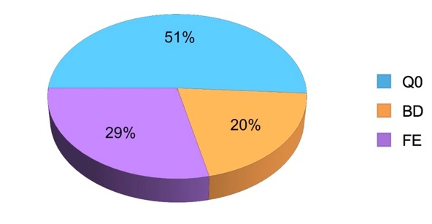
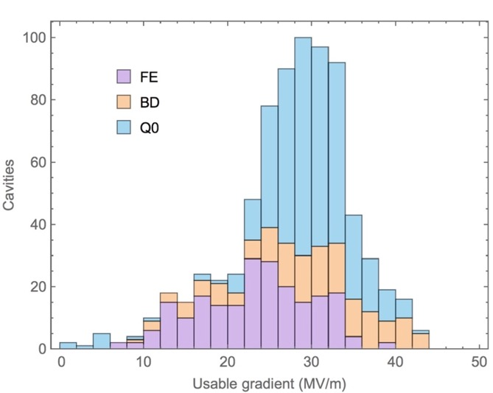
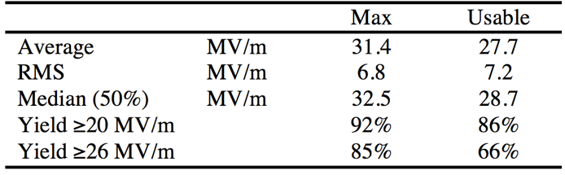
As Received Usable Gradient
Include operations spec
  Q₀ ≥ 1×10¹⁰
  FE threshold (X-ray)
→ Usable Gradient

Slide 23
Final performance: Eacc
Total after 313 retreatments performed on 237 of the 831 cavities
Before:
E max 31.4 ± 6.8 [MV/m]
(RI): E max 33.0 ± 6.5 [MV/m])
(EZ): E max 29.8 ± 6.6 [MV/m])
After:
E max 33.0 ± 4.8 [MV/m]
(RI): E max 34.7 ± 4.4 [MV/m])
(EZ): E max 31.5 ± 4.9 [MV/m])
Before:
E usable 27.7 ± 7.2 [MV/m]
(RI): E usable 29.0 ± 7.3 [MV/m])
(EZ): E usable 26.4 ± 6.6 [MV/m])
After:
E usable 29.8 ± 5.1 [MV/m]
(RI): E usable 31.2 ± 5.2 [MV/m])
(EZ): E usable 28.6 ± 4.8 [MV/m])

Slide 24
Final performance: Q0
Total after 313 retreatments performed on 237 of the 831 cavities
Before :
Q0 @ 4 MV/m 2.15 ± 0.32 [1.10¹⁰]
(RI): Q0 @ 4 MV/m 2.11 ± 0.32 [1.10¹⁰])
(EZ): Q0 @ 4 MV/m 2.18 ± 0.32 [1.10¹⁰])
After:
Q0 @ 4 MV/m 2.23 ± 0.34 [1.10¹⁰]
(RI): Q0 @ 4 MV/m 2.21 ± 0.34 [1.10¹⁰])
(EZ): Q0 @ 4 MV/m 2.26 ± 0.33 [1.10¹⁰])
Before:
Q0 @ 23.6 MV/m 1.31 ± 0.26 [1.10¹⁰]
(RI): Q0 @ 23.6 MV/m 1.29 ± 0.24 [1.10¹⁰])
(EZ): Q0 @ 23.6 MV/m 1.34 ± 0.28 [1.10¹⁰])
After:
Q0 @ 23.6 MV/m 1.37 ± 0.25 [1.10¹⁰]
(RI): Q0 @ 23.6 MV/m 1.34 ± 0.22 [1.10¹⁰])
(EZ): Q0 @ 23.6 MV/m 1.41 ± 0.26 [1.10¹⁰])

Slide 25
Some Considerations from the E-XFEL
Industry, once trained, is doing as well as the lab behind
but with a better yield
Results obtained are very close to those available at the time of the ITRP: 15 years ago
  Results depend on the technology applied
  The complete cycle in Industry improves the yield, but not dramatically
The option of a second treatment is still mandatory to improve the yield. That’s very expensive
  HPR is usually sufficient, flash BCP can be required, EP is excluded (HT installed)
  Second treatment is improving the yield, both for high field and field emission

Slide 26
3rd cavity production with BCP – TESLA TDR ref.
Year 2000
TESLA 500 specs:
24.3 MV/m @ Q₀ = 5 × 10⁹

Slide 27
High Q - High Gradiend
Since ninties TESLA/ILC pushed for High Gradient
All CW applications are now asking for high Q
With a percent duty cycle the maximum usable gradient is a crucial cost driver
With CW operation cryogenisc is the limiting factor
ElectroPolishing - Zero B Field - Fast Cooldown Nitrogen Doping - Infusion - Large Grain - ……

Slide 28
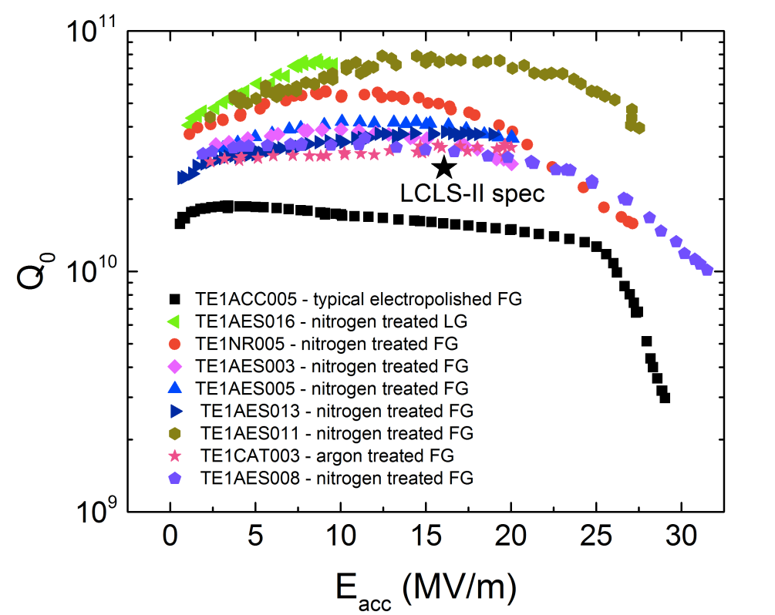
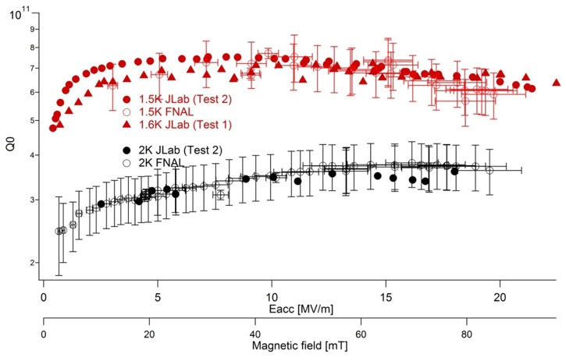
The “strange effect” of Nitrogen Doping
High Q₀ for CW (FermiLab & JLab)
  For CW operation Cryogenics is a significant cost driver that limits the usable accelerating field
  Once fixed machine energy gain and cavity geometry the dissipated power at cryogenic temperature is directly proportional to (E_{acc})² and inversely to Q₀.
  CW needs high Q₀ @ moderate field
2
A. Grassellino, SRF Materials Workshop 2012
Ari D. Palczewski
Q₀ vs. E_{acc} – JLab test 1 & 2 and FNAL
T = 2 K

Slide 29
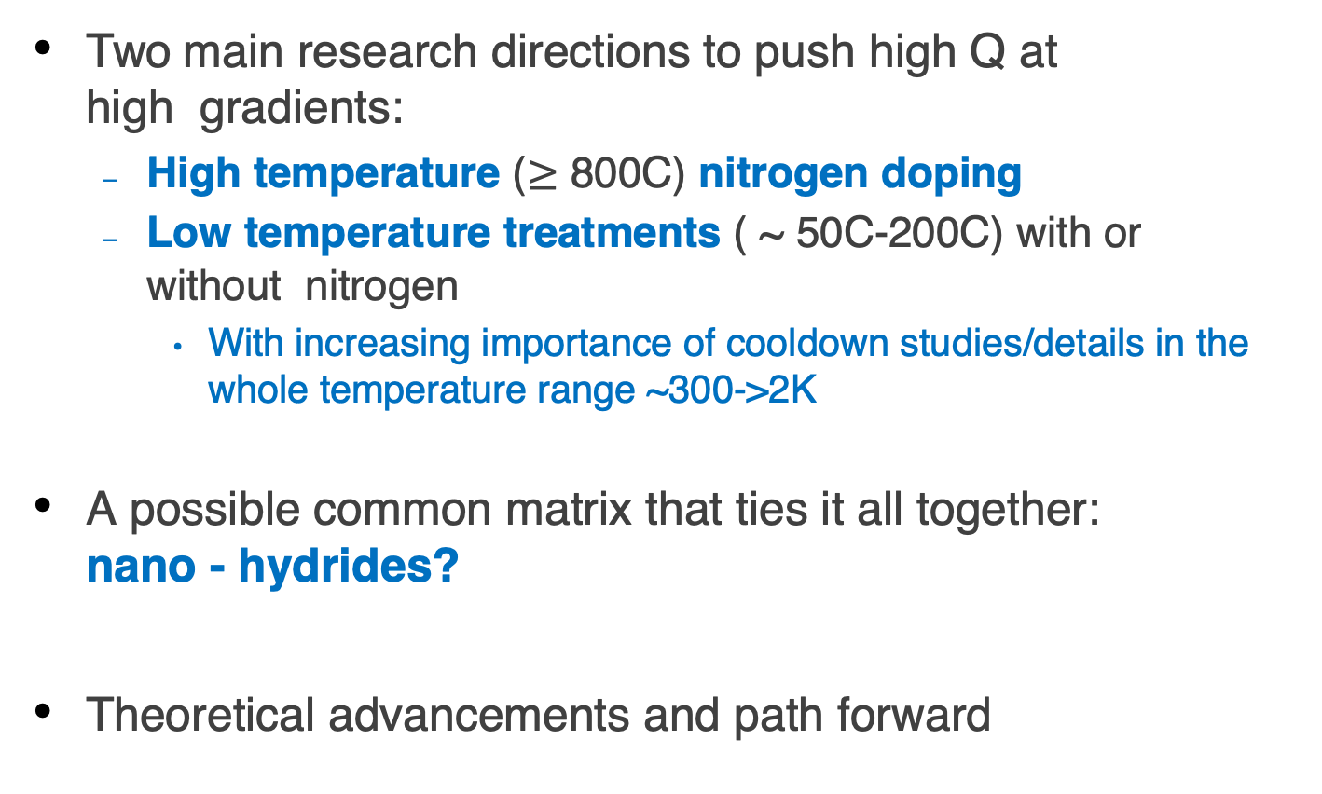
High Q and High Gradient
Two main research directions to push high Q at high gradients:
  High temperature ($≥$ 800C) nitrogen doping
  Low temperature treatments ( ~ 50C-200C) with or without nitrogen
    With increasing importance of cooldown studies/details in the whole temperature range ~300->2K
A possible common matrix that ties it all together: nano - hydrides?
Theoretical advancements and path forward
A. Grassellino et al.

Slide 30
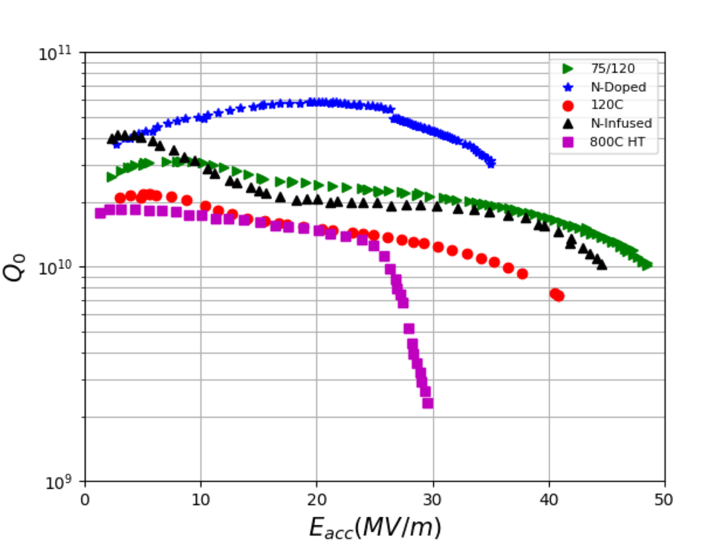
State of the art (high Q and G @ 1.3 GHz, 2K)
Q > 3 10¹⁰ @35 MV/m with N doping
Q > 1 10¹⁰ at 49 MV/m (B_{pk} = 210 mT) with 75/120C bake
But: moderate reproducibility and material dependent
A. Grassellino et al.

Slide 31
From Pulsed E-XFEL to CW LCLS II
EZ & RI produced all the 1.3 GHz cavities for LCLS II – phase I, including final treatment and Nitrogen doping
All the cryomodules, from XFEL drawing modified for CW, have been produced in China by Wuxi
DOE subscribed the high nominal value for the cavity Qo (as promised by the successful application of the nitrogen doping) but doubled the cryoplant: just in case
Big effort to successfully adopt a technology that was still at the R&D phase
Cavity treatments and criomodule/cryogenics design are going together: deep magnetic igene and fast cool down

Slide 32
The LCLS-II Challange from SRF2019 (Marc Ross)
CEBAF (94) LEP2 (99) LCLS-II (2021) HE (2026)
Three large CW Superconducting linacs:
Parameter | CEBAF 1994 | LEP2 1999 | LCLS-II 2021 | LCLS-II-HE 2026
N_cav | 338 | 288 | 280 | 440
E_acc (MV/m) | 7.5 | 7.2 | 18.5 | 20.8
Meters of SRF | 169 | 490 | 296 | 466
E_tot (GeV) | 1.2 | 3.6 | 4.6 | 8.6
<Q0> | 4.0e9 | 3.2e9 | 2.7e10 | 2.7e10
f (MHz) | 1497 | 352 | 1300 | 1300
Temp (K) | 2.08 | 4.5 | 2.0 | 2.0
Heat Load (kW) | 5 | 53 | 3.7 | 7.3
Heat Load kW/GeV | 4.2 | 14.7* | 0.8 | 0.8
* @4.5K. Divide by 3.5 to convert to equivalent load at 2 K, (4.2 for LEP2)
Substantial investment in CW SRF

Slide 33
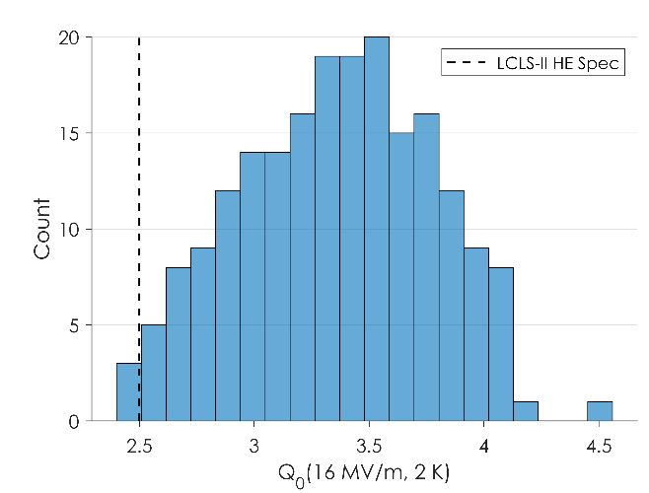
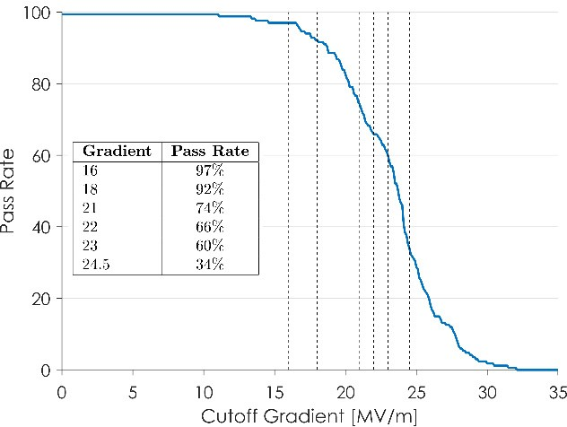
LCLS-II cavity data from SRF2019 (Marc Ross)
MOP044 Gonnella
FRCAA3 Gonnella
Vertical Test
Q₀
Testing Complete 07.2019
E_acc
>19 MV/m
→ Pass
Fermilab VT / year
200
100
16

Slide 34
LCLS-II cryomodule data from SRF2019 (Marc Ross)
Typical Performance Summary (F-17, 04.2019)
 | VTS |  |  | CMTF Test
Cavity | Eacc* [MV/m] | FE onset | Q0@16MV/m | Max** Gradient [MV/m] | Usable Gradient*** [MV/m] | FE onset [MV/m] | Q0 @16MV/m 2K @ 30 g/s | Material
CAV0540 | 21.4 | none | 2.8E+10 | 20.5 | 20.5 | none | 3.19E+10 | TD 200/900
CAV0530 | 20.6 | 24 | 2.9E+10 | 19 | 17 | none | 2.56E+10 | TD 200/900
CAV0533 | 25 | none | 3.0E+10 | 18.5 | 18.5 | none | 3.22E+10 | TD 200/900
CAV0529 | 19 | none | 3.2E+10 | 18.5 | 18 | none | 3.16E+10 | TD 200/900
CAV0525 | 19.5 | none | 3.3E+10 | 19 | 17 | none | 3.84E+10 | TD 200/900
CAV0535 | 25.7 | none | 3.5E+10 | 19 | 18.5 | none | 3.77E+10 | TD 200/900
CAV0067 | 18.8 | none | 3.4E+10 | 19 | 19 | none | 3.44E+10 | NX-C, 200/975
CAV0517 | 18.8 | none | 3.0E+10 | 10 | 7.1 | 6 | 2.12E+10† | TD 200/900
Average | 21.1 |  | 3.13E+10 | 17.9 | 16.9 |  | 3.16E+10
Total Voltage | 175.2 |  |  | 148.9 | 140.7
Marc Ross @ SRF2019

Slide 35
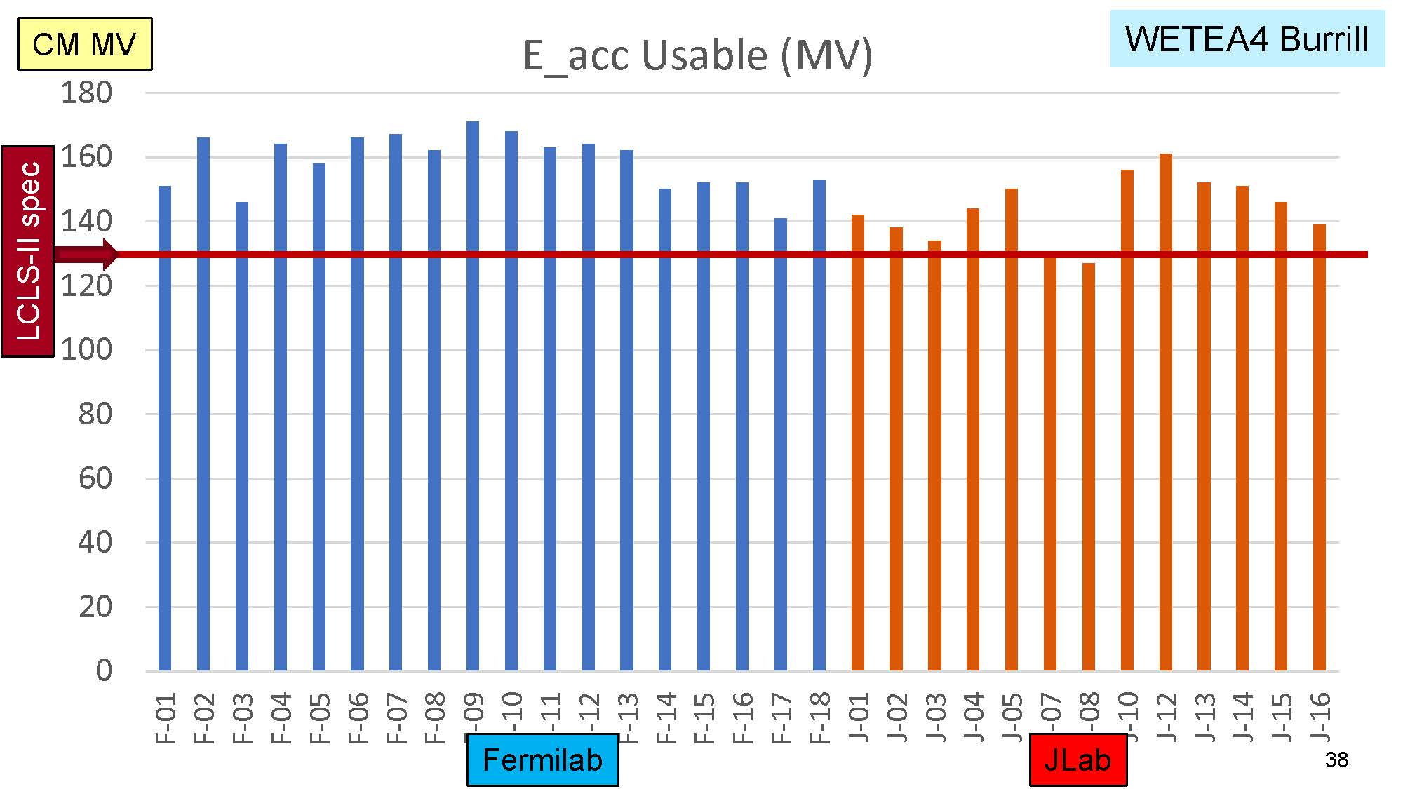
LCLS-II: Usable Gradient
Marc Ross @ SRF2019

Slide 36
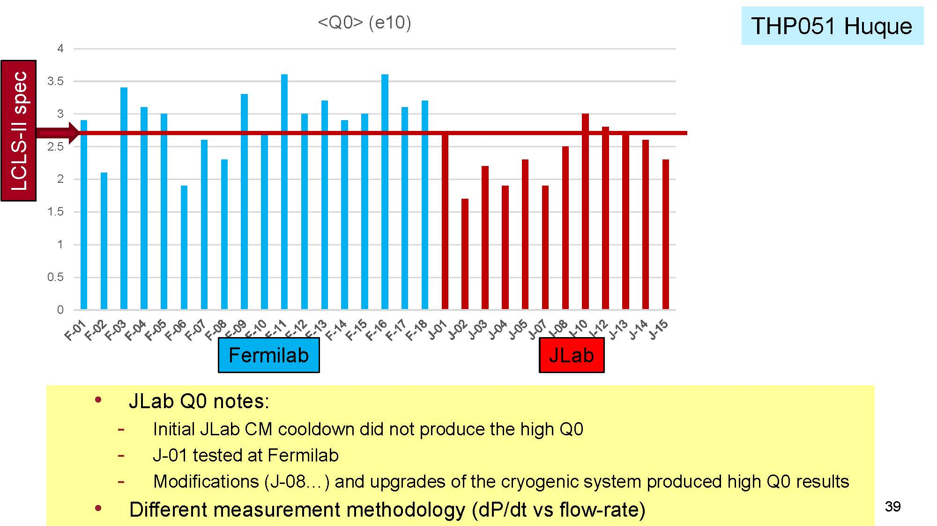
LCLS-II: The effect of Infrastructure
Marc Ross @ SRF2019

Slide 37
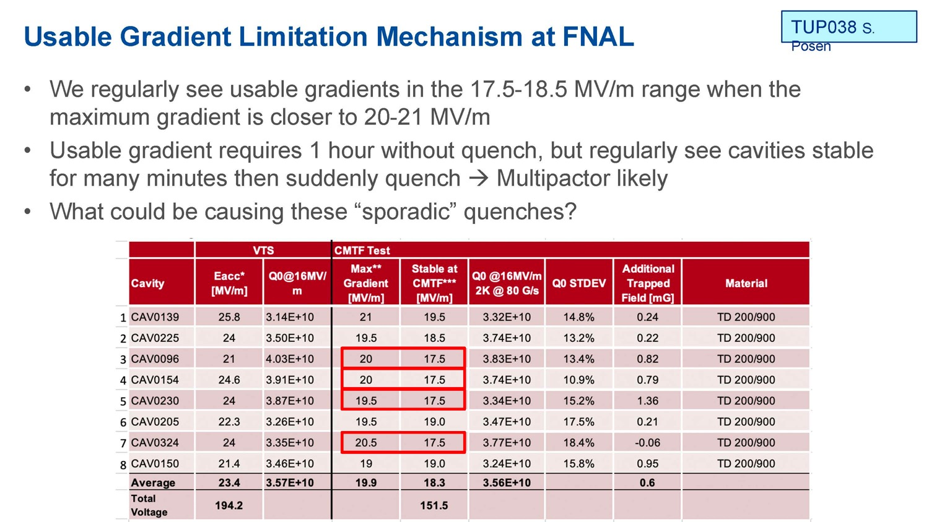
Some open Questions
Marc Ross @ SRF2019

Slide 38
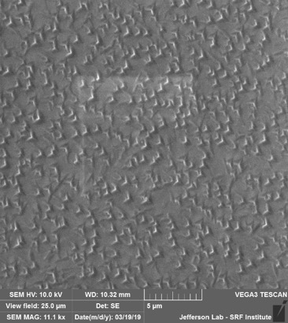




Doping and the mistery of nano-hydrides
NL115
3N60
NL115
3N60
NL115
3N60
Pre-HF Soak
NL115
HF 1hr
NL115
HF 1hr
NL115
HF 1hr
Post-HF Soak
Nb Nitration Compared to Nb Nitration + HF 1 hr Rinse

Slide 39


The effect of HF Soaking

Slide 40

Abaut gas on surfaces ander vacuum

Slide 41












“as received” materials (cross-section)
ATI -good flux expulsion- Ningxia -bad flux expulsion-
Material that shows good flux expulsion properties
(after annealing at 900C) has larger grain in the “as received” condition
Material with bad
Band contour map w GBs misorientation
Band contour map w GBs misorientation
flux expulsion properties shows small grains, many with high level of local misorientation
From Martina Martinetto at SRF 2019
Local misorientation map
Local misorientation map

Slide 42




Large Grain Niobium, the DESY experience
Large grain Nb (proposed at JLab)
  Should reduce the material cost by 20-30%
  Should simplify the surface treatments
  Mechanics and PED more delicate
  Results comparable to those with fine grain
Large grain
Fine grain
A variety of cavity have been built in many labs
Very good results have been obtained in single and multi-cell cavity at different frequency
Best Results @ DESY
© Waldemar Singer

Slide 43







Promissing resulta from Peking University
Efforts for 9-cell cavities at PKU (collaboration with HIT)
Cavity | Nb | Eacc (MV/m) | Q @ Emax | Q @ 16MV/m
PKU1 | FG | 23.0 | 6.0E09 | 1.1E10
PKU2 | LG | 22.4 | 2.2E10 | 2.0E10
PKU3 | FG | 28.6 | 4.0E09 | 7.0E09
PKU4 | LG | 32.6 | 1.0E10 | 1.6E10
SRF2017
Eacc: 22.4 MV/m,
Q₀=2E10 @ 20 MV/m, 2K
Eacc: 32.6MV/m, Q₀:1E10 (1.8K)
Reach ILC requirement

Slide 44






Ingot Slicing from LASA experience
CBMM ingot. Ø=480 mm
RRR>300
Wire sawing with oxygen
Protection @Heraeus
25 (x2) 4.675 mm slices
produced:
3D rendering of ingot inner structure
From slices grain boundary pattern.
GB displace but «topological» structure remains nearly unaltered.

Slide 45




2 ESS-like LG Cavitie Tested at LASA
December 2016 & October 2019 - Good Q₀ but limited by quench

Slide 46
650 MHz multicell cavities

Slide 47



INFN, β = 067, ESS cavities as a reference (BCP)
Scaling R/Q and frequency to 650 MHZ @ β=1 a Q₀ = 3-4 10¹⁰ is expected @ 17 MV/m
37 out of 38 cavities produced, 14 jacketed
Total of 11 cavities already qualified at DESY
On average, Q₀ at 16.7 MV/m at 1.8 10¹⁰
Soft multipacting easily processed around 10-12 MV/m as expected
ESS insert at AMTF

Slide 48


The 650 MHz elliptical cavities for PIP-II
LB650
β = 0.61
β = 0.90
HB650
 | LB650 | HB650
# cavities | 36 | 24
Q₀ | 2.3e10 | 3.2e10
R_{s} (nΩ) | 8.4 | 8.1
E_{acc} (MV/m) | 16.7 | 19
B_{pk} (mT) | 73.7 | 73.9

Slide 49

By next Summer new experience for PIP-II
INFN LB650 RF Design rationales:
Cell coupling k_{cc} optimized assuming TESLA-type cavity as a reference, of the quantity N²/(βk_{cc}), where N is number of cells, β relative velocity. It models field-flatness sensitivity to cell frequency errors.
End Cell frequency tuning achieved by increasing the diameter of the whole terminal cell thus preserving its round shape and symmetry.
Maximize G factor while preserving sidewall angle at 2° avoiding potentially negative value during the cavity field flatness tuning stage.
Achieve a large frequency separation between π and 4/5 π modes.
Single stiffening rings at both end and inner cells,
preserving manufacturing quality and
tunability with respect to a
double stiffener.
INFN LB650 for PIP-II, cold cavity
β_{geometric} | 0.61
Frequency | 650 MHz
Number of cells | 5
Iris diameter | 88 mm
Cell-to-cell coupling, k_{cc} | 0.95 %
Frequency separation π-4π/5 | 0.57 MHz
Eq. diameter - IC | 389.8 mm
Eq. diameter - EC | 392.1 mm
Wall angle – Inner & End cells | 2 °
Effective length (10*L_{hc}) | 704 mm
Optimum beta β_{opt} | 0.65
E_{peak}/E_{acc} @ β_{opt} | 2.40
B_{peak}/E_{acc} @ β_{opt} | 4.48 mT/(MV/m)
R/Q @ β_{opt} | 340 Ω
G @ β_{opt} | 193 Ω
Inner cells stiffening radius | 90 mm
External cells stiffening radius | 90 mm
Wall thickness | 4.2 mm
Longitudinal stiffness | 1.8 kN/mm
Longitudinal frequency sensitivity | 250 kHz/mm
LFD coefficient k_{ext} at 40 kN/mm | -1.4 Hz/(MV/m)²
Pressure sensitivity k_{ext} at 40 kN/mm | -11 Hz/mbar
Maximum Pressure VM stress at 50 MPa | 2.9 bar
Maximum Displacement VM stress at 50 MPa | 1.5 mm

Slide 50




EP Qualification on single cell – 5-cell next Spring
Treatment trial
Charge removal: 1200 kC. Avg. removal of 60 μm. 7 hours
Acid chilling if temperature on beam tubes is >25°C
External water cooling during the whole treatment
Continuous measurement of thickness (by US thickness gage placed on cavity wall) and temperature (by thermocouple sensors)
15 V voltage (in the polishing zone of V-I curve)
64 μm avg removal (0.15 μm/min)
51 kHz frequency variation (0.79 kHz/μm)
current is the 30-40 A range

Slide 51
Results from FermiLab – 5-cell, β = 0.9
2/6 N-doping + 7um EP + xxx cold EP
2/6 N-doping + xxx cold EP
Higher Q most likely due to better field compensation
Quench field improvement due to cold EP
Quench field improved from 20 to 24 MV/m by adding 3um of cold EP
Cavity limited by FE at ~23MV/m, quench field may be higher
Martina Marinello: private communication

Slide 52
Some Considerations for the Future
The successful large scale production of SRF components for the European XFEL pushed toward new frontiers
Several labs are investing on R&D to improve accelerating gradient and quality factor
A few very exciting results have been obtained with a reasonable reproducibility
LCLS-II is now the new reference with pros and cons
The results dependence from the bulk material producer and from the production batch is still much to high
Higher E_{acc} and Q_{o} design parameters need more stable results and completely understood parameters
Deep scientific control on the niobium production is becoming a unavoidable must

