Slide 1
Rb measurement at CEPC MC Level
Bo Li

Slide 2
Outline
Introduction
Rb
Double tagging method
B-tagging performance
Method
I/O test
Effect of ε_{c} , ε_{uds} and C_{b}

Slide 3
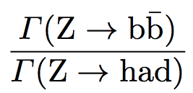
Introduction
R_{b} : the relative decay width of Z into b quarks
Based on the CEPC MC samples: Zbb, Zcc, Zuds
Produced from FSClasser ~110k events
By using the Double tagging method

Slide 4
Introduction
Double Tagging Method
The two jets are divided into two hemispheres according to the plane perpendicular to the thrust axis
Double tagging method :
The ratio of one jet tagged as b jet
The ratio of both jets tagged as b jets
$$\frac{N_{t}}{2N_{had}}=R_{b}{ ε}_{b}+R_{c}ε_{c}+\left(1−R_{b}−R_{c}\right)ε_{uds}$$
$$\frac{N_{tt}}{N_{had}}=C_{b}R_{b}ε_{b}^{2}+{C_{c}R}_{c}ε_{c}^{2}+C_{uds}\left(1−R_{b}−R_{c}\right)ε_{uds}^{2}$$
The ${R_{uds} ,R}_{c}，ε_{uds} ,ε_{c}{, C}_{b}$，$C_{c}$，$C_{uds}$are gotten from MC samples
The $N_{t}$ ,${ N}_{tt}$ , $N_{had}$ are gotten from DATA samples

Slide 5
Rb method
Double Tagging Method
$R_{c}，ε_{c}$，$ε_{uds}C_{b}$，$C_{c}$，$C_{uds}$
Get from MC
$$\frac{N_{t}}{2N_{had}}=R_{b}ε_{b}+R_{c}ε_{c}+\left(1−R_{b}−R_{c}\right)ε_{uds}$$
$$\frac{N_{tt}}{N_{had}}=C_{b}R_{b}ε_{b}^{2}+{C_{c}R}_{c}ε_{c}^{2}+C_{uds}\left(1−R_{b}−R_{c}\right)ε_{uds}^{2}$$
$$C_{b}=\frac{ε_{2jet−tagged}}{{(ε_{1jet−tagged})}^{2}}$$
LEP measurement 0.21594 ±0.00066
Syst error : ~0.2%
Major systematics is hemisphere tag correlations
CEPC
Expected Syst error (0.02%)
hemisphere tag correlations depends on b tagging efficiency
with a high b-tagging efficiency above 80% and rejection of charm and light jet above 90%

Slide 6
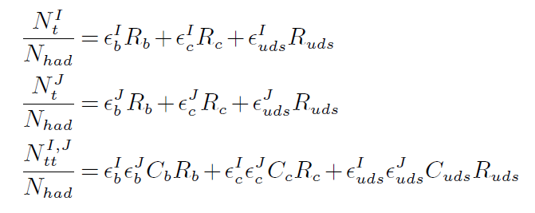
Rb method
Double Tagging Method
Get From Mixed MC Sample
$R_{c}，ε_{c}$，$ε_{uds}C_{b}$，$C_{c}$，$C_{uds}$
Get from MC
$$\frac{N_{t}}{2N_{had}}=R_{b}ε_{b}+R_{c}ε_{c}+\left(1−R_{b}−R_{c}\right)ε_{uds}$$
$$\frac{N_{tt}}{N_{had}}=C_{b}R_{b}ε_{b}^{2}+{C_{c}R}_{c}ε_{c}^{2}+C_{uds}\left(1−R_{b}−R_{c}\right)ε_{uds}^{2}$$
$$C_{b}=\frac{ε_{2jet−tagged}}{{(ε_{1jet−tagged})}^{2}}$$
$$\frac{N_{t}}{N_{had}}=R_{b}{εI}_{b}+R_{c}{εI}_{c}+\left(1−R_{b}−R_{c}\right){εI}_{uds}$$
The ratio of jet tagged as b jet in Hemisphere I
$$\frac{N_{t}}{N_{had}}=R_{b}{εJ}_{b}+R_{c}{εJ}_{c}+\left(1−R_{b}−R_{c}\right){εJ}_{uds}$$
The ratio of jet tagged as b jet in Hemisphere J
$$C_{b}=\frac{ε_{2jet−tagged}}{{εI}_{b}{εJ}_{b}}$$

Slide 7
B-tagging method
The default algorithm is based on the LCFIPlus: combines more than 60 variables to calculate the b jet probability by BDT method
B-tagging method for hemisphere I:
Calculating the b jet probability based on the number of vertex
B-tagging method for hemisphere J:
Calculating the b jet probability based on the number of lepton(we set >=1 lepton)

Slide 8
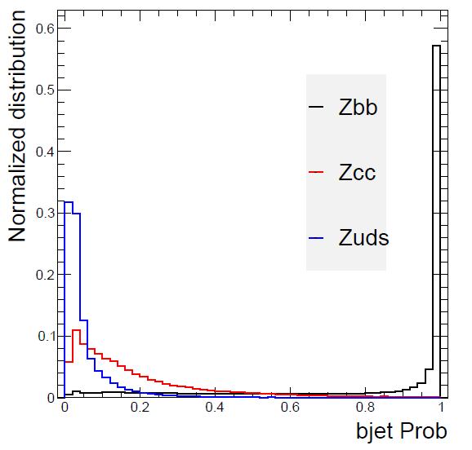
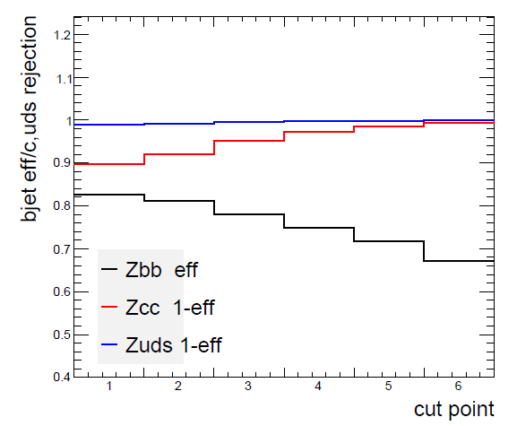
B-tagging method
B-tagging method for hemisphere I:
Calculating the b jet probability based on the number of vertex
b jet efficiency and c, light jet rejection
>0.45 >0.5 >0.6 >0.7 >0.8 >0.9

Slide 9
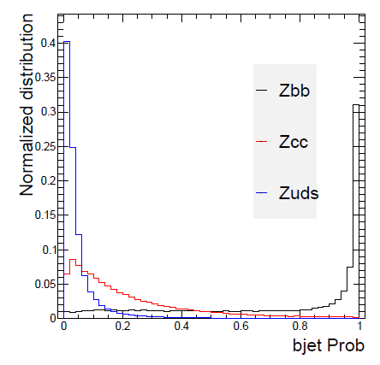
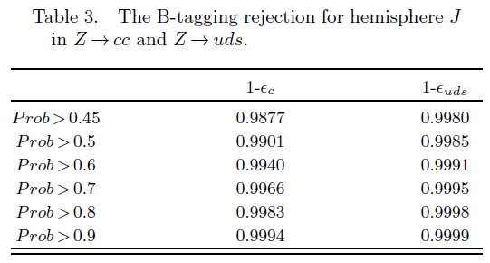
B-tagging method
B-tagging method for hemisphere J:
Calculating the b jet probability based on the number of lepton

Slide 10
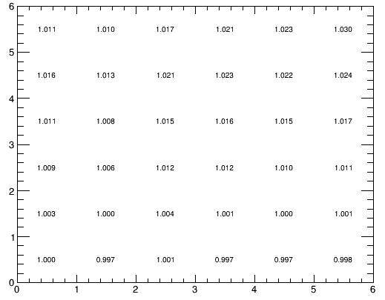
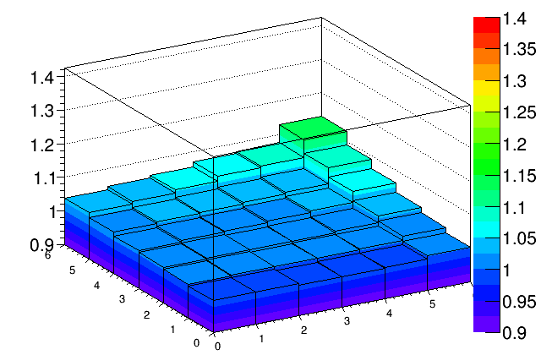
2D B_likelihood
Correlation Factor
zbb
$$C_{b}=\frac{ε_{2jet−tagged}}{{εI}_{b}{εJ}_{b}}$$
hemisphere I
I : Prob>0.45 >0.5 >0.6 >0.7 >0.8 >0.9
hemisphere J
J : Prob>0.45 >0.5 >0.6 >0.7 >0.8 >0.9
Working point J
Working point J
Working point I
Working point I
Correlation Factors ~ 1

Slide 11
Rb method
I/O test
The ratio of jet tagged as b jet in Hemisphere I
The ratio of jet tagged as b jet in Hemisphere J
Following this procedure, we can meausere the R_{b}, ε_{b}
The Z hadronic pseudo‘DATA’ is mixed by MC samples: Zbb sample, Zcc sample, Zll sample
We set Rb=0.2, Rb=0.4, Rb=0.6 as the Input Rb to mix the ‘DATA’
11

Slide 12
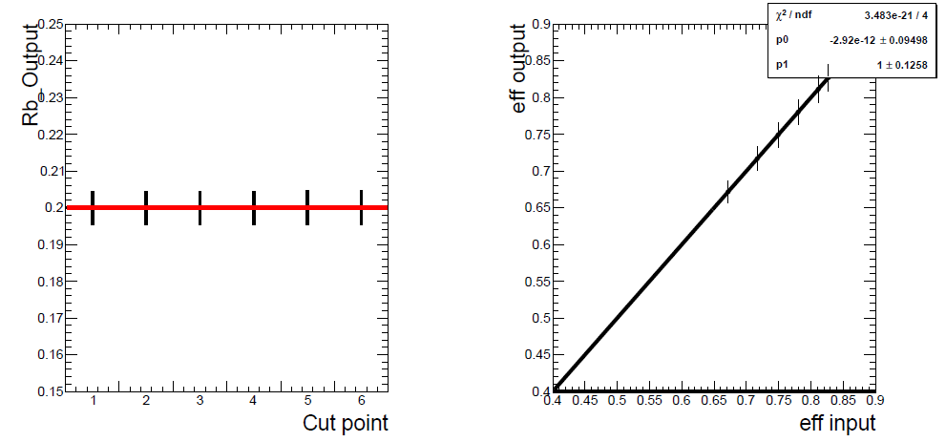
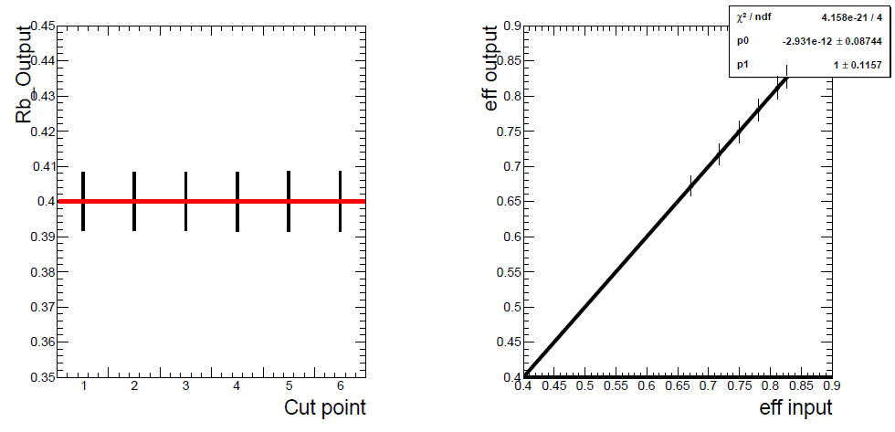
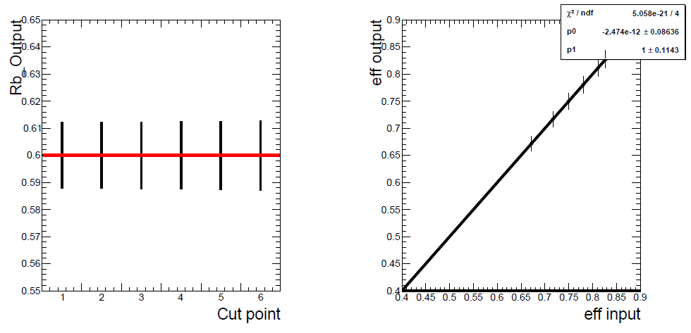
Method
I/O test
Input Rb=0.2, 0.4, 0.6.
Btag work points: Prob>0.45 >0.5 >0.6 >0.7 >0.8 >0.9
Input Rb=0.2
Input Rb=0.4
Input Rb=0.6

Slide 13
Method
Effect of ε_{c} ， ε_{uds} and C_{b}
Input theory Rb=0.2158, Btag Prob work points: Prob>0.45 >0.5 >0.6 >0.7 >0.8 >0.9
I/O test with ε_{c} ±10%, ε_{uds} ±10%, C_{b} ±10%
 | (Measured Rb-0.2158)/0.2158
 | Prob>0.45 | Prob>0.50 | Prob>0.60 | Prob>0.70 | Prob>0.8 | Prob>0.9
ε_{c} ±10% | 1.03% | 0.82% | 0.51% | 0.31% | 0.18% | 0.08%
ε_{uds} ±10% | 0.36% | 0.29% | 0.19% | 0.13% | 0.09% | 0.06%
C_{b} ±10% | 10.54% | 10.51% | 10.47% | 10.45% | 10.43% | 10.42%

Slide 14
Plan
Both the B-tagging efficiency for Z->bb and rejection for Z->cc, Z->uds are good for method
The double tagging method procedure works well as shown in I/O test
The b tagging correlation factors ~ 1
Next step :
Increase the statistics to reduce the effect from ε_{c} ， ε_{uds} and C_{b}
Study on the systematic errors such as the gluon splitting, charm physics modeling

Slide 15
Back up

Slide 16
Method
Effect of C_{b}
Follow the procedure in : Measurement of Rb and Br(b → ℓνX) at LEP Using Double-Tag Methods (L3 Collaboration)
In section 4.3.3 Systematics from Hemisphere Correlation
The normalized distribution of λ for all hemispheres, N(λ).
The single-hemisphere tagging efficiency as a function of λ, ϵ(λ).
The normalized distribution of λ in a co-tagged hemisphere, C(λ). A co-tagged hemisphere is the one opposite to a tagged hemisphere, regardless of whether it is itself tagged.
Angular effects: λ=cosθ; λ=φ
QCD effects: λ=Energy_jet

Slide 17
Method
Effect of C_{b}
I : Prob>0.45
J : Prob>0.45
pt : 1.00904
d0: 0.99996
z0 : 1.00035
signd0 : 1.00074
signz0 : 0.999531
Thrust : 1.0032
Thrust_theta : 1.0021
Thrust_phi : 1.00006
Energy : 1.00149
Px : 1.00171
Py : 1.00154
Pz : 1.00086
ntrk : 0.999593
nclu : 0.99983
charge : 1.00037
mass : 1.00031
Ptot : 1.00449
Rapidity : 1.00563

Slide 18
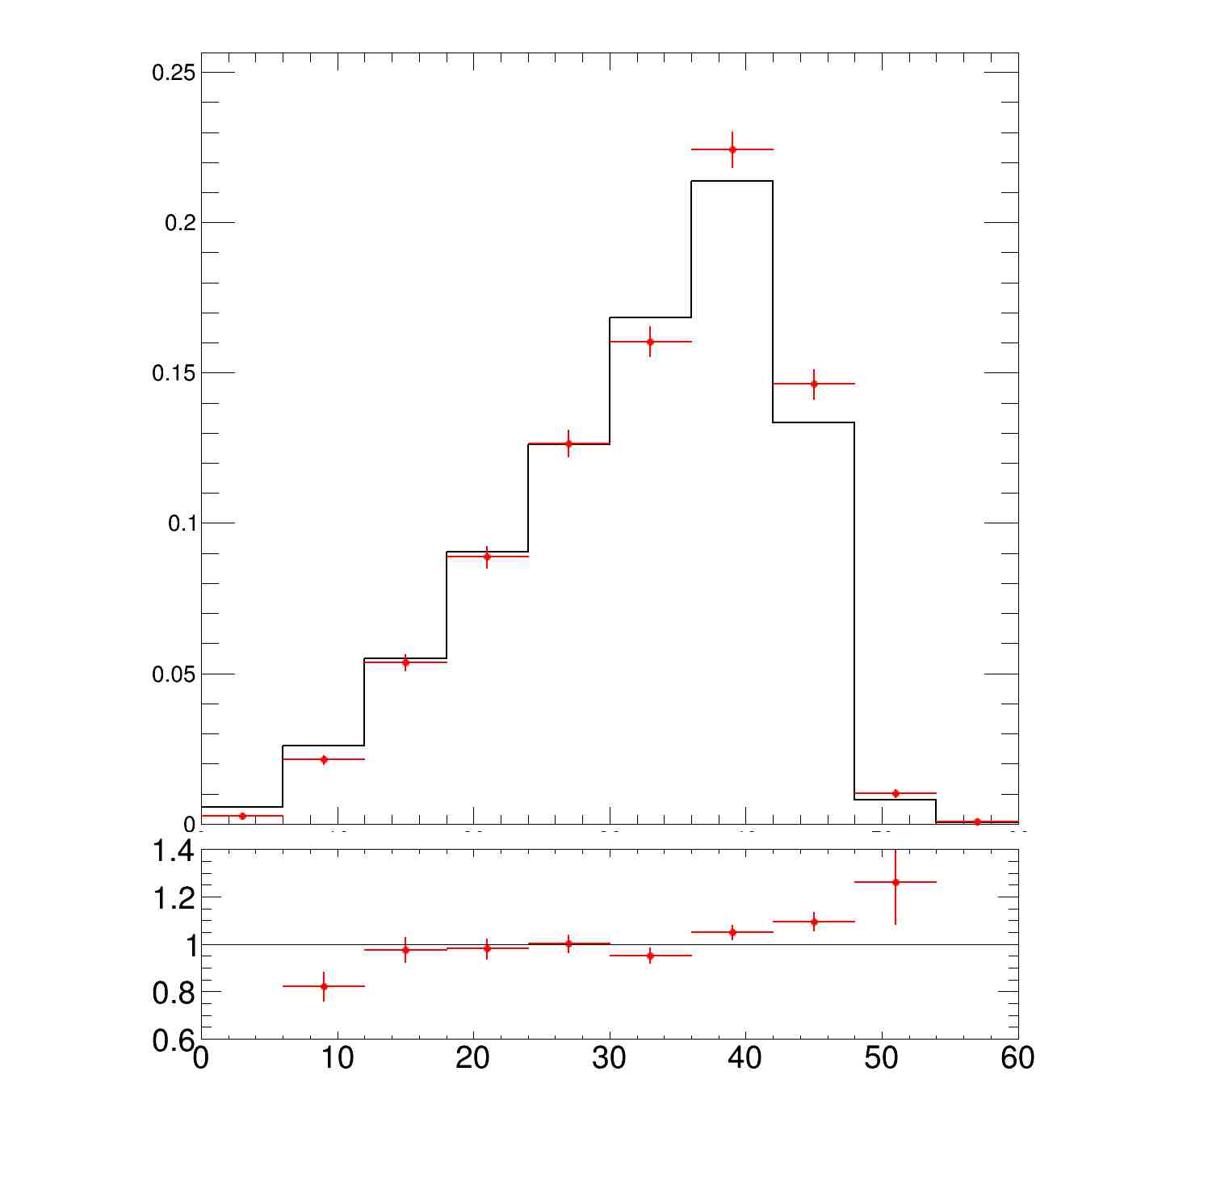
Method
Effect of C_{b}
I : Prob>0.45 J : Prob>0.45
λ: Jet_Pt
pt : 1.00904

Slide 19
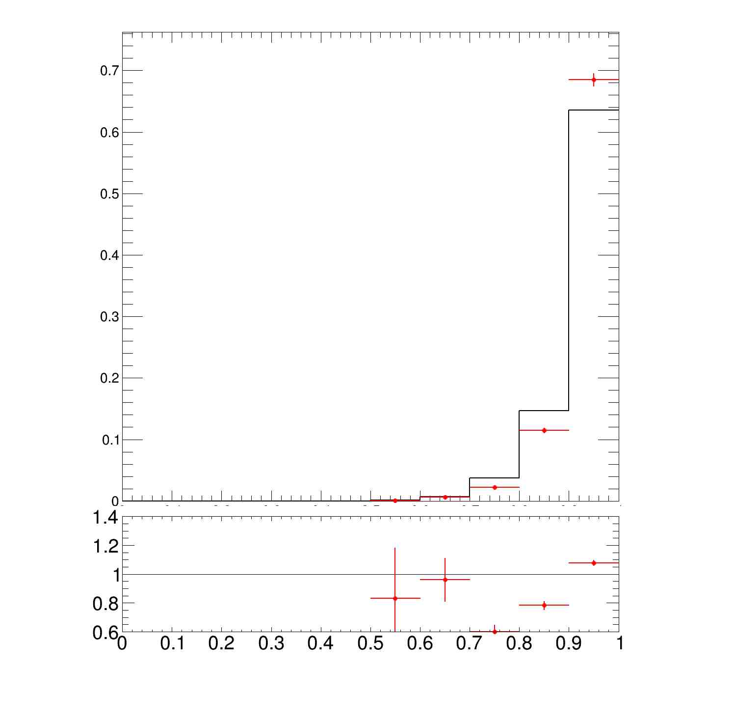
Method
Effect of C_{b}
I : Prob>0.45 J : Prob>0.45
λ: Thrust
Thrust : 1.0032

Slide 20
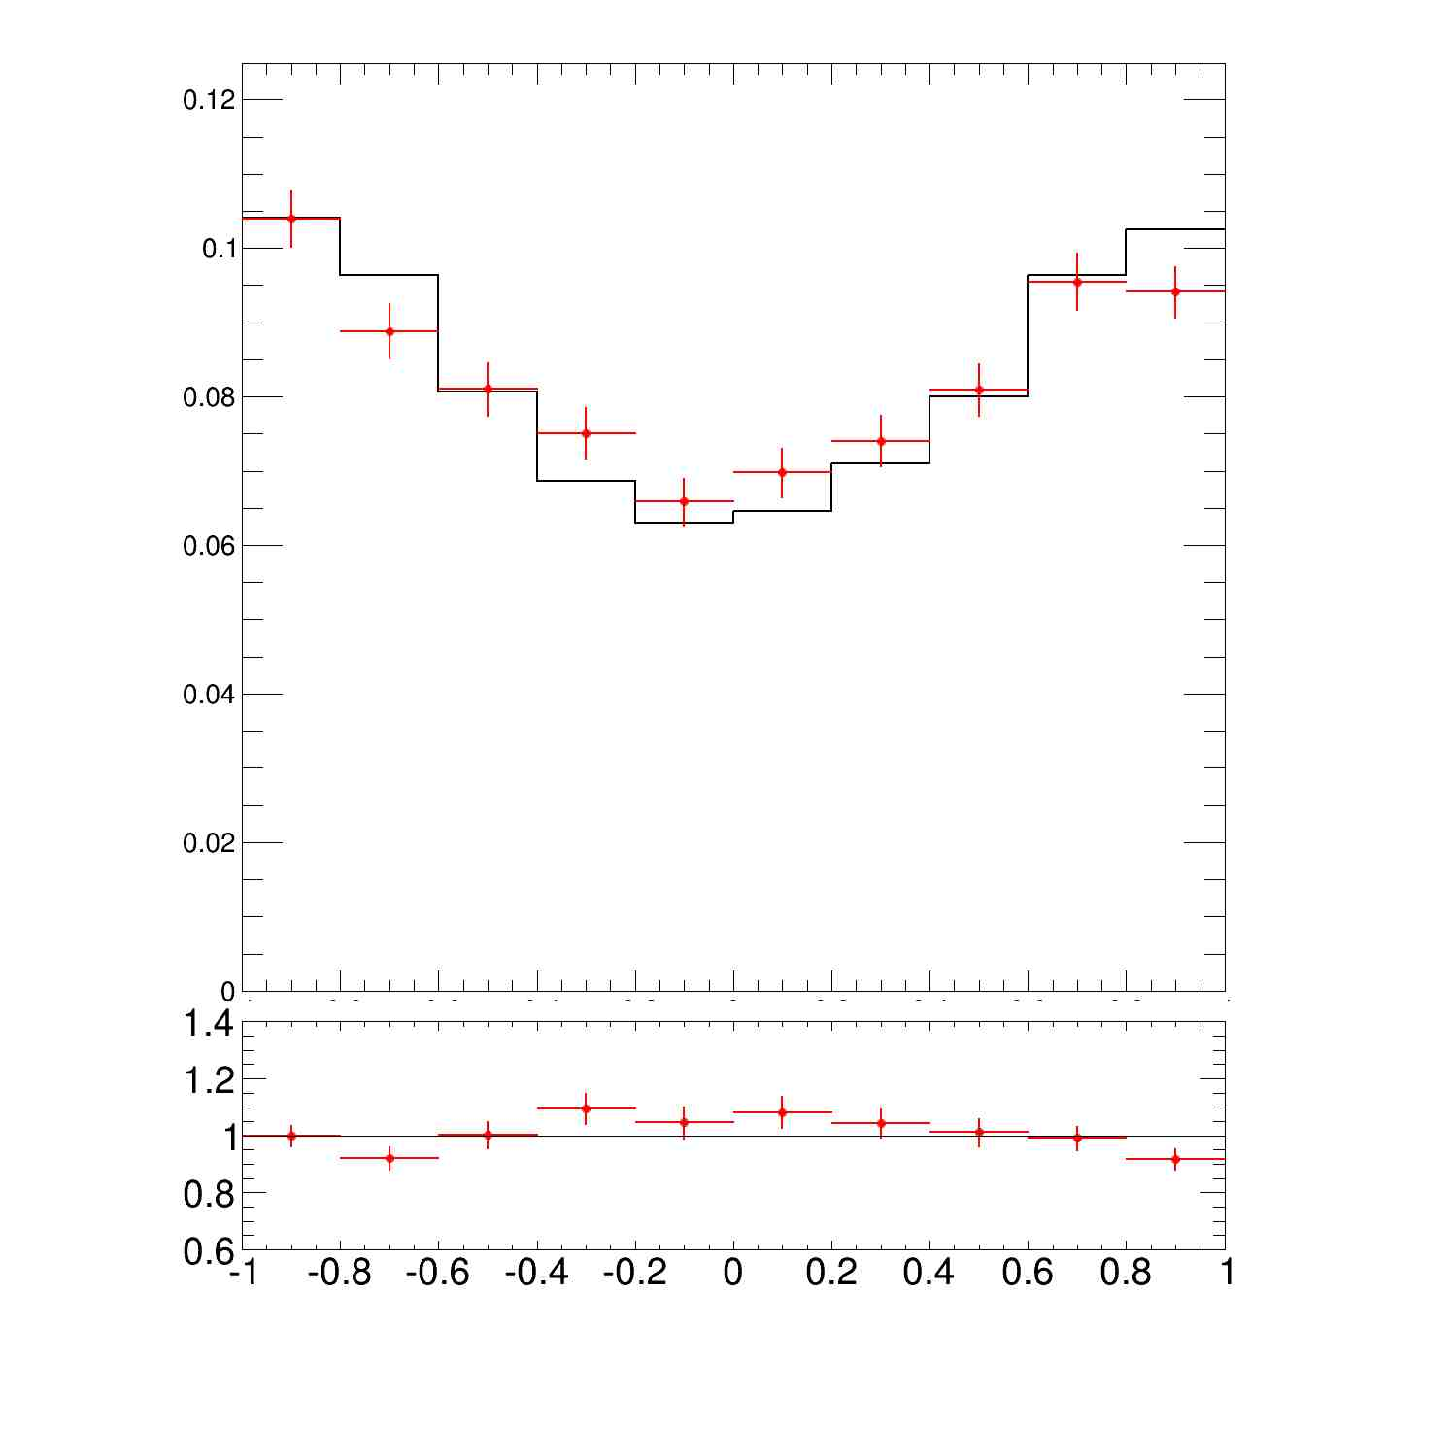
Method
Effect of C_{b}
I : Prob>0.45 J : Prob>0.45
Thrust_theta : 1.0021

Slide 21
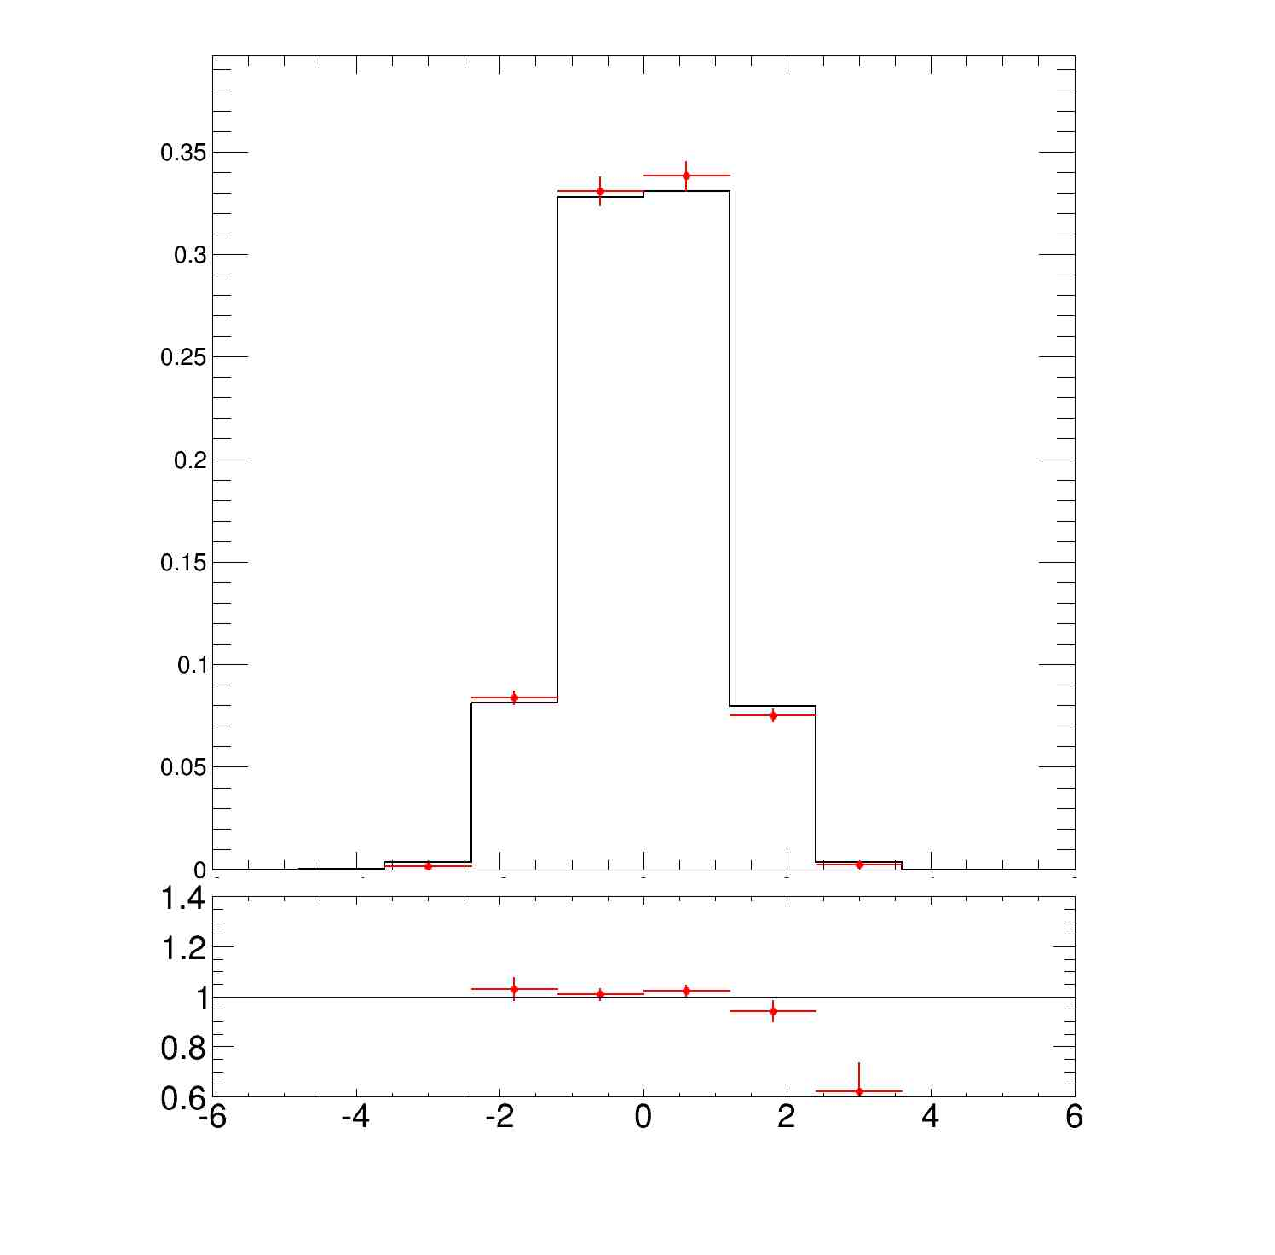
Method
Effect of C_{b}
I : Prob>0.45 J : Prob>0.45
λ: Jet_η

Slide 22
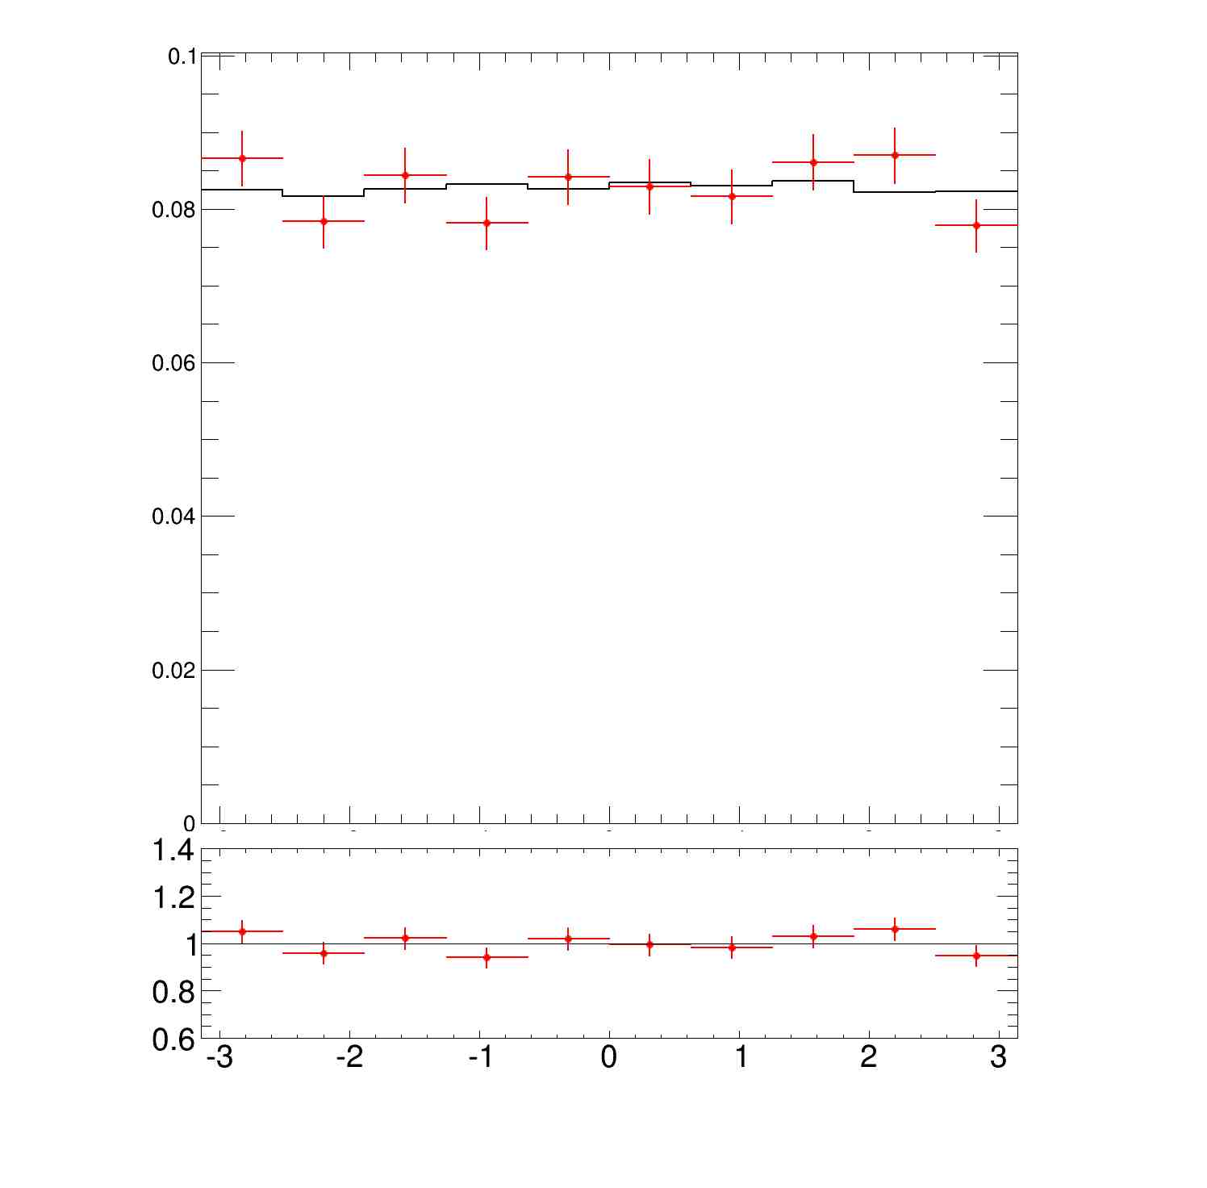
Method
Effect of C_{b}
I : Prob>0.45 J : Prob>0.45
Thrust_phi : 1.00006

Slide 23
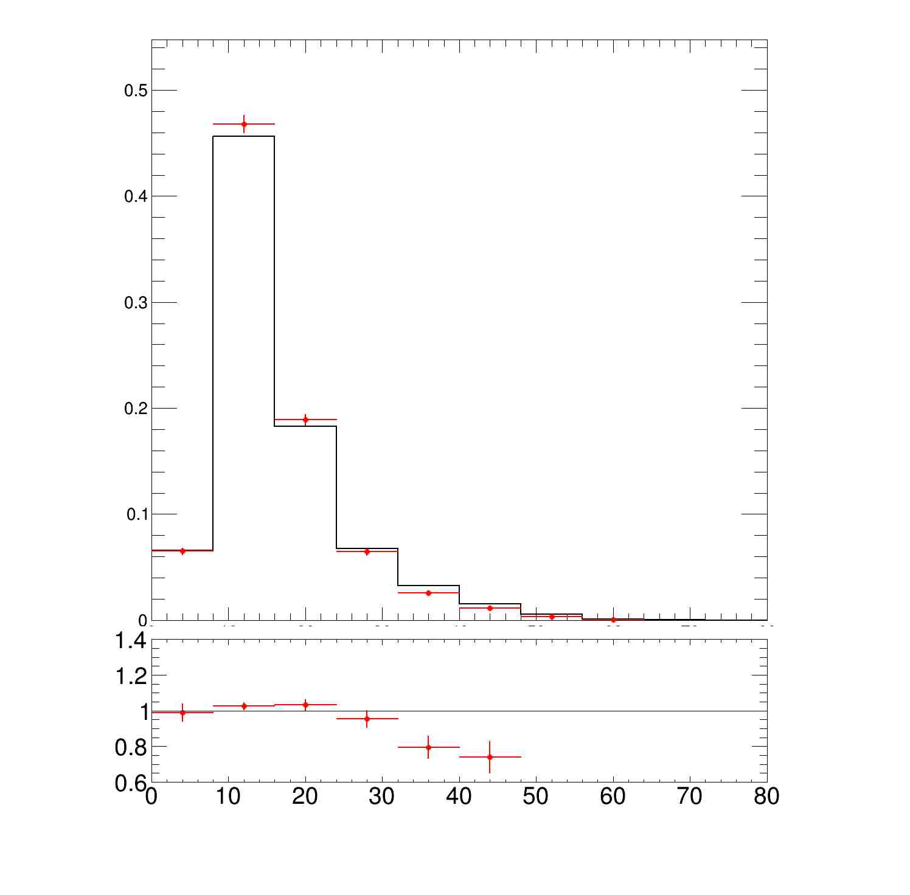
Method
Effect of C_{b}
I : Prob>0.45 J : Prob>0.45
λ: Jet_mass

Slide 24
Method
Effect of C_{b}
I : Prob>0.9
J : Prob>0.9
pt : 1.04939
d0 : 1.0004
z0 : 1.0044
signd0 : 1.00092
signz0 : 0.998709
Thrust : 1.00788
Thrust_theta : 1.02492
Thrust_phi : 0.999965
Energy : 1.00962
Px : 1.01379
Py : 1.01177
Pz : 1.01045
ntrk : 1.00303
nclu : 1.00089
charge : 1.00152
mass : 1.00137
Ptot : 1.01527
Rapidity : 1.032

Slide 25
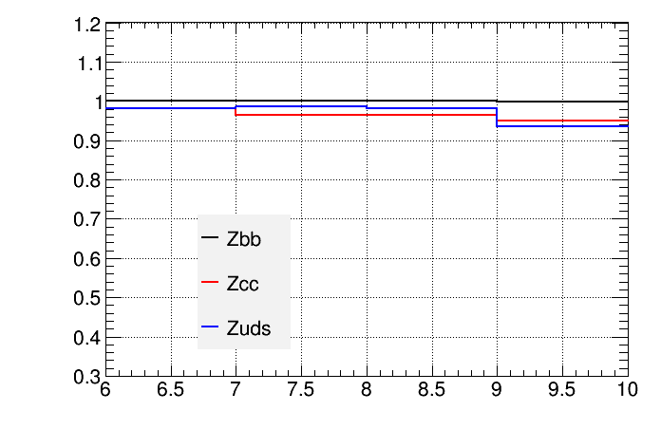
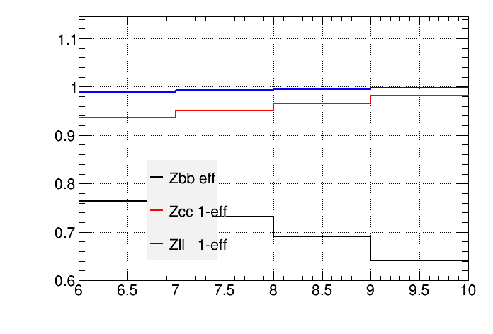
Check
the measured Rb and effb in DATA are different from the Input Truth Rb and effb at Prob>0.9
The $R_{c}，ε_{c}{, C}_{b}$，$C_{c}$，$C_{uds}$is got by MC samples: Zbbsample2, Zccsample2, Zllsample2
So if DATA sample1≠sample2，which means the MC $R_{c}，ε_{c}{, C}_{b}$，$C_{c}$，$C_{uds}$ is different from the ‘DATA’
The difference as a Ratio: Eff in ‘DATA’/ Eff in MC
${ ε}_{b}$difference between DATA and MC are very small
$ε_{c}$ and $ε_{uds}$ differences are big at Prob>0.9 :
which may come from the very low statistics after B-tagging
which will lead to the difference in the IO test
$ε_{uds}$ effect is very small, as The Zllrejction at four work point are ~100%

Slide 26
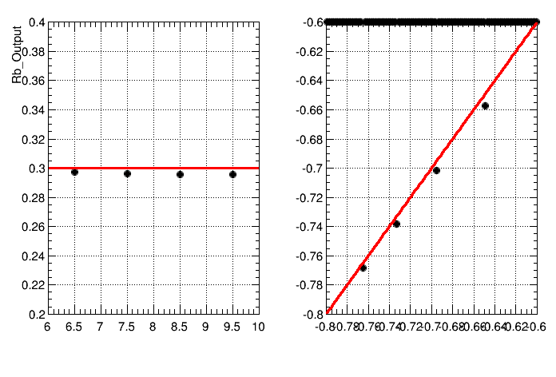
Check
Input Rb=0.3
We redo the IO test by ‘DATA’ and MC with same Zcc sample
Zcc DATA Sample≠ Zcc MC Sample
Zcc DATA Sample= Zcc MC Sample
We can see the differences of measured Rb and effb between DATA and MC are smaller

Slide 27
Check
Input Rb=0.5
Zcc DATA Sample= Zcc MC Sample

Slide 28
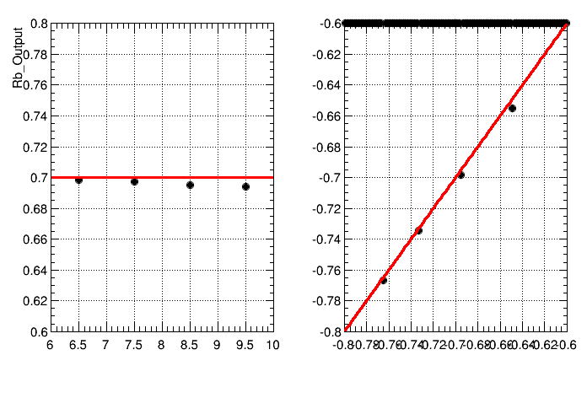
Check
Input Rb=0.7
Zcc DATA Sample= Zcc MC Sample

