Slide 1
Overview of the FCAL activities
Yan Benhammou
Tel Aviv University
on behalf of the FCAL collaboration

Slide 2
Outline
The collaboration
FCAL detectors : simulation
FCAL detectors : hardware
Electronics
Conclusion

Slide 3
The collaboration
FCAL detectors : simulation
FCAL detectors : hardware
Electronics
conclusion

Slide 4
The FCAL collaboration
54 members from 13 institutes :
AGH University of science & technology, Krakow, Poland
CERN, Geneva, Switzerland
DESY, Zeuthen, Germany
IFJ PAN, PL-31342, Krakow, Poland
ISS, Bucharest, Romania
JINR, Dubna, Russia
NC PHEP, Belarusian State University, Minsk, Belarus
Pontificia Universidad Catolica de Chile, Santiago, Chile
Taras Shevchenko National University of Kiyv, Ukraine
Tel Aviv University, Tel Aviv, Israel
Tohoku University, Sendai, Japan
University of California, Santa Cruz, USA
Vinca Institute of Nuclear Sciences, University of Belgrade, Serbia

Slide 5
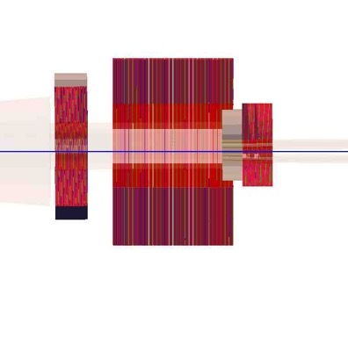
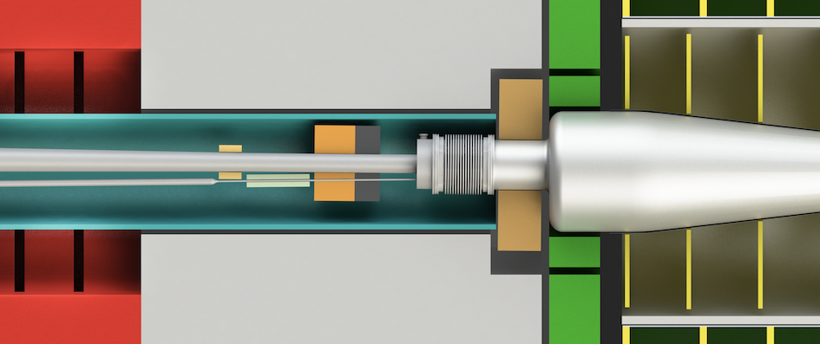
Forward region detector purposes
Precise luminosity measurement, O(10⁻³) up 500 GeV
Fast luminosity measurement and beam tuning
Hermeticity
For these purposes, mainly three detectors : the LumiCal, BeamCal and LHCal
BeamCal
LumiCal
BeamCal
LumiCal
LHCal
+Z
2450 2680 3195

Slide 6
FCAL detector purposes in future e+e- accelerators
LumiCal :
  Precise integrated luminosity measurements (Bhabha events)
  Extend calorimetric coverage to small polar angles. Important for physics analysis
LHCal :
  Extend the hadronic calorimeter coverage
BeamCal :
  Measure instant luminosity. feedback for beamtuning
  tagging of high energy electrons to suppress backgrounds to potential BSM process
  shielding of the accelerator components from the beam-induced background
  providing supplementary beam diagnostics information extracted from the pattern of incoherent-pair energy depositions

Slide 7
The collaboration
FCAL detectors : simulation
FCAL detectors : hardware
Electronics
conclusion

Slide 8
FCAL detector designs in future e+e- linear accelerators
LumiCal :
  Electromagnetic sampling calorimeter
  layers of 3.5 mm thick tungsten plates with 1 mm gap for silicon sensors (30 for ILC, 40 for CLIC)
LHCal :
  Sampling Calorimeter (silicon)
  29 layers of 16mm thickness. Absorber : tungsten or iron
BeamCal:
  Sampling calorimeter based on tungsten plates (30 layers for ILC, 40 layers for CLIC)
  Due to large dose, rad hard sensors (GaAs, Diamond, Sapphire)

Slide 9
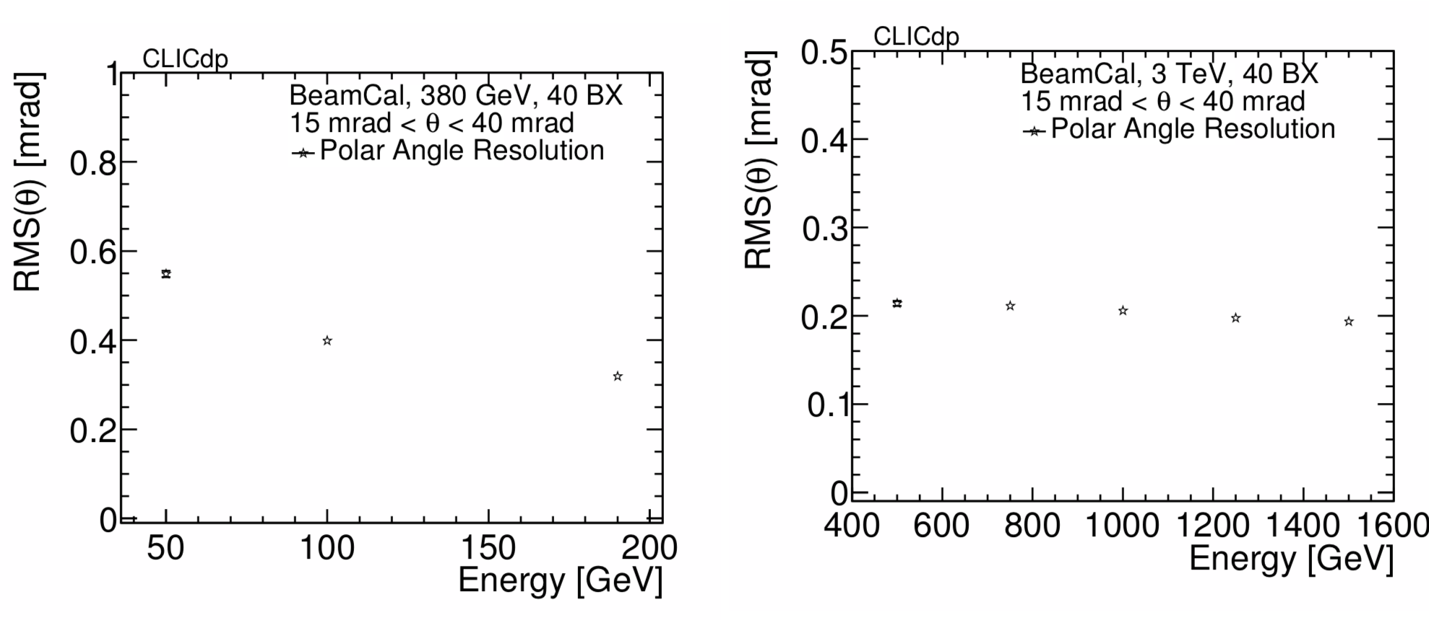
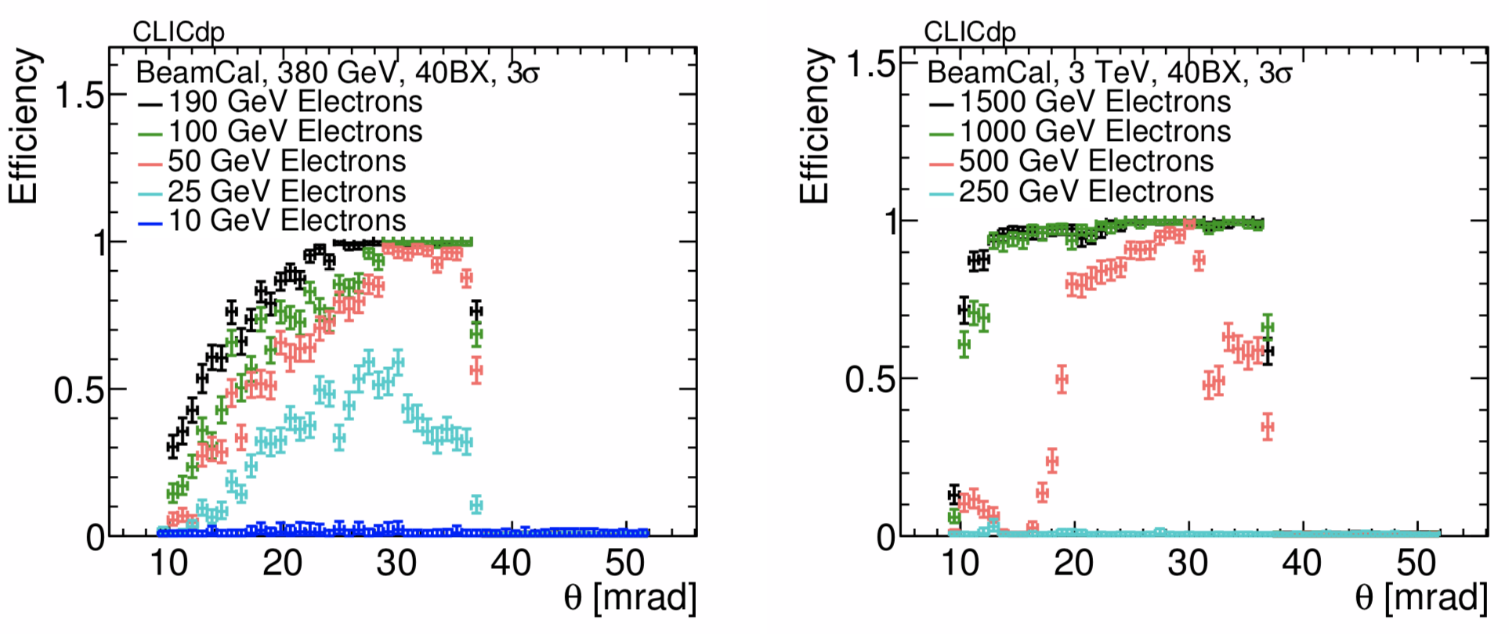
BeamCal simulation in future e+e- linear accelerators
Cover the polar angles between 10 mrad (CLIC)/6 mrad (ILC) to 43 mrad
background simulated for different beam parameters and magnetic fields and different reconstruction algorithms compared
Results : for example, efficiency and angle resolution with 40 bunch crossing overlaid to the signal
CLICdp-Note-2018-005

Slide 10
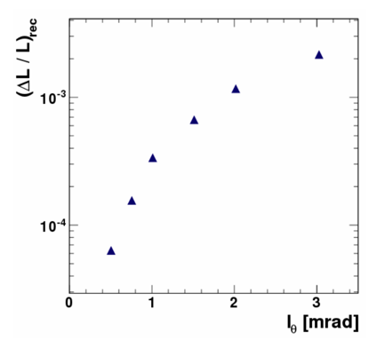
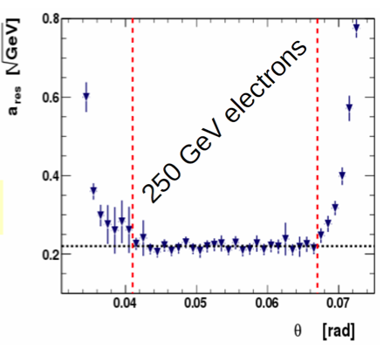

LumiCal simulation in future e+e- linear accelerators
Cover the angles between 41 mrad to 67 mrad
Polar angular pad size calculated to obtain the given precision of luminosity measurement
Simulation of the
energy resolution
Small Moliere radius
ILC
Polar angle pad size
For I_{θ} =0.8 mrad, ΔL/L = 1.6 10⁻⁴
H Abramowicz et al 2010 JINST 5 P12002

Slide 11
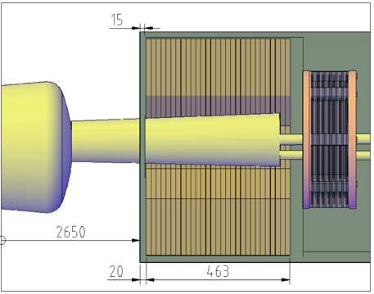
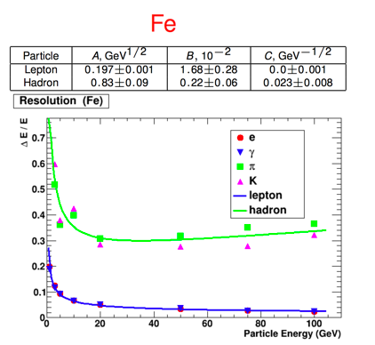
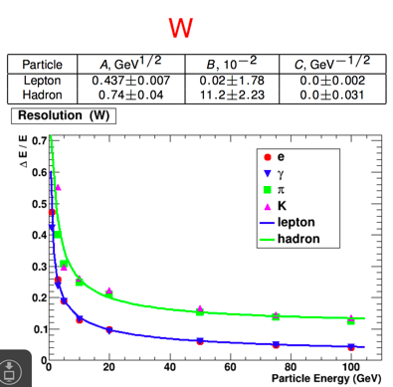

LHCal simulation in future e+e- linear accelerators
Located between the LumiCal and BeamCal
Total thickness : 463 mm
Simulation of tungsten-Si and iron-Si with different incident particles
Tungsten looks to be the best candidate

Slide 12
The collaboration
FCAL detectors : simulation
FCAL detectors : hardware
Electronics
conclusion

Slide 13
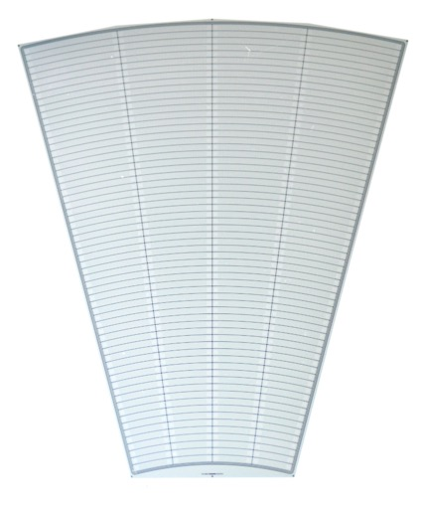
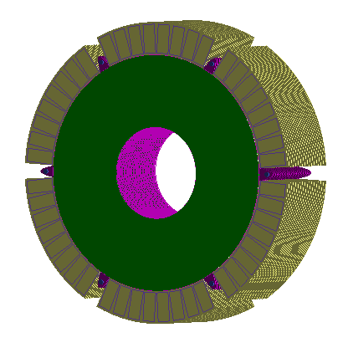
LumiCal sensor
4 sectors:
L1
R1
L2
R2
Silicon senor, 320 μm thickness
64 radial pads, pitch 1.8 mm
4 azimuthal sectors in one tile, each 7.5 degrees
12 tiles make full azimuthal coverage
p+ implants in n-type bulk
DC coupled with read-out electronics
40 modules were produced by Hamamatsu
Outer active radius R = 195.2 mm
channels: 1 - 64
3 x 100 μm guard rings
Inner active radius R = 80.0 mm

Slide 14
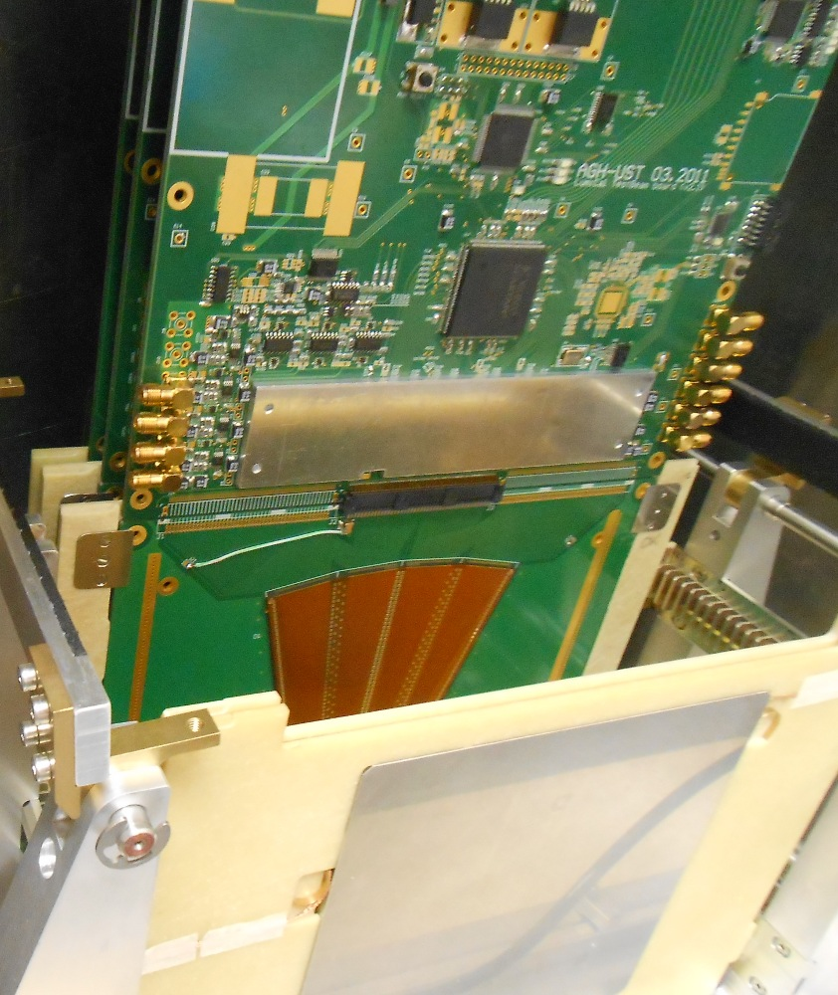
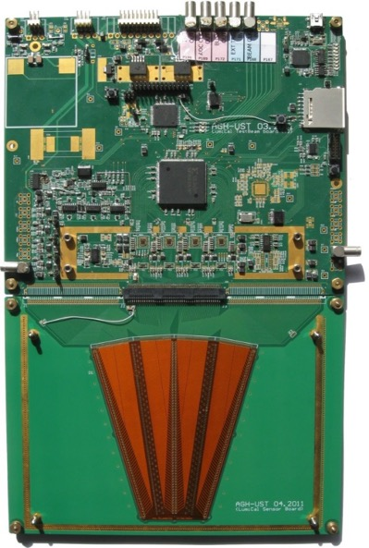
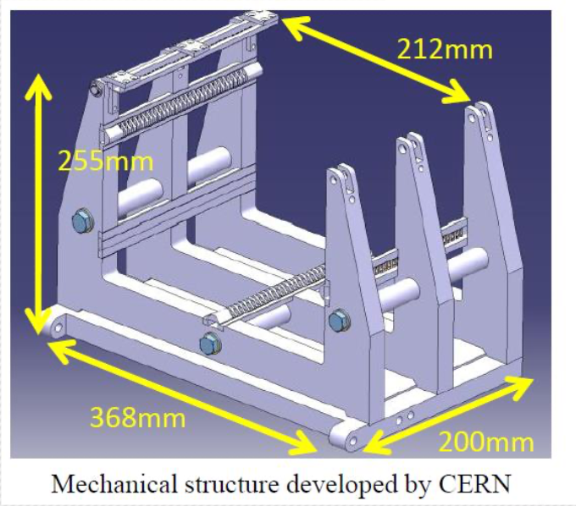
LumiCal test at CERN in 2014
4 LumiCal detector planes equipped with dedicated electronics (32 channels) glued on a 2.5 mm PCB
4.5 mm between tungsten plates
Tested in test beam at PS with 5 GeV e-/μ

Slide 15
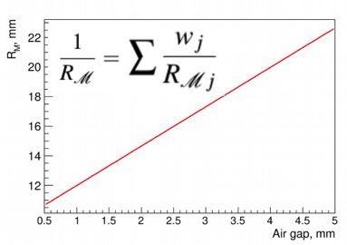
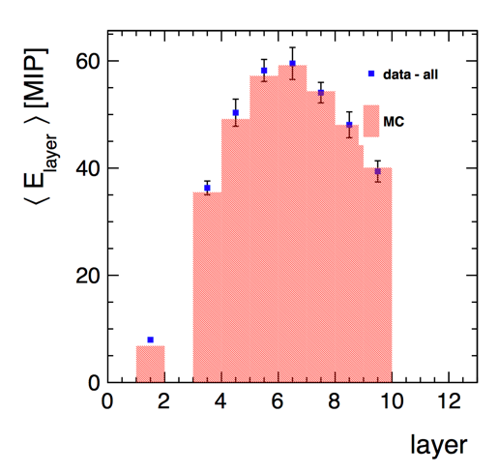
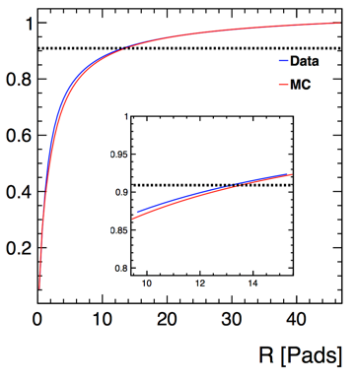
LumiCal test at CERN in 2014
Energy deposited per layer
Energy fraction
Effective Moliere radius :
24.0 ± 0.6 (stat.) ± 1.5 (syst.) mm
Eur. Phys. J. C 78 (2018) 135.

Slide 16
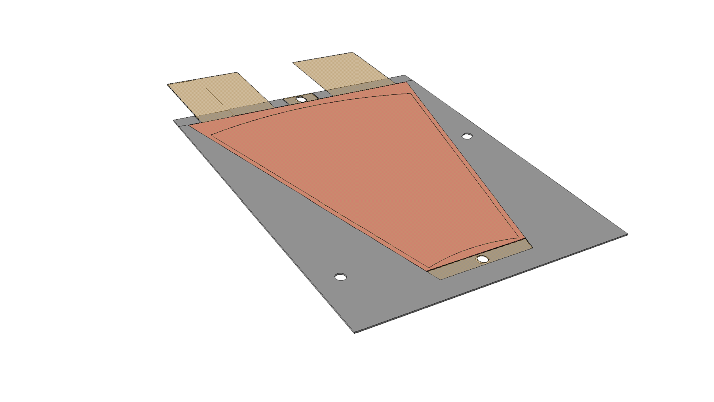
2015 : design of a thin LumiCal module design
100 μm
320 μm
50 μm
150 μm
Current LumiCal detector planes are based on 3.5 mm thick PCB : compactness is an essential requirement to provide small Molière radius/accurate shower position reconstruction.
In current LumiCal conceptual design the space between absorbers is 1 mm!
Easy to mount on tungsten planes
Kapton fan out (connectors)
Sensor
envelope
Kapton HV
650 μm

Slide 17
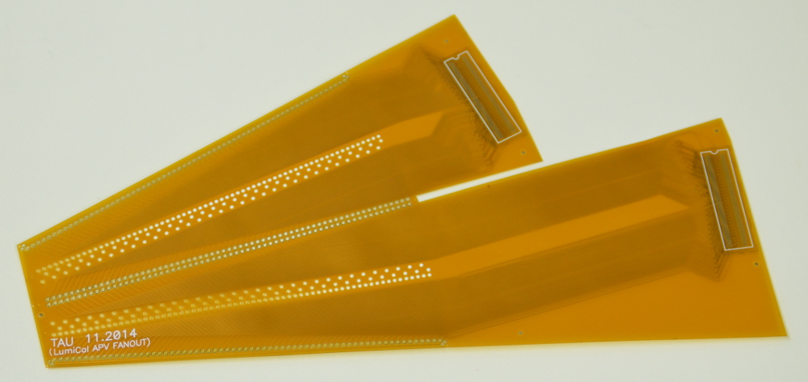
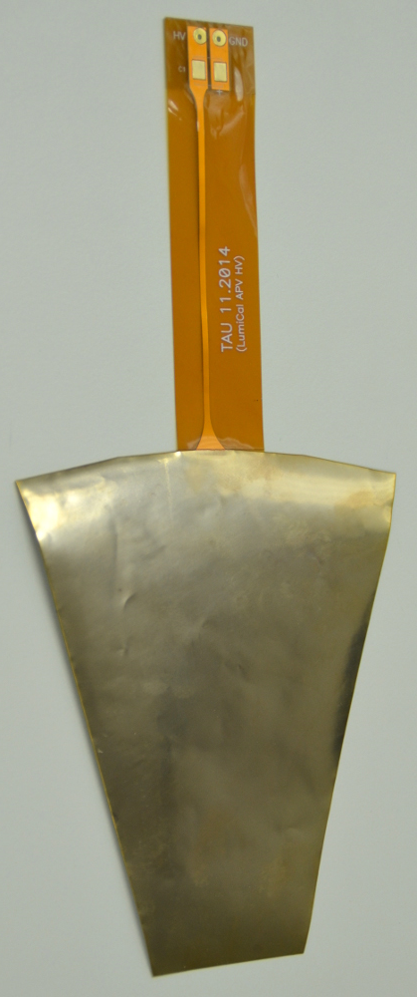
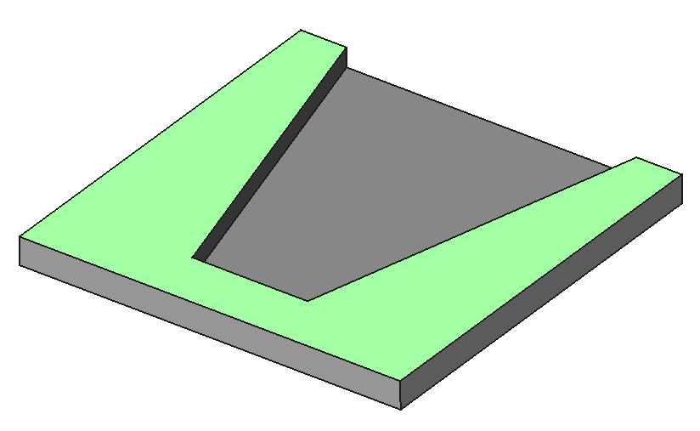
2016 : thin LumiCal detector plane
The envelope
The HV PCB
The readout PCB
The 3D printing was not rigid and flat enough so we opted for the carbon fiber solution
The thickness of the HV flexible PCB is ~90 μm
Thickness of fan-out varies in different areas from
129 μm to 158 μm

Slide 18
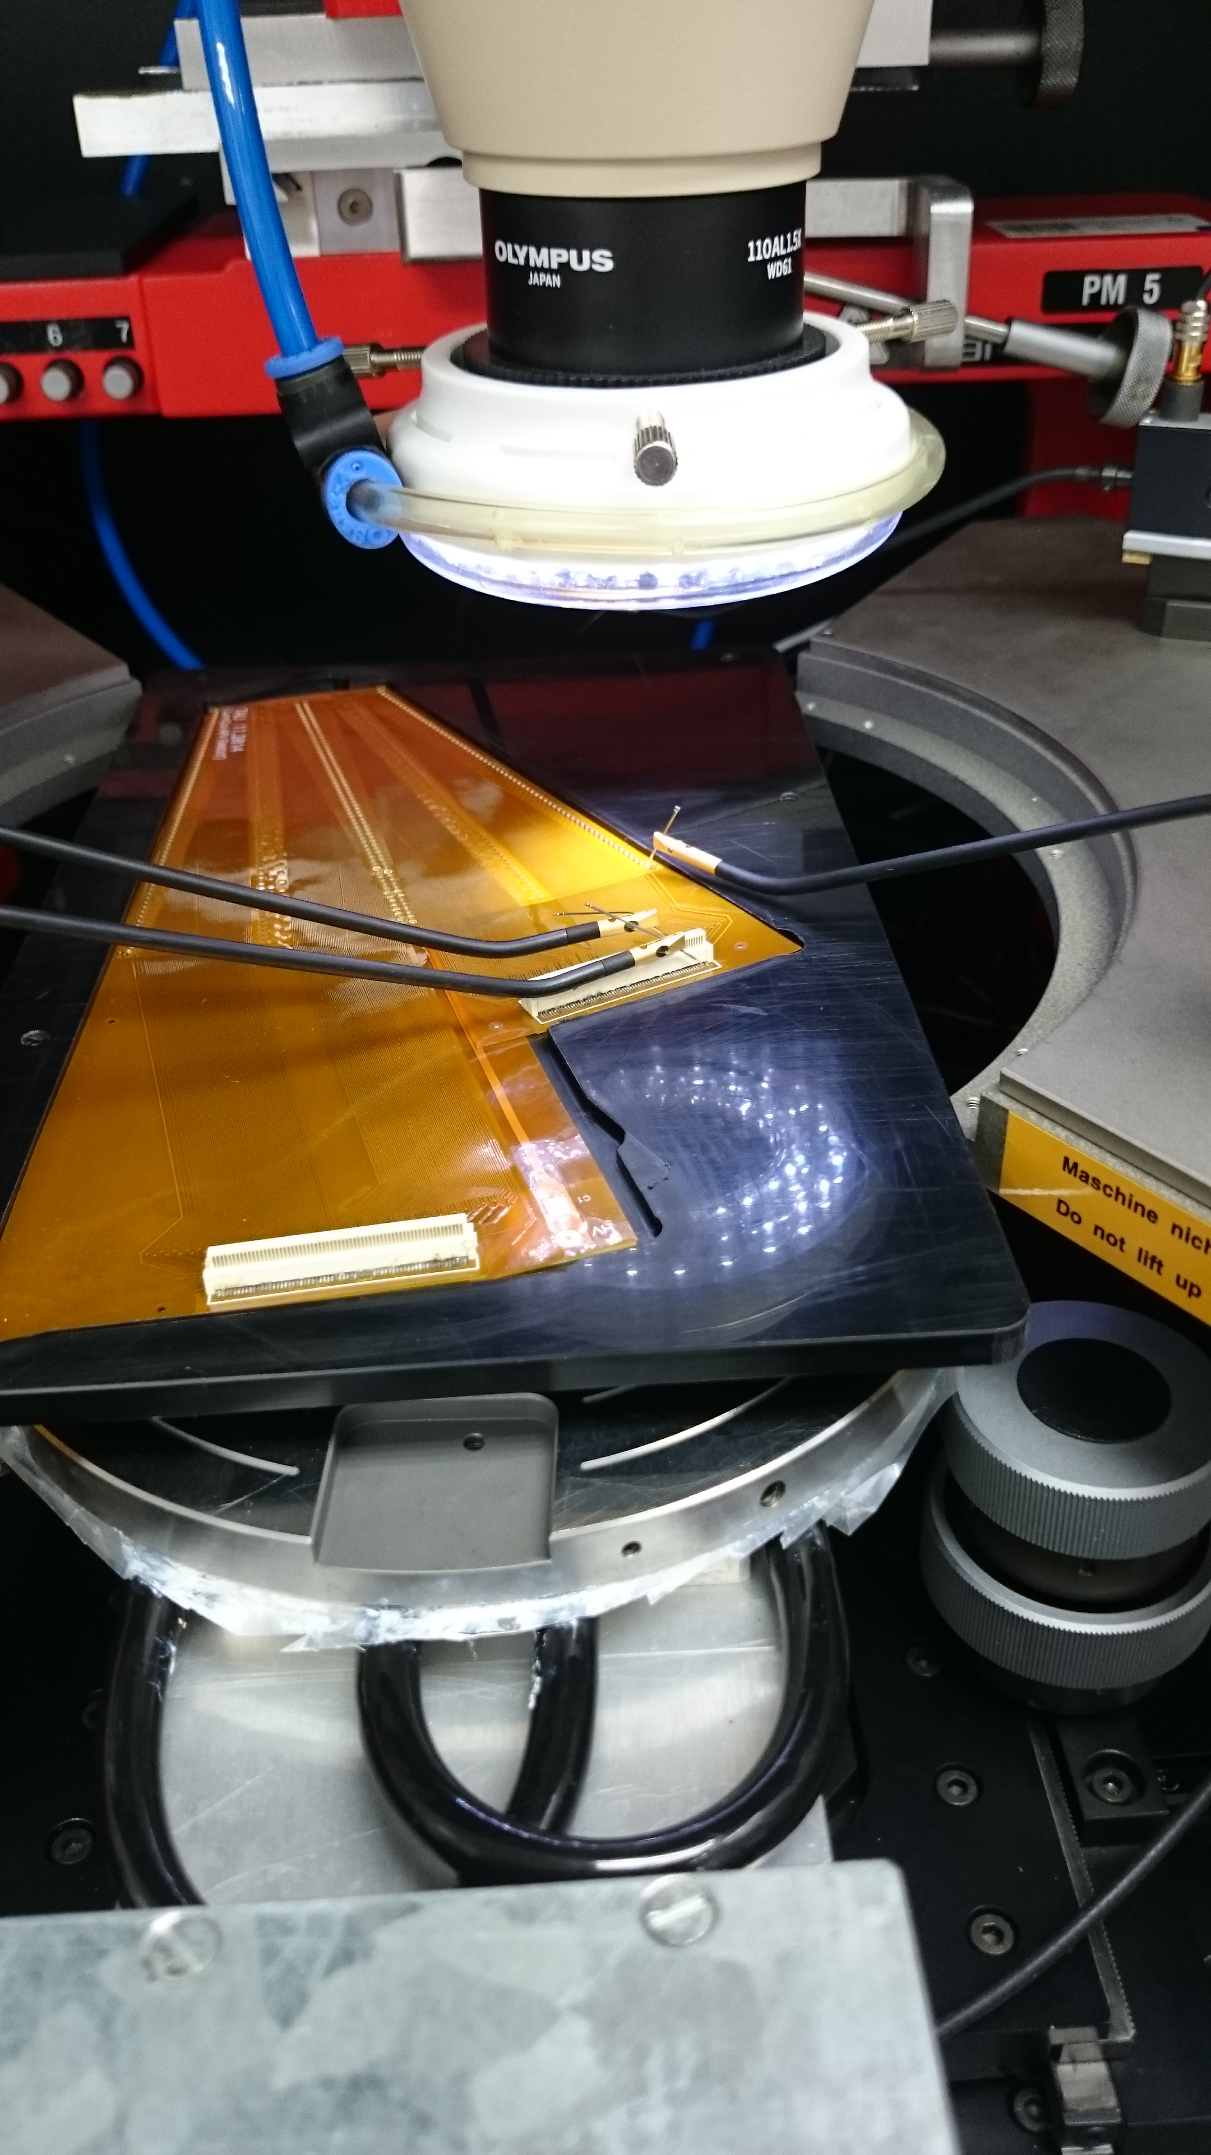
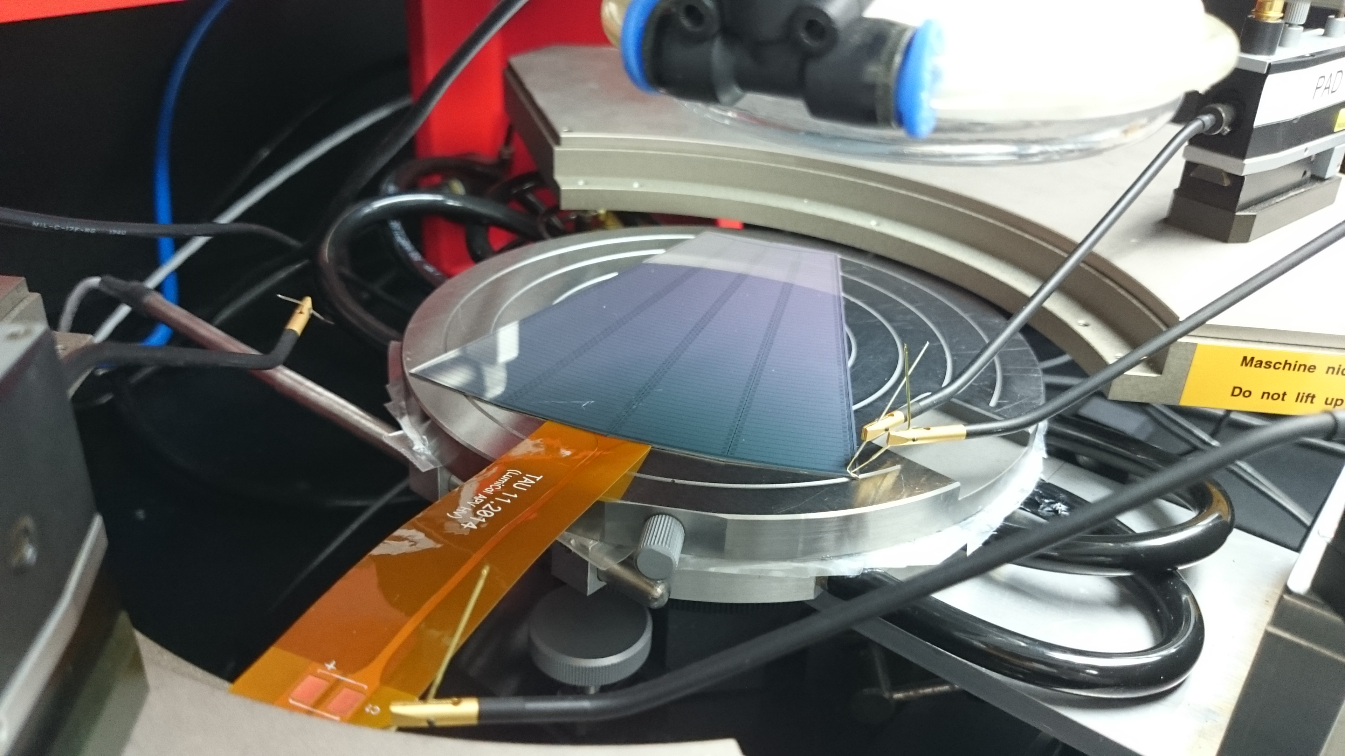
Module assembly and Tests
HV flexible PCB is glued to the n-side of the sensor using conductive glue;
Fanout with Panasonic connector soldered was glued to the p-side of the sensor;
Traditional ultrasonic wire bonding was used to connect sensor pads to fanout traces;

Slide 19
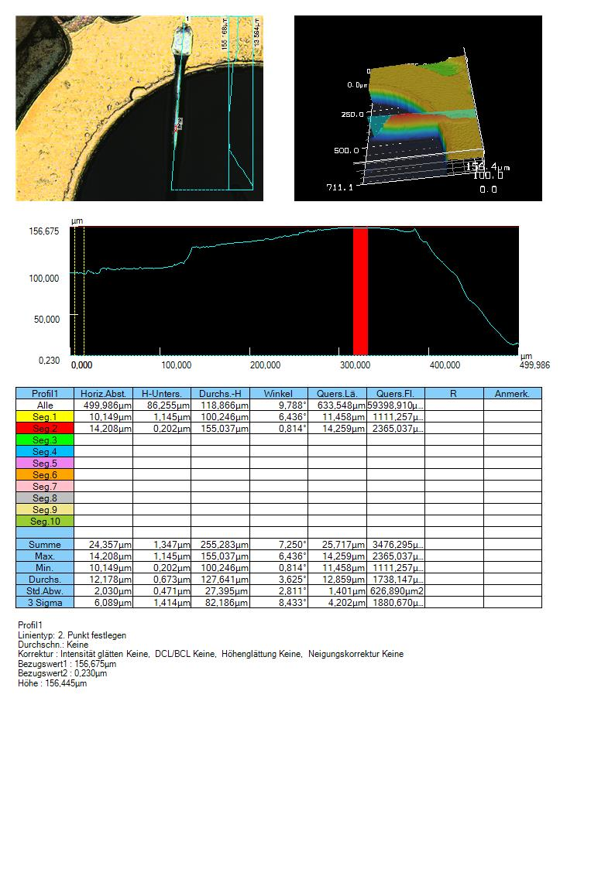
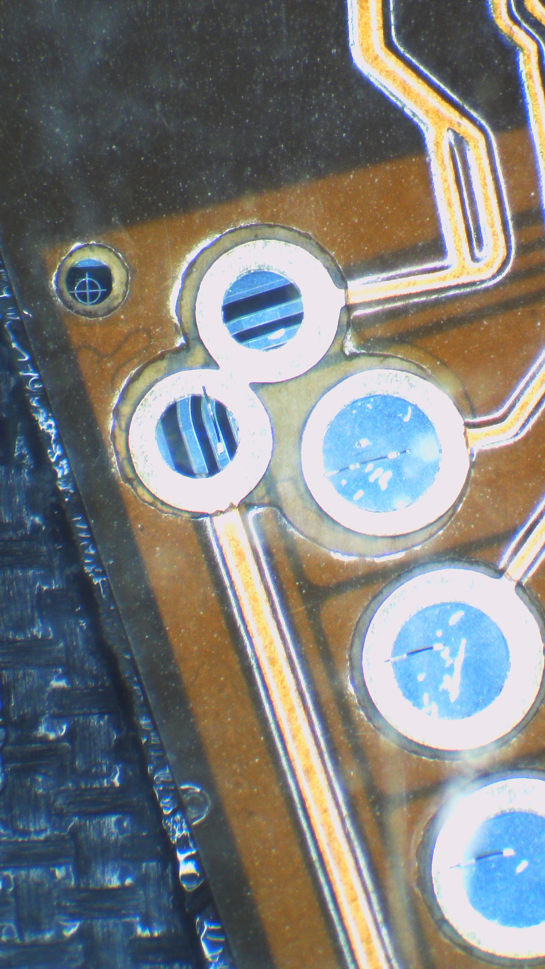
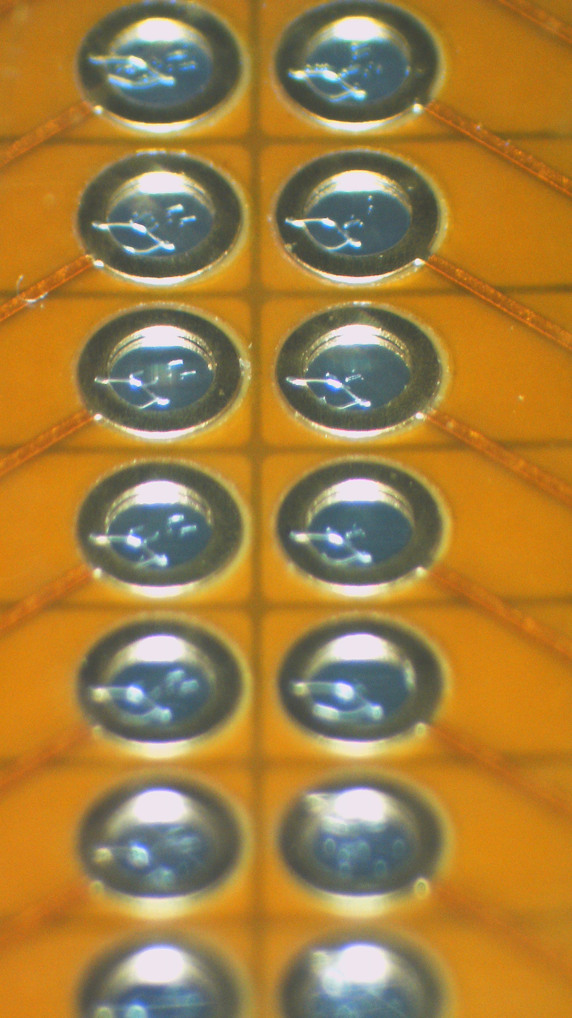
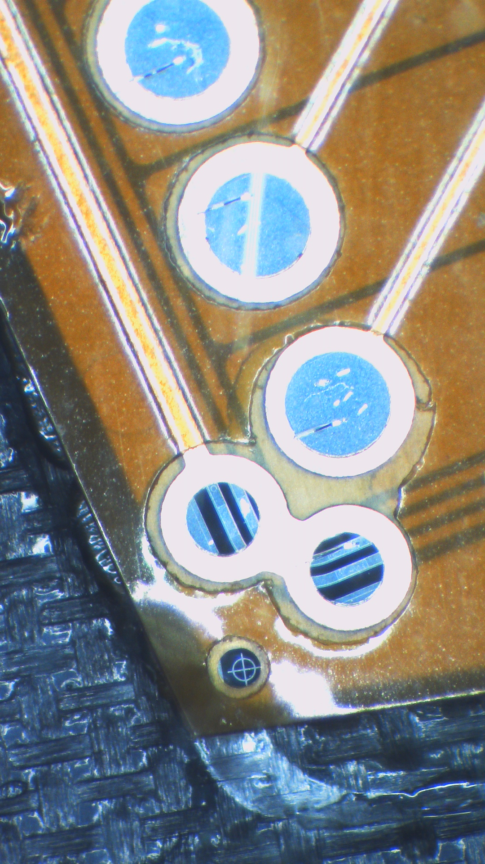
Wire bonding : loop size

Slide 20
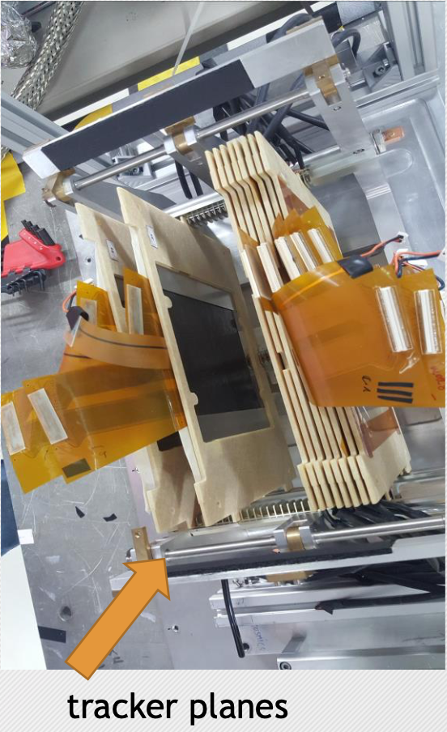
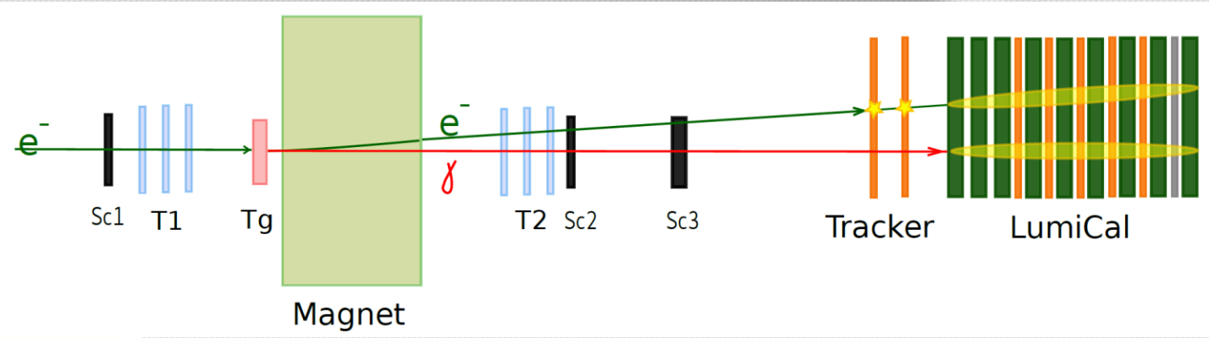
LumiCal test at DESY in 2016
DESY-II Synchrotron electron beam 1-5 GeV (beam size 5x5 mm2)
T1, T2 Eudet telescopes each with 3 MIMOSA Si-pixel planes
Sc1,2,3 scintillator trigger
Tg copper target
Dipole magnet –13 kGs for e/γ separation
8 detector planes (6 -LumiCal, 2-tracker), 256 read-out channels
8 W absorber plates
External electronics (ASD-based)

Slide 21
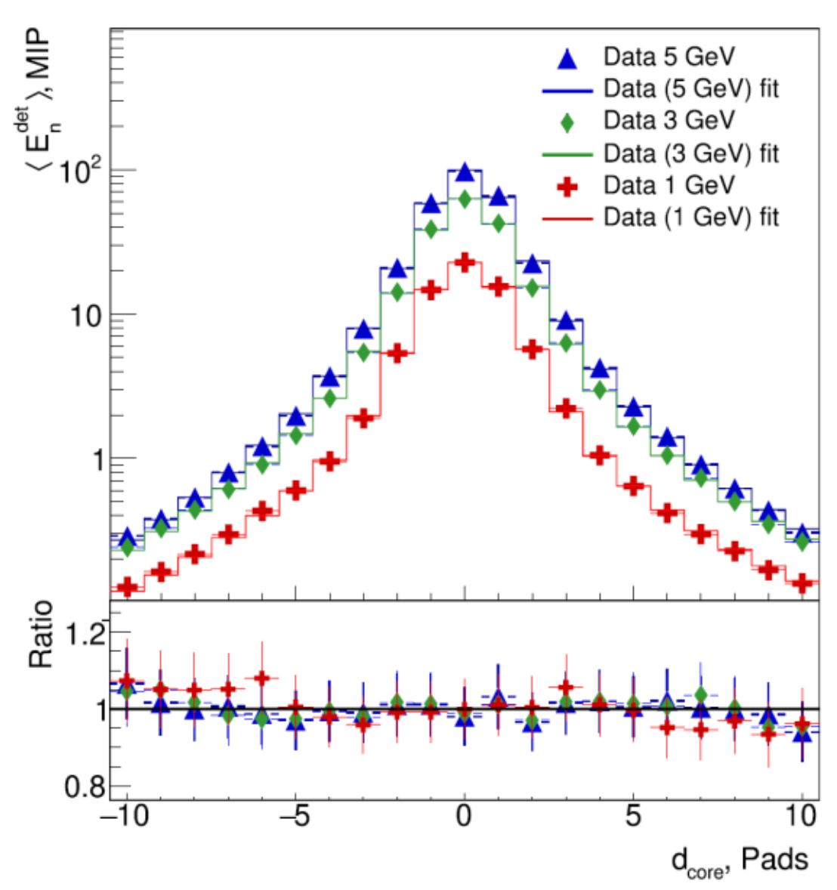
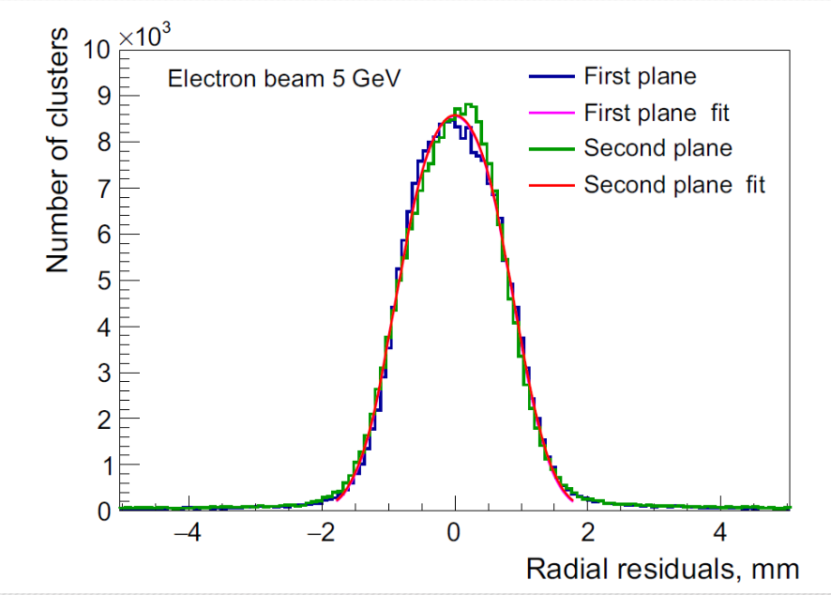
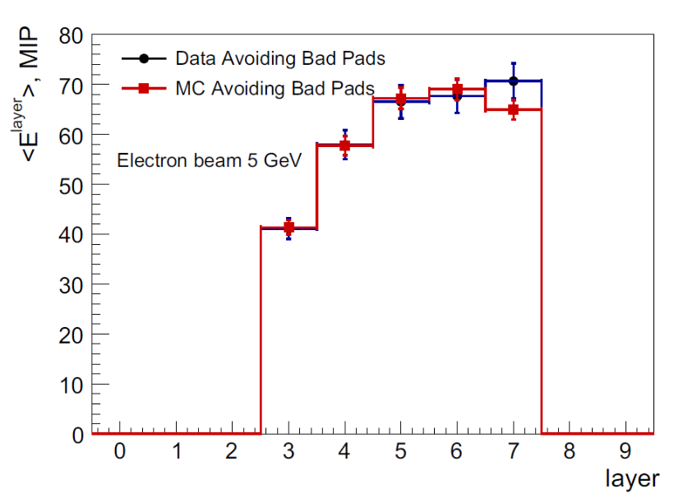
LumiCal test at DESY in 2016
transverse shower development
Shower position measurement
Longitudinal shower development
Resolution of (440±20) μm is found
Good agreement between data and MC (within statistical
uncertainties)
Effective Moliere radius :
Eur.Phys.J. C79 (2019) no.7, 579
8.1 ± 0.1 (stat) ± 0.3 (syst) mm
21

Slide 22
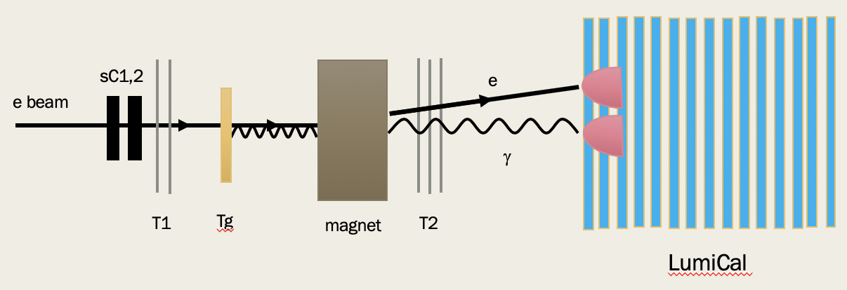
LumiCal test at DESY 2019 (11-18/11/19)
DESY-II Synchrotron electron beam 1-5 GeV (beam size 5x5 mm2)
T1,T2 : Alpide telescope with 5 ALPIDE planes (15x30 mm2)
Sc1,2 scintillator trigger
Tg W target
Dipole magnet –13 kGs for e/γ separation
16 detector planes; 11 equipped with a dual readout (high and low gain)
17 W absorber plates
External electronics (ASD-based)

Slide 23
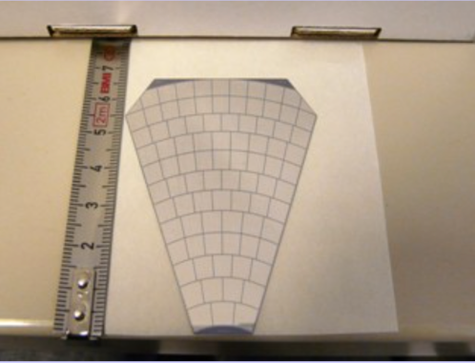
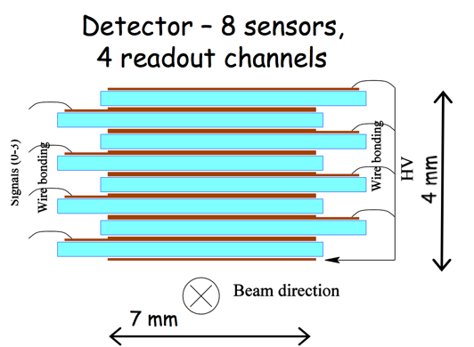
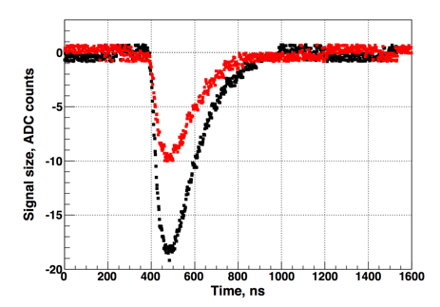
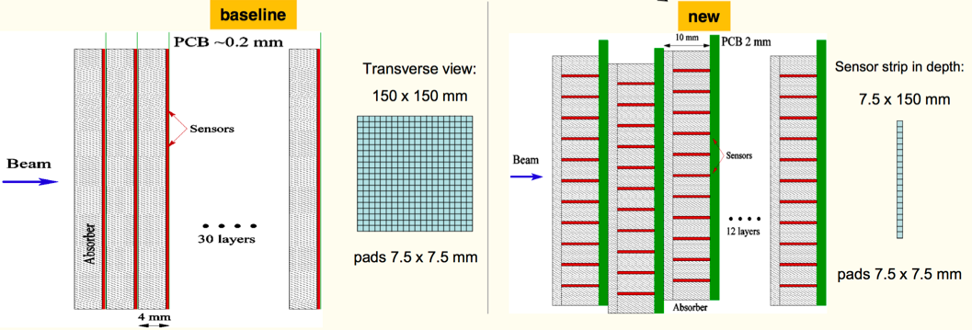
BeamCal test beam
DESY 2010 :
  GaAs sensor with Al metallization: 500 μm thick
  45 deg tiles, segmented into 12 rings, 5x5mm² pads
  S/N ratio and CCE are good: CCE ~33% at 60V, S/N ~19 for all channels.
  4 independent pad areas show identical charge collection
DESY 2013 :
  Idea to test sapphire sensors parallel to the beam line
  Perfect electrical properties, excellent radiation hardness, but presently low charge collection efficiency
2017 :
  New design of the detector
  Aiming to build and test this new model in 2020
Red : 550V
Black 950V

Slide 24
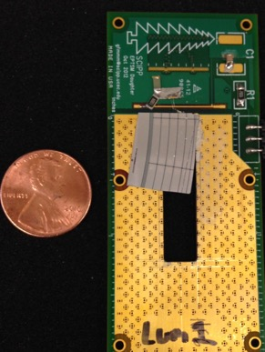
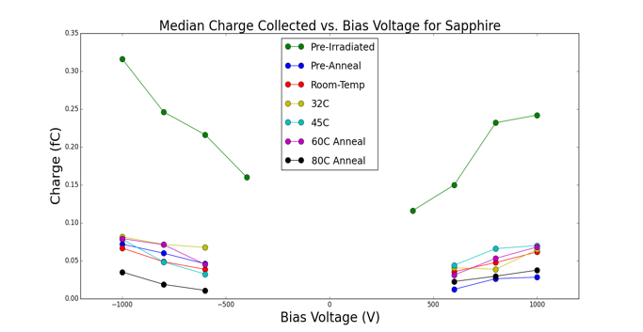
Radiation damage in electromagnetic shower
BeamCal maximum dose ~100 MRad/yr
Study is performed at California University of Santa Cruz
Exposition of Si, GaAs, Sapphire, Silicone carbide
Nucl. Instrum. Meth. A908 (2018) 198-205
Dark current remain low for Sapphire
300 Mrad Exposure
500 μm thick Al₂O₃
300 Mrad Exposure

Slide 25
The collaboration
FCAL detectors : simulation
FCAL detectors : hardware
Electronics
conclusion

Slide 26
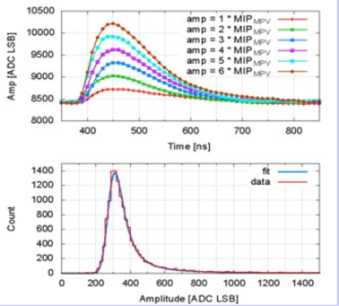
LumiCal readout in 2014
Development of an ASIC for the 2014 test beam
Charge amplifier shaper with different gain (MIP/electron)
8 front end channels
Development of an 8 channel 10 bit ADC
Signal to noise ratio ~19
Cross Talk < 1%

Slide 27
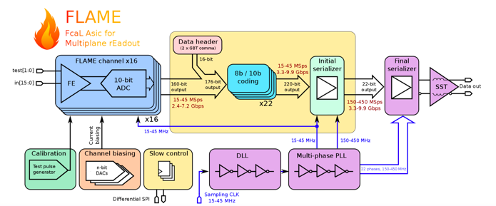
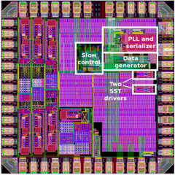
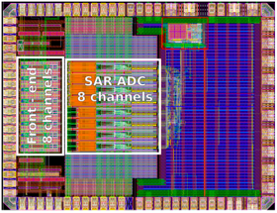
New readout : FLAME
JINST 10 (2015) P11012
JINST 10 (2015) P12015
FLAME: project of 32-channel readout ASIC in CMOS 130nm, front-end&ADC in each channel, fast serialization and data transmission, all functionalities in a single ASIC
FLAME prototype :
  Prototype 8-channel FE+ADC ASIC
  Prototype serializer ASIC
  Very good results
Chip and front end board produced. Will equip the 2020 test beam

Slide 28

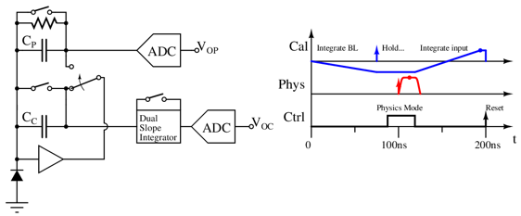
BeamCal readout
Firstly, BeamCal is hit by beam halo (muons)
  MIP deposition, low noise electronics
  Clean environment
  Good for calibration
~25ns later, BeamCal is hit by collision scattering
  Large deposit energy
  Physics readout
Dual slope integrator for calibration signal
  Integrate baseline (negative gain)
  Calibration halo signal is deposited and held
  Switch to physics mode, process and digitize Vop
  Then integrate calibration signal and digitize Voc

Slide 29
Conclusion
The precise and complete geometry of the FCAL detectors has been simulated and showed that :
  above 15 mrad, the BeamCal high energy electron reconstruction efficiency is close to 100%
  Very good energy resolution and luminosity measurements with the LumiCal (stochastic term ~0.2)
  Tungsten seems to be the best candidate for the LHCal
A prototype of a compact calorimeter is studied in electron beams. The measurement of the longitudinal and transverse shower size is in very good agreement with simulations. The effective Moliere radius is obtained to be 8.1 ± 0.1 (stat) ± 0.3 (syst) mm and the resolution of the shower position reconstruction (440±20) μm. A 16 layers has just been tested last week
A fully instrumented detector plane using GaAs sensors was studied in a test-beam. A signal-to-noise ration for relativistic particles was measured to be ~19 The detector homogeneity was excellent.
LumiCal prototypes of key blocks readout fabricated and first promising results obtained. BeamCal readout chip is under intensive study
2020
LumiCal test beam with :
  Between 18 to 20 thin layers
  Close to final front end electronics + readout and DAQ

Slide 30
thanks

Slide 31
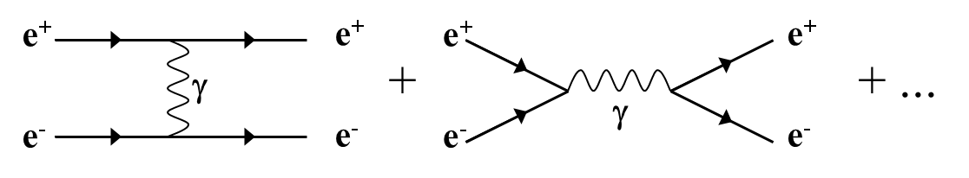
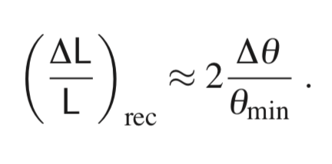
Luminosity at e⁺e⁻ collider
Bhabha scattering at low polar angles is used
e⁺e⁻ e⁺e⁻ (γ)
L = N / σ
Count Bhabha events
From theory
ECFA, Linear Collider Workshop 2016
31
31/05/16

Slide 32
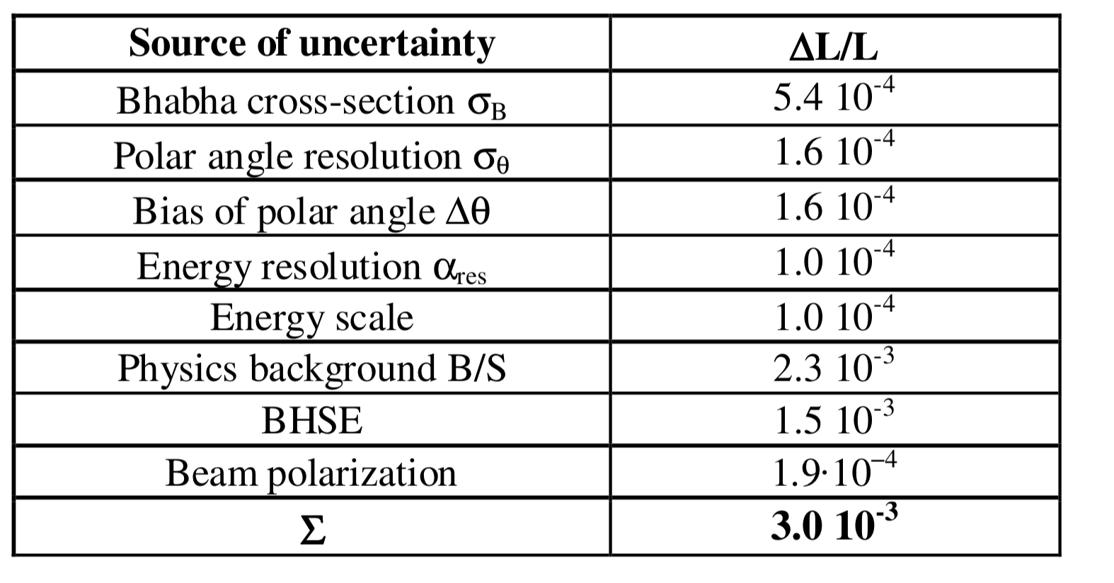
Luminosity precision details

