Slide 1
Progress on Low Power FEE ASIC Development for TPC
Wei Liu^{1,2}, Xinyuan Zhao^{1,2} ,Zhi Deng^{1,2}, Fule Li³, Xian Gu³, Yulan Li^{1,2}, Huirong Qi⁴
¹ Department of Engineering Physics, Tsinghua University, Beijing, China
²Key Laboratory of Particle & Radiation Imaging, Ministry of Education, Beijing, China
³Institute of Microelectronics, Tsinghua University, Beijing, China
⁴Institute of High Energy Physics, Chinese Academy of Science, Beijing, China
Notes:
Good afternoon ,I’m Wei Liu from Tsinghua University. Today my topic is about Progress on Low Power FEE ASIC Development for TPC.

Slide 2
Outline
Introduction
Progress on ASIC Design
Progress on Digital Filters and Data Compression
Summary & Future Plan
Notes:
Firstly I’d like to talk about the introduction. Secondly, I’d like to talk about the progress on ASIC design. Digital filter and data compression are also mentioned. The summary and future plan are in the end.

Slide 3
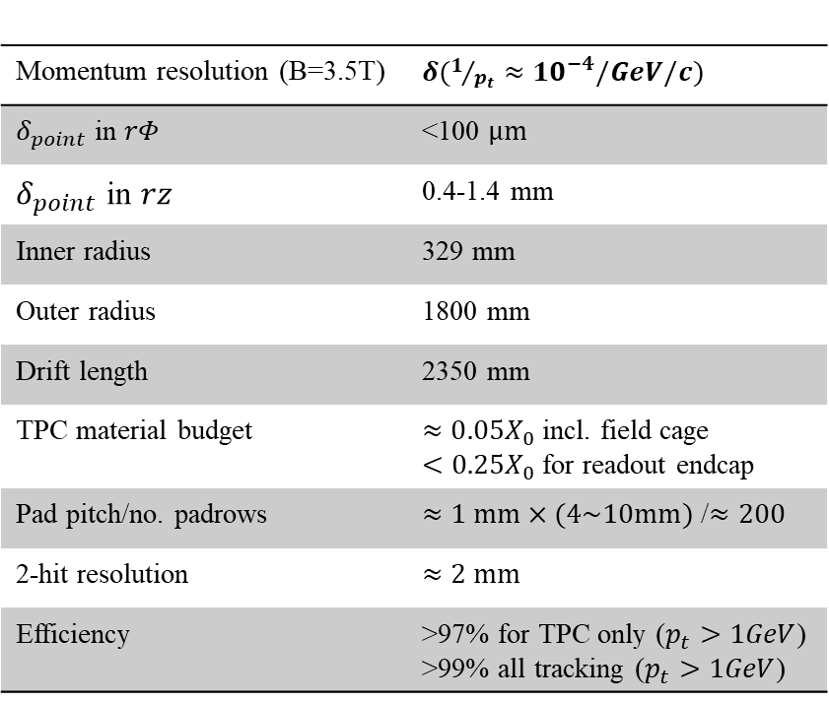
Introduction
Momentum resolution (B=3.5T) | $δ(1/{p_{t}}≈{10}^{−4}/GeV/c)$
$δ_{point}$ in $rΦ$ | <100 $μm$
$δ_{point}$ in $rz$ | 0.4-1.4 mm
Inner radius | 329 mm
Outer radius | 1800 mm
Drift length | 2350 mm
TPC material budget | $≈0.05X_{0}$ incl. field cage $<0.25X_{0}$ for readout endcap
Pad pitch/no. padrows | $≈1 mm×(4\sim 10mm)$ /$≈200$
2-hit resolution | $≈2 mm$
Efficiency | >97% for TPC only ($p_{t}>1GeV$) >99% all tracking ($p_{t}>1GeV$)
TPC can provide large-volume high-precision 3D track measurement with stringent material budget
In order to achieve high spatial resolution, small pads (e.g. 1 mm x 6mm) are needed, resulting ~1 million channel of readout electronics
Need low power consumption readout electronics working at continuous mode
Notes:
There are about 1 million channels of readout electronics working at continuous mode in CEPC-TPC. So, power consumption is crucial and a few milliiwatt per channel is required.

Slide 4
Current TPC Readout ASICs
 | PASA/ALTRO | AGET | Super-ALTRO | SAMPA
TPC | ALICE | T2K | ILC | ALICE upgrade
Pad size | 4x7.5 mm² | 6.9x9.7 mm² | 1x6 mm² | 4x7.5 mm²
Pad channels | 5.7 x 10⁵ | 1.25 x 10⁵ | 1-2 x 10⁶ | 5.7 x 10⁵
Readout Chamber | MWPC | MicroMegas | GEM/MicroMegas | GEM
Gain | 12 mV/fC | 0.2-17 mV/fC | 12-27 mV/fC | 20/30 mV/fC
Shaper | CR-(RC)⁴ | CR-(RC)² | CR-(RC)⁴ | CR-(RC)⁴
Peaking time | 200 ns | 50 ns-1us | 30-120 ns | 80/160 ns
ENC | 385 e | 850 e @ 200ns | 520 e | 482 e @ 180ns
Waveform Sampler | ADC | SCA | ADC | ADC
Sampling frequency | 10 MSPS | 1-100 MSPS | 40 MSPS | 20 MSPS
Dynamic range | 10 bit | 12 bit(external) | 10 bit | 10 bit
Power consumption | 32 mW/ch | 10.0 mW/ch | 47.3 mW/ch | 8 mW/ch
CMOS Process | 250 nm | 350 nm | 130 nm | 130 nm
No current chips can meet the readout requirement for the CEPC TPC
More advanced 65nm process
Adopt simplified circuit structure such as SAR-ADC,CR-RC shaper
Notes:
Dedicated TPC readout ASICs have been developed for the last two decades but none of them can fulfill the requirements of such low power consumption and high rate .Therefore, we develop a CEPC TPC readout ASIC using advanced 65nm process And adopting simplified circuit such as SAR-ADC,CR-RC shaper .

Slide 5
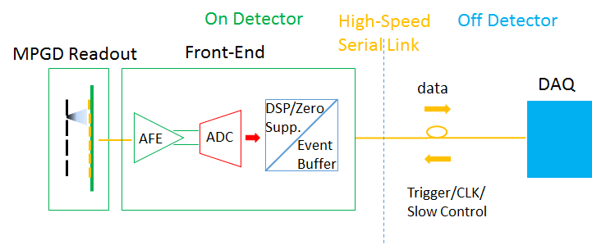
Architecture and Specifications of FEE
AFE(Analog Front-End)
Signal Polarity | Negative
Detector Capacitance | 5-20 pF
Shaper | CR-RC
Shaping Time | 160 ns
ENC (Equivalent Noise Charge) | <500 e @ 10pF
Dynamic Range | 120 fC
Gain | 10 mV/fC
INL (Integrated Non-Linearity) | <1%
Crosstalk | <1%
Power Consumption (AFE) | <2.5 mW/ch
SAR-ADC
Input Range | -0.6 V ~ 0.6 V diff.
Resolution | 10 bit
Sampling Rate | 40 MS/s
DNL | <0.6 LSB
INL | <0.6 LSB
SFDR @ 2MHz, 40MSPS | 68 dBc
SINAD | 57 dB
ENOB | >9.2 bit @ 2MHz
Power Consumption (ADC) | <2.5 mW/ch
Notes:
The architecture of the TPC readout electronics is shown in this Figure. It consists of the front-end electronics on the detector panel and DAQ off the detector. They communicate using high-speed serial link. The front-end ASIC consists of analog front-end ,ADC and DSP.The specification are shown in these two table. The power consumption of AFE,ADC should be less than 2.5 mW/ch, with low ENC and high sampling rate.

Slide 6
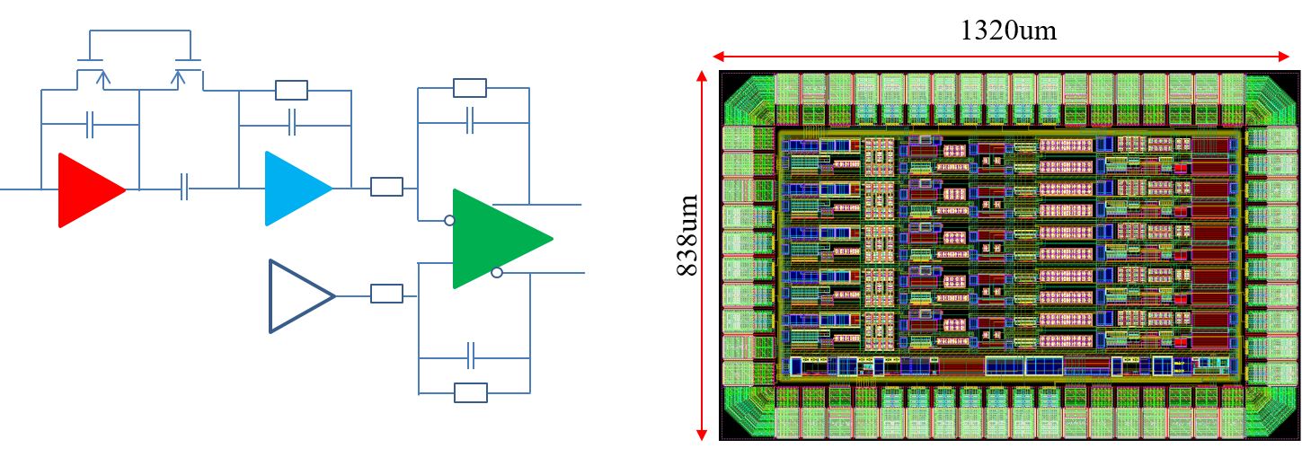
Current Status : Analog Front-End ASIC
Three prototype chips have been taped out and evaluated during 2017 2018
5 channel Analog Front-End ASIC
Single channel SAR-ADC ASIC
Single channel Analog Front-End +SAR-ADC ASIC
1320μm
838μm
Charge sensitive amplifier
Shaper amplifier
Full differential amplifier
The test results of main specifications of 5 channel Analog Front-End ASIC：
Power consumption：2.02 mW/channel
Gain：9.8 mV/fC
ENC(equivalent noise charge)：589 e @10pF
Notes:
Three prototype chips have been developed and evaluated. The test results of Analog Front-end such as power consumption, and Gain show in good agreement with specification .

Slide 7
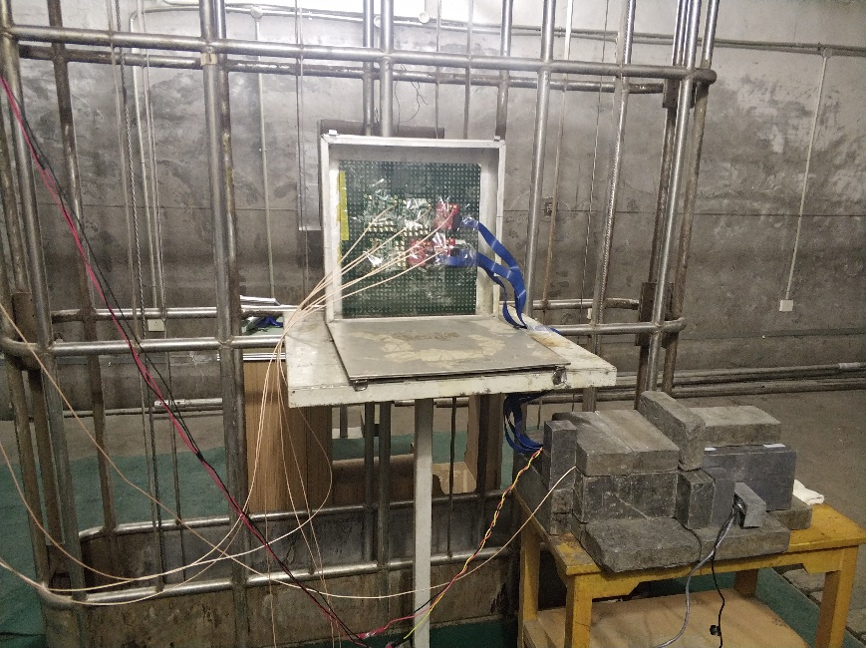
Current Status :TID Tests for Analog Front-End
Test setup:
  Radiation Source: Co-60
  Does rate: 50 rad(Si)/s
  TID(total ionizing dose): 1 Mrad (Si)
  Sample no.: 3
  Chip working condition: 1.2 V supply voltage with 25 uA mater bias current
TID test results:
The power consumption remained basically unchanged before and after TID test.
The gain increased slightly （9.8 mV/fC10.4 mV/fC）and the maximum integral non-linearity of there chips remained basically unchanged.
The ENC increased slightly（589 e605 e @ 10pF） before and after TID test.
Notes:
TID test for AFE have been done. No significant performance degradation have been observed.

Slide 8
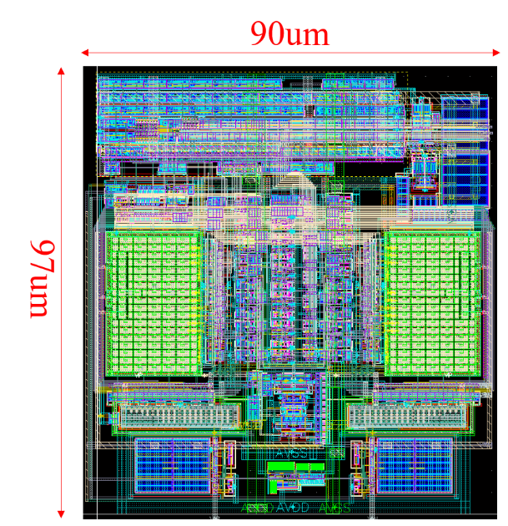
Current Status : SAR ADC
90μm
97μm
Module Name | Power(mW)
Chip | 4.0
Referred Buffer Module | 0.25
SAR ADC Core Module | 1.0
Clock Generation Module , etc | 2.75
The test results of main specifications of single SAR ADC
The core power consumption of SAR ADC:1 mW
Maximum INL(integral non-linearity),DNL(differential nonlinearity)=0.6 LSB
ENOB=9.15 bit under 50 MS/s sampling rate with 2.4 MHz differential sinewave input
Notes:
The SAR ADC also have been evaluated. The tested results show in good agreement with the specification, with the core power consumption of 1 mW .

Slide 9
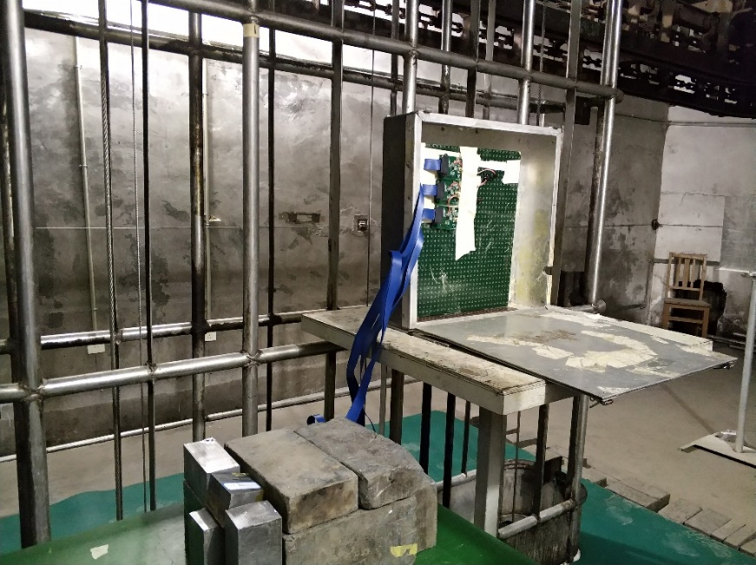
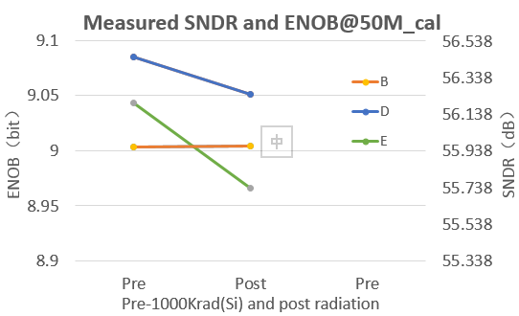
Current Status : TID Tests for SAR ADC
Test setup:
  Radiation Source: Co-60
  Does rate: 50 rad(Si)/s
  TID: 1Mrad (Si)
  Sample no.: 3
  Chip working condition: CLK=50 M, fed with 2.4 MHz sine input signal
TID test results:
The ENOB decreased slightly before and after TID test.
The INL and DNL remained basically unchanged before and after TID test.
Notes:
The TID test for SAR ADC also have been done. No significant performance degradation was observed

Slide 10
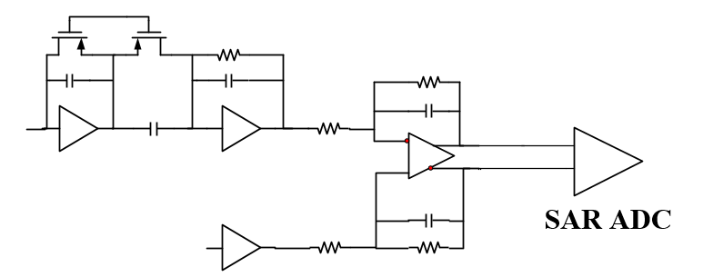
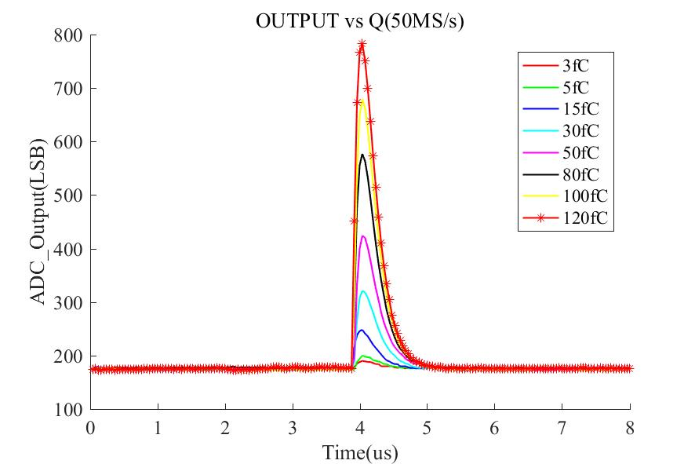
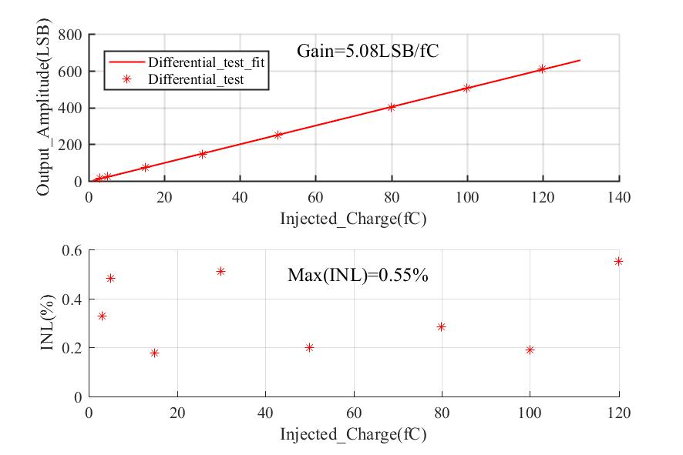
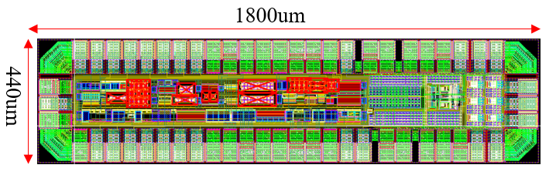
Current Status : Analog Front-End + SAR ADC
1800μm
440μm
The test results of main specifications of single Analog Front-End + SARADC
Power consumption：2.5 mW
gain：5.08 LSB/fC
ENC：900 e @10pF
Notes:
The AFE+SARADC also have been evaluated . The tested results show in good agreement with the specification. But the ENC is slightly higher than specification .The quantizing noise of ADC is a big contribution. And the digital filter can reduce the noise. It will be introducted in the later.

Slide 11
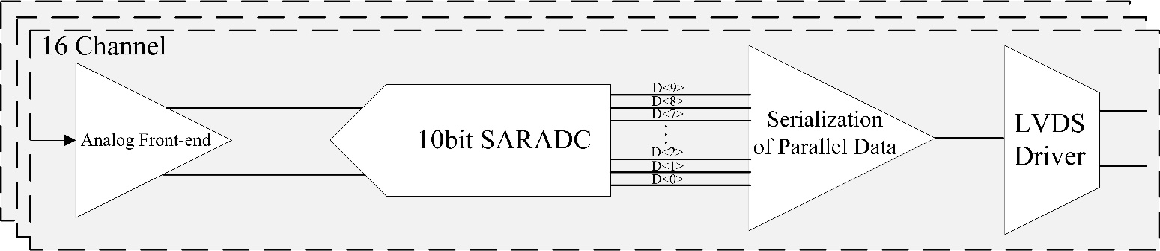
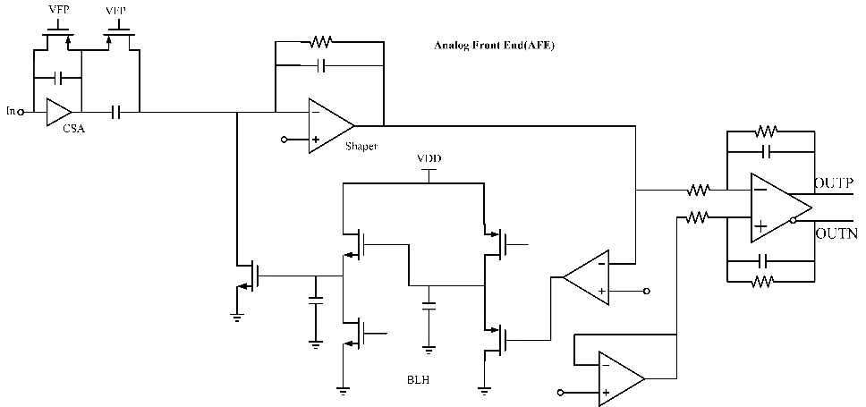
The 16-ch TPC Readout ASIC
Design highlights：
16 channel
Power consumption of Analog Front-end : from 2.02 mW/channel to 1.4 mW/channel
ENC : from 589 e to 303 e @10 pF
Notes:
Based on the first prototype ASIC, an 16 channel TPC readout ASIC have been developed. It consist of AFE, SARADC ,serialization of SARADC output parallel data and LVDS driver.

Slide 12
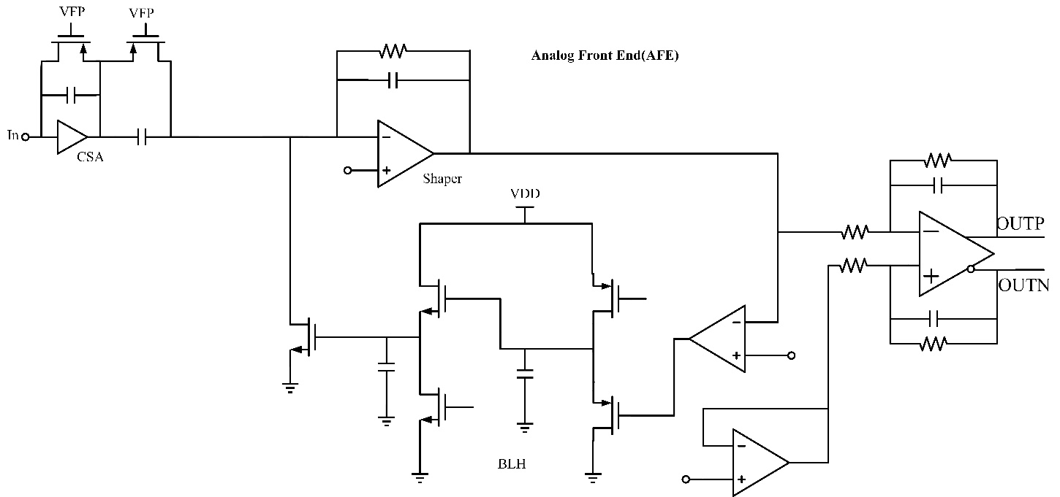
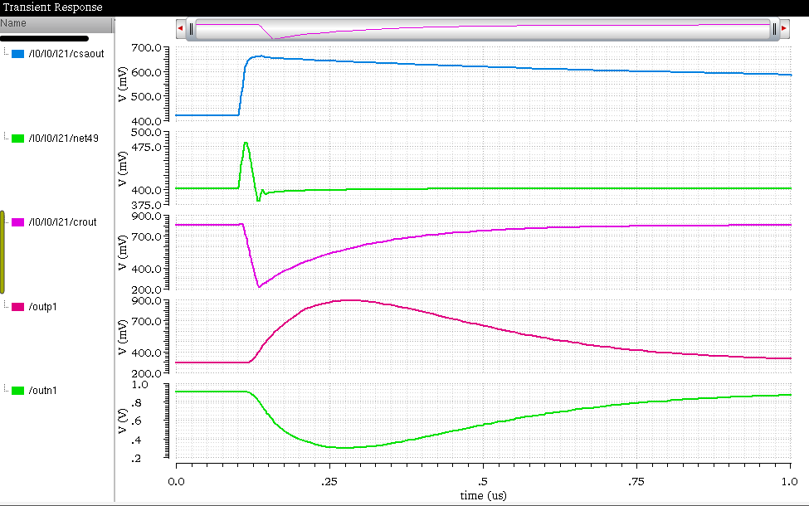
Transient Simulation of Analog Front-End
Injected charge：120 fC（Gain:10 mV/fC）
The simulation power consumption of Analog Front-end：1.4 mW/channel
The test power consumption of 5 channel Analog Front-end：2.02 mW/channel
Notes:
The transient simulation of Analog Front-end have been done.The power consumption of 1.4mW is achieved.

Slide 13
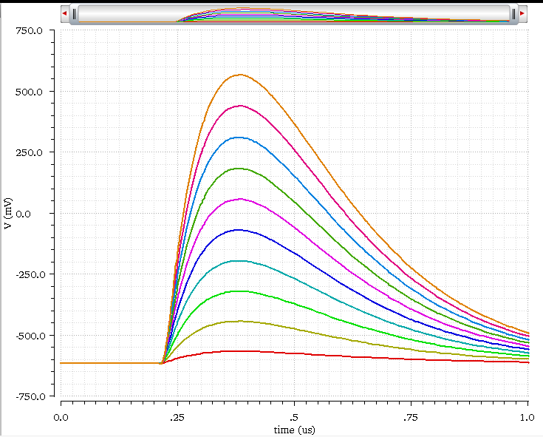
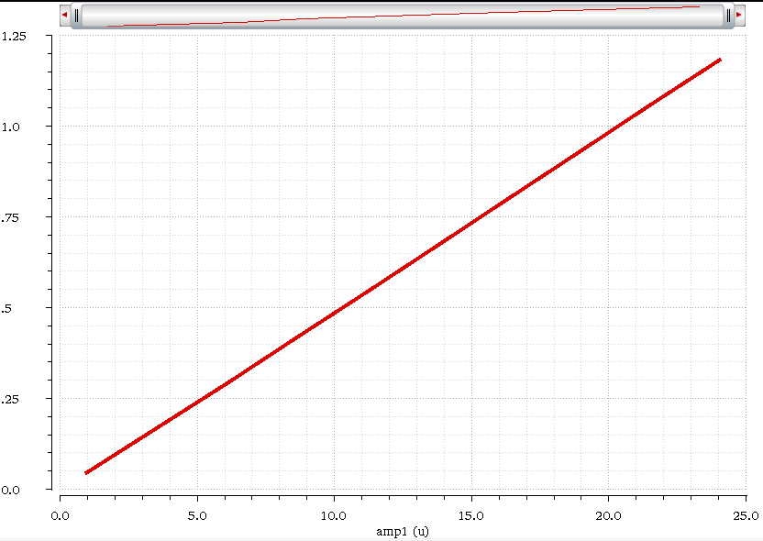
Linearity Simulation of Analog Front-End
Q=5 fC120 fC
Gain=9.9 mV/fC
Amplitude(V)
Gain(design value） mV/fC | 10 | 20 | 30 | 40
Gain（simulation value） mV/fC | 9.9 | 19.5 | 29.2 | 39.2
Notes:
The linearity simulation show the linearity is very well.

Slide 14
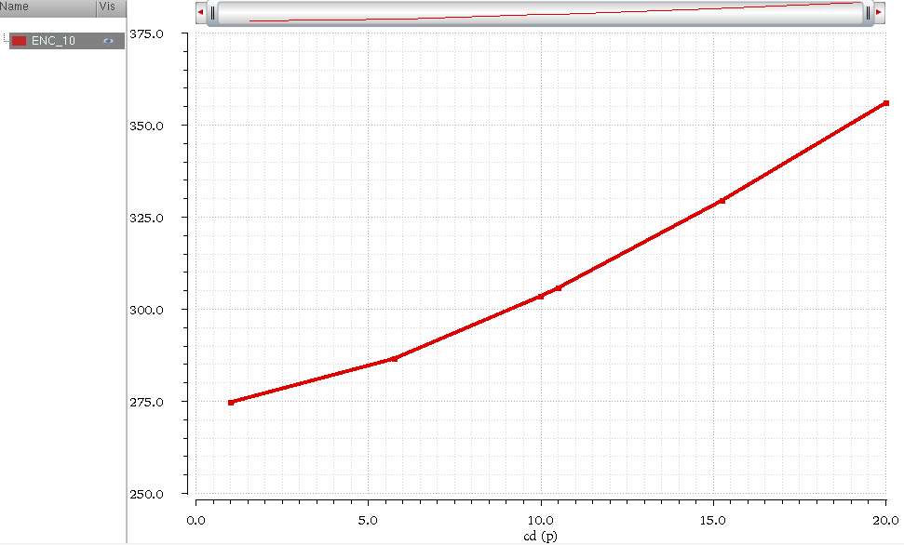
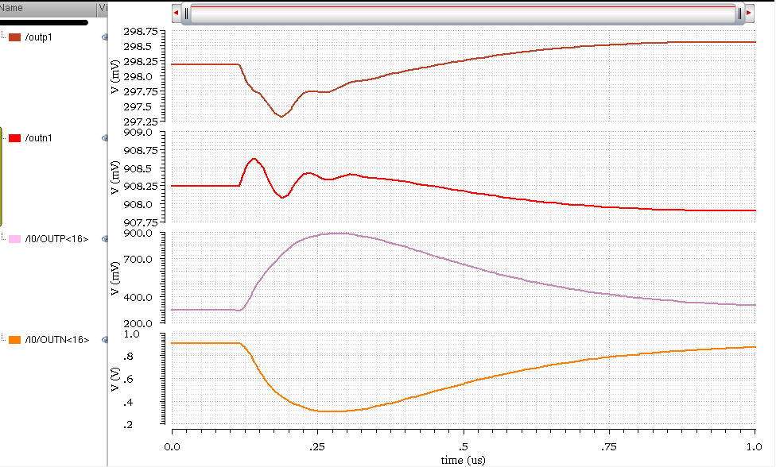

ENC and Crosstalk Simulation of Analog Front-End
ENC
Crosstalk
Q_1：0 fC
Q_16： 120 fC
ENC=303 e @ 10 pF,10 mV/fC
Gain mV/fC | 10 | 20 | 30 | 40
ENC e @10 pF | 303 | 189 | 159 | 146
Crosstalk：$\frac{1.526 mV}{1196 mV}=0.12\%<1\%$
Notes:
During noise simulation , the enc of 303 electron is achieved at the gain of 10 mV/ fC. And the crosstalk is much less than 1%.

Slide 15
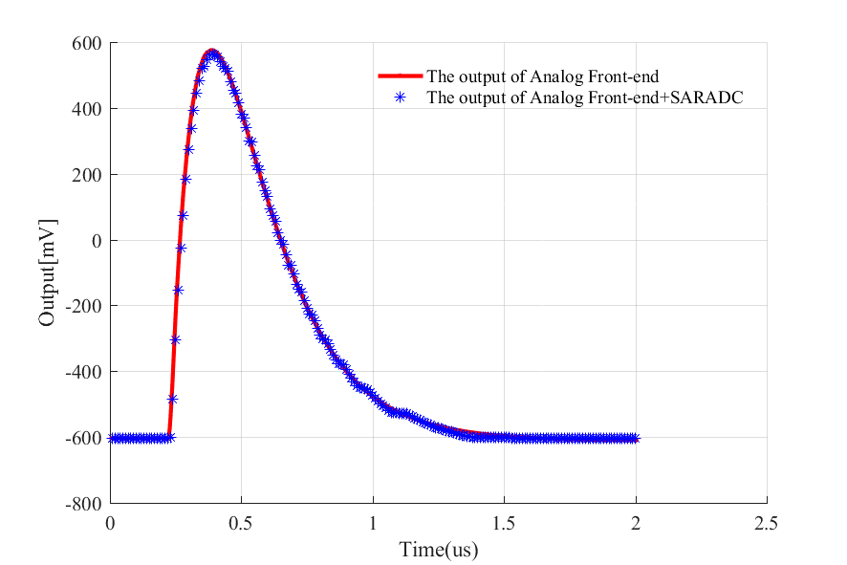
Transient Simulation of TPC Readout ASIC
Sampling Rate:100 MS/s
Peaking time:~160 ns
Time(μs)
Notes:
The simulation output of AFE and AFE+SARADC is shown in this figure. The simulation results showed in good agreement with the expectation.

Slide 16
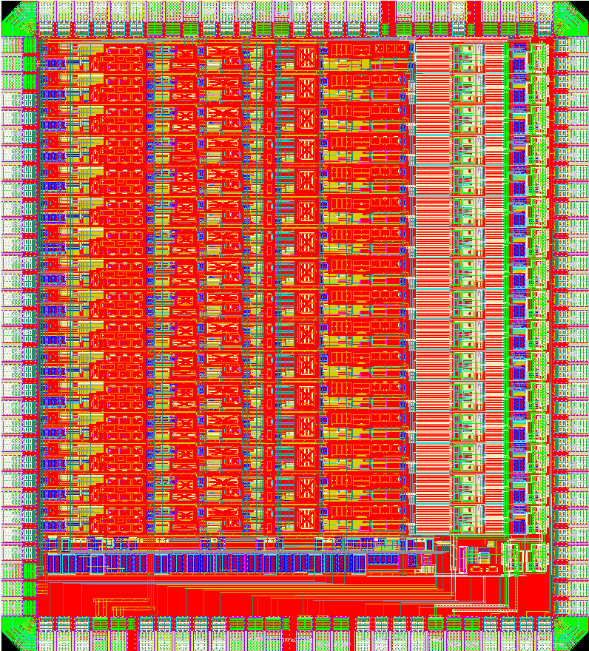
Layout of 16-ch TPC Readout ASIC
1950μm
The floor plan in layout ：
The die size of 1950 μm x 2160 μm
Analog Front-End , SPI, SAR ADC, LVDS driver are supplied by separate power
The ASIC have been taped out in November 6 ,2019 and will be evaluated in February,2020.
2160μm
LVDS driver
Analog Front-End
Bias
SAR ADC
Notes:
The layout of the ASIC is shown in this figure and it consists of AFE , bias, SARADC and LVDS driver. The floor plan in layout is very crucial . Different parts are supplied by separate power in order to reduce the interference.

Slide 17
Digital Filter and Data Compression
100 MS/s10 bit
500 MS/s(DDR , double data rate)
The drawback of ADC data direct output:
Pile up due to the long decay tail of CR-RC shaper
The high data rate from LVDS driver
The high power consumption of LVDS driver
The solution:
Digital trapezoidal filter balances the ballistic deficit and pile up
Compress the data via zero suppression , Huffman suppression , etc
Notes:
ADC data direct output have many drawbacks such as pile up, high data rate and power consumption. So, Digital trapezoidal filter is used to balances the ballistic deficit and pile up. And data compression is used to reduce data bandwidth.

Slide 18
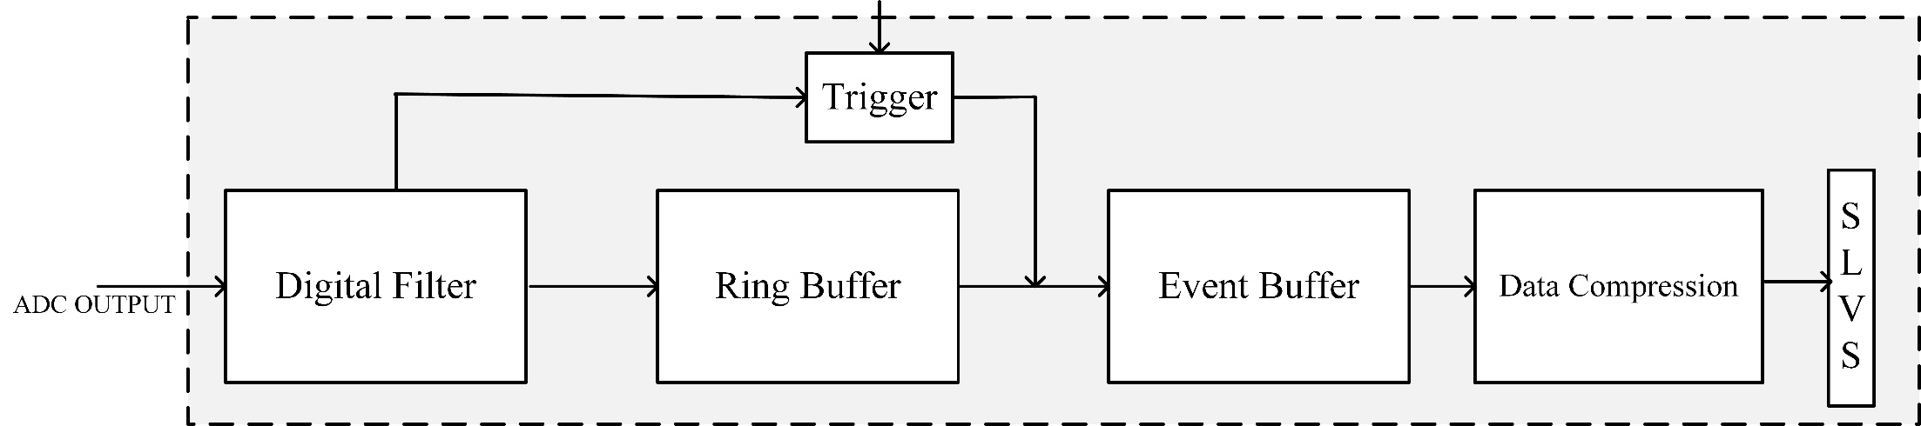
Preliminary Block Diagram of Digital Filter and Data Compression
Operating mode:
Trigger mode: external trigger and self trigger
Continuous operation
Notes:
The preliminary block diagram of digital filter and data compression is shown in this figure. The AFE and SARADC have been developed. The digital filter such as, trapezoidal filter is being studied .

Slide 19
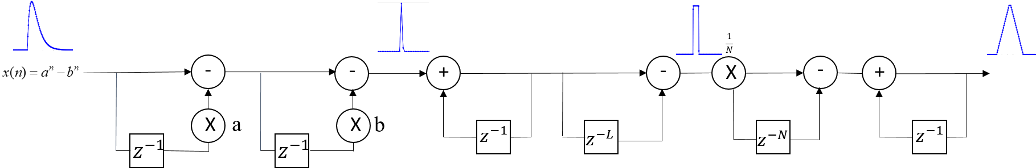
Digital Trapezoidal Filter
for self trigger
The ballistic deficit can be avoided when the flat top is longer than detector charge collection time
The waveform is symmetric, can achieve high SNR(signal to noise ratio)
Hardware resource is low cost, can be well implemented on chip
2 MUL (multiplications)
6 ADD (additions) and SUB (subtractions)
some shift operations
Notes:
The block diagram of trapezoidal filter is shown in this figure. The trapezoidal filter have many advantages , such as symmetric waveform and low cost hardware.

Slide 20
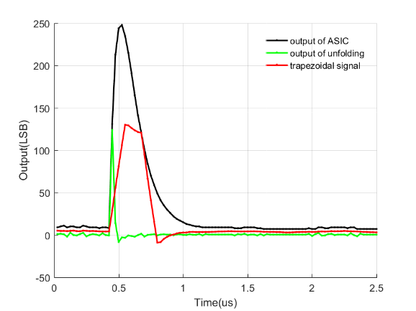
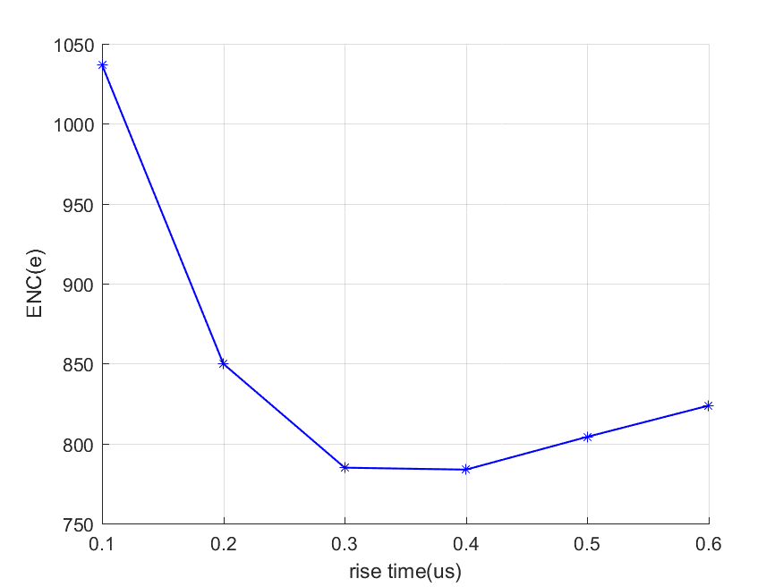
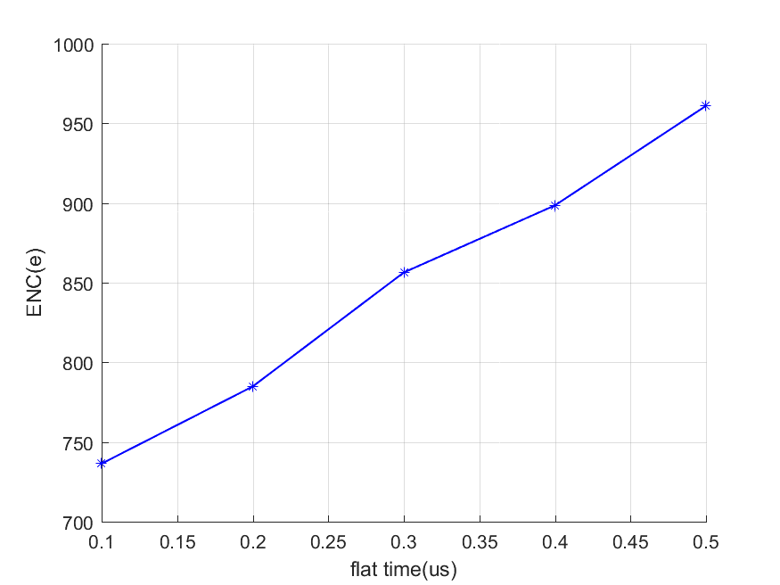
Digital Trapezoidal Filter in MATLAB
When the flat top and rise time are suitable, the ENC can achieve minimum.
Notes:
The output of single channel AFE +ADC ASIC is fed into trapezoidal filter, the key nodes output of trapezoidal filter is shown in the left figure. The ENC with the rise time and flat top time are shown in the right two figures.

Slide 21
Summary
16 channel low power consumption and high integration ASIC for TPC readout have been developed
Based on the prototype ASICs of the first MPW run
adopting CR-RC shaper ，achieving the analog part power consumption of 1.4 mW/channel, ENC:303 e @10 pF,10 mV/fC,
Adopting SAR ADC, achieving the core power consumption of 1 mW/channel，ENOB:9.2 bit @50 MS/s
Notes:
Based on the prototype ASICs of the first MPW run , 16 channel low power consumption and high integration ASIC for TPC readout have been developed. The power consumption of AFE and SARADC core is 1.4mW and 1 mW respectively.

Slide 22
Future Plan
The evaluation of the 16 channel lower power and high integration ASIC using signal generator and TPC prototype
Development of the full function CEPC TPC readout ASIC
Low power digital filter and data compression in FPGA
Full function ASIC including AFE,SARADC,DSP design
Thank You
Notes:
In the future, the 16ch ASIC will be evaluated and the full function CEPC TPC readout ASIC will be developed.

