Slide 1
Development of high-performance DLC resistive electrodes for MPGDs
You Lv , Yi Zhou , Jianbei Liu
State Key Laboratory of Particle Detection and Electronics
University of Science and Technology of China
The 2019 International Workshop on the High Energy Circular Electron Positron Collider
18/11/2019---20/11/2019

Slide 2
Outline
Introduction
R&D on DLC resistive electrodes
Application of DLC coating
  Low-rate μRWELL
  high-rate μRWELL
  Charging-up free THGEM
Summary

Slide 3
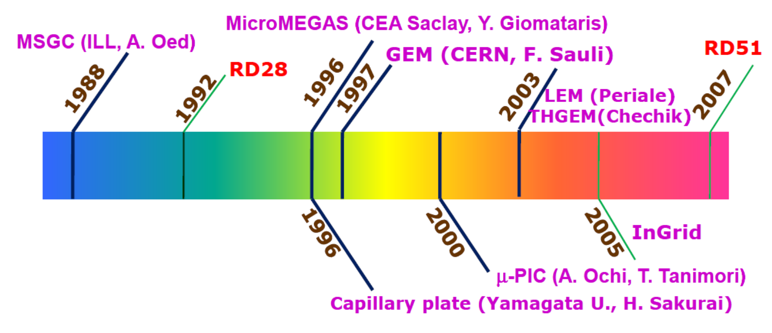
Development of MPGDs
Advantages of MPGDs :
High rate capability (>> 1 MHz/cm²)
Space resolution, mainly depending on the readout segmentation and FEE capability, easily below 200 μm
Time resolution below 10 ns
Larger area (m²/single detector), lower cost
MPGD technology are well established after more than 20 years of production at CERN, and it have already been widely studied and used in nuclear and particle physics experiments.

Slide 4
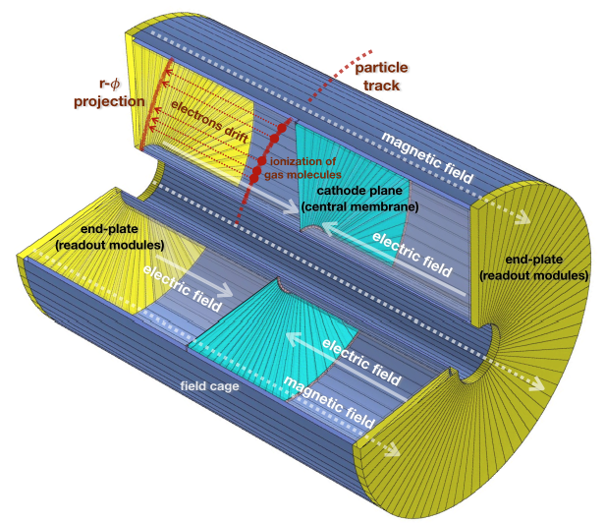
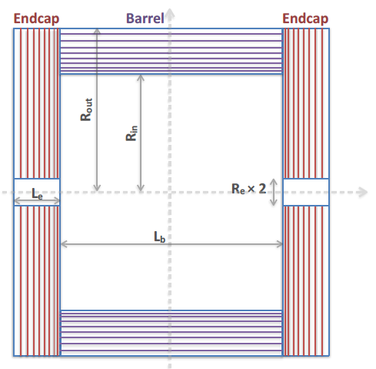
MPGDs applied in CEPC
Gas amplification detector module for CEPC TPC readout
Baseline detector: GEM & MM
Gain: 10³−10⁴
Spatial granularity: 1 mm²
Position resolution: 100 μm in r - φ
CEPC muon detector system
Candidate MPGD detector: μ-RWELL
Sensitive area: 8600 m²
Time resolution: 1-2 ns
Detector efficiency: 95% (P_{μ} >5GeV)
Rate capability: ~ 60 Hz/cm²

Slide 5
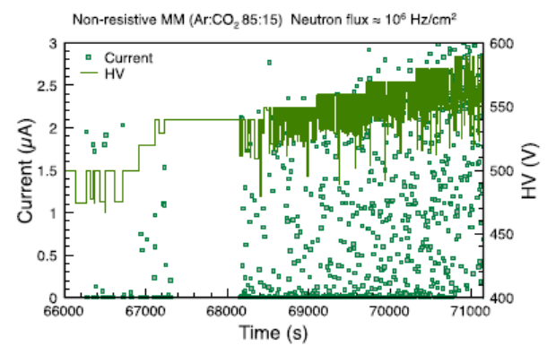
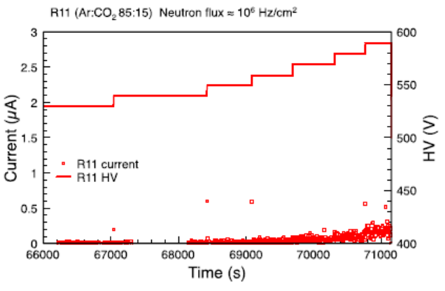
Challenge in MPGDs
MPGDs: suffer discharge due to a large amount of avalanche charge created in a very narrow multiplication region.
Resistive electrode
Resistive electrode based on Carbon loaded pastes have already been used in MPGDs to suppress the discharges and reduce the damaging effects on MPGDs
Resistivity sometimes out of control in manufacture;
Unable to make fine structures;
Difficult to make conductive route on it precisely;
Can not open opportunities for new micro-structures;
New reliable resistive materials and preparation methods needed

Slide 6
Introduction
R&D on DLC resistive electrodes
Application of DLC coating
  Low-rate μRWELL
  high-rate μRWELL
  Charging-up free THGEM
Summary

Slide 7
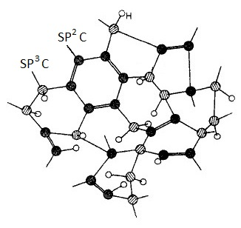
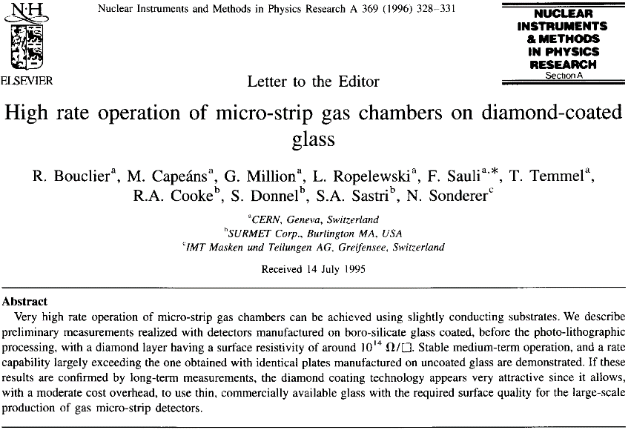
Diamond-like Carbon
Diamond-like Carbon (DLC): a class of metastable amorphous carbon material that contains both the diamond-structure and graphite-structure.
DLC coating was firstly used in MSGC in 1995 to resolve the charging-up effect
Atom structure of DLC
DLC coating shows good stability in surface resistivity and good chemical stability.
Resistive electrodes based on DLC are very resistant to discharge and radiation, and able to withstand chemical or physical manufacturing processes.

Slide 8
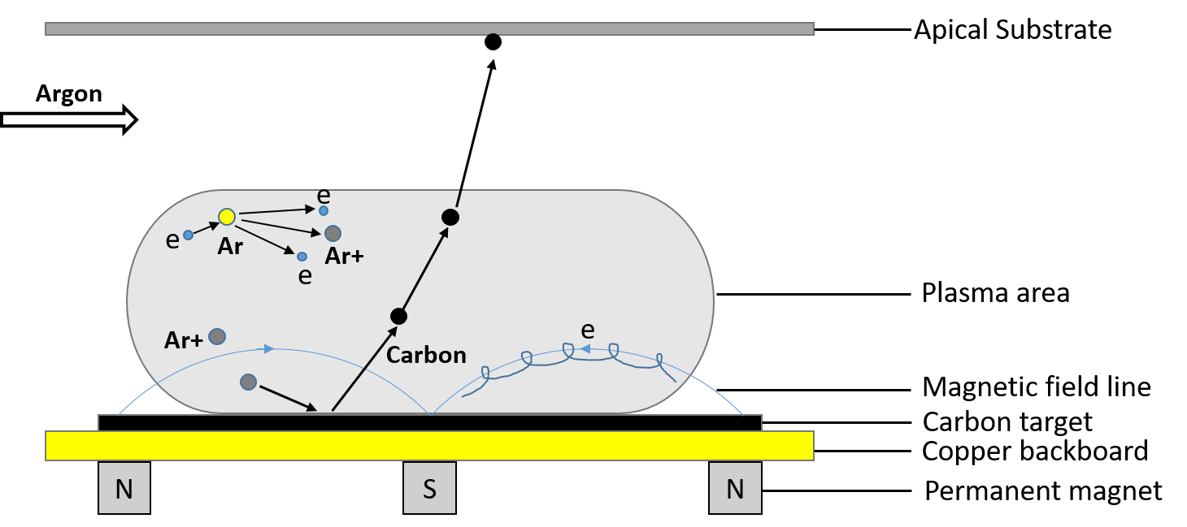
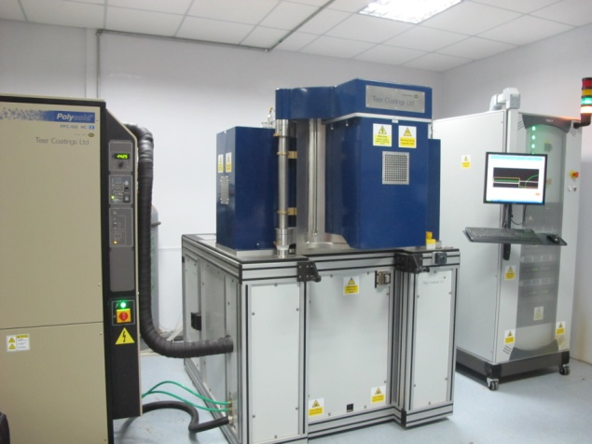
R&D on DLC resistive electrodes
Magnetron sputtering technique: an effective way for DLC coating at low-temperature, which ensures both accurate surface resistivity and uniform thickness of the coating.
Schematic of magnetron sputtering technique
Magnetron sputtering system
(LICP Teer 650)
Voltage between substrate and target ramping up
Glow discharges appear, producing primary electrons and ions
Ions hitting targets and sputtering carbons
Ejected atoms depositing on substrate
DLC coating deposited by Magnetron sputtering shows good adhesion and good uniformity.

Slide 9
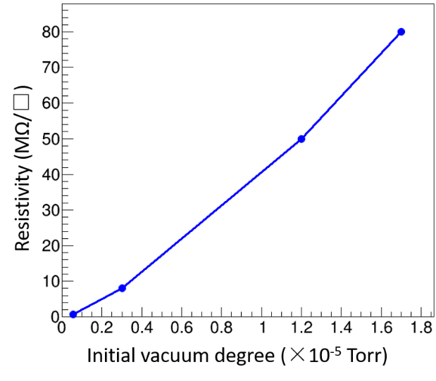
Surface resistivity of DLC coating
a-C DLC: pure DLC
Surface resistivity: MΩ/□ — GΩ/□
Thickness: 50nm —100 nm
a-C:H DLC: Hydrogen doping DLC
Surface resistivity : MΩ/□ —TΩ/□
Thickness: 50nm — 1μm
Resistivity vs Vacuum
a-c DLC
a-c:H DLC
a-c:H DLC
  a-C DLC: Surface resistivity can be adjusted by initial vacuum degree and DLC thickness.
a-C:H DLC: The surface resistivity is sensitive to hydrogen, it can be adjusted in a very wide range by adjusting the ratio of hydrogen, and more precise by controlling deposition time.

Slide 10
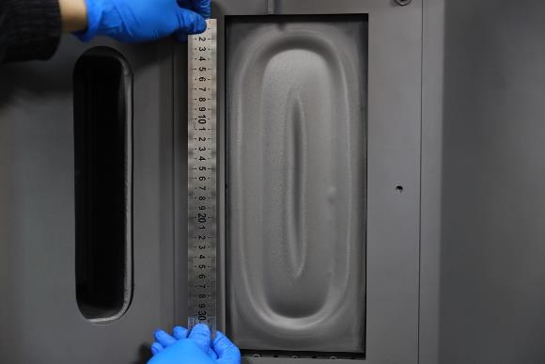
Stability & uniformity
  Surface resistivity increase about 30% in 4 days (exposure to air), and then kept stable.
  Resistivity is independent with the voltage, showing the ohmic behavior.
Carbon target
  The resistivity uniformity better than 15% for 15cm×15cm sample size, and 44% @30cm × 30cm DLC sample.
210 | 200 | 178 | 176 | 200
105 | 93 | 96 | 82 | 102
68 | 70 | 72 | 71 | 68
78 | 77 | 78 | 81 | 77
135 | 130 | 120 | 135 | 126
The height of carbon target is about 30 cm almost same as our large sample size.
DLC thickness showing difference at different region of the large DLC sample, which result to the bad uniformity.

Slide 11
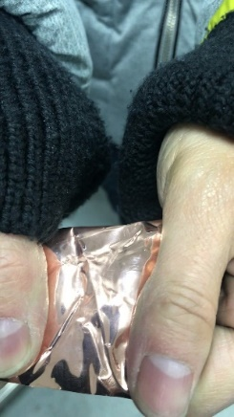
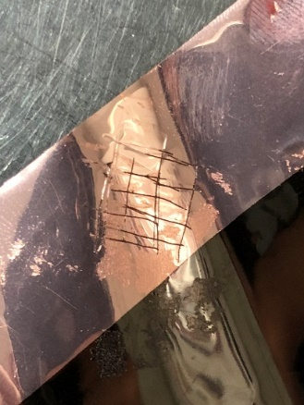
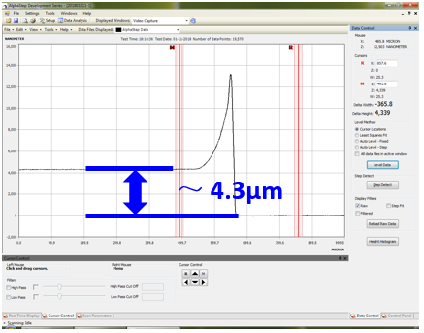
Copper-coated DLC
A copper-coated DLC is developed to extend the application of DLC coating in MPGDs.
Cu layer
Cr-Cu interlayer
Cr layer
DLC layer
APICAL foil
Substrate/DLC/Cr/Cr-Cu/Cu
Copper-coated DLC
Good adhesion
Deposit DLC on APICAL/Cu substrate
Deposit copper on DLC/APICAL/Cu substrate
It shows good adhesion between DLC and copper.
The thickness of copper can be adjusted from 1 μm to 5 μm.
Further processing of the copper-coated DLC can be achieved thanks to the copper layer on the surface of DLC.
Thickness measurment

Slide 12
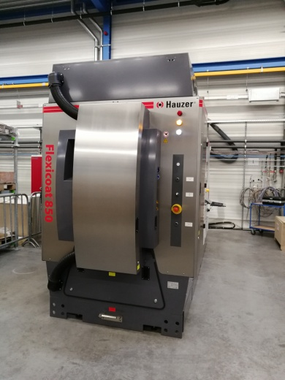
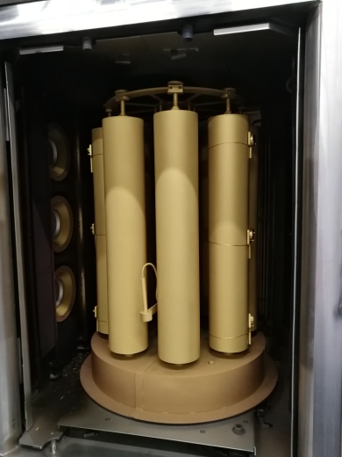
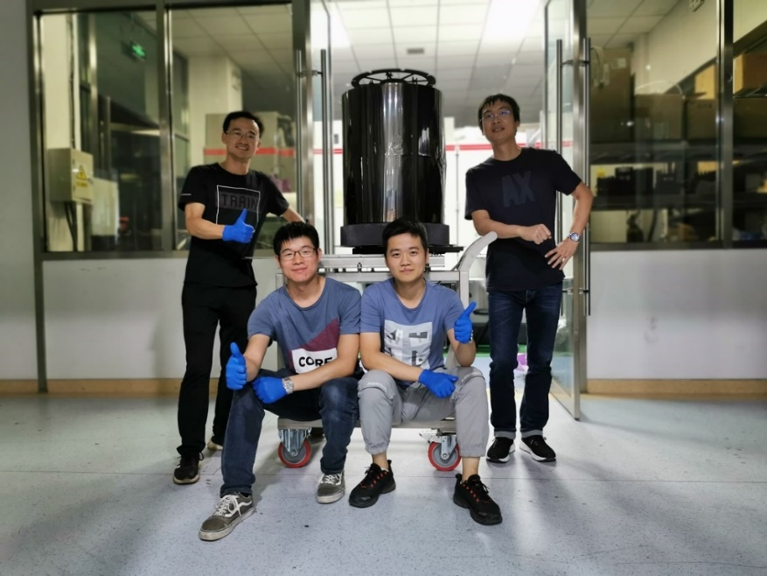
R&D on larger DLC sample
A new sputtering system (Hauzer 850) is ready to make larger area DLC samples.
Picture of new sputtering system (Hauzer 850)
600mm × 120mm DLC sample
Chamber size: Φ800mm×900mm
Target size: 600mm×125mm
Resistivity uniformity:
25% @400mm×1200mm DLC sample
Resistivity shows good uniformity along the long edge, and bad on the short edge due to the limitation of target size.

Slide 13
Introduction
R&D on DLC resistive electrodes
Application of DLC coating
  Low-rate μRWELL
  high-rate μRWELL
  Charging-up free THGEM
Summary

Slide 14
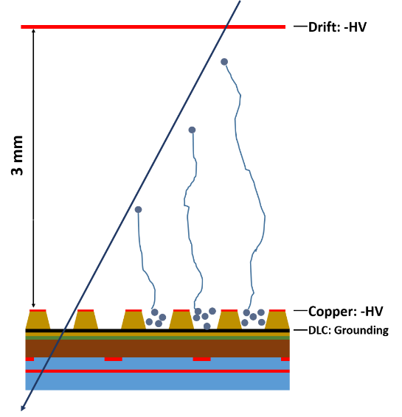
Low-rate μRWELL
Micro-Resistive WELL (μRWELL): a novel MPGD with resistive electrode and a single stage of well-type gas amplification.
  Resistive electrode
  One-stage WELL pattern
  Suppress discharge
  Compact and high granularity
  Fabrication fast
μRWELL PCB: It is a stack of “readout PCB / insulating pre-preg / DLC resistive layer / well-type amplification” structure.
A critical component of μRWELL PCB is DLC resistive electrode, which is used to suppress the discharge.
μRWELL detector

Slide 15
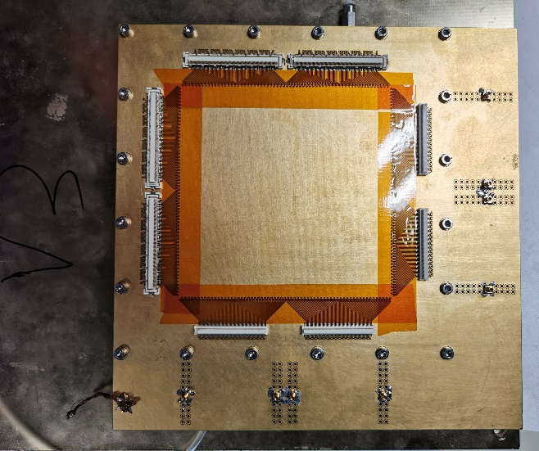
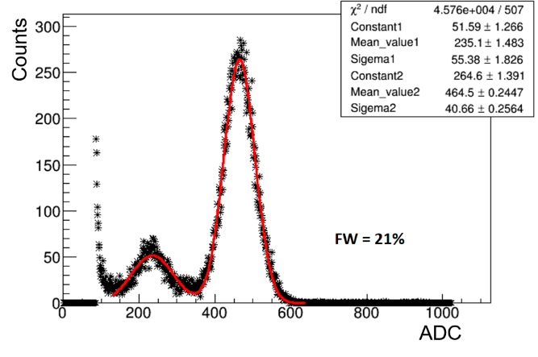
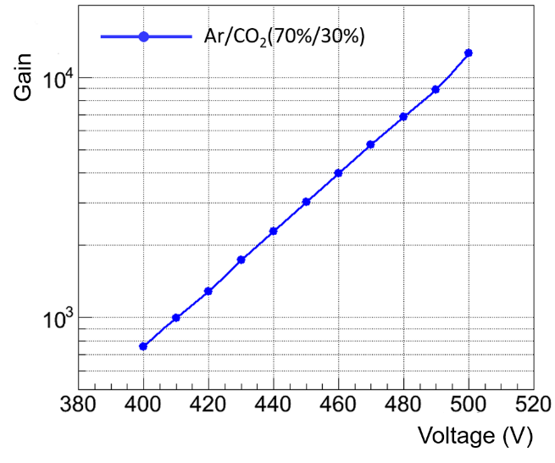
2-D μRWELL prototype
A 2-D μRWELL detector prototype was designed and fabricated.
It is composed of a drift cathode and a μRWELL PCB which are fixed in a frame.
Drift region： 3 mm
The μRWELL detector prototype was fully tested with X-rays/moun beam in Ar/CO₂ (70%/30%) gas mixture.
μRWELL prototype
8 keV Cu X-rays
Energy resolution: 21% @8keV X-rays
Gas gain: 1.4×10⁴ @500V

Slide 16
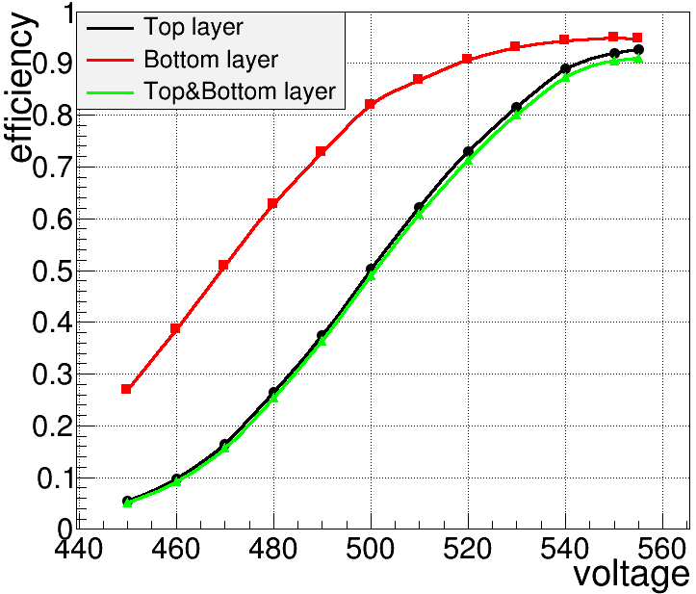
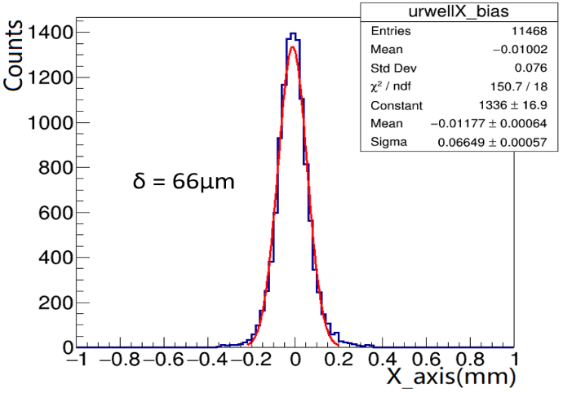
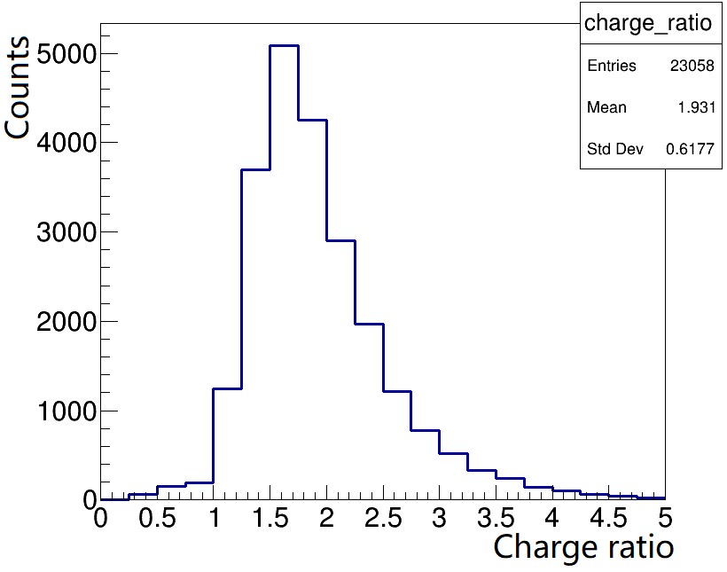
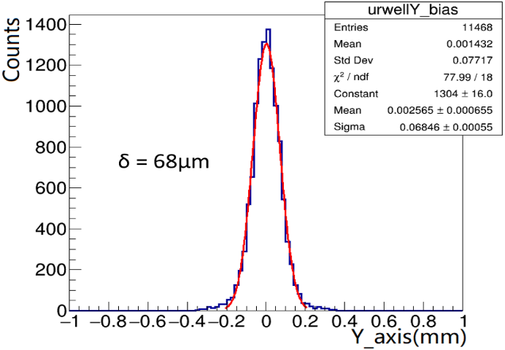
Efficiency & position resolution
Detection efficiency VS Voltage
Top layer: ~95%, Bottom layer: ~92%
Top & Bottom efficiency: ~90%
Top induced charge is 1.9 times of Bottom
Position resolutions: Charge-weighted center of gravity method.
Position resolution better than 70 μm achieved on both readout directions.
Bottom layer
Top/Bottom charge
Efficiency vs Voltage
Top layer

Slide 17
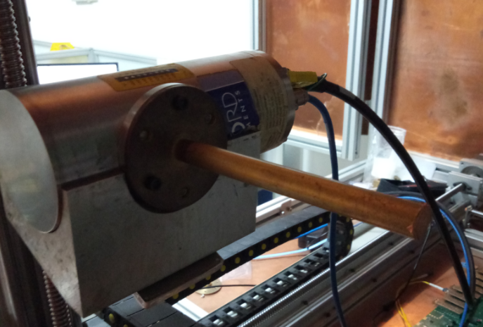
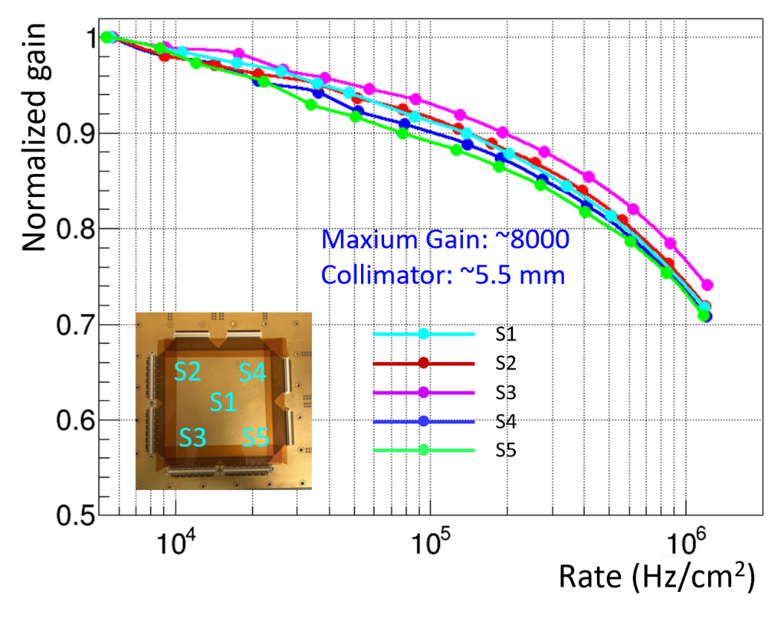
Rate capability
The rate capability is assessed by measuring the detector gain as a function of counting rate per unit area.
X-ray gun
Source: 8keV Copper x-ray
Collimator: 5.5mm-diameter
Normalized gain vs. Rate at different region
Gain decreases about 10% @100 kHz/cm². Gain drop is still modest (<30%) @1 MHz/cm² .
The charge spreads on the DLC resistive electrode, inducing a current flowing through the resistive layer, generating a localized drop of the amplifying voltage, decreasing the gain.

Slide 18
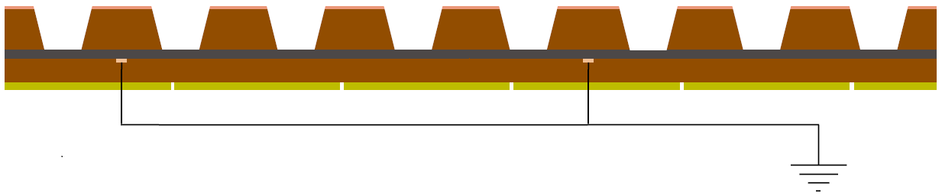
High-rate μRWELL solution
Two types of high-rate μRWELL solution are presented based on copper-coated DLC resistive electrode.
Solution1: 1-DLC layer μRWELL with fast grounding lines.
Solution2: 2-DLC layers μRWELL by SBU (Sequential Build Up).
5% Dead area
12mm
The copper clad on the DLC coating is etched to dash lines (100 μm width) and grounded, the electrons accumulated on DLC electrode can release faster.
Reduce the path of the current on the DLC surface by implementing the first matrix of conductive vias connecting two stacked resistive layers. The second matrix conductive vias connects the second resistive layer to ground through the readout electrodes.

Slide 19
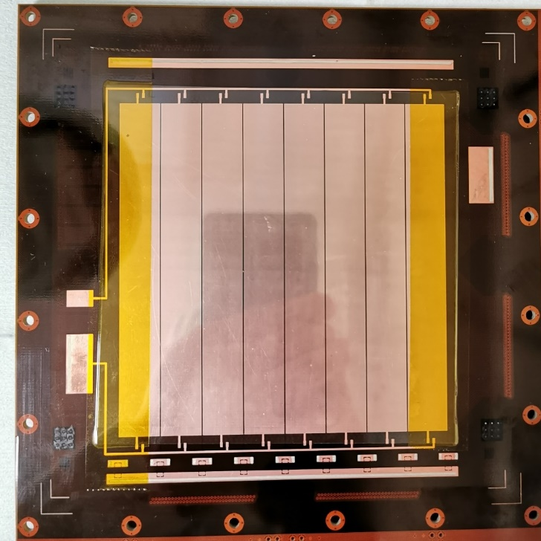
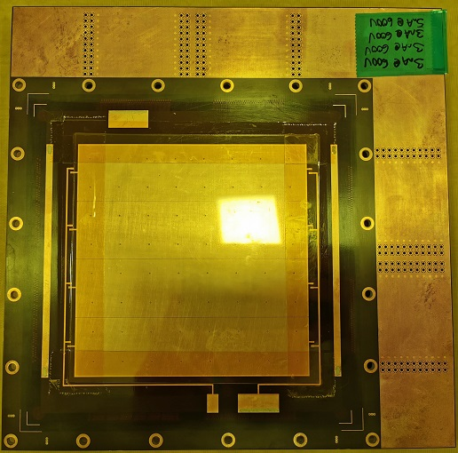
High-rate μRWELL PCB
1-DLC layer
2-DLC layers
Grounding line
DLC
Copper
  Two different high-rate μRWELL prototype have been designed and fabricated.
  These μRWELL prototype are tested in Ar/CO₂ (70%/30%) gas mixture, showing a good response to X-rays, but a lower gas gain (~1000).
Lower resistivity of DLC resistive electrode, weak suppress to discharge, lower gain.
We are in close collaboration with Rui from CERN to optimize these detectors.

Slide 20
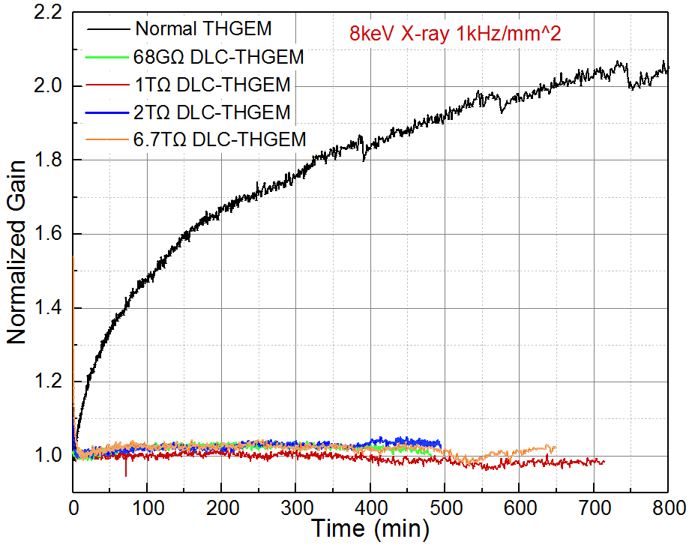
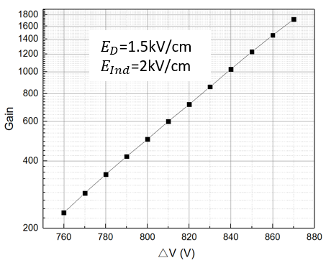

Charging-up free THGEM
DLC is deposited on the dielectric surface of THGEM foil, in attempt to remove charging-up effect.
$$I_{i}$$
Copper
PCB
DLC
DLC THGEM
Gain vs. voltage
Gain vs. time
The long term charging-up effect of DLC-THGEM is removed.

Slide 21
Summary
Performance and production process of DLC, as high quality resistive materials, have been studied based on magnetron sputtering technique.
Surface resistivity: 1MΩ/□~100MΩ/□ @a-C MΩ/□~ TΩ/□ @a-C:H
Resistivity uniformity: <15% @15cm×15cm <25% @25cm×25cm
The characterization of a 2-D readout μRWELL based on DLC resistive electrode are performed.
Gas gain: >10⁴ 2-D position resolution: <70 μm @3mm drift region
2-D detection efficiency: >90% @3mm drift region
Rate capability: Gain drop 10% @100 kHz/cm², 30% @1 MHz/cm²
Two different types of high-rate μRWELL based on copper-coated DLC and the DLC-THGEM for charging-up free are presented too.
Next step
Exploring the larger DLC sample with new sputtering system (Hauzer 850).
Optimizing the high-rate μRWELL prototype.

Slide 22
BACKUP

Slide 23
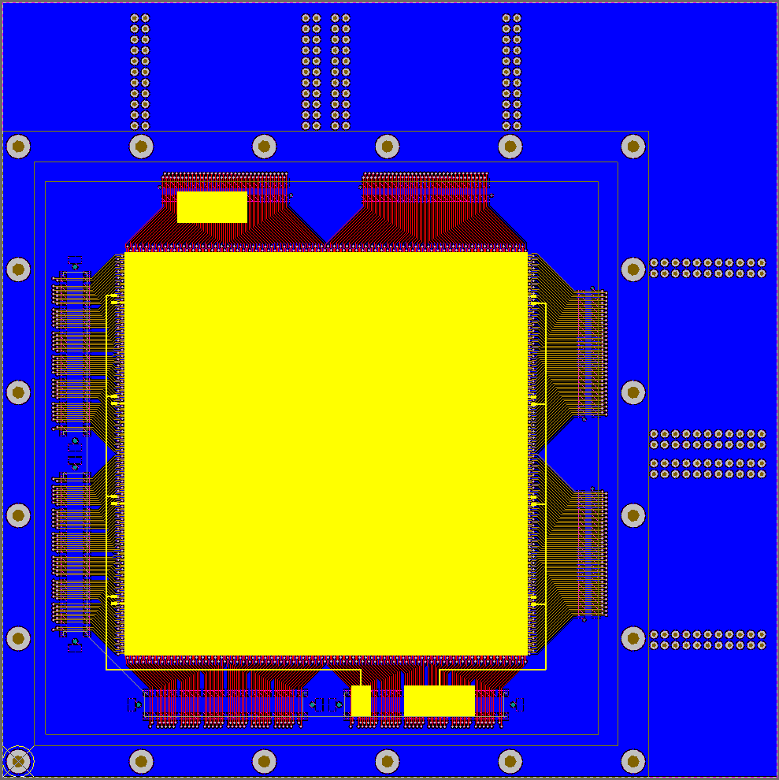
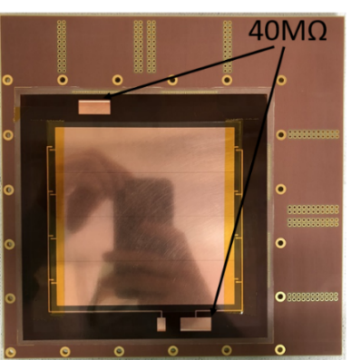
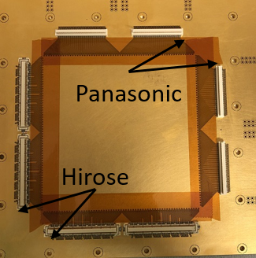
2-D μRWELL PCB
A 2-D μRWELL PCB with 15cm×15cm a-C DLC was designed and fabricated.
Readout strip pitch: 400 μm
Top layer: 80 μm
Bottom layer: 350 μm
Readout strip channel: 512
Distance (Top to Bottom layer): 50 μm
Schematic of μRWELL PCB
Sensitive area:
10cm×10cm divided into 4 sectors
Well pitch: 140 μm
Pre_preg (50 μm) isolate the DLC electrode from readout strip
μRWELL PCB
All the readout strips are connected to 4 HIROSE (for laboratory test) and 4 PANASONIC (for beam test) connectors.

Slide 24
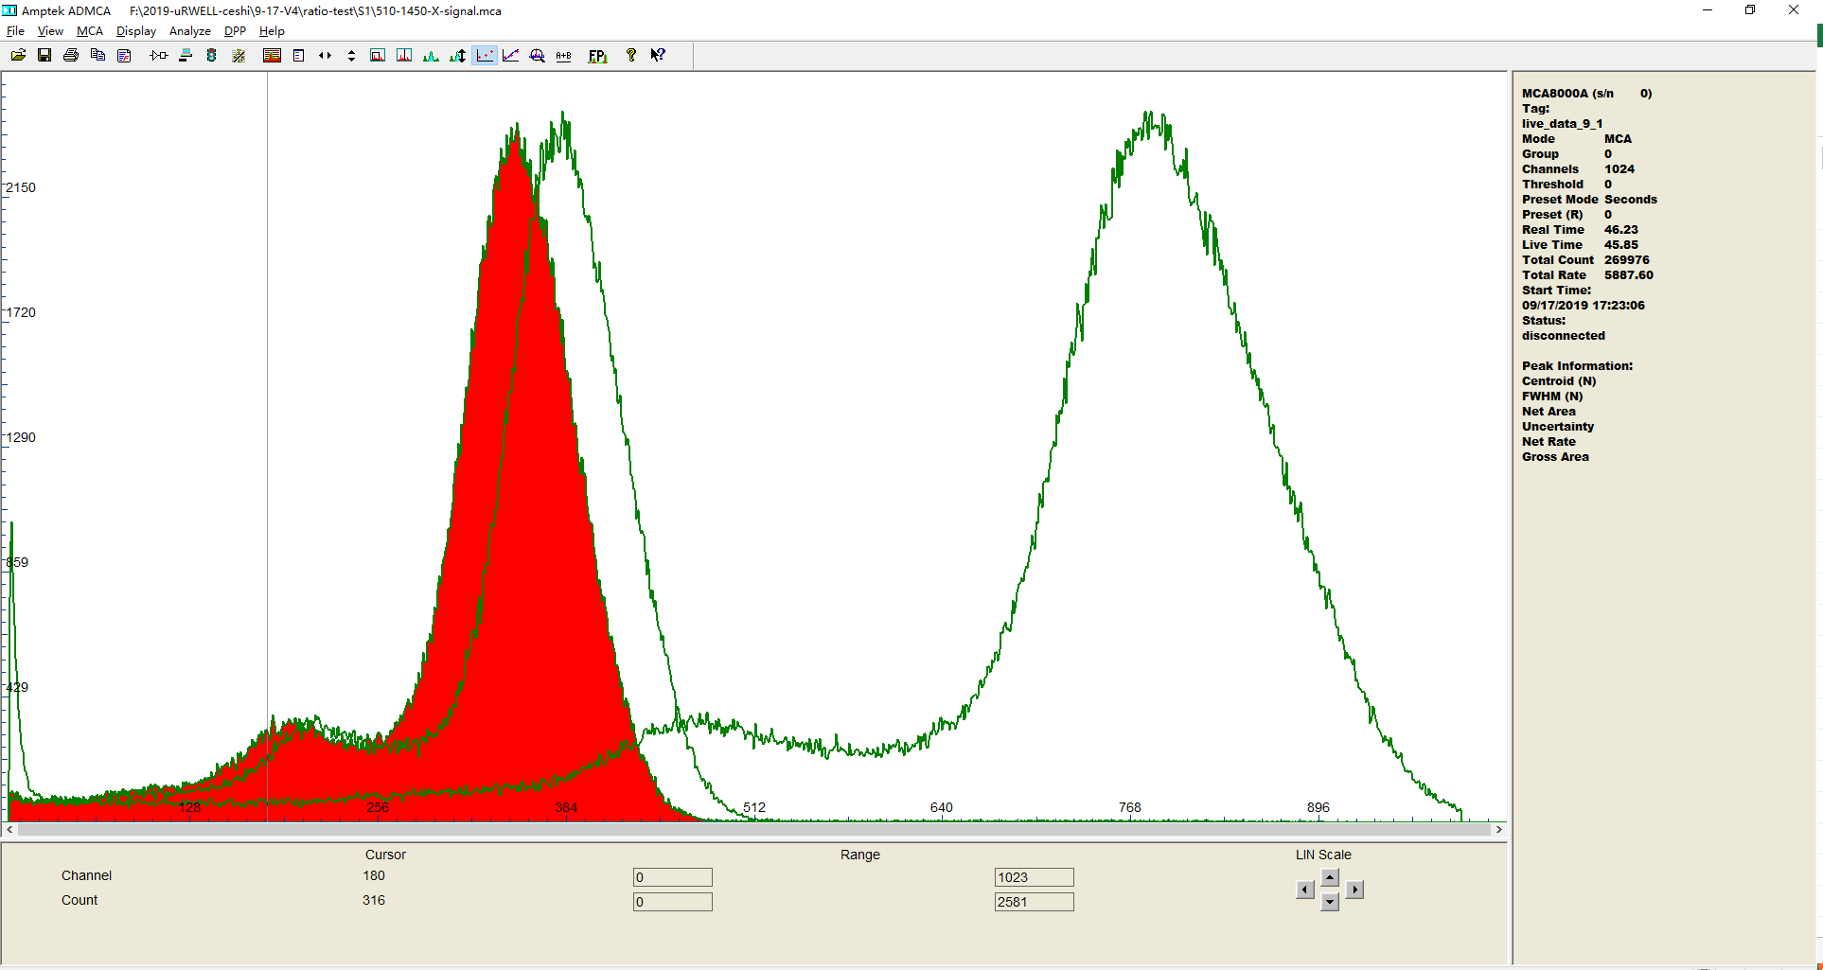
Optimization of 2-D readout strip
Achieving an equivalent induced signal on the 2-D readout strips.
Detector’s geometry & Electric field map are resolved by ANSYS.
Induced signal is exported from GARFIELD++ by simulating single electron avalanching.
Before
Top layer: 80 μm
Bottom layer: 350 μm
Distance : 50 μm
Top layer
Bottom layer
Copper
NOW
Top layer: 60 μm
Bottom layer: 350 μm
Distance : 25 μm
Spectrum after optimization of 2-D readout strip
Increase strip width of bottom layer and decrease strip width of top layer.
The energy spectrum peak of top layer almost same with bottom layer after optimization.
 | Bottom/Top | Copper/Bottom
Sector 1 | 1.09 | 2.03
Sector 2 | 1.11 | 1.95
Sector 3 | 1.14 | 2.06
Sector 4 | 1.11 | 1.95
Peak ratio in different sector

Slide 25
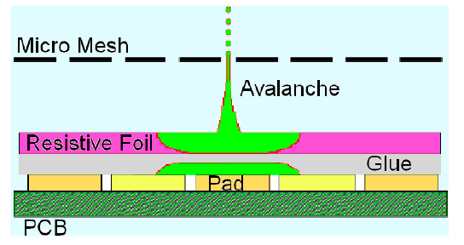
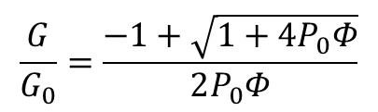
The charge spread on the DLC resistive electrode, inducing a current flowing through the resistive layer, generates a localized drop of the amplifying voltage, decreased the gain.
$$\frac{G}{G_{0}}=\frac{−1+\sqrt{1+4P_{0}Φ}}{2P_{0}Φ}$$

Slide 26
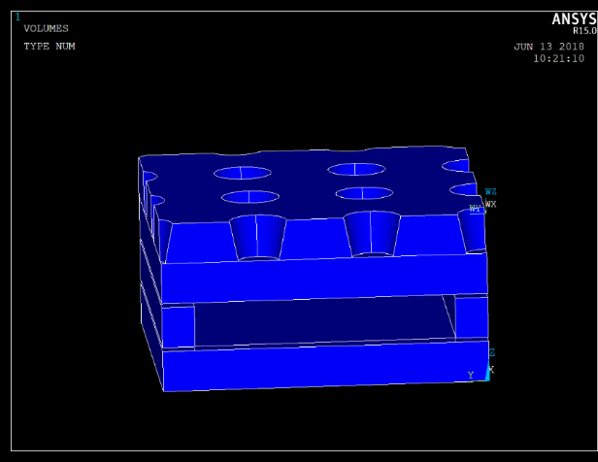
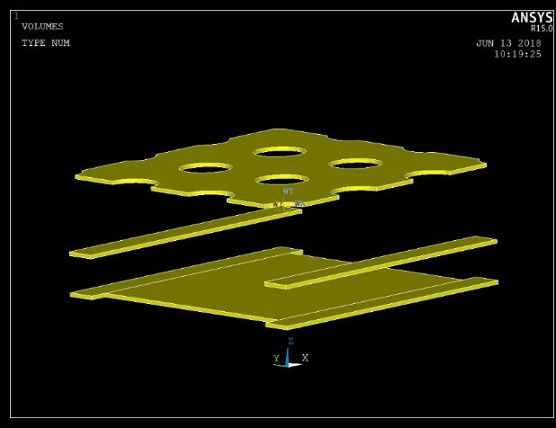
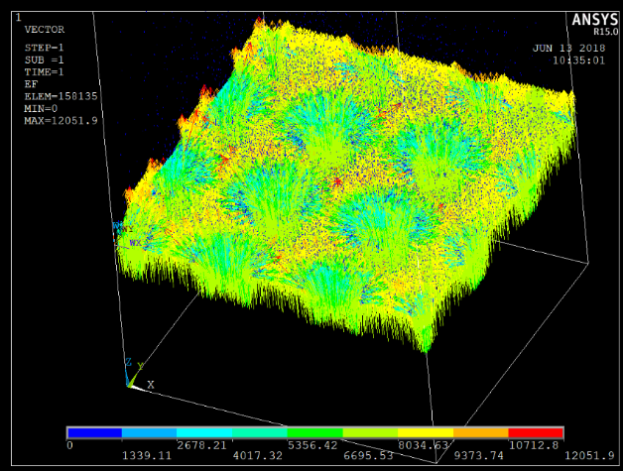
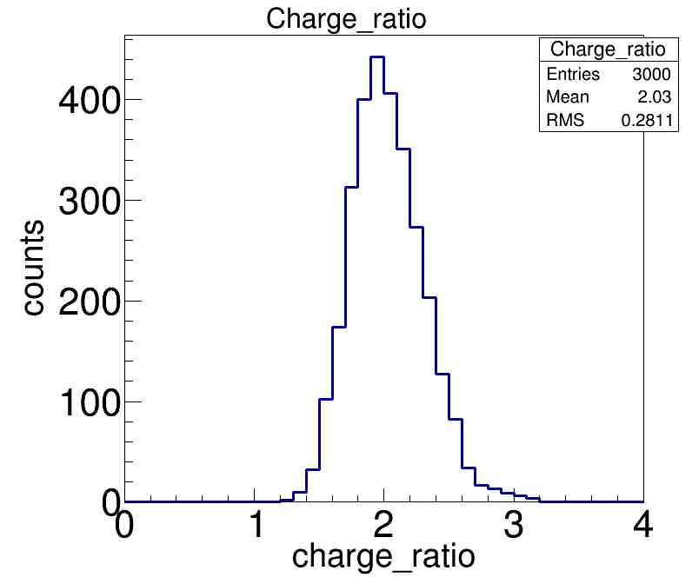
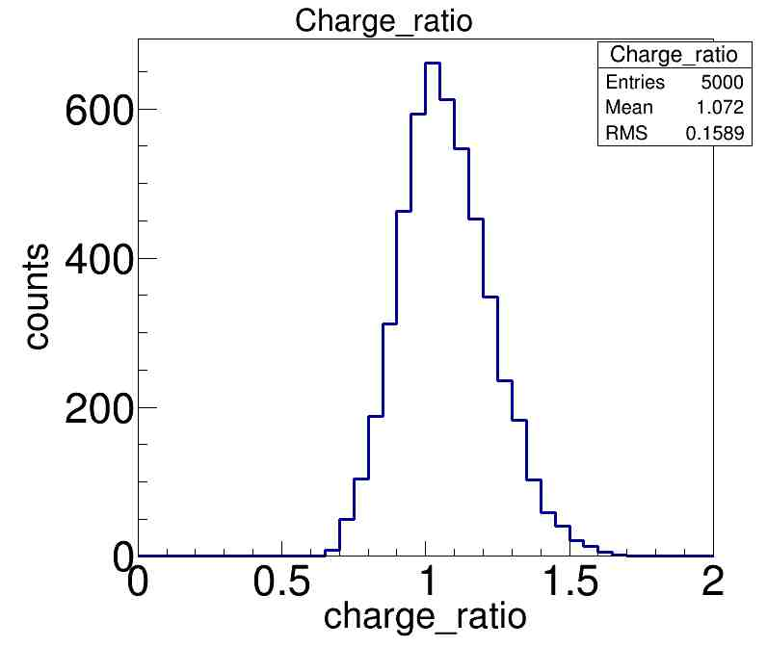
二维读出条感应信号模拟
ANSYS建模，GARFIELD++模拟电子雪崩产生感应信号
介质
读出条
电场
优化前参数:
Top layer: 80 μm
Bottom layer: 350 μm
Distance : 50 μm
优化后参数:
Top layer: 60 μm
Bottom layer: 350 μm
Distance : 25 μm
优化前
优化后

Slide 27
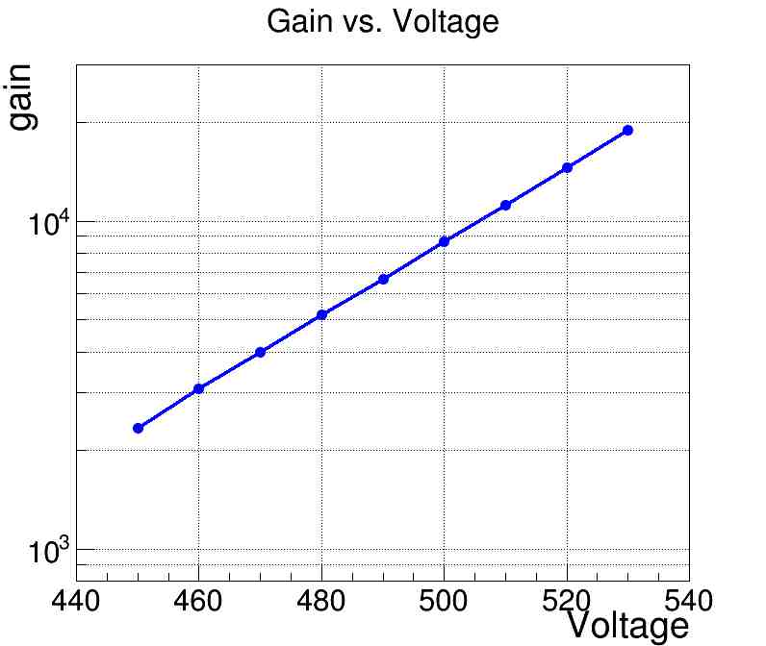
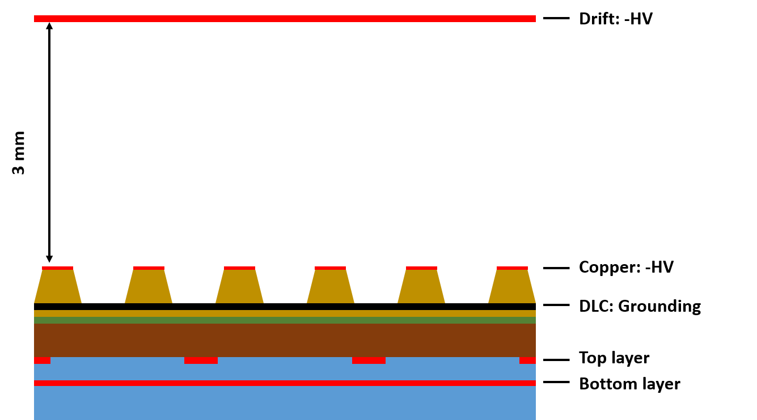
优化后测试结果
Ar/CO2=70/30 8 keV copper X-rays
Top layer
Bottom layer
Copper
Gain
Sector 1能谱
 | Bottom/Top | Copper/Bottom
Sector 1 | 1.09 | 2.03
Sector 2 | 1.11 | 1.95
Sector 3 | 1.14 | 2.06
Sector 4 | 1.11 | 1.95
Energy spectrum peak at different sector

Slide 28
