Slide 1
DMM & TMM: the Double and Triple Micro-Mesh gaseous structures for ultra-low ion-backflow applications
Zhiyong Zhang
For the USTC MPGD group
State Key Laboratory of Particle Detection and Electronics, China
University of Science and Technology of China
CEPC 2019, Beijing
Nov.18, 2019

Slide 2
Outline
  Motivation
Double Micro-Mesh gaseous structure
  Design and Fabrication
  Performance Characterization
  Optimization for further IBF suppression
  Triple Micro-Mesh gaseous structure
    Design and performance study
  Summary

Slide 3
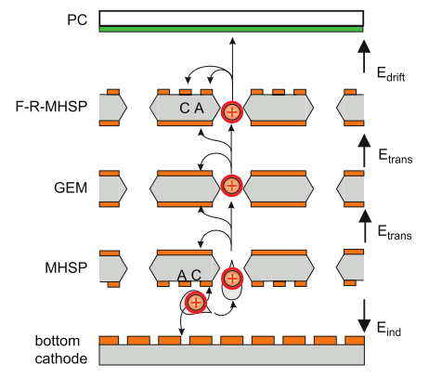
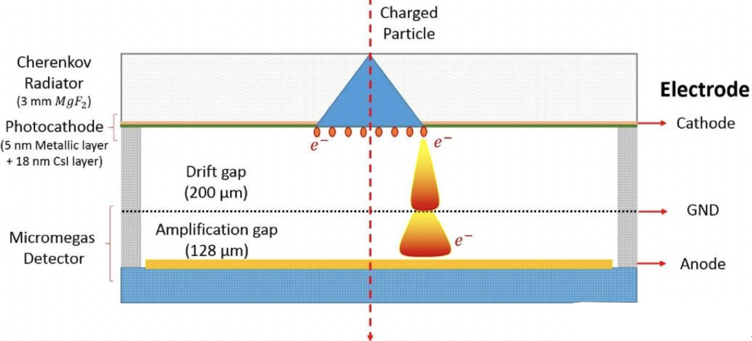

  Motivation : GPD
  Gaseous Photon Detectors (GPD) with MPGD
    large area, high spatial and timing resolution, resistant to magnetic field, IBF suppression, low cost …
  Challenges
    High gain: to be sensitive to single photons
    Very low IBF
F-R-MHSP+GEM+MHSP
UV light：CsI，~mC/cm²
Visible light：Bi-alkali, ~μC/cm² ！
Gas-PMT
IBF: $\sim$0.03%
Complex structure
PIC-SEC
A. Lyashenko et al. , NIM A 598(2009) 116-120

Slide 4
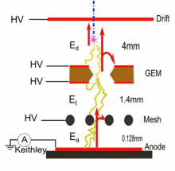
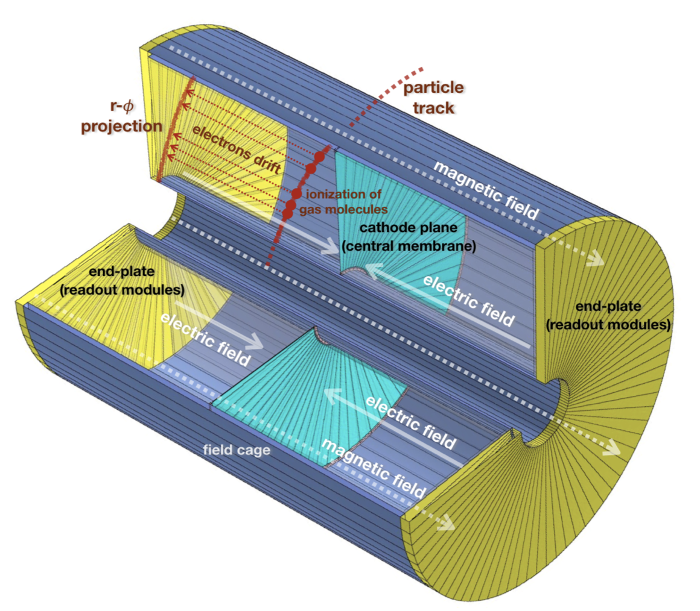
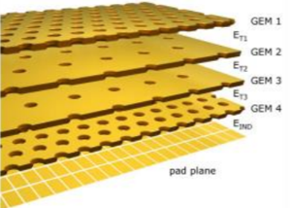
  Motivation: TPC
  Application of TPC in high-rate environments: ALICE upgrade, ILD, CEPC …
    Very low IBF is the key: to minimize drift field distortion caused by ion space charge
    Continuous readout to keep up with high event rate
ALICE
CEPC
Quadruple GEM, IBF < 1%
GEM+MM, Gain×IBF<~5
IBF <~ 0.1% required
MPGD is the only solution so far. The IBF still need to be further reduced.

Slide 5

DMM Design
DMM: Double Micro-Mesh gaseous structure
Hole-type → mesh-type : to strongly reduce IBF
Double mesh: cascading avalanche for high gain
“Piggyback”
Drift region
~3-5 mm
PA
~0.2 mm
SA
~0.1 mm
Stacked two meshes
Gap between the stacked meshes: 200-300um, serving as pre-amplification (PA)
Gap between the bottom mesh and anode: 50-100um as secondary amplification (SA)
Allows to achieve very high gain, and yet significantly reduce ion back-flow.

Slide 6
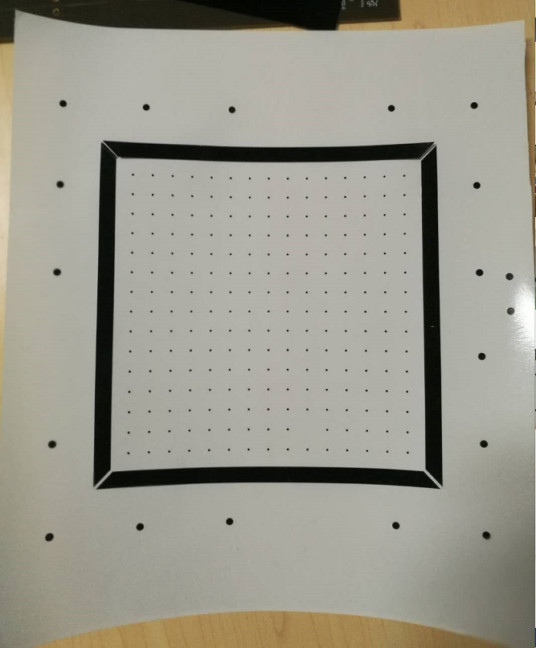
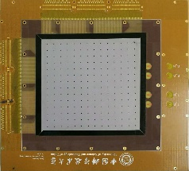
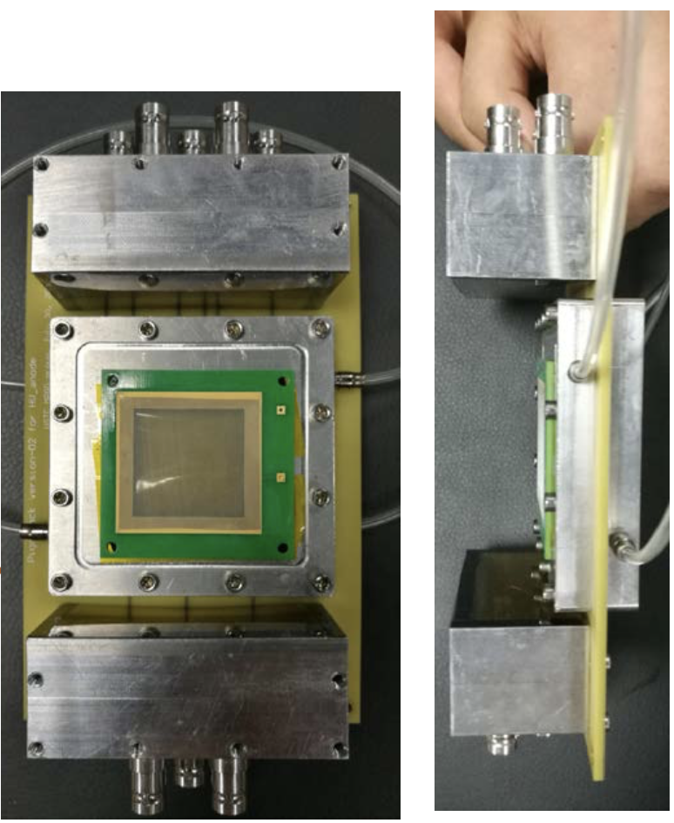
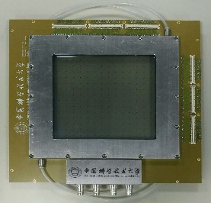
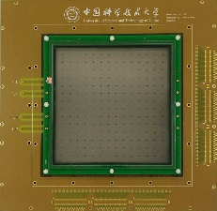
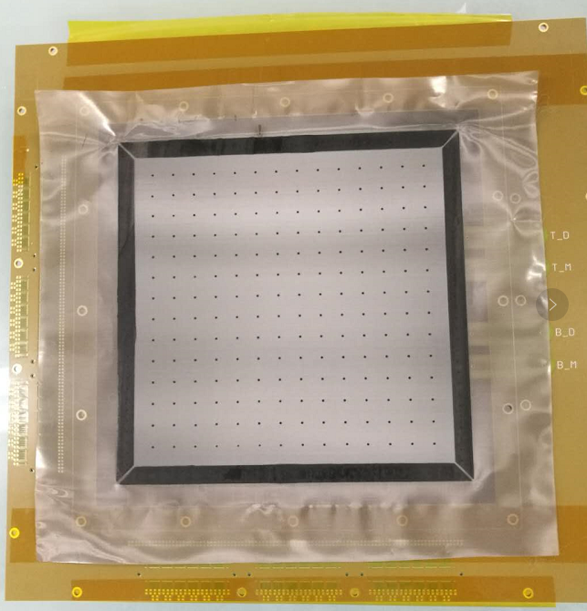
DMM Fabrication
  DMM is fabricated with the thermal bonding technique that has been developed at USTC.
  Micromegas fabrication process with thermal bonding technique
  A 2.5cm×2.5cm DMM prototype
Transferred to PCB by pre-heating
Φ1mm spacer
10mm spacer pitch
150mm×150mm
Thermal bonding
Assembling
Cutting mesh
More details:
Thermal bonding method for fabricating Micromegas detectors and its applications (arXiv:1910.03170）
A Thermal-Bonding Method for Fabrication of Micromegas and its applications, MPGD2019, 5-10 May 2019, La Rochelle, France.

Slide 7
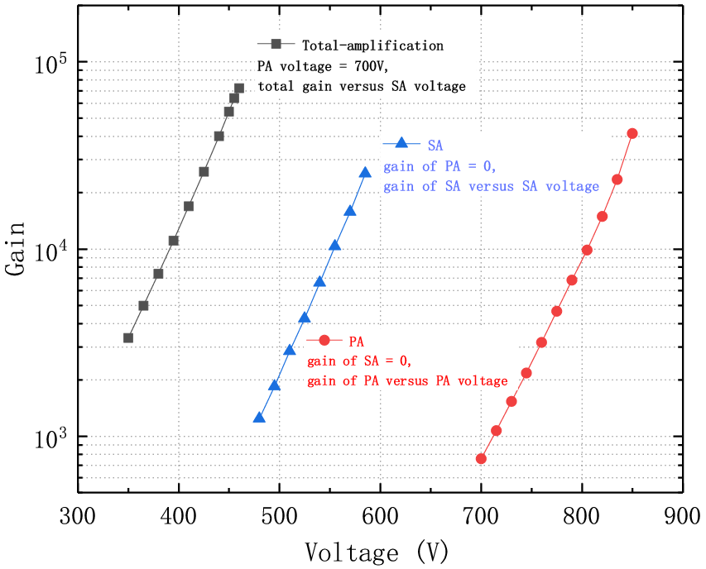
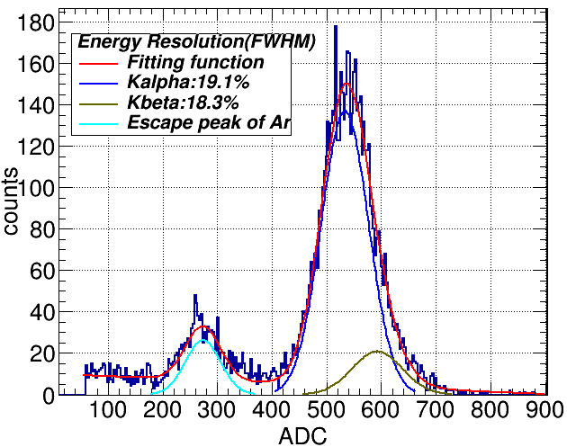
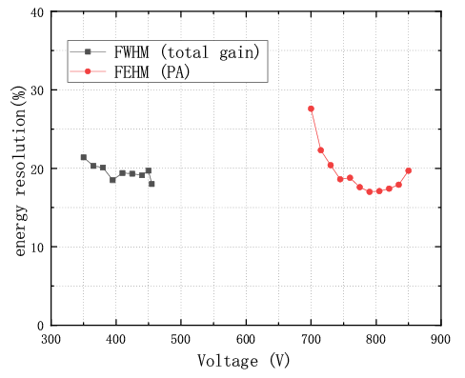
Gas Gain and Energy Resolution with ⁵⁵Fe
Gain: PA, SA and combined
A typical ⁵⁵Fe energy spectrum
PA+SA
SA alone
PA+SA
19.1%
PA alone
Combined gain can reach up to 7×10⁴ for 5.9 keV X-rays.
Combined resolution remains almost constant and is close to PA-alone resolution, suggesting a close-to-full collection of primary electrons for the high-voltage configurations we used.
PA+SA
PA alone
Resolution: PA and PA+SA combined

Slide 8
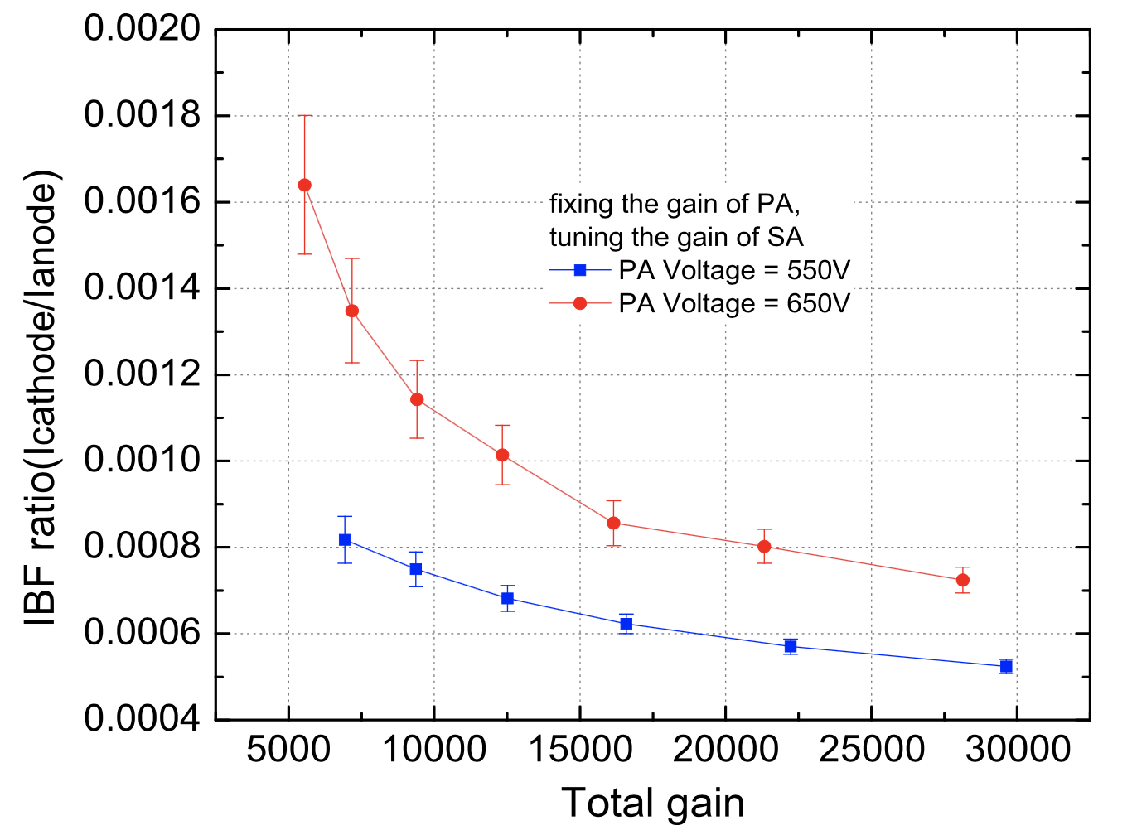
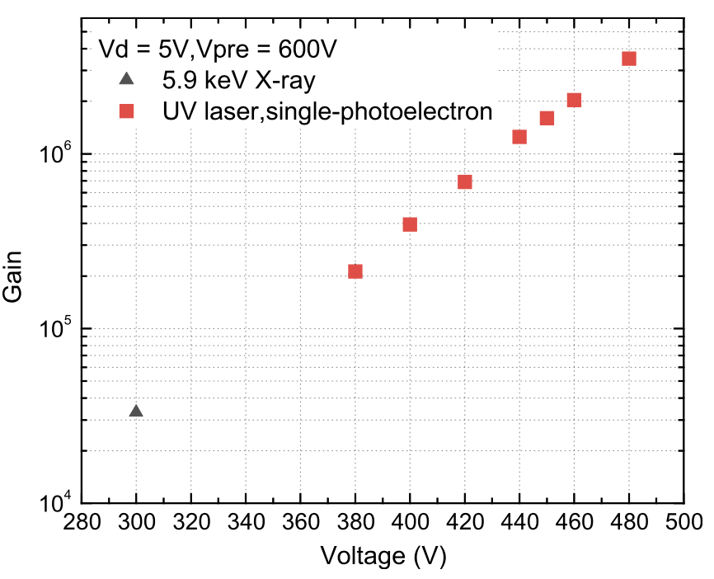
Previous results and validation
  down to 0.05% IBF
  Up to 3×10⁶ gain for single electrons
Gain measured with X-ray energy spectrum (Q_{full-energy peak}/Q_{Primary}) is consistent with I_{Anode}/I_{Primary} .
No ion space charge effect is confirmed in the DMM test.
More details:
A high-gain, low ion-backflow double micro-mesh gaseous structure for single electron detection， NIM-A , 889 (2018) 78–82.
Study on the double micro-mesh gaseous structure (DMM) as a photon detector, https://doi.org/10.1016/j.nima.2019.03.033.
https://indico.cern.ch/event/757322/contributions/3387079/attachments/1840422/3017748/DMM-MPGD2019.pdf
Also in backup slides

Slide 9
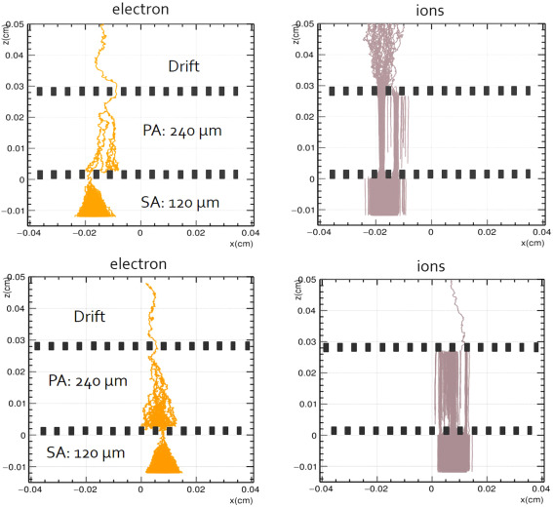
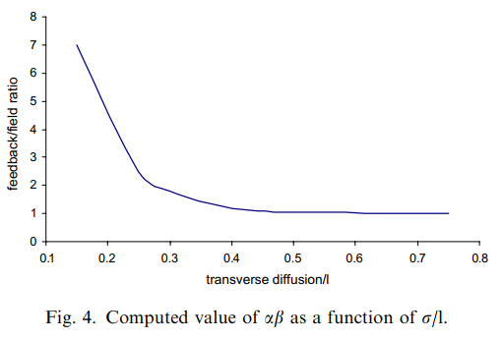
Can we further lower the IBF?
Obviously, the IBF is depend on the geometry of the detector structure, in which the alignment, density, distance etc. of two meshes can be optimized.
Colas P, Giomataris I, Lepeltier V. Ion backflow in the Micromegas TPC for the future linear collider, Nuclear Instruments and Methods in Physics Research Section A, 2004, 535(1-2): 226-230.
It suggests to increase the size of the ion cloud (σ) and decrease the mesh pitch (I)
➔To enlarge PA gap and mesh density in DMM
  Two meshes are perfectly aligned
  Two meshes are maximally mis-aligned

Slide 10
Optimization for Low IBF
  It’s impractical to make any precise alignment of the two meshes. So setting the two meshes with a crossing angle is a practical way to ensure their mis-alignment.

Slide 11
Optimization for Extremely Low IBF
PA gap: from 160 to 240 μm
500 vs. 650 LPI (same opening rate)
Larger gap increase the transverse diffusion of avalanche
Higher mesh density decrease the mesh pitch
Both of these increase the σ/l value, optimizing the IBF as a consequent.

Slide 12
Optimization Outcome For DMM
To push IBF down to an extremely low level:
low PA electric field
large PA gap
high mesh density
crossing mesh setting
A IBF ratio down to ~0.025%, which has been improved with a factor of 2 compared with that before optimization.

Slide 13
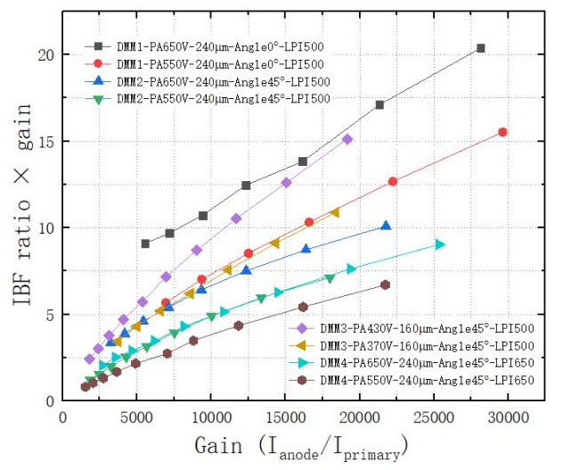
Optimization Outcome for DMM
Define IBF ratio ×gain as ε:
ε = 5
This result fulfill the requirement of ε < 5 in the R&D of CEPC TPC， even operated in higher gain of >10000 is possible to improve the S/N.

Slide 14
Can the IBF be lower?
For the case of DMM, when we set PA at 550V and switch off SA, the I_{drift}/I_{primary} was measured at ~1.3
Drift cathode (0V)
➔It means that the PA only contributes ~0.3 for the ε factor, the SA dominates the total IBF
Pre-mesh (+HV)
Sec-mesh (+HV)
Anode (same to Sec-mesh)
So, adding another mesh on the DMM to suppress the SA ions is a easy option.
➔Let’s go to TMM

Slide 15

TMM Design
TMM: Triple Micro-Mesh gaseous structure
One more mesh on the DMM
More stable gain, lower IBF from second avalanche…
Drift region
~3-5 mm
“Piggyback +”
PA
~0.2 mm
SA
~0.2 mm
TA
~0.1 mm
Stacked three meshes
Gap between the 1st and 2nd meshes: 200-300um, serving as pre-amplification (PA)
Gap between the 2nd and 3rd meshes : 200-300um as secondary amplification (SA)
Gap between the bottom mesh and anode: 50-100um as secondary amplification (TA)

Slide 16
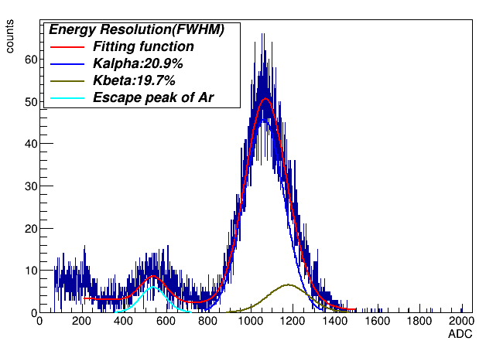
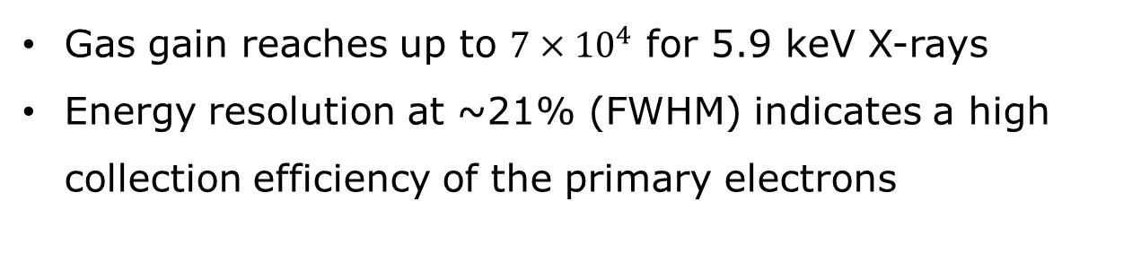
Gain and energy resolution
Gas gain reaches up to $7×{10}^{4}$ for 5.9 keV X-rays
Energy resolution at ~21% (FWHM) indicates a high collection efficiency of the primary electrons

Slide 17
IBF measurement for TMM
ε = ~0.3
~0.003% IBF
    The back-flow ions (at ε = ~0.3) is mainly from PA, concluding that the IBF can not be further reduced by adding more meshes, the TMM reaches the lowest IBF level for the mesh-type structure.

Slide 18
To optimize
    Combined gain = PA gain × SA trans × SA gain × TA trans × TA gain
Drift region
PA
SA
TA
PA and TA voltages are fixed at 650V and 530V, this plot shows the combined gain changes with the variation of SA voltages

Slide 19
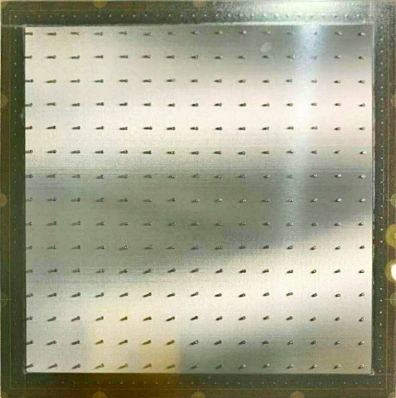
Towards large area
It is a crucial issue for the DMM (TMM) is to make a large area for real experiments
Bulk etching method does not work well in the DMM due to the large thickness of 100um (SA) + 200um(PA) regions, but it will not be a problem for the thermal bonding method
Spacer setting
Mesh bonding
UV light exposure
Spacer setting
Mesh bonding
A 150mm ×150mm DMM prototype is fabricated and under testing…
Bulk etching
Thermal bonding

Slide 20
Summary
Developed the DMM &TMM featuring high gain and low IBF
Demonstrated the performance of DMM &TMM with small-size prototypes:
  Gain: 7×10⁴ for 5.9 keV X-rays and 3×10⁶ for single electrons.
  IBF ratio: down to ~ 0.03% for DMM, ~ 0.003% for TMM
  Verified the feasibility of fabricating large area detectors
Potential applications
  Gaseous photon detectors
  High-rate TPC readout
  Many others…

Slide 21
Summary
Developed the DMM &TMM featuring high gain and low IBF
Demonstrated the performance of DMM &TMM with small-size prototypes:
  Gain: 7×10⁴ for 5.9 keV X-rays and 3×10⁶ for single electrons.
  IBF ratio: down to ~ 0.03% for DMM, ~ 0.003% for TMM
  Verified the feasibility of fabricating large area detectors
Potential applications
  Gaseous photon detectors
  High-rate TPC readout
  Many others…
Thank you!

Slide 22
Back-up

Slide 23
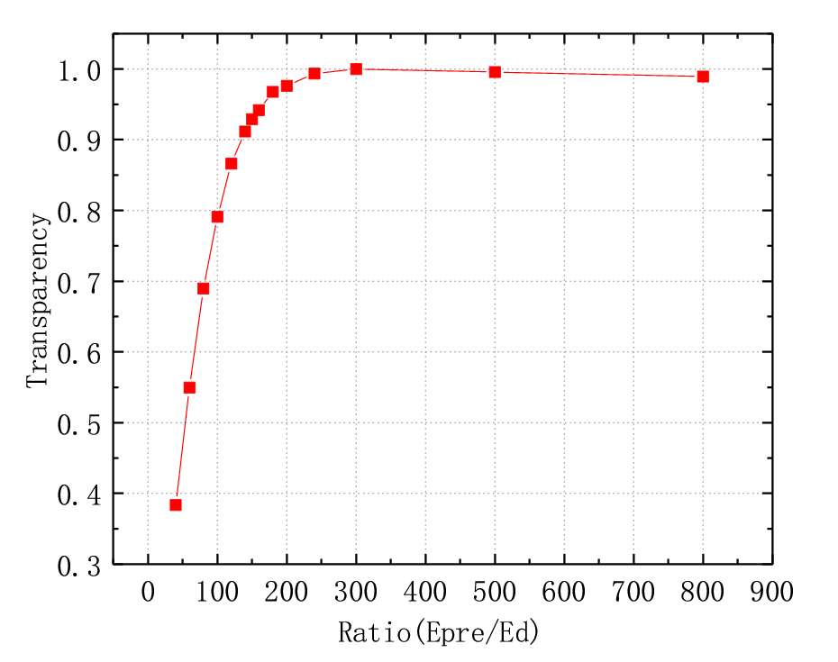
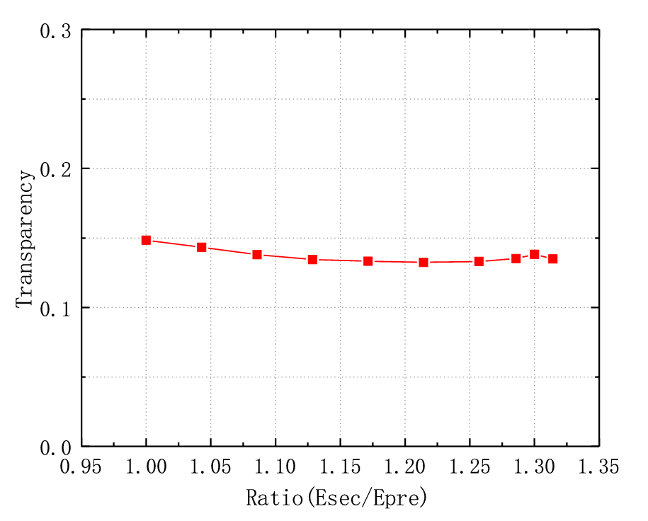
Electron Transparency
  Transparencies for electrons passing through PA and SA meshes are extracted by measuring PA, SA and total (PA and SA combined, DMM) gas gains
    Combined gain = PA gain × SA trans × SA gain
PA relative transparency
SA transparency
E_{PA}/E_{drift} is set to 200 to maximize transparency most of the time.
SA trans ~ 15% @ E_{SA}/E_{PA} ~ 1

Slide 24
Ion Back-Flow (IBF) Measurement
IBF ratio = (I_{Drift} - I_{Primary})/I_{Anode}
I_{Drift,} I_{Primary(no avalanche)}
I_{Anode}
Drift cathode (0V)
Drift cathode (-HV)
Pre-mesh (+HV)
Pre-mesh (-HV)
Sec-mesh (+HV)
Sec-mesh (-HV)
Anode (+HV)
Anode (0V)
Keithley (6482) Picoammeter with ~10-fA resolution in a range of ±20 nA

Slide 25
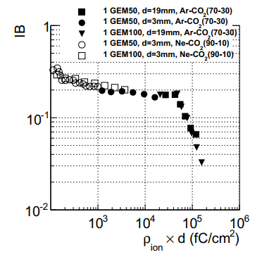
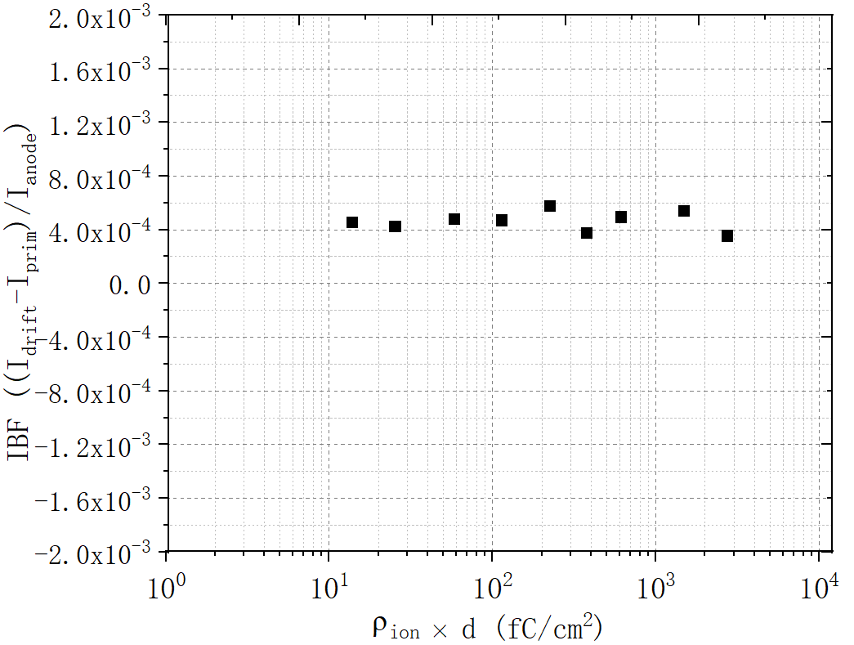
Ion Space-Charge Effect
M Ball et al 2014 JINST 9 C04025
Conditions for our IBF measurement
Single GEM
  Our IBF measurements are reliable in terms of ion space-charge effect (impact is negligible).

Slide 26
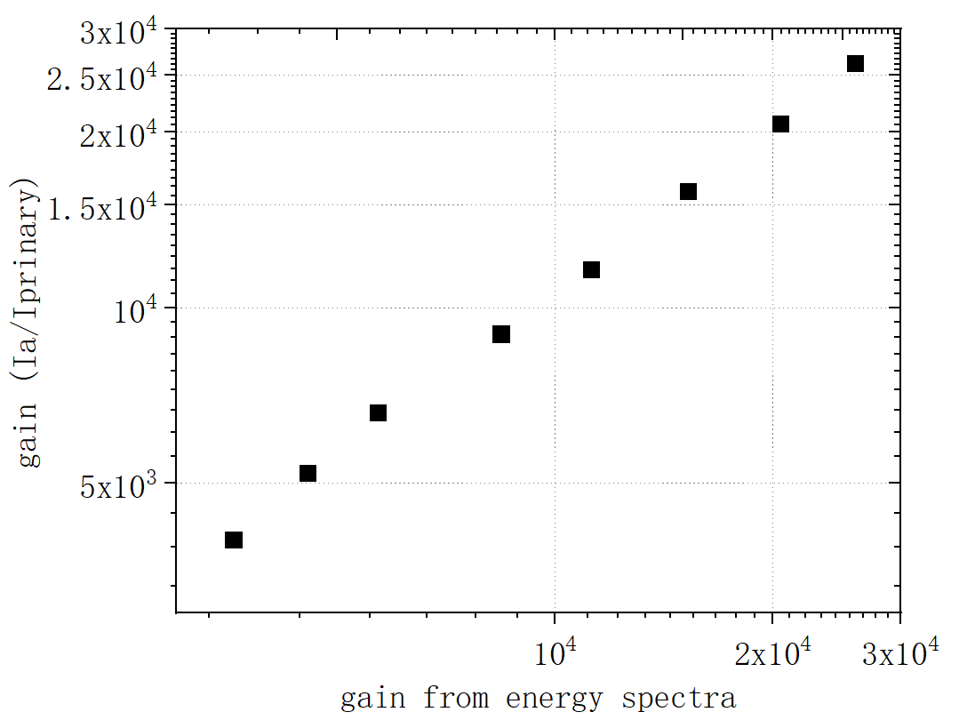
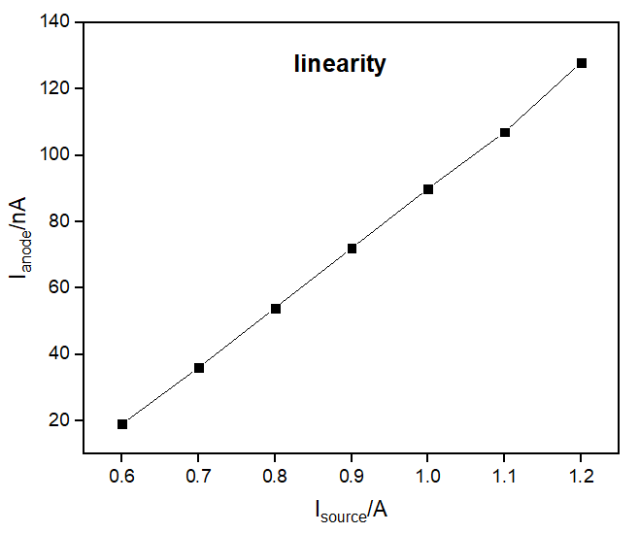
Validation of IBF Measurement
Q_{full-energy peak}/Q_{Primary}= I_{Anode}/I_{Primay}
no gas gain saturation
Gain measured with X-ray energy spectrum (Q_{full-energy peak}/Q_{Primary}) consistent with I_{Anode}/I_{Primay}
I_{Anode} stays proportional to X-ray intensity in a rather wide range, suggesting no gas gain saturation in the IBF measurement.
IBF ratios measured with 55Fe and X-ray tube are consistent

Slide 27
Performance Characterization
  DMM with Ar (93%) + CO₂ (7%)
    Electron transparency
    Energy resolution and gas gain
    Ion back-flow ratio
  DMM with Ne (80%) + CF₄ (10%) + C₂H₆ (10%)
    Single photon electron response
Drift region
3 mm
Mesh specs
500 LPI, 27um thick, 40% opening rate
PA
0.24 mm
SA
0.12 mm

Slide 28
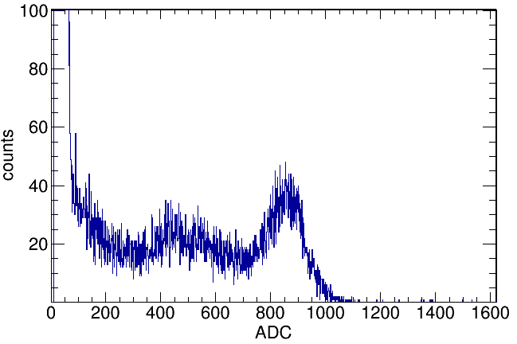
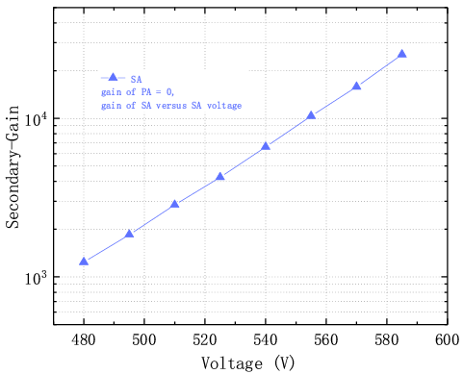
Sec-amplification (SA)
Drift (-HV )
~240um
~120um
Avalanche (-HV)
Anode (0V)
Full energy peak due to the lateral angle photoelectrons and Auger electrons
Gain VS avalanche voltages
The transparency should be similar to PA’s, since their have the same mesh type.
up to 2ᵡ10⁴

