Slide 1
Polarization issues in circular electron-positron supercolliders
Sergei Nikitin
BINP SB RAS, Novosibirsk
The 2019 International Workshop on the High Energy
Circular Electron Positron Collider
IHEP, Beijing
18-20 Nov 2019

Slide 2
Conditions under which radiative transverse self-polarization
in collider rings reaches required degree within reasonable time:
-- speeding up radiative polarization process
-- depolarization factors
-- spin harmonic matching
Comparison of projects with known precedent:
CEPC and FCCee vs LEP
Alternative possibility of obtaining polarization:
acceleration of polarized particles in booster
Longitudinal polarization:
search for convenient opportunities
Main points
non-resonant spin diffusion
resonant spin diffusion

Slide 3
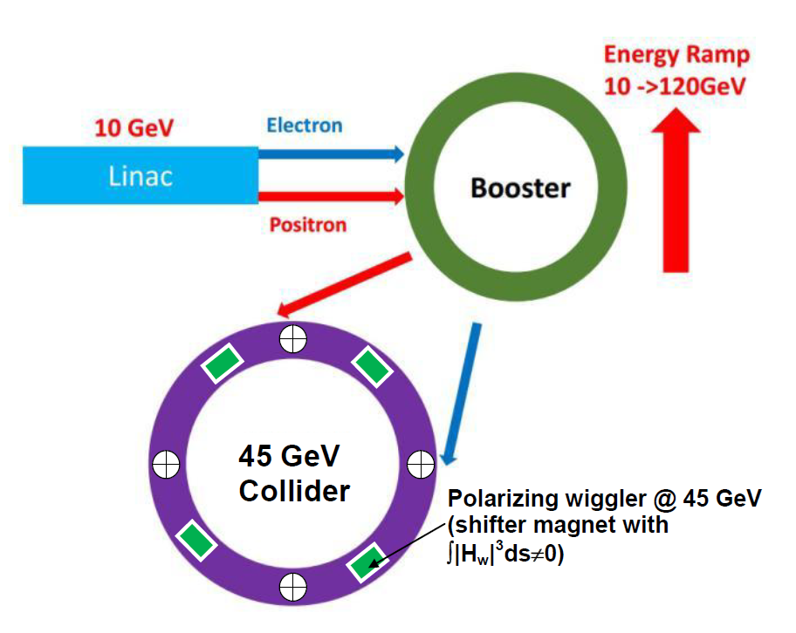
Radiative self-polarization in CEPC
Sokolov-Ternov time of polarization
in CEPC is huge:
260 hrs at 45 GeV!
At 80 GeV, this time falls as (45/80)⁵
to 15 hrs.
45 GeV FCCee: 250 hrs
45 GeV LEP: 5 hrs
Long-known tool:
special wigglers
amplify polarizing
effect of storage ring magnetic field!

Slide 4
Wigglers to speed up polarization at CEPC
Shifter magnet
While using laser polarimeter for RD technique it is enough to ensure polarization degree about of 10%. It may require about 2-4 hours to achieve such a level, if appling shifter magnets.

Slide 5
Radiative polarization in real storage ring
(Derbenev-Kondratenko )
“Shake” of precession axis due to quantum fluctuations→ “non-resonant” spin diffusion growing nearby spin resonances, main depolarization factor in storage rings as long as spin tune spread is much less than distance to closest dangerous resonances

Slide 6
Depolarization factor with synchrotron modulation
G=P/P₀=P/0.92

Slide 7
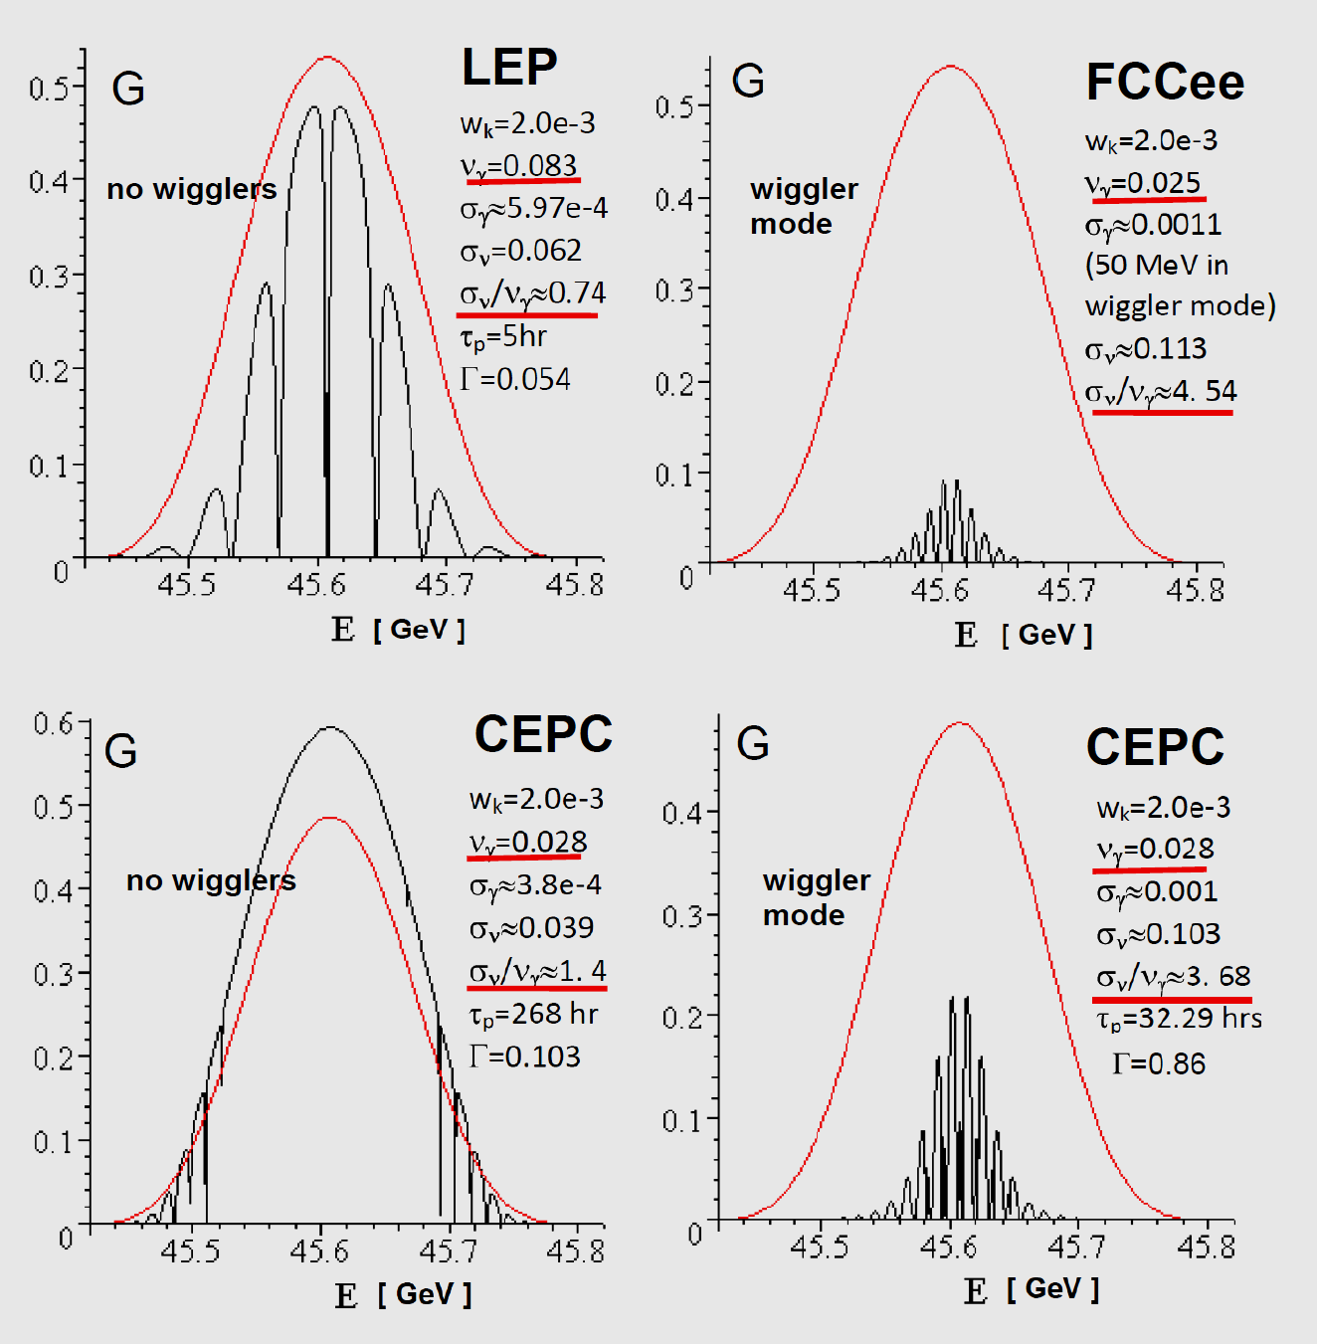
Comparison of CEPC, FCCee and LEP at 45 GeV
All is at the same amplitude of spin harmonic
LEP at left: w/o wigglers
←
FCCee at right: with 50 MeV energy spread due to wigglers
|w_{k}|=2⋅10⁻³
CEPC at left: good conditions for conservation of
polarization in luminosity mode (wigglers ‘off’)
←
CEPC at right: wiggler mode, equilibrium polarization is noticeably decreased
Only harmonics k=103 and k+1=104 are ‘on’
with assumption |w_{k}|= |w_{k+1}|

Slide 8
Comparison of CEPC, FCCee and LEP at 45 GeV
In given wiggler mode examples,
FCCee loses to CEPC due to higher spin tune spread (.113 vs .103) as well as modulation index (4.54 vs. 3.68).
Index=spread/synchrotron tune.
FCCee has lower synchrotron tune (0.025 vs 0.028).
The lower the modulation index,
the higher the degree of equilibrium polarization!
Therefore,
a higher synchrotron tune and a lower energy spread are beneficial
|w_{k}|=2⋅10⁻³

Slide 9
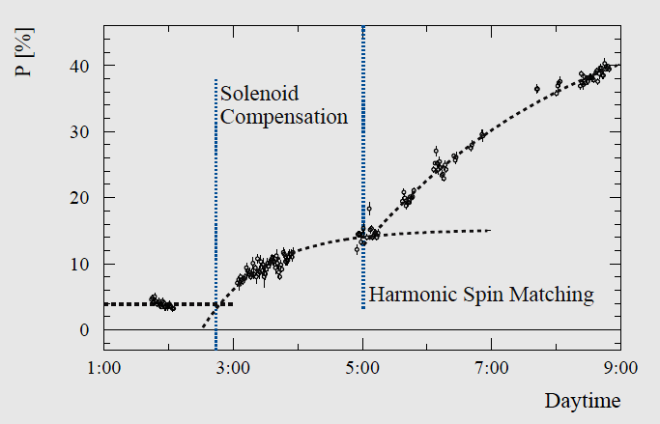
Expectations vs observation: LEP experience at 45 GeV
45 GeV LEP polarization benefited from Spin Matching techniques
Polarization (%)
It is important to reduce the resonant harmonic amplitudes in orbit distortions down to level |w_{k}| ≤10⁻³ using special orbit bumps or global correction. There was positive experience of LEP team: polarization
was improved to more than 35 % with average around 50% using Harmonic Spin Matching technique
(R. Assmann , A.Blondel et.al., CERN SL/94-62 (AP)

Slide 10
Effect of spin tune spread increase at CEPC
Equilibrium polarization degree in region of Z-pole vs spin tune in two cases of wiggler mode
|w_{k}|=10⁻³
B₊=0.5 T
energy spread σ_{γ}=9.9e-4
spin tune spread σ_{ν}=0.103
B₊=0.6 T
energy spread σ_{γ}=1.25e-3
spin tune spread σ_{ν}=0.128

Slide 11
Response of transverse field perturbations in spin motion
At ν=k, F^{k} is a response of dipole perturbations
CEPC: m=2
Properties of F^{ν} were first studied in experiments at VEPP-4 and then confirmed at VEPP-4M

Slide 12
Tracking-based method to calculate F^{ν}
Compare these two graphs for CEPC
“z” stands for vertical
S.A. Nikitin. Talk at 20th Intern. Spin Physics Symposium (SPIN 2012), 17-22 Sept. 2012, Dubna, Russia
Self-Test OK!

Slide 13
Comparison of contributions to spin harmonics for 45 GeV CEPC
45387 MeV < E_{Z pole} =45594 MeV < 45828 MeV
k=103 k=104
Ofsets of quads is main contributor!

Slide 14
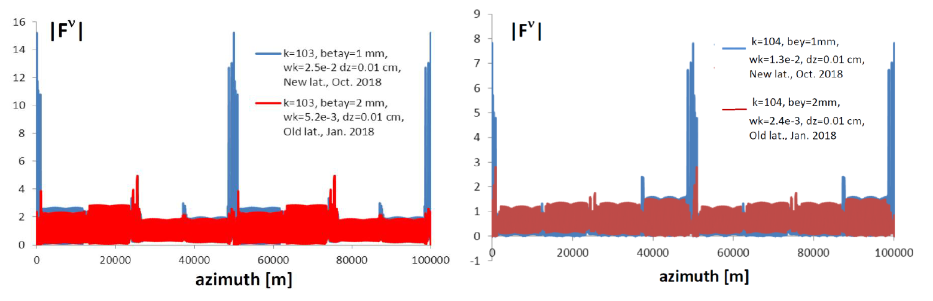
Spin response at Z-pole region with comparison of two CEPC lattice options
Z
dz=100 u
ν=k=103
w_{k}=2.5e-2
w_{k}=5.2e-3
Z
dz=100 u
ν=k=104
w_{k}=1.3e-2
w_{k}=2.4e-3

Slide 15
Spin response at W threshold region with comparison of two CEPC lattice options
W
dz=100 u
ν=k=182
w_{k}=5.0e-2
w_{k}=2.5e-2
W
dz=100 u
ν=k=183
w_{k}=3.5e-1
w_{k}=1.5e-1

Slide 16
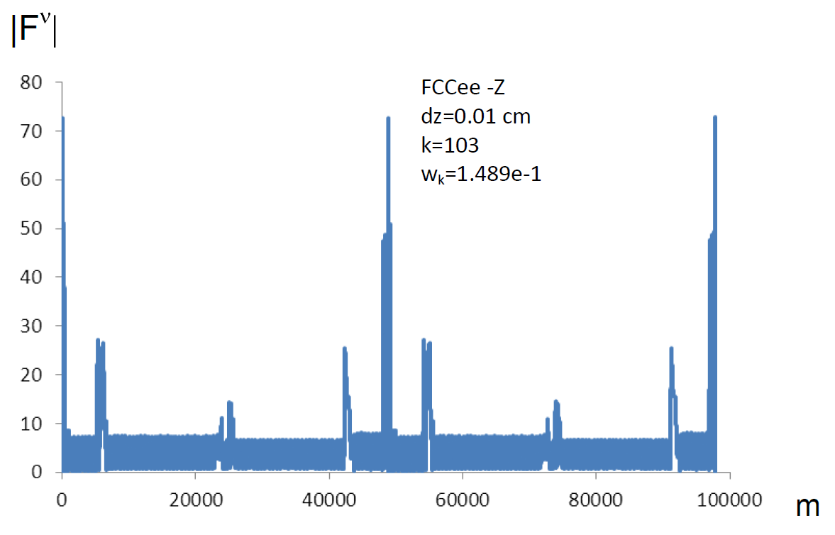
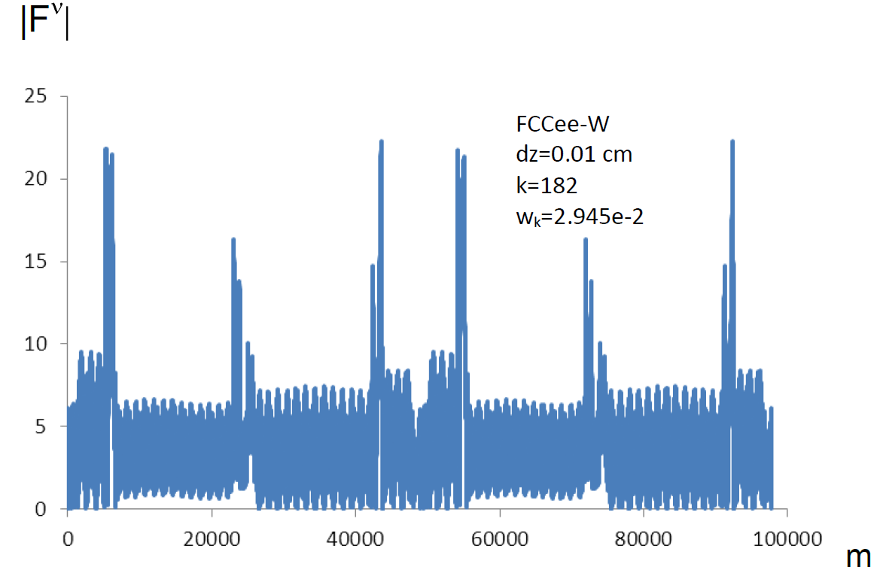
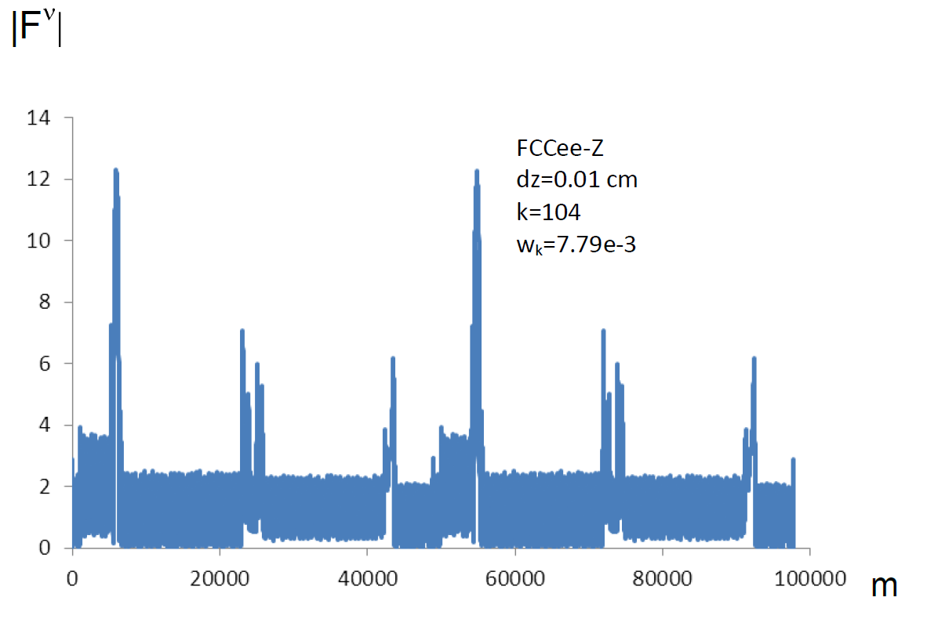
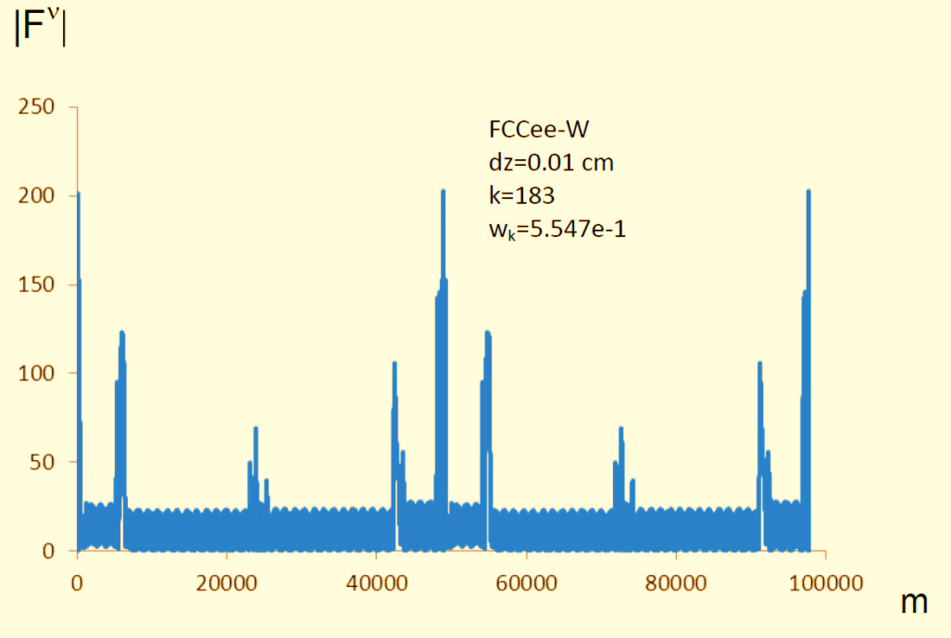
Spin response at FCCee-Z and FCCee-W
Z
ν=k=103
W
ν=k=182
Z
ν=k=104
W
ν=k=183

Slide 17
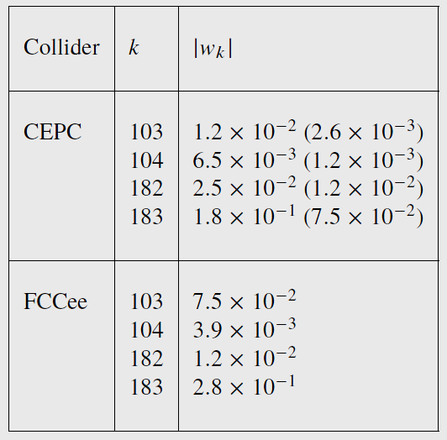
Expected resonant harmonics due to 50μm offsets of quads
For typical vertical offset tolerances , the amplitudes of the harmonics vary in a wide range from 10⁻³ to 10⁻¹ in order of magnitude depending on the energy, the harmonic number, and also on the magnetic lattice option. In principle, even the highest in magnitude harmonics can be reduced down to required level 5⋅10⁻⁴ with the help of a distributed system of dipole correctors of vertical orbit (SHM, i.e. Spin Harmonic Matching).
Factors contribute this:
the number of correctors is of the same order with
the number of disturbance sources ;
the spin response of correctors is described by the same function F^{ν} as for the sources
Spin Harmonic Matching using dipole correctors is complicated by the need to simultaneously solve the orbit correction problem.
(…another optics option)

Slide 18
Orbit correction and spin harmonic matching
In practice, SHM will be preceded by stage of orbit correction which is necessary to provide relevant closed orbit. Without any correction, orbit distortions in supercolliders will be unacceptably large even at micron offsets of quads. In addition to use of dipole correctors, it may also be necessary to adjust alignment of FF lenses with micron accuracy
Global dipole correction of closed orbit at each step should include minimizing effect of correction on main spin harmonics (for example, through target function in least squares method).
In turn, SHM steps will be performed provided that vertical orbit increments are minimized. Each step is accompanied by observation of beam polarization using laser polarimeter and is aimed at reducing amplitudes of dangerous spin harmonics.
It is assumed that such a sequence of actions converges, i.e. leads to required result. Of course, numerical simulation is needed.

Slide 19
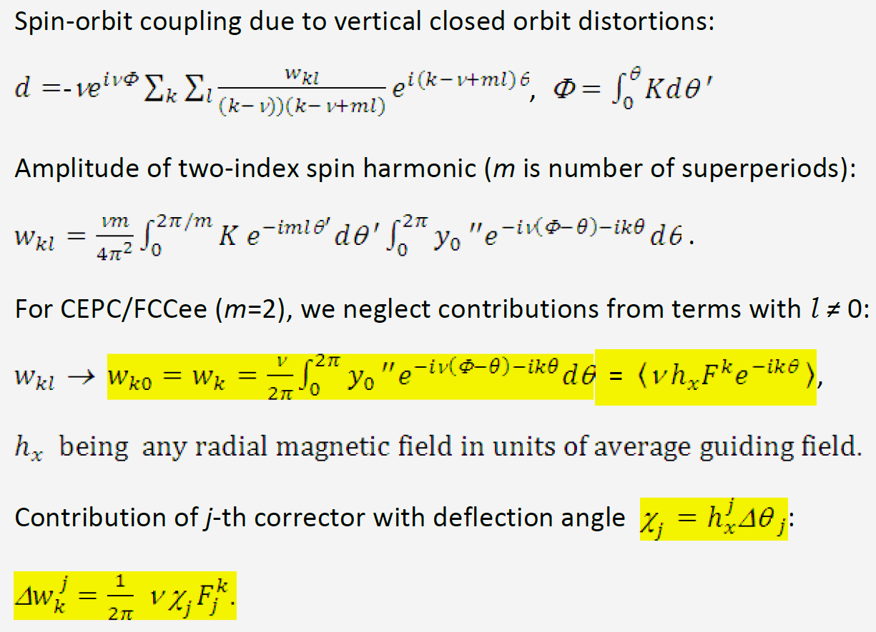
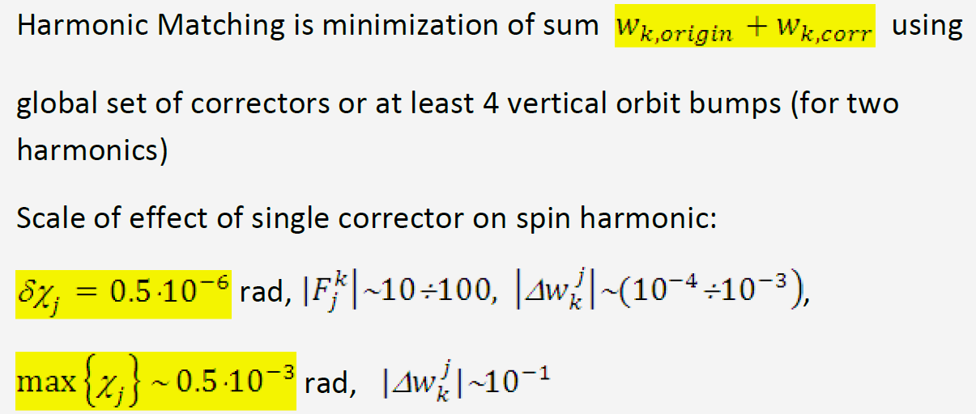
On efficiency of vertical orbit correctors in SHM
Quality of correction of resonant harmonics depends on minimum controlled step (resolution) when changing strength of correctors.
This resolution should be sufficiently high given a wide dynamic range in which amplitudes of harmonics are adjusted

Slide 20
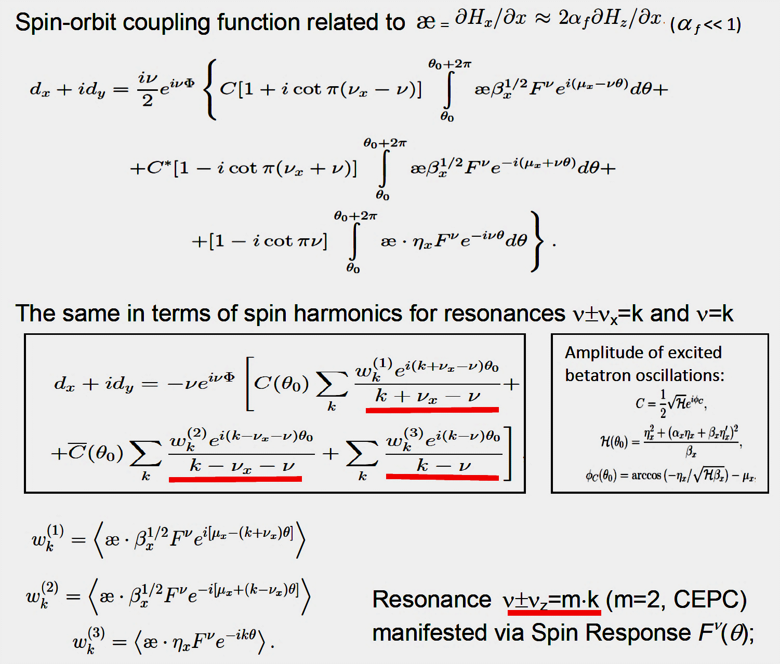
Spin-betatron resonances due to tilts of quads

Slide 21
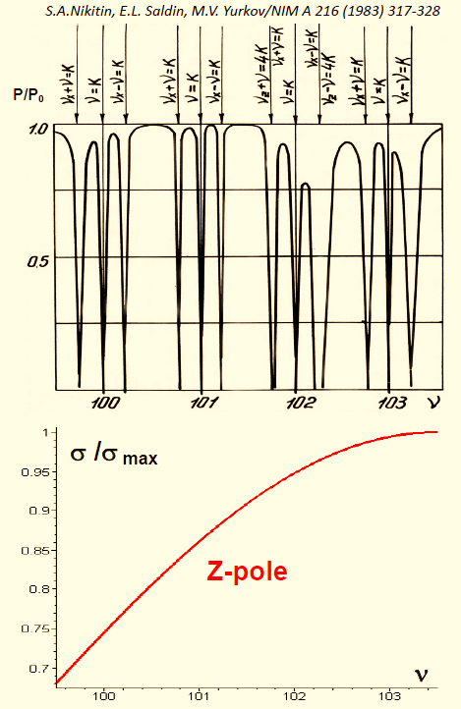
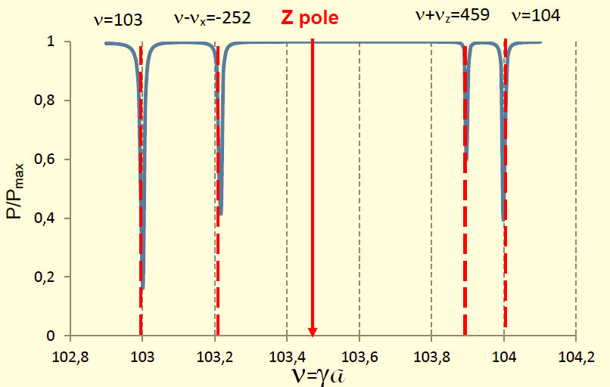
Tilts of quads at LEP (δϕ=5⋅10⁻⁴) and CEPC (δϕ =6⋅10⁻⁴)
LEP
CEPC
Z pole
Obviously, in CEPC as well as in FCCee, influence of betatron oscillations on polarization in working energy region, where spin tune is close to half integer values, can be neglected
cross section

Slide 22
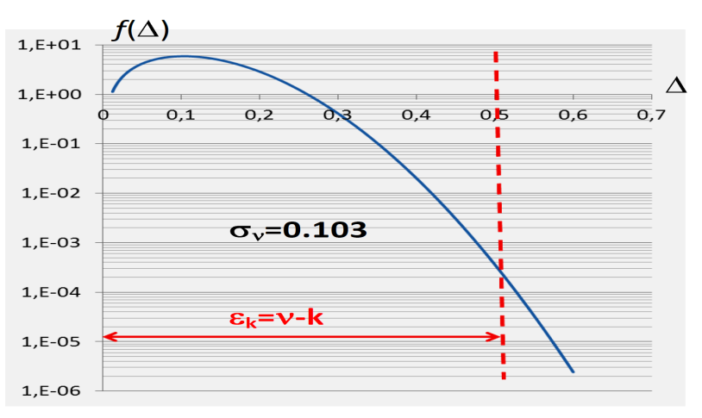
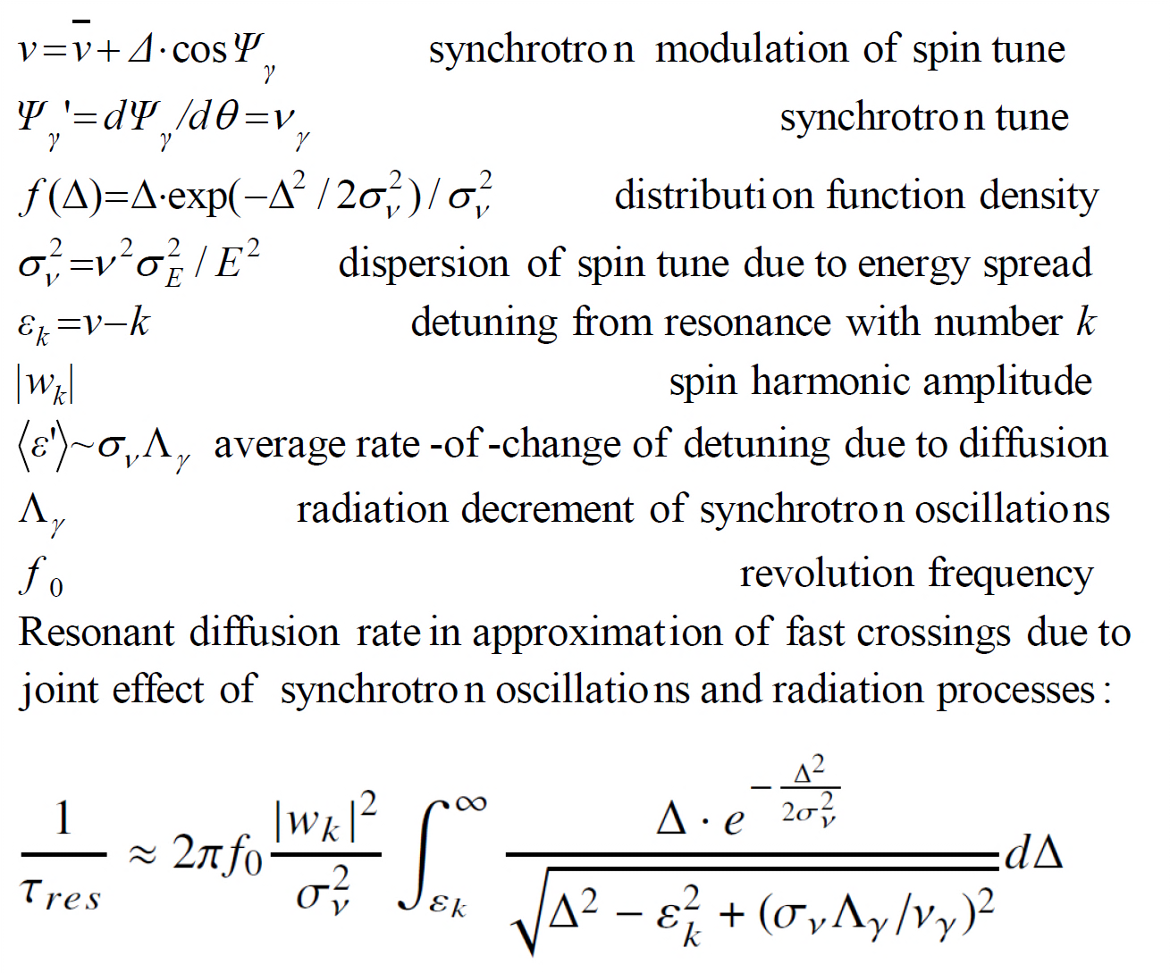
Resonant diffusion of polarization preliminary consideration
The issue for which, it seems, the hour has come!
It was not so relevant in electron-positron rings
of previous generations.
S. Nikitin, Talk at CEPC Workshop, IHEP, Beijing 12-14 Nov. 2018
Resonant diffusion due to large instant spin tune spread (σ_{ν}∼0.1 in wiggler mode) should be considered in framework of model basing on radiative excitation and damping. For particle falling into tail of distribution function, amplitude of spin tune modulation by synchrotron oscillations can sporadically overlap distance to closest spin integer resonances (ε_{k}≈0.5). As result, there are accidentally recurring fast intersections of those resonances…
Amplitude distribution
Suggested model

Slide 23
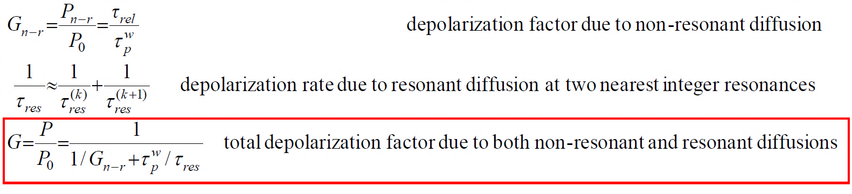
Combined effect of non-resonant and resonant diffusions
In our calculations, the intersections of integer resonances k=103 and k=104 at Z-pole as well as k=182 and k=183 at W-threshold due to large spin tune spread are taken into account

Slide 24
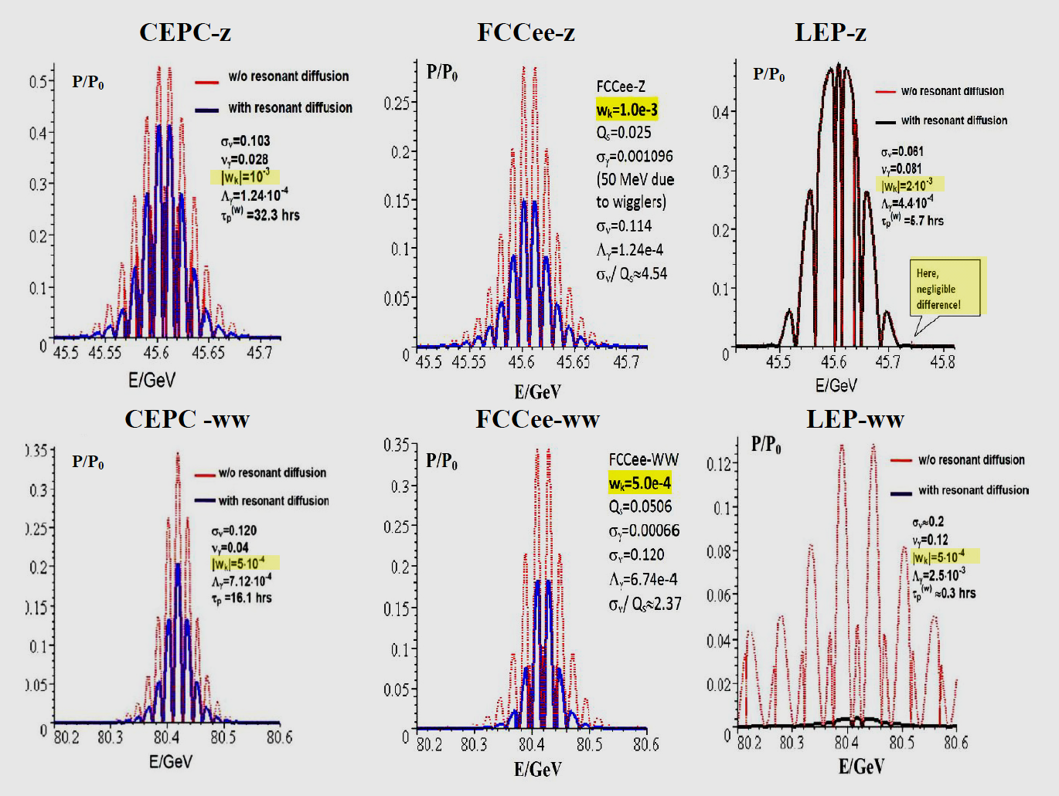
Combined effect of non-resonant and resonant diffusions
Resonant diffusion is nothing!
Resonant diffusion fatally dominates!

Slide 25
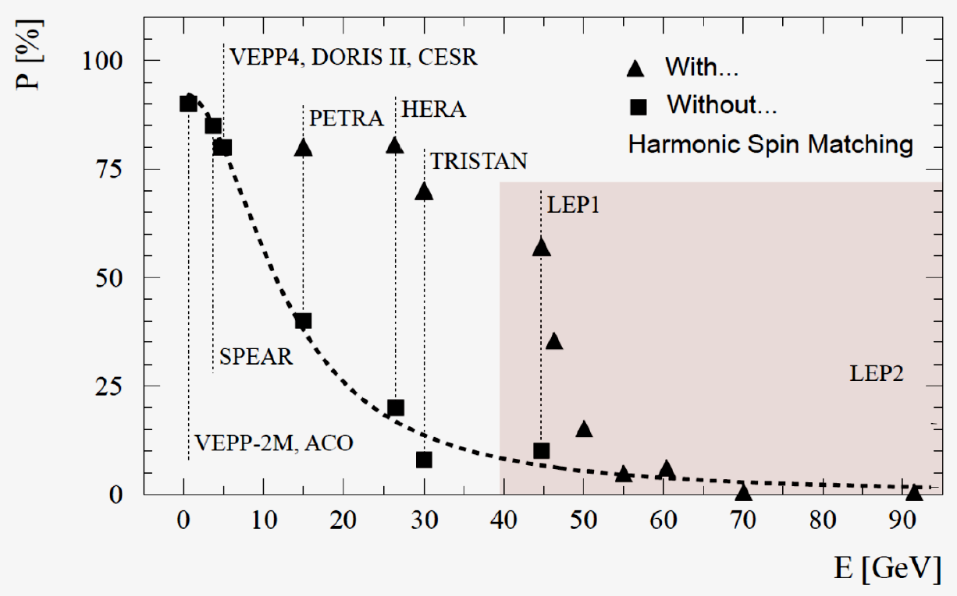
Combined effect of non-resonant and resonant diffusions
σ_{ν}≈0.061
|w_{k}|=2e-3
Resonant diffusion is nothing!
σ_{ν}≈0.2
|w_{k}|=5e-4
Resonant diffusion
fatally dominates!

Slide 26
Where is this important?
In CEPC and FCCee cases (in wiggler mode at Z-pole as well as no-wiggler mode at WW-threshold ), the considered resonant diffusion is quite noticeable, but not fatal. Just need more careful spin harmonic matching!
LEP-z case (σ_{ν}=0.061) is most comfortable! Resonant diffusion is nothing!
LEP-ww (σ_{ν}=0.2) is the worse case due to too much spin tune spread!
Remember, attempts to get a polarization at 80 GeV LEP failed!
Unlike the cases of CEPC and FCCee cases, polar opposite results for LEP
at 45 and 80 GeV are indirectly related to the fact that its radius is 3 times smaller than that in new projects!

Slide 27
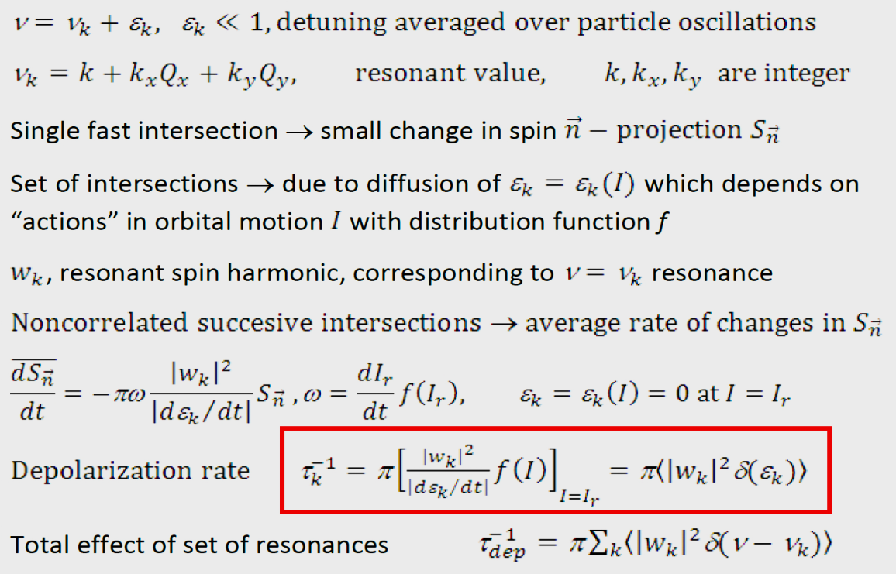
Remark on another type of resonant spin diffusion
Kondratenko’s theory of beam-beam depolarization (BBD) effect
BBD is based on diffusion of average detuning from spin resonance . Spin-orbit resonances of high order may fall into footprint of betatron tune shift caused by
counter beam nonlinear field. This tune shift is
determined by of betatron oscillation amplitudes
squared – ’actions’
Pilot bunches intended for polarization in FCCee
and CEPC are not in collisions. In this regard, this
type of diffusion for the projects does not matter!
It remains to estimate an influence of the betatron tune footprint related to nonlinearities in magnets.

Slide 28
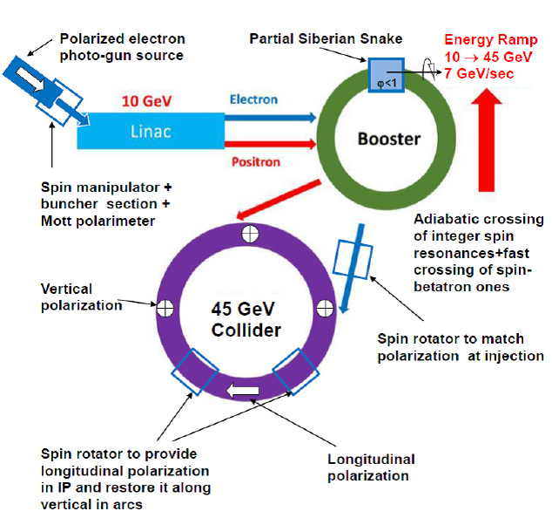
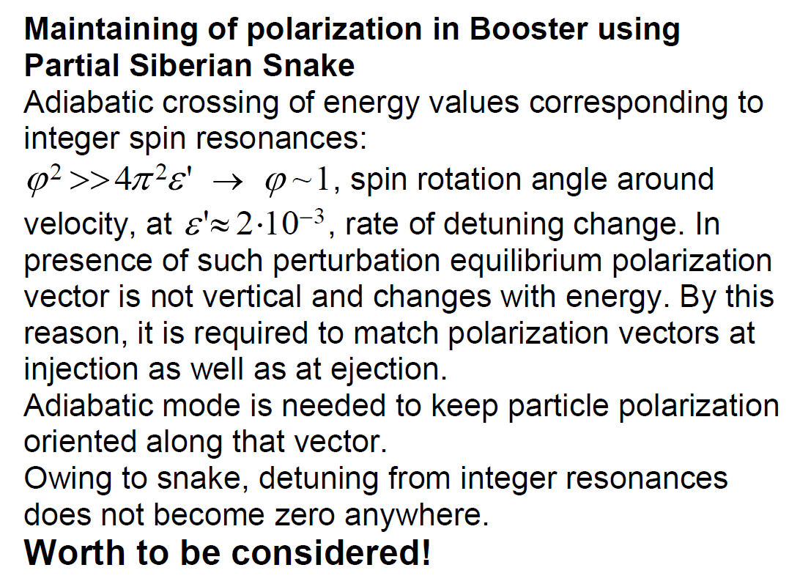
Acceleration of polarized beam in CEPC booster
electrons
just as at proton machines
Record rate!
≈2⋅10⁻³
or transverse one
if no rotators
Proposed in: S.Nikitin, Talk at IAS Program on HEP, Jan. 2018, Hong Kong; IJMP A, Vol. 34 No. 13n14, 1940004 (2019)
High energy ramping rate + large machine size →
huge rate of change of detuning are basis of proposal!

Slide 29
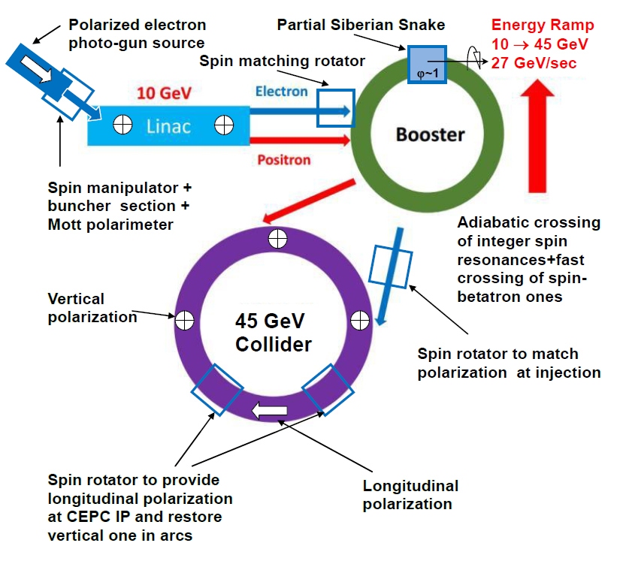
Acceleration of polarized beam in CEPC booster
electrons and positrons
just as at proton machines
~7 GeV/s
1÷2 GeV
e+ Polarizer
Ring
≈2⋅10⁻³
or transverse one
if no rotators
Proposed in: S.Nikitin, Talk at IAS Program on HEP, Jan. 2018, Hong Kong; IJMP A, Vol. 34 No. 13n14, 1940004 (2019)
High energy ramping rate + large machine size →
huge rate of change of detuning are basis of proposal!
High energy ramping rate + large machine size →
huge rate of change of detuning are basis of proposal!

Slide 30
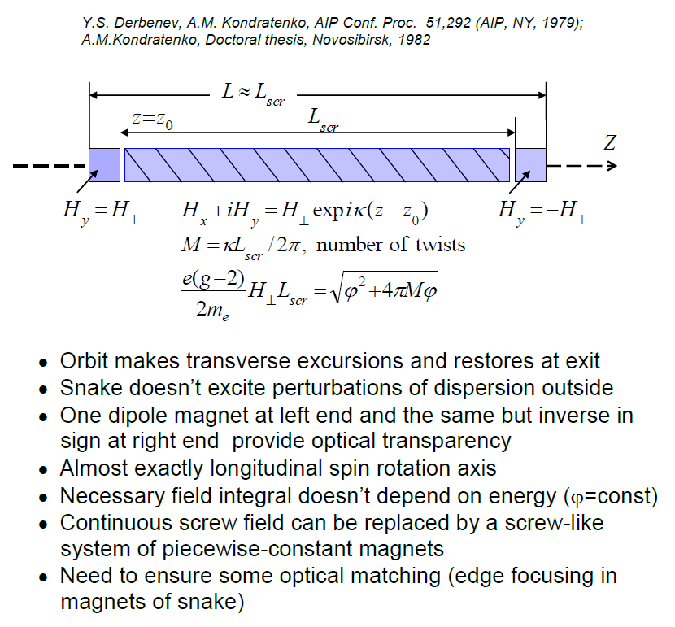
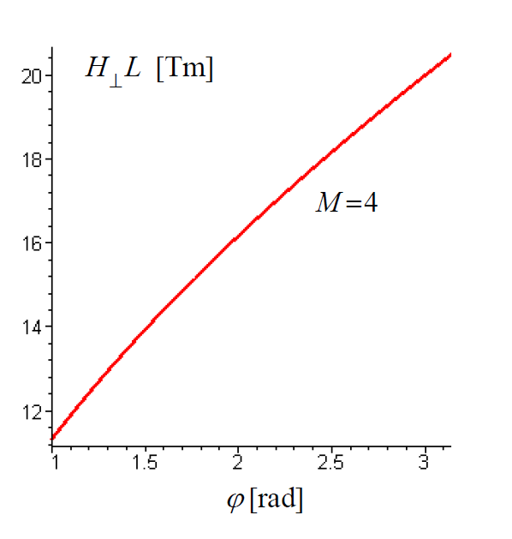
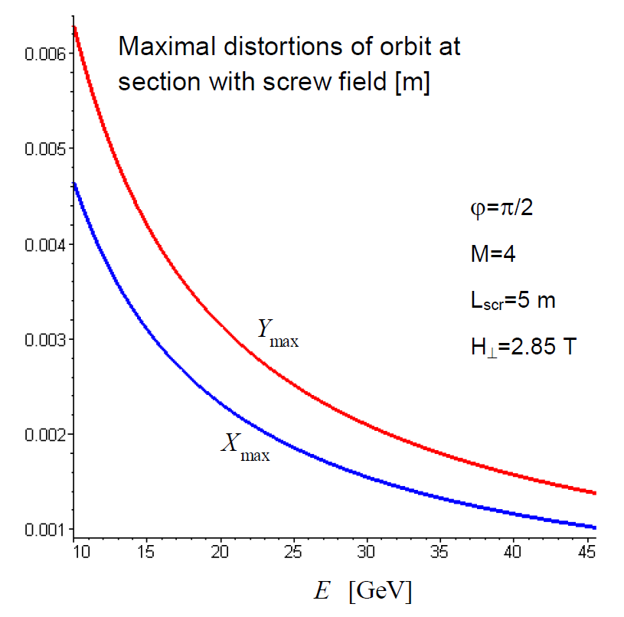
Helix snake
≈20T⋅m for ϕ=π

Slide 31
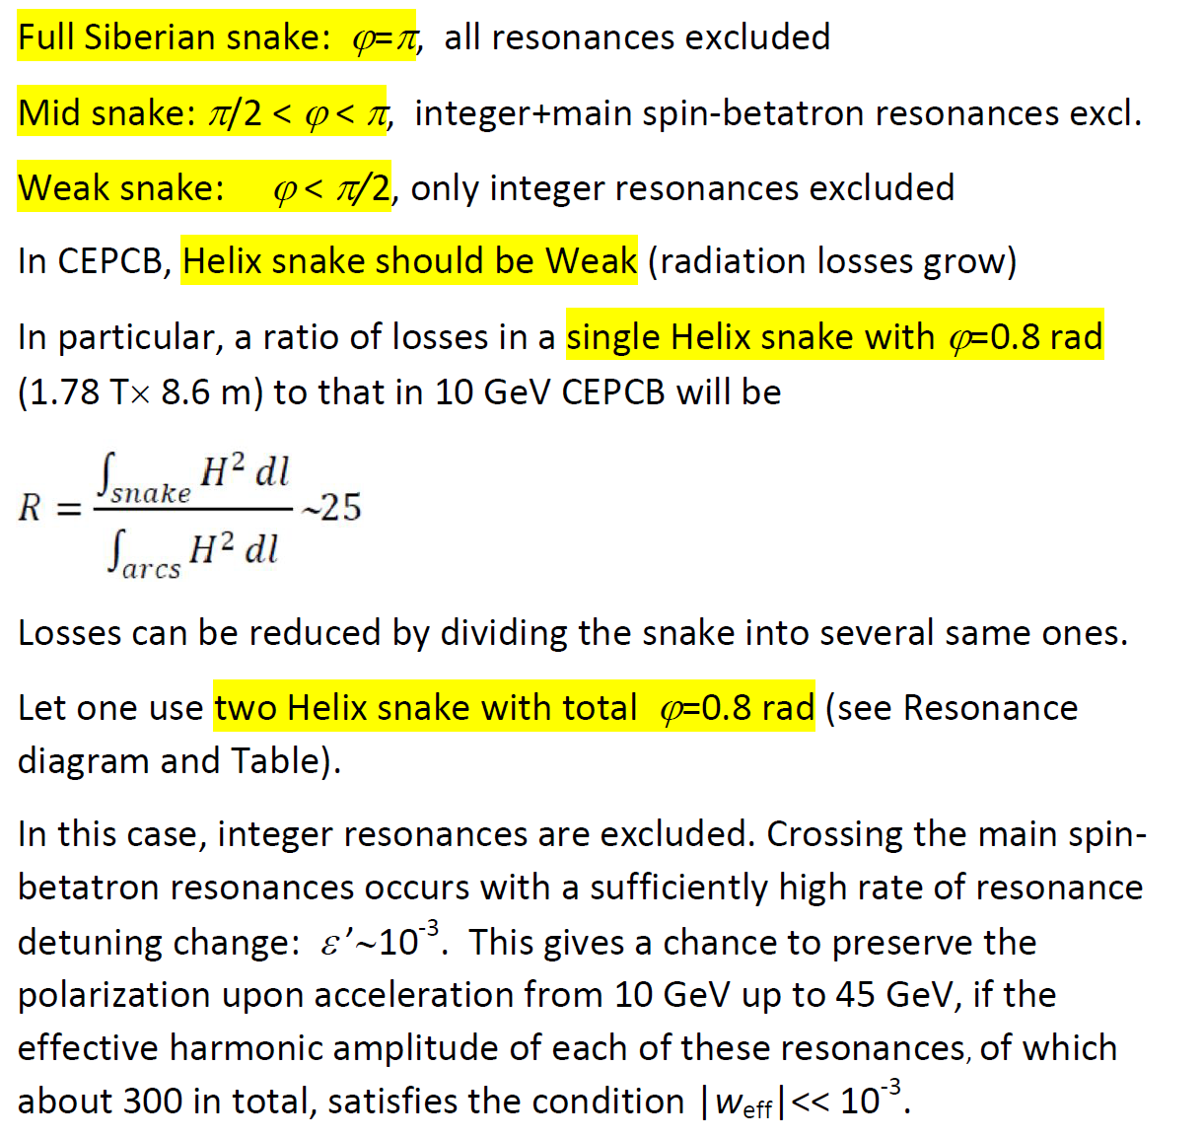
Crossing spin resonances using two weak helix snakes

Slide 32
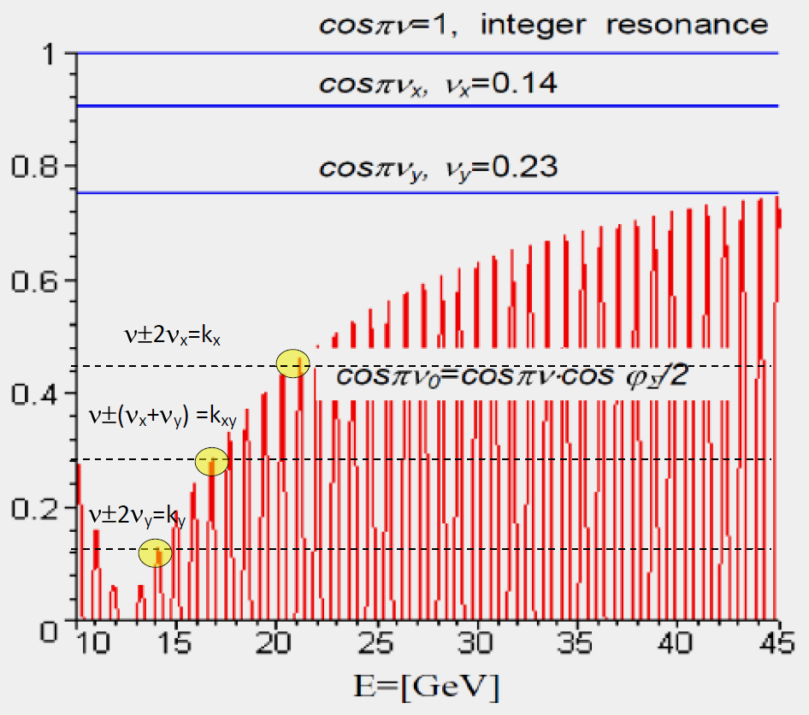
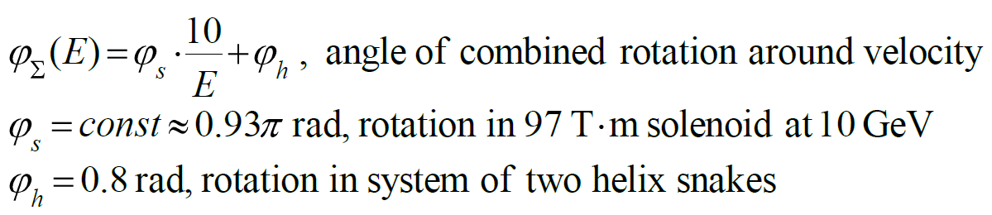
Combined scheme to avoid all main spin resonances
Two helix snakes + solenoid
with field=const during acceleration
At marked points , the rate of crossing the spin-betatron resonances related to quadratic nonlinearities
drops sharply. Here, apparently, one needs to apply a method of fast jump in betatron tunes .

Slide 33
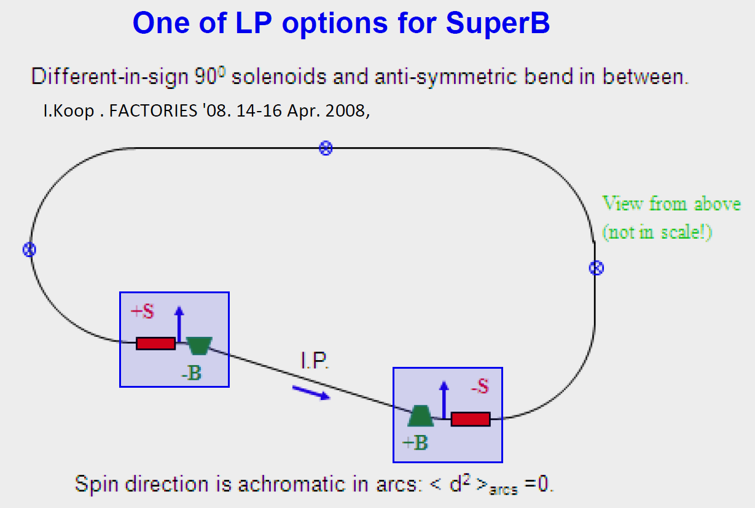
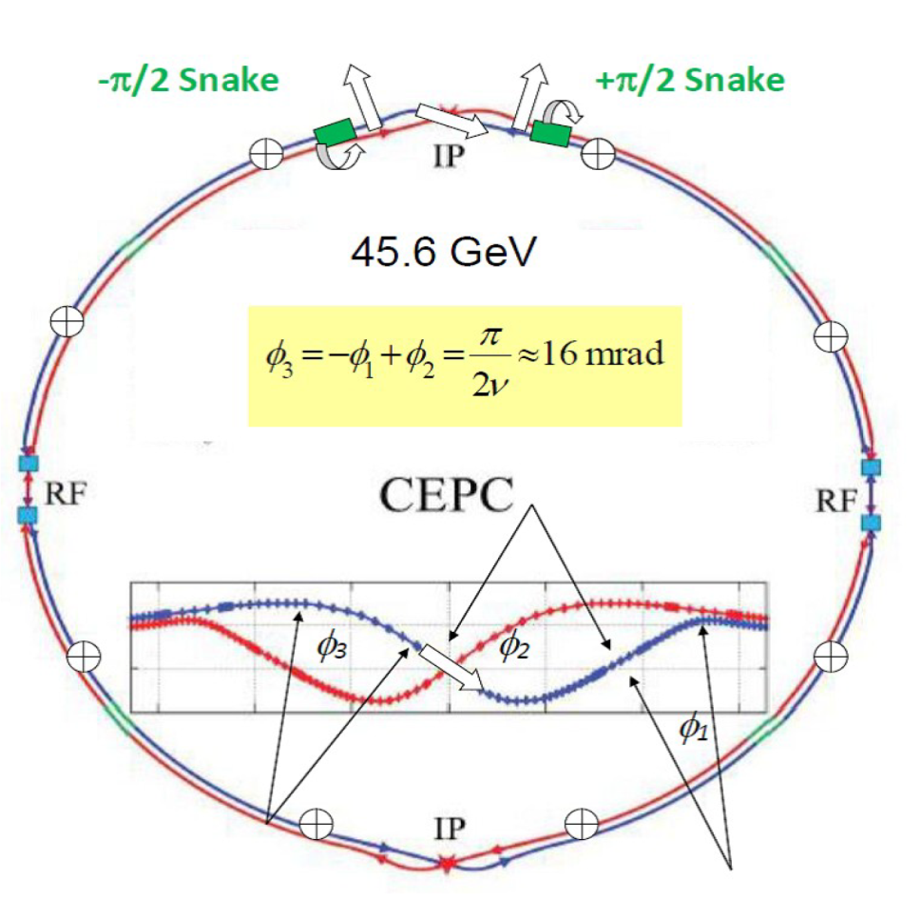
LP scheme with minimization of spin-orbit coupling
e.g. H||L≈8T×30 m solenoid-based snake
Antisymmetric rotator insert system:
solenoids S± rotate spin by ±π/2
Bends B±= ±π/2ν rotate it by ±π/2 (bends to left
and to right of IP, between solenoids).
Contributions to spin chromaticity from left and right parts of rotator system cancel each other. Depolarization effect of SR in arcs is suppressed.
S-shaped orbit in CEPC/FCCee helps to do it!
Wagging orbit in the CEPC interaction region with bending angles close to optimal ones (half crossing angle=15 mrad) allows us to consider respective spin kinematic design basing on solenoid inserts
Proposed in: S.Nikitin, Talk at IAS Program on HEP, Jan. 2018, Hong Kong; IJMP A, Vol. 34 No. 13n14, 1940004 (2019)

Slide 34
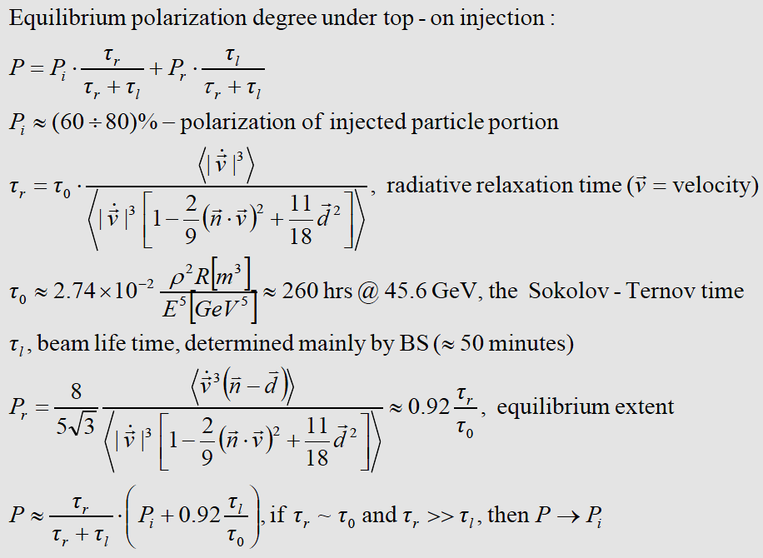
Kinetics of LP with top-on injection
Radiative relaxation time τ_{r} of
polarization in order of
magnitude can be comparable
with S-T time τ_{p}=260 hrs due to
minimization of spin-orbit coupling!
Longitudinal polarization degree
In CEPC main ring averaged
over injection cycles is close
to polarization preserved to the
end of acceleration in Booster

Slide 35
Summary
Spin harmonic amplitudes of vertical closed orbit distortion sources at Z-pole and
W threshold should be corrected to level ≤ 5⋅10⁻⁴ to ensure equilibrium polarization
degree close to 50%
Due to high sensitivity of closed orbit to disturbances and large expected range of amplitudes of dangerous spin harmonics (10⁻³-10⁻¹), a step-by-step procedure SHM using vertical dipole correctors with minimization of orbit distortions is required
Contribution of random tilts of quads into depolarization effect can be neglected
(spin-betatron resonances are very narrow)
Other things being equal, equilibrium degree of polarization increases with decreasing
index of modulation of spin tune by synchrotron oscillations. Decrease in index is provided
by decrease in energy spread or increase in synchrotron tune

Slide 36
If we obtain amplitudes of harmonics ≤ 5⋅10⁻⁴ , it is possible to reach polarization in range (6-10)% in CEPC in time of (2-4) hours using e.g. ten shifter magnets with moderate parameters
First performed estimates basing on proposed model indicates that one have to take into account additional depolarizing effect -- resonant spin diffusion due to large spin tune spread. Cross-checking based on spin tracking simulations is needed
It was shown numerically that unsuccessful attempts to obtain polarization on LEP at energies above 60 GeV could be associated with resonant spin diffusion. At the same time, similar calculations for CEPC and FCCee have shown that although this effect is noticeable at 45 (wiggler mode) and 80 GeV, but is not fatal

Slide 37
Variant of combined partial Siberian snake with moderate parameters is proposed, which allows one to completely eliminate integer spin resonances, as well as main spin-betatron resonances during acceleration in CEPC booster from 10 to 45 GeV. Snake includes solenoid and two spiral magnets. All snake fields remain constant during acceleration
Under top-on injection of polarized beam, there is principal possibility to provide high average degree of longitudinal polarization. For this purpose, due to S-shaped designed orbit in the area around IP, well-known kinematic scheme can be used that minimizes spin-orbit coupling in arcs.

Slide 38
I am grateful to Prof. Jie Gao and Prof. Evgeni Levichev for initiation of discussion on CEPC polarization. I thank Anatoly Kondratenko for conversations on spin dynamics; Alain Blondel, Evgeni Levichev, Ivan Koop and Dmitry Shatilov for useful discussions on FCCee project; Sergei Sinyatkin, Dou Wang and Yiwei Wang for technical help
THANK YOU FOR ATTENTION!

