Slide 1
CEPC light sources applications
The 2019 International Workshop on the High Energy Circular Electron Positron Collider （18 Nov. - 20 Nov. 2019, IHEP）
Yongsheng Huang
EPC,IHEP
2019.11.18

Slide 2
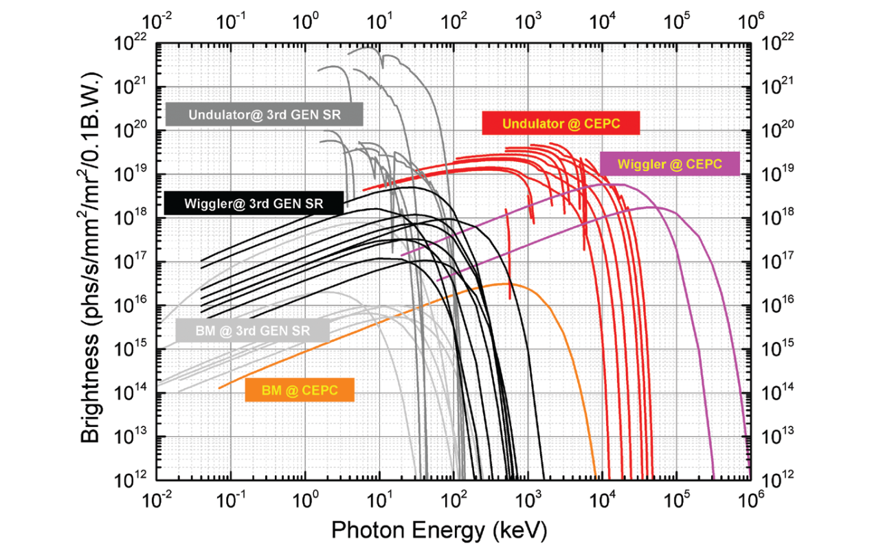
Brightness of the SR from bent iron, torsion, oscillator and low-K undulators in future high-energy particle colliders(CEPC-CDR)
The torsion pendulum has a characteristic gamma energy of 19.2 MeV and a high flux radiant energy of 300 MeV. The gamma light energy produced by the undulator can reach 20 MeV at high flux. Moreover, in the energy region greater than 100 keV, the brightness and flux of the future high energy particle collider synchrotron source are higher than those of the third generation synchrotron radiation source.

Slide 3
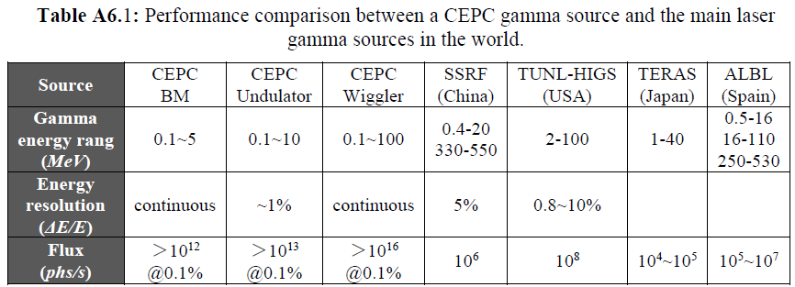
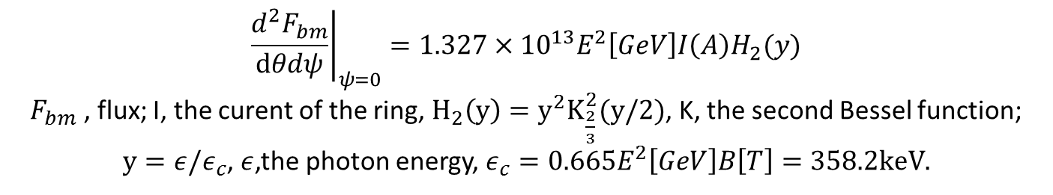
Central intensity of Synchrotron radiation,[photon/s/mrad2/0.1%b.w.]
$${\left.\frac{d^{2}F_{bm}}{dθdψ}\right|}_{ψ=0}=1.327×{10}^{13}E^{2}\left[GeV\right]I\left(A\right)H_{2}(y)$$
$F_{bm}$ , flux; I, the curent of the ring, $H_{2}\left(y\right)=y^{2}K_{\frac{2}{3}}^{2}(y/2)$, K, the second Bessel function;
$y=ε/ε_{c}$, $ε$,the photon energy, $ε_{c}=0.665E^{2}\left[GeV\right]B\left[T\right]=358.2keV.$

Slide 4
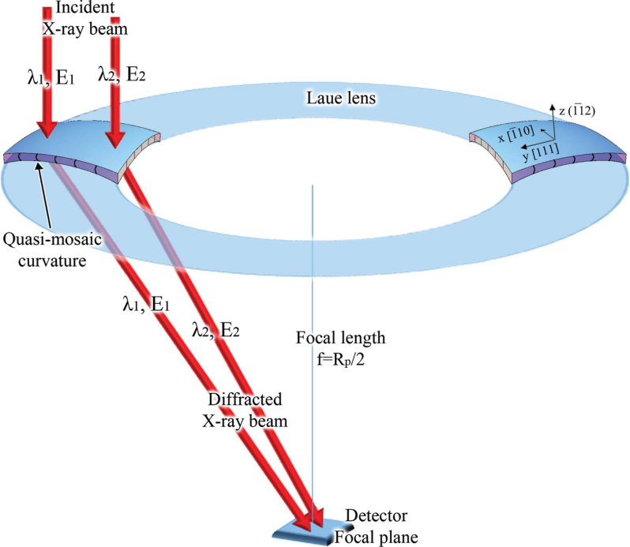
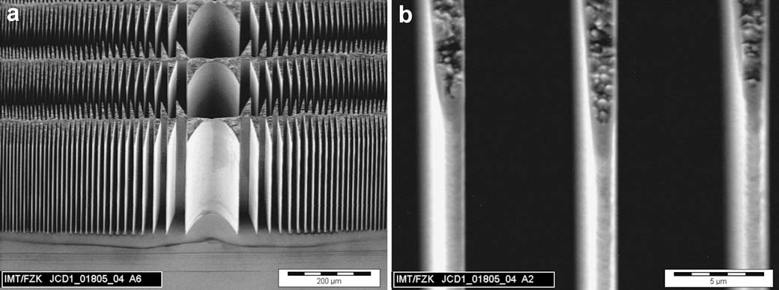
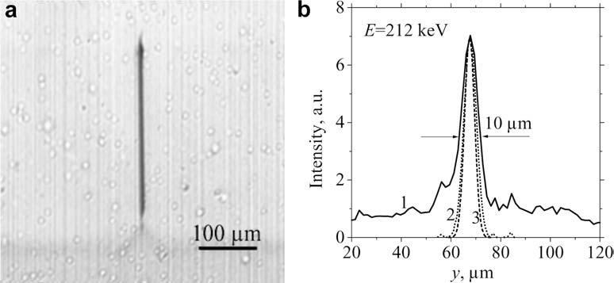
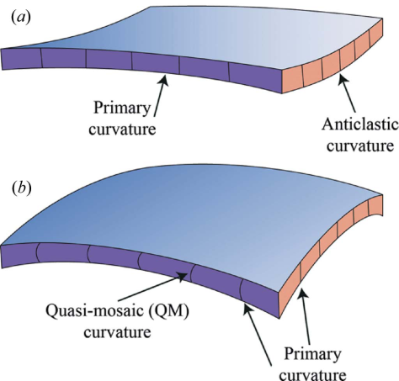
The focalization of hard x-ray
And soft gamma-ray 100keV-1MeV, 1MeV still problem?
LIGA fabrication of X-ray Nickel lenses
100keV-1MeV : Microsystem Technologies 11 (2005) 292–297
Schematic representation of a Laue lens based on QM crystals. J. Appl. Cryst. (2015). 48, 977–989

Slide 5
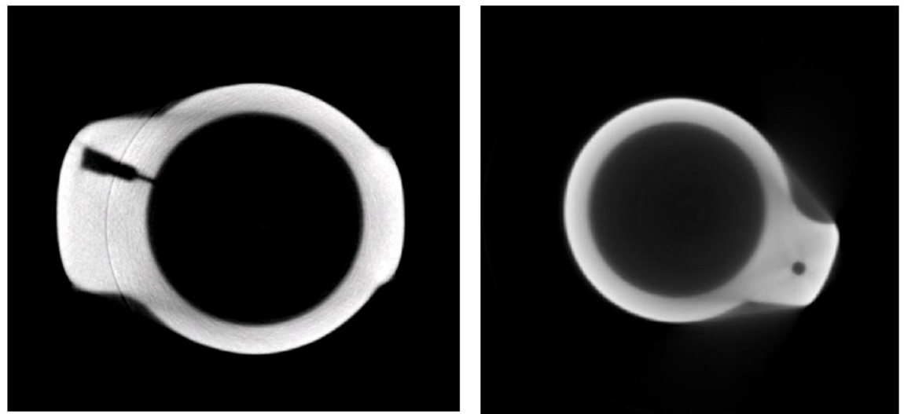

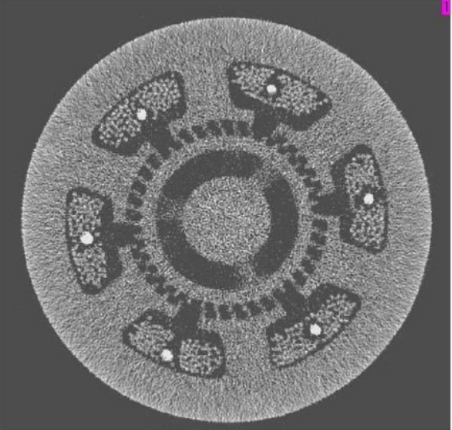
CEPC-SR：Applications—Industrial, material applications
1. Measurement of the internal structure of precision workpieces in the aerospace, aerospace and other industries and the detection of defects;
2. Inspection of ammunition packing density and quality inspection of key components of weapons in the weapon industry;
3. Non-destructive testing of key components in the automotive industry
4. Online monitoring and quality inspection of products in the steel industry: Engine blade ( *um/1cm)
5. Evaluation of samples in geology and archaeology;

Slide 6
Science Case : Time-resolved XRS probes the growth behaviors of nucleus
Applications of Synchrotron Radiation X-ray Scattering on Interfacial Structure and Physics，Huan-Hua Wang
Islands structure on growing SrTiO₃ by PLD
DXRS intensity ring reveals the islands’ separation
Strontium titanate

Slide 7
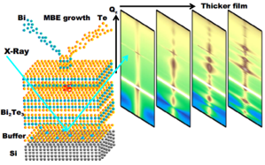
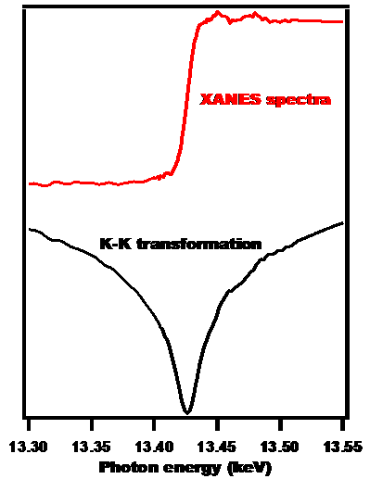
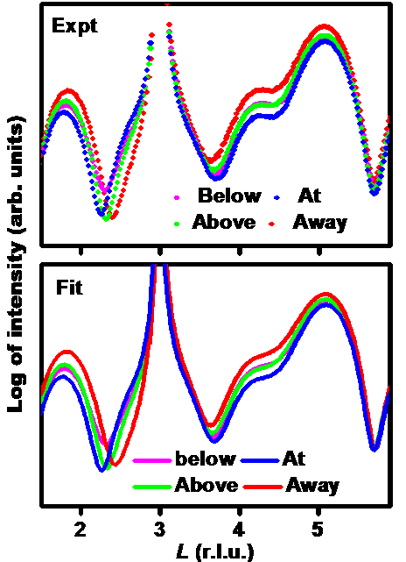
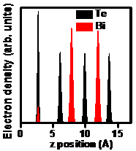
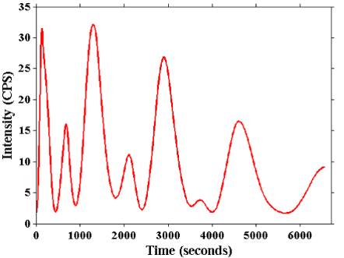
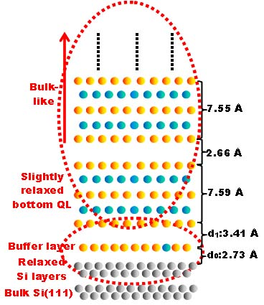
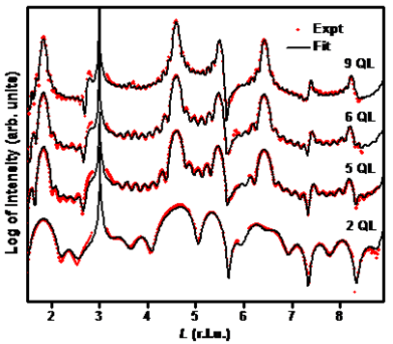
Science Case : Thin film growth and interface structure by in-situ (Resonant) SXRS
Applications of Synchrotron Radiation X-ray Scattering on Interfacial Structure and Physics，Huan-Hua Wang
Composition？Thickness?
Out-of-plane relaxation?
In-plane structure？
Resonant XRS: Bi L3 edge; EXRR; Structure
Time-resolved XRS intensity oscillations at (0 0 ½)

Slide 8
Science Case : Oxygen Octahedral Rotation (OOR) detected by XRD
Applications of Synchrotron Radiation X-ray Scattering on Interfacial Structure and Physics，Huan-Hua Wang
Doubled lattice periods resulting from OOR lead to half integer Bragg peaks

Slide 9
Science Case : Interfacial Structure and Multi-interactions coupling at FeSe/SrTiO₃ interface
1st→2nd ML: Sudden in-plane structure change
Key: in-situ interfacial structure information
Applications of Synchrotron Radiation X-ray Scattering on Interfacial Structure and Physics，Huan-Hua Wang

Slide 10
CEPC-SR：Applications on Nuclear Physics
Wang Naiyan: High-intensity γ-rays for nuclear science research
Photonuclear action is a valve-like reaction
The valve energy of the (γ, n) and (γ, p) reactions is the binding energy of the last neutron and proton in the target nucleus.
The data of the binding energy of the last neutron can be accurately obtained by measuring the (γ, n) reaction threshold.

Slide 11
CEPC-SR：Applications
Wang Naiyan: High-intensity γ-rays for nuclear science research
Giant resonance for photonuclear reaction:
By measuring the excitation function of the photonuclear reaction giant resonance, information on the nuclear deformation can be obtained.
Giant resonance absorption is not the only mechanism of photonuclear reaction: by measuring the ratio of (γ, p) and (γ, n) reaction yield Y(γ, p) / Y(γ, n) indicates that it is larger than predicted by the resonance absorption mechanism. Much more, this may be due to the existence of a direct interaction process in the photonuclear reaction, and the giant resonance absorption is not the only process.

Slide 12
Wang Naiyan: High-intensity γ-rays for nuclear science research
The important role of high-intensity γ-rays in the study of Nuclear transmutation

Slide 13
Wang Naiyan: High-intensity γ-rays for nuclear science research
There have been a small number of studies in the world (as opposed to a large number of neutron metamorphosis studies)
Most of them use the bremsstrahlung gamma source generated by high-power laser to high Z target, which is less efficient.
I only see an experiment in Japan that uses an inverse Compton scattering gamma source with electron beam and laser collision.
→ The conclusion is that it is feasible to use gamma for tens of kilograms of nuclear waste!

Slide 14

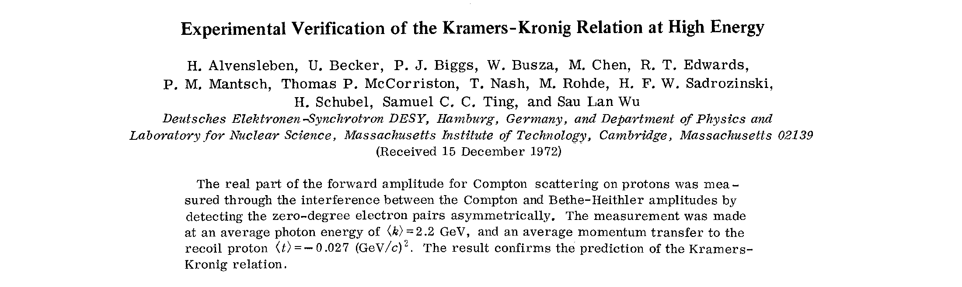
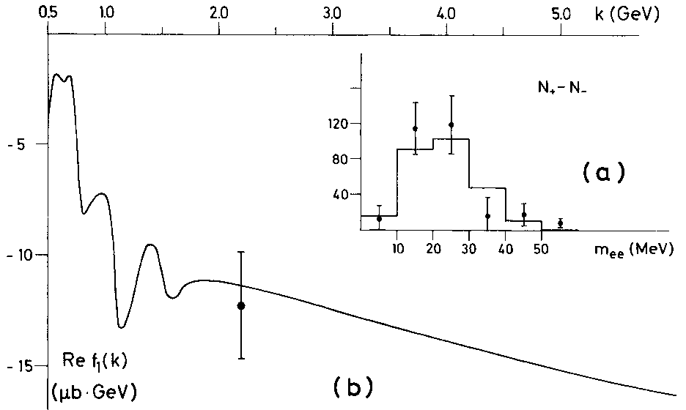
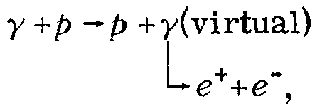
On the CEPC-γ source
2.2 GeV
γ + N → ?
100 MeV γ, λ ≈ 12.4 fm
PRL 30, 328(1973).
CEPC-γ CJLin@ciae.ac.cn 20

Slide 15


Poison and Holy Grail in the Evolution of Stellars
--- Based on the gamma light device, He Jianjun
Poison in the process of slow neutron capture
The first
¹⁷O(n, γ)¹⁸O
The second
¹³C(n, γ)¹⁴C
s-process
s-process

Slide 16

Poison and Holy Grail in the Evolution of Stellars
--- Based on the gamma light device, He Jianjun
¹²C(α,γ)¹⁶O Holy Grail
(Hoyle grail)
¹²C(α,γ)¹⁶O The reaction plays a key role in the evolution of all M > 0.55 M⊙ stars. The reaction cross section has a decisive influence on the synthesis of medium-quality nuclei up to iron and the evolution of large-mass stars. It is known as the "Holy Grail" of nuclear astrophysics.

Slide 17
Photonuclear reaction¹⁶O(γ, α) ¹²C measurement
University of Stuttgart, Germany：¹²C(α,γ)¹⁶O
Beam：400 μA (2.5×10¹⁵ pps),
Target thickness：2×10¹⁸ atom/cm³
Time ：150h
Photonuclear reaction：¹⁶O(γ, α)¹²C
Target thickness：×1000times
Cross section：×100times
α/γ Detection efficiency ratio ： ×20times
time：150h
beam：≥ 10⁹ photon/s
Time projection room technology(TPC)

Slide 18
Holy Grail and Poison: need wiggler field in CEPC
The gamma from the Wiggler field response to 8.3MeV for the Holy Grail ！

Slide 19
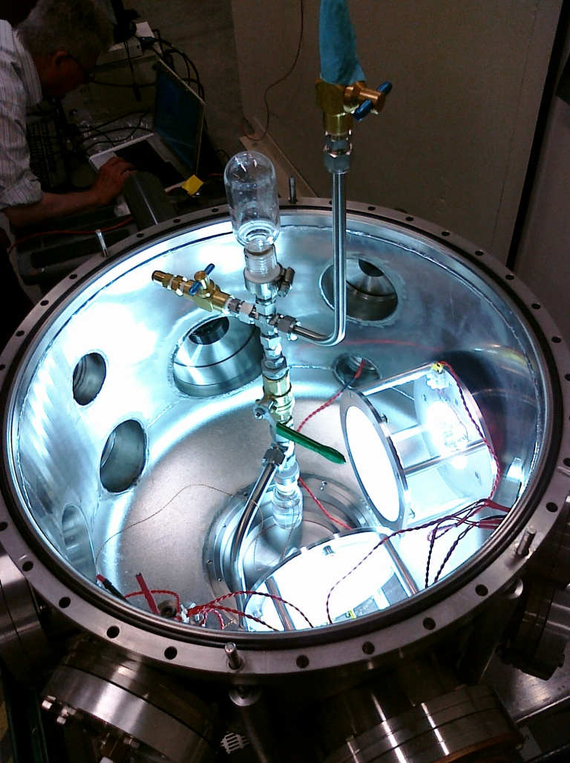
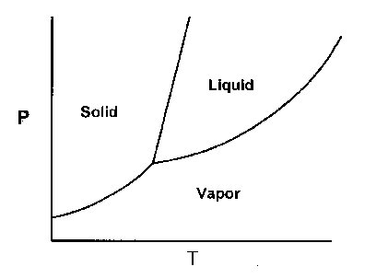
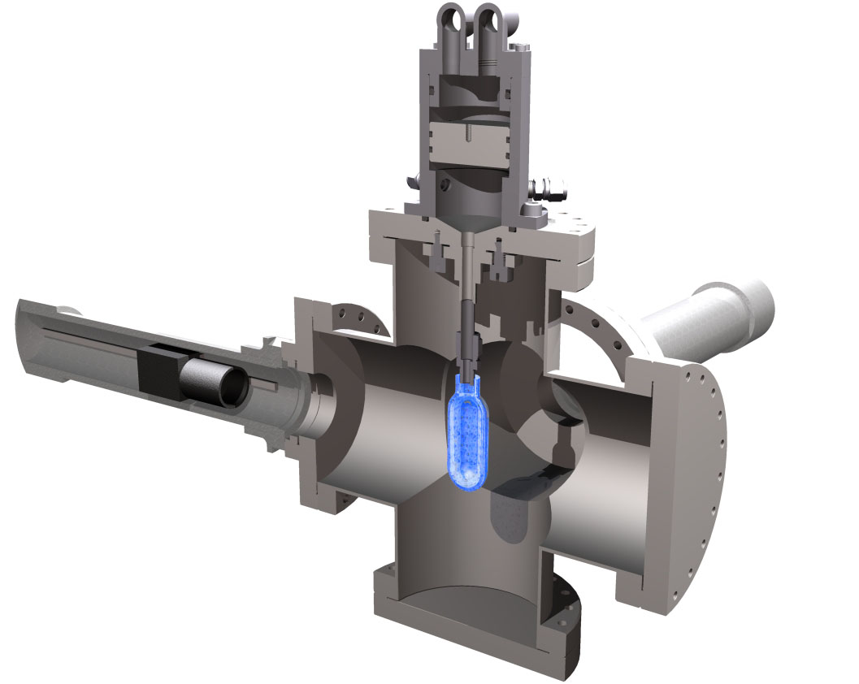
Proof of Principle of a superheated bubble chamber for the ¹⁹F(γ,α)¹⁵N reaction
P~ 1-6 atm T~20-50 C
2 fast cameras

Slide 20
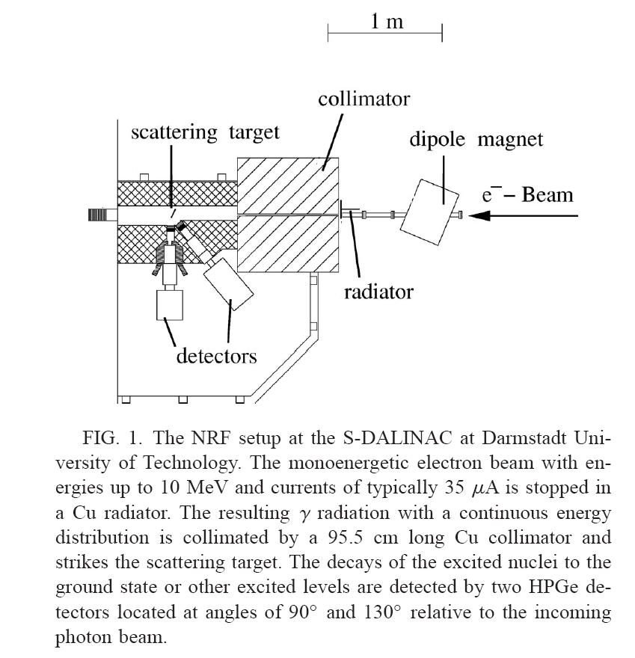
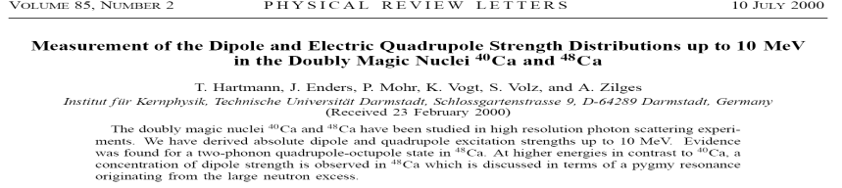
Quasi monoenergetic γ nuclear reactions, Qiao Huan, Zhang Chunlei , Baichun Lin
In a classical picture the excess neutrons form a skin around the proton/neutron core with N Z. An oscillation of the skin vs the core would lead to an electric dipole excitation mode. Because this mode bears resemblance to a “mini” giant dipole resonance it is often called pygmy dipole resonance (PDR).
perform very sensitive Ca(γ , γ、 ) experiments up to an excitation energy of 10.5 MeV
performed photon scattering experiments on ⁴⁰Ca and ⁴⁸Ca

Slide 21
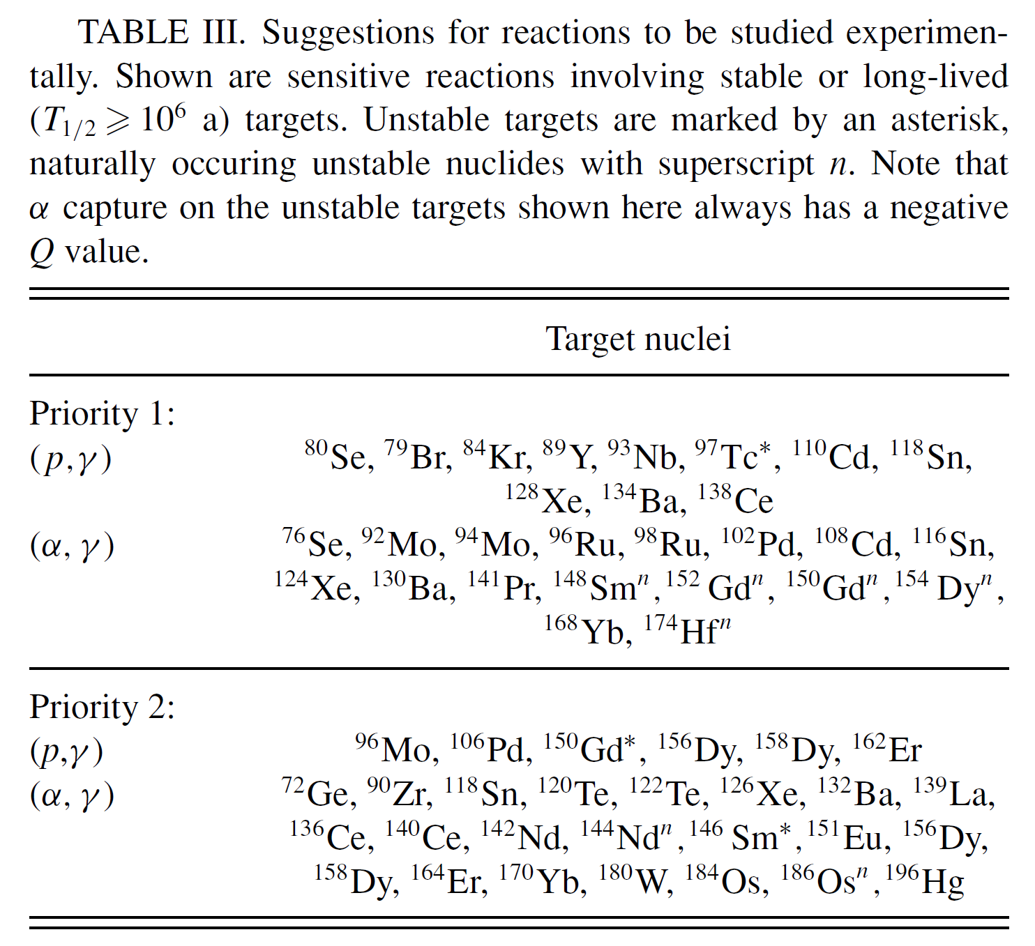
Suggestions for reactions to be studied experimentally
Photodisintegration reaction measurement: a probe of p-process for nuclear astrophysics, Liuchun He, Bao-Hua Sun, Li-Hua Zhu, Jian-Wei Zhao, Meng Wang, Kang Wang
Proposed photonuclear reactions for research in astrophysics!
Thomas Rauscher, PRC, 73, 015804 (2006)
Notes:
A well-known deficiency in the model is the underproduction of the Mo-Ru region, but the region 151 A 167 is also underproduced, even in recent calculations [3].
In this work the sensitivity of the location of the γ process path to reaction rates is investigated, showing which nuclei should be preferred in experimental studies.
表左：产率具有较大误差的核素，下角标表示与（g,n）反应产率接近的反应。
表右：优先进行实验研究的核素。

Slide 22

¹²C(α,γ)¹⁶OHoly Grail
第1瓶
¹⁷O(n, γ)¹⁸O
Photoreaction threshold
s-process
圣杯(Holy grail)
Gamma assisted transmutation
Giant resonance,
Nuclear resonance fluorescence
s-process
γ + N → ?
100 MeV γ, λ ≈ 12.4 fm
第2瓶
¹³C(n, γ)¹⁴C
industry,
Heavy material inspection
Archaeology, etc.
a “mini” giant dipole resonance it is often called pygmy dipole resonance (PDR).

Slide 23
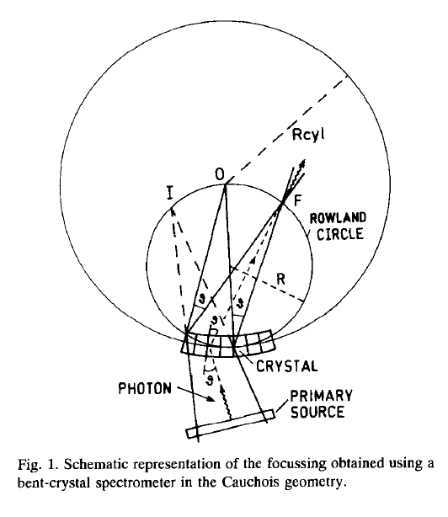
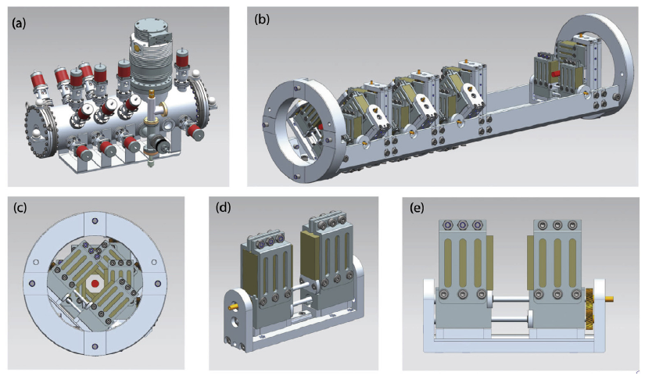
1.使用弯晶进行单色和聚焦
2.利用材料对γ射线的折射性能进行聚焦（refractive index≠0）
目前仅有文献提出可行，但是未见文献报道
有文献报道：在能量比较高的情况下（大于 700 keV for silicon），折射系数变为正数，此时的聚焦透镜面形为凸透镜（与X射线不同）
D. Habs et al., The Refractive Index of Silicon at γ-ray energies, Phys. Rev. Lett. 108, 18402 (2012)
3.目前光束准直使用一些列狭缝
J. Jolie & M.Bertschy, Nuclear Instruments and Methods in Physics Research B, 95,(1995) 431-436
G. Paternò et al. Nuclear Instruments and Methods in Physics Research B,402 (2017) 343-353

Slide 24
Thank you very much for
your support and attention!

