Slide 1
CEPC SRF System R&D Status
Jiyuan Zhai (IHEP)
On behalf of the CEPC SRF Team
International Workshop on the High Energy Circular Electron Positron Collider
November 19, 2019

Slide 2
Outline
CEPC SRF System Design
TDR Plan and R&D Status
SRF Industrialization Study

Slide 3
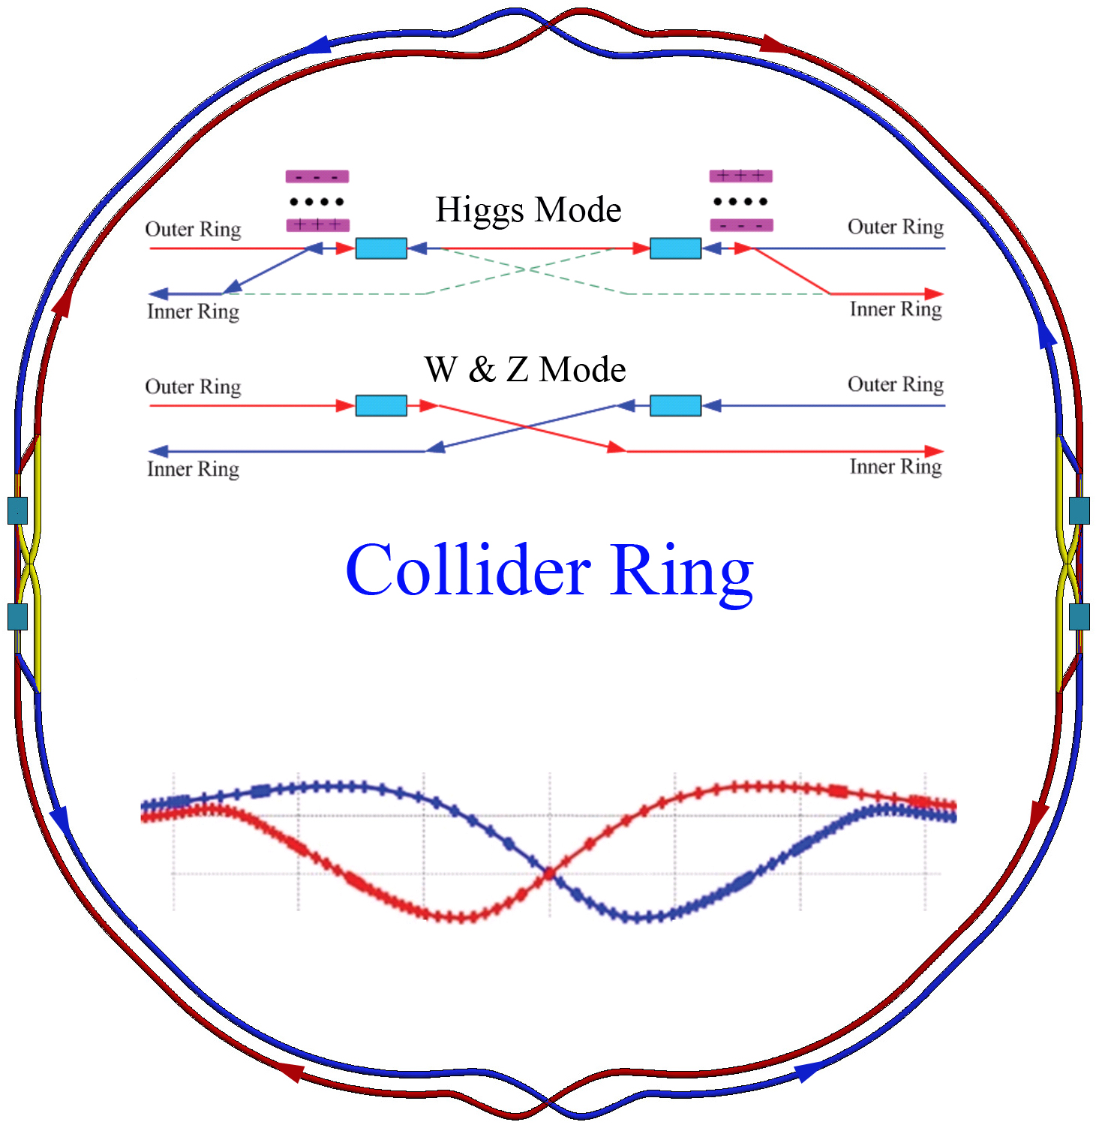
CEPC SRF System
 | H | W | Z
Collider Ring | 650 MHz 2-cell cavity
Lumi. / IP (10³⁴ cm⁻²s⁻¹) | 2.93 | 10.1 | 16.6 / 32.1
RF voltage (GV) | 2.17 | 0.47 | 0.1
Beam current (mA) | 17.4 x 2 | 87.7 | 460
SR power / beam (MW) | 30 | 30 | 16.5
Cavity number | 240 | 108 x 2 | 60 x 2
Q₀ at max gradient | 4E10 @ 22 MV/m (vertical test) 1.5E10 @ 20 MV/m (long term operation)
2 K cavity wall loss (kW) | 6.1 | 1.3 | 0.1
Booster Ring (extraction) | 1.3 GHz 9-cell cavity
RF voltage (GV) | 1.97 | 0.585 | 0.287
Beam current (mA) peak | 0.52 | 2.63 | 6.91
Cavity number | 96 | 64 | 32
Q₀ at max gradient | 3E10 @ 24 MV/m (vertical test) 1E10 @ 20 MV/m (long term operation)
100 km CEPC Collider. Common H cavities and separate W/Z cavities for the two collider rings. One-time full installation of all the same cavities for H, W, Z. Use part of the Higgs cavities for W and Z.
High Q high gradient in high power ring accelerator.

Slide 4
CEPC SRF Cryomodules
Collider 650 MHz Cryomodule (6x2-cell, 10 m)
Booster 1.3 GHz Cryomodule (8x9-cell, 12 m)

Slide 5
SRF Challenges for High Luminosity Z
CEPC CDR SRF system was well designed for CDR parameters.
Now to pursue doubling Z luminosity (32 → 75 x 10³⁴ cm⁻²s⁻¹ / IP) by increasing beam current (460 → 820 mA) up to 30 MW SR power per beam. Cavity should be able to handle 1.4 A beam current (50 MW SR power upgrade, maybe too small bunch spacing due to half fill).
The obvious impact on SRF system is the cavity HOM power, HOM and FM CBI and the active cavity number (limited by coupler power) for Z.
To reduce cavity HOM power, Jie Gao proposed common 1-cell cavities for both Z and Higgs. This will inevitably double Higgs operation gradient and Q to unprecedented 40 MV/m and 3E10 if no change in cavity number and cryogenic loss. This means you need 45 MV/m and 4E10 (10% margin and uncertainty) in vertical test. 45 MV/m (190 mT): theoretical limit of Nb.
Reaching unexplored frontier of High Current, High Power, High Gradient, High Q together.
Do we have better (more balanced) options? By-pass. RF power source redistribution…

Slide 6
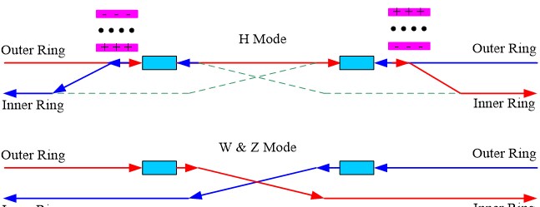
CEPC Collider Ring SRF Parameters (CDR and HL-Z)
New machine parameters 20190226 SRF parameters 20190301 | CDR (2-cell) |  |  | HL-Z (new2) (1-cell) |  |  |  | HL-Z (2-cell) | Performance Limits & Risks
 | H | W | Z | H | W | Z (a) | Z (b) | Z
Luminosity / IP [10³⁴ cm⁻²s⁻¹] | 2.93 | 10.1 | 32.1 | 2.93 | 10.1 | 74.5 | 74.5 | 74.5
SR power / beam [MW] | 30 | 30 | 16.5 | 30 | 30 | 30 | 30 | 30
RF voltage [GV] | 2.17 | 0.47 | 0.1 | 2.17 | 0.47 | 0.1 | 0.1 | 0.1
Beam current / beam [mA] | 17.4 | 87.7 | 460 | 17.4 | 87.7 | 838 | 838 | 838
Bunch charge [nC] | 24 | 19.2 | 12.8 | 24 | 19.2 | 19.2 | 19.2 | 19.2
Bunch number / beam | 242 | 1524 | 12000 | 242 | 1524 | 14564 | 14564 | 14564
Bunch length [mm] | 3.26 | 5.9 | 8.5 | 3.26 | 5.9 | 10 | 10 | 10
Cavity number (650 MHz) | 240 | 2 x 108 | 2 x 60 | 240 | 2 x 120 | 2 x 120 | 2 x 60 | 2 x 120 | Smart by-pass could be a better approach than 1-cell.
Cell number / cavity | 2 | 2 | 2 | 1 | 1 | 1 | 1 | 2 | Common 1-cell for Z & H/W necessary or different cavity?
Idle cavities on line / ring | 0 | 12 | 60 | 0 | 0 | 0 | 60 | 0 | Z 2x60 symmetry detune parked half cavities for FM CBI
Cavity gradient [MV/m] | 20 | 9.5 | 3.6 | 40 | 17 | 3.6 | 7.2 | 1.8 | Current status: ~ 10 MV/m in storage ring. Field emission
Q₀ for long term operation | 1.5E10 | 1.5E10 | 1.5E10 | 3E10 | 3E10 | 3E10 | 3E10 | 1.5E10 | ~ 1E9 in storage ring. Field emission. Magnetic shield
Input power / cavity [kW] | 250 | 278 | 275 | 250 | 250 | 250 | 500 | 250 | ~ 300 kW in storage ring. Window events and damages
Klystron max power [kW] | 800 | 800 | 800 | 800 | 800 | 800 | 1400 | 800 | Klystron max power limit: 1200 kW? KLY # & $
Number of cavities / klystron | 2 | 2 | 2 | 2 | 2 | 2 | 2 | 2 | Avoid RF power source reconfiguration
HOM power / cavity [kW] | 0.57 | 0.75 | 1.94 | 0.29 | 0.37 | 2.28 | 2.28 | 4.57 | HOM coupler capacity (not HOM power per cavity) : 1 kW
Optimal Q_{L} | 1.5E6 | 3.2E5 | 4.7E4 | 3.1E6 | 5.8E5 | 2.6E4 | 5.2E4 | 1.3E4 | Coupler variation range, coupler kick to beam
Optimal detuning [kHz] | 0.2 | 1.0 | 17.8 | 0.1 | 0.5 | 32.3 | 16.1 | 64.6 | Fundamental mode coupled bunch instability
Wall loss / cavity @ 2 K [W] | 25.6 | 5.9 | 0.9 | 25.6 | 4.8 | 0.2 | 0.9 | 0.2 | Field emission will drastically increase the cryogenic load.
Total cavity wall loss [kW] | 6.1 | 1.3 | 0.1 | 6.1 | 1.2 | 0.05 | 0.05 | 0.05 | (cryogenic wall loss in two rings)

Slide 7
Cavity HOM Power Revisit (2-cell)
CDR Z-pole (460 mA, 12.8 nC)
2 kW estimated average HOM power per cavity, 1 kW with real beam spectrum.
Assume ALL the power go through HOM coupler (impossible), 500 W power each.
Actually much less power through HOM coupler (below cut-off only 25 W each).
HOM coupler design power 1 kW is much more than enough.
Scale to High luminosity Z (820 mA, 19.2 nC), need calculation
4.6 kW estimated average HOM power per cavity, 2.3 kW with real beam spectrum.
Assume ALL the power go through HOM coupler (impossible), 1.15 kW power each.
Actually much less power through HOM coupler (below cut-off only 60 W each).
HOM coupler design power 1 kW is still much more than enough even up to 1.4 A.
But, very large propagating HOM power (27 kW per module with six cavities)
Tapers and absorbers will contribute a lot of additional HOM power.

Slide 8
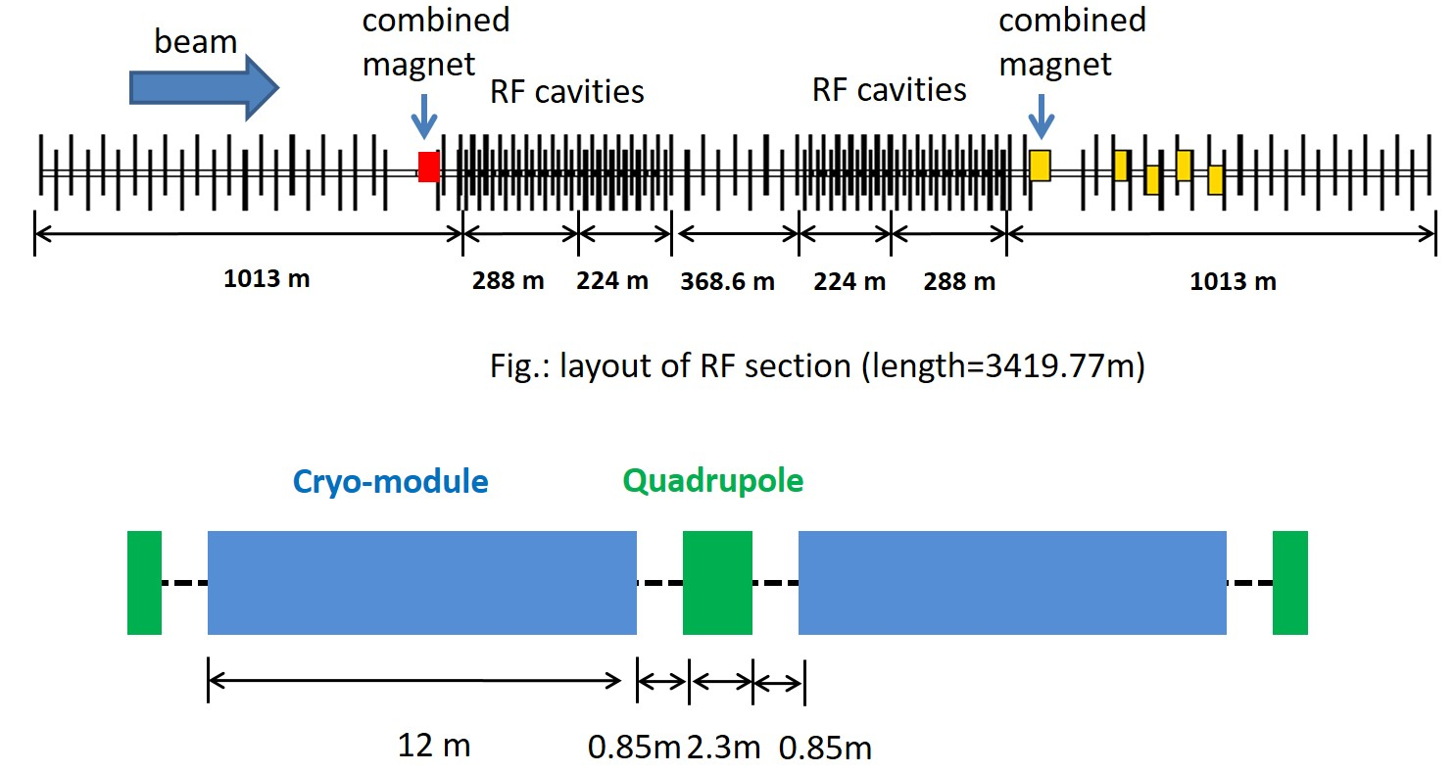
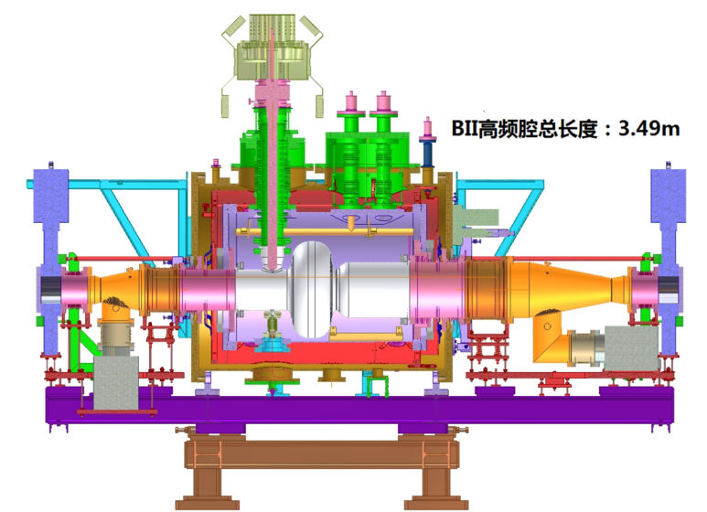
One Single-Cell Cavity Module
BEPCII 3.5 m single cavity cryomodule, could be reduced to 2.5 m each for cavity pair.
4 cavities (4 cells) between quadrupoles (CDR: 6x2=12 cells): 16 m
60 cavities for a quarter: 240 m. Enough space in RF section (224+288=512 m).

Slide 9
TDR Tasks for CEPC System Design
Simulation and experiment on HOM power generation and propagation through multi-cavity string and HOM couplers and absorbers. Cold components heating. Give input to practical HOM damping scheme and cryomodule design for HL Z.
Optimize HOM damping of most dangerous mode to the CBI growth time that longitudinal bunch-by-bunch feedback system can deal with. Cavity shape and asymmetry, beam pipe diameter, HOM coupler shape and orientation, (artificial enlarged) HOM frequency spread.
Develop time domain simulation code of beam cavity interaction with RF feedback for the fundamental mode CBI and RF transient (including individual cavity position, detuning and parking, injection, swap, booster ramp…). Elegant as the start.
Details of the Booster RF ramping and stability.
NSFC funded. PhD thesis work. Try up to 1.4 A for Z-pole mode.

Slide 10
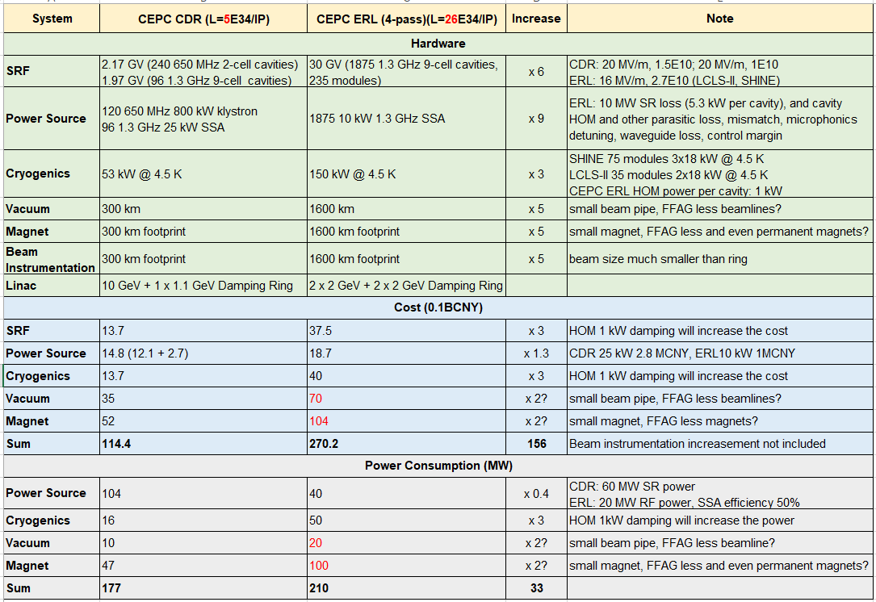
CEPC ERL Scheme Study
ERL-based collider high luminosity: higher beam power than linear collider, smaller beam size than ring collider. Beam power recovered to SRF linac.
Significantly increase cavity number, cryogenics, vacuum, magnet and beam instrumentation thus increase the total machine cost.
Total AC power reduction not sure, at least marginal.
Technology challenge and risk high.
Litvinenko et al. Future High Energy Circular e+e- Collider using Energy-Recovery Linacs. arXiv:1909.04437

Slide 11
Outline
CEPC SRF System Design
TDR Plan and R&D Status
SRF Industrialization Study

Slide 12
TDR Plan of CEPC SRF System
Time | TDR R&D Plan | Resources (in CNY)
2018-2020 | System design and optimization Key technology R&D 650 MHz test cryomodule | MOST CEPC 7 M (650 MHz, IHEP & PKU) PAPS 20 M (650 MHz & 1.3 GHz) SHINE R&D 13 M (1.3 GHz cavity and coupler) 4 FTEs now, 2 more FTEs needed
2020-2022 | Cryomodule prototyping Industrialization study | 80 M (one 650 MHz & one 1.3 GHz module with power sources) SHINE pre- and mass production ? M (1.3 GHz) 12 FTEs
2022-2023 | Industrialization and pre-production Cryomodule beam test | 90 M (three 650 MHz modules + two 1.3 GHz modules） SHINE mass production ? M (1.3 GHz) 18 FTEs

Slide 13
CEPC SRF Technological Uncertainties
Uncertainty | Impact | Mitigation Method
High Q operation (long term) | Cryogenic capacity, Field emission | Practical Q target, Moderate gradient, Clean (tunnel) assembly
Power coupler (variable) | Window event or failure, RF trip | Limit coupler power, Stand-by cavities, Fast closing valves between modules
HOM coupler and bellow | RF heating, cable heating, bellow heating | High power test at 2 K Special designed rigid coaxial line Class 10, RF shielded bellow at 2 K
LLRF (hardware in RF power source system) | FM CBI, Parking cavities for W & Z, Booster RF ramp | Direct RF feedback, symmetry detuning, Booster cavity para-phase ramp

Slide 14
CEPC SRF Hardware Specifications
Hardware | Qualification | Normal Operation | Max. Operation
650 MHz 2-cell Cavity | VT 4E10 @ 22 MV/m HT 2E10 @ 20 MV/m | 1.5E10 @ 20 MV/m | 2E10 @ 20 MV/m
1.3 GHz 9-cell Cavity | VT 3E10 @ 24 MV/m | 1E10 @ 20 MV/m | 2E10 @ 23 MV/m
650 MHz Input Coupler (variable) | HPT 300 kW sw | < 280 kW | 300 kW
1.3 GHz Input Coupler (variable) | HPT 20 kW peak, 4 kW avr. | < 20 kW peak | 20 kW peak
650 MHz HOM Coupler | High power test at RT and 2 K: 1 kW | < 1 kW | 1 kW
650 MHz HOM Absorber | High power test at RT: 5 kW | < 5 kW | 5 kW
650 MHz Cryomodule (six 2-cell cavities) | static loss 5 W @ 2 K | static loss 8 W @ 2 K | static loss 10 W @ 2 K
Tuner (Collider & Booster) | tuning range and resolution 400 kHz / 1 Hz | 300 kHz / 1 Hz | 400 kHz / 1 Hz

Slide 15
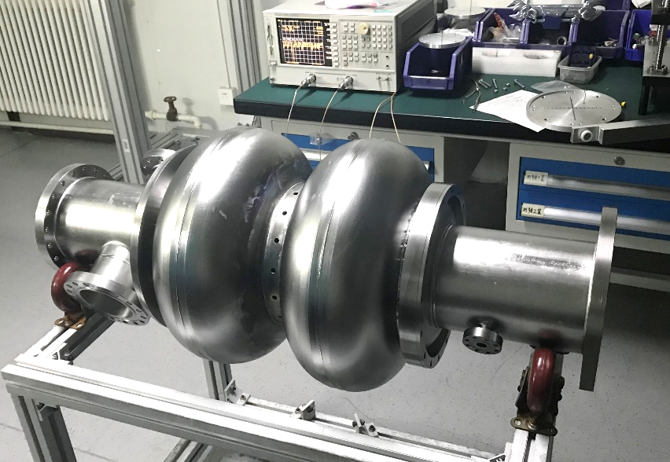
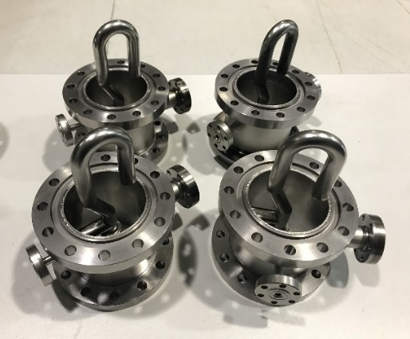
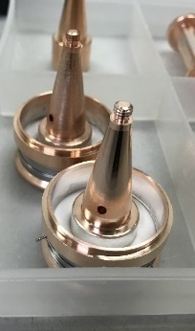
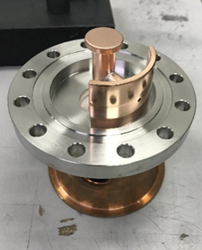
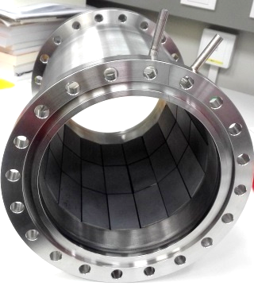
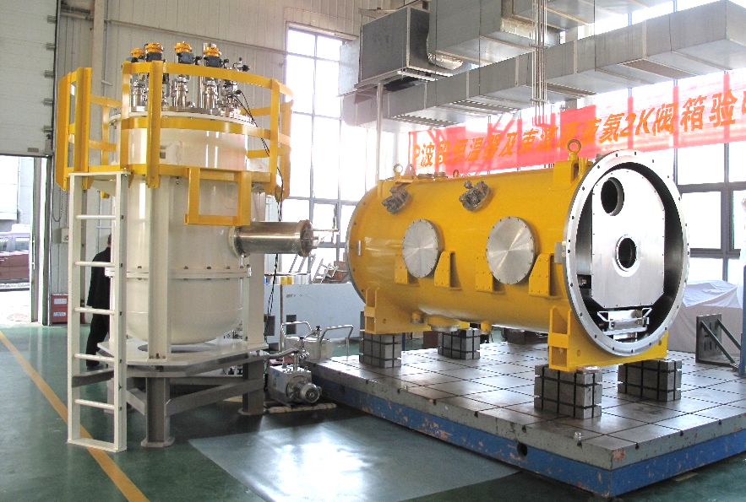
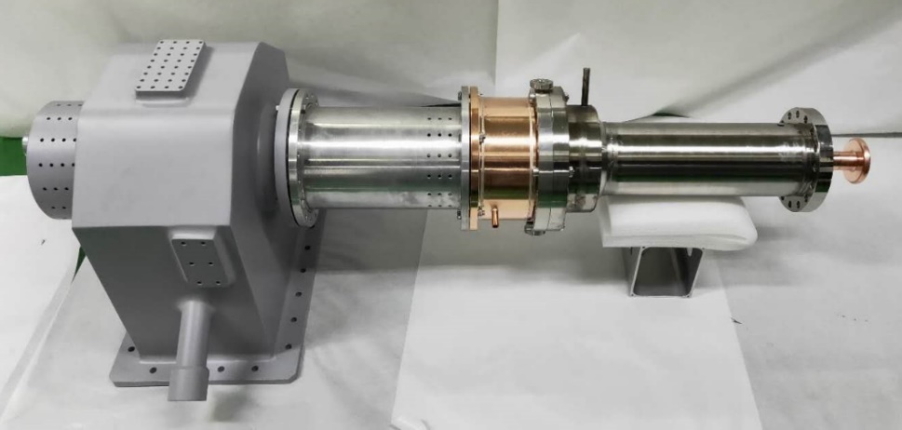
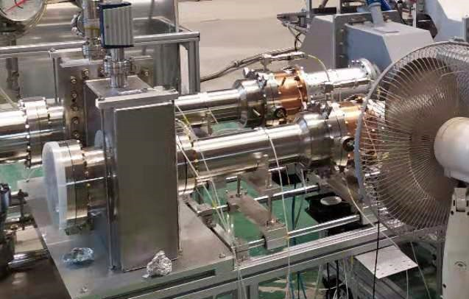
Prototypes of CEPC 650 MHz SRF System
Three fine grain 650 MHz 2-cell cavities fabricated and processed (BCP). Vertical test and helium vessel weld with magnetic shield inside soon. Two for module horizontal test and beam test. Tuner fabrication completed and will test in a stand. Cavity details and high Q study in Peng Sha’s talk.
Four high power HOM couplers fabricated and low power tested with cavity. Three will mount on the 2-cell cavities. Vertical test soon with the cavity to verify the notch properties. High power test (1 kW) at RT and 2 K planned with special rigid coaxial line.
High power test of one 650 MHz fixed coupling input coupler reached 150 kW SW (corresponding to 400 kW TW at the window). Another coupler’s window broke due to excess ceramic heating. New window and two variable couplers in fabrication.
Wideband high power room temperature HOM absorber with SiC+AlN material. 5 kW high power test planned.
Cryomodule and valve box for two 650 MHz 2-cell cavities etc. Module assembly and beam test at PAPS in 2020.

Slide 16
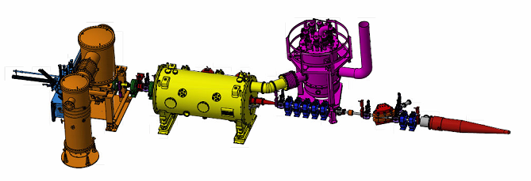
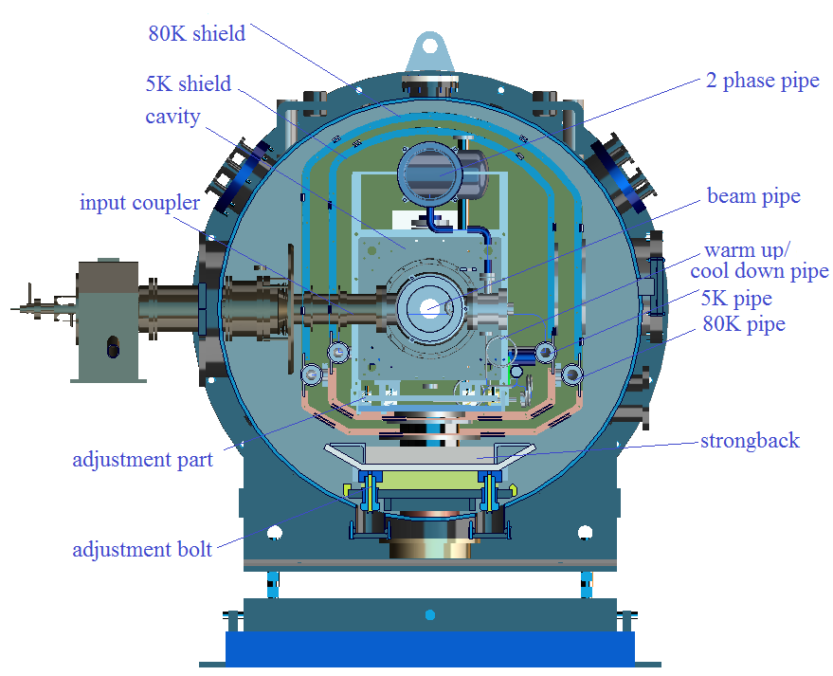
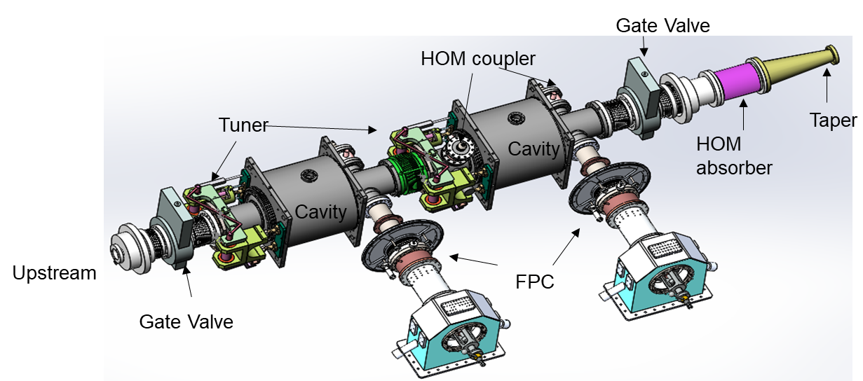
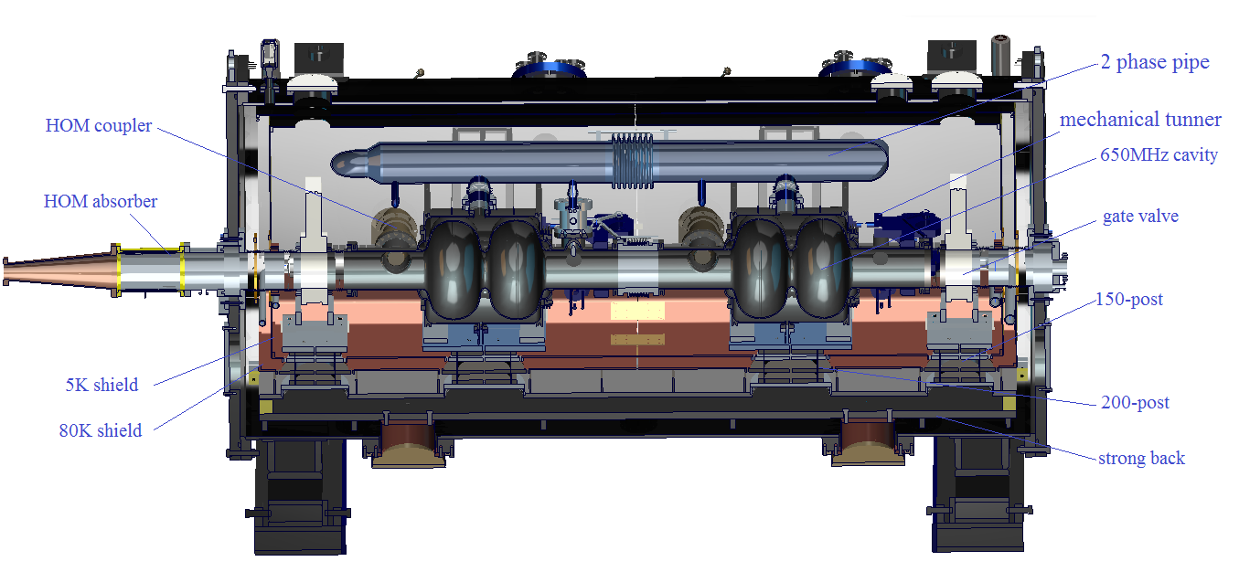
CEPC 650 MHz Test Cryomodule
Two 650 MHz 2-cell cavities with input couplers, HOM couplers and absorbers, tuners etc.
Module assembly and 15 MeV beam test with 1 ~ 10 mA from DC photo-cathode gun in 2020.
Demonstrate system integration and performance of high Q 650 MHz cavity (but with low input power and HOM power) for the Collider Ring.

Slide 17
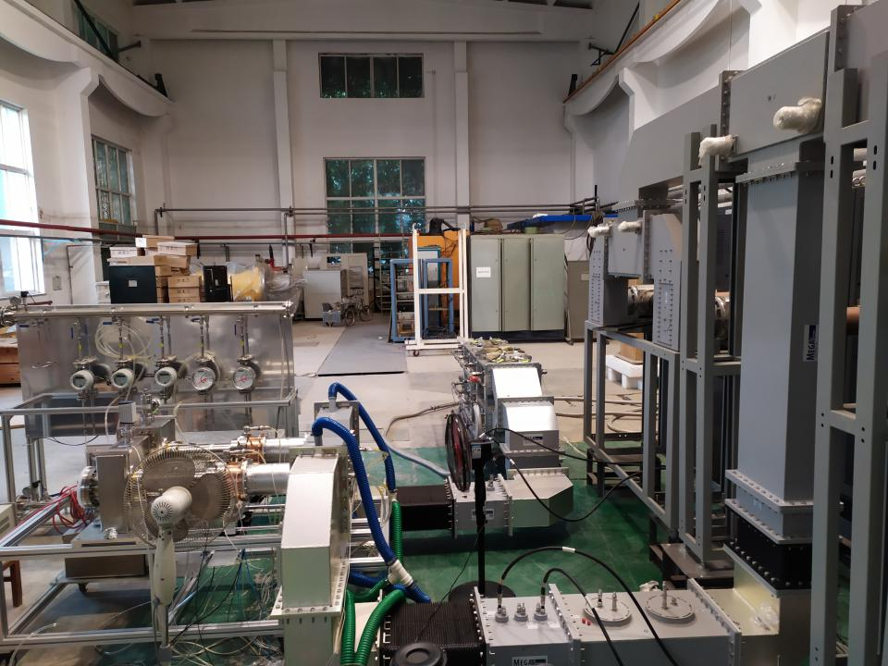
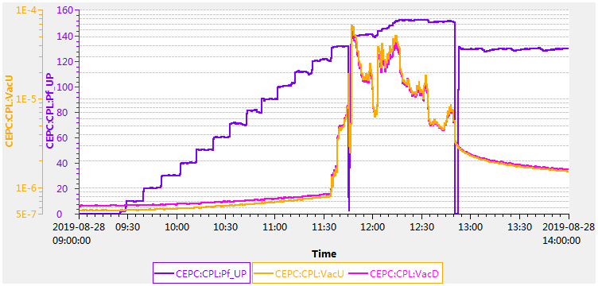
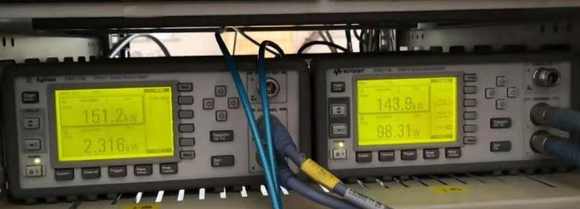
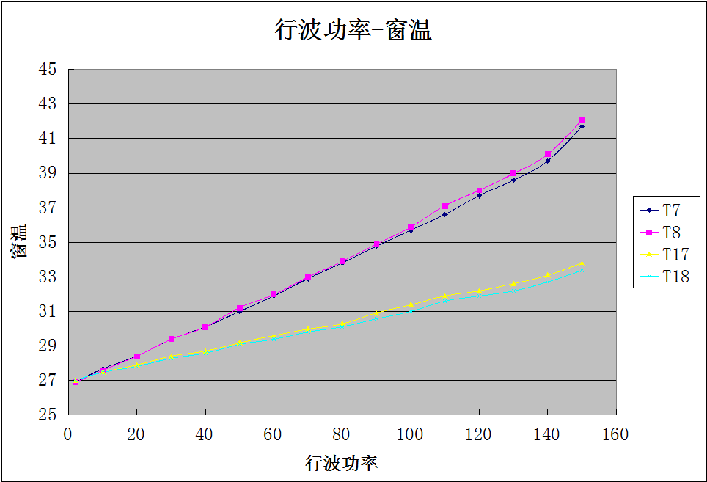
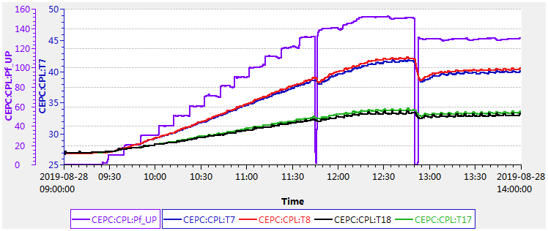
650 MHz Input Couplers TW Test
Tested to 150 kW TW (limited by the power source).
Upstream coupler has higher window heating (41.9 C, 8 degree higher than the downstream), thus higher loss.

Slide 18
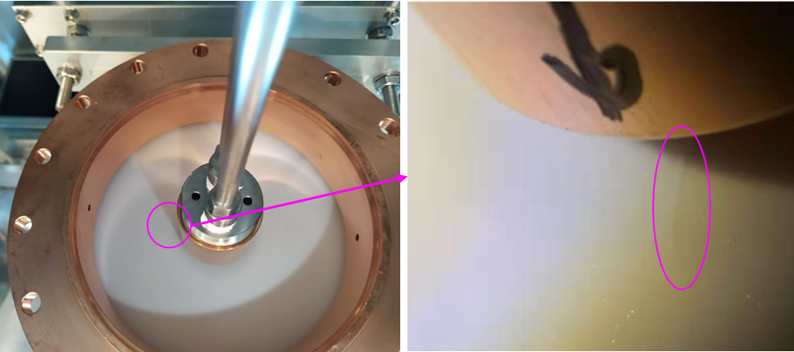
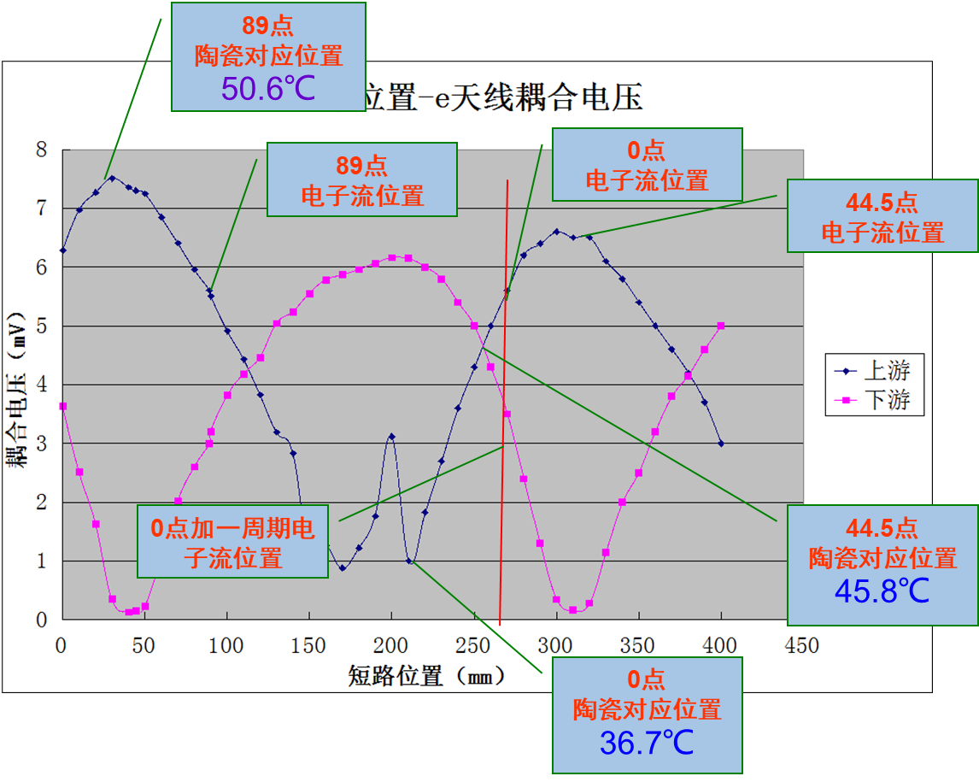
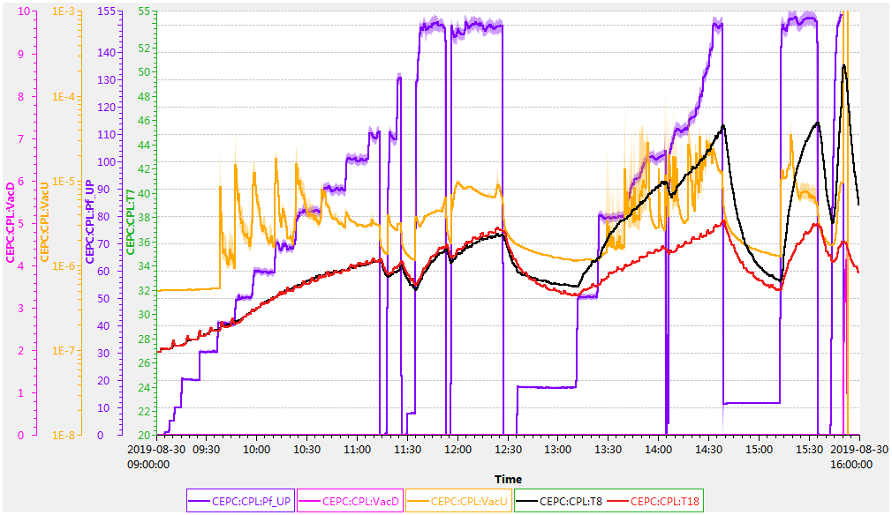
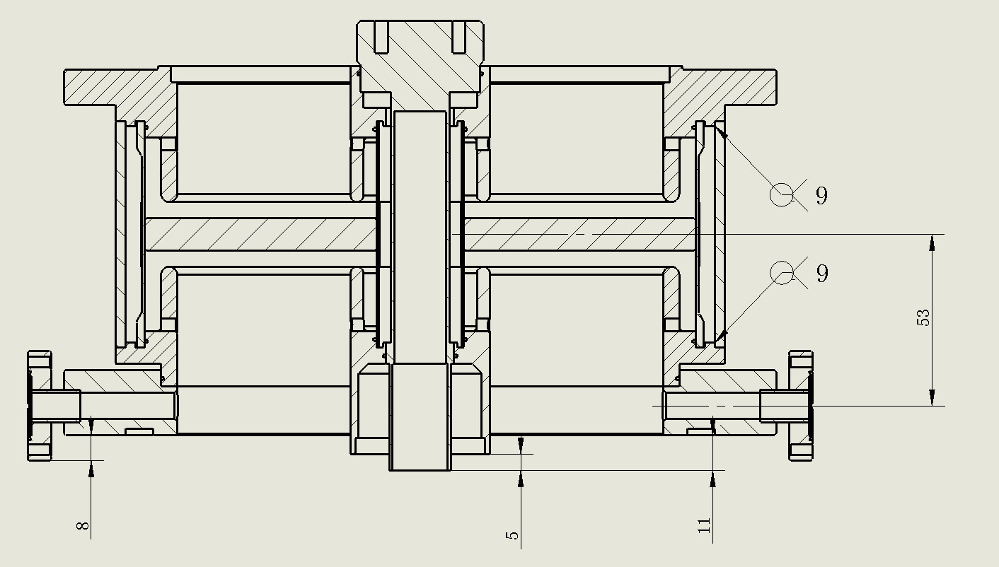
650 MHz Input Couplers SW Test
Two couplers tested to 150 kW SW. Corresponding TW power at the window is 500 kW of the upstream coupler and 400 kW of the downstream.
Upstream coupler’s ceramic window broke after 3 min at 150 kW SW. Crack on air side, no Cu sputter on vacuum side. Detect SW amplitude at low power by electron probe near the window. The SW peak (antinode) is very near to the window when it broke. New window in fabrication.
window ceramic
Electron probe

Slide 19
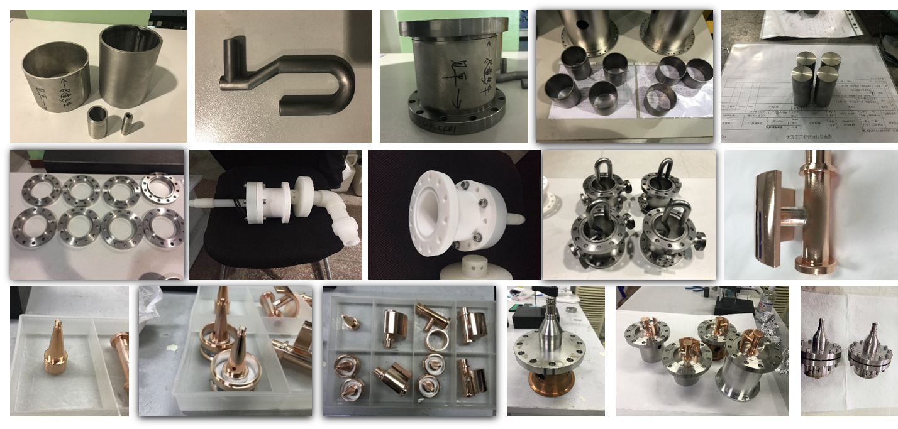
650 MHz HOM Coupler Fabrication

Slide 20
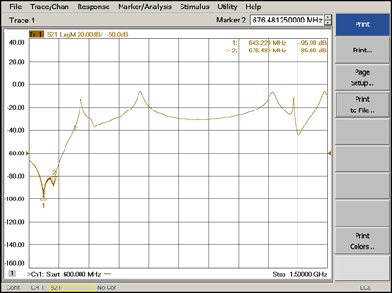
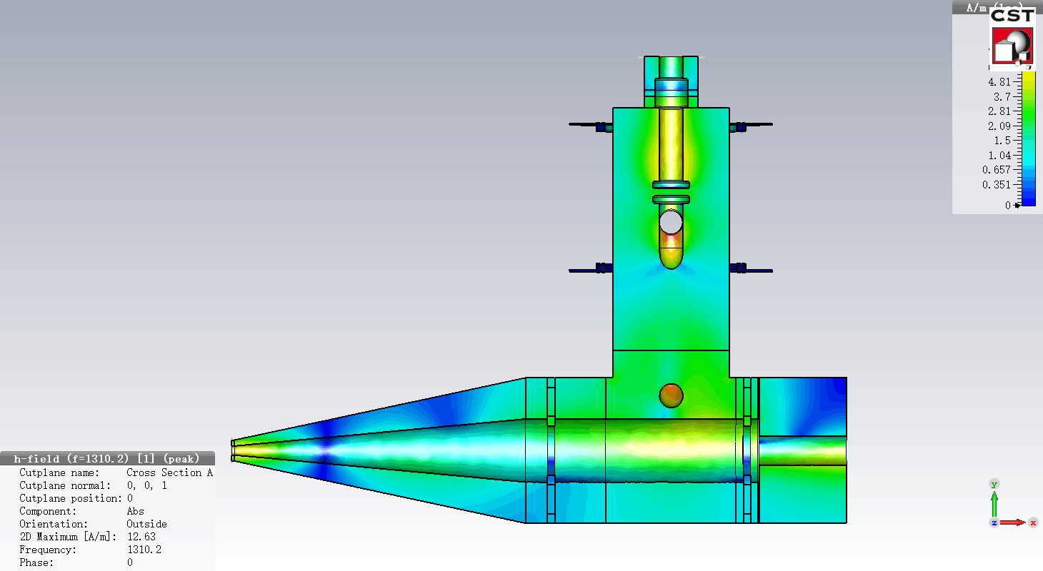
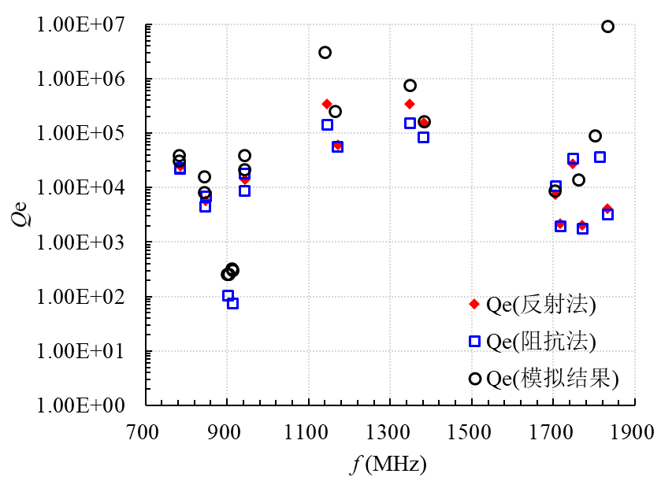
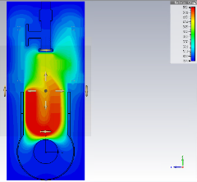
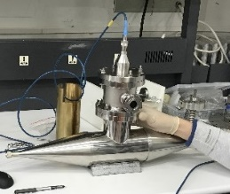
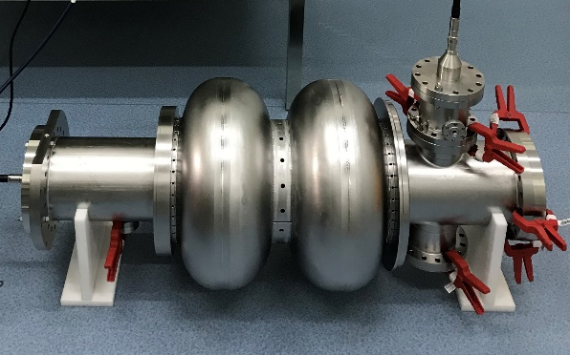
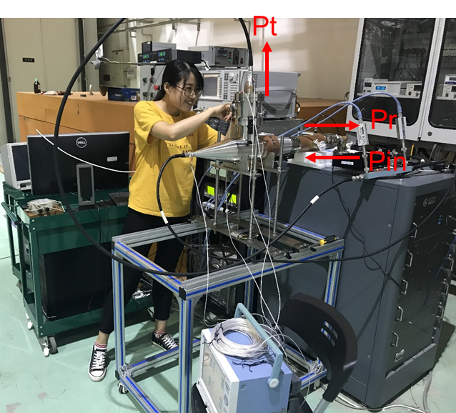
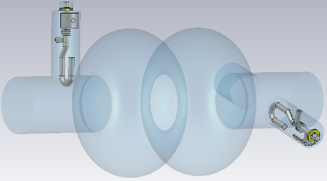
650 MHz HOM Coupler Testing
FM Qe of 4 HOM couplers installed on cavity meets spec because of double-notch advantage.
TE111&TM110 Qe agree well with simulation. TM011-2 measured Qe 6E4. Need to optimize to 1E4 (10 ms growth time for CEPC Z) and reduce effective Qe to 1E3 with freq spread (100 ms, longitudinal FB request).
FM & HOM Qe measure with cavity at 2K soon. 1 kW high power test with 1.3 GHz SSA at RT and 2 K planned.
Most dangerous monopole for CEPC Collider Ring Z-pole
End plate match at RT, rigid coaxial line
HOM coupler | FM Qe at RT
#1 | 4.0E+12
#2 | 1.7E+14
#3 | 3.3E+11
#4 | 3.7E+13
Off-resonance excitation of 1.3 GHz power at 2 K
RT high power test stand

Slide 21
Outline
CEPC SRF System Design
TDR Plan and R&D Status
SRF Industrialization Study

Slide 22
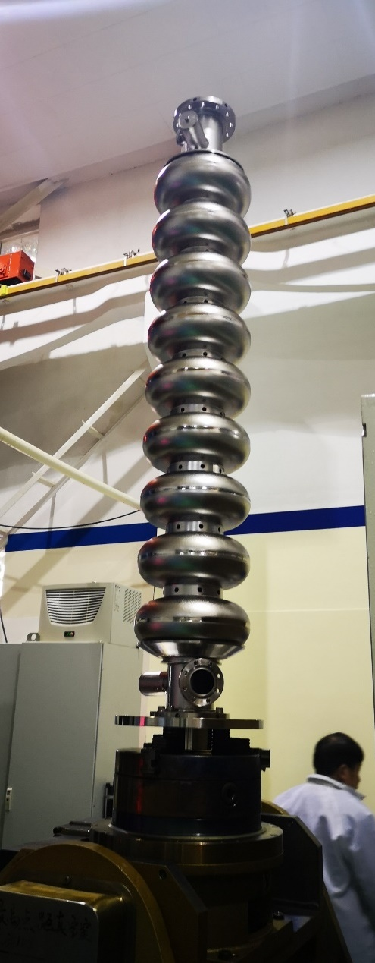
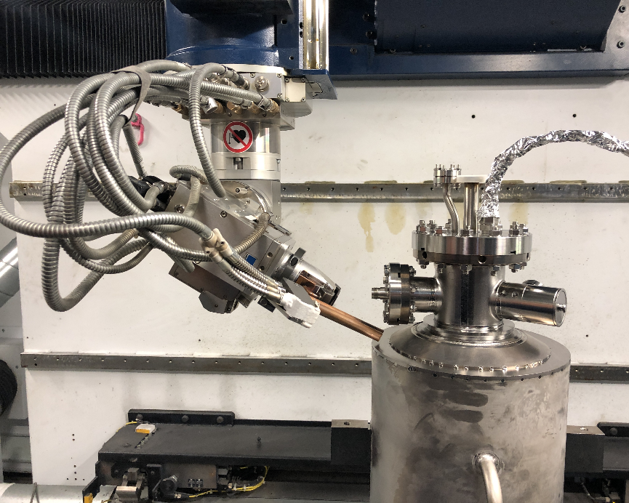
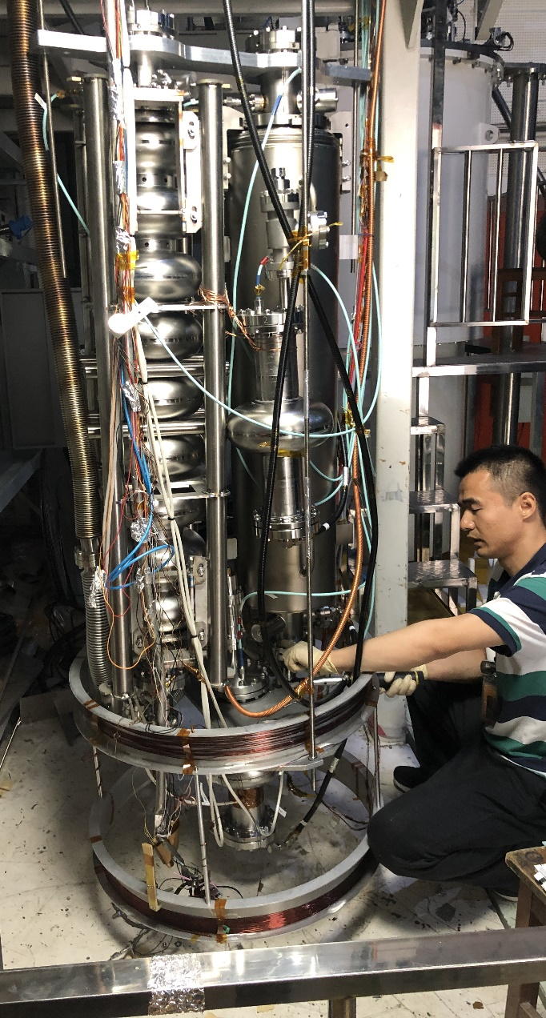
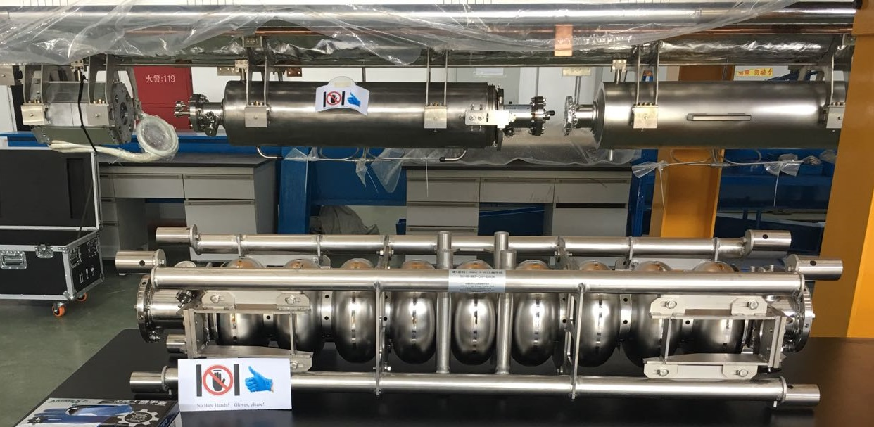
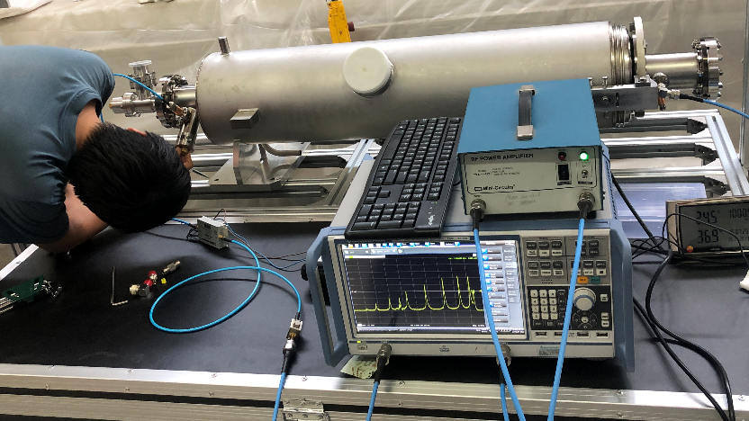
Industrialization of 1.3 GHz 9-cell Cavities
Seven 9-cell cavities made for SHINE R&D. Four cavities BCP and vertical tested. 3+8 more cavities.
Four cavities laser welded with helium vessel. Will deliver to Shanghai for test module assembly.
Two key issues that are pointed out: Chemistry Inside SRF Lab and Vendor, High Pressure Vessel Code

Slide 23
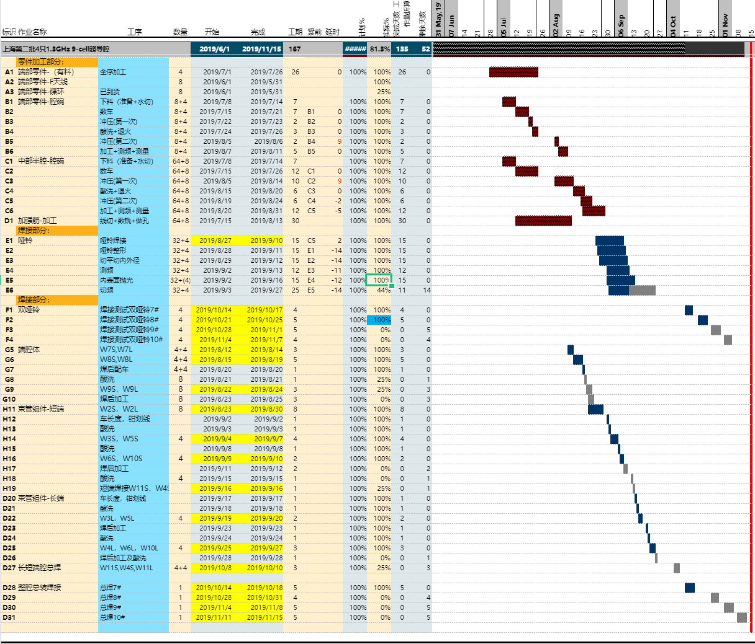
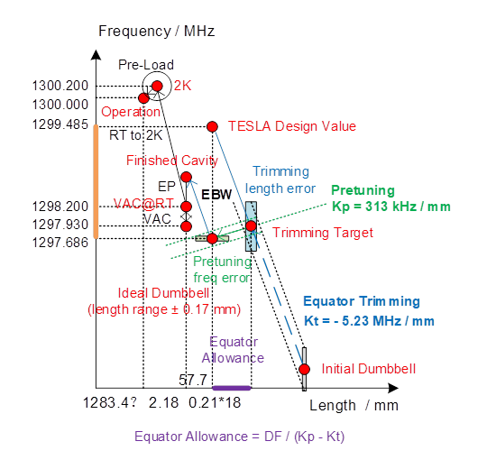
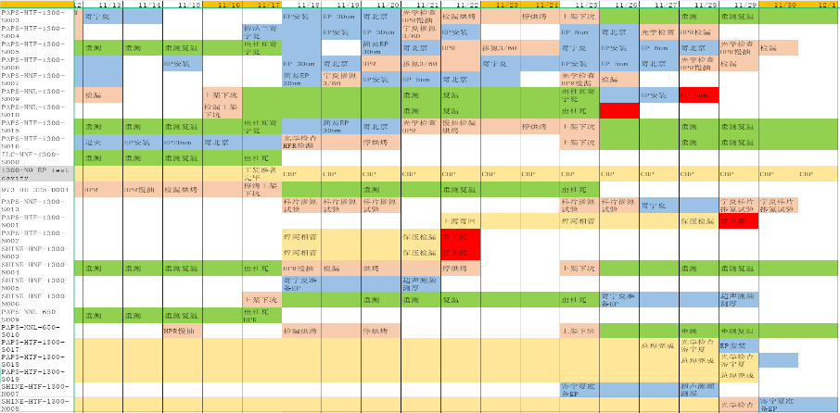
Cavity Quality Control
Cavity database and QC documents (on cloud). Use ten 9-cell cavities to build the best architecture and integrate into one database for mass production.
Comprehensive records of fabrication, processing and testing. More than 10000 data and images per cavity.
Precise control of frequency, shape, length, eccentricity and field flatness through the whole cavity life cycle.
Cavity QC Documents and Databases
1. Half cell, dumbbell, end group records & trimming
2. 9-cell RF and mechanical control and records
3. 9-cell pretuning and field flatness
4. Processing and assembly procedures & parameters
5. HOM notch tuning at RT
6. Vertical test with passband and OST
7. FM Qe & notch and HOM Qe measurement at 2 K
8. Schedule of fabrication, processing, dressing and testing

Slide 24
RF and Mechanical Quality Control
 | Specification | 1300-N001 | 1300-N002 | 1300-N003 | 1300-N004
Dumbbell shape error | ≤ +/- 0.5 mm | ± 0.4 | ± 0.4 | ± 0.4 | ± 0.4
Cavity length (after pre-tuning) | 1283.40 +/- 3.0 mm | 1284.55 mm | 1283.19 mm | not measured | not measured
Cavity length in helium vessel | 1283.40 +/- 3.0 mm | 1283.56 mm | 1282.30 mm | 1280.94 mm | to be measured
Eccentricity (radius) | ≤ 0.4 mm | no adjustment | no adjustment | no adjustment | no adjustment
Frequency bare cavity (vacuum, RT) | 1298.2 +/- 0.1 MHz | 1298.210 MHz | 1298.160 MHz | 1298.162 MHz | not measured
Frequency bare cavity (2K) | 1300.2 +/- 0.1 MHz | 1300.252 MHz | 1300.199 MHz | 1300.318 MHz | 1300.280 MHz
Frequency dressed cavity (2K) | 1300.2 +/- 0.1 MHz | 1299.870 MHz | 1300.018 MHz | 1300.062 MHz | 1300.147 MHz
Field flatness bare cavity | ≥ 95 % | 95% | 98% | 97% | 96%
Field flatness dressed cavity | ≥ 90 % | 85% | 94% | 98% | 98%
Leak rate | ≤ 1.0e-8 Pa l/s | OK | OK | OK | OK
HOM coupler FM Q_{e} (2K) | > 2.7E11 | 1.5E12, 3.5E13 | 3.7E12, 4.7E11 | 1.6E11, 2.1E12 | 2.7E14, 1.9E12
Bare cavity gradient (BCP) | > 19 MV/m | 20 MV/m | 19.5 MV/m | 25 MV/m | 26.5 MV/m
Bare cavity Q₀ (BCP) | > 1.0×10¹⁰ @16 MV/m | 1.50E+10 | 1.20E+10 | 1.90E+10 | 1.90E+10
Dressed cavity gradient (BCP) | > 19 MV/m | 20 MV/m | 19.5 MV/m | 23.2 MV/m | 17 MV/m (FE limit)
Dressed cavity Q₀ (BCP) | > 1.0×10¹⁰ @16 MV/m | 1.50E+10 | 1.40E+10 | 1.90E+10 | 1.0E10

Slide 25
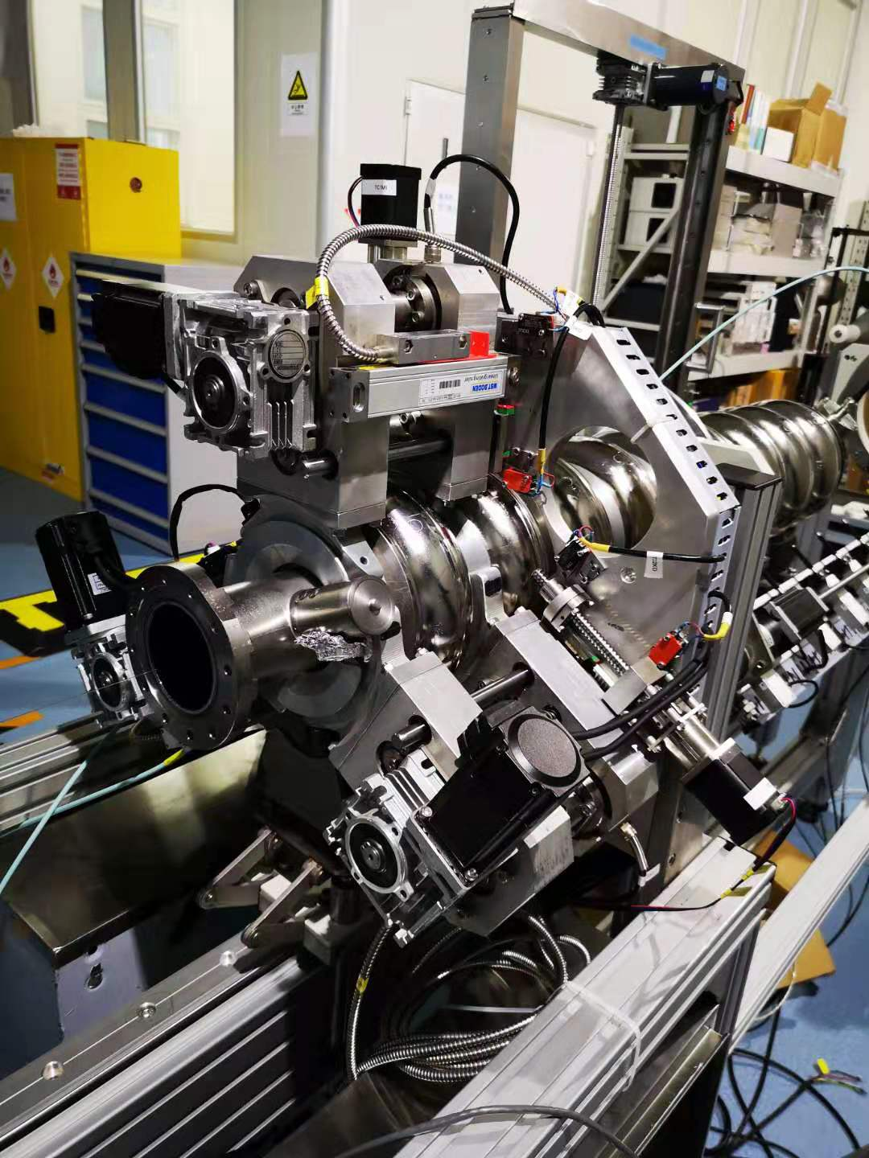
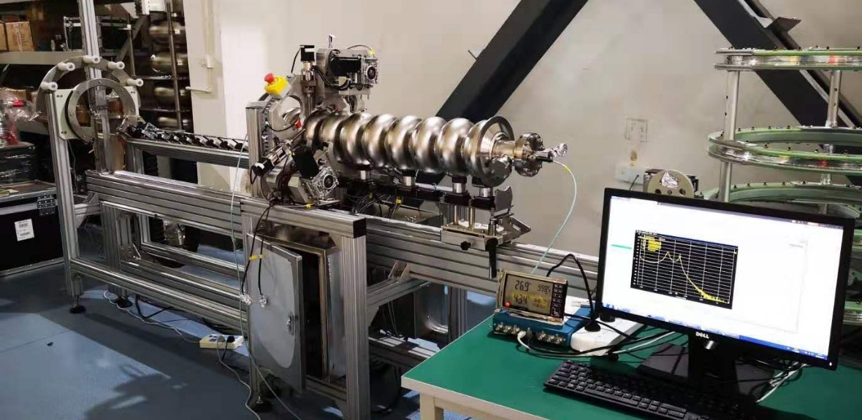
IHEP New Tuning Machine (by PKU)
Cavity frequency tuning and field flatness, length and eccentricity adjustment. Similar to DESY’s design for XFEL.
Need to improve automatic tuning procedure for higher efficiency (target: half day a cavity).

Slide 26
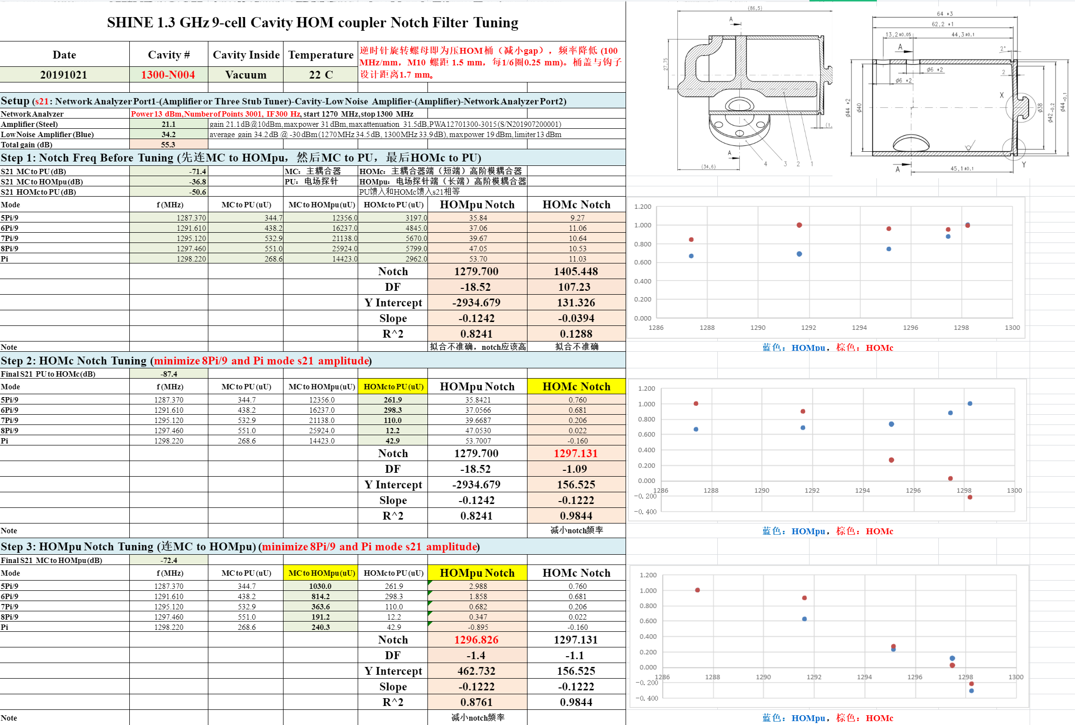
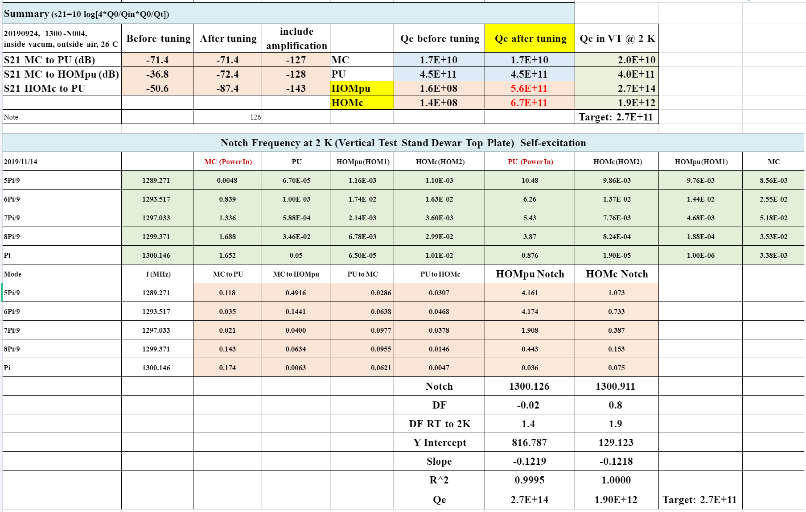
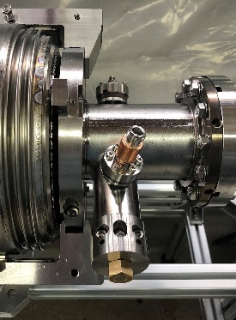
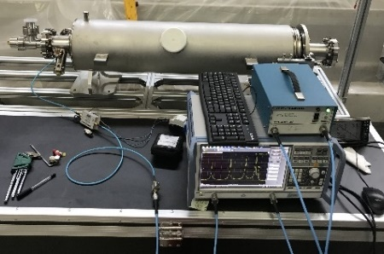
HOM Coupler Notch Tuning
HOM coupler notch tuning at RT. Notch frequency allowance for cap pressure difference (cavity in vacuum).
FM Qe @ 2K well above the spec. 2K notch increase 1.4~1.9 MHz. More data needed.

Slide 27
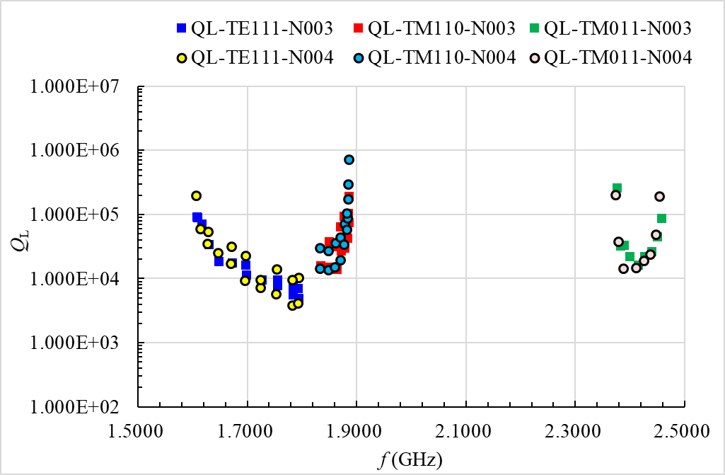
HOM Mode Damping
HOM Qe at 2K: TE111 & TM110 OK. N004 TM011-9 exceeds 1E5.
N007 TM011-9 Qe after EBW exceeds 1E5 (with flat dumbbell matching).
Match dumbbells and end groups with tilted FM field (higher field at cell#1).
LCLS-II and SHINE limit
XFEL, ILC & CEPC limit
Qe1=7.6E4
Qe2=1.2E5
Qe=4.7E4
Qe1=3.9E5
Qe2=1.8E5
Qe=1.2E5
N007-TM011-8_2Pi/9
N007-TM011-9_Pi/9
Opposite F-L coefficient. TM011-Pi/9 field in cell#1 increases (thus reduce Qe) after TM010-Pi field flatness tuning.
TESLA 9-cell Cavity HOM Qe at 2K
(modes in red ovals have high R/Q)
N007-TM010-9_Pi
TM011_Pi/9
TM010_Pi

Slide 28
CEPC Booster HOM CBI and Feedback
Modes | f (GHz) | R/Q (monopole Ω, dipole Ω/m) | Q_{e} measured | CBI Growth Time (ms)
 |  |  |  | H-extraction | W-extraction | Z-extraction
TM011 | 2.45 | 156 | 5.9E4 | 2307 | 236.7 | 51.3
TM012 | 3.845 | 44 | 2.4E5 | 1281.3 | 131.5 | 28.5
TE111 | 1.739 | 4283 | 3.4E3 | 7308.6 | 967.1 | 209.6
TM110 | 1.874 | 2293 | 5.0E4 | 928.3 | 122.8 | 26.6
TM111 | 2.577 | 4336 | 5.0E4 | 490.9 | 65 | 14.1
TE121 | 3.087 | 196 | 4.4E4 | 12341 | 1633 | 353.9
 |  |  |  | H-injection | W-injection | Z-injection
TM011 | 2.45 | 156 | 5.9E4 | 149 | 29.6 | 11.3
TM012 | 3.845 | 44 | 2.4E5 | 82.7 | 16.4 | 6.3
TE111 | 1.739 | 4283 | 3.4E3 | 609 | 120.9 | 46.1
TM110 | 1.874 | 2293 | 5.0E4 | 77.4 | 15.4 | 5.9
TM111 | 2.577 | 4336 | 5.0E4 | 40.9 | 8.1 | 3.1
TE121 | 3.087 | 196 | 4.4E4 | 1028.4 | 204.1 | 77.8
All larger than the beam transverse feedback time limit of 1.6 ms (5 turns) and longitudinal feedback time limit of 2.5 ms (synchrotron oscillation period)
If the parked booster cavities are moved off beamline, the growth time will be increased to 1.5 and 3 times for the W and Z respectively.
Cavity HOM frequency spread (> 1 MHz) will have more margin. Need statistics.
Average beta_x,y in RF cavity ~ 30 m
Monopole Cut off frequency:
2934 MHz
Longitudinal FB limit: 65 ms.
Dipole Cut off frequency: 2253 MHz

Slide 29
Statistics of Cavity HOM Frequency Spread
Empirical model of the cavity HOM frequency spread used for many projects:
σ_{HOM} = 0.1 ~ 0.5 % f_{HOM}
Statistics for the 50 TESLA cavities fabricated for the TTF linac and measured at 2 K:
TE111: 5 MHz, almost the same for all 18 modes.
TM110: varies from 1 MHz to 6 MHz and modes with lower frequency are more sensitive to the machining errors.
TM011: 9 MHz for all modes
Euro-XFEL data?
J. Sekutowicz. “Multicell superconducting structures for high energy e+e- colliders and free electron laser linacs,” EuCARD Editorial Series on Accelerator Science and Technology, Vol.01 (2007).

Slide 30
Industrialization of 1.3 GHz Variable Coupler
Two 1.3 GHz TTFIII-type variable input couplers. Modified for 7 kW CW power. Can be used for ILC.
High power conditioning at Shanghai soon (14 kW TW, 7 kW SW).

Slide 31
1.3 GHz Variable Coupler Quality Control
 | Specifications | Test Results | Notes
Thickness of inner conductor Cu plating | 150 ± 20 % μm | 150 – 190 μm | bellow 30 %
Thickness of outer conductor Cu plating | 30 ± 20 % μm | 30 – 40 μm | bellow 30 %
RRR after annealing | 30 - 80 | 24 - 26 | need optimization
Thickness of TiN Coating | 10 nm (7-15 nm) | 20 - 40 nm | not accurate
Ceramic Brazing
Strength Test (>100 MPa)
Copper Plating
TiN Sputtering device and SEM section
(will try profilometer to measure the thickness)

Slide 32
Summary
CEPC SRF system well designed for CDR parameters. SRF options for HL Z under discussion.
CEPC 650 MHz SRF key components prototypes have been developed. Will integrate into a test cryomodule to demonstrate several key performances.
Rapid industrialization of 1.3 GHz cavities and input couplers. To keep the momentum and competence, eight-cavity cryomodule integration should be done at PAPS as soon as possible.
International collaborations on SRF technology and infrastructure have been and will continue to be of unique importance. CEPC SRF specific design and R&D collaborations are welcomed.

Slide 33
RF Parameter Comparison
 | BEPCII | BEPCII RF Upgrade Plan B | CEPC HL-Z 1-cell | CEPC HL-Z 1-cell | CEPC H (HL-Z) 1-cell | CEPC HL-Z 2-cell | CEPC HL-Z 2-cell | CEPC H (HL-Z) 2-cell | CEPC Ultimate Z 1-cell
Beam current (mA) | 600 | 1200 | 840 | 840 | 2 x 17.4 | 840 | 840 | 2 x 17.4 | 1400
Cell number | 1 | 1 | 1 | 1 | 1 | 2 | 2 | 2 | 1
Cavity number / ring | 1 | 1 | 120 | 60 | 2 x 120 | 120 | 60 | 2 x 120 | 60
Eacc (MV/m) | 6 (1.5 MV) | 10 (2.5 MV) | 3.6 | 7.2 | 40 | 1.8 | 1.8 | 20 | 7.2
Temperature (K) | 4.2 | 4.2 | 2 | 2 | 2 | 2 | 2 | 2 | 2
Q₀ | 1E9 | 5E8 | 3E10 | 3E10 | 3E10 | 1.5E10 | 1.5E10 | 1.5E10 | 3E10
Input power (kW) | 120 | 250 | 250 | 500 | 250 | 250 | 250 | 250 | 1000
Cavity# / klystron | 1 | 1 | 2 | 2 | 2 | 2 | 2 | 2 | 1
Klystron power (kW) | 250 | 300 | 800 | 1400 | 800 | 800 | 800 | 800 | 1400
HOM damper | Absorber | Absorber | (Hook+) Absober | (Hook+) Absober | (Hook+) Absober | (Hook+) Absober | (Hook+) Absober | (Hook+) Absober | (Hook+) Absober
HOM power (kW) | 7* | 15 | 2.3+ | 2.3+ | 0.3+ | 4.6+ | 4.6+ | 0.6+ | 4 +
* Bunch length 15 mm, cavity cell HOM loss factor 0.1 V/pC, tapers 0.06 V/pC, absorbers 0.26 V/pC.

