Slide 1
MOST2 PLL_Ser Design Review
Xiaoting Li
IHEP
April 30, 2019

Slide 2
Outline
Requirement
32-bit-input data, output data rate: 160Mbps@trigger, 4Gbps@triggerless
Data valid flag
Low power consumption
PLL Design and simulation
Design A (in pixel chip)
2.56GHz, ~ -100dBc/Hz@1MHz offset（Divisor N is 64）
1.28GHz（N is 32）
160MHz/80MHz output clock for periphery @triggerless mode ---- CKOUT
Design B (test block)
2.24GHz（N is 56）
140MHz CKOUT
Serializer Design and simulation
5.12Gbps is hard to realize by using 180nm process
4.48Gbps seems to work at worst case in the preliminary simulation
3.84Gbps

Slide 3
Requirement
Data rate
SFR structure: DR=Fpll, 4Gbps requires a 4GHz clock
Tree structure (2:1): DR=2Fpll, a 2GHz clock is enough
Data valid flag
D31 ---- When D31 is high, data is valid
Low power consumption

Slide 4
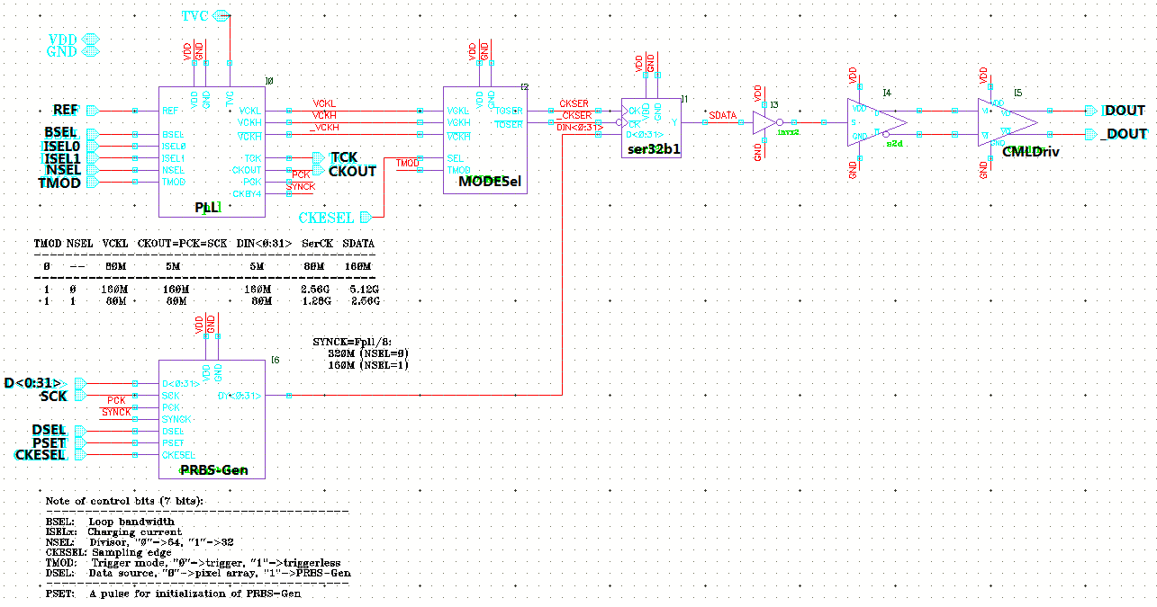
Top sch of PLL_Ser
Control bits (7)
BSEL, ISEL0, ISEL1, NSEL, TMOD, DSEL, CKESEL
Reset signal for test module
PSET (high → reset)
Input
REF
Output
DOUT/_DOUT
Test
TVC, TCK
Power
AVDD/AGND, DVDD/DGND
Inner interface
D<0:31>, SCK, CKOUT

Slide 5
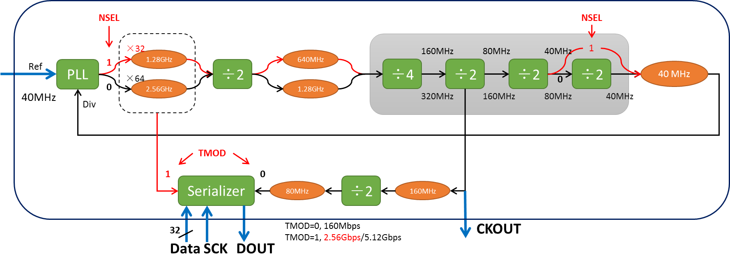
Operating mode (Design A)
TMOD-NSEL | Operating Mode | CKOUT (Hz) | D<0:31> (bps) | SCK (Hz) | SerCK (Hz) | Serial DOUT (bps)
0-x | Trigger | ---- | 5M | 5M | 80M | 160M
1-0 | Triggerless, ×64 | 160M | 160M | 160M | 2.56G | 5.12G
1-1 | Triggerless, ×32 | 80M | 80M | 80M | 1.28G | 2.56G

Slide 6
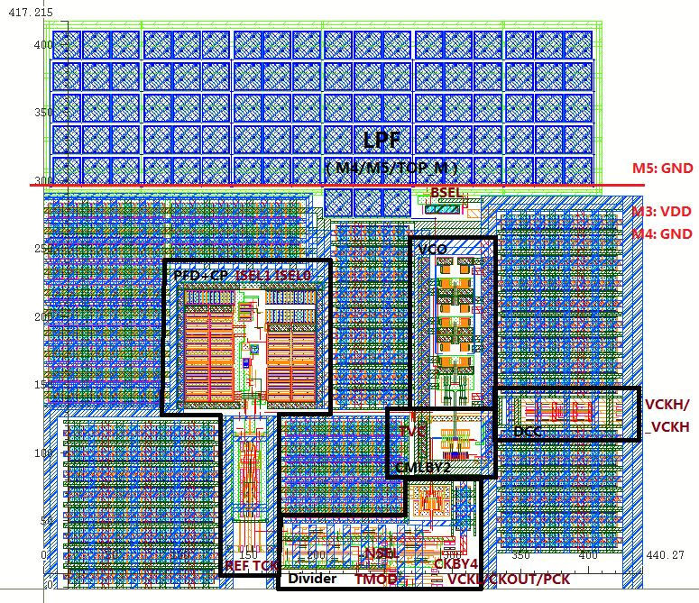
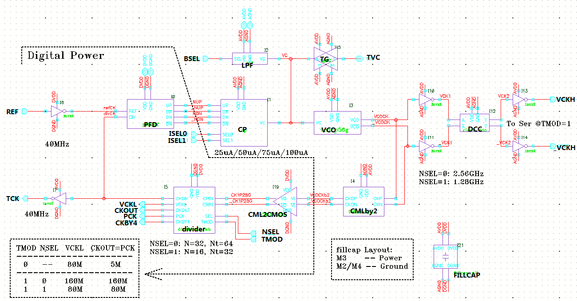
PLL Design A
420×450 μm²
NSEL: 0→2.56GHz, 1→1.28GHz
ISEL1/ISEL0: 00/01/10/11 → 25/50/75/100μA
BSEL： 0→3kΩ, 1→8kΩ
TMOD: 0→Trigger, 1→Triggerless

Slide 7
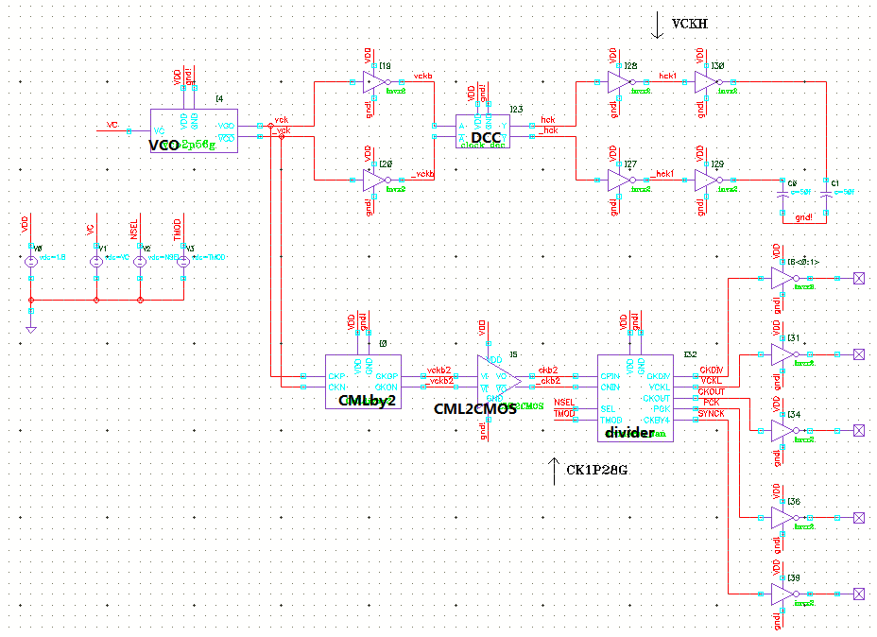
VCO post-simulation
Test bench A
VF-Curve
Phase noise
Test bench B
Max frequency
Function
Single-end output swing of VCO and CMLby2
Duty cycle
Test bench B
Test bench A

Slide 8
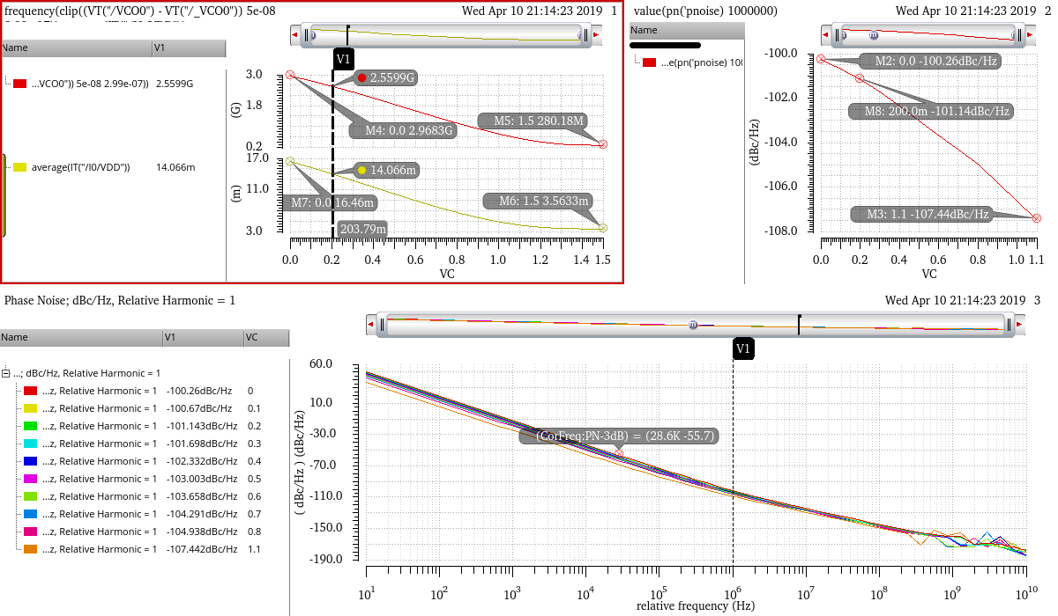
VCO post-sim @ SS 85℃
Tuning range @ SS 85
280MHz ~ 2.96GHz
Current range @ SS 85
3.57mA ~ 16.46mA
Phase noise
~ -100dBc/Hz@1MHz offset
Current @ 2.56GHz & FF -40
16.09mA
Current range @ FF -40
6.85mA ~ 26.26mA

Slide 9
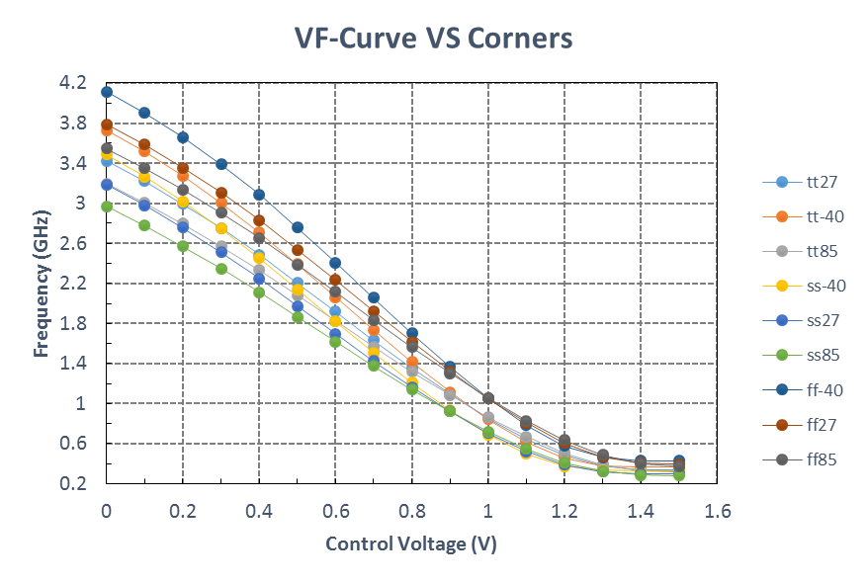
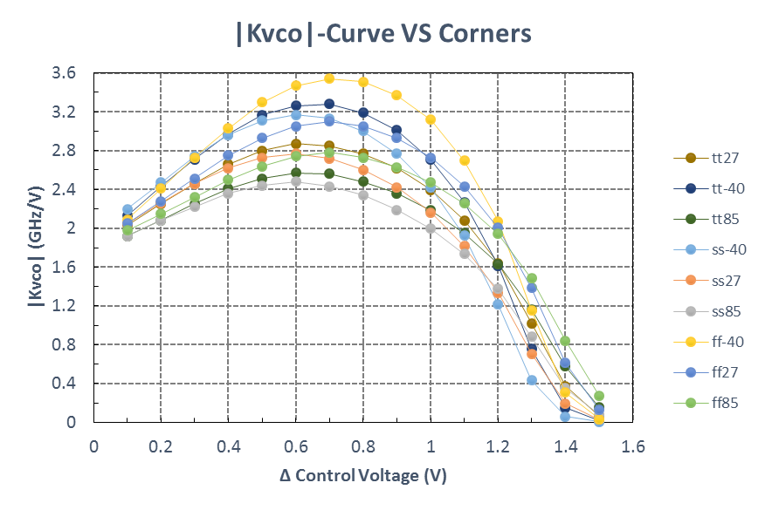
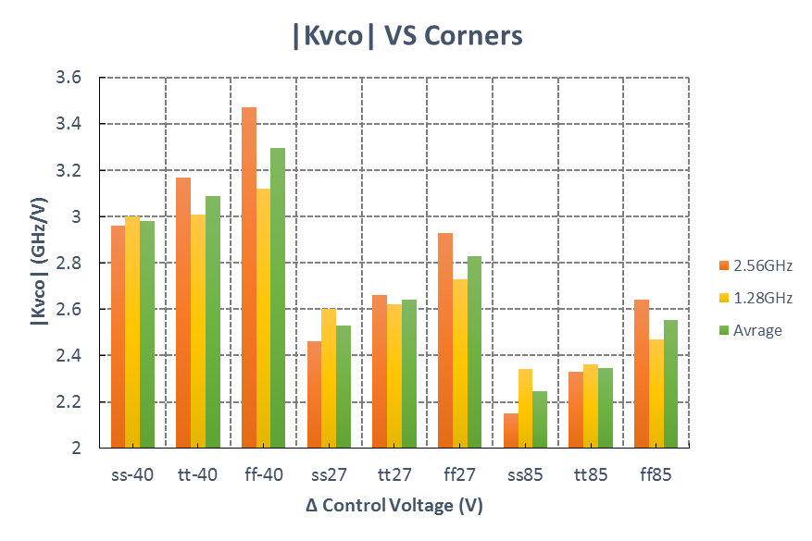
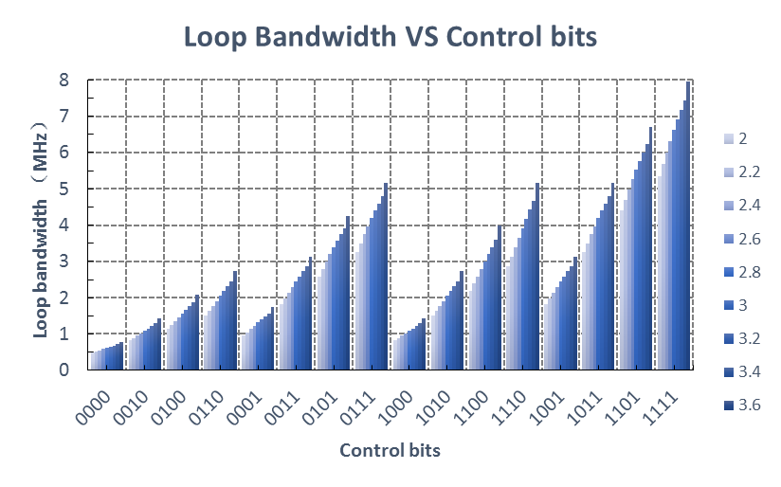
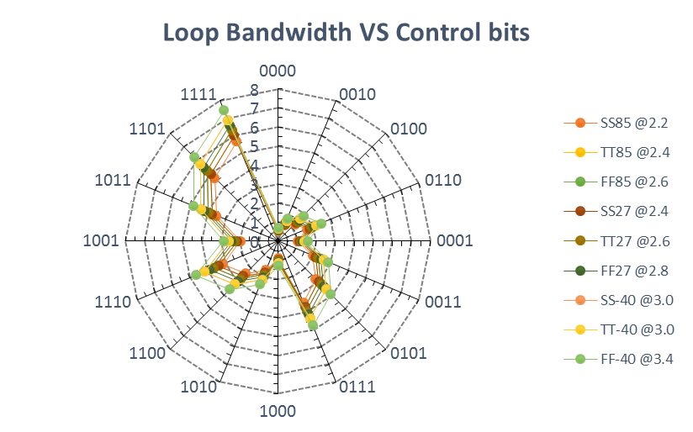
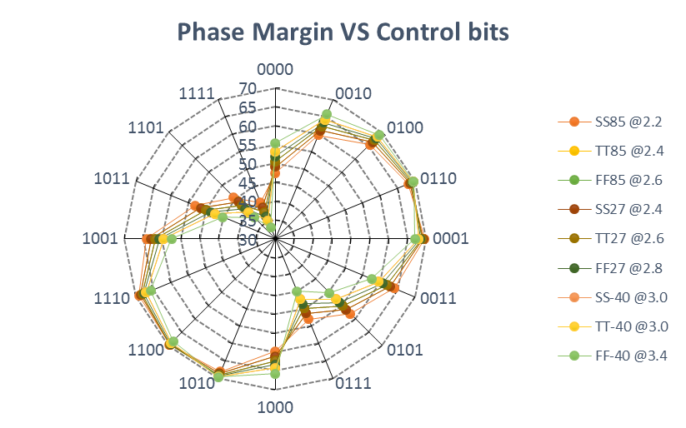
VCO post-sim: VF-Curve, Kvco and Loop specs
C1: 3pF, C2: 120pF, R2: 3kΩ/8kΩ
Control bits: NSEL-ISEL1-ISEL0-BSEL

Slide 10
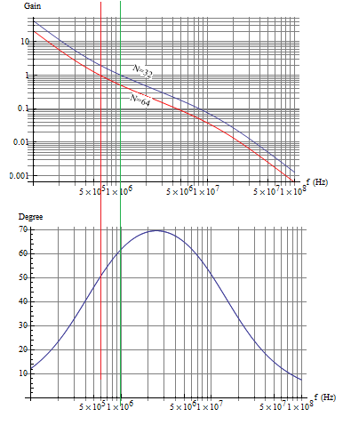
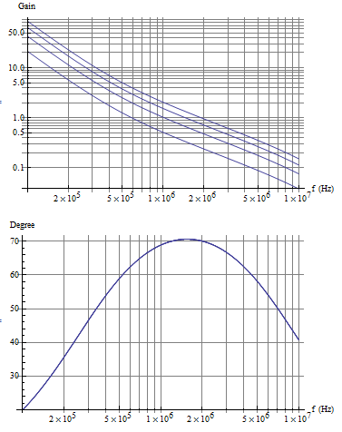
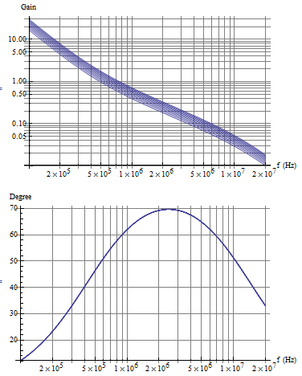
Open loop response bode plot
Different N
Different charging current
Different Kvco

Slide 11
PLL simulation
Half-post simulation
TT 27℃, 1-0110:
triggerless
Fpll=2.56GHz
Icp=100μA
LBW=1.5~2.5MHz
ΔF = 117.5MHz, ΔT = 17ps, ΔVC =55mV @4μs
FF -40℃, 0-1110:
trigger
Fpll=1.28GHz
Icp=100μA
LBW=3~5MHz
SS 85℃, 1-0000:
triggerless
Fpll=2.56GHz
Icp=25μA
LBW=0.5~0.8MHz
Pre-simulation (7 corners)
ΔF < 20MHz
ΔT < 3ps
ΔVC < 7mV
Ipll=25mA @ 2.56G & FF 85
Ipll=19.5mA @ 2.56G & TT 27

Slide 12
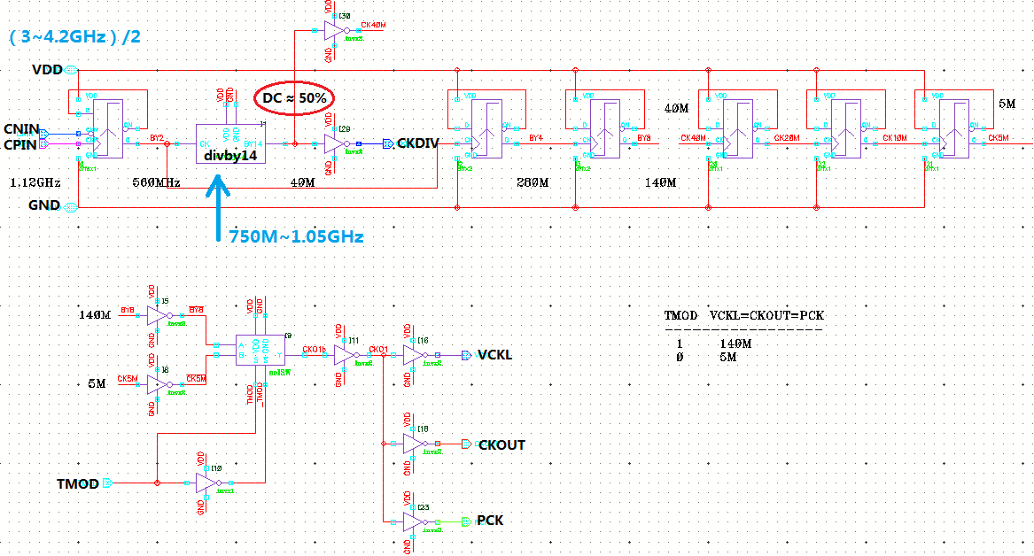
PLL Design B ---- Divby28
Why the divisor is 28?
4Gbps purpose
Max frequency of divider
50% Duty cycle
N should be integral multiple of 8
64/56/48/40/32?
2.56G/2.24/1.92/1.6/1.28G
56=2*28=2*2*7*2
Passed pre-simulations
Post-simulations are ongoing
Other blocks of PLL are remained

Slide 13
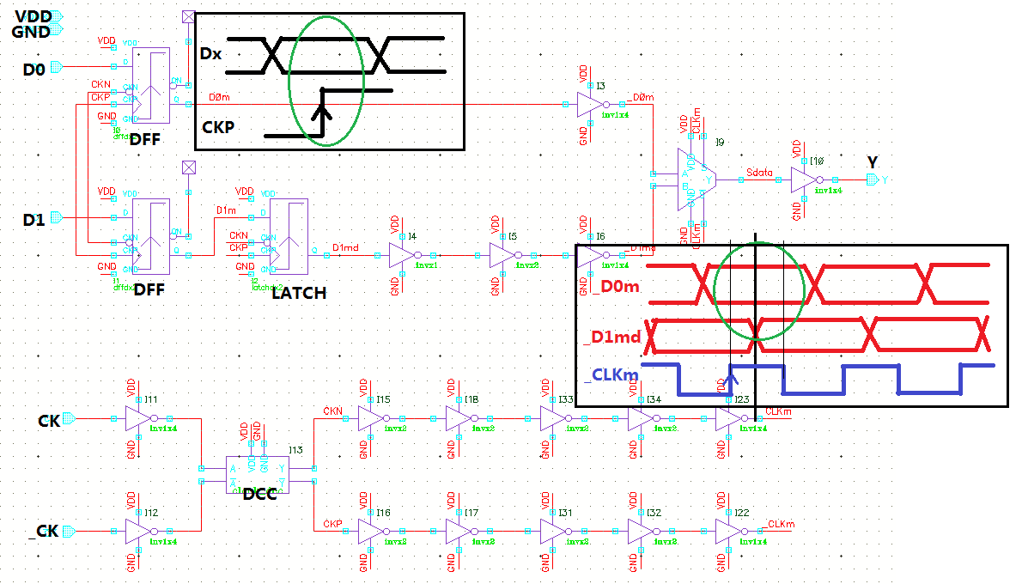
32:1 Serializer Design
Timing
Stage timing
Data sampling
Unit timing
Data sampling (Dx--CKP)
MUX (_Dxm--CLK)
1UI = 500ps @ 2Gbps
Time margin is very small at high speed
Delay of data and clock
Big-small eye in eye diagram
50% DC of clock

Slide 14
2:1 unit pre-simulation @2.3GHz-4.6Gbps
↑SS85
↓FF-40
MUX timing
Data sampling
Serialized correctly

Slide 15
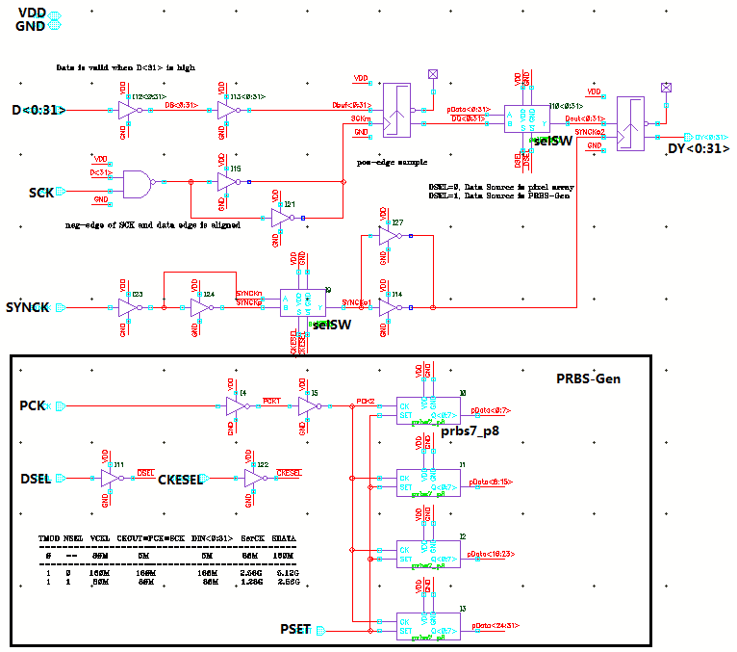
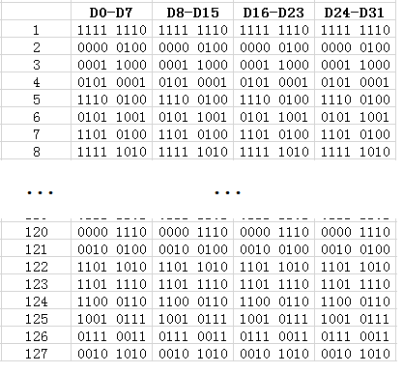
Data sampling and self testing
When data is invalid, that is D31 is low
Hold the previous data
SYNCK (Fpll/8) and CKESEL
Placing CKESEL (clock edge selection) in the first stage of Serializer maybe better
DSEL, select the data source
0 → pixel array data
1 → PRBS data
PRBS initial value
1111 1110 1111 1110 1111 1110 1111 1110 0000 0100 0000 0100 0000 0100 0000 0100…

Slide 16
Summary
Total current is less than 85mA (estimate)
Done/almost done
PLL
PLL_test (post-simulations of divby28, and simulations of whole PLL)
Ongoing
Serializer (more pre-simulations, layout, and post-sim)
PRBS-Gen (layout and post-sim)
Unfinished
CML Driver
Layout of PLL+Ser
Test block with PAD (layout)
Thank you!

