Slide 1
Progress on R&D of the WCDA Experiment
Mingjun Chen
On Behave of WCDA Group
Feb18, 2011

Slide 2
Outline
Introduction to WCDA experiment
R&D of Water Cerenkov Detector Unit
Measurement of the muon events
Water quality control
Progress on the engineering array
PMT test
Slow control
Calibration system
……
Summary

Slide 3
WCDA experiment
Physics details, please see Yao Zhiguo’s report. This report will focus on R&D of the WCDA experiment.
Four steps:
A unit of water Cerenkov detector(one cell) at IHEP.
A engineering array(9 cells) at YBJ.
A ¼ array(900 cells).
Full array(3600 cells).
Step 1 was done. And the engineering array goes smoothly now.

Slide 4
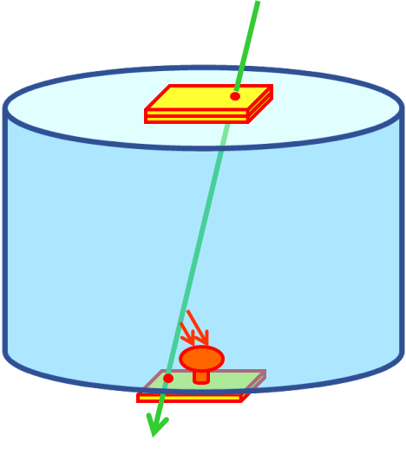
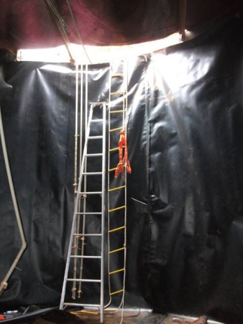
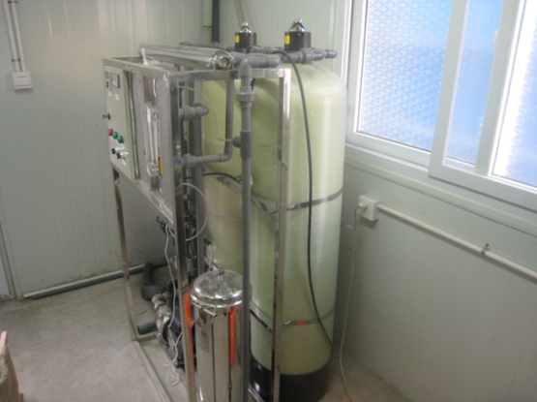
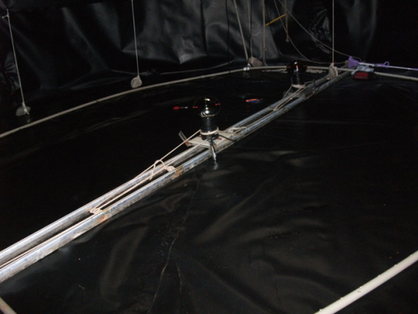
Unit of water Cerenkov detector
Diameter:7m
Height: 5m
Water purification system

Slide 5
Main events of the unit
April,2009 | Construction was done， And the First PMT deployed.
June,2009 | Replaced with a new water-proof PMT, and start events taking.
April,2010 | Replaced with a Hamamatsu R5912 PMT
June,2010 | Black PE film was hung inside the water tank. And the water recycling and purification was upgraded.
August,2010 | Study on the water quality, and solve the problem of the stability of the water quality.

Slide 6
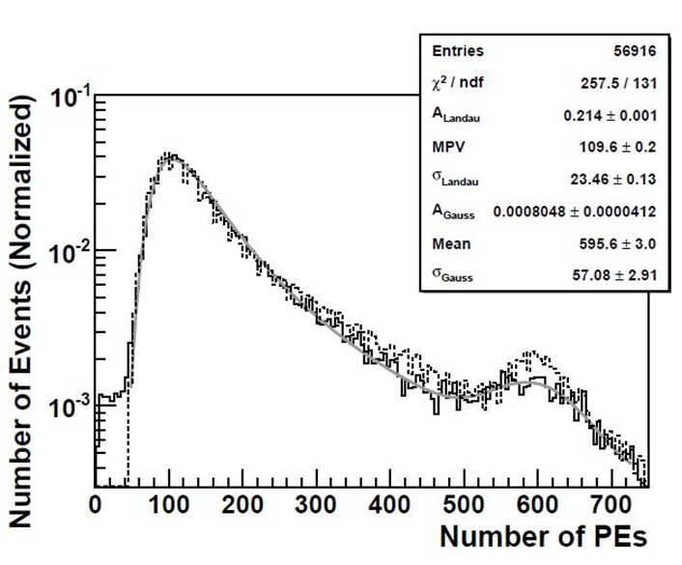
Measure the muon events.
The vertical and central muons, which cross the tank, are selected.
Dotted line is from the simulation(scale up 5.2%)，real line is experimental data.
The second peak in the muon spectrum was FOUND!
It comes from that the photo-cathode of PMT is directly hit by the charge particles!
A possible method to calibrate the system.

Slide 7
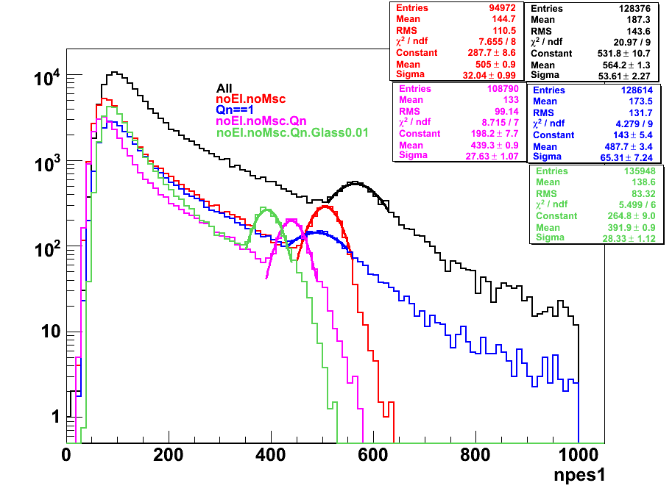
Study on the components of the second peak by simulation：
Black line ➔all processes ：564.2；
Red line ➔A：505.0；
Blue line ➔B：487.7；
Pink line ➔A&B：439.3
Green line ➔A&B&C：391.9。
Contribution from δ-ray & MSC：
(B-A&B)/B = 10%
Contribution from uneven QE：
(A-A&B)/A=13%
Contribution from the boundary effect and thickness of glass：
(A&B-A&B&C)/A&B=11%
Consider QE and track length:：
A&B&C / 6.3 / 60 = 1.04。 Only 4% difference is left.
Three cases：
Without δ-ray and MSC process；
Uniform QE(A/An = 1)；
Without the glass boundary effect and thickness of glass is 0.01mm。
Note：Case B and C are related！

Slide 8
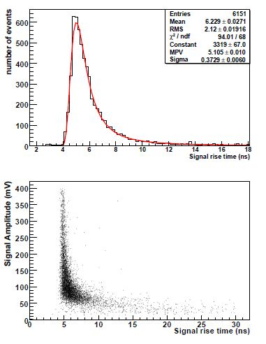
Rise time measurement of muon signal
Tektronix TDS 3054B scope；
Vertical muon events selected；
8-in R5912 PMT at Gain10⁶ ；
Typical RT from datasheet: 4ns;
Typical TTS from datasheet: 2.2 ns；
Results：
Min. value：4.3 ns ➔ PMT RT;
MPV：5.1 ns ➔ Including the difference of PE’s arrival time；
Smaller amplitude, wider RT distribution ➔ measurement error；TTS；scattering of Cerenkov light。

Slide 9
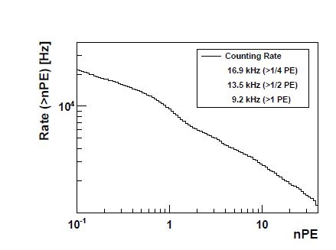
Single rate measurement of PMT signals
PMT HV @ +1350V(3.4*10⁶)
16μs waveform is recorded and analyzed by the FADC electronics.
Results：
16.9kHz @ 1/4PE；
9.2 kHz @ 1PE。
Very small rate of large PEs.
Notes:
Gain ?

Slide 10
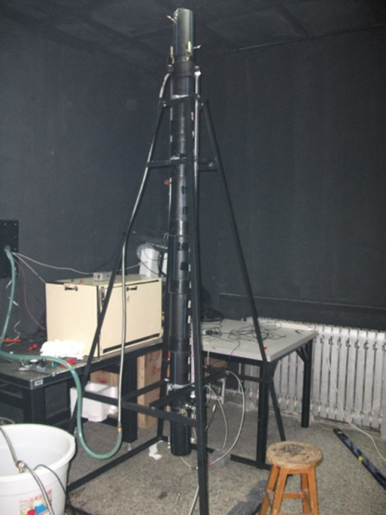
Water recycling and purification system
After three months’ hard work, water quality is controlled：
Organic carbon is the main problem for the water quality.
One UV light(185nm) was added.
Filter with three levels: 5 μm、 1 μm & 0.22 μm.
>10m of water attenuation length is already kept for more than 3 months.

Slide 11
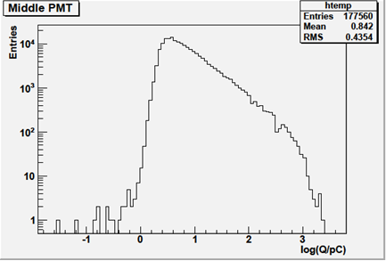
Joint measurement with 43 plastic scintillator detectors.
August12th-18th；
705K events are taken. ¼ events has the signals from the center 8-in PMT.
PMT HV :1072 V ➔Gain 0.61×10⁶。➔ 1 pC = 10 PE；
Simple estimation：
MPV = 3.3 pC × 10 PE/pC = 33 PE。
25 m² × (5 particles/5 m² × 5/40)×10 (gamma）× 0.8 PE/particle = 24 PE!
Peak position is close to the estimation。

Slide 12
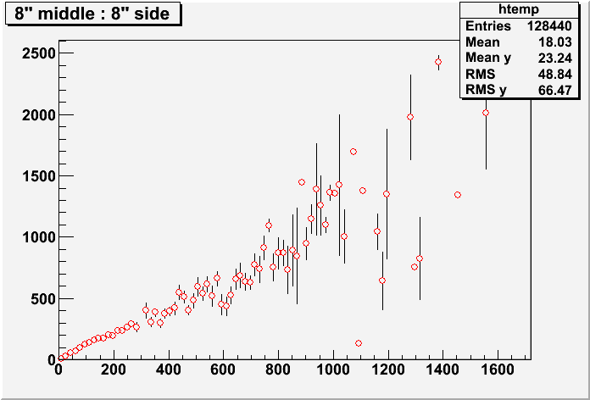
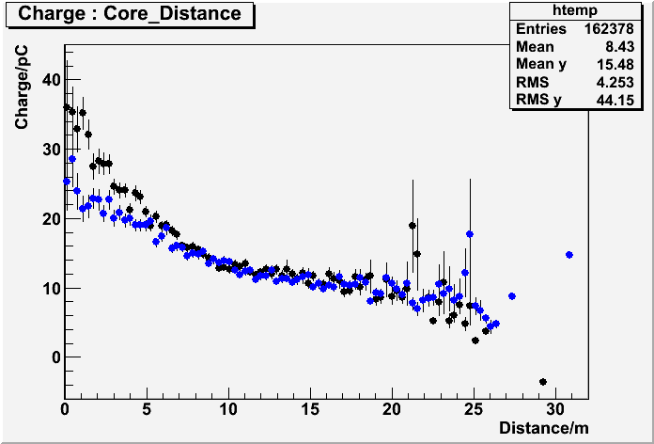
Some related distributions
Distribution of two 8-in PMTs’charge.
Distribution of the reconstructed core distance and two 8-in PMTs’charge.

Slide 13
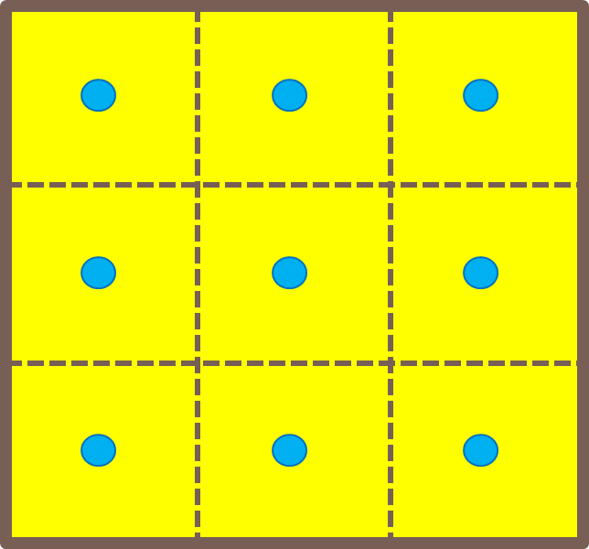
The Engineering Array experiment

Slide 14
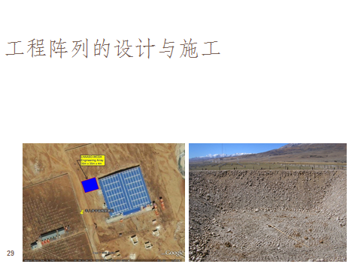
Construction of the engineering array

Slide 15
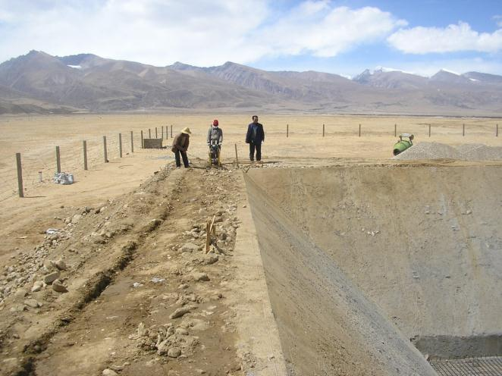
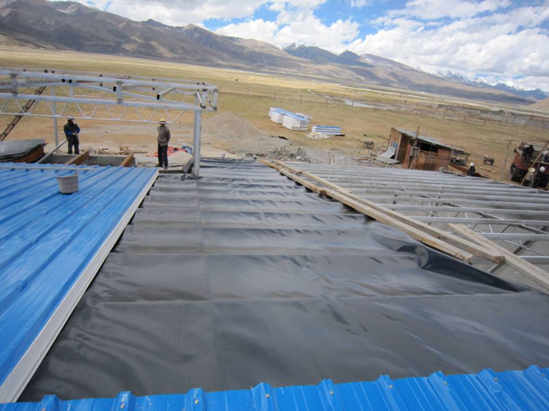
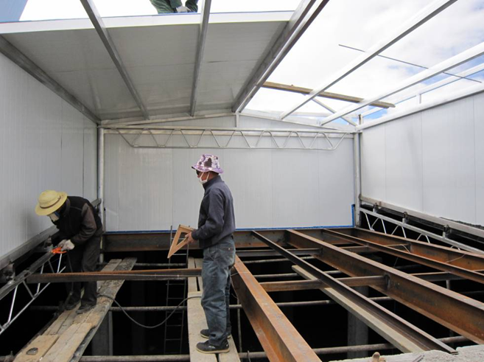

Slide 16
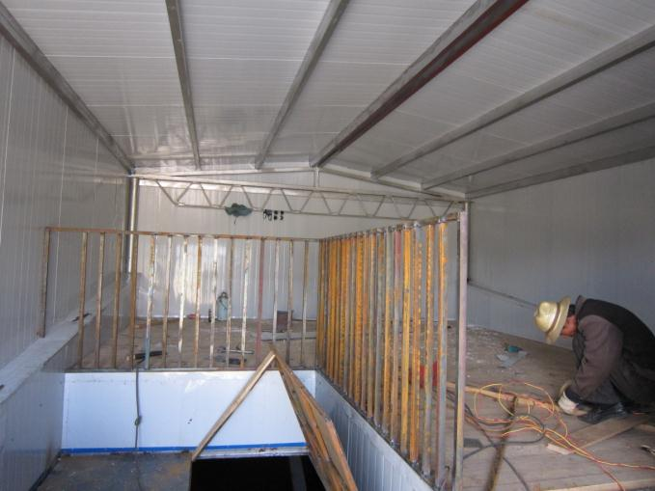
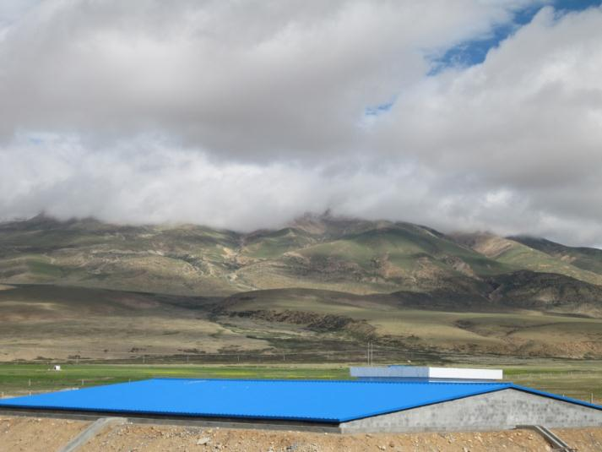
Construction was done in last September.

Slide 17
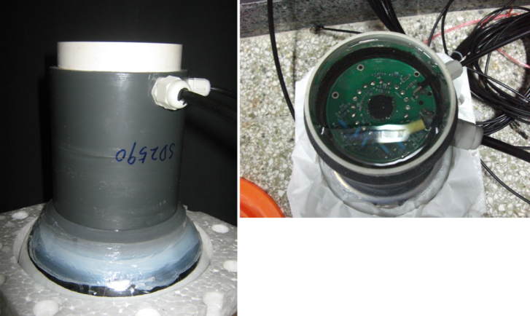
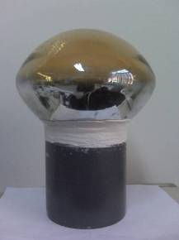
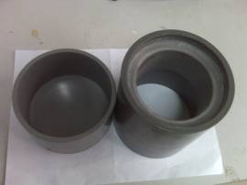
PMT Potting
Soft sealant
Epoxy
Signal & HV cables
Nine PMTs were potted successfully.

Slide 18
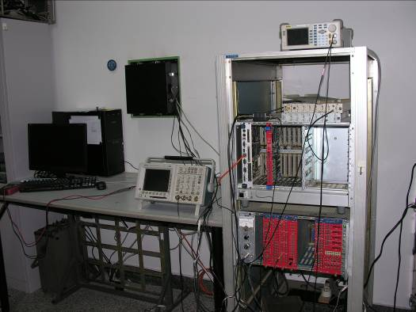
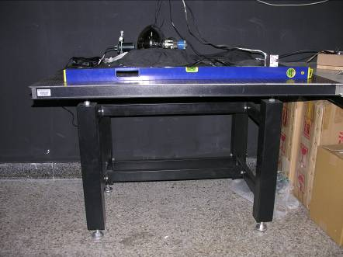
PMT test for the engineering array.
The following parameters are tested:
Single Photo-electron(P/V)
HV VS. Gain
Non-linearity
Dark noise rate with different thresholds
Earth magnetic effect
Rise time
TTS
PMT test stand
Calibration of PMT test stand:
Overshoot simulation of PMT signal
Attenuation of PMT signal cable
Calibrate the pre-amplifier
Calibrate the FADC system.
Temperature effect of HV system

Slide 19
PMT test process
Before the potting:
Three days burn-in;
SPE,P/V, HV VS. Gain, linearity and dark noise rate were measured.
After the potting:
SPE,P/V,HV VS. Gain, linearity, dark noise rate, rise time and TTS were measured.
Detailed studies on PMT’s performance:
Relation between P/V and different HV
Relation between P/V and different LED light intensity
Relation between BETA and different LED light intensity
Stability of BETA value(<2%)
Relation between BETA and different HV range(<2%).
Stability of PMT test system(<2%).

Slide 20
Schematic of PMT test
Pulser Generator
trigger
FADC
PC
HV
Pre-amplifier
~26X
Discriminator
Scaler
SPE measurement→ LED method, 405nm LED pulsed 1KHZ， Gain@2*10⁶
(SPE events/total events)=~10%
Non-Linearity → Two LEDs method
Non-L(%)=(C-(A+B)+pedestal)/(A+B-2*pedestal)*100%

Slide 21
Hamamatsu 8-in PMT: SD2590
HV VS. Gain
SPE measurement
Non-linearity

Slide 22
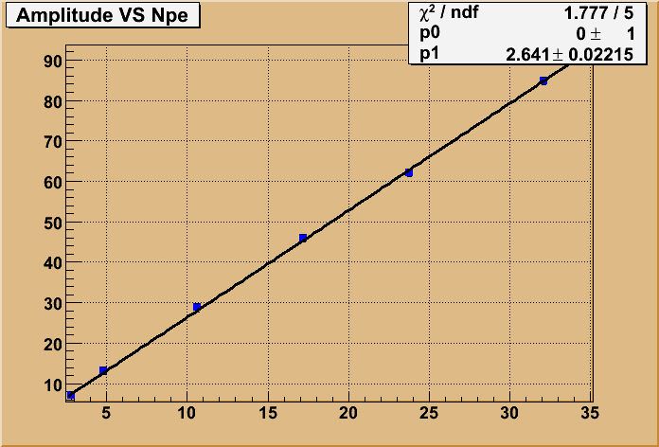
Dark noise rate(SD2590)
Amplitude VS nPE：
Amplitude is got from the scope；
Number of PEs is taken by FADC；
Amp=2.641×nPE。
Threshold (PE) | 1/4 | 1/3 | 1/2 | 1 | 2
Rate (kHz) | 0.98 | 0.90 | 0.83 | 0.65 | 0.20

Slide 23
TTS measurement：SD2514
Wavelength:466nm
FWHM:90ps
Pico-second Laser
PMT
CFD
TDC
HV（V） | Sigma（ns）
1200 | 1.06
1230 | 0.97
1250 | 0.93
TTS（FWHM）：1.01×2.35 = 2.49 ns
Reproducibility ： ~0.2ns
TTS value is close to the datasheet.

Slide 24
Table of PMT test
PMT No. | HV（V) | P/V | Beta | Non_linearity (<10%) | Dark noise rate（>1/2PE） | TTS (ns) | Rise time(ns)
SD2585 | 1266 | 2.50 | 7.98 | 820 | 1.01KHZ | 1.86 | 3.2
SD2602 | 1265 | 2.39 | 8.48 | 934 | 1.92KHZ | 2.02 | 3.2
SD2538 | 1164 | 4.68 | 8.05 | 745 | 0.52KHZ | 2.37 | 3.4
SD2514 | 1213 | 3.53 | 8.01 | 680 | 0.94KHZ | 2.49 | 3.3
SD2580 | 1279 | 2.76 | 8.43 | 730 | 0.65KHZ | 2.04 | 3.2
SD2586 | 1248 | 4.30 | 7.83 | 730 | 1.41KHZ | 2.30 | 3.3
SD2559 | 1132 | 5.84 | 7.92 | 625 | 0.95KHZ | 1.93 | 3.3
SD2576 | 1215 | 3.30 | 7.88 | 620 | 1.01KHZ | 2.16 | 3.2
SD2590 | 1273 | 3.50 | 7.78 | 764 | 0.83KHZ | 2.59 | 3.2

Slide 25
Optical calibration system
To calibrate the stability of the whole system, and it also could monitor the PMT gain by LED method.
PC
ADC/TDC
PMT Signals
Light Source
LED
30m/45m optical fibers
Reference PMT
Status:
Fibers are ready;
All parts are already tested;
Uniform light source is not perfect yet.

Slide 26
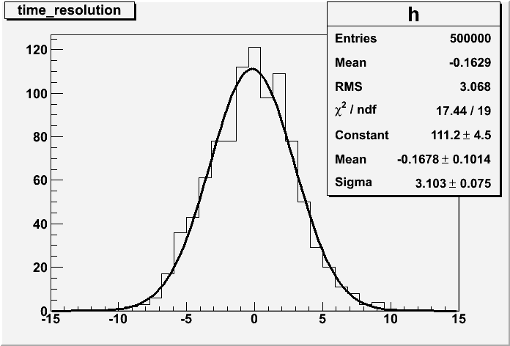
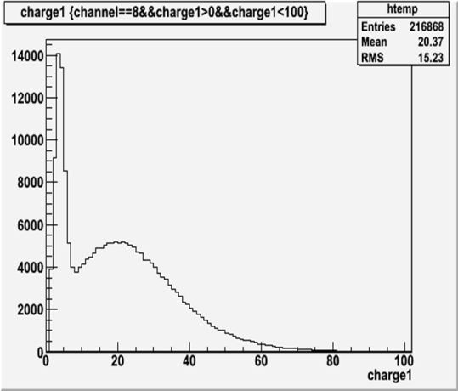
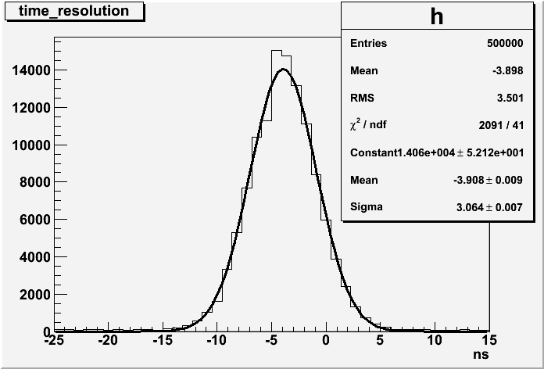
Joint test of electronics/DAQ system and PMTs’signal.
Arrival timing difference of ch4 and ch2
Electronics system is developed by USTC, based on 9U VME standard.
More details, please see Hao Xinjun’s report.
During the middle of Jan., Electronics system was connected with 8 PMTs.
SPE and arrival timing difference are studied.
Sigma.3.10ns
Arrival timing difference of ch9 and ch8
Sigma.3.06ns
SPE spectrum of channel 8
LED method and 2 channels fired

Slide 27
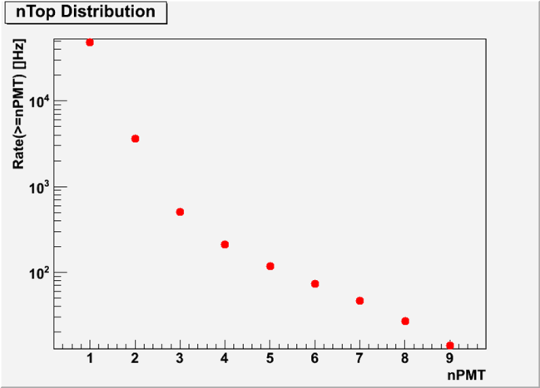
Trigger mode.
Within 100ns, 3 channels of nine PMTs are fired;
2 channels of nine PMTs are fired ,filtered with 1/100(only one trigger outputs when 100 times);
1 channel is fired, filtered with 1/10000；
1Hz force trigger；
External trigger(Possibly from ARGO-YBJ or other detectors)；
The above five cases work with “OR” mode.
nPMT | Rate (Hz) | Int. Rate (Hz)
1 | 44800 | 48408
2 | 3100 | 3608
3 | 298 | 508
4 | 92 | 210
Simulation of the trigger rate.

Slide 28
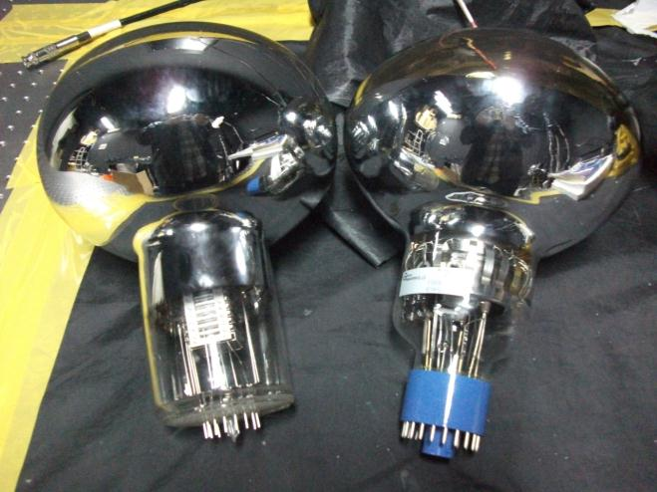
More selections of PMTs
Since ~4000 8-in PMTs are required by WCDA experiment, we also consider other products besides Hamamatsu company.
Two 8-in PMT were bought from the Electron Tube company. It has better linearity and worse timing compared with Hamamatsu’s.
A prototype of 8-in PMT(the left one) was made by a domestic factory. It indeed works, but need more optimization.
LED light source is used and work
with same Gain(2*10⁶)
 | Rise Time | Fall Time
ET 9354KB | 6.9 ns | 13.7 ns
Hamamatsu | 4.6 ns | 6.3 ns

Slide 29
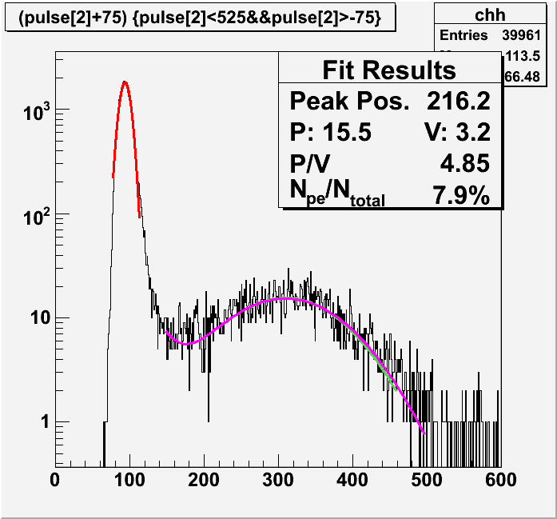
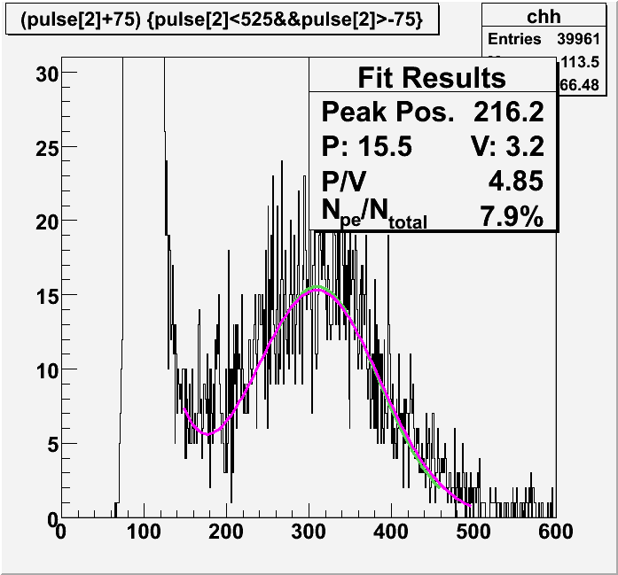
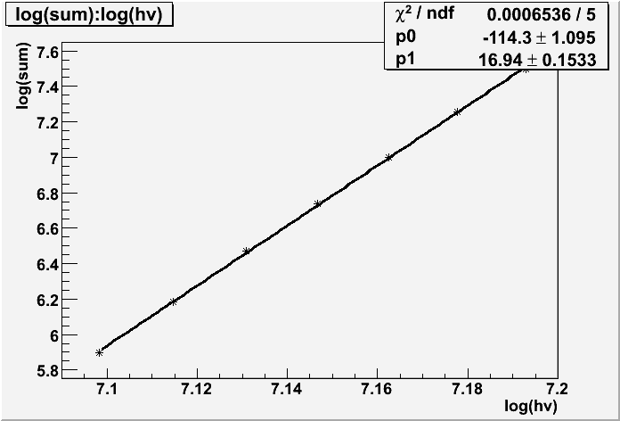
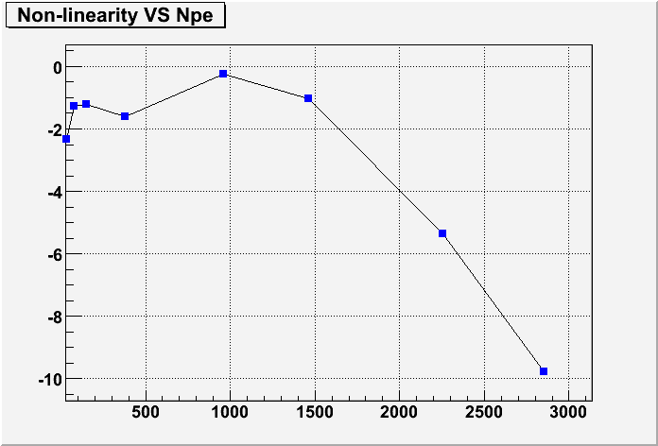
Test of ET 9354KB PMT
Beta=16.94
HV：+1260 V；
Gain：2.08×10⁶。

Slide 30
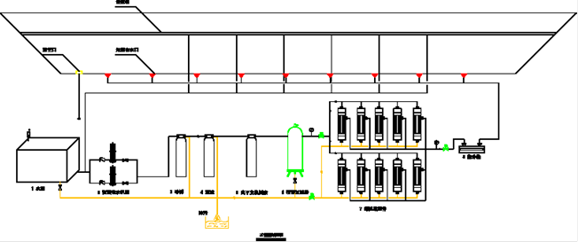
Design of the water recycling and purification system.
Water inlet
outlet
Active carbon
Quartz sand
5um
filter
1um
filter
UV light
0.2um
filter
Schematic of water purification system
Recycling ability: 1 volume/month.

Slide 31
Slow control system of the engineering array
Online setup of water attenuation length measurement
Used to monitor the water quality;
It will automatically measure the water attenuation length everyday.
Environment monitor system
Room temperature and humidity of the control room
Water temperature of the water pool
Water level
PMT HV protection system
Once light leak in the water pool, PMT HV will be shut down immediately.
Concept design was done.
The joint test with the sensors and setup was tested.
The group from the Center for Space Science and Applied Research, CAS, is responsible for this slow control system.

Slide 32
Schedule of the engineering array
Content | Progress or Status
PMT related | Potted, tested and ready.
Water pool building | Construction was done in last September.
Black film inside the water pool | Part was done. It will be finished by April
Slow control system | Should be deployed by April.
DAQ system | Joint test was done and ready.
Water recycling and purification system | Concept design was done. Will be deployed by May.
Data taking will start in June!

Slide 33
Brief Summary
R&D of the unit of the water Cerenkov detector was done.
The second peak in the muon energy spectrum is found and well studied.
Water quality control is studied. It gives us much experience for the future experiment.
The engineering array goes smoothly.
After about four months' hard team work, we hope that we could run this array in June.

Slide 34
Thanks.

Slide 35
Backup

Slide 36
原型探测器实验
2010年大事记：
1-2月份：冰冻期，采取了若干防冻措施；
3月份：从水中取出了其中的两支MACRO PMT；测量了水的吸收长度；对测量数据的增益和衰减进行了修正；
4月份：对即将放入水中的滨松PMT进行了测试；
5月份：
5日：反冲了水净化系统；
10日：放入一支R5912的PMT；
12-16日：测量了近垂直入射的μ子信号；
17-24日：测量了其它入射方向的μ子信号；
25-30日：测量了μ子信号的脉冲波形；
31日：测量了水吸收长度；
6月份：把水放干，取出了了PMT，正在焊接和安装塑料衬层。

Slide 37
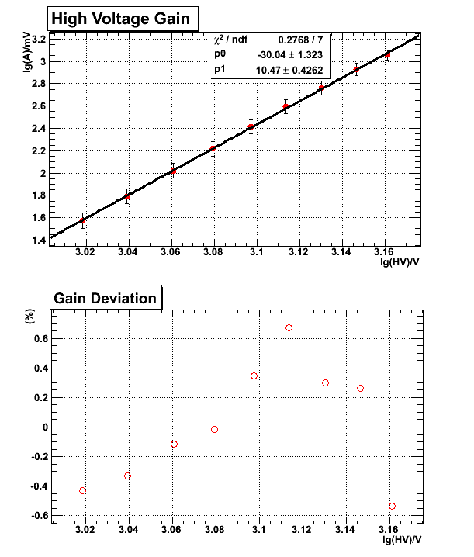
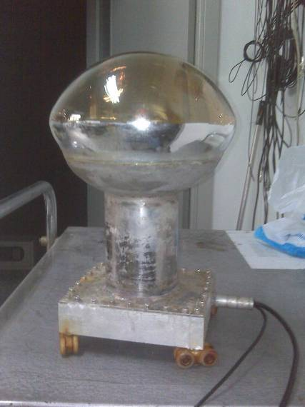
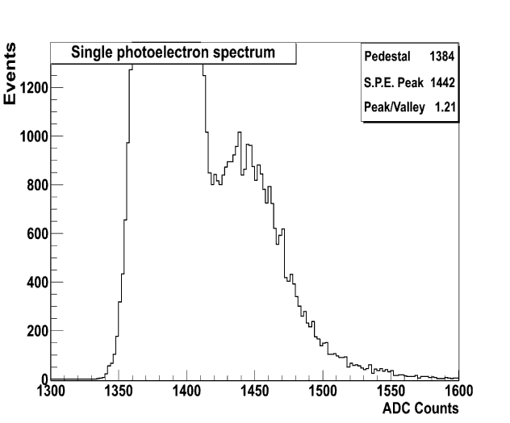
光电倍增管

Slide 38
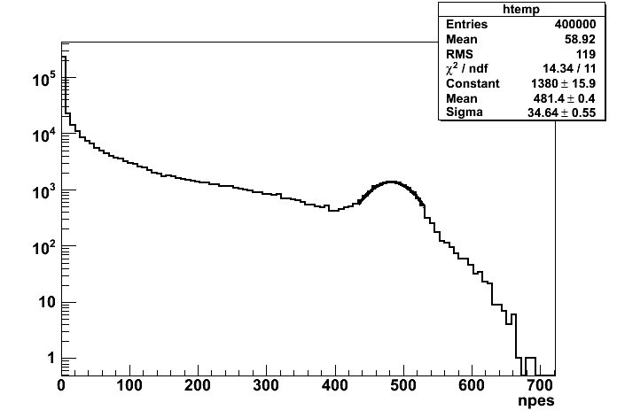
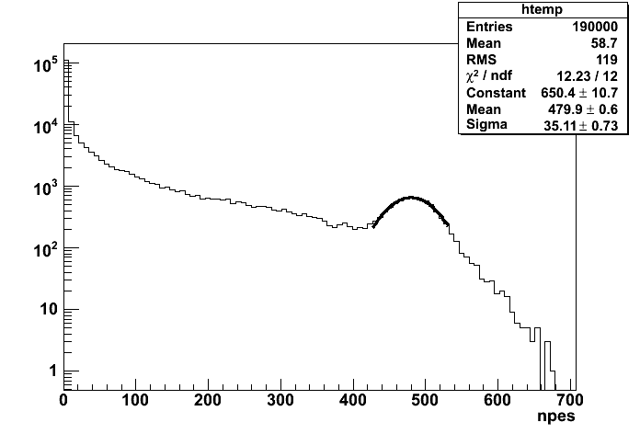
模拟：利用遮光系统的标定

Slide 39
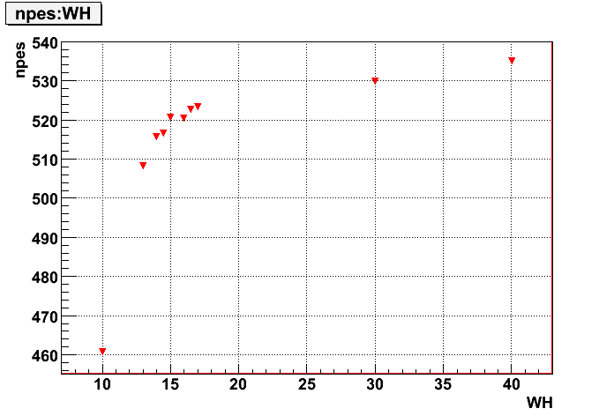
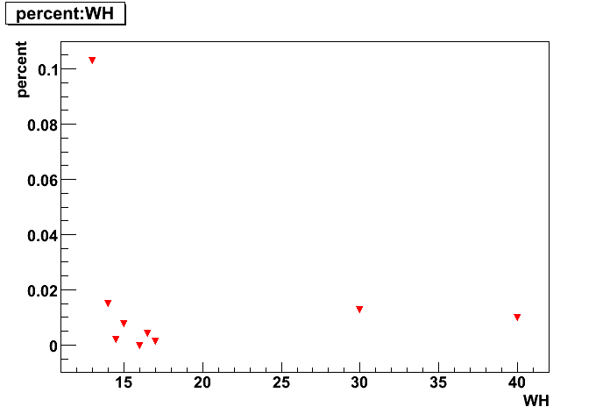
利用第二个峰标定单元探测器

Slide 40
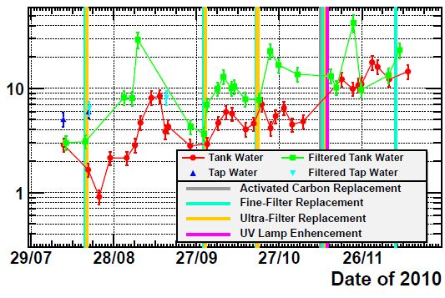
水衰减长度（m）
>10m
Water attenuation length
Measurement setup.
Red points：水箱内部取出来的水，
测出来的水衰减长度。
经过半年持续的努力：
1)对水衰减长度的不间断测量；
2)对水箱内部各种材料的浸泡和吸收度测量对比；
3)对水样成分细化分析测量。
有机碳(含细菌)为主要水质的影响因素。
目前，改进水衰减长度已经一个多月保持在10米以上。
为将来的工程阵列的水循环净化系统工作奠定了基础。

Slide 41
PMT测试结果稳定性的研究
单光电子峰的峰谷比（P/V）及增益的系统变化
PMT高压不变（工作高压：+1213V），LED光强不变（SPE比例为13.8%），不间断连续测量了6次：
P/V值：4.53±0.6，变化范围为±13.2%；
增益：2.03±0.03，系统变化为±1.5%。
对于同一只PMT，在同一工作高压下、不同的时间进行测量其SPE：
增益：(2.0±0.1)×10⁶，变化范围为5%。
不同光强下单光电子峰的峰谷比（P/V）及增益的变化
理论上，光强越强，P/V值会越大，但是经过9次测量，发现P/V值并非随LED光强变强而变大，这可能是系统的涨落所致。增益为： (2.04±0.07)×10⁶。
不同LED光强下高压响应beta值的变化
高压的变化范围一样，PMT的入射光强不一样，测量的beta值不变。
不同时间beta值的变化
LED光强相同，高压变化范围相同，间隔100分钟进行了两次测量，测得beta值分别为7.97和8.00，这说明不同时间测量得到的beta值是不变的。

Slide 42
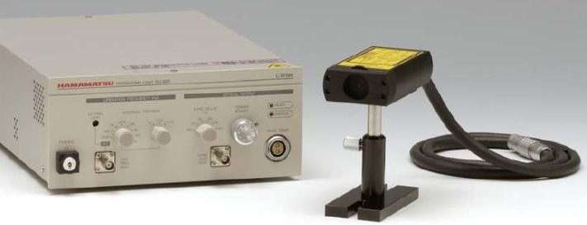
光电倍增管的TTS测量
TTS（Transit time spread）可分解成两种机制：
光阴极不同位置处产生的光电子到达第一打拿极的由于径迹长度不同造成的渡越时间差；
电子在打拿极倍增、加速运动过程形成的固有时间晃动（jitter）。
综合测量手段 - 滨松手册上的TTS测量方法：
定义：全面照射光电面的单光电子脉冲的渡越时间起伏。
Pico-second laser source（Hamamatsu C10196）（山东大学）：
Features：
Pulse width （FWHM）less than 100 ps；
High stability, low jitter；
Application：
Pulse response measurements of high-speed photo-detectors。
FWHM: 70 ps
Wavelength: 466 nm

Slide 43
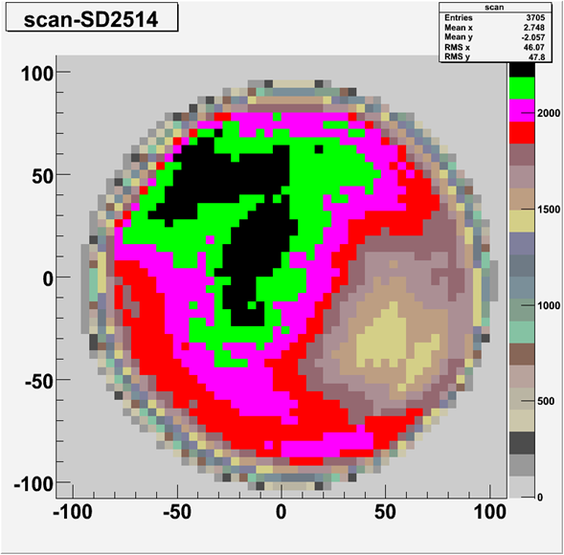
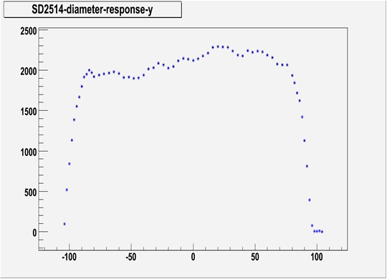
二维平面扫描信号大小分布
Y轴向(mm)
X轴向(mm)
Y轴向的信号大小分布

Slide 44
WCDA的电子学需求：动态范围
PE数的统计分布（无smearing、无噪声）：
小PE的着火数非常多：
1 PE：42.6%，2 PE：18.4%；
大PE的着火数非常小：
nPE>2000：2×10⁻⁴和7×10⁻⁴（E>5 TeV）。
对灵敏度的影响（30%的smearing、噪声）：
nPE<1000和nPE<50000基本无差别；
nPE>0和nPE>2稍有差别。
建议动态范围：
0.5 – 2000 PE。
44

Slide 45
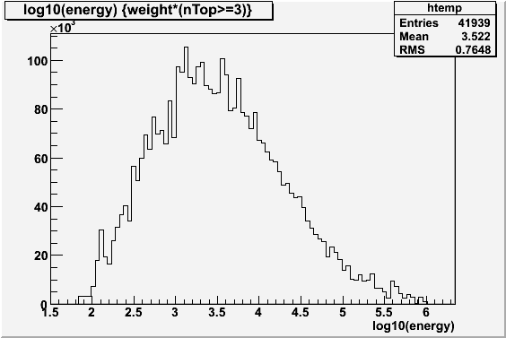
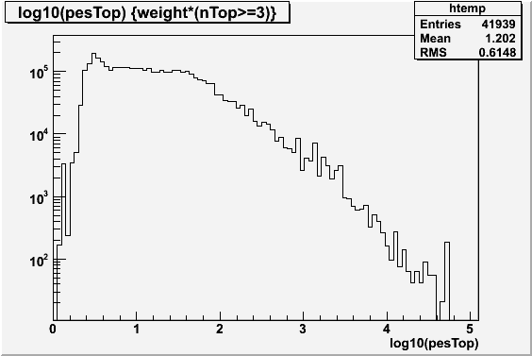
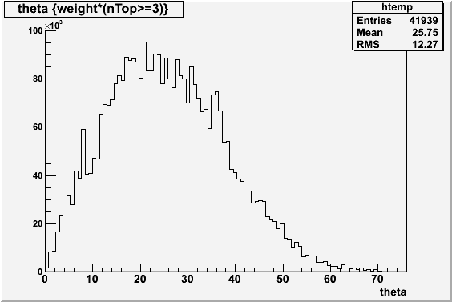
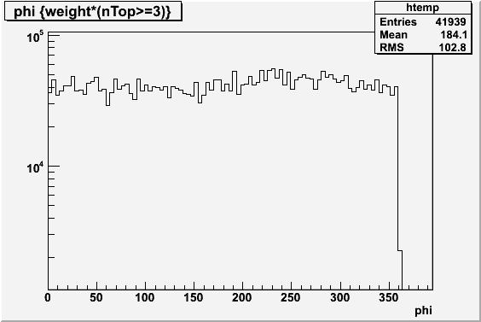
模拟工作：触发事例的分布

Slide 46
定标系统的几点考虑
脉冲光源（LED/激光）+ 光纤；
标定时间和增益（ADC&SPE）；
触发效率（有可能）。
双光纤方案：
监测光纤本身的变化；
标定多hit情况下的测量精度；
实现一次脉冲的两次标定；
特殊情况下实现cluster、PMT之间的相互标定。
高频脉冲方案：
例如每次发射相隔200 ns的5个脉冲；
实现一次取数的多次测量。
实时定标方案：
每秒定标一次。
Cluster
A
Cluster
B

Slide 47
定标系统待解决的问题
LED的选型和测试：
窄脉宽、大功率；
NICHIA、 Chicago Miniature等等。
LED驱动电路的设计和制作：
LED阵列。
光均匀化处理：
Teflon、光导等；
保证光强一致性。
光纤稳定性的研究。

